Slide 1
School-Wide Positive Behavioral Interventions and Supports (SWPBIS)
Northeast PBIS (NEPBIS) School-Wide Team Training
District Capacity Building Half Day Module 2
[Insert Trainers Names]
with support from Brandi Simonsen, Jen Freeman,
Susannah Everett, Adam Feinberg, & George Sugai
Notes:
Add trainer names for your event

Slide 2

Advance Organizer
Review of PBIS Blueprint Self-Assessment
Review District Leadership Team structures
Today’s Focus 1: District Evaluation
Today’s Focus 2: Integration / Alignment with related initiatives
Report out & Action Planning

Slide 3

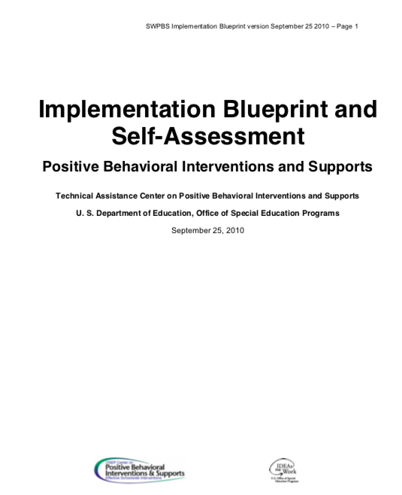

Tools!
nepbis.org
pbis.org
Implementation Blueprint & Self Assessment
Evaluation Plan
Action Plan

Slide 4

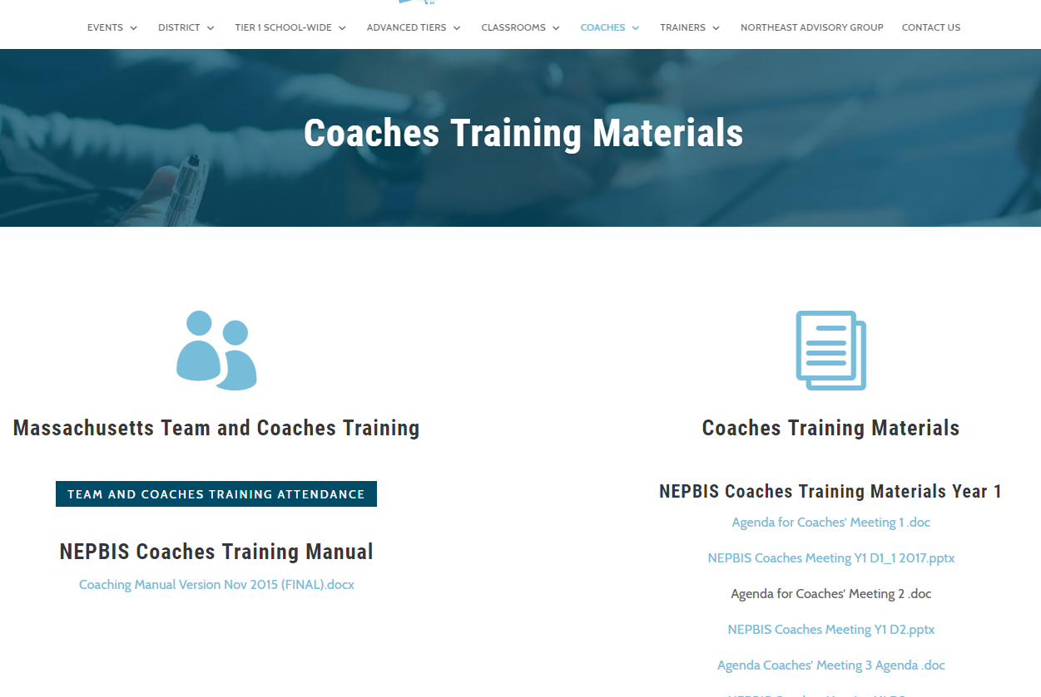
Activity:
Please Enter Attendance
1 min
Please login on nepbis.org, go to the coaches’ tab, and click on the Team Training Attendance Link. Follow prompts to enter team attendance.

Slide 5



SWPBIS: Building Effective Schools
Notes:
Why are we here? Effective schools
District systems are key to organizing expected work by staff of our schools. We can easily support or unfortunately easily create barriers without intention.

Slide 6
District & School-wide PBIS
Culturally Equitable Academic &
Social Competence
OUTCOMES
Culturally Relevant
Support for
Student
Behavior
Culturally Valid
Decision
Making
DATA
PRACTICES
SYSTEMS
Culturally Knowledgeable
Staff Behavior
Notes:
SWPBS: Four Elements
SWPBS builds from a focus on student Outcomes: academic achievement, social competence, and safety.
SWPBS “Practices” are the behaviors of adults that affect how students perform. These are the daily, classroom, and on-going discipline practices of the school
SWPBS “Systems” are the organizational decisions and structures that support effective STAFF Behavior. A major strength of SWPBS is the emphasis on practices delivered WITH the systems needed to support the practices.
The use of data for decision-making is the single most important system within SWPBS. This element is used both to ensure the SWPBS practices are tailored to the local context/culture, and to benefit the continuous regeneration needed for sustained implementation.

Slide 7
Outcomes
School-wide behavior expectations
Class-wide Behavior expectations and routines
Practices
School-wide Instruction on Expectations
Class-wide Instruction on Routines
Academic Success
Social Emotional Competence
Active Supervision
Effective Recognition
Corrective Consequences
Function-based Support
Systems
Team-based
Supportive Leadership
Selection, Training, Coaching
Multi-tiered Support
Policies and funding
Data
Universal Screening
Progress Monitoring
Implementation Fidelity
Standardized Assessments

Slide 8
Main Messages
Sustained and High Fidelity Implementation of SWPBIS requires active District Support.
    Especially for Tiers II and III
-----------------------------------------------------------
Student = unit of impact
Schools = unit of analysis
District = unit of implementation

Slide 9
PBIS Academy: Systems & Timeline district capacity building supports
Year 1
Team Training
Coaches Training
Year 2
Team Training
Year 3
Team Training
SWIS support
Coaches Training
SWIS support
Coaches Training
SWIS support
on-site TA
on-site TA
on-site TA
Year 1
Year 2
Year 3
2 half days
district team building
3 brief content sessions targeting district capacity building
2 half days
district team building
3 brief content sessions targeting district capacity building
2 half days
district team building
2 brief content sessions targeting district capacity building
1 Day District Team technical assistance
1 Day District Team technical assistance
1 Day District Team technical assistance

Slide 10
PBIS Academy:
Data, measures, and assessing impact
Tiered Fidelity Inventory (TFI)
Trainer & Team assessment of PBIS Implementation
Completed 1x per year
Team Implementation Checklist (TIC)
Team assessment of PBIS Implementation
Completed 2-3x per year
School Outcome Data
Office discipline referrals (ODRs) – some schools
In school suspension
Out of school suspension
Social Validity Data
Training evaluation data
District Leadership Capacity
Blueprint Self-Assessment
Completed 1x per year

Slide 11
How to we plan district level PBIS supports?
Do not go down this road alone…
Make sure you have a team!
Recruit a diverse group of district and school level colleagues
Use a guide
Bring data to every team meeting and use it to guide action planning!!
Consider the PBIS Blueprint Self-Assessment

Slide 12
Stakeholder Support
Funding
Policy & Systems Alignment
Workforce Capacity
Executive Functions
LEADERSHIP TEAMING
Implementation Functions
Training
Coaching
Evaluation & Performance Feedback
Behavioral Expertise
Local Implementation Demonstrations
Notes:
Version 2017-3-8
Swaps Stakeholder Support and Funding

Slide 13
Guiding District level PBIS Capacity
Self Assessment
Available at pbis.org or search PBIS Implementation blueprint
Notes:
https://www.pbis.org/Common/Cms/files/pbisresources/PBIS%20Implementation%20Blueprint%20Part%202%20Self-Assessment%202017-5-15.docx

Slide 14
Guiding District level PBIS Capacity
PBIS Blueprint & Self Assessment

Slide 15

Guiding District level PBIS Capacity
Self Assessment
Online Access

Slide 16
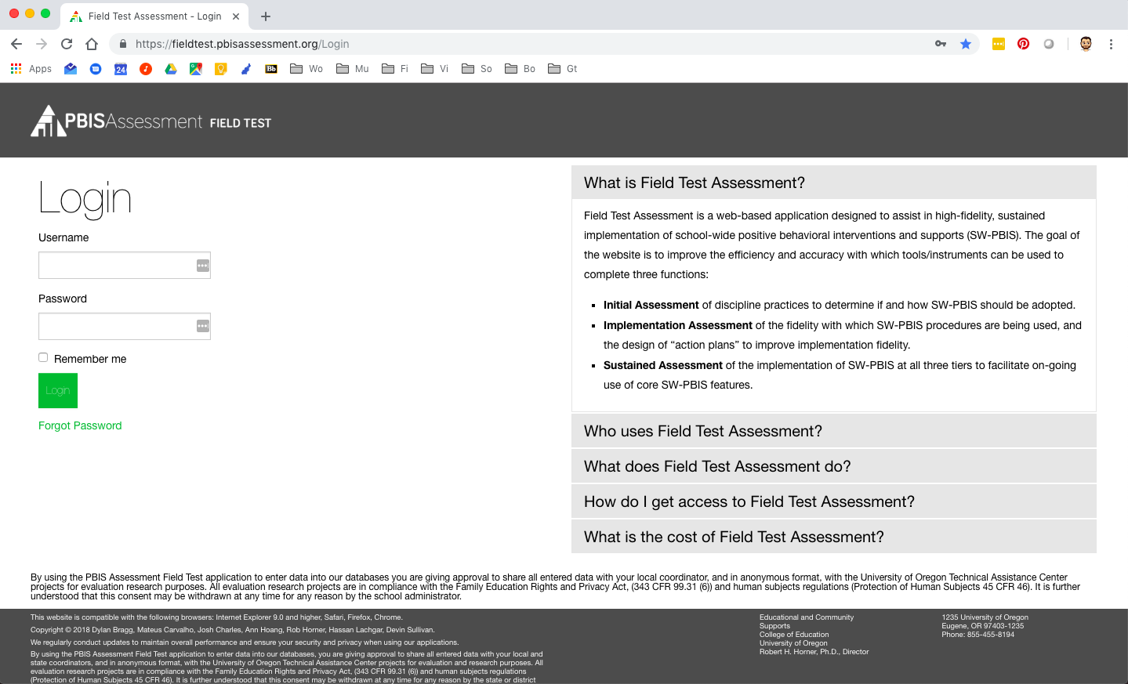
Guiding District level PBIS Capacity
Self Assessment
Online Access: fieldtest.pbisassessment.org

Slide 17
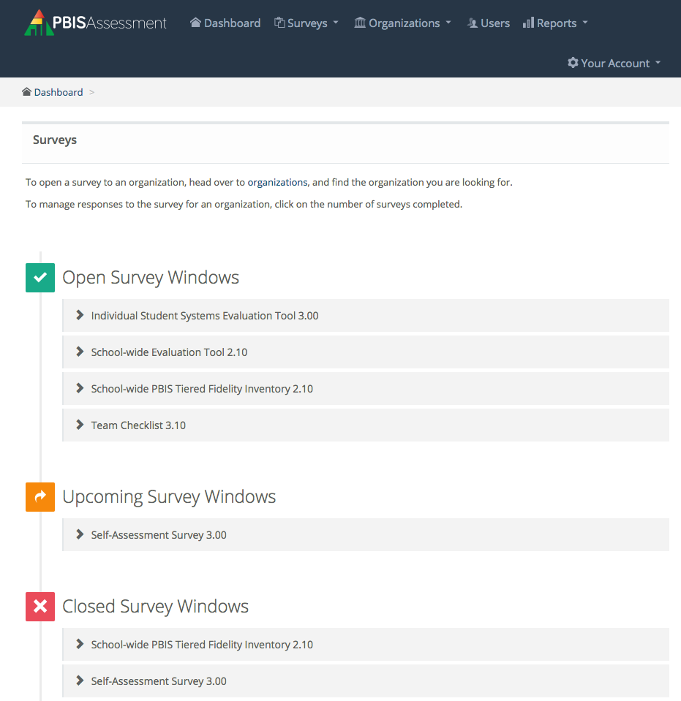
Guiding District level PBIS Capacity
Self Assessment
Look for IBSA

Slide 18
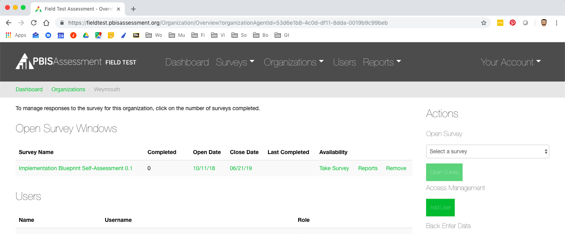
Guiding District level PBIS Capacity
Self Assessment

Slide 19
Stakeholder Support
Funding
Policy & Systems Alignment
Workforce Capacity
Executive Functions
LEADERSHIP TEAMING
Implementation Functions
Training
Coaching
Evaluation & Performance Feedback
Behavioral Expertise
Local Implementation Demonstrations
Notes:
Version 2017-3-8
Swaps Stakeholder Support and Funding

Slide 20
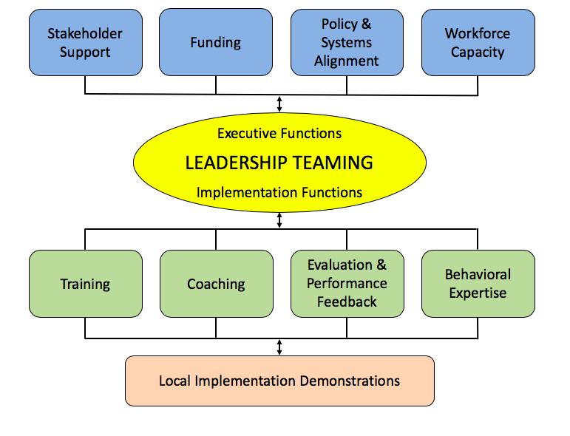
PBIS Self-Assessment
Role and Function of District Team: Clear and Consistent Leadership
Executive Functions: Provide the funding, visibility, and political support needed to allow school teams to travel through the full sequence of adoption stages. Adopting an integrated framework is process that will challenge the assumptions and traditional practices of most school faculty, and mental health systems.
Implementation functions: Provide the training, coaching and feedback systems needed to establish personnel with both the specific technical skills needed to deliver integration and the organizational vision to deliver those skills within a unified framework.
Notes:
What will be the role of the DCLT? Here are some ways we can help clarify some of the ways we work…
Here is where the consumer guide comes into play…we continue to overwhelm staff and system with more to do….how to we become better consumers of EBP? How could we use the consumer guide to ask the right questions before we add one more thing???
How do we use the implementation framework to be the common “way of work”???

Slide 21

Academic and/or behavioral MTSS Director
Who should be on the team?
School Improvement
Special Education Director,
Professional Development/Teacher Mentoring
Local MH provider/Core Service Agency
Family Youth Community Leaders
Board Member
District Community Leadership Team
Law Enforcement
Implementation Team
Juvenile Services Coordinator
Youth Move
Social Services
Afterschool
Dept of Recreation Services
Student Supports Director
Administrative and Teacher
Representative
(Union)
Notes:
a.) School System Student Services and Special Education Directors
b.) Local Mental Health Provider
c.) Core Service Agency’s Child and Adolescent Coordinator
d.) Juvenile Services Coordinator/Law Enforcement
e.) Coalition of Families offices
f.) Family, Youth and Community members
g.) Local Management Board representative
h.) Social Services representative other to include (where present) Youth MOVE Rep, System of Care Case Management entity or Family Navigator, community health provider, non-public special education school rep, recreation services, local health dept, board of education representative or other stakeholders identified by leadership

Slide 22
Trauma Informed Strategies
Discipline Handbook
School Mental Health
Wraparound
Check & Connect
Function-based Support
Classroom Management
Academic & Social Emotional Behavior Success
Restorative Practices
Wellness & Self-Regulation
Cognitive Behavior Counseling
Check In Check Out
Social Emotional Learning
Dropout Prevention
Bullying Prevention
School Climate
Literacy Instruction
Cultural Responsiveness
Social Skills Programming

Slide 23
Stakeholder Support
Funding
Policy & Systems Alignment
Workforce Capacity
Executive Functions
LEADERSHIP TEAMING
Implementation Functions
Training
Coaching
Evaluation & Performance Feedback
Behavioral Expertise
Local Implementation Demonstrations
Notes:
Version 2017-3-8
Swaps Stakeholder Support and Funding

Slide 24
PBIS Blueprint & Self Assessment
Leadership Team
1. Leadership Team has the authority to influence the organization (e.g., decision-making for budget, implementation, policy, data systems).
2. Leadership Team has representation from range of stakeholders with investment in youth outcomes from the local community and individuals with detailed knowledge about the current social-emotional-behavioral initiatives (e.g., accountability, administrators, families, general and special education, higher education, mental health, school board and community members, school board attorneys, trade organizations, youth-serving agencies).
3. Leadership Team includes individuals with behavioral science expertise across the full continuum of behavior support (Tiers I, II, III) to ensure fidelity of implementation of PBIS practices and systems in three domains: (a) training, (b) coaching, and (c) evaluation.

Slide 25
PBIS Blueprint & Self Assessment
Leadership Team
4. Leadership Team is led or facilitated by a coordinator(s) with (a) adequately allocated FTE and (b) experience in data-based decision-making, systems to support implementation, and evidence-based social-emotional-behavioral practices.
5. Leadership Team completes a 3-5 year action plan guided by the PBIS Implementation Blueprint Self-Assessment, state/district strategic plan, and district/school fidelity of implementation data (e.g., Tiered Fidelity Inventory), and matches resources to needs based on student outcome data, especially for vulnerable populations.
6. Leadership Team uses standard meeting process and problem solving agenda (e.g., Team-Initiated Problem Solving) with clearly defined operating procedures (e.g., procedures for securing agreements, resolving conflicts and integration of system features).
7. Leadership Team engages in ongoing, two-way communication with executive leadership regarding implementation progress and outcomes related to student behavior goals and PBIS fidelity of implementation.
8. Leadership Team members who coordinate daily implementation of the initiative regularly monitor and report implementation activities and follow agreed-upon procedures for monitoring progress.
9. Leadership Team regularly (e.g., quarterly) uses two-way communication with other stakeholders (e.g., school boards, families, community organization leaders, politicians, youth) to solicit feedback on implementation progress and link to outcomes.

Slide 26
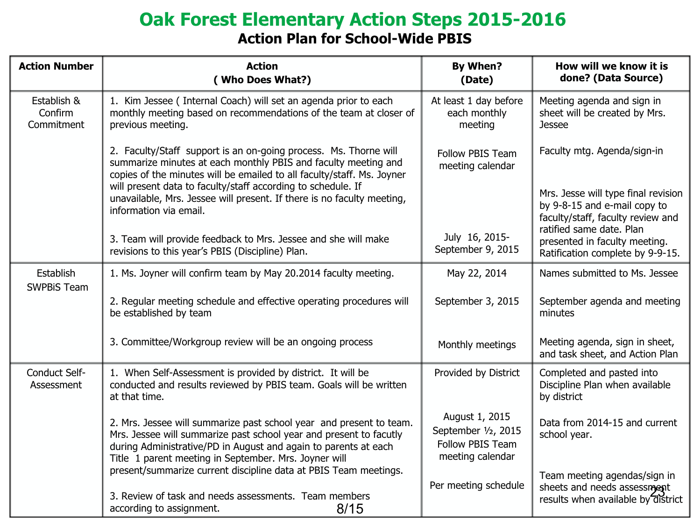
PBIS / MTSS Leadership Team
School Action Plan / Agenda
School team example
Just as our school teams are using agenda / action plans, so should we at the district

Slide 27
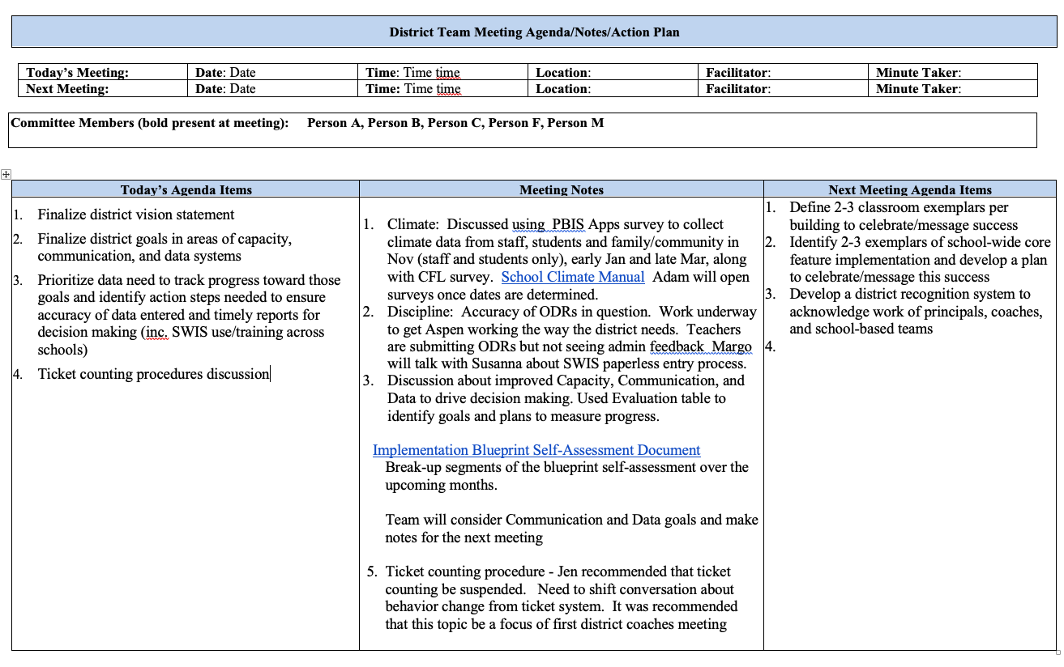
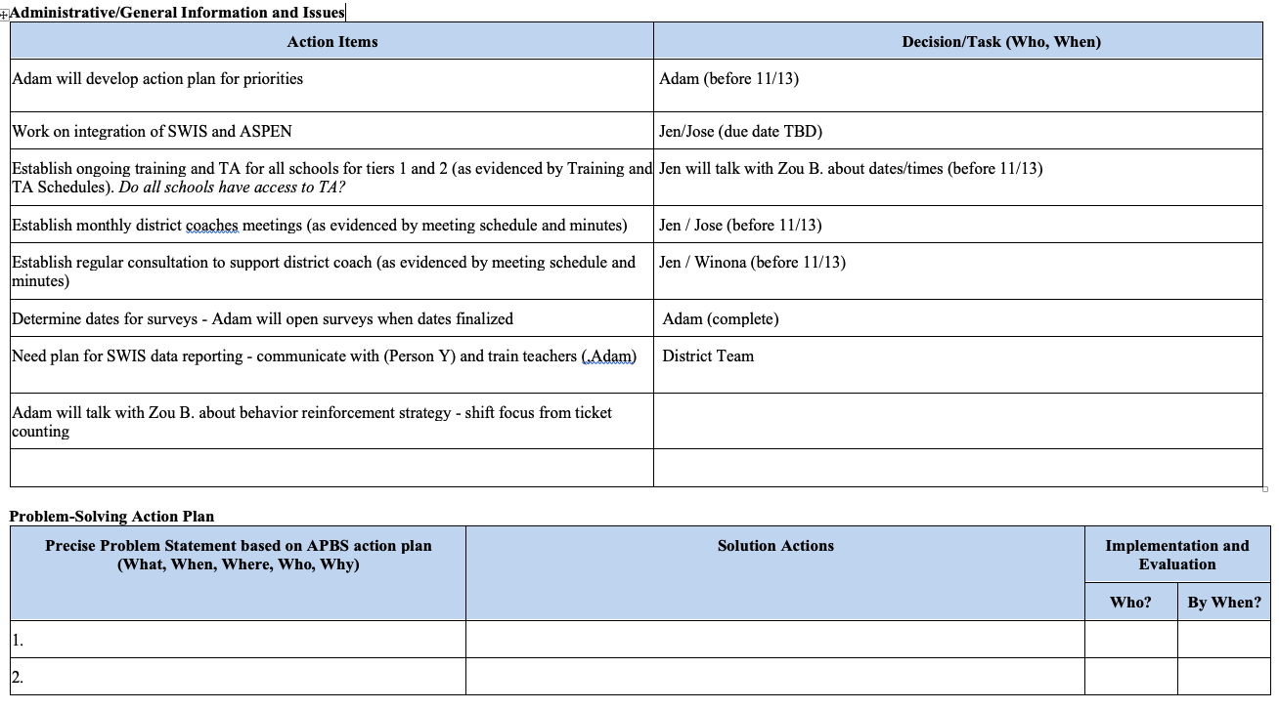
District Leadership Team agenda / action plan

Slide 28
Activity:
District Team Time!
District Team Members
10 min
Review leadership team items.
  Self-Assess
  Rate current status
  Celebrate successes!
  Identify areas of needs / growth
  List specific actions
  Be ready to report out!!

Slide 29
Stakeholder Support
Funding
Policy & Systems Alignment
Workforce Capacity
Executive Functions
LEADERSHIP TEAMING
Implementation Functions
Training
Coaching
Evaluation & Performance Feedback
Behavioral Expertise
Local Implementation Demonstrations
Notes:
Version 2017-3-8
Swaps Stakeholder Support and Funding

Slide 30
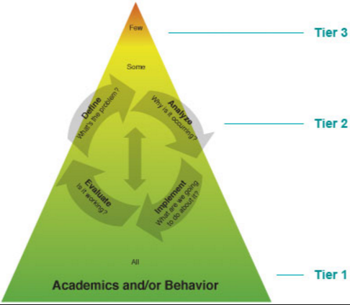
PBIS Blueprint & Self Assessment
Evaluation and Performance Feedback
Data is used to make decisions during:
  Every step of the Problem-Solving
  At every tier of support
  Progress monitoring data
      Response to intervention?
  Fidelity of implementation data
      Intervention delivered as intended?

Slide 31
Data based decision making GOALs for districts
Increase positive outcomes for ALL students
  Tier 1
  Tier 2
  Tier 3
Define “positive outcomes”
Identify measures
Develop performance targets

Slide 32
Domains of data based decision making
Type | Function | Key Question
Screening/ Benchmarking | Quickly determine if students are preforming adequately & identify if at-risk of future problems | What students are at-risk (in need of additional support)?
Progress Monitoring | Ensure the intervention is working | Is the student/s making progress towards a predetermined goal?
Outcome | Document the effectiveness of an intervention | Has the program been a success?
Diagnostic* | Develop a support plan to address a significant problem | What supports does the student need and how to provide them?
*Reserved for when progress monitoring data indicate that various supports have not worked.
(Adapted from Hosp, Hosp, & Howell, 2007)
Notes:
Add or say another key question for screening here: Is Universal/Core instruction meeting the needs of the majority of our students?
Add outcomes/say or keep the outcomes slide:
Are students responding positively to the interventions?
Are students responding at a rate that will ensure they will reach goals?

Slide 33
Data based decision making at advanced tiers
Target schools need to identify, if possible:
Number of students receiving Tier 2 and Tier 3 supports (can you define/differentiate?)
How students’ response to interventions are monitored at Tier 2 and Tier 3 (may look different for different programs/approaches)
Number of students receiving Tier 2 and Tier 3 supports that are having a “positive response”

Slide 34
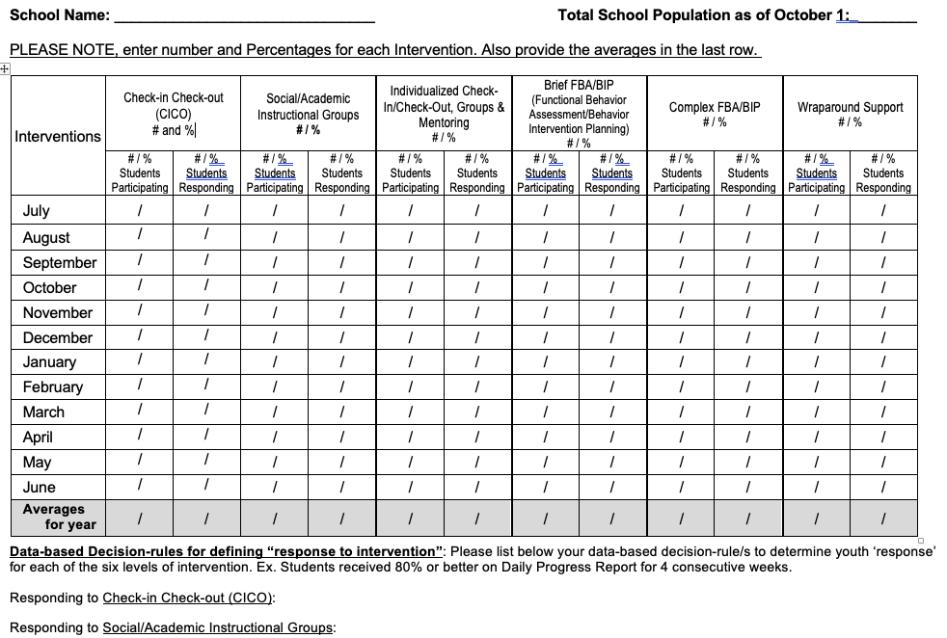
Tier 2 / Tier 3 Tracking Tool
Notes:
http://www.midwestpbis.org/evaluation/Midwest%20Tracking%20Tool%20Dec.%202015.doc.docx?attredirects=0&d=1

Slide 35
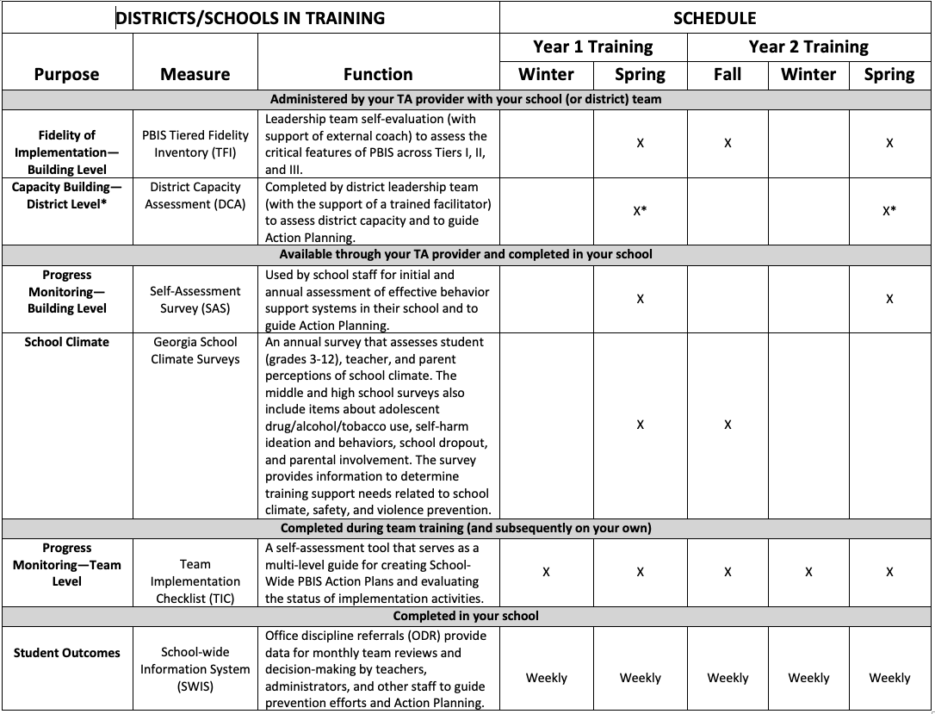
District Evaluation System Document Examples
Find this at nepbis.org
Notes:
Evaluation Schedule: https://nepbis.org/tier-1-workbook-and-supplemental-materials/

Slide 36
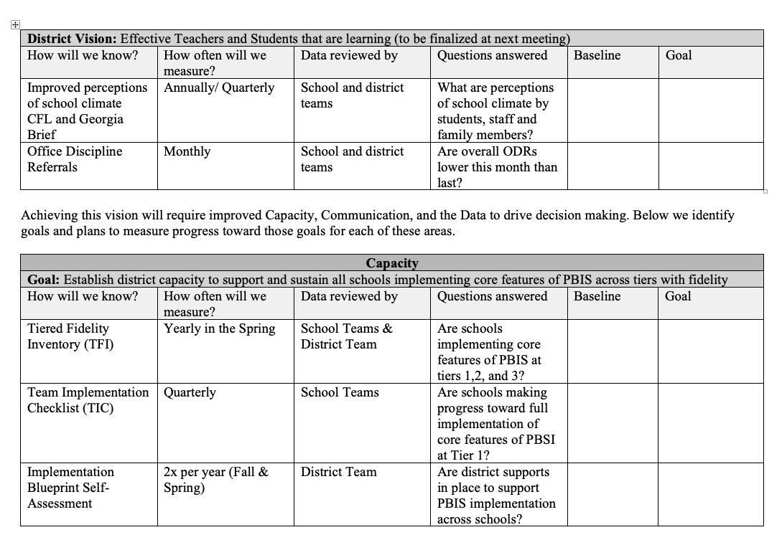
PBIS / MTSS Leadership Team
Evaluation Organizer
District Leadership Team evaluation schedule example

Slide 37
PBIS Blueprint & Self Assessment
Evaluation and Performance Feedback
42. School-based data systems (e.g., data collection tools and evaluation processes) are in place to enable continuous performance feedback.
43. Data systems are used to provide regular performance feedback to school teams and coaches for problem solving and action planning.
44. Evaluation schedule and process is used at all implementation levels (e.g., student, classroom, district, state) for examining the extent to which: (a) teams are implementing PBIS, (b) PBIS implementation is improving student outcomes, and (c) the Leadership Team’s action plan is implemented.
45. Annual progress reports tailored to external stakeholders are created and distributed at least annually on the activities and outcomes related to PBIS fidelity of implementation and student behavior goals.
46. Outcomes and accomplishments are disseminated, acknowledged, and celebrated at least quarterly.
47. Districts have transitioned from external to internal evaluation and performance feedback capacity (e.g., core group identified and supported in leading efforts).
48. System is in place for identifying districts, schools, or classrooms in need of additional training and coaching support.

Slide 38
Activity:
District Team Time!
District Team Members
10 min
Review Evaluation and Performance Feedback items.
  Self-Assess
  Rate current status
  Celebrate successes!
  Identify areas of needs / growth
  List specific actions
  Be ready to report out!!

Slide 39
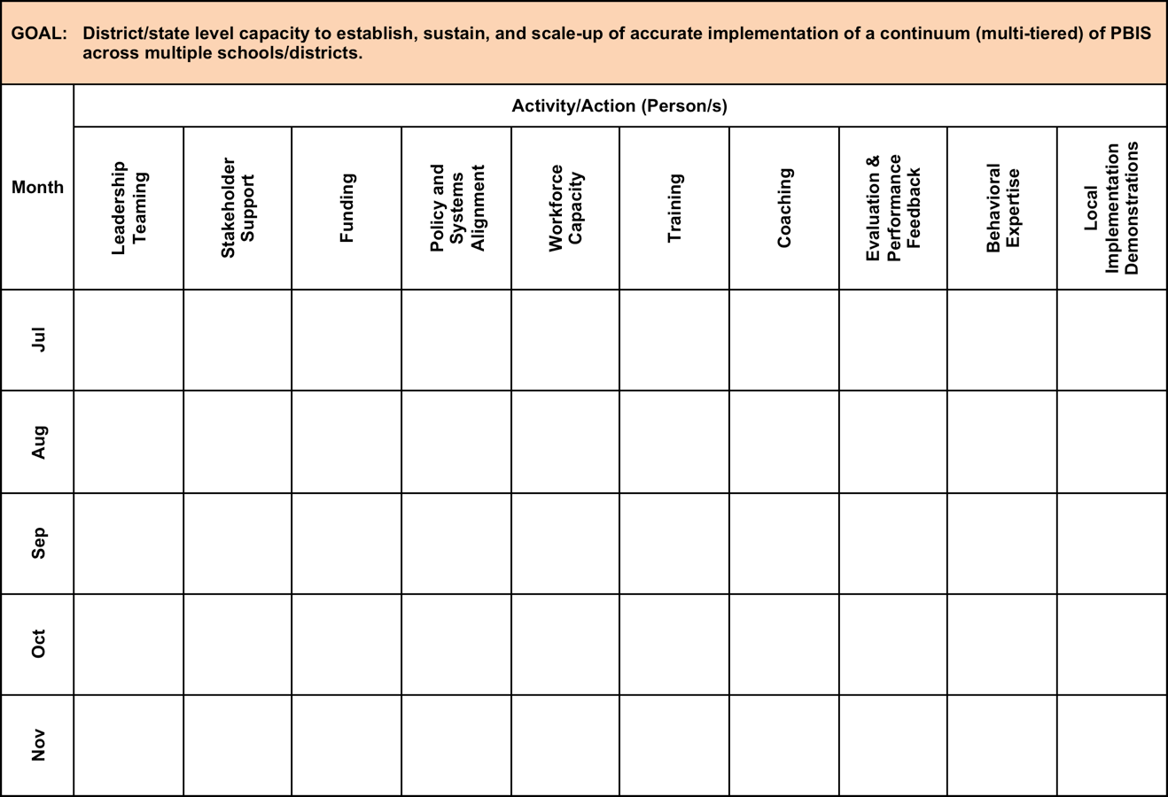
Notes:
https://www.pbis.org/Common/Cms/files/pbisresources/PBIS%20Implementation%20Blueprint%20Part%202%20Self-Assessment%202017-5-15.docx

Slide 40
Stakeholder Support
Funding
Policy & Systems Alignment
Workforce Capacity
Executive Functions
LEADERSHIP TEAMING
Implementation Functions
Training
Coaching
Evaluation & Performance Feedback
Behavioral Expertise
Local Implementation Demonstrations
Notes:
Version 2017-3-8
Swaps Stakeholder Support and Funding

Slide 41
Response: Work Smarter
Do less…better
Do it once
Invest in clear outcomes
Invest in a sure thing
Be strategic about problem solving

Slide 42
Sample Teaming Matrix
Initiative, Committee | Purpose | Outcome | Target Group | Staff Involved | SIP/SID
Attendance Committee | Increase attendance | Increase % of students attending daily | All students | Eric, Ellen, Marlee | Goal #2
Character Education | Improve character | Improve character | All students | Marlee, J.S., Ellen | Goal #3
Safety Committee | Improve safety | Predictable response to threat/crisis | Dangerous students | Has not met | Goal #3
School Spirit Committee | Enhance school spirit | Improve morale | All students | Has not met
Discipline Committee | Improve behavior | Decrease office referrals | Bullies, antisocial students, repeat offenders | Ellen, Eric, Marlee, Otis | Goal #3
DARE Committee | Prevent drug use |  | High/at-risk drug users | Don
EBS Work Group | Implement 3-tier model | Decrease office referrals, increase attendance, enhance academic engagement, improve grades | All students | Eric, Ellen, Marlee, Otis, Emma | Goal #2 Goal #3

Slide 43
Working Smarter
Initiative, Project, Committee | Purpose | Outcome | Target Group | Staff Involved | District Improvement Plan Goal
Attendance Committee
Trauma Informed Team
SEL Committee
Anti bullying Committee
Data Workgroup
Literacy program evaluation group
Behavior Work Group
Complete a resource audit!!!
Consider an executive District Team that integrates the other various teams / outcomes.
Use a district evaluation plan across various teams

Slide 44
Activity:
Committee Audit (Working Smarter)
Work as team for 20 min
Complete District Committee/ Group Self Assessment and Action Planning
Add items to your Action Plan as necessary
Present 2-3 “big ideas” from your group (1 min. reports)
Notes:
https://www.pbisapps.org/Resources/SWIS%20Publications/Working%20Smarter%20Matrix.rtf

Slide 45
Alignment of What?
SEL
Trauma Informed Practices
Restorative Practices
Responsive Classroom
Open Circle
Character Education
Olweus Bully Prevention

Slide 46
Are They All the Same?
Is the approach we are considering a compelling rationale that buttresses the need for MTSS/PBIS implementation?
Is the approach we are considering a supportive practice that will enhance what they are doing?

Slide 47
Alignment of What?
Compelling Rational
SEL
Trauma Informed Practices
Supportive Practices
Restorative Practices
Responsive Classroom
Open Circle
Character Education
Olweus Bully Prevention

Slide 48
How We Are Infusing SEL
Strategies to Set the Stage
  Mission statement
  Embedded in the training curriculum
    ‘Think About It’ alignment chart
    Setting the tone for specific content modules

Slide 49
Alignment, Braiding & Integration
It’s not an either or choice – It’s about how these different approaches complement one another to meet your school’s needs
Universal Intervention Components | PBIS | Common Initiatives, Programs and Interventions
 |  | Character Education | Restorative Practices | Responsive Classroom | Open Circle | Bully Prevention
Operationalized SW Expectations | X | X |  |  |  | X Specific to Bullying
Anchor Instruction to Teach Expectations | X | X | X Specific to RP |  |  | X Specific to Bullying
Reinforcement System | X
Consistent Response to Infractions | X |  | X
Emphasis on Core Prevention Practices | X |  | X – some elements
Engagement Opportunities | X
Data-Driven Decision Making | X | X Climate Surveys | X |  |  | X Specific to Bullying
Re-envisioning of the Discipline System | X |  | X
Family Component | X |  | X |  |  | X Specific to Bullying
Notes:
49

Slide 50

NJ Example
Mission
The mission of the NJ PBSIS initiative is to build capacity among New Jersey school personnel to implement a multi-tiered system of support for behavior, conduct, and social-emotional wellness that promotes equity for all students.
Implementation of multi-tiered systems of support create learning environments that contribute to everyone…
        being safe emotionally, physically, and socially.
        experiencing success every day.
        receiving what they need to be successful.
        working together to achieve goals.
        feeling welcomed and valued.
        further developing their strengths.

Slide 51
Alignment Activity Form
Consider reviewing your current support programs across your district by systems of support, data for review, and alignment of practices.
Notes:
https://nepbis.org/wp-content/uploads/2018/11/Alignment-Activity-1.docx

Slide 52
PBIS Blueprint & Self Assessment
Developing Policy and Systems Alignment
17. PBIS vision statement (and clear rationale) supporting importance of school climate (and how PBIS can improve both school climate and academic achievement) is developed and endorsed by lead state/district/school administrators.
18. PBIS vision statement is articulated into observable, measurable, specific, and actionable long-term outcomes.
19. PBIS implementation is included in organizational policy and procedural guidelines.
20. Policy, technical briefs, and procedural guides are posted and distributed at least annually.

Slide 53
PBIS Blueprint & Self Assessment
Developing Policy and Systems Alignment
21. Policies are reviewed and refined regularly to enhance their effects on fidelity of implementation and association with behavior and academic outcomes.
22. Periodic formal review (e.g., audit, survey, resource mapping, alignment) of existing social-emotional-behavioral-related initiatives or programs to determine effectiveness, relevance, and fidelity of implementation is completed at least annually.
23. Clear description of initiative alignment (e.g., graphic organizer, organizational chart, conceptual map) displays integrated and/or collaborative implementation of PBIS with existing initiatives having similar goals, outcomes, systems, and practices.
24. New potential initiatives are reviewed for fit with existing social-emotional-behavioral initiatives and resources before deciding whether to adopt, align, and/or integrate them.

Slide 54
Activity:
District Team Time!
District Team Members
10 min
Review Policy & Systems Alignment items.
  Self-Assess
  Rate current status
  Celebrate successes!
  Identify areas of needs / growth
  List specific actions
  Be ready to report out!!

Slide 55
District & School-wide PBIS
Culturally Equitable Academic &
Social Competence
OUTCOMES
Culturally Relevant
Support for
Student
Behavior
Culturally Valid
Decision
Making
DATA
PRACTICES
SYSTEMS
Culturally Knowledgeable
Staff Behavior
Notes:
SWPBS: Four Elements
SWPBS builds from a focus on student Outcomes: academic achievement, social competence, and safety.
SWPBS “Practices” are the behaviors of adults that affect how students perform. These are the daily, classroom, and on-going discipline practices of the school
SWPBS “Systems” are the organizational decisions and structures that support effective STAFF Behavior. A major strength of SWPBS is the emphasis on practices delivered WITH the systems needed to support the practices.
The use of data for decision-making is the single most important system within SWPBS. This element is used both to ensure the SWPBS practices are tailored to the local context/culture, and to benefit the continuous regeneration needed for sustained implementation.

Slide 56
Outcomes
School-wide behavior expectations
Class-wide Behavior expectations and routines
Practices
School-wide Instruction on Expectations
Class-wide Instruction on Routines
Academic Success
Social Emotional Competence
Active Supervision
Effective Recognition
Corrective Consequences
Function-based Support
Systems
Team-based
Supportive Leadership
Selection, Training, Coaching
Multi-tiered Support
Policies and funding
Data
Universal Screening
Progress Monitoring
Implementation Fidelity
Standardized Assessments

Slide 57
Main Messages
Sustained and High Fidelity Implementation of SWPBIS requires active District Support.
    Especially for Tiers II and III
-----------------------------------------------------------
Student = unit of impact
Schools = unit of analysis
District = unit of implementation

