Slide 1
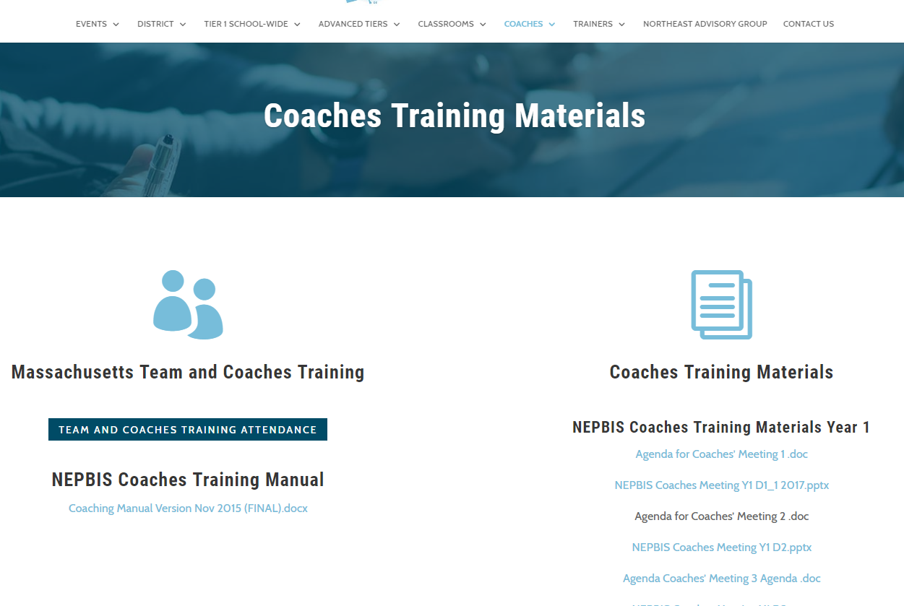
Welcome tO THE PBIS School-Wide COACHES’ MEETing!
As you wait for the training to begin, please:
Update your display name in Zoom to read: [Your School], [Your Name] (e.g., Eastside HS, Joe Clark)
Pull up your current action plan
Enter your attendance by following the hyperlink or through nepbis.org or by scanning the QR code
Notes:
TRAINERS –
Add your cohort number
Post a link to the attendance survey (below) in the chat for those who do not use the QR code on the slide:
ATTENDANCE: https://uconn.co1.qualtrics.com/jfe/form/SV_cGVCgkHJ7l6SApE

Slide 2
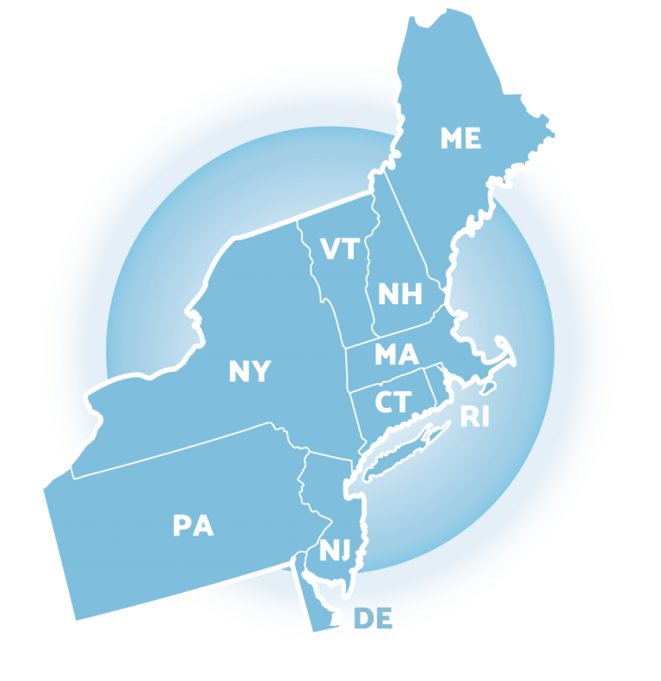
NEPBIS School-Wide Coach Training Year 4: April, 2022
INSERT TRAINER NAME
with support from Brandi Simonsen, Jen Freeman, Susannah Everett, Adam Feinberg,
Katie Meyer, & Karen Robbie
Notes:
Add trainer names for your event

Slide 3
EXPECTATIONS
Self
Others
Environment
Self-monitor
Mute when listening, unmute to talk​
Have your computer charged and ready to go​
If you have questions or comments:
Work as a team:
Keep necessary materials at hand
Are you participating?
Engaged as a learner?
Stretch, break, stand as needed​
unmute
use the chat box
Room for every voice
Reinforce participation
action plan
relevant docs
water/snacks
Minimize distractions if possible​

Slide 4
Agenda & Coaches' Tasks
Coaches’ Tasks:
Share your Annual Evaluation Plan with your trainers.
Presentation Content:
Glows & Grows: Action Planning
Annual Evaluation: Planning & Reporting
Looking Ahead: Completing the TFI Tier 1
Resource: Integrated TFI Companion Guide

Slide 5
ACTIVITY: ATTENDANCE
Scan QR code on the left or follow the URL posted in the chat to access the online attendance survey
Follow prompts to enter attendance information
Notify trainers if you require assistance (e.g., identifying your cohort or cohort group)
You are in Cohort ??
1 minute
Notes:
TRAINERS –
Add your cohort number
Post a link to the attendance survey (below) in the chat for those who do not use the QR code on the slide:
ATTENDANCE: https://uconn.co1.qualtrics.com/jfe/form/SV_cGVCgkHJ7l6SApE

Slide 6
HELPFUL RESOURCES
RESOURCES:
TFI Administration Manual
TFI Resources
Tidy Up with the TFI
Integrated TFI Companion Guide
Notes:
Resources:
TFI Administration Manual: https://www.pbisapps.org/resource/tfi
TFI Resources: https://www.pbisapps.org/Applications/Pages/Tiered-Fidelity-Inventory-(TFI).aspx
Tidy Up with the TFI: https://www.pbisapps.org/articles/tidy-up-with-the-tfi
Integrated TFI Companion Guide: https://www.pbis.org/resource/integrated-tiered-fidelity-inventory-companion-guide

Slide 7
Glows & Grows
Notes:
12:30

Slide 8
DISCUSSION: GLOWS & GROWS
What is something to celebrate & something you’re working on related to updates to your team’s action plan following March’s team training.
5 minutes
15 minutes
Independent Jot
Whole Group

Slide 9
Big Idea Check In: Annual Evaluation

Slide 10
TYPES OF DATA
TFI and TIC are our fidelity of implementation tools
What school wide outcomes do you monitor?
Fidelity
Outcomes
Notes:
There are type types of data we want to pay attention to:
Fidelity data tells us about the systems and practices that we, as adults, provide to students.
Outcome data tells us about the impact that our current systems and practices are having on students.

Slide 11
CONNECTING OUTCOMES & FIDELITY
Lucky | Sustaining
Positive outcomes, low understanding of how they were achieved Replication of success is unlikely | Positive outcomes, high understanding of how they were achieved Replication of success likely
Losing Ground | Learning
Undesired outcomes, low understanding of how they were achieved Replication of failure likely | Undesired outcomes, high understanding of how they were achieved Replication of mistakes unlikely
Where does your school fit in this table? Why?
Outcomes
Fidelity
Notes:
When we fail to look at information about our systems and practices as adults, then the outcomes might be good, but we consider it luck or attribute it to things outside our control (e.g., it’s a good group of kids). When the outcomes show that we’re losing ground, then we are surprised or start blaming resources or students. Both set up schools for failure. When we pay attention to adult behaviors and kid behaviors, then we can learn from mistakes or adjust practices and systems when resources or student needs change over time, and we can start sustaining success over time.

Slide 12
Do you have an EVALUATION PLAN?
At a minimum, it is strongly recommended that teams include the following in an evaluation plan:
School-wide student outcomes (weekly)
Student and staff perceptions (annually)
Fidelity (annually with the TFI)
DISTRICTS/SCHOOLS IN TRAINING |  |  | SCHEDULE
Purpose | Measure | Function | Year 1 Training |  | Year 2 Training
 |  |  | Winter | Spring | Fall | Winter | Spring
Capacity Building—District Level | District Systems Fidelity Inventory (DSFI) | Completed by district leadership team (with the support of a trained facilitator) to assess district capacity and to guide Action Planning. |  | X |  |  | X
Fidelity of Implementation—Building Level | PBIS Tiered Fidelity Inventory (TFI) | Leadership team self-evaluation (with support of external coach) to assess the critical features of PBIS across Tiers I, II, and III. |  | X | X |  | X
Progress Monitoring—Building Level | Self-Assessment Survey (SAS) | Used by school staff for initial and annual assessment of effective behavior support systems in their school and to guide Action Planning. |  | X |  |  | X
Progress Monitoring—Team Level | Team Implementation Checklist (TIC) | A self-assessment tool that serves as a multi-level guide for creating School-Wide PBIS Action Plans and evaluating the status of implementation activities. | X | X | X | X | X
School Climate | PBIS School Climate Survey (Extended & Brief) | An annual survey that assesses student (grades 3-12), teacher, and parent perceptions of school climate. The middle and high school surveys also include items about adolescent drug/alcohol/tobacco use, self-harm ideation and behaviors, school dropout, and parental involvement. The survey provides information to determine training support needs related to school climate, safety, and violence prevention. |  | X | X
Student Outcomes | School-wide Information System (SWIS) | Office discipline referrals (ODR) provide data for monthly team reviews and decision-making by teachers, administrators, and other staff to guide prevention efforts and Action Planning. | Weekly | Weekly | Weekly | Weekly | Weekly
A written plan will support the sustainability of PBIS.
Notes:
Evaluation Schedule template: https://nepbis.org/tier-1-workbook-and-supplemental-materials/

Slide 13
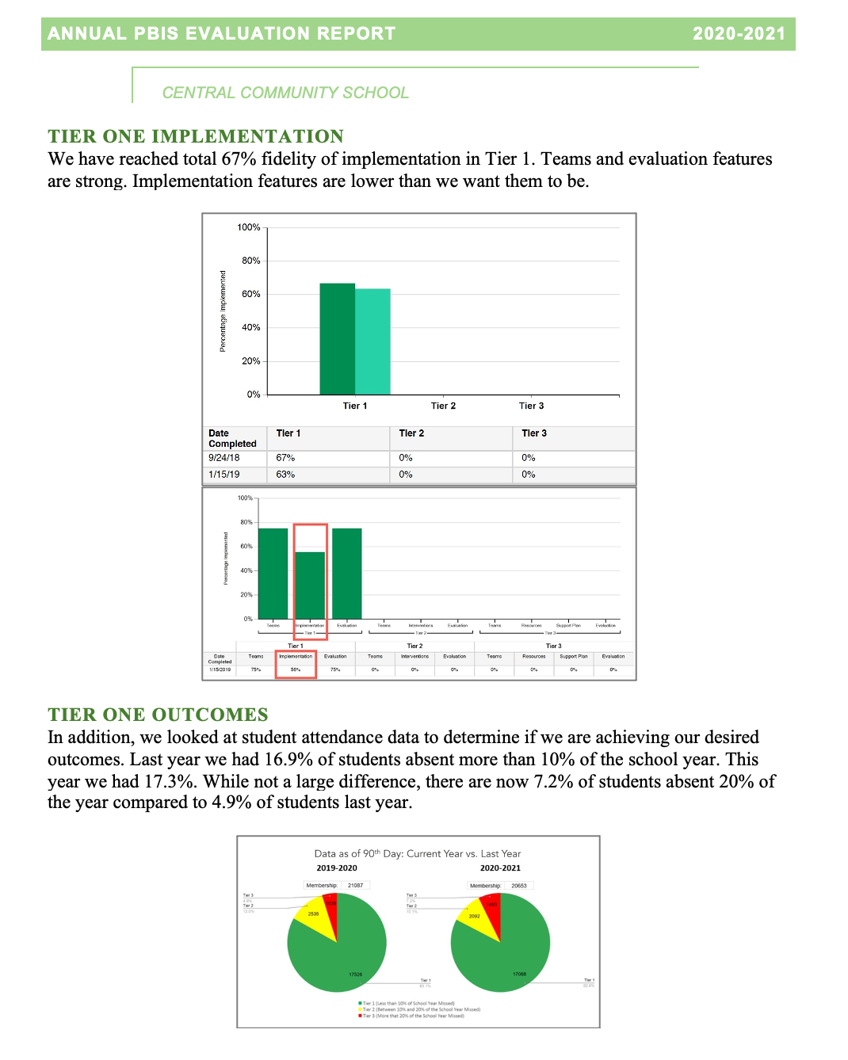
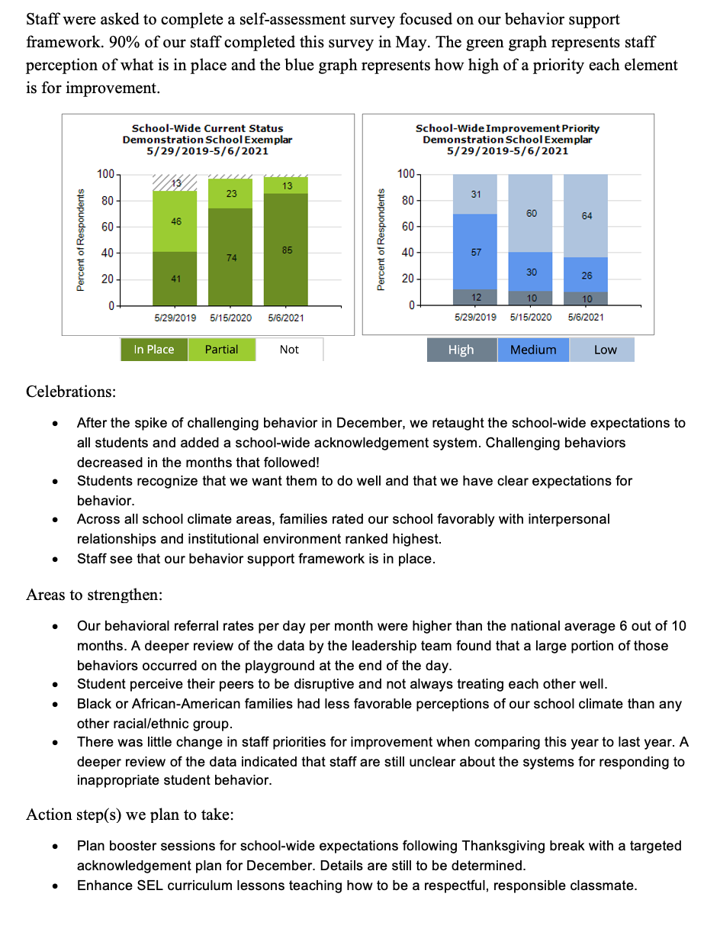
Yearly PBIS Evaluation Report
Developing & sharing evaluation reports communicates goals and progress to stakeholders and supports the sustainability of PBIS.
Implementation of the core components of PBIS is enhanced if the Tier I team assesses the implementation status at least annually and provides “snapshot” reports to the staff, community, school board

Slide 14
Outcome Data
Fidelity Data
Celebrations
Areas to Strengthen
Action Steps
Notes:
TRAINER NOTE: Use this sample to discuss what each school might choose to include in a “snapshot” evaluation report

Slide 15
DISCUSSION: BIG IDEA CHECK IN
How has your team moved forward with developing a written Evaluation Plan and Annual Evaluation Report?
What further support do you need so you can support your team with this work?
What examples can you share?
3 minutes
12 minutes
Independent Jot
Whole Group

Slide 16
Resource Spotlight: TFI Walkthrough Tool & Administration Resources

Slide 17
It’s TFI Season!
How can we support you in:
Completing the TFI this spring?
Preparing to complete the TFI independently next spring?

Slide 18
TFI Tier 1: Walkthrough Tool
TFI Administration Manual recommends the walkthrough is completed by someone external to the school to maintain validity as an external evaluation of fidelity.
External evaluator options:
District PBIS coach
PBIS coach from another school in district
Parent/Community member (requires training)
PBIS Academy Trainer
Other?
Notes:
TRAINER NOTE: Trainers can continue to complete the walkthrough for schools, however, work with schools on building internal capacity to plan completion of the walkthrough in the future.
TFI Administration Manual (walkthrough instruction & tool pgs. 27-28): https://www.pbisapps.org/resource/tfi

Slide 19
TFI Tier 1: Walkthrough Tool
Identify the 3-5 school-wide expectations and what they are commonly called (e.g., core values, Dive for 5, 3 Rs, etc.).
Identify the name of the school-wide acknowledgement system (e.g. Sand Dollars, Bobcat Bucks, etc.).
Survey a representative sample of students (across grades) and staff (across positions, departments).
Notes:
TFI Administration Manual (walkthrough instruction & tool pgs. 27-28): https://www.pbisapps.org/resource/tfi

Slide 20
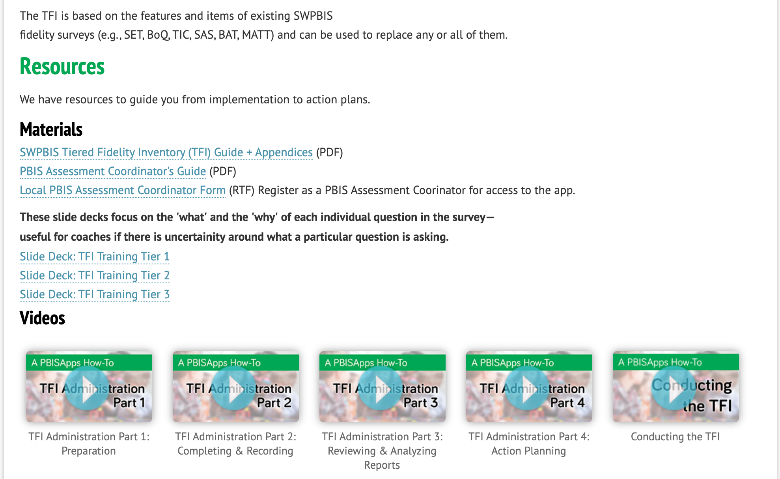
TFI Administration Resources
Review TFI resources
(available HERE)
as needed to build fidelity review & action planning into your regular data routines.
Notes:
Trainer note:
Please remind coaches of the resources available for review for those that would benefit from administration, review, and action planning planning.
TFI Resources are available here: https://www.pbisapps.org/Applications/Pages/Tiered-Fidelity-Inventory-(TFI).aspx

Slide 21
ACTIVITY: RESOURCE SPOTLIGHT
Review the TFI resources independently.
With a partner discuss:
How you would like to complete the TFI walkthrough this year.
Do you want to complete Tier 2 of the TFI this year as a baseline assessment?
Who and how you would like to complete the TFI next year and in the future.
Be ready to provide a 1 minute share-out of your discussion
Independent
Partner/Small Group
Whole Group
5 minutes
10 minutes
5 minutes

Slide 22
Looking Ahead

Slide 23
TFI Administration Planning
Discussion: What steps of the process need some planning ahead?
External support: District level or other coach
Schedule walkthrough
Schedule administration meeting
Complete Walkthrough tool
Review decision making process
Recording procedures
Preparation
Facilitation
Review item scores and identify next
Share information at faculty meetings
Planning
Notes:
Trainer Note: Preparation for Administration/ Completion Time School teams completing the Tier 1 scale should arrange a TFI Walkthrough (see Appendix A) before completing the TFI. We recommend that an external coach complete the TFI Walkthrough, although teams completing the Tier 1 scale more than once per year (i.e., for progress monitoring) may have a school staff member complete it. The time to complete the TFI depends on (a) the experience that the team and coach have with the process, (b) the extent of preparation for TFI completion , and (c) the number of tiers assessed. School teams new to the TFI should schedule 30 min for Tier 1, 30 min for Tier 2, and 30 min for Tier 3. If team leaders have assembled relevant sources of information prior to the meeting, and, if the team and coach have already completed the TFI at least twice, the time required for implementation may be approximately 15 min for each tier.
Coaches should plan ahead with team to complete the walkthrough tool
Coaches can work with team to develop a plan for reviewing items and decision making process for coming to concensus.
Coaches can support team on recording items. Consider PBISApps.

Slide 24
DISCUSSION: LOOKING AHEAD
What do you already have in place to support sustained annual evaluation with the TFI?
What further support do you need to support your team with this work?
Take out your calendars and schedule a time to complete the TFI with your trainer.
3 minutes
12 minutes
Independent Jot
Whole Group

Slide 25
AGENDA & FOLLOW-UP
Presentation Content:
Glows & Grows: Action Planning
Annual Evaluation: Planning & Reporting
Looking Ahead: Completing the TFI Tier 1
Resource: Integrated TFI Companion Guide
Coaches’ Tasks:
Share your Annual Evaluation Plan with your trainers.
What questions do you have on today’s content?
What questions do you have on the follow-up tasks?

Slide 26
HELPFUL RESOURCES
RESOURCES:
TFI Administration Manual
TFI Resources
Tidy Up with the TFI
Integrated TFI Companion Guide
Notes:
Resources:
TFI Administration Manual: https://www.pbisapps.org/resource/tfi
TFI Resources: https://www.pbisapps.org/Applications/Pages/Tiered-Fidelity-Inventory-(TFI).aspx
Tidy Up with the TFI: https://www.pbisapps.org/articles/tidy-up-with-the-tfi
Integrated TFI Companion Guide: https://www.pbis.org/resource/integrated-tiered-fidelity-inventory-companion-guide

Slide 27
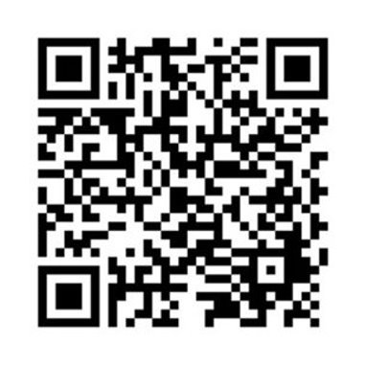
EVALUATION
Please remember to complete the evaluation to receive your PDPs!
Scan the QR code to access.
Notes:
TRAINERS -
Put link to evaluation (below) in the chat for those who do not use the QR code:
https://uconn.co1.qualtrics.com/jfe/form/SV_7PBRl9EB3mmOG4C

