Slide 1
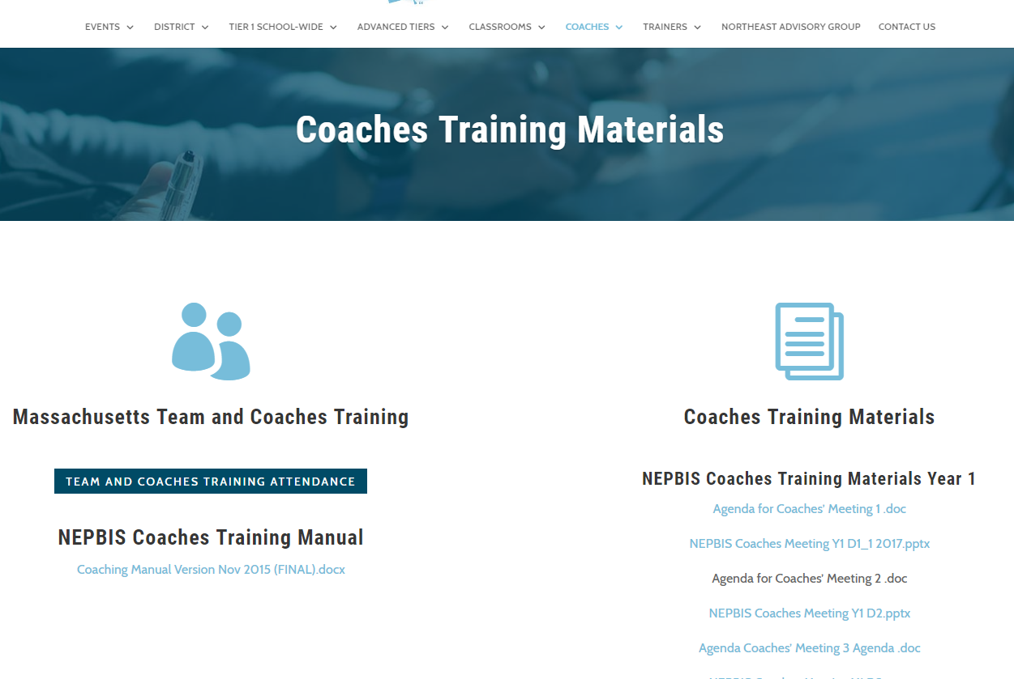
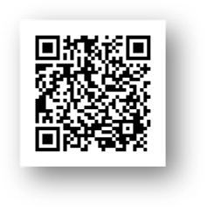
Welcome tO THE PBIS School-Wide COACHES’ MEETing!
As you wait for the training to begin, please:
Update your display name in Zoom to read: [Your School], [Your Name] (e.g., Eastside HS, Joe Clark)
Pull up your current action plan
Enter your attendance by following the hyperlink or through nepbis.org or by scanning the QR code
Notes:
TRAINERS –
Add your cohort number
Post a link to the attendance survey (below) in the chat for those who do not use the QR code on the slide:
ATTENDANCE: https://uconn.co1.qualtrics.com/jfe/form/SV_cGVCgkHJ7l6SApE

Slide 2
NEPBIS School-Wide Coach Training Year 4: February 2022
INSERT TRAINER NAME
with support from Brandi Simonsen, Jen Freeman, Susannah Everett, Adam Feinberg,
Katie Meyer, & Karen Robbie
Notes:
Add trainer names for your event

Slide 3
EXPECTATIONS
Self
Others
Environment
Self-monitor
Mute when listening, unmute to talk​
Have your computer charged and ready to go​
If you have questions or comments:
Work as a team:
Keep necessary materials at hand
Are you participating?
Engaged as a learner?
Stretch, break, stand as needed​
unmute
use the chat box
Room for every voice
Reinforce participation
action plan
relevant docs
water/snacks
Minimize distractions if possible​

Slide 4
Agenda & Coaches' Tasks
Coaches’ Tasks:
Help teams prepare VIRTUAL poster for next month
Presentation Content:
Glows & Grows: Using data to action plan
Check in on Communication of Data
Resource: REVISED Supporting & Responding Guide
Looking Ahead: March VIRTUAL Team Meeting
Complete TIC with your team & share action plan with trainers.

Slide 5
ACTIVITY: ATTENDANCE
Scan QR code on the left or follow the URL posted in the chat to access the online attendance survey
Follow prompts to enter attendance information
Notify trainers if you require assistance (e.g., identifying your cohort or cohort group)
You are in Cohort 6A
1 minute
Notes:
TRAINERS –
Add your cohort number
Post a link to the attendance survey (below) in the chat for those who do not use the QR code on the slide:
ATTENDANCE: https://uconn.co1.qualtrics.com/jfe/form/SV_cGVCgkHJ7l6SApE

Slide 6
HELPFUL RESOURCES
RESOURCES:
Be a Data Hero: Sustaining Practices & Sharing Data
Data-based Decision Making
Supporting & Responding to Student Behavior (revised)
Notes:
Be a Data Hero: https://www.pbisapps.org/articles/be-a-data-hero-sustaining-practices-and-sharing-data
Data-based Decision Making: https://www.pbis.org/topics/data-based-decision-making
Supporting & Responding to Student Behavior: https://www.pbis.org/resource/supporting-and-responding-to-behavior-evidence-based-classroom-strategies-for-teachers

Slide 7
Glows & Grows

Slide 8
DISCUSSION: GLOWS & GROWS
What is something to celebrate & something you’re working on related to: using data (e.g., TIC, classroom, survey, behavior) to inform your action planning.
3 minutes
12 minutes
Independent Jot
Whole Group

Slide 9
Big Idea Check In: Communication of Data
Notes:
TRAINERS: The big idea of this section is to check in with coaches on who the team is sharing data with, what they are sharing and for what purpose, how, and how often.

Slide 10
WHY COMMUNICATE DATA?
Supports Buy-In
Communicates Clear Goals
Sustains Implementation
Celebrates Progress

Slide 11
COMMUNICATION OF DATA: CONSIDERATIONS
WHO? | WHAT? | WHEN?
All Staff | Outcome goals Survey results Student outcome data Fidelity data | At least quarterly
Students/Families/ Community Partners | Outcome goals Survey results Fidelity data Celebrations | At least quarterly
Other teams (e.g., with similar goals, across tiers) | Outcome goals Outcome data | Depends on purpose and level of collaboration
District Leadership | Outcome goals Celebrations | Annually

Slide 12
What is most related to high sustainability?
The frequency that data are presented to all school staff.
McIntosh, K., Kim, J., Mercer, S. H., Strickland-Cohen, M. K., & Horner, R. H. (2015).

Slide 13
SHARING DATA WITH STAFF
TYPES OF DATA
School-wide behavior/discipline data (NOT individual students)
Survey results
Outcome goals
PBIS fidelity data
WAYS TO SHARE DATA
Evaluation reports
Monthly newsletters
Data walls
Staff meetings
Pinkelman, S., McIntosh, K., Kim, J. R., Rasplica, C.K., Berg, T. & Strickland-Cohen, M. K. (2015).

Slide 14
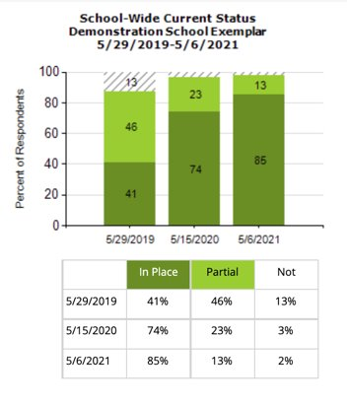
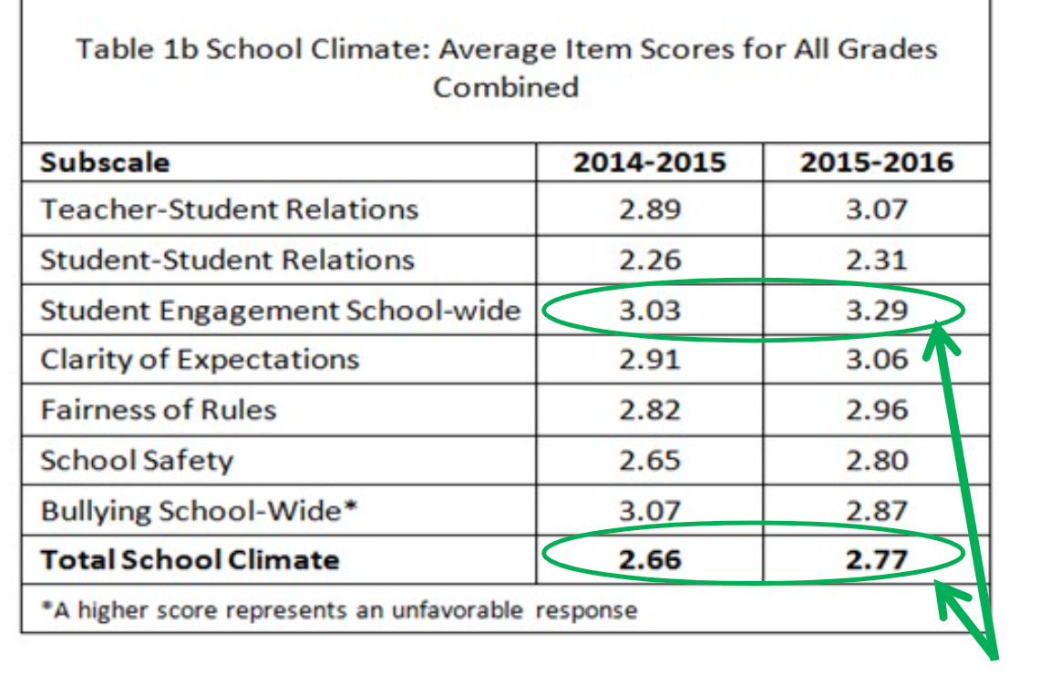
MORE DATA SHARING EXAMPLES

Slide 15
DISCUSSION: BIG IDEA CHECK IN
How has your team moved forward with sharing data with various stakeholders?
What examples can you share?
What further support do you need so you can support your team with this work?
3 minutes
12 minutes
Independent Jot
Whole Group

Slide 16
Resource Spotlight

Slide 17
SUPPORTING & RESPONDING (Updated)
Expanded focus on supporting students’ social, emotional, and behavioral (SEB) growth
Additional practice areas
Establishing positive connections
Planning relevant instruction
Fostering positive relationships
Enhanced focus on staff implementation
Revised self-assessment
Corresponding action planning tool
Updated resource links
Notes:
Supporting & Responding (updated): https://www.pbis.org/resource/supporting-and-responding-to-behavior-evidence-based-classroom-strategies-for-teachers

Slide 18
ACTIVITY: RESOURCE SPOTLIGHT
Review the shared resource independently.
With a partner discuss:
What was your key takeaway from this resource?
How might your team use this in the future?
Can this be used to provide professional development to staff? How?
Be ready to provide a 1 minute share-out of your discussion
Independent
Partner/Small Group
Whole Group
5 minutes
10 minutes
5 minutes
Notes:
Supporting & Responding (updated): https://www.pbis.org/resource/supporting-and-responding-to-behavior-evidence-based-classroom-strategies-for-teachers

Slide 19
Looking Ahead

Slide 20
LOOKING AHEAD
February Asynchronous Content:​
Complete TIC with team
March Virtual Team Training:
Action Plan with TIC
Annual Action Plan
Annual Evaluation Report
Poster Session

Slide 21
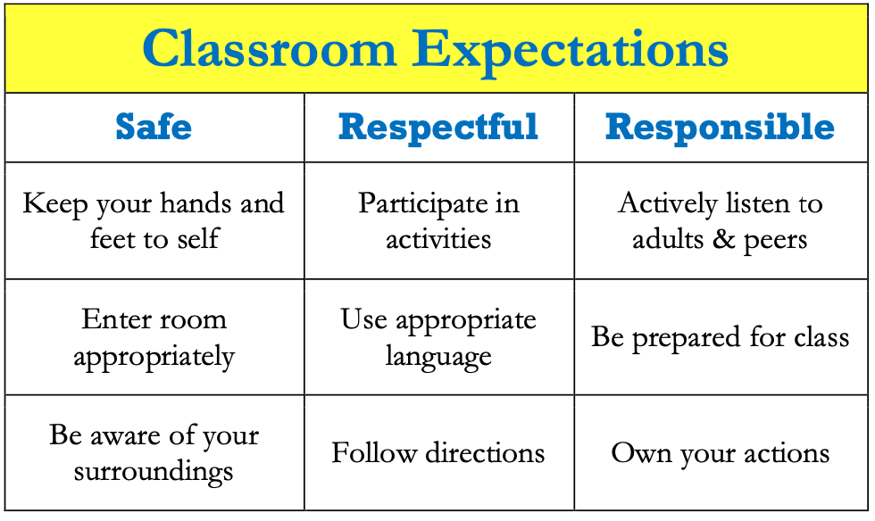
POSTER SESSION
Target Goal:
Share examples of implementation of the PBIS Framework across districts and schools
Structure
Show off! Each school will showcase aspects of your PBIS implementation with other teams
One shared visual file! During March team training, we'll be randomized into breakout rooms and share our example file with others.
Get ideas! Bring ideas back to your school for follow up action planning
Notes:
This should be brief (5 minutes)

Slide 22
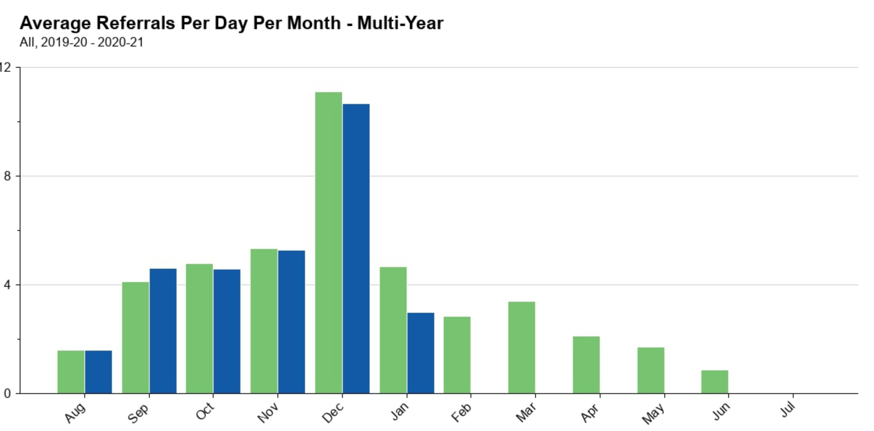
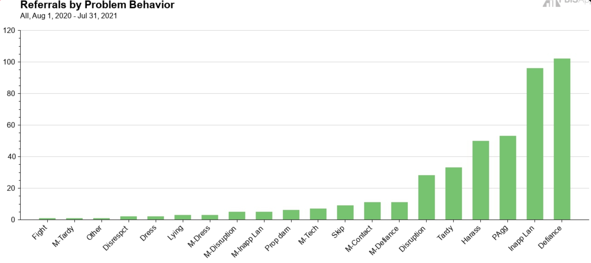
What to include on your poster
Examples of Systems, Data, and Practices!
Data Examples
Fidelity Data (e.g., TFI or TIC)
Outcome Data (e.g., ODR or attendance)
System Examples
Team Action Plans
Staff Survey
Practice Examples
Lesson Plan
Teaching Matrix
Consequence Flow Chart
Please include data as part of your poster!
Notes:
This should be brief (5 minutes)

Slide 23
What to include on your poster
Consider including features that promote sustainability!
PBIS Handbook image
Newsletter sharing data with staff or families
Picture of policy on school website
Sample PD agenda to introduce new staff to PBIS
Notes:
This should be brief (5 minutes)

Slide 24
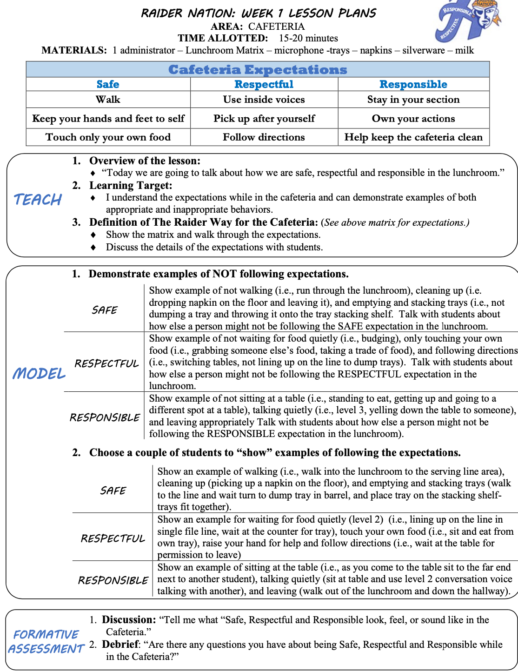
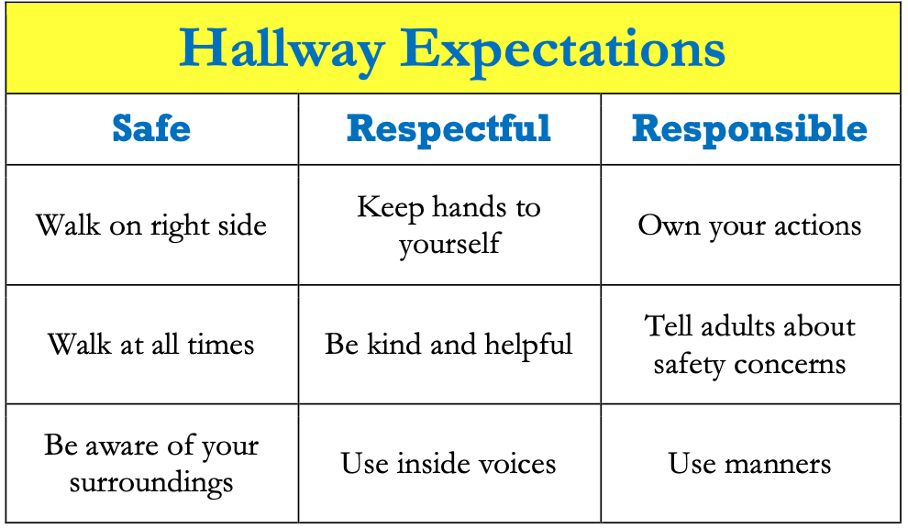
Virtual Poster Example

Slide 25
VIRTUAL POSTER EXAMPLE
Notes:
TRAINER NOTE: Here is an example of a virtual poster from last year, created in google slides. You can click on the TV, fish, chalkboard, and computer screen to view various elements of PBIS, including the start of a PBIS Handbook. Feel free to get creative in your virtual poster design!

Slide 26
Dr. Lewis S. Libby School Logic Model
OUTCOME
How do we sustain this?
Staff encouragement- Parking spot, funding for paw power cards, system to make sure paws are put on the wall and cards are readily available with lanyards.
Feel free to update or expand your logic model slide with visuals if that is easier for you.
Develop procedures to increase appropriate behavior
Lanyards to make cards available, Card stations for staff, Paw containers for people to help hang paws, upstairs bucket for middle school drawing, PD for PBIS expectations which included PBIS team giving cards to staff for examples/practicing filling out SWIS forms, student of the month assemblies
DATA
Triangle data looks like it should! Full pre-K-4 bucket, walls full of paws, continued giving cards and doing drawings during closure.
How do we support staff to
implement this with fidelity?
SYSTEMS
What is one highlight
associated with this outcome?
Drawing can continue in school closure promoting system and consistency
What is one lesson learned?
_We need to figure out a better system for our paw power cards to get home, a name on the wall, and in the drawing, without too much work for staff!
Paw Power Cards, Drawings, Paw Walls Behavior Matrix, common language, wall posters, PBIS card stations for staff, lanyards for staff when we return, student of the month assemblies
How do we know we are doing what we say we are doing? How do we know it is working?
What are we doing?
What do we want to be doing?
PRACTICES

Slide 27
DISCUSSION: LOOKING AHEAD
Decide on a virtual poster format (PPT or other).
Discuss what to include on your poster and what steps need to be completed between now and the team training.
What further support do you need so you can support your team with this work?
10 minutes
5 minutes
With co-coach
Whole Group

Slide 28
AGENDA & FOLLOW-UP
Presentation Content:
Glows & Grows: Using data to action plan
Check in on Communication of Data
Resource: REVISED Supporting & Responding Guide
Looking Ahead: March VIRTUAL Team Meeting
Coaches’ Tasks:
Help teams prepare VIRTUAL poster for next month
Complete TIC with your team & share action plan with your trainers.
What questions do you have on today’s content?
What questions do you have on the follow-up tasks?

Slide 29
HELPFUL RESOURCES
RESOURCES:
Be a Data Hero: Sustaining Practices & Sharing Data
Data-based Decision Making
Supporting & Responding to Student Behavior (revised)
Notes:
Be a Data Hero: https://www.pbisapps.org/articles/be-a-data-hero-sustaining-practices-and-sharing-data
Data-based Decision Making: https://www.pbis.org/topics/data-based-decision-making
Supporting & Responding to Student Behavior: https://www.pbis.org/resource/supporting-and-responding-to-behavior-evidence-based-classroom-strategies-for-teachers

Slide 30
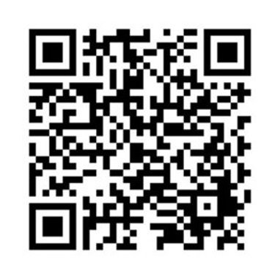
EVALUATION
Please remember to complete the evaluation to receive your PDPs!
Scan the QR code to access.
Notes:
TRAINERS -
Put link to evaluation (below) in the chat for those who do not use the QR code:
https://uconn.co1.qualtrics.com/jfe/form/SV_7PBRl9EB3mmOG4C

