Slide 1
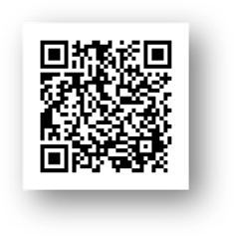
Welcome tO THE PBIS School-Wide COACHES’ MEETing!
As you wait for the training to begin, please:
Update your display name in Zoom to read: [Your School], [Your Name] (e.g., Eastside HS, Joe Clark)
Pull up your current action plan
Enter your attendance by following the hyperlink or through nepbis.org or by scanning the QR code
Notes:
TRAINERS –
Add your cohort number
Post a link to the attendance survey (below) in the chat for those who do not use the QR code on the slide:
ATTENDANCE: https://uconn.co1.qualtrics.com/jfe/form/SV_cGVCgkHJ7l6SApE

Slide 2
NEPBIS School-Wide Coach Training Year 4: January, 2022
INSERT TRAINER NAME
with support from Brandi Simonsen, Jen Freeman, Susannah Everett, Adam Feinberg,
Katie Meyer, & Karen Robbie
Notes:
Add trainer names for your event

Slide 3
EXPECTATIONS
Self
Others
Environment
Self-monitor
Mute when listening, unmute to talk​
Have your computer charged and ready to go​
If you have questions or comments:
Work as a team:
Keep necessary materials at hand
Are you participating?
Engaged as a learner?
Stretch, break, stand as needed​
unmute
use the chat box
Room for every voice
Reinforce participation
action plan
relevant docs
water/snacks
Minimize distractions if possible​

Slide 4
Agenda & Coaches' Tasks
Coaches’ Tasks:
Complete the TIC with your team
Presentation Content:
Glows & Grows: Assessing Classroom PBIS
Disaggregating Data
Resource: 5 Questions Every Team Should Ask About Racial Disproportionality
Looking Ahead: Complete TIC
Submit your plan for assessing Classroom PBIS (if you haven’t yet)

Slide 5
ACTIVITY: ATTENDANCE
Scan QR code on the left or follow the URL posted in the chat to access the online attendance survey
Follow prompts to enter attendance information
Notify trainers if you require assistance (e.g., identifying your cohort or cohort group)
You are in Cohort ??
1 minute
Notes:
TRAINERS –
Add your cohort number
Post a link to the attendance survey (below) in the chat for those who do not use the QR code on the slide:
ATTENDANCE: https://uconn.co1.qualtrics.com/jfe/form/SV_cGVCgkHJ7l6SApE

Slide 6
HELPFUL RESOURCES
RESOURCES:
A 5 Point Intervention Approach for Enhancing Equity in School Discipline
Examples of Engaging Instruction to Increase Equity in Education
Video: SWIS Equity Report: Risk Index
Notes:
https://www.pbis.org/resource/a-5-point-intervention-approach-for-enhancing-equity-in-school-discipline
https://www.pbis.org/resource/examples-of-engaging-instruction-to-increase-equity-in-education
https://www.pbisapps.org/resource/equity-graph-1-risk-index

Slide 7
Glows & Grows
Notes:
12:30

Slide 8
DISCUSSION: GLOWS & GROWS
What is something to celebrate & something you’re working on related to: assessing classroom PBIS implementation this year (and using the data to guide PD planning)?
3 minutes
12 minutes
Independent Jot
Whole Group

Slide 9
Big Idea Check In: Disaggregating Data

Slide 10
WHY DISAGGREGATE OUTCOME DATA?
Allows comparisons between groups (e.g., grade, gender, (dis)ability, race/ethnicity, etc.)
Facilitates development of precise problem statements
Supports equitable decision-making

Slide 11
Identify a question
Identify the data source
Disaggregate the data to answer the question
Are racial groups chronically absent at the same rate?
Attendance
Disaggregate by race
Are students with disabilities being referred at the same rate?
Office Discipline Referrals
Disaggregate by disability status
Do our LGBTQ+ students feel safe at school?
School Climate Survey
Disaggregate by gender identity
Notes:
TRAINERS: Please note the three examples when you put slide in slide show mode.

Slide 12
EXAMPLE 1: SURVEY DATA
Do students who are gay/lesbian feel safe at school?
“I feel safe…”
Average scores by sexual orientation

Slide 13
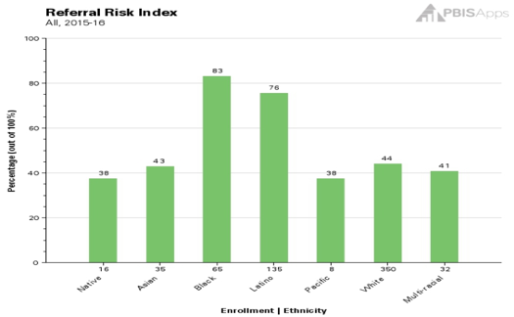
EXAMPLE 2: ATTENDANCE
Are racial groups chronically absent at the same rate?
 | # of Enrolled Students | # of Students Identified as Chronically Absent | % of Students Within Ethnicity Identified as Chronically Absent | Risk Index
Native | 16 | 6 | 37.50% | 0.38
Asian | 35 | 15 | 42.86% | 0.43
Black | 65 | 54 | 83.08% | 0.83
Latino | 135 | 102 | 75.56% | 0.76
Pacific | 8 | 3 | 37.50% | 0.38
White | 350 | 154 | 44.00% | 0.44
Multi-racial | 32 | 13 | 40.63% | 0.41
Totals: | 641 | 347
Chronic Absenteeism Risk Index
54 of the 65 Black students are identified as chronically absent, so __?% of the Black students are missing significant instructional time.
102 of the __ Latino students are identified as chronically absent, so 76% of the Latino students are missing significant instructional time.

Slide 14
EXAMPLE 3: ODRS
Are students with disabilities being referred at the same rate?
 | # of Enrolled Students | # of Students with Referrals | % of Students within Disability with Referrals | Risk Index
IEP | 45 | 17 | 38% | 0.38
504 | 25 | 6 | 24% | 0.24
None | 300 | 63 | 21% | 0.21
17 of the 45 students with IEPs have a discipline referral, so __?% of students with IEPs have a referral.
63 of the __ students without a disability have a discipline referral, so 21% of the students without a disability have a referral.

Slide 15
DISAGGREGATING DATA
What questions does your team or school have about equitable outcomes or experiences for students?
Bring student data that you can or have disaggregated to answer those questions. Such as:
Survey data (school climate, etc.)
Attendance
ODRs
Referrals to Special Education
Suspension
How can you ensure that all students have access to equitable educational opportunities?

Slide 16
DISCUSSION: BIG IDEA CHECK IN
What questions does your team or school have about equitable outcomes or experiences for students?
How have/can you answer them?
What further support do you need?
What examples can you share?
3 minutes
12 minutes
Independent Jot
Whole Group

Slide 17
Resource Spotlight

Slide 18
5 QUESTIONS EVERY TEAM SHOULD ASK ABOUT RACIAL DISPROPORTIONALITY
Is there an inequity problem in our school?
What is it about our people, policies, and practices that contribute to this inequity?
Which equitable practices can address this discipline inequity?
Did the equity strategies decrease our discipline disparity?
Who is at the table when decisions are made about our school systems?
What is 1 question you feel is important to bring back to your team?
Notes:
This should be brief (5 minutes)
https://www.pbisapps.org/articles/5-questions-every-team-should-ask-about-racial-disproportionality

Slide 19
ACTIVITY: RESOURCE SPOTLIGHT
Review the shared resource independently.
With a partner discuss:
What was your key takeaway from this resource?
How might your team use this in the future?
Can this be used to provide professional development to staff? How?
Be ready to provide a 1 minute share-out of your discussion
Independent
Partner/Small Group
Whole Group
5 minutes
10 minutes
5 minutes

Slide 20
Looking Ahead

Slide 21
TIC PROGRESS MONITORING
Complete the Team Implementation Checklist (TIC) as a team.
Review the results and compare to your last administration:
Identify 1-3 strengths to celebrate with staff (and other stakeholders)
Identify 1-3 areas of improvement to prioritize and add to your action plan
Notes:
This should be brief (5 minutes)

Slide 22
DISCUSSION: TIC
If you completed the TIC in the fall, how did you use it to update your action plan?
What further support do you need to complete the TIC with your team by the end of February?
3 minutes
12 minutes
Independent Jot
Whole Group

Slide 23
AGENDA & FOLLOW-UP
Presentation Content:
Glows & Grows: Assessing Classroom PBIS
Disaggregating Data
Resource: 5 Questions Every Team Should Ask About Racial Disproportionality
Looking Ahead: Complete TIC
Coaches’ Tasks:
Complete the TIC with your team
Submit your plan for assessing Classroom PBIS (if you haven’t yet)
What questions do you have on today’s content?
What questions do you have on the follow-up tasks?

Slide 24
HELPFUL RESOURCES
RESOURCES:
A 5 Point Intervention Approach for Enhancing Equity in School Discipline
Examples of Engaging Instruction to Increase Equity in Education
Video: SWIS Equity Report: Risk Index
Notes:
https://www.pbis.org/resource/a-5-point-intervention-approach-for-enhancing-equity-in-school-discipline
https://www.pbis.org/resource/examples-of-engaging-instruction-to-increase-equity-in-education
https://www.pbisapps.org/resource/equity-graph-1-risk-index

Slide 25
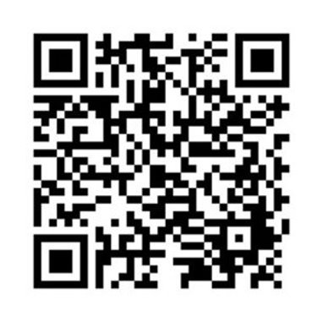
EVALUATION
Please remember to complete the evaluation to receive your Certificate of Attendance!
Scan the QR code to access.
Notes:
TRAINERS -
Put link to evaluation (below) in the chat for those who do not use the QR code:
https://uconn.co1.qualtrics.com/jfe/form/SV_7PBRl9EB3mmOG4C

