Slide 1
ACTIVITY: TEAM IMPLEMENTATION CHECKLIST
COACHES (1 per team) go to www.pbisapps.org and login at the top right corner.
If you haven't set up your password, go through the “forgot password” process.
Select PBIS Assessment. Under Surveys Currently Open, Select Team Checklist 3.1.
Click “Take Survey” and find the Team Checklist.
Select → under the “Action” column .
Complete TIC as a team
Review Reports to support your action planning.
Compare results from this administration to previous.
Identify 1 celebration and 1 priority for improvement.
Teams 35 minutes

Slide 2
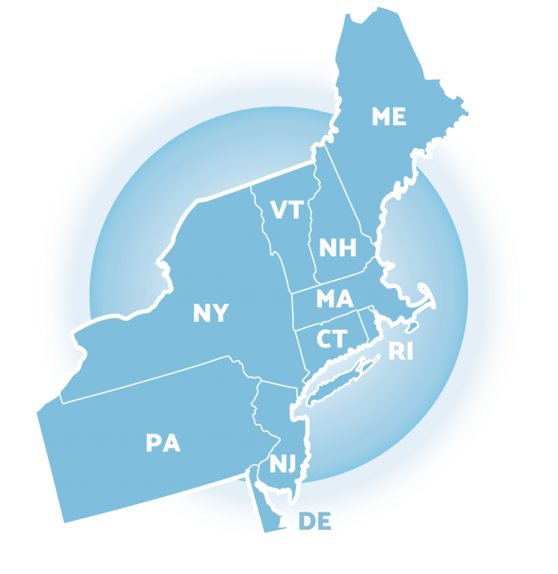
NEPBIS School-Wide Team Training Year 1: April
[Insert Trainer Names]
with support from Brandi Simonsen, Jen Freeman, Susannah Everett,
Adam Feinberg & Katie Meyer

Slide 3
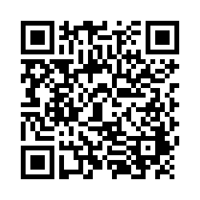
ACTIVITY: ATTENDANCE
Scan QR code on the left or follow the URL posted in the chat to access the online attendance survey
Follow prompts to enter attendance information
Notify trainers if you require assistance (e.g., identifying your cohort or cohort group)
1 minute
Notes:
TRAINERS –
Post a link to the attendance survey (below) in the chat for those who do not use the QR code on the slide:
https://uconn.co1.qualtrics.com/jfe/form/SV_0iZuJ0aKCo5IkG9

Slide 4
NEPBIS (VIRTUAL) LEADERSHIP FORUM
May 13th & 14th, 12:00-4:30pm
COST: $25
STRANDS:
Implementation & Sustainability
School-Wide PBIS
Class-Wide PBIS
Advanced Tiers of PBIS
Integration & Alignment
District & State
KEYNOTES
Ruthie Payno-Simmons, Great Lakes Equity Center
George Sugai, University of Connecticut
Notes:
For more information and to register: https://nepbis.org/forum/

Slide 5
Did your team PIVOT your PBIS implementation during the ’20-’21 school year due to the COVID-19 pandemic?
If your school:
Had school representation at...
Monitored implementation fidelity in PBIS Assessment
Adapted at least one core PBIS feature
teaching matrix
lesson plans
acknowledgment system
data sources/routines
all Team Trainings
90% of Coaches Trainings
completed the Team Implementation Checklist (TIC)
OR Tiered Fidelity Inventory (TFI)
Has evidence partnering with families to support PBIS at home
remote learning/at-home matrix
family communication exemplars
home-based acknowledgement systems
OR
Schools meeting criteria will receive...
A certificate of recognition
A shoutout in The Progress Monitor and cohort training
One free registration to the NEPBIS Forum in May 2021
Then, follow this link to let us know about it!
Notes:
Survey Link: https://uconn.co1.qualtrics.com/jfe/form/SV_1CkeJFo0d9xCt25

Slide 6
APRIL TEAM AGENDA
Presentation Content
Team planning time
Team Tasks
Complete TIC
Overview of Assessment Tools: Self-Assessment Survey (SAS), School Climate Survey, Tiered Fidelity Inventory (TFI)
Schedule TFI (April-June)

Slide 7
LEGEND
Discussion
Poll
Activity
&
Positive & Negative Examples
Preview

Slide 8
EXPECTATIONS
Self
Others
Environment
Self-monitor (Are you participating? Engaged as a learner?)​
Mute when listening; unmute to talk​
Have your computer charged and ready to go​
Stretch, break, stand as needed​
If you have questions or comments, unmute, use the chat box, or click the "raise hand" icon
Work as a team (room for every voice, reinforce participation)
Keep necessary materials at hand (e.g., action plan & other docs, water, snacks, etc.)​

Slide 9
TOOLS
WEBSITES
School-Wide PBIS Workbook & Appendices
Action Plan
nepbis.org
pbis.org
pbisapps.org

Slide 10
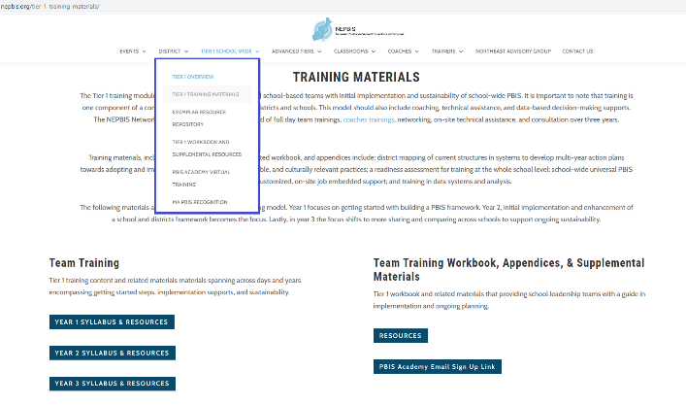
NEPBIS.ORG
Notes:
Trainer note: Please remind participants of Year 2 Syllabus access as well as the reminder email sign up link if they are not receiving reminder emails. Remind them of their Cohort Group (e.g. 6A)

Slide 11
Overview of Assessment Tools
Self-Assessment Survey, School Climate Survey, Tiered Fidelity Inventory
Notes:
TRAINERS: All schools participating in the PBIS Academy are expected to complete the TFI this spring. Briefly review the SAS and School Climate Survey as additional assessment options.

Slide 12
SELF ASSESSMENT SURVEY (SAS)
Purpose: | Progress monitoring survey. Staff perception of the implementation status and improvement priority for school-wide, classroom, non-classroom and individual student systems.
Format: | Email link to survey. 20-30 mins.
Completed by: | All school staff, with at least 80% response rate recommended for reliable results. In subsequent admins, all staff OR individuals from a representative group.
When? | Annually

Slide 13
SELF ASSESSMENT SURVEY
SCHOOL-WIDE SYSTEMS
Current Status |  |  | Feature | Priority for Improvement
In Place | Partial in Place | Not in Place | School-wide is defined as involving all students, all staff, & all settings. | High | Med | Low
 |  |  | 1. A small number (e.g. 3-5) of positively & clearly stated student expectations or rules are defined.
 |  |  | 2. Expected student behaviors are taught directly.
 |  |  | 3. Expected student behaviors are rewarded regularly.
 |  |  | 4. Problem behaviors (failure to meet expected student behaviors) are defined clearly.
 |  |  | 5. Consequences for problem behaviors are defined clearly.
 |  |  | 6. Distinctions between office v. classroom managed problem behaviors are clear.
 |  |  | 7. Options exist to allow classroom instruction to continue when problem behavior occurs.

Slide 14
Let us know if you’re interested in conducting the SAS this year.
Notes:
Red – less than 50% in place
Yellow – 50-79% in place
White – 80% in place or higher

Slide 15
SCHOOL CLIMATE SURVEY
Purpose: | Assess students’, staffs’, and families’ perspective of the overall climate in the building.
Format: | Survey ratings pertaining to school climate and demographic questions. 10-15 mins.
Completed by: | Two student formats. Elementary: grades 3-5. Middle/high: grades 6-12. Staff survey. Family survey. Can administer all or targeted stakeholders.
When? | At start and end of school year OR annually.
A modified version of the survey that takes into account learning modality is available at https://nepbis.org/district-data-tools-resources/
Notes:
Modified School Climate Survey: https://nepbis.org/district-data-tools-resources/

Slide 17
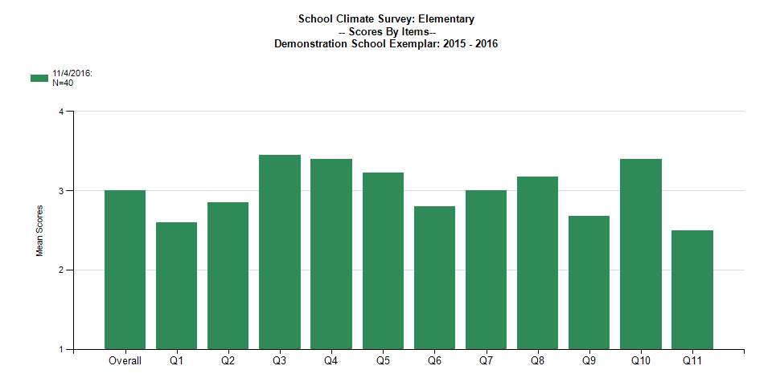
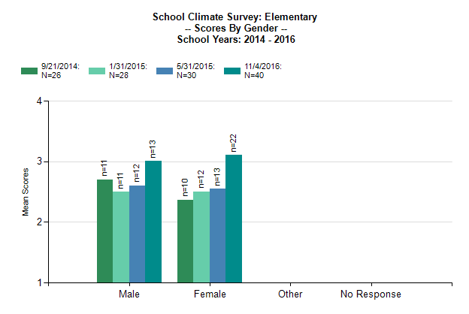
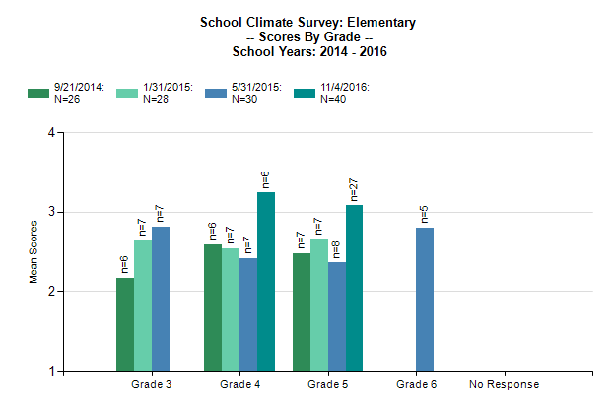
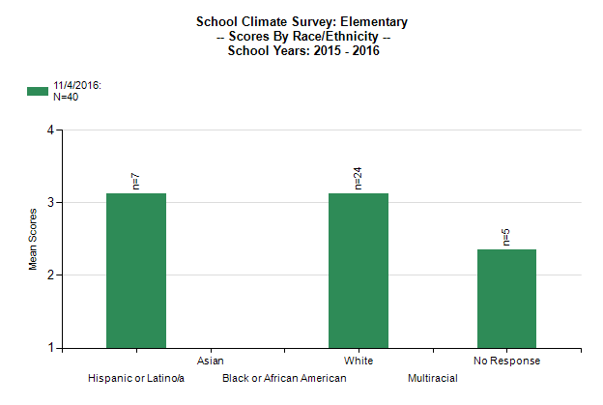
SCHOOL CLIMATE SURVEY
Let us know if you’re interested in conducting the School Climate Survey this year.

Slide 18
TIERED FIDELITY INVENTORY (TFI)
Purpose: | Assess evidence of critical features of school-wide PBS implementation; Progress over time; Helps team make data-based decisions on intervention and program efficacy; Guides action-planning.
Format: | Survey ratings of features in place (self-assessment). About 30 mins per tier.
Completed by: | Team members with the coaches. Walkthrough tool completed by external coach.
When? | Annually (in spring)
Assessment & walkthrough can be conducted remotely

Slide 19
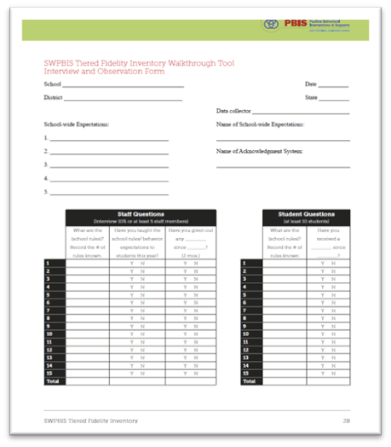
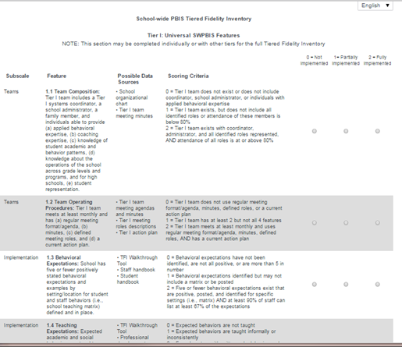
TIERED FIDELITY INVENTORY (SWPBIS TFI 2.1)
PBIS Assessments
Walkthrough Tool

Slide 20
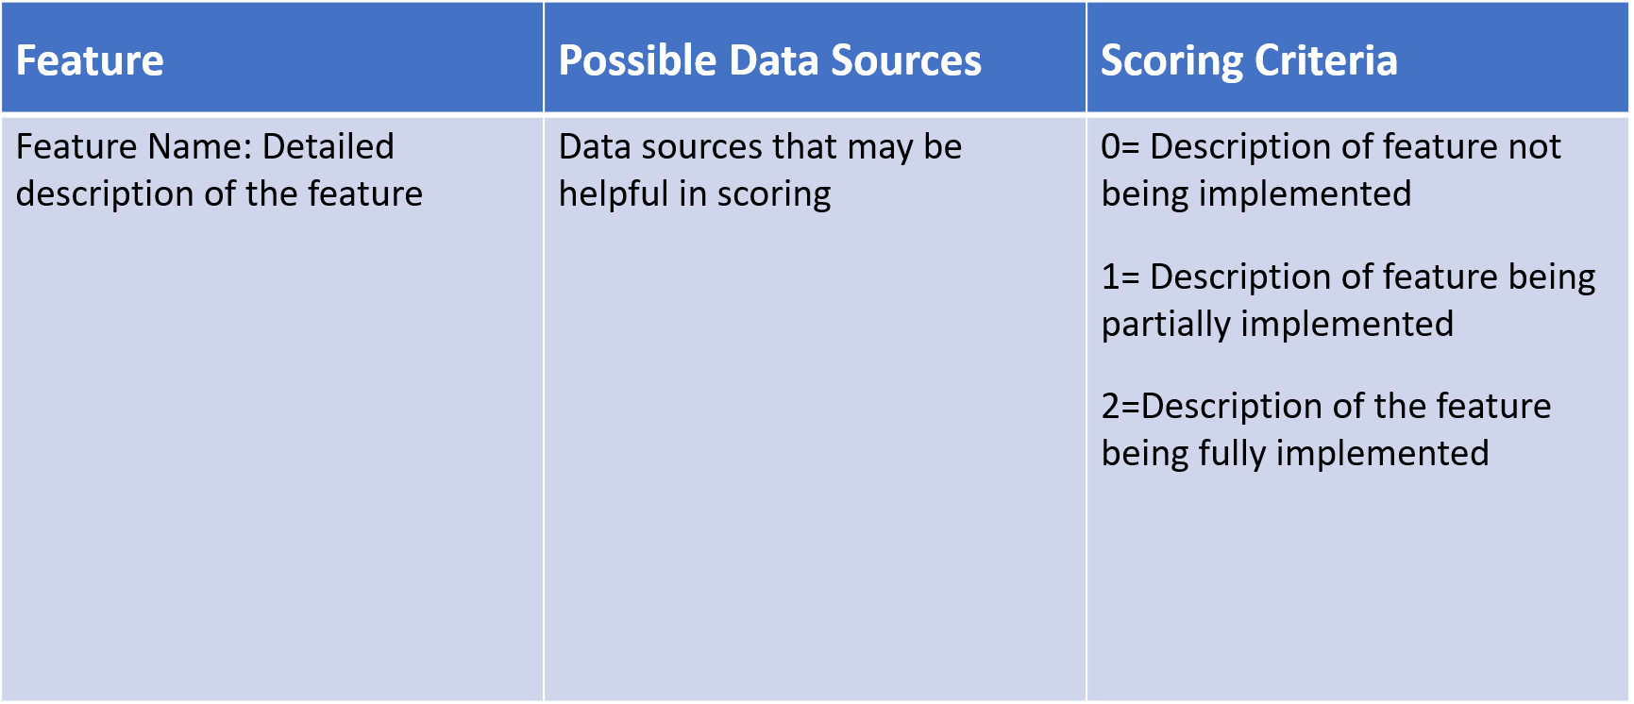
TFI FORMAT
Tier 1 = 15 items
Team Subscale – 2 items
Implementation Subscale – 9 items
Evaluation Subscale – 4 items

Slide 21
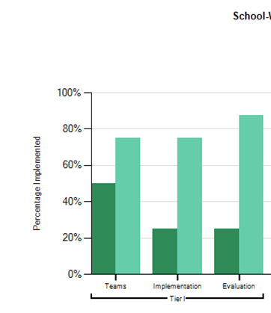
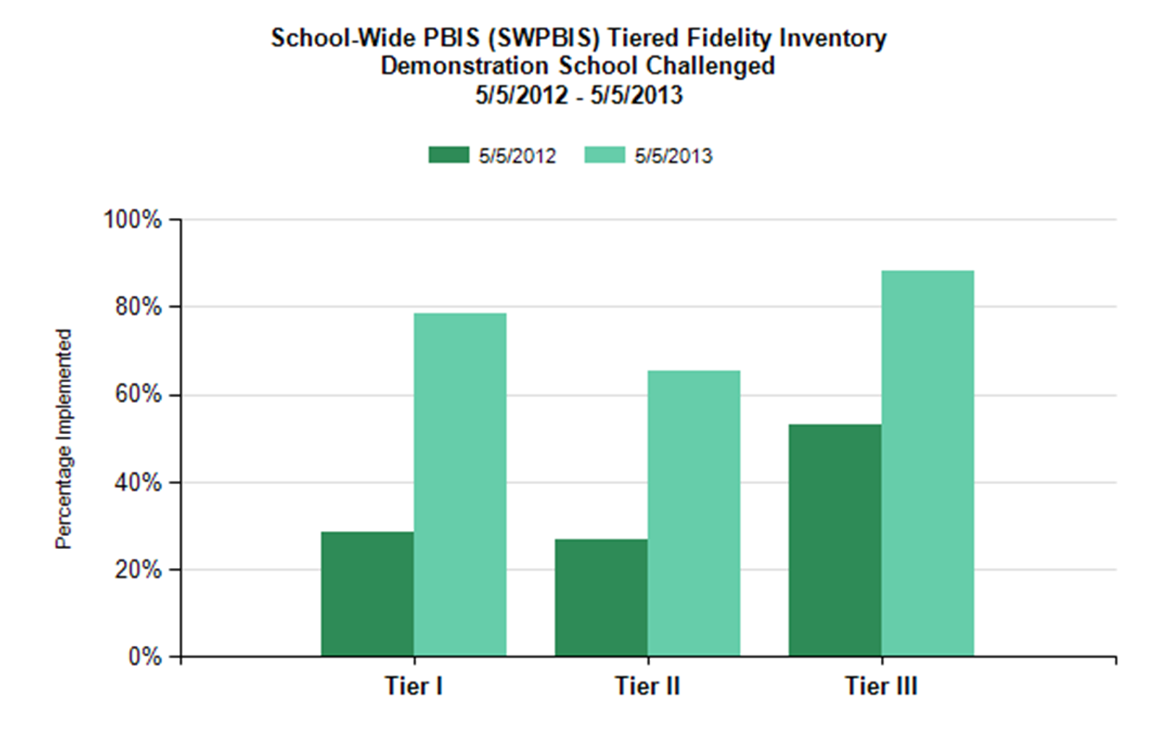
TFI REPORTS
Use the Scale, Subscale and Item reports to guide action planning.

Slide 22
INTEGRATED TFI COMPANION GUIDE
The Integrated Companion Guide supports alignment of cultural responsiveness and mental health & wellness with the PBIS framework.
Notes:
TRAINERS: The Integrated TFI Companion Guide combines guidance from the Cultural Responsiveness Field Guide, the Interconnected Systems of Support Action Planning Field Guide, the Returning to School During and After Crisis Guide, and the Teaching Social Emotional Competencies within the PBIS Framework Brief. You may want to model pulling this tool up on the pbis.org website using the search feature.
Integrated TFI Companion Guide: https://www.pbis.org/resource/integrated-tiered-fidelity-inventory-companion-guide

Slide 23
ACTIVITY: TEAM PLANNING TIME
Pull up your team meeting schedule and set a time to complete the TFI with your trainer.
Review the Integrated TFI Companion Guide and identify 1-3 items to focus on as a team.
Discuss whether you want to conduct any of the other assessments this year.
Action plan or work on any of the getting started steps we’ve covered.
Prepare to present 1 goal or accomplishment from your group.
Consider breaking into smaller groups for efficiency. We can create additional breakout rooms.
Teams
45 minutes

Slide 24
ACTIVITY: SHARE OUT
Share 1 goal or accomplishment from your team.
Related to your TIC
Any of the getting started steps/products
Pertaining to your action plan
Whole group
10 minutes

Slide 25
TODAY’S AGENDA & TASKS
What questions do
you have on today’s content?
Presentation Content
Overview of Assessment Tools: Self-Assessment Survey (SAS), School Climate Survey, Tiered Fidelity Inventory (TFI)
Team planning time
Team Tasks
Complete TIC
Schedule TFI (April-June)
What questions do
you have on today’s
follow-up team tasks?

Slide 26
ADDITIONAL READINGS & RESOURCES
READINGS:
Tidy up with the TFI
3 Ways to Ensure School is a Place Everyone Wants to Be
RESOURCES:
Integrated TFI Companion Guide
Cultural Responsiveness Field Guide and TFI Companion Tool
Descriptions & hard copies of Assessments on PBIS Assessment
Notes:
Resource links
Readings:
Tidy up with the TFI: https://www.pbisapps.org/community/Pages/Tidy-Up-With-the-TFI.aspx
3 Ways to Ensure School is a Place Everyone Wants to Be: https://www.pbisapps.org/community/Pages/School-Climate.aspx
Resources:
Integrated TFI Companion Guide: https://www.pbis.org/resource/integrated-tiered-fidelity-inventory-companion-guide
Cultural Responsiveness Field Guide: https://www.pbis.org/resource/pbis-cultural-responsiveness-field-guide-resources-for-trainers-and-coaches
PBIS Assessment: https://www.pbisapps.org/Applications/Pages/PBIS-Assessment.aspx

Slide 27
PREVIEW: MAY AGENDA & TASKS
Presentation Content
Family Engagement
Team Tasks
Family-School Partnership Survey
Planning for the Beginning of the Year
Planning for Next Year Activity

Slide 28
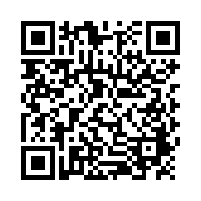
EVALUTION
Action Plan
Behavior Definitions
Discipline Flowchart
Office Referral Form
Please send to your trainer
Please remember to complete the evaluation to receive your PDPs!
Scan the QR code to access.
Notes:
TRAINERS -
Put link to evaluation (below) in the chat for those who do not use the QR code:
https://uconn.co1.qualtrics.com/jfe/form/SV_5BXYIXLvg0qmSzP

