Slide 1
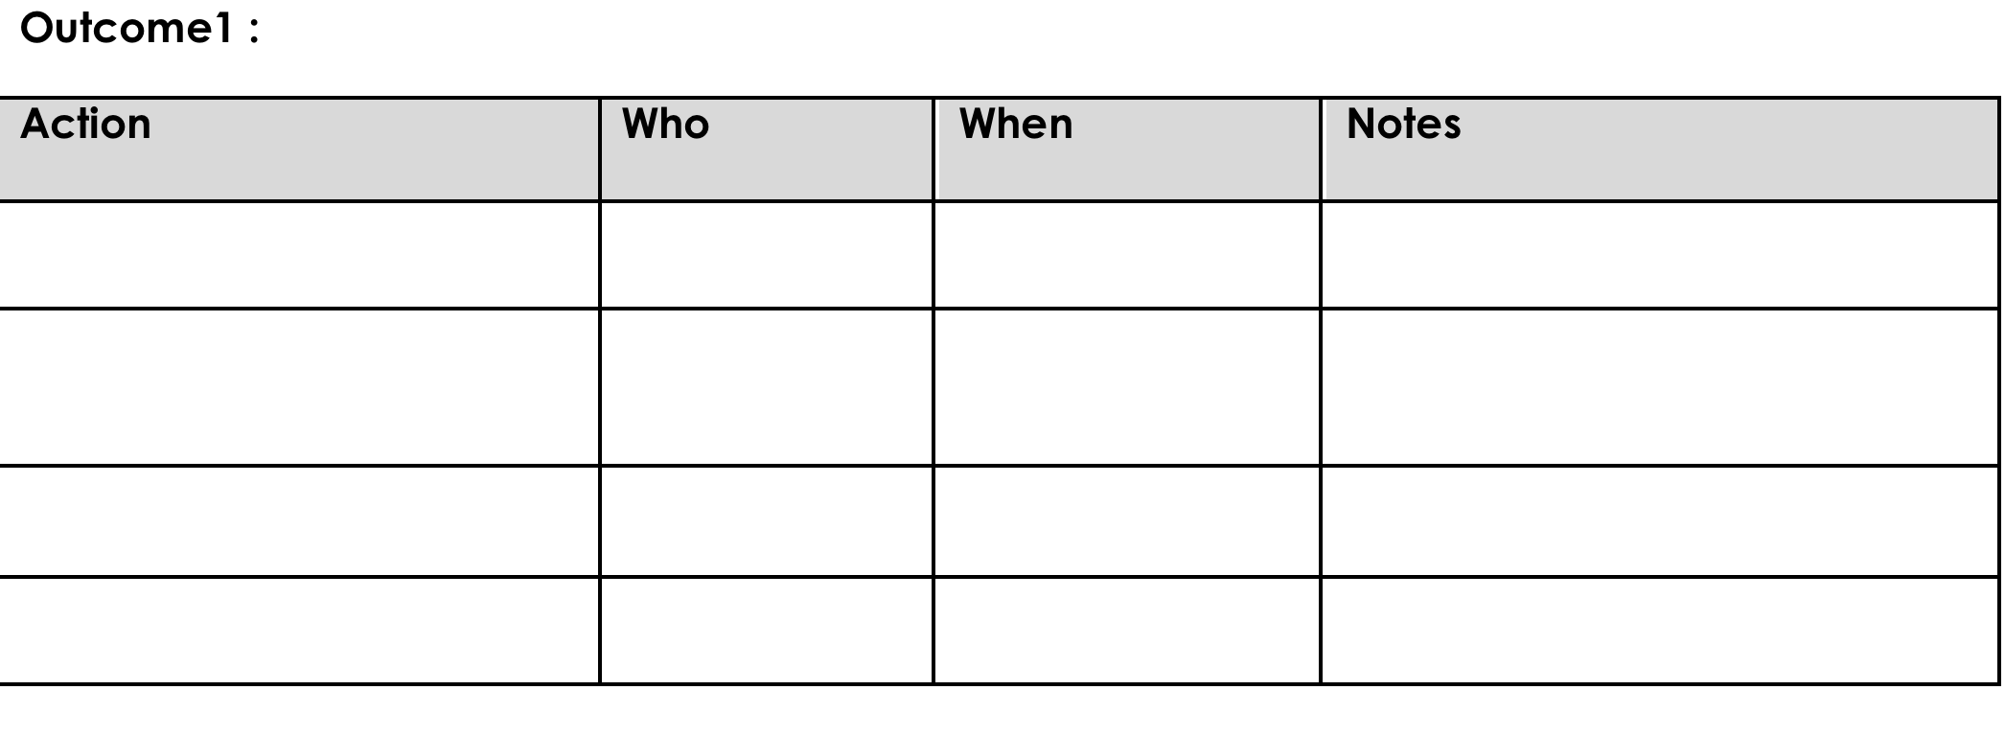
WELCOME TO YEAR 2 OF
PBIS TEAM TRAINING!
Please update your display name in Zoom to read: [Your School], [Your Name] (e.g., Eastside HS, Joe Clark)
This will help us create breakout rooms!
You will spend the first 10 min in a breakout room with your team.
Pull up your current action plan.
Review/update where you are with the goal you identified last month
Take 10 minutes to make sure your action plan is up to date.
Notes:
TRAINER NOTE: Once you welcome participants and share that they’ll start with some team action planning, send them into breakout rooms by school. Plan to close the breakout rooms at XX:10 so you have time to get through content. You may want to broadcast a 5 and/or 2 minute warning.

Slide 2

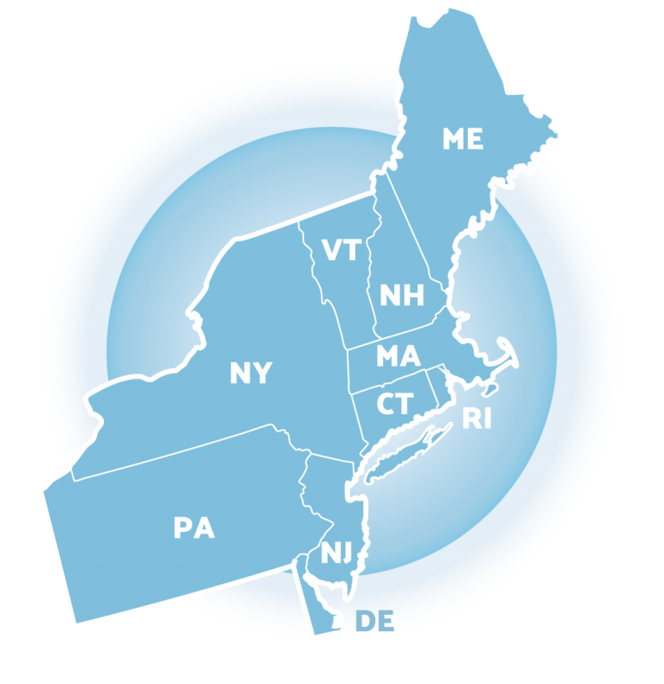
NEPBIS School-Wide Team Training
Year 2: March
[Insert Trainer Names]
with support from Brandi Simonsen, Jen Freeman, Susannah Everett, Adam Feinberg,
Katie Meyer, & Karen Robbie
Notes:
Add trainer names for your event

Slide 3
LEGEND
Discussion
Poll
Activity
&
Positive & Negative Examples
Preview

Slide 4
Agenda & Coaches' Tasks
Team Tasks:
Review Function of Behavior Activity
Presentation Content:
Avoiding Power Struggles
Assessing Classroom Practices
Review FAST Guidelines
Understanding Function

Slide 5
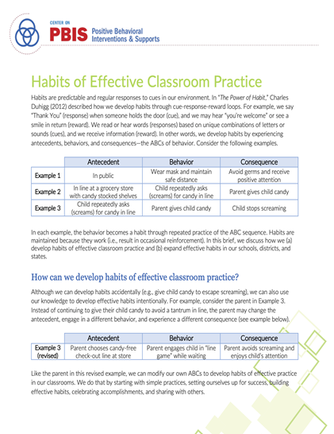
RESOURCES
READINGS
Motive, Motivate, Motivation
Dodging the Power Struggle Trap
Supporting & Responding to Student Behavior
Habits of Effective Practice Brief
RESOURCES
Function of Behavior Mini Module
Avoiding Power Struggles Mini Module
Habits of Effective Practice Webinar
Notes:
Readings:
Motive, Motivate, Motivation: https://www.pbisapps.org/community/Pages/Motivation-of-Problem-Behavior.aspx
Dodging the Power Struggle Trap: https://www.interventioncentral.org/behavioral-interventions/challenging-students/dodging-power-struggle-trap-ideas-teachers
Supporting and Responding to Behavior Guide: https://www.pbis.org/resource/supporting-and-responding-to-behavior-evidence-based-classroom-strategies-for-teachers
Habits of Effective Practice Brief: https://www.pbis.org/resource/habits-of-effective-classroom-practice
Resources:
Function of Behavior Mini-Module: https://www.youtube.com/watch?v=KYEm-FdWyXE&feature=youtu.be
Avoiding Power Struggles Mini-Module: https://www.youtube.com/watch?v=b5QINNFT0Ek&feature=youtu.be
Habits of Effective Practice Webinar: https://www.pbis.org/video/building-habits-of-effective-practice-webinar

Slide 6

EXPECTATIONS
Self
Others
Environment
Self-monitor (Are you participating? Engaged as a learner? Talking during allotted times?)​
Mute when listening, unmute to talk​
Have your computer charged and ready to go​
Stretch, break, stand as needed​
If you have questions or comments, unmute, use the chat box, or click the "raise hand" icon
Work as a team: Room for every voice, reinforce participation
Keep necessary materials at hand (e.g., action plan & other docs, water, snacks, etc.)​

Slide 7
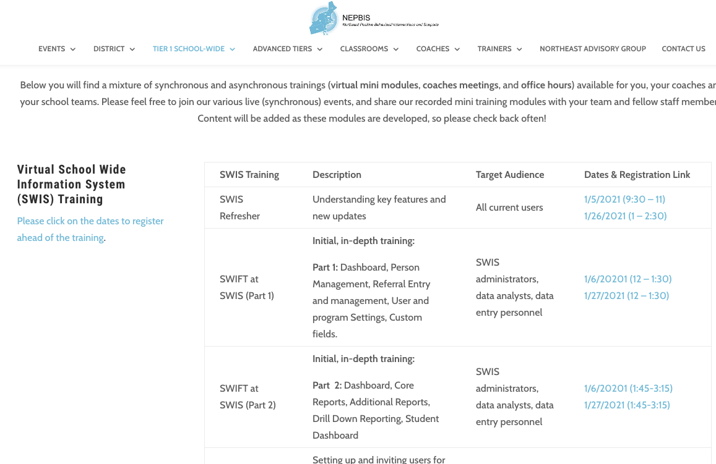
SWIS Training Events
You can find the available dates and registration links here:
https://nepbis.org/pbis-academy-virtual-training-page/
Notes:
TRAINER NOTE: The virtual training page has our current schedule of state wide SWIS training events. Please inform your coaches and teams about this opportunity. They can register for these trainings through the hyperlinked dates. Please have them register ahead of time, so we know that there are attendees and we can hold the training sessions.
Please the link to the chat: https://nepbis.org/pbis-academy-virtual-training-page/

Slide 8
Did your team PIVOT your PBIS implementation during the ’20-’21 school year due to the COVID-19 pandemic?
If your school:
Had school representation at...
Monitored implementation fidelity in PBIS Assessment
Adapted at least one core PBIS feature
teaching matrix
lesson plans
acknowledgment system
data sources/routines
all Team Trainings
90% of Coaches Trainings
completed the Team Implementation Checklist (TIC)
OR Tiered Fidelity Inventory (TFI)
Has evidence partnering with families to support PBIS at home
remote learning/at-home matrix
family communication exemplars
home-based acknowledgement systems
OR
Schools meeting criteria will receive...
A certificate of recognition
A shoutout in The Progress Monitor and cohort training
One free registration to the NEPBIS Forum in May 2021
Then, follow this link to let us know about it!
Notes:
Survey Link: https://uconn.co1.qualtrics.com/jfe/form/SV_1CkeJFo0d9xCt25

Slide 9
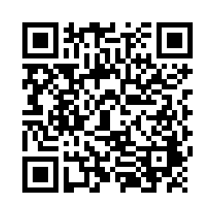
ACTIVITY: ATTENDANCE
Scan QR code on the left or follow the URL posted in the chat to access the online attendance survey
Follow prompts to enter attendance information
Notify trainers if you require assistance (e.g., identifying your cohort or cohort group)
1 minute
You are in Cohort 6
Notes:
TRAINERS –
Post a link to the attendance survey (below) in the chat for those who do not use the QR code on the slide:
https://uconn.co1.qualtrics.com/jfe/form/SV_0iZuJ0aKCo5IkG9

Slide 10










GETTING STARTED WITH SWPBIS
Establish an effective leadership team
Develop a continuum to strengthen appropriate behaviors
Develop a brief statement of purpose
Develop a continuum to discourage violations of expectations
Identify positive school-wide behavior expectations
Develop data-based procedures for monitoring
Develop procedures to teach school-wide expectations
Develop systems to support staff
Develop procedures to teach class-wide expectations
Build routines to ensure ongoing implementation

Slide 11
DISCUSSION:
CHECKING IN ON TIER 1 GETTING STARTED STEPS
What progress occurred with your identified team goal from the Tier 1 Getting Started Step review?
What do you plan to do next?
Randomized Breakouts
10 minutes

Slide 12
FUNCTION OF BEHAVIOR
Notes:
Function of Behavior for Coaches (30 minutes)

Slide 13
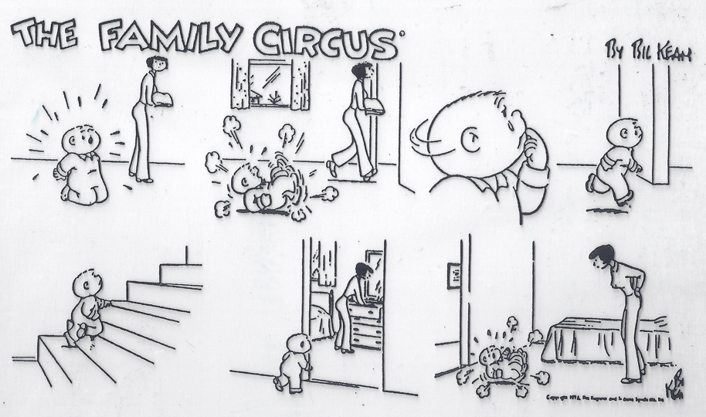
WHY?

Slide 14
ALL BEHAVIOR SERVES A FUNCTION
Problem Behavior
Pos Reinforcement
Obtain / Get Something
Escape / Avoid Something
Neg Reinforcement
Sensory Stimulation
Social
Tangible / Activity
Adult
Peer

Slide 15
FUNCTIONAL APPROACH:
NON-EXAMPLE
“Lantana, you skipped 2 school days, so we’re going to suspend you for 2 more.”
“You want my attention?! I’ll show you attention,…let’s take a walk down to the office & have a little chat with the principal.”
“Function” = outcome, result, purpose, consequence
What makes these non-examples of a function-based approach?
Unmute or type into chat

Slide 16
TO DETERMINE FUNCTION OF BEHAVIOR
What typically precedes?
What do the behaviors look like?
What typically follows?
Antecedent
Behavior
Consequence
Based on observing patterns across time, we can infer the probable function of behavior.
Notes:
When thinking about behavior, it’s important to consider...
The antecedent...what is happening before a behavior occurs
The actual behavior...what can be seen and heard
The consequence... Be careful here because in this context, consequence does not refer to a punishment as is often the case with many people.
Instead, consequence means what happens as a result of the behavior
To determine the probable function of a behavior, you need to take a careful look over multiple incidents.
Let’s look at a couple examples.

Slide 17
PRACTICE: DETERMINE THE FUNCTION
During teacher lectures, Martha repeatedly and loudly calls out (without raising her hand). Each time, the teacher gives her a look, a redirection, or occasionally calls on her.
Teacher lecture (minimal attention)
Calling out repeatedly
Teacher attention
Antecedent?
Behavior?
Consequence?
Function?
Get/obtain attention

Slide 19
UNDERSTANDING FUNCTION,
WE CAN INTERVENE MORE EFFECTIVELY
How can we prevent?
What should we teach the student to do instead?
How should we respond to ensure the new skill “works”?
Antecedent
Behavior
Consequence
We can make simple tweaks to the antecedents, behaviors, and consequences, to prevent, teach, and respond, respectively.
Notes:
When we know the function behind a behavior, we can make better decisions about how to adjust the environment or intervene to reduce the likelihood of the problem behavior from happening.
We can consider the antecedent and think “Are there things that can be done to prevent the behavior from happening”?
Same idea with the behavior. “Is there a different behavior that can be taught so the individual can still get or obtain what they want or avoid what they don’t want but in a more appropriate way?”
And then, how can we respond so the new behavior is strengthened and reinforced while the inappropriate behavior is diminished?

Slide 20
PRACTICE: HOW TO RESPOND
During teacher lectures, Martha repeatedly and loudly calls out (without raising her hand). Each time, the teacher gives her a look, a redirection, or occasionally calls on her.
Provide attention ahead of lecture and frequent eye contact
Teach and prompt hand raising
Call on her ONLY when raising her hand (otherwise ignore)
Reinforce/
Respond?
Prevent?
Teach?
Simple strategies like this are part of good “Tier 1” responses to minor disruptive behavior.

Slide 21
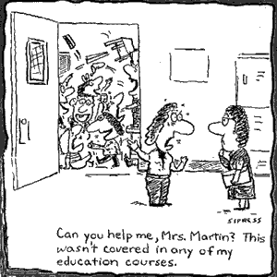
FUNCTION-BASED LOGIC AT THE CLASSROOM LEVEL

Slide 22
PRACTICE: DETERMINE THE FUNCTION
A 6th grade teacher found that over 30% of the behavioral incident reports coming from her classroom occurred as students were being dismissed from class.
Too many students leaving the room at once & confusion over where to turn in work
Physical contact & arguing
Getting to the hallway
Antecedent?
Behavior?
Consequence?
Function?
Peer attention (socializing)
Notes:
Let’s practice how to consider function from a class-wide lens.
(Read example)
The antecedents might include students rushing to leave the class, or trying to figure out where turn in the work that was done during class.
The behavior is arguing with adults and peers, and physical contact
The immediate consequence is getting to the hallway as soon as possible
So what is the function here? Why might students want to get to the hallway quickly? If you’ve spent time with middle schoolers, you probably know that time spent with peers is really important to many in that age group. They are trying to gain access to peers so they can socialize.

Slide 23
PRACTICE: HOW TO RESPOND
A 6th grade teacher found that over 30% of the behavioral incident reports coming from her classroom occurred as students were being dismissed from class.
Dismiss one table or row at a time. Collect student work before dismissal.
Teach and prompt waiting behavior (how to keep busy while waiting) and traffic flow routines.
Reinforce waiting, walking, and accurate traffic flow patterns.
Reinforce/
Respond?
Prevent?
Teach?

Slide 24

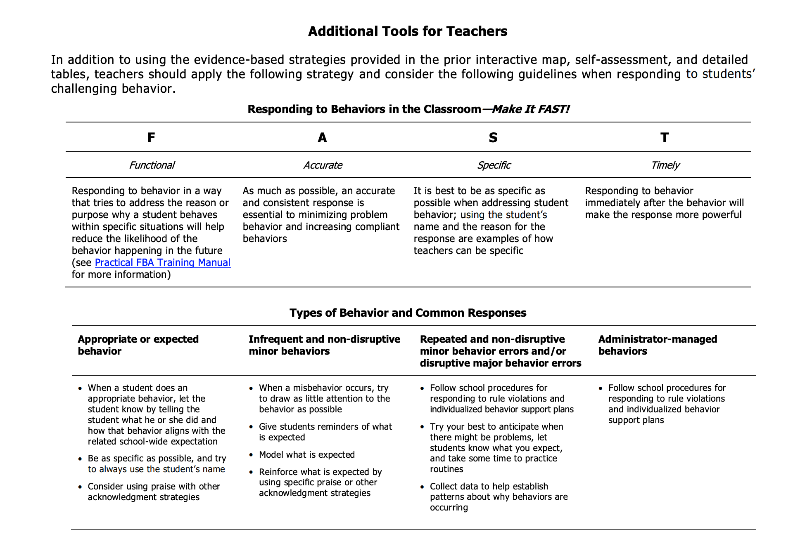
RESPONDING TO STUDENT BEHAVIOR – MAKE IT “FAST”
FUNCTIONAL
ACCURATE
Provide an accurate and consistent response
SPECIFIC
Use student’s name while identifying the behavior and the reason for the behavior
TIMELY
Address the reason or purpose behind the behavior to reduce likelihood of reoccurrence
Respond to behavior as soon as possible after it occurs to make the biggest impact
Notes:
Resource link: https://www.pbis.org/resource/supporting-and-responding-to-behavior-evidence-based-classroom-strategies-for-teachers\

Slide 25
EXAMPLE: MAKE IT “FAST”
During class discussion, Myra consistently calls out responses rather than raising her hand. Her teacher quickly but, briefly to Myra by saying “Myra, we know you have a lot to share and would love to hear your thoughts, but please wait for me to call on you so everyone can have a turn to be heard.” Then, when Myra does raise her hand, the teacher calls on her immediately.
FUNCTIONAL
Provided another opportunity to share and called on her when she raised her hand
SPECIFIC
Used Myra’s name and addressed the reason for the behavior (being eager to share)
TIMELY
Identified that Myra had a lot to share
Responded immediately after the behavior occurred
ACCURATE
Notes:
Resource link: https://www.pbis.org/resource/supporting-and-responding-to-behavior-evidence-based-classroom-strategies-for-teachers\

Slide 26
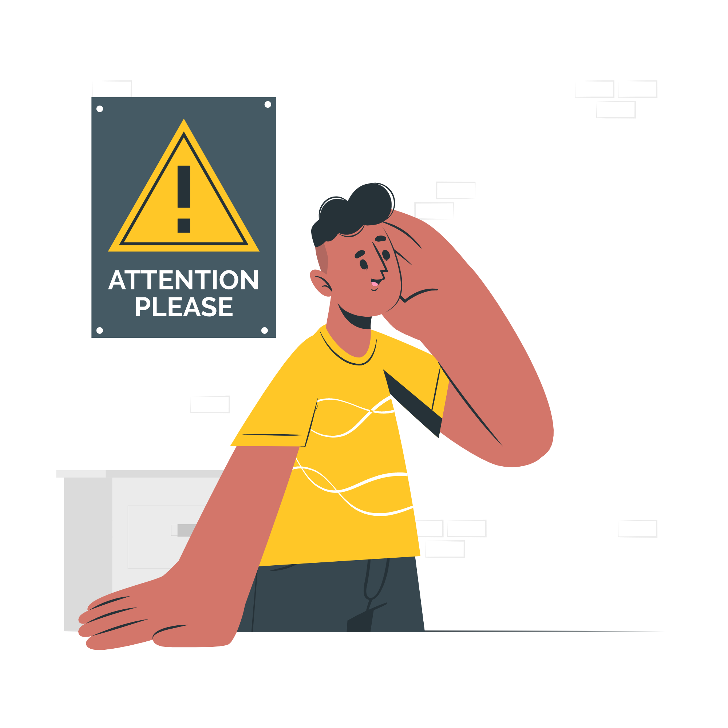
WHY IS FUNCTION IMPORTANT?
Use your school-wide data to look for patterns in behavior
Select strategies that “connect” to function
Modify environments to focus on prevention and prompting the use of more effective skills
Determine what adults need to help reinforce new skills

Slide 27
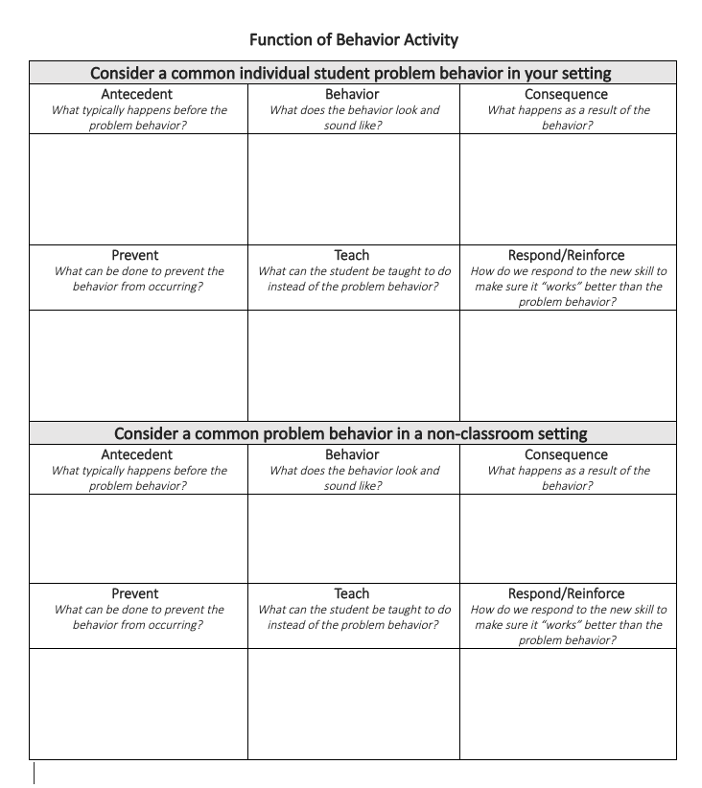
ACTIVITY: FUNCTION OF BEHAVIOR
In your school team breakout room (15 minutes):
Consider a common individual student problem behavior in the classroom setting
  Describe the “ABCs”
  Identify strategies to prevent, teach, and respond/reinforce
Consider a common problem behavior in a non-classroom setting
  Describe the “ABCs”
  Identify strategies to prevent, teach, and respond/reinforce
Teams / 15 minutes/
Whole Group 5 minutes
Notes:
TRAINERS – Prompt below; allow 15 minutes for school teams in breakouts, 5 minutes as whole group.
Function of behavior activity: https://nepbis.org/wp-content/uploads/2020/12/Function-of-Behavior-Activity.docx
In your school team breakout room (15 minutes):
Consider a common individual student problem behavior in the classroom setting
Describe the “ABCs”
Identify strategies to prevent, teach, and respond/reinforce
Consider a common problem behavior in a non-classroom setting
Describe the “ABCs”
Identify strategies to prevent, teach, and respond/reinforce

Slide 28
AVOIDING POWER STRUGGLES

Slide 29
Teacher | Jason
Jason, please turn in your assignment. | What assignment?
The assignment you didn’t finish during class. | I finished it.
Great, please turn it in now | I don’t have it with me now
You have a choice…..turn it in or do it again. | You never believe me.
I guess you’ve made the choice to do it again. | Make me
That’s disrespect…go to the office. | F_____ you!
Moves closer…& puts hand on J. shoulder. | Pulls away, glares, & raises fist as if to strike.
Type yes in chat if you have witnessed a similar exchange between a teacher and a student
(Colvin & Sugai, 1989)
Notes:
TRAINERS: Rather than reading through this, consider asking participants to read through it and type a yes in chat if they have witnessed similar exchanges.

Slide 30
ASSUMPTIONS
Behavior is learned (function)
Behavior is lawful (function)
Behavior is escalated through successive interactions (practice)
Behavior can be changed through an instructional approach
How do these assumptions relate to the scenario just shared?
Is this how staff think about behavior in your building?
(Colvin & Sugai, 1989)

Slide 31

De-Escalation Phases
Midwest PBIS Network v12/17/20
Problem Behaviors
Recovery
Prevention
Crisis
Youth Behavior
(C&S,2015)
De-escalation
Recovery
Calm
Agitation
Acceleration
Peak
The Brain
Regulated
Regulated or Dysregulated
Dysregulated
Regulated
Teacher Practices
Encourage
Appropriate Behavior
Continuum of Strategies to Respond to Inappropriate Behavior
Neutralizing Routine
Crisis Teaching Routine
Recovery Practices
Regulate
Relate (Connect with youth)
Reason
Systems
Installation and fidelity of classroom practices
Classroom Practices
Staff Self-Care
Safety Procedures
Data Collection/ Documentation
BEHAVIOR INTENSITY
Notes:
TRAINER NOTE: This is a new slide from Midwest PBIS. It replaces our previous escalation slide because it provides a more thorough description of the roles for all stakeholders.
The focus during this training should be on the prevention and responding to problem behaviors and how this fits within this training’s content.
Put in chat:
For more information around a Crisis Teaching Routine: https://iris.peabody.vanderbilt.edu/module/beh2/cresource/q2/p08/
For more information about Regulate, Relate, Reason as a recovery practice: https://www.youtube.com/watch?v=_3is_3XHKKs

Slide 32
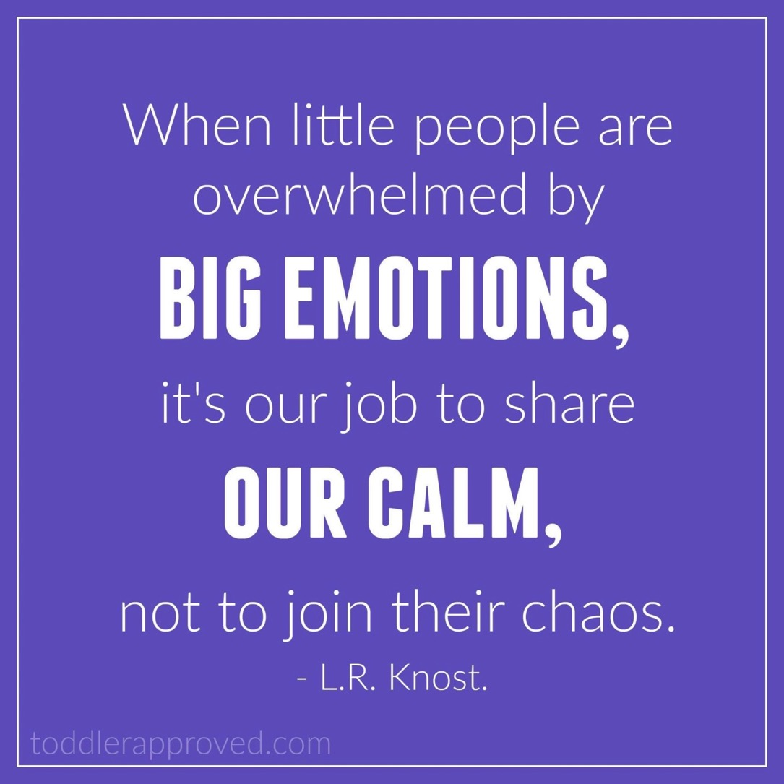
Dr. Kent McIntosh

Slide 33
KEY STRATEGIES
Identification of how to intervene early in an escalation
Identification of environmental factors that can be manipulated
Identification of replacement behaviors that can be taught (and serve same function as problem)
Develop a neutralizing routine

Slide 34
TWO-STEP NEUTRALIZING ROUTINE
When you see unwanted behavior or the start to a power struggle, stop and ask yourself:
Am I triggered or agitated?
  By this student/situation
  Or by an outside factor (e.g., not feeling well that day)
If so, use an agreed-upon alternative response

Slide 35
ACTIVITY: PREVENTING POWER STRUGGLES
As a team, reflect on the example and consider how the escalation may have been avoided by identifying examples of:
  Intervening early
  Manipulating the environment
  Pre-teaching a replacement behavior to the student
  Utilizing a neutralizing or FAST routine
Discuss the extent to which avoiding power struggles are or could be an issue in your school
Add 1-2 items to your action plan identifying how you will provide professional development and coaching support to your staff as needed on this content
Teams / 10 minutes/
Whole Group 5 minutes
Teacher | Jason
Jason, please turn in your assignment. | What assignment?
The assignment you didn’t finish during class. | I finished it.
Great, please turn it in now | I don’t have it with me now
You have a choice…..turn it in or do it again. | You never believe me.
I guess you’ve made the choice to do it again. | Make me
That’s disrespect…go to the office. | F_____ you!
Moves closer…& puts hand on J. shoulder. | Pulls away, glares, & raises fist as if to strike.
Notes:
TRAINERS – Prompt below; allow 10 minutes for school teams in breakouts, 5 minutes as whole group.
Function of behavior activity: https://nepbis.org/wp-content/uploads/2020/12/Function-of-Behavior-Activity.docx
As a team, reflect on the example and consider how the escalation may have been avoided by identifying examples of:
Intervening early
Manipulating the environment
Pre-teaching a replacement behavior to the student
Utilizing a neutralizing or FAST routine
Discuss the extent to which avoiding power struggles are or could be an issue in your school
Add 1-2 items to your action plan identifying how you will provide professional development and coaching support to your staff as needed on this content

Slide 36

Teacher | Jason
Jason, please turn in your assignment. | What assignment?
The assignment you didn’t finish during class. | I finished it.
Great, please turn it in now | I don’t have it with me now
You have a choice…..turn it in or do it again. | You never believe me.
I guess you’ve made the choice to do it again. | Make me
That’s disrespect…go to the office. | F_____ you!
Moves closer…& puts hand on J. shoulder. | Pulls away, glares, & raises fist as if to strike.
“Oh no, here we go again…Let me take 3 deep breaths and give him a choice”
(Colvin & Sugai, 1989)
Notes:
So lets get back to our example of Jason and the teacher
Let's see where we could introduce a neutralizing routine
Erik: "Christine if you were the teacher, when would you get frustrated with the student?"
Christine: "I'd probably start getting frustrated with him when he said that he said that he doesn't have his homework, especially if he had a pattern of doing this. That would make my blood boil. For me, THAT would be a good moment to conduct a self assessment and start using neutralizing routines."
Erik: "What would you do?"
Christine: "I'd probably....
Take note of my frustration with Jason.
Try to delay any decisions about consequences and take a few deep breaths to calm down
And I might try to reframe the situation by thinking and saying something like, "I'm glad you completed it" and try to offer options as to how and when he can get the work to me"

Slide 37

ASSESSING CLASSROOM PRACTICES
Now is the time to start thinking about next year in classrooms...

Slide 38
Notes:
TRAINERS: Use this opportunity to remind/refresh coaches that this content and an opportunity to review this guide was provided in November

Slide 39
POSITIVE CLASSROOM
BEHAVIOR SUPPORT:
3 KEY
QUESTIONS
Are the foundations of effective classroom PBIS in place?
Are classroom PBIS practices implemented consistently?
Do data indicate that students are still engaging in problem behavior?
Notes:
TRAINER NOTE: Prompt coaches to consider these questions and encourage them to consider ways to determine accurate data-based answers to these questions

Slide 40
CLASSROOM PRACTICES SELF-ASSESSMENT
Notes:
TRAINER NOTE: Remind coaches that this self-assessment is in the Supporting and Responding to Behavior Guide and can be used to support staff in strengthening their skills, reinforcing their practices, etc.

Slide 41
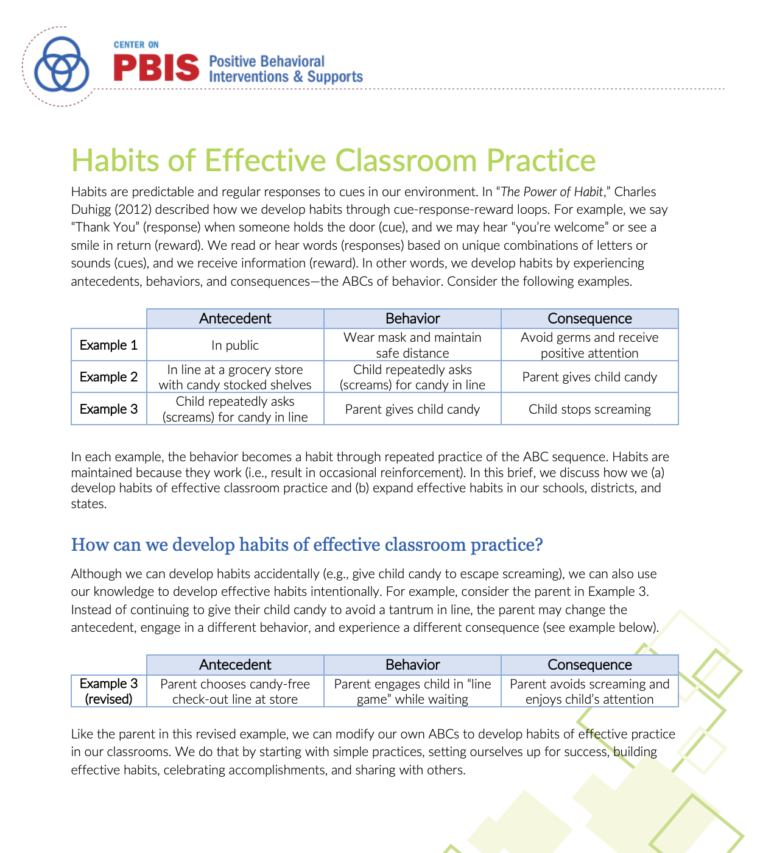
Building Habits of Effective Practice
Identify a practice to strengthen
Set up for success
Add cues for effective practice
Build Effective Habits
Use practice to build fluency
Prevent undesired practices
Add prompts
Monitor Implementation
Celebrate Successes
Provide specific feedback
Celebrate progress toward implementation
Habits of
Effective Practice
Brief and Webinar
Notes:
Brief: https://www.pbis.org/resource/habits-of-effective-classroom-practice
Webinar: https://www.pbis.org/video/building-habits-of-effective-practice-webinar

Slide 42
DISCUSSION: SUPPORTING CLASSROOM PBIS
First, consider what is currently in place:
What is the classroom culture in your building?
What systems exist to support teachers with positive classroom practices?
Then, consider next steps:
How do you think staff will respond to this content?
What systems need to be developed to support staff with implementing PBIS consistently in classrooms?
How will you know when classroom practices are implemented consistently and who needs support or with what?
Whole Group Discussion
10 minutes

Slide 43
AGENDA & FOLLOW-UP
Presentation Content:
Understanding Function
Avoiding Power Struggles
Assessing Classroom Practices
Team Tasks:
Review Function of Behavior Activity
Review FAST Guidelines
What questions do you have on today’s content?
What questions do you have on the follow-up tasks?

Slide 44
PREVIEW: APRIL AGENDA & TASKS
Presentation Content
Explore Class-wide PBIS Systems
Review: TFI & Guides
Team Tasks
Action Plan for Classwide Systems
Schedule Surveys & TFI
Complete Team Implementation Checklist (TIC)

Slide 45
RESOURCES
READINGS
Motive, Motivate, Motivation
Dodging the Power Struggle Trap
Supporting & Responding to Student Behavior
Habits of Effective Practice Brief
RESOURCES
Function of Behavior Mini Module
Avoiding Power Struggles Mini Module
Habits of Effective Practice Webinar
Notes:
Readings:
Motive, Motivate, Motivation: https://www.pbisapps.org/community/Pages/Motivation-of-Problem-Behavior.aspx
Dodging the Power Struggle Trap: https://www.interventioncentral.org/behavioral-interventions/challenging-students/dodging-power-struggle-trap-ideas-teachers
Supporting and Responding to Behavior Guide: https://www.pbis.org/resource/supporting-and-responding-to-behavior-evidence-based-classroom-strategies-for-teachers
Habits of Effective Practice Brief: https://www.pbis.org/resource/habits-of-effective-classroom-practice
Resources:
Function of Behavior Mini-Module: https://www.youtube.com/watch?v=KYEm-FdWyXE&feature=youtu.be
Avoiding Power Struggles Mini-Module: https://www.youtube.com/watch?v=b5QINNFT0Ek&feature=youtu.be
Habits of Effective Practice Webinar: https://www.pbis.org/video/building-habits-of-effective-practice-webinar

Slide 46
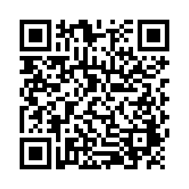
EVALUTION
Please remember to complete the evaluation to receive your PDPs!
Scan the QR code to access.
Notes:
TRAINERS -
Put link to evaluation (below) in the chat for those who do not use the QR code:
https://uconn.co1.qualtrics.com/jfe/form/SV_5BXYIXLvg0qmSzP

