Slide 1

Welcome to Year 2 of
PBIS School-Wide COACHES Training!
As you wait for the training to begin, please:
Update your display name in Zoom to read: [Your School], [Your Name] (e.g., Eastside HS, Joe Clark)
This will help us create breakout rooms!
Pull up your current action plan
Enter your attendance by following the hyperlink or through nepbis.org

Slide 2

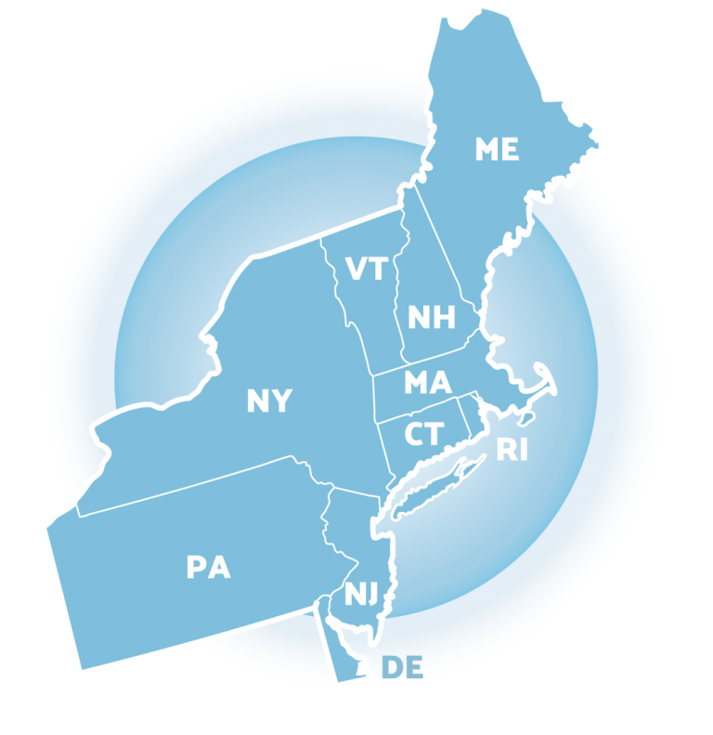
NEPBIS School-Wide Coach Training
Year 2: March
[Insert Trainer Names]
with support from Brandi Simonsen, Jen Freeman, Susannah Everett, Adam Feinberg,
Katie Meyer, & Karen Robbie
Notes:
Add trainer names for your event

Slide 3
LEGEND
Discussion
Poll
Activity
&
Positive & Negative Examples
Preview

Slide 4
Agenda & Coaches' Tasks
Coaches’ Tasks:
Review Function of Behavior Activity
Presentation Content:
Avoiding Power Struggles
Assessing Classroom Practices
Review FAST Guidelines
Understanding Function

Slide 5

EXPECTATIONS
Self
Others
Environment
Self-monitor (Are you participating? Engaged as a learner? Talking during allotted times?)​
Mute when listening, unmute to talk​
Have your computer charged and ready to go​
Stretch, break, stand as needed​
If you have questions or comments, unmute, use the chat box, or click the "raise hand" icon
Work as a team: Room for every voice, reinforce participation
Keep necessary materials at hand (e.g., action plan & other docs, water, snacks, etc.)​

Slide 6
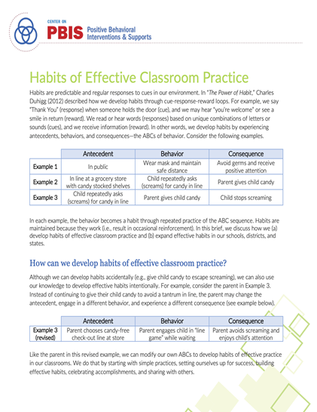
RESOURCES
READINGS
Motive, Motivate, Motivation
Dodging the Power Struggle Trap
Supporting & Responding to Student Behavior
Habits of Effective Practice Brief
RESOURCES
Function of Behavior Mini Module
Avoiding Power Struggles Mini Module
Habits of Effective Practice Webinar
Notes:
Readings:
Motive, Motivate, Motivation: https://www.pbisapps.org/community/Pages/Motivation-of-Problem-Behavior.aspx
Dodging the Power Struggle Trap: https://www.interventioncentral.org/behavioral-interventions/challenging-students/dodging-power-struggle-trap-ideas-teachers
Supporting and Responding to Behavior Guide: https://www.pbis.org/resource/supporting-and-responding-to-behavior-evidence-based-classroom-strategies-for-teachers
Habits of Effective Practice Brief: https://www.pbis.org/resource/habits-of-effective-classroom-practice
Resources:
Function of Behavior Mini-Module: https://www.youtube.com/watch?v=KYEm-FdWyXE&feature=youtu.be
Avoiding Power Struggles Mini-Module: https://www.youtube.com/watch?v=b5QINNFT0Ek&feature=youtu.be
Habits of Effective Practice Webinar: https://www.pbis.org/video/building-habits-of-effective-practice-webinar

Slide 7
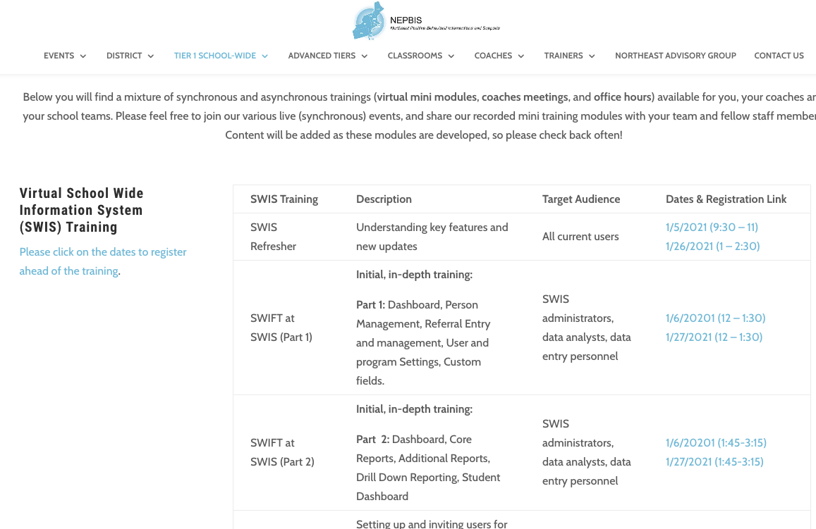
SWIS Training Events
You can find the available dates and registration links here:
https://nepbis.org/pbis-academy-virtual-training-page/
Notes:
TRAINER NOTE: The virtual training page has our current schedule of state wide SWIS training events. Please inform your coaches and teams about this opportunity. They can register for these trainings through the hyperlinked dates. Please have them register ahead of time, so we know that there are attendees and we can hold the training sessions.
Please the link to the chat: https://nepbis.org/pbis-academy-virtual-training-page/

Slide 8
Did your team PIVOT your PBIS implementation during the ’20-’21 school year due to the COVID-19 pandemic?
If your school:
Had school representation at...
Monitored implementation fidelity in PBIS Assessment
Adapted at least one core PBIS feature
teaching matrix
lesson plans
acknowledgment system
data sources/routines
all Team Trainings
90% of Coaches Trainings
completed the Team Implementation Checklist (TIC)
OR Tiered Fidelity Inventory (TFI)
Has evidence partnering with families to support PBIS at home
remote learning/at-home matrix
family communication exemplars
home-based acknowledgement systems
OR
Schools meeting criteria will receive...
A certificate of recognition
A shoutout in The Progress Monitor and cohort training
One free registration to the NEPBIS Forum in May 2021
Then, follow this link to let us know about it!
Notes:
Survey Link: https://uconn.co1.qualtrics.com/jfe/form/SV_1CkeJFo0d9xCt25

Slide 9
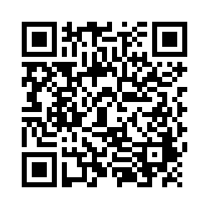
ACTIVITY: ATTENDANCE
Scan QR code on the left or follow the URL posted in the chat to access the online attendance survey
Follow prompts to enter attendance information
Notify trainers if you require assistance (e.g., identifying your cohort or cohort group)
1 minute
You are in Cohort 6
Notes:
TRAINERS –
Post a link to the attendance survey (below) in the chat for those who do not use the QR code on the slide:
https://uconn.co1.qualtrics.com/jfe/form/SV_0iZuJ0aKCo5IkG9

Slide 10










GETTING STARTED WITH SWPBIS
Establish an effective leadership team
Develop a continuum to strengthen appropriate behaviors
Develop a brief statement of purpose
Develop a continuum to discourage violations of expectations
Identify positive school-wide behavior expectations
Develop data-based procedures for monitoring
Develop procedures to teach school-wide expectations
Develop systems to support staff
Develop procedures to teach class-wide expectations
Build routines to ensure ongoing implementation

Slide 11
DISCUSSION:
CHECKING IN ON TIER 1 GETTING STARTED STEPS
What areas do you see as strengths?
What areas need to be strengthened?
What do you need to move forward?
Independently or with your co-coach:
  Review your action plan and identify one next step for the month ahead
  Type it into chat when you are done
Whole Group/ Coach Pairs
15 minutes/ 5 minutes

Slide 12
BUILDING AN ADVANCED UNDERSTANDING OF BEHAVIOR

Slide 13
Why does this matter?
A basic understanding of the science of behavior change gives us tools to observe, measure, teach, and correct behaviors effectively and efficiently.
Moves us away from perceptions, opinions, and assumptions about motivations or intentions to a conversation that recognizes that
  Behavior is communication, and
  Behavior occurs in the context of an antecedent and consequence.

Slide 14
BUILDING BLOCKS OF BEHAVIOR: Three Term Contingency
Antecedent
“Stimulus that precedes a behavior”
Behavior
”Observable and measurable act of an individual (also called a response)”
Consequence
Stimulus change that occurs contingent on a behavior

Slide 15
EXAMPLE: JONAS
When Jonas is asked to complete an independent assignment,
he disrupts his peers and refuses to begin the assignment.
After this behavior,
the teacher immediately sits with him and helps him complete the work.
Antecedent
Behavior
Consequence

Slide 16
REINFORCEMENT & PUNISHMENT
Reinforcement: when a consequence of a behavior functions to increase the likelihood of future occurrences of that behavior
Punishment: when a consequence of a behavior functions to decrease the likelihood of future occurrences of that behavior

Slide 17
REINFORCEMENT & PUNISHMENT
Effect
Give (+)
Take (-)
Action
Positive
Negative
Inc. ( )*
Reinforcement
Reinforcement
Positive
Negative
Dec. ( )*
Punishment
Punishment
* Future probability of behavior

Slide 18
EXAMPLE: JAKE
BREAKDOWN
When Jake is presented with school work, he whines, “School’s not for kids!”
In the past, Jake’s teacher gets frustrated and takes his work away. In the future, Jake continues to whine whenever he is presented with work.
Presented with school work
Whines, “school’s not for kids!”
Antecedent (S^{D})
Behavior(s)
Consequence
Action (+ or –)
Effect (↑ or ↓)
Teacher takes his work away
So, it’s:
Negative
Reinforcement
Teacher takes his work away
Jake continues to whine

Slide 19
BREAKDOWN
EXAMPLE: BRIAN
During lunch with peers, Brian made a derogatory comment toward one of his peers. The peer punched him.
In the future, Brian was less likely to make derogatory comments (at least toward that peer).
Lunch with peers
Makes derogatory comment
Antecedent (S^{D})
Behavior(s)
Consequence
Action (+ or –)
Effect (↑ or ↓)
Peer punches him
So, it’s:
Positive
Punishment
Peer gave him a punch
Less likely to comment

Slide 20
ACTIVITY: NEGATIVE REINFORCEMENT
In a small group, develop an example to show an of negative reinforcement that commonly occurs in school settings
Be sure to identify the:
  Antecedent
  Behavior
  Consequence
Be ready to share with whole group
Randomized Breakouts 10 minutes
Notes:
TRAINERS – Prompt below; allow 10 minutes for discussion – 5 in breakouts and 5 as whole group.
In a small group, develop an example to show an of negative reinforcement that commonly occurs in school settings (5 min.)
Be sure to identify the:
Antecedent
Behavior
Consequence
Be ready to share with whole group (5 min.)

Slide 21

TAKE HOME MESSAGE
You only know if a consequence is reinforcing or punishing by looking at the effect on future behavior.

Slide 22
FUNCTION OF BEHAVIOR
Notes:
Function of Behavior for Coaches (30 minutes)

Slide 23
ALL BEHAVIOR SERVES A FUNCTION
GET OR OBTAIN:
Desired activities
Tangible items
Attention
Sensory stimulation
ESCAPE OR AVOID:
Aversive activities
Tangible Items
Attention
Sensory stimulation

Slide 24


UNDERSTANDING FUNCTION MATTERS!

Slide 25
Function- Based Support
Foundations in behavioral theory, ABA, and PBIS
Attention to environmental context
Emphasis on purpose (or history of reinforcement) of behavior
Focus on teaching behaviors
Attention to implementers (adult behaviors) & redesign of teaching & learning environments

Slide 26
FUNCTIONAL APPROACH:
NON-EXAMPLE
When Jake is presented with school work, he whines, “Schools not for kids!” In the past, Jake’s teacher gets frustrated and takes his work away. In the future, Jake continues to whine whenever he is presented with work.
“Function” = outcome, result, purpose, consequence
What makes this a non-example of a function-based approach?
Unmute or type into chat

Slide 27
TO DETERMINE FUNCTION OF BEHAVIOR
What typically precedes?
What do the behaviors look like?
What typically follows?
Antecedent
Behavior
Consequence
Based on observing patterns across time, we can infer the probable function of behavior.
Notes:
When thinking about behavior, it’s important to consider...
The antecedent...what is happening before a behavior occurs
The actual behavior...what can be seen and heard
The consequence... Be careful here because in this context, consequence does not refer to a punishment as is often the case with many people.
Instead, consequence means what happens as a result of the behavior
To determine the probable function of a behavior, you need to take a careful look over multiple incidents.
Let’s look at a couple examples.

Slide 28
PRACTICE: DETERMINE THE FUNCTION
In the hallway with peers, Tim often teases, trips, or pushes a student who talks and walks a little slower than others. Each time, Tim’s peers laugh and pat him on the back.
In hallway with peers
Teasing, tripping, or pushing peer
Peers laugh and pat on the back
Antecedent?
Behavior?
Consequence?
Function?
Peer attention

Slide 29
UNDERSTANDING FUNCTION,
WE CAN INTERVENE MORE EFFECTIVELY
How can we prevent?
What should we teach the student to do instead?
How should we respond to ensure the new skill “works”?
Antecedent
Behavior
Consequence
We can make simple tweaks to the antecedents, behaviors, and consequences, to prevent, teach, and respond, respectively.
Notes:
When we know the function behind a behavior, we can make better decisions about how to adjust the environment or intervene to reduce the likelihood of the problem behavior from happening.
We can consider the antecedent and think “Are there things that can be done to prevent the behavior from happening”?
Same idea with the behavior. “Is there a different behavior that can be taught so the individual can still get or obtain what they want or avoid what they don’t want but in a more appropriate way?”
And then, how can we respond so the new behavior is strengthened and reinforced while the inappropriate behavior is diminished?

Slide 30
PRACTICE: HOW TO RESPOND
In the hallway with peers, Tim often teases, trips, or pushes a student who talks and walks a little slower than others. Each time, Tim’s peers laugh and pat him on the back.
Increase prompts and active supervision in hallway
Teach and prompt respectful behavior toward all peers
Reinforce peers for supporting good choices & ignoring teasing
Reinforce/
Respond?
Prevent?
Teach?
With these strategies, we’ve:
increased the likelihood of respectful behavior and (b) minimized attention for disrespectful behavior.
(This may start to look like Tier 2.)

Slide 31
DISCUSSION: UNDERSTANDING BEHAVIOR
How well do most staff in your building understand function of behavior?
How does this approach fit with your school’s culture?
How does (or would) a function-based approach to behavior affect:
  How staff respond to behavioral errors?
  How decisions about behavior are made at a school-wide level?
Whole Group
10 minutes

Slide 32

TAKE HOME MESSAGE
We should consider the function of behavior when we design programs for students and staff.

Slide 33

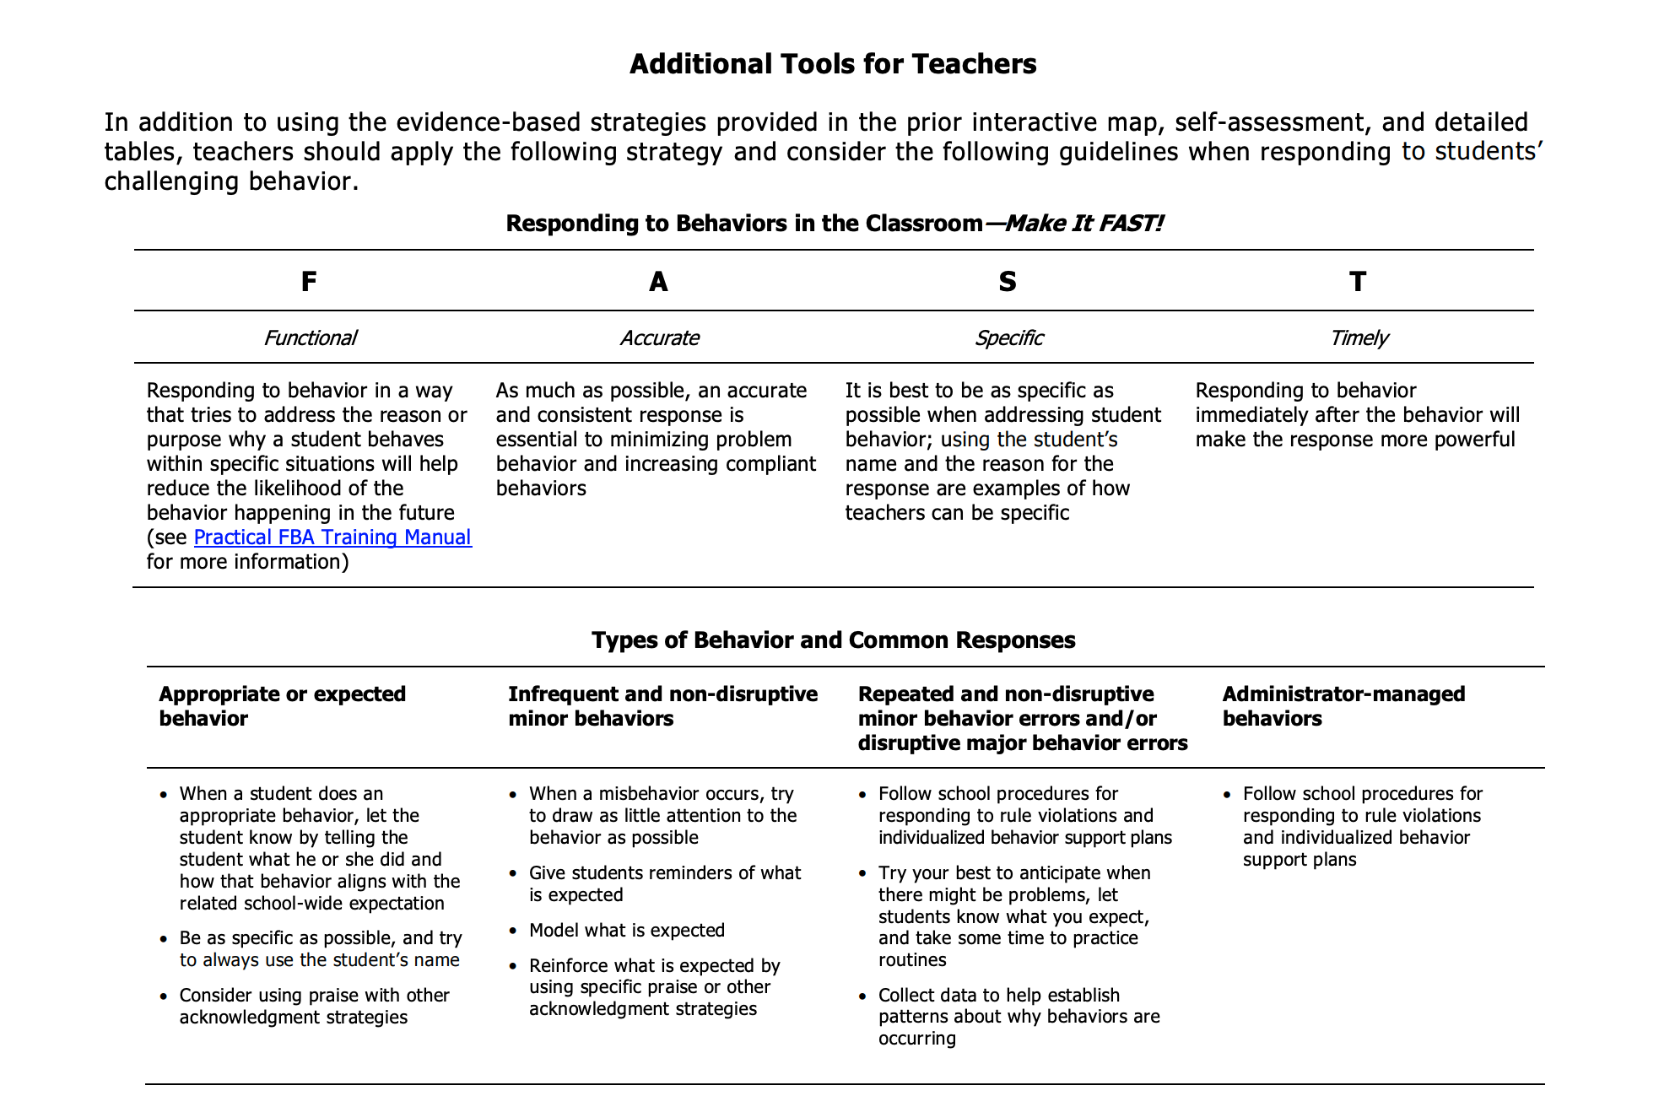
RESPONDING TO STUDENT BEHAVIOR – MAKE IT “FAST”
FUNCTIONAL
ACCURATE
Provide an accurate and consistent response
SPECIFIC
Use student’s name while identifying the behavior and the reason for the behavior
TIMELY
Address the reason or purpose behind the behavior to reduce likelihood of reoccurrence
Respond to behavior as soon as possible after it occurs to make the biggest impact
Notes:
Resource link: https://www.pbis.org/resource/supporting-and-responding-to-behavior-evidence-based-classroom-strategies-for-teachers\

Slide 34
EXAMPLE: MAKE IT “FAST”
During class discussion, Myra consistently calls out responses rather than raising her hand. Her teacher quickly but, briefly to Myra by saying “Myra, we know you have a lot to share and would love to hear your thoughts, but please wait for me to call on you so everyone can have a turn to be heard.” Then, when Myra does raise her hand, the teacher calls on her immediately.
FUNCTIONAL
Provided another opportunity to share and called on her when she raised her hand
SPECIFIC
Used Myra’s name and addressed the reason for the behavior (being eager to share)
TIMELY
Identified that Myra had a lot to share
Responded immediately after the behavior occurred
ACCURATE
Notes:
Resource link: https://www.pbis.org/resource/supporting-and-responding-to-behavior-evidence-based-classroom-strategies-for-teachers\

Slide 35
DISCUSSION:
FUNCTION-BASED BEHAVIOR SUPPORT
What should be considered when…
responding to appropriate student behavior?
responding to inappropriate student behavior?
designing staff recognition systems?
How can this content be shared with staff so they can respond more effectively to students?
What does your team need to provide effective support to staff?
Independent/ Whole Group
3 minutes / 7 minutes
Notes:
TRAINER NOTE: Remind coaches that these slides are available to use with staff if they are interested in incorporating this content into future professional development.

Slide 36

ASSESSING CLASSROOM PRACTICES
Now is the time to start thinking about next year in classrooms...

Slide 37
Notes:
TRAINERS: Use this opportunity to remind/refresh coaches that this content and an opportunity to review this guide was provided in November

Slide 38
POSITIVE CLASSROOM
BEHAVIOR SUPPORT:
3 KEY
QUESTIONS
Are the foundations of effective classroom PBIS in place?
Are classroom PBIS practices implemented consistently?
Do data indicate that students are still engaging in problem behavior?
Notes:
TRAINER NOTE: Prompt coaches to consider these questions and encourage them to consider ways to determine accurate data-based answers to these questions

Slide 39
CLASSROOM PRACTICES SELF-ASSESSMENT
Notes:
TRAINER NOTE: Remind coaches that this self-assessment is in the Supporting and Responding to Behavior Guide and can be used to support staff in strengthening their skills, reinforcing their practices, etc.

Slide 40
GUIDELINES FOR CLASSROOM SETTINGS
Practices
Academic achievement linked to social success, active engagement, & effective teaching
Good teaching is used as a behavior management strategy
Behavior management is used as an instructional management strategy
3-tiered prevention logic applied to classroom context
Classroom management linked to school-wide behavior support
Classroom routines have been taught, practiced, & reinforced regularly
School-wide support systems used to sustain effective classroom management strategies
Data-based progress monitoring & action planning
Regular review of accuracy of intervention implementation
Notes:
Use these guidelines as a checklist for your team to determine what systems are in place to support staff’s use of C-PBIS.

Slide 41
DISCUSSION:
COACHING PBIS IN CLASSROOMS
Discuss with co-coach or jot down your own thoughts:
What is the classroom culture in your building? What systems exist to support teachers with classroom management?
How comfortable do you feel coaching & supporting implementation in classrooms?
Where might be a good place to begin? Where is there buy in?
Coaches
10 minutes

Slide 42
AGENDA & FOLLOW-UP
Presentation Content:
Understanding Function
Avoiding Power Struggles
Assessing Classroom Practices
Coaches’ Tasks:
Review Function of Behavior Activity
Review FAST Guidelines
What questions do you have on today’s content?
What questions do you have on the follow-up tasks?

Slide 43
PREVIEW: APRIL AGENDA & TASKS
Presentation Content
Class-wide PBIS Systems
Review: TFI & Other Surveys
Coaches Tasks
Preview: Class-wide Jigsaw Activity
Prepare for TFI & Upcoming Surveys

Slide 44
RESOURCES
READINGS
Motive, Motivate, Motivation
Dodging the Power Struggle Trap
Supporting & Responding to Student Behavior
Habits of Effective Practice Brief
RESOURCES
Function of Behavior Mini Module
Avoiding Power Struggles Mini Module
Habits of Effective Practice Webinar
Notes:
Readings:
Motive, Motivate, Motivation: https://www.pbisapps.org/community/Pages/Motivation-of-Problem-Behavior.aspx
Dodging the Power Struggle Trap: https://www.interventioncentral.org/behavioral-interventions/challenging-students/dodging-power-struggle-trap-ideas-teachers
Supporting and Responding to Behavior Guide: https://www.pbis.org/resource/supporting-and-responding-to-behavior-evidence-based-classroom-strategies-for-teachers
Habits of Effective Practice Brief: https://www.pbis.org/resource/habits-of-effective-classroom-practice
Resources:
Function of Behavior Mini-Module: https://www.youtube.com/watch?v=KYEm-FdWyXE&feature=youtu.be
Avoiding Power Struggles Mini-Module: https://www.youtube.com/watch?v=b5QINNFT0Ek&feature=youtu.be
Habits of Effective Practice Webinar: https://www.pbis.org/video/building-habits-of-effective-practice-webinar

Slide 45
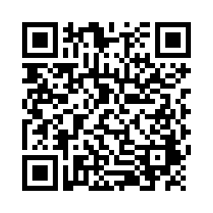
EVALUTION
Please remember to complete the evaluation to receive your PDPs!
Scan the QR code to access.
Notes:
TRAINERS -
Put link to evaluation (below) in the chat for those who do not use the QR code:
https://uconn.co1.qualtrics.com/jfe/form/SV_5BXYIXLvg0qmSzP

