Slide 1
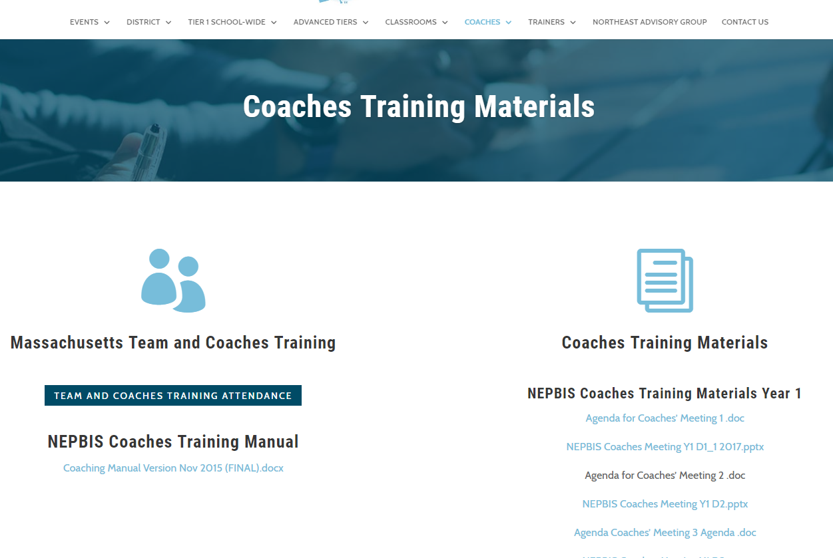
Welcome to Year 2 of PBIS School-Wide COACHES Training!
As you wait for the training to begin, please:
Update your display name in Zoom to read: [Your School], [Your Name] (e.g., Eastside HS, Joe Clark)
This will help us create breakout rooms!
Pull up your current action plan
Enter your attendance by following the hyperlink or through nepbis.org

Slide 2
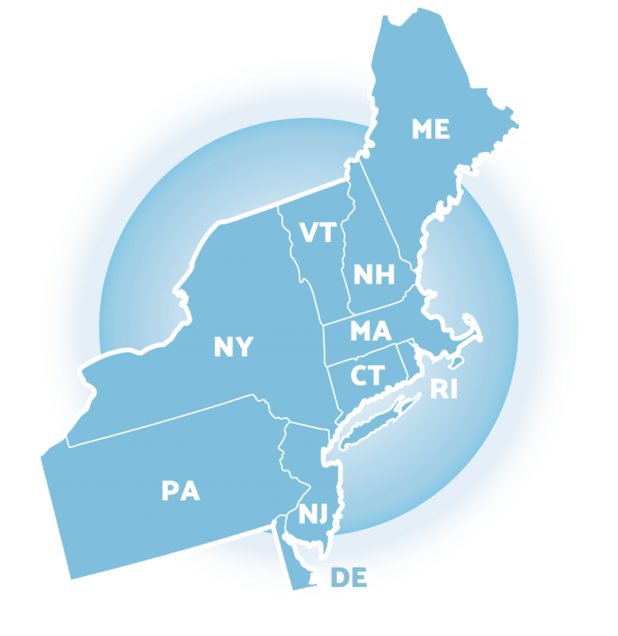
NEPBIS School-Wide Coaches Training Year 2: April
[Insert Trainer Names]
with support from Brandi Simonsen, Jen Freeman, Susannah Everett,
Adam Feinberg & Katie Meyer

Slide 3
Agenda & Coaches' Tasks
Coaches’ Tasks:
Presentation Content:
Prepare to facilitate team planning time
Review: Data-based Decision Making: Monitoring & Evaluating PBIS Practices
Preview: Overview of Assessment Tools
Prepare to complete the TIC with your team

Slide 4
EXPECTATIONS
Self
Others
Environment
Self-monitor (Are you participating? Engaged as a learner? Talking during allotted times?)​
Mute when listening, unmute to talk​
Have your computer charged and ready to go​
Stretch, break, stand as needed​
If you have questions or comments, unmute, use the chat box, or click the "raise hand" icon
Work as a team: Room for every voice, reinforce participation
Keep necessary materials at hand (e.g., action plan & other docs, water, snacks, etc.)​

Slide 5
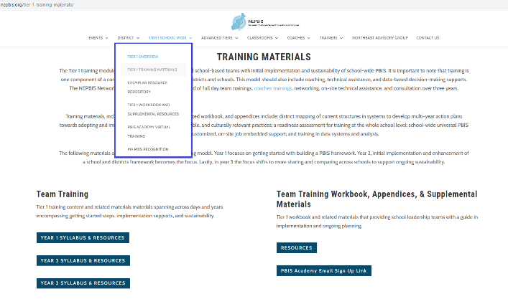
NEPBIS.ORG
Notes:
Trainer note: Please remind participants of Year 2 Syllabus access as well as the reminder email sign up link if they are not receiving reminder emails. Remind them of their Cohort Group (e.g. 6A)

Slide 6
LEGEND
Discussion
Poll
Activity
&
Positive & Negative Examples
Preview

Slide 7
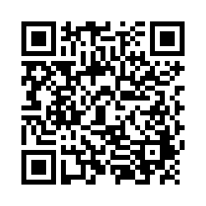
ACTIVITY: ATTENDANCE
Scan QR code on the left or follow the URL posted in the chat to access the online attendance survey
Follow prompts to enter attendance information
Notify trainers if you require assistance (e.g., identifying your cohort or cohort group)
1 minute
Scan QR code on the left or follow the URL posted in the chat to access the online attendance survey
Follow prompts to enter attendance information
Notify trainers if you require assistance (e.g., identifying your cohort or cohort group)
1 minute
You are in Cohort 7
Notes:
TRAINERS –
Post a link to the attendance survey (below) in the chat for those who do not use the QR code on the slide:
https://uconn.co1.qualtrics.com/jfe/form/SV_0iZuJ0aKCo5IkG9

Slide 8
Did your team PIVOT your PBIS implementation during the ’20-’21 school year due to the COVID-19 pandemic?
If your school:
Had school representation at...
Monitored implementation fidelity in PBIS Assessment
Adapted at least one core PBIS feature
teaching matrix
lesson plans
acknowledgment system
data sources/routines
all Team Trainings
90% of Coaches Trainings
completed the Team Implementation Checklist (TIC)
OR Tiered Fidelity Inventory (TFI)
Has evidence partnering with families to support PBIS at home
remote learning/at-home matrix
family communication exemplars
home-based acknowledgement systems
OR
Schools meeting criteria will receive...
A certificate of recognition
A shoutout in The Progress Monitor and cohort training
One free registration to the NEPBIS Forum in May 2021
Then, follow this link to let us know about it!
Notes:
Survey Link: https://uconn.co1.qualtrics.com/jfe/form/SV_1CkeJFo0d9xCt25

Slide 9
REVIEW: Glows & Grows

Slide 10
MONITORING & EVALUATING PBIS PRACTICES
Use data to monitor the implementation & effectiveness of PBIS practices
Linked with meaningful outcome goals
Communicates purpose
Guides action planning
Used to measure and demonstrate progress

Slide 11
STEPS FOR SELECTING, MONITORING, & EVALUATING SWPBIS PRACTICES

Slide 12
BIG IDEAS
Collect Data!
Present the data in a user-friendly fashion
(i.e., graph)
Use the data to make decisions

Slide 13
DISCUSSION: GLOWS & GROWS
Something to celebrate & something you’re working on related to:
Establishing goals and evaluation questions
Getting input from staff & other stakeholders on goals
Identifying data to answer evaluation questions
Whole Group
20 minutes

Slide 14
OVERVIEW OF ASSESSMENT TOOLS
Self-Assessment Survey, School Climate Survey, Tiered Fidelity Inventory
Notes:
TRAINERS: All schools participating in the PBIS Academy are expected to complete the TFI this spring. Briefly review the SAS and School Climate Survey as additional assessment options.

Slide 15
SELF ASSESSMENT SURVEY (SAS)
Purpose: | Progress monitoring survey. Staff perception of the implementation status and improvement priority for school-wide, classroom, non-classroom and individual student systems.
Format: | Email link to survey. 20-30 mins.
Completed by: | All school staff, with at least 80% response rate recommended for reliable results. In subsequent admins, all staff OR individuals from a representative group.
When? | Annually

Slide 16
SCHOOL CLIMATE SURVEY
Purpose: | Assess students’, staffs’, and families’ perspective of the overall climate in the building.
Format: | Survey ratings pertaining to school climate and demographic questions. 10-15 mins.
Completed by: | Two student formats. Elementary: grades 3-5. Middle/high: grades 6-12. Staff survey. Family survey. Can administer all or targeted stakeholders.
When? | At start and end of school year OR annually.
A modified version of the survey that takes into account remote and hybrid learning modalities is available at https://nepbis.org/district-data-tools-resources/
Notes:
Modified School Climate Survey: https://nepbis.org/district-data-tools-resources/

Slide 17
TIERED FIDELITY INVENTORY (TFI)
Purpose: | Assess evidence of critical features of school-wide PBS implementation; Progress over time; Helps team make data-based decisions on intervention and program efficacy; Guides action-planning.
Format: | Survey ratings of features in place (self-assessment). About 30 mins per tier.
Completed by: | Team members with the coaches. Walkthrough tool completed by external coach.
When? | Annually (in spring)
Assessment & walkthrough can be conducted remotely
Notes:
TFI remove walkthrough brief: https://www.pbis.org/resource/conducting-the-tiered-fidelity-inventory-and-walkthrough-remotely

Slide 18
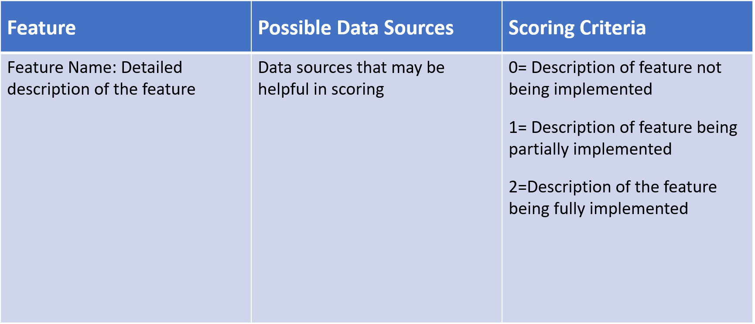
TFI FORMAT
Tier 1 = 15 items
Team Subscale – 2 items
Implementation Subscale – 9 items
Evaluation Subscale – 4 items

Slide 19
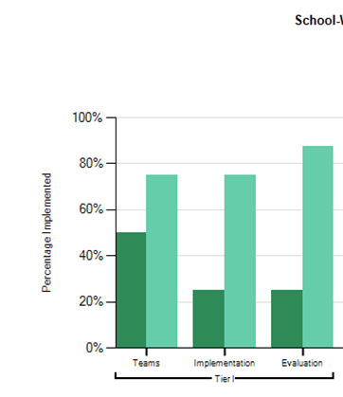
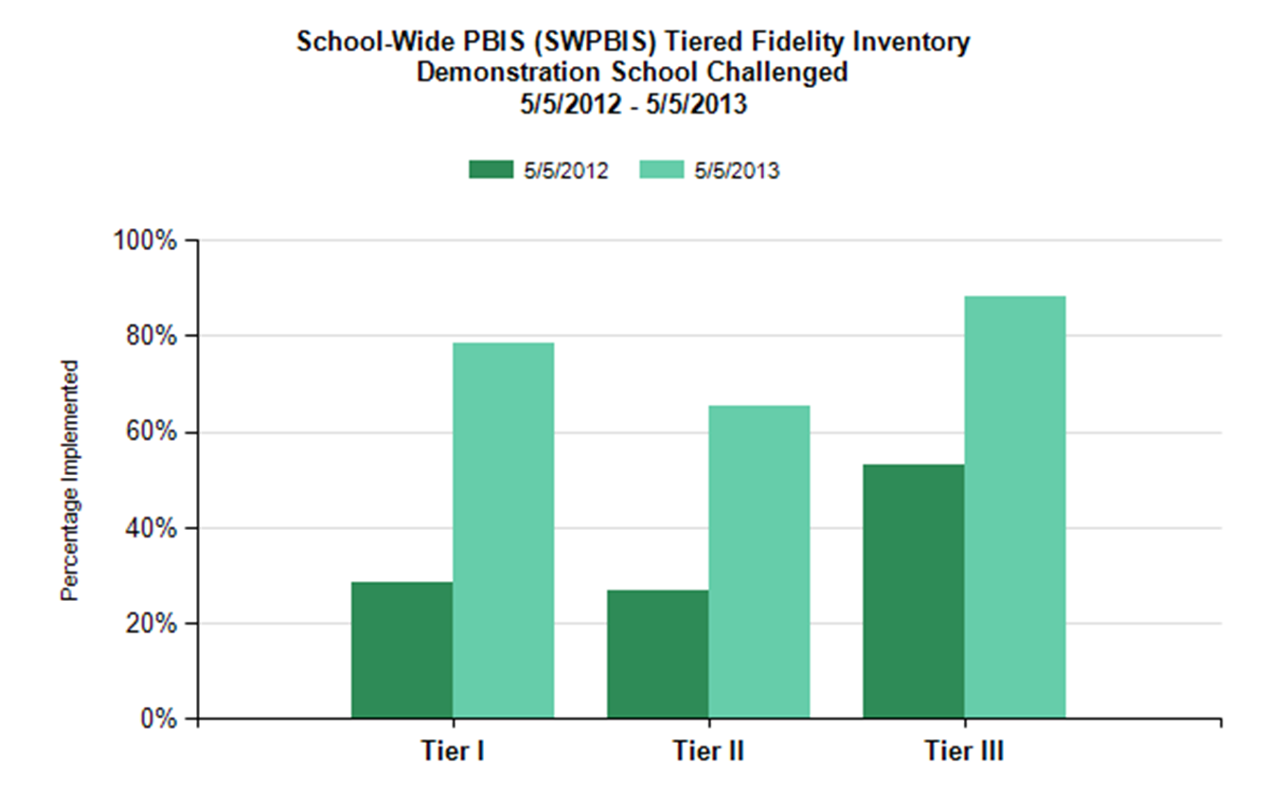
TFI REPORTS
Use the Scale, Subscale and Item reports to guide action planning.

Slide 20
INTEGRATED TFI COMPANION GUIDE
The Integrated Companion Guide supports alignment of cultural responsiveness and mental health & wellness with the PBIS framework.
Notes:
TRAINERS: The Integrated TFI Companion Guide combines guidance from the Cultural Responsiveness Field Guide, the Interconnected Systems of Support Action Planning Field Guide, the Returning to School During and After Crisis Guide, and the Teaching Social Emotional Competencies within the PBIS Framework Brief. You may want to model pulling this tool up on the pbis.org website using the search feature.
Integrated TFI Companion Guide: https://www.pbis.org/resource/integrated-tiered-fidelity-inventory-companion-guide

Slide 21
PREVIEW ACTIVITY: REVIEW & SCHEDULE TFI
Pull up your team meeting schedule and set a time to complete the TFI with your trainer.
Review the Integrated Companion to the TFI and identify 1-3 items to focus on as a team.
Discuss whether you want to conduct any of the other assessments this year (e.g., school climate).
Teams
15 minutes

Slide 22
ACTIVITY: PREVIEW INTEGRATED TFI COMPANION GUIDE
Review the 15 items in the Integrated Guide.
Highlight 1-3 items to inform your action plan and implementation of PBIS at your school.
With Co-Coach
20 minutes
Notes:
TRAINERS: Paste link in chat before sending to breakout rooms.
Integrated TFI Companion Guide: https://www.pbis.org/resource/integrated-tiered-fidelity-inventory-companion-guide

Slide 23
COMPLETING THE TIC WITH YOUR TEAM

Slide 24
ACTIVITY: TEAM IMPLEMENTATION CHECKLIST
COACHES (1 per team) go to www.pbisapps.org and login at the top right corner.
If you haven't set up your password, go through the “forgot password” process.
Select PBIS Assessment. Under Surveys Currently Open, Select Team Checklist 3.1.
Click “Take Survey” and find the Team Checklist.
Select → under the “Action” column .
Complete TIC as a team
Review Reports to support your action planning.
Compare results from this administration to previous.
Identify 1 celebration and 1 priority for improvement.
Teams 35 minutes
Notes:
TRAINERS: Model pulling up the TIC in PBISApps so coaches are prepared to complete this with their teams at the start of the team training day. Teams will begin the April team training in breakout rooms to complete the TIC.

Slide 25
TEAM PLANNING TIME

Slide 26
PREVIEW ACTIVITY: TEAM PLANNING TIME
Pull up your team meeting schedule and set a time to complete the TFI with your trainer.
Review the Cultural Responsiveness Companion to the TFI and identify 1-3 items to focus on as a team.
Discuss whether you want to conduct any of the other assessments this year.
Action plan or work on any of the getting started steps we’ve covered.
Prepare to present 1 goal or accomplishment from your group.
Consider breaking into smaller groups for efficiency. We can create additional breakout rooms.
Teams
45 minutes

Slide 27
ACTIVITY: SHARE OUT
Share 1 goal or accomplishment from your team.
Related to your TIC
Any of the getting started steps/products
Pertaining to your action plan
Whole group
10 minutes

Slide 28
DISCUSSION
Share your action plan with your trainer so they can support you and provide feedback.
With your co-coach, review your action plan and plan how to utilize the team planning time
What do you want to work on?
What materials do you need?
Does it make sense to break into smaller groups?
How can we help?
Co-Coaches
15 minutes

Slide 29
AGENDA & FOLLOW-UP
What questions do you have on today’s content?
Presentation Content:
Review: Data-based Decision Making: Monitoring & Evaluating PBIS Practices
Preview: Overview of Assessment Tools
Coaches’ Tasks:
Prepare to complete the TIC with your team
Prepare to facilitate team planning time
What questions do you have on the follow-up tasks?

Slide 30
APRIL TEAM AGENDA
Presentation Content
Team planning time
Team Tasks
Complete TIC
Overview of Assessment Tools: Self-Assessment Survey (SAS), School Climate Survey, Tiered Fidelity Inventory (TFI)
Schedule TFI (April-June)

Slide 31
RESOURCES
Descriptions & copies of Assessments on PBIS Assessment
Integrated TFI Companion Guide
Notes:
Resources:
Descriptions and copies of Assessments on PBIS Assessment: https://www.pbisapps.org/Applications/Pages/PBIS-Assessment.aspx
Integrated TFI Companion Guide: https://www.pbis.org/resource/integrated-tiered-fidelity-inventory-companion-guide

Slide 32
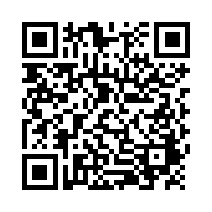
EVALUTION
Please remember to complete the evaluation to receive your PDPs!
Scan the QR code to access.
Notes:
TRAINERS -
Put link to evaluation (below) in the chat for those who do not use the QR code:
https://uconn.co1.qualtrics.com/jfe/form/SV_5BXYIXLvg0qmSzP

