Slide 1
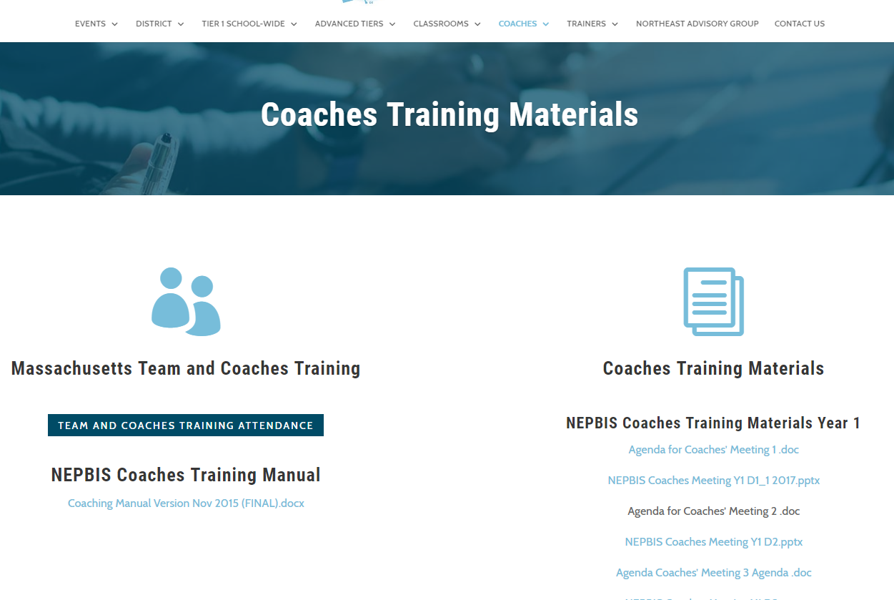
Welcome to YEAR 3 of PBIS TEAM Training!
As you wait for the training to begin, please:
Update your display name in Zoom to read: [Your School], [Your Name] (e.g., Eastside HS, Joe Clark)
This will help us create breakout rooms!
Pull up your current action plan
Enter your attendance by following the hyperlink or through nepbis.org

Slide 2
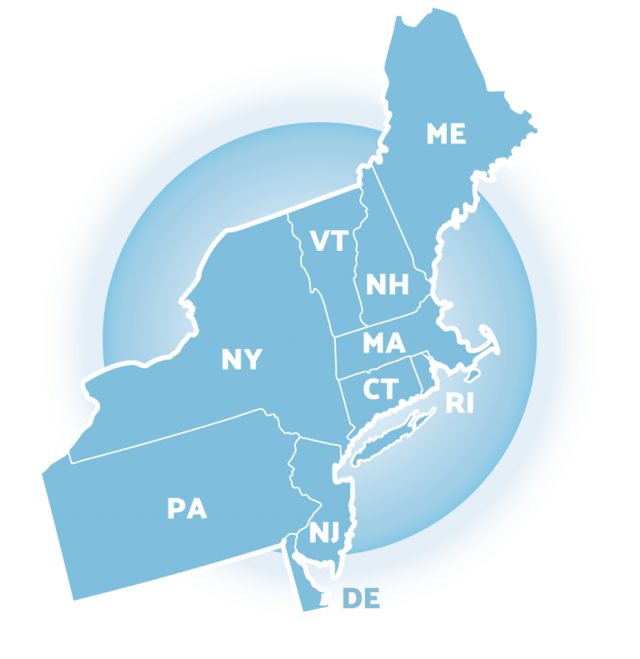
NEPBIS School-Wide Team Training Year 3: March
INSERT TRAINER NAMES
with support from Brandi Simonsen, Jen Freeman, Susannah Everett,
Adam Feinberg & Katie Meyer

Slide 3
LEGEND
Discussion
Poll
Activity
&
Positive & Negative Examples
Preview

Slide 4
TODAY’S AGENDA & TASKS
Presentation Content:
Guest Speaker: Family Engagement (Dr. Fefer)
Team Tasks:
Complete Family-School Practices Survey
Poster Session
Action Planning
Update action plan for this and next year

Slide 5
ADDITIONAL READINGS & RESOURCES
READINGS
PBIS & Family Support
RESOURCES
Stakeholder Input & Satisfaction Survey (SISS) Family
Planning for the Upcoming School Year Mini Module
Notes:
https://www.pbis.org/resource/technical-guide-for-alignment-of-initiatives-programs-and-practices-in-school-districts

Slide 6
EXPECTATIONS
Self
Others
Environment
Self-monitor (Are you participating? Engaged as a learner?)​
Mute when listening, unmute to talk​
Have your computer charged and ready to go​
Stretch, break, stand as needed​
If you have questions or comments, unmute, use the chat box, or click the "raise hand" icon
Work as a team - room for every voice, reinforce participation
Keep necessary materials at hand (e.g., action plan & other docs, water, snacks, etc.)​

Slide 7
TOOLS
WEBSITES
School-Wide PBIS Workbook & Appendices
Action Plan
nepbis.org
pbis.org
pbisapps.org

Slide 8
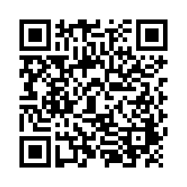
ACTIVITY: ATTENDANCE
Scan QR code on the left or follow the URL posted in the chat to access the online attendance survey
Follow prompts to enter attendance information
Notify trainers if you require assistance (e.g., identifying your cohort or cohort group)
1 minute
Notes:
TRAINERS –
Post a link to the attendance survey (below) in the chat for those who do not use the QR code on the slide:
https://uconn.co1.qualtrics.com/jfe/form/SV_0iZuJ0aKCo5IkG9

Slide 9
Guest Speaker
Sarah Fefer
University of Massachusetts-Amherst
School Psychology Program
Research Interests:
PBIS &
Family Support

Slide 10
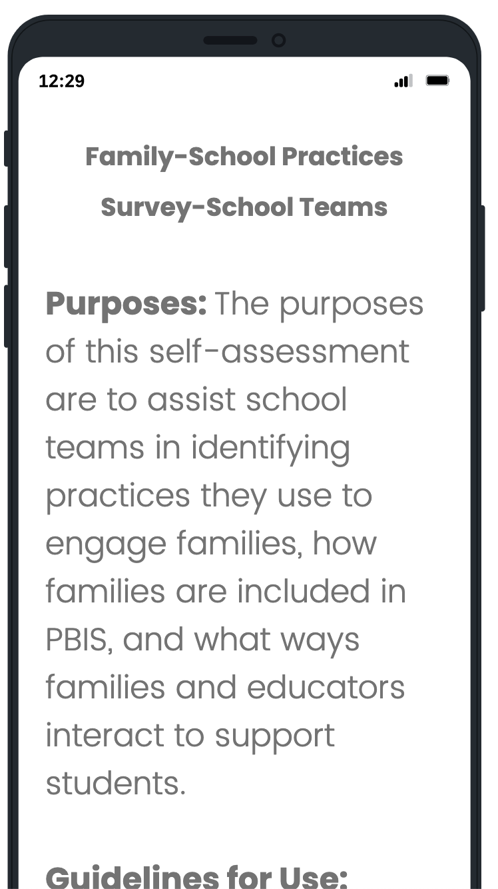
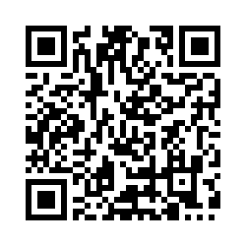
ACTIVITY: FAMILY-SCHOOL PARTNERSHIPS
Discuss primary messages and takeaways with your team.
Complete School-Family Partnership Survey
Consider adding at least one item scored partially or not in place from each of the sub sections to your action plan.
Be prepared to share out what was added with the large group
Teams
15 minutes
Notes:
TRAINERS: Prompts for activity below; allow 15 minutes for teamwork then 5 minutes for group discussion.
Split into breakout rooms
Complete the Working Smarter Matrix to identify all teams and details.
Review data on the matrix and use guiding questions to develop an action plan for eliminating or modifying teams as needed.
Be ready to report on 2 to 3 “big ideas” from your group (1 minute).
https://nepbis.org/wp-content/uploads/2020/09/Working-Smarter-Activity.docx

Slide 11
Planning for Virtual Poster Session

Slide 12
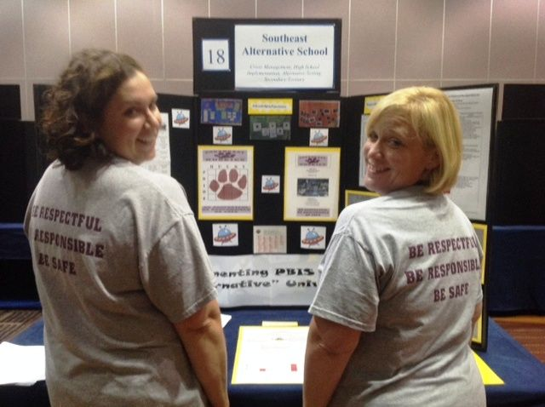
Virtual Poster Session
Target Goal:
Share examples of implementation of the PBIS Framework across districts & schools
Structure:
One shared visual file! We'll be randomized into breakout rooms and each school can share their visual with others.
Get ideas! Bring ideas back to your school for follow up action planning.

Slide 13
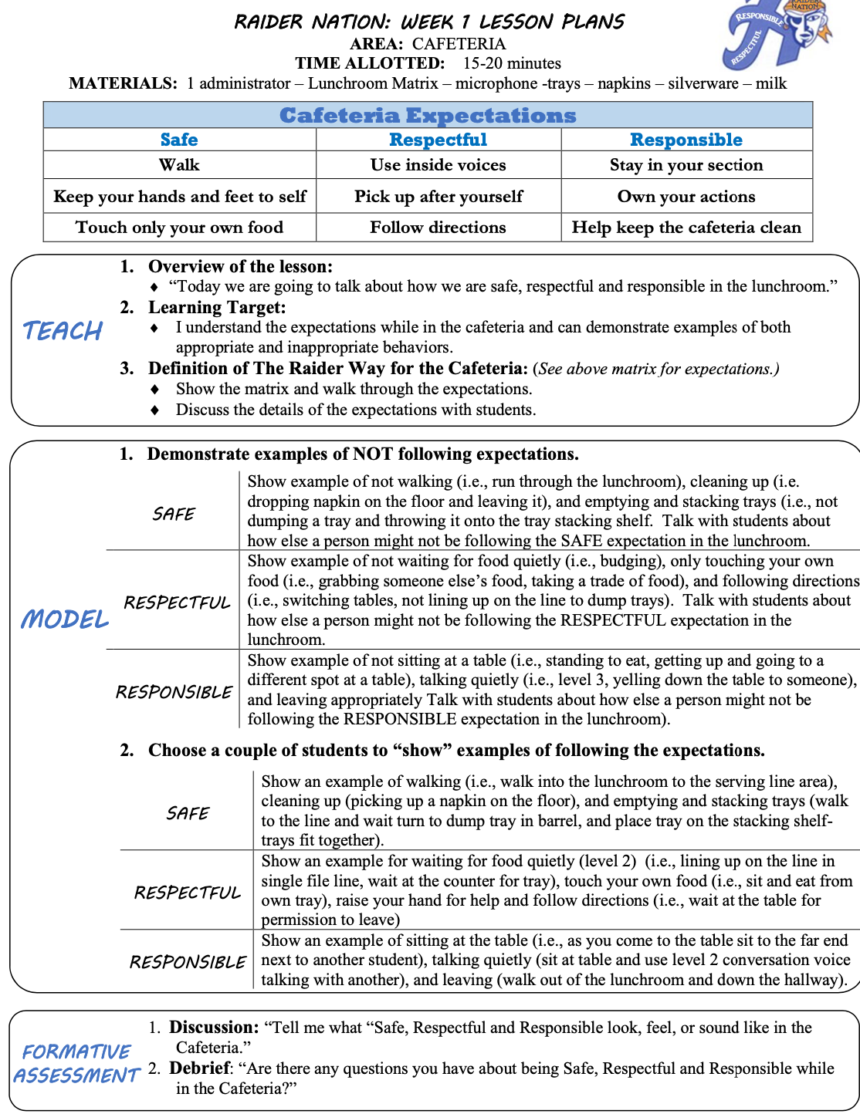
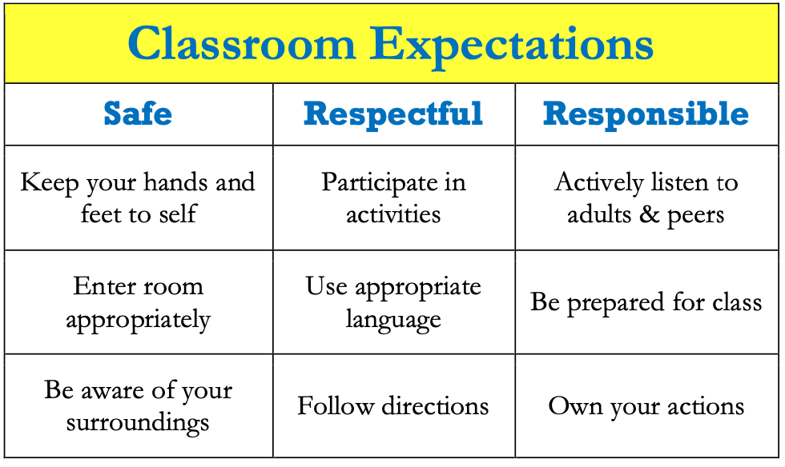
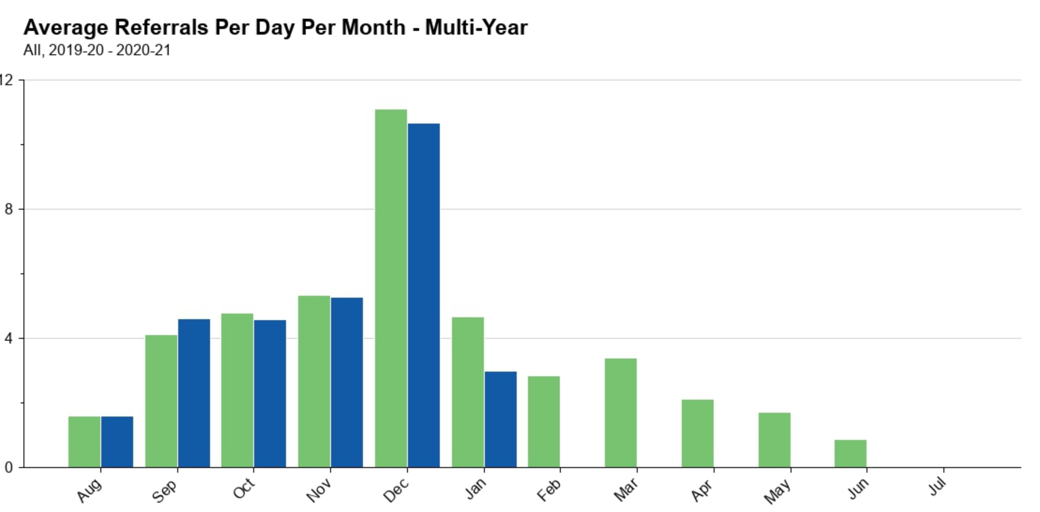
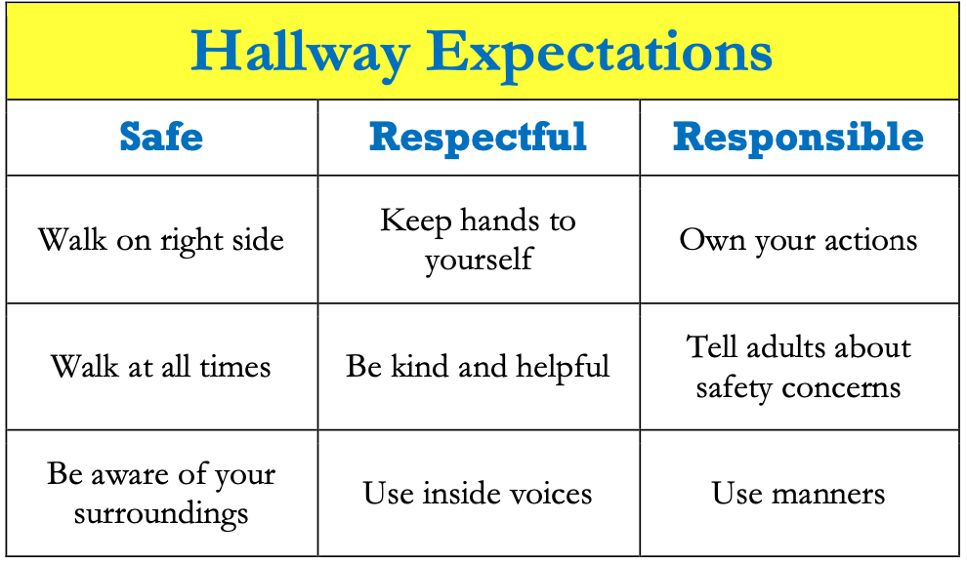
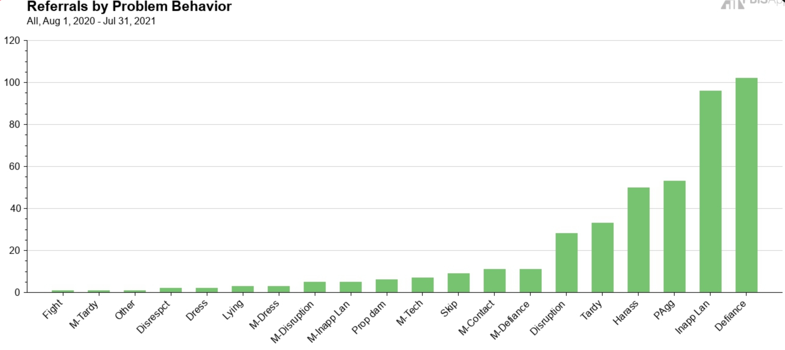
Virtual Poster Examples
Virtual Poster Examples

Slide 14
Dr. Lewis S. Libby School Logic Model
OUTCOME
How do we sustain this?
Staff encouragement- Parking spot, funding for paw power cards, system to make sure paws are put on the wall and cards are readily available with lanyards.
Develop procedures to increase appropriate behavior
Alternative Option: update or expand your logic model slide with visuals if that is easier for you.
Lanyards to make cards available, Card stations for staff, Paw containers for people to help hang paws, upstairs bucket for middle school drawing, PD for PBIS expectations which included PBIS team giving cards to staff for examples/practicing filling out SWIS forms, student of the month assemblies
DATA
Triangle data looks like it should! Full pre-K-4 bucket, walls full of paws, continued giving cards and doing drawings during closure.
How do we support staff to
implement this with fidelity?
SYSTEMS
What is one highlight
associated with this outcome?
Drawing can continue in school closure promoting system and consistency
What is one lesson learned?
We need to figure out a better system for our paw power cards to get home, a name on the wall, and in the drawing, without too much work for staff!
Paw Power Cards, Drawings, Paw Walls Behavior Matrix, common language, wall posters, PBIS card stations for staff, lanyards for staff when we return, student of the month assemblies
How do we know we are doing what we say we are doing? How do we know it is working?
What are we doing?
What do we want to be doing?
PRACTICES

Slide 15
School: ___________________________
Identify an outcome to focus on for this activity. For example:
Implement Tier 1 PBIS with fidelity (≥ 70 on TFI)
Implement a continuum of responses to increase appropriate behavior
Reduce disruptive behavior across the school day
OUTCOME
How do we sustain this?
SYSTEMS
DATA
How do we support staff to
implement this with fidelity?
What is one highlight
associated with this outcome?
__________________________________
__________________________________
What is one lesson learned?
__________________________________
__________________________________
How do we know we are doing what we say we are doing? How do we know it is working?
What are we doing?
What do we want to be doing?
PRACTICES

Slide 16
Outcome:
Increase consistancy in our ODR system to ensure equicty across our students
Systems
Clear definitions for problem behaviors both Major and Minor with examples.
Discipline Flow Chart updated to ensure all staff understand the strategies and process of behavioral management techniques before writing a referral.
Staff PD on how to write up a referral. Staff reviewed sample discipline scenarios to determine if it is a Minor, Major or a simple correction with no write up.
Discipline definitions and flowchart added to school handbook.
Data
Team examines equity reports monthly in SWIS as well as the drill down tool to ensure discpline is not disproportionate amongs different groups of students.
Data is shared with staff during faculty meeting to determine next steps
Practices
Teachers utilize behavior management techniques as:
Cool down space
Redirection/proximity/planned ignoring
Movement breaks
Mindfulness activities.
Only write up behaviors that fit a definition
Highlight:
Our ODR’s decreased signifantly once staff truly understood what should be a Major or Minor and after feeling comfortable with using the responding techniques that were practices during PD.
Lessons Learned:
Adults need lots of practice at writing referrals and keeping it unemotional.
Staff need lots of training and coaching on how to use behavior management

Slide 17
ACTIVITY: POSTER SESSION!
Make sure all team members have their poster visual file to share during breakout rooms.
Move into randomized breakout rooms
In breakout rooms, take turns describing highlights from your school.
Ask questions of others, get ideas!
Bring back your ideas to your team!
Randomized breakout rooms
25 minutes
Notes:
Trainer note: about 5 +/- people per breakout room. Try and combine elementary folks and secondary folks together when at all possible.

Slide 18
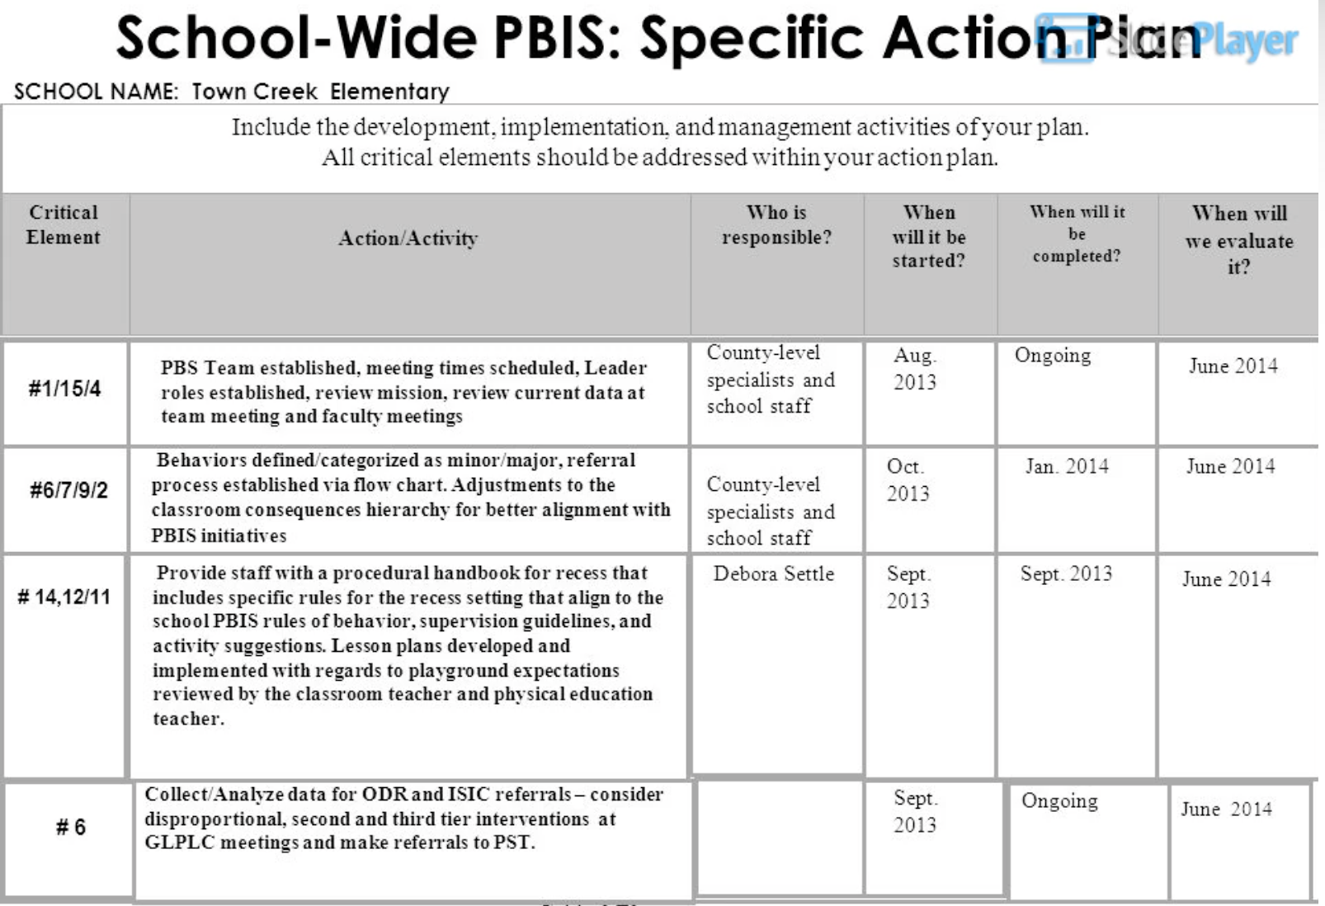
ACTIVITY: ACTION PLANNING
Take turns sharing different ideas collected during the Poster Session.
Decide as a team which ones are important to add to your action plan
Be ready to report on 1 or 2 “big ideas” from your group (1 minute).
Teams
20 minutes
Notes:
TRAINERS: Prompts for activity below; allow 20 minutes. (15 mins team time + 5 mins group discussion)
Split into breakout rooms
Complete the Working Smarter Matrix to identify all teams and details.
Review data on the matrix and use guiding questions to develop an action plan for eliminating or modifying teams as needed.
Be ready to report on 2 to 3 “big ideas” from your group (1 minute).
https://nepbis.org/wp-content/uploads/2020/09/Working-Smarter-Activity.docx

Slide 19
ACTIVITY: TEAM IMPLEMENTATION CHECKLIST
Coaches (1 per team) go to www.pbisapps.org
Go to PBIS Applications login on the top right corner of your screen.
Login with your email and password (if you haven’t set up your password yet, just go through the Forgot Password process).
Select PBIS Assessment. Under Surveys Currently Open, Select Team Checklist 3.1.
Click “Take Survey.” Find Team Checklist.
Select → under “Action” column .
Complete TIC as a team.
Review reports to support your action planning.
Teams
15 minutes
Notes:
TRAINER NOTES: Allow 15 min for teams to complete the TIC. Please cut/copy this text to the chat:
COACHES (1 per team) go to www.pbisapps.org
Go to pbis applications login on the top right corner of your screen
Login with your email and password (if you haven’t set up your password yet, just go through forgot password process)
Select PBIS Assessment
Under Surveys Currently Open, Select Team Checklist 3.1
Click “Take Survey”
Find Team Checklist
Select under Action column
Complete TIC as a team
Review reports to support your action planning

Slide 20
PLANNING FOR NEXT YEAR
Available Support: 2021 – 2022 school year
Team training content
Next steps:
Complete Tiered Fidelity Inventory (April – June)
On-going coaching support
Technical assistance
Coaches: be on the look out for a survey this Spring to identify supports for next school year.
District capacity support

Slide 21
AGENDA & FOLLOW-UP
What questions do you have on today’s content?
Presentation Content:
Guest Speaker: Family Engagement (Dr. Fefer)
Poster Session
Action Planning
Team Tasks:
Complete Family-School Practices Survey
Update action plan for this and next year
What questions do you have on the follow-up tasks?

Slide 22
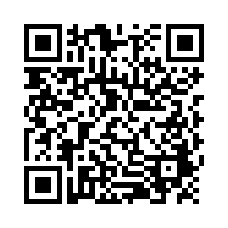
EVALUTION
Reminder:
Send Action Plan to Trainers for
Feedback
Please remember to complete the evaluation to receive your PDPs!
Scan the QR code to access.
Notes:
TRAINERS -
Put link to evaluation (below) in the chat for those who do not use the QR code:
https://uconn.co1.qualtrics.com/jfe/form/SV_5BXYIXLvg0qmSzP

