Slide 1
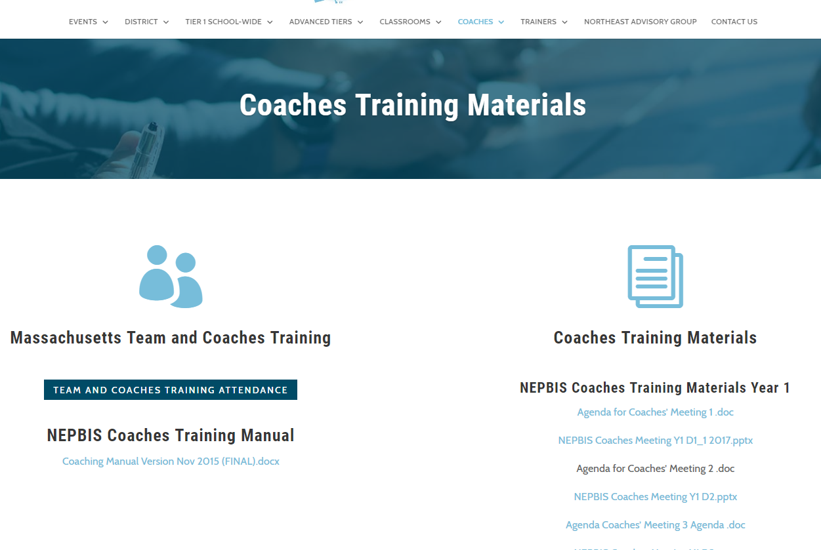
Welcome to Year 1 of PBIS School-Wide COACHES Training for High Schools!
As you wait for the training to begin, please:
Update your display name in Zoom to read: [Your School], [Your Name] (e.g., Eastside HS, Joe Clark)
This will help us create breakout rooms!
Pull up your current action plan
Enter your attendance by following the hyperlink or through nepbis.org

Slide 2
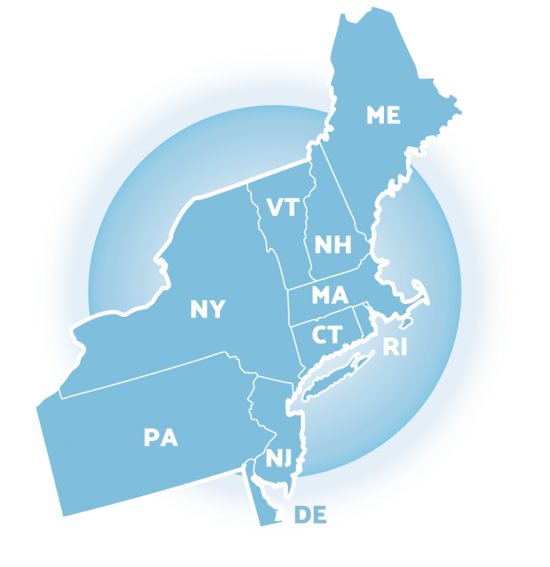
NEPBIS School-Wide Coaches Training Year 1: February
[Insert Trainer Names]
with support from Brandi Simonsen, Jen Freeman, Susannah Everett,
Adam Feinberg & Katie Meyer

Slide 3
Agenda & Coaches' Tasks
Coaches’ Tasks:
Consider When to Schedule TFI with Trainer (April-June)
Presentation Content:
Sharing Data with Staff
Preview Step #6: Acknowledgement Systems
Planning for the TFI
Review Cultural Responsiveness Field Guide
Review: Teaching Classwide Expectations

Slide 4
EXPECTATIONS
Self
Others
Environment
Self-monitor (Are you participating? Engaged as a learner? Talking during allotted times?)​
Mute when listening, unmute to talk​
Have your computer charged and ready to go​
Stretch, break, stand as needed​
If you have questions or comments, unmute, use the chat box, or click the "raise hand" icon
Work as a team: Room for every voice, reinforce participation
Keep necessary materials at hand (e.g., action plan & other docs, water, snacks, etc.)​

Slide 5
LEGEND
Discussion
Poll
Activity
&
Positive & Negative Examples
Preview

Slide 6
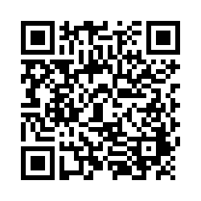
ACTIVITY: ATTENDANCE
Scan QR code on the left or follow the URL posted in the chat to access the online attendance survey
Follow prompts to enter attendance information
Notify trainers if you require assistance (e.g., identifying your cohort or cohort group)
1 minute
You are in Cohort 7
Notes:
TRAINERS –
Post a link to the attendance survey (below) in the chat for those who do not use the QR code on the slide:
https://uconn.co1.qualtrics.com/jfe/form/SV_0iZuJ0aKCo5IkG9

Slide 7
REVIEW: Teaching Classwide Expectations

Slide 8
PBIS IN THE CLASSROOM
It may be beneficial to have some expectations or routines consistent across a grade level or a department.
Example: All 9th grade teachers will accept late assignments, up to 1 week, for partial credit.
Example: Expectations and routines for accessing and using lab equipment is the same across all science labs.

Slide 9
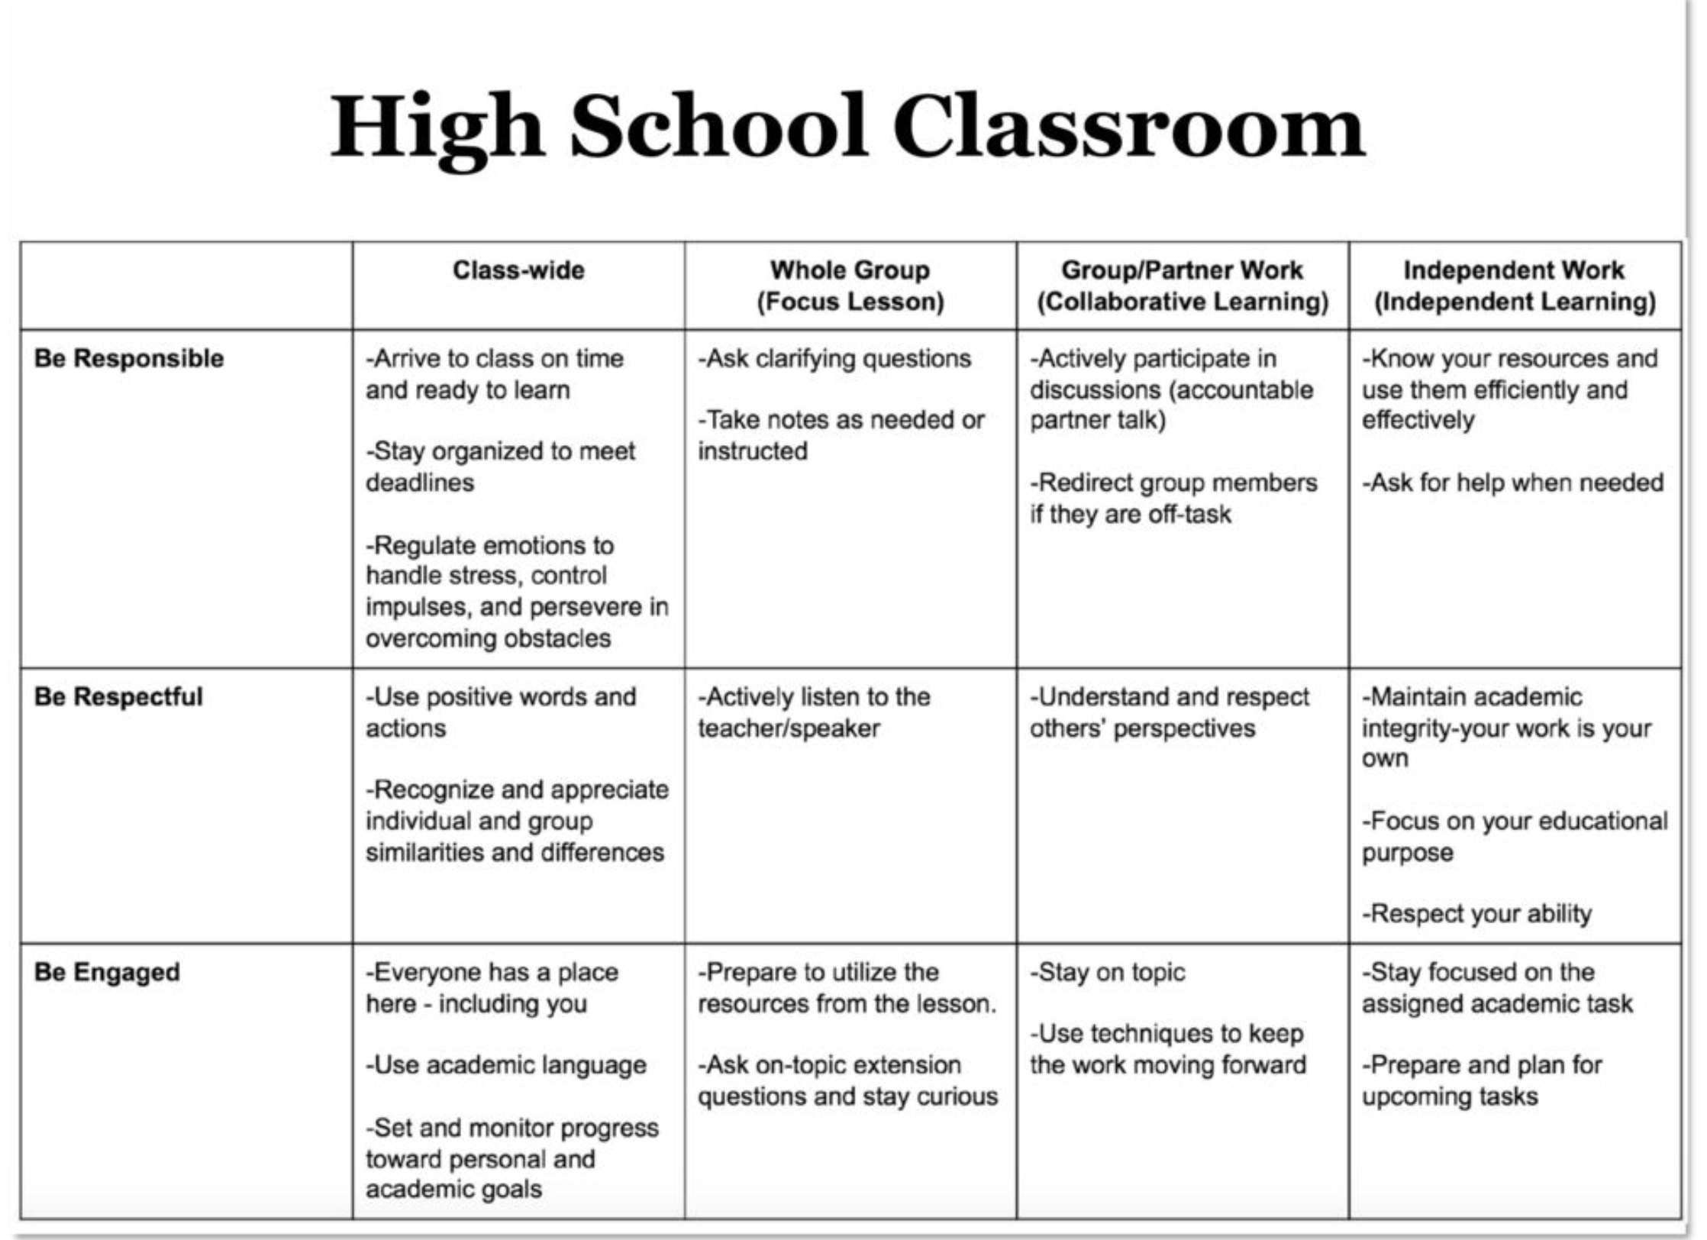
2. NATURAL CONTEXT
1. SOCIAL SKILL
3. BEHAVIOR EXAMPLES

Slide 10
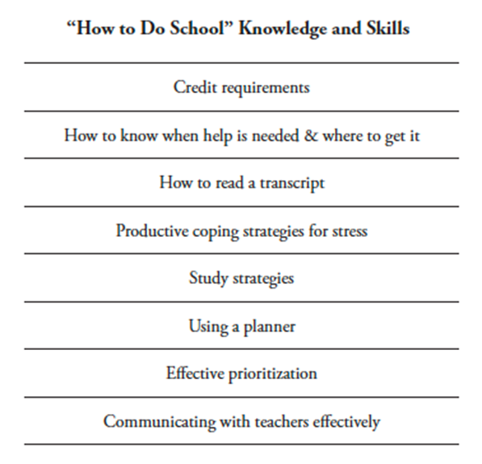
TEACH CRITICAL SKILLS FOR SUCCESS
Identify and explicitly teach "How to Do School" skills
Teach most intensively to 9th grade
Consider surveying upperclassmen and 10th grade teachers to get input on what’s most important
Vet with staff, upperclassmen & families
Align with broader school goals

Slide 11
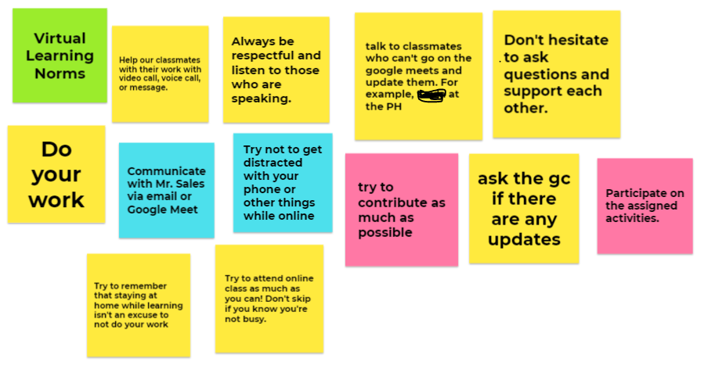
Involve staff and students in developing classwide expectations and identifying critical skills for success (e.g., focus groups/surveys to identify common concerns)

Slide 12
“Building this level of “buy in” around consistency is a process that requires time and communication. All teachers will not completely agree, but begin with those who will and build momentum over time.”
Kato, Flannery, Triplett, & Sueteurn, 2018

Slide 13
CHECK-IN: CLASSWIDE EXPECTATIONS
What routines or contexts do you plan to include on classroom matrices (e.g., group/partner work, bathroom, or hall pass)?
What “How to Do School” skills have you considered teaching explicitly?
Where do you plan to start?
How do will you approach with staff?
How will you involve students?
Whole Group
10 minutes
Notes:
TRAINERS: Remind coaches that developing consistency with classwide expectations and other components of classroom PBIS (e.g. use of precorrections and prompts, explicit teaching of routines, acknowledgement, continuum of error correction) across teachers and classrooms takes TIME. This is a gradual process that requires communication. Not all teachers will agree, but begin with those who buy in and build momentum over time.

Slide 14
SHARING DATA WITH STAFF

Slide 15
What is most related to high sustainability?
The frequency that data are presented to all school staff.
Pinkelman, S., McIntosh, K., Kim, J. R., Rasplica, C.K., Berg, T. & Strickland-Cohen, M. K. (2015).

Slide 16
SHARING DATA WITH STAFF
Share your annual outcome goals
When everyone understands the goals and sees progress from their efforts, staff members are more likely to embrace interventions to meet those goals.
Email a monthly report
Give context, provide connections, suggest next steps
Ex: Referrals from the hallway, month by month + intervention
Create a data wall focusing on data related to school-wide goals
Display data related to school-wide goals so everyone walking through can see the progress
Ex: # of days since last playground referral
Share data at monthly staff meeting
Invite staff to actively participate in generating solutions

Slide 17
ACTIVITY: SHARING DATA WITH STAFF
With someone from another school, discuss different ways your team has shared data with staff:
Survey results
School-wide behavior/discipline data (NOT individual students)
Outcome goals
PBIS fidelity data
In the last 2 minutes, jot down & tally as many different ways of sharing data with staff as you can
Individually or with your partner coach, add new items to your action plan related to sharing data with staff
Pairs 20 min
Notes:
TRAINERS – Prompt below; allow 10 minutes for discussion and 10 for action plan
With someone from another school, discuss different ways your team has shared data with staff:
Survey results
School-wide behavior/discipline data (NOT individual students)
Outcome goals
PBIS fidelity data
In the last 2 minutes, jot down & tally as many different ways of sharing data with staff as you can
Individually or with your partner coach, add new items to your action plan related to sharing data with staff
Have the pair that came up with the most ways to share data with staff read aloud their strategies.

Slide 18
PREVIEW: DEVELOPING STUDENT & STAFF ACKNOWLEDGEMENT SYSTEMS

Slide 19
DISCUSSION: ACKNOWLEDGEMENT
What is the current culture, attitudes, and beliefs about acknowledgement of behavior in your building? In the broader community?
What is currently in place to acknowledge students? Staff?
Whole group
5 minutes

Slide 20
Behavior is likely to occur again when it is reinforced…
When a student gets something desirable following a behavior, that behavior is strengthened and more likely to occur again.
Examples
If a student is given verbal praise for persisting with a difficult assignment, the student is likely to persist on later difficult assignments
If a student is removed from the classroom after refusing to do a difficult assignment, the student will likely act up later when he does not want to (or cannot) complete work

Slide 21
The Importance of Behavior-Specific Praise
Behavior-specific praise (BSP) gives students specific, positive verbal feedback indicating approval of social or academic behavior
BSP should be...
A description of a desired Behavior (social or academic)
Specific to the student or class.
A positive Praise statement
4:1 ratio of positive interactions to corrections are important!
Positive Praise
Behavior-Specific
Student-Specific
BSP
Notes:
a higher ratio (9:1) has been deemed necessary for students with EBD to increase academic engagement and decrease interfering behaviors

Slide 22
Determining the Need for a Formal Acknowledgement System
Is the current pattern of student social behavior acceptable? Or is there a need to improve school-wide social culture?
Do students perceive their positive behavior is acknowledged regularly?
Do faculty and staff perceive that they acknowledge positive student behavior adequately?
Do students from non-dominant populations experience acknowledgement for their positive behavior?
Survey your students to find out.
Survey your staff to find out.
Disaggregate student survey results.
Flannery et al., 2020
Notes:
TRAINERS: Give coaches an opportunity to answer each question privately. Allow each question to generate discussion among coaches.
Is the current pattern of student social behavior acceptable? Or is there a need to improve school-wide social culture?
Do students perceive their positive behavior is acknowledged regularly?
Do faculty and staff perceive that they acknowledge positive student behavior adequately?
Do students from non-dominant populations experience acknowledgement for their positive behavior?
High School Acknowledgement Systems https://www.pbis.org/resource/high-school-acknowledgement-systems

Slide 23
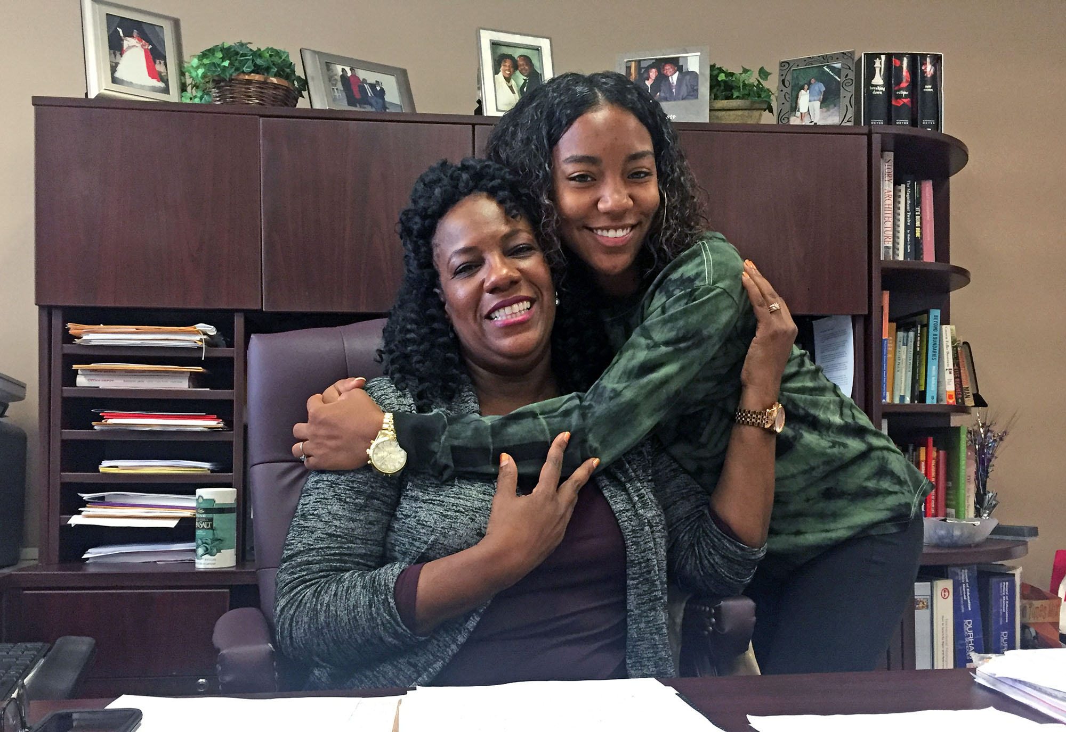
DISCUSSION: DETERMINING THE NEED FOR A FORMAL ACKNLOWLEDGEMENT SYSTEM
Review the High School Acknowledgement Systems brief.
Consider the questions from the previous slide.
Is there a need for a formal system of acknowledging students?
Would it be informative to survey staff and/or students to determine need?
How would you disaggregate survey data to determine if all students feel acknowledged?
Plan how to determine need and establish buy in for a formal system.
Add items to your action plan as necessary
Plan to share your conclusions and next steps with the group.
Teams
20 minutes
Notes:
Review the High School Acknowledgement Systems brief: https://www.pbis.org/resource/high-school-acknowledgement-systems
Consider the following questions:
Is the current pattern of student social behavior acceptable? Or is there a need to improve school-wide social culture?
Do students perceive their positive behavior is acknowledged regularly?
Do faculty and staff perceive that they acknowledge positive student behavior adequately?
Do students from non-dominant populations experience acknowledgement for their positive behavior?

Slide 24
Elements of HS Acknowledgement Systems
Commitment (Staff Buy-In)
Data Systems
Recognition Rhythm
Tie in with larger system (teaching, correcting)
Used as an instructional strategy
Parallel academic acknowledgement
Climate survey data
Led by building administration
Regular & predictable schedule for recognizing positive social behavior
Fidelity data
Fit into daily activities
Layered: daily, weekly, monthly, quarterly
Walkthrough data
Student Acknowledgment of Students
Formal systems
Ensure students less likely to receive positive attention are acknowledged
Teaches students to take responsibility for own behavior & support others' behavior
Relevant & varied
Faculty & Staff Acknowledgment of Students
Outline how students can support others
Informal positive interactions
An effective acknowledge-ment system is more than a list of rewards!
Notes:
Drawn from High School Acknowledgement Systems brief included in additional readings.

Slide 25
Notes:
Examples of Popular Student Incentives
List of FREE rewards that secondary students can choose from:
Sit in comfy chair for the day
Switch seats for a day
Listen to headphones during individual or AR time
Positive phone call home
Positive email home
Photo on an acknowledgement wall
Draw on the white board/chalk board
Free pass for homework
Pass for running a teacher errand

Slide 27
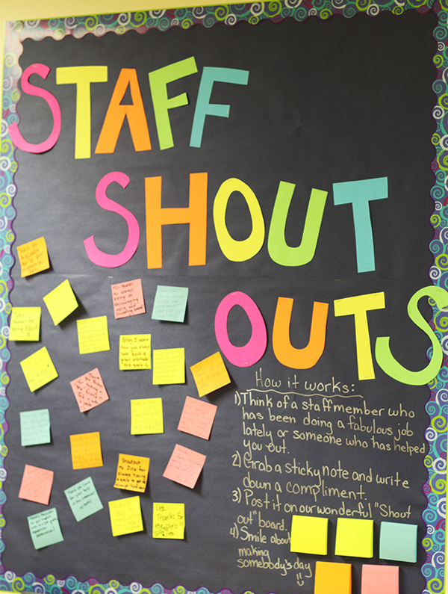
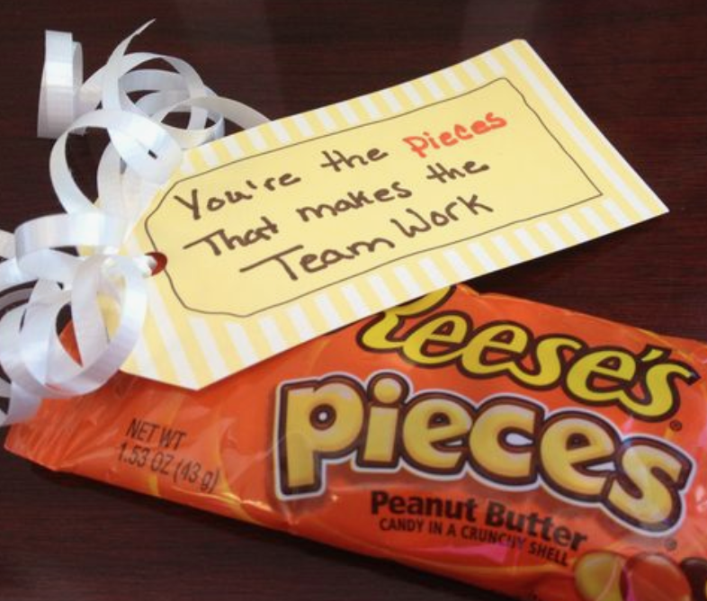
Adults like to be acknowledged, too!
Recognize staff for implementing PBIS components.
Build positive climate by celebrating the contributions staff make to support student success.

Slide 28
Staff Recognition Examples
What has been well-received by staff in the past?
Unmute or enter in the chat to share examples

Slide 29
GUIDELINES: Continuum of Procedures to Strengthen Appropriate Behaviors
Practices
Easy & quick form of acknowledgement linked to SW-expectations and used across all settings (non-classroom & classroom)
Considerate of strategies/processes that already exist
Develop written procedures for acknowledgements
Schedule (add to PD calendar) for teaching acknowledgement systems
Consider the following activity for your school:
Random but demographically representative student interview.
“What was the last thing you were acknowledged for?”
or
“What do the expectations mean to you?”

Slide 30
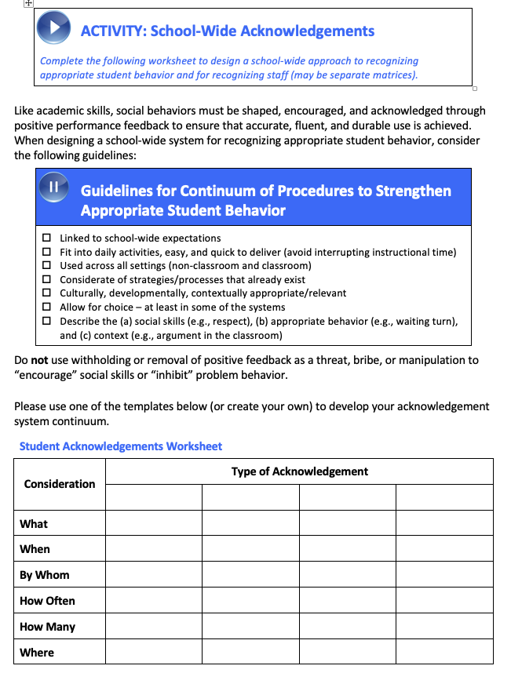
ACTIVITY: School-Wide Acknowledgements
Complete Acknowledgements Worksheet
Brainstorm ideas for high frequency, intermediate & long-term acknowledgement
Brainstorm ideas for staff acknowledgement
Create an Acknowledgement Matrix with clear instructions
Add items to your Action Plan as necessary
Teams
20 minutes
Notes:
Acknowledgements Worksheet: https://nepbis.org/wp-content/uploads/2020/12/Y1-Jan-Acknowledgement-System-Activity.docx
Exemplar Repository: https://nepbis.org/tier-1-school-wide/pbis-exemplar-resource-repository/
Virtual Acknowledgement ideas: https://www.pbisrewards.com/blog/pbis-incentives-distance-learning/

Slide 31
DISCUSSION: ACKNOWLEDGEMENT
How can staff, students, and other stakeholders be involved in developing an acknowledgement system?
What ideas do you have about developing or modifying your student and staff acknowledgement system?
Whole Group
5 minutes

Slide 32
TFI PLANNING
TFIs will be completed with a Trainer April-June

Slide 33
TIERED FIDELITY INVENTORY (TFI)
Purpose: | Assess evidence of critical features of school-wide PBS implementation Progress over time Helps team make data-based decisions on intervention & program efficacy Guides action-planning.
Format: | Survey ratings of features in place (self-assessment). About 30 mins per tier
Completed by: | Team members with the coaches Walkthrough tool completed by external coach
When? | Annually (in spring)
Assessment & walkthrough can be conducted remotely
Notes:
TRAINERS: Although teams won’t be completing the TFI until the spring, it’s helpful for coaches to have a broad understanding of the tool and the “end goal” of PBIS implementation as they develop their framework. For the same reasons, we want coaches familiar with the TFI CR Companion tool, so they can plan how to incorporate CR systems and practices as they complete the 10 getting started steps.

Slide 34
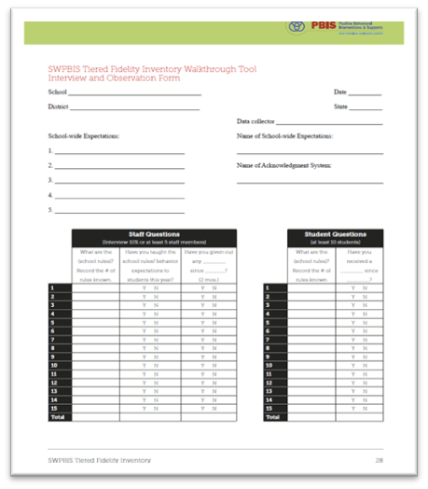
COMPLETING THE TFI REMOTELY
Step 1: Conduct Remote TFI Walkthrough
Identify a random and representative sample of classrooms, staff, and students
15 staff, 15 students, across grades
Coordinate with teachers to schedule interviews
Determine how to conduct the walkthrough interviews in the remote platform (e.g. breakout rooms)
Notes:
Guidance on completing the TFI Remotely: https://www.pbis.org/resource/conducting-the-tiered-fidelity-inventory-and-walkthrough-remotely

Slide 35
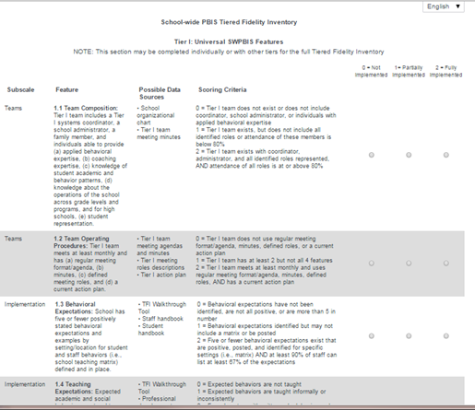
COMPLETING THE TFI REMOTELY
Step 2: Complete TFI with Team & Trainer
Schedule a time before the end of May
Appoint someone to record the responses in PBIS Assessment
Share a hard copy with your team ahead of time
Consider items based on your current learning mode (e.g. remote), although you may consider other modes (e.g. in-person)
If item scores differ depending on learning mode, retain the lower score to prompt action planning
Notes:
Guidance on completing the TFI Remotely: https://www.pbis.org/resource/conducting-the-tiered-fidelity-inventory-and-walkthrough-remotely

Slide 36
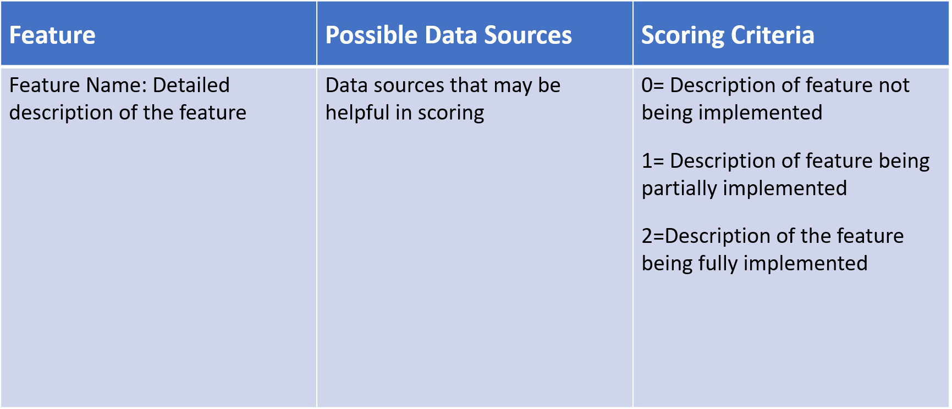
TFI FORMAT
Tier 1 = 15 items
Team Subscale – 2 items
Implementation Subscale – 9 items
Evaluation Subscale – 4 items

Slide 37
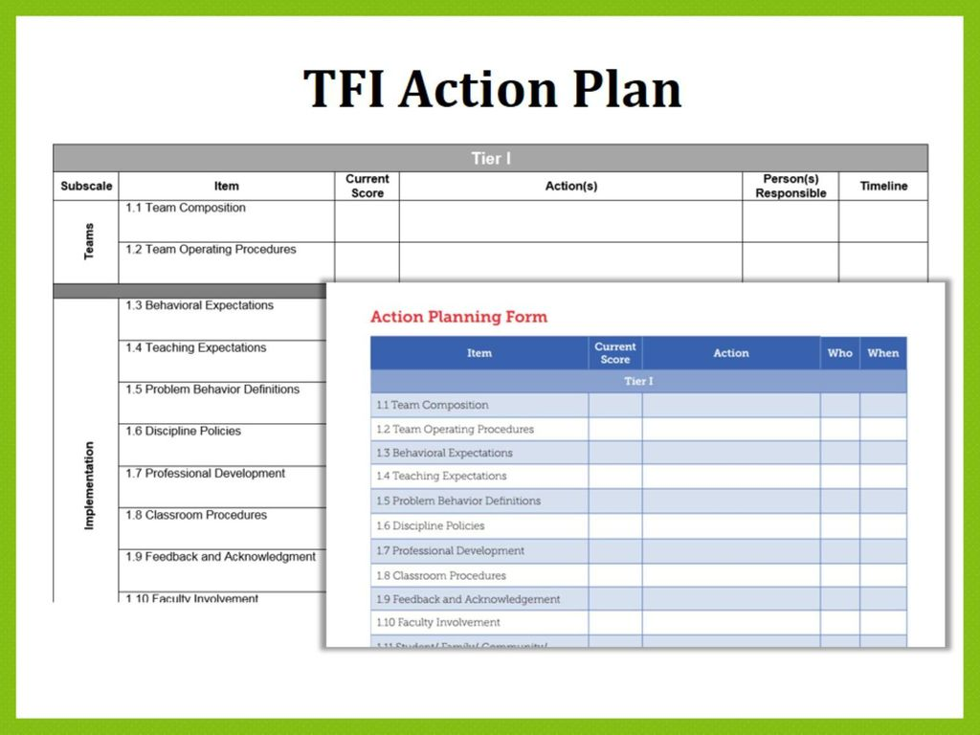
COMPLETING THE TFI REMOTELY
Step 3: Use Results to Support Action Planning
It is less important to focus on the score and more important to use the information to guide decisions
Identify priorities based on results
Notes:
Guidance on completing the TFI Remotely: https://www.pbis.org/resource/conducting-the-tiered-fidelity-inventory-and-walkthrough-remotely

Slide 38
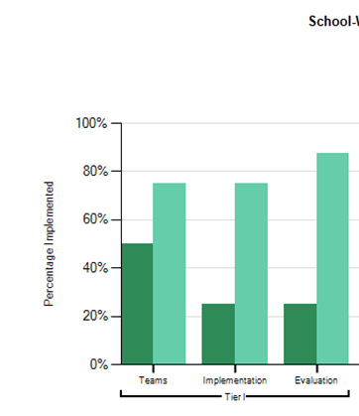
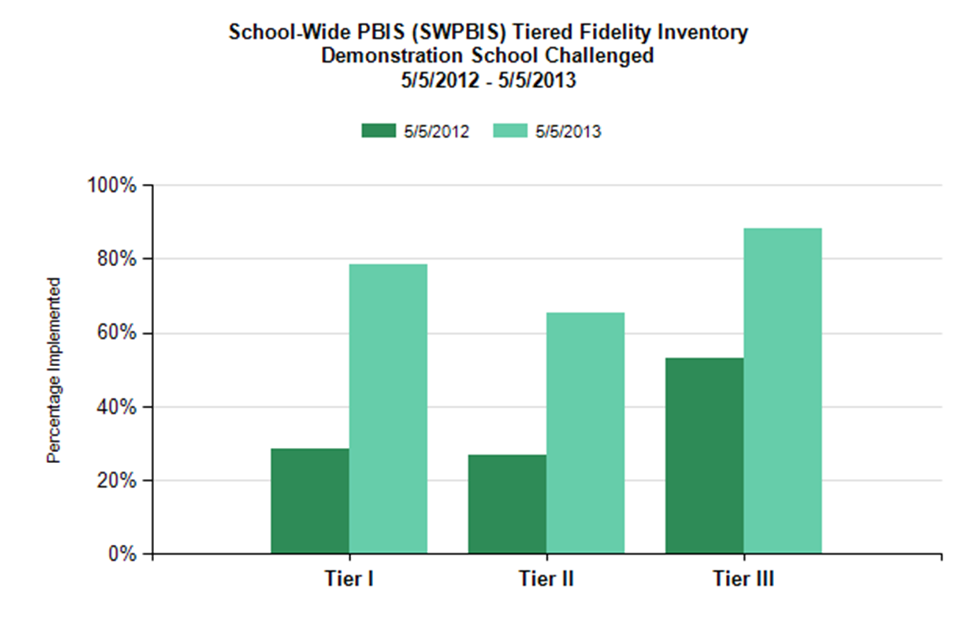
TFI REPORTS
Use the Scale, Subscale and Item reports to guide action planning.

Slide 39
CULTURAL RESPONSIVENESS FIELD GUIDE
The CR Field Guide outlines ways to embed equity through alignment with the core components of SWPBIS
Section 1: Identity Awareness
Section 2: Cultural Responsiveness Companion to the TFI
Appendices: materials, tools, sample activities, lesson plans, examples
See Section II: TFI Cultural Responsiveness Companion on pg. 6
Notes:
TRAINERS: You may want to model pulling this tool up on the pbis.org website using the search feature.
The field guide includes a section on identity awareness as well as the TFI CR Companion tool. https://www.pbis.org/resource/pbis-cultural-responsiveness-field-guide-resources-for-trainers-and-coaches

Slide 40
EXAMPLE: 1.9 Feedback & Acknowledgement
CR Concept: SUPPORTIVE ENVIRONMENT
SWPBIS Big Idea: Attending to and acknowledging desired student behaviors increases the likelihood of these behaviors recurring.
CR Elaboration: Teams involve students, families, and communities in development and use of acknowledgement systems to create systems that:
are meaningful and authentic
consider the culture of students served when designing recognition systems
Non-Examples: Some student enrollment groups have inequitable access to acknowledgement.
Examples: Teams actively seek feedback from students, families, and the community about preferences for acknowledgement and perceptions of the current systems at least annually

Slide 41
HOMEWORK: REVIEW CR COMPANION TO TFI
Review the Cultural Responsiveness Companion to the TFI in the CR Field Guide
Identify 2-4 items or areas to highlight with your team when you complete the TFI
Independent Approx. 20 min
Notes:
10 min breakout rooms with co-coach
5 min debrief with whole group
Find a PDF of the full TFI under Materials. Tier 1 begins on pg. 6: https://www.pbisapps.org/Applications/Pages/Tiered-Fidelity-Inventory-(TFI).aspx

Slide 42
ACTIVITY: REVIEW THE TFI
Review Tier 1 of the TFI (pg. 6).
What materials should you have available during the inventory?
What questions do you have about individual items?
What questions do you have about scheduling or completing the TFI?
Look at your school calendar April-June and consider when might be a good time to complete.
Breakout rooms 15 min
Notes:
10 min breakout rooms with co-coach
5 min debrief with whole group
Find a PDF of the full TFI under Materials. Tier 1 begins on pg. 6: https://www.pbisapps.org/Applications/Pages/Tiered-Fidelity-Inventory-(TFI).aspx

Slide 43
AGENDA & FOLLOW-UP
Presentation Content:
Review: Teaching Classwide Expectations
Sharing Data with Staff
Preview Step #6: Acknowledgement Systems
Planning for the TFI
Coaches’ Tasks:
Consider When to Schedule TFI with Trainer (April-June)
Review Cultural Responsiveness Field Guide
What questions do you have on today’s content?
What questions do you have on the follow-up tasks?

Slide 44
FEBRUARY TEAM MEETING
Presentation Content
Review: Classwide Expectations
STEP #6: Acknowledgement System
Team Tasks
Draft Acknowledgement System

Slide 45
RESOURCES
READINGS
Be a Data Hero
Conducting the TFI and Walkthrough Remotely
RESOURCE
Tiered Fidelity Inventory (TFI)
Notes:
Readings:
https://www.pbisapps.org/community/Pages/Sustaining-Implementation-Together.aspx
https://www.pbis.org/resource/conducting-the-tiered-fidelity-inventory-and-walkthrough-remotely
Resources:
https://www.pbis.org/resource/tfi

Slide 46
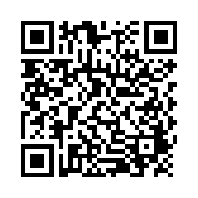
EVALUTION
Please remember to complete the evaluation to receive your PDPs!
Scan the QR code to access.
Notes:
TRAINERS -
Put link to evaluation (below) in the chat for those who do not use the QR code:
https://uconn.co1.qualtrics.com/jfe/form/SV_5BXYIXLvg0qmSzP

