Slide 1
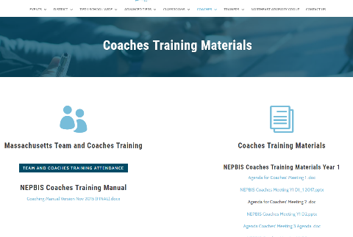
Welcome to YEAR 3 of PBIS COACHES Training!
As you wait for the training to begin, please:
Update your display name in Zoom to read: [Your School], [Your Name] (e.g., Eastside HS, Joe Clark)
This will help us create breakout rooms!
Pull up your current action plan
Enter your attendance by following the hyperlink or through nepbis.org

Slide 2
NEPBIS School-Wide Coaches Training Year 3: February
[Insert Trainer Names]
with support from Brandi Simonsen, Jen Freeman, Susannah Everett, Adam Feinberg,
Katie Meyer, & Karen Robbie

Slide 3
TODAY’S AGENDA & TASKS
Presentation Content
Tiered Fidelity Inventory Administration for Sustainability
Coaches’ Tasks
Review Tiered Fidelity Inventory Administration Training Videos
Efficient Decision Systems with TIPS
Sustainability
Review TIPS Team Decision Making Procedures
Initial Poster Planning
Planning for March Poster Session
Review Sustainability Checklist

Slide 4
LEGEND
Discussion
Poll
Activity
&
Positive & Negative Examples
Preview

Slide 5
ADDITIONAL READINGS & RESOURCES
RESOURCES:
Tiered Fidelity Inventory
PBIS Academy Poster Webinar
Cultural Responsiveness Field Guide
Notes:
Resource links:
https://www.pbisapps.org/Applications/Pages/Tiered-Fidelity-Inventory-(TFI).aspx
https://youtu.be/5CTIZdkw_gQ
https://www.pbis.org/resource/pbis-cultural-responsiveness-field-guide-resources-for-trainers-and-coaches

Slide 6
EXPECTATIONS
Self
Others
Environment
Self-monitor (Are you participating? Engaged as a learner?)​
Mute when listening, unmute to talk​
Have your computer charged and ready to go​
Stretch, break, stand as needed​
If you have questions or comments, unmute, use the chat box, or click the "raise hand" icon
Work as a team - room for every voice, reinforce participation
Keep necessary materials at hand (e.g., action plan & other docs, water, snacks, etc.)​

Slide 7
TOOLS
WEBSITES
School-Wide PBIS Workbook & Appendices
Action Plan
nepbis.org
pbis.org
pbisapps.org

Slide 8
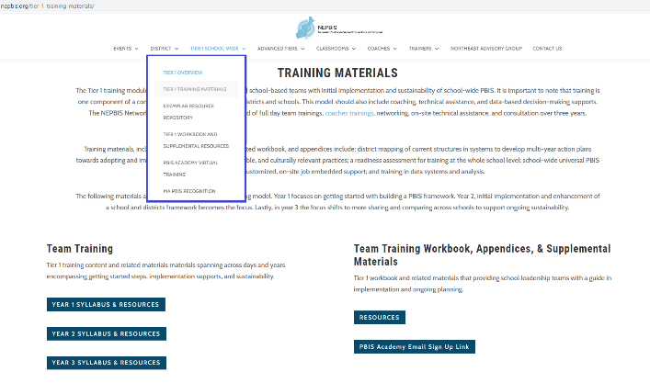
NEPBIS.ORG

Slide 9
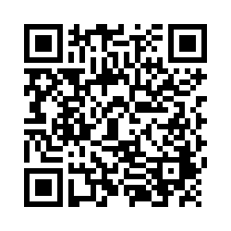
ACTIVITY: ATTENDANCE
Scan QR code on the left or follow the URL posted in the chat to access the online attendance survey
Follow prompts to enter attendance information
Notify trainers if you require assistance (e.g., identifying your cohort or cohort group)
1 minute
You are in Cohort 5
Notes:
TRAINERS –
Post a link to the attendance survey (below) in the chat for those who do not use the QR code on the slide:
https://uconn.co1.qualtrics.com/jfe/form/SV_0iZuJ0aKCo5IkG9

Slide 10
Review
PBIS Integration & Alignment with Other Initiatives

Slide 11
DISCUSSION: GLOWS & GROWS
Glows: What implementation successes have you had since our last coaches meeting?
Grows: What are some challenges that you have been experiencing that could use some support?
Notes:
TRAINERS – Discussion prompts below:
Glows: What implementation successes have you had since our last coaches meeting?
Grows: What are some challenges that you have been experiencing that could use some support?
Trainer note: Support coaches in how they will plan TFI administration for next year, post PBIS Academy. What support do they need during this year's administration to help build capacity to implement independently next year?

Slide 12
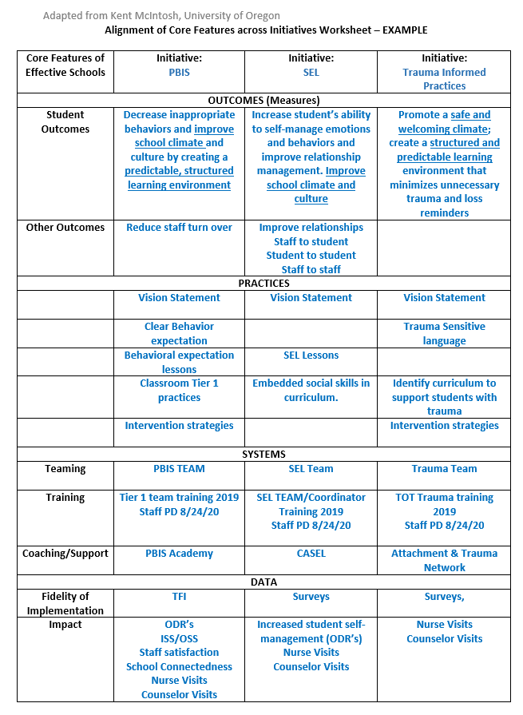
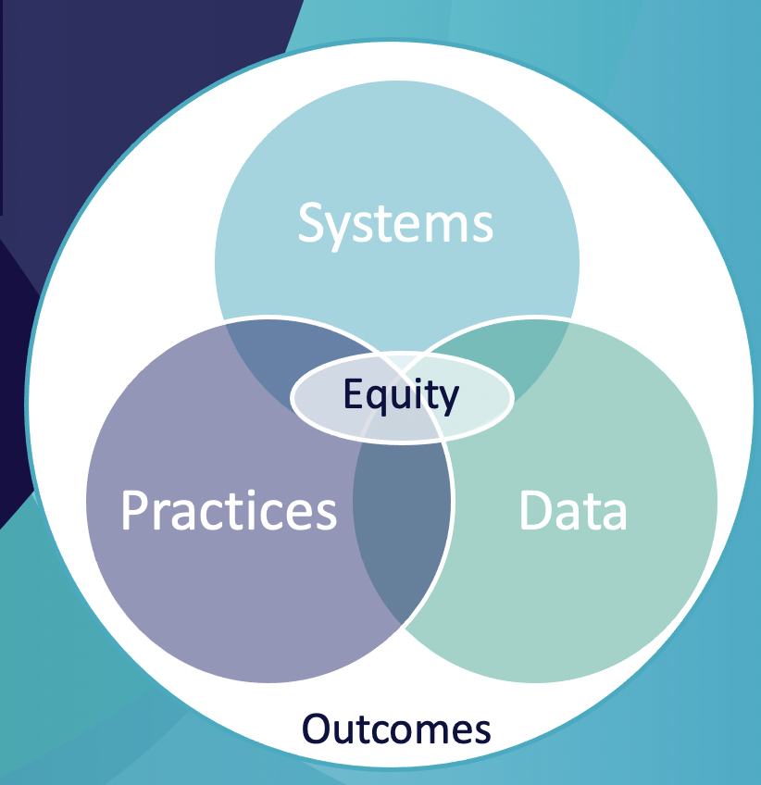
OUTCOMES
PRACTICES
Unmute or type in the chat:
What discussions have your team had relative to integration and alignment?
Equity
SYSTEMS
DATA
Notes:
TRAINERS: Begin by reinforcing that Equity should always be prioritized because MTSS is for all students, families, and educators. Equity should be considered throughout this entire exercise.
complete the Alignment Worksheet - NEPBIS website under Tier 1 School wide ->workbook and supplemental resources.

Slide 13
Tiered Fidelity Inventory & Planning for Ongoing Implementation

Slide 14
TFI Administration Planning
Discussion: Have you met as a team?
Discussion: What steps of the process need some planning ahead?
External support: District level or other coach
Schedule walkthrough
Schedule administration meeting
Complete Walkthrough tool
Review decision making process
Recording procedures
Preparation
Facilitation
Review item scores and identify next
Share information at faculty meetings
Planning
Notes:
Trainer Note: Preparation for Administration/ Completion Time School teams completing the Tier 1 scale should arrange a TFI Walkthrough (see Appendix A) before completing the TFI. We recommend that an external coach complete the TFI Walkthrough, although teams completing the Tier 1 scale more than once per year (i.e., for progress monitoring) may have a school staff member complete it. The time to complete the TFI depends on (a) the experience that the team and coach have with the process, (b) the extent of preparation for TFI completion , and (c) the number of tiers assessed. School teams new to the TFI should schedule 30 min for Tier 1, 30 min for Tier 2, and 30 min for Tier 3. If team leaders have assembled relevant sources of information prior to the meeting, and, if the team and coach have already completed the TFI at least twice, the time required for implementation may be approximately 15 min for each tier.
Coaches should plan ahead with team to complete the walkthrough tool
Coaches can work with team to develop a plan for reviewing items and decision making process for coming to concensus.
Coaches can support team on recording items. Consider PBISApps.

Slide 15
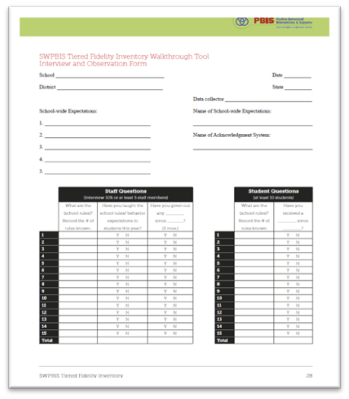
Completing the TFI Remotely
Step 1: Conduct Remote TFI Walkthrough
Identify a random representative sample of classrooms, staff, and students
15 staff & 15 students, across grades
Coordinate with teachers to schedule interviews
Determine how to conduct the walkthrough interviews via remote platform (e.g. breakout rooms)
Notes:
Guidance on completing the TFI Remotely: https://www.pbis.org/resource/conducting-the-tiered-fidelity-inventory-and-walkthrough-remotely

Slide 16
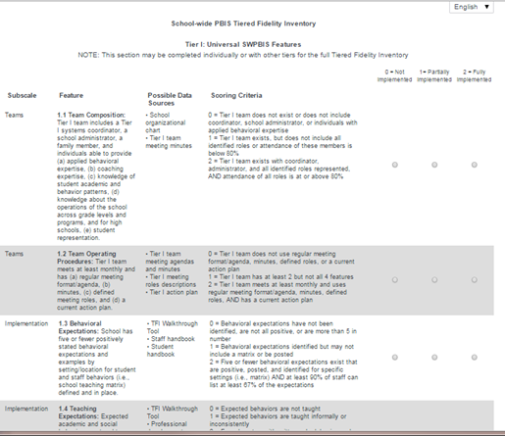
Completing the TFI Remotely
Step 2: Complete TFI with Team & Trainer
Schedule a time before the end of May
Appoint someone to record the responses in PBIS Assessment
Share hard copy with your team ahead of time
Consider items based on current learning mode (e.g., remote), although you may consider other modes (e.g., in-person)
If item scores differ depending on learning mode, retain the lower score to prompt action planning
Notes:
Guidance on completing the TFI Remotely: https://www.pbis.org/resource/conducting-the-tiered-fidelity-inventory-and-walkthrough-remotely

Slide 17
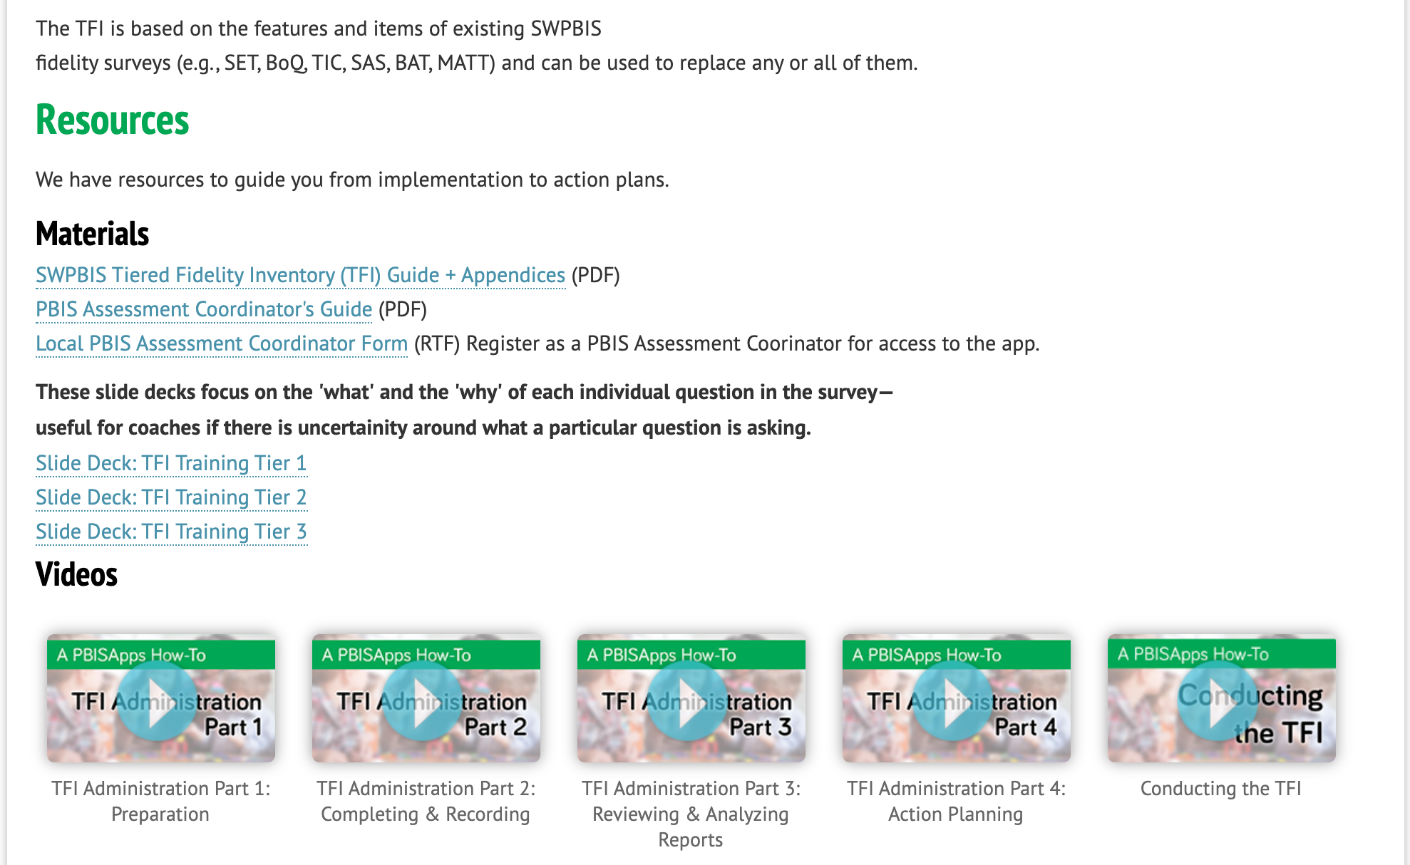
TFI Administration Resources
Review TFI resources
(available HERE)
as needed to build fidelity review & action planning into your regular data routines.
Notes:
Trainer note:
Please remind coaches of the resources available for review for those that would benefit from administration, review, and action planning planning.
TFI Resources are available here: https://www.pbisapps.org/Applications/Pages/Tiered-Fidelity-Inventory-(TFI).aspx

Slide 18
TFI Administration: Future Planning
What support do you need during this year's administration to help build capacity to conduct independently next year?
How will your schools complete fidelity checks next year?
District administrator support?
Swap buildings with other school coaches in district?
Schedule TFI administration
Schedule TFI walkthrough tool administration
Review item consensus decision making strategy with team
Review process for adding items to action plan
5 min. Individual + 5 min. Whole-Group
10 minutes
Notes:
Trainer note: Support coaches in how they will plan TFI administration for next year, post PBIS Academy. What support do they need during this year's administration to help build capacity to implement independently next year?

Slide 19
Efficient Decision Systems During Team Meetings

Slide 20
Efficient Team Meetings: Self-Check
Review your current team meeting operating procedures. Are they organized with the following?
Predictable Structure?
Meeting roles and responsibilities?
Agenda and action plan

Slide 21
Predictable Structure
A meeting schedule is created and respected (date and times)
Clear start time/stop time
Attendance at meetings
Consideration of group size
Agreement on group norms
Notes:
Meetings that start/end on time are found to be less disruptive, leader to higher perceived quality by team members, and result in higher engagement by meeting attendants
Larger groups have lower participation

Slide 22
Member Roles & Responsibilities
Can one person serve multiple roles?
Are more roles needed?
CORE ROLES
Facilitator
Minute Taker
Data Analyst
Administrator
Active Team Members
ADDITIONAL ROLES
Timekeeper
Parent/ Family Member
Consultant
Parking Lot Supervisor
Assumption Buster
Communicator
Parent/ Family Liaison
Back-up for each role!

Slide 23
Action Planning: A Critical Step
Action planning and documentation provides direction for team, increases implementation integrity, and accountability among implementers
Increases purposeful directive conversations about progress

Slide 24
Key Components of Action Planning
Date | Task/ Goal | Action Plan | Who? | By When? | Status?
What was the date this goal was discussed? | What task or goal does the team want to achieve? | What specific tasks need to be done to achieve the team’s task/goal? | Who will complete each task item? | What is the deadline for completion? | Have task items been completed?

Slide 25
Sample Action Planning
Date | Task/ Goal | Action Plan | Who? | By When? | Status?
3/2/21 | Improve average daily school attendance | Send monthly attendance data to all families Greet all students who are on time and provide tickets Provide all teachers with signs of being at risk for absenteeism | Ava All building admin Paige | 4/5/21 Ongoing begin 3/8/21 4/1/21 | In progress In progress Completed

Slide 26
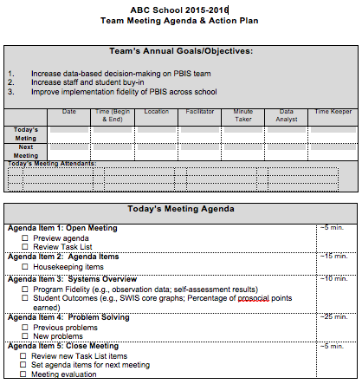
Purpose
Meeting Demographics
Agenda Items
(with times)

Slide 27
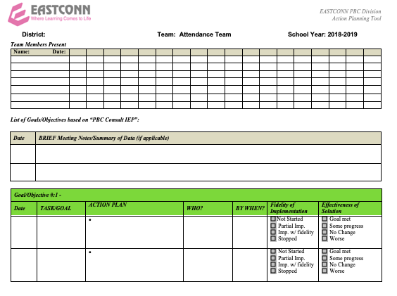
Meeting Demographics
Purpose/Agenda
Minutes
Action Items

Slide 28
DISUSSION: Efficient Team Meetings Self-Check
Which of these aspects of efficient team meetings are in place?
Which need review and a reset?
Predictable structure?
Meeting roles and responsibilities?
Agenda and action plan?
Notes:
TRAINERS – prompts for discussion below
Which of these aspects of efficient team meetings are in place?
Which need review and a reset?
Predictable structure?
Meeting roles and responsibilities?
Agenda and action plan?

Slide 29
PBIS & Sustainability
Unmute or type in the chat:
What experiences have you had with initiative abandoment?

Slide 30
Barriers to Sustainability: The Three C’s
Antecedent
Behavior
Consequence
Ongoing
Challenge
Select Practices
& Implement
with Fidelity
Student
Outcomes
Changes in Context
- Lack of contextual fit
- New challenges exist
- Competing initiatives
Changes in Capacity
- Loss of funding
- Attrition of key opersonnel
Changes in Consequences
- Diminished effectiveness odue to poor fidelity
- Outcomes no longer operceived as important

Slide 31
Four Principles for Enhancing the Sustainability of PBIS
Promote Priority
Ensure Effectiveness
Increase Efficiency
Use Data for Continuous Regeneration

Slide 32
Promoting Priority
Maximize Visibility
Get into written policy
Present data to people with resources
Describe effects of abandoning support for the practice
Braid project with other initiatives
Show how practice can lead to outcomes of new initiatives

Slide 33
Enhance Priority: SCHOOL PERSONNEL
Keep the practices fresh!
Especially the acknowledgement system
Learn tips from others
Other Schools in District / Conferences
Websites from other places (e.g., pbismaryland.org)
Share your struggles with others (e.g., District team support?)
Other teachers and staff, parents
Celebrate successes of PBIS efforts!
Bring data to every team meeting to guide action planning!
Share data with staff

Slide 34
Enhance Priority: SCHOOL ADMINISTRATORS
Promote PBIS across multiple settings
Share PBIS with parents & parents groups
Acknowledge PBIS efforts regularly
Be an active participant of the PBIS team
Attend team meetings and join in action planning implementation
Encourage data-based decision making
Protect from competing initiatives
Braid and buffer team from too many initiatives
Allocate resources to the PBIS effort
Make time for teams to meet, and teams to update school staff
Share with parent groups

Slide 35
Enhance Priority: DISTRICT ADMINISTRATORS
Share successes
Provide presentations to school board, community agencies, local businesses, news crews
Emphasize outcomes and threats
Provide regular acknowledgements for PBIS efforts
Facilitate sharing among school team facilitators
Connect school teams with similar PBIS schools
Encourage data-based decision making
Set accountability for data collection and reporting
Model good uses of data
Plan for the future
Create an action plan with short & long term goals
Identify and pursue short & long term funding

Slide 36
Ensuring Effectiveness
Focus on FIDELITY OF IMPLEMENTATION
Implement in all settings
Implement in all tiers of support
Consider family trainings
Share data showing how fidelity is related to effectiveness
Regular evaluation of fidelity data

Slide 37
Increasing Efficiency
Get it Down on Paper
Lesson Plans
Schedules
Agendas
Focus on Efficient Team Meetings
Create a virtual PBIS handbook!
See an example here, and more in the notes section of this slide.
Notes:
Examples of a PBIS handbook:
#1: https://nepbis.org/wp-content/uploads/2021/01/FHSTeacherPBISHandbook2014-15.docx
#2: https://nepbis.org/wp-content/uploads/2021/01/PBIS-HS-Staff-Handbook-Example.pdf
#3: https://nepbis.org/wp-content/uploads/2021/01/Pierce-MS-SWBSP-PBIS-Team-Handbook-2012-13.pdf

Slide 38
DISCUSSION: SUSTAINABILITY
With a fellow coach, discuss the following:
What major ideas regarding sustaining PBIS resonated with you?
What areas are important to focus on to ensure sustainability of you PBIS efforts?
Update you action plans accordingly.
5 minutes
Promote Priority
Ensure Effectiveness
Increase Efficiency
Use Data for Continuous Regeneration
Teams
Notes:
TRAINERS: Prompt below; allow 5 minutes in coach pairs
With a fellow coach, discuss the following:
What major ideas regarding sustaining PBIS resonated with you?
What areas are important to focus on to ensure sustainability of you PBIS efforts?
Update you action plans accordingly

Slide 39
Planning for Virtual Poster Session

Slide 40
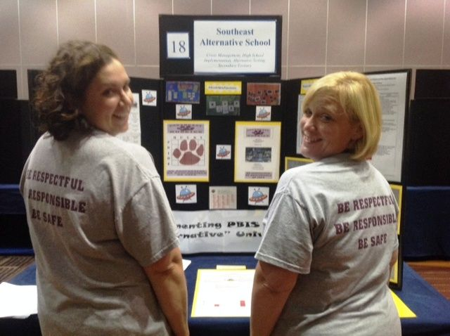
Virtual Poster Session
Target Goal:
Share examples of implementation of the PBIS Framework across districts and schools
Structure
Show off! Each school will showcase aspects of your PBIS implementation with other teams
One shared visual file! During March team training, we'll be randomized into breakout rooms and share our example file with others.
Get ideas! Bring ideas back to your school for follow up action planning

Slide 41
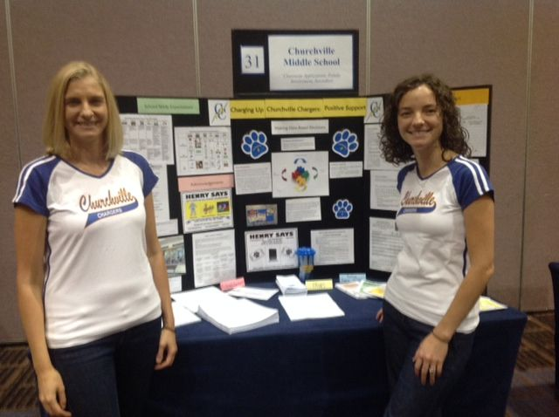
What to Include on Your Poster
Ideas Examples of Systems, Data, and Practices!
Data Examples
Fidelity Data (e.g., TFI or TIC)
Outcome Data (e.g., ODR or attendance)
System Examples
Team Action Plans
Staff Survey
Practice Examples
Lesson Plan
Teaching Matrix
Consequence Flow Chart
Please include data as part of your virtual poster!

Slide 42
What to Include on Your Poster
Consider including features that promote sustainability!
PBIS Handbook image
Newsletter sharing data with staff or families
Picture of policy on school website
Sample PD agenda to introduce new staff to PBIS

Slide 43
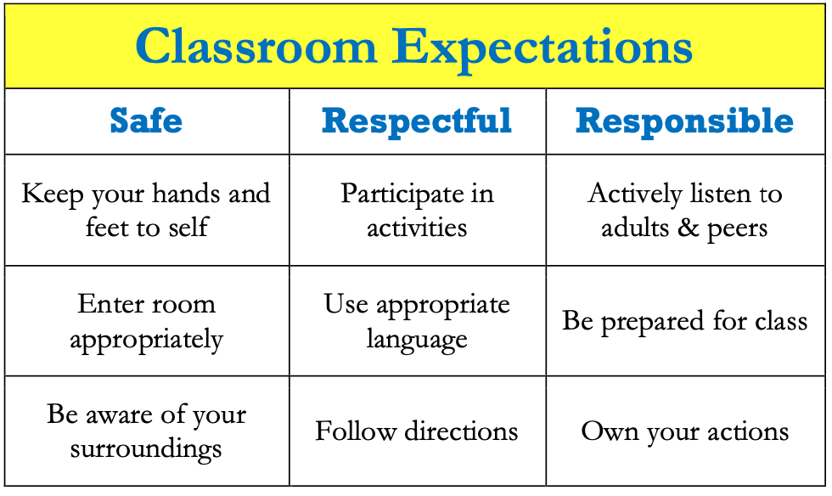
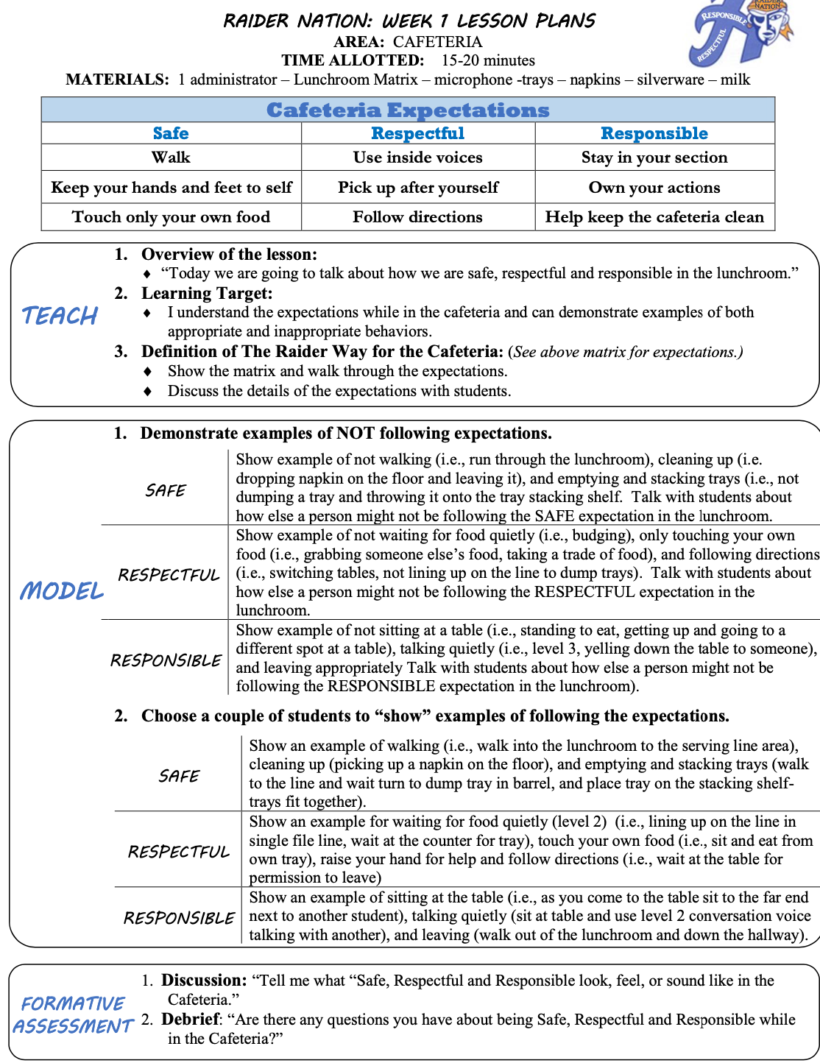
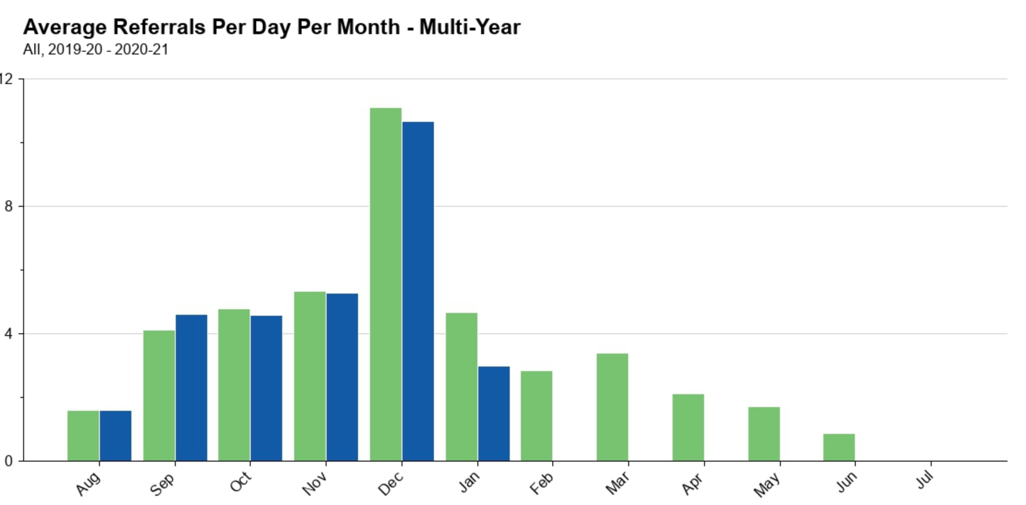
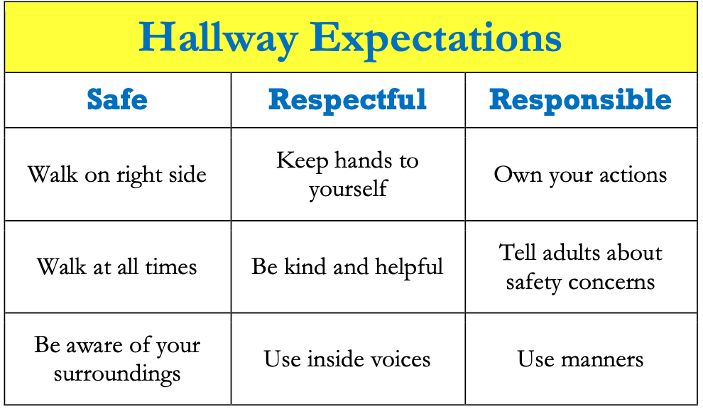
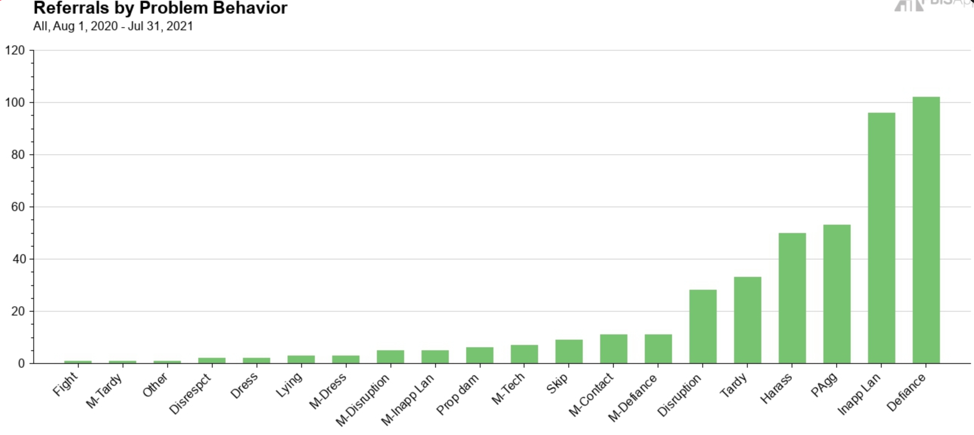
Virtual Poster Example

Slide 44
Dr. Lewis S. Libby School Logic Model
OUTCOME
How do we sustain this?
Staff encouragement- Parking spot, funding for paw power cards, system to make sure paws are put on the wall and cards are readily available with lanyards.
Feel free to update or expand your logic model slide with visuals if that is easier for you.
Develop procedures to increase appropriate behavior
Lanyards to make cards available, Card stations for staff, Paw containers for people to help hang paws, upstairs bucket for middle school drawing, PD for PBIS expectations which included PBIS team giving cards to staff for examples/practicing filling out SWIS forms, student of the month assemblies
DATA
Triangle data looks like it should! Full pre-K-4 bucket, walls full of paws, continued giving cards and doing drawings during closure.
How do we support staff to
implement this with fidelity?
SYSTEMS
What is one highlight
associated with this outcome?
Drawing can continue in school closure promoting system and consistency
What is one lesson learned?
_We need to figure out a better system for our paw power cards to get home, a name on the wall, and in the drawing, without too much work for staff!
Paw Power Cards, Drawings, Paw Walls Behavior Matrix, common language, wall posters, PBIS card stations for staff, lanyards for staff when we return, student of the month assemblies
How do we know we are doing what we say we are doing? How do we know it is working?
What are we doing?
What do we want to be doing?
PRACTICES

Slide 45
School: ___________________________
Identify an outcome to focus on for this activity. For example:
Implement Tier 1 PBIS with fidelity (≥ 70 on TFI)
Implement a continuum of responses to increase appropriate behavior
Reduce disruptive behavior across the school day
OUTCOME
How do we sustain this?
SYSTEMS
DATA
How do we support staff to
implement this with fidelity?
What is one highlight
associated with this outcome?
__________________________________
__________________________________
What is one lesson learned?
__________________________________
__________________________________
How do we know we are doing what we say we are doing? How do we know it is working?
What are we doing?
What do we want to be doing?
PRACTICES

Slide 46
Outcome:
Increase consistancy in our ODR system to ensure equicty across our students
Systems
Clear definitions for problem behaviors both Major and Minor with examples.
Discipline Flow Chart updated to ensure all staff understand the strategies and process of behavioral management techniques before writing a referral.
Staff PD on how to write up a referral. Staff reviewed sample discipline scenarios to determine if it is a Minor, Major or a simple correction with no write up.
Discipline definitions and flowchart added to school handbook.
Data
Team examines equity reports monthly in SWIS as well as the drill down tool to ensure discpline is not disproportionate amongs different groups of students.
Data is shared with staff during faculty meeting to determine next steps
Highlight: Our ODR’s decreased signifantly once staff truly understood what should be a Major or Minor and after feeling comfortable with using the responding techniques that were practices during PD
Lessons Learned:
Adults need lots of practice at writing referrals and keeping it unemotional.
Staff need lots of training and coaching on how to use behavior management
Practices
Teachers utilize behavior management techniques as:
Cool down space
Redirection/proximity/planned ignoring
Movement breaks
Mindfulness activities.
Only write up behaviors that fit a definition a

Slide 47
ACTIVITY: PLANNING POSTERS!
Decide on a virtual poster format (PPT or other).
Discuss with your co-coach what your school will show on your poster.
Discuss what final steps need to be completed between now and the team training session to complete your poster.
More planning time will be provided during our March coaches meeting
10 minutes
With Co-coach

Slide 48
AGENDA & FOLLOW-UP
Presentation Content
Tiered Fidelity Inventory Administration for Sustainability
Coaches’ Tasks
Review Tiered Fidelity Inventory Administration Training Videos
Efficient Decision Systems with TIPS
Sustainability
Review TIPS team Decision Making Procedures
Initial Poster Planning
Planning for March Poster Session
Review Sustainability Checklist
What questions do
you have on today’s content?
What questions do
you have on today’s
follow-up team tasks?

Slide 49
ADDITIONAL READINGS & RESOURCES
RESOURCES:
Tiered Fidelity Inventory
PBIS Academy Poster Webinar
Cultural Responsiveness Field Guide
Notes:
Resource links:
Integration and Alignment Technical Guide: https://www.pbis.org/resource/technical-guide-for-alignment-of-initiatives-programs-and-practices-in-school-districts
How Schools are Using School Climate Surveys: https://www.pbis.org/resource/how-are-schools-using-the-school-climate-surveys
CR Field Guide: https://www.pbis.org/resource/pbis-cultural-responsiveness-field-guide-resources-for-trainers-and-coaches

Slide 50
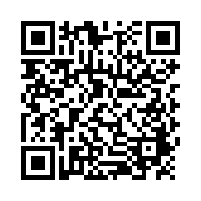
EVALUTION
Please remember to complete the evaluation to receive your PDPs!
Scan the QR code to access.
Notes:
TRAINERS -
Put link to evaluation (below) in the chat for those who do not use the QR code:
https://uconn.co1.qualtrics.com/jfe/form/SV_5BXYIXLvg0qmSzP

