Slide 1
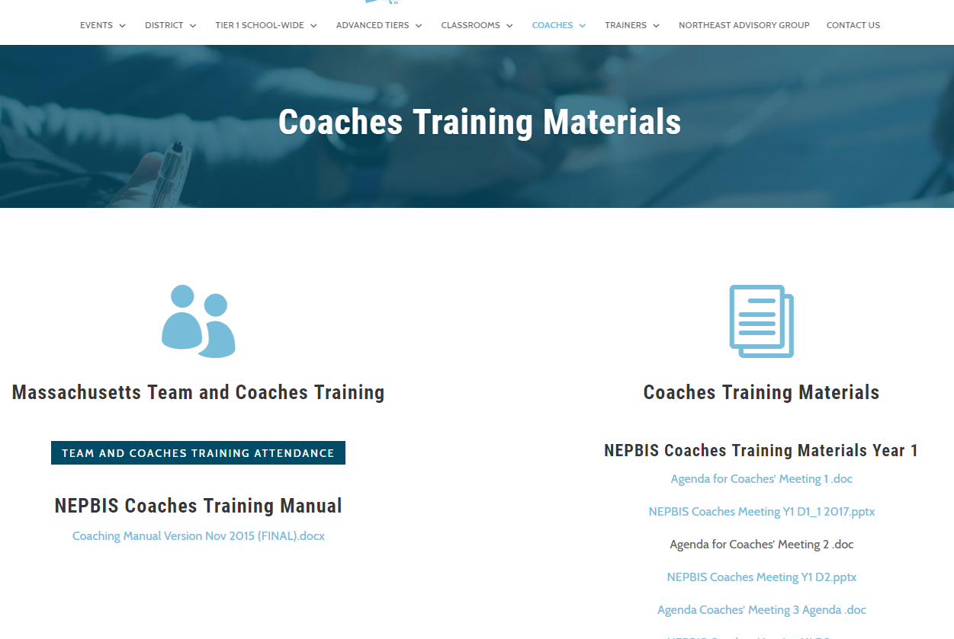
Welcome to YEAR 2 of PBIS
COACH Training!
As you wait for the training to begin, please:
Update your display name in Zoom to read: [Your School], [Your Name] (e.g., Eastside HS, Joe Clark)
This will help us create breakout rooms!
Pull up your current action plan
Enter your attendance by following the hyperlink or through nepbis.org

Slide 2


NEPBIS Coaches’ Training
Year 2: February
[Insert Trainer Names]
with support from Brandi Simonsen, Jen Freeman, Susannah Everett,
Adam Feinberg & Katie Meyer
Notes:
Add trainer names for your event

Slide 3
TODAY’S AGENDA & TASKS
Presentation Content
Coaches Tasks
Identify Potential Vulnerable Decision Points and Develop Neutralizing Routines
Review: Equity Data Review
Implicit Bias and Neutralizing Routines
Assessing Tier 1 Getting Started Steps
Prepare for Team Review of Tier 1 Getting Started Steps

Slide 4
LEGEND
Discussion
Poll
Activity
&
Positive & Negative Examples
Preview

Slide 5

ADDITIONAL READINGS & RESOURCES
READINGS:
Neutralizing Implicit Bias in School Discipline
Don't Discipline Hangry
RESOURCES:
Function of Behavior Mini Module
Neutralizing Routines Mini Module
Avoiding Power Struggles Mini Module
VDP Worksheet
Notes:
Reading Links:
https://www.pbis.org/resource/neutralizing-implicit-bias-in-school-discipline
https://www.pbisapps.org/community/Pages/Responding-to-Student-Behavior.aspx
Resource Links:
https://www.youtube.com/watch?v=KYEm-FdWyXE&feature=youtu.be
https://www.youtube.com/watch?v=gkxB6jgmgkw&feature=youtu.be
https://www.youtube.com/watch?v=b5QINNFT0Ek&feature=youtu.be
https://kentmcintosh.files.wordpress.com/2011/04/ib-worksheets-2015-4-9.pdf

Slide 6

EXPECTATIONS
Self
Others
Environment
Self-monitor (Are you participating? Engaged as a learner?)​
Mute when listening; unmute to talk​
Have your computer charged and ready to go​
Stretch, break, stand as needed​
If you have questions or comments, unmute, use the chat box, or click the "raise hand" icon
Work as a team (room for every voice, reinforce participation)
Keep necessary materials at hand (e.g., action plan & other docs, water, snacks, etc.)​

Slide 7




TOOLS
WEBSITES
School-Wide PBIS Workbook & Appendices
Action Plan
nepbis.org
pbis.org
pbisapps.org

Slide 8
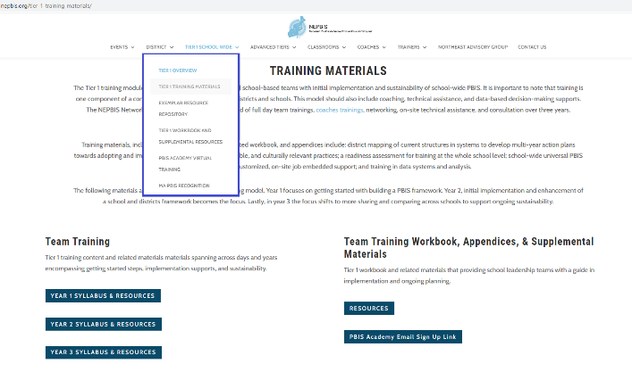
NEPBIS.ORG

Slide 9
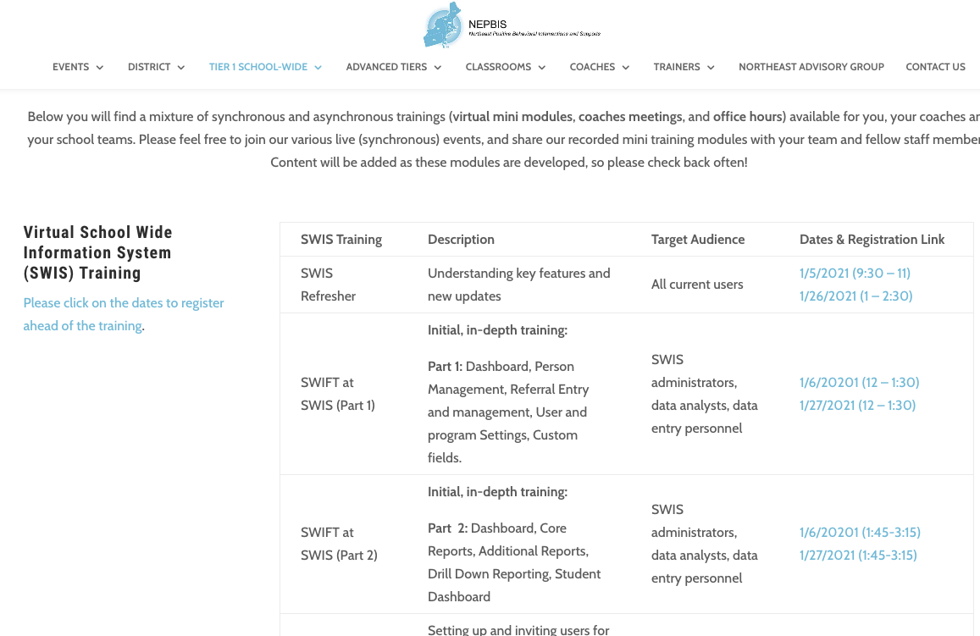
SWIS Training Events
You can find the available dates and registration links here:
https://nepbis.org/pbis-academy-virtual-training-page/
Notes:
TRAINER NOTE: The virtual training page has our current schedule of state wide SWIS training events. Please inform your coaches and teams about this opportunity. They can register for these trainings through the hyperlinked dates. Please have them register ahead of time, so we know that there are attendees and we can hold the training sessions.
Please the link to the chat: https://nepbis.org/pbis-academy-virtual-training-page/

Slide 10
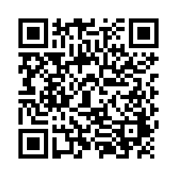
ACTIVITY: ATTENDANCE
Scan QR code on the left or follow the URL posted in the chat to access the online attendance survey
Follow prompts to enter attendance information
Notify trainers if you require assistance (e.g., identifying your cohort or cohort group)
1 minute
Notes:
TRAINERS –
Post a link to the attendance survey (below) in the chat for those who do not use the QR code on the slide:
https://uconn.co1.qualtrics.com/jfe/form/SV_0iZuJ0aKCo5IkG9

Slide 11
ACTIVITY: EQUITY DATA REVIEW
What student outcome data (e.g., ODRs, attendance, suspension, etc.) did you review?
    If you haven’t yet, what barriers got in the way? How can they be addressed?
Which sub-groups did you examine?
What did you notice?
What should be strengthened? ...changed?
Individual Jot
3 minutes
Partner Share
7 minutes
Whole Group Share
5 minutes
Notes:
TRAINERS: After giving participants 3 minutes to gather some thoughts in a private jot, send them to breakout rooms with a coach from another school to respond to these questions. As a whole group, discuss takeaways and themes
ACTIVITY PROMPT:
What student outcome data (e.g., ODRs, attendance, suspension, etc.) did you review?
If you haven’t yet, what barriers got in the way? How can they be addressed?
Which sub-groups did you examine?
What did you notice?
What should be strengthened? ...changed?

Slide 12
EQUITY DATA REVIEW: PBIS TEAM
Look at disaggregated referrals by ethnicity graphs
Do Referral Risk Ratios differ across groups?
Continue implementing Tier 1 supports for all students
How can this information be used to inform interventions?
NO
Drill Down:
1. ODR x Student
2. ODR x Problem Behavior
3. ODR x Location
4. ODR x Referral Type
5. ODR x Time of Day
Design Action Plan based on these data & consider neutralizing routines
YES
PLAN

Slide 13
DISCUSSION: ALIGNMENT
How does equity ”fit” into other initiatives within your school?
What other equity initiatives are being implemented?
Whole Group Discussion
10 minutes

Slide 14
Implement SWPBIS as part of a preventative, multi-tiered, culturally responsive behavior framework
Collect, use, and report disaggregated student discipline data
Develop policies with accountability for disciplinary equity
Use engaging instruction to reduce the opportunity gap
Teach strategies for neutralizing implicit bias in discipline decisions
Click HERE for more about equity in PBIS
Notes:
TRAINERS: Provide a very brief refresher for steps 1-4 covered in January. Then, highlight #5 as the next block of content

Slide 15
What is Implicit Bias?
Unconscious, automatic
Based on stereotypes
  We all have it (even those affected by it)
  Generally not an indication of what we believe or would endorse
More likely to influence:
  Snap decisions
  Decisions that are ambiguous
Notes:
Let’s look further at implicit bias.

Slide 16
ACTIVITY: EXPLORE IMPLICIT BIAS
Individually spend some time exploring some of the implicit association tests
    Select “guest” as login
    Choose a preferred implicit association test (IAT) to complete
Team Debrief: Discuss with your team how this information can impact our relationships with staff and students.
Individual
15 minutes
Whole Group Debrief
5 minutes
Notes:
The IAT measures the strength of associations between concepts (e.g., black people, gay people) and evaluations (e.g., good, bad) or stereotypes (e.g., athletic, clumsy). The main idea is that making a response is easier when closely related items share the same response key.
https://implicit.harvard.edu/implicit/selectatest.html
PREVIEW slide

Slide 17
Reduce Effects of Implicit Bias through Specific Training
Reduce ambiguity in ODR definitions and processes
  Clear guidelines for classroom vs. office- managed behaviors
  Avoid rules that result in disproportionate exclusion
Identify specific vulnerable decision points
  General
  Local (school)
Teach a neutralizing routine
  Self-assess presence of VDP
  Use alternative response
Notes:
In order to reduce the effects of implicit bias we can take these steps. 1) ensure discipline systems are clearly defined teams can pause here to review the work they have done on this so far. 2) use data to identify if there are specific times, locations or rules in your school where disproportionality is more likely to show up. 3) teach a response that can be used to address those specific situations.
PREVIEW slide

Slide 18
VDPs from National ODR Data
Subjective problem behavior
  Defiance, Disrespect, Disruption
  Major vs. minor
Non-classroom areas
  Hallways
Classrooms
Afternoons
ambiguity
LACK OF contact
DEMANDS? Relevance?
fatigue

Slide 19
Two-Step Neutralizing Routine
When you see unwanted behavior or the
start of a power struggle, stop and ask yourself:
Is this a VDP?
  What are the elements of the situation?
  What is my internal decision state?
If so, use a pre-determined agreed-upon alternative response.

Slide 20
Elements of a Good Neutralizing Routine
If-Then Statement
Brief
Clear Steps
Doable
Interrupts the Chain of Events

Slide 21
DISCUSSION: VDPs AT YOUR SCHOOL
Reflect on your school setting…
What are some potential triggers that may lead to VDPs for staff?
How could those triggers be minimized?
Which contexts within your school are ambiguous and more likely to contribute to VDPs?
How can those contexts be altered to reduce ambiguity and/or promote neutralizing routines?
Individual Jot
5 minutes
Whole Group Discussion
10 minutes

Slide 22
Getting Started with SWPBIS
PANDEMIC
Knowledge
Buy-in
Momentum
Establish an effective and representative leadership team
Develop brief statement of behavioral purpose
Identify positive SW behavioral expectations
Develop procedures for teaching SW expectations
Develop procedures for teaching class-wide expectations
Develop continuum for strengthening appropriate behavior
Develop continuum for discouraging violations of expectations
Develop data-based procedures for monitoring
Develop systems to support staff
Build routines to ensure on-going implementation
Day 1
Fall 2019
Day 2
Day 3
Winter 2020
Day 4

Slide 23
ACTIVITY: TEAM TIME
Assess your Tier 1 Getting Started Steps and Action Plan.
As the team coach(es), what do you see as the greatest need?
What needs to be available for the team to use this time effectively?
What goal(s) do you have for this time?
Work for 20 minutes to review your action plan, review your TIC data, identify priorities, and organize resources.
Be prepared to share 1 hope for your team time with the large group.
*Review your action plan
*Identify areas…
to strengthen
to learn more about
to develop
*Choose 1 person to share 1 identified team goal for the month ahead
45 minutes
Notes:
Trainers: Place in individual or co-coach breakout rooms

Slide 24
ADDITIONAL READINGS & RESOURCES
READINGS:
Neutralizing Implicit Bias in School Discipline
Don't Discipline Hangry
RESOURCES:
Function of Behavior Mini Module
Neutralizing Routines Mini Module
Avoiding Power Struggles Mini Module
VDP Worksheet
Notes:
Reading Links:
https://www.pbis.org/resource/neutralizing-implicit-bias-in-school-discipline
https://www.pbisapps.org/community/Pages/Responding-to-Student-Behavior.aspx
Resource Links:
https://www.youtube.com/watch?v=KYEm-FdWyXE&feature=youtu.be
https://www.youtube.com/watch?v=gkxB6jgmgkw&feature=youtu.be
https://www.youtube.com/watch?v=b5QINNFT0Ek&feature=youtu.be
https://kentmcintosh.files.wordpress.com/2011/04/ib-worksheets-2015-4-9.pdf

Slide 25
AGENDA & FOLLOW-UP
What questions do you have on today’s content?
Presentation Content
Review: Equity Data Review
Implicit Bias and Neutralizing Routines
Assessing Tier 1 Getting Started Steps
Coaches Tasks
Identify Potential Vulnerable Decision Points & Develop Neutralizing Routines
Prepare for Team Review of Tier 1 Getting Started Steps
What questions do you have on the follow-up tasks?

Slide 26
PREVIEW: MARCH AGENDA & TASKS
Presentation Content
Understanding Function
Coaches’ Tasks
Review function of behavior
Avoiding Power Struggles
Assessing Classroom Systems
Review FAST guidelines for responding to behavior in the classroom
Make a plan for assessing classroom systems

Slide 27
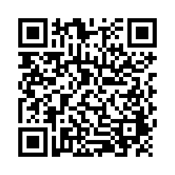
EVALUTION
Reminder:
Send Action Plan to Trainers for
Feedback
Please remember to complete the evaluation to receive your PDPs!
Scan the QR code to access.
Notes:
TRAINERS -
Put link to evaluation (below) in the chat for those who do not use the QR code:
https://uconn.co1.qualtrics.com/jfe/form/SV_5BXYIXLvg0qmSzP

