Slide 1
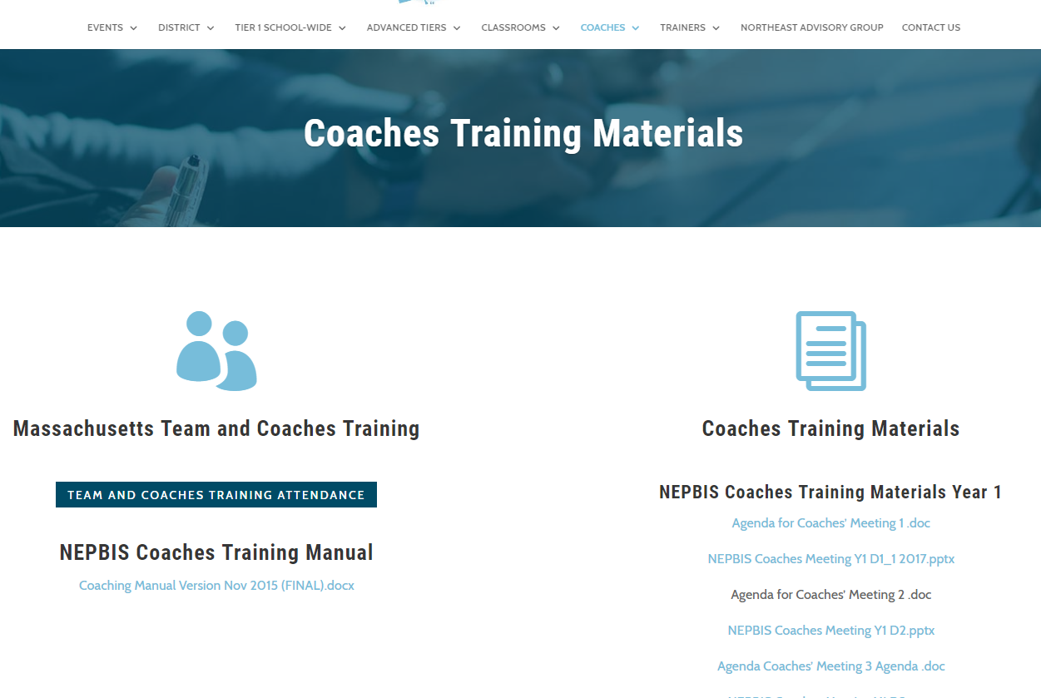
Welcome to Year 1 of PBIS School-Wide COACHES Training for High Schools!
As you wait for the training to begin, please:
Update your display name in Zoom to read: [Your School], [Your Name] (e.g., Eastside HS, Joe Clark)
This will help us create breakout rooms!
Pull up your current action plan
Enter your attendance by following the hyperlink or through nepbis.org

Slide 2
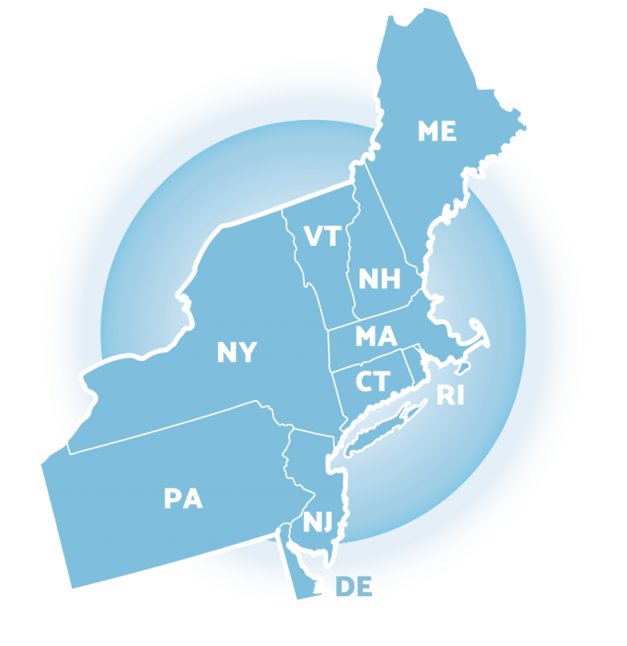
NEPBIS School-Wide Coaches Training Year 1: January
[Insert Trainer Names]
with support from Brandi Simonsen, Jen Freeman, Susannah Everett,
Adam Feinberg & Katie Meyer

Slide 3
Agenda & Coaches' Tasks
Coaches’ Tasks:
Review Team Implementation Checklist (TIC) & Action Plan
Presentation Content:
Review: Coaching Team Meetings
Preview: Teaching Class-Wide Expectations (Step #5)
Review: Team Implementation Checklist (TIC)
Consider surveying staff to identify top concerns

Slide 4
EXPECTATIONS
Self
Others
Environment
Self-monitor (Are you participating? Engaged as a learner? Talking during allotted times?)​
Mute when listening, unmute to talk​
Have your computer charged and ready to go​
Stretch, break, stand as needed​
If you have questions or comments, unmute, use the chat box, or click the "raise hand" icon
Work as a team: Room for every voice, reinforce participation
Keep necessary materials at hand (e.g., action plan & other docs, water, snacks, etc.)​

Slide 5
LEGEND
Discussion
Poll
Activity
&
Positive & Negative Examples
Preview

Slide 6
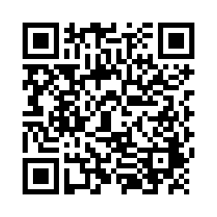
ACTIVITY: ATTENDANCE
Scan QR code on the left or follow the URL posted in the chat to access the online attendance survey
Follow prompts to enter attendance information
Notify trainers if you require assistance (e.g., identifying your cohort or cohort group)
1 minute
Notes:
TRAINERS –
Post a link to the attendance survey (below) in the chat for those who do not use the QR code on the slide:
https://uconn.co1.qualtrics.com/jfe/form/SV_0iZuJ0aKCo5IkG9

Slide 7
WHAT ROLE DO COACHES PLAY?
Facilitate
Content Knowledge
Communicate
Share Advanced Content with Team
Team Meetings
Activities at Training Events
Implementation
Local PBIS Expert
Positive “Nag”
Link to Resources
Share Information at Faculty Meetings
Discussion:
How are you communicating with your team between trainings?

Slide 8
REVIEW: COACHING TEAM MEETINGS

Slide 9
FACILITATING EFFECTIVE TEAM MEETINGS
Be prepared & expect others to be as well
Begin on time by reviewing agenda & outcomes for the meeting
Involve everyone
Use data to clearly and quickly define a problem before beginning problem solving
Create an action plan
Debrief at the end of the meeting
After the meeting, electronically publish meeting minutes
(see details in Coaches’ Workbook)
Notes:
TRAINER NOTE: This content is review for coaches. The purpose of the content review is to prompt a discussion and check in on the facilitation of team meetings.

Slide 10
HS COACHING TIPS FROM THE FIELD
Keep a positive attitude, even in tense situations
Don't rush the process; allow your school to find it's path to implementation while guiding toward fidelity
Build trusting relationships - be transparent about what you can & can't do
Model moving past mistakes
Build on what's in place and working
Hershfeldt, Flammini & Matheson, 2018
Notes:
Chapter 4 in Flannery, K. B., Hershfeldt, P., & Freeman J. (2018). Lessons Learned on Implementation of PBIS in High Schools: Current Trends and Future Directions. Center for Positive Behavioral Interventions and Supports (funded by the Office of Special Education Programs, U.S. Department of Education). Eugene, Oregon: University of Oregon Press.

Slide 11
DISCUSSION: TEAM MEETINGS
How are your team meetings going?
Have you assigned and maintained roles for all team members?
Which features are going well?
What challenges are you encountering?
Whole Group
10 minutes
Notes:
TRAINERS – Discussion prompts are below; allow 10 minutes as a whole group.
How are your team meetings going?
- Have you assigned and maintained roles for all team members?
- Which features are going well?
- What challenges are you encountering?

Slide 12
DISCUSSION: WHAT IS YOUR PBIS ENTRY POINT WITH STAFF?
What are the top concerns of faculty, staff, and administration in your building (e.g., graduation rates, attendance, tardiness)?
What issues are meaningful for staff?
Do you have data that relate to these concerns?
Consider surveying your staff to identify their concerns.
Whole Group
10 minutes
Notes:
TRAINERS – Discussion prompts are below; allow 10 minutes as a whole group.
How are your team meetings going?
- Have you assigned and maintained roles for all team members?
- Which features are going well?
- What challenges are you encountering?

Slide 13
REVIEW: TEAM IMPLEMENTATION CHECKLIST (TIC)

Slide 14
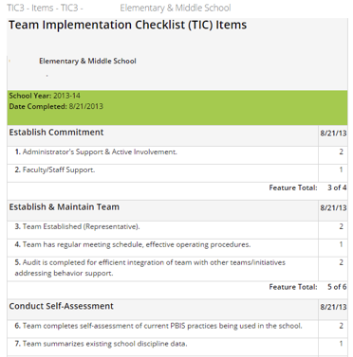
REVIEW TIC & IDENTIFY PRIORITIES
Log in to www.pbisapps.org to access the results of the TIC
Enter your username (school email) and password to login
Go to "PBIS Assessment" in the black bar
Select "Reports" -> "Survey Reports"
Using the dropdown menus, generate the Subscale and Item reports for the TIC3
You'll be completing this activity with your teams this month. Practice logging in and accessing your reports by subscale, and by items.
What items are important to discuss with your team? How will you summarize results to facilitate action planning?
Notes:
TRAINER NOTE: Model pulling up these reports in PBIS Apps.

Slide 15
ACTIVITY: REVIEW TIC & IDENTIFY PRIORITIES
Review Subscale and Item reports of the TIC. As an initial assessment, focus on items you’ve started putting in place.
Identify 2-3 items/ accomplishments to celebrate.
Identify 2-3 items/elements to prioritize.
Note accomplishments and priorities on your action plan and prepare to share with the group.
With co-coach
10 minutes
Notes:
TRAINERS – Provide 10-15 min for coaches to review TIC and 5 min or so for coaches to share out with whole group.

Slide 16
SCHOOL-WIDE EXPECTATIONS MATRIX
Poll:
Have you had a chance to obtain staff & student input on your teaching matrix?
Not yet
Not yet but we have plans to
Yes, from staff
Yes, from students
Yes, from both!
Notes:
Poll: Have you had a chance to obtain staff & student input on your teaching matrix?
Not yet
Not yet but we have plans to
Yes, from staff
Yes, from students
Yes, from both!

Slide 17
LESSON PLAN TEMPLATE
Poll 2:
Have you received feedback from any of the following groups on your lesson plans?
Staff
Students
Families
None Yet
Poll 1:
How many settings have completed lesson plans?
0
1
2
3
4
5+
Skill Name
Getting Help (How to ask for assistance for difficulty tasks)
Teaching Examples
1. When you’re working on a math problem that you can’t figure out, raise your hand and wait until the teacher can help you. 2. You and a friend are working together on a science experiment but you are missing a piece of lab equipment, ask the teacher for the missing equipment. 3. You are reading a story but you don’t know the meaning of most of the words, ask the teacher to read and explain the word.
Kid Activity
1. Ask 2-3 students to give an example of a situation in which they needed help to complete a task, activity, or direction. 2. Ask students to indicate or show how they could get help. 3. Encourage and support appropriate discussion/responses. Minimize attention for inappropriate responses.
After the Lesson (During the Day)
1. Just before giving students difficult or new task, direction, or activity, ask them to tell you how they could get help if they have difficulty (precorrection). 2. When you see students having difficulty with a task (e.g., off task, complaining), ask them to indicate that they need help (reminder). 3. Whenever a student gets help the correct way, provide specific praise to the student.
Notes:
TRAINER NOTE: Lesson plan template available on website and link in resources section at the end of presentation
Poll 1: How many settings have completed lesson plans?
0
1
2
3
4
5+
Poll 2: Have you received input or feedback from any of the following groups on your lesson plans?
Staff
Students
Families
None yet

Slide 18
CONGRATULATIONS!
Establish an effective leadership team
Develop a brief statement of purpose
We have reviewed the first 5 getting started steps!
When these components are in place we will have proactively set our students and staff up for success!
Identify positive school-wide behavior expectations
Develop procedures to teach school-wide expectations
Develop procedures to teach class-wide expectations

Slide 19
PREVIEW: TEACHING CLASS-WIDE EXPECTATIONS
Notes:
Trainer Note: The purpose of this section is to expose coaches to the supporting and responding document. Have a brief discussion about how coaches could bring this back to their teams and maybe integrate a feature or two into their action plans.

Slide 20
PBIS IN THE CLASSROOM
Clear, consistent classroom expectations
Ratio of 4:1 positive to corrective feedback
Established routines for classroom activities
Pre-correction and prompts provided
The same components of SWPBIS are important to replicate consistently in classrooms.
An important element of providing universal, preventive support is working with classroom faculty & staff to establish buy in and a commitment to consistently implement these practices.
This requires time and communication.
Notes:
MAIN IDEA: These PBIS Classroom Systems are also cornerstones of good classroom management & strong teaching. They provide structure and stability for students. Establishing a high level of buy in and commitment to consistency with these practices is a process that requires time and communication. Focus on building this consistency and consensus among 9th grade faculty (or whichever is the incoming grade in the HS). Not all teachers will agree, but begin with those who buy in and build momentum over time.

Slide 21
PBIS IN THE CLASSROOM
It may be beneficial to have some expectations or routines consistent across a grade level or a department.
Example: All 9th grade teachers will accept late assignments, up to 1 week, for partial credit.
Example: Expectations and routines for accessing and using lab equipment is the same across all science labs.

Slide 22
DISCUSSION: CLASSROOM EXPECTATIONS & ROUTINES
Discuss as a team:
Would it be beneficial to have consistent expectations/ routines across grade levels or departments?
Where might be a good place to begin? Is there consensus or low hanging fruit on certain issues? Where is there buy in?
Teams
10 minutes
Notes:
TRAINERS – Discussion prompts are below; allow 10 minutes in teams. Provide time to share out ideas/questions.
Would it be beneficial to have consistent expectations/ routines across grade levels or departments?
Where might be a good place to begin? Is there consensus or low hanging fruit on certain issues? Where is there buy in?

Slide 23
FOLLOW THESE KEY STEPS
Define
Teach
Prompt
Monitor
Evaluate
Notes:
Briefly describe each step

Slide 24
FOLLOW THESE KEY STEPS
Define
Teach
Prompt
Monitor
Evaluate

Slide 25
BEHAVIORAL EXPECTATIONS/RULES
Define
Operationally define what the rules look like across classroom routines and settings (e.g. turning in work, late assignments, accessing materials, pair work, transitions)
One way to do this is in a matrix format

Slide 26
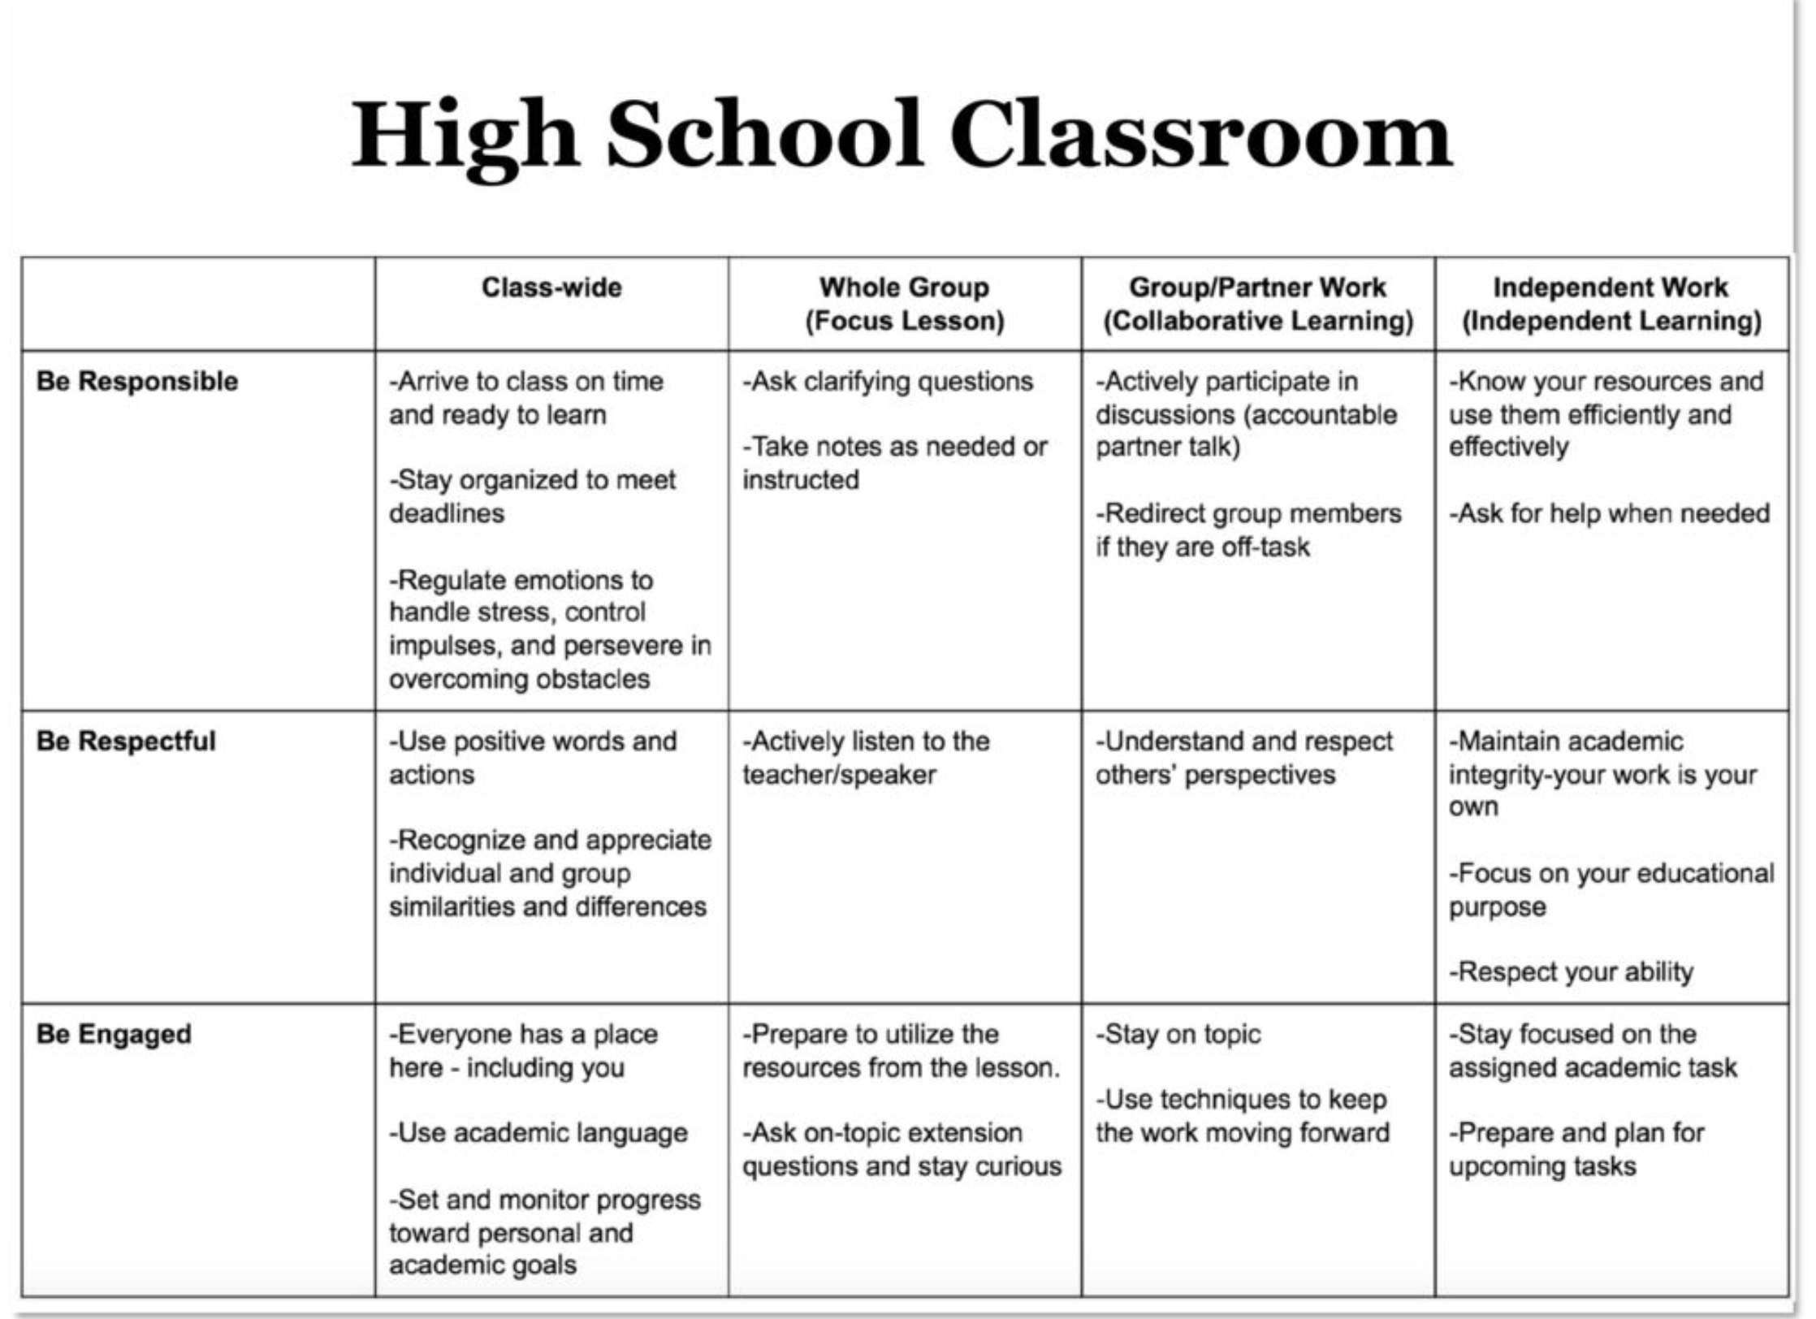
2. NATURAL CONTEXT
1. SOCIAL SKILL
3. BEHAVIOR EXAMPLES

Slide 27
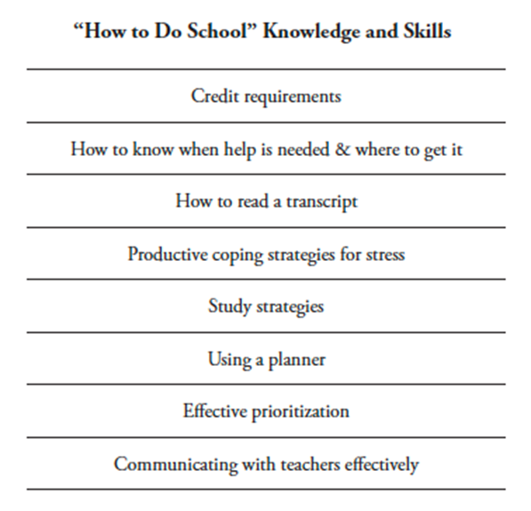
ACTIVITY: CLASSWIDE MATRIX
Plan Class-Wide Teaching Matrix
Plan how you will involve staff and students in developing classwide expectations and identifying critical skills for success (e.g., focus groups/surveys to identify common concerns)
In what classroom contexts/routines (in-person & virtual) are errors often made?
Align "How to Do School" skills with class-wide expectations
Add items to your Action Plan as necessary
Teams 20 min
Discussion:
How does your school address classroom level expectations? By department? By teacher?
Notes:
Workbook p. 71

Slide 28
FOLLOW THESE KEY STEPS
Define
Teach
Prompt
Monitor
Evaluate

Slide 29
TEACHING CLASSROOM EXPECTATIONS
Teach
Teach most intensively to 9th graders
Vet with staff, upperclassmen, and families
Consider surveying upperclassmen and 10th grade teachers to get input on what’s most important
Engage students in developing the matrix and teaching each lesson
Align with broader school expectations
Are there similar efforts or initiatives in place to align with?

Slide 30
FOLLOW THESE KEY STEPS
Define
Teach
Prompt
Monitor
Evaluate

Slide 31
PROMPTING APPROPRIATE BEHAVIOR
Use pre-corrections, which include “verbal reminders, behavioral rehearsals, or demonstrations of rule-following or socially appropriate behaviors that are presented in or before settings were problem behavior is likely” (Colvin, Sugai, Good, Lee, 1997).
Provide students with visual prompts (e.g., posters, illustrations, etc).
Discussion:
How can staff be supported in prompting & pre-correcting behavior in the classroom?

Slide 32
FOLLOW THESE KEY STEPS
Define
Teach
Prompt
Monitor
Evaluate

Slide 33
MONITOR & REINFORCE
Monitor
We’ll plan a reinforcement system next month!
When a student gets something desirable following a behavior, that behavior is strengthened and more likely to occur again
Examples:
If a student is given verbal praise for persisting with a difficult assignment, the student is likely to persist on later difficult assignments
If a student is removed from the classroom after refusing to do a difficult assignment, the student will likely act up later when he does not want to (or cannot) complete work

Slide 34
FOLLOW THESE KEY STEPS
Define
Teach
Prompt
Monitor
Evaluate

Slide 35
EVALUATE THE EFFECT OF INSTRUCTION
Evaluate
Collect data
Are rules being followed?
If there are errors,
who is making them?
where are the errors occurring?
what kind of errors are being made?
Summarize data (look for patterns)
Use data to make decisions

Slide 36
DISCUSSION: TEACHING EXPECTATIONS
What is currently in place to orient 9th graders/first year students to the school, and how high school is “done” (e.g., orientation, peer mentors)?
What types of problems/mistakes do 9th graders typically have/make? How could we prevent the most common areas of difficulty?
How can we involve staff and upperclassmen in teaching expectations?
Prepare to share 1-2 big ideas with the whole group
Random groups
10 minutes
Notes:
TRAINERS – Discussion prompts are below; allow 10 min for discussion in randomized/mixed breakout groups, then share out/debrief as a whole group
What is currently in place to orient 9th graders to the school and how high school is “done”? (e.g. orientation, peer mentors, etc.)
What types of problems/mistakes do 9th graders typically have/make? How could we prevent the most common areas of difficulty?
How can we involve staff and upperclassmen?

Slide 37
AGENDA & FOLLOW-UP
Presentation Content:
Review: Coaching Team Meetings
Review: Team Implementation Checklist (TIC)
Preview: Teaching Class-Wide Expectations (Step #5)
Coaches’ Tasks:
Review Team Implementation Checklist (TIC) & Action Plan
Consider surveying staff to identify top concerns
What questions do you have on today’s content?
What questions do you have on the follow-up tasks?

Slide 38
JANUARY TEAM MEETING
Team Tasks:
Work with staff (and students) to draft Expectations & Routines for the Classroom
Presentation Content:
Review TIC & update Action Plan
Step #5: Teaching Class-wide Expectations
Update Action Plan with priorities from TIC

Slide 39
RESOURCES
READINGS
Supporting & Responding to Student Behavior
RESOURCE
Team Implementation Checklist
Notes:
Links:
https://www.pbis.org/resource/supporting-and-responding-to-behavior-evidence-based-classroom-strategies-for-teachers
https://www.pbis.org/resource/high-school-acknowledgement-systems
https://www.pbis.org/resource/pbis-team-implementation-checklist-tic-3-1

Slide 40
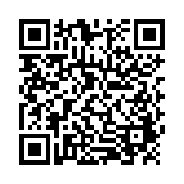
EVALUTION
Please remember to complete the evaluation to receive your PDPs!
Scan the QR code to access.
Notes:
TRAINERS -
Put link to evaluation (below) in the chat for those who do not use the QR code:
https://uconn.co1.qualtrics.com/jfe/form/SV_5BXYIXLvg0qmSzP

