Slide 1
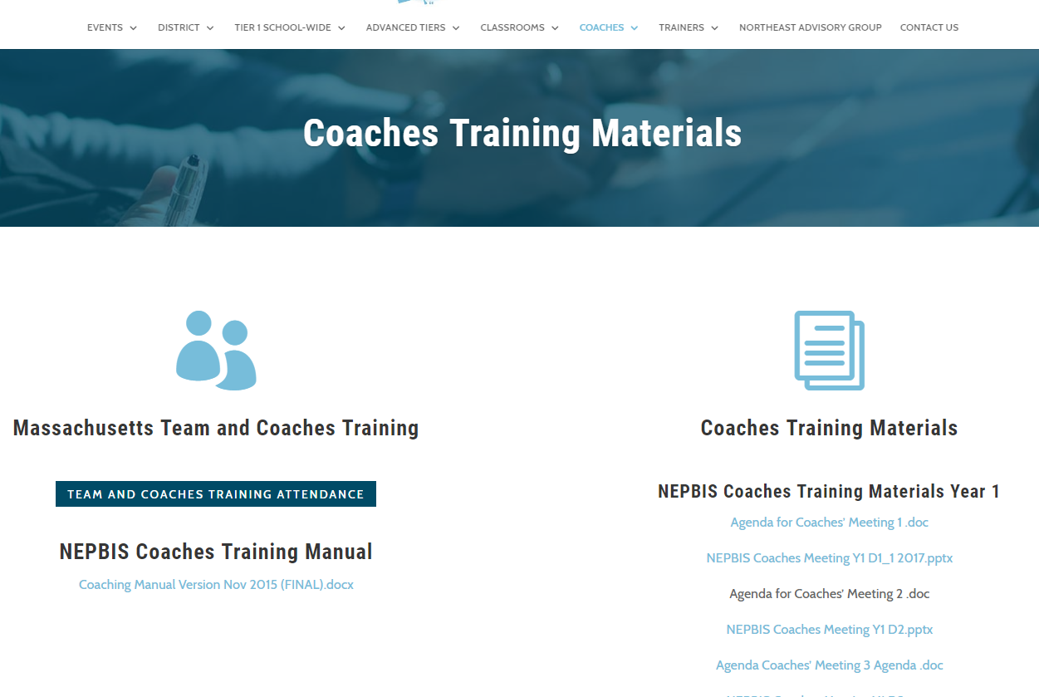
Welcome to YEAR 2 of PBIS TEAM Training!
As you wait for the training to begin, please:
Update your display name in Zoom to read: [Your School], [Your Name] (e.g., Eastside HS, Joe Clark)
This will help us create breakout rooms!
Pull up your current action plan
Enter your attendance by following the hyperlink or through nepbis.org

Slide 2
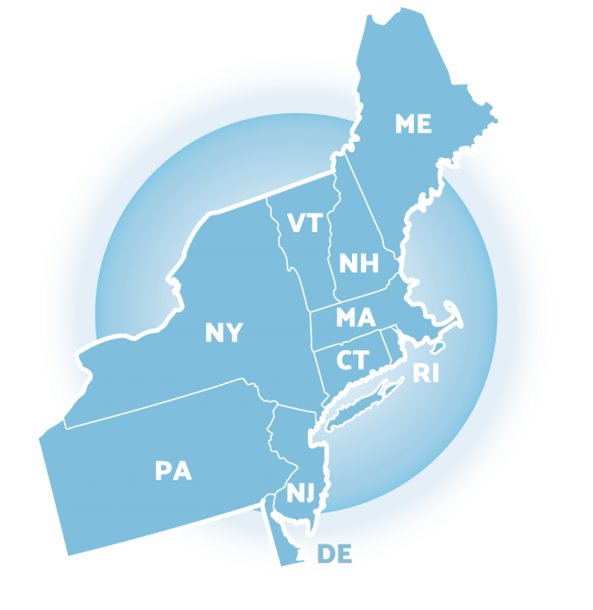
NEPBIS School-Wide Team Training Year 2: December
[Insert Trainer Names]
with support from Brandi Simonsen, Jen Freeman, Susannah Everett,
Adam Feinberg & Katie Meyer
Notes:
Add trainer names for your event

Slide 3
TODAY’S AGENDA & TASKS
Presentation Content
Integration & Alignment of PBIS
Team Tasks
Revisit Working Smarter Matrix
School-Family Partnerships
Complete School-Family Practices Survey

Slide 4
LEGEND
Discussion
Poll
Activity
&
Positive & Negative Examples
Preview

Slide 5
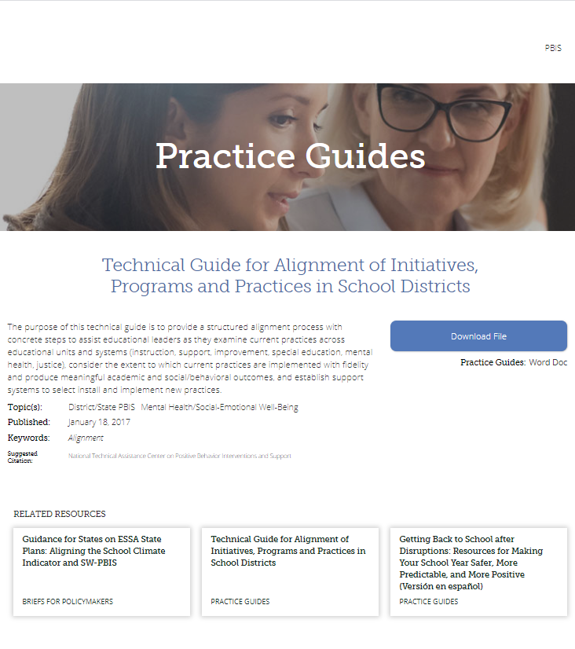
ADDITIONAL READINGS & RESOURCES
READINGS:
PBIS & Family Support
Technical Guide for Aligning Programs
RESOURCES:
Integration & Alignment Mini Module
PBIS & SEL as Essential Life Skills Video
Stakeholder Input & Satisfaction Survey (SISS)
Notes:
Reading Links:
https://www.pbis.org/topics/family
https://www.pbis.org/resource/technical-guide-for-alignment-of-initiatives-programs-and-practices-in-school-districts
Resource Links:
https://www.youtube.com/watch?v=VNZnu1tyd84&feature=youtu.be
https://nam10.safelinks.protection.outlook.com/?url=https%3A%2F%2Fwww.pbis.org%2Fvideo%2Fsocial-emotional-learning-cultivating-essential-life-skills&data=02%7C01%7Cadam.feinberg%40uconn.edu%7C430b0ff879574e89d60908d848ef5710%7C17f1a87e2a254eaab9df9d439034b080%7C0%7C1%7C637339540081615050&sdata=j%2B2Ki4ezXykKZC1oa9kya1n2tq3RMW3MMXyG0dfkZYA%3D&reserved=0
http://www.pbiscaltac.org/resources/pfc after school/Family and Stakeholder Satisfaction Survey.pdf

Slide 6
EXPECTATIONS
Self
Others
Environment
Self-monitor (Are you participating? Engaged as a learner?)​
Mute when listening; unmute to talk​
Have your computer charged and ready to go​
Stretch, break, stand as needed​
If you have questions or comments, unmute, use the chat box, or click the "raise hand" icon
Work as a team (room for every voice, reinforce participation)
Keep necessary materials at hand (e.g., action plan & other docs, water, snacks, etc.)​

Slide 7
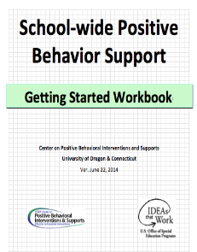
TOOLS
WEBSITES
School-Wide PBIS Workbook & Appendices
Action Plan
nepbis.org
pbis.org
pbisapps.org

Slide 8
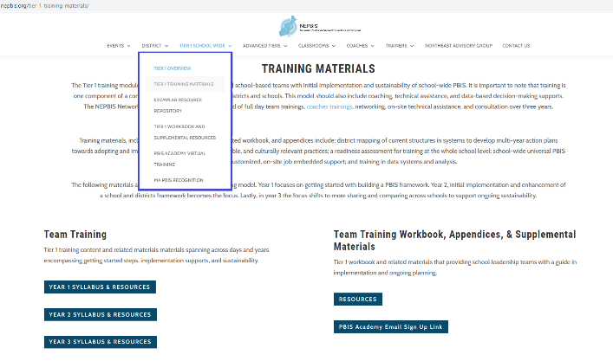
NEPBIS.ORG

Slide 9
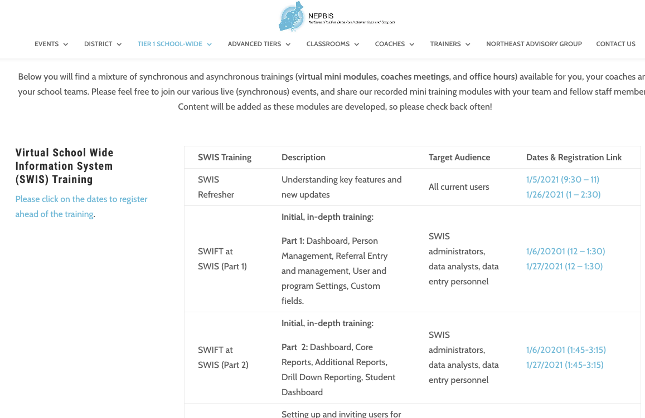
SWIS Training Events
You can find the available dates and registration links here:
https://nepbis.org/pbis-academy-virtual-training-page/
Notes:
TRAINER NOTE: The virtual training page has our current schedule of state wide SWIS training events. Please inform your coaches and teams about this opportunity. They can register for these trainings through the hyperlinked dates. Please have them register ahead of time, so we know that there are attendees and we can hold the training sessions.
Please the link to the chat: https://nepbis.org/pbis-academy-virtual-training-page/

Slide 10
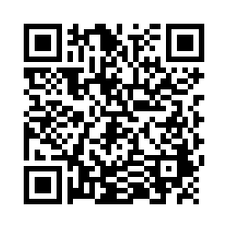
ACTIVITY: ATTENDANCE
Scan QR code on the left or follow the URL posted in the chat to access the online attendance survey
Follow prompts to enter attendance information
Notify trainers if you require assistance (e.g., identifying your cohort or cohort group)
1 minute
You are in Cohort 6
Notes:
TRAINERS – Update cohort group on slide.
Post a link to the attendance survey (below) in the chat for those who do not use the QR code on the slide:
https://uconn.co1.qualtrics.com/jfe/form/SV_cvz67c35MhUrElT

Slide 11
DISCUSSION: BACK TO BASICS
Connect
What adaptations has your team made to core systems and practices to support students and staff in the current context?
Have there been changes to the data your team uses to guide decision-making?
Prepare to share one idea from your group.
Monitor
Screen
Positive, Predictable, & Safe Learning Environments
Teach
Support
Randomized Breakouts
5 minutes
Notes:
TRAINERS – Discussion prompts are below; allow 5 minutes in breakouts.
What adaptations has your team made to core systems and practices to support students and staff in the current context?
Have there been changes to the data your team uses to guide decision-making?
Prepare to share one idea from your group.

Slide 12
POLL: CLASSROOM/VIRTUAL LEARNING MATRIX
On a scale of 0-2, how developed is your classroom/ virtual learning routines matrix?
0 – Not Yet Started
1 – In Progress
2 – Developed
How do you plan to get input from stakeholders on revisions to your matrix (e.g. teachers, other staff, students, families)?
Notes:
Poll: On a scale of 0-2, how developed is your classroom/ virtual learning routines matrix?
0 – Not yet started
1 – In progress
2 – Developed

Slide 13
CHECK IN: PBIS IN THE CLASSROOM
In randomized groups, brainstorm ideas for supporting positive classroom practices based on the Supporting & Responding to Behavior guide and/or discussions last month.
Take notes on your school’s virtual action plan.
Prepare to present 1 “big idea” from your group when we return to the larger group.
Randomized Breakouts
15 minutes
Notes:
TRAINERS: Set up randomized breakout groups; allow 15 minutes. Prompts below:
In cross school randomized groups, brainstorm ideas for supporting positive classroom practices based on the Supporting & Responding to Behavior guide and/or discussions last month.
Take notes on your school’s virtual action plan.
Prepare to present 1 “big idea” from your group when we return to the larger group.

Slide 14
INTEGRATION & ALIGNMENT WITH PBIS FRAMEWORK

Slide 15
BIG IDEAS: WHY ALIGN?
Use one coherent implementation framework to align competing initiatives for the current context and avoid repeatedly shifting focus to new initiatives.
Articulate and simplify message so district, community/school leaders and staff see a coherent framework and can support an overall improvement strategy
Use the PBIS/MTSS core features as the guiding principles of the proactive/preventative approach.

Slide 16
ALIGNING INITIATIVES, PROGRAMS, & PRACTICES
1. Define the valued outcome(s).
2. List related initiatives.
3. Identify core system features.
4. Analyze and make decisions for alignment.
5. Design the plan for effective alignment.
View
Technical
Guide on pbis.org
National TA Center on PBIS. (2017). Technical guide for alignment of initiatives, programs, practices in school districts. Eugene, OR: Retrieved from www.pbis.org
Notes:
There are 5 steps to take when thinking about Aligning initiatives.
Define your valued outcomes – Like a Positive School Culture
List your related initiatives – Like PBIS, SEL, Bully Prevention
Identify core system features – Such as Teaching Lessons or Acknowledging students
Analyze and make decisions - How to combine PD Events
And plan for effective alignment – like combining teams and outcomes.
If you're interested in learning more about integration and alignment, you can download and read the "Technical guide for Alignment" on PBIS.org
You can use section 5C in your getting started workbook for more information.

Slide 17
WORKING SMARTER TEAM MATRIX
Initiative/ Committee | Purpose | Outcome | Target Group | Staff Involved | SIP/SID/ Etc.
Attendance Committee
SEL Team
STEM team
School Spirit Committee
Discipline Committee
Restorative Practices Team
PBS Team
Review and revise your Working Smarter Team Matrix!
How is your PBIS Team aligned or integrated with other school programs?
What are some related initiatives in your school?
(Unmute or enter in chat)
1. Define the valued outcome(s).
2. List related initiatives.
Notes:
The working Smarter Team Matrix is a valuable tool to revisit as a first step towards aligning initiatives.
Start by reviewing or recreating your list of all the initiatives taking place in your school.
Really take the time to identify the purpose and outcomes for each initiative.
The last column, where you indicate the School or District Improvement Plan Goals, is especially helpful in deciding which initiatives align.

Slide 18
SAMPLE WORKING SMARTER MATRIX
Initiative, Committee | Purpose | Outcome | Target Group | Staff Involved | SIP/SID
Attendance Committee | Increase attendance | Increase % of students attending daily | All students | Eric, Ellen, Marlee | Goal #2
SEL Initiative | Increase Social Emotional skills | Increased use of self and relationship management skills by students – Fewer office referrals | All students | Marlee, J.S., Ellen | Goal #3
STEM Academic Support Team | Improve STEM academic grades | Increase the number of students passing math and science | Students Failing or in danger of failing STEM Classes | Kim, Mary, Beth, Rick | Goal #1
School Spirit Committee | Enhance school spirit | Improve morale | All students | Has not met
Discipline Committee | Improve behavior | Decrease office referrals | Bullies, antisocial students, repeat offenders | Ellen, Eric, Marlee, Otis | Goal #3
Restorative practices | Improve behavior | Decrease referrals and exclusionary consequences | All students | Don | Goal #3
PBIS Initiative | Implement 3-tier model | Decrease office referrals, increase attendance, enhance academic engagement, improve grades | All students | Eric, Ellen, Marlee, Otis, Emma | Goal #2 Goal #3

Slide 19
ALIGNING INITIATIVES, PROGRAMS, & PRACTICES
1. Define the valued outcome(s).
2. List related initiatives.
3. Identify core system features.
4. Analyze and make decisions for alignment.
5. Design the plan for effective alignment.
Notes:
There are 5 steps to take when thinking about Aligning initiatives.
Define your valued outcomes – Like a Positive School Culture
List your related initiatives – Like PBIS, SEL, Bully Prevention
Identify core system features – Such as Teaching Lessons or Acknowledging students
Analyze and make decisions - How to combine PD Events
And plan for effective alignment – like combining teams and outcomes.
If you're interested in learning more about integration and alignment, you can download and read the "Technical guide for Alignment" on PBIS.org
You can use section 5C in your getting started workbook for more information.

Slide 20
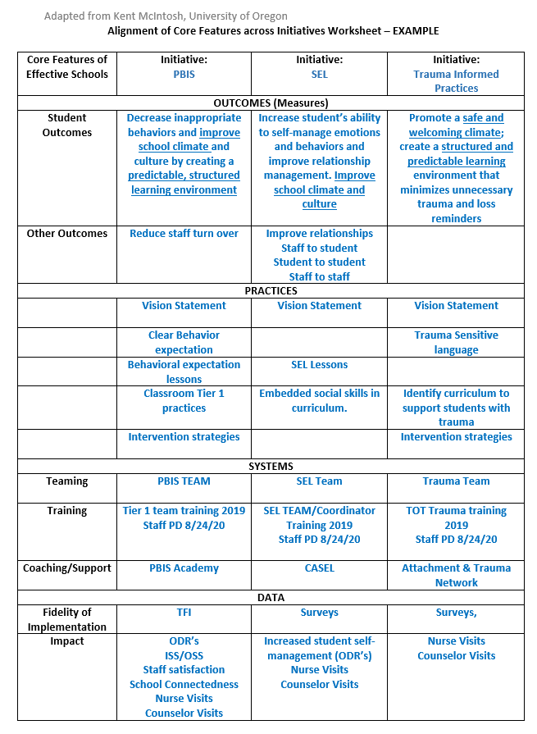
3. Identify core system features.
Notes:
Alignment Worksheet: https://nepbis.org/wp-content/uploads/2018/11/Alignment-Activity-1.docx

Slide 21
ALIGNING INITIATIVES, PROGRAMS, & PRACTICES
1. Define the valued outcome(s).
2. List related initiatives.
3. Identify core system features.
4. Analyze and make decisions for alignment.
5. Design the plan for effective alignment.
Notes:
There are 5 steps to take when thinking about Aligning initiatives.
Define your valued outcomes – Like a Positive School Culture
List your related initiatives – Like PBIS, SEL, Bully Prevention
Identify core system features – Such as Teaching Lessons or Acknowledging students
Analyze and make decisions - How to combine PD Events
And plan for effective alignment – like combining teams and outcomes.
If you're interested in learning more about integration and alignment, you can download and read the "Technical guide for Alignment" on PBIS.org
You can use section 5C in your getting started workbook for more information.

Slide 22
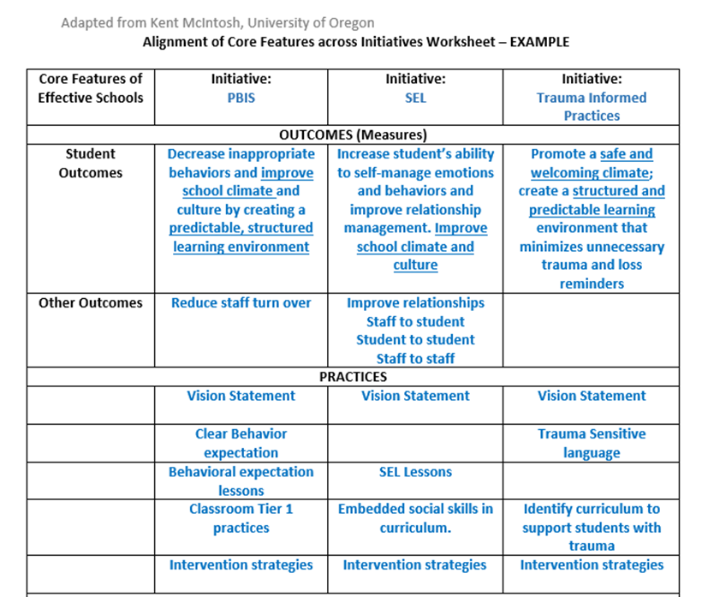
4. Analyze and make decisions for alignment.
5. Design the plan for effective alignment.
Notes:
List the Initiatives and the Outcomes for each
Wherever you can, on the worksheet align the practices so you can see where they overlap.
3 have a vision statement. (we don’t need 3 separate statements but rather 1 that encompasses all 3 initiatives.)
We can also see other areas that overlap such as lessons and intervention strategies.

Slide 23
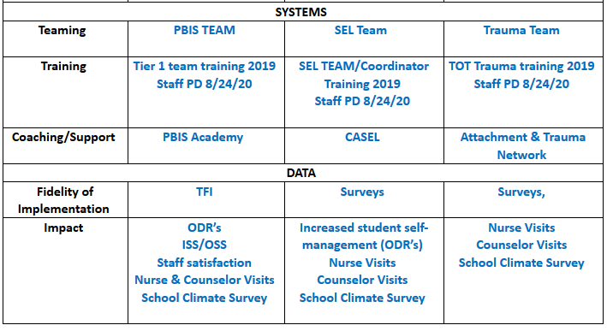
Notes:
The next area to consider are Systems and Data –
You’ll want to list the team that was created for the initiative.
Can the be combined? Revisit your working smarter matrix and see if most of the same people are on all 3 committees.
Next think of the training for staff -
Can we create staff PD that covers all 3 topics so that staff understand their interconnectedness?
Finally, consider what Fidelity and outcome data you will use to determine fidelity and effectiveness.
Here you can see that Nurse and counselor visits and the school climate survey will be outcome measures for all 3 initiatitves

Slide 24
PBIS FRAMEWORK & SEB CROSSWALK
Poll:
Does your school have universal SEL practices (e.g., a curriculum such as Second Step, restorative practices, Responsive Classroom)?
Yes
No
Not Sure
Expectation | Specific Behavior or Social Emotional Skill
Be Safe | Keep hands and feet to self
 | I tell an adult when I am worried about a friend.
Be Respectful | Use the signal to ask a public or private question.
 | Make sure everyone gets a turn.
Be Responsible | Turn in all work on time
 | Check in with my feelings during the day
*SEB = Social, Emotional, & Behavioral
Notes:
Poll:
Does your school have universal SEL practices (e.g., a curriculum such as Second Step, restorative practices, Responsive Classroom)?
Yes
No
Not Sure
Once you complete your worksheet of where initiatives align, you’ll want to begin integrating content and practices where possible
Specific behaviors are important and necessary, but we are also addressing social competency with all our students.

Slide 25
Teaching Matrix |  | INCORPORATE Coping Strategies for Managing Stress
 |  | All Settings | Hallways | Playgrounds | Lunch | Library/ Computer Lab | Assembly | Bus
Expectations | Respectful | Be on task. Give your best effort. Be prepared. | Walk. | Have a plan. | Invite those sitting alone to join in | Study, read, compute. | Sit in one spot. | Watch for your stop.
 | Achieving & Organized | Be kind. Hands/feet to self. Help/share with others. | Use normal voice volume. Walk to right. | Play safe. Include others. Share equipment. | Have a lunch plan and choose quiet or social lunch area | Whisper. Return books. | Listen/watch. Use appropriate applause. | Use a quiet voice. Stay in your seat.
 | Responsible | Recycle. Clean up after self. | Pick up litter. Maintain physical space. | Use equipment properly. Put litter in garbage can. | Use my breathing technique Listen to my signals | Push in chairs. Treat books carefully. | Pick up. Treat chairs appropriately. | Wipe your feet.
Notes:
If dealing with stress and anxiety became a major priority in school, the team can develop strategies and skills and incorporate them into their social curriculum
- it would be a matter of teaching skills to students. – the matrix is the delivery mechanism to get skills out to EVERYONE!!! It’s the common language and script use to teach, acknowledge, pre-correct
This allows all staff to use the same approach for teaching and supporting across the school day and throughout the year.

Slide 26
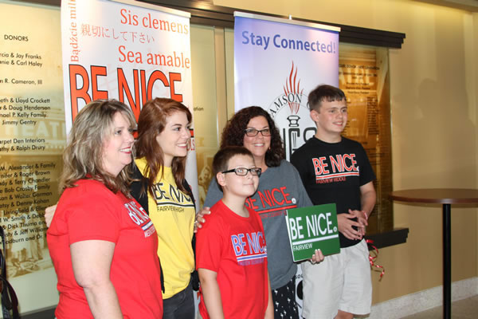
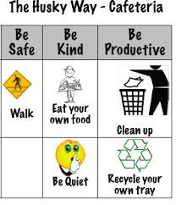
TEACHING EXPECTATIONS FOR STUDENTS
Kick-off events
Teaching staff, students and families the
expectations and rules
On-going Direct Instruction
Data-driven and scheduled designed lessons
Pre-correction
Re-teaching immediately after behavioral errors
Embedding into curriculum
Booster trainings
Scheduled and data-driven
Continued visibility
Visual Displays – posters, agenda covers
Daily announcements
Newsletters
Notes:
Continue to integrate across the core features
At your Kickoff events Booster Trainings
Throughout your ongoing Direct instruction to students
Embedded into the academic curriculum
And through all visibility avenues like displays and posters, daily announcements, on Social media etc...

Slide 27
INTEGRATION ACROSS CORE FEATURES: EXPECTATIONS
Infraction = |  | Failure to Comply |  | Inappropriate Language |  | Tardiness
Linked SW Expectation |  | Responsible |  | Respectful and Reflective |  | Responsible
What You Want The Student To Do |  | Timely cooperation with instructions & directions |  | Use words that are appropriate to express the sentiment (e.g., considerate, polite, kind, professional, etc.) |  | Be in seat when the bell rings
Social and Emotional Skill Options to Teach |  | Asking for help Active listening Paraphrasing understanding Managing frustration (e.g., positive self-statements or deep breaths) |  | Stop-think-act Managing disappointment Turning the conversation Making a complaint Reframing negative thoughts |  | Managing transition time Planning ahead Self monitoring Using conversation enders (e.g., ‘catch you later’)
In partnership with NJDOE OSE funded by IDEA funds - Part B 2018-2019

Slide 28
INTEGRATION ACROSS ACTIVITIES
Content Area | Examples of How the Teacher Embedded Social and Emotional Skills Into the Curriculum
Math | SW Expectation: Responsibility SEL Sub Competency: Identify and apply ways to persevere School-Wide Instruction Theme ‘Stick With It’: Mrs. Smith has her students generate two strategies for how to be persistent when faced with challenging math work.
Science | SW Expectation: Respectful SEL Sub Competency: Utilize positive communication and social skills to interact positively with others School-wide Instruction Theme ‘It Takes Two’: Ms. Pelaez teaches her students the principles of cooperation and working together to achieve a goal during lab work.
In partnership with NJDOE OSE funded by IDEA funds - Part B 2018-2019

Slide 29
GUIDELINES: EFFECTIVE ALIGNMENT
Organizational Level
Professional Development
Outcome Measures
Systems
Align multiple initiatives where common budget authority exists
Build aligned PD by comparing & combining core features of initiatives
Compare fundamental assumptions
Start with common “core features” & compare practices used to achieve these features
Determine how to incorporate additional core features efficiently
Build single PD curriculum that combines core features
Align multiple initiatives by using common measures to assess effectiveness
Logic Model
Resolve any logic model conflict
Notes:
Follow these guidelines to effectively align and integrate your initiatives.
Always start at the organizational level if possible – Can or does the same person have administrative and budget authority over the various initiatives? This can help to avoid redundancies in trainers, repetitive tasks, staffing and resources.
Use your Working Smarter matrix to align your common outcomes and outcome measures
Align and integrate the common core features into your practices and PD to be as efficient as possible with your time and resources.
Finally Resolve Logic Model Conflicts – Examine how everything flows together and resolve any issues where procedures might diverge. - such as one initiative might use Tangible reinforcers while another stresses only verbal feedback - work with your team to come up with a collaborative workable protocol or solution

Slide 30
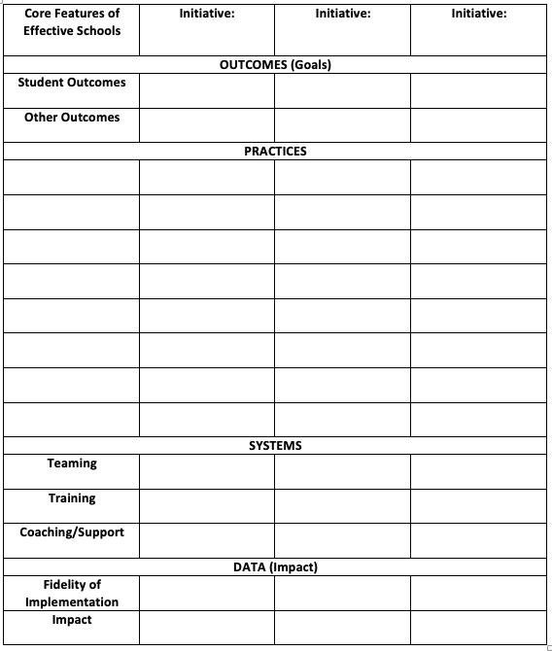
ALIGNMENT WORKSHEET RESOURCE
Available on nepbis.org
Notes:
https://nepbis.org/wp-content/uploads/2018/11/Alignment-Activity-1.docx

Slide 31
ACTIVITY: INTEGRATION & ALIGNMENT
Review Integration & Alignment Activity
Consider additional resources you may need to be able to address this in your school.
Review Working Smarter Matrix to align teams where necessary.
What action steps are necessary to begin this work?
Add relevant items to your action plan or adjust as needed.
Teams
15 minutes
Notes:
Integration & Alignment worksheet: https://nepbis.org/wp-content/uploads/2018/11/Alignment-Activity-1.docx
Working Smarter Matrix template: https://nepbis.org/wp-content/uploads/2020/09/Working-Smarter-Activity.docx

Slide 32
SCHOOL – FAMILY PARTNERSHIPS
Supported by
Andrew Garbacz

Slide 33
WHAT DOES FAMILY ENGAGEMENT LOOK LIKE?
Families and educators coordinating and collaborating to support children
Embedded in cultural beliefs and ideologies
Active, interactive, and dynamic
Active: Equal partners in planning, decision-making, and implementation
Interactive: Work with other stakeholders
Dynamic: Changes over time
Eccles & Harold; Epstein & Dauber, 1991; Fette et al., 2009; Garbacz (in press); Hill, 2010; Leverson, Smith, McIntosh, Rose, & Pinkelman, 2016; Sheridan, Clarke, & Christenson, 2014; Sheridan, Rispoli, & Holmes, 2014
Notes:
At its core, family engagement involves families and educators coordinating and collaborating to support children. The focus is on coordinating goals and activities across home and school. Collaboration includes families and educators making decisions together and working as partners.
Family engagement is embedded in cultural beliefs and ideologies. Families have different beliefs about education and their role in supporting their child. Part of working together as partners is clearly defining role expectations in a manner that is congruent with family culture and expectations.
Family engagement is active, interactive, and dynamic.
When families are engaged as partners, there is an expectation that family members and educators are active in making plans, setting goals, and carrying out activities to address goals.
Family engagement is also interactive. Collaboration involves working together as a team rather than in isolation.
Family engagement changes over time. Evidence indicates that family engagement is important for children, families, and schools in early childhood, elementary school, middle school, and through high school. However, the nature of how families and educators collaborate as children progress through school changes. For example, as children transition to middle school, families may provide less direct support for homework, but rather will establish systems that support their child to self-monitor during homework time with check-ins, and acknowledgements for appropriate behavior.

Slide 34
RESEARCH SUPPORTS FAMILY ENGAGEMENT
Student
Parents & Teachers
Achievement (Fan & Chen, 2001)
Attendance (Simon, 2001)
School drop-out (Barnard, 2004)
Social behavior (Fantuzzo, McWayne, Perry, & Childs, 2004; Garbacz & McIntyre, 2016)
Peer affiliations (Garbacz, Zerr, Dishion, Seeley, & Stormshak, in press)
Parent efficacy and competence (Semke, Garbacz, Kwon, Sheridan, & Woods, 2010; Sheridan et al., 2012)
Parent trust of teachers (Santiago, Garbacz, Beattie, & Moore, 2016)
Teachers improved job satisfaction and fewer transfer requests (Christenson, 1995)
Parent-teacher relationship (Sheridan et al., 2017)

Slide 35
KEY FAMILY ENGAGEMENT APPROACHES
Define family engagement at the school and district level that is linked to systems and practices
Improve proactive outreach to families and strengthen multidirectional communication
Differentiate approaches so all families can access information and engage
Assume that the most effective and efficient support for a student is from their family
Dishion (2011); Garbacz (in press); Horner (2017); Mapp & Hong (2010); Moore et al. (2016)
Notes:
Research results suggest support for a few key family engagement approaches.
One of the first things to focus on is creating support for family engagement at the district and school level. It is important to clarify the district’s approach to family engagement with role definitions for schools and families.
In addition, evidence indicates families typically wait for schools to contact them about working together. Thus, it is important for schools to reach out proactively to families to initiate a collaborative relationship. Such an approach is also an opportunity to establish communication pathways. Common approaches to communication include sending material or notices home to families (e.g., approval for a field trip) rather that establish communication systems that support multidirectional communication, or communication that can initiate from families or schools and flow easily back-and-forth.
We know that families differ with regard to their beliefs about education, expectations for schooling, and availability and motivation to collaborate. Thus, family engagement systems support activities and practices that provide a range of opportunities and experiences for families to collaborate. Logistically, this can include holding school events at community centers that may be easier for families to attend. It also means holding events at different times over months and years. Although such approaches require an investment in educator time, they reflect a commitment to working with all families in the school community.
Finally, collaborating with families is often viewed as something extra or an add-on that requires an investment in resources without an associated tangible benefit for students. However, the most efficient and effective support for students is their family. By organizing systems to support families use of evidence-based approaches at home with their children and through coordinating home and school supports, we can actually positively influence child development and promote academic, behavior, and life success.

Slide 36
APPROACHES TO FAMILY ENGAGEMENT IN PBIS
Engage families in PBIS at school
Support families to use positive behavior approaches at home
Coordinate practices across home and school
https://www.pbis.org/resource/supporting-families-with-pbis-at-home
https://www.pbis.org/resource/aligning-and-integrating-family-engagement-in-pbis
Notes:
There are several research informed approaches to engage families in PBIS. These approaches emphasize engaging families in PBIS at school, extending the core features of positive behavior support to the home setting, and coordinating support across home and school.
The next three slides describe each family engagement domain in depth.
If you would like to learn more after this session, you can download an e-book from pbis.org, ”Aligning and Integrating Family Engagement in Positive Behavioral Interventions and Supports.”
LINK: https://www.pbis.org/Common/Cms/files/pbisresources/Family%20Engagement%20in%20PBIS.pdf

Slide 37
DISCUSSION: FAMILY ENGAGEMENT STRATEGIES
Share strategies your school has used to:
Share information with families
Get input/feedback from families
Include families in decision-making, planning, implementation
Ensure ALL families are included in engagement efforts
Make changes based on input
Take notes and bring at least 1 idea back to your team
Randomized Breakouts
5 minutes
Notes:
TRAINERS – Discussion prompts are below; allow 5 minutes.
Share strategies your school has used to:
Share information with families
Get input/feedback from families
Include families in decision-making, planning, implementation
Ensure ALL families are included in engagement efforts
Make changes based on input
Take notes and bring at least 1 idea back to your team

Slide 38
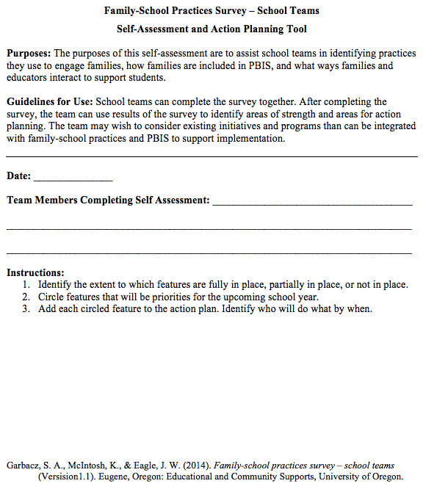
EXAMINING SCHOOL APPROACHES TO FAMILY ENGAGEMENT IN PBIS
The Family-School Practices Survey for School Teams is a self-assessment and action planning tool
Implementation of school approaches to family engagement are assessed across:
Communication
Family-School Activities
PBIS Practices at Home and School
Decision-Making/Shared-Ownership
Resources
Garbacz, McIntosh, & Eagle (2014)
Notes:
The family-school practices survey was designed for school teams to use as a self-assessment and action planning tool.
The tool allows school teams to rate implementation of school approaches to engaging families in PBIS across several dimensions
Dimensions on the tool include
Systems-level problem solving, which assesses team activities to promote family engagement
Data-based decision making
School-home communication about PBIS
Resources to support family engagement, and
PBIS practices at home and school
Take a few minutes to complete the self-assessment, identify areas of strength and need, and complete the action plan at the end of the tool to target areas of need that build on strengths
Link to assessment: https://uconn.co1.qualtrics.com/jfe/form/SV_4U9QPw9ASvLr83z

Slide 39
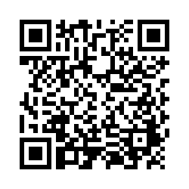
ACTIVITY: FAMILY ENGAGEMENT STRATEGIES
Review all content
Complete and use the Family-School Practices Survey (use QR code →)
Add 2 to 3 items to your action plan based on priorities discussed while completing the survey
Identify one person who will present big ideas from action planning for your group
Teams
20 minutes
Notes:
Link to Family School Practices Survey: https://uconn.co1.qualtrics.com/jfe/form/SV_4U9QPw9ASvLr83z

Slide 40
TODAY’S AGENDA & TASKS
What questions do
you have on today’s
content?
Presentation Content
Integration & Alignment of PBIS
Team Tasks
Revisit Working Smarter Matrix
School-Family Partnerships
Complete School-Family Practices Survey
What questions do
you have on today’s
follow-up team tasks?

Slide 41
ADDITIONAL READINGS & RESOURCES
READINGS:
PBIS & Family Support
Technical Guide for Aligning Programs
RESOURCES:
Integration & Alignment Mini Module
PBIS & SEL as Essential Life Skills Video
Stakeholder Input & Satisfaction Survey (SISS)
Notes:
Reading Links:
https://www.pbis.org/topics/family
https://www.pbis.org/resource/technical-guide-for-alignment-of-initiatives-programs-and-practices-in-school-districts
Resource Links:
https://www.youtube.com/watch?v=VNZnu1tyd84&feature=youtu.be
https://nam10.safelinks.protection.outlook.com/?url=https%3A%2F%2Fwww.pbis.org%2Fvideo%2Fsocial-emotional-learning-cultivating-essential-life-skills&data=02%7C01%7Cadam.feinberg%40uconn.edu%7C430b0ff879574e89d60908d848ef5710%7C17f1a87e2a254eaab9df9d439034b080%7C0%7C1%7C637339540081615050&sdata=j%2B2Ki4ezXykKZC1oa9kya1n2tq3RMW3MMXyG0dfkZYA%3D&reserved=0
http://www.pbiscaltac.org/resources/pfc after school/Family and Stakeholder Satisfaction Survey.pdf

Slide 42
PREVIEW: JANUARY AGENDA & TASKS
Presentation Content
Team Tasks
Tiered Fidelity Inventory (TFI)
Equity, Implicit Bias, VDPs, & Neutralizing Routines
Cultural Responsiveness (CR) Tool
Identify Potential VDPs
Notes:
TRAINER NOTE: TFIs will be scheduled in February.
Links:
https://www.pbis.org/resource/tfi
https://www.pbis.org/resource/pbis-cultural-responsiveness-field-guide-resources-for-trainers-and-coaches
https://nepbis.org/wp-content/uploads/2020/08/ib-worksheets-2015-4-9.pdf

Slide 43
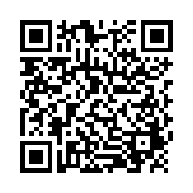
EVALUTION
Please remember to complete the evaluation to receive your PDPs!
Scan the QR code to access.
Notes:
TRAINERS -
Put link to evaluation (below) in the chat for those who do not use the QR code:
https://uconn.co1.qualtrics.com/jfe/form/SV_5BXYIXLvg0qmSzP

