Slide 1
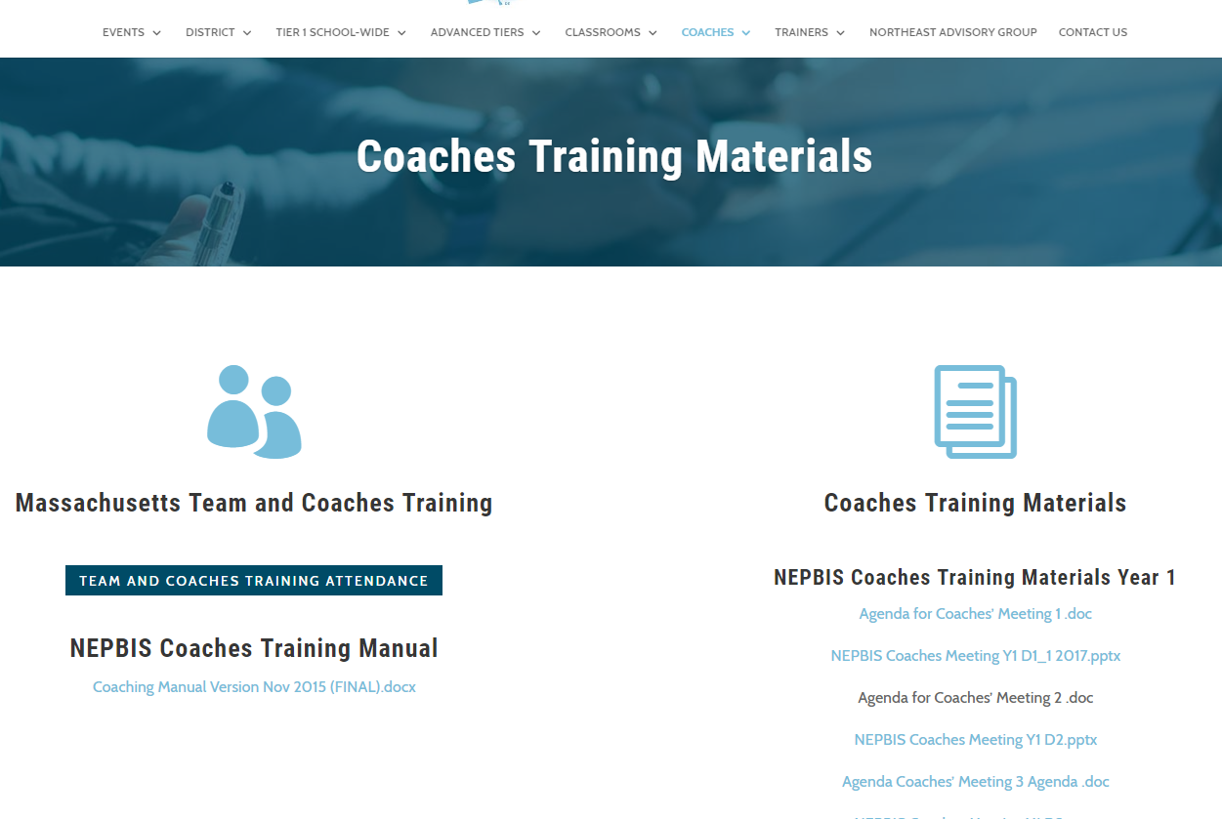
Welcome to PBIS Team Training FOR HIGH SCHOOLS!
As you wait for the training to begin, please:
Update your display name in Zoom to read: [Your School], [Your Name] (e.g., Eastside HS, Joe Clark)
This will help us create breakout rooms!
Pull up your current action plan
Enter your attendance by following the hyperlink or through nepbis.org

Slide 2
RECORDING OF SESSIONS
We anticipate that throughout the year, all team members may not always be able to attend all trainings.
At the end of each month we'll post a recorded version of the content of this training session. Individuals who are not able to attend this session can view the recorded content at a time that is convenient to them.

Slide 3
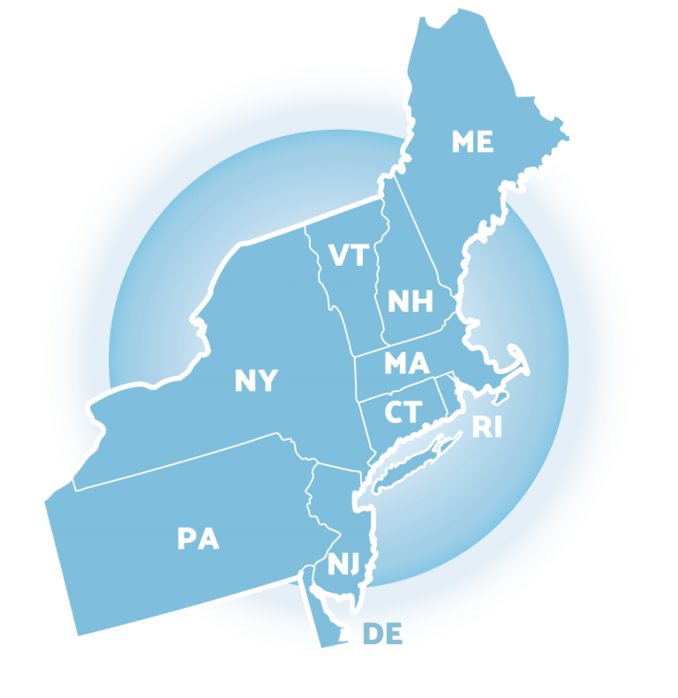
NEPBIS School-Wide Team Training Year 1: November
[INSERT TRAINER NAMES]
with support from Brandi Simonsen, Jen Freeman, Susannah Everett,
Adam Feinberg & Katie Meyer
Notes:
Trainers: refer to training manual for:
Tips on presenting the overview content
Explanation for short activity periods and ideas for teaching this to teams
Ideas for facilitating review and team action planning

Slide 4
Agenda & Team Tasks
Presentation Content
Overview of SWPBIS (Part 2)
Team Tasks
Develop a Statement of Purpose
Getting Started with SWPBIS (steps 2-4)
Develop a statement of purpose
Identify school wide expectations
Develop teaching procedures
Develop school wide expectations
Develop teaching matrix
Develop home matrix plan

Slide 5
EXPECTATIONS
Self
Others
Environment
Self-monitor (Are you participating? Engaged as a learner?)​
Mute when listening, unmute to talk​
Have your computer charged and ready to go​
Stretch, break, stand as needed​
If you have questions or comments, unmute, use the chat box, or click the "raise hand" icon
Work as a team - room for every voice, reinforce participation
Keep necessary materials at hand (e.g., action plan & other docs, water, snacks, etc.)​

Slide 6
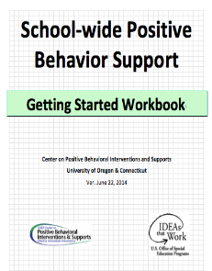
TOOLS
WEBSITES
School-Wide PBIS Workbook & Appendices
Action Plan
nepbis.org
pbis.org
pbisapps.org

Slide 7
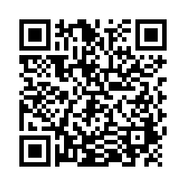
ACTIVITY: ATTENDANCE
Scan QR code on the left or follow the URL posted in the chat to access the online attendance survey
Follow prompts to enter attendance information
Notify trainers if you require assistance (e.g., identifying your cohort or cohort group)
1 minute
Notes:
TRAINERS –
Post a link to the attendance survey (below) in the chat for those who do not use the QR code on the slide:
https://uconn.co1.qualtrics.com/jfe/form/SV_cvz67c35MhUrElT

Slide 8
Poll: What is the state of your team?
Is your team representative of your school and community?
Which of the following groups are represented on your team?
Teachers across departments/ grade levels
Administration
Related staff
Students
Families
Community leaders/mental health providers
Notes:
Poll:
Which of the following groups are represented on your team?
Teachers across departments/ grade levels
Administration
Related staff
Students
Families
Community leaders/mental health providers

Slide 9
ACTIVITY: DISCUSSION
What is the state of our leadership team?
What other members should we invite (e.g., students, parents, mental health provider)?
Are there other school teams that we should consider coordinating with (e.g., SEL, School Climate)?
What items do we need to add to our action plan?
Teams
5 minutes

Slide 10
SWPBIS Overview (Part 2)

Slide 11
Collecting stakeholder input to guide our work helps with...
Staff buy in
Ensuring our supports reflect each member of our school community (students, parents, community members).
Ensuring different perspectives and cultural values are considered.
Respond in the chat!
Outside of team members, what stakeholder groups are important to solicit input from?

Slide 12
Staff Buy-In
Effective Messenger(s)
Buy-in!
Effective
Team…
Staff
Info & Drafts
Feedback
…powered
by Data
Effective Leadership
Notes:
Trainer Note:
Key message: Information should flow both ways (from team to staff AND from staff to team) and reliable systems may need to be built to support communication.
It is important that leadership teams are sharing information and plan drafts with the larger school community (staff, students, families) to solicit their input prior to implementation. A little time invested in advance on these tasks may delay implementation a bit, but will save a great deal of time in modification and implementation changes later.

Slide 13
Identify the social/emotional/ behavioral priorities of your school community with these surveys:
Students
(School Climate Survey)
Families
(School Climate Survey)
(Family / Community Survey)
Staff
(Self-Assessment Survey)
Notes:
TRAINER NOTE: SAS and School Climate surveys reviewed with Coaches in Oct but will be new to teams.

Slide 14
ACTIVITY: TEAM DISCUSSION
How will you collect information from important stakeholder groups to inform your work?
Who are your important stakeholder groups?
What information do you want from these groups?
How will you obtain it? What venues will work for them?
Teams
5 minutes

Slide 15
GETTING STARTED WITH SWPBIS
Establish an effective leadership team
Develop a continuum to strengthen appropriate behaviors
Develop a brief statement of purpose
Develop a continuum to discourage violations of expectations
Identify positive school-wide behavior expectations
Develop data-based procedures for monitoring
Develop procedures to teach school-wide expectations
Develop systems to support staff
Develop procedures to teach class-wide expectations
Build routines to ensure ongoing implementation

Slide 16
Step 2: DEVELOPING A STATEMENT OF PURPOSE

Slide 17
GUIDELINES FOR PURPOSE STATEMENT
Positively stated
2 to 3 sentences in length
Comprehensive in scope (all students, staff, & settings)
Practices
01
02
03
04
Supportive of academic achievement & social, emotional, and behavioral health

Slide 18
Purpose Statement
Purpose Statement
Action Plan Outcome Goals
SIP/ DIP
Working Smarter Matrix (e.g. resource allocation)
College & Career Readiness
Consider the following when developing your purpose statement.
What do you hope to achieve by implementing PBIS in your building?
Notes:
SIP = School Improvement Plan

Slide 19
EXAMPLES
NON-EXAMPLES
Ensure all students develop the behavioral, social, and emotional skills to be effective learners through the implementation of evidence-based interventions and use of data to inform decisions.
&
Our school will rock.
We will have a positive climate.
We will improve the school
What does that mean?
To develop and implement universal systems and interventions supporting the academic and social success of each student.

Slide 20
ACTIVITY: BEHAVIORAL PURPOSE STATEMENT
Draft School-Wide Behavioral Purpose Statement
Add items to your Action Plan as necessary
Present 1-2 “big ideas” from your group (1 min. reports)
Teams
10 minutes
Notes:
Draft School-Wide Behavioral Purpose Statement
Add items to your Action Plan as necessary
Present 1-2 “big ideas” from your group (1 min. reports)

Slide 21
Continuum of School-Wide Instructional & Positive Behavior Support
Tertiary Prevention:
Specialized
Individualized
Systems for Students with High-Risk Behavior
Primary Prevention:
School-/Classroom-
Wide Systems for
All Students,
Staff, & Settings
~5%
receive
~20%
receive
Secondary Prevention:
Specialized Group
Systems for Students with At-Risk Behavior
How are students and staff grouped in your building? Which group of students tend to need the most support?
~100% of Students (receive)*
(*Breen 2019 - Adapted from OSEP National PBIS Center)
Notes:
Key Points
-Many of you have probably seen this triangle before. It’s the same triangle we see when talking about Response to Intervention (RTI), Multi-tiered Systems of Support (MTSS), AND Positive Behavioral Interventions and Supports (PBIS). It’s ALL THE SAME TRIANGLE using ALL THE SAME PRINCIPLES.
-We presume that if we provide evidence-based intervention (whether academic or behavioral), to ALL students, that at least 80% of students should respond and need no further intervention. We call this Tier I, School wide, or universal intervention.
-But, we know that there will be a portion of the population, around 15%, who will need more specialized intervention. NOTE….they’ll still be getting that Tier I intervention, but we may provide an additional exposure to that Tier I intervention or maybe provide a short-term group to address the need. Once the students show they don’t need the additional layer of intervention anymore, that intervention is peeled away and they continue to get the Tier I.
-Yet, there will always be a smaller part of the population who may need more intensive, more individualized intervention. We assume that this will be about 5% of the population. This population with “tier III needs” will receive: the Tier I interventions, the Tier II interventions, AND their own individualized intervention. Once they show that they don’t NEED the Tier III intervention anymore, that layer is peeled away, and so on.
NOTICE GREEN GOES IS FOR “ALL”
Marathon – all runners have the same chance of winning the race? (some come to the race with more training and support behind them…these are usually the winners)
Tier 1 - 100% of total runners
We give All runners have access some basic support: Water, Gatorade, bathrooms and first aide
Tier 2 - 20% of total runners
Some runners need more support such as a Support Runner or a Guide Runner…they offer verbal cues or a tether to support a runner who might have visual or other physical impairment.
Tier 3 - 5% of total runners
A few runners might need a racing wheelchair or running chair that is pushed by someone else.
We should be and ARE as excited for the first person as we are for the 20000th person who crossed the finish line.
We don’t disparage anyone for using a chair or guide runner…we are impressed they could do it! We are impressed by runners who seem less fit or physically able finishing the race…because it is clearly harder for them to compete and finish, but they persevered. We need to have the same attitude towards students who struggle. We must find a way to help them overcome their challenges and succeed, no matter how many supports they need.

Slide 22
Why Focus on Ninth Grade?
Highest rates of ODRs, academic (course) failures, and attendance problems
Performance in ninth grade can determine whether a student graduates from or drops out of high school
Increased unemployment (8.2% for dropouts vs. 5.6% for graduates)
Over a lifetime, high school dropouts cost taxpayers an average of $292,000, while high school graduates make an average contribution of $287,000
Early prevention can improve outcomes for at-risk students
(Kato, Flannery, Triplett, & Saeteurn, 2018; Sum et al., 2009, 2011; https://blogs.uoregon.edu/freshmensuccess/; www.bls.gov/news.release/empsit.t04.htm)
Notes:
SIP = School Improvement Plan

Slide 23
Why Freshmen: FACT or FICTION?
9TH GRADE IS A CRITICAL YEAR
ALL STUDENTS STRUGGLE
ACADEMIC AND BEHAVIOR
1. Research indicates that students are twice as likely to fail a class in 9th grade than in any other grade.
FICTION – 3-5x MORE LIKELY
2. In a large multi-school study, 15% of students performing in the top quartile of their 8th grade class were found to be off track by the end of their 9th grade year.
FICTION – 25% OF HIGH ACHIEVING STUDENTS
3. The national SWIS dataset demonstrates that 9th grade behavioral infractions in high schools across the country dramatically outnumber those of students in the upper grades.
FACT
4. Lower attendance during the first 30 days of 9th grade is a stronger indicator that a student will drop out than any other 8th grade predictor, including test scores, other indicators of academic achievement, and age.
FACT
5. Students who fall behind in 9th grade have a 30% lower graduation rate than students who are able to stay on track during the 9th grade year.
FICTION – 58% LOWER GRAD RATE

Slide 24
FACT or FICTION References
Southern Regional Educational Board. (2002). Opening doors to the future: Preparing low achieving middle grade students to succeed in high school. Atlanta, GA: Author.
Allensworth, E. M., & Easton, J. Q. (2005). The on-track indicator as a predictor of high school graduation. Chicago, IL: Consortium on Chicago School Research. Retrieved from www.consortium-chicago.org/publications/p78.html
Flannery, K. B., Fenning, P., McGrath Kato, M., & Bohanon, H. (2013). A descriptive study of office disciplinary referrals in high schools. Journal of Emotional Behavior Disorders, 21, 138-149. doi: 10.1177/1063426611419512
Jerald, C. D. (2006). Dropping out is hard to do: Issue Brief. Center for Comprehensive School Reform and Improvement. Washington, DC. Retrieved from www.cenerforsci.org/files/CenterIssueBriefJune06.pdf
Allensworth, E. M., & Easton, J. Q. (2007). What matters for staying on track and graduating in Chicago Public High Schools. Chicago, IL: Consortium on Chicago School Research. Retrieved from http://ccsr.uchicago.edu/content/publications.php?pub_id=116

Slide 25
PROTECTIVE FACTORS FOR FRESHMEN
Connection to School
Understand Key Knowledge & Skills
Positive Relationships with Teachers & Staff
Positive Relationships with Peers
(https://blogs.uoregon.edu/freshmensuccess/)

Slide 26
Focus on Freshmen
Increase consistent implementation of PBIS
Emphasize effective classroom management
Teach skills needed for success
Teaching expectations, acknowledging appropriate behavior
Greet students at the door, use pre-corrections, maintain ratio of 4:1, establish routines for classroom activities, maintain consistent expectations
Getting work done, getting to graduation, getting connected
Utilize upperclasssmen
Review disaggregated data regularly
Especially attendance, behavior (esp. skip & tardy), and course performance (credit accrual, GPA, etc.)
To act as peer coaches, help with orientation activities, assist with homework, test prep, etc.
Kato, Flannery, Triplett, & Sueteurn, 2018

Slide 27
DISCUSSION
What is currently in place to support Freshmen?
How can your team enhance or build upon those supports as you develop your PBIS framework?
What needs to happen in order to align supports (e.g., conversations, action planning, etc.)?
Whole Group
5 minutes

Slide 28
Step 3: IDENTIFY POSITIVE SCHOOL-WIDE BEHAVIOR EXPECTATIONS
Practices

Slide 29
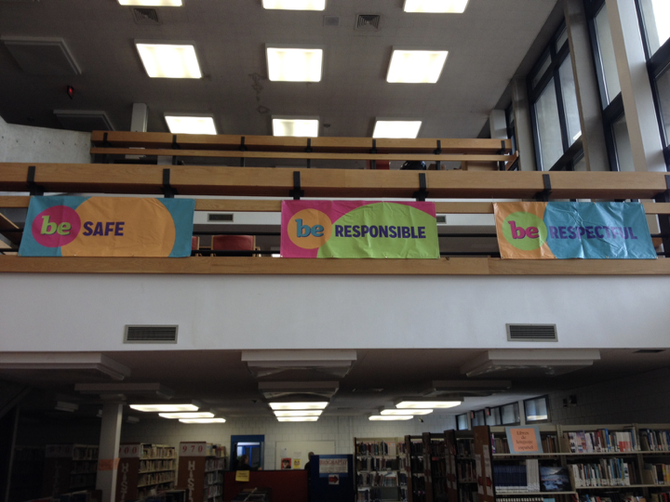
REDESIGN LEARNING & TEACHING ENVIRONMENTS
NO Food
NO Weapons
NO Drugs
NO Backpacks
NO Smoking
NO Bullying

Slide 30
GUIDELINES FOR EXPECTATIONS
PRACTICES
Linked to social culture of school
Appropriate cultural and contextual fit
Considerate of social skills that already exist
3-5 in number
1-3 words per expectation
Positively Stated
Supportive of academic achievement
Comprehensive in scope
Mutually exclusive (minimal overlap)

Slide 31
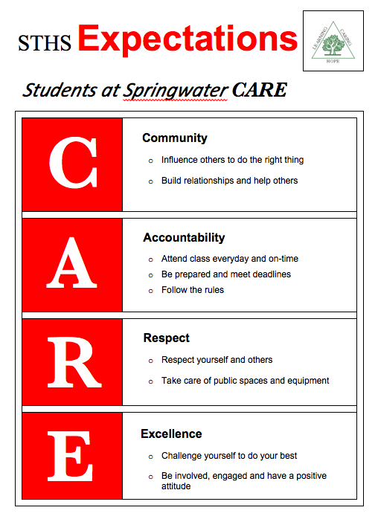

Slide 32
ACTIVITY: BEHAVIORAL EXPECTATIONS
Draft School-Wide Behavior Expectations
Add items to your Action Plan as necessary
Present 1-2 “big ideas” from your group (1 min. reports)
Teams
10 minutes
Notes:
Trainers: Provide this activity assuming time permits. If you are short on time, you can combine this with the Teaching Matrix activity.
Draft School-Wide Behavior Expectations
Add items to your Action Plan as necessary
Present 1-2 “big ideas” from your group (1 min. reports)
Workbook pg. 60

Slide 33
Step 4: DEVELOP PROCEDURES TO TEACH SCHOOL-WIDE EXPECTATIONS
Practices

Slide 34
Define
Teach
Prompt
Monitor
Evaluate
KEY STEPS

Slide 35
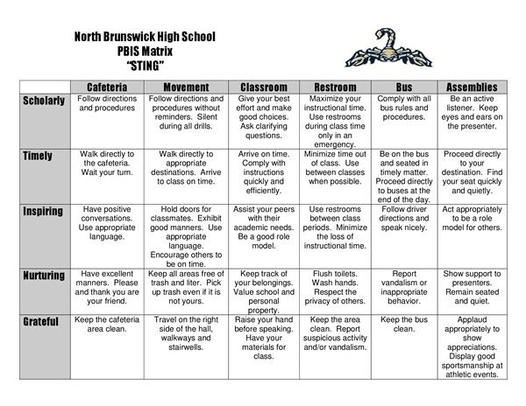
Behavioral Expectations
Define
Operationally define what expectations look like across all the routines and settings in your school.
One way to do this is in a matrix format.

Slide 36
Teaching Matrix |  | SETTING
 |  | All Settings | Hallways | Playgrounds | Cafeteria | Library/ Computer Lab | Assembly | Bus
 | Respect Ourselves | Be on task. Give your best effort. Be prepared. | Walk. | Have a plan. | Eat all your food. Select healthy foods. | Study, read, compute. | Sit in one spot. | Watch for your stop.
 | Respect Others | Be kind. Hands/feet to self. Help/share with others. | Use normal voice volume. Walk to right. | Play safe. Include others. Share equipment. | Practice good table manners | Whisper. Return books. | Listen/watch. Use appropriate applause. | Use a quiet voice. Stay in your seat.
 | Respect Property | Recycle. Clean up after self. | Pick up litter. Maintain physical space. | Use equipment properly. Put litter in garbage can. | Replace trays & utensils. Clean up eating area. | Push in chairs. Treat books carefully. | Pick up. Treat chairs appropriately. | Wipe your feet. Sit appropriately.
2. NATURAL CONTEXT
1. SOCIAL SKILL
3. BEHAVIOR EXAMPLES

Slide 38
PBIS + College and Career Readiness (CCR)
Use expectations to directly promote the non-academic skills critical for ensuring all students are CCR
Develop or modify existing matrix & teaching protocols to emphasize relationship between CCR & expectations
Critical Thinking
Engagement
Mindset
Learning Processes
Interpersonal Engagement
Transition Knowledge

Slide 39
 | Cafeteria | Hallway | Bus | Classrooms
Respect |  | Keep your locker locked |  | Complete assignments with a professional appearance Have goals and a plan to achieve them
Responsibility | Monitor your lunch account Use technology productively & positively |  |  | Be attentive and ready to learn Keep track of missed assignments and have a plan to make them up
Be Informed |  |  | Know and use safety procedures Cross at crosswalks | Use course/ reading content to answer questions Self monitor your learning by asking clarifying questions
Ready to Succeed
EXPECTATIONS
ROUTINES
Embed examples of CCR skills in matrix across settings
Add an expectation focused on CCR

Slide 40
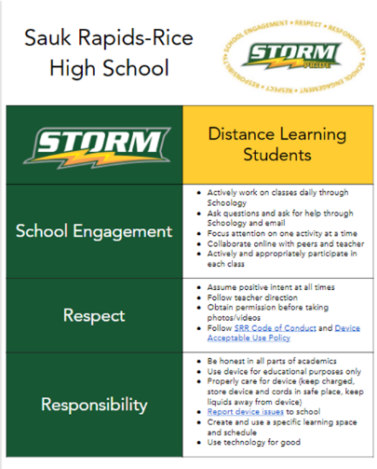
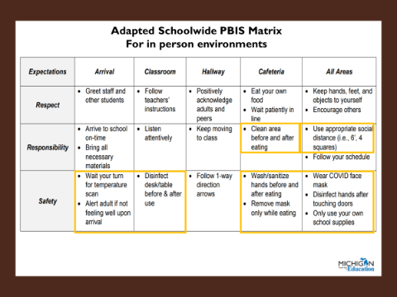

Slide 41
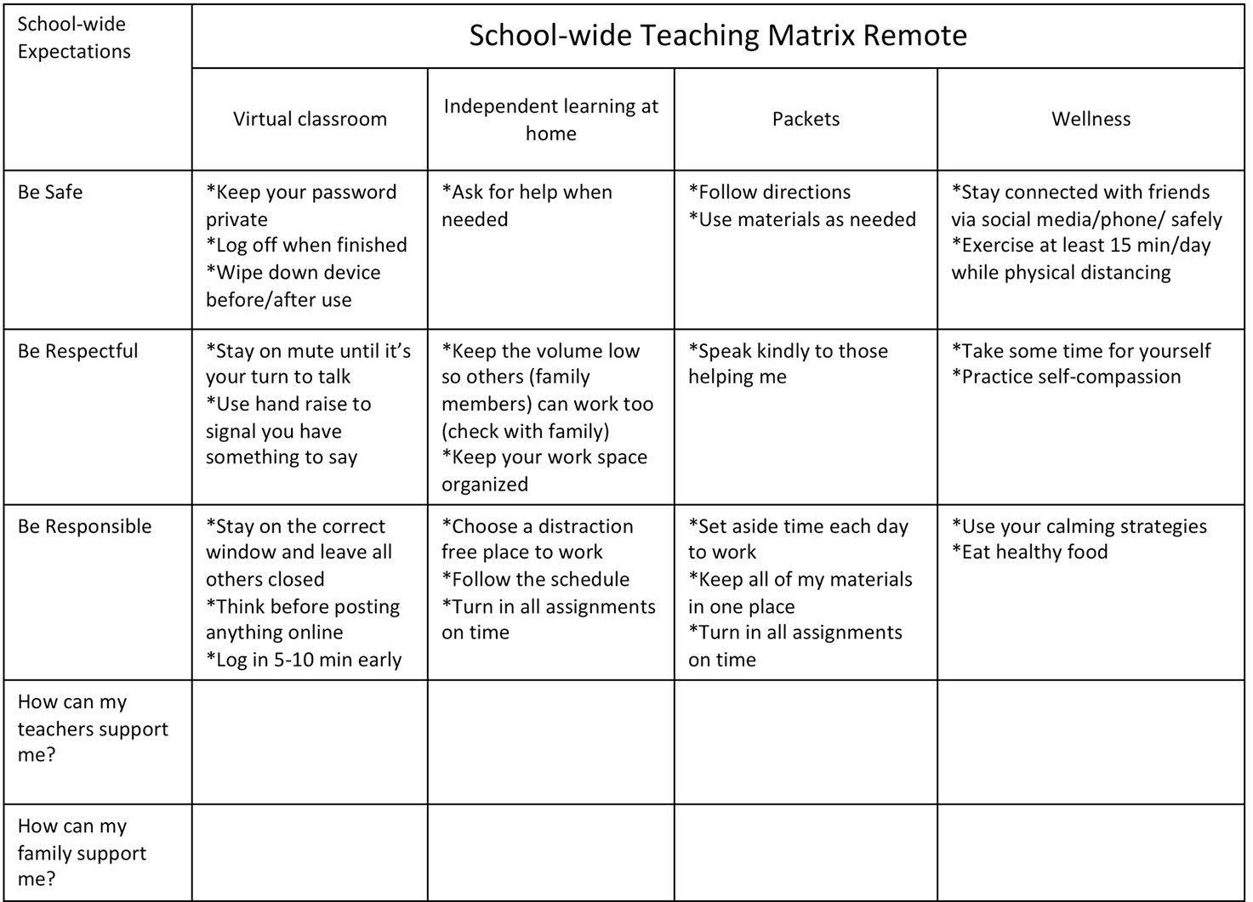
Adapted for remote instruction

Slide 42
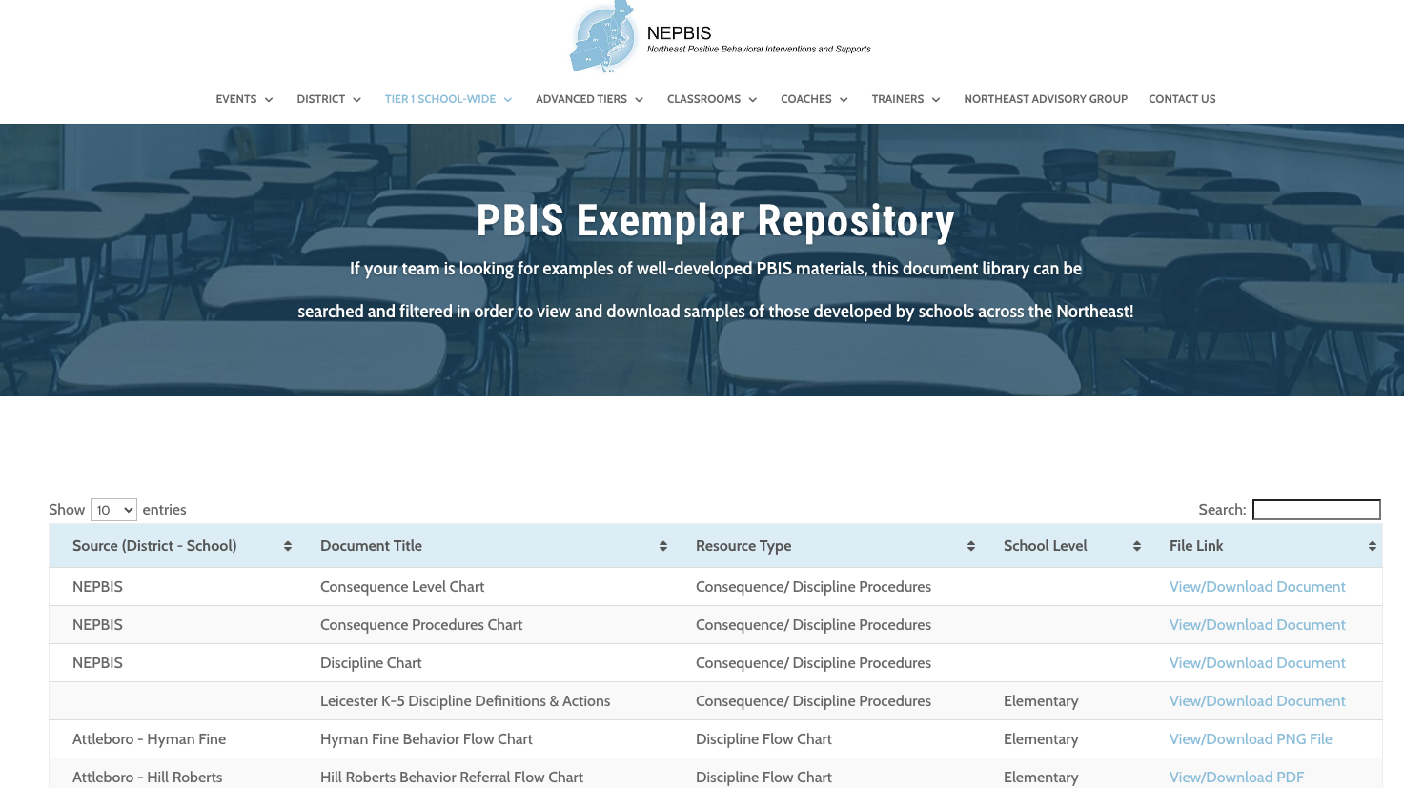
For more examples drawn from schools across the state, check out the
Exemplar Repository
Includes examples of teaching matrices, lesson plans, recognition systems, discipline flow charts, etc.

Slide 43
ACTIVITY: BEHAVIORAL EXPECTATIONS
Draft School-Wide Teaching Matrix
Write in your school-wide expectations
Identify typical settings/contexts in your school
Identify 1-2 observable, measurable, and positively stated behaviors for each cross-section
Add items to your Action Plan as necessary
Present 2-3 “big ideas” from your group (1 min. reports)
Teams
15 minutes
Notes:
https://nepbis.org/wp-content/uploads/2020/09/Teaching-Matrix-Activity.docx
Draft School-Wide Teaching Matrix
Write in your school-wide expectations
Identify typical settings/contexts in your school
Identify 1-2 observable, measurable, and positively stated behaviors for each cross-section
Add items to your Action Plan as necessary
Present 2-3 “big ideas” from your group (1 min. reports)
Workbook pg. 64

Slide 44
Here is an opportunity to get input from important stakeholders!
Have our implicit biases impacted our schoolwide expectations?
Do our expectations reflect the cultural values of the surrounding community?
Do expectations and specific rules serve a legitimate purpose within the setting, as opposed to simply tradition or maintaining the status quo?
How can we involve staff and students in developing expectations?
Notes:
TRAINER NOTE: Use this to introduce the topic of soliciting input from stakeholders.

Slide 45
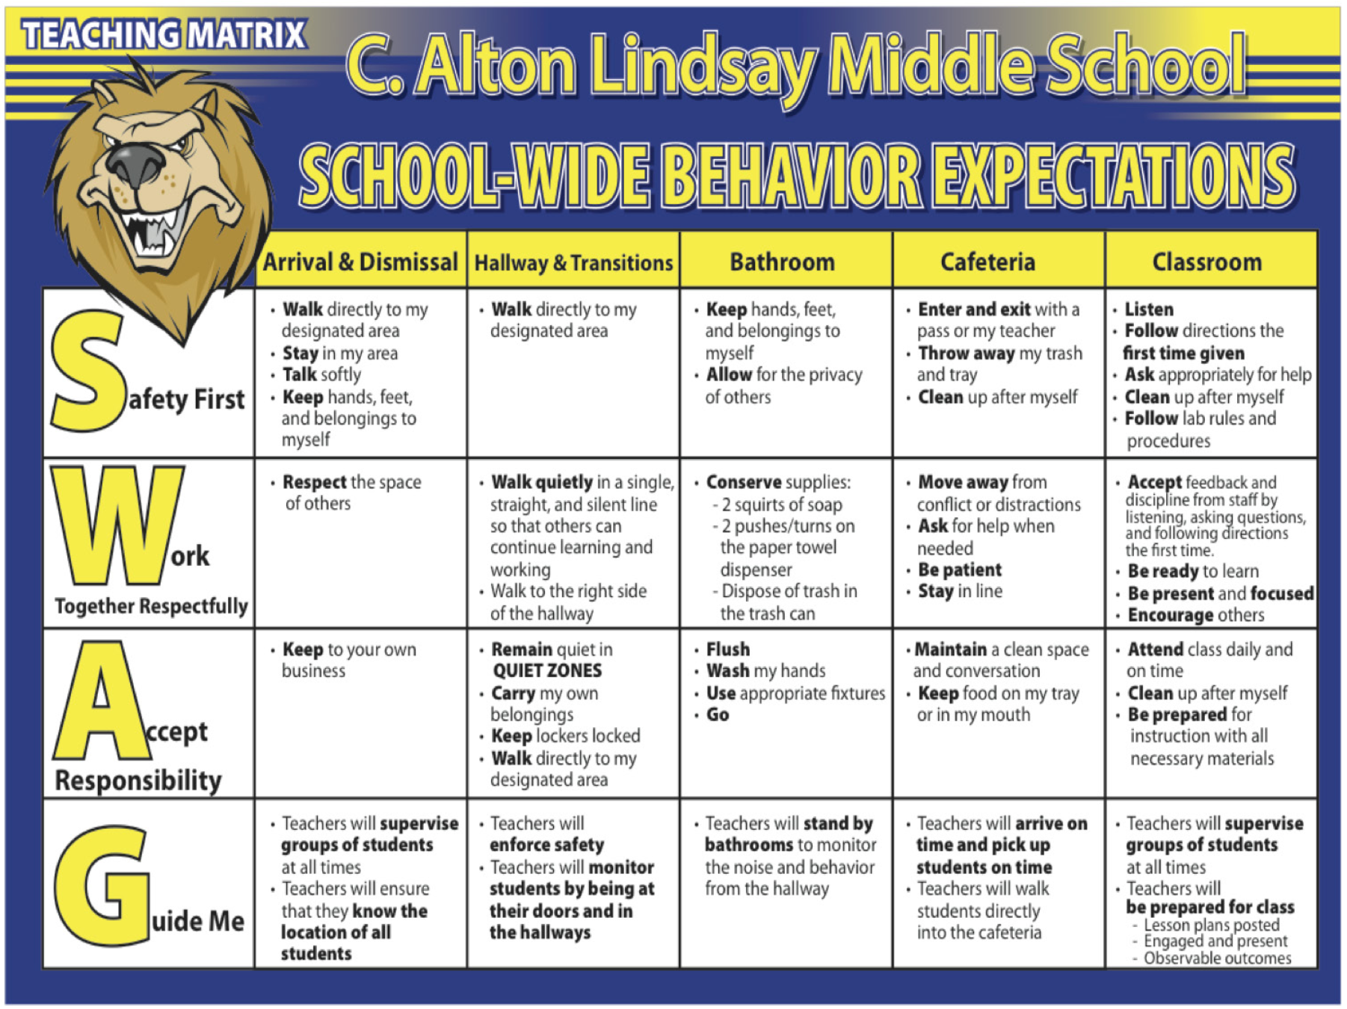
Lindsay Middle School incorporated student feedback and language into their SW matrix.
Includes how staff will support students
Notes:
Note the changes in expectations based on student input. Especially the GUIDE ME section that includes expectations for staff to follow supporting students.

Slide 46
Consider a student activity similar to the existing school-wide behavior matrix
“The Tweak”
Take school expectations and have students:
Apply expectations to their home setting
2. Apply expectations to their community
Obtaining
Student
Voice!
Notes:
Consider implementing the following activity with students in your school, either a selected class, subsection, or with the entire student body, as a way to ensure expectations are meaningful to students and incorporate student perspective into the development of your school’s teaching matrix.

Slide 47
Expectation | At SCHOOL it looks like… | At HOME it looks like… | In my NEIGHBORHOOD it looks like…
Be Safe | Keep hands and feet to self Tell an adult if there is a problem | Protect your friends and family Don’t talk back | Stick up for your friends Don’t back down Keep an eye out
Be Respectful | Treat others how you want to be treated Include others Listen to adults | Do exactly what adults tell you to do Don’t stand out Don’t bring shame | Text back within 30 seconds Be nice to friends’ parents Share food
Be Responsible | Do my own work Personal best Follow directions Clean up messes | Help your family out first Own your mistakes Share credit for successes | Have each other’s backs Own your mistakes Check in about what to do
Provides the opportunities for students to:
articulate their expectations at home & community
discuss similarities & differences
Notes:
Here is a sample completed matrix in perfect comic sans writing

Slide 48
Considering Students’ Personal Matrix
For the differences between school and other settings, are the “different” school rules necessary for positive student development?
NO
YES
Change the rules to align more with home and neighborhood
Acknowledge explicitly and provide additional teaching, practice, and acknowledgment
Notes:
Trainer Note: Here is a process for addressing discrepancies between school based and personal matricies.

Slide 49
EXAMPLE
Are the different school rules necessary for positive student development?
YES: Acknowledge explicitly and provide additional teaching, practice, and acknowledgment

Slide 50
EXAMPLE
Are the different school rules necessary for positive student development?
NO: Change the rules to align more with home and neighborhood

Slide 51
A tool for identifying student voice & integrating into school and classroom expectations and routines:
V
A
B
B
Validation
legitimizing aspects of students’ cultures that have historically been seen as illegitimate by the dominant culture.
Affirmation
explicitly acknowledging the worth of students’ cultures and learning histories.
Building
providing specific instruction regarding why certain student behaviors are necessary in certain school settings.
Bridging
giving the student opportunities to practice and build fluency in school behaviors, with performance feedback.
Notes:
Youtube video: https://www.youtube.com/watch?v=eAx7-9TPatQ
Validation
legitimizing aspects of students’ cultures that have historically been seen as illegitimate by the dominant culture, including intentionally allowing time and space for cultural aspects within the school day
Affirmation
explicitly acknowledging the worth of students’ cultures and learning histories. If rap music is an aspect of student culture at a school, affirmation requires harnessing and capitalizing on the communication, creativity, and spontaneity of the music.
Building
providing specific instruction regarding why certain student behaviors are necessary in certain school settings. Strategies for building include teaching expectations in each setting instead of assuming students know them, teaching code-switching, and describing unwanted behaviors as “not for school” as opposed to wrong.
Bridging
giving the student opportunities to practice and build fluency in school behaviors, with performance feedback.

Slide 52
Steps for a Personal Matrix Activity
Ask students about the purpose of expectations.
Ask students to write down multiple examples of how their friends expect them to behave.
Ask students to share similarities and differences in expectations across settings.
Review the school-wide expectations and specific examples with students.
Ask students to write down multiple examples of following each of the expectations at home.
Develop a continuum to strengthen appropriate behaviors
Develop a continuum to discourage violations of expectations
Notes:
Trainer Note: Here is a suggested set of steps for teams to collect student input on the teaching matrix.

Slide 53
ACTIVITY: PERSONAL MATRIX
Review the steps to the Personal Matrix activity. Plan when and how you could complete this activity with students to inform the development of your school matrix.
Add items to your Action Plan as necessary
Teams
10 minutes
Notes:
Review the steps to the Personal Matrix activity. Plan when and how you could complete this activity with students to inform the development of your school matrix.
Add items to your Action Plan as necessary
Cultural Responsiveness Field Guide (pg. 44) https://assets-global.website-files.com/5d3725188825e071f1670246/5d70468ef10ca28bb416e7b0_pbis%20cultural%20responsiveness%20field%20guide.pdf

Slide 54
AGENDA & FOLLOW-UP
Overview of SWPBIS (Part 2)
Team Tasks:
Develop a Statement of Purpose
Presentation Content:
Getting Started with SWPBIS (steps 2-4)
Develop a statement of purpose
Identify school wide expectations
Develop teaching procedures
Develop school wide expectations
Develop teaching matrix
Develop home matrix plan
What questions do you have on today’s content?
What questions do you have on the follow-up tasks?

Slide 55
ADDITIONAL READINGS & RESOURCES
Readings
VABB (Validate, Affirm, Building, Bridging, Page 47-49).
VABB Definitions
PBIS & CCR (Chapter 5 of monograph)
Creating a Matrix for Remote Instruction
Investing in Freshmen: Providing Preventive Support to 9th Graders (Ch 6)
Resources
Mini module on behavioral expectations
Personal / Home Matrix (page 44 – 44)
VABB Video (Wisconsin RTI Center)
Notes:
https://www.pbis.org/resource/school-climate-survey-suite

Slide 56
PREVIEW OF NEXT TEAM MEETING
Presentation Content
Overview of SWPBIS (Part 3)
Team Tasks
Revisit SW Matrix
Systems to support staff
Getting Started with SWPBIS (Step 4)
Teaching SW expectations
Write a sample SW lesson plan
Establish procedures for teaching SW expectations
Plan how to present and get feedback from staff on your work!
Complete the TIC

Slide 57
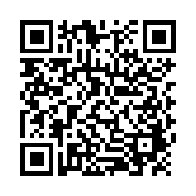
EVALUTION
Please remember to complete the evaluation to receive your PDPs!
Scan the QR code to access.
Notes:
TRAINERS -
Put link to evaluation (below) in the chat for those who do not use the QR code:
https://uconn.co1.qualtrics.com/jfe/form/SV_5BXYIXLvg0qmSzP

