Slide 1
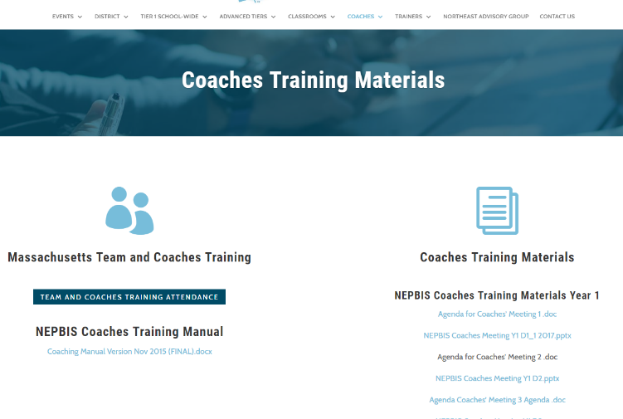
Welcome to YEAR 2 of PBIS
COACHES Training!
As you wait for the training to begin, please:
Update your display name in Zoom to read: [Your School], [Your Name] (e.g., Eastside HS, Joe Clark)
This will help us create breakout rooms!
Pull up your current action plan
Enter your attendance by following the hyperlink or through nepbis.org

Slide 2


NEPBIS School-Wide Coaches Training
Year 2: November
[insert trainer names here]
with support from Brandi Simonsen, Jen Freeman, Susannah Everett,
Adam Feinberg & Katie Meyer

Slide 3
TODAY’S AGENDA & TASKS
Presentation Content
Coaching Self-Assessment
Coaches’ Tasks
Review Coaching Self-Assessment
Preview: Teaching SWPBIS in the Classroom
Review Supporting & Responding to Student Behavior Document
Data-Driven Problem Solving for Classrooms
Watch SWIS Drill-Down Video
Notes:
TRAINER NOTE: SWIS drill down will be discussed at next month's coaches meeting.

Slide 4
LEGEND
Discussion
Poll
Activity
&
Positive & Negative Examples
Preview

Slide 5

ADDITIONAL READINGS &
RESOURCES
READINGS:
Classroom Support Systems Brief
Classroom Data Technical Guide
RESOURCES:
Supporting & Responding to Student Behavior
SWIS Drill Down Video
Notes:
Resource links:
https://www.pbis.org/resource/pbis-technical-brief-on-systems-to-support-teachers-implementation-of-positive-classroom-behavior-support
https://www.pbis.org/resource/pbis-technical-guide-on-classroom-data
https://www.pbis.org/resource/supporting-and-responding-to-behavior-evidence-based-classroom-strategies-for-teachers
https://www.pbisapps.org/Resources/Pages/SWIS-5-Preview-Data-Drill-Down.aspx

Slide 6

EXPECTATIONS
Self
Others
Environment
Self-monitor (Are you participating? Engaged as a learner?)​
Mute when listening; unmute to talk​
Have your computer charged and ready to go​
Stretch, break, stand as needed​
If you have questions or comments, unmute, use the chat box, or click the "raise hand" icon
Work as a team (room for every voice, reinforce participation)
Keep necessary materials at hand (e.g., action plan & other docs, water, snacks, etc.)​

Slide 7




TOOLS
WEBSITES
School-Wide PBIS Workbook & Appendices
Action Plan
nepbis.org
pbis.org
pbisapps.org

Slide 8
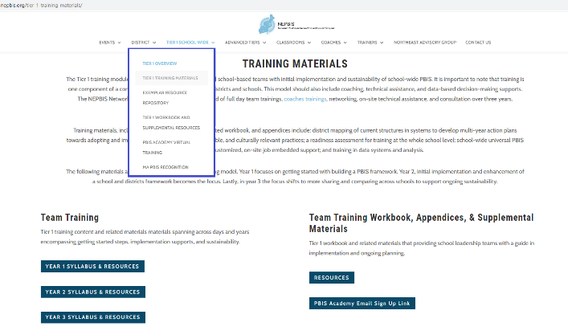
NEPBIS.ORG

Slide 9
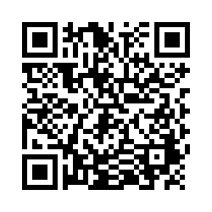
ACTIVITY: ATTENDANCE
Scan QR code on the left or follow the URL posted in the chat to access the online attendance survey
Follow prompts to enter attendance information
Notify trainers if you require assistance (e.g., identifying your cohort or cohort group)
1 minute
You are in Cohort 6
Notes:
TRAINERS – Update cohort group on slide.
Post a link to the attendance survey (below) in the chat for those who do not use the QR code on the slide:
https://uconn.co1.qualtrics.com/jfe/form/SV_cvz67c35MhUrElT

Slide 10





Regularly check-in with students and families with purposeful communication to build relationships. Consider positive greetings at the door (or at login for remote learning).
Connect
Screen
Select and implement a SEB screener or develop procedures for informal screening (e.g., extant data, family wellness check). Review data in school-wide team meetings to make decisions, based on level of risk: differentiate or intensify supports.
Check-in: In what ways has your school provided support in these areas?
Support
Establishing a safe, predictable, and positive environment to build predictable routines and key SEB skills within routines for in-person or remote instruction. Plan ways to acknowledge desired behavior.
Teach
Prioritize key SEB skills to empathize, and plan to integrate within instructional routines. Ensure instruction is culturally responsive. Actively engage students in instruction.
Monitor
Collect and use simple data to monitor student engagement and SEB skills. Regularly plan time to review and further adjust or enhance support as needed.
Notes:
TRAINER NOTE: Use these review slides to guide follow up on content and discussions from the previous month. If these have been adequately covered in previous discussions or the self-assessment, feel free to skip.

Slide 11
COACHING ROLES
Discussion:
How are you facilitating team meetings?
Content Knowledge
Content
Facilitate
Facilitate
Facilitate
Communicate
Communicate
Local PBS expert
Positive “nag”
Link to resources (e.g., nepbis.org, pbis.org)
Team meetings
Activities at training events
Implementation
Share advanced content with team
Share information at faculty meetings

Slide 12
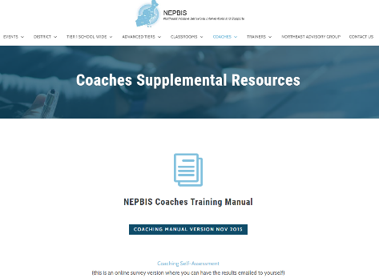
ACTIVITY: COACHING SELF-ASSESSMENT
Work individually or with partner coach
Navigate to nepbis.org
Select the “Coaches” dropdown menu and click on the “Coaching Supplemental Resources” page
At the bottom of the page, click the link to the Coaching Self-Assessment
Develop an Action Plan to address areas of growth identified on the self-assessment
Present: 1-2 coaching strengths and 1-2 coaching concerns/challenges
15 minutes
Notes:
TRAINER NOTE:
Allow coaches 10-15 min to complete the Self-Assessment
Plan for another 10-15 min to present/discuss
Link to self assessment: https://uconn.co1.qualtrics.com/jfe/form/SV_da0jBfzKmRWkM4Z

Slide 13

November Team Training
Preview: PBIS in the Classroom

Slide 14
NOVEMBER TEAM AGENDA
Presentation Content
Classwide PBIS
Team Tasks
Classroom/Virtual Learning Routines Matrix
Review & Discuss Supporting & Responding to Behavior
Complete TIC
Let’s preview this content now

Slide 15

RESOURCE

Slide 16
INTERACTIVE MAP OF CORE FEATURES

Slide 17
CLASSROOM INTERVENTIONS SELF-ASSESSMENT

Slide 18
TABLES W/ DEFINITIONS, EXAMPLES & NON-EXAMPLES, RESOURCES
How might you use this tool?
Unmute or type in the chat

Slide 19
ADDITIONAL
TOOLS

Slide 20
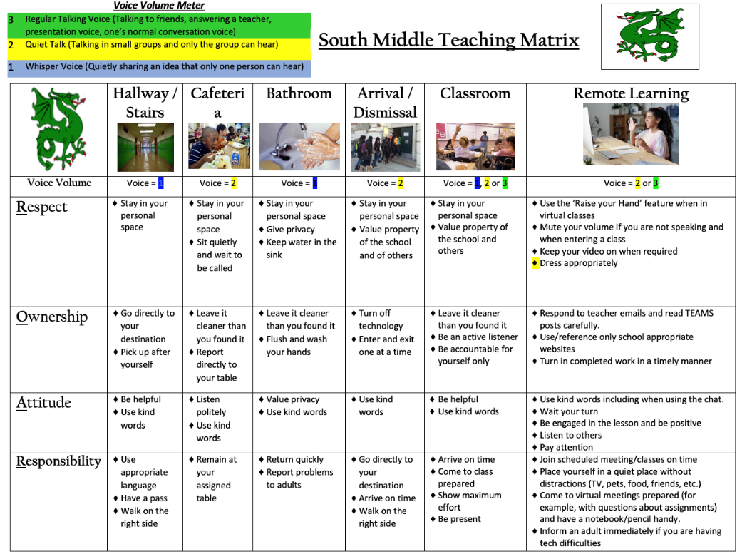
VIRTUAL LEARNING MATRIX
How are we supporting classrooms in our current context?

Slide 21
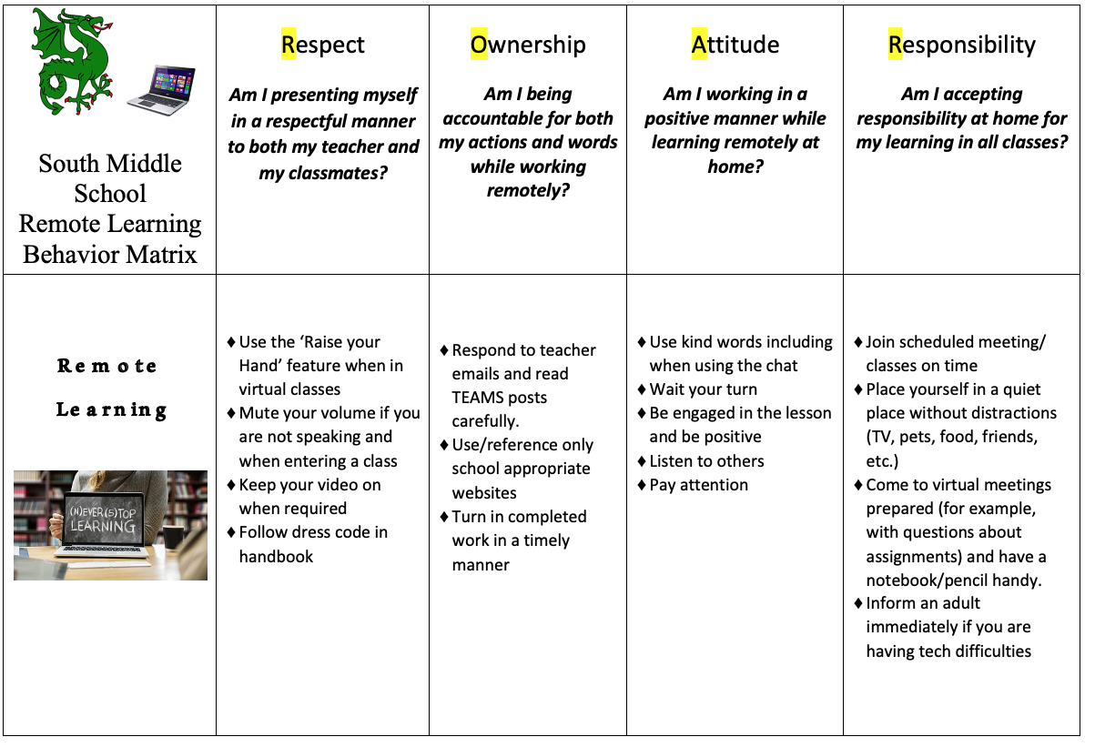
How are we reviewing or posting in our virtual environments?
Video backgrounds?

Slide 22

ACTIVITY: PREVIEW THE GUIDE
With your partner coach, review virtual matrix example and Supporting Behavior document and brainstorm how they can be used to support classrooms in your school.
Take notes on your school's action plan.
Prepare to present one big idea when we return to the larger group.
15 minutes
Coach Pairs
Notes:
TRAINER: Activity prompt below; allow 15 minutes
With your fellow school coaches, review virtual matrix example and Supporting Behavior document and brainstorm how they can be used to support classrooms in your school.
Take notes on your school's virtual action plan.
Prepare to present 1 “big idea” when we return to the larger group.
https://www.pbis.org/resource/supporting-and-responding-to-behavior-evidence-based-classroom-strategies-for-teachers

Slide 23
DEVELOPING SYSTEMS TO SUPPORT CLASSROOM PRACTICES
Supporting Educators’ Implementation

Slide 24
GUIDELINES FOR CLASSROOM SETTINGS
Practices
Academic achievement linked to social success, active engagement, & effective teaching
Good teaching is used as a behavior management strategy
Behavior management is used as an instructional management strategy
3-tiered prevention logic applied to classroom context
Classroom management linked to school-wide behavior support
Classroom routines have been taught, practiced, & reinforced regularly
School-wide support systems used to sustain effective classroom management strategies
Data-based progress monitoring & action planning
Regular review of accuracy of intervention implementation
Notes:
Use these guidelines as a checklist for your team to determine what systems are in place to support staff’s use of PCBS.

Slide 25
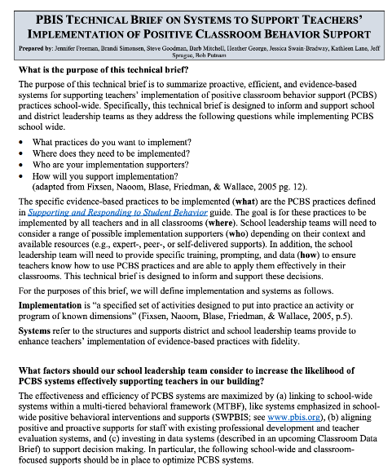
PBIS TECHNICAL BRIEF: Systems to Support Teachers’ Implementation of Positive Classroom Behavior Support (Classroom PBIS)
Jennifer Freeman
Brandi Simonsen
Steve Goodman
Barbara Mitchell
Heather George
Jessica Swain-Bradway
Kathleen Lane
Jeff Sprague
Bob Putnam
Notes:
https://www.pbis.org/resource/pbis-technical-brief-on-systems-to-support-teachers-implementation-of-positive-classroom-behavior-support

Slide 26
CLASSROOM PBIS: ACTION PLANNING GUIDE
Are the foundational systems in place to support implementation of PCBS by all staff?
Do data indicate that staff are implementing positive classroom practices effectively?
Do all staff know what positive classroom practices to implement and if they’re doing it accurately?
Notes:
TRAINER NOTE: The main idea is that we need systems in place to support consistent implementation of Positive Classroom Behavior Support (PCBS) across classrooms. The implementation of PCBS practices in the classroom is key to effective PBIS implementation because students spend the majority of their time in the classroom. The following action planning guide describes the process of establishing these systems.

Slide 27

ARE FOUNDATIONAL SYSTEMS IN PLACE?
CPBIS implementation is a clear school and district priority
Examples:
District and school administrators have communicated a clear priority for PCBS implementation
Non-Examples:
No practices are prioritized for implementation, identified strategies lack evidence of effectiveness, and/or priority practices are not effectively disseminated among all staff.
Notes:
MAIN IDEA: Practices that administration communicates as a priority are more likely to be implemented consistently and with fidelity.

Slide 28

ARE FOUNDATIONAL SYSTEMS IN PLACE?
CPBIS implementation is a clear school and district priority
School and district resources are available to support CPBIS implementation
Examples:
Dedicated time for training
Dedicated time for coaching functions
Regular data review
Celebration or recognition of staff implementation
Non-Examples:
No dedicated time or resources
Data not shared or not used in problem solving
Staff recognition not available or used to celebrate PCBS implementation
Notes:
MAIN IDEA: Durable implementation of positive classroom practices with fidelity requires resources (time, people).

Slide 29
ARE FOUNDATIONAL SYSTEMS IN PLACE?
CPBIS implementation is a clear school and district priority
School and district resources are available to support CPBIS implementation
School and district teams have considered alignment & integration of CPBIS with other district priorities and initiatives
Examples:
Implementation of PCBS connected to clear need in building
Implementation of PCBS connected to academic instruction
PCBS strategies adapted to ensure classroom contextual and cultural fit
Non-Examples:
Data demonstrating need are not regularly shared
Academic strategies taught in isolation
Training on practices not connected to why it is important in the school
Notes:
MAIN IDEA: When teams have done the work to align & integrate PCBS with other priorities, positive classroom practices are more likely to be implemented in a way that is meaningful and sustainable.

Slide 30
CLASSROOM PBIS: Self-Assess
Are the foundational systems in place to support implementation of CPBIS by all staff?
Poll:
Where do you rate your school’s foundational systems?
Not in place
Partially in place
Mostly in place
Fully in place
Notes:
Poll:
Where do you rate your school’s foundational systems?
Not in place
Partially in place
Mostly in place
Fully in place

Slide 31
CLASSROOM PBIS: ACTION PLANNING GUIDE
Are the foundational systems in place to support implementation of PCBS by all staff?
Do data indicate that staff are implementing positive classroom practices effectively?
Do all staff know what positive classroom practices to implement and if they’re doing it accurately?

Slide 32
DO STAFF KNOW WHAT & HOW TO IMPLEMENT?
Clear expectations and explicit training about practices that should be implemented by all staff
Examples:
Clearly stated outcomes
Explicit (model, lead, test) approach
  Job-embedded (linked to school data, delivered in various contexts & connected to practice)
Non-Examples:
PD focuses only on theory and assumes educators will discover practices
Full-day intensive training with no follow-up
Short trainings not connected to larger need, structure, etc.
Notes:
MAIN IDEA: Training and PD need to be on-going and include opportunities to model and practice key positive classroom practices.

Slide 33
DO STAFF KNOW WHAT & HOW TO IMPLEMENT?
Clear expectations and explicit training about practices that should be implemented by all staff
Coaching and/or regularly available performance feedback on the use of PCBS practices?
Examples:
Prompts and reminders
Supportive data-based feedback
Supports may be delivered by: coach/mentor, peer/peer team, self
Non-Examples:
Data delivered in punitive evaluative fashion
Feedback delayed or not data-based
Notes:
MAIN IDEA: Staff need to be supported in using these practices if they are to implement them with fidelity.

Slide 34
SEE SYSTEMS
BRIEF
Notes:
Examples (left) and non-examples (right) from the brief of multiple ways of supporting staff with implementation of PCBS.

Slide 35
CLASSROOM PBIS: Self-Assess
Do all staff know what positive classroom practices to implement and if they’re doing it accurately?
Poll:
Where do you rate your school’s systems to support staff implementation of CPBIS?
Not in place
Partially in place
Mostly in place
Fully in place
Notes:
Poll:
Where do you rate your school’s systems to support staff implementation of PCBS?
Not in place
Partially in place
Mostly in place
Fully in place

Slide 36
CLASSROOM PBIS: ACTION PLANNING GUIDE
Are the foundational systems in place to support implementation of PCBS by all staff?
Do data indicate that staff are implementing positive classroom practices effectively?
Do all staff know what positive classroom practices to implement and if they’re doing it accurately?

Slide 37
DO DATA INDICATE EFFECTIVE IMPLEMENTATION?
If Yes…Well done! Monitor outcomes and adjust as needed
If Many… Review and adjust universal support
If Few… Determine type and severity of implementation changes (minor or major)
If Minor… Provide supplemental support to small groups of staff needing support
If No…Determine the number of classrooms needing support (many or a few)
If Major… Consider individualized supports and other strategies for staff members needing intensified support.
Notes:
MAIN IDEA: Use this decision tree to determine how best to support staff (using a tiered support logic).

Slide 38
MULTITIERED FRAMEWORK OF PROFESSIONAL DEVELOPMENT SUPPORT
Tier 3
Intensive PD: Data-driven Consultation
Tier 2
Targeted PD: Self-Management with Peer or Coaching Supports
Tier 1
Universal PD: Training & Self-Management
Progress Monitoring
Walk-through, Student Data Review, Teacher Collected Data
Universal Screening
Walk-through & Student Data Review
How can we approach intensifying our supports
for educators implementing PCBS?
(adapted from Simonsen, MasSuga, Briere, Freeman, Myers, Scott, & Sugai, 2013)

Slide 39
SEE SYSTEMS
BRIEF
New
Examples!!
CMOT
Notes:
Examples of tools to support data-based decision making from the brief (most are free).

Slide 40
CLASSROOM PBIS: Self-Assess
Do data indicate that staff are implementing positive classroom practices effectively?
Poll:
Where do you rate your team’s data systems for assessing CPBIS?
Not in place
Partially in place
Mostly in place
Fully in place
Notes:
Poll:
Where do you rate your team’s data systems for assessing PCBS?
Not in place
Partially in place
Mostly in place
Fully in place

Slide 41
SEE SYSTEMS
BRIEF
T
4
AB
L
E
.
S
TR
A
TEG
I
ES
TO
I
N
TEN
S
I
F
Y
S
U
P
P
O
R
TS
Intensifying supports for educators
I
n
d
i
vi
d
u
al
i
z
e
S
u
p
p
d
l
e
me
n
tal
S
u
p
p
or
t
S
u
p
p
or
U
n
t
i
ve
r
s
al
S
u
p
p
or
t
T
hi
s
c
at
e
gor
y
i
de
nt
i
f
i
e
T
s
hi
s
c
at
e
gor
y
of
broad
a m
or
e
s
t
r
at
e
gi
c
T
hi
s
c
at
e
gor
y
support
i
of
s
pr
ov
i
de
d
appr
oac
h of
s
uppor
t
s
pe
c
i
al
i
z
e
d s
uppor
t
uni
s
v
e
r
s
al
l
y
t
o al
l
t
hat
f
oc
us
e
s
on c
or
e
c
ons
i
de
r
s
t
ne
he
uni
que
e
ds
of
e
duc
at
or
s
i
e
n
duc
at
or
s
t
o i
m
pr
ov
e
f
ac
t
or
s
t
hat
P
CB
s
houl
d be
S
i
n pl
ac
e
f
or
e
f
f
e
c
t
i
v
e
i
m
pl
e
m
e
nt
at
i
i
on of
m
pl
e
m
e
nt
at
i
on of
P
CB
P
CB
S
S
F
oc
u
s
of s
u
p
p
or
ts
T
he
s
c
hool
a
nd/
or di
s
t
ri
c
t
S
m
a
l
l
groups
of e
duc
a
t
ors
Indi
vi
dua
l
e
duc
a
t
ors
a
provi
re
de
s
ge
ne
ra
l
gui
da
nc
e
e
xpre
s
s
i
nt
e
re
s
t
i
n or
i
de
nt
i
fi
e
d for s
pe
c
i
a
l
i
z
e
(pre
d
c
i
s
i
on)
on
P
CBS
.
i
ndi
c
a
t
e
ne
e
d for
s
upport
. T
hi
s
s
upport
i
i
s
nc
re
a
s
e
d s
upport
.
m
a
t
c
he
d t
o t
he
ne
e
d of t
E
ns
ure
he
t
ha
t
t
he
re
i
s
e
duc
a
t
a
or t
hrough
dm
i
ni
s
t
ra
t
i
ve
s
upport
for
S
upport
i
s
provi
de
d by
func
t
i
ona
l
a
s
s
e
s
s
m
e
nt
P
CBS
t
o
t
hrough vi
s
i
bi
l
i
t
y,
gi
vi
ng
a
ddi
t
i
ona
l
de
t
e
rm
i
ne
i
f t
he
re
i
s
pol
a
i
c
y, a
nd pri
ori
t
y.
i
nform
a
t
i
on or
s
ki
l
l
s
de
fi
c
i
t
(e
duc
a
t
profe
or
s
s
i
ona
l
de
ve
l
opm
e
nt
doe
s
not
ha
ve
t
he
re
qui
s
i
t
on
e
P
CBS
a
nd r
e
m
ov
a
l
of
s
ki
l
l
s
t
o
i
m
pl
e
m
e
ba
rri
nt
e
rs
t
ha
t
m
a
y i
nt
e
rfe
re
P
CBS
) or pe
rform
a
nc
(
e
e
.g.,
c
om
pe
t
i
ng
de
fi
c
i
t
(e
duc
a
t
or ha
s
t
i
he
ni
t
i
a
t
i
ve
s
, a
c
c
e
s
s
t
o
s
ki
l
l
s
e
t
but
doe
s
t
not
ra
i
ni
ng/
c
oa
c
hi
ng)
.
c
ons
i
s
t
e
nt
l
y i
m
pl
e
m
e
t
nt
he
P
CBS
)
.
Re
m
ovi
ng ba
rri
e
rs
t
ha
m
t
a
y i
nt
e
rfe
re
w
i
t
e
h
ffe
c
t
i
ve
P
CBS
pra
c
t
i
c
e
(c
om
pe
s
t
i
ng i
ni
t
i
a
t
i
ve
s
a
,
c
c
e
s
s
t
t
o
ra
i
ni
ng/
c
oa
c
hi
ng)
P
.
e
r
for
man
c
e
E
xpe
c
t
a
t
i
ons
E
xpe
a
re
c
t
a
t
i
ons
a
re
E
xpe
c
t
a
t
i
ons
a
re
re
c
-
om
m
uni
c
a
t
e
d t
o a
l
l
s
t
a
ff
i
t
e
ra
t
e
d or re
-
vi
s
i
t
e
d w
i
t
h
c
om
m
uni
c
a
t
e
e
d
xp
e
c
t
ati
on
s
t
o de
ve
l
op a
s
c
hool
s
e
l
e
c
t
e
d/
s
om
e
s
t
a
ff t
o
s
pe
c
i
fi
c
a
l
l
y a
nd c
l
e
a
climate
rl
y t
o
c
onduc
i
ve
t
o
furt
he
r c
om
m
uni
c
a
t
e
t
he
i
ndi
vi
dua
l
t
e
a
c
l
he
rs
a
bout
e
a
rni
ng
.
i
m
port
una
t
e
of s
c
hool
t
he
i
m
port
a
nc
e
de
ve
of
l
opi
ng e
ffe
c
t
i
c
ve
l
i
m
a
t
e
for t
he
i
c
r
l
a
s
s
room
s
(e
.g., gr
a
de
c
l
a
s
s
room
e
nvi
ronm
e
nt
s
l
.
e
ve
l
)
.
Le
ar
n
i
n
g ap
p
l
i
c
ati
on
Re
vi
e
w
of t
ra
i
ni
ng c
ont
e
nt
A
ddi
t
i
ona
l
opport
uni
t
ies
P
rovi
de
a
ddi
t
i
ona
t
l
ha
t
w
a
s
pre
vi
ous
l
y
t
o pra
c
t
i
c
e
P
CBS
i
n a
opport
uni
t
y t
o provi
op
p
or
tu
n
de
i
ty
provi
de
d
.
t
ra
i
ni
ng s
e
t
t
i
ng w
i
t
h
pra
c
t
i
c
e
of
P
CBS
i
n a
c
t
ua
fe
l
e
dba
c
k from
t
he
t
ra
i
ne
r
c
l
a
s
s
room
s
e
t
t
i
ng w
i
t
a
h
re
provi
de
d.
gui
da
nc
e
a
nd fe
e
dba
c
from
k
a
c
oa
c
h
A
mou
.
n
t an
d
P
rovi
de
hi
gh qua
l
i
t
y
Inc
re
a
s
e
d
opport
uni
t
i
e
t
s
P
rovi
de
fre
que
nt
ra
i
ni
ng w
i
t
h
profe
s
s
i
ona
l
for c
oa
c
hi
ng a
s
a
fol
l
ow
-
i
ndi
vi
dua
l
c
oa
c
fr
hi
ng
e
q
u
e
n
c
y of th
e
l
e
a
rni
ng c
om
m
uni
t
y
t
o
up t
o t
ra
i
ni
ng
a
re
t
hrough c
oa
c
hi
ng, vi
s
de
o
u
p
p
or
t
s
upport
i
m
pl
e
m
e
nt
a
t
i
on
.
re
vi
e
w
of re
c
orde
d

Slide 42

Systems
Data
Practices
Equity
Outcomes
Notes:
MAIN IDEA: These 3 resources are available to guide teams in the development of effective, meaningful, and sustainable PCBS practices that improve outcomes for ALL students.
Classroom Practices: https://www.pbis.org/resource/supporting-and-responding-to-behavior-evidence-based-classroom-strategies-for-teachers
Classroom Systems: https://www.pbis.org/resource/pbis-technical-brief-on-systems-to-support-teachers-implementation-of-positive-classroom-behavior-support
Classroom Data: https://www.pbis.org/resource/pbis-technical-guide-on-classroom-data

Slide 43
TODAY’S AGENDA & TASKS
What questions do
you have on today’s content?
Presentation Content
Coaching Self-Assessment
Coaches’ Tasks
Review Coaching Self-Assessment
Preview: Teaching SWPBIS in the Classroom
Review Supporting & Responding to Student Behavior Document
Data-Driven Problem Solving for Classrooms
Watch SWIS Drill-Down Video
What questions do
you have on today’s
follow-up team tasks?
Notes:
TRAINER NOTE: SWIS drill down will be discussed at next month's coaches meeting.

Slide 44
ADDITIONAL READINGS &
RESOURCES
READINGS:
Classroom Support Systems Brief
Classroom Data Technical Guide
RESOURCES:
Supporting & Responding to Student Behavior
SWIS Drill Down Video
Notes:
Resource links:
https://www.pbis.org/resource/pbis-technical-brief-on-systems-to-support-teachers-implementation-of-positive-classroom-behavior-support
https://www.pbis.org/resource/pbis-technical-guide-on-classroom-data
https://www.pbis.org/resource/supporting-and-responding-to-behavior-evidence-based-classroom-strategies-for-teachers
https://www.pbisapps.org/Resources/Pages/SWIS-5-Preview-Data-Drill-Down.aspx

Slide 45
PREVIEW: DECEMBER AGENDA & TASKS
Presentation Content
Review TIC
Coaches’ Tasks
SWIS Drill-Down Practice
SWIS Drill Down
Preview: Integration & Alignment
Preview: School-Family Partnerships
Preview: School-Family Practices Survey
Preview: Integration & Alignment

Slide 46
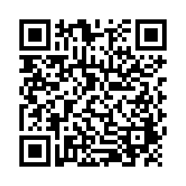
EVALUTION
Reminder:
Send Action Plan to Trainers for
Feedback
Please remember to complete the evaluation to receive your PDPs!
Scan the QR code to access.
Notes:
TRAINERS -
Put link to evaluation (below) in the chat for those who do not use the QR code:
https://uconn.co1.qualtrics.com/jfe/form/SV_5BXYIXLvg0qmSzP

