Slide 1

Welcome to YEAR 2 of PBIS
TEAM Training!
As you wait for the training to begin, please:
Update your display name in Zoom to read: [Your School], [Your Name] (e.g., Eastside HS, Joe Clark)
This will help us create breakout rooms!
Pull up your current action plan
Enter your attendance by following the hyperlink or through nepbis.org

Slide 2

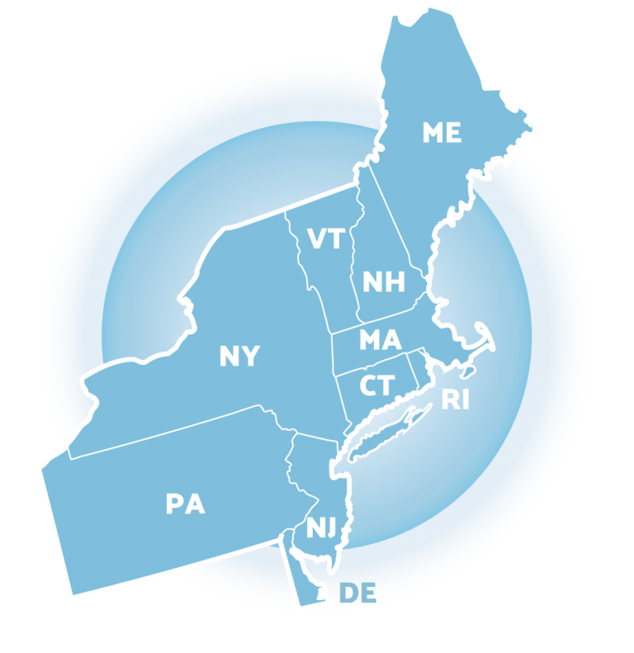
NEPBIS School-Wide Team Training
Year 2: November
[Insert Trainer Names]
with support from Brandi Simonsen, Jen Freeman, Susannah Everett,
Adam Feinberg & Katie Meyer

Slide 3
NOVEMBER TEAM AGENDA
Presentation Content
Class-wide PBIS
Team Tasks
Classroom/Virtual Learning Routines Matrix
Review & Discuss Supporting & Responding to Behavior
Complete TIC

Slide 4
LEGEND
Discussion
Poll
Activity
&
Positive & Negative Examples
Preview

Slide 5

ADDITIONAL READINGS &
RESOURCES
READINGS:
PBIS in the Classroom
Student/Teacher Game
RESOURCES:
Supporting & Responding to Student Behavior
Notes:
Resource links:
https://www.pbis.org/topics/classroom-pbis
https://www.pbis.org/resource/the-student-teacher-game
https://www.pbis.org/resource/supporting-and-responding-to-behavior-evidence-based-classroom-strategies-for-teachers

Slide 6

EXPECTATIONS
Self
Others
Environment
Self-monitor (Are you participating? Engaged as a learner?)​
Mute when listening; unmute to talk​
Have your computer charged and ready to go​
Stretch, break, stand as needed​
If you have questions or comments, unmute, use the chat box, or click the "raise hand" icon
Work as a team (room for every voice, reinforce participation)
Keep necessary materials at hand (e.g., action plan & other docs, water, snacks, etc.)​

Slide 7



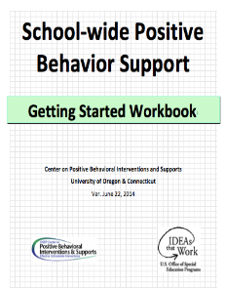
TOOLS
WEBSITES
School-Wide PBIS Workbook & Appendices
Action Plan
nepbis.org
pbis.org
pbisapps.org

Slide 8
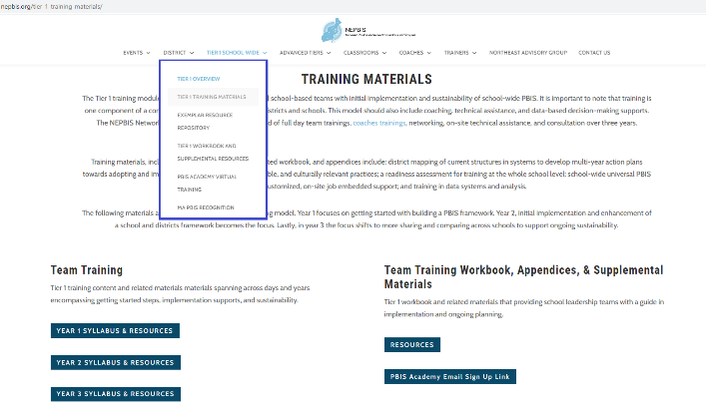
NEPBIS.ORG
Notes:
Trainer note: Please remind participants of Year 2 Syllabus access as well as the reminder email sign up link if they are not receiving reminder emails. Remind them of their Cohort Group (e.g. 6A)

Slide 9
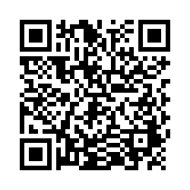
ACTIVITY: ATTENDANCE
Scan QR code on the left or follow the URL posted in the chat to access the online attendance survey
Follow prompts to enter attendance information
Notify trainers if you require assistance (e.g., identifying your cohort or cohort group)
1 minute
You are in Cohort 6
Notes:
TRAINERS – Update cohort group on slide.
Post a link to the attendance survey (below) in the chat for those who do not use the QR code on the slide:
https://uconn.co1.qualtrics.com/jfe/form/SV_cvz67c35MhUrElT

Slide 10
RETURNING TO
SCHOOL GUIDE
Notes:
Complete guide: https://www.pbis.org/current/returning-to-school-during-and-after-crisis
District level guide: https://www.pbis.org/resource/a-district-guide-for-returning-to-school-during-and-after-crisis
School level guide: https://www.pbis.org/resource/a-school-guide-for-returning-to-school-during-and-after-crisis

Slide 11
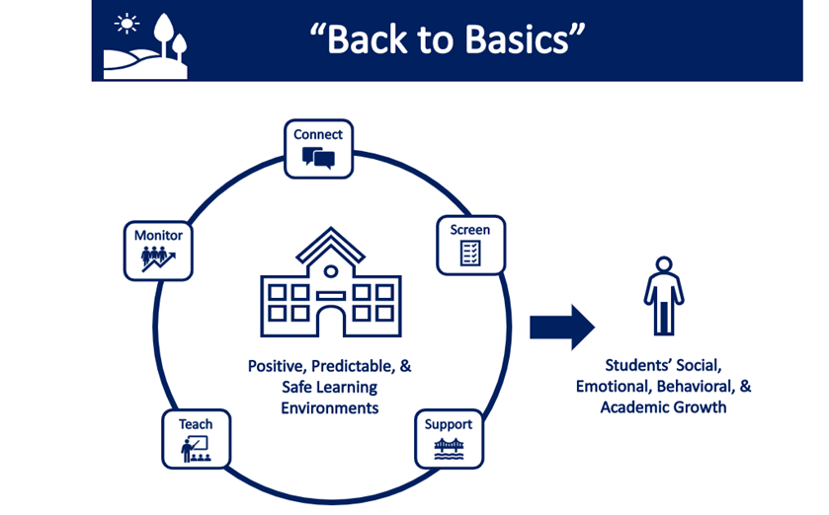
POLL 1: BACK TO BASICS
Which of the following areas is your team strongest in addressing?
Connecting with staff, students, families, and your community
Screening students for emotional, behavioral, and social needs
Identifying supports for effective remote or in-person instruction
Supporting effective teaching practices
Monitoring the effectiveness of your supports
Notes:
Poll #1:
Which of the following areas, is your team strongest in addressing?
1. Connecting with staff, students, families, and your community
2. Screening students for emotional, behavioral, and social needs
3. Identified supports for effective remote or in-person instruction
4. Supporting effective teaching practices
5. Monitoring the effectiveness of your supports

Slide 12
POLL 2: BACK TO BASICS
Which of the following areas is in greatest need of support?
Connecting with staff, students, families, and your community
Screening students for emotional, behavioral, and social needs
Identifying supports for effective remote or in-person instruction
Supporting effective teaching practices
Monitoring the effectiveness of your supports
Notes:
Poll #2:
Which of the following areas, is in greatest need of support?
1. Connecting with staff, students, families, and your community
2. Screening students for emotional, behavioral, and social needs
3. Identified supports for effective remote or in-person instruction
4. Supporting effective teaching practices
5. Monitoring the effectiveness of your supports

Slide 13





Regularly check-in with students and families with purposeful communication to build relationships. Consider positive greetings at the door (or at login for remote learning).
Connect
Screen
Select and implement a SEB screener or develop procedures for informal screening (e.g., extant data, family wellness check). Review data in school-wide team meetings to make decisions, based on level of risk: differentiate or intensify supports.
Check-in: In what ways has your school provided support in these areas?
Support
Establishing a safe, predictable, and positive environment to build predictable routines and key SEB skills within routines for in-person or remote instruction. Plan ways to acknowledge desired behavior.
Teach
Prioritize key SEB skills to empathize, and plan to integrate within instructional routines. Ensure instruction is culturally responsive. Actively engage students in instruction.
Monitor
Collect and use simple data to monitor student engagement and SEB skills. Regularly plan time to review and further adjust or enhance support as needed.
Notes:
TRAINER NOTE: Use these review slides to guide follow up on content and discussions from the previous month. If these have been adequately covered in previous discussions or the self-assessment, feel free to skip.

Slide 14
DISCUSSION: RETURNING TO SCHOOL
How have you leveraged your existing PBIS framework to support the current context (e.g. virtual, hybrid, etc.)?
What modifications/ adaptations have you made (or do you want to make) to fit new contexts (e.g. virtual learning, new safety/hygiene protocols)?
Share ideas and strategies in breakout groups. Prepare 1 min. report for the whole group.
Randomized Breakouts + Whole Group
10 minutes
Notes:
TRAINER: Activity prompt below; allow 15 minutes (10 minute randomized breakouts, 5 minutes whole group)
How have you leveraged your existing PBIS framework to support a return to school?
What modifications/ adaptations have you made (or do you want to make) to fit new contexts (e.g. virtual learning, new safety/hygiene protocols)?
Share ideas and strategies in breakout groups. Prepare 1 min. report for the whole group.

Slide 15
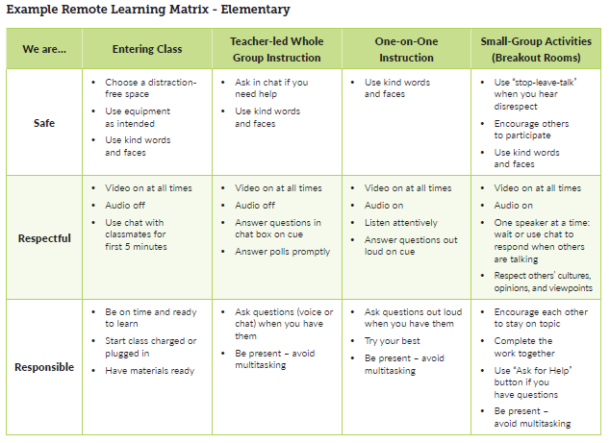
EXAMPLE REMOTE LEARNING MATRIX
How are we adapting our expectations to the current environment?

Slide 16
VIRTUAL REINFORCEMENT
Magnetic Gumball Machine
Google Slides Marbles
PBIS Rewards
Class Dojo
How are we adapting our acknowledgements to the current environment?

Slide 17


VIRTUAL SHOUTOUTS
How are we adapting our acknowledgements to the current environment?
Notes:
Links:
https://youtu.be/nbyQdbLUqAg
https://youtu.be/MyyuiuyAhFY

Slide 18
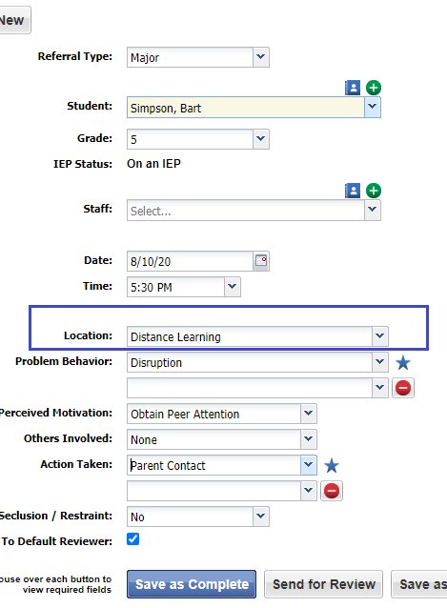
REFERRALS IN DISTANCE
LEARNING
How are we adapting our data systems to the current environment?

Slide 19
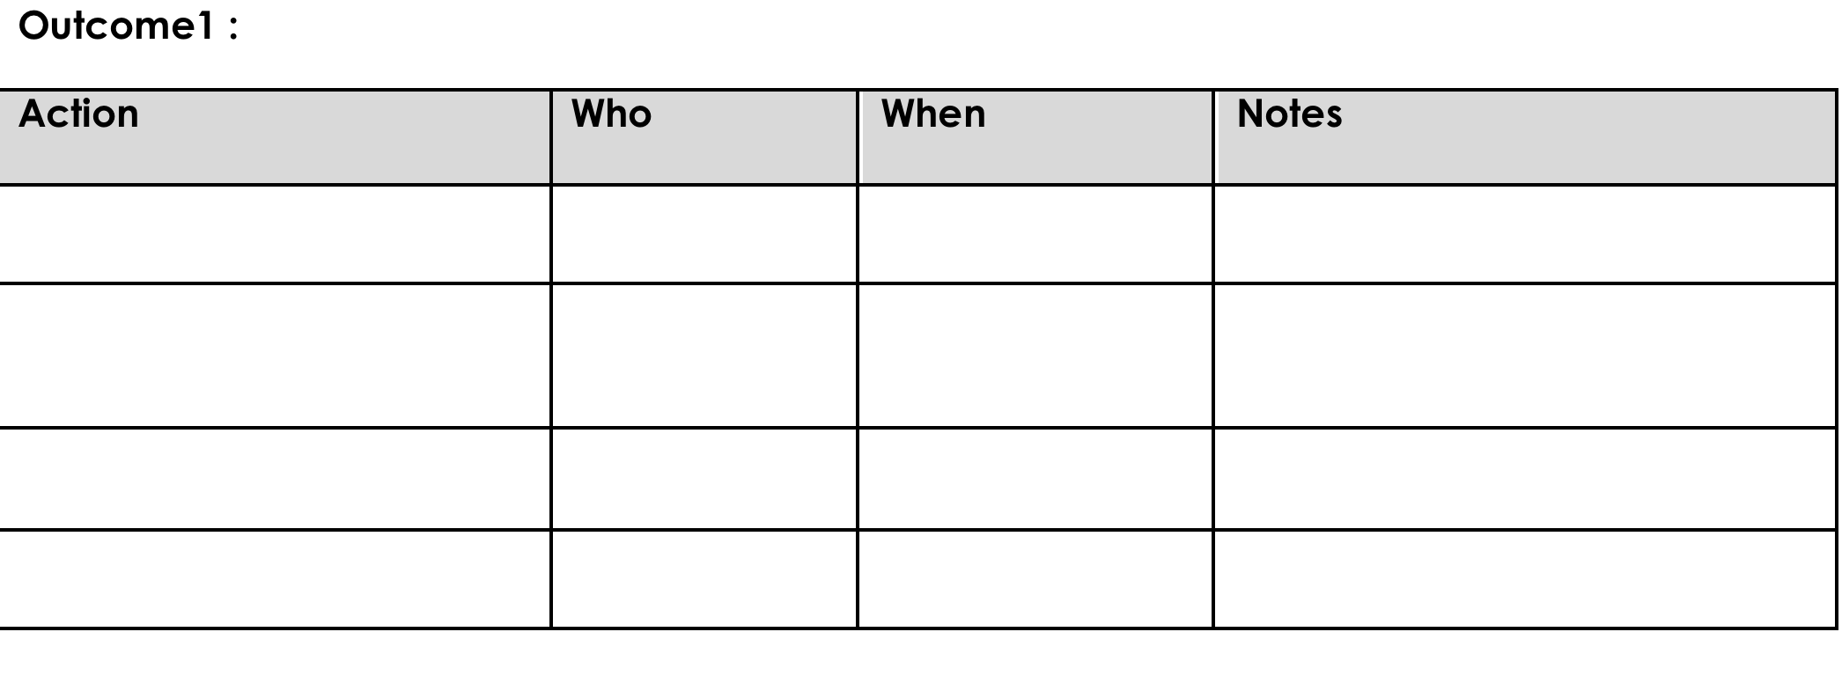
ACTION PLANNING
Process of organizing and using resources to enable individuals to engage in activities designed to achieve specific and important outcomes
Take 5 minutes and make sure your team’s action plan is up to date.

Slide 20
POSITIVE CLASSROOM BEHAVIOR SUPPORT PRACTICES

Slide 21

RESOURCE
Brandi Simonsen
Jennifer Freeman
Steve Goodman
Barbara Mitchell
Jessica Swain-Bradway
Brigid Flannery
George Sugai
Heather George
Bob Putnam
Renee Bradley et al. (OSEP)
Notes:
Resource link: https://www.pbis.org/resource/supporting-and-responding-to-behavior-evidence-based-classroom-strategies-for-teachers\

Slide 22
INTERACTIVE MAP OF CORE FEATURES

Slide 23
CLASSROOM INTERVENTIONS SELF-ASSESSMENT

Slide 24
DECISION-MAKING CHART
Helps to guide teachers with implementing best practices in preventing & responding to behaviors in the classroom

Slide 25
TABLES W/ DEFINITIONS, EXAMPLES & NON-EXAMPLES, RESOURCES

Slide 26
ADDITIONAL
TOOLS

Slide 27
What needs to be in place?
The effects of Classroom PBIS strategies are maximized by:
  Implementing within a school-wide multi-tiered behavioral framework (MTB), like PBIS
  Directly linking classroom and school-wide expectations and systems
  Merging classroom PBIS strategies with effective instructional design, curriculum, and delivery; and
  Using classroom-based data to guide decision making
But… you can implement Classroom PBIS even if your school does not yet have a multi tiered behavior framework in place

Slide 28
POSITIVE CLASSROOM BEHAVIOR SUPPORT:
3 KEY
QUESTIONS
Are the foundations of effective Classroom PBIS in place?
Do data indicate that students are still engaging in problem behavior?
Are Classroom PBIS practices implemented consistently?

Slide 29

ARE FOUNDATIONS OF CLASSROOM PBIS IN PLACE?
Effectively design the physical environment of the classroom
Examples:
Plan layout according to the type of activity
Elementary: tables for centers, separate desks for independent work, circle area for group work
Secondary: “U” or circle for discussion, rows for group instruction
Non-Example:
Disorderly, messy, unclean, and/or visually unappealing environment
Notes:
MAIN IDEA: Practices that administration communicates as a priority are more likely to be implemented consistently and with fidelity.

Slide 30

ARE FOUNDATIONS OF CLASSROOM PBIS IN PLACE?
Effectively design the physical environment of the classroom
Develop & teach predictable classroom routines
Examples:
Establish routines and procedures for:
  Elementary: arrival/dismissal, transitions between activities, accessing help
  Secondary: turning in work, accessing materials, making up missed work, transitions/interruptions
Non-Example:
Assuming students automatically know routines & procedures without instruction/ feedback
Notes:
MAIN IDEA: Durable implementation of positive classroom practices with fidelity requires resources (time, people).

Slide 31
ARE FOUNDATIONS OF CLASSROOM PBIS IN PLACE?
Poll:
Which area is most in need of support in your school?
A: Design
B: Routines
C: Expectations
D: All the above
Effectively design the physical environment of the classroom
Develop & teach predictable classroom routines
Post, define, & teach 3-5 positive classroom expectations
Examples:
Elementary: poster of “Be Safe, Kind, & Ready,” matrix to define behavior for each classroom routine, teach engaging lessons for each expectation
Secondary: student-created poster of “Citizenship, Achievement, & Grit,” engage students in developing and teaching matrix
Non-Examples:
Assuming students know your expectations
Having more than 5 expectations
Listing only behaviors you do not want from students
Notes:
Poll:
Which area is most in need of support in your school?
A: Design
B: Routines
C: Expectations
D: All the above

Slide 32
POSITIVE CLASSROOM BEHAVIOR SUPPORT:
3 KEY
QUESTIONS
Are the foundations of effective Classroom PBIS in place?
Are Classroom PBIS practices implemented consistently?
Do data indicate that students are still engaging in problem behavior?

Slide 33
ARE CLASSROOM PBIS PRACTICES IMPLEMENTED CONSISTENTLY?
Provide high rates of varied opportunities to respond
Examples:
Elementary: Individual/Small Group - Student names on sticks in a jar. As questions are posed, a student name is drawn; Choral - All students recite letter sounds..
Secondary: Individual/Small Group - I just showed you how to do #1, I am going to start #2. Second row, help explain my steps; Non-Verbal - Clickers to respond a, b, or c..
Non-Example:
A teacher provides a 20-minute lesson without asking any questions or prompting any student responses.
Notes:
MAIN IDEA: Training and PD need to be on-going and include opportunities to model and practice key positive classroom practices.

Slide 34
ARE CLASSROOM PBIS PRACTICES IMPLEMENTED CONSISTENTLY?
Provide high rates of varied opportunities to respond
Use prompts & active supervision
Examples:
Elementary: Before students begin seatwork, provide a reminder about how to access help and materials; poster of expected behaviors.
Secondary: Review of group activity participation rubric prior to the start of group work; sign above the homework (HW) basket with checklist for handing in HW.
Non-Example:
While teaching a lesson, a student calls out and the educator states, “Instead of calling out, I would like you to raise your hand.”
Notes:
MAIN IDEA: Staff need to be supported in using these practices if they are to implement them with fidelity.

Slide 35
ARE CLASSROOM PBIS PRACTICES IMPLEMENTED CONSISTENTLY?
Provide high rates of varied opportunities to respond
Use prompts & active supervision
Examples:
Elementary: While students are working independently, scan & move around the classroom, checking in with students.
Secondary: While monitoring students, move around the area, interact with students, and observe behaviors of individuals & the group.
Non-Example:
Sitting or standing where you cannot see the entire room / space. Such as with your back to the group or behind your desk.
Notes:
MAIN IDEA: Staff need to be supported in using these practices if they are to implement them with fidelity.

Slide 36
ARE CLASSROOM PBIS PRACTICES IMPLEMENTED CONSISTENTLY?
Poll:
Which area is most in need of support in your school?
A: OTRs
B: Supervision
C: Acknowledgements
Provide high rates of varied opportunities to respond
Use prompts & active supervision
Acknowledge behavior with specific praise & other strategies
Examples:
Elementary: In teacher-directed instruction, a student raises her hand. The educator says, “Thank you for raising your hand.”
Secondary: A teacher quietly states, “I really appreciate how you facilitated your group discussion. Peers had many ideas, and you managed it well.”
Non-Example:
“Thank you for trying to act like a human.” (This, at best, is sarcasm, not genuine praise.)
Notes:
Poll:
Which area is most in need of support in your school?
A: OTRs
B: Supervision
C: Acknowledgements

Slide 37
OTHER STRATEGIES TO ACKNOWLEDGE
 | Elementary Example | Secondary Example | Non-Example
Behavior Contract | Class Constitution signed by all | Integrity Pledge signed by all | Zero Tolerance Acknowledgement
Group Contingency | “If all students will hand in homework #2 by the due date, next Friday we will play State Bingo instead of a formal test review.” | “If we generate 5 questions that are examples of ‘Synthesis’ by 2:15, you may sit where you would like for the last 20 min. of class.” | Making the goal unattainable or undeliverable, or singling out a student for failing to meet goal.
Token Economy | “Group 2, you were all respectful during your discussion, and each of you earned a “star buck” to use in the school-wide store.” | “Alyiah, you were very respectful when your peer came in and asked for space. You’ve earned 10 bonus points toward your behavior goal.” | Providing points or tokens without (a) specific praise or (b) demonstrated behaviors

Slide 38
POSITIVE CLASSROOM BEHAVIOR SUPPORT: 3 KEY
QUESTIONS
Are the foundations of effective classroom PBIS in place?
Are classroom PBIS practices implemented consistently?
Do data indicate that students are still engaging in problem behavior?

Slide 39
Are students still engaging in problem behavior?
If No…Well done! Monitor outcomes and adjust as needed
If Minor… Use brief, specific error correction & other strategies
If Major… How many students are involved? (Many or Few?)
If Few… Request additional (Tier 2 & 3) support for students.
If Yes…Are behaviors minor or major expectation violations?
If Many… Review, adjust, & intensify CW PBIS. Ask for help!

Slide 40
IN RESPONSE TO MINOR PROBLEM BEHAVIOR…
Use brief, specific error correction & other strategies
Examples:
Elementary: After a student calls out in class the teacher responds, “Please raise your hand before calling out your answer”
Secondary: After student plays with lab equipment inappropriately, teacher responds, “Please don’t play with lab equipment, keep it on the table.”
Non-Examples:
Shouting, “No!” (This is not calm, neutral, or specific.)
A 5-minute conversation about what the student was thinking. (This is not brief.)

Slide 41
OTHER STRATEGIES TO RESPOND
 | Elementary Example | Secondary Example | Non-Example
Planned Ignoring | During a whole group activity, James shouts the teachers’ name to get her attention. The teacher ignores the callouts and proceeds with the activity. | During a lecture, Jen interrupts the teacher and loudly asks her question. The teacher ignores Jen until she quietly raises her hand. | A student is loudly criticizing a peer, resulting in other students laughing at the targeted peer. The teacher does nothing.
Differential Reinforcement | In the same scenario above, the teacher ignores James’ callouts, but immediately calls on and praises James when he raises his hand, “That’s how we show respect! Nice hand raise.” (DRA) | “If we can make it through this discussion without inappropriate language, you can listen to music during your independent work time at the end of class.” (DRO) | The teacher reprimands students each time they engage in problem behavior and ignore appropriate behavior.

Slide 42
OTHER STRATEGIES TO RESPOND
 | Elementary Example | Secondary Example | Non-Example
Response Cost | When a student talks out, the teacher pulls the student aside, provides a quiet specific error correction, and removes a marble from his/her jar on the teacher’s desk. | When a student engages in disrespectful language, the teacher privately provides feedback and removes a point from the student’s point card. | The teacher publicly flips a card (from green to red) to signal the student has lost privileges. When asked why, the teacher states, “you know what you did.”
Time Out from Reinforcement | After throwing a game piece at a peer, the teacher removes the game from the student, asks her to return to her desk, and reviews expectations before allowing her to resume activities. | When a student disrupt a preferred art class, the teacher asks the student to “take 5” to review the expectations in art. The student re-joins the class after restating expectations. | Sending the student from a difficult, disliked class to in-school suspension, which is facilitated by a preferred adult and often attended by preferred peers for the remainder of the day.
What are good examples of responding to behavior that you’ve seen in your school?
(Type in the chat)

Slide 43
NON-EXAMPLE: OTHER STRATEGIES TO RESPOND
Negative Effects of Clip Charts
  Ineffective in changing behavior class-wide
  Contribute to labeling and stigmatization
  Focus on public corrections
  Intensify anxious behavior and decrease engagement
  Provide attention for unwanted behavior
  Don’t teach appropriate behavior
Better Alternatives
  Positive expectations and routines
  Start a positive reward system
  Provide corrections privately
  Teach emotional regulation

Slide 44

ACTIVITY: PREVIEW THE GUIDE
Review “Supporting and Responding to Behavior” on pbis.org
Discuss the extent to which you believe all/most teachers are implementing all/most of the evidence-based critical features of classroom management.
Action plan virtual/remote learning matrix.
What are biggest challenges?
Prepare to present 1 “big idea” from your group.
20 minutes
Teams
Notes:
TRAINER: Activity prompt below; allow 20 minutes
Review “Supporting and Responding to Behavior” on pbis.org
Discuss the extent to which you believe all/most teachers are implementing all/most of the evidence-based critical features of classroom management.
Action plan virtual / remote learning matrix
What are biggest challenges?
Prepare to present 1 “big idea” from your group.
https://www.pbis.org/resource/supporting-and-responding-to-behavior-evidence-based-classroom-strategies-for-teachers

Slide 45
ACTIVITY: TEAM IMPLEMENTATION CHECKLIST
Coaches (1 per team) go to www.pbisapps.org
  Go to pbis applications login on the top right corner of your screen
  Login with your email and password (if you haven’t set up your password yet, just go through the Forgot Password process).
  Select PBIS Assessment. Under Surveys Currently Open, Select Team Checklist 3.1.
  Click “Take Survey.” Find Team Checklist.
  Select → under “Action” column .
Complete TIC as a team.
Review reports to support your action planning.
20 minutes
Teams
Notes:
TRAINER NOTES: Allow ~20-25 min for teams to complete the TIC. December’s meeting will start with a check-in and discussion of TIC results. Please cut/copy this text to the chat:
COACHES (1 per team) go to www.pbisapps.org
Go to pbis applications login on the top right corner of your screen
Login with your email and password (if you haven’t set up your password yet, just go through forgot password process)
Select PBIS Assessment
Under Surveys Currently Open, Select Team Checklist 3.1
Click “Take Survey”
Find Team Checklist
Select under Action column
Complete TIC as a team
9. Review reports to support your action planning

Slide 46
TODAY’S AGENDA & TASKS
What questions do
you have on today’s content?
Presentation Content
Class-wide PBIS
Team Tasks
Classroom/Virtual Learning Routines Matrix
Review & Discuss Supporting & Responding to Behavior
Complete TIC
What questions do
you have on today’s
follow-up team tasks?
Notes:
TRAINER NOTE: SWIS drill down will be discussed at next month's coaches meeting.

Slide 47
ADDITIONAL READINGS &
RESOURCES
READINGS:
PBIS in the Classroom
Student/Teacher Game
RESOURCES:
Supporting & Responding to Student Behavior
Notes:
Resource links:
https://www.pbis.org/topics/classroom-pbis
https://www.pbis.org/resource/the-student-teacher-game
https://www.pbis.org/resource/supporting-and-responding-to-behavior-evidence-based-classroom-strategies-for-teachers

Slide 48
PREVIEW: DECEMBER AGENDA & TASKS
Presentation Content
Integration & Alignment with PBIS
Team Tasks
Revisit Working Smarter Matrix
School-Family Partnerships
Complete Family-School Partnership Survey

Slide 49
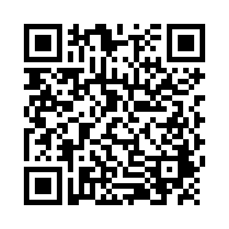
EVALUTION
Reminder:
Send Action Plan to Trainers for
Feedback
Please remember to complete the evaluation to receive your PDPs!
Scan the QR code to access.
Notes:
TRAINERS -
Put link to evaluation (below) in the chat for those who do not use the QR code:
https://uconn.co1.qualtrics.com/jfe/form/SV_5BXYIXLvg0qmSzP

