Slide 1
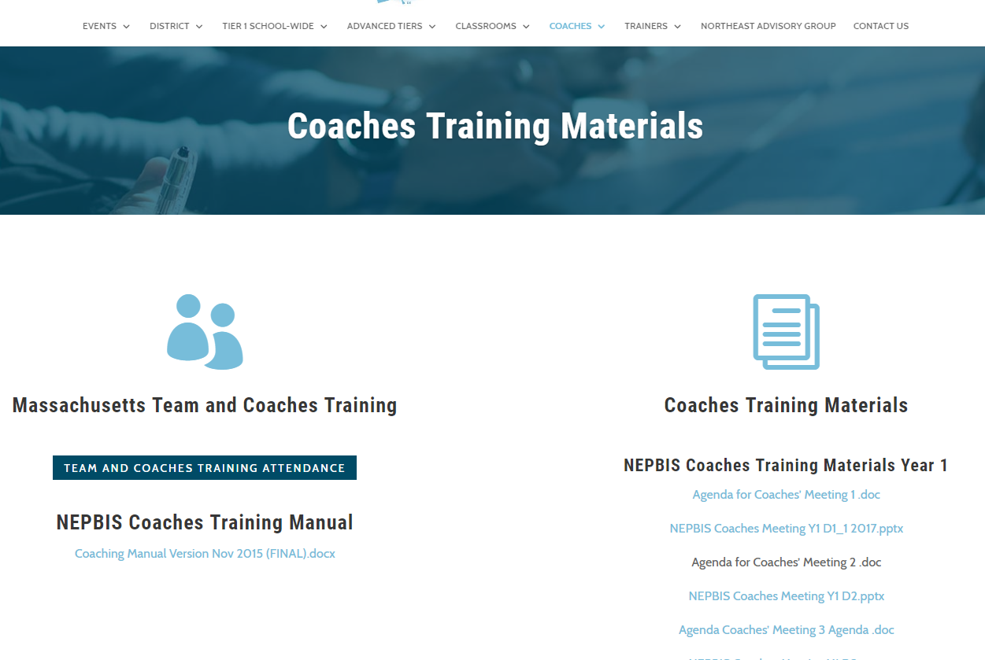
Welcome to Day 1 of PBIS Team Training FOR HIGH SCHOOLS!
As you wait for the training to begin, please:
Update your display name in Zoom to read: [Your School], [Your Name] (e.g., Eastside HS, Joe Clark)
This will help us create breakout rooms!
Pull up your current action plan
Enter your attendance by following the hyperlink or through nepbis.com

Slide 2
BEFORE WE GET STARTED…
We anticipate that throughout the year, all team members may not always be able to attend all trainings. We can record trainings to allow absent team members to “catch up” on what they missed.
Recordings would be kept by trainers for 1 month, then deleted
Recordings would only be shared with team members from your cohort
Recordings would not include activities/discussions in breakout rooms
If you have any discomfort with the training being recorded, message a trainer in the chat (privately) or unmute and let us know your concern.
Notes:
TRAINERS –

Slide 3
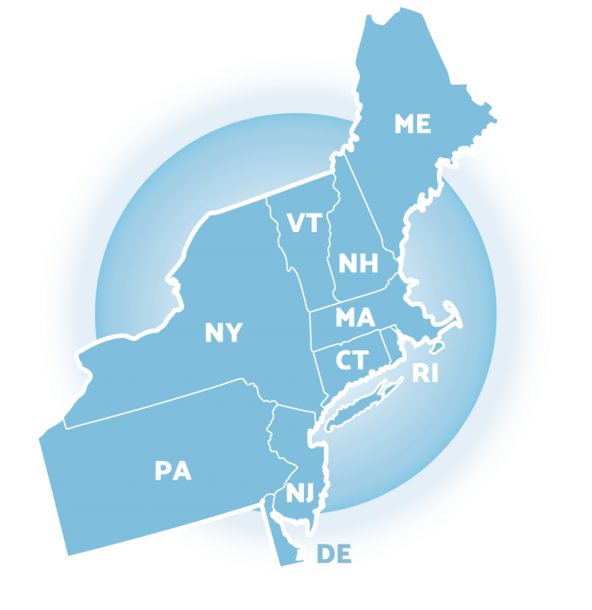
NEPBIS School-Wide Team Training Year 1: October
[Insert Trainer Names]
with support from Brandi Simonsen, Jen Freeman, Susannah Everett,
Adam Feinberg & Katie Meyer
Notes:
Trainers: refer to training manual for:
Tips on presenting the overview content
Explanation for short activity periods and ideas for teaching this to teams
Ideas for facilitating review and team action planning

Slide 4
School-Wide Positive Behavior Interventions & Supports (SWPBIS)

Slide 5
Agenda & Team Tasks
Training Overview
Overview of NEPBIS School-Wide Training
Getting Started with PBIS
Leadership Team
Working Smarter (Not Harder)
Team Tasks
Select Action Plan Template
Establish Leadership Team
Complete Working Smarter Matrix
Overview of SWPBIS

Slide 6
LEGEND
Discussion
Poll
&
Positive & Negative Examples
Activity

Slide 7
OVERVIEW
NEPBIS School-Wide Training

Slide 8
TIER 1 MEETINGS: TEAMS & COACHES
Year
Years
01
02
03
Attendees
Team Training (Minimum):
Administrator
Grade-Level Representatives
Support Staff
Coaches Training:
2-3 Coaches
Technical Assistance:
Administrator
Coach
Data Entry Staff
Virtual Support
Monthly Team Trainings
Monthly Coaches Meetings
2 days Technical Assistance per school
SWIS Data System & Training
District Coordinator Support
In-Person/Hybrid Support
Team Trainings
Coaches Meetings
School-based Technical Assistance
SWIS Data System & Training
District Coordinator Support
Notes:
Trainer note: Review support options for this year. Please let folks that future trainings will include a mixture of in person and online (hybrid) approaches (e.g., in person team trainings, but virtual coaches meetings). Regardless of support delivery, the categories of the support will be listed and developed based on DESE recommendations.

Slide 9
EXPECTATIONS
Self
Others
Environment
Self-monitor (Are you participating? Engaged as a learner? Talking during allotted times?)​
Mute when listening, unmute to talk​
Have your computer charged and ready to go​
Stretch, break, stand as needed​
If you have questions or comments, unmute, use the chat box, or click the "raise hand" icon
Work as a team: Room for every voice, reinforce participation
Keep necessary materials at hand (e.g., action plan & other docs, water, snacks, etc.)​

Slide 10
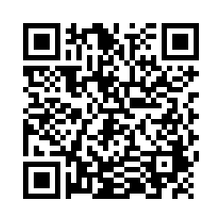
ACTIVITY: ATTENDANCE
Scan QR code on the left or follow the URL posted in the chat to access the online attendance survey
Follow prompts to enter attendance information
Notify trainers if you require assistance (e.g., identifying your cohort or cohort group)
1 minute
Notes:
TRAINERS –
Post a link to the attendance survey (below) in the chat for those who do not use the QR code on the slide:
https://uconn.co1.qualtrics.com/jfe/form/SV_cvz67c35MhUrElT

Slide 11
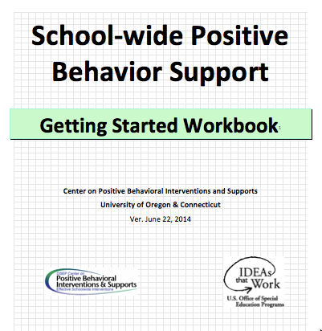
TOOLS
WEBSITES
School-Wide PBIS Workbook & Appendices
Action Plan
nepbis.org
pbis.org
pbisapps.org

Slide 12
ACTION PLANNING
Definition:
The process of organizing resources to enable individuals to engage in activities designed to achieve specific and important outcomes.

Slide 13
ACTION PLANNING
Action Plan
Foundation for all you do as a team
Vital for achieving goals
Specifies three features:
1
2
3
Who
What
When
Who is responsible…
…for doing what…
…by when?

Slide 14
ACTION PLAN PRINCIPLES
District Alignment
Measureable
Contextual Fit
Sustainable
Evidence-Based
Effective, Efficient, & Relevant
Does your action plan match the goals of your district?
Does your plan support desired mesurable outcomes?
Can your plan be revised based on the needs shown by data?
Will the plan ensure implementation can continue over time?
Does your action plan prioritize what is already known to work?
Are the decisions you are making feasible, important, and maximizing potenntial benefits?
Notes:
As you and your team develop your action plan, there are important principles to keep in mind:
How does your action plan match the goals of your district?
Are the items on your action plan supporting your desired measurable outcomes?
Is there room for revision based upon the needs shown by data?
Does your action plan prioritize what is already known to work?
Will the work you are doing ensure that implementation can continue long term?
Are the decisions you are making feasible, important and “the best bang for your buck”?
Use your action plan to help you remember what you plan to do and prioritize your next steps

Slide 15
nepbis.org
Choose an action plan template that works for your team and your stage of implementation!
Notes:
It’s important to identify an action plan document that works for your team. You can find a few versions on the NEPBIS.org website

Slide 16
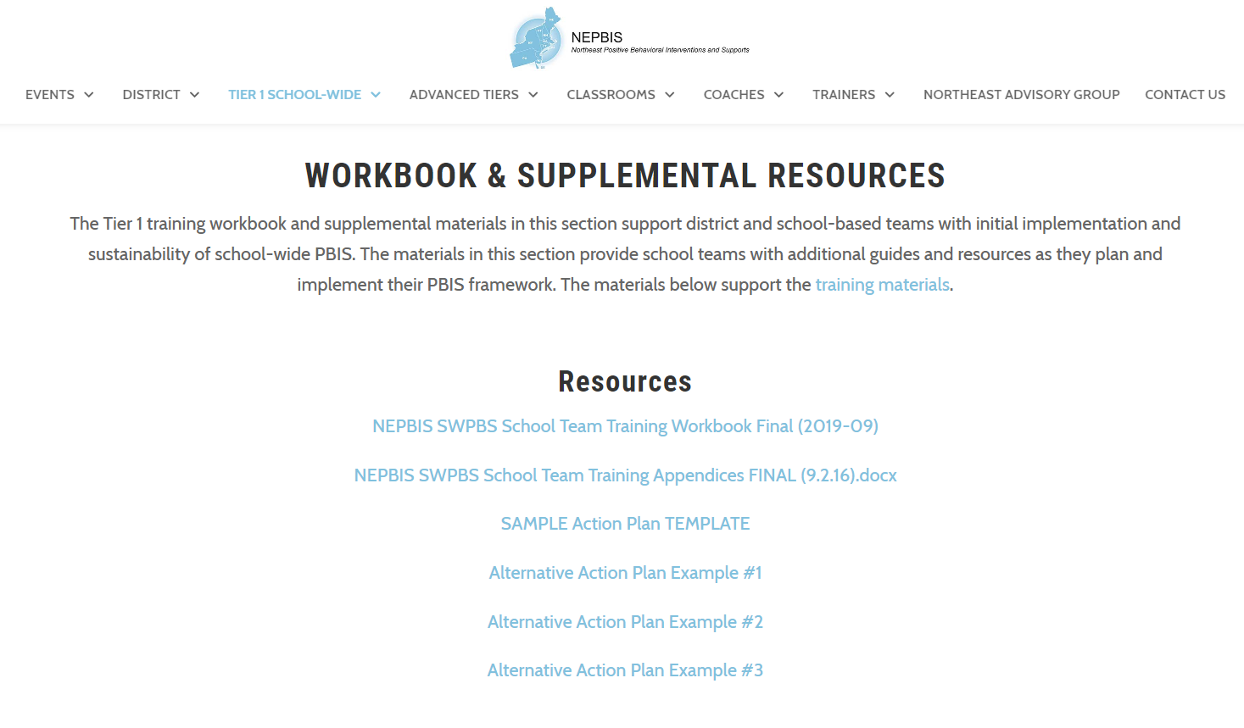
ACTIVITY: ACTION PLAN TEMPLATE
Split into breakout rooms
Navigate to nepbis.org
Select the “Tier 1 School-Wide” dropdown menu and click on the “Tier 1 Workbook and Supplemental Resources” page
Use pages 39-42 of the workbook as a guide
Review the action plan templates, selecting one for your team to use as a foundation
Begin to customize the content for your team’s school
5 minutes
Team Breakouts
Notes:
TRAINERS – Activity prompt below; allow 5 minutes.
Split into breakout rooms
Navigate to nepbis.org
Select the “Tier 1 School-Wide” dropdown menu and click on the “Tier 1 Workbook and Supplemental Resources” page
Use pages 39-42 of the workbook as a guide
Review the action plan templates, selecting one for your team to use as a foundation
Begin to customize the content for your team’s school

Slide 17
SWPBIS
Overview of Steps 1 & 2

Slide 18
WHY SWPBIS?
“Getting tough” doesn’t work
Context matters
Schools asked to do more with less
SWPBIS works
SWPBIS provides a framework to promote equity

Slide 19
Immediate & seductive solution... “Get Tough!”
False sense of
safety and security!
Fosters environments of control
Triggers & reinforces antisocial behavior
Shifts accountability away from school
Devalues child-adult relationship
Weakens relationship between academic & social behavior programming
Increase intensity, frequency, and duration of “aversive” consequences
Give additional and more “aversive” consequences
Give initial “aversive” consequence
Notes:
A common behavior management strategy in schools is “getting tough”
Student acts out, we redirect, student responds, we respond with increasing intensity
Unfortunately this only works with a few students and can have multiple undesirable effects including fostering an environment of control and impairing our relationships with our students.
Important to remember that this does not mean we just let students get away with undesired behavior
And there will be responses to bad behavior in the framework of PBIS
We’ll be talking about ways to make sure that we’re addressing WHY the undesirable behavior is happening, and TEACHING more appropriate behaviors, so students don’t need to continue to use inefficient, inappropriate behavior

Slide 20
SWPBIS Message!
Successful individual student behavior support is linked to host environments or school climates that are effective, efficient, relevant, & durable.
(Zins & Ponti, 1990)

Slide 21
COMPETING GOALS
Teach Common Core
Improve academic skills
Eliminate bullying
Prevent drug use
Support social-emotional learning
Promote college & career readiness
Reduce at-risk, antisocial behavior
Create positive learning environment
What other initiatives or priorities are on your plate or competing for resources in your school?
Type your response(s) in the chat.
…and more
And now, in a virtual learning environment

Slide 22
PBIS Works!
Notes:
Another reason schools implement PBIS is because it helps us to get the outcomes that schools typically seek.
There is over 25 years of research on PBIS demonstrating
Improved outcomes for students
Reductions in exclusionary discipline practices
Improved outcomes for teachers
More research available on www.pbis.org

Slide 23
…EVEN IN HIGH SCHOOLS!
Bohanon, H., Fenning, P., Carney, K. L., Minnis-Kim, M. J., Anderson-Harriss, S., Moroz, K. B., . . . Sailor, W. (2006). Schoolwide application of positive behavior support in an urban high school: A case study. Journal of Positive Behavior Interventions, 8, 131-145. doi: 10.1177/10983007060080030201
Bradshaw, C. P., Debnam, K. J., Lindstrom Johnson, S., Pas, E. T., Hershfeldt, P., Alexander, A., Barrett, S., & Leaf, P.J. (2014). Maryland's evolving system of social, emotional, and behavioral interventions in public schools: The Maryland Safe and Supportive Schools Project. Adolescent Psychiatry, 4, 194-206.
Flannery, K. B., Fenning, P., Kato, M. M., & McIntosh, K. (2013, November 4). Effects of School-Wide Positive Behavioral Interventions and Supports and Fidelity of Implementation on Problem Behavior in High Schools. School Psychology Quarterly. Advance online publication. doi: 10.1037/spq0000039
Flannery, K. B., Frank, J. L., McGrath Kato, M., Doren, B., & Fenning, P. (2013). Implementing Schoolwide Positive Behavior Support in high school settings: Analysis of eight high schools. The High School Journal, 96(4), 267-282. doi: 10.1353/hsj.2013.0015
Freeman, J., Simonsen, B., McCoach, D.B., Sugai, G., Lombardi, A., Horner, R. (2016). Relationship between school-wide positive behavior interventions and supports and academic, attendance, and behavior outcomes in high schools. Journal of Positive Behavior Interventions. DOI: 10.1177/1098300715580992
Freeman, J., Simonsen, B., McCoach, D.B., Sugai, G., Lombardi, A., Horner, R. (2015). An Analysis of the Relationship Between Implementation of School-wide Positive Behavior Interventions and Supports and High School Attendance and Dropout Rates. The High School Journal.
Morrissey, K. L., Bohanon, H., & Fenning, P. (2010). Teaching and acknowledging expected behaviors in an urban high school. Teaching Exceptional Children, 42, 27-35.
Muscott, H., Mann, E., & LeBrun, M. (2008). Positive behavioral interventions and supports in New Hampshire: Effects of large-scale implementation of schoolwide positive behavior support on student discipline and academic achievement. Journal of Positive Behavior Interventions, 10, 190-205. doi: 10.1177/1098300708316258
Swain-Bradway, J., Pinkney, C. & Flannery, K. B. (2015) Implementing SWPBIS in High Schools: Contextual Factors and Stages of Implementation. Teaching Exceptional Children. 47 (5), 245–255
RESOURCE
Flannery, K. B. & Sugai, G. (2010) School-Wide PBIS Implementation in High Schools: Current Practice and Future Directions. Eugene, OR: University of Oregon, Educational and Community Supports. Available on http://pbis.org
“Recent high school evidence!!”
Positive effects on student perceptions of school climate and safety
Positive effects on behavior & attendance
Improvement in Academic performance
reading and math assessments
Attendance & behavior related to dropout risk, but impact of PBIS unclear
Relationship between dropout & PBIS better w/ fidelity but requires more time & intensity

Slide 24
FRAMEWORK FOR EQUITY PROMOTION
Data-based decision making
Classroom PBIS Systems
Formal reward systems
Tobin & Vincent (2011)
Tobin & Vincent (2011)
Barclay (2017),
Tobin & Vincent (2011)

Slide 25
What is SWPBIS?
What’s your initial quick definition/word association of PBIS?
Type your response in the chat.

Slide 26
SWPBIS is
Framework for enhancing adoption & implementation of
Continuum of evidence-based interventions to achieve
Academically & behaviorally important outcomes for
All students
Notes:
Discuss how the PBIS framework applies to changing contexts. The beauty of the PBIS framework is that it can be adapted to each context.

Slide 27
SWPBIS = MTSS
Data-based
decision making
Continuous progress
01
Implemeted with
Monitoring
06
02
fidelity
Prevention
05
03
Continuum
and early intervention
of evidence-based interventions
04
Universal
Screening

Slide 28
Continuum of School-Wide Instructional & Positive Behavior Support
Tertiary Prevention:
Specialized
Individualized
Systems for Students with High-Risk Behavior
Primary Prevention:
School-/Classroom-
Wide Systems for
All Students,
Staff, & Settings
~5%
~15%
Secondary Prevention:
Specialized Group
Systems for Students with At-Risk Behavior
~80% of Students
Notes:
Erik
Key Points
-Many of you have probably seen this triangle before. It’s the same triangle we see when talking about Response to Intervention (RTI), Multi-tiered Systems of Support (MTSS), AND Positive Behavioral Interventions and Supports (PBIS). It’s ALL THE SAME TRIANGLE using ALL THE SAME PRINCIPLES.
-We presume that if we provide evidence based intervention (whether academic or behavioral), to ALL students, that at least 80% of students should respond and need no further intervention. We call this Tier I, School wide, or universal intervention.
-But, we know that there will be a portion of the population, around 15%, who will need more specialized intervention. NOTE….they’ll still be getting that Tier I intervention, but we may provide an additional exposure to that Tier I intervention or maybe provide a short-term group to address the need. Once the students show they don’t need the additional layer of intervention anymore, that intervention is peeled away and they continue to get the Tier I.
-Yet, there will always be a smaller part of the population who may need more intensive, more individualized intervention. We assume that this will be about 5% of the population. This population with “tier III needs” will receive: the Tier I interventions, the Tier II interventions, AND their own individualized intervention. Once they show that they don’t NEED the Tier III intervention anymore, that layer is peeled away, and so on.
(click)
NOTICE GREEN GOES IS FOR “ALL”
Tier 1 must be firmly in place before you build Tier2 and Tier 3.
Otherwise, you will wind up with an inverted triangle or volcano!
Karen:
It can be so hard to stay focused on Tier 1 when students are engagind in concerning beh
Without solid Tier I supports in place you’ll likely have disproportionate numbers of students who will need Tier II and Tier III services. There are only so many staff and resources to go around. By providing Tier I to fidelity, you reduce the need for Tier II and Tier III services and reduce the burden on those providers. This is a way to use your resources more efficiently.
But getting started can be overwhelming...let’s take a look

Slide 29
Guiding Principles
Systems
Data
Practices
Prioritize equity. MTSS is for all students, families, and educators. Use the MTSS framework to differentiate supports for students and monitor to ensure equitable outcomes are observed.
Equity
Outcomes

Slide 30
Equity
Make student growth and benefit central to all decisions. Student outcomes that reflect equitable learning opportunities must be the ultimate criteria for all decisions.
Outcomes

Slide 31
Systems
Data
Practices
Prioritize the most efficient and effective practices. Do a few important and relevant practices well. Emphasize practices that are supported by evidence, match the local culture and current context, and promote high-quality implementation across time. Integrate, align, and connect practices.
Equity
Outcomes

Slide 32
Systems
Data
Practices
Equity
Use data to inform decisions about which students, families, and educators need which supports, as well as whether supports should be continued, adjusted, or faded. Data should be used to ensure that all recipients experience benefit and that supports are implemented with fidelity.
Outcomes

Slide 33
Systems
Data
Practices
Continue to invest in systems to support high-fidelity implementation over time. Leverage existing leadership teams to guide planning and implementation, and consider effective means to support educators’ professional learning and wellness given current resources, experience, and expertise.
Equity
Outcomes

Slide 34
What’s Unique About Implementing PBIS in High Schools?
Size
Impacts communication & collaboration
Critical that admin & staff are informed and clear about the direction, priorities, and messaging around PBIS, as well as their role in it
Organizational Culture
Sole focus on academics
Belief students should have self-management skills
Increased use of exclusionary practices
Developmental Level
Utilize students in the planning & implementation process
Student desire for independence and autonomy
Collect and use data to inform decisions on needs and outcomes
(Flannery et al., 2013; Swain-Bradway et al., 2015)
Notes:
TRAINER NOTES: Two critical features for successful implementation of PBIS in HS:
1. Active involvement of students
2. Invest in systems and practices that support all students

Slide 35
DISCUSSION: IMPLEMENTATION
How do the size, organizational culture, and developmental level of your students impact implementation of school-wide programs and supports in your building?
Discuss in randomized breakout rooms.
Breakouts
8 minutes
Notes:
TRAINERS – Discussion prompt is below; allow 8 minutes
How does the size, organizational culture and developmental level of your students impact implementation of school-wide programs and supports in your building?

Slide 36
KEY FOUNDATIONAL SYSTEMS IN HS
Leadership
Obtain diverse staff & student input with subcommittees or ad hoc committees
Develop communication plan between PBIS & administrative team
Data
Identify data needed for decision making and develop standard visuals for meetings
Include academic & attendance indicators
Data
Leadership
Communication
Communication
Share SW data & host conversations on what the data mean
Use multiple mechanisms to communicate with students & staff
Flannery & Kato, 2018
Notes:
The foundational systems most impacted by the unique HS context are: Leadership, Communication, and Data systems. The following recommendations represent some suggestions for high schools to help address the contextual impacts that challenge PBIS implementation. The full chapter & monograph is available on pbis.org and listed in additional resources at the end of this presentation.

Slide 37
Getting Started
Establish a Leadership Team,
Work Smarter (Not Harder),
Statement of Purpose

Slide 38
Getting started with swpbis
Establish an effective leadership team
Develop a continuum to strengthen appropriate behaviors
Develop a brief statement of purpose
Develop a continuum to discourage violations of expectations
Identify positive school-wide behavior expectations
Develop data-based procedures for monitoring
Develop procedures to teach school-wide expectations
Develop systems to support staff
Develop procedures to teach class-wide expectations
Build routines to ensure ongoing implementation

Slide 39
ESTABLISH AN EFFECTIVE LEADERSHIP TEAM
Systems
How will we work together?

Slide 40
GENERAL IMPLEMENTATION PROCESS
Team
Agreements
Data-based
Action Plan
Evaluation
Implementation
Notes:
SAY: In general, the implementation of a school-wide PBS approach at the school level is built around five main implementation steps.

Slide 41
TEAM COMPOSITION
Administrator
Support Staff
Grade/Department Representatives
Parent/Family Members
Specialists
Community Members
Office, Supervisory, Custodial, Bus, Security, etc.
Special Educator, Counselor, School Psychologist, Social Worker, etc.
Mental Health Providers, Businesses
Student involvement is critical
Student

Slide 42
Consider a focus on FRESHMEN
Focused on universal supports for 9th graders
Involve teachers & staff that work with freshmen, including:
Counselor
Dean of Students
Attendance Committee Representative
Administrator
At least 1 person serving on PBIS Leadership team

Slide 43
Ensuring a Representative Team
Supports Relevance & Equity
Improves student outcomes
Promotes Engagement
Family/Student Voice
Ensure the family/student role is clearly outlined, defined, and understood
Give families ownership of system components (e.g., celebrations, acknowledgements)
Ask families to assist in reporting team discussions & data
Seek family/student feedback regarding school processes

Slide 44
Navigating a Complex Administrative Structure
Clarify how the principal will support implementation, especially if not part of team (announcements, sharing data, distributing acknowledgements to staff, etc.)
Develop a communication system between the PBIS team & administrative team
Determine which decisions the PBIS team has the authority to make and which need to be reviewed by admin team
Establish protocols for what happens when admin rep is called away from PBIS team meetings (e.g., will review & comment on minutes w/in 48 hours)
Consider these strategies to help ensure adequate administrative involvement:
Notes:
There are often multiple administrators in high schools that operate independent of one another (e.g., Principal, APs, Deans, department heads, etc.). Therefore, having a single representative administrator on the team may not be effective unless other steps are taken to ensure the entire leadership team is kept up to date on activities and decisions around PBIS implementation. PBIS requires schoolwide agreement on a number of systems and practices, and a clear system needs to be developed to assist in communication and decision making related to the common systems and practices.

Slide 45
DISCUSSION: TEAM COMPOSITION
How do you currently ensure student involvement in decision-making?
What members of the admin team need to be included in decision making?
Thoughts on focusing on 9th grade?
Team Breakouts
5 minutes
Notes:
TRAINERS – Discussion prompt is below; allow 5 minutes. Can be done as a whole group or in randomized breakout groups.
How do you currently ensure student involvement in decision-making?
What members of the admin team need to be included in decision making?
What do you think about forming a separate team focused on 9th grade?

Slide 46
GUIDELINES FOR TEAMS
Membership
Systems
Scheduling
Systems
Representative of school/community demographics
1-2 members with behavior/classroom management competence
1-2 family members
Active participation from administrator
Integrated with other behavior-related initiatives/programs
Given appropriate priority relative to school/district goals
Established rules/agreements
Coaching support (at the school, district, or regional level)
Monthly meetings
Monthly presentations to staff
Annual self-assessments

Slide 47
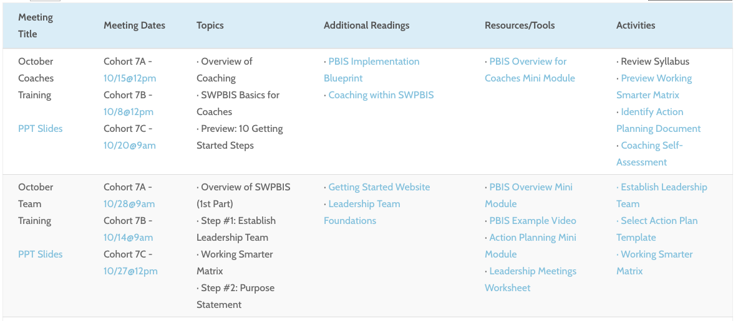
ACTIVITY: TEAM PROFILE & AGREEMENTS
Work as a team in breakout rooms
Navigate to nepbis.org
Select the “Tier 1 School-Wide” dropdown menu and click on the “Tier 1 Training Materials” and click on Year 1 Syllabus
Click on Establish Leadership Team under October Team Activities.
Complete Team and Profile Agreements activity.
Add items to your action plan, as needed.
15 minutes
Team Breakouts
Notes:
TRAINERS – Prompts for activity below; allow 15 minutes.
Split into breakout rooms
Navigate to nepbis.org
Select the “Tier 1 School-Wide” dropdown menu and click on the “Tier 1 Workbook and Supplemental Resources” page
Complete the Team Profile and Agreements in the workbook (pp. 51-53).
Establish routines for conducting effective and efficient meetings (use workbook p. 54).
Add items to your action plan, as needed.

Slide 48
WORK SMARTER
Systems
How does PBIS fit with what is already in place in our school?

Slide 49
Do less,
better
Work
smarter!
Do it once
Invest in a
sure thing
Invest in clear
outcomes
Be strategic about problem solving

Slide 50
DISCUSSION: COMMITTEES & INITIATIVES
Are there multiple committees working on social, emotional, or behavioral initiatives in your school?
Is there communication and coordination among related initiatives/teams?
Whole Group
5 minutes
Notes:
TRAINERS – Discussion prompt is below; allow 5 minutes. Whole group discussion.
Are there multiple committees working on social, emotional, or behavioral initiatives in your school?
Is there communication and coordination among related initiatives/teams?

Slide 51
ALIGNING TEAM STRUCTURES
Purpose: Provide an overall picture of existing teams within your school and determine the need for merging these teams
Initiative/
Committee/ Team
Purpose & Strategic Goal Supported
Measurable, Data-Based Outcome(s)
Target Group
Staff Involved
Overlap? Modify? Eliminate?

Slide 52
ALIGNING TEAM STRUCTURES
Instructions: using the Working Smarter worksheet, complete the following three steps.
Identify current teams (e.g., discipline, instruction, climate, etc.) and initiatives (e.g., Second Step, Character Counts, Spirit Committee, etc.) in place
Complete the Working Smarter Table (below)
Based on these results, what committees or initiatives can you eliminate, combine, or provide with more support? How can you infuse PBIS into your current committees or teams?
Initiative/
Committee/ Team
Purpose & Strategic Goal Supported
Measurable, Data-Based Outcome(s)
Target Group
Staff Involved
Overlap? Modify? Eliminate?

Slide 53
ALIGNING TEAM STRUCTURES – EXAMPLE
Initiative/
Committee/ Team
Purpose & Strategic Goal Supported
Measurable, Data-Based Outcome(s)
Target Group
Staff Involved
Overlap? Modify? Eliminate?
PBIS
Ensure positive, safe, predictable, & consistent environment
ODRs, suspensions, attendance, universal screening, school climate survey
All students, staff, & families
Principal, social worker, 3 general + 1 special ed. teachers
- Overlap with crisis/TI teams
- Combine and rename
- Add EOY meeting to revise safety protocols
Safety/Crisis Team
Update protocols to ensure safe environment & plan for crisis
None
All students, staff, & families
Principal, social worker, 2 general ed. teachers
- Expand use of data to monitor police contacts from school & safety assessments
Trauma-Informed Team
Ensure students feel safe, supported, & ready to learn
ODRs, suspensions, attendance, universal screening, school climate
All students, staff, & families
Principal, social worker, 2 general + 1 special ed. teachers
- Overlap with PBIS team
Combine team
- Make current members coaches

Slide 54
GUIDING QUESTIONS
Systems
How would our teams work more effectively if we had a single model of service delivery to address the social-emotional-behavioral needs of our students?
What communication loops and /or progress monitoring exists among all of these support personnel?
Are there other school teams with similar goals we should consider coordinating with?

Slide 55
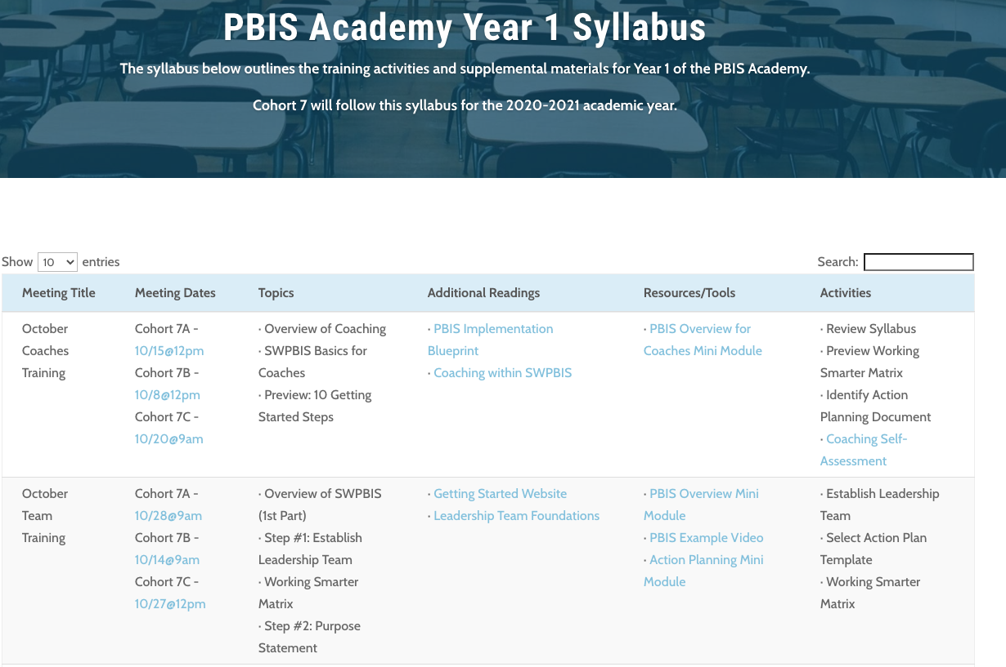
ACTIVITY: COMMITTEE AUDIT (WORKING SMARTER)
Work with your team in breakout rooms
Navigate to nepbis.org
Select “Tier 1 School-Wide” dropdown menu and select “Training Materials,” then select “Year 1 Syllabus & Resources” Click on Working Smarter Matrix.
Review data on the matrix and use guiding questions to develop an action plan for eliminating or modifying teams as needed.
Be ready to report on 2 to 3 “big ideas” from your group (1 minute).
15 minutes
Team Breakouts
Notes:
TRAINERS: Prompts for activity below; allow 15 minutes.
Split into breakout rooms
Complete the Working Smarter Matrix to identify all teams and details.
Review data on the matrix and use guiding questions to develop an action plan for eliminating or modifying teams as needed.
Be ready to report on 2 to 3 “big ideas” from your group (1 minute).
https://nepbis.org/wp-content/uploads/2020/09/Working-Smarter-Activity.docx

Slide 56
AGENDA & FOLLOW-UP
Training Overview
Overview of NEPBIS School-Wide Training
Getting Started with PBIS
Leadership Team
Working Smarter (Not Harder)
Team Tasks
Select Action Plan Template
Establish Leadership Team
Complete Working Smarter Matrix
Overview of SWPBIS
What questions do you have on today’s content?
What questions do you have on the follow-up team tasks?

Slide 57
RESOURCES
Mini Module: PBIS Overview
PBIS Example Video
Mini Module: Action Planning
Conducting Leadership Meetings Worksheet

Slide 58
READINGS
Getting Started Website
HS PBIS Implementation: Student Voice
Context of Implementing PBIS in HS (Chapter 2)
Returning to School During & After a Crisis

Slide 59
NEXT MEETING
Training Overview
Overview of SWPBIS, Part 2
Getting Started with PBIS
Develop Statement of Purpose
Develop Teaching Procedures
Team Tasks
Develop Statement of Purpose
Identify School-Wide Expectations
Develop School-Wide Expectations
Develop Teaching Matrix
Develop Home Matrix Plan

Slide 60
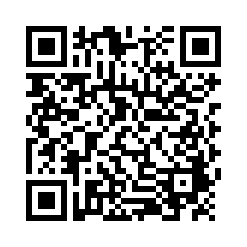
EVALUTION
Please send your trainers your Team Profile.
Please remember to complete the evaluation to receive your PDPs!
Notes:
TRAINERS -
Put link to evaluation (below) in the chat for those who do not use the QR code:
https://uconn.co1.qualtrics.com/jfe/form/SV_5BXYIXLvg0qmSzP

