Slide 1
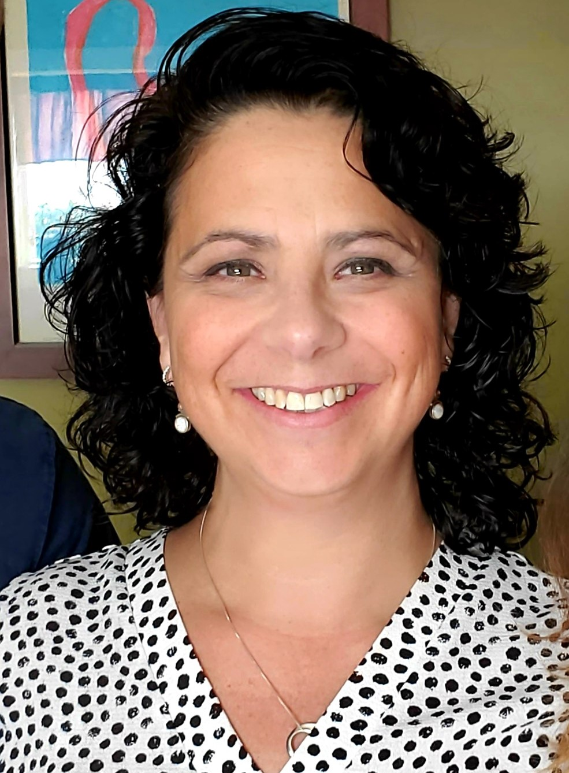
School-Wide Positive Behavioral Interventions and Supports (SWPBIS)
Data Based Procedures for Monitoring
Christine Downs & Erik Maki
with support from Brandi Simonsen, Jen Freeman,
Susannah Everett, Adam Feinberg, Katie Meyer, & George Sugai

Slide 2
Getting Started with SWPBIS
Establish an effective and representative leadership team
Develop brief statement of behavioral purpose
Identify positive SW behavioral expectations
Develop procedures for teaching SW expectations
Develop procedures for teaching class-wide expectations
Develop continuum for strengthening appropriate behavior
Develop continuum for discouraging violations of expectations
Develop data-based procedures for monitoring
Develop systems to support staff
Build routines to ensure on-going implementation

Slide 3
Getting Started with SWPBIS
Establish an effective leadership team
Develop brief statement of behavioral purpose
Identify positive SW behavioral expectations
Develop procedures for teaching SW expectations
Develop procedures for teaching class-wide expectations
Develop continuum for strengthening appropriate behavior
Develop continuum for discouraging violations of expectations
Develop data-based procedures for monitoring
Develop systems to support staff
Build routines to ensure on-going implementation
II.B.viii

Slide 4
Why Use Data for Decision Making?
Decisions are more likely to be effective and efficient when they are based on data. Use data to:
Identify problems
Refine problems
Define the questions that lead to a solution
The quality of decision making depends most on defining problems with precision & clarity.
Data help place the “problem” in the context rather than in the students.
II.B.viii

Slide 5
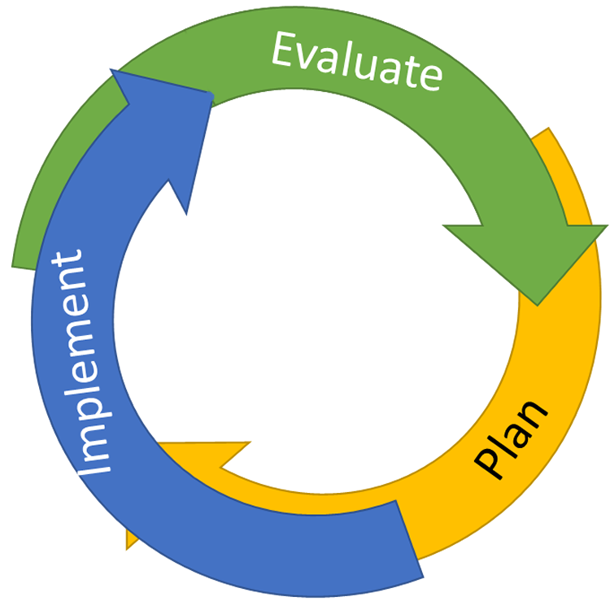
Continuous Quality Improvement
Reassess and revise solution(s) as needed
Identify problems with precision
Monitor outcomes and compare
to goal(s)
DATA
Establish goal(s)
Develop solution(s)
Implement solution(s) with integrity and fidelity

Slide 6
Steps for Selecting, Monitoring, and Evaluating SWPBIS Practices
Step 1: Develop evaluation questions.
What do you want to know?
II.B.viii

Slide 7
Steps for Selecting, Monitoring, and Evaluating SWPBIS Practices
Step 1: Develop evaluation questions.
Step 2: Identify indicators or measures.
What do you want to know?
What information can be collected?
II.B.viii

Slide 8
Types of Information (Data)
Fidelity Data
Outcome Data
Did we implement the systems and strategies we agreed upon?
Is the plan resulting in progress toward our goals?

Slide 9
Steps for Selecting, Monitoring, and Evaluating SWPBIS Practices
Step 1: Develop evaluation questions.
Step 2: Identify indicators or measures.
Step 3: Develop methods for collecting and analyzing indicators.
What do you want to know?
What information can be collected?
How/when should information be gathered?
II.B.viii

Slide 10
Guidelines for Efficient Data Analysis
Protect team time to review data monthly
Data system managed by 2-3 staff members
Efficient, timely, and graphic displays of data
Structures and routines for staff members to receive weekly/monthly data reports about status of SW discipline
Decision rules for guiding data analysis and actions
II.B.viii

Slide 11
Steps for Selecting, Monitoring, and Evaluating SWPBIS Practices
Step 1: Develop evaluation questions.
Step 2: Identify indicators or measures.
Step 3: Develop methods for collecting and analyzing indicators.
Step 4: Make decisions and action plan from analysis of indicators.
What do you want to know?
What information can be collected?
How/when should information be gathered?
How was the question answered and what should be done next?
II.B.viii
Notes:
-

Slide 12
Data Review: PBIS Team
Look at Average Referrals Per Day per Month Graph
Past 3 months greater than 25th Percentile
Examine Students who need Tier 2 Supports
No
Yes
Look at 3 Graphs:
ODR x Problem Behavior
ODR x Location
ODR x Time of Day
Design Action Plan to Teach, Prevent, or Reinforce based on these data
Plan
Example Goal Statement: Reduce ODRs by 20% overall this year, in comparison to last year’s overall numbers.

Slide 13
Action plan from analysis
Data indicate:
ODR data show's more than 3 months above the 50th percentile, and a large spike in data for Grade 5
Grade 5 Team Data also indicate:
Location: Playground
What to do?
Prevent Remind of expected behaviors when conflicts occur at recess
Behavior: Physical Aggression
Time: 11:30 to 12:00
Re-teach Role play of conflict resolution (rock, paper, scissors) from lesson plan
Reinforce Provide special reinforcement for use of conflict resolution skill
Notes:
-

Slide 14
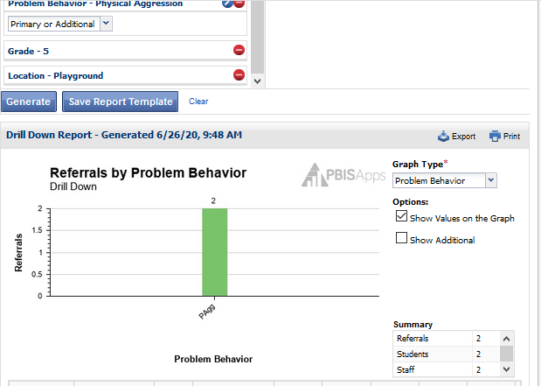

Slide 15
What is the single factor most related to high sustainability?
The frequency that data are presented to all school staff.
McIntosh, K., Kim, J. R., Pinkelman, S., Rasplica, C., Berg, T. & Strickland-Cohen, M. K. (2014).

Slide 16
Activity: Data Evaluation
Work as team
Create a goal statement related to student behavior or discipline referrals
Action plan
What data will be collected
By whom
How often
How will it be shared (e.g. with staff, pertinent stakeholders)
Add items to your Action Plan as necessary

