Slide 1
School-Wide Positive Behavioral Interventions and Supports (SWPBIS)
Northeast PBIS (NEPBIS) School-Wide Team Training
Day 11
INSERT TRAINER NAMES
Guest Speakers: Sarah Fefer, University of Massachusetts-Amherst
Adam Feinberg, University of Connecticut
with support from Brandi Simonsen, Jen Freeman,
Susannah Everett, Adam Feinberg, & George Sugai
Notes:
Add trainer names for your event

Slide 2

Advance Organizer
Quick Recap of Day 7-10 Training
Guest Speakers
Poster Session
TIC & Action Planning

Slide 3
Tier 1 Leadership Team & Coaches Meetings
WHAT | WHO
6 days of Team Training | Minimum membership: administrator, grade level representatives, support staff
3 days Coaches Meetings | 2 Coaches
1day of TA per school | Admin, Coach, Data Entry
YEAR 1
3 days of Team Training | Same above
3 days Coaches Meetings | Same above
1day of TA per school | Same above
YEAR 2
2 days of Team Training | Same above
2 days Coaches Meetings | Same above
1 day of TA per school | Same above
YEAR 3+
Tier 2 Training will also be offered to schools implementing Tier 1 with fidelity.

Slide 4
MAIN TRAINING OBJECTIVES in YEAR 3
Enhance leadership team
Maintain staff agreements
Enhance knowledge of SWPBIS outcomes, data, practices, and systems
Refine individualized action plan for SWPBIS
Enhance and sustain implementation in future years

Slide 5
Training Expectations:
RESPECT…
SELF
Self-monitor (Are you participating? Engaged as a learner? Talking during allotted times?)
Stretch, break, stand as needed
OTHERS
Cell phones (inaudible): Converse in lobbies and breaks
ENVIRONMENT
Recycle
Work as a team: Room for every voice, reinforce participation
Maintain neat working area

Slide 6

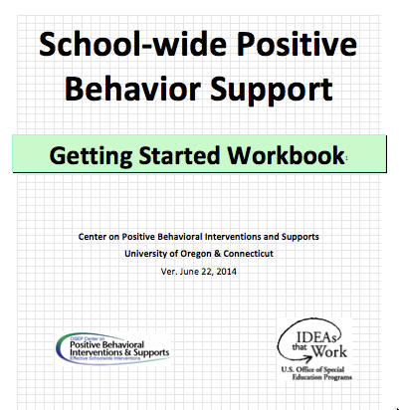

Tools!
nepbis.org
pbis.org
School-wide PBIS Workbook and Appendices
Evaluation Plan
Action Plan

Slide 7

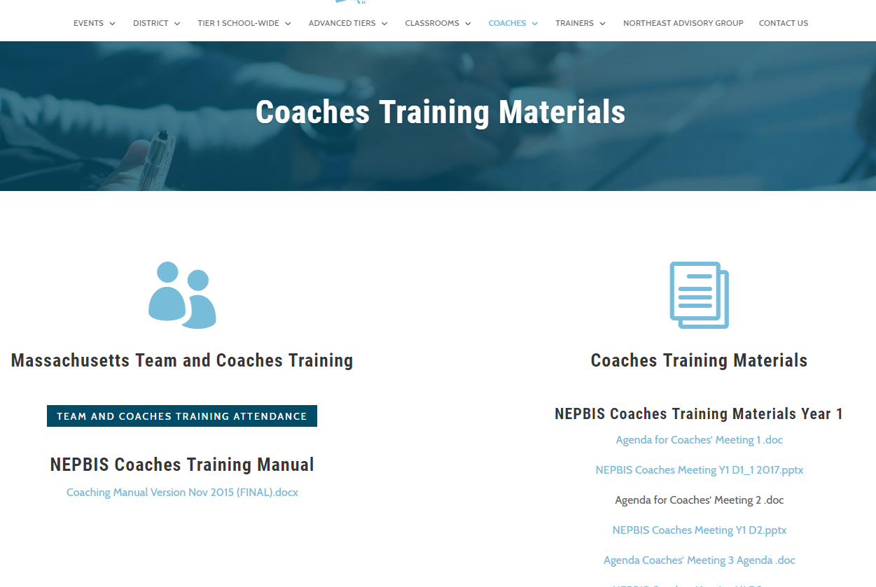
Activity:
Please Enter Attendance
1 min
Please login on nepbis.org, go to the coaches’ tab, and click on the Team Training Attendance Link. Follow prompts to enter team attendance.

Slide 8
Advance Organizer
Introduction and Focus on Coaching
Quick Review and Focus on Year 3 training activities
Coaching Self-Assessment and Reports
Share information on implementation of the PBIS Framework
Advanced Skill Building
Sustaining the PBIS Framework in your school
Congratulations!

Slide 9
PBIS Framework
Sustainability
(Adapted from the work of Kent McIntosh)

Slide 10
School Program Implementation
What experiences have you had with initiative abandonment?
  What school factors often lead to initiatives going away in your schools?
  What factors help initiatives stay in place over the long term?
Talk with your neighbor for 3 minutes about your experiences. Be prepared to share out.

Slide 11
Barriers to Sustainability:
The Three Cs
Antecedent
Behavior
Consequence
Ongoing
Challenge
Select Practices
& Implement
with Fidelity
Student
Outcomes
Changes in Context
- Lack of contextual fit
- New challenges exist
- Competing initiatives
Changes in Capacity
- Loss of funding
- Attrition of key opersonnel
Changes in Consequences
- Diminished effectiveness odue to poor fidelity
- Outcomes no longer operceived as important

Slide 12
Barriers to Sustainability Worksheet
 | Risk Factors/ Barriers | Plan to Address Barriers
Changes in Context
Changes in Capacity
Changes in Consequences

Slide 13
What are enablers of sustainability?
Administrator Support
Staff Buy-in
Fidelity
Data
Teaming
Resources
Stakeholder Involvement
Training
SWPBS Philosophy
Motivation
District Support
What are the most important factors? Turn to your neighbor and discuss?
McIntosh, K., Predy, L., Upreti, G., Hume, A. E. & Mathews, S. (2014). Perceptions of contextual features related to implementation and sustainability of School-wide Positive Behavior Support. Journal of Positive behavior Interventions, 16, 29-41.

Slide 14
Four Principles for Enhancing the Sustainability of PBIS
Promote Priority
Ensure Effectiveness
Increase Efficiency
Use data for Continuous Regeneration

Slide 15
Promoting Priority
Maximize Visibility
Get into written policy
Present data to people with resources
Describe effects of abandoning support for the practice
Braid project with other initiatives
Show how practice can lead to outcomes of new initiatives

Slide 16
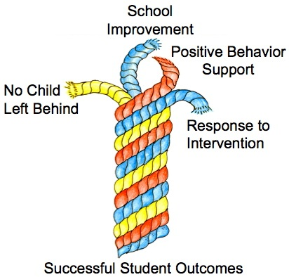
What is Braiding?
(Bohanon, Goodman, & McIntosh, 2009)

Slide 17
Practices Evaluation Flowchart
    Available as handout on www.neswpbis.org

Slide 18
How to enhance priority? SCHOOL PERSONNEL
Keep the practices fresh!
Especially the acknowledgement system
Learn tips from others
Other Schools in District / Conferences
Websites from other places (e.g., pbismaryland.org)
Share your struggles with others (e.g., District team support?)
Other teachers and staff, parents
Celebrate successes of PBIS efforts!
Bring data to every team meeting and use it to guide action planning!
Share data with staff

Slide 19
How to enhance priority? SCHOOL ADMINISTRATORS
Promote PBIS across multiple settings
Share PBIS with parents & parents groups
Acknowledge PBIS efforts regularly
Be an active participant of the PBIS team
Protect from competing initiatives
Attend team meetings and join in action planning implementation
Encourage data-based decision making
Braid and buffer team from too many initiatives
Allocate resources to the PBIS effort
Make time for teams to meet, and teams to update school staff
Share with parent groups

Slide 20
How to enhance priority? DISTRICT ADMINISTRATORS
Share successes
Provide presentations to school board, community agencies, local businesses, news crews
Emphasize outcomes and threats
Provide regular acknowledgements for PBIS efforts
Facilitate sharing among school team facilitators
Connect school teams with similar PBIS schools
Encourage data-based decision making
Set accountability for data collection and reporting
Model good uses of data
Plan for the future
Create an action plan with short & long term goals
Identify and pursue short & long term funding

Slide 21
Ensuring Effectiveness
Focus on FIDELITY OF IMPLEMENTATION
Implement in all settings
Implement in all tiers of support
Consider family trainings
Share data showing how fidelity is related to effectiveness
Regular evaluation of fidelity data

Slide 22
To effectively use data…
…use your evaluation plan
DISTRICTS/SCHOOLS IN TRAINING |  |  | SCHEDULE
Purpose | Measure | Function | Year 1 Training |  | Year 2 Training
 |  |  | Winter | Spring | Fall | Winter | Spring
Capacity Building—District Level | District Systems Fidelity Inventory (DSFI) | Completed by district leadership team (with the support of a trained facilitator) to assess district capacity and to guide Action Planning. |  | X |  |  | X
Fidelity of Implementation—Building Level | PBIS Tiered Fidelity Inventory (TFI) | Leadership team self-evaluation (with support of external coach) to assess the critical features of PBIS across Tiers I, II, and III. |  | X | X |  | X
Progress Monitoring—Building Level | Self-Assessment Survey (SAS) | Used by school staff for initial and annual assessment of effective behavior support systems in their school and to guide Action Planning. |  | X |  |  | X
Progress Monitoring—Team Level | Team Implementation Checklist (TIC) | A self-assessment tool that serves as a multi-level guide for creating School-Wide PBIS Action Plans and evaluating the status of implementation activities. | X | X | X | X | X
School Climate | Georgia School Climate Surveys | An annual survey that assesses student (grades 3-12), teacher, and parent perceptions of school climate. The middle and high school surveys also include items about adolescent drug/alcohol/tobacco use, self-harm ideation and behaviors, school dropout, and parental involvement. The survey provides information to determine training support needs related to school climate, safety, and violence prevention. |  | X | X
Student Outcomes | School-wide Information System (SWIS) | Office discipline referrals (ODR) provide data for monthly team reviews and decision-making by teachers, administrators, and other staff to guide prevention efforts and Action Planning. | Weekly | Weekly | Weekly | Weekly | Weekly
…and tools available at:

Slide 23

Increasing Efficiency
Get it down on paper
Lesson plans
Schedules
Agendas
Focus on efficient team meetings

Slide 24
Working Smarter Team Matrix
Initiative, Committee | Purpose | Outcome | Target Group | Staff Involved | SIP/SID/ etc
Attendance Committee
Character Education
Safety Committee
School Spirit Committee
Discipline Committee
DARE Committee
PBS Team
Eliminate all initiatives that do NOT have a defined purpose and outcome measure
2. Combine initiatives that have the same outcome measure and same target group
3. Combine initiatives that have 75% of the same staff
4. Eliminate initiatives that are not tied to School Improvement Goals
Review and revise your Working Smarter Team Matrix!
How is your PBIS Team braided into other school school programs!

Slide 25
Use Data for Continuous Regeneration
Adjust practices for a changing environment
Connect with a community practice
Priority
Effectiveness
Efficiency

Slide 26
Activity:
Sustainability Review
Work with team for 15 min
Review sustainability guidelines slides just presented.
Discuss above with your team how you can…
  Promote Priority
  Ensure Effectiveness
  Increase Efficiency
  Use Data for Continuous Regeneration
Modify building Action Plan
Share key highlights (1 min. reports)
Notes:
ACTIVITY FOR TEAM TRAINING IN THE SPRING!

Slide 27
Guest Speaker

Slide 28
Guest Speaker Activity & Action Planning

Slide 29
Poster Session

Slide 30
Activity:
Poster Session
90 min
First 10 minutes:
  Set up your poster so that it is visible.
Second 80 minutes:
  Have at least one team member stand by your poster the entire time.
  Take turns walking around and reviewing other school’s posters.
  Ask questions / collect ideas
  Bring information back for discussions with your team during action planning time.

Slide 31
SWPBIS Action Planning with the TIC

Slide 32
Activity:
Examine your Family-School Practices
Work as team for 20 min
Review all content
Complete and use the Family-School Practices Survey
Add 2 to 3 items to your action plan based on priorities discussed while completing the survey
Identify one person who will present big ideas from action planning for your group

Slide 33
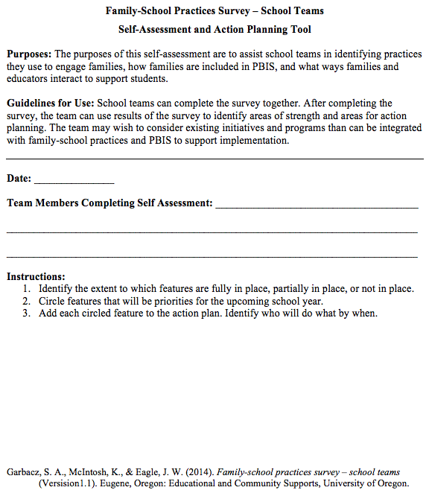
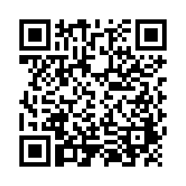
Examining School Approaches to Family Engagement in PBIS
The family-school practices survey for school teams is a self-assessment and action planning tool.
Implementation of school approaches to family engagement are assessed in several areas:
  Communication
  Family-School Activities
  PBIS Practices at Home and School
  Decision-Making/Shared-Ownership
  Resources
Garbacz, McIntosh, & Eagle (2014)
Notes:
The family-school practices survey was designed for school teams to use as a self-assessment and action planning tool.
The tool allows school teams to rate implementation of school approaches to engaging families in PBIS across several dimensions
Dimensions on the tool include
Systems-level problem solving, which assesses team activities to promote family engagement
Data-based decision making
School-home communication about PBIS
Resources to support family engagement, and
PBIS practices at home and school
Take a few minutes to complete the self-assessment, identify areas of strength and need, and complete the action plan at the end of the tool to target areas of need that build on strengths
Link to assessment: https://uconn.co1.qualtrics.com/jfe/form/SV_4U9QPw9ASvLr83z

Slide 34
Activity:
Action Planning
Work as team for 75 min
Complete the Team Implementation Checklist
Return to your Action Plan
Focus on items in your action plan, new ideas from roundtable discussions, as well as content reviewed today.
Identify relevant resources and steps to help move your school forward.
Present 2-3 “big ideas” from your group (1 min. reports)

Slide 35
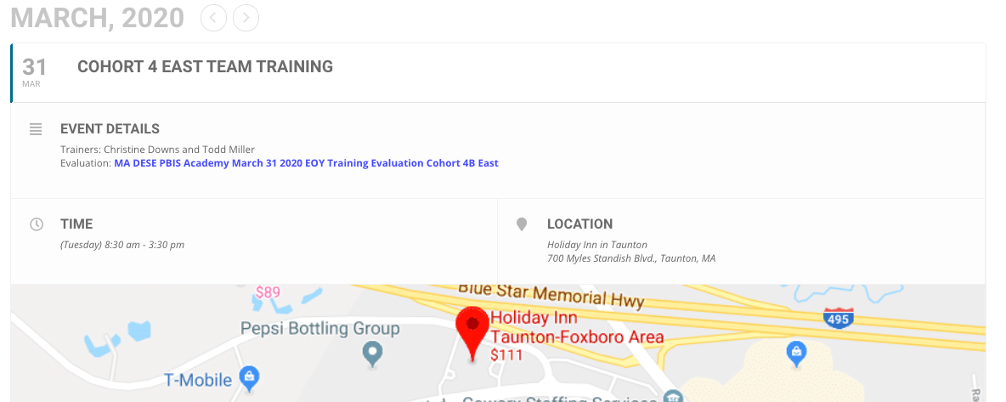
Activity:
Please Complete Brief Training Evaluation
5 min
Please go to nepbis.org, find upcoming events on the right, and click on today’s training event. On the event page, under evaluation, click on the link and complete the brief evaluation of today’s training.

Slide 36

Review of SWPBIS

Slide 37

Critical Features of PBIS
Supporting Culturally Equitable
Social Competence & Academic Achievement
OUTCOMES
Supporting
Culturally
Knowledgeable
Staff Behavior
Supporting
Culturally Valid
Decision
Making
SYSTEMS
DATA
(Vincent, Randal, Cartledge, Tobin, & Swain-Bradway, 2011; Sugai, O’Keefe, & Fallon 2012 ab)
PRACTICES
I.C
Supporting Culturally Relevant
Evidence-based Interventions
Notes:
Use data
Focus on outcomes: Academic & behavior success
On-going evaluation
Ensure cultural and contextual fit
Invest in systems
Organize research-validated practices within a continuum
Instructional & preventative approach
Integration
Tier 1 for all

Slide 38
Consider Tattoos!
4 PBIS Elements
School Systems
Supporting Social Competence &
Academic Achievement
OUTCOMES
School-wide
Classroom
SWPBIS
SYSTEMS
DATA
Supporting
Decision
Making
Supporting
Staff Behavior
Non-classroom
Family
PRACTICES
Tertiary Prevention:
Specialized
Individualized
Systems for Students with High-Risk Behavior
~5%
Student
Supporting
Student Behavior
Primary Prevention:
School-/Classroom-
Wide Systems for
All Students,
Staff, & Settings
~15%
Secondary Prevention:
Specialized Group
Systems for Students with At-Risk Behavior
~80% of Students

Slide 39
Next Steps

Slide 40
Implement Action Plan
Communicate information to staff
Meet monthly with team
  Review school data
  Review/update action plan including aspects of sustainability.
Implement activities on action plan
Use fidelity (e.g., TFI) and outcome (e.g., ODR) data to guide your decision making

Slide 41
Future Support
Use your action plan, data, TIC, and TFI to hold your team accountable (and share info with us).
Keep in touch with us.
Share your examples with other schools in your district(s)
Advocate for and start a District MTSS / PBIS Team to share / compare with other schools locally

Slide 42
Consider Tattoos!
4 PBIS Elements
School Systems
Supporting Social Competence &
Academic Achievement
OUTCOMES
School-wide
Classroom
SWPBIS
SYSTEMS
DATA
Supporting
Decision
Making
Supporting
Staff Behavior
Non-classroom
Family
PRACTICES
Tertiary Prevention:
Specialized
Individualized
Systems for Students with High-Risk Behavior
~5%
Student
Supporting
Student Behavior
Primary Prevention:
School-/Classroom-
Wide Systems for
All Students,
Staff, & Settings
~15%
Secondary Prevention:
Specialized Group
Systems for Students with At-Risk Behavior
~80% of Students

Slide 43
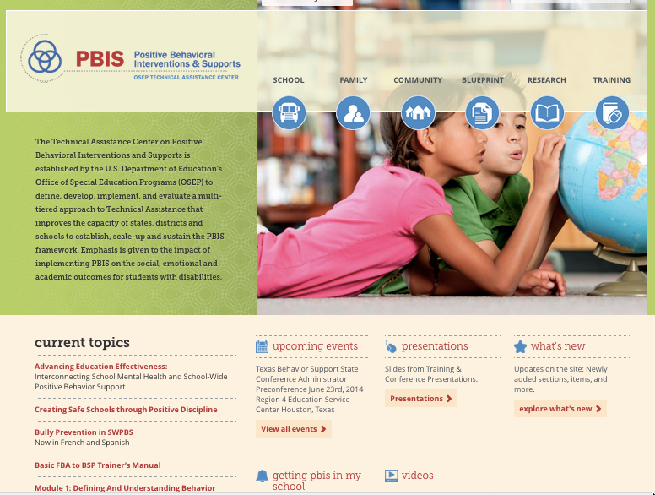
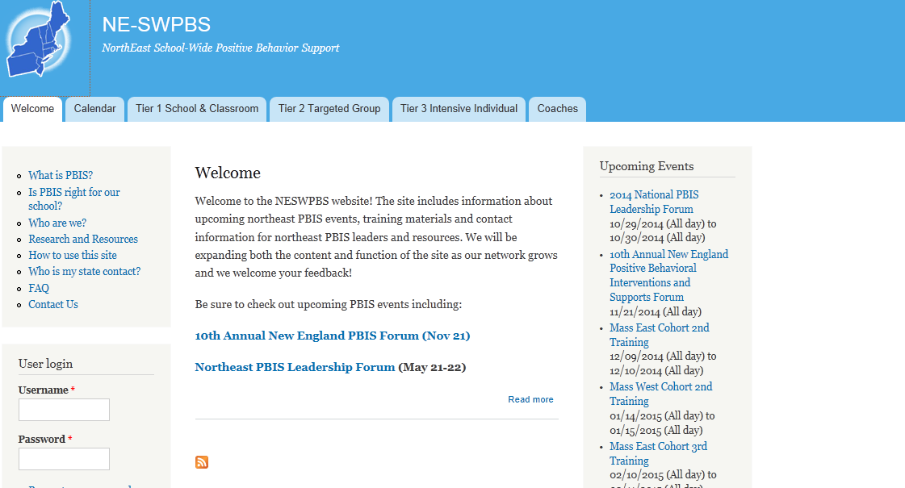
pbis.org
neswpbs.org

