Slide 1
Coaching School-Wide Positive Behavioral Interventions and Supports (SWPBIS)
Northeast PBIS (NEPBIS) Coaches Training
Coaching Day 5
INSERT TRAINER NAMES
with support from Brandi Simonsen, Jen Freeman,
Susannah Everett, Adam Feinberg, Katie Meyer, & George Sugai
Notes:
Add trainer names for your event

Slide 2

Advance Organizer
Introduction and Focus on Coaching
Quick Review and Focus on Coaching Class-wide PBIS
Coaching Reports
Advanced Skill Building
Using Data to Drive Decision Making for Classrooms
Equity Data Review
TFI Cultural Responsiveness Companion
Preparation for Next Training Event

Slide 3
Main Coaching Objectives
By the end of today’s meeting, you will be able to…
  …Describe your role as a coach.
  …Articulate the basic elements of SWPBS.
  …Identify resources for SWPBS.
  …Problem solve roadblocks in coaching
  …Facilitate your team’s activities at the next SWPBS team training.

Slide 4
Training Expectations:
RESPECT…
SELF
Self-monitor (Are you participating? Engaged as a learner? Talking during allotted times?)
Stretch, break, stand as needed
OTHERS
Cell phones (inaudible): Converse in lobbies and breaks
ENVIRONMENT
Recycle
Work as a team: Room for every voice, reinforce participation
Maintain neat working area

Slide 5


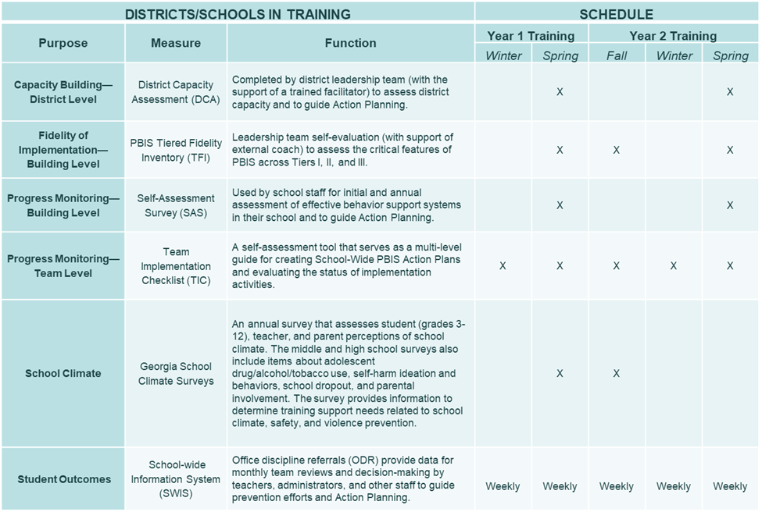

Tools!
nepbis.org
pbis.org
Coaching SWPBIS Workbook and Appendices
Evaluation Plan
Action Plan

Slide 6


Activity:
Please Enter Attendance
1 min
Please login on nepbis.org, go to the coaches’ tab, and click on the Team Training Attendance Link. Follow prompts to enter team attendance.

Slide 7





Legend
New Content
Review
Guidelines
+Ex
-Ex
Training Organization
Activity

Slide 8


Legend
Section Header (I.A)
Chapter Header (e.g., I)

Slide 9
Advance Organizer
Introduction and Focus on Coaching
Quick Review and Focus on Coaching Class-wide PBIS
Coaching Reports
Advanced Skill Building
Using Data to Drive Decision Making for Classrooms
Equity Data Review
TFI Cultural Responsiveness Companion
Preparation for Next Training Event

Slide 10
Overview of Coaching in swpbis
(Chapter i)

Slide 11
How is it going with your various roles?
Coaching Roles
Facilitate
Content Knowledge
Communicate
  Team meetings
  Activities at training events
  Implementation
  Local PBS expert
Positive “nag”
Link to resources (e.g., nepbis.org, www.pbis.org)
  Share advanced content with team
  Share information at faculty meetings
I.A.ii
Notes:
Move quickly through review content (just hit the highlights). Then, for each item, ask questions about how its going and use this to reinforce, correct, or problem solve as appropriate.

Slide 12
Basics of swpbis for coaches
(Chapter Ii)

Slide 13

Critical Features of PBIS
Supporting Culturally Equitable
Social Competence & Academic Achievement
OUTCOMES
Supporting
Culturally
Knowledgeable
Staff Behavior
Supporting
Culturally Valid
Decision
Making
SYSTEMS
DATA
(Vincent, Randal, Cartledge, Tobin, & Swain-Bradway, 2011; Sugai, O’Keefe, & Fallon 2012 ab)
PRACTICES
I.C
Supporting Culturally Relevant
Evidence-based Interventions
Notes:
Move quickly through review content (just hit the highlights). Then, for each item, ask questions about how its going and use this to reinforce, correct, or problem solve as appropriate.

Slide 14
coaching team meetings
(Chapter iII)

Slide 15
Facilitating Effective Team Meetings
(see details in Coaches’ Workbook)
Be prepared and expect others to be as well
Begin on time by reviewing agenda and outcomes
Involve everyone
Use data to clearly and quickly define a problem before beginning problem solving
Create an action plan
At the end of the meeting debrief
After the meeting, electronically publish meeting minutes
III.A.i

Slide 16
Using Data Effectively
(see details in Coaches’ Workbook)
Collect appropriate and relevant data
Organize the data in a user-friendly manner that aides comprehension
Review and analyze the data at least monthly to guide decision-making
Make data available to all stakeholders
Provide staff development to all staff to use data to inform decision making
Use data analysis to inform decisions related to school-wide programs, classroom-based instructional practices, and student-specific interventions
Review data collection procedures and practices to ensure that data accurately reflect school events
Collect data on extent to which practice or intervention is being implemented accurately and fluently (implementation fidelity)
III.A.ii

Slide 17
Advance Organizer
Introduction and Focus on Coaching
Quick Review and Focus on Coaching Class-wide PBIS
Coaching Reports
Advanced Skill Building
Using Data to Drive Decision Making for Classrooms
Equity Data Review
TFI Cultural Responsiveness Companion
Preparation for Next Training Event

Slide 18
Coaching Reports
(+ or Δ)
Coach
      1-2 Details to introduce yourself
      1-2 Strengths
      (with respect to coaching)
      1-2 Concerns or challenges
      (with respect to coaching)

Slide 19
Advance Organizer
Introduction and Focus on Coaching
Quick Review and Focus on Coaching Class-wide PBIS
Coaching Reports
Advanced Skill Building
Using Data to Drive Decision Making for Classrooms
Equity Data Review
TFI Cultural Responsiveness Companion
Preparation for Next Training Event

Slide 20

Last time we met, we discussed where school-wide data fit into coaching roles.
Recognizing and communicating changes in staff behavior that should be celebrated/reinforced (e.g., school-wide roll out!)
Encouraging team to identify their accomplishments and plan for reinforcement
Providing specific, descriptive feedback on progress towards goals and other successes
Pinpointing specific targets of opportunity for growth, developing specific action plans, updating progress along the way
Ensuring that both program quality/fidelity data and student outcome data are used for problem solving and decision making
Today, we will focus on diving into your data to consider supports for classrooms.
adapted from:

Slide 21
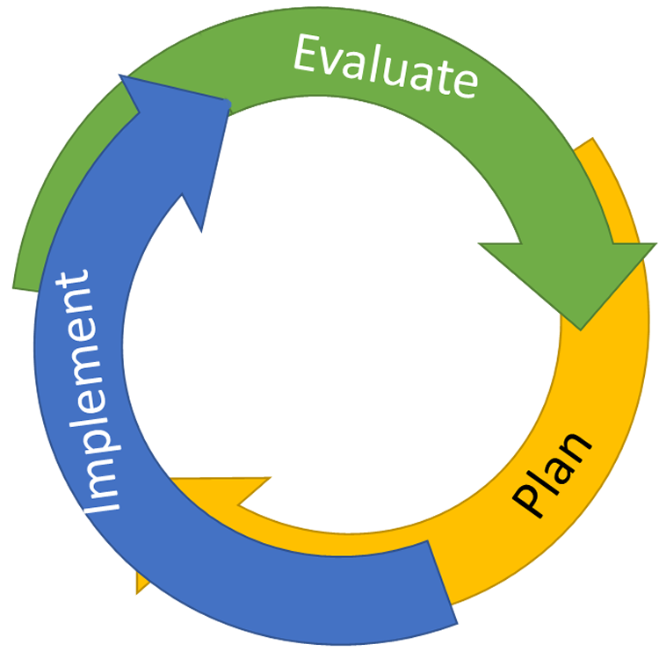
Continuous Quality Improvement
Reassess and revise solution(s) as needed
Identify problems with precision
Monitor outcomes and compare
to goal(s)
DATA
Establish goal(s)
Develop solution(s)
Implement solution(s) with integrity and fidelity
Notes:
Trainer Note: We want to interrupt the traditional cycle of admiring the problem, by talking and talking about the problem before quickly launching into determining solutions.
We can do this by building a system for improved decision making.

Slide 22
Let’s get started…
Identify problems with precision
DATA
Notes:
Trainer Note: We want to interrupt the traditional cycle of admiring the problem, by talking and talking about the problem before quickly launching into determining solutions.
We can do this by building a system for improved decision making.

Slide 23

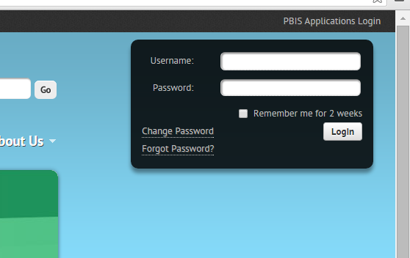
Data-Driven Problem Solving for Classrooms
We are about to engage in a series of activities that require you to review and use your school’s data on pbisapps.org
  Log on to pbisapps.org
  Go to closed survey windows
  Choose a survey (e.g., Self Assessment Survey, Team Checklist)
  Choose View Reports
Remember different types of reports (total, subscale, subsubscale, item reports)

Slide 24

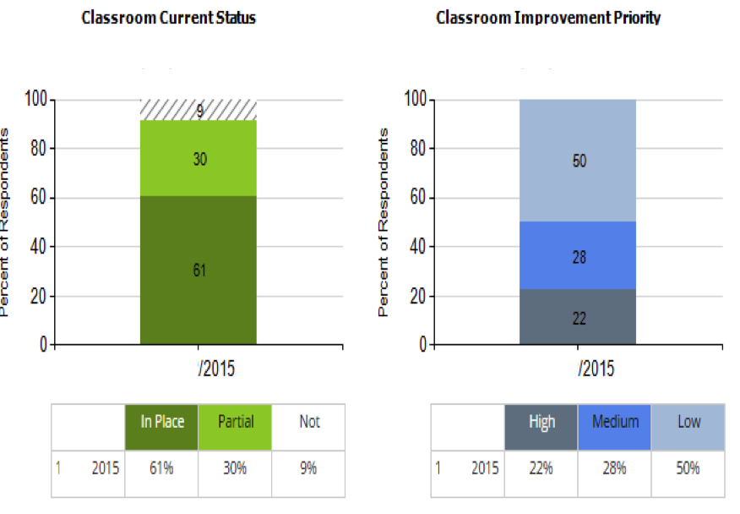
Staff Input: Self-Assessment Survey
Results for Classroom
Current Status and Improvement Priority
Classroom

Slide 25
Activity:
Review Your School’s Self-Assessment Survey
Work individually (or with partner coach) for 15 min
Follow directions to log-on to pbisapps.org and retrieve Self-Assessment Survey (SAS) data.
Review your school’s SAS data for classrooms.
  Identify 1-2 key strengths and 1-2 need areas
  Review your plan for administering this survey again this year (note intended timeline on evaluation plan)
Share 1 min reports (strengths, need areas, and questions for classrooms).

Slide 26
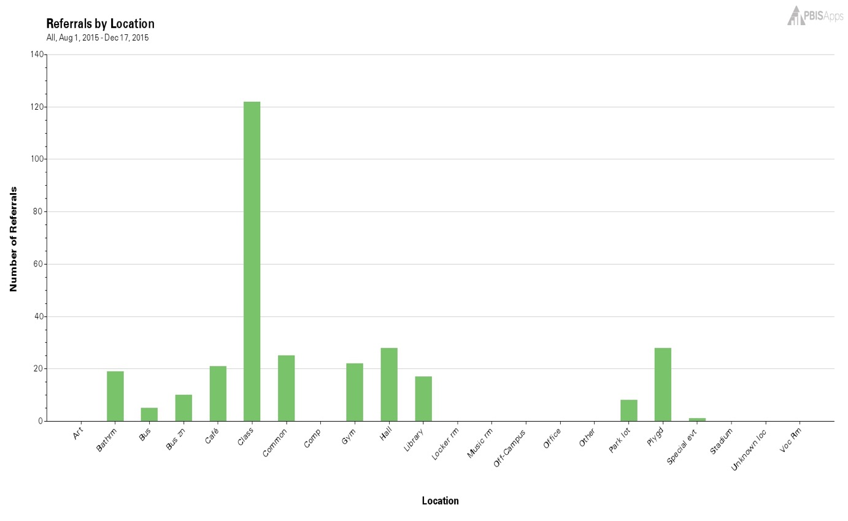
SWIS Data: Referrals By Location
Classroom

Slide 27
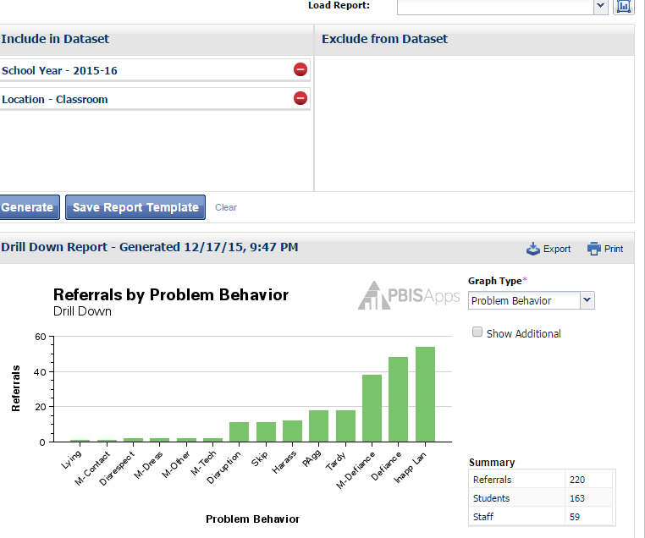
Drill Down: Referrals by Problem Behavior in the Classroom
Classroom

Slide 28
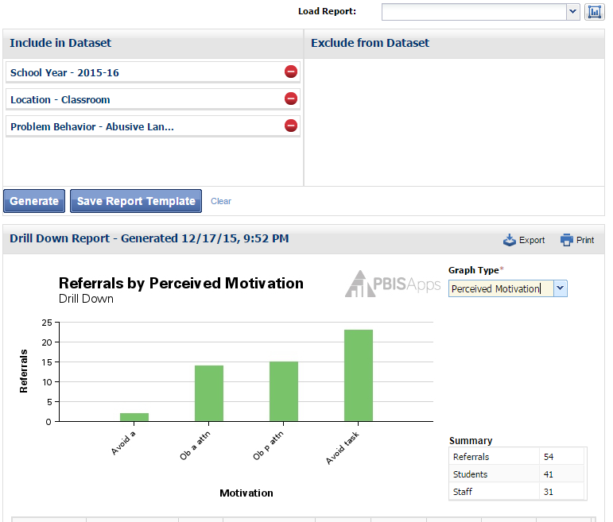
Drill Down: Inappropriate Language in the Classroom by Perceived Motivation
Classroom

Slide 29
Activity:
Review Your Office Discipline Referrals (ODRs) D
Work individually (or with partner coach) for 15 min
Log-on to pbisapps.org (or appropriate site) to review your school’s ODR data.
Review your school’s ODR data for classrooms.
  Identify 1-2 improvements relative to last year or observations
  Identify and precisely define 1-2 problems related to ODR data
  Review your plan for using ODR data to monitor progress
Share 1 min reports (strengths, need areas, and questions for classrooms).
If you do not presently have ODR data to review, use this time to develop an action plan to secure a user-friendly interface.

Slide 30
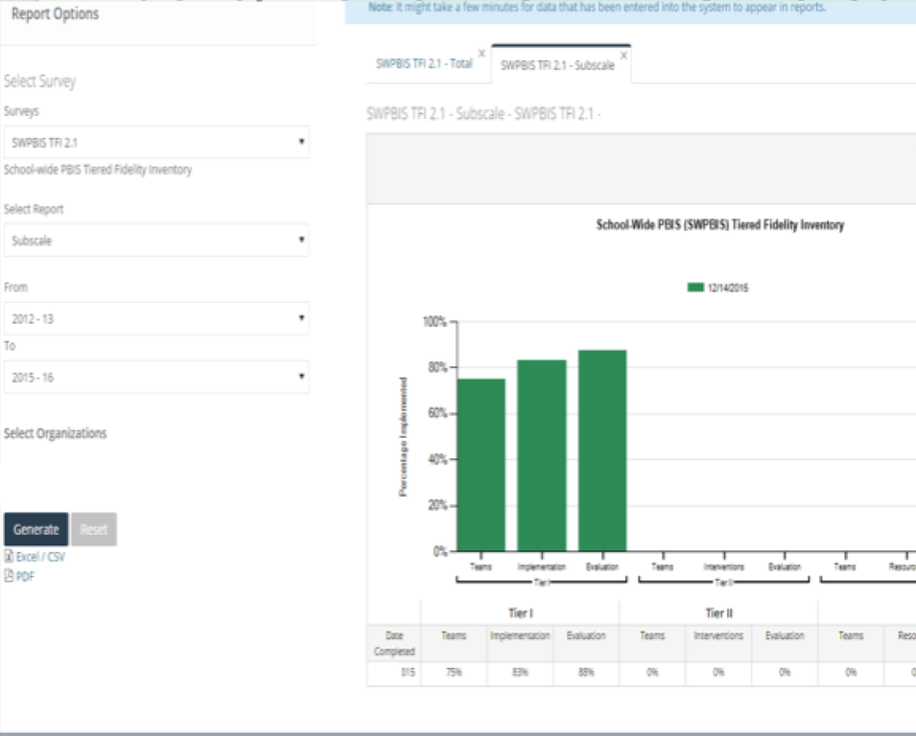
Fidelity Review: SWPBIS Tiered Fidelity Inventory
Classroom
Classroom

Slide 31
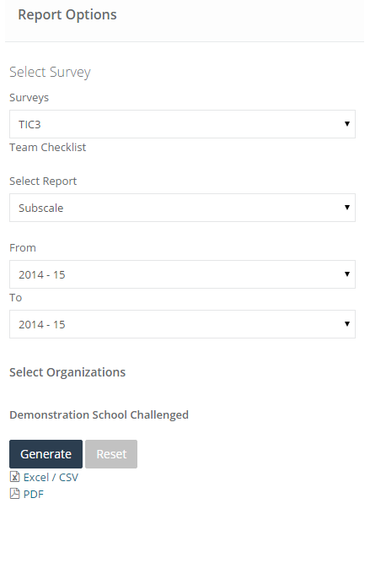
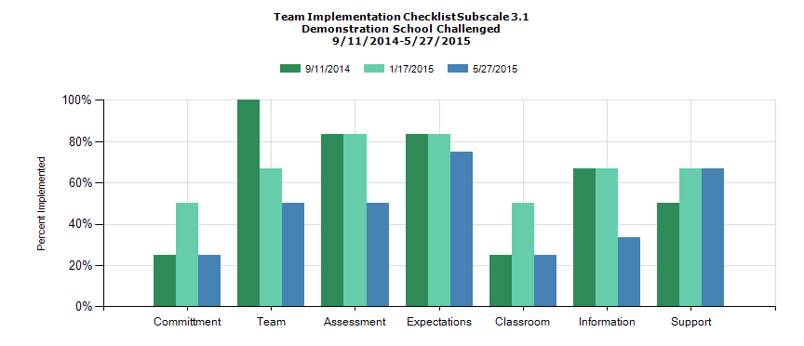
Example: Team Implementation Checklist Subscale Report focus on Classroom
Classroom

Slide 32
Activity:
Review Your School’s Fidelity Data (TIC/TFI)
Work individually (or with partner coach) for 30 min
Log-on to pbisapps.org.
Review your school’s fidelity data (TIC and/or TFI) for classrooms.
  Identify 1-2 key strengths and 1-2 need areas
  Precisely define problem statements
  Review your plan for administering this survey again this year (note intended timeline on evaluation plan)
Share 1 min reports (strengths, need areas, and questions for classrooms).

Slide 33
Let’s begin to plan
Identify problems with precision
DATA
Establish goal(s)
Develop solution(s)
Notes:
Trainer Note: We want to interrupt the traditional cycle of admiring the problem, by talking and talking about the problem before quickly launching into determining solutions.
We can do this by building a system for improved decision making.

Slide 34

A new and useful resource from OSEP and pbis.org

Slide 35
Interactive Map of Core Features

Slide 36
Self-Assessment

Slide 37
Decision Making Chart

Slide 38
Tables with Definitions, Examples, Non-Examples, and Resources

Slide 39
Additional Tools

Slide 40
Scenarios to illustrate implementation

Slide 41
Activity:
Supporting and Responding to Behavior
Work individually (or with partner coach) for 20 min
Review the “Supporting and Responding” to Behavior resource on pbis.org
Based on your data, consider where your school has the greatest needs (and opportunities for growth). Be prepared to share the data and your thoughts about a potential plan during team training, as they’ll have a similar activity.
Update your coaching action plan to reflect needed supports for you in this area.

Slide 42
Advance Organizer
Introduction and Focus on Coaching
Quick Review and Focus on Coaching Class-wide PBIS
Coaching Reports
Advanced Skill Building
Using Data to Drive Decision Making for Classrooms
Equity Data Review
TFI Cultural Responsiveness Companion
Preparation for Next Training Event

Slide 43
5-point Intervention to Enhance Equity in School Discipline
Use effective instruction to reduce the achievement gap
Implement SWPBIS to build a foundation of prevention
Collect, use, and report disaggregated student discipline data
Develop policies with accountability for disciplinary equity
Teach neutralizing routines for vulnerable decision points
http://www.pbis.org/school/equity-pbis
Notes:
Step 3 is to collect, use and report disaggregated data. – for schools using SWIS they can already do this! For others this may take some work.

Slide 44

Guiding Resource
Provides further detail and practical suggestions related to the organization and use of discipline data to address disproportionality
PBIS Technical Assistance Center
  (McIntosh, Barnes, Eliason, & Morris, 2014)
Available for free at pbis.org
Notes:
In September of 2014, the PBIS Technical Assistance Center released the follow-up document “Using Discipline Data within SWPBIS to Identify and Address Disproportionality: A Guide for School Teams” (McIntosh, Barnes, Eliason, & Morris) (aka: The Discipline Data Guide).
Additional documents were released covering the other four points. All are available for free at http://www.pbis.org > Schools > Equity and PBIS

Slide 45
Problem Identification for Disproportionality
Problem identification involving disproportionality requires comparing rates of discipline across racial/ethnic subgroups.
It is important to use multiple metrics when viewing disproportionality. (IDEA Data Center, 2014)
  Disproportionality may be hidden if only one metric or way of measuring data is used.
Notes:
It is critical to use disaggregated data to identify disproportionality within and between racial and ethnic subgroups. It is also important to avoid using just one measure as disproportionality can be easily hidden if only one measure is used.
For example:
Imagine that 25% of each of the racial/ethnic subgroups has a discipline referral. We would say that “the risk of receiving a referral is 25% for each subgroup.” That would seem equitable (i.e., each of the groups had a 25% risk of receiving a referral.
But if the students in Groups A, B, and C each only received one referral, and the students in Groups D and E received many multiple referrals that would not seem fair.
Additionally, if the consequences for Group E seemed much more harsh than for Groups A – D, that also would seem unfair.
The student outcomes for Groups D and E would not be equitable to the outcomes for the other students.
Hence, it is important to look at disaggregated data and to use more than one metric when viewing disproportionality.

Slide 46
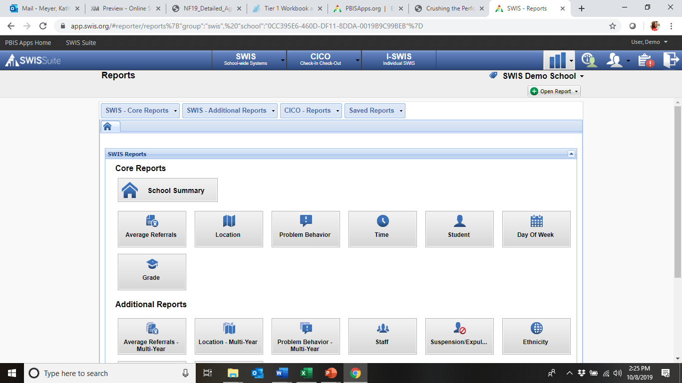
Addressing Racial Disproportionality with SWIS

Slide 47
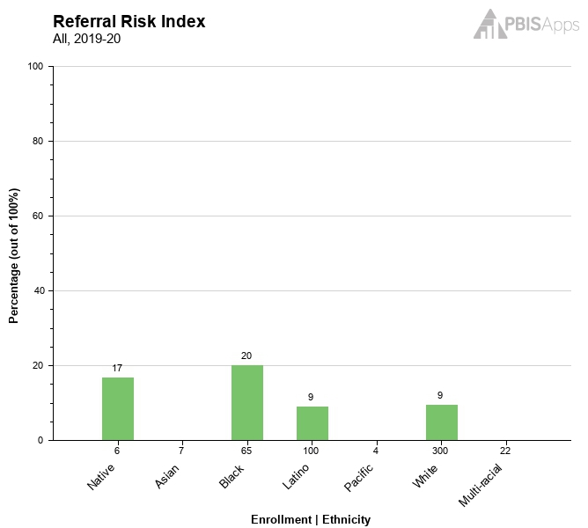
Addressing Racial Disproportionality with SWIS
Referral Risk Index
Proportion of students within each subgroup with a referral
Helps quickly compare rates of referrals across subgroups
Math: # of students with referral/# of enrolled students
Total Enroll-ment

Slide 48
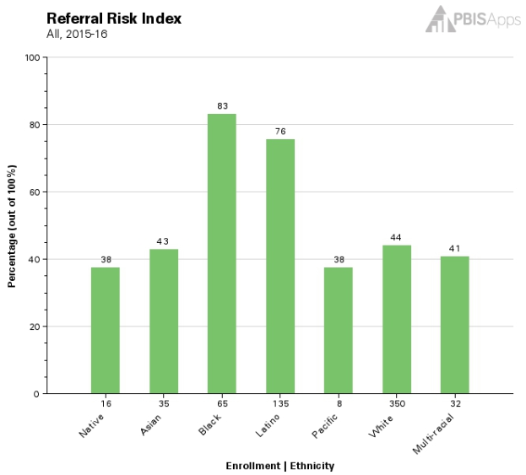
Example: Referral Risk Index
How would you read this graph and table?
54 of the 65 Black students have a referral, so 83% of the Black students have a referral.
102 of the 135 Latino students have a referral, so 76% of the Latino students have a referral.
154 of the 350 White students have a referral, so 44% of the White students have a referral.
Big Idea:
Are ethnic groups being referred at the same rate?
 | # of Enrolled Students | # of Students With Referrals | % of Students Within Ethnicity With Referrals | Risk Index
Native | 16 | 6 | 37.50% | 0.38
Asian | 35 | 15 | 42.86% | 0.43
Black | 65 | 54 | 83.08% | 0.83
Latino | 135 | 102 | 75.56% | 0.76
Pacific | 8 | 3 | 37.50% | 0.38
White | 350 | 154 | 44.00% | 0.44
Multi-racial | 32 | 13 | 40.63% | 0.41
Totals: | 641 | 347

Slide 49
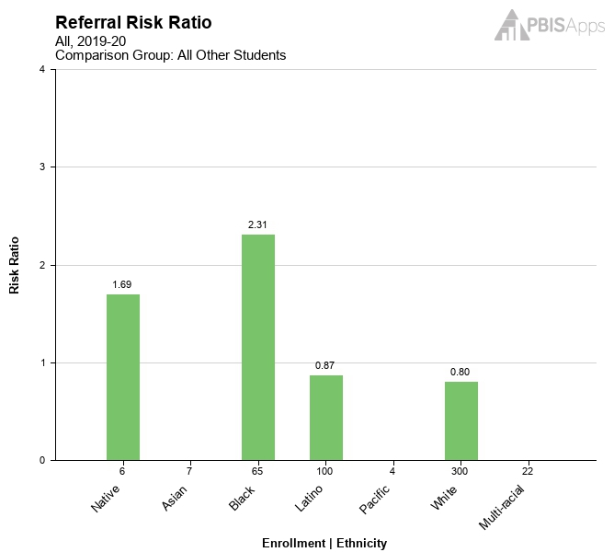
Addressing Racial Disproportionality with SWIS
Referral Risk Ratio
Likelihood of receiving a referral for each subgroup
For a given group, how much more or less likely are they to receive a referral compared to all other students?
  Risk ratio > 1.0 indicates higher risk, < 1.0 indicates lower risk.
Risk Index of Target Group
Risk Index of Comparison Group
Risk Ratio =
Notes:
The report is calculated by dividing the risk index of the specific group with the risk index of a comparison group. All other students is the default comparison group, but this setting can be changed under “School Settings”.

Slide 50
Referral Risk Ratio
Risk Ratio for Comparison Group – All Others
    Risk of one subgroup divided by risk of those not in that subgroup
  For Example:
Risk index for Black students = 47 / 65 = 72.31%
Risk Index All Others =
195 – 47 = 148 All Other students with referrals
504 – 65 = 439 All Other students enrolled
148 / 439 = 33.71% Risk Index for All Other students
Risk Ratio for Black students compared to All Others =
72.31% / 33.71% = 2.145 ---> 2.15
It is 2.15 times more likely that Black students will receive a referral when compared to the group of All Other students in the school.
 | # Students Enrolled | # Students with Referrals | % Students with Referrals | Risk Index
Native | 6 | 3 | 50.00% | 0.50
Asian | 7 | 2 | 28.57% | 0.29
Black | 65 | 47 | 72.31% | 0.72
Latino | 100 | 40 | 40.00% | 0.40
Pacific | 4 | 0 | 0.00% | 0.00
White | 300 | 103 | 34.33% | 0.34
Multi-Racial | 22 | 0 | 0.00% | 0.00
Total | 504 | 195
Notes:
Example for calculating the Risk Ratio for all other students for the African American subgroup:
Click: We see that the Risk Index for Black subgroup is 72.31%
Click: To calculate the Risk Index for the group of All Other students, we need to know All Other students with referrals divided by All Other students enrolled.
Click: There are 195 students with referrals. 47 of those students are Black. 195 – 47 = 148, so there are 148 Non-Black or All Other students who have referrals.
Click: There are 504 students enrolled in the school. 65 of those students are Black. 504 – 65 = 439, so there are 439 Non-Black (All Other) students enrolled.
Click: 148 All Other students with referrals divided by 439 All Other students enrolled is 33.71%, so the Risk Index for All Other students who do not identify as Black is 33.71%
Click: Finally, the risk index for Black students (72.31%) divided by the risk index for All Others (33.71%) is 2.15.
It is 2.15 times more likely that Black students will receive a referral as compared to the group of All Other students in the school who do not identify as Black.

Slide 51
Is “2.15 times more likely” bad?
1.0 would be an even chance or equitable
What is bad?
1.01, 1.5, 2.0, 3.0, 4.0, 5.0…?
What is the threshold for bad?
What is “significant disproportionality?”
Notes:
What is a ‘bad’ risk ratio?
What is the threshold for bad? (at what point is X.X bad?)
What we are talking about here is “What is significant disproportionality?”

Slide 52
ED, OSEP, IDEA, and Disproportionality
January 2017, the Feds mandated that all districts in all states report disproportionality using one methodology:
  Risk Ratio with All Other Students as the comparison group
  States must also establish a “reasonable threshold” for identifying significant disproportionality.
  OSEP published an example of how many districts would be found significantly disproportionate if the threshold was approximately 2 times as likely as the national median.
Notes:
Title: Commonly referred to as “the Feds,” the U.S. Department of Education (ED), the Office of Special Education Programs, and the Office of Civil Rights set the standards regarding federal mandates for education. OSEP sets the standards for identification and placement of students with disabilities in accordance with the Individuals with Disabilities Educational Act (IDEA).
The Feds said all districts in all states must use same methodology when identifying disproportionality, but they will still leave it to the states to define the threshold.
All states must establish a “reasonable” threshold, but the Feds offered no definition of “reasonable.” The Feds did say they would have states defend any threshold that they (OSEP) determined would not qualify as “reasonable.”
As such, they demonstrated what it would look like if states were to use “two times as much as the national median.”
By default SWIS uses the group of “All Other Students” as the comparator group. As we will show later, a different subgroup can be set as the comparator group but the default will be the group of All Other Students.

Slide 53
Threshold for Disproportionality
Notes:
Red line represents previous 2% when states were allowed to choose own methodology AND criteria for determining “significant disproportionality.”
OSEP requirement will be impactful!

Slide 54
MA Examination of Disproportionality
Student Discipline Data Report compiled by DESE
As reported by school districts in 2017-18
Includes ISS, OSS, Expulsion, Emergency Removal, Removed to Alternate Setting
Notes:
One way the state examines discipline data by race in MA is in the Student Discipline Data Report. Starting with the 2012-13 school year, the state compiles information from all districts on the percent of students in each racial subgroup that have received In School Suspension, Out of School Suspension, Expulsion, Emergency Removal or Removal to Alternate Setting (by an impartial hearing officer or school personnel).

Slide 55
Students with Referrals by Ethnicity
Compares the subgroup’s percentage of school enrollment to the subgroup’s percentage of just the students with referrals
  For this graph, it does not matter how many referrals each student has.
In one racial or ethnic subgroup, Billy might have 15 ODRs and Bobby might have only 1.
Between them, for their subgroup, they comprise just 2 students who have referrals.
Notes:
This composite graph answers the question, “Does a subgroup have representation in the group of students who have referrals proportionate to their representation in the total school population?”
Is there proportionate representation or do we see overrepresentation and underrepresentation?
Remember because we are looking at 100% of the school enrollment, if one subgroup is overrepresented, then another subgroup must be underrepresented.

Slide 56
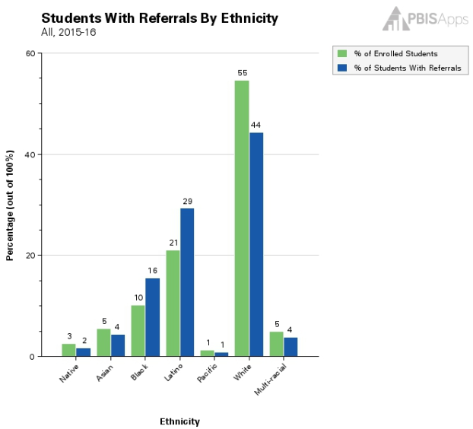
Students with Referrals by Ethnicity
(Green) Percentage of Enrolled Students by Ethnicity
(Blue) Percentage of Students with Referrals by Ethnicity
What does it compare?
It compares a subgroup’s percentage of the total school enrollment to the subgroup’s percentage of just the students who have referrals.
What is it’s value?
It helps evaluate whether a certain subgroup has an equal percentage of the students being referred when compared to that same subgroup's percentage of the total school enrollment.
 | # of Enrolled Students | # of Students With Referrals | % of Enrolled Students | % of Students With Referrals
Native | 16 | 6 | 2.50% | 1.73%
Asian | 35 | 15 | 5.46% | 4.32%
Black | 65 | 54 | 10.14% | 15.56%
Latino | 135 | 102 | 21.06% | 29.39%
Pacific | 8 | 3 | 1.25% | 0.86%
White | 350 | 154 | 54.60% | 44.38%
Multi-racial | 32 | 13 | 4.99% | 3.75%
Totals: | 641 | 347 | 100% | 100%
Notes:
This graph focuses on introducing the “Students with Referrals by Ethnicity” graph within the SWIS Ethnicity Report.
Explain what the graph “compares” and what “value” it adds for the school user.
Sometimes it helps to shorten the explanation to as few words as possible. For example:
Compares:
It compares a subgroup’s percentage of the school enrollment to their percentage of the just students who have referrals.
Value:
It helps spot disproportionality between a subgroup’s portion of the students with referrals when compared to that subgroup’s portion of the total school enrollment .

Slide 57
Example: Students with Referrals by Ethnicity
How do we make sense of this information?
21% of the school’s total enrollment is Latino, but 29% of the referred students are Latino.
This is known as overrepresentation!
55% of the school’s population is White, but only 44% of the referred students are White.
This is known as underrepresentation!
 | # of Enrolled Students | # of Students With Referrals | % of Enrolled Students | % of Students With Referrals
Native | 16 | 6 | 2.50% | 1.73%
Asian | 35 | 15 | 5.46% | 4.32%
Black | 65 | 54 | 10.14% | 15.56%
Latino | 135 | 102 | 21.06% | 29.39%
Pacific | 8 | 3 | 1.25% | 0.86%
White | 350 | 154 | 54.60% | 44.38%
Multi-racial | 32 | 13 | 4.99% | 3.75%
Totals: | 641 | 347 | 100% | 100%
Big Idea:
Is a subgroup’s portion of students attending the school equal to the subgroup’s portion of the group of students who have referrals?
Notes:
This slide shows the user how to make quick sense of the graph and uses the idea of over- and underrepresentation.
(click) First, it compares the two bars for the Latino subgroup.
21% of the school’s total population is Latino, but 29% of the students with referrals are Latino.
(click) This is known as classic overrepresentation.
The Latino subgroup is overrepresented in the group of students who have received referrals.
(click) Second, it compares the same two bars for the White subgroup.
55% of the school’s total population is White, but only 44% of the students with referrals are White.
(click) This is known as classic underrepresentation.
The White subgroup is underrepresented in the group of students who have received referrals.
(click) Finally, it explains the big idea by asking: Are the subgroups’ percentages of enrollment and percentages of students with referrals proportionate? No, they are not, they are disproportionate.

Slide 58
Referrals by Ethnicity
Compares the subgroup’s percentage of school enrollment to the subgroups percentage of all the referrals written.
  For this graph, it does matter how many referrals each student has.
In one racial or ethnic subgroup, Billy might have 15 ODRs and Bobby might have only 1.
Between them, for their subgroup, they have a total of 16 referrals.
This is how SWIS accounts for students with multiple referrals.
Notes:
This graph answers the question, “Does a subgroup have representation in number of referrals written proportionate to their representation in the total school enrollment?”

Slide 59
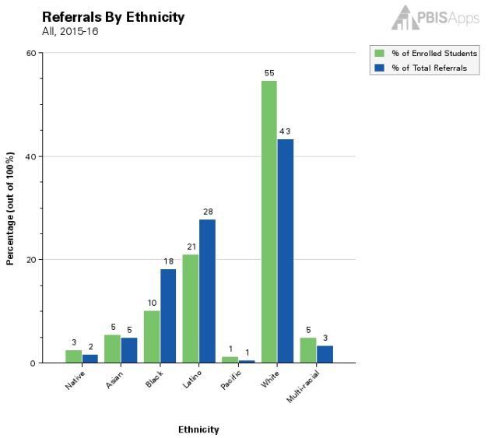
Referrals by Ethnicity
(Green) Percentage of Enrolled Students by Ethnicity
(Blue) Percentage of Total Referrals by Ethnicity
What does it compare?
  It compares a subgroup’s percentage of school enrollment to the subgroup’s percentage of total referrals.
What is it’s value?
  It helps evaluate whether a subgroup has an equal percentage of referrals when compared to the subgroup’s percentage of the total school enrollment.
 | # of Enrolled Students | # of Referrals | % of Enrolled Students | % of Total Referrals
Native | 16 | 12 | 2.50% | 1.73%
Asian | 35 | 34 | 5.46% | 4.89%
Black | 65 | 127 | 10.14% | 18.27%
Latino | 135 | 193 | 21.06% | 27.77%
Pacific | 8 | 4 | 1.25% | 0.58%
White | 350 | 301 | 54.60% | 43.31%
Multi-racial | 32 | 24 | 4.99% | 3.45%
Totals: | 641 | 695 | 100% | 100%
Notes:
This slide focuses on introducing the “Total Referrals by Ethnicity” graph within the SWIS Ethnicity Report.
Explain what the graph “compares” and what “value” it adds for the school user.
Sometimes it helps to shorten the explanation to as few words as possible. For example:
Compares:
It compares a subgroup’s percentage of the school enrollment to their percentage of all the referrals written.
Value:
It helps spot disproportionality between a subgroup’s percentage of the school enrollment when compared to their percentage of the referrals written.

Slide 60
Example: Referrals by Ethnicity
How do we make sense of this information?
10% of the school’s students are Black, but
18% of the school’s referrals are given to Black students.
This is overrepresentation!
55% of the school’s students are White, but only
43% of the school’s referrals are given to White students.
This is underrepresentation!
Big Idea:
Is a subgroup’s portion of all students enrolled in the school equal to the subgroup’s portion of all the referrals written?
 | # of Enrolled Students | # of Referrals | % of Enrolled Students | % of Total Referrals
Native | 16 | 12 | 2.50% | 1.73%
Asian | 35 | 34 | 5.46% | 4.89%
Black | 65 | 127 | 10.14% | 18.27%
Latino | 135 | 193 | 21.06% | 27.77%
Pacific | 8 | 4 | 1.25% | 0.58%
White | 350 | 301 | 54.60% | 43.31%
Multi-racial | 32 | 24 | 4.99% | 3.45%
Totals: | 641 | 695 | 100% | 100%
Notes:
This slide shows the user how to make quick sense of the graph and again demonstrates the idea of over- and underrepresentation.
(click) First, it compares the two bars for the Black subgroup.
10% of the school’s total population is Black, but 18% of all the referrals written were given to Black students.
(click) This is known as overrepresentation.
The Black subgroup is overrepresented in the category of total referrals given.
(click) Second, it compares the same two bars for the White population subgroup.
55% of the school’s total population is White, but only 43% of the referrals are given to White students.
(click) This is known as underrepresentation.
The White subgroup is underrepresented in the category of total referrals given.
(click) Finally, it explains the big idea by asking: Is a subgroups’ percentage of total school enrollment proportionate to that same subgroup’s percentage of referrals received? And the answer is “No, they are not, they are disproportionate.”

Slide 61
Ethnicity Data Review: PBIS Team
How can this information be used to inform interventions?
Do Referral Risk Ratios differ across groups?
Look at disaggregated referrals by ethnicity graphs
Continue implementing Tier 1 supports for all students
No
Yes
Drill Down:
ODR x Student
ODR x Problem Behavior
ODR x Location
ODR x Referral Type
ODR x Time of Day
Design Action Plan based on these data & consider neutralizing routines
Plan

Slide 62
Example: Addressing Disproportionality
Are certain subgroups more likely to receive an office referral?
In the 2018-2019 school year, Black students (N=65) and Native American students (N=6) were more likely than other students to receive a referral. Black students were more than twice as likely (2.16 times) to receive a referral.
Due to the small group size, disproportionality among Native American students may be due to one or two students skewing the data. Let’s check in Drill Down.

Slide 63
Example Drill Down: Referrals for Native American Students
Are Native American students more likely to receive an office referral?
3 of 6 Native American students received an office referral, and one student received 8 referrals in the 2018-2019 school year, skewing the data for this group.
Consider further examination of contextual variables to support this student.

Slide 64
Data Review: Ethnicity Drill Down
Black students were more than twice as likely to receive a referral (Risk Ratio = 2.16). In what contexts are Black students receiving referrals?
Drill Down:
ODR x Student
ODR x Problem Behavior
ODR x Location
ODR x referral type
ODR x Time of Day
Design Action Plan based on these data & consider neutralizing routines
Action

Slide 65
Example Drill Down: Referrals for Black Students
Example Problem Statement: 46 (71%) Black students have received an office referral in the 2018-19 school year. These have primarily been Major discipline referrals for defiance, inappropriate language, and harassment in the classroom primarily in the morning.

Slide 66
Action plan from analysis
Data indicate:
46 (71%) Black students have received an office referral in the 2018-19 school year.
Data also indicate:
Referral Type: Major
What to do?
Behavior: defiance, inappropriate language, harassment
Location: Classroom
Use data to identify Vulnerable Decision Points and teach all staff to use a Neutralizing Routine during those times/locations/behaviors
Time of Day: Morning

Slide 67
Action plan from analysis
Vulnerable Decision Points
Neutralizing Routines
Delay decision until I can think clearly
  See student after class or next break
Reframe the situation
  ”I respect you, but that behavior is not okay”
  ”How do we do that at school?”
Take care of myself
  Deep breaths
Before writing a major discipline referral for defiance, inappropriate language, or harassment (VDP behaviors) in the classroom (VDP location) in the morning, particularly for a Black student
Implement a Neutralizing Routine

Slide 68
Activity:
Disaggregated Discipline Data
Work individually (or with partner coach) for 15 min
Review your school’s referral data disaggregated by racial/ethnic subgroup (if you are not able to disaggregate your data, login to the SWIS Demo site at www.pbisapps.org)
  Identify questions you want to answer with the data
  What trends do you see?
Discuss integrating disaggregated student discipline data into your PBIS practices
  Who would prepare and summarize for the team? How often?
  How would you summarize and share with staff?
Share 2 min reports (strengths, need areas, and questions).

Slide 69
Advance Organizer
Introduction and Focus on Coaching
Quick Review and Focus on Coaching Class-wide PBIS
Coaching Reports
Advanced Skill Building
Using Data to Drive Decision Making for Classrooms
Equity Data Review
TFI Cultural Responsiveness Companion
Preparation for Next Training Event

Slide 70
Tiered Fidelity Inventory
(TFI)
Purpose: | Assess evidence of critical features of school-wide PBS implementation; Progress over time; Helps team make data-based decisions on intervention and program efficacy; Guides action-planning.
Format: | Survey ratings of features in place (self-assessment). About 30 mins per tier.
Completed by: | Team members with the coaches. Walk through tool completed by external coach.
When? | Annually

Slide 71
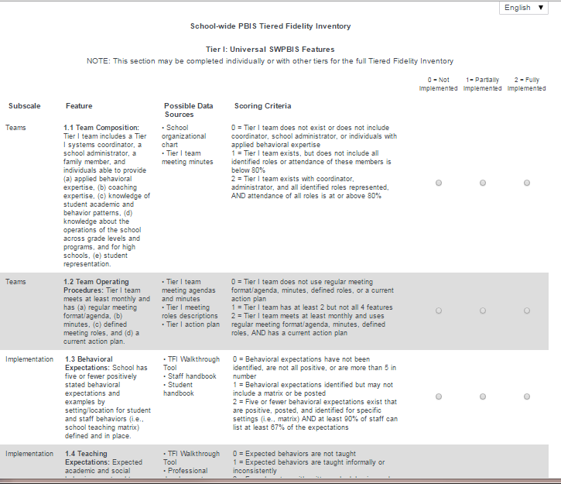
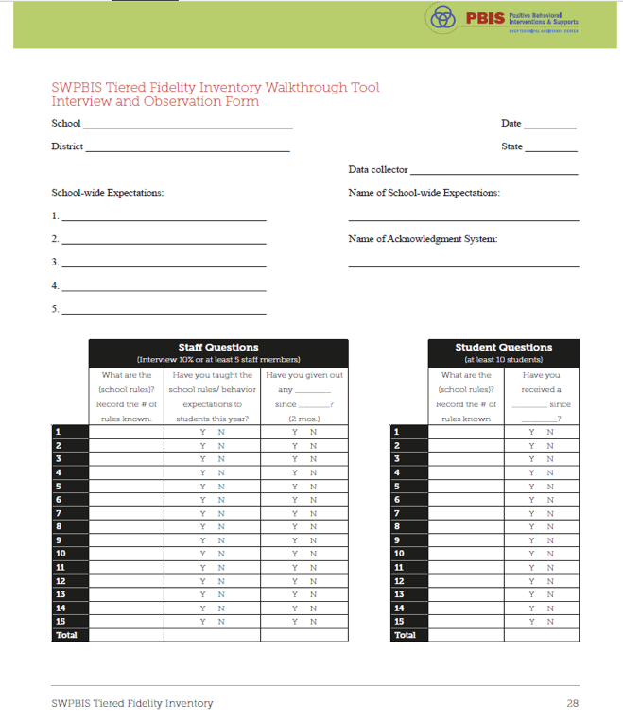
Tiered Fidelity Inventory
(SWPBIS TFI 2.1)
PBIS Assessments
Walkthrough Tool

Slide 72
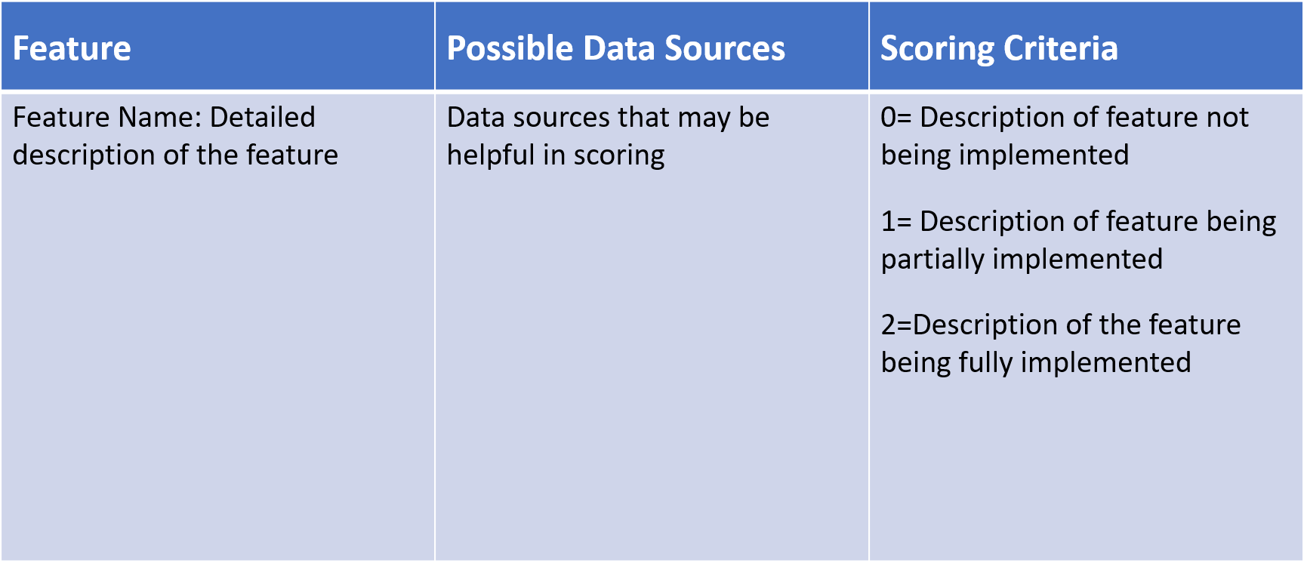
TFI Format
Tier 1: 15 items
Team Subscale – 2 items
Implementation Subscale – 9 items
Evaluation Subscale – 4 items

Slide 73

Cultural Responsiveness Field Guide
Outlines ways to embed equity efforts into SWPBIS through alignment with core PBIS components
https://www.pbis.org/resource/pbis-cultural-responsiveness-field-guide-resources-for-trainers-and-coaches
See Section II: TFI Cultural Responsiveness Companion on pg. 6
Notes:
TRAINERS: You may want to model pulling this tool up on the pbis.org website using the search feature.
The field guide includes a section on identity awareness as well as the TFI CR Companion tool. Remind coaches of the identity awareness activity completed with the full teams on Day 1: https://www.pbis.org/resource/pbis-cultural-responsiveness-field-guide-resources-for-trainers-and-coaches

Slide 74
TFI Cultural Responsiveness Companion
Administration Guidelines:
Complete the TFI
Use the TFI Cultural Responsiveness Companion
  Review whole companion
  Consult items from the TFI that are in place (to build on strengths)
  Assess items where the TFI indicates need for improvement
  *Coaches may want to preselect 4-5 items for the team to review
Incorporate into action plan

Slide 75
Example: 1.9 Feedback & Acknowledgement
CR Concept: SUPPORTIVE ENVIRONMENT
SWPBIS Big Idea: Attending to and acknowledging desired student behaviors increases the likelihood of these behaviors recurring.
CR Elaboration: Teams involve students, families, and communities in the development and use of acknowledgement systems in order to create systems that are meaningful and authentic and consider the culture of the students they serve when designing recognition systems.
Non-Examples: Some student enrollment groups have inequitable
access to acknowledgement.
Examples: Teams actively seek feedback from students, families, and the community about preferences for acknowledgement and perceptions of the current systems at least annually

Slide 76
Activity: Self-Assess with TFI & CR Companion
Work individually (or with partner coach) for 30 min
Find the Tiered Fidelity Inventory and the TFI Cultural Responsiveness Companion
  Consider bookmarking/downloading
Review/self-assess using the TFI
Review the TFI Cultural Responsiveness Companion
  Identify 3-5 items to review with your team at the next training day
  Identify any questions you have regarding use of this tool
Notes:
TRAINERS: Guide coaches to use the hyperlinks embedded in this slide to access each tool (must be in presentation mode for links to be accessed). You may also share the origins of each document: TFI is on PBIS Apps website; TFI Cultural Responsiveness Field Guide & Companion tool is on www.pbis.org website

Slide 77
Advance Organizer
Introduction and Focus on Coaching
Quick Review and Focus on Coaching Class-wide PBIS
Coaching Reports
Advanced Skill Building
Using Data to Drive Decision Making for Classrooms
Equity Data Review
TFI Cultural Responsiveness Companion
Preparation for Next Training Event

Slide 78

Topics to Be Covered on Day 8
Quick Recap of Day 7 Training
Celebrate Accomplishments
Tier 1: Class-Wide PBIS
  Focus on practices
  Focus on Systems
Action Planning

Slide 79
Activity:
Show, Tell, and Ask
Work as team for 10 min
Review your action plan and identify
  1-2 accomplishments
  1-2 questions or concerns shared by most members of team
You’ll have 5 min to show, tell, and ask!

Slide 80
Class-Wide PBIS:
Focus on Practices

Slide 81
Evidence Based Practices in Classroom Management
Maximize structure in your classroom.
Post, teach, review, monitor, and reinforce a small number of positively stated expectations.
Actively engage students in observable ways.
Establish a continuum of strategies to acknowledge appropriate behavior.
Establish a continuum of strategies to respond to inappropriate behavior.
(Simonsen, Fairbanks, Briesch, Myers, & Sugai, 2008)

Slide 82
1. Maximize structure in your classroom.
Develop Predictable Routines
  Teacher routines
  Student routines
Design environment to (a) elicit appropriate behavior and (b) minimize crowding and distraction:
  Arrange furniture to allow easy traffic flow.
  Ensure adequate supervision of all areas.
  Designate staff & student areas.
  Seating arrangements (groups, carpet, etc.)

Slide 83
2. Post, Teach, Review, Monitor, and reinforce a small number of positively stated expectations.
Establish
Teach
Prompt
Monitor
Evaluate
Notes:
Sarah

Slide 84
3. Actively engage students in observable ways.
Provide high rates of opportunities to respond
Consider various observable ways to engage students
Link engagement with outcome objectives

Slide 85
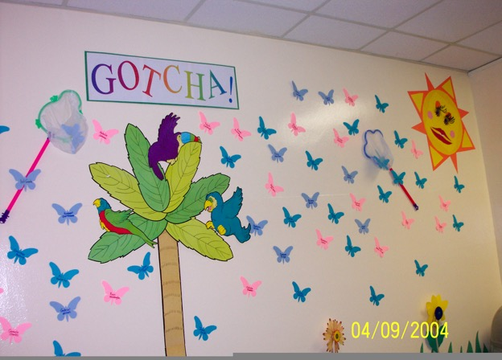
4. Establish a continuum of strategies to acknowledge appropriate behavior.
Specific and Contingent Praise
Group Contingencies
Behavior Contracts
Token Economies
Notes:
Amy

Slide 86
5. Establish a continuum of strategies to respond to inappropriate behavior.
Error Corrections
Differential Reinforcement
Planned ignoring
Response Cost
Time out from reinforcement
Notes:
Emphasize that consequences to decrease behavior should still have an instructional focus and increase the likelihood that students can be successful the next time. (That doesn’t happen through punishment alone.)
Also encourage people to use caution if the elect to use Response Cost and Time Out from Reinforcement as part of their continuum (there are caution symbols on the detail slides). I always share that I directed a school with students with significant behavioral issues, and we did not employ either of these strategies…and we successfully managed intense behavior.

Slide 87
Evidence-Based Practices in Classroom Management
Minimize crowding & distraction
Maximize structure & predictability
State, review, & reinforce positively stated expectations.
Provide more acknowledgement for appropriate than inappropriate behaviors.
Maximize varied opportunities to respond.
Maximize active engagement.
Actively & continuously supervise.
Respond to inappropriate behaviors quickly, positively, & directly.
Establish multiple strategies for acknowledging appropriate behavior.
Generally provide specific feedback for errors & corrects.
IV.B
Notes:
Annimation is out of order on this slide- I fixed on my computer but check on yours

Slide 88
Another useful resource from OSEP and pbis.org

Slide 89
Activity:
Discussion on Class-Wide PBIS
Work as team for 15 min
Review “Supporting and Responding to Behavior” on pbis.org
Discuss the extent to which you believe all/most teachers are implementing all/most of the evidence-based critical features of classroom management.
What are biggest challenges?
Prepare to present 1 “big idea” from your group.

Slide 90
Class-Wide PBIS:
Focus on Systems
To Support
Implementation

Slide 91
What is implementation?
Implementation is “…specified set of activities designed to put into practice an activity or program of known dimensions” (Fixsen, Naoom, Blasé, Friedman, & Wallace, 2005, p. 5)
It’s what we do.
Implementation outcomes include “changes in…
  “…adult professional behavior”
  “…organizational structures and cultures…to support the changes in adult professional behavior”
  “…relationships to consumers, stakeholders, …and systems partners” (Fixsen et al., 2005, p. 12)
Notes:
Fixsen, D. L., Naoom, S. F., Blase, K. A., Friedman, R. M. & Wallace, F. (2005). Implementation Research: A Synthesis of the Literature. Tampa, FL: University
of South Florida, Louis de la Parte Florida Mental Health Institute, The National Implementation Research Network (FMHI Publication #231).

Slide 92
Isn’t there science to guide implementation?
Translated into our language (based on theirs)…
Begin with an “it” (evidence-based practice [EBP] or program; aka “source” or “best example”)
Identify the “who” (individuals who work to implement with fidelity; aka “purveyors”)
Identify the “where” (individuals and organizations that will adopt the EBP; aka “destination”)
Determine “how”: train, prompt, and use data (performance feedback; aka “feedback mechanism” or information flow)
Consider context (aka “influence”)
(Fixsen, Naoom, Blasé, Friedman, & Wallace, 2005, p.12)
Notes:
Fixsen, D. L., Naoom, S. F., Blase, K. A., Friedman, R. M. & Wallace, F. (2005). Implementation Research: A Synthesis of the Literature. Tampa, FL: University
of South Florida, Louis de la Parte Florida Mental Health Institute, The National Implementation Research Network (FMHI Publication #231).

Slide 93


Isn’t there science to guide implementation?
“New Way”
“Old Way”
Context
It:
EBP
Who:
Implementation “Supporters”
How:
Train, prompt, use data
Where:
Teacher / Classroom
(Fixsen, Naoom, Blasé, Friedman, & Wallace, 2005, p.12)
Notes:
Fixsen, D. L., Naoom, S. F., Blase, K. A., Friedman, R. M. & Wallace, F. (2005). Implementation Research: A Synthesis of the Literature. Tampa, FL: University
of South Florida, Louis de la Parte Florida Mental Health Institute, The National Implementation Research Network (FMHI Publication #231).

Slide 94
This is one way to start organizing our implementation supports
Context
It:
EBP
Who:
Implementation “Supporters”
How:
Train, prompt, use data
Where:
Teacher / Classroom
We know what these are!
We know where!
But…
?
?
Expert
Self
How often?
Who needs what?
Peer
On what?
(Adapted from Fixsen, Naoom, Blasé, Friedman, & Wallace, 2005, p.12)
Notes:
Fixsen, D. L., Naoom, S. F., Blase, K. A., Friedman, R. M. & Wallace, F. (2005). Implementation Research: A Synthesis of the Literature. Tampa, FL: University
of South Florida, Louis de la Parte Florida Mental Health Institute, The National Implementation Research Network (FMHI Publication #231).

Slide 95
We can’t afford to do everything, but we can’t afford to do nothing...
We think there’s a lot in between!
NOTHING
BUT, how do we organize all of this?
EVERYTHING
No Training or Support Provided
Every teacher receives coaching and performance feedback
“Sit and Get” training delivered in isolation
Didactic training + email reminders
Didactic training + email reminders + periodic check-ins
PLUS Self-management supports

Slide 96
Multi-tiered Framework of Professional Development Support
Tier 3
Intensive PD: Data-driven Consultation
Tier 2
Targeted PD: Self-Management with Peer or Coaching Supports
Tier 1
Universal PD: Training & Self-Management
Progress Monitoring
Walk-through, Student Data Review, Teacher Collected Data
Universal Screening
Walk-through & Student Data Review
(adapted from Simonsen, MasSuga, Briere, Freeman, Myers, Scott, & Sugai, 2013)

Slide 97
Bottom line…
“training by itself does not result in positive implementation…or intervention outcomes”
(Fixen, Naoom, Blasé, Friedman, & Wallace, 2005, pp. 40-41)
So, what do we do?

Slide 98


One approach: Self-Management
Across multiple studies, we’ve found that self-management with email coaching prompts resulted in desired initial increases in specific classroom management skills across teachers. We are still working to enhance maintenance and generalization of effects.
(Simonsen, Freeman, Dooley, Maddock, & Kern, under review;
Simonsen Freeman, Dooley, Kern, & Maddock, in preparation)
  Teachers…
  Set a goal (criterion for self-reinforcement)
  Self-monitored daily
  Entered data into an Excel Spreadsheet, which automatically graphed daily skillrates relative to goal
  Self-evaluated and self-reinforced
  Received weekly email prompts to use skill and submit data

Slide 99
Strategies…What do you do?
One shot in-service?
On-going training?
Mentoring?
Coaching?
Performance feedback?
_____________________
_____________________
_____________________

Slide 100
Activity:
Jigsaw Class-Wide PBIS Systems
Work as team for 15 min
Brainstorm ideas for improving classroom management at your school
Count off and share ideas with individuals from other schools to refine/expand your ideas.
Return to your school team, debrief, and add relevant action steps to your action plan.
Prepare to present 1 “big idea” from your group.
Jigsaw for 15-20 min
Return to school team and share 10 min

Slide 101
SWPBIS Action Planning

Slide 102
Activity:
Action Planning
Work as team for 75 min
Complete the Team Implementation Checklist
Return to your Action Plan
Identify relevant resources and steps to help move your school forward.
In particular, make sure you have completed all of the steps in getting started (review your notebook).
Present 2-3 “big ideas” from your group (1 min. reports)

Slide 103
Activity:
Getting Ready for Team Training
Work with partner coach for 15 min
Review implementation guidelines and preview slides just presented.
Discuss above with a partner
  Is there content you’d like re-explained?
  What key questions do you have?
  What questions/challenges do you anticipate from your team members?
Share key highlights (1 min. reports)

Slide 104
Review of
Coaching SWPBIS

Slide 105
Main Coaching Objectives
By the end of today’s meeting, you will be able to…
  …Describe your role as a coach.
  …Articulate the basic elements of SWPBS.
  …Identify resources for SWPBS.
  …Problem solve roadblocks in coaching
  …Facilitate your team’s activities at the next SWPBS team training.

Slide 106
What roles do coaches play?
Coaching Roles
Facilitate
Content Knowledge
Communicate
  Team meetings
  Activities at training events
  Implementation
  Local PBS expert
Positive “nag”
Link to resources (e.g., nepbis.org, www.pbis.org)
  Share advanced content with team
  Share information at faculty meetings
I.A.ii

Slide 107
Continuous Quality Improvement
Reassess and revise solution(s) as needed
Identify problems with precision
Monitor outcomes and compare
to goal(s)
DATA
Establish goal(s)
Develop solution(s)
Implement solution(s) with integrity and fidelity
Notes:
Trainer Note: We want to interrupt the traditional cycle of admiring the problem, by talking and talking about the problem before quickly launching into determining solutions.
We can do this by building a system for improved decision making.

Slide 108
A new and useful resource from OSEP and pbis.org

Slide 109
Consider Tattoos!
4 PBIS Elements
School Systems
Supporting Social Competence &
Academic Achievement
OUTCOMES
School-wide
Classroom
SWPBIS
SYSTEMS
DATA
Supporting
Decision
Making
Supporting
Staff Behavior
Non-classroom
Family
PRACTICES
Tertiary Prevention:
Specialized
Individualized
Systems for Students with High-Risk Behavior
~5%
Student
Supporting
Student Behavior
Primary Prevention:
School-/Classroom-
Wide Systems for
All Students,
Staff, & Settings
~15%
Secondary Prevention:
Specialized Group
Systems for Students with At-Risk Behavior
~80% of Students

Slide 110
TAKE AWAY MESSAGE
You’re a coach!
Prepare for the next training event, and use your resources to guide your team’s activities (both at training and at school).

