Slide 1
School-Wide Positive Behavioral Interventions and Supports (SWPBIS)
Northeast PBIS (NEPBIS) School-Wide Team Training
Day 3
[Add Trainer Names Here]
with support from Brandi Simonsen, Jen Freeman,
Susannah Everett, Adam Feinberg, Katie Meyer, & George Sugai
Notes:
Add trainer names for your event

Slide 2
Acknowledgements
PBISApps; Educational and Community Supports, and the University of Oregon
I
Notes:
Thanks to PBIS Apps and U of Oregon for much of the content included in today’s presentation!

Slide 3

Advance Organizer
Quick Review
Getting Started with SWPBIS (steps 7-8)
  Continuum for discouraging rule violations
  Data-based procedures for monitoring
SWPBIS Evaluation with TFI
Action Planning

Slide 4
MAIN TRAINING OBJECTIVES
Establish leadership team
Establish staff agreements
Build working knowledge of SWPBIS outcomes, data, practices, and systems
Develop individualized action plan for SWPBIS
Organize for upcoming school year

Slide 5
Training Expectations:
RESPECT…
SELF
Self-monitor (Are you participating? Engaged as a learner? Talking during allotted times?)
Stretch, break, stand as needed
OTHERS
Cell phones (inaudible): Converse in lobbies and breaks
ENVIRONMENT
Recycle
Work as a team: Room for every voice, reinforce participation
Maintain neat working area

Slide 6

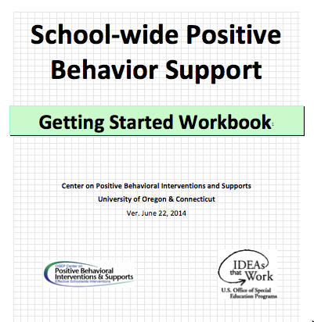
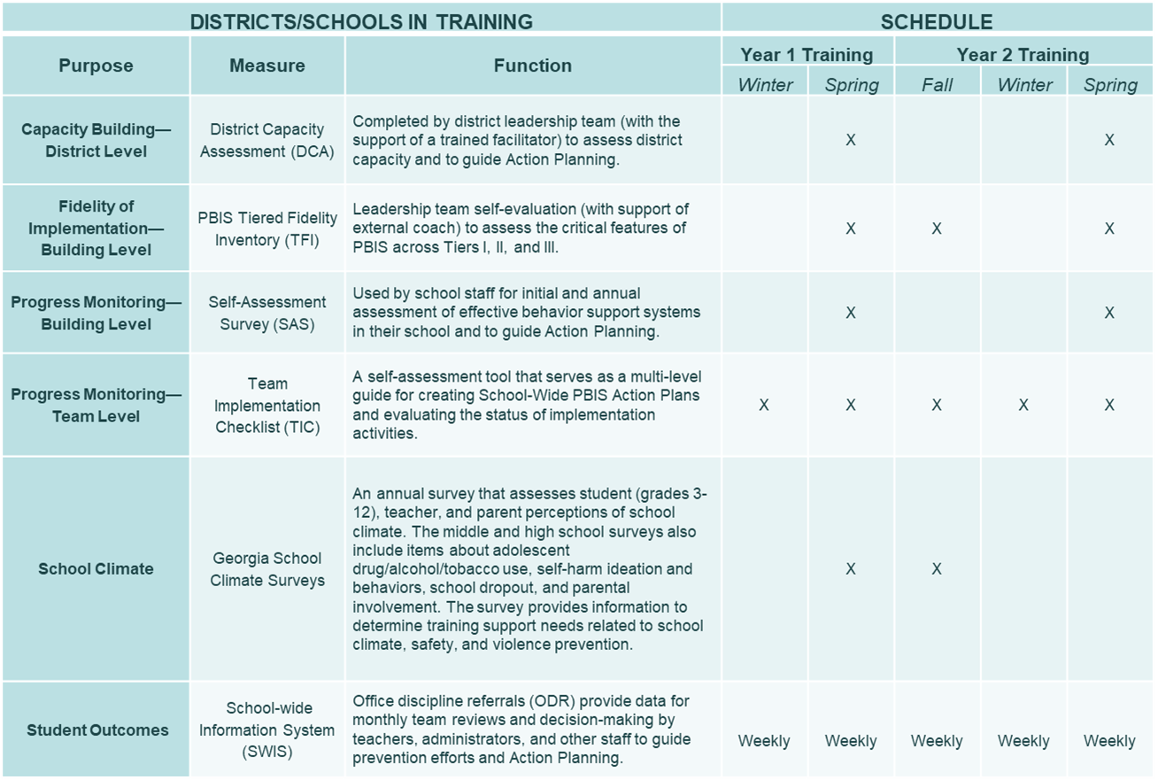

Tools!
nepbis.org
pbis.org
School-wide PBIS Workbook and Appendices
Evaluation Plan
Action Plan

Slide 7

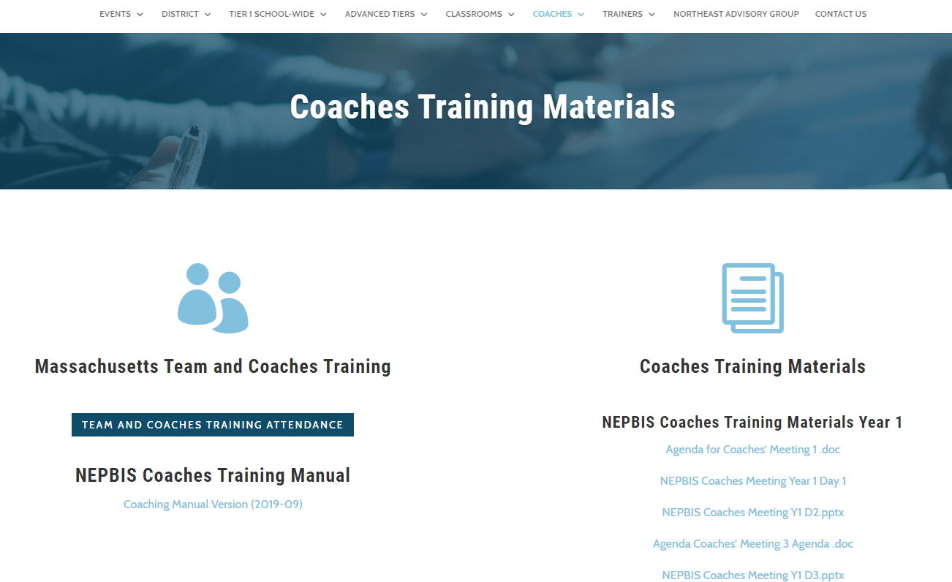
Activity:
Please Enter Attendance
1 min
Please login on nepbis.org, go to the coaches’ tab, and click on the Team Training Attendance Link. Follow prompts to enter team attendance.

Slide 8

Review
Overview & Getting Started with SWPBIS
(Days 1-2)

Slide 9
Overview of School-wide Positive Behavior Support
(Chapter I)

Slide 10

SWPBIS is
Framework for enhancing adoption & implementation of
Continuum of evidence-based interventions to achieve
Academically & behaviorally important outcomes for
All students
I.B.i

Slide 11
SWPBIS Message!
Successful individual student behavior support is linked to host environments or school climates that are effective, efficient, relevant, & durable.
(Zins & Ponti, 1990)
I.A.i

Slide 12
Critical Features of SWPBIS
Supporting Culturally Equitable
Social Competence & Academic Achievement
OUTCOMES
Supporting
Culturally
Knowledgeable
Staff Behavior
Supporting
Culturally Valid
Decision
Making
SYSTEMS
DATA
(Vincent, Randal, Cartledge, Tobin, & Swain-Bradway, 2011; Sugai, O’Keefe, & Fallon 2012 ab)
PRACTICES
I.C
Supporting Culturally Relevant
Evidence-based Interventions
Notes:
Use data
Focus on outcomes: Academic & behavior success
On-going evaluation
Ensure cultural and contextual fit
Invest in systems
Organize research-validated practices within a continuum
Instructional & preventative approach
Integration
Tier 1 for all

Slide 13

Guidelines for Good Outcomes
OUTCOMES
Based on data
Locally important and meaningful
Applicable to all (culturally equitable)
  Students’ social competence and academic achievement
  Staff implementation of critical skills
Observable and measurable
Write as goal
I.C.i

Slide 14
Evaluation plan
DATA
DISTRICTS/SCHOOLS IN TRAINING |  |  | SCHEDULE
Purpose | Measure | Function | Year 1 Training |  | Year 2 Training
 |  |  | Winter | Spring | Fall | Winter | Spring
Capacity Building—District Level | District Capacity Assessment (DCA) | Completed by district leadership team (with the support of a trained facilitator) to assess district capacity and to guide Action Planning. |  | X |  |  | X
Fidelity of Implementation—Building Level | PBIS Tiered Fidelity Inventory (TFI) | Leadership team self-evaluation (with support of external coach) to assess the critical features of PBIS across Tiers I, II, and III. |  | X | X |  | X
Progress Monitoring—Building Level | Self-Assessment Survey (SAS) | Used by school staff for initial and annual assessment of effective behavior support systems in their school and to guide Action Planning. |  | X |  |  | X
Progress Monitoring—Team Level | Team Implementation Checklist (TIC) | A self-assessment tool that serves as a multi-level guide for creating School-Wide PBIS Action Plans and evaluating the status of implementation activities. | X | X | X | X | X
School Climate | Georgia School Climate Surveys | An annual survey that assesses student (grades 3-12), teacher, and parent perceptions of school climate. The middle and high school surveys also include items about adolescent drug/alcohol/tobacco use, self-harm ideation and behaviors, school dropout, and parental involvement. The survey provides information to determine training support needs related to school climate, safety, and violence prevention. |  | X | X
Student Outcomes | School-wide Information System (SWIS) | Office discipline referrals (ODR) provide data for monthly team reviews and decision-making by teachers, administrators, and other staff to guide prevention efforts and Action Planning. | Weekly | Weekly | Weekly | Weekly | Weekly
…and tools available at:

Slide 15
SWPBIS
Practices
PRACTICES
School-wide
Classroom
Smallest #
Evidence-based
Biggest, durable effect
Non-classroom
Family
Student
I.C.iii

Slide 16
Universal
Targeted
Intensive
Continuum of Support for ALL
PRACTICES
Few
Some
All
I.C.iii
(Sugai, Dec 7, 2007)
Notes:
NOTICE GREEN GOES FOR “ALL”
Focus on Tier 1- important to build a solid tier 1 first!! Resist the push to do tier 2/3 first!

Slide 17
Key Systems Features
SYSTEMS
Staff Buy-in
Embedded Professional Development
Staff Recognition for Implementation
Team-based Implementation
Clear Action Plan
I.C.iv
Notes:
Build section numbers, color coding, and structure into ppt.

Slide 18
GENERAL IMPLEMENTATION PROCESS
Team
SYSTEMS
Agreements
Data-based
Action Plan
Evaluation
Implementation
I.C.iv
Notes:
SAY: In general, the implementation of a school-wide PBS approach at the school level is built around five main implementation steps.
Example- this process stays with you the whole time!

Slide 19
Guidelines for Systems
SYSTEMS
For each item in your action plan, ensure…
Agreement by >80% faculty and staff
Include procedures for informing others (e.g. families, community, district administrators, substitute teachers & staff)
Includes procedures for providing instruction to new faculty, staff, students, etc.
Schedule continuous evaluation of effectiveness, efficiency, and relevance
Include in school publications (e.g., handbook, posters, newsletters)
I.C.iv
Notes:
This will come back every time we talk about adding a practice!

Slide 20
Guidelines for Culture & Context
Culture & Context
For each item in your action plan, ensure…
Involve staff, students, & families in development
Contextually/culturally appropriate (e.g., age, level, language)
Examine disaggregated data to ensure implementation of each feature works for all subgroups of students
I.C.v
Notes:
This will also come back every time we introduce a new practice data source or system.

Slide 21
Overview of School-wide Positive Behavior Support
(Chapter II)

Slide 22
Getting Started with SWPBIS
Establish an effective and representative leadership team
Develop brief statement of behavioral purpose
Identify positive SW behavioral expectations
Develop procedures for teaching SW expectations
Develop procedures for teaching class-wide expectations
Develop continuum for strengthening appropriate behavior
Develop continuum for discouraging violations of expectations
Develop data-based procedures for monitoring
Develop systems to support staff
Build routines to ensure on-going implementation
Day 1
Day 2
Day 3
Day 4

Slide 23
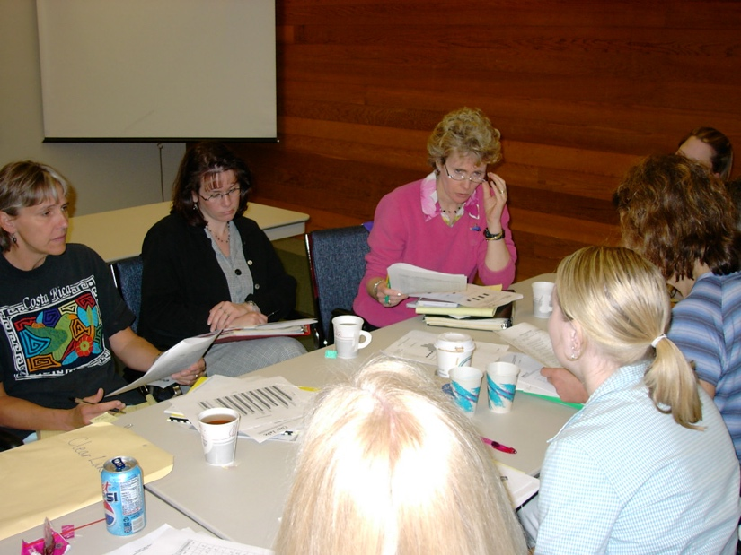
Getting Started with SWPBIS
Establish an effective and representative leadership team
Develop brief statement of behavioral purpose
Identify positive SW behavioral expectations
Develop procedures for teaching SW expectations
Develop procedures for teaching class-wide expectations
Develop continuum for strengthening appropriate behavior
Develop continuum for discouraging violations of expectations
Develop data-based procedures for monitoring
Develop systems to support staff
Build routines to ensure on-going implementation
Start with a representative team, including admin, that “works.”
And…if the same people always work…work smarter!
Do less…better
Do it once
Invest in clear outcomes
Invest in a sure thing
Be strategic about problem solving
SYSTEMS
II.B.1
Notes:
GO back and re-visit the getting smarter activity regularly

Slide 24
Getting Started with SWPBIS
Establish an effective leadership team
Develop brief statement of behavioral purpose
Identify positive SW behavioral expectations
Develop procedures for teaching SW expectations
Develop procedures for teaching class-wide expectations
Develop continuum for strengthening appropriate behavior
Develop continuum for discouraging violations of expectations
Develop data-based procedures for monitoring
Develop systems to support staff
Build routines to ensure on-going implementation
At Abrigato School, we treat each other with respect, take responsibility for our learning, and strive for a safe and positive school for all!
PRACTICES
II.B.ii
Notes:
How many have gotten staff student and family input on your behavioral purpose statement.

Slide 25
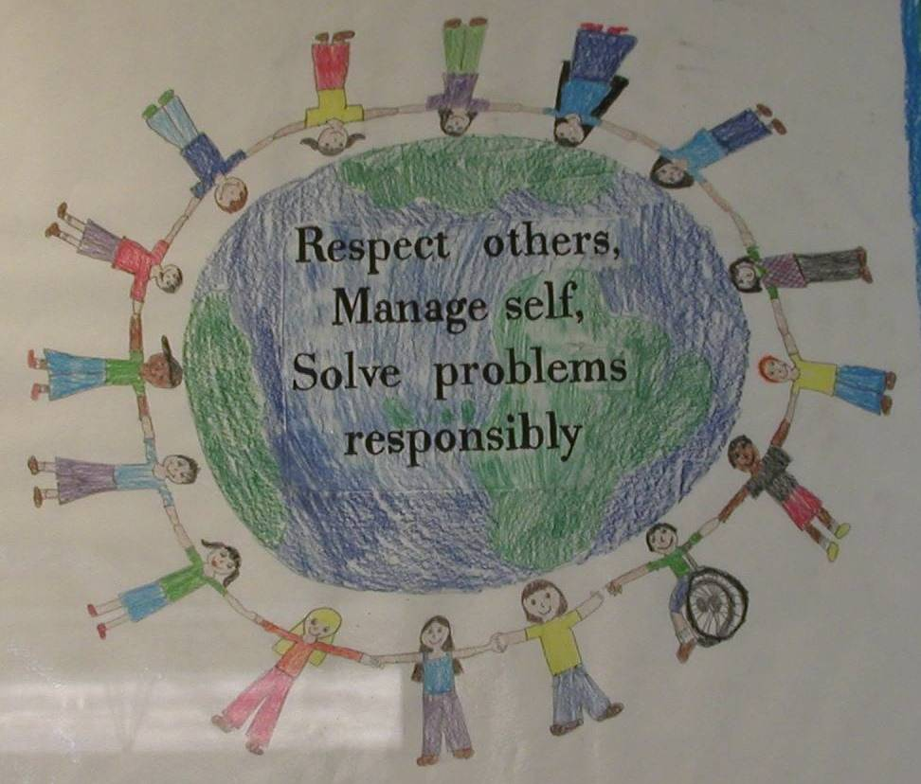
Getting Started with SWPBIS
Establish an effective leadership team
Develop brief statement of behavioral purpose
Identify positive SW behavioral expectations
Develop procedures for teaching SW expectations
Develop procedures for teaching class-wide expectations
Develop continuum for strengthening appropriate behavior
Develop continuum for discouraging violations of expectations
Develop data-based procedures for monitoring
Develop systems to support staff
Build routines to ensure on-going implementation
PRACTICES
II.B.iii
Notes:
How many have expectations, how many have staff input? Student in put? Family input?

Slide 26
Getting Started with SWPBIS
Establish an effective leadership team
Develop brief statement of behavioral purpose
Identify positive SW behavioral expectations
Develop procedures for teaching SW expectations
Develop procedures for teaching class-wide expectations
Develop continuum for strengthening appropriate behavior
Develop continuum for discouraging violations of expectations
Develop data-based procedures for monitoring
Develop systems to support staff
Build routines to ensure on-going implementation
Teaching social behavior explicitly?
Like academic behavior
PRACTICES
II.B.iv
Notes:
How is this going? This is the power of PBIS- spend time here!!
We know this is a key to successful implementation
Do you have your draft? Feedback from staff? Students? Family?
Q- if we haven’t gotten feedback yet do we have to start over? No collect feedback especially on how you teach this and suggest that you can incorporate this feedback into your next drafts

Slide 27

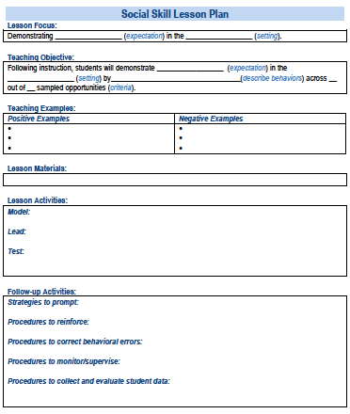
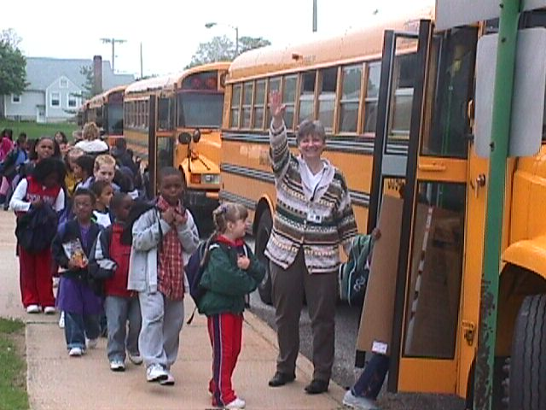
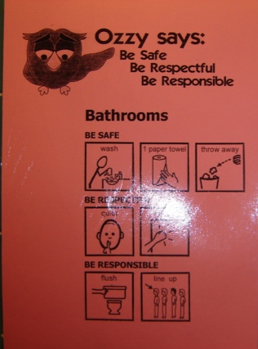
In other words…we discussed that you should follow these key steps
Define
Teach
Prompt
Monitor
Evaluate
II.B.iv
Notes:
How many of you have drafted lesson plans? Working on creating prompts, working on active supervision? Data collection systems

Slide 28
Getting Started with SWPBIS
Establish an effective leadership team
Develop brief statement of behavioral purpose
Identify positive SW behavioral expectations
Develop procedures for teaching SW expectations
Develop procedures for teaching class-wide expectations
Develop continuum for strengthening appropriate behavior
Develop continuum for discouraging violations of expectations
Develop data-based procedures for monitoring
Develop systems to support staff
Build routines to ensure on-going implementation
Same deal…in context of classroom settings and routines
PRACTICES
II.B.v
Notes:
This is the non-negotiable is teachers teaching the expectations in their classrooms

Slide 29
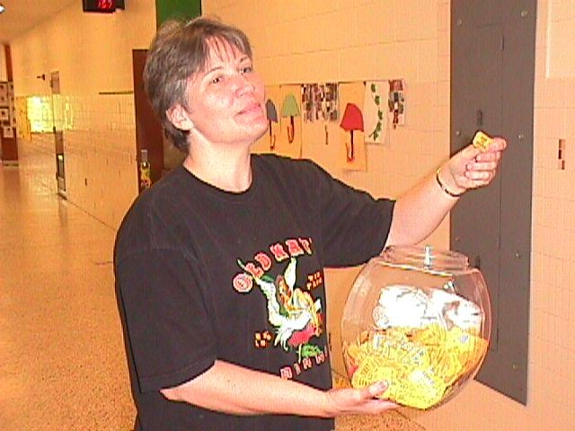
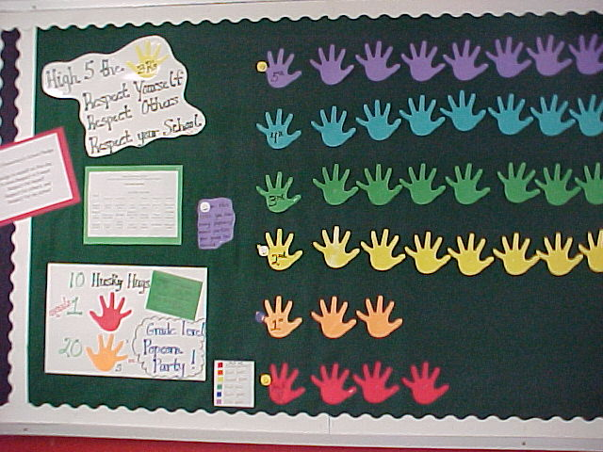
Getting Started with SWPBIS
Establish an effective leadership team
Develop brief statement of behavioral purpose
Identify positive SW behavioral expectations
Develop procedures for teaching SW expectations
Develop procedures for teaching class-wide expectations
Develop continuum for strengthening appropriate behavior
Develop continuum for discouraging violations of expectations
Develop data-based procedures for monitoring
Develop systems to support staff
Build routines to ensure on-going implementation
PRACTICES
II.B.vi
Notes:
Praise is the non-negotiable. Use a token system to make praise more likely think about this contextually and think about how to translate this up for older kids

Slide 30
Getting Started with SWPBIS
Establish an effective leadership team
Develop brief statement of behavioral purpose
Identify positive SW behavioral expectations
Develop procedures for teaching SW expectations
Develop procedures for teaching class-wide expectations
Develop continuum for strengthening appropriate behavior
Develop continuum for discouraging violations of expectations
Develop data-based procedures for monitoring
Develop systems to support staff
Build routines to ensure on-going implementation
II.B
We’ll discuss these today.

Slide 31
Activity:
Share Accomplishments
Talk as team for 5 min
Discuss with your group and identify
  1-2 accomplishments
  1-2 questions or concerns shared by most members of team
Notes:
Throughout this activity, emphasize the critical features (data use, staff buy-in, fidelity, etc.) that are reflected in teams’ reports.

Slide 32
Getting Started with SWPBIS
Establish an effective leadership team
Develop brief statement of behavioral purpose
Identify positive SW behavioral expectations
Develop procedures for teaching SW expectations
Develop procedures for teaching class-wide expectations
Develop continuum for strengthening appropriate behavior
Develop continuum for discouraging violations of expectations
Develop data-based procedures for monitoring
Develop systems to support staff
Build routines to ensure on-going implementation
PRACTICES
II.B.vii

Slide 33
Why a Continuum of Consequences
To ensure that the same consequence is not applied to all rule violations occurring in a school
To establish a hierarchy from least to most severe consequences that are aligned with rule violations
To better address the needs of a variety of students
Notes:
Notes:
Provide examples of matching consequences to discipline infractions, both examples and non-examples (2nd bullet)
Example: a student who is tardy to class might have to serve a lunch detention
Non-example: a student who is tardy to class might be suspended for 3 days
For example, all students should not serve in-school suspensions for every rule violation, regardless of the severity. The study who copies on a test (more severe violation) should not receive the same consequences as the student who forgot their homework (less severe violation)
In the hierarchy of consequences, the least severe consequences should match the behaviors/rule violations that are deemed least severe; the most severe consequences should be reserved for the most severe rule violations

Slide 34
Critical Features of Continuum for Discouraging
Inappropriate Behaviors
Relate to the function of the behavior!
Align with school-wide expectations and clearly defined rules
Exist as one component of a larger system of behavior change for the student.
  Teaching expectations and rules
  Acknowledging appropriate behaviors
System of support exists including review, teaching, and monitoring of current responses to problem behavior
Notes:
Notes:
Function- this is why the student does the behavior – what is it that he/she gets or avoids…. Tardy – to get time with peers or to get out of a class not prepared for
Non-example (bullet one): If a student tries to avoid a task by disrupting and the teacher sends him to the office or to time out, then…
the behavior has served it’s function
the task has been avoided, and
the student will see no need to change

Slide 35
District and Building
Discipline Procedures
Most schools outline their consequences in “Codes of Conduct” or written policies for behavior
Codes of Conduct developed to clearly communicate discipline procedures to prevent problems (NSRN, 1980)
Over time, Codes of Conduct have focused on punitive responses and student removal
Notes:
Notes:
When dealing with discipline procedures need to add school board and possibly legal team-when we start talking about consequences and potential removal, the board lawyers often get involved. PBS team needs this level of input-not possible for them to make these types of decisions on their own-

Slide 36
Considerations for Punishment Procedures
Punishment without a positive, proactive, and instructional approach results in increased:
Aggression
Vandalism
Truancy
Dropouts
Mayer & Sulzer-Azaroff, 1990; Skiba, Peterson, & Williams, 1997
Treat behavioral errors like academic errors!
Removing students who are struggling at reading from the classroom will not improve their reading

Slide 37
Three important components of organizing district and building responses
Clearly defined behaviors
Discipline Flow Chart
Discipline Referral Form
Are all staff consistent with how rule violating behavior is labeled?
Are all staff knowledgeable on what responses are appropriate and process when responding to rule violating behaviors?
Are all staff consistent with recording and monitoring information when problem behaviors occur?
communication and data review
consistent responses
consistent management and tracking of behaviors
Notes:
Notes:
Each of these activities are important for managing responses to inappropriate behavior in schools.

Slide 38
Three important components of organizing district and building responses
Clearly defined behaviors
Organize your responses around those that are classroom managed and those that are office managed
Are all staff consistent with how rule violating behavior is labeled?
Minor Behaviors
Identify those behaviors that generally should be managed in the classroom
frequent, low intensity behaviors
Major Behaviors
Identify those behaviors that generally should be managed in the office
in-frequent, high intensity behaviors
communication and data review
Notes:
Notes:
Each of these activities are important for managing responses to inappropriate behavior in schools.

Slide 39
Guidelines for Continuum of Procedures to Decrease Behavior
PRACTICES
Specify Definitions for Violations of SW Expectations
  Contextually appropriate labels/names
  Definitions represent continuum of severity (e.g., minor, major, illegal)
  Definitions are comprehensive in scope (school-wide)
  Definitions in measurable terms
  Mutually exclusive (minimal overlap)
II.B.vii
Notes:
Really important to clarify definitions, especially around “softer” or more subjective behaviors (e.g., disrespect, defiance, disruption).
Also critical for students to experience consistent “bars” (similar levels of expectations) as they move from setting to setting throughout the school day.

Slide 40


Office-Managed vs. Classroom-Managed Behaviors
T – Chart of Behavior
Classroom Managed
  Handled by the teacher
  No administrative action needed
  May still want documentation to track trends
  “minors”
Office - Managed
  Handled by an administrator
  Administrative action needed
  “majors”
Notes:
Charting it out helps keep administration, staff, students and families on the same page. Think of a long-term substitute or a brand new teacher in your building – how would they know what is acceptable to send to the office and what they are expected to handle themselves?

Slide 41

T – Chart of Behavior - Example
Classroom/Teacher Managed
Office/Administrator Managed
Attendance / Tardy
Profanity directed at student
Gum chewing
Homework
No supplies
Tattling
Non-compliance
Name calling
Lying
Minor stealing
Minor disruption
Cheating
Minor harassment
Dress code violations
Repeated attendance/tardy
Vandalism
Substance abuse
Weapons
Repeated disruptions
Fighting
Profanity directed at adults
Verbal/physical intimidation
Chronic dress code violation
Bullying / harassment
Gang-related activity
Major stealing
Defiance

Slide 42
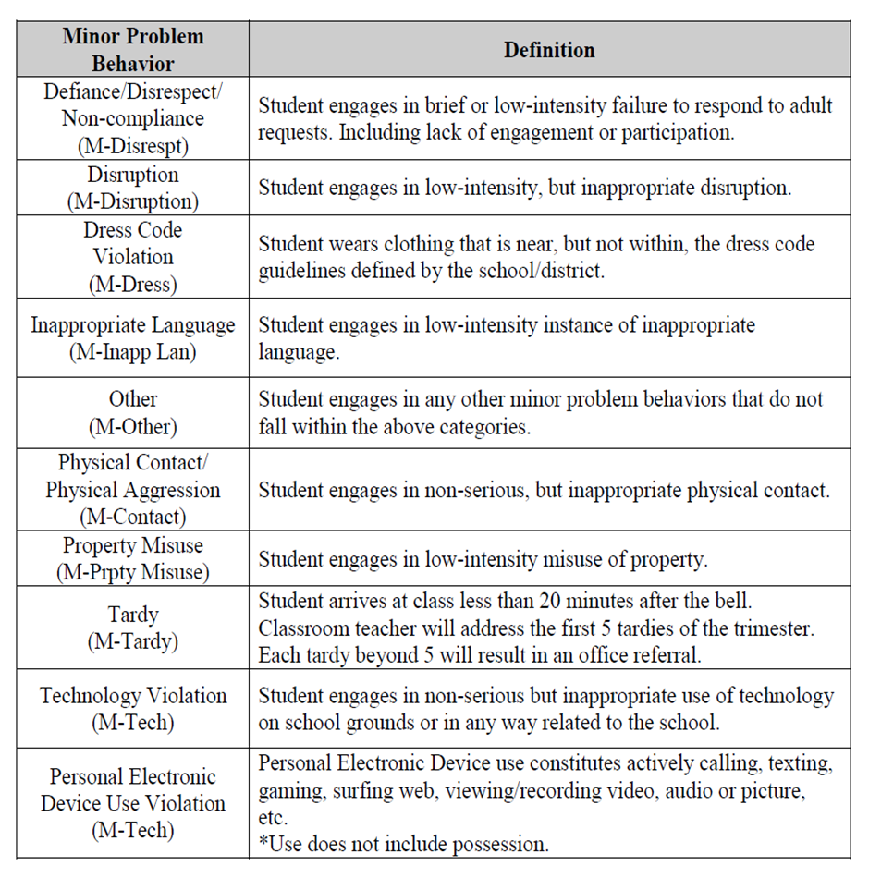
Problem Behavior DefinitionExample

Slide 43
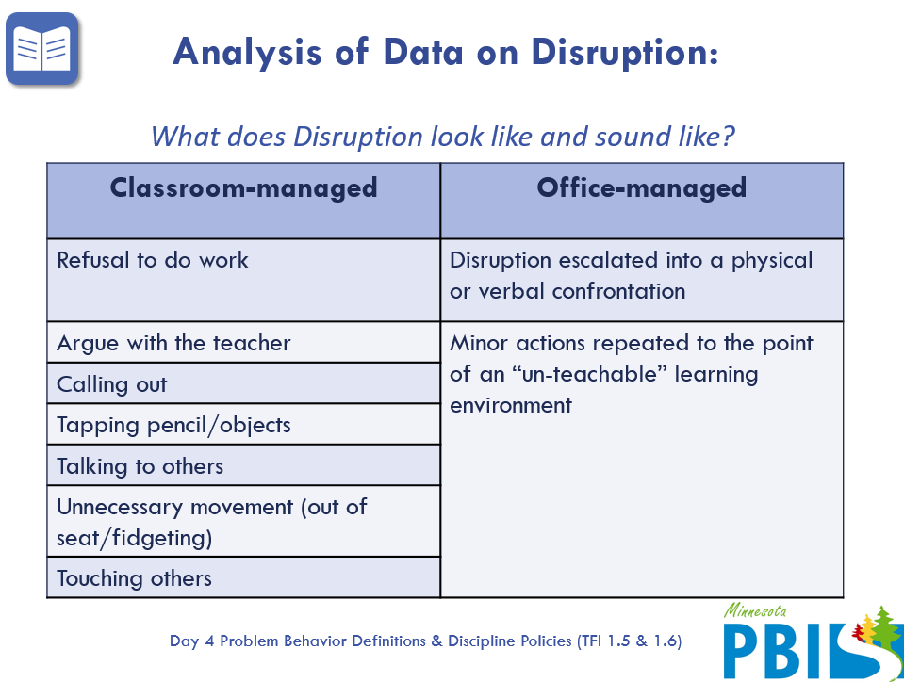
Problem Behavior Definition Example

Slide 44
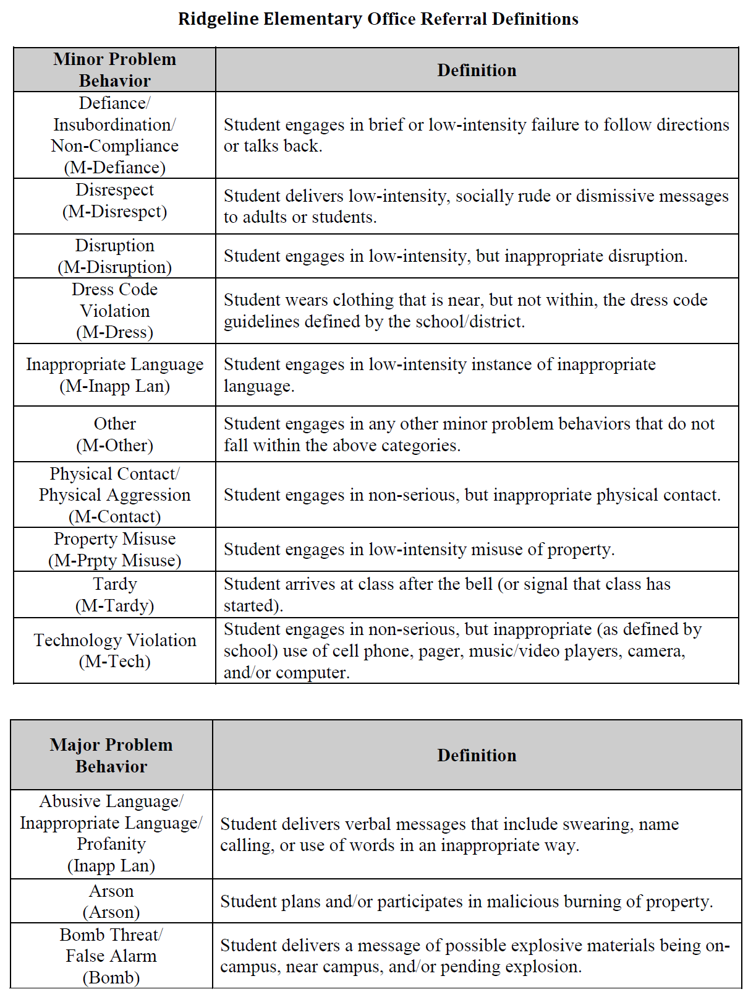
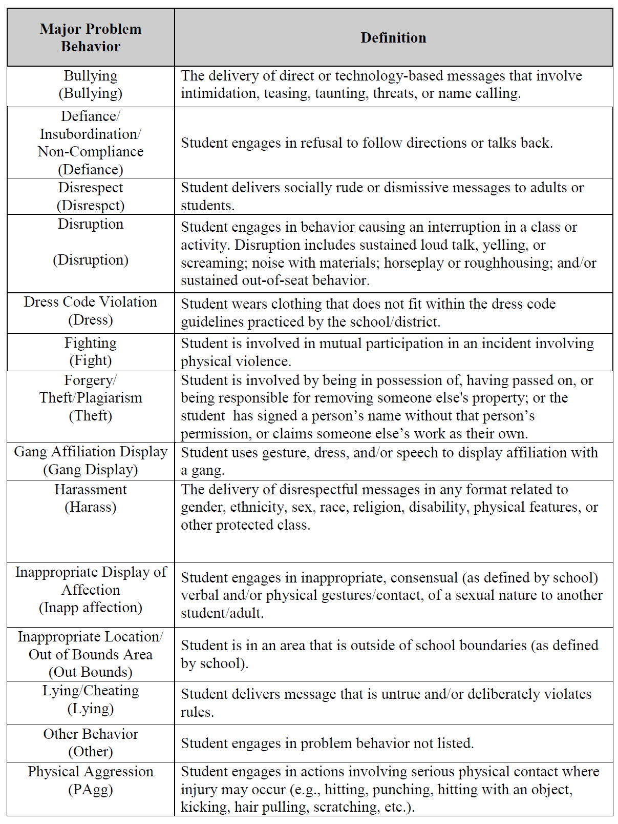
SWIS Referral Definitions
See Appendix K
Appendix
K
More information and examples are available at www.pbisapps.org in the SWIS Resources section.
Notes:
More information and examples of referral forms are available at www.pbisapps.org in the SWIS Resources section. A school/facility would want to access these resources to guide them through meeting their readiness requirements.

Slide 45
Warning/Reteach | Minor Offense | Major Offense | Expected Behaviors
Teacher handled, no documentation required, teacher discretion for consequences and personal documentation | Teacher handled, referral form completed, teacher assigns own or building consequence (building consequence examples: lunch or after school detention, time in office, community service, etc.) | Referral form completed. Administrator assigns consequence (with teacher input). Administrator communicates to teacher about situation.
LANGUAGE
Offensive remarks or gestures in a casual manner inappropriate sexual connotations; putdowns to a particular subgroup | Repeated pattern of any inappropriate language | Swearing used to harass, intimidate, show defiance, create an unsafe climate | Language that is socially appropriate I am frustrated. I don’t like that. I hate it when that happens. That’s different.
DISRUPTION
Noise making; talk-outs/side-talk; attention-getting behaviors (silly answers, class clowning, etc.); bugging others | Repeated pattern of any disruptive behaviors; misuse of cell phone/electronic devices in class [Phones and electronic devices to be confiscated and taken to office] | Behavior that stops the learning in class; defiant repetition of behavior following correction | Cooperative behaviors Turn taking Contributing to class discussions and activities Cell phones off & away during instructional time

Slide 46
DEFIANCE
Passive refusal to participate; extremely slow in response to request (limit-testing) | Ignoring reasonable request to stop low-level disruption; overt refusal to participate | Repeated refusal; ignoring reasonable request that leads to escalation to an unsafe situation | Acting in a cooperative manner respectful of school and classroom expectation. Responding appropriately when addressed.
TEASING | DEMEANING BEHAVIOR | HARASSMENT
Annoying on purpose; altering names; | “Put downs”; threatening and/or disrespectful body language/posturing; targeted insults | Threat/extortion; racist/SES/sexual/religious /disability/ethnicity/ sexual orientation/ cultural remarks; continued pattern of Tier 2 behaviors; continued proximity after separation; cyber-bullying/intimidation | Language that honors and validates others and their values and beliefs.
OVERLY PHYSICAL | ROUGHNESS | FIGHTING/AGGRESSION
Rough play | Pre-fight aggressive posturing, wrestling, bumping into others, “horse play” | Hitting or kicking; encouraging another to fight; retaliating | Respect for others’ personal space. Walking away from and reporting possible conflicts.

Slide 47
Three important components of organizing district and building responses
Clearly defined behaviors
Discipline Flow Chart
Discipline Referral Form
Are all staff consistent with how rule violating behavior is labeled?
Are all staff knowledgeable on what responses are appropriate and process when responding to rule violating behaviors?
Are all staff consistent with recording and monitoring information when problem behaviors occur?
communication and data review
consistent management and tracking of behaviors
consistent responses

Slide 48
Three important components of organizing district and building responses
Discipline Flow Chart
Clearly outline process for responding to behavior as well as how we track student / staff behavior
Are all staff knowledgeable on what responses are appropriate and process when responding to rule violating behaviors?
Staff responses
Outline responses linked to various levels of behavior and a process for both classroom and office managed behavior that is clear to both staff and students.
Behavior tracking
Outline what information is tracked at which points and where that data will be collected and housed.
Notes:
Notes:
Each of these activities are important for managing responses to inappropriate behavior in schools.

Slide 49
Guidelines for Continuum of Procedures to Decrease Behavior
PRACTICES
Specify Procedures for Processing Violations of SW Expectations
  Agreement regarding office/administrative vs. teacher/staff responsibilities
  Agreement regarding options for continuum of consequences
    Series of responses that support students’ quick return to instructional activities
  Data decision rules for intervention and support selection
II.B.vii
Notes:
Review specific procedures and prompt key features of the ODR (again referencing resources available from SWIS regardless of whether teams are using it).
Review examples from SWIS (next several slides).

Slide 50
Referral Process
What (Product)
Why (Rationale)
Makes the discipline process transparent & predictable
Improves consistency between adults
How (Implementation)
Include in handbook for students, families
Flowchart of referral process
Builds trust & communication (staff, students, families)
Process/ considerations checklist

Slide 51
Discipline Process Considerations/Checklist
What is the process?
How do I refer an incident?
How do I complete the discipline form?
What is the purpose of the discipline form?
What should I expect to happen when I complete a minor or major incident report?
How does it get to the office (administrator and/or data entry person)?
When/how should I expect to hear back from the office/administrator?
Do we track minor offenses?
Is the discipline form different for minors?
What is the process for referring minor problem behaviors?
At what point are students and/or families included in the process?
What do I do in a crisis situation (not just lockdown, but also safety situations)?
II.B.vii

Slide 52
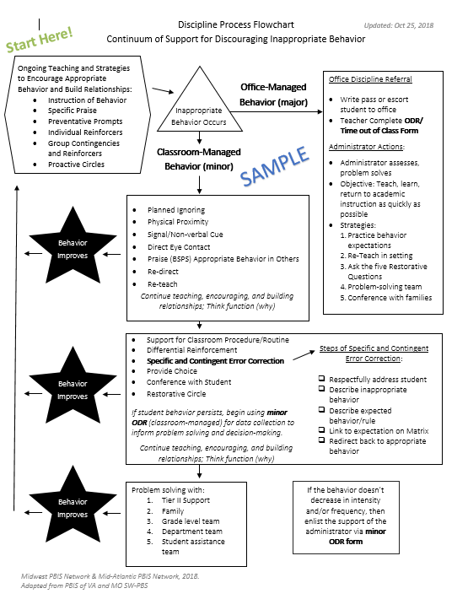
Referral Flowchart Examples

Slide 53
HS Student Behavior Procedural Flowchart
Is the behavior office managed?
Administration
Teacher
Contact front desk at x1100 with details of immediate event OR fill out SWIS referral.
No
Yes
Review expectation and redirect to activity
Administrator comes to class and escorts student to temporary placement OR will process referral.
Resolved
Not Resolved
.
Teacher
Administration
Inappropriate language
Physical contact
Defiance
Disrespect
Class disruptions
School property misuse
Dress Code violation
Misuse of technology
Student wandering in hallways
Lying for avoidance or attention
Misuse of hallway pass
Class absence/tardy
Cheating/Plagiarism *
Abusive or racist, sexist, homophobic language
Fighting/Physical aggression
Aggressive defiance
Harassment/Bullying
Sustained disruption
Chronic absenteeism/truancy
Forgery/theft
Cheating/Plagiarism
Tobacco/Drugs/Alcohol
Vandalism/Property damage
Threat to self and/or others
Chronic misuse of technology
Insubordination in hallways
Utilize Classroom Strategies
Teach/Review/Re-teach Expectations
Behavior Contract
Change of Seat
Phone call home
Differentiated instruction
Collaborate with student’s other teachers, liaison, adj. counselors, housemaster
10 minute maximum time on passes
Teacher fills out SWIS referral form by end of day. Administrator collects more information & conducts student/teacher interviews.
Administrator determines need for further consequence.
Resolved
Not Resolved
Administrator contacts teacher and home about action.
After multiple interventions for the same behavior over time
Refer to Administrator, Support Staff, and/or CST
Gray area? Refer to adjustment counselor, administration, or support staff
Resolution with student, teacher, & others occurs.
*Teacher determines severity.

Slide 54
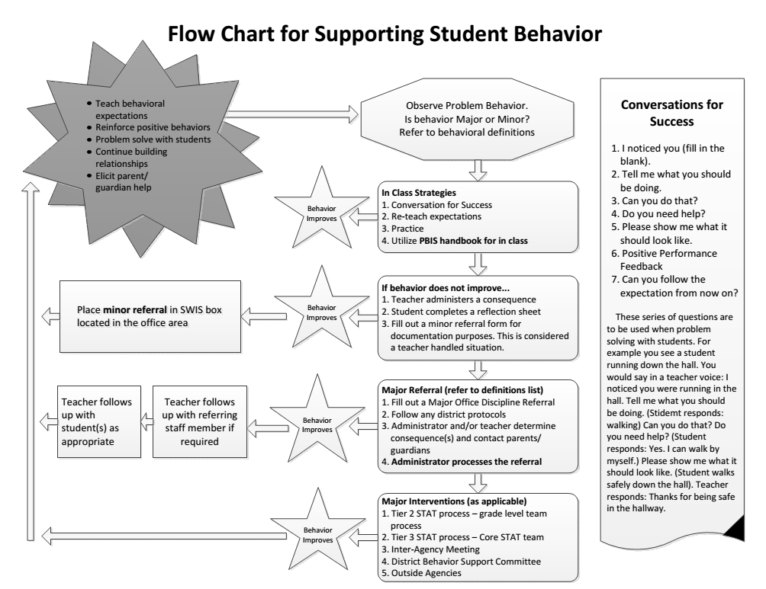

Slide 55
Level 1 Productive Personal Environment | Level 2 Productive Classroom Environment | Level 3 Orderly Environment | Level 4 Safe Environment
Behaviors that affect only the student: | Behaviors that interfere with others learning: | Behaviors that affect an orderly environment: | Behaviors that cause harm or are illegal:
-Not prepared -Out of seat -Breaking pencils -Not following directions -Whining -Playing in desk -Not doing class work -Bubbles while washing -hands -Not in line -Sleeping -Copying behavior -Not listening -Leaning in chair -Refusing to work -Crawling on floor -Not taking responsibility for action -No homework | -Talking out -Visiting/talking -Inappropriate noises -Tattling -Touching -Poking -Standing on furniture -Constant talking -Out of seat and interfering with others’ learning -Crawling on floor and -interfering with others’ learning -Inappropriate chair manners -Consistently not following directions | -Talking back to adult -Throwing things -Teasing -Lying -Cheating -Forgery -Cursing -Tantrums -Cutting others’ hair -Bathroom climbing -Bathroom-looking under stalls -Pushing -Disrespect to adults -Disrespect to children -Leaving room without permission -Name calling -Hallway Behavior -Banging on window -Profane hand gestures | -Actions that cause harm -Stealing -Fighting -Drugs -Weapons -Punching -Biting -Throwing furniture -Stealing -Threatening to do injury on person or property -Sexual harassment
Consequences may include: | Consequences may include: | Consequences may include: | Consequences may include:
-Looking -Proximity -Discussion/talking -Verbal warning -Timeout in room -Study Hall -Parent contact | --Timeout in another room -Study Hall -Loss of part of recess -Parent contact -Behavior contract -Office referral Adm/parent/student/teacher Conference -In-school suspension | --Behavior contract -Office referral Adm/parent/student/teacher Conference -In-school suspension -Out of school suspension | Per Board of Education Policies

Slide 56
Activity:
School-Wide Expectation Violations
Work as team for 25 min
Complete Behavior Expectation Violations Worksheet (Major vs. Minor behavior definitions)
Complete Behavior Violations Flowchart
Ensure that you have a behavioral tracking system and a continuum of staff responses for addressing rule violations both in and out of the classroom
Add items to your Action Plan as necessary
Present 2-3 “big ideas” from your group (1 min. reports)
II.B.vii
Notes:
Prompt teams to start worksheet in workbook. Pg. 76

Slide 57
Three important components of organizing district and building responses
Clearly defined behaviors
Discipline Flow Chart
Discipline Referral Form
Are all staff consistent with how rule violating behavior is labeled?
Are all staff knowledgeable on what responses are appropriate and process when responding to rule violating behaviors?
Are all staff consistent with recording and monitoring information when problem behaviors occur?
communication and data review
consistent management and tracking of behaviors
consistent responses
Notes:
Notes:
Each of these activities are important for managing responses to inappropriate behavior in schools.

Slide 58
Three important components of organizing district and building responses
Discipline Referral Form
Clearly outline a system for tracking behavioral infractions that will support decision making.
Are all staff consistent with recording and monitoring information when problem behaviors occur?
Referral Form(s)
Develop referral forms with adequate specificity to support data-based decision making at the universal level.
System to support fidelity
Ensure language is consistent with behavior definitions and flow chart, form can be completed quickly, and staff are trained and supported with use.
Notes:
Notes:
Each of these activities are important for managing responses to inappropriate behavior in schools.

Slide 59
Referral Form for Data Collection
What (Product)
ODR - major
ODR – minor
Why (Rationale)
Provides documentation of an incident to be used for planning and support
How (Implementation)
Paper form
Paperless
ODR - combined
Separate forms or combined?
Include required fields for problem solving (e.g. behavior, location, time of day, student, perceived motivation)

Slide 60
Office Discipline Referral Form
It is:
It is NOT:
  An interaction between Kid - Staff Member - Administrator
  Clear, mutually exclusive, exhaustive definitions
  Underestimation of actual behavior
  Piece of information used to make decisions
  Data point
    Punishment
    A reflection on teacher’s skills
    A way to change or re-teach behavior
    A first attempt at correcting behavior

Slide 61
Referral Form Required Fields for Effective Problem Solving
Student’s name
Date
Time of incident
Student’s grade level
Referring staff
Location of incident
Problem behavior
Perceived Motivation
Others involved
Action Taken
Other Notes

Slide 62
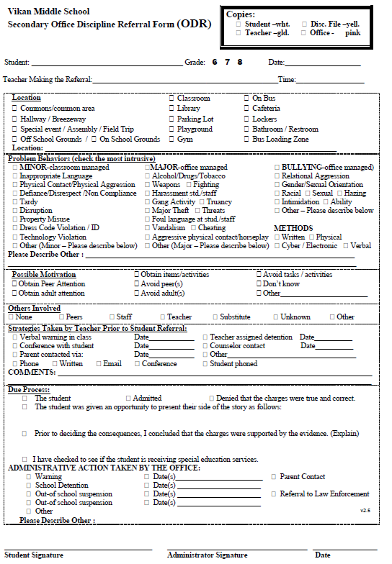
Referral Form Examples
Categorical options with checkboxes and less narrative allows for efficient completion and less confusion.
See Appendix K
Appendix
K

Slide 63
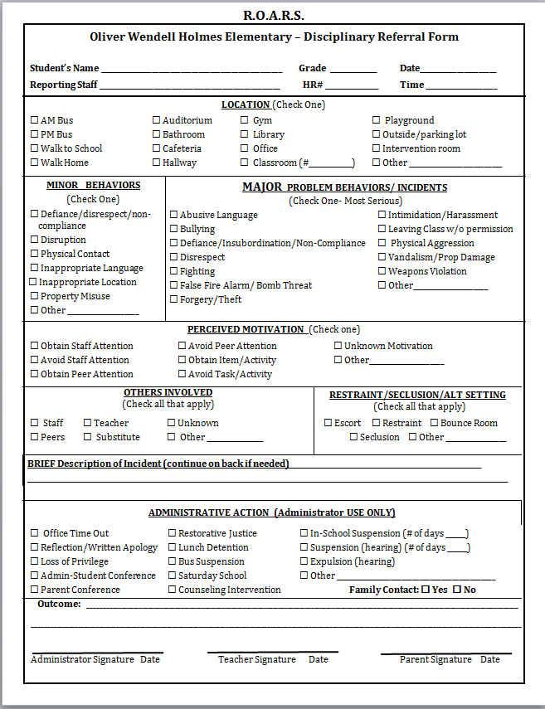
Referral Form Examples

Slide 64
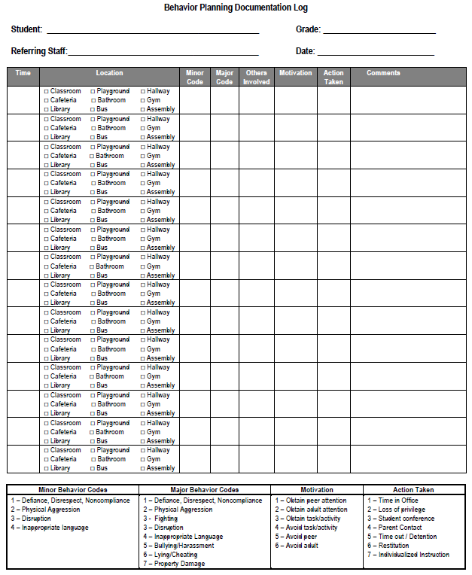
Referral Form Examples

Slide 65
Referral Form Examples

Slide 66
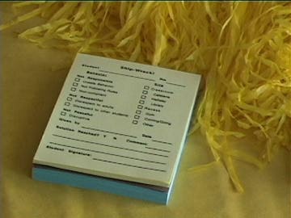
~10 positive : 1 correction

Slide 67
Guidelines for Continuum of Procedures to Decrease Behavior
PRACTICES
ODR form for tracking discipline event specifies:
  Who (i) violated rule, (ii) observed and responded to violation of expectation, and (iii) else was involved
  When (day/time)
  Where
  What (i) expectation was violated and (ii) was the possible motivation
Implement procedures
  Used by all staff
  Schedule for regular review of use and effectiveness
  Means for keeping track of number of acknowledgments vs. ODRs or other disciplinary actions
  Procedures in place for identifying and supporting students whose behaviors are not responsive
And always remember to consider systems, culture, & context.
Notes:
One of the most powerful ways you can get staff to use the procedures is to share the data back with them.
After reviewing key features of implementing procedures, remind staff to pause to ensure that (a) you have ensured systems are in place to support implementation and (b) practices and systems feature are culturally and contextually relevant.

Slide 68
Activity:
School-Wide Expectation Violations
Work as team for 15 min
Complete Discipline Referral Form
Add items to your Action Plan as necessary
Present 2-3 “big ideas” from your group (1 min. reports)
Notes:
Prompt teams to start worksheet in workbook.

Slide 69

Break

Slide 70
Getting Started with SWPBIS
Establish an effective leadership team
Develop brief statement of behavioral purpose
Identify positive SW behavioral expectations
Develop procedures for teaching SW expectations
Develop procedures for teaching class-wide expectations
Develop continuum for strengthening appropriate behavior
Develop continuum for discouraging violations of expectations
Develop data-based procedures for monitoring
Develop systems to support staff
Build routines to ensure on-going implementation
DATA
II.B.viii
Remember! Regularly using data for decision making is of the key predictors of reduced disproportionality!
Notes:
Review where we just were (coming up with procedures to discourage inappropriate behavior, and developing and using procedures for office discipline referrals).

Slide 71
Why Use Data for Decision Making?
Decisions are more likely to be effective and efficient when they are based on data. Use data to:
  Identify problems
  Refine problems
  Define the questions that lead to a solution
The quality of decision making depends most on defining problems with precision & clarity.
Data help place the “problem” in the context rather than in the students.
II.B.viii

Slide 72

What is the single factor most related to high sustainability?
The frequency that data are presented to all school staff.
McIntosh, K., Kim, J. R., Pinkelman, S., Rasplica, C., Berg, T. & Strickland-Cohen, M. K. (2014).

Slide 73
Steps for Selecting, Monitoring, and Evaluating SWPBIS Practices
Step 1: Develop evaluation questions.
What do you want to know?
II.B.viii
Notes:
Your outcome statements are a really good place to start framing your evaluation questions.

Slide 74
Questions to ask your data
Scope of Problem
Whole school (Tier 1)
  If so, when and what areas need support?
  If so, what grade levels need more support?
Small group (Tier 2)
1 student (Tier 3)
Type of problem
  Academic errors
  Attendance issues
  Behavioral issues
    Time
    Location
    Topography
    Etc.
See Appendix K
Appendix
K
Notes:
Think about the evaluation questions in two ways: scope and type of the problem.
Remind teams workbook appendices are also posted on nepbis.org

Slide 75
Steps for Selecting, Monitoring, and Evaluating SWPBIS Practices
Step 1: Develop evaluation questions.
Step 2: Identify indicators or measures.
What do you want to know?
What information can be collected?
II.B.viii

Slide 76


Types of Information (Data)
Fidelity Data
Outcome Data
Did we implement the systems and strategies we agreed upon?
Is the plan resulting in progress toward our goals?
Notes:
Those examples were all about student data. However, that’s not enough.
We need two types of data: outcome and fidelity data.
Fidelity data indicate how well adults are implementing procedures or interventions. Are we implementing the way it was designed and using the methods we said we would?
Outcome data indicates the impact of our systems and practices. How well are the students responding to our interventions or the social environment?
We want to make sure that schools and educational facilities or organizations are able to keep their finger on the pulse of what is going on to make the best programmatic decisions possible for their students and staff.
SWIS (click) is an important source of data but we also want to use the other data available. For example, the PBIS team monitors fidelity to SWPBIS. Sometimes we need information from staff members about specific procedures but sometimes a general check-up is enough to let us know that everyone understands and is implementing procedures. Attendance data, grades, state testing data... These are all examples of outcome data that might be used to support decision making.
Facilitator Note: if the school is already using tools in PBIS Assessment such as the Tiered Fidelity Inventory (TFI) or the Self-Assessment Survey (SAS) you can reference these directly. There is information at www.pbisapps.org in the Applications section if the PBIS team is interested in using the free tool available to collect PBIS fidelity data (i.e., PBIS Assessment). Just be sure that this doesn’t derail Swift at SWIS training.

Slide 77
Sources of data in school
If your team hasn’t been trained in SWIS yet, speak to your trainers today!
Office discipline referrals (see swis.org)
School climate surveys (see pbisapps.org)
Fidelity tools (see pbisapps.org)
Other school outcome indicators (use local resources)
  Grades
  Attendance
  Rates of students referred for additional support and/or identified with disabilities
  Academic performance (e.g., scores on state and district-wide assessments)
  Visits to the nurse/counselor
___________
___________
Notes:
Trainers: follow up with teams to schedule SWIS training
- Share readiness steps: https://www.pbisapps.org/Applications/Pages/Getting-Started-With.aspx
What are other sources of data you use to make decisions in your school/district?

Slide 78
Example:
Average Referrals Per day Per Month
Graph answers the question:
Do we have a school wide problem with behavior
(Tier 1)?

Slide 79
Example:
Referrals by Location
Graph answers the question:
Where is our big problem area?

Slide 80
Example:
Referrals by Problem Behavior
Graph answers the question:
What is our big problem behavior?

Slide 81
Example:
Referrals by Time of Day
Graph answers the question:
When do problems occur?

Slide 82
Example:
Referrals by Grade
Graph answers the question:
What grade levels need more support?

Slide 83
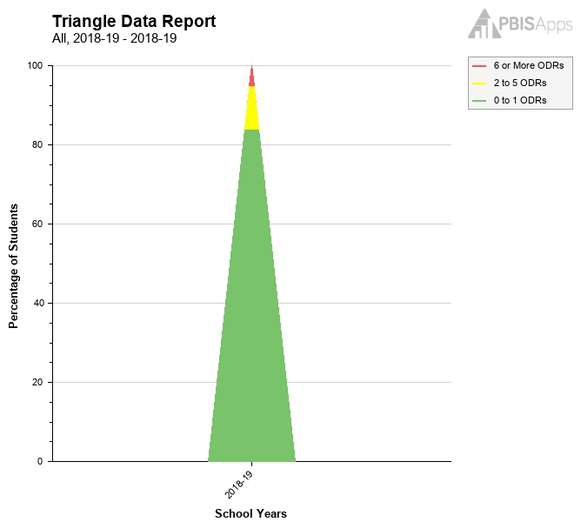
Example:
Triangle Report
Graph answers the question:
Are students responding to our systems?
*Most reliable as a fidelity measure when used at the end of the year.

Slide 84
Steps for Selecting, Monitoring, and Evaluating SWPBIS Practices
Step 1: Develop evaluation questions.
Step 2: Identify indicators or measures.
Step 3: Develop methods for collecting and analyzing indicators.
What do you want to know?
What information can be collected?
How/when should information be gathered?
II.B.viii

Slide 85
Guidelines for Efficient Data Collection
What
  Data collection limited to information that answers important student, classroom, and school questions
How should information be gathered?
  Data collection procedures are integrated into typical routines (e.g., ODRs, attendance, behavior incident reports)
  Data collection and staffing are scheduled to ensure that data are current
When?
  No more than 1% of time each day for managing data
By whom?
  Ensure access to all necessary information (e.g., student records)
  Data collection reports regularly checked for accuracy

Slide 86
Guidelines for Efficient Data Analysis
Protect team time to review data monthly
  Data system managed by 2-3 staff members
  Efficient, timely, and graphic displays of data
Structures and routines for staff members to receive weekly/monthly data reports about status of SW discipline
Decision rules for guiding data analysis and actions
II.B.viii

Slide 87

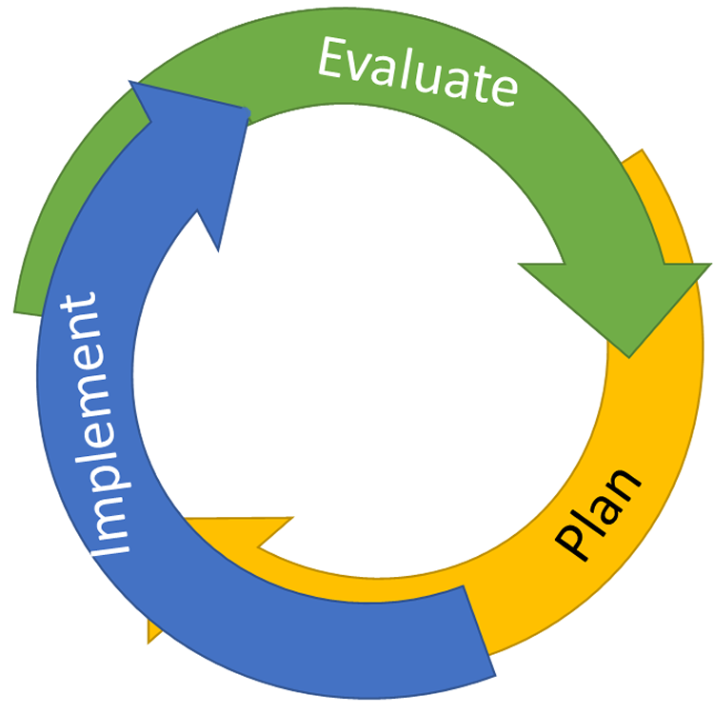
Continuous Quality Improvement
Reassess and revise solution(s) as needed
Identify problems
with precision
Monitor outcomes and compare
to goal(s)
DATA
Establish goal(s)
Develop solution(s)
Implement solution(s)
with integrity and fidelity
Notes:
Trainer Note: We want to interrupt the traditional cycle of admiring the problem, by talking and talking about the problem before quickly launching into determining solutions.
We can do this by building a system for improved decision making.

Slide 88
Steps for Selecting, Monitoring, and Evaluating SWPBIS Practices
Step 1: Develop evaluation questions.
Step 2: Identify indicators or measures.
Step 3: Develop methods for collecting and analyzing indicators.
Step 4: Make decisions and action plan from analysis of indicators.
What do you want to know?
What information can be collected?
How/when should information be gathered?
How was the question answered and what should be done next?
II.B.viii

Slide 89
Data Review: PBIS Team
Look at Average Referrals Per Day per Month Graph
Past 3 months greater than 25th Percentile
Examine Students who need Tier 2 Supports
No
Yes
Look at 3 Graphs:
ODR x Problem Behavior
ODR x Location
ODR x Time of Day
Design Action Plan to Teach, Prevent, or Reinforce based on these data
Plan
Example Goal Statement: Reduce ODRs by 20% overall this year, in comparison to last year’s overall numbers.

Slide 90
Additional Example Goal Statements
Reduce ODRs by 20% in our three most challenging months Mar, Apr, and May.
Reduce ODRs to below the 25th percentile according to the national norms for three months of the school year.

Slide 91
Data Review: Grade Level Teams
Look at 3 Graphs:
ODR x Problem Behavior
ODR x Location
ODR x Time of Day
Design Action Plan to Prevent, Teach, and Reinforce based on these data
Action

Slide 92
Action plan from analysis
Data indicate:
ODR data shows more than 3 months above the 50th percentile
Data also indicate:
Location: Classroom
What to do?
Prevent
Increase reminders of expected behaviors when returning from lunch
Behavior: Inappropriate Language
Time: 12:30 to 1:15
Teach
Re-teach lesson plans, specific to returning to work after lunch
Reinforce
Special reinforcement for appropriate language in class after lunch

Slide 93
Action plan from analysis
Data indicate:
ODR data show's more than 3 months above the 50th percentile, and a large spike in data for Grade 5
Grade 5 Team Data also indicate:
Location: Playground
What to do?
Prevent
Remind of expected behaviors when conflicts occur at recess
Behavior: Physical Aggression
Time: 11:30 to 12:00
Re-teach
Role play of conflict resolution (rock, paper, scissors) from lesson plan
Reinforce
Provide special reinforcement for use of conflict resolution skill

Slide 94
Big Ideas
Collect data!
Present the data in a user-friendly fashion (i.e., graph).
Use the data to make decisions
Use your data today for action planning.
Data should inform outcomes, practices, and systems!

Slide 95
Guidelines for Good Outcomes
OUTCOMES
Based on data
Locally important and meaningful
Applicable to all (culturally equitable)
  Students’ social competence and academic achievement
  Staff implementation of critical skills
Observable and measurable
Written as a goal
I.C.i
Notes:
Based on data – What is readily available? Is it reliable?
Locally important – has social validity. Can use results of SAS or other surveys to identify.
Applicable to all – school-wide outcome goals should apply to everyone
4. Observable and measurable – if you want to improve something that is more subjective, consider how you will measure
5. Written in terms of what you want to achieve!

Slide 96
Activity:
Data Evaluation
Work as team for 15 min
Create a goal statement related to student behavior or discipline referrals
Action plan
  What data will be collected
  By whom
  How often
  How will it be shared (e.g. with staff, pertinent stakeholders)
Add items to your Action Plan as necessary
Present 2-3 “big ideas” from your group (1 min. reports)

Slide 97
Lunch

Slide 98
SWPBIS Evaluation

Slide 99
Tiered Fidelity Inventory
(TFI)
Purpose: | Assess evidence of critical features of school-wide PBS implementation; Progress over time; Helps team make data-based decisions on intervention and program efficacy; Guides action-planning.
Format: | Survey ratings of features in place (self-assessment). About 30 mins per tier.
Completed by: | Team members with the coaches. Walk through tool completed by external coach.
When? | Annually

Slide 100
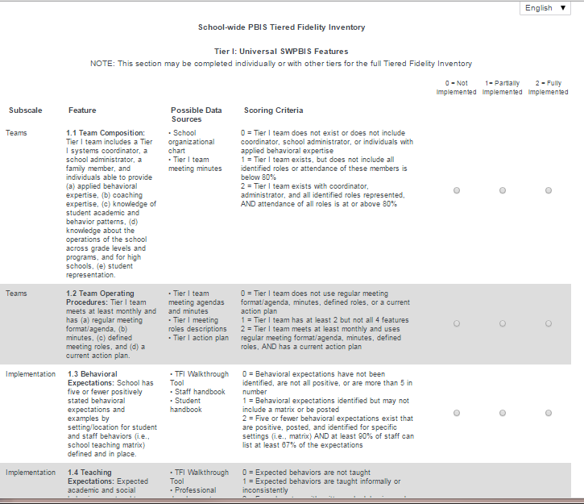
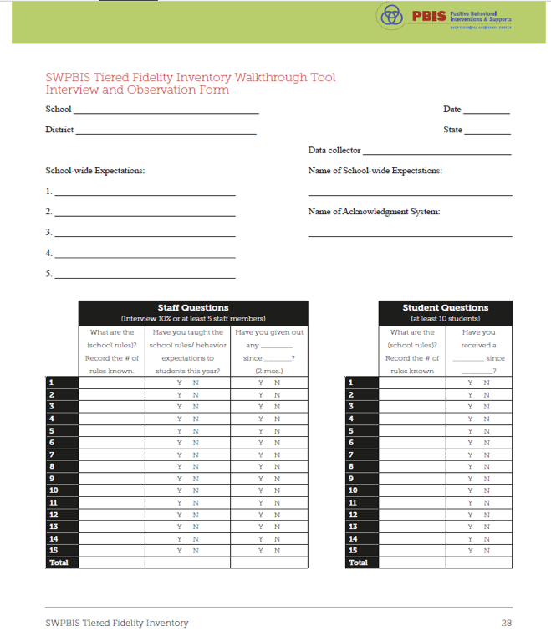
Tiered Fidelity Inventory
(SWPBIS TFI 2.1)
PBIS Assessments
Walkthrough Tool

Slide 101
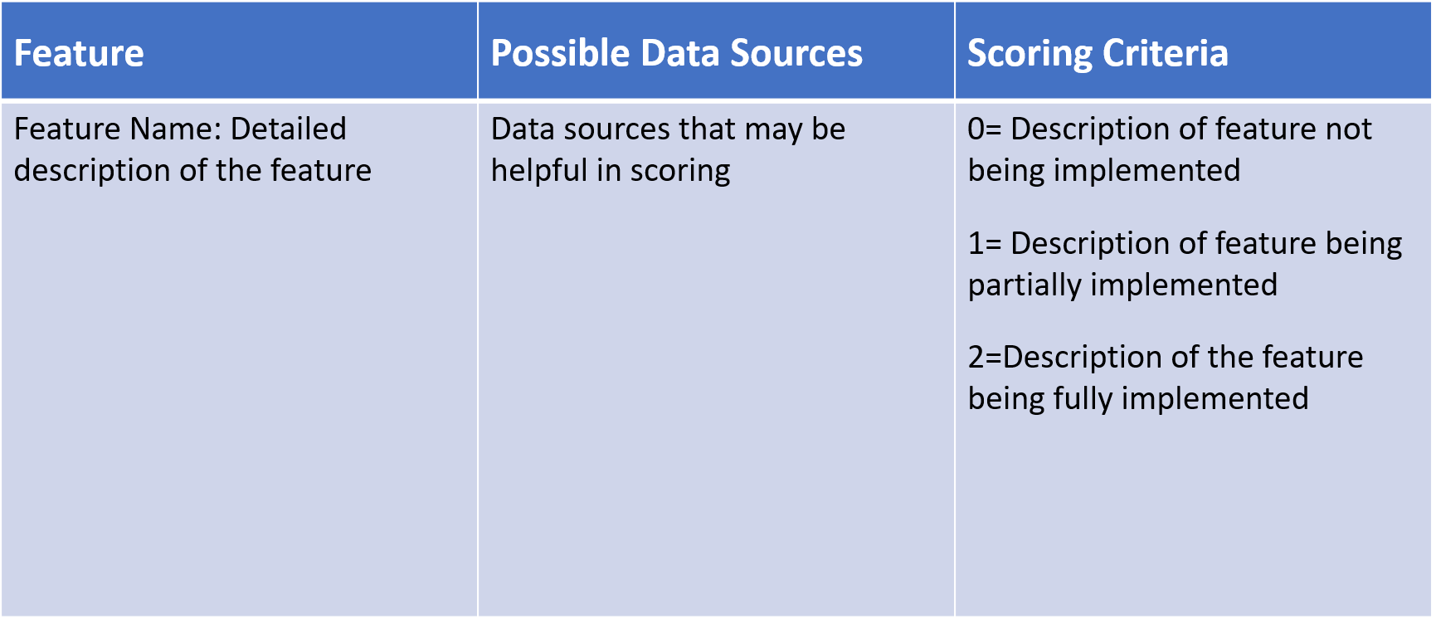
TFI Format
Tier 1: 15 items
Team Subscale – 2 items
Implementation Subscale – 9 items
Evaluation Subscale – 4 items

Slide 102
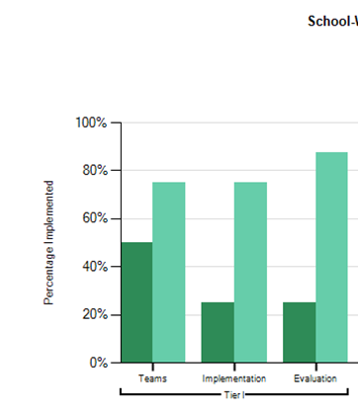
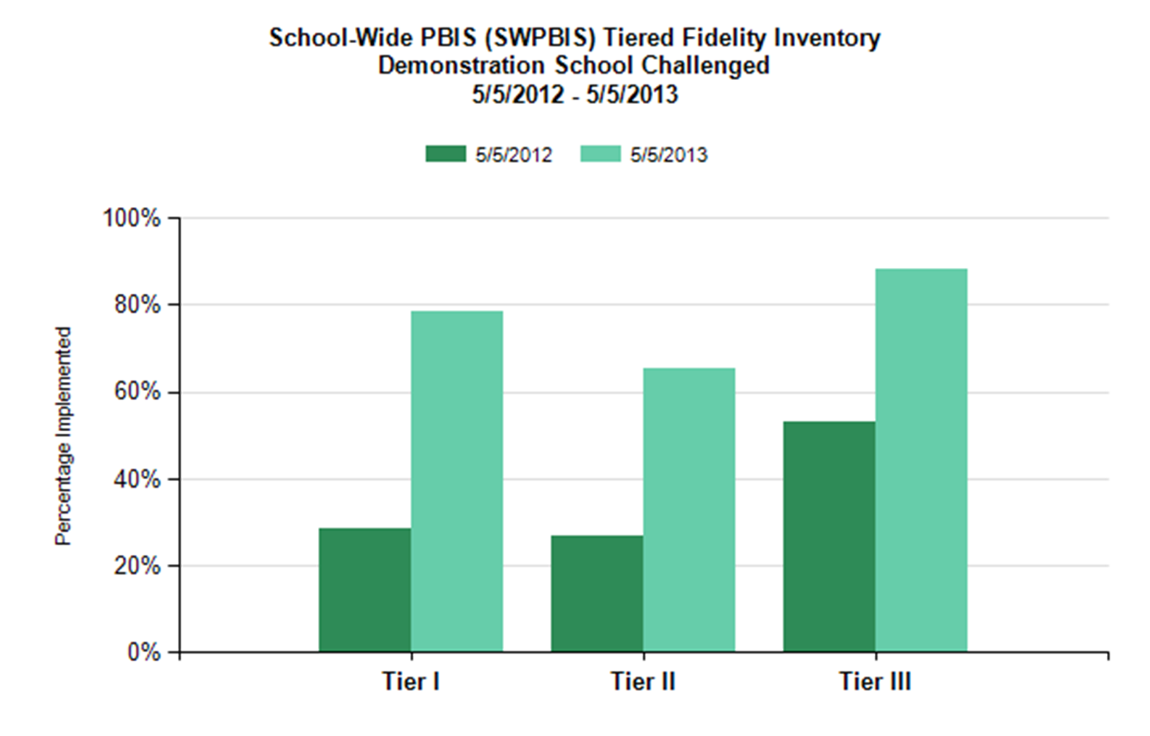
TFI Reports
Use the Scale, Subscale and Item reports to guide action planning.

Slide 103

Cultural Responsiveness Field Guide
Outlines ways to embed equity efforts into SWPBIS through alignment with core PBIS components
https://www.pbis.org/resource/pbis-cultural-responsiveness-field-guide-resources-for-trainers-and-coaches
Notes:
The field guide includes a section on identity awareness as well as the TFI CR Companion tool: https://www.pbis.org/resource/pbis-cultural-responsiveness-field-guide-resources-for-trainers-and-coaches

Slide 104
Example: 1.9 Feedback & Acknowledgement
CR Concept: SUPPORTIVE ENVIRONMENT
SWPBIS Big Idea: Attending to and acknowledging desired student behaviors increases the likelihood of these behaviors recurring.
CR Elaboration: Teams involve students, families, and communities in the development and use of acknowledgement systems in order to create systems that are meaningful and authentic and consider the culture of the students they serve when designing recognition systems.
Non-Examples: Some student enrollment groups have inequitable
access to acknowledgement.
Examples: Teams actively seek feedback from students, families, and the community about preferences for acknowledgement and perceptions of the current systems at least annually

Slide 105
Activity: Review TFI & CR Companion
Work as a team for 20 min
Find the Tiered Fidelity Inventory and the Cultural Responsiveness Companion
  Consider bookmarking/downloading
Review the TFI and selected items from the TFI CR Companion
  Identify any questions you have regarding use of these tools
Notes:
TFI is on PBIS Apps website; TFI Cultural Responsiveness Field Guide & Companion tool is on www.pbis.org website

Slide 106
SWPBIS Action Planning

Slide 107
Activity:
Action Planning
Work as team for 100 min
Return to your Action Plan
Update each section based on what you’ve learned today.
In particular, make sure to have a plan for sharing information with and gathering/using feedback from your school faculty!
Present 2-3 “big ideas” from your group (1 min. reports)

Slide 108

PREVIEW: Getting Started with SWPBIS
Establish an effective leadership team
Develop brief statement of behavioral purpose
Identify positive SW behavioral expectations
Develop procedures for teaching SW expectations
Develop procedures for teaching class-wide expectations
Develop continuum for strengthening appropriate behavior
Develop continuum for discouraging violations of expectations
Develop data-based procedures for monitoring
Develop systems to support staff
Build routines to ensure on-going implementation
SYSTEMS
II.B.ix

Slide 109
80% Rule
Tertiary Prevention:
Specialized
Individualized
Systems for Staff with High-Risk Behavior
~5%
Primary Prevention:
Systems to support
all staff:
Professional development
Reinforcement
~15%
Apply the triangle to adult behavior!
Secondary Prevention:
Specialized Group
Systems for Staff who are “At-Risk”
Additional instruction
Increased support
~80% of Staff
Notes:
Good sequence on staff acknowledgements…..important one for teams to get

Slide 110
PREVIEW: Getting Started with SWPBIS
Establish an effective leadership team
Develop brief statement of behavioral purpose
Identify positive SW behavioral expectations
Develop procedures for teaching SW expectations
Develop procedures for teaching class-wide expectations
Develop continuum for strengthening appropriate behavior
Develop continuum for discouraging violations of expectations
Develop data-based procedures for monitoring
Develop systems to support staff
Build routines to ensure on-going implementation
SYSTEMS
II.B.x

Slide 111
PREVIEW: Guidelines for Building Routines for On-Going Implementation
SYSTEMS
Work as a team.
Make decisions based upon data.
Consider needs of all students.
Integrate PBS activities into other initiatives and projects.
Begin teaching, learning, and behavioral expectations on the first day.
Involve students, staff, parents, and community.
Increase use of reminders and pre-corrections before and after transitions.
Increase/maintain high rates of positive acknowledgements.
Specify expected outcomes of every activity.

Slide 112
Review of SWPBIS

Slide 113
Getting Started with SWPBIS
Establish an effective and representative leadership team
Develop brief statement of behavioral purpose
Identify positive SW behavioral expectations
Develop procedures for teaching SW expectations
Develop procedures for teaching class-wide expectations
Develop continuum for strengthening appropriate behavior
Develop continuum for discouraging violations of expectations
Develop data-based procedures for monitoring
Develop systems to support staff
Build routines to ensure on-going implementation
Day 1
Day 2
Day 3
Day 4

Slide 114

Establish Team
Develop Statement of Behavioral Purpose or Vision
At BSG, we are responsible for ourselves, respect each other, and maintain safety in our school.
Establish Behavioral Expectations/Rules
Teach Expectations in the
Context of School Settings

Slide 115
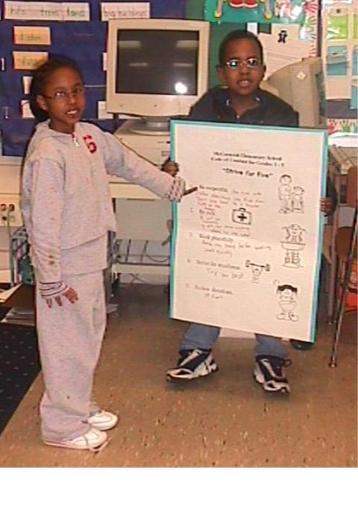
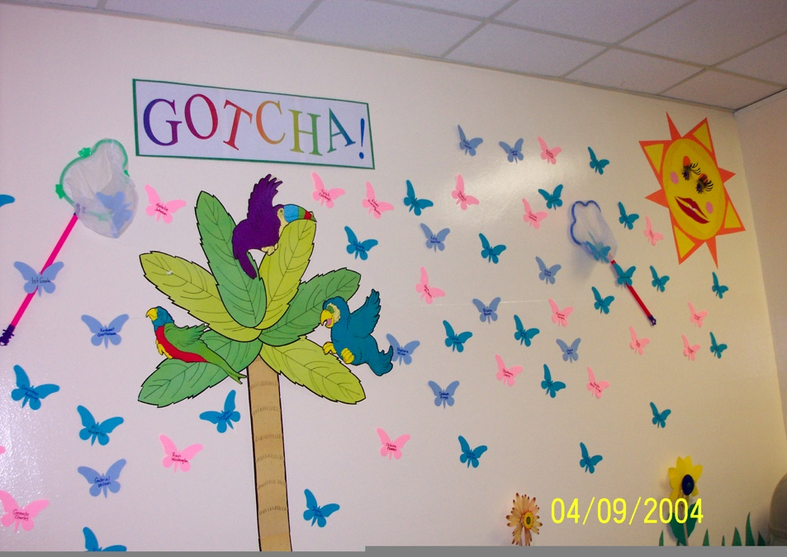
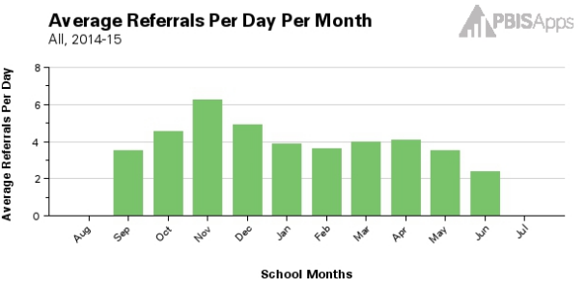
Teach Expectations in the
Context of Class Routines
Establish Procedures for Encouraging Appropriate Behavior
Establish Procedures for Responding to Inappropriate Behavior
Develop data-based procedures for monitoring

Slide 116
Consider Tattoos!
4 SWPBIS Elements
School Systems
Supporting Social Competence &
Academic Achievement
OUTCOMES
School-wide
Classroom
SWPBIS
SYSTEMS
DATA
Supporting
Decision
Making
Supporting
Staff Behavior
Non-classroom
Family
PRACTICES
Tertiary Prevention:
Specialized
Individualized
Systems for Students with High-Risk Behavior
~5%
Student
Supporting
Student Behavior
Primary Prevention:
School-/Classroom-
Wide Systems for
All Students,
Staff, & Settings
~15%
Secondary Prevention:
Specialized Group
Systems for Students with At-Risk Behavior
~80% of Students

