Slide 1
School-Wide Positive Behavioral Interventions and Supports (SWPBIS)
Northeast PBIS (NEPBIS) School-Wide Team Training
Day 7
INSERT TRAINERS NAMES
with support from Brandi Simonsen, Jen Freeman,
Susannah Everett, Adam Feinberg, Katie Meyer, & George Sugai
Notes:
Add trainer names for your event

Slide 2

Advance Organizer
Quick Recap of Year 1 (Days 1-6) Training
Tier 1 SWPBIS: Problem Solving Critical Features
Equity
Action Planning

Slide 3
Tier 1 Leadership Team & Coaches Meetings
WHAT | WHO
6 days of Team Training | Minimum membership: administrator, grade level representatives, support staff
3 days Coaches Meetings | 2 Coaches
1 day of TA per school | Admin, Coach, Data Entry
YEAR 1
3 days of Team Training | Same above
3 days Coaches Meetings | Same above
1 day of TA per school | Same above
YEAR 2
2 days of Team Training | Same above
2 days Coaches Meetings | Same above
1 day of TA per school | Same above
YEAR 3+
Tier 2 Training will also be offered to schools implementing Tier 1 with fidelity.
Notes:
Modify as appropriate to match your training approach (e.g., change number of TA days, but not training days)

Slide 4
MAIN TRAINING OBJECTIVES in YEAR 2
Enhance leadership team
Maintain staff agreements
Enhance knowledge of SWPBIS outcomes, data, practices, and systems
Refine individualized action plan for SWPBIS
Enhance and sustain implementation in future years

Slide 5
Training Expectations:
RESPECT…
SELF
Self-monitor (Are you participating? Engaged as a learner? Talking during allotted times?)
Stretch, break, stand as needed
OTHERS
Cell phones (inaudible): Converse in lobbies and breaks
ENVIRONMENT
Recycle
Work as a team: Room for every voice, reinforce participation
Maintain neat working area

Slide 6

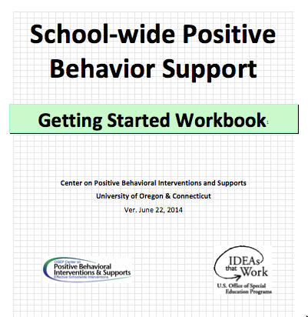
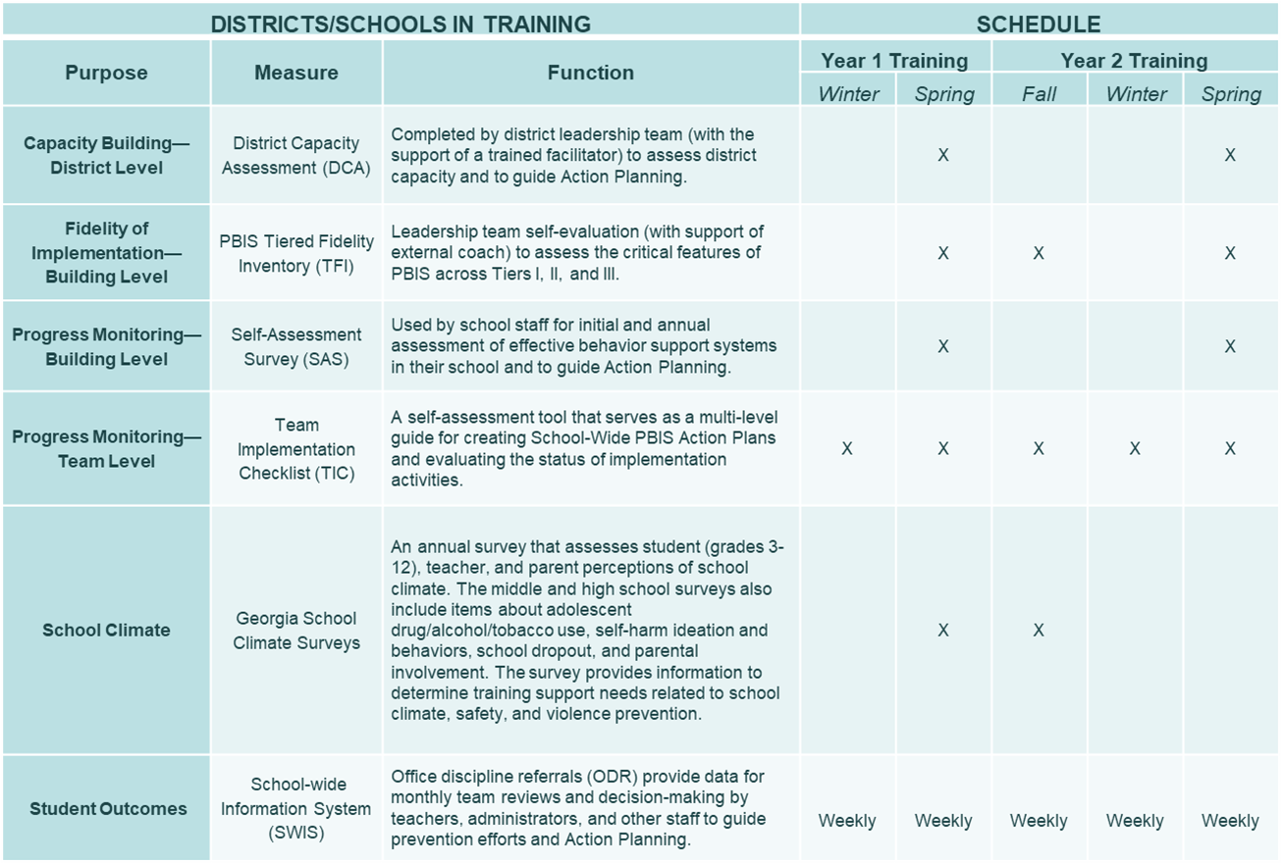

Tools!
nepbis.org
pbis.org
School-wide PBIS Workbook and Appendices
Evaluation Plan
Action Plan

Slide 7

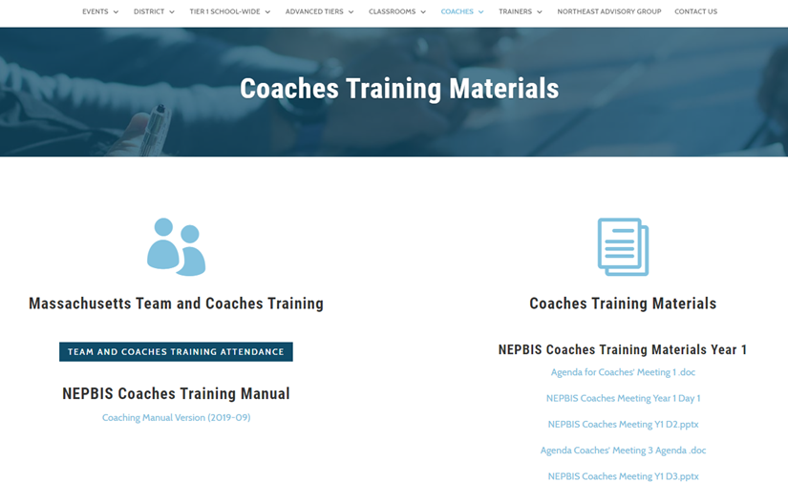
Activity:
Please Enter Attendance
1 min
Please login on nepbis.org, go to the coaches’ tab, and click on the Team Training Attendance Link. Follow prompts to enter team attendance.

Slide 8





Legend
New Content
Review
Guidelines
+Ex
-Ex
Training Organization
Activity

Slide 9

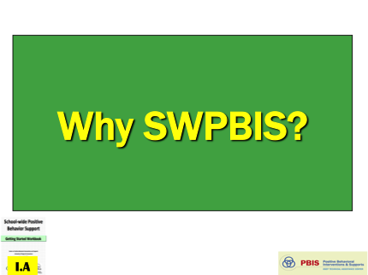
Legend
Section Header (I.A)
Chapter Header (e.g., I)

Slide 10

And now…
we present…
your tattoos!
I.A

Slide 11
SWPBIS Message!
Successful individual student behavior support is linked to host environments or school climates that are effective, efficient, relevant, & durable.
(Zins & Ponti, 1990)
I.A

Slide 12
SWPBIS is
Framework for enhancing adoption & implementation of
Continuum of evidence-based interventions to achieve
Academically & behaviorally important outcomes for
All students
I.B.i

Slide 13
Critical Features of PBIS
Supporting Culturally Equitable
Social Competence & Academic Achievement
OUTCOMES
Supporting
Culturally
Knowledgeable
Staff Behavior
Supporting
Culturally Valid
Decision
Making
SYSTEMS
DATA
(Vincent, Randal, Cartledge, Tobin, & Swain-Bradway, 2011; Sugai, O’Keefe, & Fallon 2012 ab)
PRACTICES
I.C
Supporting Culturally Relevant
Evidence-based Interventions
Notes:
Use data
Focus on outcomes: Academic & behavior success
On-going evaluation
Ensure cultural and contextual fit
Invest in systems
Organize research-validated practices within a continuum
Instructional & preventative approach
Integration
Tier 1 for all

Slide 14
SWPBIS
Practices
School-wide
Classroom
Smallest #
Evidence-based
Biggest, durable effect
Non-classroom
Family
Student
I.C.iii

Slide 15
Continuum of School-Wide
Instructional & Positive Behavior Support
Tertiary Prevention:
Specialized
Individualized
Systems for Students with High-Risk Behavior
~5%
Primary Prevention:
School-/Classroom-
Wide Systems for
All Students,
Staff, & Settings
~15%
Secondary Prevention:
Specialized Group
Systems for Students with At-Risk Behavior
~80% of Students
I.C.iii

Slide 16
GENERAL IMPLEMENTATION PROCESS
Team
Agreements
Data-based
Action Plan
Evaluation
Implementation
I.C.iv
Notes:
SAY: In general, the implementation of a school-wide PBS approach at the school level is built around five main implementation steps.

Slide 17
Implementing SWPBS: Guidelines, Examples, &
Self-check Activities

Slide 18
Critical Features of PBIS
Supporting Culturally Equitable
Social Competence & Academic Achievement
OUTCOMES
Supporting
Culturally
Knowledgeable
Staff Behavior
Supporting
Culturally Valid
Decision
Making
SYSTEMS
DATA
PRACTICES
Supporting Culturally Relevant
Evidence-based Interventions
Notes:
Use data
Focus on outcomes: Academic & behavior success
On-going evaluation
Ensure cultural and contextual fit
Invest in systems
Organize research-validated practices within a continuum
Instructional & preventative approach
Integration
Tier 1 for all

Slide 19
Focus on Outcomes
OUTCOMES
How do we develop outcome statements?
I.C.i

Slide 20
Guidelines for Good Outcomes
OUTCOMES
Based on data
Locally important and meaningful
Applicable to all (culturally equitable)
  Students’ social competence and academic achievement
  Staff implementation of critical skills
Observable and measurable
Written as a goal
I.C.i

Slide 21

Example Outcome Statements
During the 20XX-XX school year, staff members will implement PBIS with fidelity, as measured by meeting criteria on the Tiered Fidelity Inventory.
As a result of implementing PBIS during the 20XX-20XY school year, ODR data will decrease by __% relative to that same period the prior year.
As a result of implementing PBIS, staff, student, and parent surveys will indicate improved overall school climate (or target specific items related to acknowledgement, respect, etc.) as measured by an improvement of __ points on the Georgia Brief School Climate Surveys.

Slide 22
Self-Check:
Relevant Measurable Outcomes
Work as team for 5 min
Review your 1-3 observable and measurable outcome statements for your school.
Check to see outcomes reflect guidelines and include critical features illustrated by examples.

Slide 23
Critical Features of PBIS
Supporting Culturally Equitable
Social Competence & Academic Achievement
OUTCOMES
Supporting
Culturally
Knowledgeable
Staff Behavior
Supporting
Culturally Valid
Decision
Making
SYSTEMS
DATA
PRACTICES
Supporting Culturally Relevant
Evidence-based Interventions
Notes:
Use data
Focus on outcomes: Academic & behavior success
On-going evaluation
Ensure cultural and contextual fit
Invest in systems
Organize research-validated practices within a continuum
Instructional & preventative approach
Integration
Tier 1 for all

Slide 24
Focus on Data
DATA
What is data-driven decision making?
I.C.ii

Slide 25
To effectively use data…
…use your evaluation plan
DISTRICTS/SCHOOLS IN TRAINING |  |  | SCHEDULE
Purpose | Measure | Function | Year 1 Training |  | Year 2 Training
 |  |  | Winter | Spring | Fall | Winter | Spring
Capacity Building—District Level | District Systems Fidelity Inventory (DSFI) | Completed by district leadership team (with the support of a trained facilitator) to assess district capacity and to guide Action Planning. |  | X |  |  | X
Fidelity of Implementation—Building Level | PBIS Tiered Fidelity Inventory (TFI) | Leadership team self-evaluation (with support of external coach) to assess the critical features of PBIS across Tiers I, II, and III. |  | X | X |  | X
Progress Monitoring—Building Level | Self-Assessment Survey (SAS) | Used by school staff for initial and annual assessment of effective behavior support systems in their school and to guide Action Planning. |  | X |  |  | X
Progress Monitoring—Team Level | Team Implementation Checklist (TIC) | A self-assessment tool that serves as a multi-level guide for creating School-Wide PBIS Action Plans and evaluating the status of implementation activities. | X | X | X | X | X
School Climate | Georgia School Climate Surveys | An annual survey that assesses student (grades 3-12), teacher, and parent perceptions of school climate. The middle and high school surveys also include items about adolescent drug/alcohol/tobacco use, self-harm ideation and behaviors, school dropout, and parental involvement. The survey provides information to determine training support needs related to school climate, safety, and violence prevention. |  | X | X
Student Outcomes | School-wide Information System (SWIS) | Office discipline referrals (ODR) provide data for monthly team reviews and decision-making by teachers, administrators, and other staff to guide prevention efforts and Action Planning. | Weekly | Weekly | Weekly | Weekly | Weekly
…and tools available at:

Slide 26
Example Data Routines
During each PBIS meeting, we (a) review our outcomes, (b) review data sources related to each outcome, and (c) discuss our progress toward outcomes.
When a team member (or another staff person) brings a problem to the team, we define it precisely and engage in a clear problem-solving process to address it.
We share data with staff to (a) celebrate successes, (b) highlight current trends and needs identified in our data, and (c) facilitate school-wide conversations about the importance of fidelity and outcome monitoring across time.

Slide 27
Self-Check:
Using Data
Work as team for 5 min
Review data sources your team currently uses to drive decision making.
Self-evaluate the extent to which:
  You have routines to ensure regular data review
  You are actively collecting data to measure progress toward each of your outcomes
If needed, adjust your action plan to:
  Enhance routines for data review
  Actively monitor progress toward outcomes
  Collect new (or revise existing) data to address need areas and/or track progress toward outcomes

Slide 28
Critical Features of PBIS
Supporting Culturally Equitable
Social Competence & Academic Achievement
OUTCOMES
Supporting
Culturally
Knowledgeable
Staff Behavior
Supporting
Culturally Valid
Decision
Making
SYSTEMS
DATA
PRACTICES
Supporting Culturally Relevant
Evidence-based Interventions
Notes:
Use data
Focus on outcomes: Academic & behavior success
On-going evaluation
Ensure cultural and contextual fit
Invest in systems
Organize research-validated practices within a continuum
Instructional & preventative approach
Integration
Tier 1 for all

Slide 29
Focus on Practices
PRACTICES
What evidence-based interventions are included in SWPBIS?
I.C.iii

Slide 30
Guidelines for Practices
PRACTICES
The selection and organization of these practices should:
Be developmentally, contextually, and culturally appropriate and adaptable
Be linked conceptually
Have data rules that guide timely decisions within and between practices and systems
Be empirically and educationally defendable
Be associated directly with the most important and documented school climate and behavior priorities of the school
Be monitored continuously for implementation fidelity and student benefit
Represent the core features that define the tiered prevention logic

Slide 31
Example PBIS Practices
During the first week of school, we set up stations and taught all school-wide expectations to every student across each school setting. We stamped “passports” to track who had received which lessons.
We implemented a school-wide coupon system, and students can exchange tickets for privileges (e.g., teacher’s helper, announcer).
We revised our office discipline referral procedure. Students who receive 2 or more referrals are invited to a social skills ‘lunch bunch’ to work on the targeted skill during lunch on Friday.

Slide 32
Critical Features of PBIS
Supporting Culturally Equitable
Social Competence & Academic Achievement
OUTCOMES
Supporting
Culturally
Knowledgeable
Staff Behavior
Supporting
Culturally Valid
Decision
Making
SYSTEMS
DATA
PRACTICES
Supporting Culturally Relevant
Evidence-based Interventions
Notes:
Use data
Focus on outcomes: Academic & behavior success
On-going evaluation
Ensure cultural and contextual fit
Invest in systems
Organize research-validated practices within a continuum
Instructional & preventative approach
Integration
Tier 1 for all

Slide 33
Focus on Systems
SYSTEMS
What are key systems features to support staff?
I.C.iv

Slide 34
Guidelines for Systems
SYSTEMS
For each item in your action plan, ensure:
Agreement by >80% faculty and staff
Include procedures for informing others (e.g. families, community, district administrators, substitute teachers & staff)
Includes procedures for providing instruction to new faculty, staff, students, etc.
Schedule continuous evaluation of effectiveness, efficiency, and relevance
Include in school publications (e.g., handbook, posters, newsletters, etc.)
I.C.iv

Slide 35
Example PBIS Systems
Members of our team presented PBIS to our staff and presented drafts of each component of the practices. Staff were invited to give feedback and then asked to fully support the revised versions. Explicit training was also provided.
Members of the administrative and PBIS teams actively observed staff members implementation efforts and gave “Thank you” notes to staff who met and exceeded expectations.
Students were invited to nominate staff for going above and beyond by providing positive supports during classes. Nominated staff had their names read, and students brought staff coffee/tea/preferred liquid the next morning.

Slide 36
Critical Features of PBIS
Supporting Culturally Equitable
Social Competence & Academic Achievement
OUTCOMES
Supporting
Culturally
Knowledgeable
Staff Behavior
Supporting
Culturally Valid
Decision
Making
SYSTEMS
DATA
PRACTICES
Supporting Culturally Relevant
Evidence-based Interventions
Notes:
Use data
Focus on outcomes: Academic & behavior success
On-going evaluation
Ensure cultural and contextual fit
Invest in systems
Organize research-validated practices within a continuum
Instructional & preventative approach
Integration
Tier 1 for all

Slide 37
Cultural and Contextual Fit
Culture & Context
How do you ensure cultural and contextual fit?

Slide 38
Guidelines for Culture & Context
Culture & Context
For each item in your action plan, ensure:
Involve staff, students, & families in development
Contextually/culturally appropriate (e.g., age, level, language)
Examine disaggregated data to ensure implementation of each feature works for all subgroups of students
I.C.v

Slide 39
Examples of Promoting Cultural and Contextual Fit
Two parent representatives were invited onto the PBIS team, and they were asked for input on all key action steps (even if they missed a meeting).
Major “practice” ideas (lesson plans, recognition systems) were presented to student council for feedback; and student council members were also asked to suggest new ideas for promoting PBIS.
Staff worked with students to ensure the “voice” of PBIS products reflected them. (Expectations, lessons, posters, etc. were presented in student-friendly language.)

Slide 40
Self-Check:
Promoting Cultural & Contextual Fit
Work as team for 5 min
Return to your action plan.
Determine the extent to which items on your action plan meet guidelines for practices, systems, and cultural and contextual fit.
Update/revise your action plan if needed.

Slide 41
Getting Started with SWPBIS
Establish an effective leadership team
Develop brief statement of behavioral purpose
Identify positive SW behavioral expectations
Develop procedures for teaching SW expectations
Develop procedures for teaching class-wide expectations
Develop continuum for strengthening appropriate behavior
Develop continuum for discouraging violations of expectations
Develop data-based procedures for monitoring
Develop systems to support staff
Build routines to ensure on-going implementation

Slide 42
Getting Started with SWPBIS
Establish an effective leadership team
Develop brief statement of behavioral purpose
Identify positive SW behavioral expectations
Develop procedures for teaching SW expectations
Develop procedures for teaching class-wide expectations
Develop continuum for strengthening appropriate behavior
Develop continuum for discouraging violations of expectations
Develop data-based procedures for monitoring
Develop systems to support staff
Build routines to ensure on-going implementation
How will we play together?
SYSTEMS
II.B.i

Slide 43
Guidelines for Team Composition
SYSTEMS
Representative of school/community demographics
1-2 individuals with behavior/classroom management competence
Administrator as active member
Schedule for presenting to whole staff at least monthly
Schedule for meeting at least monthly
Integration with other behavior related initiatives and programs
Appropriate priority relative to school/district goals
Rules/agreements established
Schedule for annual self-assessments (see list)
Coaching support (school/district/region)

Slide 44
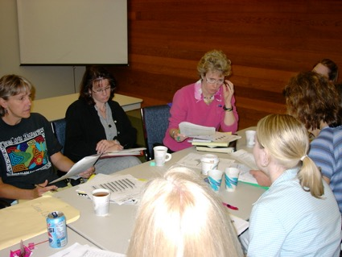
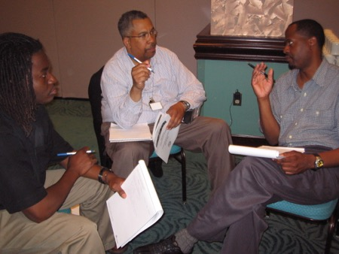
Team Composition
Administrator
Grade/Department Representation
Specialized Support
  (e.g., Special Educator, Counselor, School Psychologist, Social Worker, etc.)
Support Staff
  (e.g., Office, Supervisory, Custodial, Bus, Security, etc.)
Parent (that is not also a staff member)
Community
  Mental Health, Business
Student
Start with a
team that
“works.”

Slide 45
Self-Check:
Effective Leadership Team
Work as team for 10 min
Review guidelines for team composition.
  Administrator
  Grade/Department Representation
  Specialized Support
    (e.g., Special Educator, Counselor, School Psychologist, Social Worker, etc.)
  Support Staff
    (e.g., Office, Supervisory, Custodial, Bus, Security, etc.)
  Parent (who is not also a staff member)
  Community
    Mental Health, Business
  Student
Ensure you have 1-2 parents on your leadership team this year
Review relevant items on your action plan and add/adjust as needed to ensure your team is ready to work this year (and in the future)!

Slide 46
Getting Started with SWPBIS
Establish an effective leadership team
Develop brief statement of behavioral purpose
Identify positive SW behavioral expectations
Develop procedures for teaching SW expectations
Develop procedures for teaching class-wide expectations
Develop continuum for strengthening appropriate behavior
Develop continuum for discouraging violations of expectations
Develop data-based procedures for monitoring
Develop systems to support staff
Build routines to ensure on-going implementation
What are we “about”?
PRACTICES
II.B.ii

Slide 47
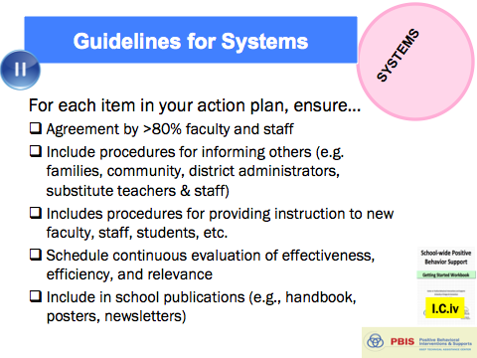
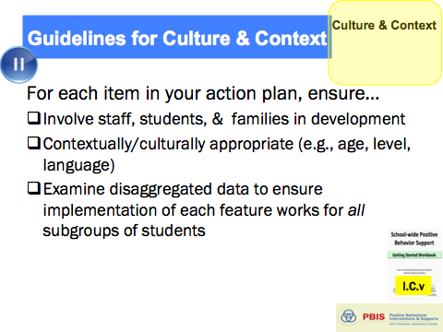
Guidelines for Purpose Statement
PRACTICES
Positively stated
2-3 sentences in length
Supportive of academic achievement
Comprehensive in scope (all students/staff/settings)
And always remember to consider systems, culture, & context:

Slide 48

Examples of Purpose Statements
G. Ikuma School is a community of learners and teachers. We are here to learn, grow, and become good citizens.
At Abrigato School, we treat each other with respect, take responsibility for our learning, and strive for a safe and positive school for all!

Slide 49
Getting Started with SWPBIS
Establish an effective leadership team
Develop brief statement of behavioral purpose
Identify positive SW behavioral expectations
Develop procedures for teaching SW expectations
Develop procedures for teaching class-wide expectations
Develop continuum for strengthening appropriate behavior
Develop continuum for discouraging violations of expectations
Develop data-based procedures for monitoring
Develop systems to support staff
Build routines to ensure on-going implementation
What do we expect?
PRACTICES
II.B.iii

Slide 50


Guidelines for Expectations
PRACTICES
Linked to social culture of school
Considerate of social skills that already exist
3-5 in number
1-3 words per expectation
Positively Stated
Supportive of academic achievement
Comprehensive in scope
Mutually exclusive (minimal overlap)
And always remember to consider systems, culture, & context:
II.B.iii

Slide 51
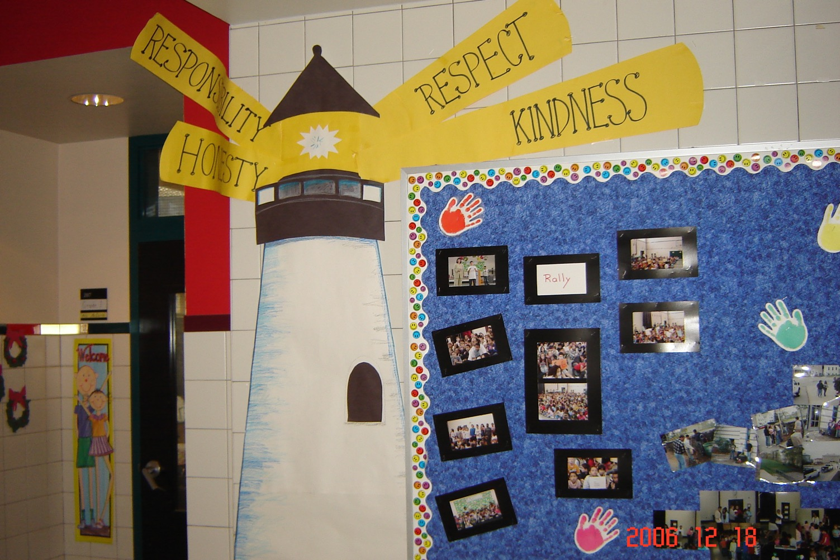
City View School
MA lighting the way with expectations!

Slide 52
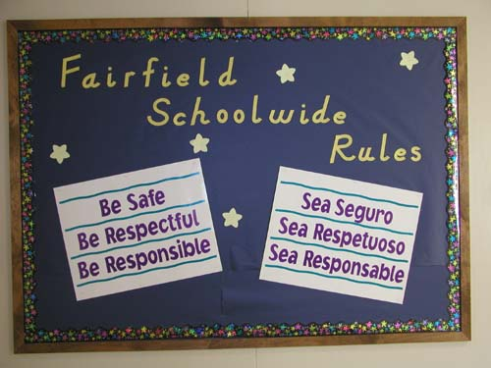

Slide 53
Getting Started with SWPBIS
Establish an effective leadership team
Develop brief statement of behavioral purpose
Identify positive SW behavioral expectations
Develop procedures for teaching SW expectations
Develop procedures for teaching class-wide expectations
Develop continuum for strengthening appropriate behavior
Develop continuum for discouraging violations of expectations
Develop data-based procedures for monitoring
Develop systems to support staff
Build routines to ensure on-going implementation
Teaching social behavior explicitly?
Like academic behavior
PRACTICES
II.B.iv

Slide 54
Guidelines for Teaching Expected Behaviors (Social Skills)
PRACTICES
Considerate of main school settings/contexts
Considerate of lessons that already exist
Specification of 2-3 observable, positive examples for each expectation within each setting/context
Teach social behavior like academic skill
Prompts, reminders, or precorrections in natural context
Feedback in natural context
Schedule (add to PD calendar) for introducing teaching plan to staff and getting feedback on lesson plans
Schedule (add to school calendar) for initial instruction in natural/typical context
Schedule (add to school calendar) for regular review, practice, and follow-up
Procedures for identifying/supporting students whose behaviors do not respond to instruction
And always remember to consider systems, culture, & context:
II.B.iv

Slide 55
Teaching Matrix |  | SETTING
 |  | All Settings | Hallways | Playgrounds | Cafeteria | Library/ Computer Lab | Assembly | Bus
 | Respect Ourselves | Be on task. Give your best effort. Be prepared. | Walk. | Have a plan. | Eat all your food. Select healthy foods. | Study, read, compute. | Sit in one spot. | Watch for your stop.
 | Respect Others | Be kind. Hands/feet to self. Help/share with others. | Use normal voice volume. Walk to right. | Play safe. Include others. Share equipment. | Practice good table manners | Whisper. Return books. | Listen/watch. Use appropriate applause. | Use a quiet voice. Stay in your seat.
 | Respect Property | Recycle. Clean up after self. | Pick up litter. Maintain physical space. | Use equipment properly. Put litter in garbage can. | Replace trays & utensils. Clean up eating area. | Push in chairs. Treat books carefully. | Pick up. Treat chairs appropriately. | Wipe your feet. Sit appropriately.
2. NATURAL CONTEXT
1. SOCIAL SKILL
Expectations
3. BEHAVIOR EXAMPLES
II.B.iv
Notes:
1. Added this slide

Slide 56
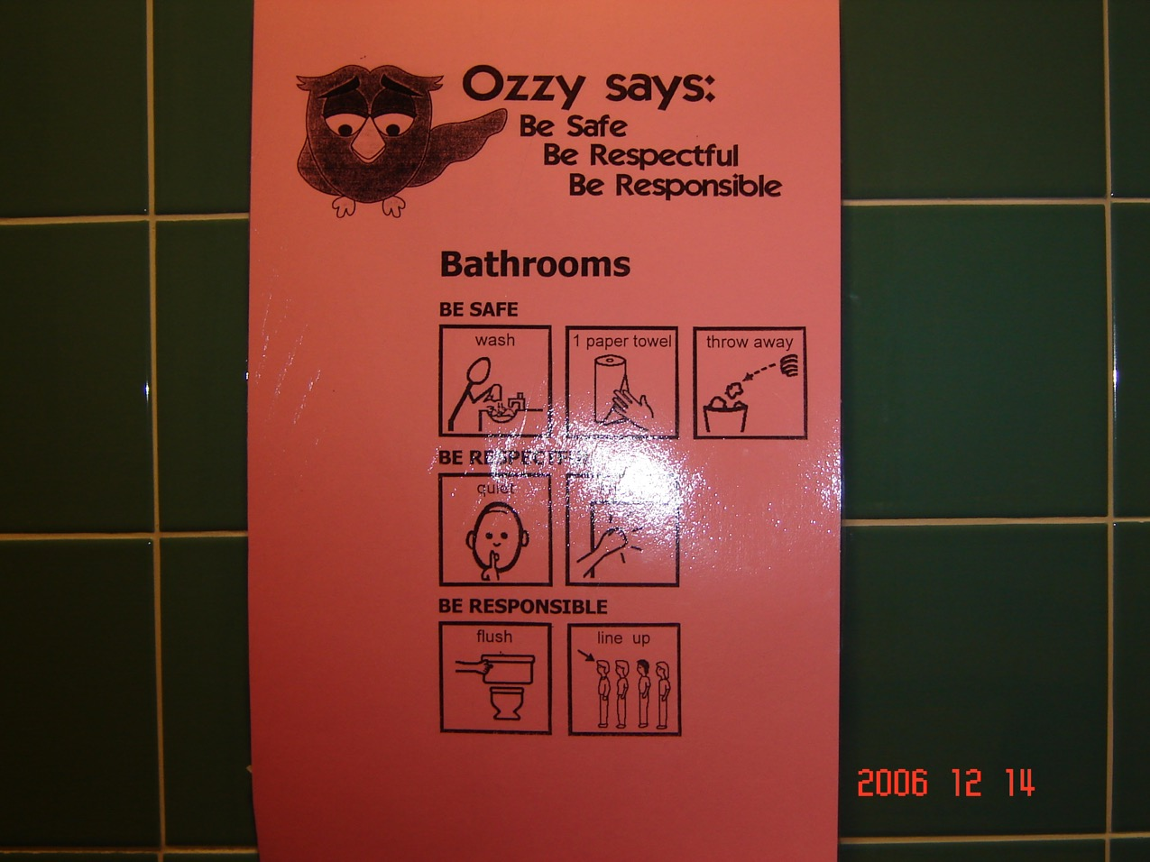
Norrback Ave. School, MA
Prompt that considers diverse reading abilities…

Slide 57
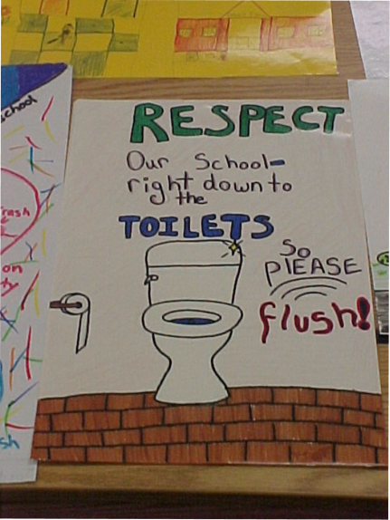
And people say high schools are different…

Slide 58
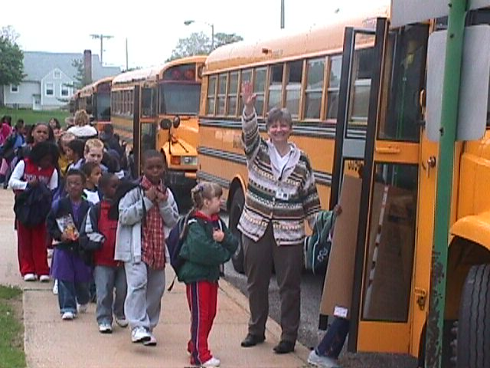
Active Supervision
Monitoring Dismissal
McCormick Elementary School, MD

Slide 59
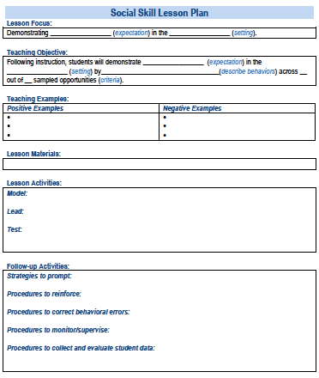
A lesson plan that prompts the critical features just described:
Simonsen, Myers, Everett, Sugai, Spencer, & LaBreck (2012)
Also see Appendix I
Notes:
Explicitly teaching social skills school-wide: Using a matrix to guide instruction. Intervention in School and Clinic, 47, 259-266. doi: 10.1177/1053451211430121
The last authors were folks from the central MA cohort of PBIS schools we trained!!!!!

Slide 60
Self-Check:
Explicitly Teaching Expectations
Work as team for 8 min
Review guidelines for behavioral purpose statement, positively stated behavioral expectations, & teaching expectations.
Self-check: does each meet guidelines?
Review relevant items to your action plan and add/adjust as needed.

Slide 61
Getting Started with SWPBIS
Establish an effective leadership team
Develop brief statement of behavioral purpose
Identify positive SW behavioral expectations
Develop procedures for teaching SW expectations
Develop procedures for teaching class-wide expectations
Develop continuum for strengthening appropriate behavior
Develop continuum for discouraging violations of expectations
Develop data-based procedures for monitoring
Develop systems to support staff
Build routines to ensure on-going implementation
PRACTICES
II.B.v

Slide 62
Guidelines for Teaching Class-Wide Expectations (Social Skills)
PRACTICES
School-wide action plan for classroom management practices and procedures based on data (self-assessment)
Definitions and process for class vs. office managed expectation-violating behaviors
Teaching matrix, procedures, and schedules developed for teaching school-wide behavior expectations in typical classroom contexts and routines
Data systems in place to monitor ODRs from classrooms
Procedures in place to support behavior of students whose behaviors do not respond to classroom management
Prompts for display of expected behaviors in natural contexts
Feedback for displays of behaviors in natural context
And always remember to consider systems, culture, & context:
II.B.v

Slide 63

Typical Contexts/ Routines | Class-Wide Rules/Expectations
 | Respect Others | Respect Property | Respect Self
All | Use inside voice. Raise hand to answer/talk. | Recycle paper. Put writing tools inside desk. | Do your best. Ask.
Morning Meeting | Eyes on speaker. Give brief answers. | Put announcements in desk. Keep feet on floor. | Put check by my announcements.
Homework | Do own work. Turn in before lesson. | Put homework neatly in box. Touch your work only. | Turn in lesson on time. Do homework night/day before.
Transition | Use inside voice. Keep hands to self. | Put/get materials first. Keep hands to self. | Have plan. Go directly.
“I Need Assistance” | Raise hand or show “Assistance Card”. Wait 2 minutes & try again. | Have materials ready. | Have plan. Ask if unclear.
Teacher Directed | Eyes on speaker. Keep hands to self. | Use materials as intended. | Have plan. Ask.
Independent Work | Use inside voice. Keep hands to self. | Use materials as intended. Return with done. | Use time as planned. Ask.
Problem to Solve | Stop, Step Back, Think, Act | Stop, Step Back, Think, Act | Stop, Step Back, Think, Act
1. SOCIAL SKILL
2. NATURAL CONTEXT
3. BEHAVIOR EXAMPLES
Notes:
1. Added this example

Slide 64
Self-Check:
Class-wide Expectations
Work as team for 5 min
Review guidelines for teaching class-wide expectation.
Self-check: does your plan meet guidelines?
Review relevant items to your action plan and add/adjust as needed.

Slide 65
Getting Started with SWPBIS
Establish an effective leadership team
Develop brief statement of behavioral purpose
Identify positive SW behavioral expectations
Develop procedures for teaching SW expectations
Develop procedures for teaching class-wide expectations
Develop continuum for strengthening appropriate behavior
Develop continuum for discouraging violations of expectations
Develop data-based procedures for monitoring
Develop systems to support staff
Build routines to ensure on-going implementation
PRACTICES
II.B.vi

Slide 66
Guidelines for Continuum of Procedures to Strengthen Behavior
PRACTICES
Easy and quick form of acknowledgement linked to SW-expectations and used across all settings (non-classroom and classroom
Considerate of strategies/processes that already exist
Culturally, developmentally, contextually appropriate/relevant name and form of acknowledgement
Define back-up or follow-up acknowledgements
Develop written procedures for acknowledgements
Schedule (add to PD calendar) for teaching acknowledgement systems
II.B.vi

Slide 67
Guidelines for Continuum of Procedures to Strengthen Behavior
PRACTICES
Instructions and practice for staff (add to PD calendar) on how to pair tangible/activity acknowledgements with social acknowledgments
Schedule (add to school calendar) for initial introduction of acknowledgements to students and regular boosters or reimplementation of acknowledgements
Means for keeping track of the ratio of acknowledgements to ODRs or corrective actions
Schedule (add to PD and school calendars) for daily, weekly, monthly, and quarterly feedback to students and staff
And always remember to consider systems, culture, & context:
II.B.vi

Slide 68
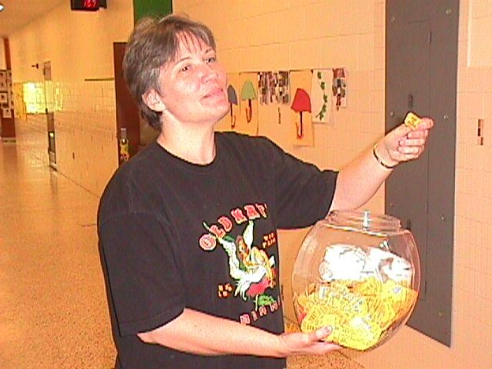
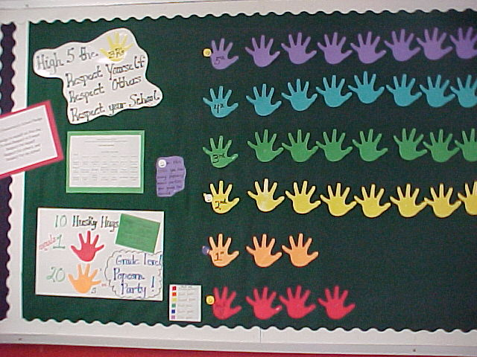
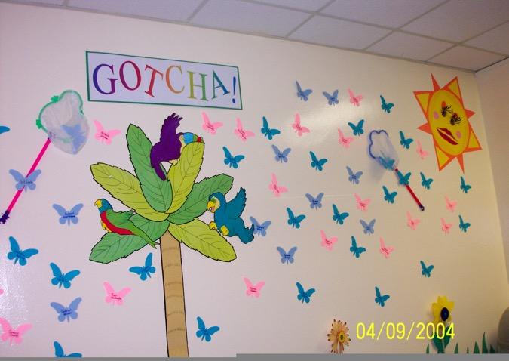
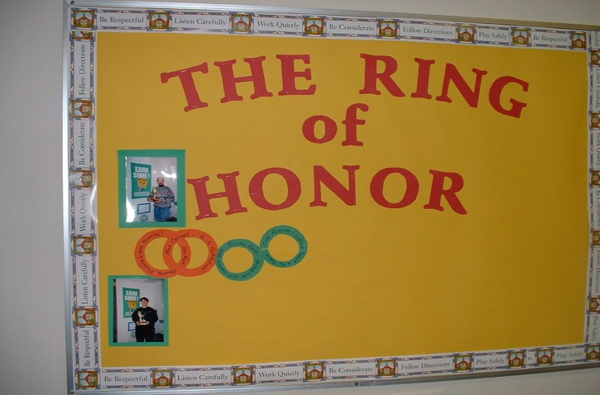
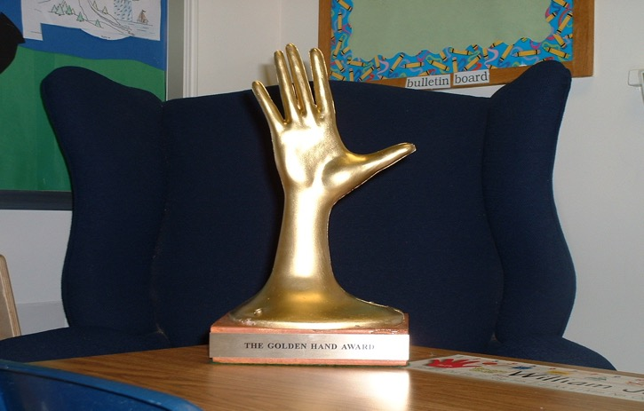
Establish a continuum of procedures to encourage rule following behavior

Slide 69
Also consider these no or low cost options
(See full list compiled by Laura Riffel*)
Assist school staff (e.g., cleaning, office work, announcements, job shadow, keep score)
Be a leader (e.g., first in line, lead game)
Choice (e.g., class job, book to read)
Privileges (e.g., partial assignment, access/pass to special class/school activity, music between classes)
Social privileges (e.g., eat with preferred peers or staff)
Positive recognition (e.g., recommendation letter)
https://www.google.com/url?q=http://www.pbis.org/common/cms/files/coach_trainer/ideastoshare/freerewards4studentsnstaff.doc&sa=U&ei=fbuAVL3_NJSquQTmtYDoDg&ved=0CAUQFjAA&client=internal-uds-cse&usg=AFQjCNEb33G_e3wALWoEmsaF_5FtRsq4Gw

Slide 70
Self-Check:
Procedures to Strengthen Expected Behaviors
Work as team for 5 min
Review guidelines for procedures to strengthen expected behaviors.
Self-check: does your plan meet guidelines?
Review relevant items to your action plan and add/adjust as needed.

Slide 71
Getting Started with SWPBIS
Establish an effective leadership team
Develop brief statement of behavioral purpose
Identify positive SW behavioral expectations
Develop procedures for teaching SW expectations
Develop procedures for teaching class-wide expectations
Develop continuum for strengthening appropriate behavior
Develop continuum for discouraging violations of expectations
Develop data-based procedures for monitoring
Develop systems to support staff
Build routines to ensure on-going implementation
PRACTICES
II.B.vii

Slide 72
Guidelines for Continuum of Procedures to Decrease Behavior
PRACTICES
Specify Definitions for Violations of SW Expectations
  Contextually appropriate labels/names
  Definitions represent continuum of severity (e.g., minor, major, illegal)
  Definitions comprehensive in scope (school-wide)
  Definitions in measurable terms
  Mutually exclusive (minimal overlap)

Slide 73

SWIS Example Definitions
Behavior | Minor (Teacher Managed) | Major (Office Managed)
Disrespect | Not working/Unfinished work Not participating in Group Work Making faces/ Rolling eyes Huffing, signing, etc. Arguing/defiance – Inappropriate Response to Teacher Request Uncooperative behavior Talking back Cheating/Lying Leaving assigned area Minor object stealing | Blatant or excessive non-compliance or defiance “F-you”, flipping off, etc. Repetitive minor incidences that normal classroom consequences are not addressing Leaving campus/hiding from staff Forgery Theft of major objects or pattern of minor stealing that is ongoing
Disruption | Making noises Constant talking Yelling Out or Blurting Disruption during instruction Crying Throwing objects Out of seat Not listening Not following directions Tardy to class or leave early | Screaming/Yelling excessively Teacher cannot teach Students cannot learn Out of control behavior in the extreme Throwing objects with the intent to cause harm Excessive pattern of absence, tardy or truancy
Notes:
Trainer Note: One example of how a school/facility may choose to demonstrate their system of staff managed vs. office managed behaviors.
More information and examples are available at www.pbisapps.org in the SWIS Resources section.

Slide 74
Guidelines for Continuum of Procedures to Decrease Behavior
PRACTICES
Specify Procedures for Processing Violations of SW Expectations
  Agreement regarding office staff vs. teacher/staff responsibilities
  ODR form for tracking discipline event specifies:
    Who (i) violated rule, (ii) observed and responded to violation of expectation, and (iii) else was involved
    When (day/time)
    Where
    What (i) expectation was violated and (ii) was the possible motivation
  Agreement regarding options for continuum of consequences
  Data decision rules for intervention and support selection

Slide 75
SWIS Example: Classroom vs. Office
Staff Managed are Minors | Office Managed are Majors
Minors Inappropriate Language Physical Contact Defiance/Insubordination/Non-Compliance Disrespect Disruption Dress Code Technology Violation Property Misuse Tardy Consequences are determined by staff | Majors Abusive/Inappropriate Language Fighting Physical Aggression Defiance/Insubordination Harassment/Intimidation Inappropriate Display of Affection Vandalism/Property Destruction Lying/Cheating Skipping Technology Violation Dress Code Theft Arson Weapons Tobacco Alcohol/Drugs
More information and examples are available at www.pbisapps.org in the SWIS Resources section
Notes:
Trainer Note: One example of how a school/facility may choose to demonstrate their system of staff managed vs. office managed behaviors.
More information and examples are available at www.pbisapps.org in the SWIS Resources section.

Slide 76
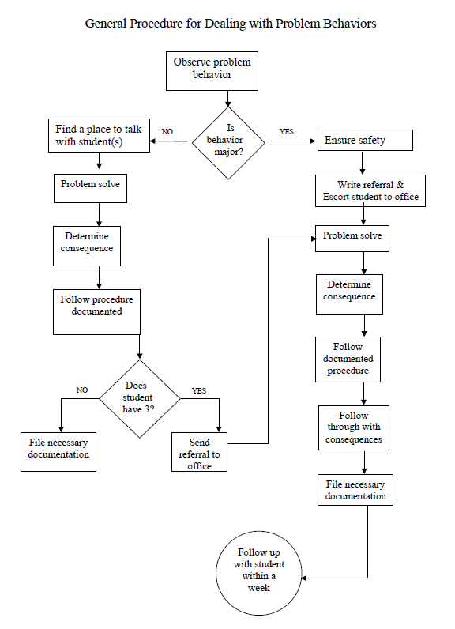
SWIS Example Flow Chart
General Process
&
Predictable System
More information and examples are available at www.pbisapps.org in the SWIS Resources section
Notes:
Trainer Note: Another example of how a school/facility may choose to demonstrate their system of staff managed vs. office managed behaviors. This example is displayed as a flow chart.
The goal is for schools/facilities to have a predictable system to support all staff in responding to behavior.
More information and examples are available at www.pbisapps.org in the SWIS Resources section.

Slide 77
Guidelines for Continuum of Procedures to Decrease Behavior
PRACTICES
Implement procedures
  Use by all staff
  Schedule for regular review of use and effectiveness
  Means for keeping track of number of acknowledgments vs. ODRs or other disciplinary actions
  Schedule and procedures for regular review and enhancement of acknowledgements
  Procedures in place for identifying and supporting students whose behaviors are not responsive
And always remember to consider systems, culture, & context:

Slide 78
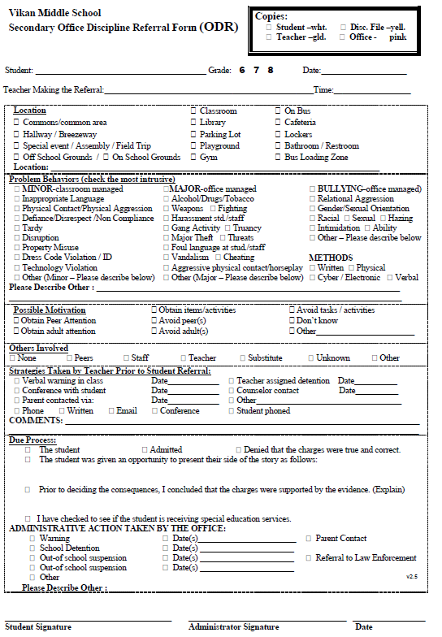
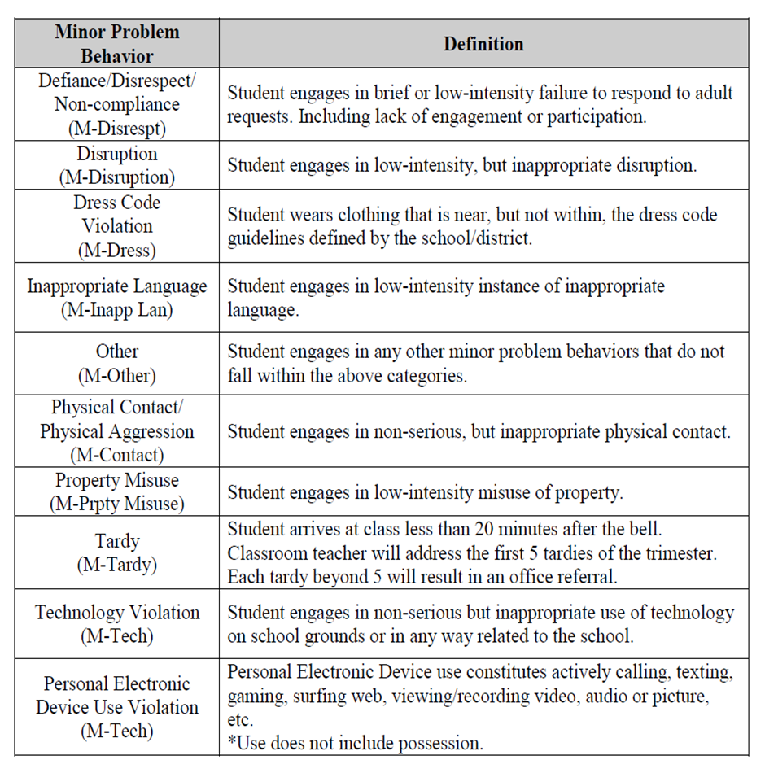
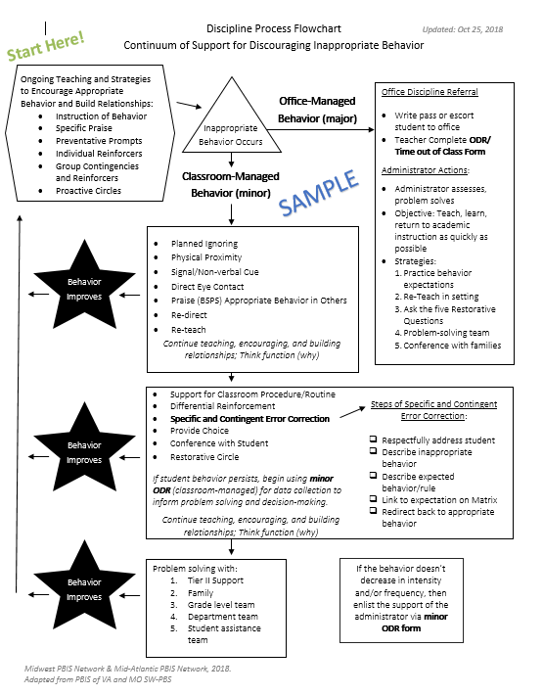
Discipline Referral Form
Behavior Definitions
Discipline Flow Chart

Slide 79
Getting Started with SWPBIS
Establish an effective leadership team
Develop brief statement of behavioral purpose
Identify positive SW behavioral expectations
Develop procedures for teaching SW expectations
Develop procedures for teaching class-wide expectations
Develop continuum for strengthening appropriate behavior
Develop continuum for discouraging violations of expectations
Develop data-based procedures for monitoring
Develop systems to support staff
Build routines to ensure on-going implementation
DATA
II.B.viii

Slide 80
Guidelines for Data-Based Monitoring of SWPBIS Outcomes
DATA
General data collection procedures
  Data collection procedures are integrated into typical routines (e.g., ODRs, attendance, behavior incident reports)
  Data collection reports regularly checked for accuracy
  Data collection limited to information that answers important student, classroom, and school questions
  Structures and routines for staff members to receive weekly/monthly data reports about status of SW discipline
  Decision rules for guiding data analysis and actions
  Schedule for daily, weekly, monthly, quarterly feedback
  Data system managed by 2-3 staff members
  No more than 1% of time each day for managing data
  Efficient, timely, and graphic displays of data
II.B.viii

Slide 81
Guidelines for Data-Based Monitoring of SWPBIS Outcomes
DATA
Office discipline referral procedures
  Agreed upon definitions of violations of expectations organized in a continuum
  A form for documenting noteworthy behavior incidents (ODR)
  School-wide procedures for processing/responding
  Efficient and user-friendly data input and storage
  Efficient and user-friendly process for summarizing and storing data
  Efficient and user-friendly procedures for producing visual displays of data
  Procedures for presenting data to staff on routine basis
  Procedures for making decisions and developing actions based on data
And always remember to consider systems, culture, & context:
II.B.viii

Slide 82
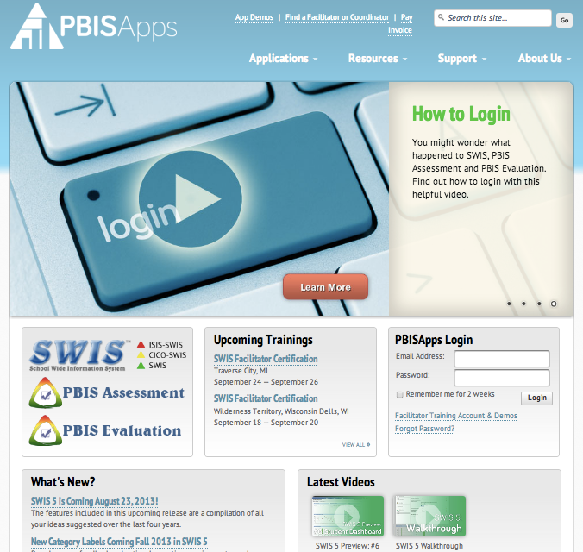

Slide 83
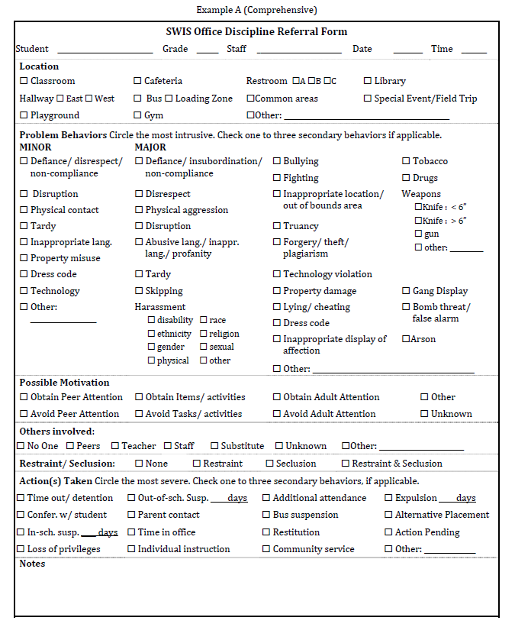
Example: Office Referral Form

Slide 84
Self-Check:
Procedures to Monitor
Work as team for 10 min
Review guidelines for procedures to discourage violations of expected behaviors and monitor implementation and outcomes.
Self-check: does your plan meet guidelines?
Review relevant items to your action plan and add/adjust as needed.

Slide 85
Getting Started with SWPBIS
Establish an effective leadership team
Develop brief statement of behavioral purpose
Identify positive SW behavioral expectations
Develop procedures for teaching SW expectations
Develop procedures for teaching class-wide expectations
Develop continuum for strengthening appropriate behavior
Develop continuum for discouraging violations of expectations
Develop data-based procedures for monitoring
Develop systems to support staff
Build routines to ensure on-going implementation
SYSTEMS
II.B.ix

Slide 86
Key Systems Features
Staff Buy-in
Embedded Professional Development
Staff Recognition for Implementation
Team-based Implementation
Clear Action Plan
I.C.iv
Notes:
Build section numbers, color coding, and structure into ppt.

Slide 87
GENERAL IMPLEMENTATION PROCESS
Team
Agreements
Data-based
Action Plan
Evaluation
Implementation
I.C.iv
Notes:
SAY: In general, the implementation of a school-wide PBS approach at the school level is built around five main implementation steps.

Slide 88
Key Systems Features
Staff Buy-in
Embedded Professional Development
Staff Recognition for Implementation
Team-based Implementation
Clear Action Plan
I.C.iv
Notes:
Build section numbers, color coding, and structure into ppt.

Slide 89
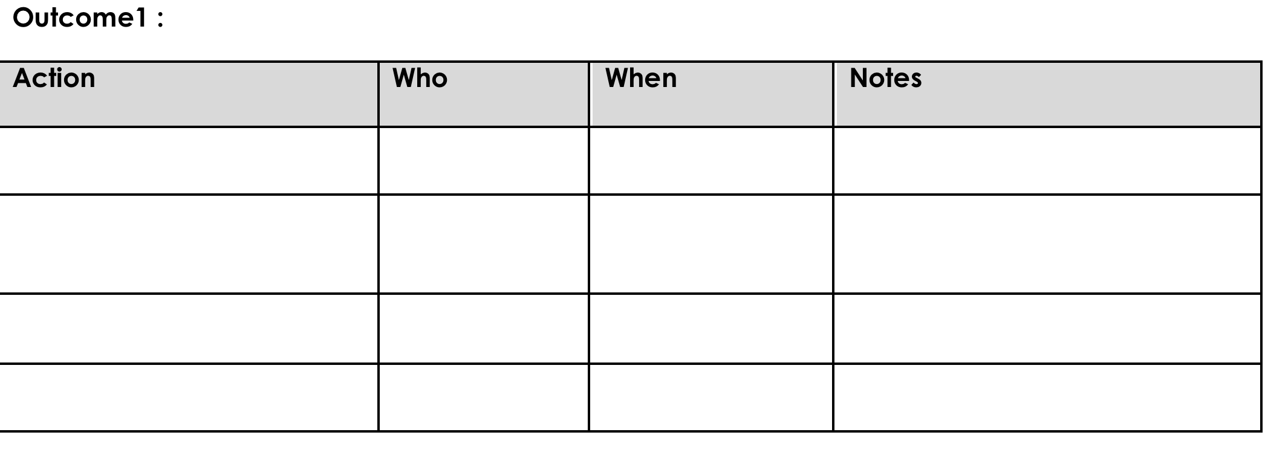
Action Planning
Process of organizing and using resources to enable individuals to engage in activities designed to achieve specific and important outcomes

Slide 90
Key Systems Features
Staff Buy-in
Embedded Professional Development
Staff Recognition for Implementation
Team-based Implementation
Clear Action Plan
I.C.iv
Notes:
Build section numbers, color coding, and structure into ppt.

Slide 91
Guidelines for Staff Buy-In
SYSTEMS
Use data to establish need
  Self-assessment
  Baseline discipline/behavior/climate data
Establish an effective team (past item) with active administrator participation
Present information in clear and efficient way(s)
Obtain and incorporate feedback on all elements of SWPBIS from staff
Start small and demonstrate success
And always remember to consider systems, culture, & context:

Slide 92
Key Systems Features
Staff Buy-in
Embedded Professional Development
Staff Recognition for Implementation
Team-based Implementation
Clear Action Plan
I.C.iv
Notes:
Build section numbers, color coding, and structure into ppt.

Slide 93
Guidelines for Embedded PD
SYSTEMS
Ensure PD includes explicit training, performance feedback and ongoing coaching
Document staff systems in staff handbook
Align staff evaluation procedures with expected practices where possible
And always remember to consider systems, culture, & context:

Slide 94
Key Systems Features
Staff Buy-in
Embedded Professional Development
Staff Recognition for Implementation
Team-based Implementation
Clear Action Plan
I.C.iv
Notes:
Build section numbers, color coding, and structure into ppt.

Slide 95
Guidelines for Staff Recognition
SYSTEMS
Easy and quick form of acknowledgement
Considerate of strategies/processes that already exist
Culturally, developmentally, contextually appropriate/relevant name and form of acknowledgement
Consider Back-up or follow-up acknowledgements
Schedule for initial introduction of acknowledgements and regular boosters or reimplementation of acknowledgements
Schedule for daily, weekly, monthly, and quarterly feedback to students and staff
And always remember to consider systems, culture, & context:

Slide 96
Self-Check:
Systems to Support Staff (Revisited)
Work as team for 5 min
Review guidelines for obtaining staff buy-in, embedded PD, and staff recognition.
Self-check: do your plans meet guidelines?
Review relevant items to your action plan and add/adjust as needed.

Slide 97
Getting Started with SWPBIS
Establish an effective leadership team
Develop brief statement of behavioral purpose
Identify positive SW behavioral expectations
Develop procedures for teaching SW expectations
Develop procedures for teaching class-wide expectations
Develop continuum for strengthening appropriate behavior
Develop continuum for discouraging violations of expectations
Develop data-based procedures for monitoring
Develop systems to support staff
Build routines to ensure on-going implementation
SYSTEMS
II.B.x

Slide 98
Guidelines for Building Routines for
On-going Implementation
SYSTEMS
Work as a team.
Make decisions based upon data.
Consider needs of all students.
Integrate PBS activities into other initiatives and projects.
Begin teaching, learning, and behavioral expectations on the first day.
Involve students, staff, parents, and community.
Increase use of reminders and pre-corrections before and after transitions.
Increase/maintain high rates of positive acknowledgements.
Specify expected outcomes of every activity.
And always remember to consider systems, culture, & context:

Slide 99
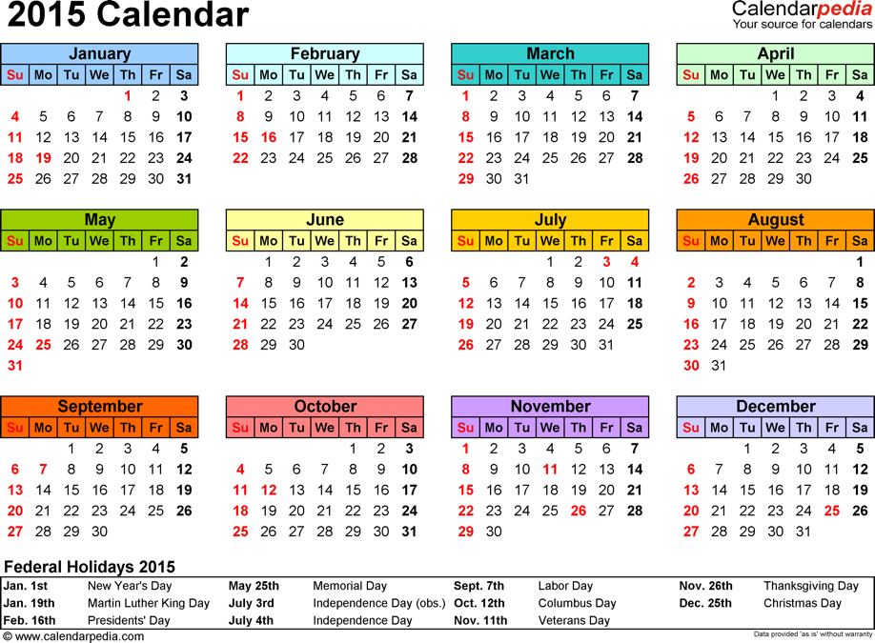
To start your semester/year off well, begin teaching and learning activities on the first day of semester/school
CHAPTER
II.B.X

Slide 100
Self-Check:
Build On-going Routines for Sustainability
Work as team for 15 min
Review guidelines for building on-going routines.
Self-check: do your plans meet guidelines?
Review relevant items to your action plan and add/adjust as needed.

Slide 101
Activity:
Show, Tell, and Ask
Work as team for 10 min
Review your action plan and identify
  1-2 accomplishments
  1-2 questions or concerns shared by most members of team
You’ll have 5 min to show, tell, and ask!

Slide 102
Equity
(adapted from Kent McIntosh)

Slide 103
Activity:
We are all Cultural Beings
10 min
Take 2 minutes to make a list of the aspects of your identity that are important to you
  The list may include information about friends, family, work, education, hobbies and anything else about hobbies or family that is a routine part of your discussions with others. Essentially, if someone from another country wanted to know “who you are” – how would you describe yourself and your life?
In groups of 2, introduce yourself to someone you do not know.
You may NOT mention any topic generated on your list of meaningful aspects of your identity.
Now, you can continue your conversation and this time talk about the topics written on your paper
CHAPTER
VI.A
Notes:
Workbook pg. 124

Slide 104
Activity:
Discussion The Silenced Self
5 min discussion with your team
How did you feel as you were completing the exercise?
  What was it like making introductions and not being able to talk about important aspects of yourself?
  What were some items you listed?
  What were some items you decided to talk about?
How do you think students might feel when important aspects of their identity or cultural backgrounds are not included in the curriculum or addressed through communications and instructional strategies?
What are some suggestions for preventing this from happening?

Slide 105
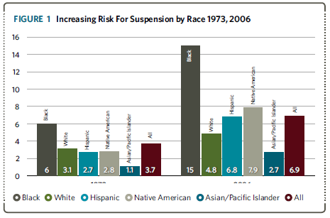
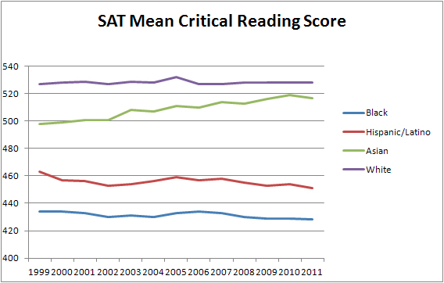
We have a problem!
Minority students are more likely to experience
  lower achievement gains
  more reactive and exclusionary disciplinary consequences
  higher special education placement rates
  higher dropout rates
  We know that the achievement gap can’t be explained away by poverty alone.

Slide 106
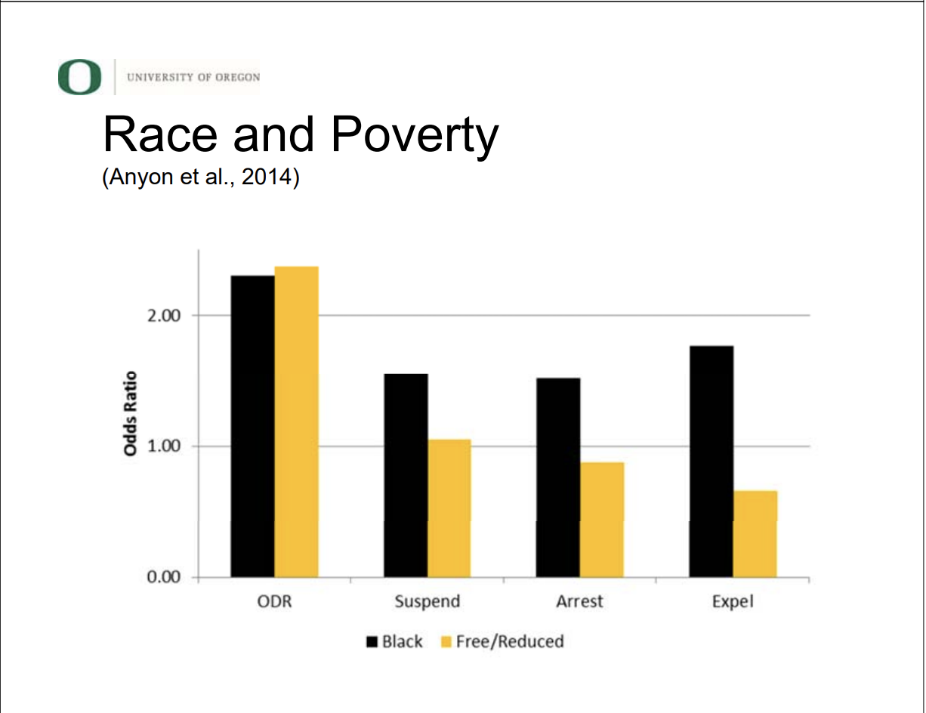
Addressing Common Questions
“Isn't it all really about poverty?”
Poverty plays a role, but racial disproportionality remains, even when controlling for poverty
  Anyon et al., 2014
  Skiba et al., 2002; 2005
  Wallace et al., 2008

Slide 107
Addressing Common Questions
“Aren’t Black boys just more violent?”
No evidence of different base rates of behavior for any subgroups
  Bradshaw et al., 2010
  Losen & Skiba, 2010
  Skiba et al., 2014

Slide 108
Disproportionality in School Discipline (Losen & Skiba, 2010)
1973
2006
Notes:
This graph indicates the changes in risk for suspension by race over time. The first half shows risk by racial group in 1973, the second half indicates risk by race in 2006. You can pause here and ask participants for ideas about reasons for increased risk now, or just use this slide to point out the fact that there is a problem.
The racial gap in suspension has grown considerably since 1973, especially for African-American students. In the 1970s Black students had a suspension rate of about 6% - twice the likelihood of suspension as White students (about 3%). With the advent of zero tolerance, Black children experienced a 9-point increase in suspension rates, from 6% in 1973 to 15% in 2006.2 Meanwhile the White suspension rate also grew but gained less than 2 percentage points. The Black/White gap has grown from 3 percentage points in the ’70s to over 10 percentage points in the 2000s. Blacks are now over three times more likely than Whites to be suspended.

Slide 109
A 5-point
Intervention to Enhance Equity in School Discipline
http://www.pbis.org/school/equity-pbis
Notes:
The content and additional resources on this topic can be found at PBIS.org/equity

Slide 110
5-point Intervention to Enhance Equity in School Discipline
Use effective instruction to reduce the achievement gap
Implement SWPBIS to build a foundation of prevention
Collect, use, and report disaggregated student discipline data
Develop policies with accountability for disciplinary equity
Teach neutralizing routines for vulnerable decision points
http://www.pbis.org/school/equity-pbis
Notes:
These are the 5 key steps to enhancing equity in school discipline. This is also the overview slide we will come back to between each step

Slide 111
Why a focus on effective academic instruction?
The discipline gap may be related to the achievement gap
  Academic skills (or the lack thereof) dramatically shapes school experiences
  Students who fall behind are more likely to act out, exposing themselves to discipline
  By catching and intervening with students early, we can change students’ school experiences for the better
(Gregory et al., 2010; McIntosh et al., 2008, 2012)
Notes:
Step one is to focus on effective academic instruction. It is important to emphasis here that although we are focused on implementing behavior supports effective academic instruction is a critical part of ensuring all students have equal access and opportunity.

Slide 112
What do we mean by effective academic instruction?
Explicit instruction
High rates of engagement and OTRs
Quality performance feedback
Progress monitoring and data-based decision making
(Hattie, 2009)
Notes:
Tie this back to how we teach behavior- so in previous training we’ve talked about how we teach behavior like academics now we want to tie back to teaching academics explicitly, keeping kids engaged in instruction and using data to guide instruction.

Slide 113
Effects of Effective Instruction on the Achievement Gap
Tigard-Tualatin School District (Chaparro, Helton, & Sadler, in press)
Notes:
This graph shows that the use of explicit instruction can help close achievement gaps.

Slide 114
5-point Intervention to Enhance Equity in School Discipline
Use effective instruction to reduce the achievement gap
Implement SWPBIS to build a foundation of prevention
Collect, use, and report disaggregated student discipline data
Develop policies with accountability for disciplinary equity
Teach neutralizing routines for vulnerable decision points
http://www.pbis.org/school/equity-pbis
Notes:
Step 2 is using SWPBIS as a foundation. Equity is NOT a separate initiative. We use the same data-based decision making framework and systems.

Slide 115
Why use a foundation of SWPBIS?
Proactive, instructional approach may prevent problem behavior and exposure to biased responses to problem behavior
Increasing positive student-teacher interactions may enhance relationships to prevent challenges
More objective referral and discipline procedures may reduce subjectivity and influence of cultural bias
Professional development may provide teachers with more instructional responses
(Greflund et al., 2014)
Notes:
Rational for using SWPBIS as a foundation. Use this to reinforce that all the work they have been doing so far is an important first step in ensuring that all students have equal access and opportunity.

Slide 116
5-point Intervention to Enhance Equity in School Discipline
Use effective instruction to reduce the achievement gap
Implement SWPBIS to build a foundation of prevention
Collect, use, and report disaggregated student discipline data
Develop policies with accountability for disciplinary equity
Teach neutralizing routines for vulnerable decision points
http://www.pbis.org/school/equity-pbis
Notes:
Step 3 is to collect, use and report disaggregated data. – for schools using SWIS they can already do this! For others this may take some work.

Slide 117
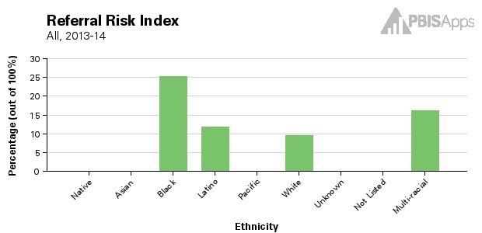
SWIS: Risk Indices
Proportion of each ethnic group with an ODR
Use to compare referral rates across ethnic groups
Black/White ODR Risk Ratio = 2.5
Notes:
Here is an example of the risk indices that can be generated in swis. Compared to white students black students are 2.5 times more likely to receive an ODR. If data indicate there is a problem it is important not to get stuck admiring the problem- use data to guide the next 2 steps.

Slide 118
5-point Intervention to Enhance Equity in School Discipline
Use effective instruction to reduce the achievement gap
Implement SWPBIS to build a foundation of prevention
Collect, use, and report disaggregated student discipline data
Develop policies with accountability for disciplinary equity
Teach neutralizing routines for vulnerable decision points
http://www.pbis.org/school/equity-pbis
Notes:
Policy with accountability is the next step

Slide 119
What does not work in policy
Enacting policies that nobody knows about
Enacting policies that don’t change practice
Policies without accountability for implementation
Notes:
Pause here to ask teams what they know about existing policy in their districts. If they don’t know what currently exists they should review that. If policy exists but without accountability then the PBIS team can suggest some revisions based on the next suggestions

Slide 120
Equity Policy Recommendations
Include a Specific Commitment to Equity
  Create mission statements that include equity
  Enact hiring preferences for equitable discipline
Install Effective Practices
  Require clear, objective school discipline procedures
  Support implementation of proactive, positive approaches to discipline
  Replace exclusionary practices w/instructional ones
Create Accountability for Efforts
  Create teams and procedures to enhance equity
  Share disproportionality data regularly
  Build equity outcomes into evaluations
Notes:
You can ask teams if they have examples of these specific recommendations

Slide 121
5-point Intervention to Enhance Equity in School Discipline
Use effective instruction to reduce the achievement gap
Implement SWPBIS to build a foundation of prevention
Collect, use, and report disaggregated student discipline data
Develop policies with accountability for disciplinary equity
Teach neutralizing routines for vulnerable decision points
http://www.pbis.org/school/equity-pbis
Notes:
Step 5 teach neutralizing routines – this will be guided by data!

Slide 122
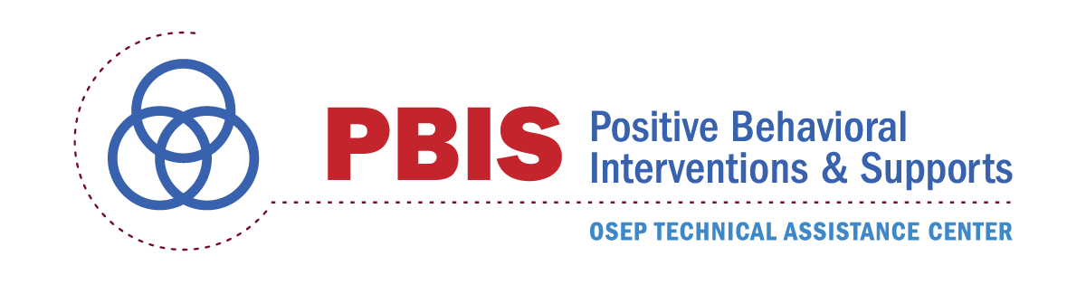
Multiple Types of Bias
Bias
Subtle Bias
Explicit Bias
Implicit Bias
Overt Bias
Dr. Kent McIntosh

Slide 123
Two Systems for Decision Making
System 1: Fast Decisions
  Automatic, snap judgments
  Intuitive, unconscious
System 2: Slow Decisions
  Deliberate decisions
  Allows for conscious attention
(Kahneman, 2011)
Notes:
4 min video

Slide 124
Different Biases, Different Solutions
Explicit Bias (System 2)
  Ineffective: Cultural sensitivity training, explaining value of diversity, telling people to be less biased
  Effective: Top-down policies with accountability
Implicit Bias (System 1)
  Ineffective: Top-down policies with accountability
  Effective: Clear discipline systems, specific guidance in decision-making
(Girvan, 2013; Girvan et al., 2013; Lai et al., 2013; Pettigrew & Tropp, 2006)
Dr. Kent McIntosh

Slide 125
What is implicit bias?
Unconscious, automatic
Based on stereotypes
  We all have it (even those affected by it)
  Generally not an indication of what we believe or would endorse
More likely to influence:
  Snap decisions
  Decisions that are ambiguous
Notes:
Let’s look further at implicit bias.

Slide 126
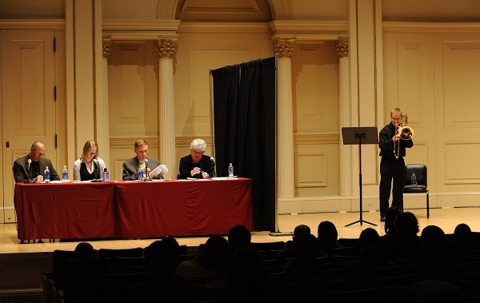
Implicit Bias in Auditions
https://csphilharmonic.org/2013/10/philharmonic-audition-process/
Dr. Kent McIntosh
Notes:
Colorado Springs Philharmonic
Auditions these days are ‘blind,’ that is they occur behind a screen so that the panel of listeners can make no distinctions regarding gender, age or physical ability. Sometimes the effort is refined by having floor covering to muffle the sound of each musician as they enter or leave the audition space.

Slide 127
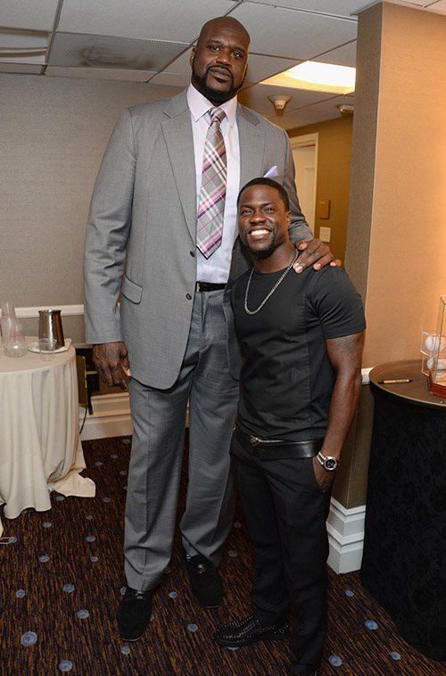

Implicit Height Bias (Judge & Cable, 2004)
One inch of height is worth $789 per year in salary
Notes:
Shaq and Kevin Hart

Slide 128
Implicit Bias and Race
“the challenge is not a small number of twisted white supremacists but something infinitely more subtle and complex: People who believe in equality but who act in ways that perpetuate bias and inequality.”
-Nicholas Kristof, The New York Times
Dr. Kent McIntosh
Notes:
2014 – “Is everyone a little bit racist” NYT OpEd

Slide 129
Implicit Bias Research:
Racism is Real (Brave New Films)
https://www.youtube.com/watch?v=fTcSVQJ2h8g
Dr. Kent McIntosh
Notes:
4 min video

Slide 130
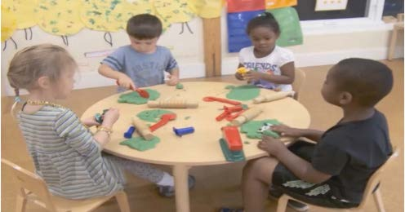
Implicit Bias in Early Learning
(Gilliam et al., 2016)
Dr. Kent McIntosh

Slide 131
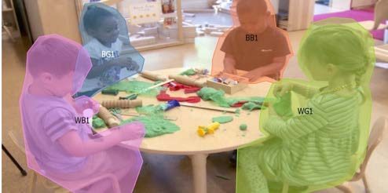
Implicit Bias in Early Learning
(Gilliam et al., 2016)
Dr. Kent McIntosh

Slide 132
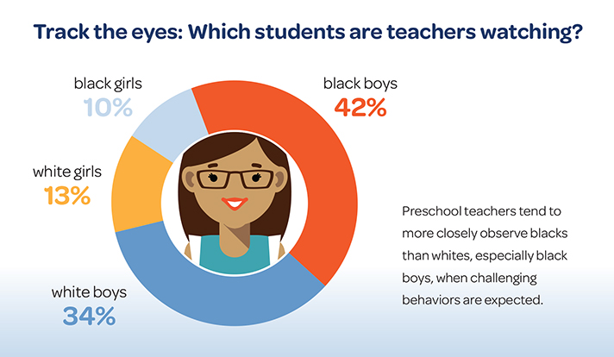
Implicit Bias in Early Learning
(Gilliam et al., 2016)
Dr. Kent McIntosh

Slide 133

Where do implicit biases come from?

Slide 134
Addressing Common Questions
“Are you saying that all teachers are racist?”
No! Our research indicates that disproportionality comes from implicit bias – that we’re not even aware of.
  Banaji & Greenwald, 2013
  Greenwald & Pettigrew, 2014
  van den Bergh et al., 2010

Slide 135
Remember: Implicit Bias
  Unconscious, automatic
  Generally not an indication of our beliefs and values
  We all have it (even those affected by it and those working to change it)
  Based on stereotypes
  More likely to influence:
  Snap decisions
  Decisions that are ambiguous
Dr. Kent McIntosh
Notes:
MOST PREVALENT IB: Age

Slide 136
Video for discussion
Verna Myers: How to overcome our biases: Walk boldly toward them
Notes:
If time, need, or interesst

Slide 137
Activity:
Explore Implicit Bias
15 min
5 min (team debrief)
  Individually spend some time exploring some of the implicit association tests
  Select “guest” as login
  Choose a preferred implicit association test (IAT) to complete
  Team Debrief: Discuss with your team how this information can impact or our relationships with staff and students.
  https://implicit.harvard.edu/implicit/selectatest.html
Notes:
The IAT measures the strength of associations between concepts (e.g., black people, gay people) and evaluations (e.g., good, bad) or stereotypes (e.g., athletic, clumsy). The main idea is that making a response is easier when closely related items share the same response key.
https://implicit.harvard.edu/implicit/selectatest.html

Slide 138
A Unidimensional View of Bias
Racial Bias
Disproportion-ate Discipline
Dr. Kent McIntosh
Notes:
2 problems:
1. it focuses solely on one variable that has been shown in many studies to be highly resistant to change
2. fails to consider contextual variables that may be as critical to biased decision making but are much more malleable.

Slide 139
A Multidimensional View of Bias
Racial Bias
Disproportion-ate Discipline
Situation
(Smolkowski et al., 2016)
Dr. Kent McIntosh
Notes:
no change to his or her attitudes or beliefs, an individual may selectively show racial bias in different decision situations. For example, a teacher may make more equitable discipline decisions at the start of the day but be more likely to send students of color to the office at the end of the day
More accurate predictor of biased decision making AND

Slide 140
Decision Points
What is an Equitable Decision Point?
What is a Vulnerable Decision Point?
A specific decision in which school/district data shows little to no disproportionality
A specific decision that is more vulnerable to the effects of implicit bias
Two parts:
  Elements of the situation
  The person’s decision state (internal state)

Slide 141
Decision States: Setting Events
An event occurring before or with an antecedent that alters the value of available reinforcement
Sometimes is present and sometimes is not
Does not require one’s awareness
Examples from students:
  Lack of sleep
  Headache/illness
  Lack of food (e.g., no breakfast)
  Fight with peer/parent/etc.
  Failed a test in previous class
  Didn’t get any coffee this morning
Dr. Kent McIntosh
Notes:
Definition is more confusing than examples (got up on the wrong side of the bed syndrome)
You look in their eyes and you just know!
TELL ME EXAMPLES!!!

Slide 142
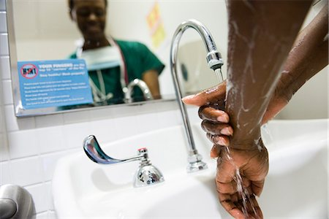
Decision States: Resource Depletion
As we become fatigued, our filters for appropriate behavior can be affected
Effects of hunger (Gailliot et al., 2009)
Decreases in willpower later in day
  “The Morning Morality Effect” (Kouchaki & Smith, 2014)
  Examples…
Handwashing compliance drops 8.7% over the course of a 12-hr shift
Best time to go before a judge is first thing in the morning or right after lunch
Dr. Kent McIntosh
Notes:
I’m sure you don’t have triggers, but I do
-My kids at school
-My diet
Bias research on judges and lemonade, also pediatricians
What are your triggers?
1. Model (Intentional disclosure): share mine (emotional response: hunger, apathy)
2. Shout out: what are some possible ones for us?
3. Individual activity: ID your own
Could be state or behavior

Slide 143
VDPs from national ODR data
Subjective problem behavior
  Defiance, Disrespect, Disruption
  Major vs. minor
Non-classroom areas
  Hallways
Classrooms
Afternoons
ambiguity
LACK OF contact
DEMANDS? Relevance?
fatigue

Slide 144
Activity:
Explore Vulnerable Decision Points
10 min
Discuss with your group:
What are some common VDPs for many adults in schools?
Individually
What do you think might be possible VDPs (situations or states) for you?

Slide 145
Reduce Effects of Implicit Bias through Specific Training
Reduce ambiguity in ODR definitions and processes
  Clear guidelines for classroom vs. office-managed behaviors
  Avoid rules that result in disproportionate exclusion
Identify specific vulnerable decision points
  General
  Local (school)
Teach a neutralizing routine
  Self-assess presence of VDP
  Use alternative response
Notes:
In order to reduce the effects of implicit bias we can take these steps. 1) ensure discipline systems are clearly defined teams can pause here to review the work they have done on this so far. 2) use data to identify if there are specific times, locations or rules in your school where disproportionality is more likely to show up. 3) teach a response that can be used to address those specific situations.

Slide 146
Two-step Neutralizing Routine (STAFF):
When you see unwanted behavior or the start of a power struggle, stop and ask yourself:
Is this a VDP?
  Situation
  Decision state
If so, use an agreed-upon alternative response
Remember we’ve used this strategy before to remain calm and avoid power struggles!
Dr. Kent McIntosh

Slide 147
Neutralizing Routines
Self-assessment
“Am I triggered or agitated?”
Setting event
Antecedent
Behavior
Consequence
Lack of positive interactions with student
Fatigue
Loud complaints about work (subjective behavior)
Student leaves class (Escape social interaction)
Send student to office (ODR)
Alternative Response
Take deep breath & model desired behavior.
Dr. Kent McIntosh
Notes:
This is ME (my routine)
“You can’t punish skills into a child”

Slide 148
What makes a good neutralizing routine?
If-then statement
Brief
Clear steps
Doable
Interrupts the chain of events
Dr. Kent McIntosh
Notes:
interruption

Slide 149


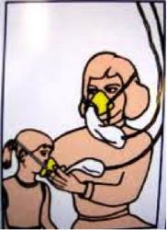
Neutralizing Routine Examples
If I am triggered or agitated…,
  Delay decision until I can think clearly
    “See me after class/at the next break”
    ask the student to reflect on their feelings/behavior
    am I acting in line with my values?
  Reframe the situation
    “I respect you, but that behavior is not ok”
    “How do we do that at school?”
    picture this student as a future doctor/lawyer/teacher
    assume student’s best effort at getting needs met
    respond as if the student was physically injured
  Take care of yourself
    take two deep breaths
    recognize my upset feelings and let them go
    model classwide cool-down strategy
Dr. Kent McIntosh

Slide 150

Example: Neutralizing Routine
TRY
  Take a deep breath
  Reflect on your emotions
  Youth’s best interest
    “Let’s TRY that again.”
    “Let’s TRY it a different way.”
    “Let’s TRY it how we do it at school.”
Dr. Kent McIntosh

Slide 151
Example: Classwide “Reset” Routine
TRY for students
  Take three deep breaths
  Reflect on your emotions
  You got this!
Social-emotional Theme
  Mistakes are part of the learning process
  We won’t always do it right the first time
  We can’t succeed unless we TRY
Dr. Kent McIntosh

Slide 152
Example: Two-step Neutralizing Routine for Administrators
(Susan Barrett)
When you have to handle problem behavior, stop and tell yourself:
Don’t just do something, stand there!
  Be sure you are ready to act in line with values
  Get information from student and staff
  Assess student-teacher relationship
Whenever possible, use an agreed-upon instructional response
  Teaches missing skills
  Connects student to school and staff
Notes:
The same can work for administrators. 1) pause and be sure you are ready to act with all the information you need and 1) take an instructional approach which re-builds a students connection to school and teachers rather than further separates the student from the class or teacher.

Slide 153
The Restorative Chat
(Lucille Eber)
Tell me what happened.
What you were thinking at the time?
What do you think about it now?
Who did this affect?
What do you need to do about it?
How can we make sure this doesn't happen again?
What I can do to help you?
Notes:
The restorative chat is one way to do this. This script can be used by administrators when handling problem behaviors.

Slide 154
Activity:
Developing a Neutralizing Routine
Work as team for 10 min
Individually, identify 2-3 examples of neutralizing routines that you could use in your classroom
Discuss and share with your team
Present 2-3 “big ideas” from your group (1 min. reports)

Slide 155
Self-Check: Equity
Work as team for 15 min
Review Equity content.
  What questions do you have about the content we just reviewed?
  What additional resources do you need to be able to address this issue in your school?
Review relevant items to your action plan and add/adjust as needed.

Slide 156
SWPBIS Action Planning

Slide 157
Activity:
Action Planning
Work as team for 120 min
Complete the Team Implementation Checklist and Family Engagement Rubric (Appendix M)
Return to your Action Plan
Identify relevant resources and steps to help move your school forward.
In particular, make sure you have completed all of the steps in getting started (review your notebook).
Present 2-3 “big ideas” from your group (1 min. reports)
Email action plans to your trainer before leaving today!
Katherine.meyer@uconn.edu
emaki@mayinstitute.org

Slide 158
Review of SWPBIS

Slide 159
SWPBIS Message!
Successful individual student behavior support is linked to host environments or school climates that are effective, efficient, relevant, & durable.
(Zins & Ponti, 1990)

Slide 160
Critical Features of PBIS
Supporting Culturally Equitable
Social Competence & Academic Achievement
OUTCOMES
Supporting
Culturally
Knowledgeable
Staff Behavior
Supporting
Culturally Valid
Decision
Making
SYSTEMS
DATA
(Vincent, Randal, Cartledge, Tobin, & Swain-Bradway, 2011; Sugai, O’Keefe, & Fallon 2012 ab)
PRACTICES
I.C
Supporting Culturally Relevant
Evidence-based Interventions
Notes:
Use data
Focus on outcomes: Academic & behavior success
On-going evaluation
Ensure cultural and contextual fit
Invest in systems
Organize research-validated practices within a continuum
Instructional & preventative approach
Integration
Tier 1 for all

Slide 161
Universal
Targeted
Intensive
Continuum of Support for ALL
Few
Some
All
I.C.iii
(Sugai, Dec 7, 2007)
Notes:
NOTICE GREEN GOES FOR “ALL”

Slide 162
GENERAL IMPLEMENTATION PROCESS
Team
Agreements
Data-based
Action Plan
Evaluation
Implementation
I.C.iv
Notes:
SAY: In general, the implementation of a school-wide PBS approach at the school level is built around five main implementation steps.

Slide 163
Getting Started with SWPBIS
Establish an effective and representative leadership team
Develop brief statement of behavioral purpose
Identify positive SW behavioral expectations
Develop procedures for teaching SW expectations
Develop procedures for teaching class-wide expectations
Develop continuum for strengthening appropriate behavior
Develop continuum for discouraging violations of expectations
Develop data-based procedures for monitoring
Develop systems to support staff
Build routines to ensure on-going implementation
Day 1
Day 2
Day 3
Day 4

Slide 164
Consider Tattoos!
4 PBIS Elements
School Systems
Supporting Social Competence &
Academic Achievement
OUTCOMES
School-wide
Classroom
SWPBIS
SYSTEMS
DATA
Supporting
Decision
Making
Supporting
Staff Behavior
Non-classroom
Family
PRACTICES
Tertiary Prevention:
Specialized
Individualized
Systems for Students with High-Risk Behavior
~5%
Student
Supporting
Student Behavior
Primary Prevention:
School-/Classroom-
Wide Systems for
All Students,
Staff, & Settings
~15%
Secondary Prevention:
Specialized Group
Systems for Students with At-Risk Behavior
~80% of Students

