Slide 1
School-Wide Positive Behavioral Interventions and Supports (SWPBIS)
Northeast PBIS (NEPBIS) School-Wide Team Training
Day 6
INSERT TRAINER NAMES
with support from Brandi Simonsen, Jen Freeman,
Susannah Everett, Adam Feinberg, Katie Meyer, & George Sugai
Notes:
Add trainer names for your event

Slide 2

Advance Organizer
Quick Review
Integration & Alignment of PBIS
Family Engagement & PBIS
TIC / TFI Planning
Planning for the Beginning of the Semester/School Year
Team Action Planning
Wrap up

Slide 3
MAIN TRAINING OBJECTIVES
Establish leadership team
Establish staff agreements
Build working knowledge of SWPBIS outcomes, data, practices, and systems
Develop individualized action plan for SWPBIS
Organize for upcoming school year

Slide 4
Training Expectations:
RESPECT…
SELF
Self-monitor (Are you participating? Engaged as a learner? Talking during allotted times?)
Stretch, break, stand as needed
OTHERS
Cell phones (inaudible): Converse in lobbies and breaks
ENVIRONMENT
Recycle
Work as a team: Room for every voice, reinforce participation
Maintain neat working area

Slide 5

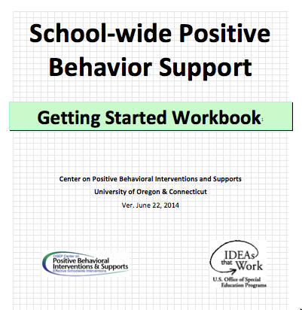
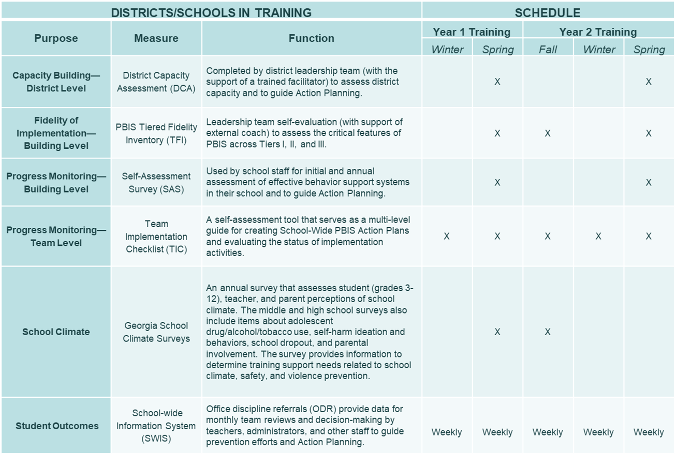

Tools!
nepbis.org
pbis.org
School-wide PBIS Workbook and Appendices
Evaluation Plan
Action Plan

Slide 6

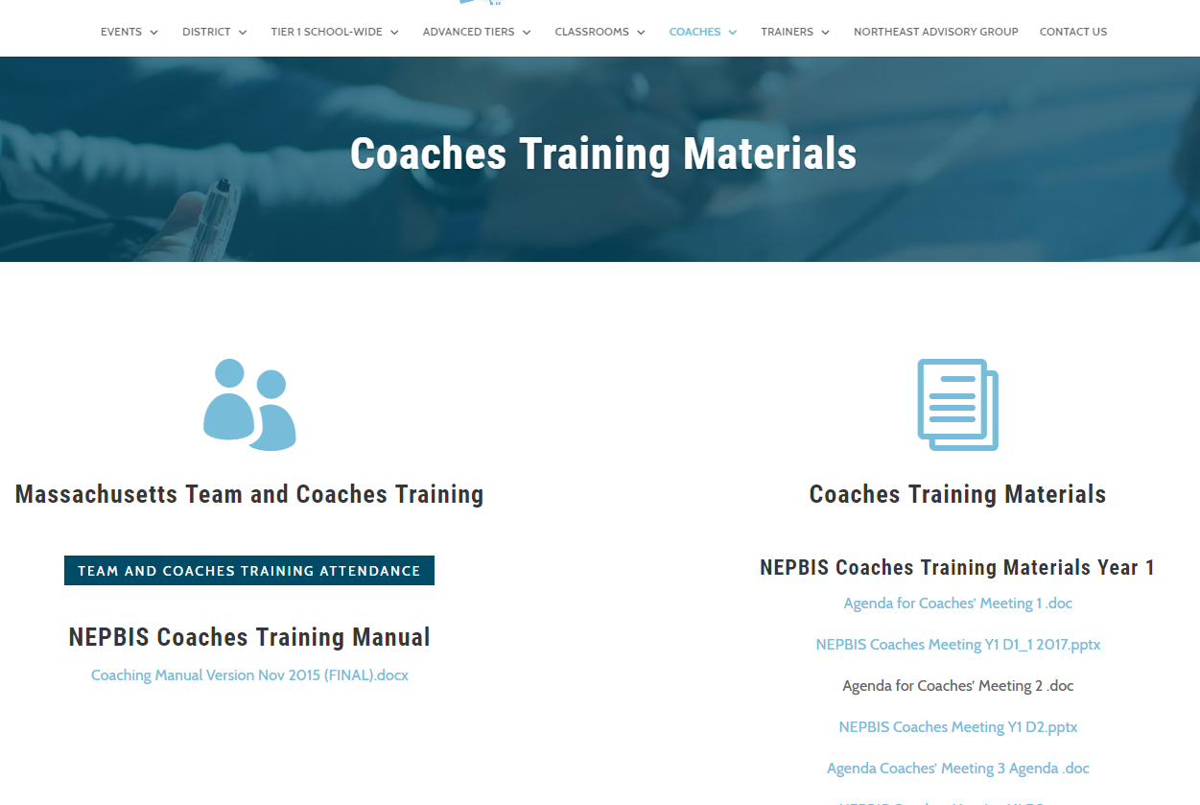
Activity:
Please Enter Attendance
1 min
Please login on nepbis.org, go to the coaches’ tab, and click on the Team Training Attendance Link. Follow prompts to enter team attendance.

Slide 7

QUICK Review
Overview & Getting Started with SWPBIS
(Days 1-5)

Slide 8

Critical Features of PBIS
Supporting Culturally Equitable
Social Competence & Academic Achievement
OUTCOMES
Supporting
Culturally
Knowledgeable
Staff Behavior
Supporting
Culturally Valid
Decision
Making
SYSTEMS
DATA
(Vincent, Randal, Cartledge, Tobin, & Swain-Bradway, 2011; Sugai, O’Keefe, & Fallon 2012 ab)
PRACTICES
I.C
Supporting Culturally Relevant
Evidence-based Interventions
Notes:
Use data
Focus on outcomes: Academic & behavior success
On-going evaluation
Ensure cultural and contextual fit
Invest in systems
Organize research-validated practices within a continuum
Instructional & preventative approach
Integration
Tier 1 for all

Slide 9
Getting Started with SWPBIS
Establish an effective leadership team
Develop brief statement of behavioral purpose
Identify positive SW behavioral expectations
Develop procedures for teaching SW expectations
Develop procedures for teaching class-wide expectations
Develop continuum for strengthening appropriate behavior
Develop continuum for discouraging violations of expectations
Develop data-based procedures for monitoring
Develop systems to support staff
Build routines to ensure on-going implementation

Slide 10
Functions
Pos Reinf
Neg Reinf
V.A

Slide 11
Avoid Power Struggles
High
Peak
Acceleration
De-escalation
Prevention
Agitation
Trigger
Calm
Recovery
Low
V.B
(Colvin & Sugai, 1989)

Slide 12
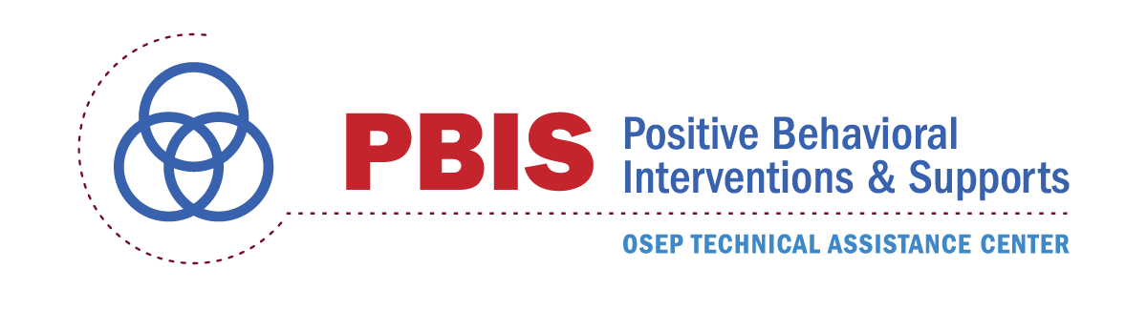
Neutralizing Routines
Self-assessment
“Am I triggered or agitated?”
Setting event
Antecedent
Behavior
Consequence
Lack of positive interactions with student
Fatigue
Loud complaints about work (subjective behavior)
Student leaves class (Escape social interaction)
Send student to office (ODR)
Alternative Response
Take deep breath & model desired behavior.
Dr. Kent McIntosh
Notes:
This is ME (my routine)
“You can’t punish skills into a child”

Slide 13
Integrating & Aligning Initiatives within a
PBIS Framework

Slide 14

Alignment: Defined
(Goodman & Horner, 2015)
Alignment
  “To be in precise adjustment or correct relative position”
  “The proper positioning of parts in relation to each other.”
Organizational Alignment
  The simultaneous implementation of multiple initiatives with efficiency and effectiveness.
Easier Said Than Done…
Notes:
From:
Alignment, Implementation and Educational Excellence
Presentation at OSEP IDEA Conference 2015
Steve Goodman --- Michigan (MiBLSi)
Rob Horner --- University of Oregon

Slide 15
Aligning Initiatives,
Programs, & Practices
View
Technical
Guide on pbis.org
National TA Center on PBIS. (2017). Technical guide for alignment of initiatives, programs, practices in school districts. Eugene, OR: Retrieved from www.pbis.org
Notes:
Link to technical guide: https://www.pbis.org/Common/Cms/files/pbisresources/Alignment%20Brief.%20for%20posting.1.16.17.docx

Slide 16
Aligning Initiatives,
Programs, & Practices
Step 1: Leadership Team Assesses Current Initiatives
Define the valued outcome(s).
List related initiatives.
Identify core system features.
Analyze and make decisions for alignment.
Design the plan for effective alignment.
V.C
National TA Center on PBIS. (2017). Technical guide for alignment of initiatives, programs, practices in school districts. Eugene, OR: Retrieved from www.pbis.org

Slide 17
Aligning Initiatives,
Programs, & Practices
Step 1: Leadership Team Assesses Current Initiatives
Define the valued outcome(s).
List related initiatives.
Identify core system features.
Analyze and make decisions for alignment.
Design the plan for effective alignment.
V.C
National TA Center on PBIS. (2017). Technical guide for alignment of initiatives, programs, practices in school districts. Eugene, OR: Retrieved from www.pbis.org

Slide 18

Example: District Community Team’s Guiding Principles
Effective leadership teams that include school and community mental health providers – ALL Professional Development is delivered to teams with leadership support coaching support and data
Data-based decision making that include school level data and community data- Team Initiated Problem Solving (TIPS) used across all levels of teaming (State, District/Community and School)
Formal processes for the selection & implementation of evidence-based practices (EBP) across tiers with team decision-making. State and District Community invests in formal routine and as a team determine the “what” based on children, youth, families’ specific needs
Early access through use of comprehensive screening, which includes internalizing and externalizing needs- This includes family screening (Dishion)
Rigorous progress-monitoring for both fidelity & effectiveness of all interventions regardless of who delivers
Ongoing coaching at both the systems & practices level for both school and community employed professionals- Culture of Coaching that involves professional learning networks
(Example courtesy of Midatlantic & Midwest PBIS Networks)

Slide 19
Aligning Initiatives,
Programs, & Practices
Step 1: Leadership Team Assesses Current Initiatives
Define the valued outcome(s).
List related initiatives.
Identify core system features.
Analyze and make decisions for alignment.
Design the plan for effective alignment.
Are the highly-valued outcome(s) for children and families defined for initiatives to be aligned (e.g., improved social emotional competence for all students)?
V.C
National TA Center on PBIS. (2017). Technical guide for alignment of initiatives, programs, practices in school districts. Eugene, OR: Retrieved from www.pbis.org

Slide 20
Aligning Initiatives,
Programs, & Practices
Step 1: Leadership Team Assesses Current Initiatives
Define the valued outcome(s).
List related initiatives.
Identify core system features.
Analyze and make decisions for alignment.
Design the plan for effective alignment.
Has a list of all related initiatives including population served across schools and community agencies been developed?
Has the department or division that oversees the initiative (i.e. budget authority), as well as individuals leading the implementation been identified?
Has the research to determine the evidence of effectiveness for each initiative been reviewed/identified?
Has the expected outcome(s) and documented results to date for each initiative been identified?
V.C
National TA Center on PBIS. (2017). Technical guide for alignment of initiatives, programs, practices in school districts. Eugene, OR: Retrieved from www.pbis.org

Slide 21
Example: Alignment, Braiding & Integration
It’s not an either or choice – It’s about how these different approaches complement one another to meet your school’s needs
NJTSS /PBIS | Popular Initiatives, Programs and Interventions
 | Character Education | Restorative Practices | Responsive Classroom | Mindfulness | Bully Prevention
(Example courtesy of NJ PBSIS, in partnership with NJDOE OSE funded by IDEA funds - Part B 2018-2019)

Slide 22
Aligning Initiatives,
Programs, & Practices
Step 1: Leadership Team Assesses Current Initiatives
Define the valued outcome(s).
List related initiatives.
Identify core system features.
Analyze and make decisions for alignment.
Design the plan for effective alignment.
Have the specifics of team-based leadership and coordination for each related initiative been identified?
Have the fidelity measures for each initiative been identified?
Have the specific core practices across each tier been identified?
Have the outcome measure(s) been identified for each initiative?
Have the comprehensive screening measure(s) for each initiative been identified?
Have the current professional development plans been identified?
National TA Center on PBIS. (2017). Technical guide for alignment of initiatives, programs, practices in school districts. Eugene, OR: Retrieved from www.pbis.org

Slide 23
Example: Alignment, Braiding & Integration
Universal Intervention Components | NJTSS /PBIS | Popular Initiatives, Programs and Interventions
 |  | Character Education | Restorative Practices | Responsive Classroom | Mindulness | Bully Prevention
Operationalized SW Expectations | X | X |  |  |  | X Specific to Bullying
Anchor Instruction to Teach Expectations | X | X | X Specific to RP |  |  | X Specific to Bullying
Reinforcement System | X
Consistent Response to Infractions | X |  | X
Emphasis on Core Prevention Practices | X |  | X – some elements
Engagement Opportunities | X
Data-Driven Decision Making | X | X Climate Surveys | X |  |  | X Specific to Bullying
Re-envisioning of the Discipline System | X |  | X
Family Component | X |  | X |  |  | X Specific to Bullying
It’s not an either or choice – It’s about how these different approaches complement one another to meet your school’s needs
(Example courtesy of NJ PBIS, in partnership with NJDOE OSE funded by IDEA funds - Part B 2018-2019)

Slide 24
Aligning Initiatives,
Programs, & Practices
Step 1: Leadership Team Assesses Current Initiatives
Define the valued outcome(s).
List related initiatives.
Identify core system features.
Analyze and make decisions for alignment.
Design the plan for effective alignment.
Have system features of the related initiatives been examined for consistency/overlap?
Has the team resolved conflicts &/or duplicity of system features?
Has the team defined acceptable & determined which practices within each initiative can be aligned?
Has the team identified initiatives without fidelity &/or outcome measures and determined if measurement is possible?
Has the team determined which initiatives should be eliminated or modified?
Has the team determined the value added/lost for these decisions?
National TA Center on PBIS. (2017). Technical guide for alignment of initiatives, programs, practices in school districts. Eugene, OR: Retrieved from www.pbis.org

Slide 25
Aligning Initiatives,
Programs, & Practices
Step 1: Leadership Team Assesses Current Initiatives
Define the valued outcome(s).
List related initiatives.
Identify core system features.
Analyze and make decisions for alignment.
Design the plan for effective alignment.
Has the team determined how the system features will be aligned to support efficiency and clarity at the building level (e.g., teaming, integrated data system, training & coaching)?
Has the team determined how the practice features will be aligned at the school level?
Has the team determined the common fidelity tool(s) to assess system features and core practices?
Has the team determined the outcome measure(s) to support effective alignment?
Has the team determined when and how leadership teams and staff are trained and supported?
National TA Center on PBIS. (2017). Technical guide for alignment of initiatives, programs, practices in school districts. Eugene, OR: Retrieved from www.pbis.org

Slide 26
Example: Installing a Trauma Approach within the Framework of PBIS
Step 4:
How do we teach staff the necessary skills? How do we support staff to implement with fidelity?
Professional Learning Communities used to support one another in development of practices. How do we use data to monitor progress toward our goal and inform each other? How do we improve ?
Step 1: What does the data say? (discipline patterns, climate surveys, fidelity checks)
Where and what time are vulnerable decision points most like to occur?
The most significant concern is ______defined as that is taking place most often in _____________ (problem location). This behavior occurs ________ (frequency/quantify behavior), and is most likely to happen (time of day) . Students from (group of students/grade level) are most frequently referred. This may be due to ___________.
SYSTEMS – Support Staff Behavior
DATA – Supports Decision Making
Step 3: What will we do to support student behavior and provide necessary coping skills?
What curriculum will we use? (e.g. SEB, Coping Cat, SPARKS) Match to need
Promote predictable, positive, safe, and consistent environments by:
-Develop caring connections (e.g. morning meetings)
-Teach expectations, replacement skills
-Develop acknowledgement system
Layered Daily Progress Report with additional time for acquiring coping skills
PRACTICES –
Support Student Behavior
Step 2: What is the SMART (specific, measureable, attainable, realistic, time-bound) goal?
(Example courtesy of Midatlantic & Midwest PBIS Networks)

Slide 27
Aligning Initiatives,
Programs, & Practices
Step 2: Leadership Team Adopts Process for New Initiatives
Consider fit and evidence-base.
If new practice/initiative is to be adopted, determine how the new practice/initiative can be aligned within the existing framework for related initiatives.
What we just said!
V.C
National TA Center on PBIS. (2017). Technical guide for alignment of initiatives, programs, practices in school districts. Eugene, OR: Retrieved from www.pbis.org

Slide 28

Guidelines for Effective Alignment
Align multiple initiatives at the organizational level where a common budget authority exists.
Align multiple initiatives by using a common outcome measure to assess effectiveness.
Build aligned professional development by comparing and combining the “core features” of multiple initiatives.
  Compare fundamental assumptions
  Start with common “core features” and compare the practices used to achieve these features.
  Determine how to incorporate additional core features with efficiency
  Build single Professional Development curricula that combine core features.
Resolve Logic Model Conflict
V.C

Slide 29
Integrating & Aligning Initiatives within a
PBIS Framework:
Building Social Emotional Competence Example
Borrowed from our friends at Mid-Atlantic and Midwest PBIS Networks
and NJ PBSIS (in partnership with NJDOE OSE)

Slide 30
Integration across Core Features: Mission / Vision Statement
Mission
The mission of the NJ PBSIS initiative is to build capacity among New Jersey school personnel to implement a multi-tiered system of support for behavior, conduct, and social-emotional wellness that promotes equity for all students.
Implementation of multi-tiered systems of support create learning environments that contribute to everyone…
        being safe emotionally, physically, and socially.
        experiencing success every day.
        receiving what they need to be successful.
        working together to achieve goals.
        feeling welcomed and valued.
        further developing their strengths.

Slide 31
What does our curriculum look like?
Teaching Matrix |  | SETTING
 |  | All Settings | Hallways | Playgrounds | Cafeteria | Library/ Computer Lab | Assembly | Bus
 | Respect Ourselves | Be on task. Give your best effort. Be prepared. | Walk. | Have a plan. | Eat all your food. Select healthy foods. | Study, read, compute. | Sit in one spot. | Watch for your stop.
 | Respect Others | Be kind. Hands/feet to self. Help/share with others. | Use normal voice volume. Walk to right. | Play safe. Include others. Share equipment. | Practice good table manners | Whisper. Return books. | Listen/watch. Use appropriate applause. | Use a quiet voice. Stay in your seat.
 | Respect Property | Recycle. Clean up after self. | Pick up litter. Maintain physical space. | Use equipment properly. Put litter in garbage can. | Replace trays & utensils. Clean up eating area. | Push in chairs. Treat books carefully. | Pick up. Treat chairs appropriately. | Wipe your feet. Sit appropriately.
1. Expectations
2. NATURAL CONTEXT (Locations)
Expectations
3. Rules or Specific Behaviors
Notes:
We develop these common expectations through the common practice of developing the teaching matrix.

Slide 32
Consider a crosswalk between PBIS Framework components and SEL targets
Expectation | Specific Behavior or Social Emotional Skill
Be Safe | Keep hands and feet to self
 | I tell an adult when I am worried about a friend.
Be Respectful | Use the signal to ask a public or private question.
 | Make sure everyone gets a turn.
Be Responsible | Turn in all work on time
 | Check in with my feelings during the day
Notes:
Consider incorporating pro-social skills within the teaching matrix. Specific behaviors are important and necessary, but we are also addressing social competency with all our students.
Because students spend more time in small cooperative, collaborative work groups, they rely on these prosocial skills for their academic work as well. You can increase content coverage when you precorrect and teach prosocial skills (Anita Archer principle).
Mention behaviors of those being successful or the pro social skills needed by children – intent is to lead the child to be more independent and better quality of life

Slide 33
Integration across Core Features:
Clear Expectations for students and staff
Teaching Matrix |  | INCORPORATE Coping Strategies for Managing Stress
 |  | All Settings | Halls | Playgrounds | Lunch | Library/ Computer Lab | Assembly | Bus
 | Respectful | Be on task. Give your best effort. Be prepared. | Walk. | Have a plan. |  | Study, read, compute. | Sit in one spot. | Watch for your stop.
 | Achieving & Organized | Be kind. Hands/feet to self. Help/share with others. | Use normal voice volume. Walk to right. | Share equipment. Include others. |  | Whisper. Return books. | Listen/watch. Use appropriate applause. | Use a quiet voice. Stay in your seat.
 | Responsible | Recycle. Clean up after self. | Pick up litter. Maintain physical space. | Use equipment properly. Put litter in garbage can. |  | Push in chairs. Treat books carefully. | Pick up. Treat chairs carefully. | Wipe your feet.
1. Expectations
Invite those sitting alone to join in
2. NATURAL CONTEXT (Locations)
Have a lunch plan and choose quiet or social lunch area
Invite friends to join me
Expectations
3. Rules or Specific Behaviors
Use my breathing technique
Listen to my signals
Notes:
Replacement behaviors- very important that we anchor in our teaching matrix as this is our core social emotional curriculum- the common language and script we use to teach, acknowledge, pre-correct – all staff are using same approach for teaching and supporting throughout the year across the school day. We get what we pay attention to and this helps provide the common language/consistent approach- our values for our school
When dealing with stress and anxiety became major priority in school, it would be a matter of teaching skills to students so they developed strategies and skills and incorporated into their social curriculum – the matrix is the delivery mechanism to get skills out ALL !!!

Slide 34
Integration across Core Features:
Clear Expectations for students and staff
Teaching Matrix |  | INCORPORATE Strategies for Using Technology
 |  | All Settings | Halls | Playgrounds | Technology | Library/ Computer Lab | Assembly | Bus
 | Respectful | Be on task. Give your best effort. Be prepared. | Walk. | Have a plan. |  | Study, read, compute. | Sit in one spot. | Watch for your stop.
 | Achieving & Organized | Be kind. Hands/feet to self. Help/share with others. | Use normal voice volume. Walk to right. | Share equipment. Include others. |  | Whisper. Return books. | Listen/watch. Use appropriate applause. | Use a quiet voice. Stay in your seat.
 | Responsible | Recycle. Clean up after self. | Pick up litter. Maintain physical space. | Use equipment properly. Put litter in garbage can. |  | Push in chairs. Treat books carefully. | Pick up. Treat chairs carefully. | Wipe your feet.
1. Expectations
Words matter, pause and reflect before you post
2. NATURAL CONTEXT (Locations)
Check your feelings
Re-read message
Expectations
3. Specific Behaviors/Skills
Model for others
double check sources and consider feelings of others
Notes:
Replacement behaviors- very important that we anchor in our teaching matrix as this is our core social emotional curriculum- the common language and script we use to teach, acknowledge, pre-correct – all staff are using same approach for teaching and supporting throughout the year across the school day. We get what we pay attention to and this helps provide the common language/consistent approach- our values for our school
When dealing with stress and anxiety became major priority in school, it would be a matter of teaching skills to students so they developed strategies and skills and incorporated into their social curriculum – the matrix is the delivery mechanism to get skills out ALL !!!

Slide 35
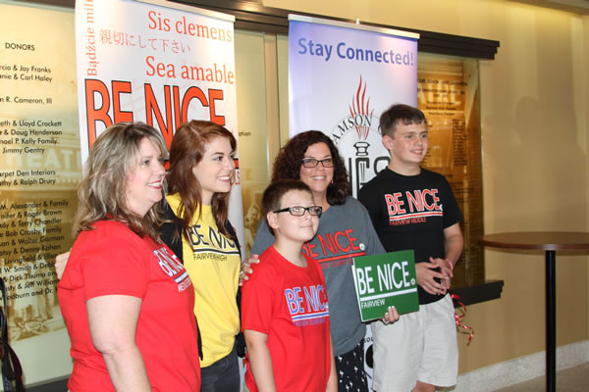

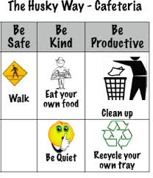
Integration across Core Features:
Teaching Expectations for students
Kick-off events
  Teaching staff, students and families the
  expectations and rules
On-going Direct Instruction
  Data-driven and scheduled designed lessons
  Pre-correction
  Re-teaching immediately after behavioral errors
Embedding into curriculum
Booster trainings
  Scheduled and data-driven
Continued visibility
  Visual Displays – posters, agenda covers
  Daily announcements
  Newsletters

Slide 36

Integration across Core Features:
Teaching Expectations for students
Infraction = |  | Failure to Comply |  | Inappropriate Language |  | Tardiness
Linked SW Expectation |  | Responsible |  | Respectful and Reflective |  | Responsible
What You Want The Student To Do |  | Timely cooperation with instructions & directions |  | Use words that are appropriate to express the sentiment (e.g., considerate, polite, kind, professional, etc.) |  | Be in seat when the bell rings
Social and Emotional Skill Options to Teach |  | Asking for help Active listening Paraphrasing understanding Managing frustration (e.g., positive self-statements or deep breaths) |  | Stop-think-act Managing disappointment Turning the conversation Making a complaint Reframing negative thoughts |  | Managing transition time Planning ahead Self monitoring Using conversation enders (e.g., ‘catch you later’)
In partnership with NJDOE OSE funded by IDEA funds - Part B 2018-2019

Slide 37
Integration across activities
Content Area | Examples of How the Teacher Embedded Social and Emotional Skills Into the Curriculum
Math | SW Expectation: Responsibility SEL Sub Competency: Identify and apply ways to persevere School-Wide Instruction Theme ‘Stick With It’: Mrs. Smith has her students generate two strategies for how to be persistent when faced with challenging math work.
Science | SW Expectation: Respectful SEL Sub Competency: Utilize positive communication and social skills to interact positively with others School-wide Instruction Theme ‘It Takes Two’: Ms. Pelaez teaches her students the principles of cooperation and working together to achieve a goal during lab work.
In partnership with NJDOE OSE funded by IDEA funds - Part B 2018-2019

Slide 38
Big Ideas
Use one coherent implementation framework to align competing initiatives and avoid repeatedly shifting focus to new initiatives.
Articulate and simplify message to district, community/school leaders and staff how a coherent framework could be envisioned that aligns initiatives to support an overall improvement strategy
Use the PBIS/MTSS core features as the guiding principles of the proactive/preventative approach.

Slide 39
Self-Check: Integration and Alignment
Work as team for 15 min
Review Integration and Alignment Guide.
  What questions do you have about the content we just reviewed?
  What additional resources do you need to be able to address this issue in your school?
Review working smarter matrix (team workbook chapter 2)
What action steps are necessary to begin this work?
Review relevant items to your action plan and add/adjust as needed.
V.C

Slide 40
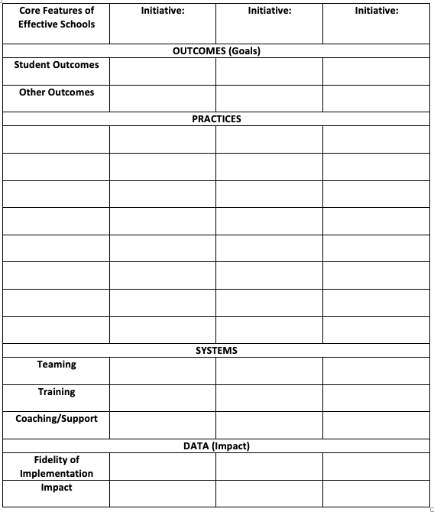
Alignment Worksheet Resource
Available on nepbis.org
V.C

Slide 41
Family Engagement
(supported by Andrew Garbacz)

Slide 42
Family Engagement
Families and educators coordinating and collaborating to support children
Embedded in cultural beliefs and ideologies
Active, interactive, and dynamic
  Active: Equal partners in planning, decision-making, and implementation
  Interactive: Work with other stakeholders
  Dynamic: Changes over time
Eccles & Harold; Epstein & Dauber, 1991; Fette et al., 2009; Garbacz (in press); Hill, 2010; Leverson, Smith, McIntosh, Rose, & Pinkelman, 2016; Sheridan, Clarke, & Christenson, 2014; Sheridan, Rispoli, & Holmes, 2014
Notes:
At its core, family engagement involves families and educators coordinating and collaborating to support children. The focus is on coordinating goals and activities across home and school. Collaboration includes families and educators making decisions together and working as partners.
Family engagement is embedded in cultural beliefs and ideologies. Families have different beliefs about education and their role in supporting their child. Part of working together as partners is clearly defining role expectations in a manner that is congruent with family culture and expectations.
Family engagement is active, interactive, and dynamic.
When families are engaged as partners, there is an expectation that family members and educators are active in making plans, setting goals, and carrying out activities to address goals.
Family engagement is also interactive. Collaboration involves working together as a team rather than in isolation.
Family engagement changes over time. Evidence indicates that family engagement is important for children, families, and schools in early childhood, elementary school, middle school, and through high school. However, the nature of how families and educators collaborate as children progress through school changes. For example, as children transition to middle school, families may provide less direct support for homework, but rather will establish systems that support their child to self-monitor during homework time with check-ins, and acknowledgements for appropriate behavior.

Slide 43
Research supports Family Engagement
Students
Achievement (Fan & Chen, 2001)
Attendance (Simon, 2001)
School drop-out (Barnard, 2004)
Social behavior (Fantuzzo, McWayne, Perry, & Childs, 2004; Garbacz & McIntyre, 2016)
Peer affiliations (Garbacz, Zerr, Dishion, Seeley, & Stormshak, in press)
Parents and Teachers
Parent efficacy and competence (Semke, Garbacz, Kwon, Sheridan, & Woods, 2010; Sheridan et al., 2012)
Parent trust of teachers (Santiago, Garbacz, Beattie, & Moore, 2016)
Teachers improved job satisfaction and fewer transfer requests (Christenson, 1995)
Parent-teacher relationship (Sheridan et al., 2017)
Notes:
Decades of research supports the positive associations between family engagement and outcomes for students, parents, and teachers.
Schoolwide family engagement is positively associated with student achievement, school attendance, peer group affiliations, and negatively associated with school drop out, and behavior problems.
Parents and teachers also benefit from working together. Parents’ report improvements in their efficacy for helping their children with schoolwork and their trust of teachers.
Teachers report improved job satisfaction and tend to request fewer transfers.
When parents and teachers collaborate to support children’s behavior, child behavior improves, parents and teachers report improvements in their problem-solving competences, and the relationship parents and teachers share improves.

Slide 44
Key Family Engagement Approaches
Define family engagement at the school and district level that is linked to systems and practices
Improve proactive outreach to families and strengthen multidirectional communication
Differentiate approaches so all families can access information and engage
Assume that the most effective and efficient support for a student is from their family
Dishion (2011); Garbacz (in press); Horner (2017); Mapp & Hong (2010); Moore et al. (2016)
Notes:
Research results suggest support for a few key family engagement approaches.
One of the first things to focus on is creating support for family engagement at the district and school level. It is important to clarify the district’s approach to family engagement with role definitions for schools and families.
In addition, evidence indicates families typically wait for schools to contact them about working together. Thus, it is important for schools to reach out proactively to families to initiate a collaborative relationship. Such an approach is also an opportunity to establish communication pathways. Common approaches to communication include sending material or notices home to families (e.g., approval for a field trip) rather that establish communication systems that support multidirectional communication, or communication that can initiate from families or schools and flow easily back-and-forth.
We know that families differ with regard to their beliefs about education, expectations for schooling, and availability and motivation to collaborate. Thus, family engagement systems support activities and practices that provide a range of opportunities and experiences for families to collaborate. Logistically, this can include holding school events at community centers that may be easier for families to attend. It also means holding events at different times over months and years. Although such approaches require an investment in educator time, they reflect a commitment to working with all families in the school community.
Finally, collaborating with families is often viewed as something extra or an add-on that requires an investment in resources without an associated tangible benefit for students. However, the most efficient and effective support for students is their family. By organizing systems to support families use of evidence-based approaches at home with their children and through coordinating home and school supports, we can actually positively influence child development and promote academic, behavior, and life success.

Slide 45

Approaches to Family Engagement in PBIS
Engage families in PBIS at school
Support families to use positive behavior support at home
Coordinate practices across home and school
Garbacz (in press)
Notes:
There are several research informed approaches to engage families in PBIS. These approaches emphasize engaging families in PBIS at school, extending the core features of positive behavior support to the home setting, and coordinating support across home and school.
The next three slides describe each family engagement domain in depth.
If you would like to learn more after this session, you can download an e-book from pbis.org, ”Aligning and Integrating Family Engagement in Positive Behavioral Interventions and Supports.”
LINK: https://www.pbis.org/Common/Cms/files/pbisresources/Family%20Engagement%20in%20PBIS.pdf

Slide 46
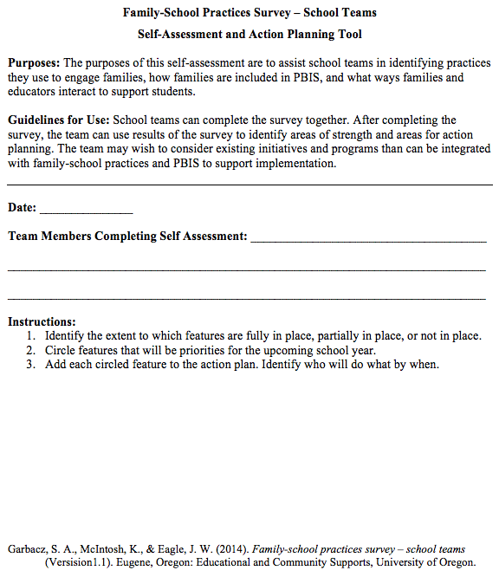
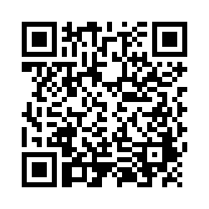
Examining School Approaches to Family Engagement in PBIS
The family-school practices survey for school teams is a self-assessment and action planning tool.
Implementation of school approaches to family engagement are assessed in several areas:
  Communication
  Family-School Activities
  PBIS Practices at Home and School
  Decision-Making/Shared-Ownership
  Resources
Garbacz, McIntosh, & Eagle (2014)
Notes:
The family-school practices survey was designed for school teams to use as a self-assessment and action planning tool.
The tool allows school teams to rate implementation of school approaches to engaging families in PBIS across several dimensions
Dimensions on the tool include
Systems-level problem solving, which assesses team activities to promote family engagement
Data-based decision making
School-home communication about PBIS
Resources to support family engagement, and
PBIS practices at home and school
Take a few minutes to complete the self-assessment, identify areas of strength and need, and complete the action plan at the end of the tool to target areas of need that build on strengths
Link to assessment: https://uconn.co1.qualtrics.com/jfe/form/SV_4U9QPw9ASvLr83z

Slide 47
Activity:
Examine your Family-School Practices
Work as team for 20 min
Review all content
Complete and use the Family-School Practices Survey
Add 2 to 3 items to your action plan based on priorities discussed while completing the survey
Identify one person who will present big ideas from action planning for your group

Slide 48
TIC/TFI Action Planning

Slide 49
Activity:
Action Planning
Work as team for 150 min
Complete the Team Implementation Checklist and School-Family Partnership Survey
Return to your Action Plan
Identify relevant resources and steps to help move your school forward.
In particular, make sure you have completed all of the steps in getting started (review your notebook).
Present 2-3 “big ideas” from your group (1 min. reports)
Email action plans to your trainer before leaving today!

Slide 50
Team Implementation Checklist (TIC)
COACHES (1 per team) go to www.pbisapps.org
Go to PBIS Applications login on the top right corner of your screen
Login with your email and password (if you haven’t set up your password yet, just go through forgot password process)
Select PBIS Assessment
Under Surveys Currently Open, Select Team Checklist 3.1
Click “Take Survey”
  Find Team Checklist
Select under Action column
Complete TIC as a team
9. Review reports to support your action planning
See Appendix D
Complete during Team Action Planning Time TODAY

Slide 51
Lunch

Slide 52
Preparing for Roll Out

Slide 53
Leadership Team: Next Steps
Create an electronic document of your PBIS Framework
Present the plan to school staff
Present the plan to students
Serve as role models, coaches, and cheerleaders to support implementation and build internal capacity

Slide 54
Presenting to Staff
First, find and schedule time to present to faculty
It is important to review the following components with all staff:
PBIS Philosophy
Expectations Matrix
Lesson Plans
Acknowledgement procedures
Consequence procedures
How data will be used to evaluate plan

Slide 55
Presenting to Students
How to present to students?
When will presentation(s) to students occur?
It is important to review the following components with students
Expectations Matrix
Acknowledgement procedures
Consequence procedures
Whole school or grade level presentation (e.g. pep rally)
School event
Classroom by classroom activities
Involve students/family/community and/or incorporate input

Slide 56
Consider Creating a PBIS Handbook
Staff Handbook
Student Handbook
Description of PBIS
SW Expectations
School Matrix
Lesson Plans
Overview of Acknowledgement System
Overview of Consequences
Classroom continuum of consequences
Problem behavior definitions
Discipline flowchart
Office Referral form
Request for Assistance form
Description of PBIS
SW Expectations
School Matrix
Home Matrix
Overview of Acknowledgement System
Overview of Consequences

Slide 57
Activity:
Action Planning
Work as team for 60 min
Review all content, including guidelines for rollout with staff and students
Use your TIC to guide action planning
Identify one person who will present big ideas from action planning for your group

Slide 58
Activity:
Tier 1 Questions and Answers
Work as team for 15 min
Time to refocus on Tier 1 implementation!
With your group brainstorm 2-3 questions that you still have related to Tier 1.
Share questions, responses, and solutions as a large group.

Slide 59
SWPBIS Action Planning

Slide 60
Activity:
Action Planning
Work as team for 105 min
Return to your Action Plan
Update content related to Tier 1.
In particular, plan for sharing information with and gathering/using feedback from your school faculty!
Present 2-3 “big ideas” from your group (1 min. reports)
Please email your action plan to your trainers by the end of the day to receive specific feedback.

Slide 61
Review of SWPBIS
V.D

Slide 62
MAIN TRAINING OBJECTIVES
✓
Establish leadership team
Establish staff agreements
Build working knowledge of SWPBIS outcomes, data, practices, and systems
Develop individualized action plan for SWPBIS
Organize for upcoming school year
✓
✓
✓
✓

Slide 63
Tier 1 Leadership Team & Coaches Meetings
WHAT | WHO
6 days of Team Training | Minimum membership: administrator, grade level representatives, support staff
3 days Coaches Meetings | 2 Coaches
1 days of TA per school | Admin, Coach, Data Entry
YEAR 1
✓
3 days of Team Training | Same above
3 days Coaches Meetings | Same above
1 day of TA per school | Same above
YEAR 2
2 days of Team Training | Same above
2 days Coaches Meetings | Same above
1 day of TA per school | Same above
YEAR 3+
Tier 2 Training will also be offered to schools implementing Tier 1 with fidelity.

Slide 64
Critical Features of PBIS
Supporting Culturally Equitable
Social Competence & Academic Achievement
OUTCOMES
Supporting
Culturally
Knowledgeable
Staff Behavior
Supporting
Culturally Valid
Decision
Making
SYSTEMS
DATA
(Vincent, Randal, Cartledge, Tobin, & Swain-Bradway, 2011; Sugai, O’Keefe, & Fallon 2012 ab)
PRACTICES
I.C
Supporting Culturally Relevant
Evidence-based Interventions
Notes:
Use data
Focus on outcomes: Academic & behavior success
On-going evaluation
Ensure cultural and contextual fit
Invest in systems
Organize research-validated practices within a continuum
Instructional & preventative approach
Integration
Tier 1 for all

Slide 65
Continuum of School-Wide
Instructional and Positive Behavior Support
TIER 1:
School-/Classroom-
Wide Systems for
All Students,
Staff, & Settings
~80% of Students

Slide 66
Getting Started with SWPBIS
Establish an effective leadership team
Develop brief statement of behavioral purpose
Identify positive SW behavioral expectations
Develop procedures for teaching SW expectations
Develop procedures for teaching class-wide expectations
Develop continuum for strengthening appropriate behavior
Develop continuum for discouraging violations of expectations
Develop data-based procedures for monitoring
Develop systems to support staff
Build routines to ensure on-going implementation

Slide 67
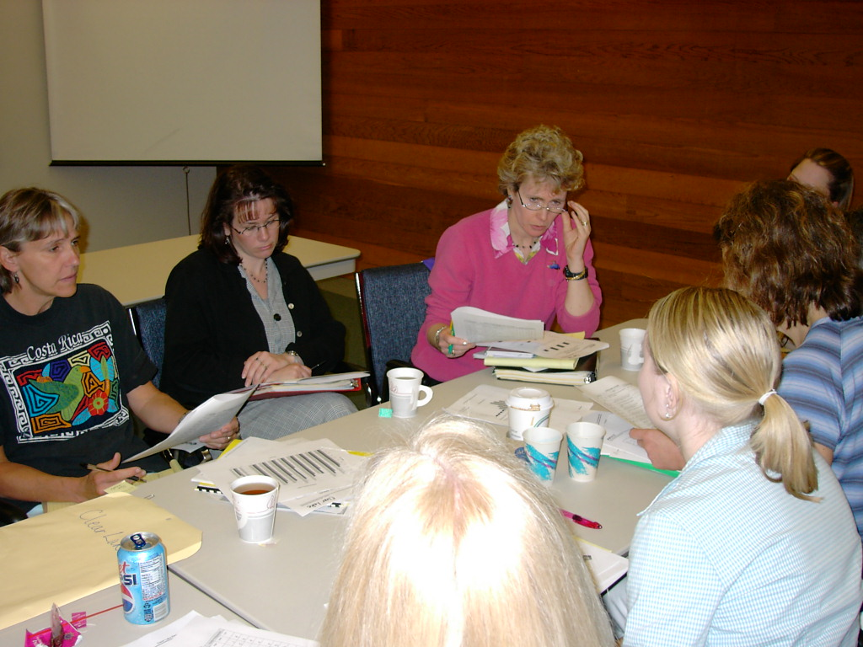
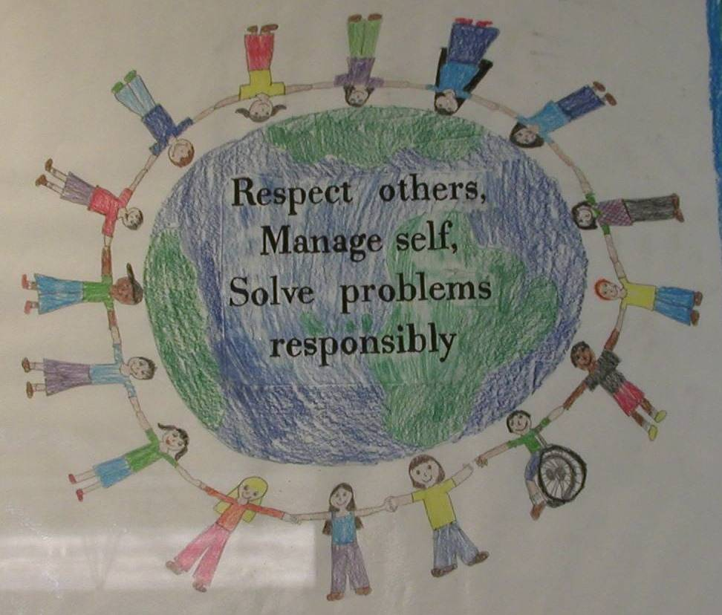

Establish Team
Develop Statement of Behavioral Purpose or Vision
At BSG, we are responsible for ourselves, respect each other, and maintain safety in our school.
Establish Behavioral Expectations/Rules
Teach Rules in the
Context of School Settings

Slide 68
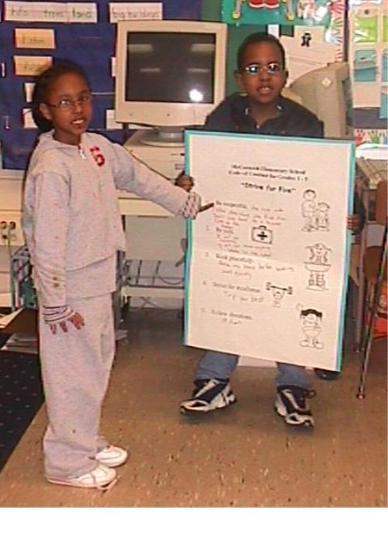
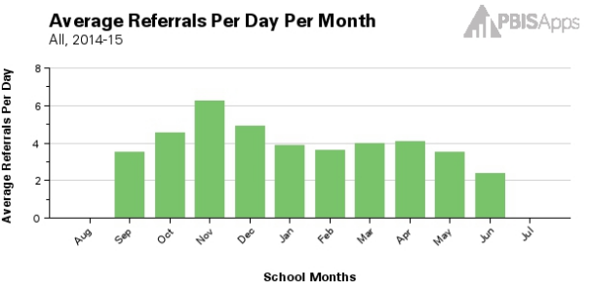
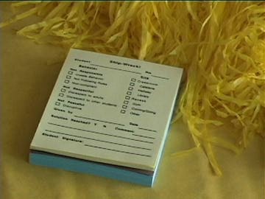
Teach Rules in the
Context of Class Routines
Establish Procedures for Encouraging Rule Following
Establish Procedures for Responding to Rule Violations
Develop data-based procedures for monitoring

Slide 69
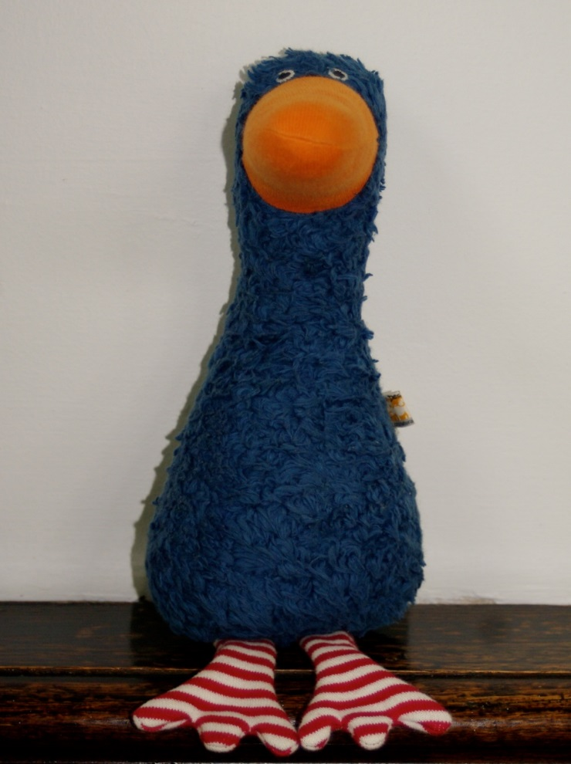

Develop Systems to Support Staff
Build Routines to Ensure On-Going Implementation

Slide 70
Non-Classroom Settings:
Basic Management
Considerations
Practices
Physical or environmental arrangements
Routines & expectations
Staff behavior
Student behavior
Teach directly expected behaviors and routines in context
Actively supervise (scan, move, interact)
Pre-correct and remind
Positively reinforce expected behavior
III.B

Slide 71
Evidence-Based Practices in Classroom Management
Minimize crowding & distraction
Maximize structure & predictability
State, review, & reinforce positively stated expectations.
Provide more acknowledgement for appropriate than inappropriate behaviors.
Maximize varied opportunities to respond.
Maximize active engagement.
Actively & continuously supervise.
Respond to inappropriate behaviors quickly, positively, & directly.
Establish multiple strategies for acknowledging appropriate behavior.
Generally provide specific feedback for errors & corrects.
IV.A
Notes:
Annimation is out of order on this slide- I fixed on my computer but check on yours

Slide 72
Key Features of Effective Alignment
Align multiple initiatives at the organizational level where a common budget authority exists.
Align multiple initiatives by using a common outcome measure to assess effectiveness.
Build aligned professional development by comparing and combining the “core features” of multiple initiatives.
  Compare fundamental assumptions
  Start with common “core features” and compare the practices used to achieve these features.
  Determine how to incorporate additional core features with efficiency
  Build single Professional Development curricula that combine core features.
Resolve Logic Model Conflict
Notes:
We are using bullying prevention as an example of alignment. Start by reviewing key features of alignment.

Slide 73
Core Feature Analysis
Core Features
Training Plan
Fidelity
Measure
Core Features
Core Features

Slide 74
Key Family Engagement Approaches
Define family engagement at the school and district level that is linked to systems and practices
Improve proactive outreach to families and strengthen multidirectional communication
Differentiate approaches so all families can access information and engage
Assume that the most effective and efficient support for a student is from their family
Dishion (2011); Garbacz (in press); Horner (2017); Mapp & Hong (2010); Moore et al. (2016)
Notes:
Research results suggest support for a few key family engagement approaches.
One of the first things to focus on is creating support for family engagement at the district and school level. It is important to clarify the district’s approach to family engagement with role definitions for schools and families.
In addition, evidence indicates families typically wait for schools to contact them about working together. Thus, it is important for schools to reach out proactively to families to initiate a collaborative relationship. Such an approach is also an opportunity to establish communication pathways. Common approaches to communication include sending material or notices home to families (e.g., approval for a field trip) rather that establish communication systems that support multidirectional communication, or communication that can initiate from families or schools and flow easily back-and-forth.
We know that families differ with regard to their beliefs about education, expectations for schooling, and availability and motivation to collaborate. Thus, family engagement systems support activities and practices that provide a range of opportunities and experiences for families to collaborate. Logistically, this can include holding school events at community centers that may be easier for families to attend. It also means holding events at different times over months and years. Although such approaches require an investment in educator time, they reflect a commitment to working with all families in the school community.
Finally, collaborating with families is often viewed as something extra or an add-on that requires an investment in resources without an associated tangible benefit for students. However, the most efficient and effective support for students is their family. By organizing systems to support families use of evidence-based approaches at home with their children and through coordinating home and school supports, we can actually positively influence child development and promote academic, behavior, and life success.

Slide 75
Next Steps

Slide 76
Implement Action Plan
Communicate information to staff
Meet monthly with team
  Review school data
  Review/update action plan
Implement activities on action plan

Slide 77
Future Support
Use your action plan, data, TIC, and TFI to hold your team accountable (and share info with us).
Keep in touch with us.
Coaches and teams will still meet next year (3 times each).
Have a great spring and summer!

Slide 78
Consider Tattoos!
4 PBIS Elements
School Systems
Supporting Social Competence &
Academic Achievement
OUTCOMES
School-wide
Classroom
SWPBIS
SYSTEMS
DATA
Supporting
Decision
Making
Supporting
Staff Behavior
Non-classroom
Family
PRACTICES
Tertiary Prevention:
Specialized
Individualized
Systems for Students with High-Risk Behavior
~5%
Student
Supporting
Student Behavior
Primary Prevention:
School-/Classroom-
Wide Systems for
All Students,
Staff, & Settings
~15%
Secondary Prevention:
Specialized Group
Systems for Students with At-Risk Behavior
~80% of Students

Slide 79


pbis.org
neswpbs.org

