Slide 1
School-Wide Positive Behavioral Interventions and Supports (SWPBIS)
Northeast PBIS (NEPBIS) School-Wide Team Training
District Capacity Building
Year 1 Day 1
[Insert Trainers Names]
with support from Brandi Simonsen, Jen Freeman,
Susannah Everett, Adam Feinberg, & George Sugai
Notes:
Add trainer names for your event

Slide 2

Advance Organizer
Review of PBIS Blueprint Self-Assessment
District Implementation Focus: Leadership Team
Review of Self-Assessment: Leadership Team
Report out & Action Planning

Slide 3

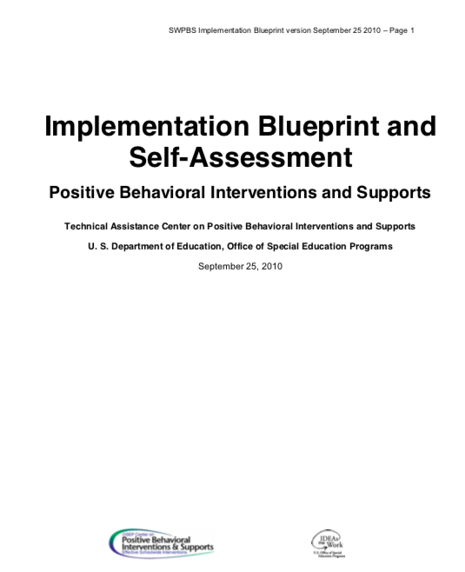

Tools!
nepbis.org
pbis.org
Implementation Blueprint & Self Assessment
Evaluation Plan
Action Plan

Slide 4

Activity:
Please Enter Attendance
District Team Members
1 min
District team members, please login on nepbis.org, go to the coaches’ tab, and click on the Team Training Attendance Link. Follow prompts to enter team attendance.

Slide 5
District & School-wide PBIS
Culturally Equitable Academic &
Social Competence
OUTCOMES
Culturally Relevant
Support for
Student
Behavior
Culturally Valid
Decision
Making
DATA
PRACTICES
SYSTEMS
Culturally Knowledgeable
Staff Behavior
Notes:
SWPBS: Four Elements
SWPBS builds from a focus on student Outcomes: academic achievement, social competence, and safety.
SWPBS “Practices” are the behaviors of adults that affect how students perform. These are the daily, classroom, and on-going discipline practices of the school
SWPBS “Systems” are the organizational decisions and structures that support effective STAFF Behavior. A major strength of SWPBS is the emphasis on practices delivered WITH the systems needed to support the practices.
The use of data for decision-making is the single most important system within SWPBS. This element is used both to ensure the SWPBS practices are tailored to the local context/culture, and to benefit the continuous regeneration needed for sustained implementation.

Slide 6
Outcomes
School-wide behavior expectations
Class-wide Behavior expectations and routines
Practices
School-wide Instruction on Expectations
Class-wide Instruction on Routines
Academic Success
Social Emotional Competence
Active Supervision
Effective Recognition
Corrective Consequences
Function-based Support
Systems
Team-based
Supportive Leadership
Selection, Training, Coaching
Multi-tiered Support
Policies and funding
Data
Universal Screening
Progress Monitoring
Implementation Fidelity
Standardized Assessments

Slide 7
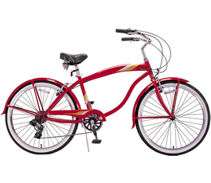
PBIS/MTSS will be the roadmap
You can change the tires- but don’t throw out the bike!!!
Coaching
School Team
Data based
problem solving
Effective interventions
School Leadership
Implementation
Notes:
Kincaid!!!

Slide 8
Main Messages
Sustained and High Fidelity Implementation of SWPBIS requires active District Support.
    Especially for Tiers II and III
-----------------------------------------------------------
Student = unit of impact
Schools = unit of analysis
District = unit of implementation

Slide 9
PBIS Academy: Systems & Timeline district capacity building supports
Year 1
Team Training
Coaches Training
Year 2
Team Training
Year 3
Team Training
SWIS support
Coaches Training
SWIS support
Coaches Training
SWIS support
on-site TA
on-site TA
on-site TA
Year 1
Year 2
Year 3
2 half days
district team building
3 brief content sessions targeting district capacity building
2 half days
district team building
3 brief content sessions targeting district capacity building
2 half days
district team building
2 brief content sessions targeting district capacity building
1 Day District Team technical assistance
1 Day District Team technical assistance
1 Day District Team technical assistance

Slide 10
PBIS Academy:
Data, measures, and assessing impact
Tiered Fidelity Inventory (TFI)
Trainer & Team assessment of PBIS Implementation
Completed 1x per year
Team Implementation Checklist (TIC)
Team assessment of PBIS Implementation
Completed 2-3x per year
School Outcome Data
Office discipline referrals (ODRs) – some schools
In school suspension
Out of school suspension
Social Validity Data
Training evaluation data
District Leadership Capacity
Blueprint Self-Assessment
Completed 1x per year

Slide 11
Guiding District level PBIS Capacity
PBIS Blueprint & Self Assessment

Slide 12
Stakeholder Support
Funding
Policy & Systems Alignment
Workforce Capacity
Executive Functions
LEADERSHIP TEAMING
Implementation Functions
Training
Coaching
Evaluation & Performance Feedback
Behavioral Expertise
Local Implementation Demonstrations
Notes:
Version 2017-3-8
Swaps Stakeholder Support and Funding

Slide 13
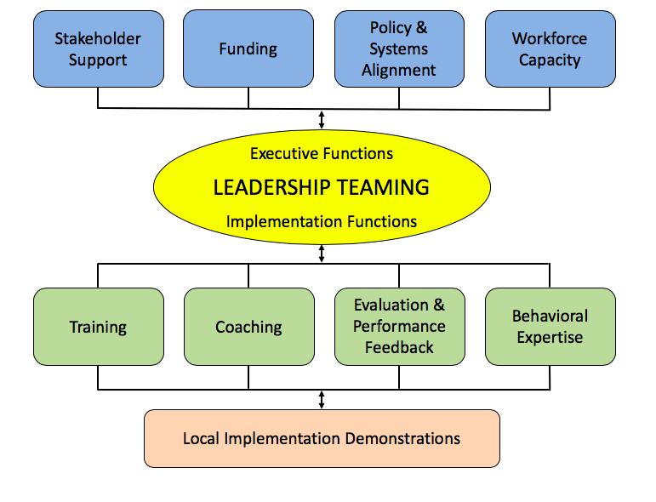
PBIS Self-Assessment
Role and Function of District Team: Clear and Consistent Leadership
Executive Functions: Provide the funding, visibility, and political support needed to allow school teams to travel through the full sequence of adoption stages. Adopting an integrated framework is process that will challenge the assumptions and traditional practices of most school faculty, and mental health systems.
Implementation functions: Provide the training, coaching and feedback systems needed to establish personnel with both the specific technical skills needed to deliver integration and the organizational vision to deliver those skills within a unified framework.
Notes:
What will be the role of the DCLT? Here are some ways we can help clarify some of the ways we work…
Here is where the consumer guide comes into play…we continue to overwhelm staff and system with more to do….how to we become better consumers of EBP? How could we use the consumer guide to ask the right questions before we add one more thing???
How do we use the implementation framework to be the common “way of work”???

Slide 14

Academic and/or behavioral MTSS Director
Who should be on the team?
School Improvement
Special Education Director,
Professional Development/Teacher Mentoring
Local MH provider/Core Service Agency
Family Youth Community Leaders
Board Member
District Community Leadership Team
Law Enforcement
Implementation Team
Juvenile Services Coordinator
Youth Move
Social Services
Afterschool
Dept of Recreation Services
Student Supports Director
Administrative and Teacher
Representative
(Union)
Notes:
a.) School System Student Services and Special Education Directors
b.) Local Mental Health Provider
c.) Core Service Agency’s Child and Adolescent Coordinator
d.) Juvenile Services Coordinator/Law Enforcement
e.) Coalition of Families offices
f.) Family, Youth and Community members
g.) Local Management Board representative
h.) Social Services representative other to include (where present) Youth MOVE Rep, System of Care Case Management entity or Family Navigator, community health provider, non-public special education school rep, recreation services, local health dept, board of education representative or other stakeholders identified by leadership

Slide 15
Trauma Informed Strategies
Discipline Handbook
School Mental Health
Wraparound
Check & Connect
Function-based Support
Classroom Management
Academic & Social Emotional Behavior Success
Restorative Practices
Wellness & Self-Regulation
Cognitive Behavior Counseling
Check In Check Out
Social Emotional Learning
Dropout Prevention
Bullying Prevention
School Climate
Literacy Instruction
Cultural Responsiveness
Social Skills Programming

Slide 16
PBIS / MTSS Leadership Team
Who should be on your team?
What are your outcomes?
Are there other district administrators / school staff who engage in related activities (e.g., SEL, Climate, Special Education)?
Important stakeholders?
Related family / community members?
Important administrators / coaches?
Other?

Slide 17
PBIS / MTSS Leadership Team
Who should be the district team facilitator?
District team facilitator engages in the following activities.
  Facilitates district team meetings.
  Serves as a point person on what activities the district team is engaging in.
  Assists in evaluation activities of district capacity through assessment (e.g., PBIS Implementation Self-Assessment).
  Coordinates important district level PBIS / MTSS documentation (e.g, District evaluation schedule)

Slide 18
Stakeholder Support
Funding
Policy & Systems Alignment
Workforce Capacity
Executive Functions
LEADERSHIP TEAMING
Implementation Functions
Training
Coaching
Evaluation & Performance Feedback
Behavioral Expertise
Local Implementation Demonstrations
Notes:
Version 2017-3-8
Swaps Stakeholder Support and Funding

Slide 19
PBIS Blueprint & Self Assessment
Leadership Team
1. Leadership Team has the authority to influence the organization (e.g., decision-making for budget, implementation, policy, data systems).
2. Leadership Team has representation from range of stakeholders with investment in youth outcomes from the local community and individuals with detailed knowledge about the current social-emotional-behavioral initiatives (e.g., accountability, administrators, families, general and special education, higher education, mental health, school board and community members, school board attorneys, trade organizations, youth-serving agencies).
3. Leadership Team includes individuals with behavioral science expertise across the full continuum of behavior support (Tiers I, II, III) to ensure fidelity of implementation of PBIS practices and systems in three domains: (a) training, (b) coaching, and (c) evaluation.

Slide 20
PBIS Blueprint & Self Assessment
Leadership Team
4. Leadership Team is led or facilitated by a coordinator(s) with (a) adequately allocated FTE and (b) experience in data-based decision-making, systems to support implementation, and evidence-based social-emotional-behavioral practices.
5. Leadership Team completes a 3-5 year action plan guided by the PBIS Implementation Blueprint Self-Assessment, state/district strategic plan, and district/school fidelity of implementation data (e.g., Tiered Fidelity Inventory), and matches resources to needs based on student outcome data, especially for vulnerable populations.
6. Leadership Team uses standard meeting process and problem solving agenda (e.g., Team-Initiated Problem Solving) with clearly defined operating procedures (e.g., procedures for securing agreements, resolving conflicts and integration of system features).
7. Leadership Team engages in ongoing, two-way communication with executive leadership regarding implementation progress and outcomes related to student behavior goals and PBIS fidelity of implementation.
8. Leadership Team members who coordinate daily implementation of the initiative regularly monitor and report implementation activities and follow agreed-upon procedures for monitoring progress.
9. Leadership Team regularly (e.g., quarterly) uses two-way communication with other stakeholders (e.g., school boards, families, community organization leaders, politicians, youth) to solicit feedback on implementation progress and link to outcomes.

Slide 21
Activity:
District Team Time!
District Team Members
10 min
Review leadership team items.
  Self-Assess
  Rate current status
  Celebrate successes!
  Identify areas of needs / growth
  List specific actions
  Be ready to discuss.

Slide 22
Main Messages
Sustained and High Fidelity Implementation of SWPBIS requires active District Support.
    Especially for Tiers II and III
-----------------------------------------------------------
Student = unit of impact
Schools = unit of analysis
District = unit of implementation

