Slide 1
School-Wide Positive Behavioral Interventions and Supports
(SWPBIS) Tier 2 Academy
Northeast PBIS (NEPBIS) Tier 2 Team Training
Day 2
Susannah Everett and Lindsay Fallon
with support from Brandi Simonsen, Jen Freeman,
Adam Feinberg, Lindsay Fallon, Susannah Everett, & George Sugai
Notes:
Add trainer names for your event

Slide 2

Advance Organizer
Review of Tier 2
  Revisiting systems, data, and practices
Self Check Steps 1-3
  Establish a Tier 2 Team
  Develop a Process for Identifying Students
  Select and Adopt Appropriate Tier 2 Practices for Your School
Getting Started Steps 4-6
Action Planning

Slide 3
MAIN TRAINING OBJECTIVES
Establish Tier 2 leadership team
Establish staff agreements
Build working knowledge of Tier 2 outcomes, data, practices, and systems
Develop individualized action plan for Tier 2
Organize for implementation

Slide 4
Tier 2 Leadership Team & Technical assistance
WHAT | WHO
4 days of Team Training | Tier 2 Team: representative from Tier 1 team, coach, staff with behavioral expertise, administrator, intervention coordinator
2 days of TA per school | Coach, Coordinator, Behavior Support Staff
Notes:
Modify as appropriate to match your training approach (e.g., change number of TA days, but not training days)

Slide 5
Team Training Overview
Day 1: Tier 2 overview, revisiting readiness, Tier 2 Getting started steps 1-3
Day 2: Getting started steps 4-6
Day 3: Getting started 7-8
Day 4: Getting started steps 9 and 10, advanced understanding of behavior, preview of Tier 3
Notes:
step 10?

Slide 6
Acknowledgements
Michigan’s Integrated Behavior & Learning Support Initiative
Dr. Heather George & FLPBS
Missouri PBIS
Drs. Leanne Hawken, Deanne Crone, and Rob Horner
Midwest PBIS Network

Slide 7


Tools!
nepbis.org
pbis.org

Slide 8

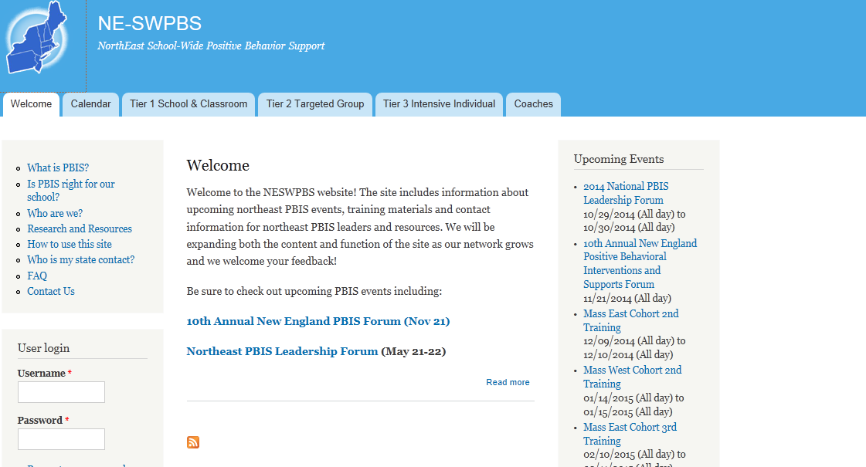
pbis.org
nepbis.org

Slide 9

Tools!
nepbis.org
pbis.org
Evaluation Plan
Action Plan

Slide 10






Legend
New Content
Review
Guidelines
+Ex
-Ex
Training Organization
Activity

Slide 11
Training Expectations:
RESPECT…
SELF
Self-monitor (Are you participating? Engaged as a learner? Talking during allotted times?)
Stretch, break, stand as needed
OTHERS
Cell phones (inaudible): Converse in lobbies and breaks
ENVIRONMENT
Recycle
Maintain neat working area
Maintain student and staff confidentiality
Work as a team: Room for every voice, reinforce participation

Slide 12
Activity:
Please Enter Attendance
Coaches/
Team Members 1 min
Coaches, please login on nepbis.org, go to the coaches’ tab, and click on the Team Training Attendance Link. Follow prompts to enter team attendance.

Slide 13
Why Tier 2?

Slide 14
Why Tier 2
Context matters for prevention at Tier 2
Part of a continuum of supports
Efficient use of resources for groups of students
Tier 2 works!
Notes:
School-wide factors influence our ability to implement what we know with accuracy, consistency, & durability for individual students.

Slide 15
Prevention Logic For All
Redesign of teaching environments…not students
Biglan (1995); Mayer (1995); Walker et al. (1996)
Biglan (1995); Mayer (1995); Walker et al. (1996)
Prevention Objectives
Prevention Actions
Decrease development of new problem behavior | Prevent worsening & reduce intensity of existing problem behavior | Eliminate triggers & maintainers of problem behavior | Add triggers & maintainers of prosocial behavior | Teach, monitor, & acknowledge prosocial behavior
Incidence
Prevalence

Slide 16
Tier 2 Critical Features

Slide 17
Tier 2
Designed to:
Use data to identify students who are at-risk for or currently experiencing emotional and/or behavioral difficulties
Prevent the development or decrease the frequency and/ or intensity of students’ problem behaviors
Provide standardized interventions that effectively and efficiently support students yet do not require the time and resources needed to develop individualized plans

Slide 18
Secondary Tier
Secondary Intervention Team
Weekly data-based program review
…
SYSTEMS
~15% of students with 2-5 major ODRs
Increasing pro-social skills of targeted group (as measured by points earned for pro-social behavior)
…
OUTCOMES
ODRs
Point card
FACTS
Academic data (CMT, CBM, grades)
…
DATA
Screening
More intense and frequent social skills instruction & reinforcement
…
PRACTICES

Slide 19
Common Tier 2 Systems Features
Consistent, standardized implementation across students
Easily accessible (e.g., within a few days of referral)
Continuous availability
Implemented by all school staff
Consistent with and extra doses of school-wide expectations and interventions
Targeted and explicit skill instruction
Acknowledgements of appropriate behavior
Increased adult support
Frequent feedback for targeted behaviors
Plans for generalization and maintenance

Slide 20
Critical Features: Tier 2 Systems
What are the key systems features to support staff at Tier 2? Similar to Tier 1!
Team-based implementation
  Tier 2 leadership team including staff with behavioral expertise, led by a coordinator
Clear action plan
Staff buy-in
Embedded professional development
Staff recognition for implementation
(OSEP Technical Assistance Center on Positive Behavioral Interventions and Supports, October, 2015)

Slide 21
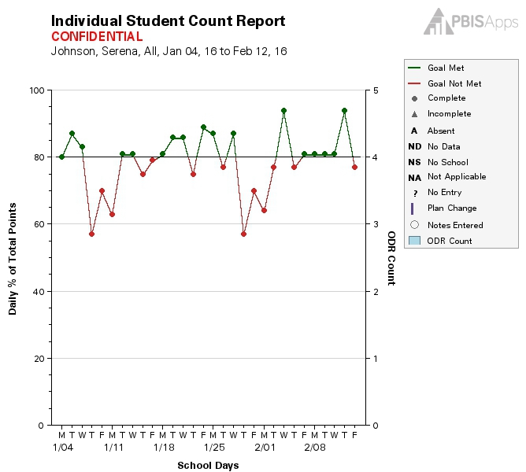
CICO SWIS: Monitoring Individual Student Progress

Slide 22

Everything Builds on Tier 1
Data-Based Guiding Questions
Is our Tier 1 system doing what it needs to do?
    Does the school have a ‘healthy’ triangle?
    Do 80% of students have ~0 -1 office referrals?
Is SWPBIS being implementing with fidelity?
    SWPBIS Tiered Fidelity Inventory (TFI) = > 70%
Are fewer than 60% of referrals coming from classrooms?
Are only a ‘few’ students receiving referrals?
Are only a ‘few’ staff writing referrals?
Are effective instruction and behavior management occurring in the classroom?
Notes:
Rationale:
Tier 1 is a building block for identifying students in need of Tier 2 supports. Essentially, Tier 1 data are your blueprint in identifying who, what and when supports need to be provided. By implementing Tier 1 with fidelity and using data for decision-making provides better information for effective and efficient planning and problem-solving.
Trainer’s Notes:
There are 6 guiding questions to assist participants in understanding if they are ready for Tier 2 supports on their campus. Remember, if your data show more than 15% of your students need Tier 2 supports, this indicates a Tier 1 issue! Each question will appear with an advanced click due to the animation.

Slide 23
Guidelines for Culture & Context
Culture & Context
For each item in your action plan, ensure:
Involve staff, students, & families in development
Contextually/culturally appropriate (e.g., age, level, language)
Examine disaggregated data to ensure implementation of each feature works for all subgroups of students

Slide 24
Getting Started with Tier 2
Establish an effective Tier 2 leadership team
Develop a process for identifying students
Select and Adopt Appropriate Tier 2 Practices for Your School
Develop a process for Installing the Selected Practice(s)
Develop a process for training staff and students & partnering with/educating families
Develop a process for Matching Student Need to Practices
Develop a process for Progress Monitoring, including Data-based decision rules
Develop a process for adjusting or modifying implementation
Develop evaluation routines for level of use, student progress, and fidelity of implementation
Document procedures, policies, and practices and establish routines
Day 1
Day 2
Day 3
Day 4

Slide 25
Tier 2 Steps 1-3
Review and Self-Check

Slide 26
Getting Started with Tier 2
Establish an effective Tier 2 leadership team

Slide 27
Tier 2 Team: Critical Features
Step 1A: Membership
  Team Membership should include:
  One or more team members that have behavioral capacity (e.g., school counselor, school psychologist, social worker, special educator)
  Team member with a defined role as a parent liaison
  Tier 2 intervention coordinator
  Administrator, Teaching staff
  Representative of school/community

Slide 28
Tier 2 Team: Critical Features
Step 1B: Roles/Responsibilities/Routines
  Effective Tier 2 Team Functioning Critical Features:
  Team has adequate membership roles
  Administrator as active member
  Rules/agreements established
  Schedule for meeting at least weekly
  Schedule for training/presenting to whole staff at least monthly
  Integration with Tier 1 activities and systems
  Appropriate priority relative to school/district goals
  Schedule for annual self-assessments (see list)
  Coaching support (school/district/region)

Slide 29
Tier 2 Team Example Activities
Provide training and support to school staff regarding the program(s)
Provide specialized behavioral assessment strategies, interventions, and supports
Meet regularly (e.g., weekly or biweekly) to review the program, monitor individual student progress, and review new referrals
Coordinate school-wide implementation of all Tier 2 practices and systems
Develop screening procedures and data-based decision rules for referring students to intervention
Develop data-based decision rules (including time frames) for placing students, monitoring progress, and fading the intervention

Slide 30
Tier 2 Team Data Routines
Summarize and review data to address the following questions:
  Are appropriate students being referred?
  Are students receiving support quickly?
  Has entire staff been trained?
  Are data reviewed on a regular basis?
  Have data-based decision rules been established for accessing, monitoring progress, and fading the intervention?
  Are interventions implemented as planned?
  Is adequate training provided to individuals who will implement interventions?
  Are students actively participating in the intervention?
  Is effectiveness of intervention and support being monitored?
Notes:
Create checklist for these questions

Slide 31
3-Tiered Systems of Support: Teams
Universal
Team
Secondary Systems Team
Problem Solving Team
Tertiary Systems Team
Plans SW & Class-wide supports
Uses data; determines overall intervention effectiveness
Standing team; uses FBA/BIP process for one youth at a time
Uses data; determines overall intervention effectiveness
Universal Support
CICO
SAIG
Brief
FBA/BIP
Complex
FBA/BIP
WRAP
Mentoring/
CnC
Brief FBA/BIP
Example Framework
Midwest PBIS
Notes:
31
31
This is how Midwest PBIS trains. It is an EXAMPLE. You don't have to create a system like this, but for them it makes sense, let me show you why....

Slide 32
Activity:
Tier 2 Team Updates
10 min
With your team, review: Tier 2 Team Profile and Agreements (pg 32)
Roles and Routines
  Minute Form
  Meeting Schedule and Roles
  Action Plan
Communication
  With faculty
  With Tier 1 Team
Alignment
  With Tier 1
  With Other Teams
Share 1-2 Accomplishments
Notes:
Team Meeting Videos from PSU:
https://sites.google.com/a/pdx.edu/basicfba/individual-pbis

Slide 33
Getting Started with Tier 2
Establish an effective Tier 2 leadership team
Develop a process for identifying students

Slide 34
Process for Identifying Students in Need of Additional Supports: Critical Features
Selecting data sources for identifying students
  Data selected should be from multiple sources
  Include both academic and behavior domains
  Include both internalizing and externalizing behavior
  Considers motivation of student behavior
  A standardized request for assistance form is available to staff, students, and families

Slide 35
Process for Identifying Students in Need of Additional Supports: Critical Features
Establish decision rules for identifying students
  Clear routines for timely response to requests for assistance, data review, and decisions
Team regularly evaluates school-wide level of use whereby 5%-15% of students have access tier 2 supports

Slide 36
Decision Rules:
When Should Tier 2 Interventions be Accessed? – Entry Criteria
Decisions rules need to be established that work within your school given:
  Current context of the school
  Resources available to support interventions
  Current capacity to implement intervention
Your school will have decision rules that address both entry criteria and exit criteria
Remember - what works in one building may not work in another building – Context Matters!
Notes:
Trainer Notes:
As teams are considering their decision rules regarding entry criteria, it is important to remind them that these will need to established within the context of their school. Each school has different resources available to support interventions, different needs, and different capacity to support implementation. This means that the entry criteria from building to building will look different.

Slide 37
Identifying Students in Need
Be Efficient
Use existing data sources to identify students needing Tier 2 supports
Early Warning Indicators
Discipline
Office referrals, Minor/teacher-managed referrals
Attendance
Absences
Academics
Grades
OSS, ISS
Time out (in or out of class)
Tardies (school and/or class)
Time/’visits’ with other staff (Nurse, Guidance, etc.)
Standardized test scores
Notes:
Rationale:
It is important to keep track of any time out of the room, even if it is to the Nurse’s office. This is lost instructional time and can be an indicator of a larger issue. Example: increased visits to the Nurse’s office may indicate school anxiety or some internalizing issues (function - escaping a task).
Trainer’s Notes:
These are examples of data sources. Have teams examine and discuss for 2-3 minutes what they already have in place. For example, an Early Warning System (EWS) will already include a lot of this information.

Slide 38
Request for Assistance Process
Timelines Determined
What is Needed?
Staff training
Decision rules
Procedures if teacher requests for support exceed resources
Staff notification of students receiving support
Nomination decisions
Providing supports to students
Family notification if child is nominated (who, what, how)
Notes:
Suggested timelines: students access intervention within 72 hours (BEP)—discuss immediate access and decisions @ nominations
Rationale:
All staff (the stakeholders) need to be trained on the purpose of the nomination process, how to participate in the nomination process, and complete the nomination form.
Trainer’s Notes:
Ask the audience:
What are going to be the decision rules for determining the how and what the student needs? This will be covered in more detail at the end of this training.
How are staff going to be notified of students receiving supports? How will they support those supports?
Does the district have a policy for family notification?

Slide 39

The Parent Readiness Screen for Positive Family Support.
Begin the School Year with Parents Expressing THEIR Needs
Use Parent Readiness Screen
to place students in the triangle
Use their data to guide your approach to contact parents
(Dishion, 2012) https://reachinstitute.asu.edu/
Notes:
Additional example for identifying students for services--transition to Middle school example
Might consider saying “pro-actively” contact parents—reach out before things start to go bad…develop “pro-active” collaborative and caring relationships…

Slide 40
Activity:
Updates on Identifying Students in Need of Additional Supports
15 min
With your team review, Identifying Students in Need of Additional Interventions (pg 42)
Share: Request for Assistance Forms and Data Sources with another team
With your team, update:
  Staff training and communication
  Screening Routines (how often?)
  Decision Rules (entry/access)
Add items to your Action Plan as necessary
Present 2-3 “big ideas” from your group (1 min. reports)
Notes:
REMINDER: ask teams to bring RFA forms!

Slide 41
Getting Started with Tier 2
Establish an effective Tier 2 leadership team
Develop a process for identifying students
Select and Adopt Appropriate Tier 2 Practices for Your School

Slide 42
Selecting and Adopting Tier 2 Practices for Your School: Critical Features
Consistent, standardized implementation across students
Easily accessible (e.g., within a few days of referral)
Continuous availability
Implemented by all school staff
Consistent with and extra doses of school-wide expectation and interventions
Must prompt and teach new/alternative behavior
Can be modified based on assessment (i.e., function of behavior)
Continuous monitoring (data-used for decision making)
Plans for generalization and maintenance

Slide 43
Evaluating Interventions
Is the Tier 2 intervention aligned with our Tier 1 systems and practices?
Is the intervention empirically validated? (see references below, and sites that review interventions such as the National Center on Intensive Intervention www.intensiveintervention.org; or What Works Clearinghouse)
Does the intervention align with the culture of our school, our current priorities, and the needs of our students?
Do we have the capacity and have we developed the systems to support this intervention (e.g., personnel, training, cost)?
Notes:
Empirically supported practices are the key piece here. If schools state that they have a practice and have fidelity and outcome data demonstrating improvement, then not only praise them for collecting data in both of these areas, but also permit the use of local evaluation in addition to use of research based evaluation.

Slide 44
Tier 2 Intervention Grid
Support | Description | School-wide Data: Entry Criteria | Data to monitor Fidelity | Data to monitor Progress | Exit Criteria (Decision Rules)
Consider data systems currently in place
Notes:
Trainer Notes:
This is an animated slide.
Have participants open to this page in their participant workbook and read through the information on that page. Provide 5 minutes for participants to complete this task before moving on to presenting the slide. Then have participants flip to the next page of slides to follow along with the information on this slide and the next two slides. This is a screen shot of the Tier 2 Intervention Grid which teams will work on throughout the rest of this training.
When you advance the slide, the blue box surrounds the first column on the left hand side and prompts teams with directions on how to complete this column – identify the Tier 2 interventions in place in their school.
When you advance the slide, the blue box surrounds the first column on the left hand side and prompts teams with directions on how to complete this column – identify the Tier 2 interventions in place in their school.

Slide 45

Considerations for Implementation
Needs of Students
Fit with current initiatives, priorities, structures and supports, and parent/community values
Resources Availability
Evidence
Readiness for Replication of the program
Capacity to Implement
Notes:
Needs of students; how well the program or practice might meet identified needs. • Fit with current initiatives, priorities, structures and supports, and parent/community values. • Resource Availability for training, staffing, technology supports, curricula, data systems and administration. • Evidence indicating the outcomes that might be expected if the program or practices are implemented well. • Readiness for Replication of the program, including expert assistance available, number of replications accomplished, exemplars available for observation, and how well the program is operationalized • Capacity to Implement as intended and to sustain and improve implementation over time.
From Hexagon Tool

Slide 46
Activity:
Updates on Selecting and Adopting Appropriate Tier 2 Practices for Your School
10 minutes
With your team review, Evaluating Tier 2 Interventions (pg. 46)
Revisit Decision Process for Evaluating Interventions
Review Intervention Grid
Update your action plan
Present 2-3 “big ideas” from your group (1 min. reports) including interventions (more than 1!) you have selected or updated
Notes:
Use team checklist list
This is a task we will return to as we learn more about specific interventions

Slide 47

Just tell us what interventions to do!
For Tier 2 to be effective, teams need to:
Have processes and procedures in place
Consistently implement school-wide expectations
Design interventions for groups of students
Be systematic in aligning interventions to support behavior
Notes:
Reminder—always revisiting systems
Rationale:
The goal of today’s training is to develop a Tier 2 system, NOT jump to interventions prior to establishing a system on campus.
Trainer’s Notes:
Emphasize that this may simply mean revising or improving on what is already being done. Schools do not have to start from scratch but instead build upon what works and add to existing systems.

Slide 48
Break

Slide 49
Getting Started with Tier 2
Establish an effective Tier 2 leadership team
Develop a process for identifying students
Select and Adopt Appropriate Tier 2 Practices for Your School
Develop a process for Installing the Selected Practice(s)

Slide 50
Installing Tier 2 Practices for Your School: Critical Features
Ensure the Tier 2 strategy includes a formal process for teaching student skills and appropriate behaviors
Ensure the strategy includes increased structure and predictability for students
Ensure the strategy includes regular opportunities for students to perform and get feedback on appropriate behaviors and skills
A document exists that describes the support process and procedures for each selected practice including all supporting materials
Staff are informed on support details and provide feedback
Orientation materials provide information for staff/substitutes who have students using the practice
Fidelity of implementation measure is established and planned for use

Slide 51
Installing Tier 2 Practices for Your School: Critical Features
Ensure the Tier 2 strategy includes a formal process for teaching student skills and appropriate behaviors
  Consider:
    How will you teach the skills necessary for students to be successful (initially and throughout the intervention)?
      CICO process, social skills lesson plans, etc.
    What will the lesson plan format be?
    How frequently will social skills be taught?
    What resources can the coordinator provide to help staff build students’ prosocial behavior skills?

Slide 52
Installing Tier 2 Practices for Your School: Critical Features
Ensure the Tier 2 strategy includes a formal process for teaching student skills and appropriate behaviors
Ensure the strategy includes increased structure and predictability for students.
  Consider:
    How will staff model appropriate behavior?
    How will the environment be organized so that students get regular opportunities for skill practice and feedback?
    How will staff be trained to do these activities?

Slide 53
Installing Tier 2 Practices for Your School: Critical Features
Ensure the Tier 2 strategy includes a formal process for teaching student skills and appropriate behaviors
Ensure the strategy includes increased structure and predictability for students
Ensure the strategy includes regular opportunities for students to perform and get feedback on appropriate behaviors and skills.
  Consider:
    How will students who are not responding to Tier 1 supports receive more frequent feedback (and practice!)?
    What opportunities for practice will students receive throughout regular school routines?
    What opportunities can be built in to provide students with frequent staff feedback?
    How can feedback be provided in multiple formats?
Notes:
circle back to the remaining steps on the initial slide (slide 50)

Slide 54
Getting Started with Tier 2
Establish an effective Tier 2 leadership team
Develop a process for identifying students
Select and Adopt Appropriate Tier 2 Practices for Your School
Develop a process for Installing the Selected Practice(s)
  4a: Identify Personnel to Coordinate and Deliver the Tier 2 Strategy
  4b: Ensure the Tier 2 Strategy is Consistent with School-Wide Expectations
  4c: Ensure the strategy includes regular opportunities for students to perform and get feedback on appropriate behaviors and skills
  4d: Ensure the Tier 2 strategy does not need unique development for each participating student

Slide 55
4a: Identify Personnel to Coordinate and Deliver the Tier 2 Strategy
Identify personnel to coordinate and deliver the Tier 2 strategy
  Consider:
    How will the coordinator be trained?
    Does the coordinator have behavioral expertise?
    Does the coordinator have time and resources to run the process?
    Is the coordinator prepared to collect and maintain data systems?
    Is the composition of the team appropriately representative of the staff?
Notes:
Teach all sub steps using this format

Slide 56
4b: Ensure the Tier 2 Strategy is Consistent with School-wide Expectations
Identify personnel to coordinate and deliver the Tier 2 strategy
Ensure the Tier 2 strategy is consistent with school-wide expectations
  Consider:
    Do Tier 2 interventions use the language of Tier 1 supports?
    Can materials for Tier 2 interventions align with Tier 1 supports?
    Can Tier 1 acknowledgment practices be included in Tier 2 interventions?

Slide 57
4c: Ensure the Strategy Includes Regular Opportunities for Students to Perform and Get Feedback on Appropriate Behaviors and Skills
Identify personnel to coordinate and deliver the Tier 2 strategy
Ensure the Tier 2 strategy is consistent with school-wide expectations
Establish the Tier 2 strategy within the school so that it does not need unique development for each participating student
Ensure the strategy includes regular opportunities for students to perform and get feedback on appropriate behaviors and skills
  Consider:
    How will staff model appropriate behavior?
    How will the environment be organized so that students get regular opportunities for skill practice and feedback?
    How will staff be trained to do these activities?

Slide 58
4d: Ensure the Tier 2 Strategy does not need unique development for every participating student
Identify personnel to coordinate and deliver the Tier 2 strategy
Ensure the Tier 2 strategy is consistent with school-wide expectations
Establish the Tier 2 strategy within the school so that it does not need unique development for each participating student
  Consider:
    Are routines established to create consistency for students receiving Tier 2 intervention?
    Has the team fully considered logistics for coordinating Tier 2 interventions (e.g., availability of time, resources, room in one’s schedule)?
    Is there a plan for common schedule variations?
      Alternate student schedules
      Substitute teachers

Slide 59
Guidelines for Implementing Tier 2 Practices
PRACTICES
Identify personnel to coordinate and deliver the Tier 2 strategy
Ensure the Tier 2 strategy is consistent with school-wide expectations
Establish the Tier 2 strategy within the school so that it does not need unique development for each participating student
Ensure the strategy includes increased structure and predictability for students.
Develop clear decision rules that address match to both student need and to the current school context, culture, and resources
Plan for generalization and maintenance of skills
Notes:
guidelines as a check list for teams prior to starting the activity. But teach the content in the sub steps with the format above- then this can just be the guidelines checklist because content has already been taught

Slide 60
Tier 2 Practices: Examples

Slide 61
Examples of Empirically-Supported Tier 2 Interventions
Check-in Check-out
Social Skills Groups
Class-wide Function-Based Intervention (CW-FIT)
Check, Connect, and Expect
First Steps to Success
Mentoring
Check and Connect
Freshman Success
See Tier 2 Intervention Resource guide for more information
Notes:
these are common Tier 2 practices that schools often implement and we are using these as examples to help demonstrate the various system, data, and practices features.
Social Skills is example

Slide 62
Developing Interventions: CICO Critical Features
Notes:
CICO; and variations) is described in detail below as an exemplar Tier 2 intervention. Development of the systems and practices of CICO models the process of the implementation of any evidence-based Tier 2 intervention.

Slide 63
Check-In, Check-Out
Check-In, Check-Out (CICO) is a Tier 2, group-oriented intervention, designed especially for students whose problem behaviors (a) are unresponsive to Tier I practices and systems, (b) do not require more immediate individualized interventions, and (c) are observed across multiple settings or contexts.
CICO Practice Features:
  Increased positive adult contact and structure
  Embedded social skills training
  Direct link to school-wide behavioral goals and expectations
  Frequent feedback
  Daily home-school communication
  Positive reinforcement contingent on meeting behavioral goals
  Can be slightly modified based on student need or response
Notes:
Added the slightly modified (thinking about aligning to CBITS/trauma informed…or self-management, or focused on academic behaviors)

Slide 64
CICO Additional Features
Efficient and Effective:
  Group-based, Standardized intervention
    Can accommodate 7-12% student population
    Student entry within a few days of referral
Built-In Data System for:
  monitoring students’ progress in the program
  evaluating the fidelity of implementation, and
  transitioning to a self-managed program.
Notes:
OTR: what is 7-12% #s in your school?

Slide 65

Why 7-12% of students receiving CICO supports?
Students in the past who would not have gotten any support “until things got worse” will now get a positive boost of support
All teachers will expect that every day they will have students cross their threshold who need higher rate of positive contact
Quicker/easier to support students who need Tier III
Notes:
ADD MIDWEST PBIS logo—important slide! Research on CICO SWIS—median (?check) # of students supported is only 3!
Preview matching to student need
Within the 5-15%, 7-12% of students will benefit and research indicates will need an additional low lever Tier II support. If your numbers for CICO are low (5-6% or less), CICO will struggle to take hold and take off because not enough staff will be exposed to the intervention. All staff should know about and probably have a student who is identified to need the support of CICO. CICO is an extension of Tier I so quick and easy to deliver and gives students a boost of support from an adult.

Slide 66
CICO Works!
Research conducted on CICO and similar programs has consistently demonstrated associated decreases in:
  problem behaviors
  office discipline referrals
  referrals for special education services
  Increases in academic engagement
Most importantly, research also has demonstrated that this intervention is most effective if Tier 1, SWPBIS systems and practices are well-established within the school.
(See citations on next slide)
Notes:
Filter, K. J., McKenna, M. K., Benedict, E. A., Horner, R. H., Todd, A. W., & Watson, J. (2007). Checkin/check out: A post-hoc evaluation of an efficient, secondary-level targeted intervention for reducing problem behaviors in schools. Education and Treatment of Children, 30(1), 69-84.
Campbell, A., & Anderson, C. M. (2011). CHECK‐IN/CHECK‐OUT: A SYSTEMATIC EVALUATION AND COMPONENT ANALYSIS. Journal of applied behavior analysis, 44(2), 315-326.
Simonsen, B., Myers, D., & Briere, D. E. (2011). Comparing a behavioral check-in/check-out (CICO) intervention to standard practice in an urban middle school setting using an experimental group design. Journal of Positive Behavior Interventions, 13(1), 31-48.

Slide 67
Research Support
Published Demonstrations
Pre schools
  Chafouleas et al. 2007
Elementary Schools
  Todd et al. ,2008
  Fairbanks et al., 2007
  Kauffman-Campbell, dissertation
  Cheney et al., 2006; 2007
  Hawken et al., 2007
  Filter et al., 2007
  Miller et al., 2015
  Mong, Johnson, & Mong, 2011
Middle Schools
  Hawken et al., 2003
  March et al., 2002
  Simonsen, Myers, & Briere, 2011
  Swoszowski et al., 2012
High Schools
  Swain-Bradway, 2009
CICO is an Evidence-Based Practice
At least 5 peer reviewed studies
At least 3 different researchers/settings
At least 20 different participants

Slide 68
Check-in Check-out Cycle
Develop Behavior Plan
Morning Check-In
Weekly Team Meeting
Class Check out
9 Week Graph Sent
Home Check-In
Teacher Feedback
Class Check in
Program Update
Afternoon Check-out
EXIT
Notes:
SHARE VIDEOS here with “West” group (add links); additional video for East team
http://www.youtube.com/watch?v=f8Jhy_LxWDk

Slide 69
Check In/Check Out: Referral and Procedure
Request for Assistance (RFA)
Office Discipline Referral (ODR)
Parent recommendation
Administrator recommendation
Student Recommended for CICO
CICO is Implemented
CICO Coordinator
Morning
check-in
Parent
feedback
Regular teacher
feedback
Afternoon
check-out
Notes:
Student recommended for CICO by Teacher, parent, other school personnel?
Prior to CICO implementation- meeting with Counselor, parent and student
Go over expectations for each party (parent, school, and student)
Set goal
Sometimes contract is signed (I don’t know if you this was ever used Kelly)
3) CICO Implemented
4) Morning check-in
What did you check for? Pencil, binder, agenda, CICO form from day before
Gave students supplies if they did not have them to help them be successful
CICO Daily progress report given (can flip to next slide to show)
Teacher Feedback
Student carries card to teachers
Teachers have been trained to provide some sort of positive interaction upon receiving the card
-Teachers have also been trained not to use the system as punishment- no nagging
Afternoon check-out
CICO coordinator checks for goal
Reinforcement for checking out (High 5)
Bigger reinforcement for checking out and meeting goal (snack)
Parent Feedback
Send home- student gets feedback from parent
Student brings back form signed the next day
CICO Coordinator Summarizes Data for Decision Making
Using Quattro pro Spread sheet program- graphs data
Weekly CICO Meeting
½ hour to assess progress
who attends meeting
decisions made in meeting

Slide 70
Morning
check-in
Parent Feedback
  DPR goes home
  Parents provide positive/neutral feedback
  Parents sign report and send back to school
Afternoon Check Out
  Student comes to coordinator
  Coordinator reviews DPR
    Provides feedback/acknowledgments
    Prepares to send the DPR home
    Records points for the day
Teacher Feedback
  Set schedule for feedback
  Student gives DPR to teacher at the start of class
  At the end of class,
    Teacher provides points on behavioral expectations
    Provides verbal, positive feedback
Morning Check In
  Student comes to coordinator
  Coordinator
    Reviews DPR
    Gives point card
    Reviews expectations
    Sets positive tone
    Provides missing materials if needed
Parent
feedback
Regular teacher
feedback
Afternoon
check-out
Notes:
Student recommended for CICO by Teacher, parent, other school personnel?
Prior to CICO implementation- meeting with Counselor, parent and student
Go over expectations for each party (parent, school, and student)
Set goal
Sometimes contract is signed (I don’t know if you this was ever used Kelly)
3) CICO Implemented
4) Morning check-in
What did you check for? Pencil, binder, agenda, CICO form from day before
Gave students supplies if they did not have them to help them be successful
CICO Daily progress report given (can flip to next slide to show)
Teacher Feedback
Student carries card to teachers
Teachers have been trained to provide some sort of positive interaction upon receiving the card
-Teachers have also been trained not to use the system as punishment- no nagging
Afternoon check-out
CICO coordinator checks for goal
Reinforcement for checking out (High 5)
Bigger reinforcement for checking out and meeting goal (snack)
Parent Feedback
Send home- student gets feedback from parent
Student brings back form signed the next day
CICO Coordinator Summarizes Data for Decision Making
Using Quattro pro Spread sheet program- graphs data
Weekly CICO Meeting
½ hour to assess progress
who attends meeting
decisions made in meeting

Slide 71
Installing Tier 2 Practices for Your School: Critical Features
Ensure the Tier 2 strategy includes a formal process for teaching student skills and appropriate behaviors
Ensure the strategy includes increased structure and predictability for students
Ensure the strategy includes regular opportunities for students to perform and get feedback on appropriate behaviors and skills
A document exists that describes the support process and procedures for each selected practice including all supporting materials
Staff are informed on support details and provide feedback
Orientation materials provide information for staff/substitutes who have students using the practice
Fidelity of implementation measure is established and planned for use
How does CICO Fit with this feature?

Slide 72
Morning Check In
  Student comes to coordinator
  Coordinator
    Reviews DPR
    Gives point card
    Reviews expectations
    Sets positive tone
    Provides missing materials if needed
Teacher Feedback
  Set schedule for feedback
  Student gives DPR to teacher at the start of class
  At the end of class,
    Teacher provides points on behavioral expectations
    Provides verbal, positive feedback
Afternoon Check Out
  Student comes to coordinator
  Coordinator reviews DPR
    Provides feedback/acknowledgments
    Prepares to send the DPR home
    Records points for the day
Parent Feedback
  DPR goes home
  Parents provide positive/neutral feedback
  Parents sign report and send back to school
Notes:
Fix colors
Student recommended for CICO by Teacher, parent, other school personnel?
Prior to CICO implementation- meeting with Counselor, parent and student
Go over expectations for each party (parent, school, and student)
Set goal
Sometimes contract is signed (I don’t know if you this was ever used Kelly)
3) CICO Implemented
4) Morning check-in
What did you check for? Pencil, binder, agenda, CICO form from day before
Gave students supplies if they did not have them to help them be successful
CICO Daily progress report given (can flip to next slide to show)
Teacher Feedback
Student carries card to teachers
Teachers have been trained to provide some sort of positive interaction upon receiving the card
-Teachers have also been trained not to use the system as punishment- no nagging
Afternoon check-out
CICO coordinator checks for goal
Reinforcement for checking out (High 5)
Bigger reinforcement for checking out and meeting goal (snack)
Parent Feedback
Send home- student gets feedback from parent
Student brings back form signed the next day
CICO Coordinator Summarizes Data for Decision Making
Using Quattro pro Spread sheet program- graphs data
Weekly CICO Meeting
½ hour to assess progress
who attends meeting
decisions made in meeting

Slide 73
Check In/Check Out: Referral and Procedure
RFA
ODR (SWPBS Team)
Parent recommendation
Administrator recommendation
Student Recommended for CICO
CICO is Implemented
CICO Coordinator
Morning
check-in
CICO Coordinator
summarizes data
for decision making
Parent
feedback
Regular teacher
feedback
Bi-weekly coordination
meeting to assess student
progress
Afternoon
check-out
Revise
program
Exit
program
Notes:
Fix colors
Student recommended for CICO by Teacher, parent, other school personnel?
Prior to CICO implementation- meeting with Counselor, parent and student
Go over expectations for each party (parent, school, and student)
Set goal
Sometimes contract is signed (I don’t know if you this was ever used Kelly)
3) CICO Implemented
4) Morning check-in
What did you check for? Pencil, binder, agenda, CICO form from day before
Gave students supplies if they did not have them to help them be successful
CICO Daily progress report given (can flip to next slide to show)
Teacher Feedback
Student carries card to teachers
Teachers have been trained to provide some sort of positive interaction upon receiving the card
-Teachers have also been trained not to use the system as punishment- no nagging
Afternoon check-out
CICO coordinator checks for goal
Reinforcement for checking out (High 5)
Bigger reinforcement for checking out and meeting goal (snack)
Parent Feedback
Send home- student gets feedback from parent
Student brings back form signed the next day
CICO Coordinator Summarizes Data for Decision Making
Using Quattro pro Spread sheet program- graphs data
Weekly CICO Meeting
½ hour to assess progress
who attends meeting
decisions made in meeting

Slide 74
Check In/Check Out: Review of Procedure
RFA
ODR (SWPBS Team)
Parent recommendation
Administrator recommendation
Student Recommended for CICO
CICO is Implemented
CICO Coordinator
Long Term Features
Weekly or Bi-weekly Principal Recognition
Data shared with all staff at least quarterly
Quarterly graph sent to parents
CICO Coordinator
summarizes data
for decision making
Bi-weekly coordination
Meeting to assess student
progress
Revise
program
Exit
program
Notes:
https://www.youtube.com/watch?v=GMo5aAm2rVw
Student recommended for CICO by Teacher, parent, other school personnel?
Prior to CICO implementation- meeting with Counselor, parent and student
Go over expectations for each party (parent, school, and student)
Set goal
Sometimes contract is signed (I don’t know if you this was ever used Kelly)
3) CICO Implemented
4) Morning check-in
What did you check for? Pencil, binder, agenda, CICO form from day before
Gave students supplies if they did not have them to help them be successful
CICO Daily progress report given (can flip to next slide to show)
Teacher Feedback
Student carries card to teachers
Teachers have been trained to provide some sort of positive interaction upon receiving the card
-Teachers have also been trained not to use the system as punishment- no nagging
Afternoon check-out
CICO coordinator checks for goal
Reinforcement for checking out (High 5)
Bigger reinforcement for checking out and meeting goal (snack)
Parent Feedback
Send home- student gets feedback from parent
Student brings back form signed the next day
CICO Coordinator Summarizes Data for Decision Making
Using Quattro pro Spread sheet program- graphs data
Weekly CICO Meeting
½ hour to assess progress
who attends meeting
decisions made in meeting

Slide 75
Lunch

Slide 76
Getting Started with Tier 2
Establish an effective Tier 2 leadership team
Develop a process for identifying students
Select and Adopt Appropriate Tier 2 Practices for Your School
Develop a process for Installing the Selected Practice(s)
  4a: Identify Personnel to Coordinate and Deliver the Tier 2 Strategy
  4b: Ensure the Tier 2 Strategy is Consistent with School-Wide Expectations
  4c: Ensure the strategy includes regular opportunities for students to perform and get feedback on appropriate behaviors and skills
  4d: Ensure the Tier 2 strategy does not need unique development for each participating student

Slide 77
4a: Identify Personnel to Coordinate and Deliver the Tier 2 Strategy
Identify personnel to coordinate and deliver the Tier 2 strategy
  Consider:
    How will the coordinator be trained?
    Does the coordinator have behavioral expertise?
    Does the coordinator have time and resources to run the process?
    Is the coordinator prepared to collect and maintain data systems?
    Is the composition of the team appropriately representative of the staff?
Notes:
Teach all sub steps using this format

Slide 78
Identify personnel to coordinate and deliver the Tier 2 Strategy
Coordinators are Key! A coordinator must be in school daily, and have a flexible schedule at the beginning and end of the day. “The coordinator must be someone who the students respect, enjoy, and trust. This person should be enthusiastic, positive, and friendly” (Crone, Hawken, & Horner, 2010).

Slide 79
CICO Coordinator
Role is central to the effective and efficient implementation.
Responsible for direct coordination and implementation of the intervention.
Focus on functions and activities rather than person or position.
Notes:
CICO coordination is usually the responsibility of one trained staff member, but specific functions and responsibilities can be shared and duplicated across staff members. The advantages of this shared approach include (a) coverage in the case of absences, (b) support for multiple students across settings and contexts, and (c) long term implementation sustainability. As such, coordination has been shared, for example, by school psychologists, counselors, administrators, paraprofessionals, and educational assistants.

Slide 80
Sample Coordinator Functions/Responsibilities
Introduce and train students entering the CICO intervention (see sample training steps and lesson plans, Appendix F)
Check students in and out on a daily basis
  Positive “set up” (e.g., reminders, practice) for the beginning of the day
  Positive reinforcement, reminders, and practice at the end of the day
Reinforce students for meeting behavioral goals, turning in progress reports, and obtaining parent/guardian signatures
Recognize staff for engaging in student check-ins positively and constructively.

Slide 81
Sample Coordinator Functions/Responsibilities
Communicate with teachers and families regarding progress and needs of individual students
Collect daily progress reports
Enter data daily into system
Summarize data and prioritize students to review with the Behavior Support Team, students and their parents, and participating staff members
Notes:
Can we add examples of what a social skills coordinator would do? I think we need to take our 2 practice examples all the way through the process.

Slide 82
Activity:
Coordinator Role and Functions
Work as team for 20 min
Review the Coordinator Checklist
  (Appendix F, a-b)
Identify Coordinator (s)
Plan for allocation of time and resources
Plan for backup systems
Add any additional items to your action plan
Present 2-3 “big ideas” from your group (1 min. reports)
Notes:
Add page/reference to workbook here

Slide 83
Getting Started with Tier 2
Establish an effective Tier 2 leadership team
Develop a process for identifying students
Select and Adopt Appropriate Tier 2 Practices for Your School
Develop a process for Installing the Selected Practice(s)
  4a: Identify Personnel to Coordinate and Deliver the Tier 2 Strategy
  4b: Ensure the Tier 2 Strategy is Consistent with School-Wide Expectations
  4c: Ensure the strategy includes regular opportunities for students to perform and get feedback on appropriate behaviors and skills
  4d: Ensure the Tier 2 strategy does not need unique development for each participating student

Slide 84
4b: Ensure the Tier 2 Strategy is Consistent with School-wide Expectations
Identify personnel to coordinate and deliver the Tier 2 strategy
Ensure the Tier 2 strategy is consistent with school-wide expectations
  Consider:
    Do Tier 2 interventions use the language of Tier 1 supports?
    Can materials for Tier 2 interventions align with Tier 1 supports?
    Can Tier 1 acknowledgment practices be included in Tier 2 interventions?

Slide 85
Name Your Tier 2 Program: Example CICO Names
CICO Program | Daily Progress Report
Behavior Education Program | Daily Progress Report
Students on a Road to Success (SOARS) Program | SOARS Card
Helping a Winning Kid (HAWK) Program | HAWK Report
Hello, Update, and Goodbye (HUG) Program | HUG Card
Reinforcement of Appropriate Response (ROAR) Program | Wild Card
Positive Action with Support (PAWS) Program | PAWS Card
Building Up Fantastic Futures (BUFF) Program | BUFF Card
Trying All I Can to Learn (TAIL) Program | Tiger Tail Card
Rams Achieve More (RAM) Program | RAM Card
Heading with Energy in the Right Direction (HERD) Program | Earn Your Stripes Card
Excel and Gain Life Educational Skills (EAGLES) Program | EAGLES Card
Safe, Honest, Accountable, Responsible and Kind (SHARK) Program | Shark Code

Slide 86
Getting Started with Tier 2
Establish an effective Tier 2 leadership team
Develop a process for identifying students
Select and Adopt Appropriate Tier 2 Practices for Your School
Develop a process for Installing the Selected Practice(s)
  4a: Identify Personnel to Coordinate and Deliver the Tier 2 Strategy
  4b: Ensure the Tier 2 Strategy is Consistent with School-Wide Expectations
  4c: Ensure the strategy includes regular opportunities for students to perform and get feedback on appropriate behaviors and skills
  4d: Ensure the Tier 2 strategy does not need unique development for each participating student

Slide 87
4c: Ensure the Strategy Includes Regular Opportunities for Students to Perform and Get Feedback on Appropriate Behaviors and Skills
Identify personnel to coordinate and deliver the Tier 2 strategy
Ensure the Tier 2 strategy is consistent with school-wide expectations
Establish the Tier 2 strategy within the school so that it does not need unique development for each participating student
Ensure the strategy includes regular opportunities for students to perform and get feedback on appropriate behaviors and skills
  Consider:
    How will staff model appropriate behavior?
    How will the environment be organized so that students get regular opportunities for skill practice and feedback?
    How will staff be trained to do these activities?

Slide 88
The card functions to provide (a) visual prompts for appropriate behavior (expectations are written on the card) and (b) points or other written feedback.
Positive adult interactions
Constructive corrective feedback

Slide 89
Designing Daily Progress Reports
Use school-wide expectations
Expectations stated positively
Numeric Rating scale vs.
  Ratings should be age appropriate
  0-2 Scale for SWIS Compatibility
Teacher and Student Friendly
  Circling versus writing & place for teacher initials
  Consistent expectations
Data easy to summarize and determine if goal is met
Consider collecting baseline data

Slide 90
DPR Rating System
Define points (for example)
  2 = Met expectations with positive behavior with no more than one reminder during a period
  1 = Needed 2-3 reminders/corrections during a period
  0 = Needed 3 or more reminders or corrections during a period

Slide 91
Check in/Check Out Form (Daily Progress Report)
Review of Example 2
CICO Form
Name: ________________ Date: ______________
2 = great 1 = OK 0= hard time
 | Safe | Responsible | Respectful
Check In | 2 1 0 | 2 1 0 | 2 1 0
Before Recess | 2 1 0 | 2 1 0 | 2 1 0
Before Lunch | 2 1 0 | 2 1 0 | 2 1 0
After Recess | 2 1 0 | 2 1 0 | 2 1 0
Check Out | 2 1 0 | 2 1 0 | 2 1 0
Today’s goal |  | Today’s total points
Behaviors listed are linked to school-wide expectations
Comments:

Slide 92
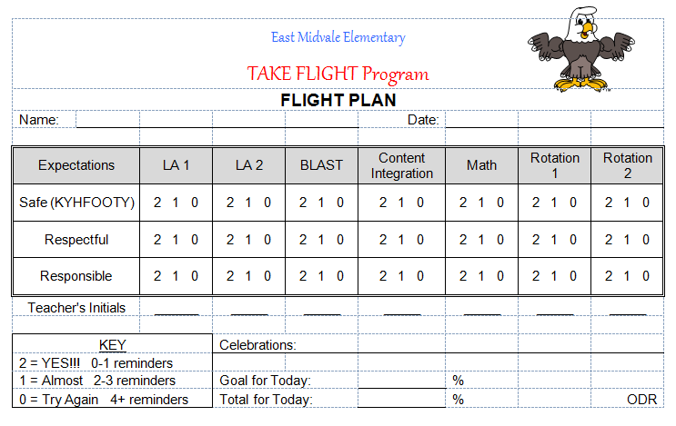
Notes:
MW slide
SWIS is set for a 0,1,2 rating scale. If the 0’s don’t fit with your school you can always change the out in the form with other language:
2-Got it
1=Getting there
0- Still trying
Whoever enters the data can translate the language to numbers in SWIS

Slide 93
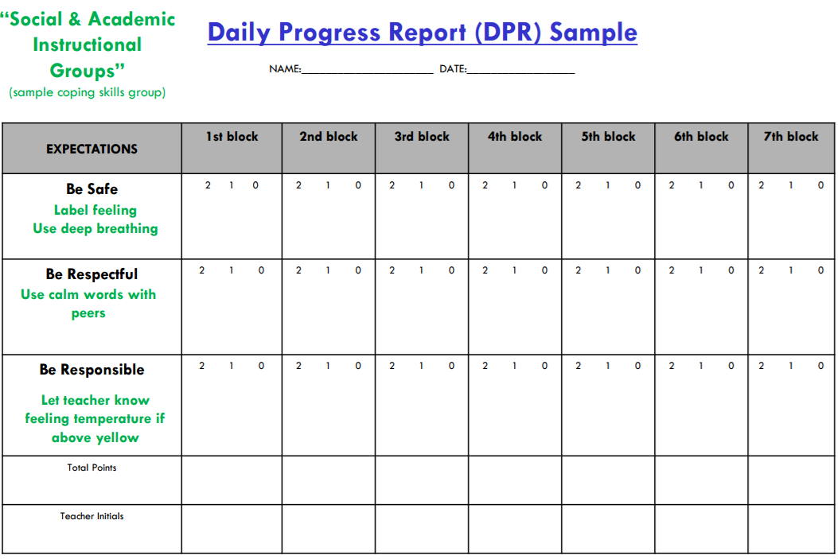
Integration with Additional Interventions
(Eber, 2016)
Notes:
Example—integration with coping skills group to support generalization of skills; THIS IS a slight modification to a standard card —will address more later in training

Slide 94
KENNEDY CARD
 |  |  | Name _____________________________________________________
Materials To Class | Worked and Let Others Work | Follow Directions the First Time |  | Teacher | Parent
2 1 No | 2 1 No | 2 1 No | Assignments:
 |  |  | Wow,
2 1 No | 2 1 No | 2 1 No | Assignments:
 |  |  | Wow,
2 1 No | 2 1 No | 2 1 No | Assignments:
 |  |  | Wow,
2 1 No | 2 1 No | 2 1 No | Assignments:
 |  |  | Wow,
2 1 No | 2 1 No | 2 1 No | Assignments:
 |  |  | Wow,
2 1 No | 2 1 No | 2 1 No | Assignments:
 |  |  | Wow,
 |  |  | = _____ Goal = 36
Notes:
High school/MS example

Slide 95
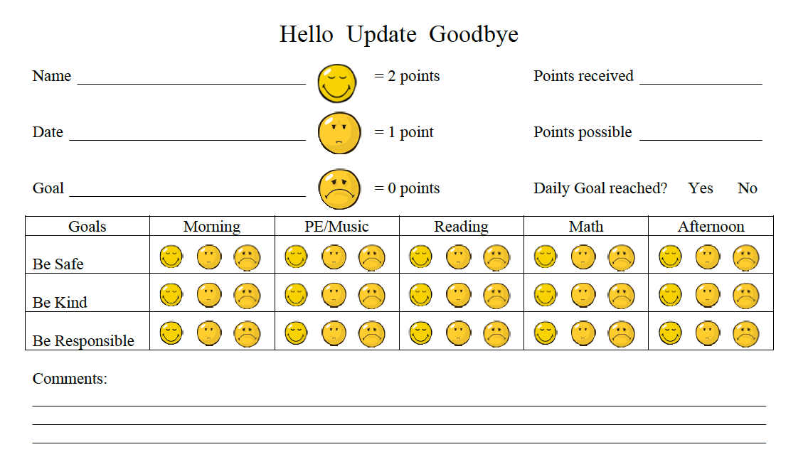
CAUTION! Refer to next slide for precautions regarding comments on DPR cards.

Slide 96
DPR Card Comment- Cautions!
Be careful about allowing space for open comments on the DPR. This is meant to be a data tracking tool. Allowing space for comments can:
  Prompt adults to write something negative
  Discourages staff from having the verbal interaction with student (allows them to only write it)
  Parents/families tend to “use” these comments with their student in ways they not intended
  We lose opportunity to re-teach if we are only using written comments
However, space can also be a prompt to write positive comments!
Notes:
a content slide followed by a non example or 2

Slide 97
Student Acknowledgment System
Consider how students will be acknowledged for displaying expected behavior:
  Will you use a point system, token economy, other?
  What will students receive if/when they trade in points or tokens?
When will acknowledgement occur? How often? Where?
How will students’ preferences be incorporated into the acknowledgment system?
How will you track/monitor points, tokens, or other system?
How can acknowledgements be delivered efficiently?
  Fit into daily activities - Avoids interrupting instructional time
  Easy to teach, implement, etc.
Notes:
Still part of step 4c- let’s make that link explicit!! And again a couple of content slides followed by some examples

Slide 98
Student Acknowledgment System
Aligns with school-wide recognition system
Student included in identification of acknowledgment
Consider social acknowledgement to enhance student engagement and school connectedness
Special considerations: absent students, students who receive an Office Discipline Referral
Notes:
MW slide
Non-contingent examples: team develops a sense of community, opportunities for leadership among the CICO participants
Acknowledge student for checking in and out?

Slide 99
Example of a Point System
CICO Point System: Focus on Building Relationships “School Connectedness”
Points Required | Wants attention | Wants item/activity | Wants to escape attention | Wants to avoid something
100 pts | Take note to office/teacher Ask a peer to play/read/draw Be a leader Principals recess Teacher Helper | Choose HW Choose a 5 min. activity School wide sticker Principals recess | Computer time by self | Short break Alternative activity
250 pts | Computer with a friend Extra sharing time | More time for selected activity Free ticket to sporting event | Time alone Independent work space | Alternative assignment
400 pts | Out to lunch with TBA Class recess, free time, or popcorn party | New school /art supplies |  | Get out of school early

Slide 100




Example of Tokens

Slide 101
Time with a preferred adult
is a powerful reinforcement tool!
ROAR Rewards
Activity Who
When Where
Official Signature
Notes:
MW slide

Slide 102
REINFORCER CHECKLIST
To be completed by your student
Please answer YES or NO to if the item or activity is reinforcing/fun to you
(Someone can help you decide)
Activity Reinforcers
Video Game YES NO Basketball YES NO
Swimming YES NO Magazine YES NO
Watch DVD YES NO Drawing YES NO
Walking YES NO Field Trips YES NO
Comic Books YES NO Puzzles YES NO
Play Dough YES NO Board Game YES NO
Craft Activities YES NO Card Game YES NO
Please list any favorite activities or special favorites that you may have
Notes:
Easy tool to use with students for reinforcer ideas

Slide 103
Notes on Developing a
Reinforcement System
Most schools include an opportunity for small daily reinforcement (note: should always be paired with social praise)
  Snack, sticker, school token, high five
Opportunity to earn larger reinforcement
  Points on a credit card
  Stickers on a chart
Examples of long-term reinforcement:
  Free time: gym, computer, time with friends
  Lunch with preferred adult
  Coupons to snack bar, movie theater, school store
Notes:
Things to consider when developing acknowledgment system

Slide 104
Questions to be Answered Prior to Implementation – Reinforcement
  What will students’ daily point goal be?
  What reinforcers will students receive for checking in and out (e.g., praise and lottery ticket)?
  What reinforcers will students receive for checking out AND meeting their daily point goal?
  How will you ensure students do not become satiated on the reinforcers?
Notes:
Is this too much on reinforcement?
More considerations. Have teams talk about these items

Slide 105
Acknowledgement Considerations…
Pre-correct during staff professional learning:
  This is not meant to be a Response Cost approach- we do not take points away
  Consequences for behavioral infractions are driven by the separate system
  Think natural consequences: If students are not in the classroom, then they do not have the opportunity to earn points for that time period
  Minors and majors are data sources that can be used to inform feedback from the facilitator and team decisions

Slide 106
Activity:
Frequent Feedback & Acknowledgement System Consistent with your Culture and Context
Work as team for 30 min
Select Name
Develop/Tweak Daily Progress Report (see samples in Appendix F-3)
Develop Reinforcement System
FOR HIGH SCHOOLS: See appendix G
Add any additional items to your action plan
Present 2-3 “big ideas” from your group (1 min. reports)
Notes:
Add page/reference to workbook here
Lots of folks already have point card—ask @ how much time needed for this activity

Slide 107
Getting Started with Tier 2
Establish an effective Tier 2 leadership team
Develop a process for identifying students
Select and Adopt Appropriate Tier 2 Practices for Your School
Develop a process for Installing the Selected Practice(s)
  4a: Identify Personnel to Coordinate and Deliver the Tier 2 Strategy
  4b: Ensure the Tier 2 Strategy is Consistent with School-Wide Expectations
  4c: Ensure the strategy includes regular opportunities for students to perform and get feedback on appropriate behaviors and skills
  4d: Ensure the Tier 2 strategy does not need unique development for each participating student

Slide 108
4d: Ensure the Tier 2 Strategy does not need unique development for every participating student
Identify personnel to coordinate and deliver the Tier 2 strategy
Ensure the Tier 2 strategy is consistent with school-wide expectations
Establish the Tier 2 strategy within the school so that it does not need unique development for each participating student
  Consider:
    Are routines established to create consistency for students receiving Tier 2 intervention?
    Has the team fully considered logistics for coordinating Tier 2 interventions (e.g., availability of time, resources, room in one’s schedule)?
    Is there a plan for common schedule variations?
      Alternate student schedules
      Substitute teachers

Slide 109
Establish CICO Process
Consider:
Do students check in and out at different places? Or same place?
Will students go to the coordinator or will the coordinator come to them?
Where will students check in in the morning and check out in the afternoon?
  Consider accessibility
Do students need to come early and leave last class early?
What other logistical concerns do you think are worth discussing now?

Slide 110
Contingency Planning
Think proactively about the following possible scheduling scenarios:
  Students arriving early or being dismissed early
  Students who use bus, walk/bike, get dropped off
  Days during which a field trip or assembly occurs
  Substitute staff

Slide 111
Coordinator Tasks
Select and prepare location for first and last check-in
Develop schedule for first and last check-in
Gather and prepare materials and supplies
Develop list of check-in procedures (e.g., previous review, goal setting, reminders)
Develop list for check-out procedures (e.g., data summary, progress monitoring, reinforcement, reminders)
Develop checklist for assessing implementation fidelity

Slide 112
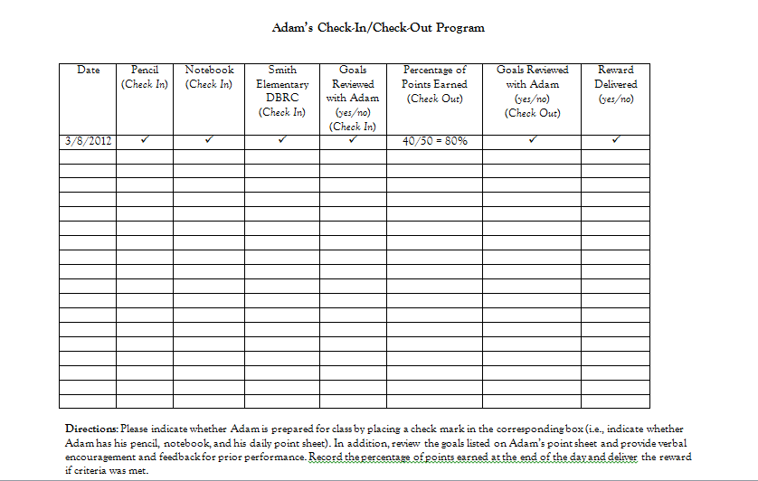
Morning Check In/Afternoon Check Out
**Takes 1-2 minutes for most kids
Notes:
Tracking students daily

Slide 113
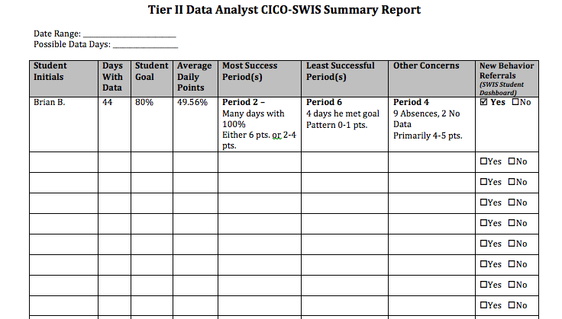
Coordinator/Data Analyst Meeting Preparation
Notes:
MW slide summarizing data for team meetings

Slide 114
Guidelines for Implementing Tier 2 Practices
PRACTICES
Identify personnel to coordinate and deliver the Tier 2 strategy
Ensure the Tier 2 strategy is consistent with school-wide expectations
Establish the Tier 2 strategy within the school so that it does not need unique development for each participating student
Ensure the strategy includes increased structure and predictability for students.
Develop clear decision rules that address match to both student need and to the current school context, culture, and resources
Plan for generalization and maintenance of skills
Notes:
guidelines as a check list for teams prior to starting the activity. But teach the content in the sub steps with the format above- then this can just be the guidelines checklist because content has already been taught

Slide 115
Activity:
Tier 2 Procedures
Work as team for 20 min
Discuss Logistics:
  Location
  Contingencies
  Personnel
  Materials
Review Coordinator Tasks, and CICO Fidelity Checklist (Appendix F-5)
Add any additional items to your action plan
Present 2-3 “big ideas” from your group (1 min. reports)
Notes:
This activity is not in the workbook….
Check!
Add page/reference to workbook here
Lots of folks already have point card—ask @ how much time needed for this activity

Slide 116
Developing Interventions: Social Skills Groups
Notes:
Intended to be a quick overview of social skills instruction; have participants evaluate how current practices match critical features and implementation guidelines for T2

Slide 117
Getting Started with Tier 2
Establish an effective Tier 2 leadership team
Develop a process for identifying students
Select and Adopt Appropriate Tier 2 Practices for Your School
Develop a process for Installing the Selected Practice(s)
  4a: Identify Personnel to Coordinate and Deliver the Tier 2 Strategy
  4b: Ensure the Tier 2 Strategy is Consistent with School-Wide Expectations
  4c: Ensure the strategy includes regular opportunities for students to perform and get feedback on appropriate behaviors and skills
  4d: Ensure the Tier 2 strategy does not need unique development for each participating student
Notes:
Use these sub steps to highlight each part of the social skills example

Slide 118
Installing Tier 2 Practices for Your School: Critical Features
Ensure the Tier 2 strategy includes a formal process for teaching student skills and appropriate behaviors
Ensure the strategy includes increased structure and predictability for students
Ensure the strategy includes regular opportunities for students to perform and get feedback on appropriate behaviors and skills
A document exists that describes the support process and procedures for each selected practice including all supporting materials
Staff are informed on support details and provide feedback
Orientation materials provide information for staff/substitutes who have students using the practice
Fidelity of implementation measure is established and planned for use
Notes:
Same critical features for ss groups; if ss groups already exist, evaluate if they have these features

Slide 119
Social Skills Training
Social Skills Training: Social Skills Training includes direct instruction of appropriate social behavior. Instruction can be delivered to small targeted groups of students. Direct instruction includes modeling of appropriate behavior, feedback on behavior, and opportunities to practice appropriate behavior (Hawken et al., 2009).
Social Skills Training Practice Features:
  Increased positive adult contact
  Direct social skills training
  Direct link to school-wide behavioral goals and expectations
  Frequent feedback (Daily or weekly)
  Increased home-school communication
  Plans for generalization and maintenance
  Positive reinforcement contingent on meeting skill based goal goals

Slide 120
Social Skills Instruction Works!
Research conducted on social skills interventions demonstrates positive outcomes across ages, level of support needs, and types of skill deficits, especially when specific strategies are included to program for skill maintenance and generalization
(e.g., Gresham, Sugai, & Horner, 2001; Lane, Menzies, Barton-Arwood, Doukas, & Munton, 2005; Miller, Lane, & Wehby, 2005; Quinn, Kavale, Mathur, Rutherford, & Forness, 1999; Ray and Elliott, 2006).

Slide 121
Getting Started with Tier 2
Establish an effective Tier 2 leadership team
Develop a process for identifying students
Select and Adopt Appropriate Tier 2 Practices for Your School
Develop a process for Installing the Selected Practice(s)
  4a:Identify Personnel to Coordinate and Deliver the Tier 2 Strategy
  4b: Ensure the Tier 2 Strategy is Consistent with School-Wide Expectations
  4c: Ensure the strategy includes regular opportunities for students to perform and get feedback on appropriate behaviors and skills
  4d: Ensure the Tier 2 strategy does not need unique development for each participating student
Notes:
Use these sub steps to highlight each part of the social skills example

Slide 122
4a: Identify Personnel to Coordinate and Deliver the Tier 2 Strategy
Identify personnel to coordinate and deliver the Tier 2 strategy
  Consider:
    How will the coordinator be trained?
    Does the coordinator have behavioral expertise?
    Does the coordinator have time and resources to run the process?
    Is the coordinator prepared to collect and maintain data systems?
    Is the composition of the team appropriately representative of the staff?
Notes:
Teach all sub steps using this format

Slide 123
Sample Coordinator
Functions / Responsibilities
Social Skills group facilitators (ideally 2 per group) directly teach social skills groups to students. They meet weekly, at minimum, with a small group of students who demonstrate similar social skill deficits. Facilitators also:
Organize lesson plans and materials
Serve as a communication link with teaching staff who will prompt and reinforce student use of newly learned skills (including skills taught, and variations of the skills that may be recognized as “reasonable approximations” of the target behavior)
Assist classroom teachers as they regularly rate student performance of specific social skills learned during the intervention sessions.
(2015-2016 MO SW-PBS Tier 2 Team Workbook)

Slide 124
Sample Coordinator
Functions / Responsibilities
Train staff and parents to support the skills intervention
Collect and summarize data to organize groups and monitor students’ response to the intervention
Communicate regularly with the school’s Tier 2 Team and school staff to provide information about numbers of students participating in social skills intervention groups, fidelity checks for the intervention sessions, maintenance procedures, student progress during intervention, and long-term outcomes after a group has ended
(2015-2016 MO SW-PBS Tier 2 Team Workbook)

Slide 125
Identifying Students for Social Skills Groups
Designed for students who demonstrate deficits in:
  social skill acquisition (student does not know the skill)
  OR
  fluency (student knows the skill but does not use it consistently or appropriately for the context).
Students who benefit from social skills instruction are (a) unresponsive to Tier I practices and systems, (b) do not require more immediate individualized interventions, and (c) have skill acquisition or fluency deficits that are observed across multiple settings or contexts.

Slide 126
Social Skills Deficits Classifications
Acquisition
  Lack of knowledge or ability to execute the skill or failure to discriminate which social behaviors are appropriate for the situation
Fluency
  Skill is present in student’s repertoire, but student has had insufficient rehearsal and practice, across or between contexts. Student does not demonstrate skill consistently or appropriately for the context

Slide 127
Social Skills Group Features
MO SWPBS
Smaller number of students with access to high rates of adult attention
Situated learning
Systematic, explicit instruction
Modeling
Sequencing of positive and negative examples
Frequent rehearsal (role playing) and problem solving with feedback
School to home communication
Self-assessment and recording

Slide 128
Social Skills Instruction: Benefits
Provide students a more intensive dosage of school-wide, Tier 1 instruction.
Potential to provide students with:
  conflict resolution and problem solving strategies,
  to develop students’ prosocial skills that are culturally and contextually appropriate,
  and to support decreases in problem behaviors and improvements in school safety.

Slide 129
Getting Started with Tier 2
Establish an effective Tier 2 leadership team
Develop a process for identifying students
Select and Adopt Appropriate Tier 2 Practices for Your School
Develop a process for Installing the Selected Practice(s)
  4a: Identify Personnel to Coordinate and Deliver the Tier 2 Strategy
  4b: Ensure the Tier 2 Strategy is Consistent with School-Wide Expectations
  4c: Ensure the strategy includes regular opportunities for students to perform and get feedback on appropriate behaviors and skills
  4d: Ensure the Tier 2 strategy does not need unique development for each participating student
Notes:
Use these sub steps to highlight each part of the social skills example

Slide 130
4b: Ensure the Tier 2 Strategy is Consistent with School-wide Expectations
Identify personnel to coordinate and deliver the Tier 2 strategy
Ensure the Tier 2 strategy is consistent with school-wide expectations
  Consider:
    Do Tier 2 interventions use the language of Tier 1 supports?
    Can materials for Tier 2 interventions align with Tier 1 supports?
    Can Tier 1 acknowledgment practices be included in Tier 2 interventions?

Slide 131

Crosswalk PBIS with SEL
Sara Whitcomb
 | Cooperation | Accountability | Respect | Empathy
Learning to Listen | X |  | X
Focusing Attention | X | X
Following Directions | X |  | X
Self-Talk | X | X
Notes:
Also Sara’s slide
Tier 1 Leadership Team might address SEL programming AND PBIS
Giving scripts/cheat sheets to help teachers make links
Integrating PBIS teaching/lessons intro Morning Meeting (Responsive Classroom)
Crosswalking the language from various curricula

Slide 132
Getting Started with Tier 2
Establish an effective Tier 2 leadership team
Develop a process for identifying students
Select and Adopt Appropriate Tier 2 Practices for Your School
Develop a process for Installing the Selected Practice(s)
  4a: Identify Personnel to Coordinate and Deliver the Tier 2 Strategy
  4b: Ensure the Tier 2 Strategy is Consistent with School-Wide Expectations
  4c: Ensure the strategy includes regular opportunities for students to perform and get feedback on appropriate behaviors and skills
  4d: Ensure the Tier 2 strategy does not need unique development for each participating student
Notes:
Use these sub steps to highlight each part of the social skills example

Slide 133
4c: Ensure the Strategy Includes Regular Opportunities for Students to Perform and Get Feedback on Appropriate Behaviors and Skills
Identify personnel to coordinate and deliver the Tier 2 strategy
Ensure the Tier 2 strategy is consistent with school-wide expectations
Establish the Tier 2 strategy within the school so that it does not need unique development for each participating student
Ensure the strategy includes regular opportunities for students to perform and get feedback on appropriate behaviors and skills
  Consider:
    How will staff model appropriate behavior?
    How will the environment be organized so that students get regular opportunities for skill practice and feedback?
    How will staff be trained to do these activities?

Slide 134
General Strategies for Teaching Social Skills
Introduce a problem and a key skill as a solution
Provide physical models while thinking aloud key steps
Sequence positive examples then juxtapose negative
Frequent questions to students – “is this right or wrong?”
Differentiate instruction as necessary for individuals
When students answer correctly – introduce role plays
Provide all students with tasks during role play
All students role play each skill to mastery
Test with novel examples
Terry Scott (2015)

Slide 135
Structuring Social Skills Groups
Tell =
Coaching
Practice =
Rehearsal
Monitor Progress =
more modeling? / practice?
Show =
Modeling
Do =
Role Play
Generalization & Maintain

Slide 136
Social Skills Training Process
Students grouped based on target skills by Tier 2 coordinator (e.g., anxiety reduction techniques)
Students attend a regular (e.g., weekly) social skills lesson where skills are directly taught, practiced, and reinforced.
Students receive feedback on their behavior from adults in small groups and throughout the day
Target skills and examples for use at home are shared with parents

Slide 137
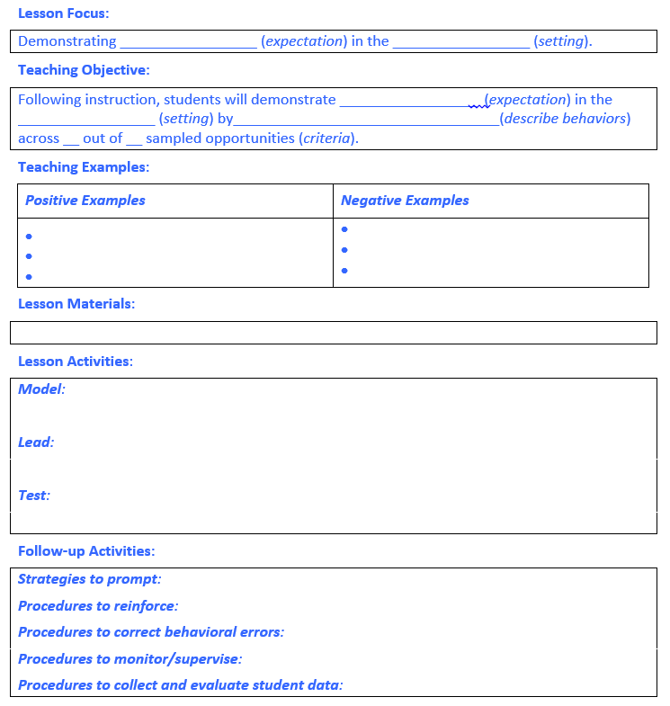
Notes:
Workbook page 57

Slide 138
Generalization and Maintenance
Do students receive feedback from teachers on their skill development throughout the day?
Do we share with parents target skills and examples for use at home?
Are appropriate replacement skills and role play examples identified from environment?
Do students have opportunities to practice in multiple settings and under variable conditions?
Are prompts available (posters, verbal phrases) in typical classroom and non-classroom settings to remind students of skills learned in small-group context?
Notes:
This gets to evaluation and progress monitoring that we’ll spend more time on in day 3

Slide 139
Evidence-Based Social Skills Programs
Second Step (Frey, et al., 2000)
First Step to Success (Walker, et al., 2009)
Incredible Years (Webster-Stratton, 2008)
Social Skills Improvement System (Elliot & Gresham, 2008)
Skillstreaming (Goldstein & McGinnis, 2005)
Strong Teens (Merrell, et al. 2007)
Think First (Larson, 2007)

Slide 140
4d: Ensure the Tier 2 Strategy does not need unique development for every participating student
Identify personnel to coordinate and deliver the Tier 2 strategy
Ensure the Tier 2 strategy is consistent with school-wide expectations
Establish the Tier 2 strategy within the school so that it does not need unique development for each participating student
  Consider:
    Are routines established to create consistency for students receiving Tier 2 intervention?
    Has the team fully considered logistics for coordinating Tier 2 interventions (e.g., availability of time, resources, room in one’s schedule)?
    Is there a plan for common schedule variations?
      Alternate student schedules
      Substitute teachers

Slide 141
Coordinator Tasks
Select and prepare location for social skills groups
Develop schedule
Gather and prepare materials and supplies
Develop list of teaching procedures (e.g., previous review, goal setting, practice)
Develop data collection tools for monitoring skill development within and outside of groups (e.g., data summary, progress monitoring, reinforcement, reminders)
Develop checklist for assessing implementation fidelity

Slide 142
Installing Tier 2 Practices for Your School: Critical Features
Ensure the Tier 2 strategy includes a formal process for teaching student skills and appropriate behaviors
Ensure the strategy includes increased structure and predictability for students
Ensure the strategy includes regular opportunities for students to perform and get feedback on appropriate behaviors and skills
A document exists that describes the support process and procedures for each selected practice including all supporting materials
Staff are informed on support details and provide feedback
Orientation materials provide information for staff/substitutes who have students using the practice
Fidelity of implementation measure is established and planned for use
How does your social skills support system fit with this feature?

Slide 143
Guidelines for Implementing Tier 2 Practices
PRACTICES
Identify personnel to coordinate and deliver the Tier 2 strategy
Ensure the Tier 2 strategy is consistent with school-wide expectations
Establish the Tier 2 strategy within the school so that it does not need unique development for each participating student
Ensure the strategy includes increased structure and predictability for students.
Develop clear decision rules that address match to both student need and to the current school context, culture, and resources
Plan for generalization and maintenance of skills
Notes:
guidelines as a check list for teams prior to starting the activity. But teach the content in the sub steps with the format above- then this can just be the guidelines checklist because content has already been taught

Slide 144
Activity:
Social Skills Groups For Your Culture and Context
Work as team for 20 min
Evaluate coordinator and facilitator roles and responsibilities
Evaluate how Tier 2 social skills instruction is aligned with Tier 1 teaching and expectations
Visit (or re-visit) how and when social skills groups are developed and scheduled
Visit (or re-visit) how and when social skills groups are taught, and the systems in place to support student skill generalization
Update your action plan
Notes:
Add page/reference to workbook here

Slide 145
Getting Started with Tier 2
Establish an effective Tier 2 leadership team
Develop a process for identifying students
Select and Adopt Appropriate Tier 2 Practices for Your School
Develop a process for Installing the Selected Practice(s)
Develop a process for training staff and students & partnering with/educating families

Slide 146
Training staff and students, and partnering with / educating families: Critical Features
For staff:
  Documentation of the process and procedures for each selected practice, including all supporting materials
  Initial and ongoing professional development (including boosters as needed); including opportunities for feedback on Tier 2 practice
  Orientation materials for new staff and substitutes
For students:
  Training materials, including opportunities to practice routines
  Review of student daily routine
For families:
  Materials developed for providing information, permission, and ongoing communication.
  Information on what the families’ role is relative to supporting positive behavior routines, including review of expectations, practice in home setting, and feedback.

Slide 147
Staff Training Topics
  Referral/Request for Assistance Procedures
  Rationale for and critical features of Tier 2 practice
  Opportunities to provide feedback on both practice and implementation procedures
  Opportunities to practice (including, for example, giving error corrections and behavior specific praise)
  Regular updates and training boosters
  Special considerations: substitutes (visiting teacher), coaching for individual teachers
For sample staff, student, and parent training lesson plans (using CICO as an example), see Appendix F-4.

Slide 148
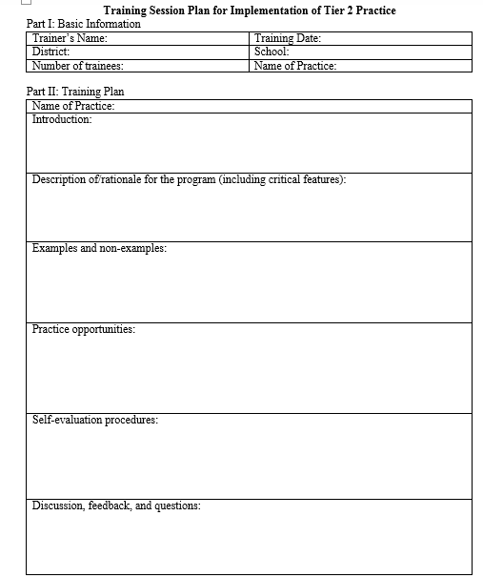
Notes:
Workbook p.61

Slide 149
Staff Training for CICO:
Ensure the strategy includes regular opportunities for students to perform and get feedback on appropriate behaviors and skills
Comprehensive CICO Support Training for ALL staff
Video is a great resource, but it is not sufficient.
School must add their own description of how the CICO system will operate
  Data used to identify students
  Referral/Request for Assistance
  Reverse Request for Assistance
Must also introduce your Tier 2 DPR and detailed explanation of how the intervention will work
  Pre-correct: what to do when a student is unhappy with their score (corrective vs. negative feedback and other prompts for teachers based on common student reactions…)
Notes:
MW slide
Solid understanding of WHY CICO works
Clarify first bullet point, NOT the same training as today’s but within their building, their building’s specific decision rules etc. of how Tier IIT systems and Cico will work in THEIR building

Slide 150
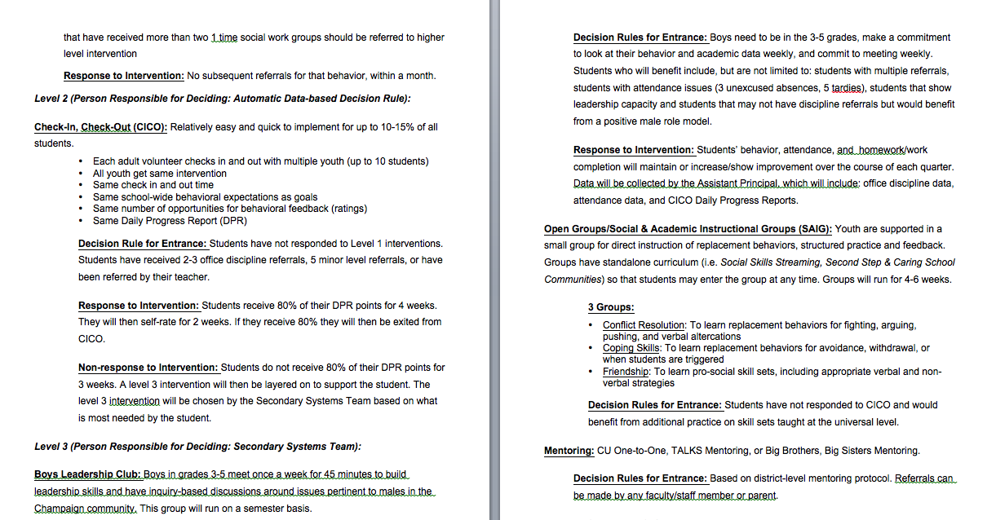
Staff Training for CICO:
Information for Staff
Notes:
MW Example of providing information to all staff. Important to have written in staff handbook, student handbook, and parent handbook!
Appendix ?

Slide 151
Activity:
Training Staff
Work as team for 30 min
Develop a plan and materials for staff training on the Tier 2 support (select practice)
  See staff training template and staff script (Workbook p. 61, Appendix F-4)
  Develop plan for ALL staff including the following:
    Introduction
    Description of program (including rationale and critical features)
    Examples and non-examples
    Opportunity for practice
    Self-evaluation procedures
    Discussion, feedback, and questions
Develop program description (Appendix F-6)
Add items to your action plan
Notes:
How will we train everyone?

Slide 152
Training staff and students, and partnering with / educating families: Critical Features
For staff:
  Documentation of the process and procedures for each selected practice, including all supporting materials
  Initial and ongoing professional development (including boosters as needed); including opportunities for feedback on Tier 2 practice
  Orientation materials for new staff and substitutes
For students:
  Training materials, including opportunities to practice routines
  Review of student daily routine
For families:
  Materials developed for providing information, permission, and ongoing communication.
  Information on what the families’ role is relative to supporting positive behavior routines, including review of expectations, practice in home setting, and feedback.

Slide 153
Student Training for CICO:
Ensure the Tier 2 strategy includes a formal process for teaching student skills and appropriate behaviors
Student involvement in development of CICO
Student training developed and delivered
  Role playing
  Discussion of routines
  Responding to redirection from teacher
Special Considerations: training for students who need support accepting redirection
Notes:
MW
Students all need to be involved in the development.

Slide 154
Student Orientation
For students on intervention
  Who, what, when, where
  Pre-correct: Teach students what to do when they disagree with a score
Notes:
MW
Consider what the orientation for students will look like, who will teach students what the intervention look like, how they get card, who/where they go to Check in and Check out, what to do if they get a score that they don’t like, etc.

Slide 155
Family Orientation
All families...what is the Tier 2 support?
  Inform during registration process
  Address at open house, through newsletters, newspaper and other…
Families of students on the Tier 2 support...process for explaining/consent
  Best if phone call is made directly to family by the student’s teacher
  Followed by letter (see Appendix F-6)
  Consent: check with your district’s decision makers
  “Back-up Plan” in place if needed
Notes:
MW
NOTE SRE—parent feedback/participation is encouraged, but students should not be excluded from intervention if families do not participate (past consent)
How do we orient ALL families?
How do we specifically notify families of students who are nominated for CICO?
Are you going to get written permission, verbal, etc?

Slide 156
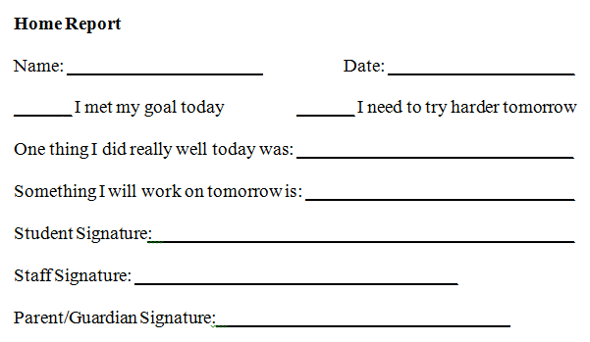
Home report/contact form developed
Notes:
This can be used as an alternative to sending home the actual DPR.

Slide 157
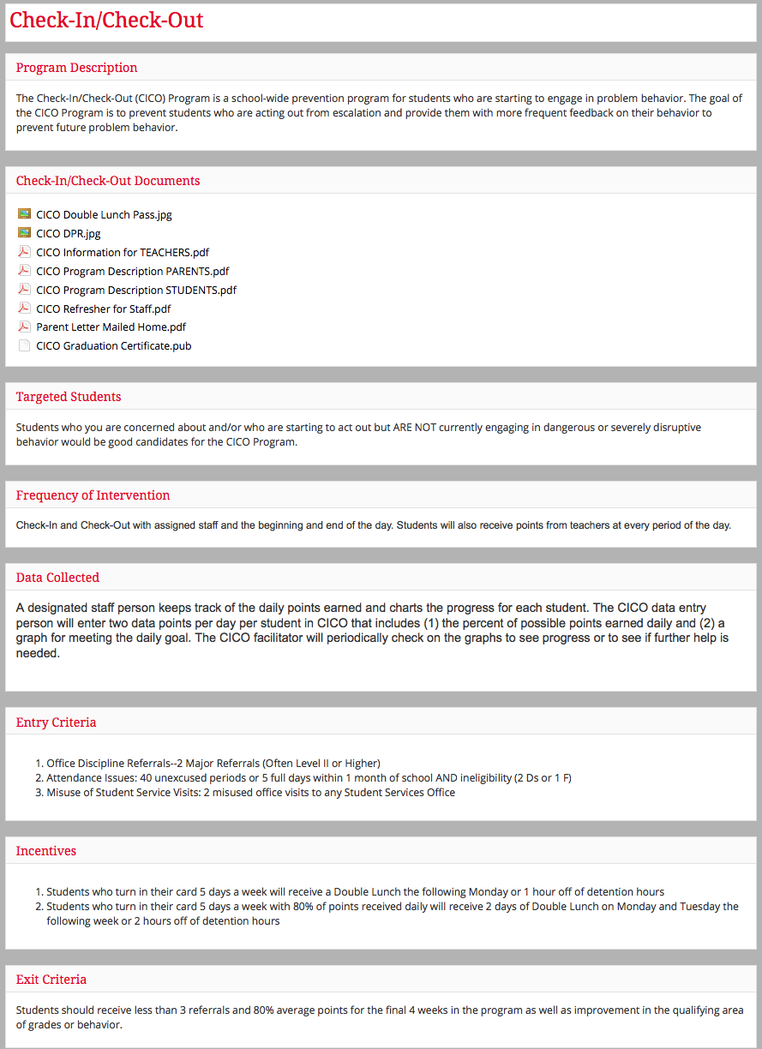
Stakeholder Information
Notes:
MW include in appendix Information that could be shared with all staff, subs, others who are in the building working with students.

Slide 158
Guidelines for Implementing Tier 2 Practices
PRACTICES
Develop a written process for teaching and coaching all staff on Tier 2 interventions (including lesson plans)
Schedule initial and ongoing professional development
Develop procedures for training substitutes and new staff
Develop lesson plans for student orientation and practice
Design information for families, orientation materials, and procedures for ongoing communication

Slide 159
Activity:
Training Students; Partnering with Families
Work as team for 30 min
Develop a plan and materials for training/orienting students to the Tier 2 support
  Include routines, expectations, and opportunities to practice
  See student training script (Appendix F-4)
Develop a plan for partnering with families
  Develop informational and orientation materials for families (including family involvement)
  Decide on home-school communication routines
  See parent information letter sample and orientation for CICO
Develop program description (Appendix F-6)
Add items to your action plan
Notes:
How will we train everyone?

Slide 160
Getting Started with Tier 2
Establish an effective Tier 2 leadership team
Develop a process for identifying students
Select and Adopt Appropriate Tier 2 Practices for Your School
Develop a process for Installing the Selected Practice(s)
Develop a process for training staff and students & partnering with/educating families
Develop a process for Matching Student Need to Practices
Notes:
Just a very brief intro! More on day 3

Slide 161
Matching Intervention to Student Need: CICO
APPROPRIATE
Low-level problem behavior (reoccurring minor incidents)
2-5 referrals (office referrals)
Behavior occurs across multiple locations
Examples
  talking out
  minor disruption
  work completion
INAPPROPRIATE
Serious or violent behaviors/ infractions
Extreme chronic behavior
(8-10+ referrals)
Require more individualized support
  functional assessment
  wrap around services
Notes:
MIDWEST
Check for understanding that CICO is a low level intervention and not intended to be the only intervention tried for more serious or chronic behaviors.

Slide 162
Targeted Groups for CICO
Students new to your school
Children with low-level problem behavior (identified by # of ODRs, teacher referral based on classroom management charts, etc.)
Children who are display internalizing behaviors (identified by visits to nurses office, other time out of class, sits alone at lunch, etc.)
CAN be used as one layer of a more complex support plan (see day 3)
Notes:
in some places we call this social skills groups in others we call it targeted groups. I think we need to be consistent and just use social skills groups

Slide 163
Activity:
Complete Baseline TFI Tier 2 Subscale
Work as team for 15 min
Go to PBISapps.org and log in with username and password
Click on PBISAssessment to access TFI
Open TFI Survey window
Work as team to complete Tier 2 Subscale of TFI

Slide 164
Activity:
Action Planning
Work as team for 75 min
Return to your Action Plan
Update sections corresponding to:
Present 2-3 “big ideas” from your group (1 min. reports)
Reminder: We will be collecting team action plans at the end of day 2 in order to provide specific feedback for your team.

Slide 165
Review of Tier 2
Notes:
Here add critical features, systems

Slide 166
Secondary Tier
Secondary Intervention Team
Weekly data-based program review
…
SYSTEMS
~15% of students with 2-5 major ODRs
Increasing pro-social skills of targeted group (as measured by points earned for pro-social behavior)
…
OUTCOMES
ODRs
Point card
FACTS
Academic data (CMT, CBM, grades)
…
DATA
Screening
More intense and frequent social skills instruction & reinforcement
…
PRACTICES

Slide 167
Getting Started with Tier 2
Establish an effective Tier 2 leadership team
Develop a process for identifying students
Select and Adopt Appropriate Tier 2 Practices for Your School
Develop a process for Installing the Selected Practice(s)
Develop a process for training staff and students & partnering with/educating families
Develop a process for Matching Student Need to Practices
Develop a process for Progress Monitoring, including Data-based decision rules
Develop a process for adjusting or modifying implementation
Develop evaluation routines for level of use, student progress, and fidelity of implementation
Document procedures, policies, and practices and establish routines
Day 1
Day 2
Day 3
Day 4
Notes:
Re-organized steps; added step 9; changed screen to identify
Keep procedures, policies and practices?

Slide 168
Consider Tattoos!
4 SWPBIS Elements
School Systems
Supporting Social Competence &
Academic Achievement
OUTCOMES
School-wide
Classroom
SWPBIS
SYSTEMS
DATA
Supporting
Decision
Making
Supporting
Staff Behavior
Non-classroom
Family
PRACTICES
Tertiary Prevention:
Specialized
Individualized
Systems for Students with High-Risk Behavior
~5%
Student
Supporting
Student Behavior
Primary Prevention:
School-/Classroom-
Wide Systems for
All Students,
Staff, & Settings
~15%
Secondary Prevention:
Specialized Group
Systems for Students with At-Risk Behavior
~80% of Students

