Slide 1




NEPBIS TOT
Day 2
NorthEast PBIS Training of Trainers (NEPBIS TOT)
Oct 2017
Brandi Simonsen, Jen Freeman, Susannah Everett, & Adam Fienberg

Slide 2
NEPBIS TOT Day 2 Advance Organizer
Re-Introductions
Baseline knowledge self-assessment
Foundational content: Team Training day 2
Content: Readiness Requirements and Setting teams up for success
Working lunch (plan 5-min presentation of FAQ)
Video recording (5-min presentation) & feedback
Debrief, HW introduction, and wrap-up

Slide 3
Re-Introductions

Slide 4
Knowledge/Skill
Self-Assessment

Slide 5

Self Assess:
Baseline Knowledge/Skill of Training PBIS
20-30 min
(independent)
Go to nepbis.org
Log in and click on trainer tab
Complete baseline knowledge/skill self-assessment
You will see this (or a similar) self-assessment throughout the year

Slide 6
Groups for Activities
Shannon D
Kc N-O
Lola G
Erin C
Clarissa F
Glenna F
Nikki H
Michelle W
Courtney P
Kristin G
Nicole H
Erik M
Mitch O
Marlene M R
Gina K
Missy W
Matt S
Laura K
Nicole S
Sarah W
Sarah J
Karen R
Meghan W
Terry M
Christopher R
Pat R
Susannah
Brandi
Jen

Slide 7
Foundations of SWPBIS:
Overview of Team Training Day 2
Follow along in your trainer manual.

Slide 8
TRAIN
Teach, Relate, Adapt, Implement, Navigate
Teach content explicitly.
Relate to audience.
Adapt presenter behaviors based on audience assessment data.
Implement to promote meaningful outcomes.
Navigate through the presentation.

Slide 9
School-Wide Positive Behavioral Interventions and Supports (SWPBIS)
Northeast PBIS (NEPBIS) School-Wide Team Training
Day 2
INSERT TRAINER NAMES
with support from Brandi Simonsen, Jen Freeman,
Susannah Everett, & George Sugai
Notes:
Add trainer names for your event

Slide 10

Advance Organizer
Review of SWPBIS from Day 1
Getting Started with SWPBIS: Steps 4-6
Preview Steps 7-10
SWPBIS Action Planning
Wrap up

Slide 11
MAIN TRAINING OBJECTIVES
Establish leadership team
Establish staff agreements
Build working knowledge of SWPBIS outcomes, data, practices, and systems
Develop individualized action plan for SWPBIS
Organize for upcoming school year

Slide 12
Training Expectations:
RESPECT…
SELF
Self-monitor (Are you participating? Engaged as a learner? Talking during allotted times?)
Stretch, break, stand as needed
OTHERS
Cell phones (inaudible): Converse in lobbies and breaks
ENVIRONMENT
Recycle
Work as a team: Room for every voice, reinforce participation
Maintain neat working area

Slide 13

Review of Day 1

Slide 14


SWPBIS Message!
Successful individual student behavior support is linked to host environments or school climates that are effective, efficient, relevant, & durable.
(Zins & Ponti, 1990)
I.A.i

Slide 15
Critical Features of SWPBIS
Supporting Culturally Equitable
Social Competence & Academic Achievement
OUTCOMES
Supporting
Culturally
Knowledgeable
Staff Behavior
Supporting
Culturally Valid
Decision
Making
SYSTEMS
DATA
(Vincent, Randal, Cartledge, Tobin, & Swain-Bradway, 2011; Sugai, O’Keefe, & Fallon 2012 ab)
PRACTICES
I.C
Supporting Culturally Relevant
Evidence-based Interventions
Notes:
Use data
Focus on outcomes: Academic & behavior success
On-going evaluation
Ensure cultural and contextual fit
Invest in systems
Organize research-validated practices within a continuum
Instructional & preventative approach
Integration
Tier 1 for all

Slide 16
SWPBIS
Practices
School-wide
Classroom
Smallest #
Evidence-based
Biggest, durable effect
Non-classroom
Family
Student
I.C.iii

Slide 17
Universal
Targeted
Intensive
Continuum of Support for ALL
Few
Some
All
I.C.iii
(Sugai, Dec 7, 2007)
Notes:
NOTICE GREEN GOES FOR “ALL”

Slide 18
GENERAL IMPLEMENTATION PROCESS
Team
Agreements
Data-based
Action Plan
Evaluation
Implementation
I.C.iv
Notes:
SAY: In general, the implementation of a school-wide PBS approach at the school level is built around five main implementation steps.

Slide 19
Getting Started with SWPBIS
Establish an effective leadership team
Develop brief statement of behavioral purpose
Identify positive SW behavioral expectations
Develop procedures for teaching SW expectations
Develop procedures for teaching class-wide expectations
Develop continuum for strengthening appropriate behavior
Develop continuum for discouraging violations of expectations
Develop data-based procedures for monitoring
Develop systems to support staff
Build routines to ensure on-going implementation
Day 1
Day 2
Day 3

Slide 20
Getting Started with SWPBIS
Establish an effective leadership team
Develop brief statement of behavioral purpose
Identify positive SW behavioral expectations
Develop procedures for teaching SW expectations
Develop procedures for teaching class-wide expectations
Develop continuum for strengthening appropriate behavior
Develop continuum for discouraging violations of expectations
Develop data-based procedures for monitoring
Develop systems to support staff
Build routines to ensure on-going implementation
Teaching social behavior explicitly?
Like academic behavior
PRACTICES
II.B.iv

Slide 21
Teaching Academic
& Social Behaviors
ADJUST for
Efficiency
DEFINE
Simply
MONITOR &
ACKNOWLEDGE
Continuously
MODEL
PRACTICE
In Setting
II.B.iv
Notes:
1. Note for myself—make sure there is an electronic version of blank matrix for teams to use (or can they manage to make a table???)

Slide 22
Teaching calculating hypotenuse of triangle
“Work w/ another partner & do these 4 examples….”
“C² = A² + B² where C is side opposite right angle….”
ADJUST for
Efficiency
DEFINE
Simply
“I noticed that everyone got #1 & #3 correct. #2 was tricky because no right angle….”
MONITOR &
ACKNOWLEDGE
Continuously
“Watch me,…If A = 3 & B = 4, then C² = 25, & C = 5….”
MODEL
“Work w/ your partner & calculate hypotenuse of triangle for these 3 examples……”
PRACTICE
In Setting

Slide 23
Teaching social behaviors like academic skills
“You got it. Tomorrow let’s figure out how to handle cyber-teasing.”
“If someone won’t stop teasing your friend, you should look cool & walk away w/ your friend…”
ADJUST for
Efficiency
DEFINE
Simply
“That was great. What would that look like if you were stuck on the bus? In the classroom?”
MONITOR &
ACKNOWLEDGE
Continuously
“Watch. This is how I would do it at a concert.”
MODEL
“Tell me how you would do it if you were in hallway.” “At school dance.”
PRACTICE
In Setting

Slide 24
In other words… follow these key steps
Define
Teach
Prompt
Monitor
Evaluate
II.B.iv
Notes:
Sarah

Slide 25
Define
Behavioral expectations/Rules
Operationally define what the rules look like across all the routines and settings in your school.
One way to do this is in a matrix format.
II.B.iv

Slide 26
Teaching Matrix |  | SETTING
 |  | All Settings | Hallways | Playgrounds | Cafeteria | Library/ Computer Lab | Assembly | Bus
 | Respect Ourselves | Be on task. Give your best effort. Be prepared. | Walk. | Have a plan. | Eat all your food. Select healthy foods. | Study, read, compute. | Sit in one spot. | Watch for your stop.
 | Respect Others | Be kind. Hands/feet to self. Help/share with others. | Use normal voice volume. Walk to right. | Play safe. Include others. Share equipment. | Practice good table manners | Whisper. Return books. | Listen/watch. Use appropriate applause. | Use a quiet voice. Stay in your seat.
 | Respect Property | Recycle. Clean up after self. | Pick up litter. Maintain physical space. | Use equipment properly. Put litter in garbage can. | Replace trays & utensils. Clean up eating area. | Push in chairs. Treat books carefully. | Pick up. Treat chairs appropriately. | Wipe your feet. Sit appropriately.
2. NATURAL CONTEXT
1. SOCIAL SKILL
Expectations
3. BEHAVIOR EXAMPLES
II.B.iv
Notes:
1. Added this slide

Slide 27
RAH – at Adams City High School
II.B.4
RAH | Classroom | Hallway/ Commons | Cafeteria | Bathrooms
Respect | Be on time; attend regularly; follow class rules | Keep location neat, keep to the right, use appropriate lang., monitor noise level, allow others to pass | Put trash in cans, push in your chair, be courteous to all staff and students | Keep area clean, put trash in cans, be mindful of others’ personal space, flush toilet
Achievement | Do your best on all assignments and assessments, take notes, ask questions | Keep track of your belongings, monitor time to get to class | Check space before you leave, keep track of personal belongings | Be a good example to other students, leave the room better than you found it
Honor | Do your own work; tell the truth | Be considerate of yours and others’ personal space | Keep your own place in line, maintain personal boundaries | Report any graffiti or vandalism

Slide 28
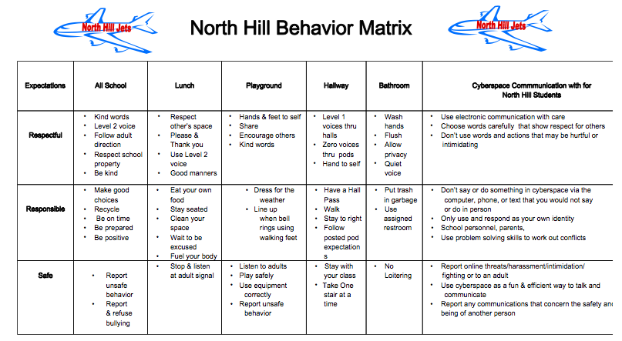
II.B.4
Highline School District, Washington May 2011
Notes:
1. I added this George example as it included electronic communications too

Slide 29
E’ Ola Pono- to live the proper way
School Behavioral Standards | All Settings | Walkways | Playground Recess P.E. | Cafeteria | Restrooms | Arrival/ Dismissal | Assembly | Field Trips
Kuleana Be Responsible | Be on time Be prepared w/ necessary supplies Be accountable for choices Respond to/complete tasks Keep area clean & litter free | Plan ahead Walk directly to destination | Take care of equipment/facilities Plan appropriate times for drinks/ restroom visits | Have lunch card ready Be orderly in all lines | Flush Turn off water Use restroom at designated times Use facilities for intended purposes | Have money/pass ready Be on time | Listen attentively Keep hands and feet to yourself | Turn in paperwork/$ on time Wear appropriate footwear/clothing Bring home lunch
Ho’ihi Be Respectful | Use appropriate voice Listen to/follow directions of staff Respect self, others property Be polite/use manners Express appreciation Accept/respect differences in people | Use quiet voices when classes are in session | Be a good sport Include others in your play | Use proper table manners Eat your own food | Observe privacy of others Use polite words and actions | Listen to JPO’s supervisors and bus driver Use quiet voice and polite words on bus | Focus on program Sit quietly Clap at appropriate times | Care for the field trip site Listen to speakers
Laulima Be Cooperative | Be helpful Participate with a positive attitude Be patient; share/ wait your turn Acknowledge others Play in designated areas only | Keep movement flowing Share equipment and play space | Follow rules/ procedures | Wait patiently/ quietly | Wait patiently/ quietly | Enter/exit vehicles in an orderly fashion Share bus seats | Sit properly in designated area Enter/exit in an orderly fashion Remain seated unless asked to do otherwise | Stay with your chaperone/group
Malama Be Safe | Immediately report dangerous situations Remain in designated areas Practice healthy behaviors/universal precautions Use appropriate footwear Follow safety rules in all areas | Walk at all times | Avoid rough, dangerous play Use equipment properly | Walk at all times Wash hands Chew food well; don’t rush | Use designated restroom Walk | Wait in designated area Remain seated when riding the bus Watch out for traffic Use crosswalk only | Be careful when approaching or leaving the stage area | Use the buddy system Follow school/bus rules
II.B.4
King Kaumualii on Kauai

Slide 30
Activity:
Behavioral Expectations
Work as team for 20 min
Draft School-Wide Teaching Matrix
  Write in your school-wide expectations
  Identify typical settings/contexts in your school
  Identify 1-2 observable, measurable, and positively stated behaviors for each cross-section
Add items to your Action Plan as necessary
Present 2-3 “big ideas” from your group (1 min. reports)

Slide 31
In other words… follow these key steps
Define
Teach
Prompt
Monitor
Evaluate
II.B.iv
Notes:
Sarah

Slide 32
Teach
rules in the context of routines
Teach expectations directly.
  Define rule in operational terms—tell students what the rule looks like within routine.
  Provide students with examples and non-examples of rule-following within routine.
II.B.iv
Notes:
1. Check on amount of time for this activity?

Slide 33
“Cool Tool”
Skill Name
Getting Help (How to ask for assistance for difficulty tasks)
Teaching Examples
1. When you’re working on a math problem that you can’t figure out, raise your hand and wait until the teacher can help you. 2. You and a friend are working together on a science experiment but you are missing a piece of lab equipment, ask the teacher for the missing equipment. 3. You are reading a story but you don’t know the meaning of most of the words, ask the teacher to read and explain the word.
Kid Activity
1. Ask 2-3 students to give an example of a situation in which they needed help to complete a task, activity, or direction. 2. Ask students to indicate or show how they could get help. 3. Encourage and support appropriate discussion/responses. Minimize attention for inappropriate responses.
After the Lesson (During the Day)
1. Just before giving students difficult or new task, direction, or activity, ask them to tell you how they could get help if they have difficulty (precorrection). 2. When you see students having difficulty with a task (e.g., off task, complaining), ask them to indicate that they need help (reminder). 3. Whenever a student gets help the correct way, provide specific praise to the student.
Notes:
1. Just a note for myself—make sure we have a blank cool tool and blank lesson plan template in appendices

Slide 34
Teach
rules in the context of routines
Teach expectations directly.
  Define rule in operational terms—tell students what the rule looks like within routine.
  Provide students with examples and non-examples of rule-following within routine.
Actively involve students in lesson—game, role-play, etc. to check for their understanding.
II.B.iv

Slide 35
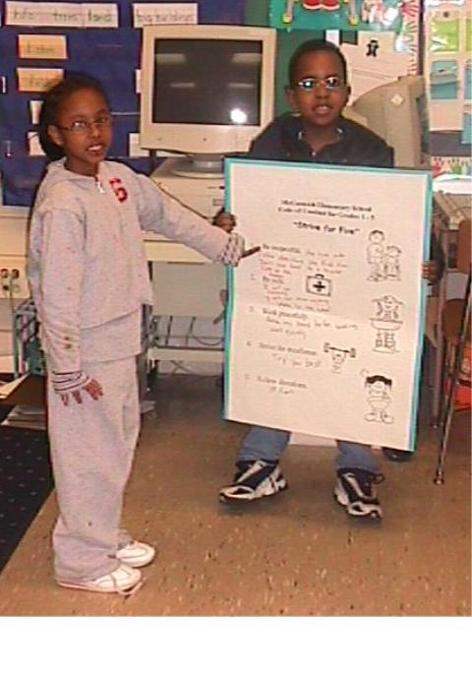
Reviewing Strive for Five
Be respectful.
Be safe.
Work peacefully.
Strive for excellence.
Follow directions.
McCormick Elem. MD 2003

Slide 36
Teach
rules in the context of routines
Teach expectations directly.
  Define rule in operational terms—tell students what the rule looks like within routine.
  Provide students with examples and non-examples of rule-following within routine.
Actively involve students in lesson—game, role-play, etc. to check for their understanding.
Provide opportunities to practice rule following behavior in the natural setting.
II.B.iv

Slide 37
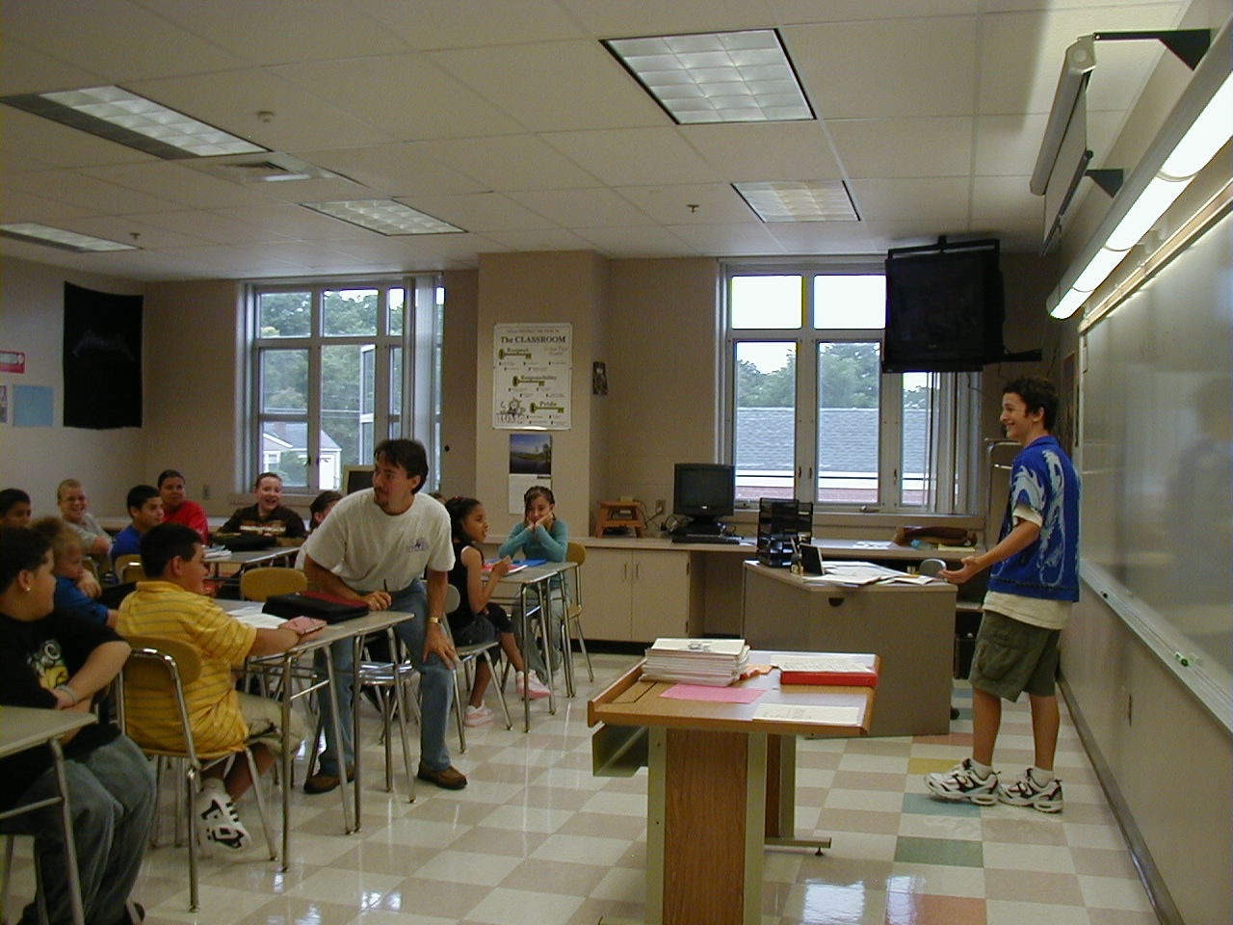
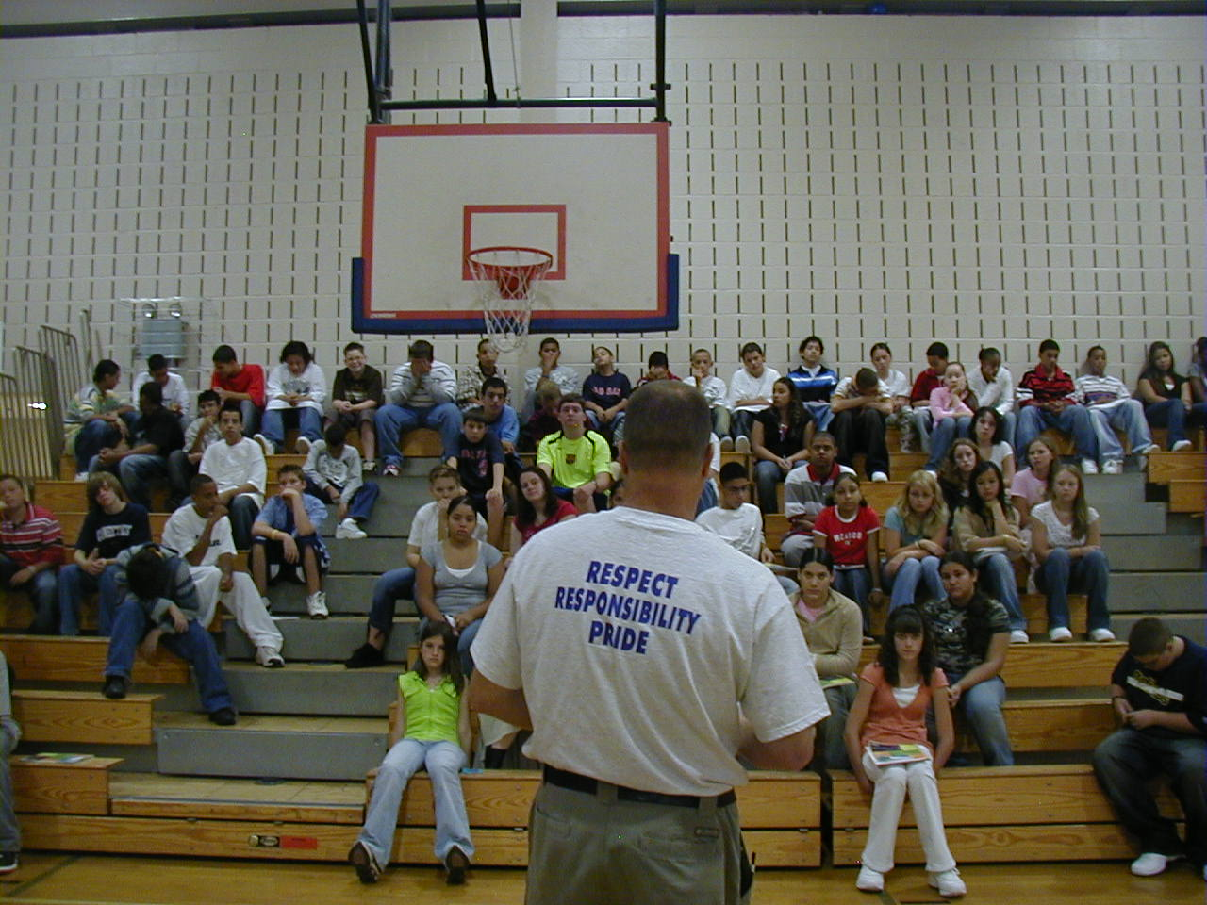
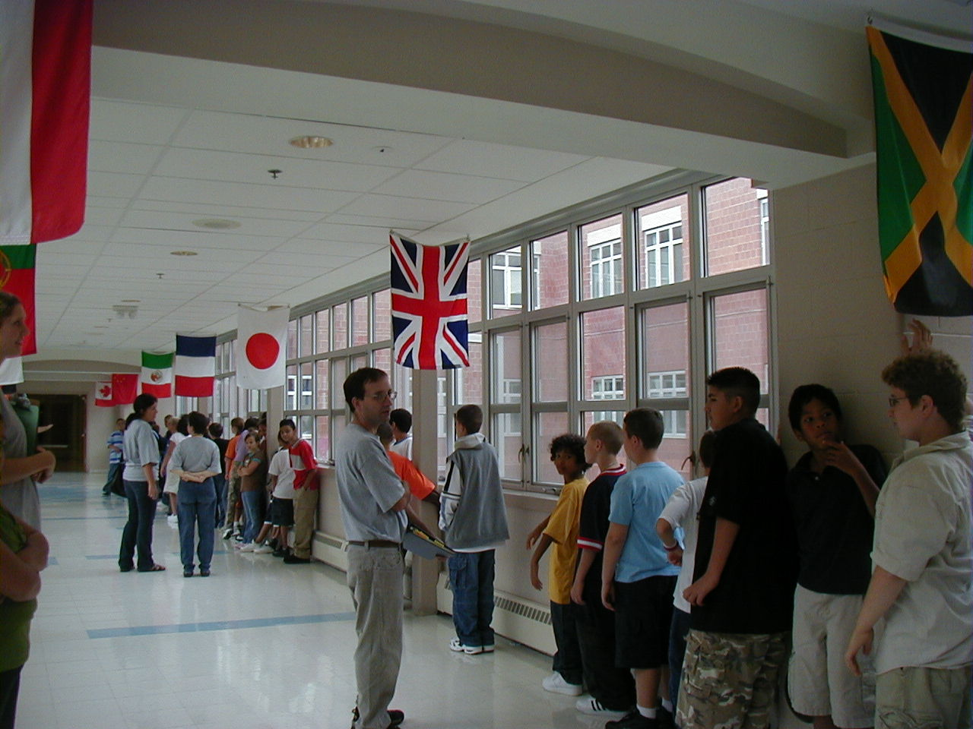
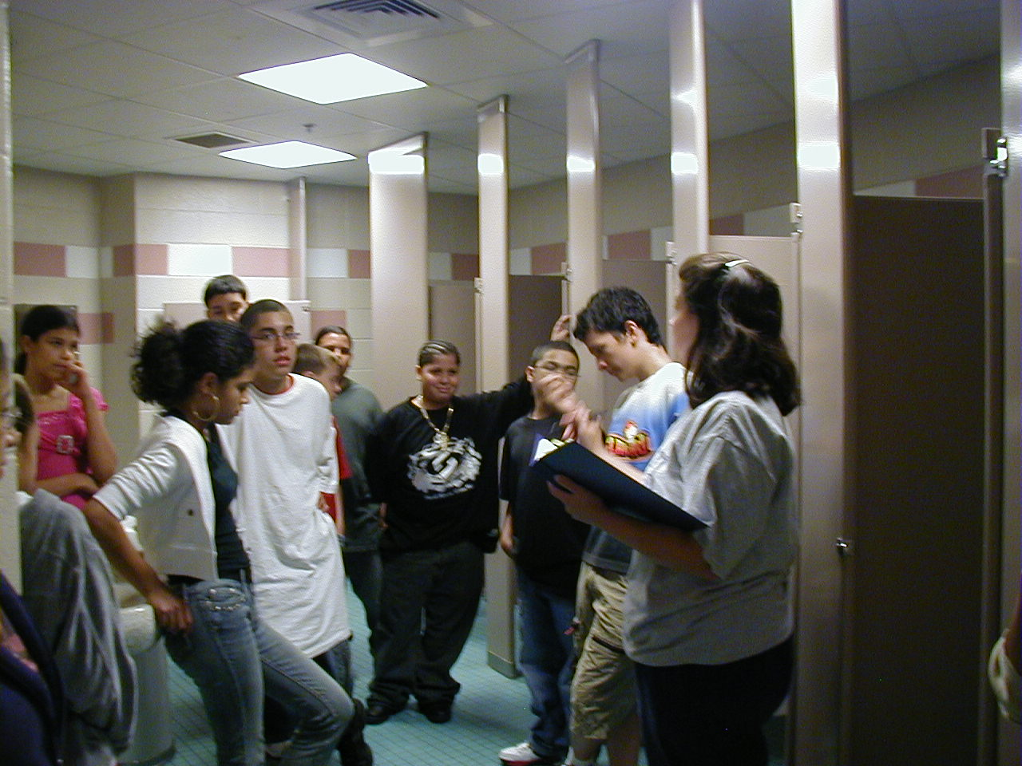
Expectations & behavioral skills are taught & recognized in natural context

Slide 38
In other words… follow these key steps
Define
Teach
Prompt
Monitor
Evaluate
II.B.iv
Notes:
Sarah

Slide 39
Prompt
or remind students of the rule
Provide students with visual prompts (e.g., posters, illustrations, etc).
II.B.iv

Slide 40

School Wide Expectations Everywhere!
School website
Building entrances
Computer wallpaper
TV screens
School newspaper
Hallways
Classrooms
Sporting Events
Dances

Slide 41
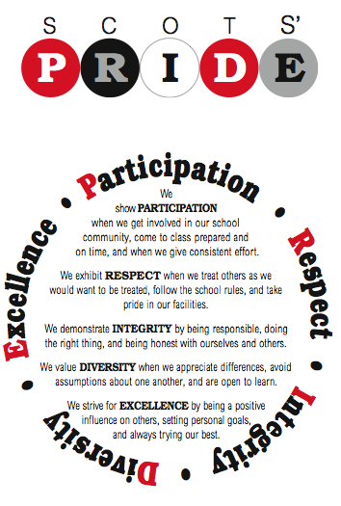

Slide 42
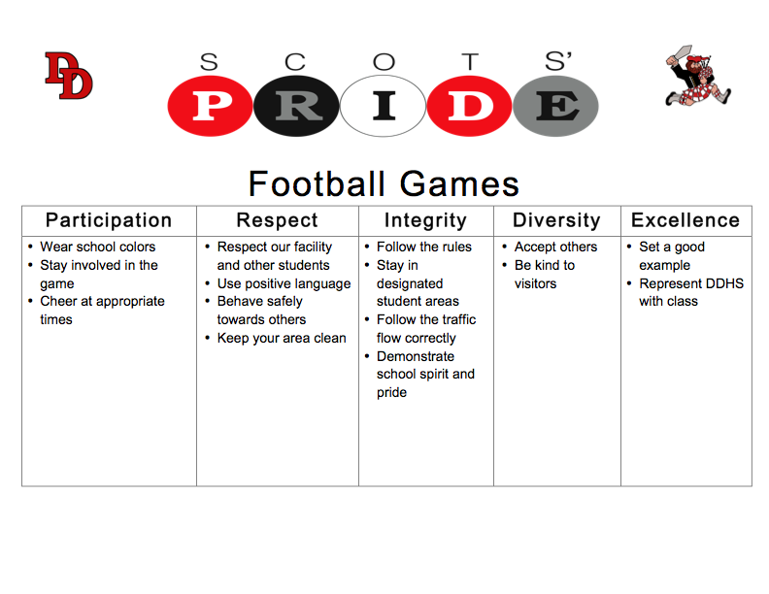
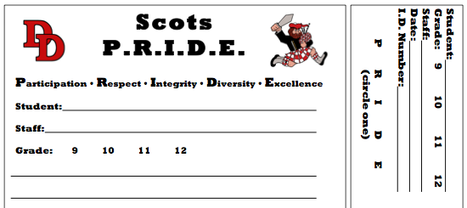
Notes:
David Douglas H.S. September 2009 (Rob’s alma mater!)

Slide 43


Walkways
Kuleana: Be Responsible
Plan ahead
Walk directly to destination
Ho’ihi: Be Respectful
Walk quietly when classes are in session
Laulima: Be Cooperative
Keep movement flowing
Share equipment and play space
Malama: Be Safe
Walk at all times
King Kaumualii on Kauai

Slide 44
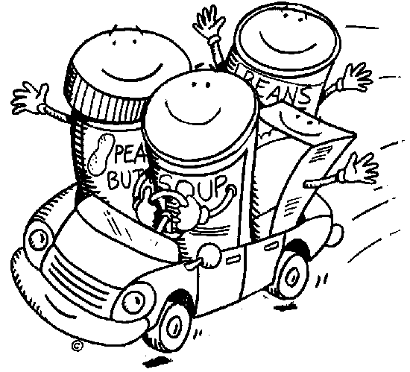
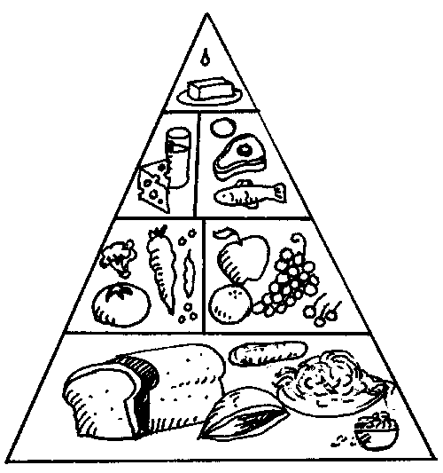
Kuleana: Be Responsible
Have lunch card ready
Be orderly in all lines
Ho’ihi: Be Respectful
Use proper table manners
Eat your own food
Laulima: Be Cooperative
Wait patiently/ quietly
Malama: Be Safe
Walk at all times
Wash hands
Chew food well; don’t rush
Cafeteria
King Kaumualii on Kauai

Slide 45
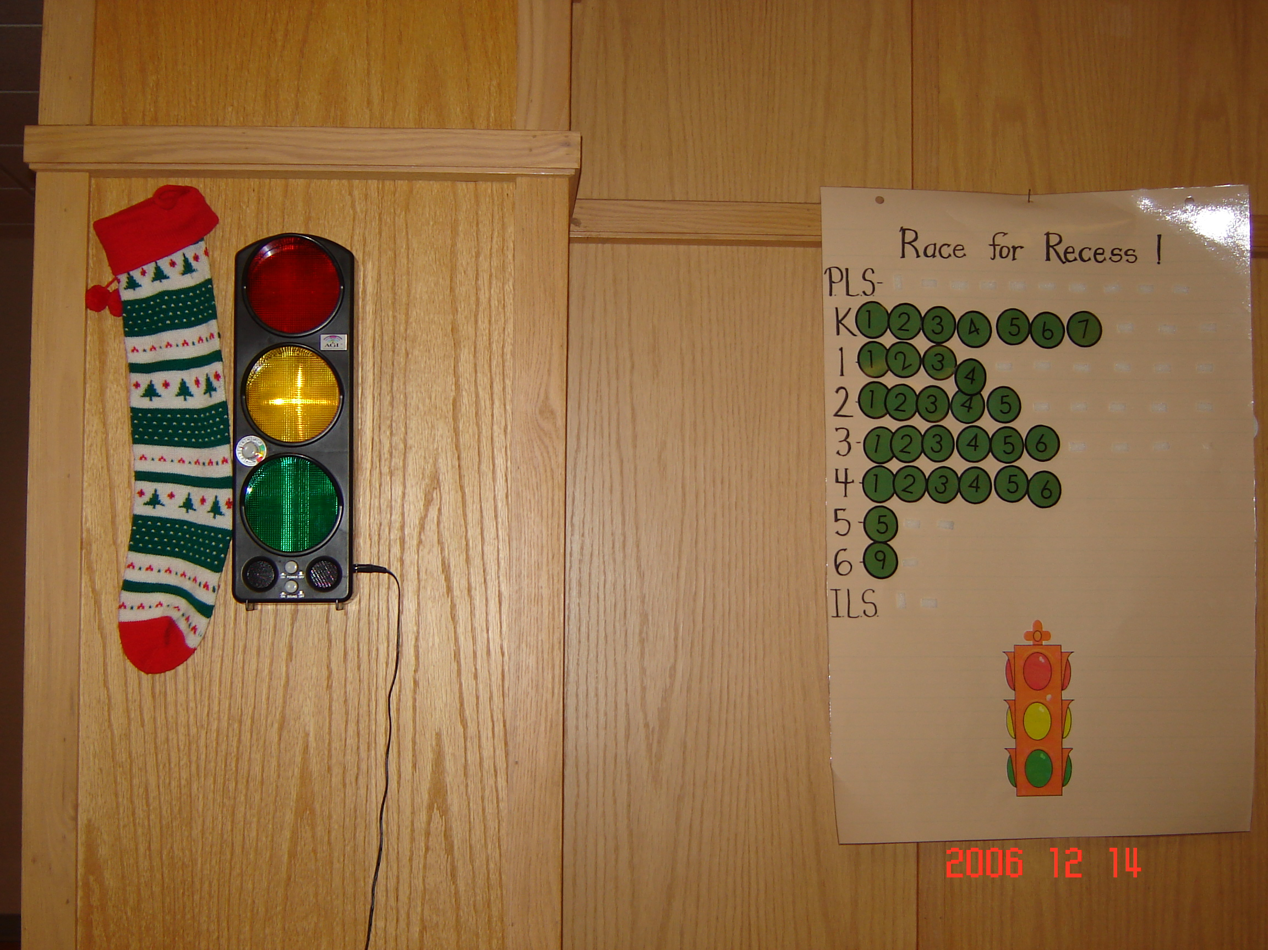
…and in Massachusetts
Norrback Ave. School
Cafeteria Yacker Tracker
Notes:
1. These are terrific! I wonder if we can get a few examples from the schools we are currently working with (a couple are already implementing to some extent…)

Slide 46
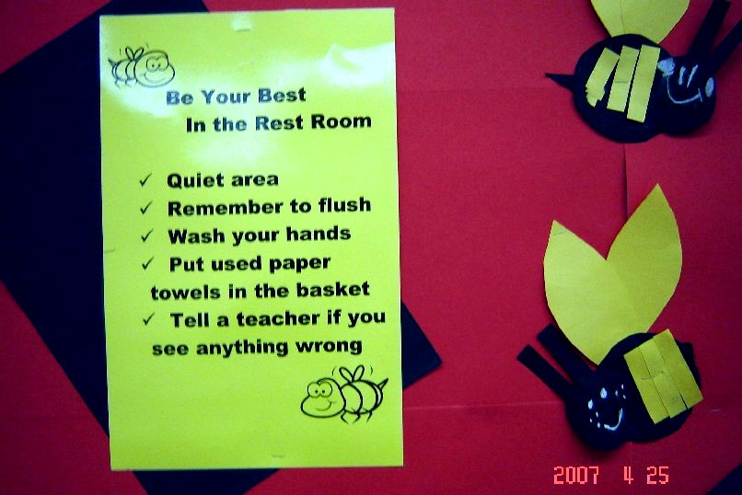
In Massachusetts, we also care about…

Slide 47
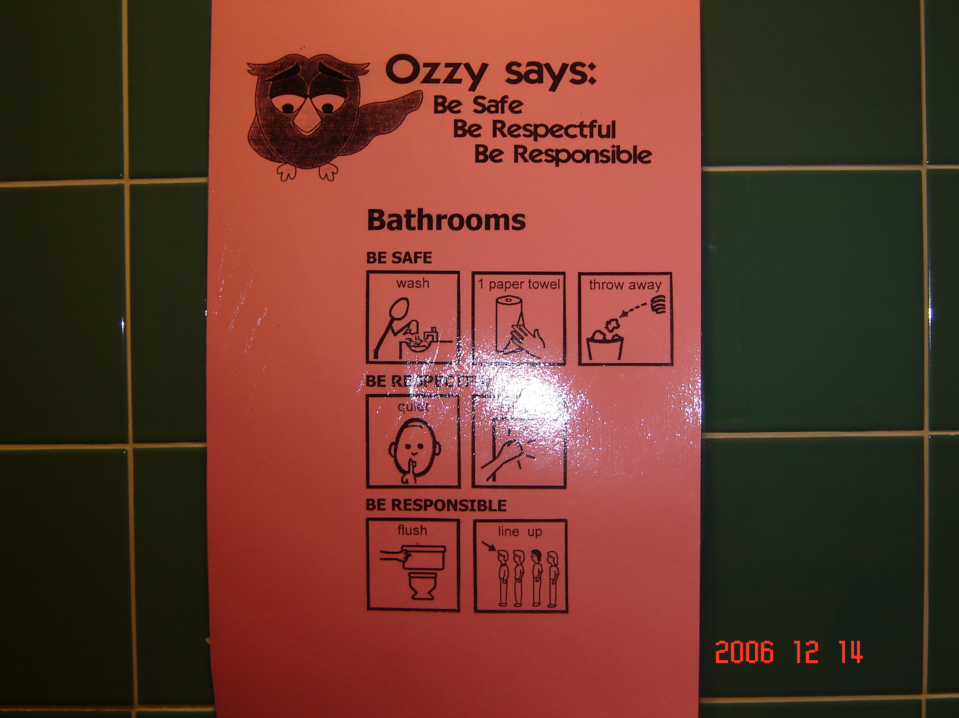
Norrback Ave. School
In MA, we consider diverse reading abilities…

Slide 48
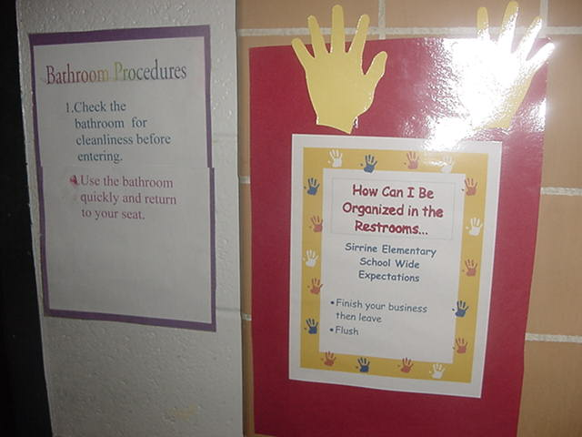
In a South Carolina Elementary School
Expected behaviors are visible
Sirrine Elementary June 8, 2004 SC

Slide 49
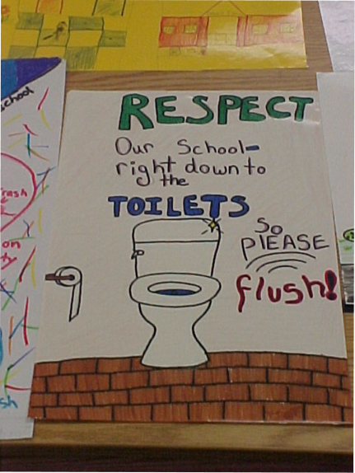
And people say high schools are different…

Slide 50
Prompt
or remind students of the rule
Provide students with visual prompts (e.g., posters, illustrations, etc).
Use pre-corrections, which include “verbal reminders, behavioral rehearsals, or demonstrations of rule-following or socially appropriate behaviors that are presented in or before settings were problem behavior is likely” (Colvin, Sugai, Good, Lee, 1997).
II.B.iv

Slide 51
In other words… follow these key steps
Define
Teach
Prompt
Monitor
Evaluate
II.B.iv
Notes:
Sarah

Slide 52
Monitor
students’ behavior in natural context
Active Supervision (Colvin, Sugai, Good, Lee, 1997):
            Move around
            Look around (Scan)
            Interact with students
                Reinforce
                Correct
II.B.iv

Slide 53
In other words… follow these key steps
Define
Teach
Prompt
Monitor
Evaluate
II.B.iv
Notes:
Sarah

Slide 54
Evaluate
the effect of instruction
Collect data
  Are rules being followed?
  If there are errors,
    who is making them?
    where are the errors occurring?
    what kind of errors are being made?
Summarize data (look for patterns)
Use data to make decisions
II.B.iv

Slide 55
Evaluate
the fidelity of implementation
Collect data
  Are we doing what we said we’d do?
    How will we support lessons taught within routines?
    How will we know when lessons are taught?
    How will we know when and where we might need boosters?
Summarize data (look for patterns)
Use data to make decisions
II.B.iv
Notes:
1. I added this slide too—what do you think?

Slide 56
A lesson plan that puts all of this together…
Define
Teach
Prompt
Monitor
Evaluate
II.B.iv
Notes:
Sarah

Slide 57
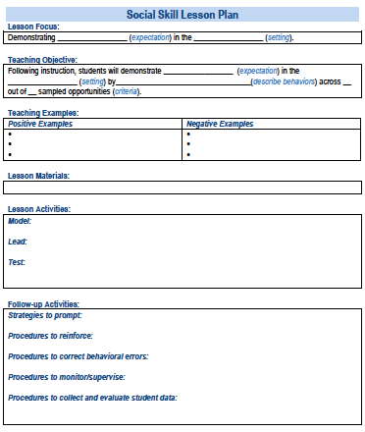
A lesson plan that prompts the critical features just described:
Simonsen, Myers, Everett, Sugai, Spencer, & LaBreck (2012)
See Appendix I
Notes:
Explicitly teaching social skills school-wide: Using a matrix to guide instruction. Intervention in School and Clinic, 47, 259-266. doi: 10.1177/1053451211430121
The last authors were folks from the central MA cohort of PBIS schools we trained!!!!!

Slide 58

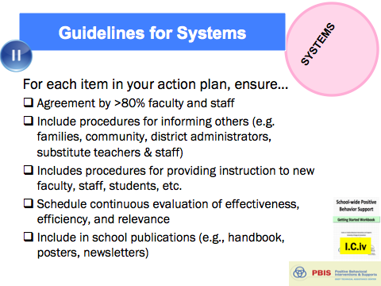
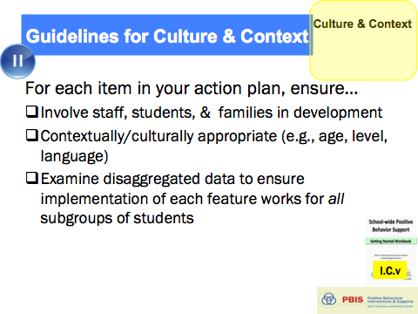
Guidelines for Teaching Expected Behaviors (Social Skills)
PRACTICES
Considerate of main school settings/contexts
Considerate of lessons that already exist
Specification of 2-3 observable, positive examples for each expectation within each setting/context
Teach social behavior like academic skill
Prompts, reminders, or precorrections in natural context
Feedback in natural context
Schedule (add to PD calendar) for introducing teaching plan to staff and getting feedback on lesson plans
Schedule (add to school calendar) for initial instruction in natural/typical context
Schedule (add to school calendar) for regular review, practice, and follow-up
Procedures for identifying/supporting students whose behaviors do not respond to instruction
And always remember to consider systems, culture, & context:
II.B.iv

Slide 59
Activity:
Teaching Expectations (Social Skills)
Work as team for 15 min
Review guidelines for teaching expectations.
Draft components of a social skills lesson plan for one box on your matrix using provided template.
Add items to your Action Plan as necessary
Present 2-3 “big ideas” from your group (1 min. reports)

Slide 60

Break

Slide 61
Getting Started with SWPBIS
Establish an effective leadership team
Develop brief statement of behavioral purpose
Identify positive SW behavioral expectations
Develop procedures for teaching SW expectations
Develop procedures for teaching class-wide expectations
Develop continuum for strengthening appropriate behavior
Develop continuum for discouraging violations of expectations
Develop data-based procedures for monitoring
Develop systems to support staff
Build routines to ensure on-going implementation
PRACTICES
II.B.v

Slide 62
Guidelines for Teaching Class-Wide Expectations (Social Skills)
PRACTICES
School-wide action plan for classroom management practices and procedures based on data (self-assessment)
Definitions and process for class vs. office managed expectation-violating behaviors
Teaching matrix, procedures, and schedules developed for teaching school-wide behavior expectations in typical classroom contexts and routines
Data systems in place to monitor ODRs from classrooms
Procedures in place to support behavior of students whose behaviors do not respond to classroom management
Prompts for display of expected behaviors in natural contexts
Feedback for displays of behaviors in natural context
And always remember to consider systems, culture, & context:
II.B.v

Slide 63
In other words… follow these key steps.
Define
Teach
Prompt
Monitor
Evaluate
II.B.v
Notes:
Sarah

Slide 64
Define
Behavioral expectations/Rules
Operationally define what the rules look like across all the routines and settings in each classroom.
You can use the same matrix format.
II.B.v

Slide 65
Rules within Routines Matrix
Routines Rules | Transitions (e.g., in/out) | Whole Group Instruction | Independent Seatwork | Cooperative Group Work
Respect
Responsibility
Safety

Slide 66
Typical Contexts/ Routines | Class-Wide Rules/Expectations
 | Respect Others | Respect Property | Respect Self
All | Use inside voice. Raise hand to answer/talk. | Recycle paper. Put writing tools inside desk. | Do your best. Ask.
Morning Meeting | Eyes on speaker. Give brief answers. | Put announcements in desk. Keep feet on floor. | Put check by my announcements.
Homework | Do own work. Turn in before lesson. | Put homework neatly in box. Touch your work only. | Turn in lesson on time. Do homework night/day before.
Transition | Use inside voice. Keep hands to self. | Put/get materials first. Keep hands to self. | Have plan. Go directly.
“I Need Assistance” | Raise hand or show “Assistance Card”. Wait 2 minutes & try again. | Have materials ready. | Have plan. Ask if unclear.
Teacher Directed | Eyes on speaker. Keep hands to self. | Use materials as intended. | Have plan. Ask.
Independent Work | Use inside voice. Keep hands to self. | Use materials as intended. Return with done. | Use time as planned. Ask.
Problem to Solve | Stop, Step Back, Think, Act | Stop, Step Back, Think, Act | Stop, Step Back, Think, Act
1. SOCIAL SKILL
2. NATURAL CONTEXT
3. BEHAVIOR EXAMPLES
Notes:
1. Added this example

Slide 67
Activity:
Class-Wide Expectations Matrix
Work as team for 5 min
Draft Class-Wide Teaching Matrix
  Write in your school-wide expectations
  Identify typical contexts/routines in your classroom
  Identify 1-2 observable, measurable, and positively stated behaviors for ONE cross-section
Add items to your Action Plan as necessary
Present 2-3 “big ideas” from your group (1 min. reports)

Slide 68
Teach
rules in the context of routines
Teach expectations directly.
  Define rule in operational terms—tell students what the rule looks like within routine.
  Provide students with examples and non-examples of rule-following within routine.
Actively involve students in lesson—game, role-play, etc. to check for their understanding.
Provide opportunities to practice rule following behavior in the natural setting.
II.B.v

Slide 69
Prompt
or remind students of the rule
Provide students with visual prompts (e.g., posters, illustrations, etc).
Use pre-corrections, which include “verbal reminders, behavioral rehearsals, or demonstrations of rule-following or socially appropriate behaviors that are presented in or before settings were problem behavior is likely” (Colvin, Sugai, Good, Lee, 1997).
II.B.v

Slide 70
Monitor
students’ behavior in natural context
Active Supervision (Colvin, Sugai, Good, Lee, 1997):
            Move around
            Look around (Scan)
            Interact with students
                Reinforce
                Correct
II.B.v

Slide 71
Evaluate
the effect of instruction
Collect data
  Are rules being followed?
  If there are errors,
    who is making them?
    where are the errors occurring?
    what kind of errors are being made?
Summarize data (look for patterns)
Use data to make decisions
II.B.v

Slide 72
Evaluate
the fidelity of implementation
Collect data
  Are we doing what we said we’d do?
    How will we support lessons taught within routines?
    How will we know when lessons are taught?
    How will we know when and where we might need boosters?
Summarize data (look for patterns)
Use data to make decisions
II.B.v
Notes:
1. I added this slide too—what do you think?

Slide 73
A lesson plan that puts all of this together…
Define
Teach
Prompt
Monitor
Evaluate
II.B.v
Notes:
Sarah

Slide 74
Getting Started with SWPBIS
Establish an effective leadership team
Develop brief statement of behavioral purpose
Identify positive SW behavioral expectations
Develop procedures for teaching SW expectations
Develop procedures for teaching class-wide expectations
Develop continuum for strengthening appropriate behavior
Develop continuum for discouraging violations of expectations
Develop data-based procedures for monitoring
Develop systems to support staff
Build routines to ensure on-going implementation
PRACTICES
II.B.vi

Slide 75
Key Features of
Acknowledgement Systems
Acknowledgements are
  Tied to school-wide expectations
  Age appropriate and students/staff will find them valuable
  Varied types that are valuable to diverse groups of students (tangible, social, privilege) (individual and group contingencies)
  Allow for choice – at least in some of the systems
Efficiently delivered
  Fit into daily activities - Avoids interrupting instructional time
  Easy to teach, implement, etc.
Predictable and dense schedule
  Allow for all students to be eligible to earn acknowledgements daily
  Layered: daily, weekly, monthly, quarterly, etc.
Available to both Students and Staff
Notes:
Notes:
Be sure to emphasize that verbal should always be tied to any tangible / privilege
Some acknowledgements will be used daily - “high frequency” acknowledgements Coupons to the school store, daily announcements over the P.A.
Other types of acknowledgements will be used intermediately (weekly, quarterly) These are used less frequently (weekly, quarterly) to acknowledge students on a bigger level. Student of the Month, class pizza party for good attendance
Larger celebrations will be used a few times a year to acknowledge student behavior Typically include larger groups of students (i.e., the freshmen class, whole school). Honors banquet, end of the year assembly/picnic

Slide 76
Behavior is likely to occur again when it is reinforced
When a student gets something desirable following an inappropriate behavior, that behavior is strengthened and more likely to occur again
Examples
  if a student is removed from the classroom after refusing to do a difficult assignment, the student will likely act up later when he does not want to (or cannot) complete work
  if a student is given verbal praise for persisting with a difficult assignment, the student is likely to persist on later difficult assignments
Notes:
Notes:
Positive reinforcement adds something pleasant following the demonstration of a desired behavior but also INCREASES the likelihood that a behavior will occur again
BUT positive reinforcement used following appropriate behaviors increases the likelihood that APPROPRIATE behaviors (i.e. persistence on difficult work) will continue

Slide 77
Benefits of
Acknowledgement Systems
Creates positive student-to-teacher interactions
Clarifies school expectations for appropriate behavior
Increases the likelihood that desired behaviors will be repeated by letting students know what they are doing “right”
Reduces the need for engaging in time- consuming disciplinary measures
Notes:
Focuses teacher attention to “catch you being good”
Philosophy - Philosophical shift toward positive, prevention: Move from traditional view of discipline as punishing and discipline as teaching- this supports that shift
Adolescence – age appropriate

Slide 78
Acknowledgement Systems for Older Students?
Adolescents typically have a heightened flight or fight response and may perceive neutral interactions as threatening (Blakemore et al., 2007).
Adolescents typically need a more intense experience to recognize it as rewarding (Sprague, 2008).
Adolescents may need acknowledgement that is:
  Frequent
  Varied
  Meaningful
  Specific & genuine
  As soon after the expected behavior is displayed as possible
A school-wide system ensures all students have access to acknowledgements and prompts adults to engage in this critical practice.
Notes:
Notes:
Be specific
“Thank you for being respectful and holding the door open for me.”
Be genuine
Convey sincerity with tone of voice and body language, message, and choice of behavior to acknowledge (avoid patronizing)
Handout:
Delivering Acknowledgments

Slide 79
High schools already have methods to recognize students
Honor roll acknowledgement breakfast
Athletic award assemblies
PA announcements
Newsletters home
Teacher to student kudos
The list goes on…….
Expand to recognize all behaviors and all students!

Slide 80
 | Notable Deeds | Cave Buddies | Student of the Month | Good News Postcards | ABS Movie night | PRIDE Qualities | Teacher of the Year | PRIDE Expectations | Weekly Tardy Raffle | Friday Pick-me Up
Description | Certificates presented to students / staff in class by admin or to staff members at staff meetings. Anyone can fill out a nomination form. | Stuffed cavemen presented to staff members at staff meetings by peers. Each recipient chooses the next recipient. 4 are passed on each month. | Students receive a certificate and a free pizza lunch with the principal. Each teacher selects two students per month | Staff members write notes to parents or students that are mailed home. Postcards are available for staff use. | Students get free admission to a movie afternoon at school. Includes popcorn or ice cream sundaes. | Each staff member is given 10 tickets per month to give to students. Tickets good for entry in a raffle of the student’s choice. Different quality each month | Students vote for the teacher who has had the biggest impact on their lives. Top 5 teachers are presented with awards at the end of the year assembly. | Admin. randomly selecting students to recite the expectations. If they can they get a HOINOR T-shirt | 4 classes are randomly selected. 1 student in each class is randomly selected until a student is found with no tardies for the previous week. Winners get $5 from admin. during 3rd period. | Each Friday an admin. randomly selects a teacher who has been faithful with a given task for that week. Teacher gets coffee beverage of his or her choice during class.
By whom / to whom | Staff to , staff & students Students to Students, & staff | Staff to staff | Staff to students | Staff to students/ parents | Staff to students | Staff to students | Students to staff | Administration to Students | Administration to Students | Administration to Staff
Coordinates? | Joy | Chan | Albert | JoAnna | Chan | Joy | Kirk (with help from Student Leadership) | Sven | Sven | Deb
Cost | Printing costs for awards | Cave Buddies already purchased | $6 / month | Printing plus postage | $50 / month | $150 /month | Plaques paid for by Student Leadership | $15 /month ($5 per student) | $20/week | $2 week
Frequency | On-going for students, presented monthly for staff | Monthly | Monthly | On-going | Quarterly | Monthly | Yearly | Weekly | Weekly | Weekly
Desired Behavior | Catch-all for positive behavior | Above and beyond on the job Completing extra tasks Helping others Good attitude Excelling in his or her field | Up to teacher discretion Most improved Best behavior Highest grade Good attitude Hardest worker | Up to teacher discretion Most improved Best behavior Highest grade Good attitude Hardest worker | Academic success in the classroom No D’s or F’s | PRIDE Qualities: Perseverance Respect Integrity Discipline Excellence | Rapport with Students Positive relationships | Knowledge of PRIDE qualities | On-time to all classes | Changes each month Assignments online Grade books updated Attendance taken regularly
GPHS 2009
Notes:
Notes:
Focus on relevant features of columns Aligning with previous features EMPHASIZE staff and student systems same process as with student-wide

Slide 81
Acknowledgment Systems in High Schools
Design structures and mechanisms for regular recognition of positive behaviors, events, and activities of the school
  Staff-Student – Develop ways to identify, communicate and publicly recognize excellence
  Staff-Staff – Create and promote opportunities for staff/admin to recognize and appreciate other staff
  Student-Staff – Create ways for students to share appreciation of staff
  School-Student – Attendance, grades, behavior, state assessment, improvement, etc. (i.e. Attendance Campaign)
Notes:
“Cave Buddy” – Staff recognition
Notable Deeds – Staff and student recognition
Admin – T-shirt and coffee tickets to students for identifying WE ARE GP qualities
Tickets / prizes for perfect attendance

Slide 82
Guidelines for Continuum of Procedures to Strengthen Behavior
PRACTICES
Easy and quick form of acknowledgement linked to SW-expectations and used across all settings (non-classroom and classroom
Considerate of strategies/processes that already exist
Culturally, developmentally, contextually appropriate/relevant name and form of acknowledgement
Define back-up or follow-up acknowledgements
Develop written procedures for acknowledgements
Schedule (add to PD calendar) for teaching acknowledgement systems
II.B.vi

Slide 83
Guidelines for Continuum of Procedures to Strengthen Behavior
PRACTICES
Instructions and practice for staff (add to PD calendar) on how to pair tangible/activity acknowledgements with social acknowledgments
Schedule (add to school calendar) for initial introduction of acknowledgements to students and regular boosters or reimplementation of acknowledgements
Means for keeping track of the ratio of acknowledgements to ODRs or corrective actions
Schedule (add to PD and school calendars) for daily, weekly, monthly, and quarterly feedback to students and staff
And always remember to consider systems, culture, & context:
II.B.vi

Slide 84
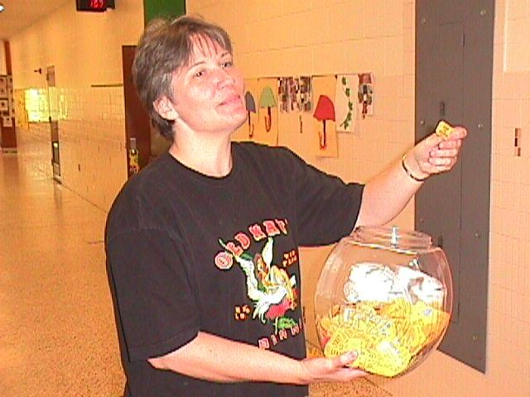
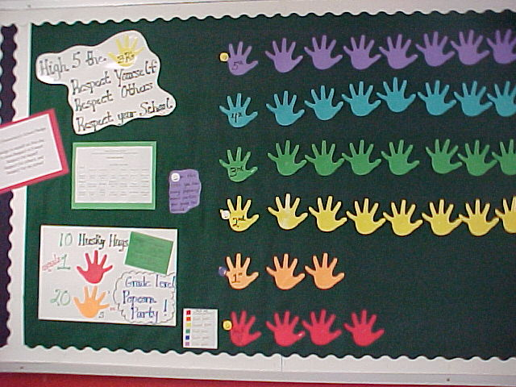
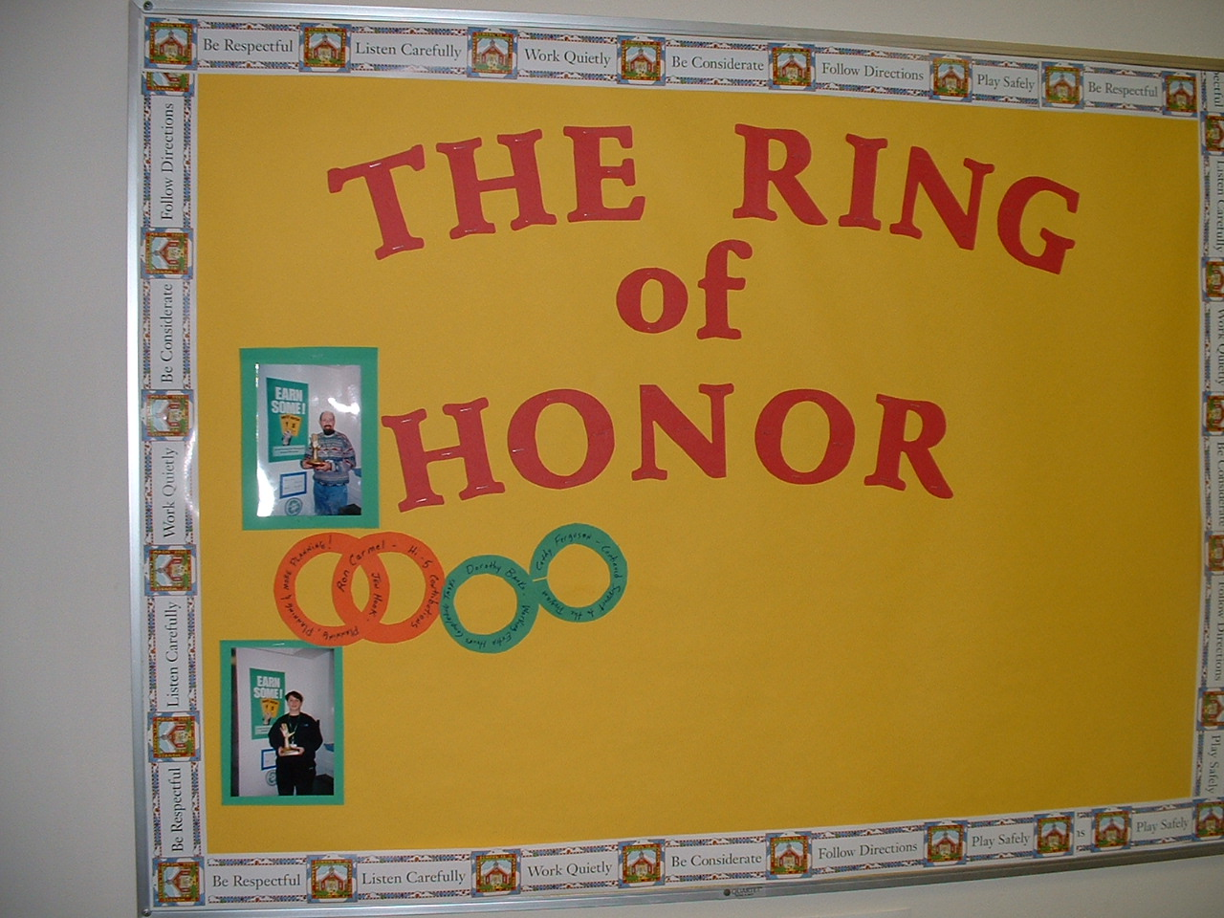
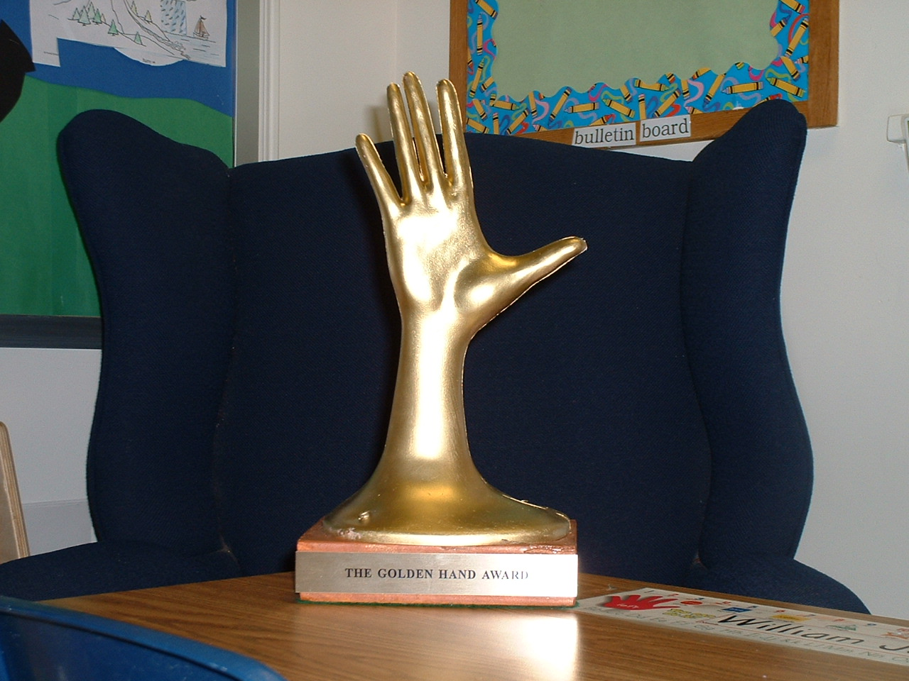
Establish a continuum of procedures to encourage rule following behavior

Slide 85
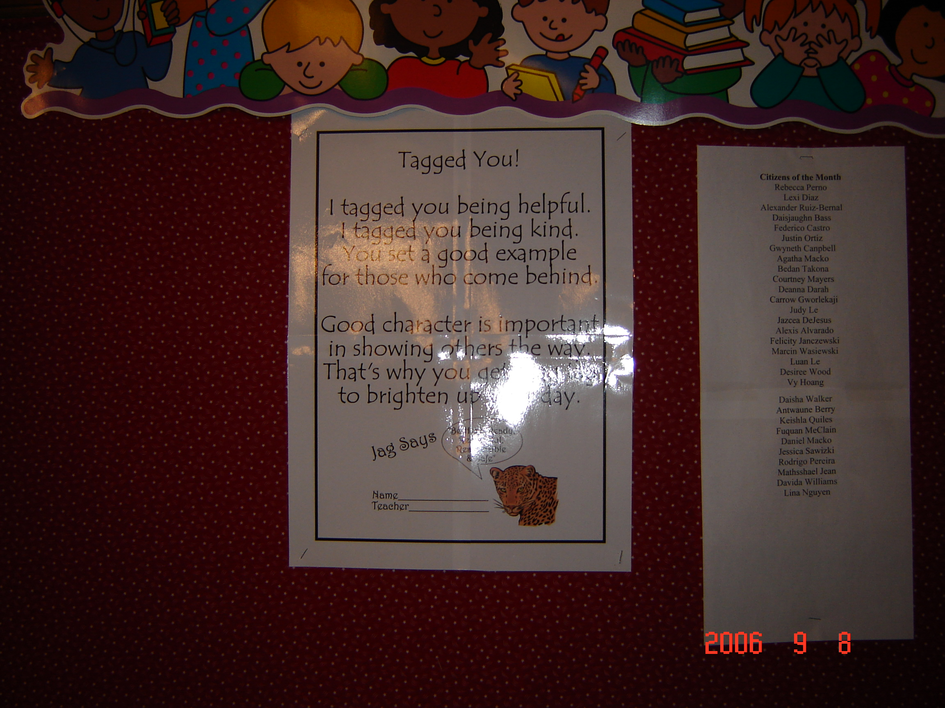

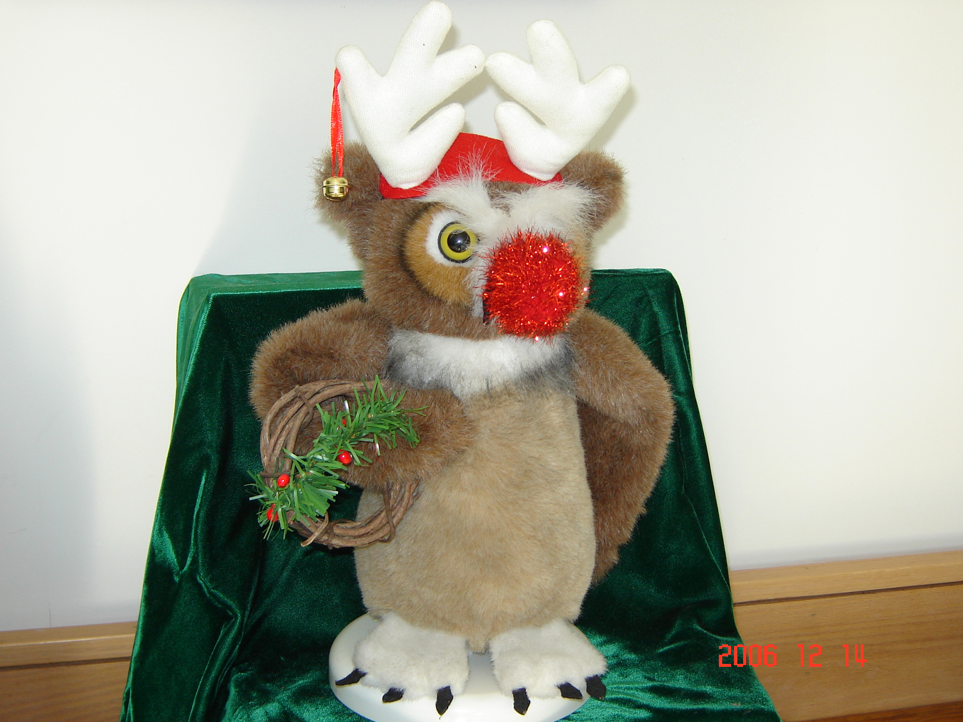
Establish a continuum of procedures to encourage rule following behavior in Massachusetts
Vernon Hill School
Jag Tags
Norrback Ave. School
Ozzy the Owl
Notes:
1. Again, possibly ask implementing schools for examples? Kind of like a pbis selfie…

Slide 86
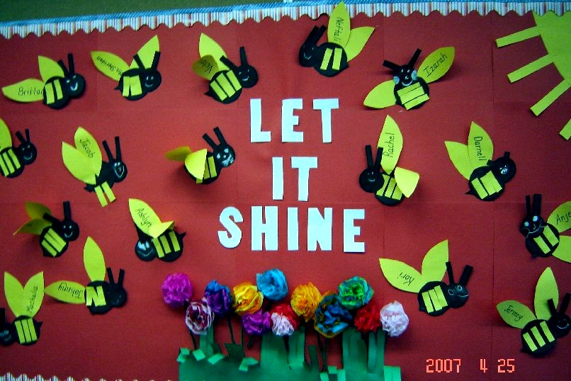
Establish a continuum of procedures to encourage rule following behavior
more in Massachusetts

Slide 87
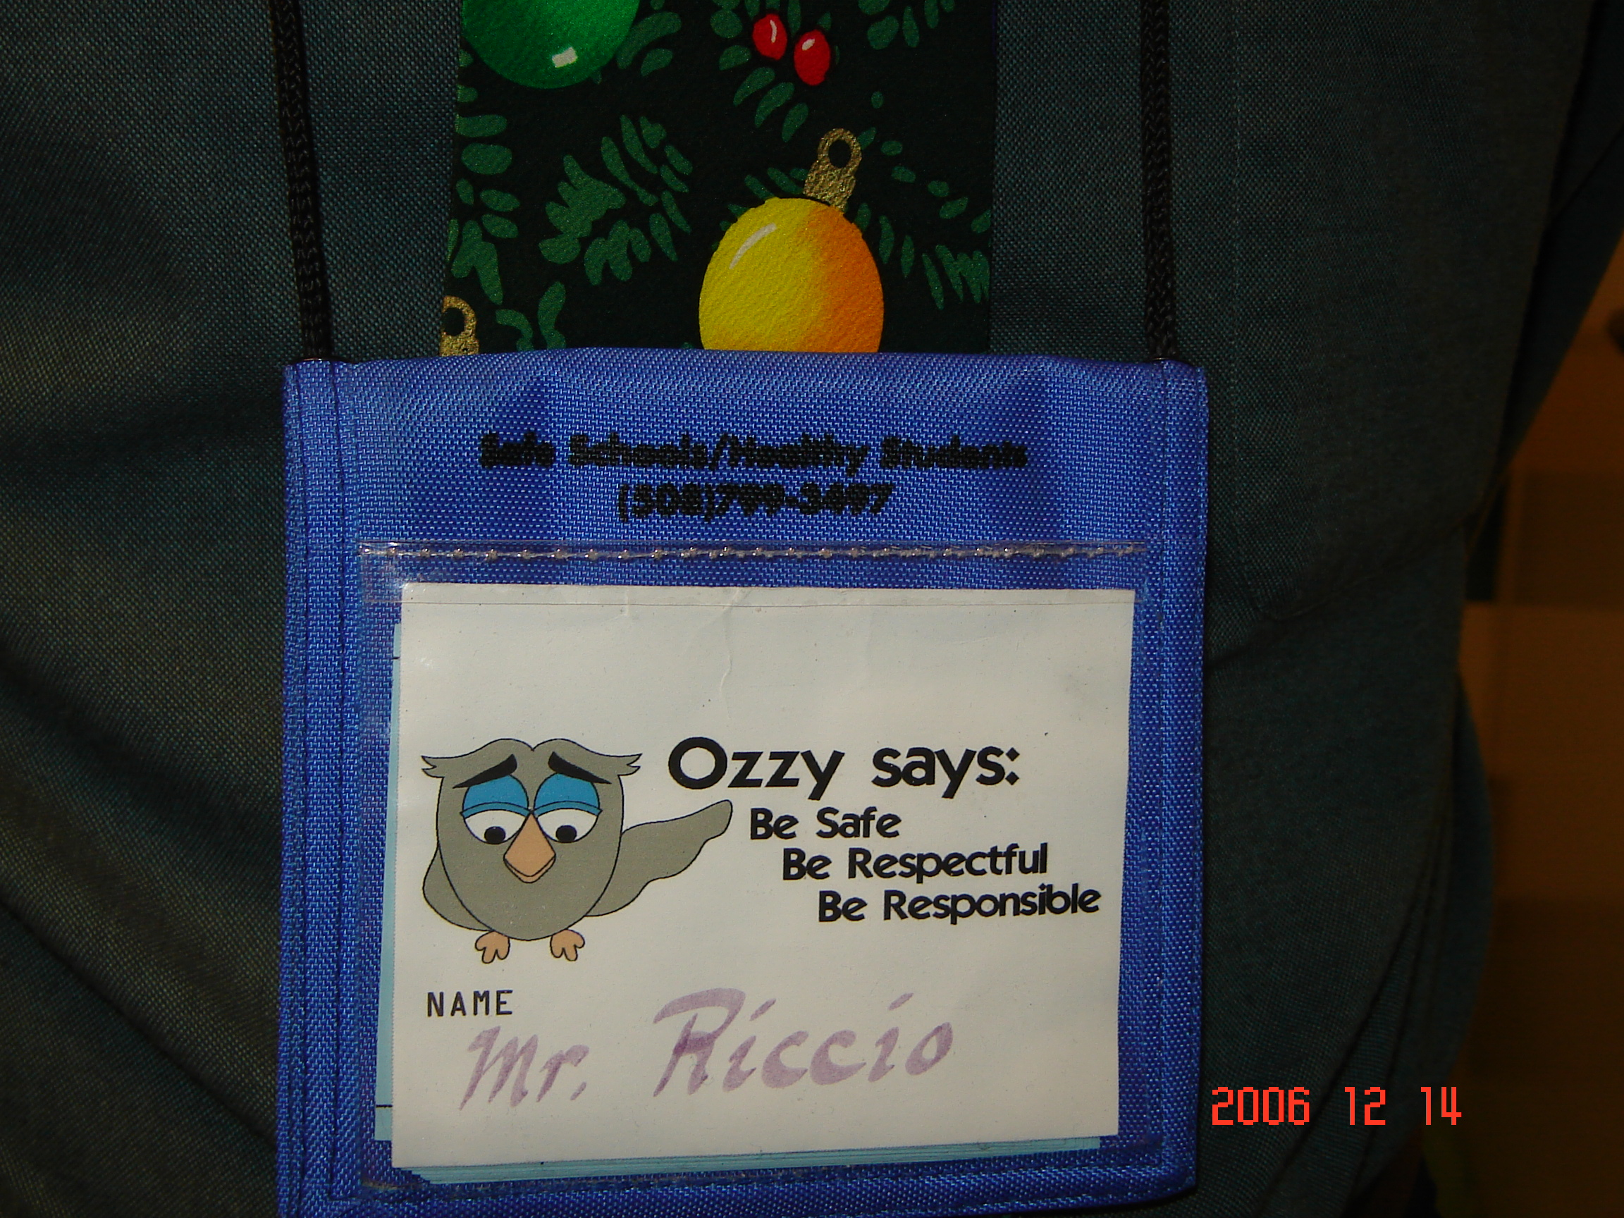
Norrback Ave. School
And we make it easy on the teachers
and fun for the students in MA
Teacher Coupon Carrier

Slide 88
Also consider these no or low cost options
(See full list compiled by Laura Riffel*)
Assist school staff (e.g., cleaning, office work, announcements, job shadow, keep score)
Be a leader (e.g., first in line, lead game)
Choice (e.g., class job, book to read)
Privileges (e.g., partial assignment, access/pass to special class/school activity, music between classes)
Social privileges (e.g., eat with preferred peers or staff)
Positive recognition (e.g., recommendation letter)
https://www.google.com/url?q=http://www.pbis.org/common/cms/files/coach_trainer/ideastoshare/freerewards4studentsnstaff.doc&sa=U&ei=fbuAVL3_NJSquQTmtYDoDg&ved=0CAUQFjAA&client=internal-uds-cse&usg=AFQjCNEb33G_e3wALWoEmsaF_5FtRsq4Gw

Slide 89
Are “Rewards” Dangerous?
“…our research team has conducted a series of reviews and analysis of (the reward) literature; our conclusion is that there is no inherent negative property of reward. Our analyses indicate that the argument against the use of rewards is an overgeneralization based on a narrow set of circumstances.”
  Cameron, 2002
  Cameron & Pierce, 1994, 2002
  Cameron, Banko & Pierce, 2001
Notes:
SCRIPT:

Slide 90
Considerations for the Effective Use of Rewards
Provide reinforcement consistent with the students phase of learning (e.g., more reinforcement when a skill is new)
Provide reinforcement in a manner that is considerate of the student’s developmental and cultural characteristics and learning history
Be Specific!
Provide greater attention for the desired social skill than for the problem behavior
Do not use withholding or removal of positive feedback as a threat or bribe, to “encourage” social skills

Slide 91
Activity:
School-Wide Acknowledgements
Work as team for 5 min
Consider the following questions. Your team should have a provide consistent message.
  Is it fair to all students?
  They are in high school, students don’t need to be acknowledged.
  It’s bribery!
  Why can’t we just tell them they’re doing a good job?
  You’re building a token society.
  Why are we rewarding them for what they’re supposed to do?
What additional questions do you have or resources will you need to address these questions?
Present 2-3 “big ideas” from your group (1 min. reports)

Slide 92
Activity:
School-Wide Acknowledgements
Work as team for 15 min
Complete Acknowledgements Worksheet
Add items to your Action Plan as necessary
Present 2-3 “big ideas” from your group (1 min. reports)

Slide 93
Lunch

Slide 94
Getting Started with SWPBIS
Establish an effective leadership team
Develop brief statement of behavioral purpose
Identify positive SW behavioral expectations
Develop procedures for teaching SW expectations
Develop procedures for teaching class-wide expectations
Develop continuum for strengthening appropriate behavior
Develop continuum for discouraging violations of expectations
Develop data-based procedures for monitoring
Develop systems to support staff
Build routines to ensure on-going implementation
PRACTICES
II.B.vii

Slide 95

PREVIEW: Guidelines for Continuum of Procedures to Decrease Behavior
PRACTICES
Specify Definitions for Violations of SW Expectations
Specify Procedures for Processing Violations of SW Expectations
Implement procedures
And always remember to consider systems, culture, & context:

Slide 96
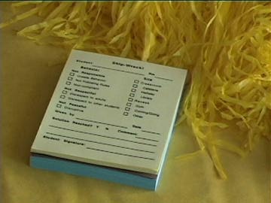
~10 positive : 1 correction

Slide 97
Getting Started with SWPBIS
Establish an effective leadership team
Develop brief statement of behavioral purpose
Identify positive SW behavioral expectations
Develop procedures for teaching SW expectations
Develop procedures for teaching class-wide expectations
Develop continuum for strengthening appropriate behavior
Develop continuum for discouraging violations of expectations
Develop data-based procedures for monitoring
Develop systems to support staff
Build routines to ensure on-going implementation
DATA
II.B.viii

Slide 98
PREVIEW: Guidelines for Data-Based Monitoring of SWPBIS Outcomes
DATA
General data collection procedures
  Data collection procedures are integrated into typical routines (e.g., ODRs, attendance, behavior incident reports)
  Data collection reports regularly checked for accuracy
  Data collection limited to information that answers important student, classroom, and school questions
  Structures and routines for staff members to receive weekly/monthly data reports about status of SW discipline
  Decision rules for guiding data analysis and actions
  Schedule for daily, weekly, monthly, quarterly feedback
  Data system managed by 2-3 staff members
  No more than 1% of time each day for managing data
  Efficient, timely, and graphic displays of data
II.B.viii

Slide 99
PREVIEW: Guidelines for Data-Based Monitoring of SWPBIS Outcomes
DATA
Office discipline referral procedures
  Agreed upon definitions of violations of expectations organized in a continuum
  A form for documenting noteworthy behavior incidents (ODR)
  School-wide procedures for processing/responding
  Efficient and user-friendly data input and storage
  Efficient and user-friendly process for summarizing and storing data
  Efficient and user-friendly procedures for producing visual displays of data
  Procedures for presenting data to staff on routine basis
  Procedures for making decisions and developing actions based on data
II.B.viii

Slide 100
Getting Started with SWPBIS
Establish an effective leadership team
Develop brief statement of behavioral purpose
Identify positive SW behavioral expectations
Develop procedures for teaching SW expectations
Develop procedures for teaching class-wide expectations
Develop continuum for strengthening appropriate behavior
Develop continuum for discouraging violations of expectations
Develop data-based procedures for monitoring
Develop systems to support staff
Build routines to ensure on-going implementation
SYSTEMS
II.B.ix

Slide 101
80% Rule
Tertiary Prevention:
Specialized
Individualized
Systems for Staff with High-Risk Behavior
~5%
Primary Prevention:
Systems to support
all staff:
Professional development
Reinforcement
~15%
Apply the triangle to adult behavior!
Secondary Prevention:
Specialized Group
Systems for Staff who are “At-Risk”
Additional instruction
Increased support
~80% of Staff
Notes:
Good sequence on staff acknowledgements…..important one for teams to get

Slide 102
Getting Started with SWPBIS
Establish an effective leadership team
Develop brief statement of behavioral purpose
Identify positive SW behavioral expectations
Develop procedures for teaching SW expectations
Develop procedures for teaching class-wide expectations
Develop continuum for strengthening appropriate behavior
Develop continuum for discouraging violations of expectations
Develop data-based procedures for monitoring
Develop systems to support staff
Build routines to ensure on-going implementation
SYSTEMS
II.B.x

Slide 103
PREVIEW: Guidelines for Building Routines for On-Going Implementation
SYSTEMS
Work as a team.
Make decisions based upon data.
Consider needs of all students.
Integrate PBS activities into other initiatives and projects.
Begin teaching, learning, and behavioral expectations on the first day.
Involve students, staff, parents, and community.
Increase use of reminders and pre-corrections before and after transitions.
Increase/maintain high rates of positive acknowledgements.
Specify expected outcomes of every activity.

Slide 104
SWPBIS Action Planning

Slide 105
Team Implementation Checklist (TIC)
COACHES (1 per team) go to www.pbisapps.org
Go to pbis applications login on the top right corner of your screen
Login with your email and password (if you haven’t set up your password yet, just go through forgot password process)
Select PBIS Assessment
Under Surveys Currently Open, Select Team Checklist 3.1
Click “Take Survey”
  Find Team Checklist
Select under Action column
Complete TIC as a team
9. Review reports to support your action planning
See Appendix C
Complete during Team Action Planning Time TODAY

Slide 106
Family Engagement Rubric
Review the Family, School, and Community Partnership Fundamentals (http://www.doe.mass.edu/boe/sac/parent/FSCPfundamentals.pdf)
Complete self assessment as a team
Add relevant items to your action plan
See Appendix M
Complete during Team Action Planning Time TODAY
Notes:
Add this to the appendix

Slide 107
Activity:
Action Planning
Work as team for 75 min
Return to your Action Plan
Update sections corresponding to identifying outcomes and Steps 1-6.
In particular, make sure have a plan for sharing information with and gathering/using feedback from your school faculty!
Present 2-3 “big ideas” from your group (1 min. reports)
Please email your action plan to your trainers by the end of the day to receive specific feedback.

Slide 108
Review of SWPBIS

Slide 109
MAIN TRAINING OBJECTIVES
✓
Establish leadership team
Establish staff agreements
Build working knowledge of SWPBIS outcomes, data, practices, and systems
Develop individualized action plan for SWPBIS
Organize for upcoming school year
✓
IP
IP

Slide 110
Tier 1 Leadership Team & Coaches Meetings
WHAT | WHO
6 days of Team Training | Minimum membership: administrator, grade level representatives, support staff
3 days Coaches Meetings | 2 Coaches
2 days of TA per district | Admin, Coach, Data Entry
6
YEAR 1
3 days of Team Training | Same above
3 days Coaches Meetings | Same above
2 days of TA per district | Same above
YEAR 2
2 days of Team Training | Same above
3 days Coaches Meetings | Same above
2 days of TA per district | Same above
YEAR 3+
Tier 2 Training will also be offered to schools implementing Tier 1 with fidelity.

Slide 111
Getting Started with SWPBIS
Establish an effective leadership team
Develop brief statement of behavioral purpose
Identify positive SW behavioral expectations
Develop procedures for teaching SW expectations
Develop procedures for teaching class-wide expectations
Develop continuum for strengthening appropriate behavior
Develop continuum for discouraging violations of expectations
Develop data-based procedures for monitoring
Develop systems to support staff
Build routines to ensure on-going implementation
Day 1
Day 2
Day 3

Slide 112
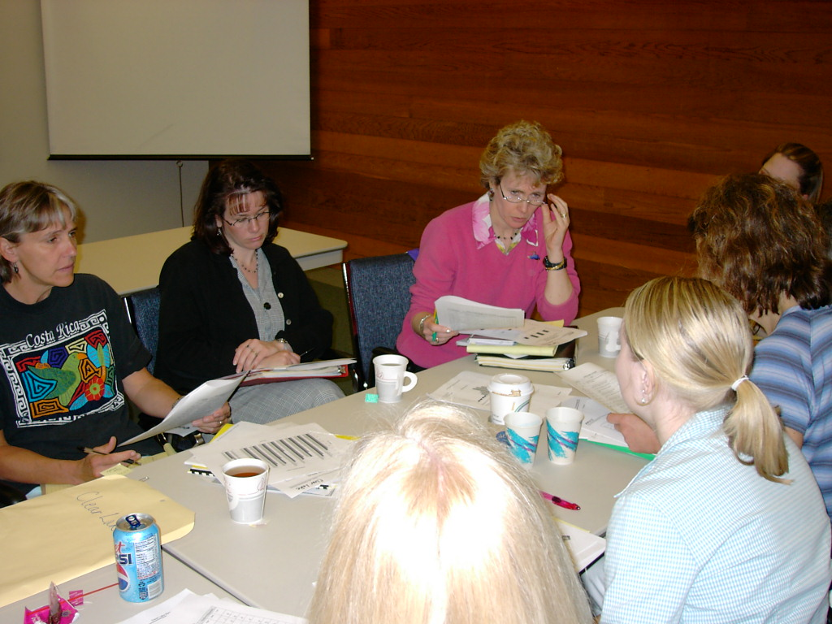
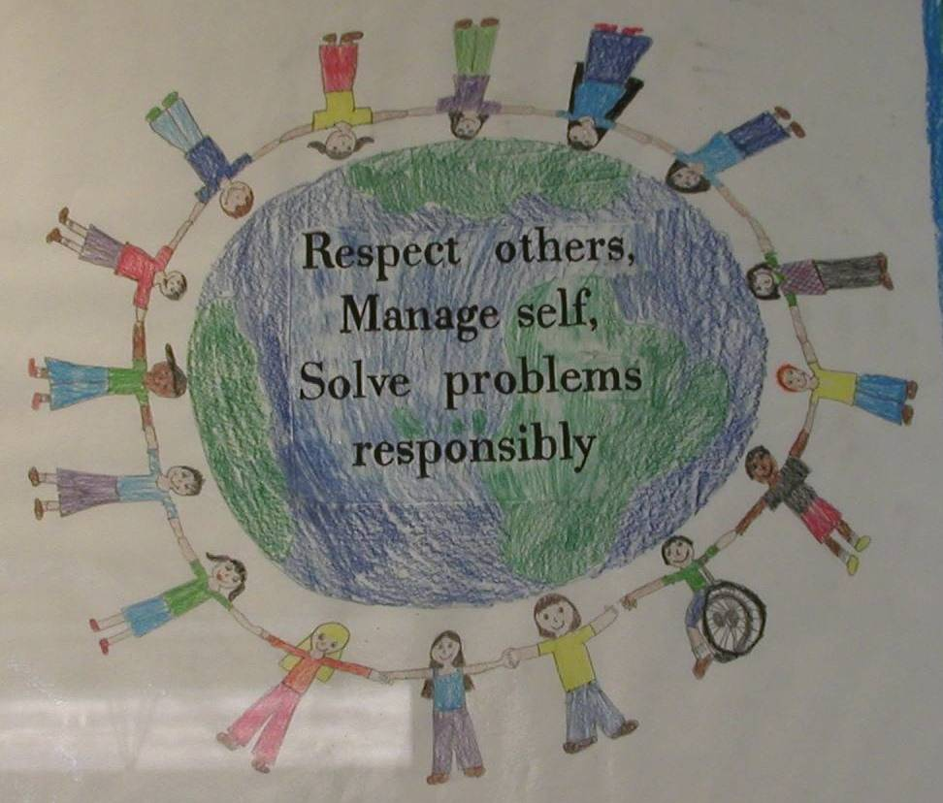
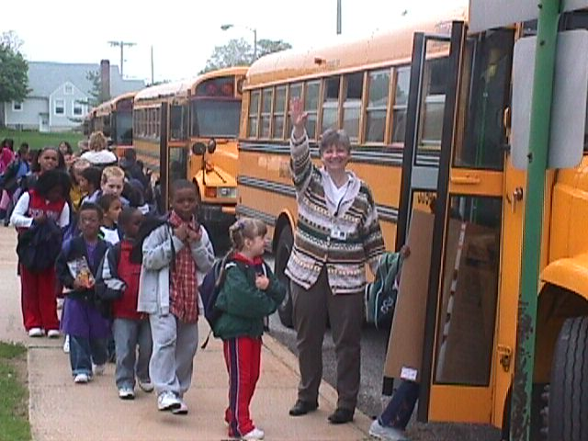
Establish Team
Develop Statement of Behavioral Purpose or Vision
At BSG, we are responsible for ourselves, respect each other, and maintain safety in our school.
Establish Behavioral Expectations/Rules
Teach Expectations in the
Context of School Settings

Slide 113
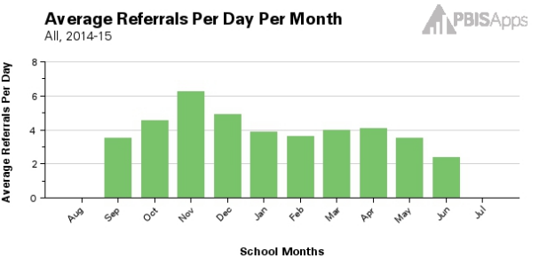
Teach Expectations in the
Context of Class Routines
Establish Procedures for Encouraging Appropriate Behavior
Establish Procedures for Responding to Inappropriate Behavior
Develop data-based procedures for monitoring

Slide 114
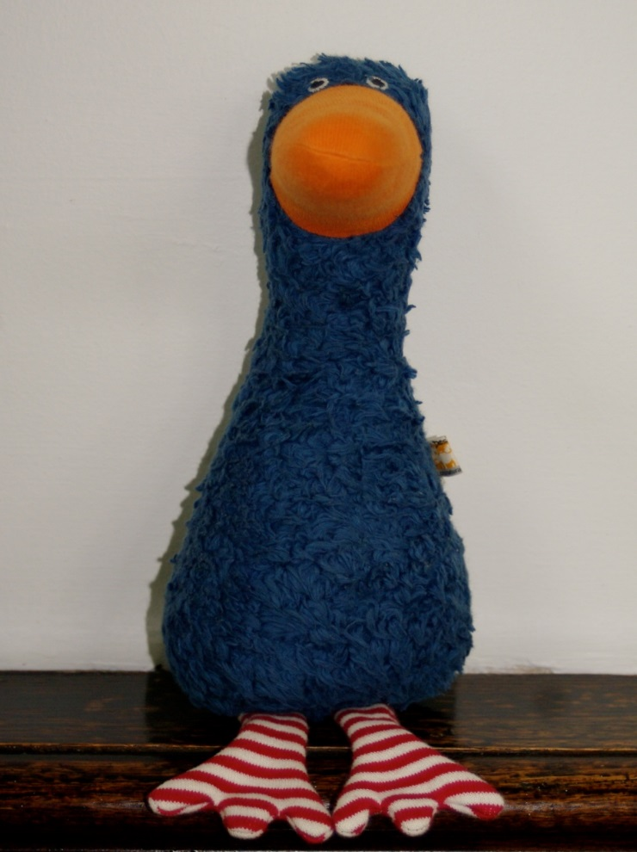

Develop Systems to Support Staff
Build Routines to Ensure On-Going Implementation
We will discuss steps 7-10 in more depth the next time we are together.

Slide 115
Consider Tattoos!
4 SWPBIS Elements
School Systems
Supporting Social Competence &
Academic Achievement
OUTCOMES
School-wide
Classroom
SWPBIS
SYSTEMS
DATA
Supporting
Decision
Making
Supporting
Staff Behavior
Non-classroom
Family
PRACTICES
Tertiary Prevention:
Specialized
Individualized
Systems for Students with High-Risk Behavior
~5%
Student
Supporting
Student Behavior
Primary Prevention:
School-/Classroom-
Wide Systems for
All Students,
Staff, & Settings
~15%
Secondary Prevention:
Specialized Group
Systems for Students with At-Risk Behavior
~80% of Students

Slide 116

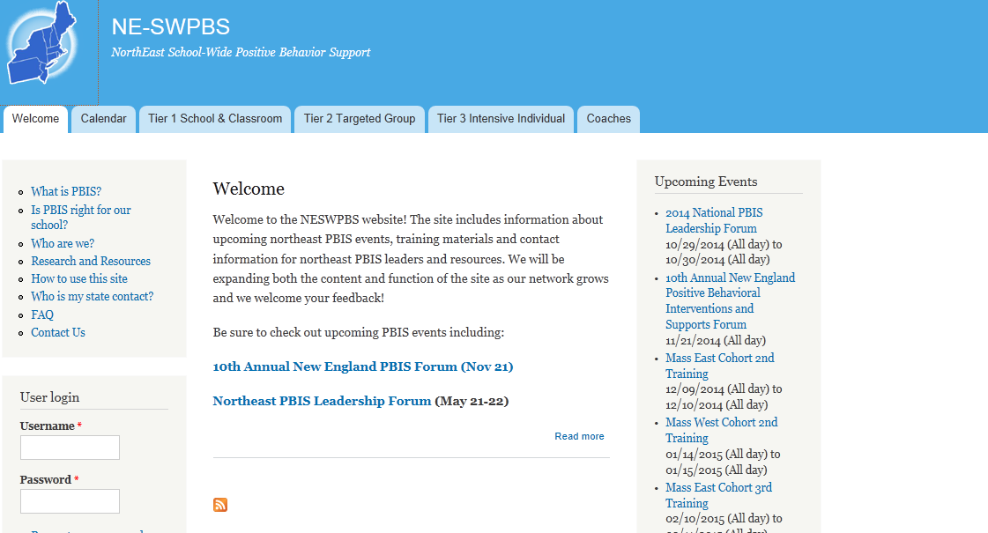
pbis.org
nepbis.org

Slide 117
TRAIN
Teach, Relate, Adapt, Implement, Navigate
Teach content explicitly.
Relate to audience.
Adapt presenter behaviors based on audience assessment data.
Implement to promote meaningful outcomes.
Navigate through the presentation.

Slide 118
Readiness Requirements

Slide 119
NEPBIS Readiness Requirements:
Develop Readiness Checklist
15 min
(assigned groups)
Review
  Example readiness requirements from various states training models
Discuss
  Rationale for each requirement
  Action steps for supporting schools in (and/or holding them accountable for) meeting
Draft
  Trainer tips for supporting teams in meeting readiness requirements
Debrief

Slide 120
Before and After Training Steps:
Prepare and Evaluate

Slide 121
Before and After Training Steps:
Preparing for and Evaluating Training
15 min
(assigned groups)
Review
  Review (a) chapter intros and (b) checklist on last page in NEPBIS TOT Trainer Manual
  Example checklists
Discuss
  Key preparation and evaluation activities
  Rationale for preparation and evaluation activities
Draft
  Ideal set of preparation and evaluation activities for NEPBIS trainers
Debrief

Slide 122
Facilitating Team Activities & Action Planning

Slide 123
Recap: TRAIN
Teach, Relate, Adapt, Implement, Navigate
Teach content explicitly.
Relate to audience.
Adapt presenter behaviors based on audience assessment data.
Implement to promote meaningful outcomes.
Navigate through the presentation.
How would this apply when responding to Frequently Asked Questions (FAQ)?

Slide 124
NEPBIS Approach to Action Planning
Intersperse activities throughout training to expose teams to content, allow them to begin to apply it, and raise questions
Reserve longer time for action planning at the end of each training day
  Teams can use time to make progress based on their own needs and current levels of implementation
  Trainers can use that time to differentiate trainer support

Slide 125
Strategies for Effective Facilitation
Provide clear instructions, describe intended outcomes, and set clear expectations (e.g., all participate, use time effectively).
Adapt trainer behaviors based on audience assessment data
Active supervision while respecting teams process
  Periodically monitor to identify teams who need assistance
  Offer support when requested or needed
  Encourage teams and reinforce progress
  Provide positive redirections when necessary to keep teams focused on outcomes

Slide 126
Discussion:
Facilitating Action Planning
20 min
(assigned groups)
Review
  Overview of action planning in the NEPBIS TOT Trainer Manual
  Activities in the NEPBIS TOT Trainer Manual
Discuss
  Applications of successful strategies
  Strategies to overcome challenges
  Additional key strategies
Debrief

Slide 127
Working Lunch

Slide 128
Recap: TRAIN
Teach, Relate, Adapt, Implement, Navigate
Teach content explicitly.
Relate to audience.
Adapt presenter behaviors based on audience assessment data.
Implement to promote meaningful outcomes.
Navigate through the presentation.
How would this apply when responding to Frequently Asked Questions (FAQ)?

Slide 129
Groups for Activities
Danielle D
Rochelle C
Lola G
Kate R
Christine K
Erica L
Kc N-O
Erin C
Clarissa F
Glenna F
Maryallyn B
Ellen R
Hannah G-B
Mary Jo T
Karyn S
Alicya S
Glenna F
Kristin G
Nicole H
Erik M
Nate G
Jennifer D
Melanie F
Julie D
Deb L
Janet V
Nikki S
Mitch O
Marlene M R
Gina K
Meghan W
Amanda B
Sharon W
Michele W-D
Claudia E
Cheyenne R
Karen W
Nicole S
Sarah W
Sarah J
Karen R
Brandi
Susannah
Adam
Jen

Slide 130
Working Lunch:
Plan Presentations of FAQ in PBIS
1 hour
(independent or small group)
Review
  Trainer manual
  School team training materials from Days 1-2 (workbook, power points, agendas)
Discuss
  FAQ
    Review content in trainer manual
    Discuss other FAQ
  Be prepared to respond to a FAQ in a 5-min presentation
Plan approach for 5-min FAQ presentation

Slide 131
5-min Presentations of FAQ in SWPBIS

Slide 132
5-Min Presentations:
FAQ in SWPBIS
2 hours
(assigned groups)
In groups, review procedures and roles
Presentation (each trainer in turn)
  Facilitator will select and read a FAQ
  Trainer will present 5-min response AND video record the presentation
  Observers will use video feedback form to evaluate trainer behavior
  Time keeper will provide a 5 min “shut off” reminder, and any time prompts requested by trainer
Feedback discussion
  Following each response, trainer and observers (i.e., all group members) will discuss the strengths, areas for improvement, and any questions using the feedback form

Slide 133
Debrief 5-Min Presentations:
Discuss Presentations of FAQ in PBIS
~50 min
(whole group)
What went well?
What was challenging?
Were there common areas of strength or suggestions for improvement?
What questions do you have about responding to FAQ from school team members?

Slide 134
Reminders
& Wrap-up

Slide 135
Reminder: NEPBIS TOT Schedule
We will meet at UConn (Gentry Building, Rooms 142-144) on:
Days 1-2: October 3-4
Days 3-4: February 27-28
Days 5-6: June 5-6
Day 7: October 4
Day 8: February 28
Day 9: June 6
Attend one of the Northeast PBIS conferences in year 1
and both in year 2:
• New England PBS in Norwood, MA in (November 14-15, 2017)
• Northeast PBIS in Mystic, CT (May 17-18, 2018)
Notes:
Need to update conference dates

Slide 136
Reminder: NEPBIS TOT Requirements
To become endorsed, prior to the end of your training sequence you must submit a minimum of:
  All TOT and homework activities (see above)
  Three training videos and DOT-Q self-reflections
    Preferred: three 20-30-min video samples of cohort-based training using NEPBIS content
    Alternative: three 20-30-min video samples of live PD on behavior content + 1 mock training of NEPBIS content
  Training evaluations from at least one school team
  Data from at least one trained school demonstrating fidelity (e.g., TFI, BoQ, SET; required) and ideally outcome data (e.g., ODRs; preferred)
  Attend three NEPBIS TOT Boosters (one at each NEPBIS Conference)
  Complete SWIS facilitator training

Slide 137
Reminder: NEPBIS TOT Requirements
To maintain endorsement, every 2 years you must submit a minimum of:
  One 20-30 min video demonstrating training NEPBIS content with a self-completed DOT-Q
  Training evaluations from at least one school team
  Data from at least one trained school demonstrating fidelity (e.g., TFI, BoQ, SET; required) and ideally outcome data (e.g., ODRs; preferred)
  Attend four NEPBIS TOT Boosters (one at each NEPBIS Conference)

Slide 138
Day 2, Homework 1
Review/Revise Presentations of “FAQ”
30 min
(individually)
DUE 10/20/17
Review video and feedback
  Review your video and group feedback from your 5-min presentations
  Evaluate the extent to which you effectively respond to the FAQ
Revise video (if appropriate
  Based on feedback, either determine that your video is appropriate to submit or re-record a 5-min presentation to address feedback
Complete your DOT-Q self assessment
  Include evidence to support your scores
  Include narrative indicating what you changed from your original presentation
Upload to your Dropbox folder
  Video (or video link)
  Self Assessment
  Indicate submission on your master spreadsheet

Slide 139
Day 2, Homework 2
Foundational Content Review: Culture and Context
~90 min
(individually)
Due 10/20/17
Read Sugai, O’Keefe, & Fallon, 2012
  Posted in nepbis.org on the trainers tab
Watch Kent McIntosh APBS Keynote
  Go to APBS.org under APBS Videos. Click on videos from conference 2015
  Click on APBS 2015 welcome and keynote video
  If you are not an APBS member you will need to sign up for a visitor pass to access this content.
Script speakers notes for teaching about culture and context content and putting it all together (Day 1 slides 136-137; 144)
Submit scripted slides via day 1+2 dropbox folder and updated your endorsement tracker

