Slide 1
School-Wide Positive Behavioral Interventions and Supports (SWPBIS)
Northeast PBIS (NEPBIS) School-Wide Team Training
Day 1
INSERT TRAINER NAMES
with support from Brandi Simonsen, Jen Freeman,
Susannah Everett, & George Sugai
Notes:
Add trainer names for your event

Slide 2

Activity Times
Trainers: refer to training manual for:
Tips on presenting the overview content
Explanation for short activity periods and ideas for teaching this to teams
Ideas for facilitating review and team action planning

Slide 3

Advance Organizer
Overview of NEPBIS School-Wide Training
Overview of PBIS/SWPBIS
  Why SWPBIS?
  What is SWPBIS?
  Critical Features
  Evidence Based Behavioral Interventions
  Continuum of Behavior Support
  SWPBIS Team Implementation Process
Getting Started with SWPBIS (steps 1-3)
Action Planning

Slide 4
Tier 1 Leadership Team & Coaches Meetings
WHAT | WHO
6 days of Team Training | Minimum membership: administrator, grade level representatives, support staff
3 days Coaches Meetings | 2 Coaches
2 days of TA per district | Admin, Coach, Data Entry
YEAR 1
3 days of Team Training | Same above
3 days Coaches Meetings | Same above
2 days of TA per district | Same above
YEAR 2
2 days of Team Training | Same above
3 days Coaches Meetings | Same above
2 days of TA per district | Same above
YEAR 3+
Tier 2 Training will also be offered to schools implementing Tier 1 with fidelity.
Notes:
Modify as appropriate to match your training approach (e.g., change number of TA days, but not training days)

Slide 5
MAIN TRAINING OBJECTIVES
Establish leadership team
Establish staff agreements
Build working knowledge of SWPBIS outcomes, data, practices, and systems
Develop individualized action plan for SWPBIS
Organize for upcoming school year

Slide 6
Training Expectations:
RESPECT…
SELF
Self-monitor (Are you participating? Engaged as a learner? Talking during allotted times?)
Stretch, break, stand as needed
OTHERS
Cell phones (inaudible): Converse in lobbies and breaks
ENVIRONMENT
Recycle
Work as a team: Room for every voice, reinforce participation
Maintain neat working area

Slide 7
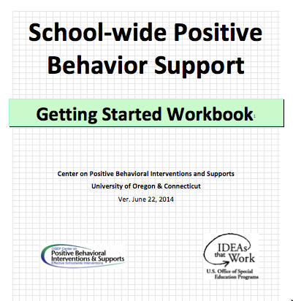
Tools!
School-Wide PBIS Workbook and Appendices

Slide 8
1. Overview of SWPBIS
2. Getting Started with SWPBIS
3. Non-classroom Settings
4. Classroom Settings
5. Building Behavioral Capacity

Slide 9

Tools!
nepbis.org
pbis.org
School-Wide PBIS Workbook and Appendices

Slide 10
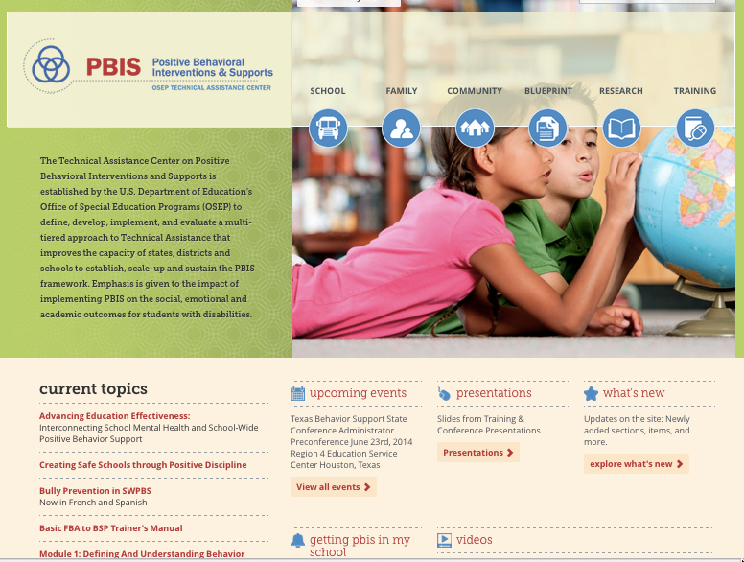
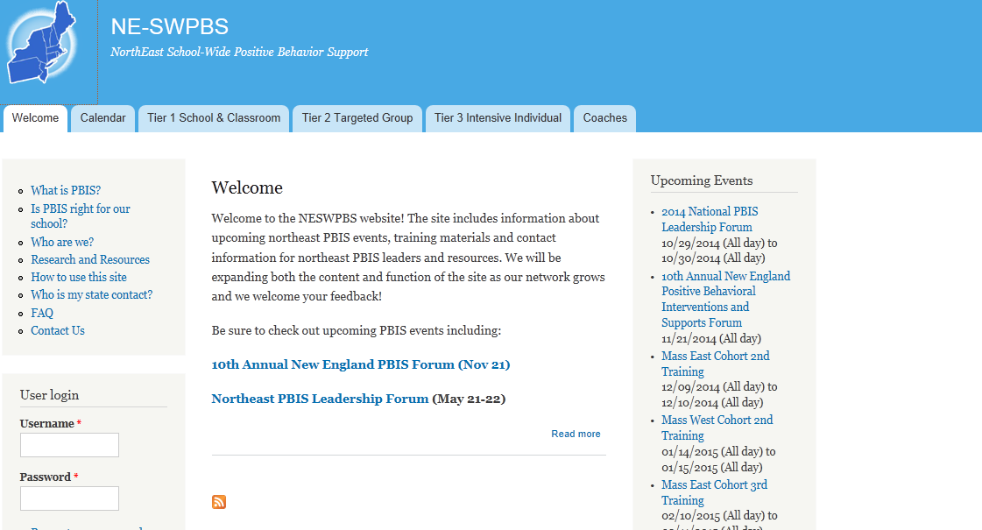
pbis.org
nepbis.org

Slide 11
Tools!
nepbis.org
pbis.org
School-Wide PBIS Workbook and Appendices
Evaluation Plan

Slide 12
See evaluation plan…
DISTRICTS/SCHOOLS IN TRAINING |  |  | SCHEDULE
Purpose | Measure | Function | Year 1 Training |  | Year 2 Training
 |  |  | Winter | Spring | Fall | Winter | Spring
Capacity Building—District Level | District Capacity Assessment (DCA) | Completed by district leadership team (with the support of a trained facilitator) to assess district capacity and to guide Action Planning. |  | X |  |  | X
Fidelity of Implementation—Building Level | PBIS Tiered Fidelity Inventory (TFI) | Leadership team self-evaluation (with support of external coach) to assess the critical features of PBIS across Tiers I, II, and III. |  | X | X |  | X
Progress Monitoring—Building Level | Self-Assessment Survey (SAS) | Used by school staff for initial and annual assessment of effective behavior support systems in their school and to guide Action Planning. |  | X |  |  | X
Progress Monitoring—Team Level | Team Implementation Checklist (TIC) | A self-assessment tool that serves as a multi-level guide for creating School-Wide PBIS Action Plans and evaluating the status of implementation activities. | X | X | X | X | X
School Climate | Georgia School Climate Surveys | An annual survey that assesses student (grades 3-12), teacher, and parent perceptions of school climate. The middle and high school surveys also include items about adolescent drug/alcohol/tobacco use, self-harm ideation and behaviors, school dropout, and parental involvement. The survey provides information to determine training support needs related to school climate, safety, and violence prevention. |  | X | X
Student Outcomes | School-wide Information System (SWIS) | Office discipline referrals (ODR) provide data for monthly team reviews and decision-making by teachers, administrators, and other staff to guide prevention efforts and Action Planning. | Weekly | Weekly | Weekly | Weekly | Weekly
…in your materials on nepbis.org

Slide 13

Tools!
nepbis.org
pbis.org
School-Wide PBIS Workbook and Appendices
Evaluation Plan
Action Plan

Slide 14
Activity:
Coaches Please Enter Attendance
Coaches 1 min
Coaches, please login on nepbis.org, go to the coaches’ tab, and click on the Team Training Attendance Link. Follow prompts to enter team attendance.

Slide 15





Legend
New Content
Review
Guidelines
+Ex
-Ex
Training Organization
Activity

Slide 16

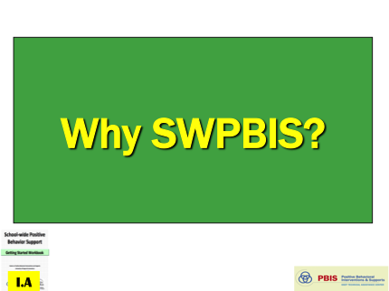
Legend
Section Header (I.A)
Chapter Header (e.g., I)

Slide 17
Overview of School-wide Positive Behavior SupportS
(Chapter i)

Slide 18

Why SWPBIS?
I.A

Slide 19
Why SWPBIS?
“Get Tough” doesn’t work
Context matters
Schools are asked to do more with less
SWPBIS works
I.A.i

Slide 20
“Get Tough” Doesn’t Work
Student Acts Out
Teacher says no and gives initial consequence
Student becomes disrespectful
Teacher sends student to office
Student escapes class
Notes:
These slides are a slightly shorter way to make this point- feel free to delete but given feedback on number of slides I put them here as an option

Slide 21
“Get Tough” Doesn’t Work
So why do we keep doing it?
What did the student learn?
What did the teacher learn?

Slide 22
“Get Tough” Doesn’t Work
So why do we keep doing it?
Student Acts Out
Teacher says no and gives initial consequence
Student becomes disrespectful
Teacher sends student to office
Student escapes class
Student escapes work
Teacher can teach class without disruption
For some students this is effective- so we think it works

Slide 23
“Teaching” by Getting Tough
Runyon: “I hate this f____ing school, & you’re a dumbf_____.”
Teacher: “That is disrespectful language. I’m sending you to the office so you’ll learn never to say those words again….starting now!”

Slide 24
Immediate & seductive solution…. “Get Tough!”
Give initial “aversive” consequence
  Say “no”
  Remove privilege
  Send to “think seat”
...Predictable individual response
Some students’ behaviors improve (“respond” );
Other students’ behaviors continue…
I.A.i

Slide 25
Reactive responses are predictable….
When we experience aversive situation, we want select interventions that produce immediate relief
  Remove student
  Remove ourselves
  Modify physical environment
  Assign responsibility for change to student &/or others
I.A.i

Slide 26
When behavior still doesn’t improve, we “Get Tougher!”
Give additional and more “aversive” consequences
  Repeat “NO” louder
  Move closer and point
  Complete ODR
  Threaten and establish bottom line
  Send to in-school detention
Again, some students’ behaviors improve (“respond” );
Other students’ behaviors continue…
I.A.i

Slide 27
When behavior still doesn’t improve, we “Get Even Tougher!”
Increase intensity, frequency, and duration of “aversive” consequences
  Zero tolerance policies
  Increased monitoring and security
  Physically assist or intervene
  Give out of school suspension
Behavior escalates in intensity, frequency, and duration to levels that interfere with teaching and learning
I.A.i

Slide 28
Erroneous assumptions that …
….student is inherently “bad”
…student must prove they deserve to be part of class
…aversive consequences teach
…some kids improve (even temporarily), so all will
…will be better tomorrow…
I.A.i

Slide 29
But….false sense of safety/security!
Fosters environments of control
Triggers & reinforces antisocial behavior
Shifts accountability away from school
Devalues child-adult relationship
Weakens relationship between academic & social behavior programming
I.A.i

Slide 30
Science of behavior has taught us that students….
…are NOT born with “bad behaviors”
…do NOT learn when presented contingent aversive consequences
...DO LEARN better ways of behaving by being taught directly & receiving positive feedback
The power of SWPBIS is not in the rewards, it is in the teaching!

Slide 31
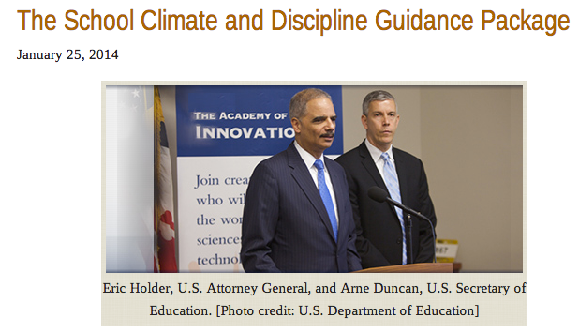


School Discipline and Climate
Mental Health and School Violence
Disproportionality
Notes:
Not only does “get tough” not work because it is built on bad assumptions and reinforces the wrong things but there is increasing public pressure and policy to find a better way. The challenge is unless we provide students and teachers with other options the status quo is unlikely to change.

Slide 32
VIOLENCE PREVENTION
Positive, predictable school-wide climate
High rates of academic & social success
Formal social skills instruction
Positive, active supervision & reinforcement
Positive adult role models
Multi-component, multi-year school-family-community efforts
Surgeon General’s Report on Youth Violence (2001)
Coordinated Social Emotional & Learning (Greenberg et al., 2003)
Center for Study & Prevention of Violence (2006)
White House Conference on School Violence (2006)
I.A.i

Slide 33
Why SWPBIS?
“Get Tough” doesn’t work
Context matters
Schools are asked to do more with less
SWPBIS works
I.A.ii

Slide 34
Context Matters!
Examples:
Individual Student
vs.
School-wide

Slide 35
“Albert”
Albert displays a number oppositional behaviors such as refusing to remain in his seat when asked, walking out of the classroom without permission, and talking during independent seatwork. When his usual routines are unexpectedly changed (e.g. school-wide assembly, guest speaker, or fire drill) his behavior behavior increases, he walks out of class, yells, and swears at his peers. His teachers are unable to convince him to return to class.
What would you do?

Slide 36
“Brooke”
Brooke dresses in black every day, rarely interacts with teachers or other students, & she often puts her head down on her desk, or listens to her iPod. When approached or confronted by teachers, she pulls hood of her black sweatshirt or coat over her head & walks away. Mystified by Brooke’s behavior, teachers usually shake their heads & let her walk away. Recently, Brooke drew pictures depicting morbid scenes such as gory skeletons and graveyards on the front of her notebooks. Other students became frightened when they noticed what she was drawing. When asked about the pictures she mumbles f@$& you.
What would you do?

Slide 37
Fortunately, we have a science that guides us to…
Assess these situations
Develop behavior intervention plans based on our assessment
Monitor student progress & make enhancements
All in ways that can be culturally & contextually appropriate
(Crone & Horner, 2003)

Slide 38
However, context matters….
What factors influence our ability to implement what we know with accuracy, consistency, & durability for students like Albert and Brooke?
I.A.ii

Slide 39
“159 Days!”
Intermediate/senior high school with 880 students reported over 5,100 office discipline referrals in one academic year. Nearly 2/3 of students have received at least one office discipline referral.

Slide 40
5,100 referrals =
76,500 min @15 min =
1,275 hrs =
159 days @ 8 hrs
Albert and Brooke are in this school!

Slide 41
SWPBIS Message!
Successful individual student behavior support is linked to host environments or school climates that are effective, efficient, relevant, & durable.
(Zins & Ponti, 1990)
I.A.ii

Slide 42
Why SWPBIS?
“Get Tough” doesn’t work
Context matters
Schools are asked to do more with less
SWPBIS works
I.A.iii

Slide 43
School Reform Problem Context
School violence
School completion & dropping out
Under-achievement
Suspension & expulsions
Disability
Disproportionality & Equity
Restraint & seclusion
Bullying
Delinquency
Substance use
School Climate
Notes:
School have been asked to address MANY problems.

Slide 44
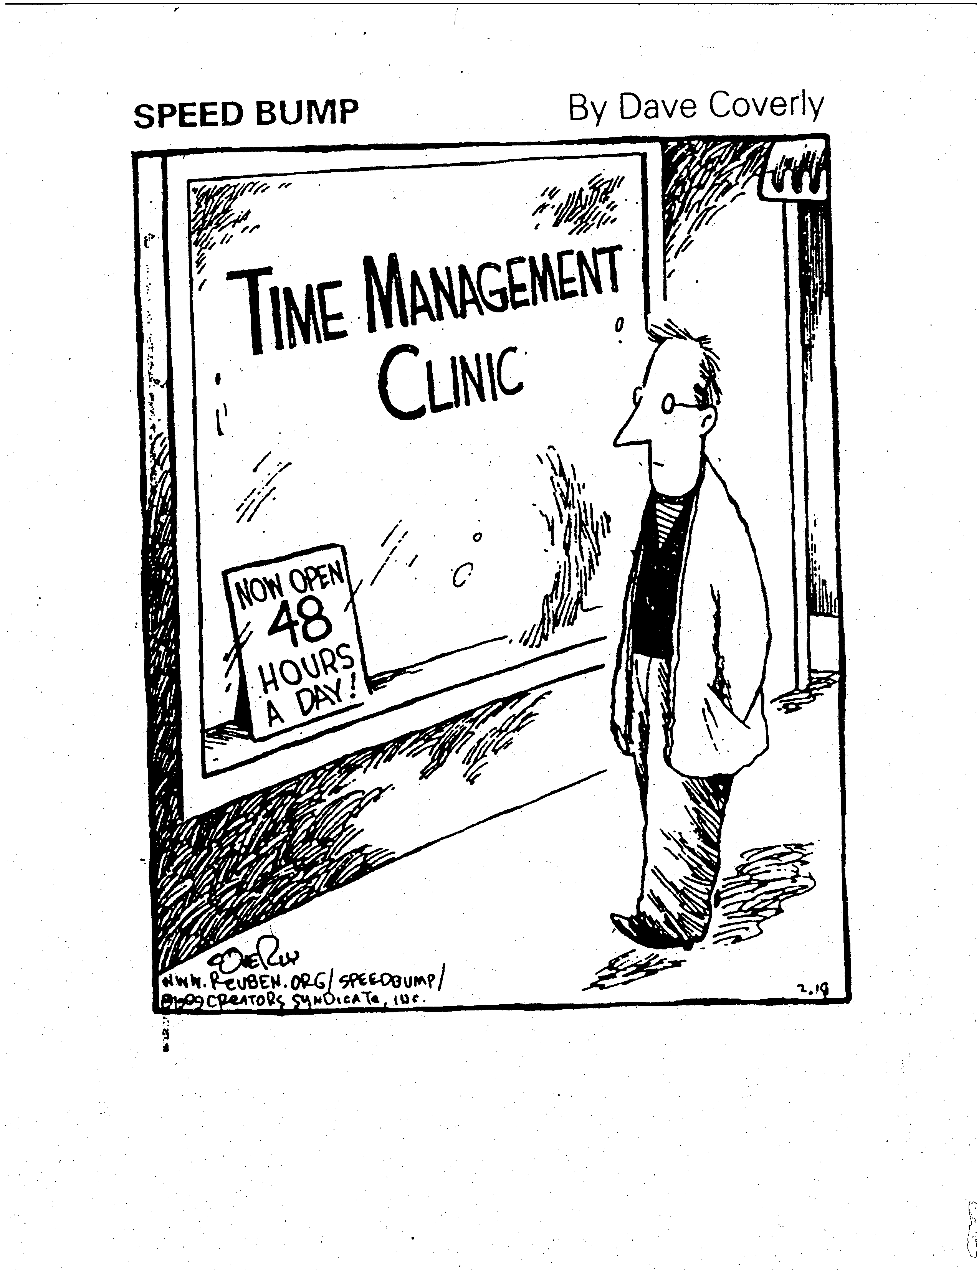
Notes:
If only we had more time.

Slide 45
School Reform Problem Context
School violence
School completion & dropping out
Under-achievement
Suspension & expulsions
Disability
Disproportionality & Equity
Restraint & seclusion
Bullying
Delinquency
Substance use
School Climate
Not Equal
Notes:
School have been asked to address MANY problems.

Slide 46
Antecedents | Behaviors | Consequences
STUDENT BEHAVIOR | ADULT BEHAVIOR | OUTCOMES
Aggression Bullying behavior Non-compliance Insubordination Social w/drawal Truancy Law/norm violations Substance use Weapon possession Harassment Self-injury | Office referral In school detention Out of school suspension Probation & parole Arrests & incarceration Restraint & seclusion Mental health referral | Disproportionality Dropping out School failure Mental illness School-to-prison pipeline Achievement gap Unemployment Delinquency
Logic Model
Notes:
But those problems are not equal. Some are student behaviors some are adult behaviors and some are outcomes. And I’m not smart enough to come up with this so George gets the credit for this logic. But what this logic allows us to do is focus on the parts we can control. If we look at the student behaviors as antecedents for the adult behaviors then we can begin to create a plan to change those behaviors and the outcomes.

Slide 47
Notes:
We can then build a plan to set the environment up for success and teach what we’d like kids and adults to do instead – PBIS gives us the framework to organize all that is on our plates in a way that leads us to a preventative and instructional solution and then gives us the tools to make sure we implement that plan with fidelity.

Slide 48
Competing, Inter-related National Goals
Common core
Improve literacy, math, geography, science, etc.
Make schools safe, caring, & focused on teaching & learning
Improve student character & citizenship
Eliminate bullying
Prevent drug use
College & career readiness
Provide a free & appropriate education for all
Prepare viable workforce
Affect rates of high risk, antisocial behavior
Leave no child behind
Etc….

Slide 49
Challenge

Slide 50
Why SWPBIS?
“Get Tough” doesn’t work
Context matters
Schools are asked to do more with less
SWPBIS works
I.A.iv

Slide 51
And, when done well, SWPBIS makes things better for kids and adults!

Slide 52
Research Says…
Implementing Tier 1 SWPBS is associated with the following positive outcomes:
  Increases in prosocial behavior
  Increases in organizational health/climate
  Increases in state-wide test scores (tentative)
  Decreases in office discipline referrals
  Decreases in suspensions
  Decreases in reported bullying
(e.g., Bradshaw, Koth, Thornton, & Leaf, 2009; Bradshaw, Koth, Bevans, Ialongo, & Leaf, 2008; Bradshaw, Mitchell, & Leaf, 2010; Bradshaw, Waasdorp, & Leaf, 2012; Horner et al., 2009; Waasdorp, Bradshaw, & Leaf, 2012 )a

Slide 53
Research Says…
Further, among schools implementing SWPBS, those that implement with fidelity experience greater
  decreases in ODRs,
  decreases in suspensions, and
  increases in state-wide test scores in math over time.
(Simonsen, Eber, Sugai, Black, Lewandowski, Simms, & Myers, 2012)

Slide 54
Schools Implementing PBIS
August, 2017
25,911 Schools Implementing PBIS
-----------------------------------
13,832,582 Students
3367
High Schools

Slide 55
Schools Implementing PBIS August, 2017
21 States with over 500 schools using PBIS

Slide 56
Proportion of Schools Implementing PBIS by State, August 2017
14 States with over 40% of schools using PBIS

Slide 57
Activity:
Why SWPBIS In Your School?
Work as team for 5 min
Discuss the rationale for implementing PBIS
  What does staff knowledge and support for PBIS currently look like in your school?
  What are the current student and staff needs in your building?
  How can PBIS help meet those needs?
  What messages will be important for you to take back to share with staff and build support?
Summarize key points

Slide 58
What is SWPBIS?
I.B

Slide 59
SWPBIS is
Framework for enhancing adoption & implementation of
Continuum of evidence-based interventions to achieve
Academically & behaviorally important outcomes for
All students
I.B.i

Slide 60
SWPBIS is an organizational approach for…
Improving classroom & school climate
Integrating academic and behavior initiatives
Decreasing reactive management
Improving support for students with EBD
Maximizing academic achievement
I.B.ii

Slide 61
Conceptual Foundations of SWPBIS
Behaviorism
  Behavior
  is learned,
  lawful, and maleable
ABA
  Apply to socially important problems in applied settings
PBIS
  Consider larger context of improving quality of life
SWPBIS
I.B.iii

Slide 62
Revisiting SWPBIS Message!
Successful individual student behavior support is linked to host environments or school climates that are effective, efficient, relevant, & durable.
(Zins & Ponti, 1990)
I.A

Slide 63
Effective Organizations
POSITIVE SCHOOL-WIDE CLIMATE FOR ALL (Students, Family, School, Community)
Common Language
Common Experience
Common Vision/Values
Quality
Leadership
I.B.vi

Slide 64
What are the critical features of SWPBIS?
I.C

Slide 65
Critical Features of PBIS
Supporting Culturally Equitable
Social Competence & Academic Achievement
OUTCOMES
Supporting
Culturally
Knowledgeable
Staff Behavior
Supporting
Culturally Valid
Decision
Making
SYSTEMS
DATA
(Vincent, Randal, Cartledge, Tobin, & Swain-Bradway, 2011; Sugai, O’Keefe, & Fallon 2012 ab)
PRACTICES
I.C
Supporting Culturally Relevant
Evidence-based Interventions
Notes:
Use data
Focus on outcomes: Academic & behavior success
On-going evaluation
Ensure cultural and contextual fit
Invest in systems
Organize research-validated practices within a continuum
Instructional & preventative approach
Integration
Tier 1 for all

Slide 66
Critical Features of PBIS
Supporting Culturally Equitable
Social Competence & Academic Achievement
OUTCOMES
Supporting
Culturally
Knowledgeable
Staff Behavior
Supporting
Culturally Valid
Decision
Making
SYSTEMS
DATA
PRACTICES
Supporting Culturally Relevant
Evidence-based Interventions
Notes:
Use data
Focus on outcomes: Academic & behavior success
On-going evaluation
Ensure cultural and contextual fit
Invest in systems
Organize research-validated practices within a continuum
Instructional & preventative approach
Integration
Tier 1 for all

Slide 67
Focus on Outcomes
OUTCOMES
How do we develop outcome statements?
I.C.i

Slide 68
Guidelines for Good Outcomes
OUTCOMES
Based on data
Locally important and meaningful
Applicable to all (culturally equitable)
  Students’ social competence and academic achievement
  Staff implementation of critical skills
Observable and measurable
Written as a goal
I.C.i

Slide 69

Non-example Outcome Statement
Student behavior will improve.
How would you know?

Slide 70

Example Outcome Statement
As a result of implementing PBIS during the 20XX-20XY school year, ODR data will decrease by __% relative to that same period the prior year.

Slide 71
Non-example Outcome Statement
As a result of implementing PBIS, school climate will improve and the school will feel better.
How would you know?

Slide 72
Example Outcome Statement
As a result of implementing PBIS, staff, student, and parent surveys will indicate improved overall school climate (or target specific items related to acknowledgement, respect, etc.) as measured by an improvement of __ points on the Georgia Brief School Climate Surveys.

Slide 73
Non-example Outcome Statement
During the first semester of PBIS implementation, staff members will teach expectations to students and “catch them being good.”
How would you know?

Slide 74
Example Outcome Statement
During the first semester of PBIS implementation, staff members will implement PBIS with fidelity, as measured by meeting criteria on the Tiered Fidelity Inventory.

Slide 75
Non-example Outcome Statement
During the first semester of PBIS implementation, staff members will be more positive toward students.
How would you know?

Slide 76
Example Outcome Statement
During the first semester of PBIS implementation, 80% of staff members will meet or exceed a 4:1 positive to negative ratio as measured by calculating a ratio of positive tickets/acknowledgements to office discipline referrals (ODRs) per staff.

Slide 77
Activity:
Developing Outcomes
Work as team for 10 min
Begin to draft 1-3 observable and measurable outcome statements for your school.
  Consider at least one outcome statement focused on student behavior and one focused on adult behavior
Present 2-3 “big ideas” from your group (1 min. reports)

Slide 78
Critical Features of PBIS
Supporting Culturally Equitable
Social Competence & Academic Achievement
OUTCOMES
Supporting
Culturally
Knowledgeable
Staff Behavior
Supporting
Culturally Valid
Decision
Making
SYSTEMS
DATA
PRACTICES
Supporting Culturally Relevant
Evidence-based Interventions
Notes:
Use data
Focus on outcomes: Academic & behavior success
On-going evaluation
Ensure cultural and contextual fit
Invest in systems
Organize research-validated practices within a continuum
Instructional & preventative approach
Integration
Tier 1 for all

Slide 79
Focus on Data
DATA
What is data-driven decision making?
I.C.ii

Slide 80
To effectively use data…
…use your evaluation plan
DISTRICTS/SCHOOLS IN TRAINING |  |  | SCHEDULE
Purpose | Measure | Function | Year 1 Training |  | Year 2 Training
 |  |  | Winter | Spring | Fall | Winter | Spring
Capacity Building—District Level | District Capacity Assessment (DCA) | Completed by district leadership team (with the support of a trained facilitator) to assess district capacity and to guide Action Planning. |  | X |  |  | X
Fidelity of Implementation—Building Level | PBIS Tiered Fidelity Inventory (TFI) | Leadership team self-evaluation (with support of external coach) to assess the critical features of PBIS across Tiers I, II, and III. |  | X | X |  | X
Progress Monitoring—Building Level | Self-Assessment Survey (SAS) | Used by school staff for initial and annual assessment of effective behavior support systems in their school and to guide Action Planning. |  | X |  |  | X
Progress Monitoring—Team Level | Team Implementation Checklist (TIC) | A self-assessment tool that serves as a multi-level guide for creating School-Wide PBIS Action Plans and evaluating the status of implementation activities. | X | X | X | X | X
School Climate | Georgia School Climate Surveys | An annual survey that assesses student (grades 3-12), teacher, and parent perceptions of school climate. The middle and high school surveys also include items about adolescent drug/alcohol/tobacco use, self-harm ideation and behaviors, school dropout, and parental involvement. The survey provides information to determine training support needs related to school climate, safety, and violence prevention. |  | X | X
Student Outcomes | School-wide Information System (SWIS) | Office discipline referrals (ODR) provide data for monthly team reviews and decision-making by teachers, administrators, and other staff to guide prevention efforts and Action Planning. | Weekly | Weekly | Weekly | Weekly | Weekly
…and tools available at:

Slide 81
Measure | Year 1 Training |  | Year 2 Training
 | Winter | Spring | Fall | Winter | Spring
District Capacity Assessment (DCA) |  | X |  |  | X
PBIS Tiered Fidelity Inventory (TFI) |  | X | X |  | X
Self-Assessment Survey (SAS) |  | X |  |  | X
Team Implementation Checklist (TIC) | X | X | X | X | X
Georgia School Climate Surveys |  | X | X
SWIS | Weekly | Weekly | Weekly | Weekly | Weekly
Let’s quickly preview SWIS (www.pbisapps.org)

Slide 82

SWIS & Systems Change
OUTCOMES
Social Competence & Academic Achievement
Supporting
Decision
Making
Supporting
Student Behavior
DATA
PRACTICES
SYSTEMS
Supporting Staff Behavior
Notes:
Systems Model
Outcome: Increase social competence
SWIS is a data collection tool (data) that works as part of the larger system for meeting this outcome.
Point out that on a smaller scale SWIS has it’s own systems and practices?
SWIS is a system for organizing information around social behavior, beginning with readiness.
SWIS includes a set of specific practices including SWIFT at SWIS and TIPS.

Slide 83

What is the School-Wide Information System (SWIS)?
The School-Wide Information System (SWIS) is a web-based decision system used to improve behavior support in schools and other educational facilities by providing school personnel with accurate, timely, and practical information for making decisions about school environments.
Notes:
Trainer Note: Reminder – this is what SWIS is about.

Slide 84
Three Components of SWIS
Computer Application
  Web-based technology that is secure, subscription-based, and continuously available for entry, management, and reporting of data
Data Collection System
  Practices and resources to support collection and organization of data (e.g., documentation, staff, time, training)
Decision System
  Practices and resources to support team-based analysis of data for continuous quality improvement (e.g., documentation, team agreements, problem-solving routines)
Notes:
Trainer Note: This is something that participants should be reminded of throughout the training! SWIS is more than just a computer application that schools purchase, it’s about embedding data into a data collection system that provides the foundation for a comprehensive decision system which leads to improved student social competence and academic outcomes.

Slide 85
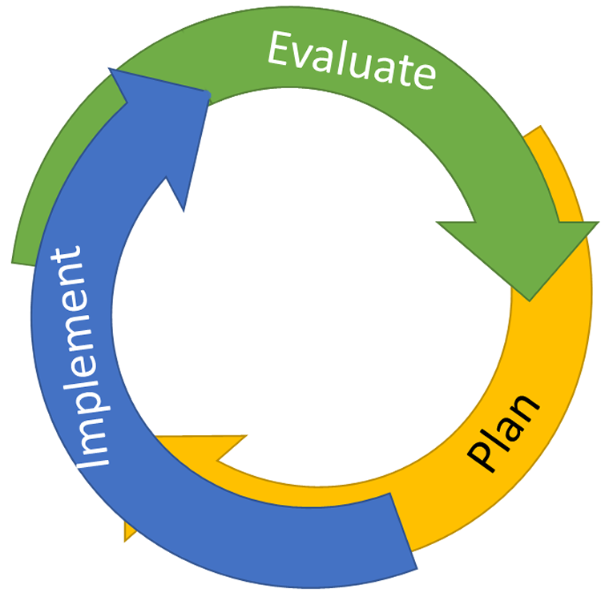
Continuous Quality Improvement
Reassess and revise solution(s) as needed
Identify problems with precision
Monitor outcomes and compare
to goal(s)
DATA
Establish goal(s)
Develop solution(s)
Implement solution(s) with integrity and fidelity
Notes:
Trainer Note:
We want to interrupt the traditional cycle of admiring the problem, by talking and talking about the problem before quickly launching into determining solutions.
We can do this by building a system for improved decision making.

Slide 86
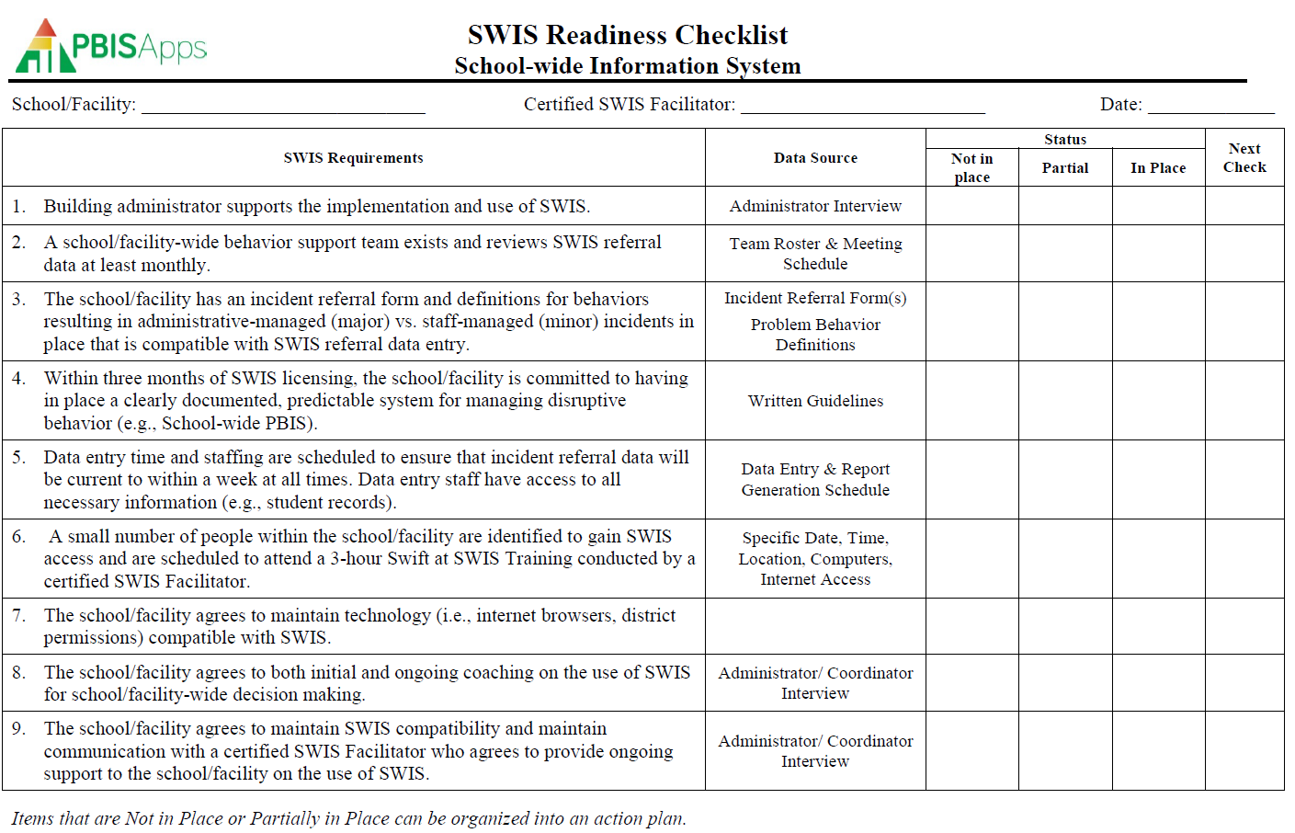
SWIS Implementation Readiness
Notes:
Trainer Note: Here is the SWIS Readiness Checklist. There are nine requirements to meet readiness, and typically, numbers 3 and 4 take the longest for schools/facilities to address. We will come back to these and do some simulations to demonstrate what readiness looks like for #s 3 and 4.

Slide 87
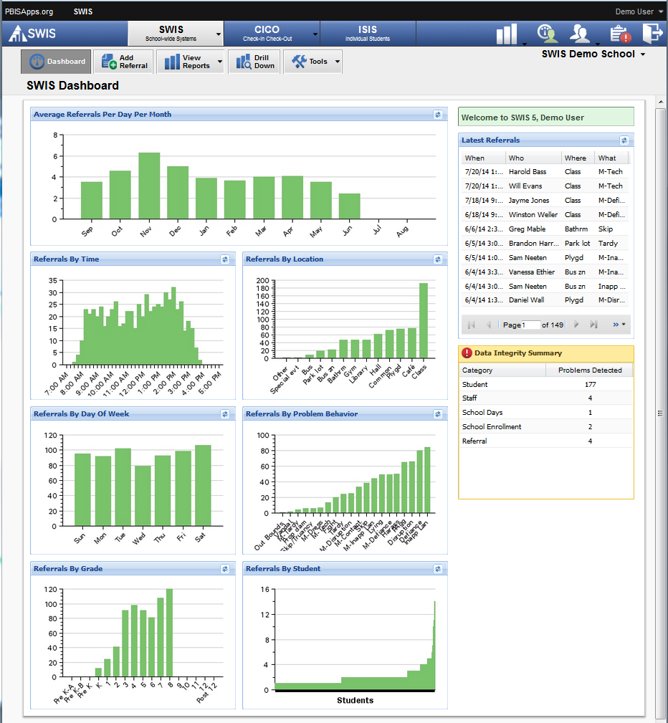
Notes:
Trainer Note: Remember this is the SWIS Dashboard.

Slide 88
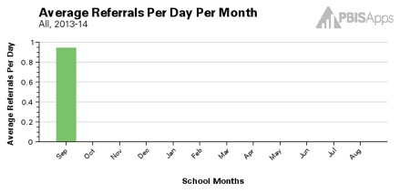
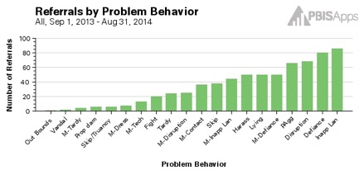
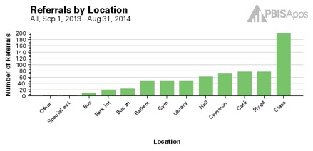
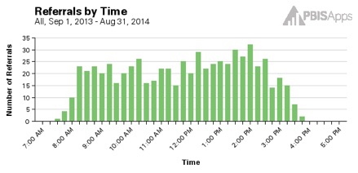
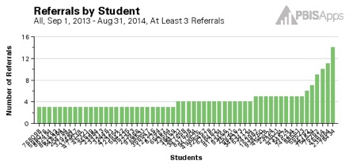
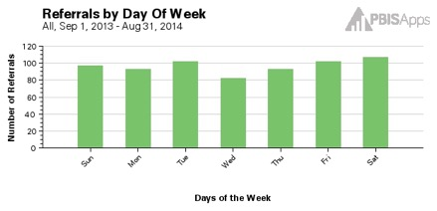
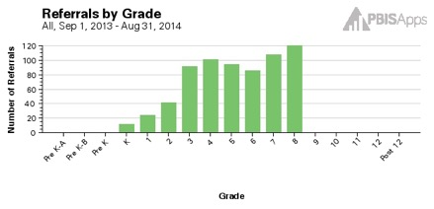
Core SWIS Reports
Notes:
Trainer Notes:
Core Reports provide information at the school-wide level. These reports are presented on the main SWIS Dashboard and are also available in the reports dashboard (View Reports). The value of the Core Reports is that they help schools quickly and visually identify “red flags” or potential problems that may need further inquiry. The Core Reports include: Average Referrals Per Day Per Month, Referrals By Location, Referrals By Problem Behavior, Referrals By Time, Referrals By Student, Referrals By Day of Week, and Referrals By Grade. Both the day of week and grade reports are new in SWIS 5.

Slide 89
This is what it would actually look like at www.pbisapps.org
Notes:
Trainer Note: Remember this is the SWIS Dashboard.

Slide 90
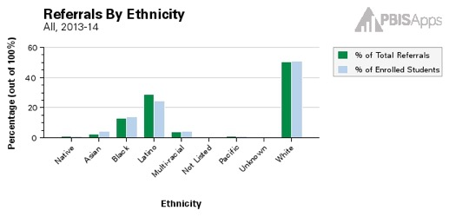
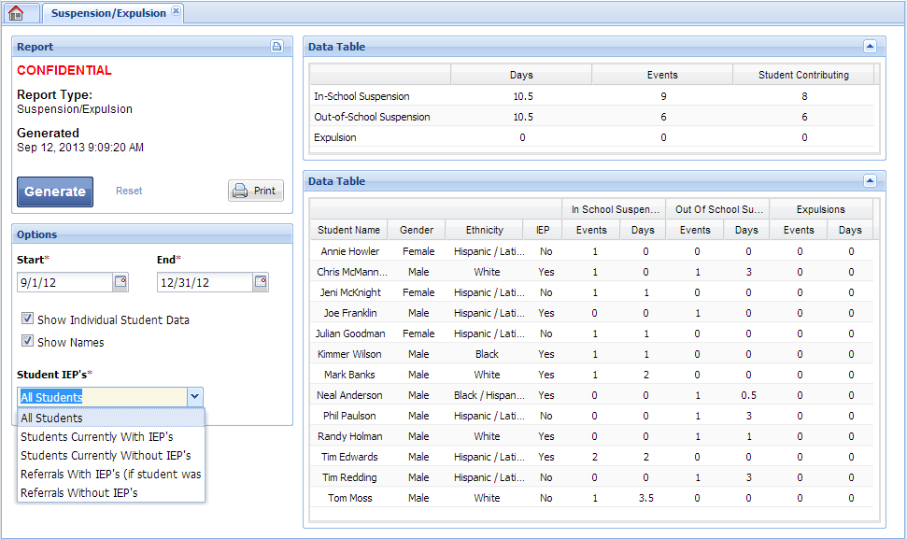
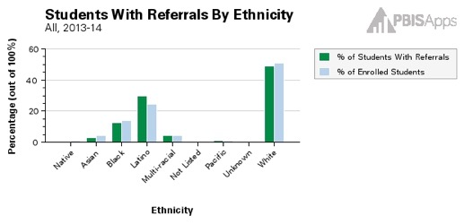
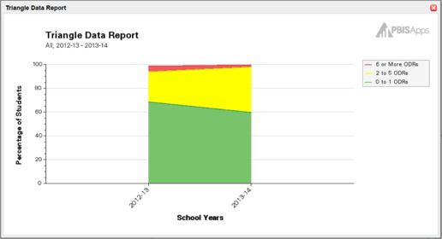
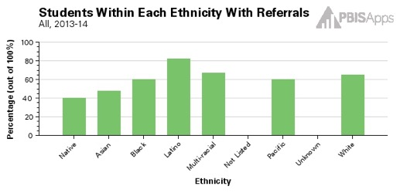
Additional SWIS Reports (cont.)
Notes:
Trainer Notes:
The Suspension/Expulsion Report displays the total number of students, total number of events, and total number of days involved in in-school suspensions, out-of-school suspensions, and expulsions. This report will also display individual student information and note which specific students received a suspension or expulsion. The Ethnicity report is presented using three different graphs and is used to monitor referral patterns across a school/facility’s various racial/ethnic groups. The Ethnicity report can assist schools in providing equity in education and taking actionable steps towards avoiding disproportionality in discipline practices. We will go deeper in utilizing the Ethnicity report for decision making in Module 6.

Slide 91

Break

Slide 92
Critical Features of SWPBIS
Supporting Culturally Equitable
Social Competence & Academic Achievement
OUTCOMES
Supporting
Culturally
Knowledgeable
Staff Behavior
Supporting
Culturally Valid
Decision
Making
SYSTEMS
DATA
PRACTICES
Supporting Culturally Relevant
Evidence-based Interventions
Notes:
Use data
Focus on outcomes: Academic & behavior success
On-going evaluation
Ensure cultural and contextual fit
Invest in systems
Organize research-validated practices within a continuum
Instructional & preventative approach
Integration
Tier 1 for all

Slide 93
Focus on Practices
PRACTICES
What evidence-based interventions are included in SWPBIS?
I.C.iii

Slide 94
SWPBIS
Practices
School-wide
Classroom
Smallest #
Evidence-based
Biggest, durable effect
Non-classroom
Family
Student
I.C.iii

Slide 95
Behavioral Interventions and Practices…
School-Wide
Leadership team
Common purpose & approach to discipline
Clear set of positive expectations & behaviors
Procedures for teaching expected behavior school- and class-wide
Continuum of procedures for encouraging expected behavior
Continuum of procedures for discouraging inappropriate behavior
Procedures for on-going monitoring & evaluation
Notes:
SAY: Although most schools have a written conduct of conduct or discipline policy which is important, it tends to focus on procedures for processing rule violations (5.).
Effective school-wide discipline systems have a matching and strong proactive component that teaches and encourages prosocial behavior, and provides an on-going progress monitoring system.
The remaining five items are important but difficult to sustain without clear school-wide investments and structures in place.

Slide 96
SWPBIS
Practices
School-wide
Classroom
Non-classroom
Family
Student
I.C.iii

Slide 97
Behavioral Interventions and Practices in…
Classroom Settings
All school-wide
Maximize structure and predictability (e.g., routines, environment).
Positively stated expectations posted, taught, reviewed, prompted, and supervised.
Maximum engagement through high rates of OTRs & delivery of evidence-based instructional curriculum and practices.
Continuum of strategies to acknowledge appropriate behavior.
Continuum of strategies to respond to inappropriate behavior.
Notes:
SAY: Effective classroom environment is important because well-organized and managed classrooms provide opportunities for teachers to teach and students to learn both academic and social skills.
If you were to visit these classrooms, you would see these practices on a daily basis.
The “Classroom Practices Self-Assessment” in Chapter 4 can be used by educational leaders, teams, or facilitators to assist staff in reflecting on their own teaching practices and to develop individual or group action plans for professional development.

Slide 98
SWPBIS
Practices
School-wide
Classroom
Non-classroom
Family
Student
I.C.iii

Slide 99
Behavioral Interventions and Practices in…
Non-classroom Settings
Positive expectations & routines taught & encouraged
Active supervision by all staff
  Scan,
  Move,
  Interact
Pre-corrections, prompts & reminders
Positive reinforcement

Slide 100
SWPBIS
Practices
School-wide
Classroom
Non-classroom
Family
Student
I.C.iii

Slide 101
Behavioral Interventions and Practices for…
Individual Students
Behavioral competence at school & district levels
Function-based behavior support planning
Team- & data-based decision making
Comprehensive person-centered planning & wraparound processes
Targeted social skills & self-management instruction
Individualized instructional & curricular accommodations
Notes:
SAY: If we are successful in establishing effective school-wide, classroom, and nonclassroom practices and systems, we can support a majority of students and staff. However, some students will require more specialized, intensive, and possibly individualized PBS.
To be effective in supporting high-need students, behavior specialists must have access to and fluent knowledge about tertiary level interventions and systems as characterized by these 6 sample items. They also must be fluent in the use and facilitation of these skills.
One of the main objectives of school-wide PBS is to facilitate the accurate and sustained implementation of tertiary level interventions with student who display the most challenging problem behaviors.
An important element of individual student systems is adopting a “function-based approach” which generally means using information about what triggers and maintains problem behaviors to build effective behavior intervention plans. Functional behavioral assessments are conducted to build and serve as the backbone of these plans. Two checklists can be used to validate the completeness and accuracy of functional behavioral assessments and behavior intervention plans (see Appendices 7 & 8, respectively).

Slide 102
SWPBIS
Practices
School-wide
Classroom
Non-classroom
Family
Student
I.C.iii

Slide 103
Behavioral Interventions and Practices in…
Family Systems
Formal and active participation and involvement as equal partners
Continuum of positive behavior support for all families
Frequent, regular, and positive contacts, communications, and acknowledgements
Access to system of integrated school and community resources

Slide 104
Family Engagement
Continuum: offer multiple opportunities and ways for families to connect with school; wrap-around services
Frequent, regular, and positive contacts, communications, and acknowledgements: use multiple communication paths
Formal and active participation and involvement as equal partners: help families support learning at home and at school
Access to system of integrated school and community resources: distribute information to families about various services and programs in a language they can understand

Slide 105
Guidelines for Practices
PRACTICES
The selection and organization of these practices should:
Be developmentally, contextually, and culturally appropriate and adaptable
Be linked conceptually
Have data rules that guide timely decisions within and between practices and systems
Be empirically and educationally defendable
Be associated directly with the most important and documented school climate and behavior priorities of the school
Be monitored continuously for implementation fidelity and student benefit
Represent the core features that define the tiered prevention logic

Slide 106
PRACTICES
What is the SWPBIS continuum of support?
I.C.iii

Slide 107
Continuum of School-Wide
Instructional & Positive Behavior Support
Tertiary Prevention:
Specialized
Individualized
Systems for Students with High-Risk Behavior
~5%
Primary Prevention:
School-/Classroom-
Wide Systems for
All Students,
Staff, & Settings
~15%
Secondary Prevention:
Specialized Group
Systems for Students with At-Risk Behavior
~80% of Students
I.C.iii

Slide 108
Universal
Targeted
Intensive
Continuum of Support for ALL
Few
Some
All
I.C.iii
(Sugai, Dec 7, 2007)
Notes:
NOTICE GREEN GOES FOR “ALL”

Slide 109
Universal
Targeted
Intensive
Continuum of Support for ALL
Math
Science
Spanish
Reading
Soc skills
Soc Studies
Basketball
Label behavior…not people
I.C.iii
Dec 7, 2007
Notes:
NOTICE GREEN GOES IS FOR “ALL”

Slide 110
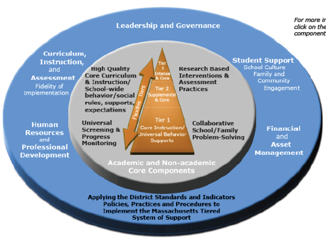
MTSS
Integrated Continuum
Academic Continuum
Behavior Continuum
Mar 10 2010
Notes:
Insert appropriate state model (this is an example with MA)

Slide 111
SWPBIS = MTSS = RtI
?
?
Implementation with fidelity
Universal screening
Continuum of evidence based
interventions
Data-based decision making & problem solving
Prevention and Early Intervention
Continuous progress
monitoring
I.C.iii

Slide 112
Activity:
Developing a SWPBIS Continuum
Work as team for 20 min
Review Core Behavioral Interventions and Practices for Each Tier
Complete Practices Evaluation Chart
  Identify current practices
  Evaluate each using criteria
Complete your current Continuum of SWPBIS (p. 30)
Review flowchart to improve decisions for selection and use of practices
Present 2-3 “big ideas” from your group (1 min. reports)

Slide 113
Critical Features of SWPBIS
Supporting Culturally Equitable
Social Competence & Academic Achievement
OUTCOMES
Supporting
Culturally
Knowledgeable
Staff Behavior
Supporting
Culturally Valid
Decision
Making
SYSTEMS
DATA
PRACTICES
Supporting Culturally Relevant
Evidence-based Interventions
Notes:
Use data
Focus on outcomes: Academic & behavior success
On-going evaluation
Ensure cultural and contextual fit
Invest in systems
Organize research-validated practices within a continuum
Instructional & preventative approach
Integration
Tier 1 for all

Slide 114
Focus on Systems
SYSTEMS
What are key systems features to support staff?
I.C.iv

Slide 115
Key Systems Features
Staff Buy-in
Embedded Professional Development
Staff Recognition for Implementation
Team-based Implementation
Clear Action Plan
I.C.iv
Notes:
Build section numbers, color coding, and structure into ppt.

Slide 116
Avoiding “Train & Hope”
WAIT for
New
Problem
REACT to
Problem
Behavior
Expect, But
HOPE for
Implementation
Select &
ADD
Practice
Hire EXPERT
to Train
Practice
I.C.iv

Slide 117
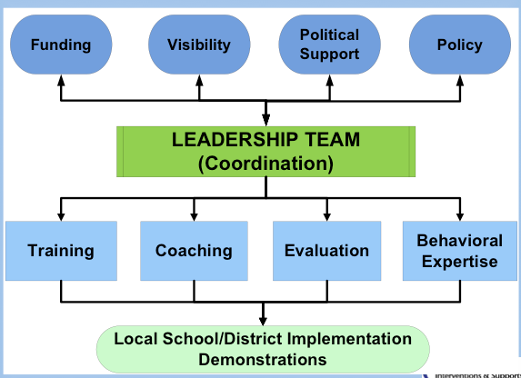
SWPBIS Systems Implementation Logic
I.C.iv

Slide 118
Basic SWPBIS Implementation
I.C.iv
District Behavior Team
SWPBIS practices, data, systems
School Behavior Team
2 yr. action plan
School Staff
SWPBIS
CWPBS
Data plan
Small group
Individual student
Leadership
Student Benefit
Academic
Social skills
Self-management
Expectations & routines
Policy, funding, leadership, priority, agreement
Team meeting schedule
Regional/State Leadership
Internal Coaching Support
External Coaching Support
Team Support

Slide 119
GENERAL IMPLEMENTATION PROCESS
Team
Agreements
Data-based
Action Plan
Evaluation
Implementation
I.C.iv
Notes:
SAY: In general, the implementation of a school-wide PBS approach at the school level is built around five main implementation steps.

Slide 120
Behavioral
Capacity
Priority &
Status
Representation
Team
Team
Data-based
Decision
Making
Administrator
Communications
Agreements
Data-based
Action Plan
Evaluation
Implementation
I.C.iv
Notes:
SAY: In general, the implementation of a school-wide PBS approach at the school level is built around five main implementation steps.

Slide 121
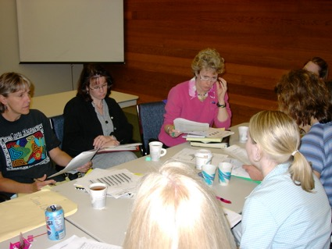
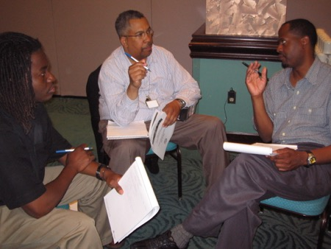
Team Composition
= Required Team membership
Administrator
Grade/Department Representation
Specialized Support
  (e.g., Special Educator, Counselor, School Psychologist, Social Worker, etc.)
Support Staff
  (e.g., Office, Supervisory, Custodial, Bus, Security, etc.)
Parent (who is not also a staff member)
Community
  Mental Health, Business
Student

Slide 122
3-4 Year
Commitment
Team
Top 3 School-
Wide
Initiatives
3-Tiered
Prevention
Logic
Agreements
Agreements
Coaching &
Facilitation
Administrative
Participation
Dedicated
Resources
& Time
Data-based
Action Plan
Evaluation
Implementation
I.C.iv
Notes:
SAY: In general, the implementation of a school-wide PBS approach at the school level is built around five main implementation steps.

Slide 123
Team
Self-Assessment
Agreements
Efficient
Systems of Data
Management
Existing
Discipline
Data
Data-based
Action Plan
Data-based
Action Plan
Team-based
Decision
Making
Multiple
Systems
Evidence-
Based
Practices
Evaluation
Implementation
I.C.iv
Notes:
SAY: Team should work from a specific action plan that specifies (a) what needs to be achieved, (b) what needs to be done, (c) who needs to do the work, (d) what resources are needed to achieve the desired outcome, (e) when the outcomes need to be achieved, (f) how progress will be monitored.
Data must be collected to specify the above features of an action.
A variety of data sources should be considered:
The EBS Survey allows staff members to give their perception of what is in place and the degree to which it needs to be improved. (Appendix 4).
2. Office discipline referrals are collected in most schools and represent an excellent source of information to determine the general effectiveness of the school-wide discipline systems. (See www.swis.org)
Academic achievement data also can be used to identify which students might need behavioral supports.
Other information also might be available to guide how the action plan is developed and implemented, for example, (a) attendance/tardy patterns, (b) bus citations, (c) staff/parent recommendations.
The Team Implementation Checklist (Appendix 3) can be used as an implementation self-monitoring tool, especially, w/r to systems level elements of school-wide PBS.

Slide 124
Team
Agreements
Team Managed
Data-based
Action Plan
Staff
Acknowledgements
Effective
Practices
Evaluation
Implementation
Implementation
Continuous
Monitoring
Administrator
Participation
I.C.iv
Staff Training
& Support
Notes:
SAY: In general, the implementation of a school-wide PBS approach at the school level is built around five main implementation steps.

Slide 125
Team
Agreements
Relevant &
Measurable
Indicators
Data-based
Action Plan
Team-based
Decision Making &
Planning
Efficient
Input, Storage, &
Retrieval
Evaluation
Implementation
Evaluation
Continuous
Monitoring
Effective
Visual Displays
I.C.iv
Regular
Review
Notes:
SAY: In general, the implementation of a school-wide PBS approach at the school level is built around five main implementation steps.

Slide 126
In other words...
State
District
School
Classroom
Student
Implementation Levels
I.C.iv

Slide 127
Key Systems Features
Staff Buy-in
Embedded Professional Development
Staff Recognition for Implementation
Team-based Implementation
Clear Action Plan
I.C.iv
Notes:
Build section numbers, color coding, and structure into ppt.

Slide 128

Action Planning
Process of organizing and using resources to enable individuals to engage in activities designed to achieve specific and important outcomes

Slide 129
Activity:
Preview Action Plan Template
Work as team for 5 min
Preview Action Plan process principles, facilitating questions, and example worksheets in workbook
Download suggested template on nepbis.org
Begin to complete individualize content (and format, if desired) for your team/school
Present 2-3 “big ideas” from your group (1 min. reports)

Slide 130
Key Systems Features
Staff Buy-in
Embedded Professional Development
Staff Recognition for Implementation
Team-based Implementation
Clear Action Plan
I.C.iv
Notes:
Build section numbers, color coding, and structure into ppt.

Slide 131

Staff Buy-In
Effective Messenger(s)
Buy-in!
Effective
Team…
Staff
Info & Drafts
Feedback
…powered
by Data
Effective Leadership

Slide 132
Key Systems Features
Staff Buy-in
Embedded Professional Development
Staff Recognition for Implementation
Team-based Implementation
Clear Action Plan
I.C.iv
Notes:
Build section numbers, color coding, and structure into ppt.

Slide 133
Embedded Professional Development
Explicit Training
Coaching/Prompting
Desired Outcomes
Performance Feedback

Slide 134
Key Systems Features
Staff Buy-in
Embedded Professional Development
Staff Recognition for Implementation
Team-based Implementation
Clear Action Plan
I.C.iv
Notes:
Build section numbers, color coding, and structure into ppt.

Slide 135
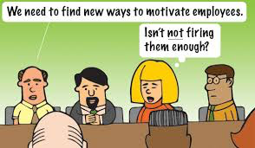
Staff Recognition
If we want staff to recognize kids, we should recognize them!
We can (and should) do better!

Slide 136
Guidelines for Systems
SYSTEMS
For each item in your action plan, ensure:
Agreement by >80% faculty and staff
Include procedures for informing others (e.g. families, community, district administrators, substitute teachers & staff)
Includes procedures for providing instruction to new faculty, staff, students, etc.
Schedule continuous evaluation of effectiveness, efficiency, and relevance
Include in school publications (e.g., handbook, posters, newsletters, etc.)
I.C.iv

Slide 137
Cultural and Contextual Fit
Culture & Context
How do you ensure cultural and contextual fit?

Slide 138
Guidelines for Culture & Context
Culture & Context
For each item in your action plan, ensure:
Involve staff, students, & families in development
Contextually/culturally appropriate (e.g., age, level, language)
Examine disaggregated data to ensure implementation of each feature works for all subgroups of students
I.C.v

Slide 139
Putting it together…
Culture & Context
OUTCOMES
SYSTEMS
DATA
PRACTICES
I.D

Slide 140
Primary Tier
SWPBIS Leadership Team
Data-based decision making
…
SYSTEMS
~80% of students with 0-1 major ODRs
~1 ODR per 500 students per day
Decreasing % of students suspended or expelled.
…
OUTCOMES
ODRs
Suspensions & Expulsions
Academic performance (CBM, CMTs)
…
DATA
Post, teach, and reinforce positively stated expectations
…
PRACTICES

Slide 141
Secondary Tier
Secondary Intervention Team
Weekly data-based program review
…
SYSTEMS
~15% of students with 2-5 major ODRs
Increasing pro-social skills of targeted group (as measured by points earned for pro-social behavior)
…
OUTCOMES
ODRs
Point card
FACTS
Academic data (CMT, CBM, grades)
…
DATA
Screening
More intense and frequent social skills instruction & reinforcement
…
PRACTICES

Slide 142
Tertiary Tier
Specialized behavioral competence
Team based decision making
…
SYSTEMS
~5% of students with 6 or more major ODR
Individualized academic and behavioral goals
…
OUTCOMES
FBA (e.g., interview and direct observation)
Academic data (CBM, grades)
…
DATA
Individualized function-based behavior support plan
Family participation
…
PRACTICES

Slide 143
Getting Started With SWPBIS
(Chapter II)

Slide 144
What is the “Basic Logic” in one picture?
II.A

Slide 145
Basic SWPBIS
“Logic”
Cultural/Context Considerations
Maximum
Student
Outcomes
II.A
SYSTEMS
DATA
Start w/ effective, efficient, & relevant, doable
PRACTICES
Implementation
Fidelity
Training
+
Coaching
+
Evaluation
Prepare & support implementation
Improve “Fit”

Slide 146
Let’s get started!
II.B

Slide 147
Getting Started with SWPBIS
Establish an effective leadership team
Develop brief statement of behavioral purpose
Identify positive SW behavioral expectations
Develop procedures for teaching SW expectations
Develop procedures for teaching class-wide expectations
Develop continuum for strengthening appropriate behavior
Develop continuum for discouraging violations of expectations
Develop data-based procedures for monitoring
Develop systems to support staff
Build routines to ensure on-going implementation
Day 1
Day 2
Day 3

Slide 148
Getting Started with SWPBIS
Establish an effective leadership team
Develop brief statement of behavioral purpose
Identify positive SW behavioral expectations
Develop procedures for teaching SW expectations
Develop procedures for teaching class-wide expectations
Develop continuum for strengthening appropriate behavior
Develop continuum for discouraging violations of expectations
Develop data-based procedures for monitoring
Develop systems to support staff
Build routines to ensure on-going implementation
How will we play together?
SYSTEMS
II.B.i

Slide 149
Team Composition
Administrator
Grade/Department Representation
Specialized Support
  Special Educator, Counselor, School Psychologist, Social Worker, etc.
Support Staff
  Office, Supervisory, Custodial, Bus, Security, etc.
Parent
Community
  Mental Health, Business
Student
Start with a
team that
“works.”

Slide 150
Guidelines for Team Composition
SYSTEMS
Representative of school/community demographics
1-2 individuals with behavior/classroom management competence
1-2 family members
Administrator as active member
Schedule for presenting to whole staff at least monthly
Schedule for meeting at least monthly
Integration with other behavior related initiatives and programs
Appropriate priority relative to school/district goals
Rules/agreements established
Schedule for annual self-assessments (see list)
Coaching support (school/district/region)

Slide 151
Activity:
Team Profile and Agreements
Work as team for 15 min
Complete Team Profile and Agreements
Review Conducting Leadership Meetings Worksheet
Establish Routines for Conducting Effective and Efficient Meetings
Add items to your Action Plan as necessary
Present 2-3 “big ideas” from your group (1 min. reports)

Slide 152
Getting Started with SWPBIS
Establish an effective leadership team
Develop brief statement of behavioral purpose
Identify positive SW behavioral expectations
Develop procedures for teaching SW expectations
Develop procedures for teaching class-wide expectations
Develop continuum for strengthening appropriate behavior
Develop continuum for discouraging violations of expectations
Develop data-based procedures for monitoring
Develop systems to support staff
Build routines to ensure on-going implementation
What if the same people are on every team?
Working Smarter
SYSTEMS
II.B.i

Slide 153
Response: Work Smarter
Do less…better
Do it once
Invest in clear outcomes
Invest in a sure thing
Be strategic about problem solving
II.B.1

Slide 154
Working Smarter
Initiative, Project, Committee | Purpose | Outcome | Target Group | Staff Involved | SIP/ SID/ etc
Attendance Committee
Character Education
Safety Committee
School Spirit Committee
Discipline Committee
DARE Committee
EBS Work Group
II.B.1

Slide 155
Sample Teaming Matrix
Initiative, Committee | Purpose | Outcome | Target Group | Staff Involved | SIP/SID
Attendance Committee | Increase attendance | Increase % of students attending daily | All students | Eric, Ellen, Marlee | Goal #2
Character Education | Improve character | Improve character | All students | Marlee, J.S., Ellen | Goal #3
Safety Committee | Improve safety | Predictable response to threat/crisis | Dangerous students | Has not met | Goal #3
School Spirit Committee | Enhance school spirit | Improve morale | All students | Has not met
Discipline Committee | Improve behavior | Decrease office referrals | Bullies, antisocial students, repeat offenders | Ellen, Eric, Marlee, Otis | Goal #3
DARE Committee | Prevent drug use |  | High/at-risk drug users | Don
EBS Work Group | Implement 3-tier model | Decrease office referrals, increase attendance, enhance academic engagement, improve grades | All students | Eric, Ellen, Marlee, Otis, Emma | Goal #2 Goal #3
II.B.1

Slide 156
Activity:
Committee Audit (Working Smarter)
Work as team for 20 min
Complete Committee/ Group Self Assessment and Action Planning
Add items to your Action Plan as necessary
Present 2-3 “big ideas” from your group (1 min. reports)

Slide 157
Getting Started with SWPBIS
Establish an effective leadership team
Develop brief statement of behavioral purpose
Identify positive SW behavioral expectations
Develop procedures for teaching SW expectations
Develop procedures for teaching class-wide expectations
Develop continuum for strengthening appropriate behavior
Develop continuum for discouraging violations of expectations
Develop data-based procedures for monitoring
Develop systems to support staff
Build routines to ensure on-going implementation
What are we “about”?
PRACTICES
II.B.ii

Slide 158
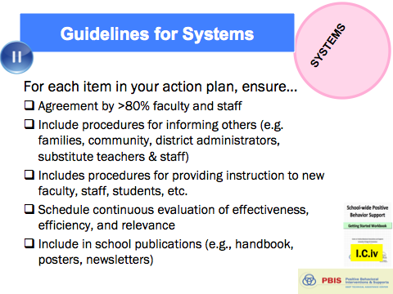
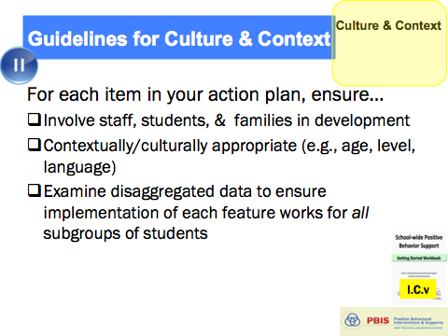
Guidelines for Purpose Statement
PRACTICES
Positively stated
2-3 sentences in length
Supportive of academic achievement
Comprehensive in scope (all students/staff/settings)
And always remember to consider systems, culture, & context:

Slide 159
Non-examples of Purpose Statements
Our school will rock.
We will have a positive climate.
What does that mean?

Slide 160

Examples of Purpose Statements
G. Ikuma School is a community of learners and teachers. We are here to learn, grow, and become good citizens.
At Abrigato School, we treat each other with respect, take responsibility for our learning, and strive for a safe and positive school for all!

Slide 161
Activity:
Behavioral Purpose Statement
Work as team for 10 min
Draft School-Wide Behavioral Purpose Statement
Add items to your Action Plan as necessary
Present 2-3 “big ideas” from your group (1 min. reports)

Slide 162
Getting Started with SWPBIS
Establish an effective leadership team
Develop brief statement of behavioral purpose
Identify positive SW behavioral expectations
Develop procedures for teaching SW expectations
Develop procedures for teaching class-wide expectations
Develop continuum for strengthening appropriate behavior
Develop continuum for discouraging violations of expectations
Develop data-based procedures for monitoring
Develop systems to support staff
Build routines to ensure on-going implementation
What do we expect?
PRACTICES
II.B.iii

Slide 163
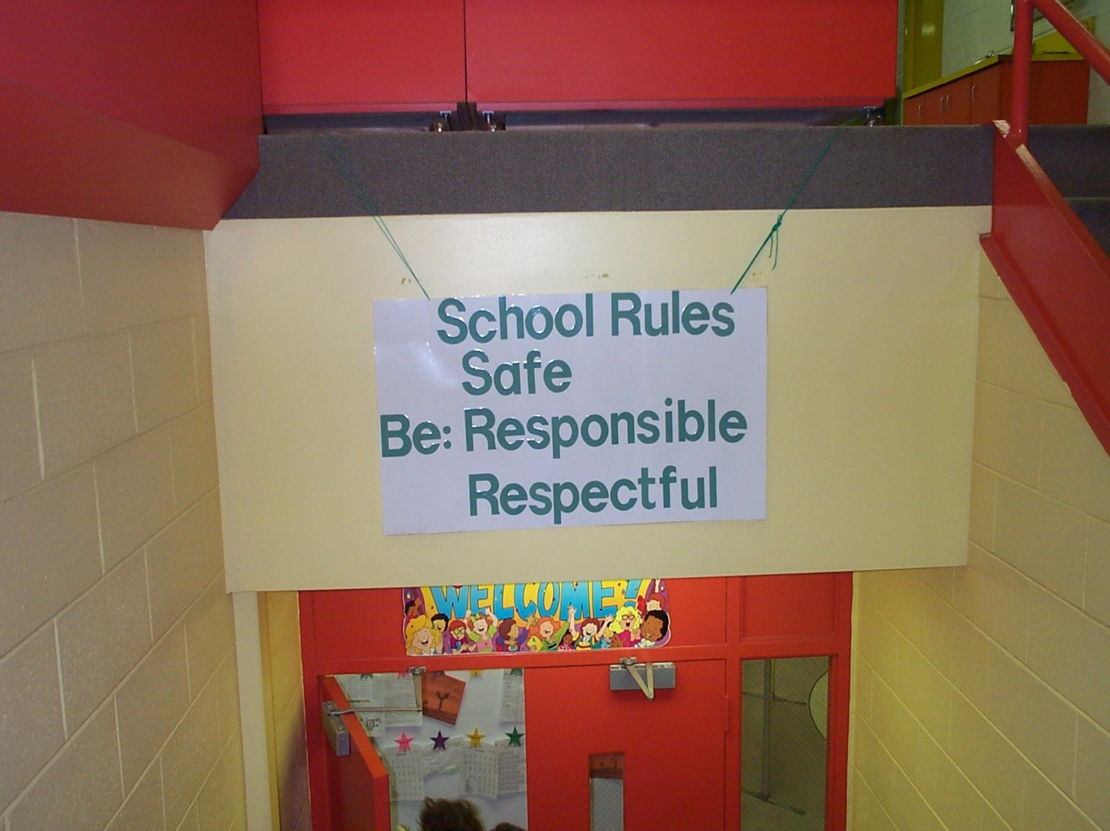
Redesign Learning & Teaching Environment
School Rules
NO Food
NO Weapons
NO Backpacks
NO Drugs/Smoking
NO Bullying

Slide 164
Guidelines for Expectations
PRACTICES
Linked to social culture of school
Considerate of social skills that already exist
3-5 in number
1-3 words per expectation
Positively Stated
II.B.iii

Slide 165
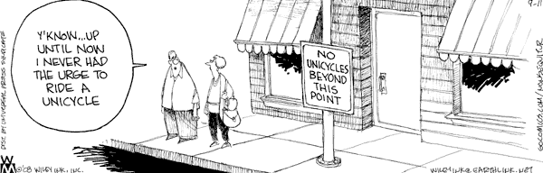

Slide 166


Guidelines for Expectations
PRACTICES
Linked to social culture of school
Considerate of social skills that already exist
3-5 in number
1-3 words per expectation
Positively Stated
Supportive of academic achievement
Comprehensive in scope
Mutually exclusive (minimal overlap)
And always remember to consider systems, culture, & context:
II.B.iii

Slide 167
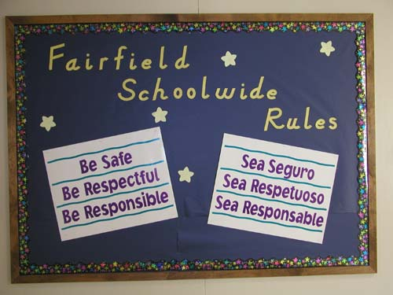

Slide 168
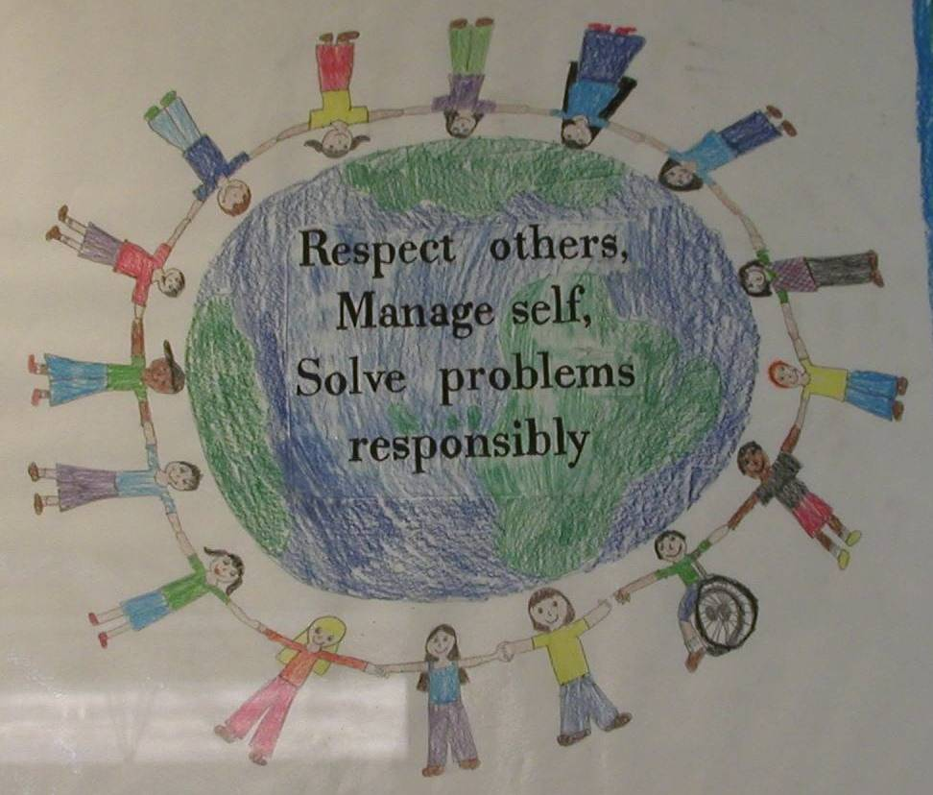

Slide 169
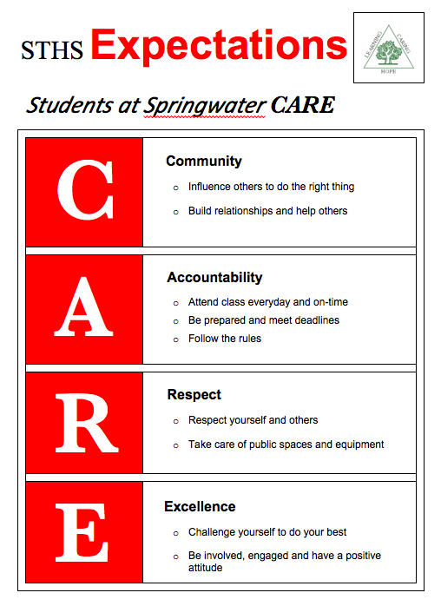

Slide 170


Slide 171
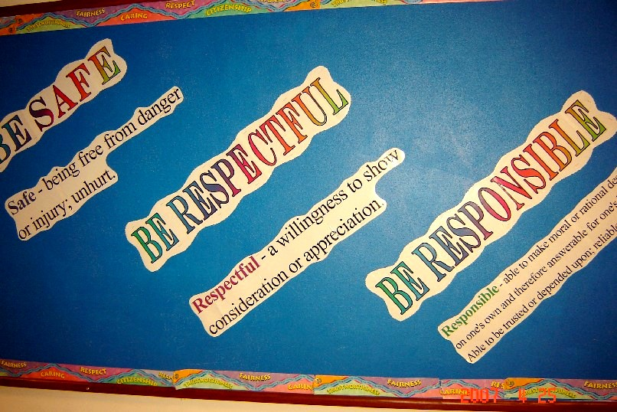
In Massachusetts, some things look familiar…

Slide 172
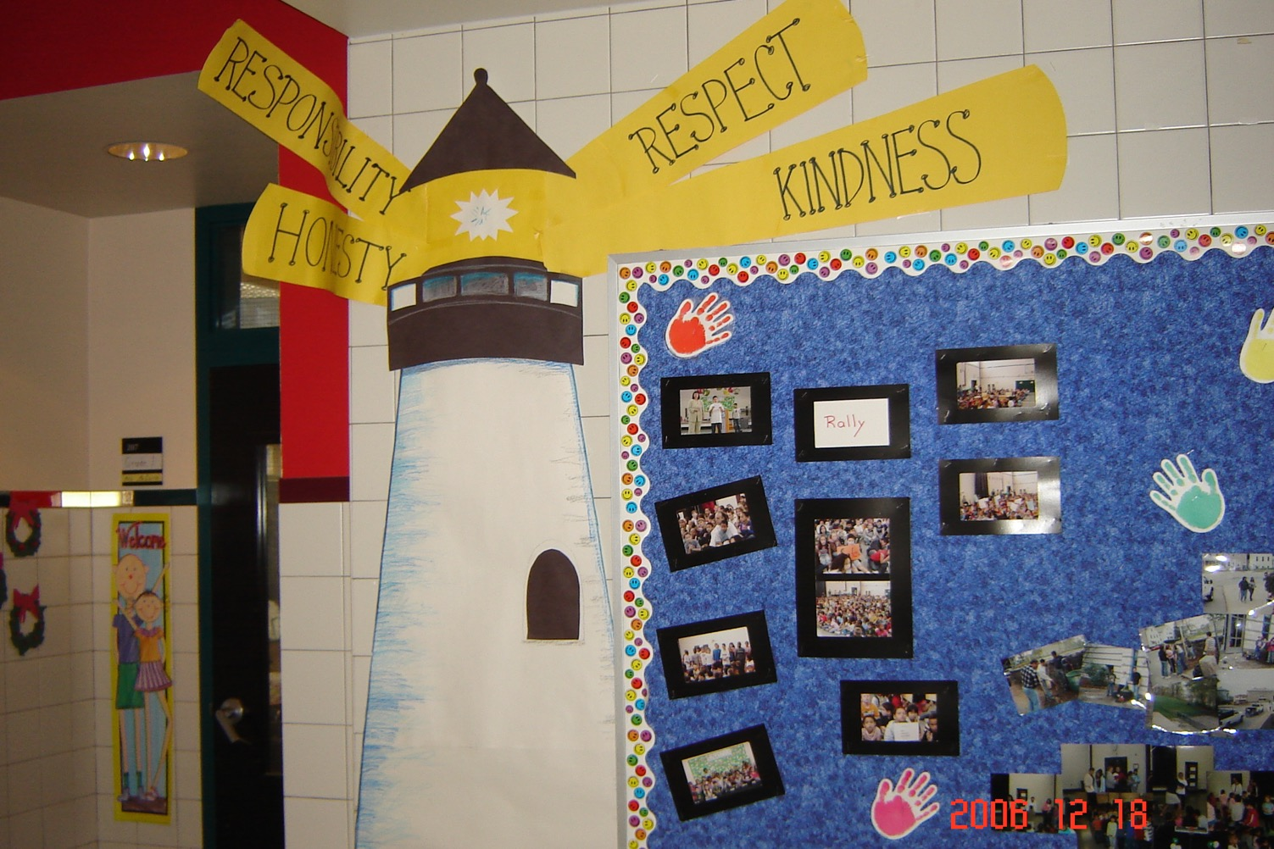
City View School
…but we put a unique spin on things as well!

Slide 173

School Wide Expectations Everywhere!
School website
Building entrances
Computer wallpaper
TV screens
School newspaper
Hallways
Classrooms
Sporting Events
Dances

Slide 174
Activity:
Behavioral Expectations
Work as team for 10 min
Draft School-Wide Behavior Expectations
Add items to your Action Plan as necessary
Present 2-3 “big ideas” from your group (1 min. reports)

Slide 175
Lunch

Slide 176
SWPBIS Action Planning

Slide 177
Activity:
Action Planning
Work as team for 75 min
Return to your Action Plan
Update sections corresponding to:
  Team profile and agreements
  Committee Audit (working smarter matrix)
  Getting started steps 1-3
In particular, make sure you’ve chosen a day, time, and setting for your regular SWPBIS team meetings!
Present 2-3 “big ideas” from your group (1 min. reports)
Reminder: We will be collecting team action plans at the end of day 2 in order to provide specific feedback for your team.

Slide 178
Review of SWPBIS

Slide 179
SWPBIS Message!
Successful individual student behavior support is linked to host environments or school climates that are effective, efficient, relevant, & durable.
(Zins & Ponti, 1990)
I.A.i

Slide 180
Critical Features of SWPBIS
Supporting Culturally Equitable
Social Competence & Academic Achievement
OUTCOMES
Supporting
Culturally
Knowledgeable
Staff Behavior
Supporting
Culturally Valid
Decision
Making
SYSTEMS
DATA
(Vincent, Randal, Cartledge, Tobin, & Swain-Bradway, 2011; Sugai, O’Keefe, & Fallon 2012 ab)
PRACTICES
I.C
Supporting Culturally Relevant
Evidence-based Interventions
Notes:
Use data
Focus on outcomes: Academic & behavior success
On-going evaluation
Ensure cultural and contextual fit
Invest in systems
Organize research-validated practices within a continuum
Instructional & preventative approach
Integration
Tier 1 for all

Slide 181
Universal
Targeted
Intensive
Continuum of Support for ALL
Few
Some
All
I.C.iii
(Sugai, Dec 7, 2007)
Notes:
NOTICE GREEN GOES FOR “ALL”

Slide 182
GENERAL IMPLEMENTATION PROCESS
Team
Agreements
Data-based
Action Plan
Evaluation
Implementation
I.C.iv
Notes:
SAY: In general, the implementation of a school-wide PBS approach at the school level is built around five main implementation steps.

Slide 183
Getting Started with SWPBIS
Establish an effective leadership team
Develop brief statement of behavioral purpose
Identify positive SW behavioral expectations
Develop procedures for teaching SW expectations
Develop procedures for teaching class-wide expectations
Develop continuum for strengthening appropriate behavior
Develop continuum for discouraging violations of expectations
Develop data-based procedures for monitoring
Develop systems to support staff
Build routines to ensure on-going implementation
Day 1
Day 2
Day 3

Slide 184
Consider Tattoos!
4 SWPBIS Elements
School Systems
Supporting Social Competence &
Academic Achievement
OUTCOMES
School-wide
Classroom
SWPBIS
SYSTEMS
DATA
Supporting
Decision
Making
Supporting
Staff Behavior
Non-classroom
Family
PRACTICES
Tertiary Prevention:
Specialized
Individualized
Systems for Students with High-Risk Behavior
~5%
Student
Supporting
Student Behavior
Primary Prevention:
School-/Classroom-
Wide Systems for
All Students,
Staff, & Settings
~15%
Secondary Prevention:
Specialized Group
Systems for Students with At-Risk Behavior
~80% of Students

