Slide 1
Coaching School-Wide Positive Behavioral Interventions and Supports (SWPBIS)
Northeast PBIS (NEPBIS) Coaches Training
Coaching Day 8
INSERT TRAINER NAMES
with support from Brandi Simonsen, Jen Freeman,
Susannah Everett, Adam Feinberg, & George Sugai
Notes:
Add trainer names for your event

Slide 2

Advance Organizer
Introduction and Focus on Coaching
End of Academy Assessment and Focus on Year 3 training activities
Coaching Self-Assessment and Reports
Share information on implementation of the PBIS Framework
Advanced Skill Building
Sustaining the PBIS Framework in your school
Enhancing Implementation with Family Engagement
Preparation for Next Training Event

Slide 3
Main Coaching Objectives
By the end of today’s meeting, you will be able to…
  …Describe your role as a coach.
  …Articulate the basic elements of SWPBS.
  …Identify resources for SWPBS.
  …Problem solve roadblocks in coaching
  …Facilitate your team’s activities at the next SWPBS team training.

Slide 4
Training Expectations:
RESPECT…
SELF
Self-monitor (Are you participating? Engaged as a learner? Talking during allotted times?)
Stretch, break, stand as needed
OTHERS
Cell phones (inaudible): Converse in lobbies and breaks
ENVIRONMENT
Recycle
Work as a team: Room for every voice, reinforce participation
Maintain neat working area

Slide 5


Tools!
nepbis.org
pbis.org
Coaching SWPBIS Workbook and Appendices
Evaluation Plan
Action Plan

Slide 6

Activity:
Coaches Please Enter Attendance
Coaches 1 min
Coaches, please login on nepbis.org, go to the coaches’ tab, and click on the Team Training Attendance Link. Follow prompts to enter team attendance.

Slide 7





Legend
New Content
Review
Guidelines
+Ex
-Ex
Training Organization
Activity

Slide 8


Legend
Section Header (I.A)
Chapter Header (e.g., I)

Slide 9
Advance Organizer
Introduction and Focus on Coaching
End of Academy Assessment and Focus on Year 3 training activities
Coaching Self-Assessment and Reports
Share information on implementation of the PBIS Framework
Advanced Skill Building
Sustaining the PBIS Framework in your school
Enhancing Implementation with Family Engagement
Preparation for Next Training Event

Slide 10
Overview of Coaching in swpbis
(Chapter i)

Slide 11
How is it going with your various roles?
Coaching Roles
Facilitate
Content Knowledge
Communicate
  Team meetings
  Activities at training events
  Implementation
  Local PBS expert
Positive “nag”
Link to resources (e.g., nepbis.org, www.pbis.org)
  Share advanced content with team
  Share information at faculty meetings
I.A.ii
Notes:
Move quickly through review content (just hit the highlights). Then, for each item, ask questions about how its going and use this to reinforce, correct, or problem solve as appropriate.

Slide 12
Basics of swpbis for coaches
(Chapter Ii)

Slide 13
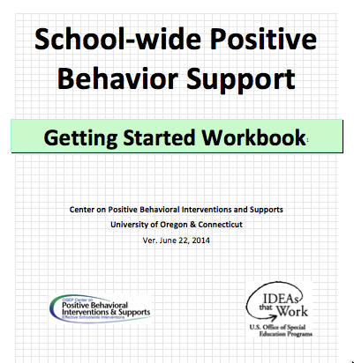
Critical Features of PBIS
Supporting Culturally Equitable
Social Competence & Academic Achievement
OUTCOMES
Supporting
Culturally
Knowledgeable
Staff Behavior
Supporting
Culturally Valid
Decision
Making
SYSTEMS
DATA
(Vincent, Randal, Cartledge, Tobin, & Swain-Bradway, 2011; Sugai, O’Keefe, & Fallon 2012 ab)
PRACTICES
I.C
Supporting Culturally Relevant
Evidence-based Interventions
Notes:
Move quickly through review content (just hit the highlights). Then, for each item, ask questions about how its going and use this to reinforce, correct, or problem solve as appropriate.

Slide 14
coaching team meetings
(Chapter iII)

Slide 15
Facilitating Effective Team Meetings
(see details in Coaches’ Workbook)
Be prepared and expect others to be as well
Begin on time by reviewing agenda and outcomes
Involve everyone
Use data to clearly and quickly define a problem before beginning problem solving
Create an action plan
At the end of the meeting debrief
After the meeting, electronically publish meeting minutes
III.A.i

Slide 16
Using Data Effectively
(see details in Coaches’ Workbook)
Collect appropriate and relevant data
Organize the data in a user-friendly manner that aides comprehension
Review and analyze the data at least monthly to guide decision-making
Make data available to all stakeholders
Provide staff development to all staff to use data to inform decision making
Use data analysis to inform decisions related to school-wide programs, classroom-based instructional practices, and student-specific interventions
Review data collection procedures and practices to ensure that data accurately reflect school events
Collect data on extent to which practice or intervention is being implemented accurately and fluently (implementation fidelity)
III.A.ii

Slide 17
Activity:
Coaching Self-Assessment
Work individually (or with partner coach) for 15 min
Review and Update Coaching Self-Assessment
Develop an Action Plan to address areas for growth from your self assessment
Present what growth you have made since you started the PBIS Academy. What coaching skills still need more attention / focus?

Slide 18

MA PBIS Academy Year 3 Goals
Support implementation and sustainability of the PBIS framework
  Review current school implementation related to specific framework principles
  Gather information on other exemplars of implementation of framework principles.
Build coaching knowledge and fluency with PBIS content
  Connect specific school systems, features, or practices with PBIS content principles
  Practice communicating important framework features present or needed in your school

Slide 19
MA PBIS Academy Year 3 Activities
Training Day 10
  Guest Speaker on School Climate: Dr. Tamika La Salle
  Roundtable Discussions w/School Leaders
  Action Planning
Training Day 11
  Guest Speaker on Sustainability: Dr. Adam Feinberg
  Poster Session
  Action Planning

Slide 20
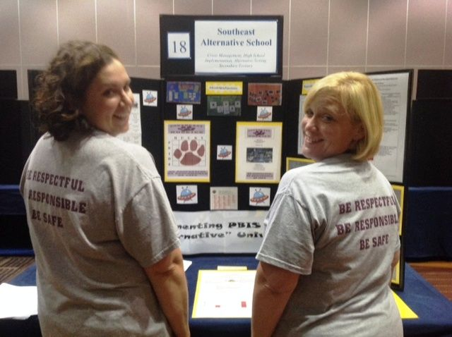
Poster Session
Target Goal:
  Share examples of implementation of the PBIS Framework across districts and schools
Structure
  Show off! Each school will present a
  poster and have at least 1 or 2 team
  members present at poster during the
  session
  Take turns! Other team members walk
  around browse other posters to review
  PBIS features of other schools
  Get ideas! Bring ideas back to your
  school for follow up action planning

Slide 21
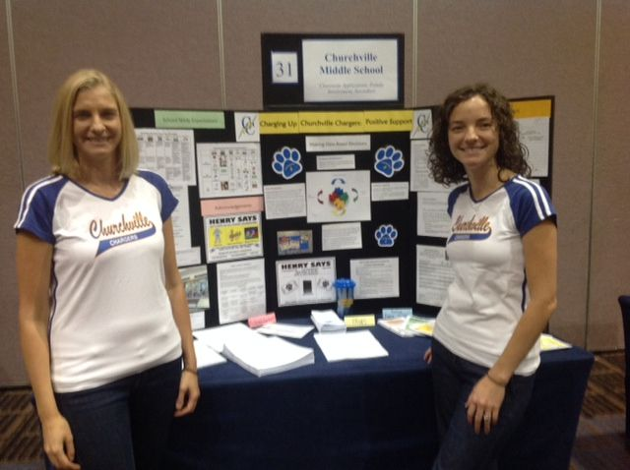
What to include in your Poster?
Ideas Examples of Systems, Data, and Practices!
  Data Examples:
    Fidelity Data (e.g., TFI or TIC)
    Outcome Data (e.g., ODR or attendance)
  System Examples
    Team action plans
    Staff Survey
  Practice Examples
    Lesson plan
    Teaching Matrix
    Consequence Flow-chart
Please include data as part of your poster!

Slide 22
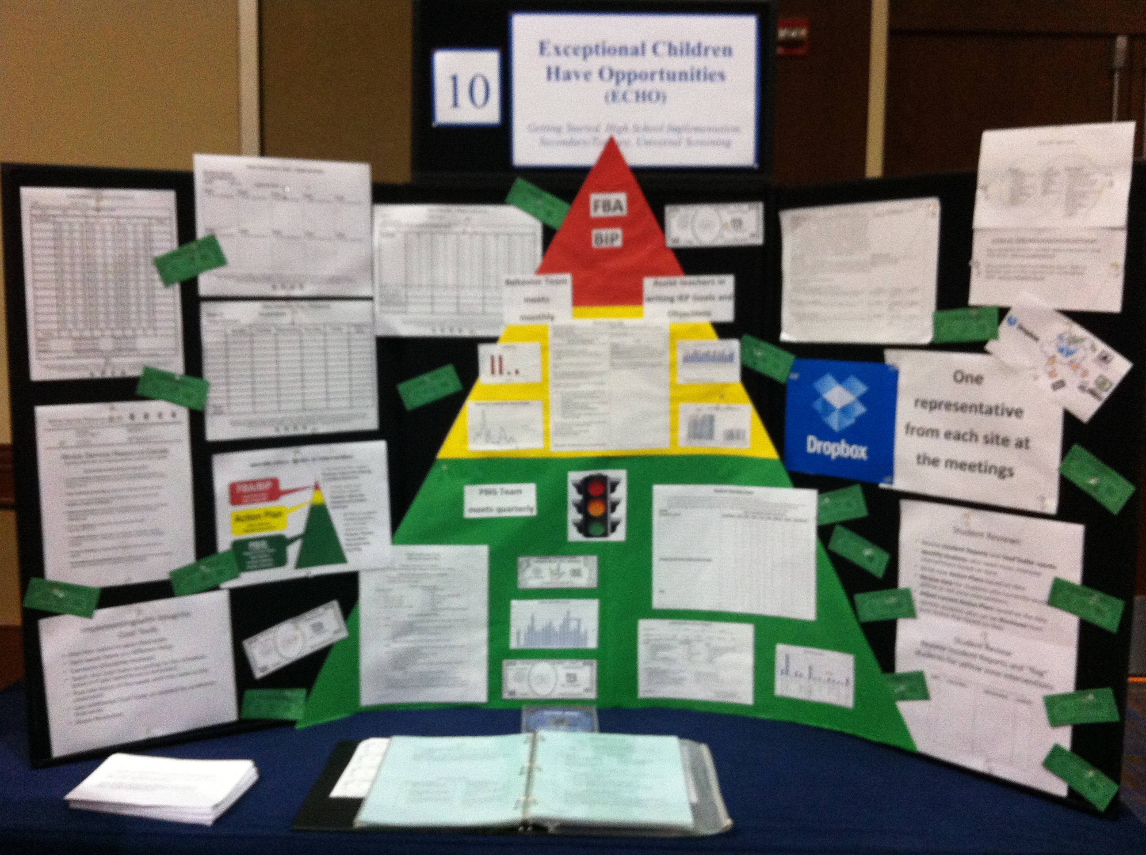
Poster Session
Invite your colleagues and administrators:
  We will email you in the winter to
  alert you of the time of the poster
  sessions.
  Please invite colleagues with whom
  you want to share your work with.
  Consider important stakeholders!
  (e.g., school board, PTO, etc.)
  Consider inviting relevant
  administrators

Slide 23
Poster Session: FAQ
When will the poster session take place?
  12 – 1:30 on Training Day 11
  We can put our posters on tables and team members and visitors can walk around and have discussions about school-specific implementation
  We will provide a tri-fold poster board and thumbtacks for each school team if needed.

Slide 24
Poster Session: FAQ
Do I have to stand by my poster the whole time?
  Work with your fellow team members and take turns standing by your poster and discussing your implementation examples with others in your cohort of school teams
Other questions?

Slide 25
Activity:
Poster Planning
Work individually (or with partner coach) for 15 min
Review Poster format and assess where you are with this activity.
Discuss with your fellow coach what your school will show on your poster.
Discuss what final steps need to be completed between now and the team training session to complete your poster.
Be prepared to share any ideas and bring up any potential barriers for problem solving.

Slide 26
Advance Organizer
Introduction and Focus on Coaching
End of Academy Assessment and Focus on Year 3 training activities
Coaching Self-Assessment and Reports
Share information on implementation of the PBIS Framework
Advanced Skill Building
Sustaining the PBIS Framework in your school
Enhancing Implementation with Family Engagement
Preparation for Next Training Event

Slide 27
Activity:
Coaching Implementation Review
Work individually (or with partner coach) for 20 min
Review Coaches Implementation Activity as well as the TIC / TFI Tier 1 Features
Review your TIC / TFI results from PBISApps.org
Review what is / is not in place in your school
Based on your school’s level of implementation, identify what other schools are doing that could be effective for your school
Be prepared to share out 1-2 ideas per domain during the upcoming discussion. What areas of implementation still need support?

Slide 28
Advance Organizer
Introduction and Focus on Coaching
End of Academy Assessment and Focus on Year 3 training activities
Coaching Self-Assessment and Reports
Share information on implementation of the PBIS Framework
Advanced Skill Building
Sustaining the PBIS Framework in your school
Enhancing Implementation with Family Engagement
Preparation for Next Training Event

Slide 29
Family
Engagement
(Adapted from the Federation for Children with Special Needs)

Slide 30
Family Engagement Domains
What practices does your school engage in relative to the following domains?
  Fundamental 1: Welcome All Stakeholders
  Fundamental 2: Communicating Effectively
  Fundamental 3: Supporting the Success of Children and Youth
  Fundamental 4: Advocating for Each Child and Youth
  Fundamental 5: Sharing Power and Responsibility
  Fundamental 6: Partnering with the Community
Based on the Massachusetts Family, School, and Community Partnership Fundamentals

Slide 31
Family Engagement Rubric
Work individually (or with partner coach) for 20 min
Review the Family, School, and Community Partnership Fundamentals http://www.doe.mass.edu/boe/sac/parent/FSCPfundamentals.pdf
Complete self assessment as a team
Add relevant items to your action plan
Be prepared to share out and discuss
See Appendix M
Complete during Team Action Planning Time TODAY

Slide 32
Review of
Sustainability
(Adapted from the work of Kent McIntosh)

Slide 33
School Program Implementation
What experiences have you had with initiative abandonment?
  What school factors often lead to initiatives going away in your schools?
  What factors help initiatives stay in place over the long term?
Talk with your neighbor for 3 minutes about your experiences. Be prepared to share out.

Slide 34
Barriers to Sustainability:
The Three Cs
Antecedent
Behavior
Consequence
Ongoing
Challenge
Select Practices
& Implement
with Fidelity
Student
Outcomes
Changes in Context
- Lack of contextual fit
- New challenges exist
- Competing initiatives
Changes in Capacity
- Loss of funding
- Attrition of key opersonnel
Changes in Consequences
- Diminished effectiveness odue to poor fidelity
- Outcomes no longer operceived as important

Slide 35
Barriers to Sustainability Worksheet
 | Risk Factors/ Barriers | Plan to Address Barriers
Changes in Context
Changes in Capacity
Changes in Consequences

Slide 36
What are enablers of sustainability?
Administrator Support
Staff Buy-in
Fidelity
Data
Teaming
Resources
Stakeholder Involvement
Training
SWPBS Philosophy
Motivation
District Support
What are the most important factors? Turn to your neighbor and discuss?
McIntosh, K., Predy, L., Upreti, G., Hume, A. E. & Mathews, S. (2014). Perceptions of contextual features related to implementation and sustainability of School-wide Positive Behavior Support. Journal of Positive behavior Interventions, 16, 29-41.

Slide 37
Four Principles for Enhancing the Sustainability of PBIS
Promote Priority
Ensure Effectiveness
Increase Efficiency
Use data for Continuous Regeneration

Slide 38
Promoting Priority
Maximize Visibility
Get into written policy
Present data to people with resources
Describe effects of abandoning support for the practice
Braid project with other initiatives
Show how practice can lead to outcomes of new initiatives

Slide 39
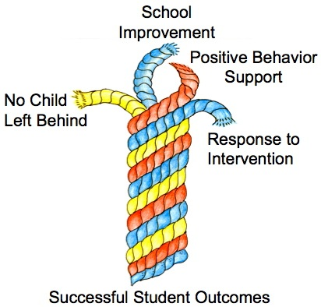
What is Braiding?
(Bohanon, Goodman, & McIntosh, 2009)

Slide 40
Practices Evaluation Flowchart
    Available as handout on www.neswpbis.org

Slide 41
How to enhance priority? SCHOOL PERSONNEL
Keep the practices fresh!
Especially the acknowledgement system
Learn tips from others
Other Schools in District / Conferences
Websites from other places (e.g., pbismaryland.org)
Share your struggles with others (e.g., District team support?)
Other teachers and staff, parents
Celebrate successes of PBIS efforts!
Bring data to every team meeting to guide action planning!
Share data with staff

Slide 42
How to enhance priority? SCHOOL ADMINISTRATORS
Promote PBIS across multiple settings
Share PBIS with parents & parents groups
Acknowledge PBIS efforts regularly
Be an active participant of the PBIS team
Protect from competing initiatives
Attend team meetings and join in action planning implementation
Encourage data-based decision making
Braid and buffer team from too many initiatives
Allocate resources to the PBIS effort
Make time for teams to meet, and teams to update school staff
Share with parent groups

Slide 43
How to enhance priority? DISTRICT ADMINISTRATORS
Share successes
Provide presentations to school board, community agencies, local businesses, news crews
Emphasize outcomes and threats
Provide regular acknowledgements for PBIS efforts
Facilitate sharing among school team facilitators
Connect school teams with similar PBIS schools
Encourage data-based decision making
Set accountability for data collection and reporting
Model good uses of data
Plan for the future
Create an action plan with short & long term goals
Identify and pursue short & long term funding

Slide 44
Ensuring Effectiveness
Focus on FIDELITY OF IMPLEMENTATION
Implement in all settings
Implement in all tiers of support
Consider family trainings
Share data showing how fidelity is related to effectiveness
Regular evaluation of fidelity data

Slide 45
To effectively use data…
…use your evaluation plan
DISTRICTS/SCHOOLS IN TRAINING |  |  | SCHEDULE
Purpose | Measure | Function | Year 1 Training |  | Year 2 Training
 |  |  | Winter | Spring | Fall | Winter | Spring
Capacity Building—District Level | District Capacity Assessment (DCA) | Completed by district leadership team (with the support of a trained facilitator) to assess district capacity and to guide Action Planning. |  | X |  |  | X
Fidelity of Implementation—Building Level | PBIS Tiered Fidelity Inventory (TFI) | Leadership team self-evaluation (with support of external coach) to assess the critical features of PBIS across Tiers I, II, and III. |  | X | X |  | X
Progress Monitoring—Building Level | Self-Assessment Survey (SAS) | Used by school staff for initial and annual assessment of effective behavior support systems in their school and to guide Action Planning. |  | X |  |  | X
Progress Monitoring—Team Level | Team Implementation Checklist (TIC) | A self-assessment tool that serves as a multi-level guide for creating School-Wide PBIS Action Plans and evaluating the status of implementation activities. | X | X | X | X | X
School Climate | Georgia School Climate Surveys | An annual survey that assesses student (grades 3-12), teacher, and parent perceptions of school climate. The middle and high school surveys also include items about adolescent drug/alcohol/tobacco use, self-harm ideation and behaviors, school dropout, and parental involvement. The survey provides information to determine training support needs related to school climate, safety, and violence prevention. |  | X | X
Student Outcomes | School-wide Information System (SWIS) | Office discipline referrals (ODR) provide data for monthly team reviews and decision-making by teachers, administrators, and other staff to guide prevention efforts and Action Planning. | Weekly | Weekly | Weekly | Weekly | Weekly
…and tools available at:

Slide 46
Increasing Efficiency
Get it down on paper
Lesson plans
Schedules
Agendas
Focus on efficient team meetings

Slide 47
Working Smarter Team Matrix
Initiative, Committee | Purpose | Outcome | Target Group | Staff Involved | SIP/SID/ etc
Attendance Committee
Character Education
Safety Committee
School Spirit Committee
Discipline Committee
DARE Committee
PBS Team
Eliminate all initiatives that do NOT have a defined purpose and outcome measure
2. Combine initiatives that have the same outcome measure and same target group
3. Combine initiatives that have 75% of the same staff
4. Eliminate initiatives that are not tied to School Improvement Goals
Review and revise your Working Smarter Team Matrix!
How is your PBIS Team braided into other school school programs!

Slide 48
Use Data for Continuous Regeneration
Adjust practices for a changing environment
Connect with a community practice
Priority
Effectiveness
Efficiency

Slide 49
Prepare for Jigsaw Activity:
Getting Ready for Team Training
Work with partner coach for 15 min
Review sustainability content preview slides just presented.
Discuss above with a partner
  Is there content you’d like re-explained?
  What key questions do you have?
  What ideas do you have for your building?
Be prepared to share your ideas with others in a jigsaw activity

Slide 50
Jigsaw Activity:
Getting Ready for Team Training
Work with others in jigsaw groups for 30 min
Count off by 4s
Get into groups based on your number
Discuss your ideas for sustaining the PBIS Framework in your building, and learn from others relative to their efforts for sustainability. How are they addressing similar barriers that you may be experiencing?

Slide 51
What Future Supports may be helpful?
How confident are you that the PBIS Framework you have developed and begun to implement will sustain for the next 5 or more years?
If we were to continue some supports, as part of a state sponsored system, are there structures that you would find helpful or necessary to continue?
  Team training days
  Coaching Training days
  TA support
  District-level / District Team Support
  Booster Team 1/2 training days
  Webinar trainings
  Other

Slide 52
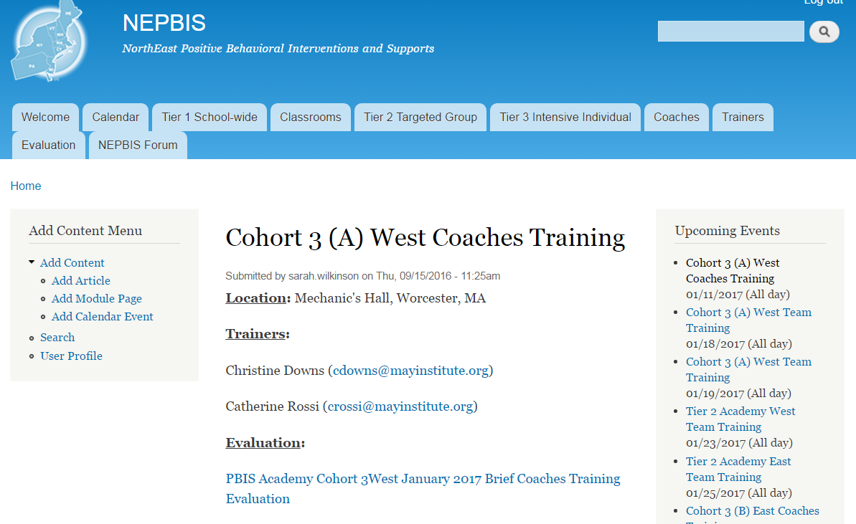
Activity:
Please Complete Brief Training Evaluation
5 min
Please go to nepbis.org, find upcoming events on the right, and click on today’s training event. On the event page, under evaluation, click on the link and complete the brief evaluation of today’s training.

Slide 53
Review of
Coaching SWPBIS

Slide 54
Main Coaching Objectives
By the end of today’s meeting, you will be able to…
  …Describe your role as a coach.
  …Articulate the basic elements of SWPBS.
  …Identify resources for SWPBS.
  …Problem solve roadblocks in coaching
  …Facilitate your team’s activities at the next SWPBS team training.

Slide 55
What roles do coaches play?
Coaching Roles
Facilitate
Content Knowledge
Communicate
  Team meetings
  Activities at training events
  Implementation
  Local PBS expert
Positive “nag”
Link to resources (e.g., nepbis.org, www.pbis.org)
  Share advanced content with team
  Share information at faculty meetings
I.A.ii

Slide 56
Consider Tattoos!
4 PBIS Elements
School Systems
Supporting Social Competence &
Academic Achievement
OUTCOMES
School-wide
Classroom
SWPBIS
SYSTEMS
DATA
Supporting
Decision
Making
Supporting
Staff Behavior
Non-classroom
Family
PRACTICES
Tertiary Prevention:
Specialized
Individualized
Systems for Students with High-Risk Behavior
~5%
Student
Supporting
Student Behavior
Primary Prevention:
School-/Classroom-
Wide Systems for
All Students,
Staff, & Settings
~15%
Secondary Prevention:
Specialized Group
Systems for Students with At-Risk Behavior
~80% of Students

Slide 57
TAKE AWAY MESSAGE
You’re a coach!
Prepare for the next training event, and use your resources to guide your team’s activities (both at training and at school).

