Slide 1
Coaching School-Wide Positive Behavioral Interventions and Supports (SWPBIS)
Northeast PBIS (NEPBIS) Coaches Training
Coaching Day 2
INSERT TRAINER NAMES
with support from Brandi Simonsen, Jen Freeman,
Susannah Everett, & George Sugai
Notes:
Add trainer names for your event

Slide 2

Advance Organizer
Introduction and Focus on Coaching
Quick Review and Focus on Facilitating Team Meetings
Coaching Self-Assessment and Reports
Re-introduce Yourself and Your school
Advanced Skill Building
Coaching PBIS in Classroom and Non-Classroom Settings
Preparation for Next Training Event
Notes:
Help them tie this to where they are in their implementation . I give us a heads up if there are topics we should be aware of.

Slide 3
Main Coaching Objectives
By the end of today’s meeting, you will be able to…
  …Describe your role as a coach.
  …Articulate the basic elements of SWPBS.
  …Identify resources for SWPBS.
  …Problem solve roadblocks in coaching
  …Facilitate your team’s activities at the next SWPBS team training.
Notes:
We really want to hear how this is going. It can be an awkward role and we want to help it feel more comfortable.

Slide 4
Training Expectations:
RESPECT…
SELF
Self-monitor (Are you participating? Engaged as a learner? Talking during allotted times?)
Stretch, break, stand as needed
OTHERS
Cell phones (inaudible): Converse in lobbies and breaks
ENVIRONMENT
Recycle
Work as a team: Room for every voice, reinforce participation
Maintain neat working area

Slide 5


Tools!
nepbis.org
pbis.org
Coaching SWPBIS Workbook and Appendices
Evaluation Plan
Action Plan

Slide 6

Activity:
Coaches Please Enter Attendance
Coaches 1 min
Coaches, please login on nepbis.org, go to the coaches’ tab, and click on the Team Training Attendance Link. Follow prompts to enter team attendance.

Slide 7





Legend
New Content
Review
Guidelines
+Ex
-Ex
Training Organization
Activity

Slide 8


Legend
Section Header (I.A)
Chapter Header (e.g., I)

Slide 9
Advance Organizer
Introduction and Focus on Coaching
Quick Review and Focus on Facilitating Team Meetings
Coaching Self-Assessment and Reports
Re-introduce Yourself and Your school
Advanced Skill Building
Coaching PBIS in Classroom and Non-Classroom Settings
Preparation for Next Training Event

Slide 10
Overview of Coaching in swpbis
(Chapter i)

Slide 11
Why Coaching?
The old models are not as effective.
I.A.i

Slide 12
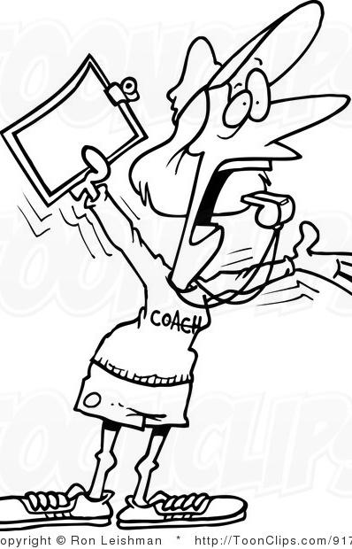
This is where you come in !
Introduction to Coaching
I.A.ii
Notes:
Whats gone well? Sharing out the data. Self starters on the team – getting things done!

Slide 13
What roles do coaches play?
Coaching Roles
Facilitate
Content Knowledge
Communicate
  Team meetings
  Activities at training events
  Implementation
  Local PBS expert
Positive “nag”
Link to resources (e.g., nepbis.org, www.pbis.org)
  Share advanced content with team
  Share information at faculty meetings
I.A.ii
Notes:
Move quickly through review content (just hit the highlights). Then, for each item, ask questions about how its going and use this to reinforce, correct, or problem solve as appropriate.

Slide 14
What is coaching?
Coaching is the active and iterative delivery of:
  a. Prompts and reinforcers that increase successful behavior
  b. Corrections that decrease unsuccessful behavior
Coaching is done by someone with credibility and experience with the target skill(s)
Coaching is done on‐site, in real time
Coaching is done after initial training
Coaching is done repeatedly (e.g., monthly)
Coaching intensity is adjusted to need
I.B.i
Notes:
Move quickly through review content (just hit the highlights). Then, for each item, ask questions about how its going and use this to reinforce, correct, or problem solve as appropriate.

Slide 15
Guidelines for Coaching SWPBIS
Before Training Activities:
Verify coaching role with your coordinator/supervisor
Review coaching role with principal
Remind team of coaching role
Ensure team is composed of the correct members and all key members are scheduled to attend training.
Assist team to review/bring relevant data, policy and procedures, updated action plan, etc.
Review tools: Team Implementation Checklist, EBS Self-Assessment Survey, Committee Review, Action Planning, Benchmarks of Quality, SET
Assist team to prepare brief summary of 1-2 significant accomplishments, 1-2 in-progress activities, and 1-2 challenges.
Notes:
Move quickly through review content (just hit the highlights). Then, for each item, ask questions about how its going and use this to reinforce, correct, or problem solve as appropriate.

Slide 16
Guidelines for Coaching SWPBIS
During Training Activities:
Remind team of coaching role
Let team lead process
Document agreements
Focus team on agenda and activity outcomes and reinforce progress
Remind team of big ideas from SWPBIS approach and presentations
Remind team to include all staff in decision making
Prompt outcomes: Action Plan, Etc.
Acknowledge/reinforce team for progress at training
Complete/review agreements/actions specified on updated action plan
Notes:
Move quickly through review content (just hit the highlights). Then, for each item, ask questions about how its going and use this to reinforce, correct, or problem solve as appropriate.

Slide 17
Guidelines for Coaching SWPBIS
After Training Activities:
Prompt team to (a) meet and review PBIS purpose and action plan with staff, (b) collect school data, (c) meet w/in 1 month, and (c) complete Team Implementation Checklist and/or Benchmarks of Quality (as assigned in training)
Contact team leader 2x in first month and ask what is planned and if assistance needed (if district coach)
Set schedule for team to meet 1x month
Review school data on monthly basis
Monitor and assist in development and completion of team action plan
Document team and coaching accomplishments, speed bumps, challenges, solutions
Identify and acknowledge team/school progress on action plan tasks/outcomes
Notes:
Move quickly through review content (just hit the highlights). Then, for each item, ask questions about how its going and use this to reinforce, correct, or problem solve as appropriate.

Slide 18
Basics of swpbis for coaches
(Chapter Ii)

Slide 19
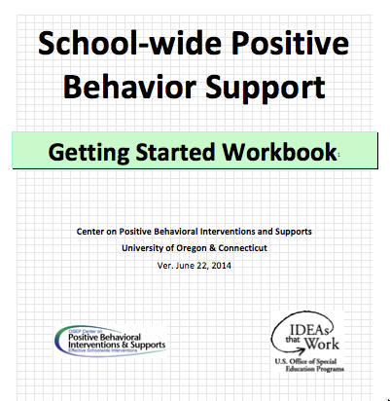
Critical Features of PBIS
Supporting Culturally Equitable
Social Competence & Academic Achievement
OUTCOMES
Supporting
Culturally
Knowledgeable
Staff Behavior
Supporting
Culturally Valid
Decision
Making
SYSTEMS
DATA
(Vincent, Randal, Cartledge, Tobin, & Swain-Bradway, 2011; Sugai, O’Keefe, & Fallon 2012 ab)
PRACTICES
I.C
Supporting Culturally Relevant
Evidence-based Interventions
Notes:
Move quickly through review content (just hit the highlights). Then, for each item, ask questions about how its going and use this to reinforce, correct, or problem solve as appropriate.
Check in on each of these- do you have outcome statements, where are you in the process of getting data? Remember the power of the practices is the instructional part, systems- support staff- how many have things in action plan to support staff?
Be honest about the cultural stuff

Slide 20
SWPBIS
Practices
School-wide
Classroom
Smallest #
Evidence-based
Biggest, durable effect
Non-classroom
Family
Student
I.C.iii
Notes:
Move quickly through review content (just hit the highlights). Then, for each item, ask questions about how its going and use this to reinforce, correct, or problem solve as appropriate.

Slide 21
Continuum of School-Wide
Instructional & Positive Behavior Support
Tertiary Prevention:
Specialized
Individualized
Systems for Students with High-Risk Behavior
~5%
Primary Prevention:
School-/Classroom-
Wide Systems for
All Students,
Staff, & Settings
~15%
Secondary Prevention:
Specialized Group
Systems for Students with At-Risk Behavior
~80% of Students
I.C.iii
Notes:
Move quickly through review content (just hit the highlights). Then, for each item, ask questions about how its going and use this to reinforce, correct, or problem solve as appropriate.
Emphasis tier 1!!

Slide 22
GENERAL IMPLEMENTATION PROCESS
Team
Agreements
Data-based
Action Plan
Evaluation
Implementation
I.C.iv
Notes:
Move quickly through review content (just hit the highlights). Then, for each item, ask questions about how its going and use this to reinforce, correct, or problem solve as appropriate.
Are folks comfortable with who is on their team? Student voice? Parents? Administrators?

Slide 23
coaching team meetings
(Chapter iII)
Notes:
How many running regular team meetings, how many are comfortable facilitating tem meetings?

Slide 24
Facilitating Effective Team Meetings
(see details in Coaches’ Workbook)
Be prepared and expect others to be as well
Begin on time by reviewing agenda and outcomes for the meeting
Involve everyone
Use data to clearly and quickly define a problem before beginning problem solving
Create an action plan
At the end of the meeting debrief
After the meeting, electronically publish meeting minutes
III.A.i

Slide 25
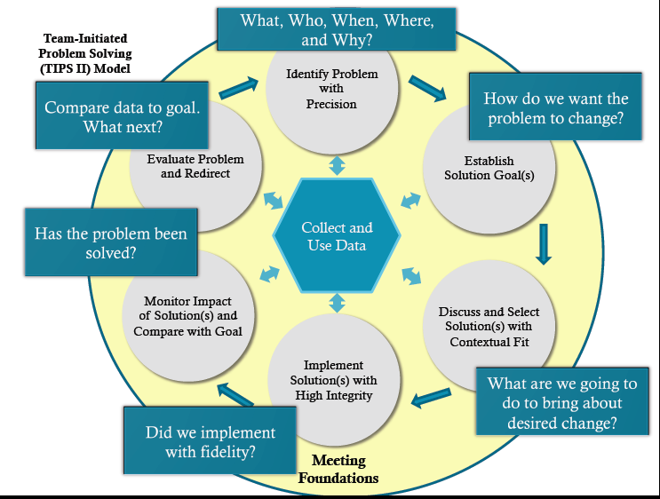
Consider the TIPS Model
(see additional resources for TIPS on pbis.org)
http://www.pbis.org/common/cms/files/Forum12/E2_TIPS_Teaser.pdf
III.A.i

Slide 26
Using Data Effectively
(see details in Coaches’ Workbook)
Collect appropriate and relevant data
Organize the data in a user-friendly manner that aides comprehension
Review and analyze the data at least monthly to guide decision-making
Make data available to all stakeholders
Provide staff development to all staff to use data to inform decision making
Use data analysis to inform decisions related to school-wide programs, classroom-based instructional practices, and student-specific interventions
Review data collection procedures and practices to ensure that data accurately reflect school events
Collect data on extent to which practice or intervention is being implemented accurately and fluently (implementation fidelity)
III.A.ii
Notes:
As a coach this is not all your job!! You can make sure it happens but delegate!

Slide 27
Guidelines for Facilitating Effective Team Meetings
Before Team Meeting:
Contact team members to solicit agenda items, prepare the agenda, and disseminate it to others prior to the team meeting.
Prompt and support facilitator, minute taker, and data analyst to prepare for meetings
Ensure meeting space and materials are prepared.
Check in with team members regarding any action plan items that will be reviewed and provide support if necessary to complete action plan items
Notes:
Move quickly through review content (just hit the highlights). Then, for each item, ask questions about how its going and use this to reinforce, correct, or problem solve as appropriate.

Slide 28
Guidelines for Facilitating Effective Team Meetings
During Team Meeting:
Prompt the use of team agendas and protocols during meeting
Guide teams in the use of data-based decision-making rules
Prompt team members to be effective and efficient in their roles
Prompt teams to not only define precision problem statements but to also define a goal for ‘what it will look like’ when problem solved
Facilitate the teams use of and understanding of data, provide suggestions for improved data collection or reporting
Set date, time, and place for next meeting
List priority agenda items for next meeting
Notes:
Move quickly through review content (just hit the highlights). Then, for each item, ask questions about how its going and use this to reinforce, correct, or problem solve as appropriate.

Slide 29
Guidelines for Facilitating Effective Team Meetings
After Team Meeting:
Check in with team members regarding meeting process and action plan items to determine what level of support will be needed to complete action plan items. Set follow-up meetings with team members if needed.
Ask for support if needed from other coaches, building administrators, district or state leaders, State or National PBIS networks
Present summary of decisions, actions, etc. to staff, administration, etc.
Notes:
Move quickly through review content (just hit the highlights). Then, for each item, ask questions about how its going and use this to reinforce, correct, or problem solve as appropriate.

Slide 30
Activity:
Practicing Parts of Effective Team Meetings
Work individually (or with partner coach) for 15 min
Complete activity to practice
  1. Effective data-driven decisions during meetings
  2. Precisely defining problems during meetings
Update your action plan with specific steps to enhance your ability to effectively facilitate a team meeting.
Notes:
9:20

Slide 31
Advance Organizer
Introduction and Focus on Coaching
Quick Review and Focus on Facilitating Team Meetings
Coaching Self-Assessment and Reports
Re-introduce Yourself and Your school
Advanced Skill Building
Coaching PBIS in Classroom and Non-Classroom Settings
Preparation for Next Training Event

Slide 32
Activity:
Coaching Self-Assessment
Work individually (or with partner coach) for 15 min
Review and Update Coaching Self-Assessment (Coaching workbook pg. 12)
Develop an Action Plan to address areas for growth from your self assessment
Present 1-2 “strengths” and 1-2 “concerns or challenges” (1 min. reports)
Notes:
9:44

Slide 33
A reminder you’ll see throughout to help us remember the role.
Coach

Slide 34
Coaching Reports
(+ or Δ)
Coach
      1-2 Details to introduce yourself
      1-2 Strengths
      (with respect to coaching)
      1-2 Concerns or challenges
      (with respect to coaching)

Slide 35
Advance Organizer
Introduction and Focus on Coaching
Quick Review and Focus on Facilitating Team Meetings
Coaching Self-Assessment and Reports
Re-introduce Yourself and Your school
Advanced Skill Building
Coaching PBIS in Classroom and Non-Classroom Settings
Preparation for Next Training Event

Slide 36
coaching PBIS in the classroom
(Chapter iV)

Slide 37
Evidence-Based PBIS
Practices in Classroom
Minimize crowding & distraction
Maximize structure & predictability
State, teach, review, & reinforce positively stated expectations.
Provide more acknowledgement for appropriate than inappropriate behaviors.
Maximize varied opportunities to respond.
Maximize active engagement.
Actively & continuously supervise.
Respond to inappropriate behaviors quickly, positively, & directly.
Establish multiple strategies for acknowledging appropriate behavior.
Generally provide specific feedback for errors & corrects.
IV.A.i

Slide 38
Basic Principles of Implementing PBIS in Classroom
Consider good teaching as one of the best behavior management tools
Apply 3 tiered prevention logic to the classroom setting
Link classroom to school-wide expectations
Teach social skills like academic skills
  Define, model, practice, monitor and acknowledge and adjust
Build systems to support sustained use of evidence based practices
IV.A.ii

Slide 39
Effective Academic Instruction
Effective Behavioral Interventions
Positive, Preventative School Culture (SWPBIS)
Continuous & Efficient Data-Based Decision Making
Systems for Durable & Accurate Implementation
IV.A.ii

Slide 40
Considerations for Coaching PBIS in Classroom: Coaching Role
Serve as a link to local and state resources
Serve as a positive role model
Support teachers’ use of data for decision making
Support teachers’ understanding of behavior basics
Ensure implementation of the essential components of SWPBIS in the classroom
IV.B.i

Slide 41
Considerations for Coaching PBIS in Classroom: Coaching Relationships
The coaching role is supportive not evaluative
Coaching responsibilities include holding teachers accountable for outcomes in their classrooms
Coaching relationships should be based on mutual respect and include an open dialogue between teachers and coaches
Informal observations and self-assessments are effective ways to begin discussions with teachers about classroom practices
  Remember teachers respond to positive feedback too. Begin with what is going well and build on teacher’s strengths when suggesting changes to classroom practices
  When making suggestions, keep them specific and concrete with a focus on implementation
Provide teachers opportunities to share successes
Whenever possible, coaching should involve providing “Conceptual” feedback regarding the “Big Ideas” of the practice or intervention
(adapted from Blase, Van Dyke, Fixsen, Duda, Horner and Sugai; 2009)
IV.B.ii

Slide 42
Considerations for Coaching PBIS in Classroom: Developing Systems
Facilitate a network of mentors among grade levels or across buildings
Support teachers in self-monitoring their own implementation strategies
Directly provide resources and supports to facilitate ongoing professional development at faculty meetings
Use technology tools to provide a central location for information regarding professional development, implementation strategies, and networking related to implementation
Work with building administration to build support for struggling teachers or staff.
IV.B.iii

Slide 43
Guidelines for Coaching PBIS in the Classroom
Coaching Individuals or Small Groups
Use informal observations and teacher self assessments to gather data on the essential elements of classroom SWPBIS
Provide feedback for teachers on all essential elements of classroom SWPBIS
Provide positive feedback to teachers on elements and systems that are already in place before giving feedback on changes that need to be made
Take a problem solving approach, and listen to teacher concerns and reported barriers to implementation.
Connect teachers who need support with teachers who are successfully implementing SWPBIS systems
Provide technical assistance to teachers for data collection and interpretation
Focus on Tier one classroom systems before developing tier 2 or 3 interventions
Notes:
Move quickly through review content (just hit the highlights). Then, for each item, ask questions about how its going and use this to reinforce, correct, or problem solve as appropriate.

Slide 44
Guidelines for Coaching PBIS in the Classroom
Developing Systems of Support
Facilitate communication between the school based team and individual teachers
Fade direct teacher support by facilitating connections between the building team members and teaching staff
Work with building administration to facilitate networks of teachers working on implementing similar strategies
Provide teachers with self monitoring tools and supports
Use technology to share information and facilitate teacher communications within and across schools
Work with building administrators to develop supports for teacher-to-teacher observations and mentoring
Develop specific classroom support systems for new teachers
Notes:
Move quickly through review content (just hit the highlights). Then, for each item, ask questions about how its going and use this to reinforce, correct, or problem solve as appropriate.

Slide 45
Activity:
Update Action Plan
Work individually (or with partner coach) for 5 min
Update your action plan to enhance your ability to coach PBIS in the classroom.

Slide 46
coaching PBIS in non-classroom Settings
(Chapter V)

Slide 47
Essential SWPBIS Components in Non-Classroom Settings
Positive expectations and routines taught and encouraged
Active supervision by all staff (scan, move, interact)
Pre-corrections and reminders
Positive reinforcement
V.A.i
Notes:
Annimation is out of order on this slide- I fixed on my computer but check on yours

Slide 48
Features of Active Supervision in Non-Classroom Settings
Positive adult-student contact should occur at high rates
Positive reinforcement should be provided at high rates
Correction procedures (rule violations) should be efficient and effective
Movement should be continuous, systematic, comprehensive across setting
Scanning should occur so all areas of the setting are assessed on a regular basis
V.A.ii
Notes:
Annimation is out of order on this slide- I fixed on my computer but check on yours

Slide 49
Roles & Responsibilities of Coaching PBIS in Non-Classroom Settings
Serve as a link to local and state resources
Positively model active supervision practices
Support collection of data on student behavior and fidelity of implementation of active supervision components
Provide positive reinforcement, precorrections, and reminders on staff use of effective behavior practices for non-classroom settings
Link practices and systems for non-classroom settings to classroom and school-wide
Work with building administrators and leaders to ensure implementation of the essential components of SWPBIS in all settings
Work with building administrators and leaders to ensure adequate training support and supervision of supervisors in non-classroom based settings.
V.A.ii
Notes:
Annimation is out of order on this slide- I fixed on my computer but check on yours

Slide 50
Guidelines for Coaching PBIS in Non-Classroom Settings
Coaching Individuals or Small Groups
Use informal observations and teacher self assessments to gather data on the essential elements of non-classroom SWPBIS
Provide feedback for teachers on all essential elements of non-classroom SWPBIS
Provide positive feedback to teachers on elements and systems that are already in place before giving feedback on changes that need to be made
Take a problem solving approach, and listen to teacher concerns and reported barriers to implementation.
Connect teachers who need support with teachers who are successfully implementing SWPBIS systems
Notes:
Move quickly through review content (just hit the highlights). Then, for each item, ask questions about how its going and use this to reinforce, correct, or problem solve as appropriate.

Slide 51
Guidelines for Coaching PBIS in Non-Classroom Settings
Developing Systems of Support
Provide technical assistance to teachers for data collection and interpretation
Focus on Tier one non-classroom systems before developing tier 2 or 3 interventions
Facilitate communication between the school based team and individual teachers
Fade direct teacher support by facilitating connections between the building team members and teaching staff
Work with building administration to facilitate networks of teachers working on implementing similar strategies
Provide teachers with self monitoring tools and supports
Develop specific non-classroom support systems for new teachers
Notes:
Move quickly through review content (just hit the highlights). Then, for each item, ask questions about how its going and use this to reinforce, correct, or problem solve as appropriate.

Slide 52
Activity:
Update Action Plan
Work individually (or with partner coach) for 5 min
Update your action plan to enhance your ability to coach PBIS in non-classroom settings.

Slide 53
Advance Organizer
Introduction and Focus on Coaching
Quick Review and Focus on Facilitating Team Meetings
Coaching Self-Assessment and Reports
Re-introduce Yourself and Your school
Advanced Skill Building
Coaching PBIS in Classroom and Non-Classroom Settings
Preparation for Next Training Event

Slide 54
Remember, Review Implementation Guidelines
Look
BEFORE
DURING
AFTER

Slide 55

Topics to be Covered
Day 1
Overview of NEPBIS School-Wide Training
Overview of PBIS/SWPBIS
Getting Started with SWPBIS (steps 1-3)
Action Planning
Day 2
Review of SWPBIS from Day 1
Getting Started with SWPBIS: Steps 4-6
Preview Steps 7-10
Action Planning
Wrap up
Let’s preview content so you’ll be ready to facilitate.

Slide 56
MAIN TRAINING OBJECTIVES
Establish leadership team
Establish staff agreements
Build working knowledge of SWPBIS outcomes, data, practices, and systems
Develop individualized action plan for SWPBIS
Organize for upcoming school year

Slide 57
Overview of School-wide Positive Behavior SupportS
(Chapter i)

Slide 58
SWPBIS Message!
Successful individual student behavior support is linked to host environments or school climates that are effective, efficient, relevant, & durable.
(Zins & Ponti, 1990)
I.A

Slide 59
SWPBIS is
Framework for enhancing adoption & implementation of
Continuum of evidence-based interventions to achieve
Academically & behaviorally important outcomes for
All students
I.B.i

Slide 60
SWPBIS is an organizational approach for…
Improving classroom & school climate
Integrating academic and behavior initiatives
Decreasing reactive management
Improving support for students with EBD
Maximizing academic achievement
I.B.ii

Slide 61
Effective Organizations
POSITIVE SCHOOL-WIDE CLIMATE FOR ALL (Students, Family, School, Community)
Common Language
Common Experience
Common Vision/Values
Quality
Leadership
I.B.vi
Notes:
1. Somewhat redundant with previous slides, however, nice to tie in family/community etc

Slide 62
Critical Features of PBIS
Supporting Culturally Equitable
Social Competence & Academic Achievement
OUTCOMES
Supporting
Culturally
Knowledgeable
Staff Behavior
Supporting
Culturally Valid
Decision
Making
SYSTEMS
DATA
(Vincent, Randal, Cartledge, Tobin, & Swain-Bradway, 2011; Sugai, O’Keefe, & Fallon 2012 ab)
PRACTICES
I.C
Supporting Culturally Relevant
Evidence-based Interventions
Notes:
Use data
Focus on outcomes: Academic & behavior success
On-going evaluation
Ensure cultural and contextual fit
Invest in systems
Organize research-validated practices within a continuum
Instructional & preventative approach
Integration
Tier 1 for all

Slide 63
Focus on Data
DATA
What is data-driven decision making?
I.C.ii

Slide 64
To effectively use data…
…use your evaluation plan
DISTRICTS/SCHOOLS IN TRAINING |  |  | SCHEDULE
Purpose | Measure | Function | Year 1 Training |  | Year 2 Training
 |  |  | Winter | Spring | Fall | Winter | Spring
Capacity Building—District Level | District Capacity Assessment (DCA) | Completed by district leadership team (with the support of a trained facilitator) to assess district capacity and to guide Action Planning. |  | X |  |  | X
Fidelity of Implementation—Building Level | PBIS Tiered Fidelity Inventory (TFI) | Leadership team self-evaluation (with support of external coach) to assess the critical features of PBIS across Tiers I, II, and III. |  | X | X |  | X
Progress Monitoring—Building Level | Self-Assessment Survey (SAS) | Used by school staff for initial and annual assessment of effective behavior support systems in their school and to guide Action Planning. |  | X |  |  | X
Progress Monitoring—Team Level | Team Implementation Checklist (TIC) | A self-assessment tool that serves as a multi-level guide for creating School-Wide PBIS Action Plans and evaluating the status of implementation activities. | X | X | X | X | X
School Climate | Georgia School Climate Surveys | An annual survey that assesses student (grades 3-12), teacher, and parent perceptions of school climate. The middle and high school surveys also include items about adolescent drug/alcohol/tobacco use, self-harm ideation and behaviors, school dropout, and parental involvement. The survey provides information to determine training support needs related to school climate, safety, and violence prevention. |  | X | X
Student Outcomes | School-wide Information System (SWIS) | Office discipline referrals (ODR) provide data for monthly team reviews and decision-making by teachers, administrators, and other staff to guide prevention efforts and Action Planning. | Weekly | Weekly | Weekly | Weekly | Weekly
…and tools available at:

Slide 65
Focus on Practices
PRACTICES
What evidence-based interventions are included in SWPBIS?
I.C.iii

Slide 66
SWPBIS
Practices
School-wide
Classroom
Smallest #
Evidence-based
Biggest, durable effect
Non-classroom
Family
Student
I.C.iii

Slide 67
Continuum of School-Wide
Instructional & Positive Behavior Support
Tertiary Prevention:
Specialized
Individualized
Systems for Students with High-Risk Behavior
~5%
Primary Prevention:
School-/Classroom-
Wide Systems for
All Students,
Staff, & Settings
~15%
Secondary Prevention:
Specialized Group
Systems for Students with At-Risk Behavior
~80% of Students
I.C.iii

Slide 68
Focus on Systems
SYSTEMS
What are key systems features to support staff?
I.C.iv

Slide 69
Key Systems Features
Staff Buy-in
Embedded Professional Development
Staff Recognition for Implementation
Team-based Implementation
Clear Action Plan
I.C.iv
Notes:
Build section numbers, color coding, and structure into ppt.

Slide 70
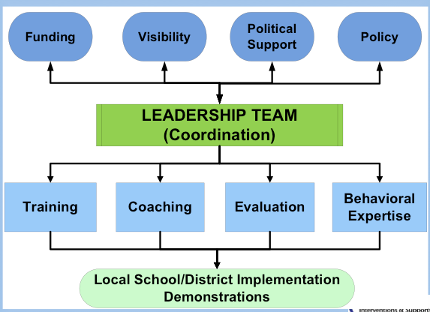
PBIS Systems Implementation Logic
I.C.iv

Slide 71
GENERAL IMPLEMENTATION PROCESS
Team
Agreements
Data-based
Action Plan
Evaluation
Implementation
I.C.iv
Notes:
SAY: In general, the implementation of a school-wide PBS approach at the school level is built around five main implementation steps.

Slide 72
Overview of School-wide Positive Behavior Support
(Chapter II)

Slide 73
Getting Started with SWPBIS
Establish an effective leadership team
Develop brief statement of behavioral purpose
Identify positive SW behavioral expectations
Develop procedures for teaching SW expectations
Develop procedures for teaching class-wide expectations
Develop continuum for strengthening appropriate behavior
Develop continuum for discouraging violations of expectations
Develop data-based procedures for monitoring
Develop systems to support staff
Build routines to ensure on-going implementation
Day 1
Day 2
Day 3

Slide 74
Getting Started with SWPBIS
Establish an effective leadership team
Develop brief statement of behavioral purpose
Identify positive SW behavioral expectations
Develop procedures for teaching SW expectations
Develop procedures for teaching class-wide expectations
Develop continuum for strengthening appropriate behavior
Develop continuum for discouraging violations of expectations
Develop data-based procedures for monitoring
Develop systems to support staff
Build routines to ensure on-going implementation
How will we play together?
SYSTEMS
II.B.i

Slide 75
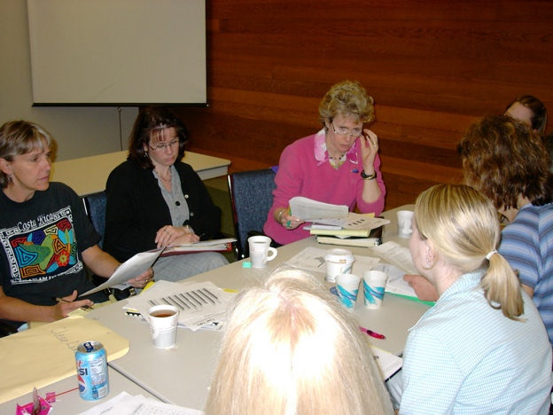
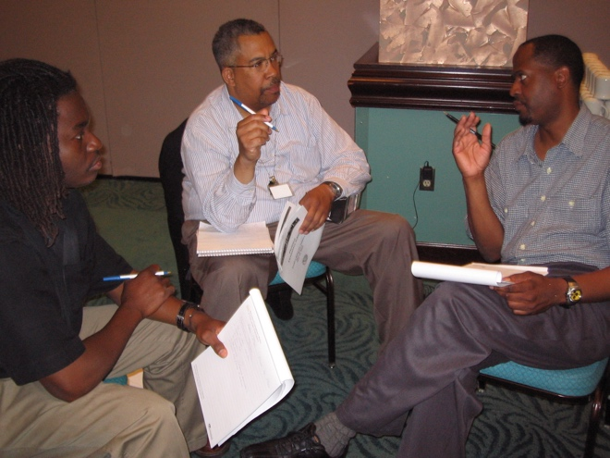
Team Composition
Administrator
Grade/Department Representation
Specialized Support
  Special Educator, Counselor, School Psychologist, Social Worker, etc.
Support Staff
  Office, Supervisory, Custodial, Bus, Security, etc.
Parent
Community
  Mental Health, Business
Student
Start with a
team that
“works.”

Slide 76
Getting Started with SWPBIS
Establish an effective leadership team
Develop brief statement of behavioral purpose
Identify positive SW behavioral expectations
Develop procedures for teaching SW expectations
Develop procedures for teaching class-wide expectations
Develop continuum for strengthening appropriate behavior
Develop continuum for discouraging violations of expectations
Develop data-based procedures for monitoring
Develop systems to support staff
Build routines to ensure on-going implementation
What if the same people are on every team?
Working Smarter
SYSTEMS
II.B.i

Slide 77
Response: Work Smarter
Do less…better
Do it once
Invest in clear outcomes
Invest in a sure thing
Be strategic about problem solving
II.B.1

Slide 78
Getting Started with SWPBIS
Establish an effective leadership team
Develop brief statement of behavioral purpose
Identify positive SW behavioral expectations
Develop procedures for teaching SW expectations
Develop procedures for teaching class-wide expectations
Develop continuum for strengthening appropriate behavior
Develop continuum for discouraging violations of expectations
Develop data-based procedures for monitoring
Develop systems to support staff
Build routines to ensure on-going implementation
What are we “about”?
PRACTICES
II.B.ii

Slide 79

Examples of Purpose Statements
G. Ikuma School is a community of learners and teachers. We are here to learn, grow, and become good citizens.
At Abrigato School, we treat each other with respect, take responsibility for our learning, and strive for a safe and positive school for all!

Slide 80
Getting Started with SWPBIS
Establish an effective leadership team
Develop brief statement of behavioral purpose
Identify positive SW behavioral expectations
Develop procedures for teaching SW expectations
Develop procedures for teaching class-wide expectations
Develop continuum for strengthening appropriate behavior
Develop continuum for discouraging violations of expectations
Develop data-based procedures for monitoring
Develop systems to support staff
Build routines to ensure on-going implementation
What do we expect?
PRACTICES
II.B.iii

Slide 81
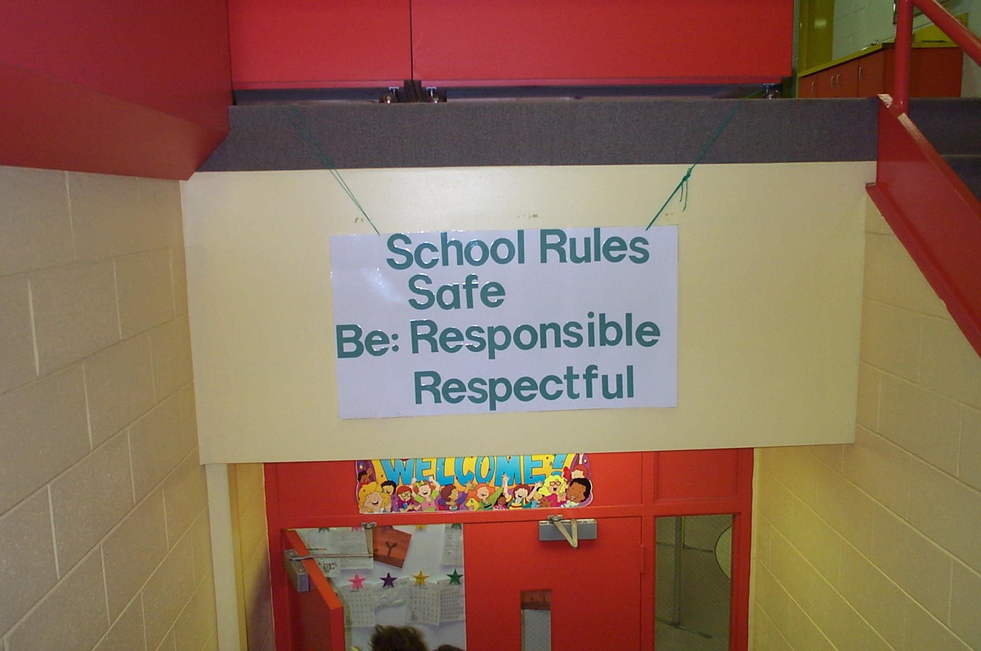
Redesign Learning & Teaching Environment
School Rules
NO Food
NO Weapons
NO Backpacks
NO Drugs/Smoking
NO Bullying

Slide 82
Getting Started with SWPBIS
Establish an effective leadership team
Develop brief statement of behavioral purpose
Identify positive SW behavioral expectations
Develop procedures for teaching SW expectations
Develop procedures for teaching class-wide expectations
Develop continuum for strengthening appropriate behavior
Develop continuum for discouraging violations of expectations
Develop data-based procedures for monitoring
Develop systems to support staff
Build routines to ensure on-going implementation
Teaching social behavior explicitly?
Like academic behavior
PRACTICES
II.B.iv

Slide 83
In other words… follow these key steps
Define
Teach
Prompt
Monitor
Evaluate
II.B.iv
Notes:
Sarah

Slide 84
Define
Behavioral expectations/Rules
Operationally define what the rules look like across all the routines and settings in your school.
One way to do this is in a matrix format.
II.B.iv

Slide 85
RAH – at Adams City High School
II.B.4
RAH | Classroom | Hallway/ Commons | Cafeteria | Bathrooms
Respect | Be on time; attend regularly; follow class rules | Keep location neat, keep to the right, use appropriate lang., monitor noise level, allow others to pass | Put trash in cans, push in your chair, be courteous to all staff and students | Keep area clean, put trash in cans, be mindful of others’ personal space, flush toilet
Achievement | Do your best on all assignments and assessments, take notes, ask questions | Keep track of your belongings, monitor time to get to class | Check space before you leave, keep track of personal belongings | Be a good example to other students, leave the room better than you found it
Honor | Do your own work; tell the truth | Be considerate of yours and others’ personal space | Keep your own place in line, maintain personal boundaries | Report any graffiti or vandalism

Slide 86
Teach
rules in the context of routines
Teach expectations directly.
  Define rule in operational terms—tell students what the rule looks like within routine.
  Provide students with examples and non-examples of rule-following within routine.
Actively involve students in lesson—game, role-play, etc. to check for their understanding.
Provide opportunities to practice rule following behavior in the natural setting.
II.B.iv

Slide 87
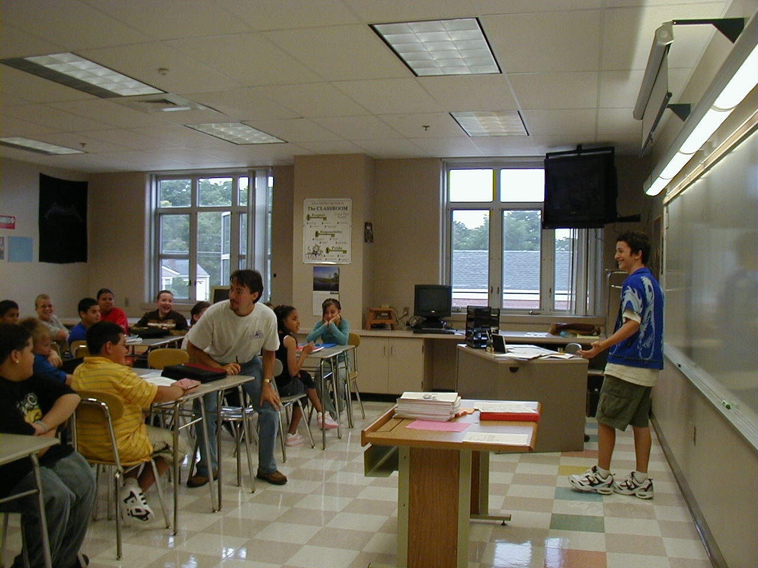
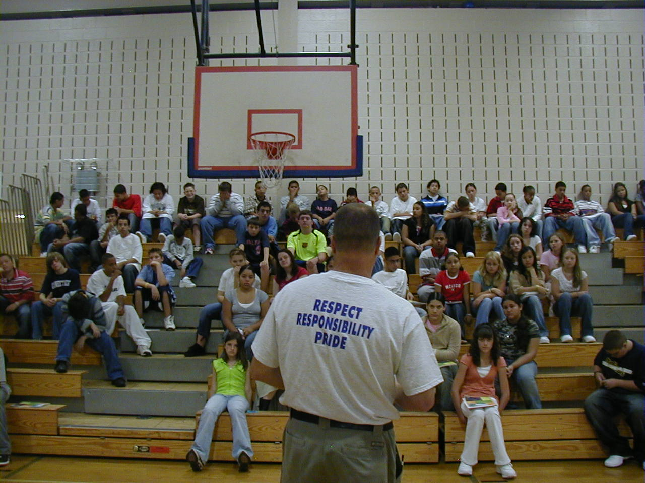

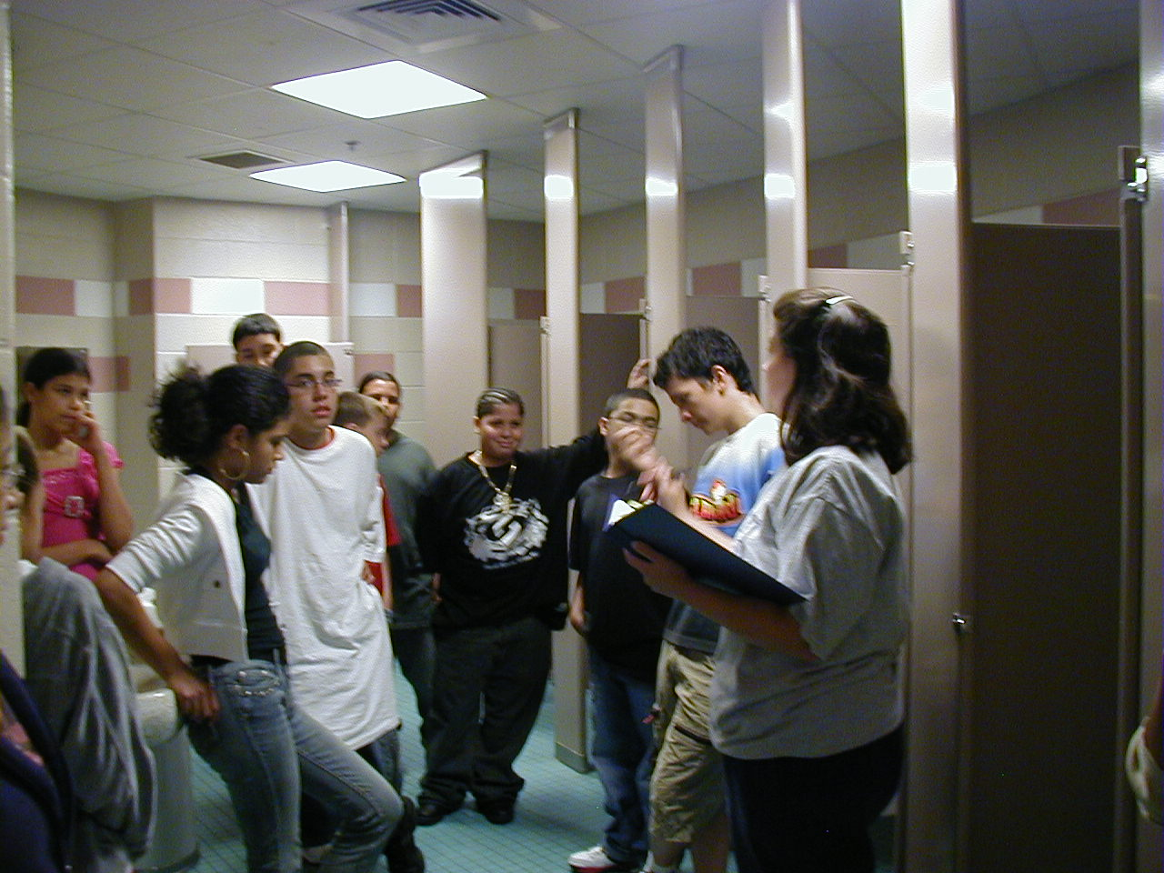
Expectations & behavioral skills are taught & recognized in natural context

Slide 88
Prompt
or remind students of the rule
Provide students with visual prompts (e.g., posters, illustrations, etc).
Use pre-corrections, which include “verbal reminders, behavioral rehearsals, or demonstrations of rule-following or socially appropriate behaviors that are presented in or before settings were problem behavior is likely” (Colvin, Sugai, Good, Lee, 1997).
II.B.iv

Slide 89
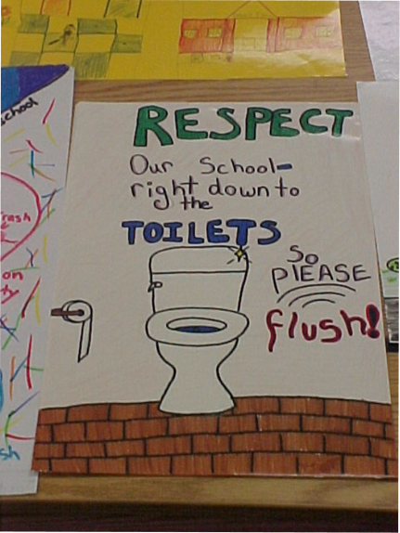
And people say high schools are different…

Slide 90
Monitor
students’ behavior in natural context
Active Supervision (Colvin, Sugai, Good, Lee, 1997):
            Move around
            Look around (Scan)
            Interact with students
                Reinforce
                Correct
II.B.iv

Slide 91

Monitoring Dismissal
McCormick Elementary School, MD

Slide 92
In other words… follow these key steps
Define
Teach
Prompt
Monitor
Evaluate
II.B.iv
Notes:
Sarah

Slide 93
Evaluate
the effect of instruction
Collect data
  Are rules being followed?
  If there are errors,
    who is making them?
    where are the errors occurring?
    what kind of errors are being made?
Summarize data (look for patterns)
Use data to make decisions
II.B.iv

Slide 94
Evaluate
the fidelity of implementation
Collect data
  Are we doing what we said we’d do?
    How will we support lessons taught within routines?
    How will we know when lessons are taught?
    How will we know when and where we might need boosters?
Summarize data (look for patterns)
Use data to make decisions
II.B.iv
Notes:
1. I added this slide too—what do you think?

Slide 95
A lesson plan that puts all of this together…
Define
Teach
Prompt
Monitor
Evaluate
II.B.iv
Notes:
Sarah

Slide 96
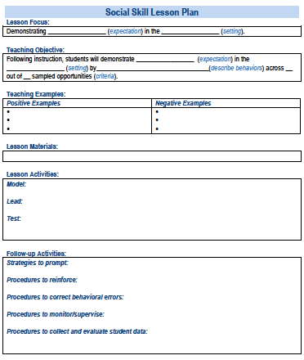
A lesson plan that prompts the critical features just described:
Simonsen, Myers, Everett, Sugai, Spencer, & LaBreck (2012)
Also see Appendix I
Notes:
Explicitly teaching social skills school-wide: Using a matrix to guide instruction. Intervention in School and Clinic, 47, 259-266. doi: 10.1177/1053451211430121
The last authors were folks from the central MA cohort of PBIS schools we trained!!!!!

Slide 97
Getting Started with SWPBIS
Establish an effective leadership team
Develop brief statement of behavioral purpose
Identify positive SW behavioral expectations
Develop procedures for teaching SW expectations
Develop procedures for teaching class-wide expectations
Develop continuum for strengthening appropriate behavior
Develop continuum for discouraging violations of expectations
Develop data-based procedures for monitoring
Develop systems to support staff
Build routines to ensure on-going implementation
PRACTICES
II.B.v

Slide 98
In other words… follow these key steps in the classroom.
Define
Teach
Prompt
Monitor
Evaluate
II.B.v
Notes:
Sarah

Slide 99
Getting Started with SWPBIS
Establish an effective leadership team
Develop brief statement of behavioral purpose
Identify positive SW behavioral expectations
Develop procedures for teaching SW expectations
Develop procedures for teaching class-wide expectations
Develop continuum for strengthening appropriate behavior
Develop continuum for discouraging violations of expectations
Develop data-based procedures for monitoring
Develop systems to support staff
Build routines to ensure on-going implementation
PRACTICES
II.B.vi

Slide 100
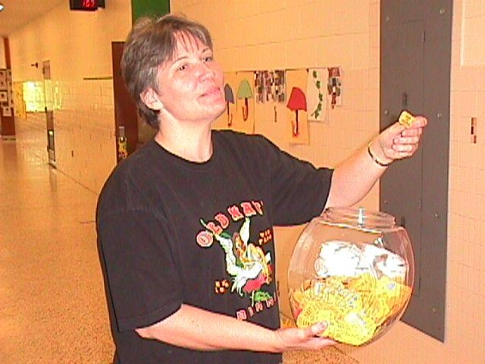
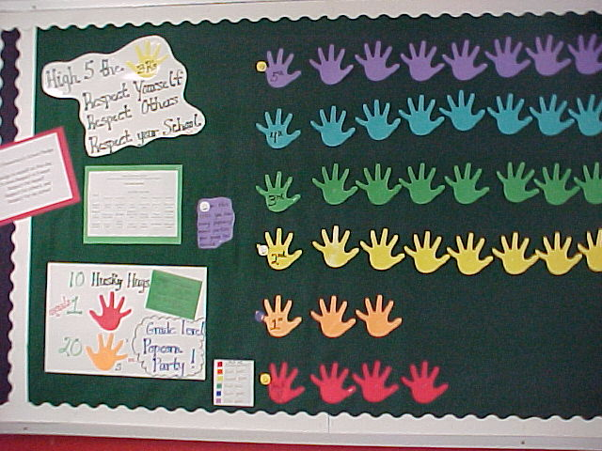
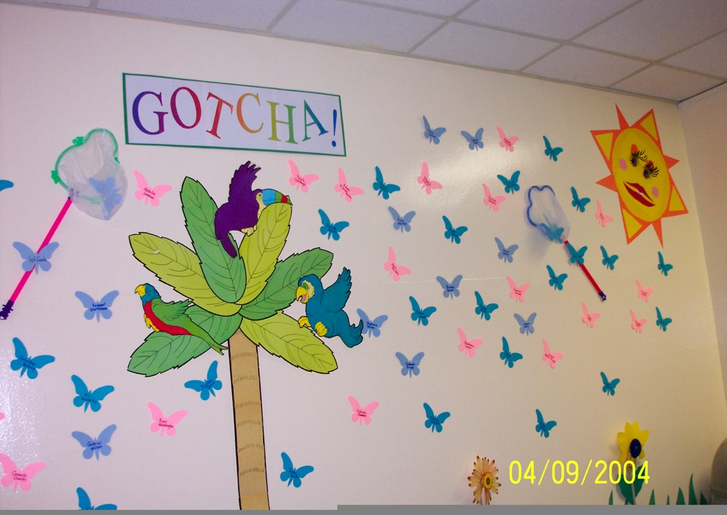
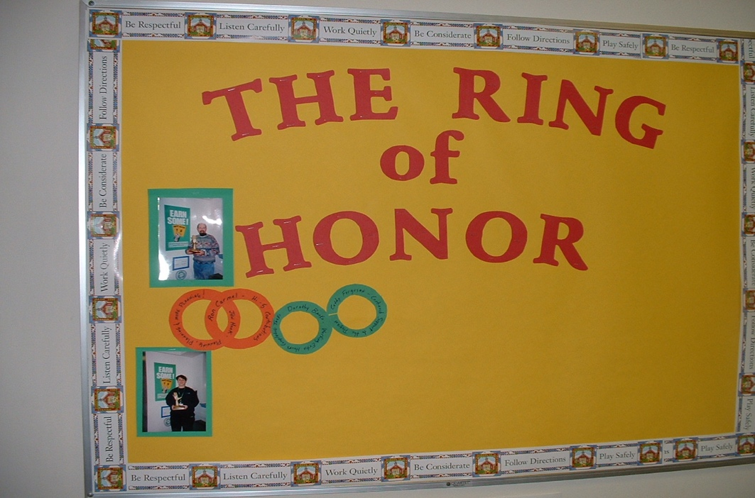
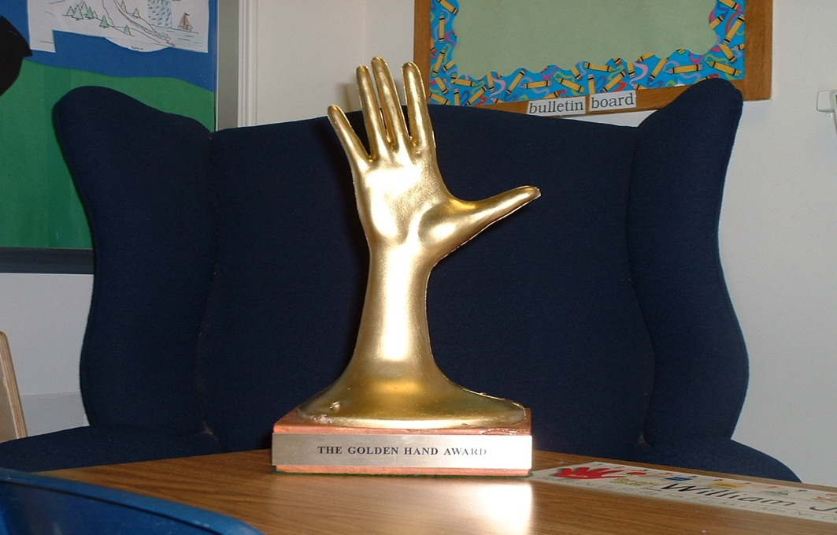
Establish a continuum of procedures to encourage rule following behavior

Slide 101
Getting Started with SWPBIS
Establish an effective leadership team
Develop brief statement of behavioral purpose
Identify positive SW behavioral expectations
Develop procedures for teaching SW expectations
Develop procedures for teaching class-wide expectations
Develop continuum for strengthening appropriate behavior
Develop continuum for discouraging violations of expectations
Develop data-based procedures for monitoring
Develop systems to support staff
Build routines to ensure on-going implementation
PRACTICES
II.B.vii

Slide 102
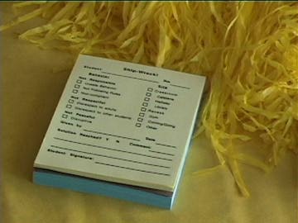
~10 positive : 1 correction

Slide 103
Getting Started with SWPBIS
Establish an effective leadership team
Develop brief statement of behavioral purpose
Identify positive SW behavioral expectations
Develop procedures for teaching SW expectations
Develop procedures for teaching class-wide expectations
Develop continuum for strengthening appropriate behavior
Develop continuum for discouraging violations of expectations
Develop data-based procedures for monitoring
Develop systems to support staff
Build routines to ensure on-going implementation
DATA
II.B.viii

Slide 104
PREVIEW: Guidelines for Data-Based Monitoring of SWPBIS Outcomes
DATA
General data collection procedures
  Data collection procedures are integrated into typical routines (e.g., ODRs, attendance, behavior incident reports)
  Data collection reports regularly checked for accuracy
  Data collection limited to information that answers important student, classroom, and school questions
  Structures and routines for staff members to receive weekly/monthly data reports about status of SW discipline
  Decision rules for guiding data analysis and actions
  Schedule for daily, weekly, monthly, quarterly feedback
  Data system managed by 2-3 staff members
  No more than 1% of time each day for managing data
  Efficient, timely, and graphic displays of data
II.B.viii

Slide 105
PREVIEW: Guidelines for Data-Based Monitoring of SWPBIS Outcomes
DATA
Office discipline referral procedures
  Agreed upon definitions of violations of expectations organized in a continuum
  A form for documenting noteworthy behavior incidents (ODR)
  School-wide procedures for processing/responding
  Efficient and user-friendly data input and storage
  Efficient and user-friendly process for summarizing and storing data
  Efficient and user-friendly procedures for producing visual displays of data
  Procedures for presenting data to staff on routine basis
  Procedures for making decisions and developing actions based on data
II.B.viii

Slide 106
Getting Started with SWPBIS
Establish an effective leadership team
Develop brief statement of behavioral purpose
Identify positive SW behavioral expectations
Develop procedures for teaching SW expectations
Develop procedures for teaching class-wide expectations
Develop continuum for strengthening appropriate behavior
Develop continuum for discouraging violations of expectations
Develop data-based procedures for monitoring
Develop systems to support staff
Build routines to ensure on-going implementation
SYSTEMS
II.B.viii

Slide 107
80% Rule
Tertiary Prevention:
Specialized
Individualized
Systems for Staff with High-Risk Behavior
~5%
Primary Prevention:
Systems to support
all staff:
Professional development
Reinforcement
~15%
Apply the triangle to adult behavior!
Secondary Prevention:
Specialized Group
Systems for Staff who are “At-Risk”
Additional instruction
Increased support
~80% of Staff
Notes:
Good sequence on staff acknowledgements…..important one for teams to get

Slide 108
Getting Started with SWPBIS
Establish an effective leadership team
Develop brief statement of behavioral purpose
Identify positive SW behavioral expectations
Develop procedures for teaching SW expectations
Develop procedures for teaching class-wide expectations
Develop continuum for strengthening appropriate behavior
Develop continuum for discouraging violations of expectations
Develop data-based procedures for monitoring
Develop systems to support staff
Build routines to ensure on-going implementation
SYSTEMS
II.B.viii

Slide 109
SWPBIS Action Planning

Slide 110
Team Implementation Checklist (TIC)
COACHES (1 per team) go to www.pbisapps.org
Go to pbis applications login on the top right corner of your screen
Login with your email and password (if you haven’t set up your password yet, just go through forgot password process)
Select PBIS Assessment
Under Surveys Currently Open, Select Team Checklist 3.1
Click “Take Survey”
  Find Team Checklist
Select under Action column
Complete TIC as a team
9. Review reports to support your action planning
Also see Appendix C
Complete during Team Action Planning Time TODAY

Slide 111
Activity:
Action Planning
Work as team for 75 min
Return to your Action Plan
Update sections corresponding to identifying outcomes and Steps 1-6.
In particular, make sure have a plan for sharing information with and gathering/using feedback from your school faculty!
Present 2-3 “big ideas” from your group (1 min. reports)
Please email your action plan to your trainers by the end of the day to receive specific feedback.

Slide 112
Topics to be Covered
Day 3
Review
Getting Started with SWPBIS (steps 7-10)
Action Planning
Day 4
Quick Review of SWPBIS from Days 1-3
Non-classroom Settings
Classroom Settings
Action Planning (w/TIC)
Wrap up
Let’s preview content so you’ll be ready to facilitate.

Slide 113
Overview of School-wide Positive Behavior Support
(Chapter II)

Slide 114
Getting Started with SWPBIS
Establish an effective leadership team
Develop brief statement of behavioral purpose
Identify positive SW behavioral expectations
Develop procedures for teaching SW expectations
Develop procedures for teaching class-wide expectations
Develop continuum for strengthening appropriate behavior
Develop continuum for discouraging violations of expectations
Develop data-based procedures for monitoring
Develop systems to support staff
Build routines to ensure on-going implementation
Day 1
Day 2
Day 3

Slide 115
Getting Started with SWPBIS
Establish an effective leadership team
Develop brief statement of behavioral purpose
Identify positive SW behavioral expectations
Develop procedures for teaching SW expectations
Develop procedures for teaching class-wide expectations
Develop continuum for strengthening appropriate behavior
Develop continuum for discouraging violations of expectations
Develop data-based procedures for monitoring
Develop systems to support staff
Build routines to ensure on-going implementation
PRACTICES
II.B.vii

Slide 116
Guidelines for Continuum of Procedures to Decrease Behavior
PRACTICES
Specify Definitions for Violations of SW Expectations
  Contextually appropriate labels/names
  Definitions represent continuum of severity (e.g., minor, major, illegal)
  Definitions comprehensive in scope (school-wide)
  Definitions in measurable terms
  Mutually exclusive (minimal overlap)

Slide 117
Guidelines for Continuum of Procedures to Decrease Behavior
PRACTICES
Specify Procedures for Processing Violations of SW Expectations
  Agreement regarding office staff vs. teacher/staff responsibilities
  ODR form for tracking discipline event specifies:
    Who (i) violated rule, (ii) observed and responded to violation of expectation, and (iii) else was involved
    When (day/time)
    Where
    What (i) expectation was violated and (ii) was the possible motivation
  Agreement regarding options for continuum of consequences
  Data decision rules for intervention and support selection

Slide 118
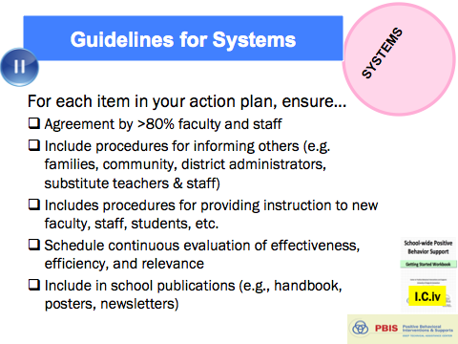
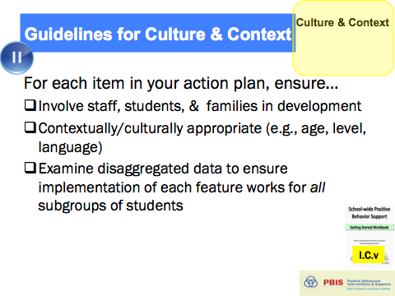
Guidelines for Continuum of Procedures to Decrease Behavior
PRACTICES
Implement procedures
  Use by all staff
  Schedule for regular review of use and effectiveness
  Means for keeping track of number of acknowledgments vs. ODRs or other disciplinary actions
  Schedule and procedures for regular review and enhancement of acknowledgements
  Procedures in place for identifying and supporting students whose behaviors are not responsive
And always remember to consider systems, culture, & context:

Slide 119
~10 positive : 1 correction

Slide 120
Getting Started with SWPBIS
Establish an effective leadership team
Develop brief statement of behavioral purpose
Identify positive SW behavioral expectations
Develop procedures for teaching SW expectations
Develop procedures for teaching class-wide expectations
Develop continuum for strengthening appropriate behavior
Develop continuum for discouraging violations of expectations
Develop data-based procedures for monitoring
Develop systems to support staff
Build routines to ensure on-going implementation
DATA
II.B.viii

Slide 121
Steps for Selecting, Monitoring, and Evaluating SWPBIS Practices
Step 1: Develop evaluation questions.
Step 2: Identify indicators or measures.
Step 3: Develop methods for collecting and analyzing indicators.
Step 4: Make decisions and action plan from analysis of indicators.
What do you want to know?
What information can be collected?
How/when should information be gathered?
How was the question answered and what should be done next?
II.B.viii

Slide 122
Getting Started with SWPBIS
Establish an effective leadership team
Develop brief statement of behavioral purpose
Identify positive SW behavioral expectations
Develop procedures for teaching SW expectations
Develop procedures for teaching class-wide expectations
Develop continuum for strengthening appropriate behavior
Develop continuum for discouraging violations of expectations
Develop data-based procedures for monitoring
Develop systems to support staff
Build routines to ensure on-going implementation
SYSTEMS
II.B.ix

Slide 123
Key Systems Features
Staff Buy-in
Embedded Professional Development
Staff Recognition for Implementation
Team-based Implementation
Clear Action Plan
I.C.iv
Notes:
Build section numbers, color coding, and structure into ppt.

Slide 124
Avoiding “Train & Hope”
WAIT for
New
Problem
REACT to
Problem
Behavior
Expect, But
HOPE for
Implementation
Select &
ADD
Practice
Hire EXPERT
to Train
Practice
I.C.iv

Slide 125
GENERAL IMPLEMENTATION PROCESS
Team
Agreements
Data-based
Action Plan
Evaluation
Implementation
I.C.iv
Notes:
SAY: In general, the implementation of a school-wide PBS approach at the school level is built around five main implementation steps.

Slide 126

Staff Buy-In
Effective Messenger(s)
Buy-in!
Effective
Team…
Staff
Info & Drafts
Feedback
…powered
by Data
Effective Leadership

Slide 127
80% Rule
Tertiary Prevention:
Specialized
Individualized
Systems for Staff with High-Risk Behavior
~5%
Primary Prevention:
Systems to support
all staff:
Professional development
Reinforcement
~15%
Apply the triangle to adult behavior!
Secondary Prevention:
Specialized Group
Systems for Staff who are “At-Risk”
Additional instruction
Increased support
~80% of Staff
Notes:
Good sequence on staff acknowledgements…..important one for teams to get

Slide 128
Embedded Professional Development
Explicit Training
Coaching/Prompting
Desired Outcomes
Performance Feedback

Slide 129
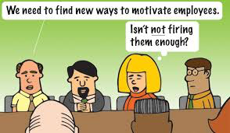
Staff Recognition
If we want staff to recognize kids, we should recognize them!
We can (and should) do better!

Slide 130
Getting Started with SWPBIS
Establish an effective leadership team
Develop brief statement of behavioral purpose
Identify positive SW behavioral expectations
Develop procedures for teaching SW expectations
Develop procedures for teaching class-wide expectations
Develop continuum for strengthening appropriate behavior
Develop continuum for discouraging violations of expectations
Develop data-based procedures for monitoring
Develop systems to support staff
Build routines to ensure on-going implementation
SYSTEMS
II.B.x

Slide 131
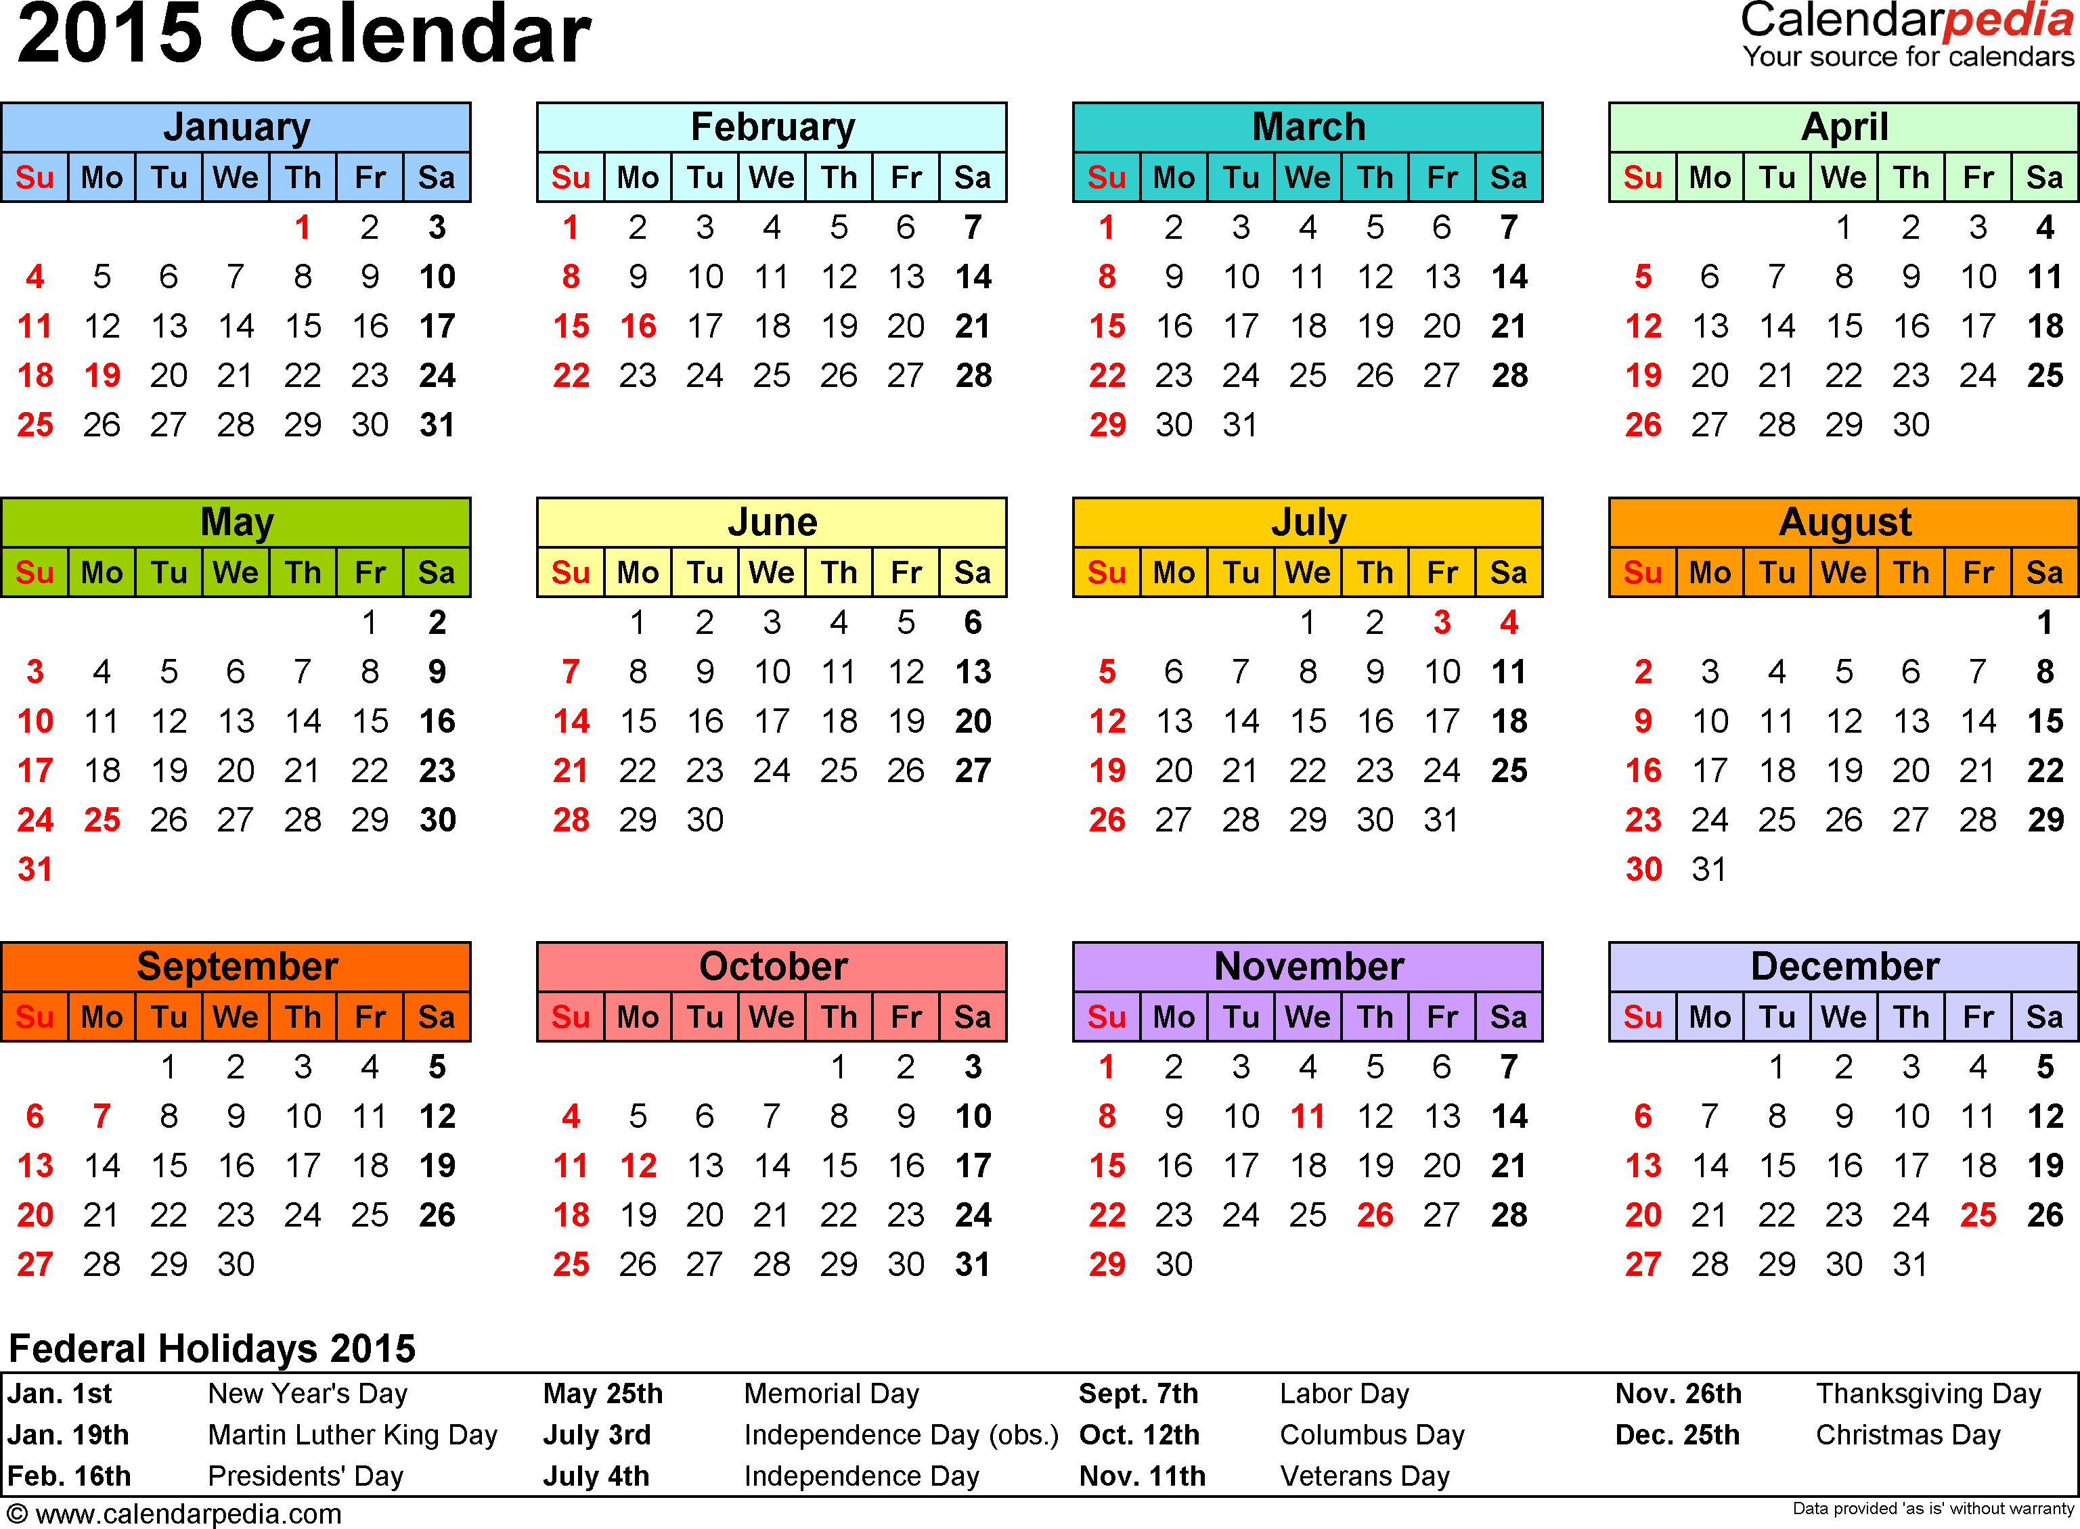
To start your semester/year off well, begin teaching and learning activities on the first day of semester/school
CHAPTER
II.X

Slide 132
Activity:
Action Planning
Work as team for 120 min
Return to your Action Plan
Update each section based on what you’ve learned in today.
In particular, make sure have a plan for sharing information with and gathering/using feedback from your school faculty!
Present 2-3 “big ideas” from your group (1 min. reports)

Slide 133
3. SWPBIS Practices and Systems in Non-Classroom Settings
(Chapter III)

Slide 134
Problematic Non-Classroom Settings
III.A

Slide 135
Examples
An elementary school principal found that over 45% of their behavioral incident reports were coming from the playground.
A high school nurse lamented that “too many students were asking to use her restroom” during class transitions.
A middle school secretary reported that she was getting at least one neighborhood complaint daily about student behavior on & off school grounds.
Over 50% of referrals occurring on “buses” during daily transitions.
III.A

Slide 136
Definitions and Intervention Considerations
III.B

Slide 137
Non-Classroom Settings
Particular times or places where supervision is emphasized
Where instruction is not available as behavior management tool
Examples:
  Cafeteria, hallways, playgrounds, bathrooms
  Buses & bus loading zones, parking lots
  Study halls, library, “free time”
  Assemblies, sporting events, dances
III.B

Slide 138
Non-Classroom Settings:
Basic Management
Considerations
Practices
Physical or environmental arrangements
Routines & expectations
Staff behavior
Student behavior
Teach directly expected behaviors and routines in context
Actively supervise (scan, move, interact)
Pre-correct and remind
Positively reinforce expected behavior
III.B

Slide 139
Guidelines for Non-Classroom Settings
PRACTICES
Implementation is school-wide by all staff
School-wide behavior expectations taught in context
Administrator is an active member
Context-specific expectations and routines taught directly and early in the school year/term
Regular opportunities for review, practice, and positive reinforcement
Team-based review, action planning, and implementation consideration
Data-based progress monitoring and action planning
Regular review of accuracy of intervention implementation
And always remember to consider systems, culture, & context:
III.C

Slide 140
Supervision
Self-assessment
YES or NO
III.D

Slide 141
Supervision Self-Assessment
Did I have at least 4 positive for 1 negative student contacts?
Did I move throughout the area I was supervising?
Did I scan the area I was supervising?
Did I positively interact with most of the students in the area?
Did I handle most minor rule violations quickly and quietly?
Did I follow school procedures for handling major rule violations?
Do I know our school-wide expectations (positively stated rules)?
Did I positively acknowledge at least 5 different students for displaying school-wide expectations?

Slide 142
SYSTEMS FEATURES
School-wide implementation
  All staff
  Direct teaching 1st day/week
  Regular review, practice, & positive reinforcement
Team-based identification, implementation, & evaluation
Data-based decision making

Slide 143
4. Classroom Management Practices and Systems
(Chapter IV)

Slide 144
Effective Classroom Management Practices
IV.A

Slide 145
Effective Academic Instruction
Effective Behavioral Interventions
Positive, Preventative School Culture (SWPBIS)
Continuous & Efficient Data-based Decision Making
Systems for Durable & Accurate Implementation
IV.A.ii

Slide 146
Evidence-Based Practices in Classroom Management
Minimize crowding & distraction
Maximize structure & predictability
State, review, & reinforce positively stated expectations.
Provide more acknowledgement for appropriate than inappropriate behaviors.
Maximize varied opportunities to respond.
Maximize active engagement.
Actively & continuously supervise.
Respond to inappropriate behaviors quickly, positively, & directly.
Establish multiple strategies for acknowledging appropriate behavior.
Generally provide specific feedback for errors & corrects.
IV.B
Notes:
Annimation is out of order on this slide- I fixed on my computer but check on yours

Slide 147

Guidelines for Classroom Settings
PRACTICES
Academic achievement is linked to social success, active engagement, and effective teaching
Good teaching is used as a behavior management strategy
Behavior management is used as an instructional management strategy
The three-tiered prevention logic is applied to the classroom context
Classroom management is linked to school-wide behavior support
Typical classroom routines have been taught, practiced, and reinforced regularly
School-wide support systems are used to sustain effective classroom management strategies
Data-based progress monitoring and action planning
Regular review of accuracy of intervention implementation
And always remember to consider systems, culture, & context:
IV.C

Slide 148
Topics to be Covered
Day 5
Quick Review of SWPBIS from Days 1-4
Function of Behavior
Escalation and De-escalation
Team Action Planning
Wrap up
Day 6
Quick Review
Review TIC/TFI & Team Action Planning
Preview of Tier II and Tier III
Planning for the Beginning of the Semester/Year
Team Action Planning
Wrap up
Let’s preview content so you’ll be ready to facilitate.

Slide 149
5. Building Behavioral Capacity
(Chapter V)

Slide 150
Function Based Support
Foundations in behavioral theory, ABA, and PBIS
Attention to environmental context
Emphasis on purpose (or history of reinforcement) of behavior
Focus on teaching behaviors
Attention to implementers (adult behaviors) & redesign of teaching & learning environments
V.A

Slide 151
Functions
Pos Reinf
Neg Reinf
V.A

Slide 152
To Determine Function of Behavior
What typically precedes?
What do the behaviors look like?
What typically follows?
Antecedent
Behavior
Consequence
Based on observing patterns across time, we can infer the probable function of behavior.
V.A

Slide 153
By understanding function, we can intervene more effectively.
How can we prevent?
What should we teach the student to do instead?
How do we respond to make sure the new skill “works”?
Antecedent
Behavior
Consequence
We can make simple tweaks to the antecedents, behaviors, and consequences, to prevent, teach, and respond, respectively.
V.A

Slide 154
Why is function important?
Function-based behavior support plans are not only effective, they are more effective than similarly intensive and individualized plans that are not function-based (e.g., Ingram, Palmer, & Sugai, 2005).
What did you say?
Show you the data?
Well…since you asked

Slide 155
(Ingram, Palmer, & Sugai, 2005)

Slide 156
If your proactive strategies fail…
Understanding Escalation and De-escalation
V.B

Slide 157
ASSUMPTIONS
Behavior is learned (function).
Behavior is lawful (function).
Behavior is escalated through successive interactions (practice).
Behavior can be changed through an instructional approach.
V.B
(Colvin & Sugai, 1989)

Slide 158
KEY STRATEGIES
Identification of how to intervene early in an escalation.
Identification of environmental factors that can be manipulated.
Identification of replacement behaviors that can be taught (& serve same function as problem).
V.B
(Colvin & Sugai, 1989)

Slide 159

Crisis Escalation & De-escalation
High
Peak
Acceleration
De-escalation
Prevention
Agitation
Trigger
Calm
Recovery
Low
V.B
(Colvin & Sugai, 1989)

Slide 160
Activity:
Questions and Answers
Work as team for 15 min
With your group brainstorm 2-3 questions that you still have.
Share questions and solutions as a large group

Slide 161
Team Implementation Checklist (TIC)
COACHES (1 per team) go to www.pbisapps.org
Go to pbis applications login on the top right corner of your screen
Login with your email and password (if you haven’t set up your password yet, just go through forgot password process)
Select PBIS Assessment
Under Surveys Currently Open, Select Team Checklist 3.1
Click “Take Survey”
  Find Team Checklist
Select under Action column
Complete TIC as a team
9. Review reports to support your action planning
Also see Appendix C
Complete during Team Action Planning Time TODAY

Slide 162
Activity:
Action Planning
Work as team for 105 min
Return to your Action Plan
Update each section based on what you’ve learned in today.
In particular, make sure have a plan for sharing information with and gathering/using feedback from your school faculty!
Present 2-3 “big ideas” from your group (1 min. reports)

Slide 163
Preview of Tier II
V.C.i

Slide 164
What is needed to consider secondary intervention?
SWPBS Systems established, including:
SWPBS Practices established, including:
School board/district/regional support
SWPBS Leadership Team
Administrator endorsement and active participation
Continuous, data-based professional development (training and coaching)
Recognition of staff behavior, contributions, and/or accomplishments
School-wide data system
3-5 positively stated and defined school-wide expectations
Expectations regularly taught in both classroom and non-classroom settings
School-wide reinforcement plan to acknowledge expected behavior
Plan and continuum of consequences for rule violations
Evidence-based classroom management practices
V.C.i

Slide 165
Common Secondary Intervention Features
Consistent, standardized implementation across students
Easily accessible (e.g., within a few days of referral)
Continuous availability
Implemented by all school staff
Consistent with and extra doses of school-wide expectations and interventions
Continuous utilization of data for decision-making (e.g., progress monitoring)
(Crone, Horner, & Hawken, 2010)
V.C.i

Slide 166
Specialized Support Team:
Roles, Responsibilities, & Functions
Provide training and support to school staff regarding the program(s)
Provide specialized behavioral assessment strategies, interventions, and supports
Meet regularly (e.g., weekly or biweekly) to review the program, monitor individual student progress, and review new referrals
Coordinate school-wide implementation of the overall Tier II practices and systems
Develop screening procedures and data-based decision rules for referring students to intervention
Develop data-based decision rules (including time frames) for placing students, monitoring progress, and fading the intervention
Summarize and review data
V.C.i

Slide 167
TAKE AWAY MESSAGE
Secondary systems efficiently support a small group of students by increasing prompts, structure, and opportunities for reinforcement.

Slide 168
Preview of Tier III
V.C.ii

Slide 169
Individual Student Systems
Behavioral competence at school & district levels
Team- & data-based decision making
Targeted social skills & self-management instruction
Individualized instructional & curricular accommodations
Function-based behavior support planning
Comprehensive person-centered planning & wraparound processes
V.C.ii
Notes:
SAY: If we are successful in establishing effective school-wide, classroom, and non-classroom practices and systems, we can support a majority of students and staff. However, some students will require more specialized, intensive, and possibly individualized PBS.
To be effective in supporting high-need students, behavior specialists must have access to and fluent knowledge about tertiary level interventions and systems as characterized by these 6 sample items. They also must be fluent in the use and facilitation of these skills.
One of the main objectives of school-wide PBS is to facilitate the accurate and sustained implementation of tertiary level interventions with student who display the most challenging problem behaviors.
An important element of individual student systems is adopting a “function-based approach” which generally means using information about what triggers and maintains problem behaviors to build effective behavior intervention plans. Functional behavioral assessments are conducted to build and serve as the backbone of these plans. Two checklists can be used to validate the completeness and accuracy of functional behavioral assessments and behavior intervention plans (see Appendices 7 & 8, respectively).

Slide 170
Behavior Support Elements
*Response class
*Routine analysis
*Hypothesis statement
*Function
V.C
*Alternative behaviors
*Competing behavior analysis
*Contextual fit
*Strengths, preferences, & lifestyle outcomes
*Evidence-based interventions
Problem Behavior
Functional Assessment
Team-based
Behavior competence
*Implementation support
*Data plan
Intervention & Support Plan
*Continuous improvement
*Sustainability plan
Fidelity of Implementation
Impact on Behavior & Lifestyle

Slide 171
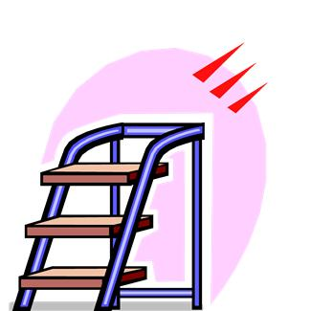
3 Basic Steps:
Developing interventions for Individual Students
3. Develop intervention strategies
Training
Required
2. Choose replacement behaviors
1. Look at the function of behavior

Slide 172
FBA
Definition of
Problem Behavior
or Class
Testable
Hypothesis
Tier III
Elements
Contextually
Appropriate
Support
Function
Statement
Behavior
Intervention
Plan
Supporting
Data
Competing
Path
Analysis
BSP
See Checklists included in Appendices.
Appendix
G
Appendix
H

Slide 173
TAKE AWAY MESSAGE
Tertiary interventions are intensive, function-based supports for individual students.
The focus is on redesigning environments and teaching functional skills.

Slide 174
Activity:
Tier 1 Questions and Answers
Work as team for 15 min
Time to refocus on Tier 1 implementation!
With your group brainstorm 2-3 questions that you still have related to Tier 1.
Share questions, responses, and solutions as a large group.

Slide 175
Activity:
Action Planning
Work as team for 105 min
Return to your Action Plan
Update content related to Tier 1.
In particular, make sure have a plan for sharing information with and gathering/using feedback from your school faculty!
Present 2-3 “big ideas” from your group (1 min. reports)
Please email your action plan to your trainers by the end of the day to receive specific feedback.

Slide 176
Next Steps

Slide 177
Implement Action Plan
Communicate information to staff
Meet monthly with team
  Review school data
  Review/update action plan
Implement activities on action plan

Slide 178
Future Support
Use your action plan, data, TIC, and TFI to hold your team accountable (and share info with us).
Keep in touch with us.
Coaches and teams will still meet next year (3 times each).
Have a great spring and summer!

Slide 179
Activity:
Getting Ready for Next Training
Work with partner coach for 15 min
Review implementation guidelines and preview slides just presented.
Discuss above with a partner
  Is there content you’d like re-explained?
  What key questions do you have?
  What questions/challenges do you anticipate from your team members?
Share key highlights (1 min. reports)

Slide 180
Review of
Coaching SWPBIS

Slide 181
Main Coaching Objectives
By the end of today’s meeting, you will be able to…
  …Describe your role as a coach.
  …Articulate the basic elements of SWPBS.
  …Identify resources for SWPBS.
  …Problem solve roadblocks in coaching
  …Facilitate your team’s activities at the next SWPBS team training.

Slide 182
What roles do coaches play?
Coaching Roles
Facilitate
Content Knowledge
Communicate
  Team meetings
  Activities at training events
  Implementation
  Local PBS expert
Positive “nag”
Link to resources (e.g., nepbis.org, www.pbis.org)
  Share advanced content with team
  Share information at faculty meetings
I.A.ii

Slide 183
Consider Tattoos!
4 PBIS Elements
School Systems
Supporting Social Competence &
Academic Achievement
OUTCOMES
School-wide
Classroom
SWPBIS
SYSTEMS
DATA
Supporting
Decision
Making
Supporting
Staff Behavior
Non-classroom
Family
PRACTICES
Tertiary Prevention:
Specialized
Individualized
Systems for Students with High-Risk Behavior
~5%
Student
Supporting
Student Behavior
Primary Prevention:
School-/Classroom-
Wide Systems for
All Students,
Staff, & Settings
~15%
Secondary Prevention:
Specialized Group
Systems for Students with At-Risk Behavior
~80% of Students

Slide 184
TAKE AWAY MESSAGE
You’re a coach!
Prepare for the next training event, and use your resources to guide your team’s activities (both at training and at school).

