Slide 1
Behavioral Principles Underlying Positive Behavior Support Practices
Brandi Simonsen, Jen Freeman, Susannah Everett, & Adam Feinberg

Slide 2
Critical Questions
What are the conceptual foundations of positive behavior support?
What are the basic principles (building blocks) of behavior?
How do we (re)design environments to promote success?
Time Permitting
How do we teach skills to increase fluency and promote generalization to expand success?

Slide 3
Critical Questions
What are the conceptual foundations of positive behavior support?

Slide 4
Conceptual Foundations of PBIS
Behaviorism
  Behavior
  is learned,
  lawful, and
  manipulable

Slide 5

A Science of Human Behavior
“By discovering and analyzing these causes [i.e., stimuli that have an effect on behavior], we can predict behavior; to the extent that we can manipulate them, we can control behavior”
(p. 23, emphasis added).
(Skinner, 1953; e-version 2005)

Slide 6
Conceptual Foundations of PBIS
Behaviorism
ABA
  Apply to socially important problems in applied settings

Slide 7
Dimensions of ABA in the words of
Baer, Wolf, & Risley, (1968)
Applied: “behavior, stimuli, and/or organism under study are chosen because of their importance to man and society” (p. 92)
Behavioral: behavior is “composed of physical events” and requires “precise measurement” (p. 93)
Analytic: “requires a believable demonstration of the events that can be responsible for the occurrence or non-occurrence of that behavior” (pp. 93-94)
Technological: “techniques making up a particular behavioral application are completely identified and described” (p. 95)
Conceptual Systems: procedures and applications should “strive for relevance to principle” (p. 96)
Effective: “practical importance…is the essential criterion” (p. 96)
Generality: a behavior change that “proves durable over time, …appears in a wide variety of possible environments, or…spreads to a wide variety of related behaviors” (p. 96)

Slide 8
Conceptual Foundations of PBIS
Behaviorism
ABA
PBS
  Consider larger context of improving quality of life

Slide 9
According to Carr et al. (2002)
What is PBS?
According to Carr et al. (2002)
What are the theoretical foundations of PBS?
Positive Behavior support (PBS) “is an applied science that uses educational methods to expand an individual’s repertoire and systems change methods to redesign an individual’s living environment to first enhance the individual’s quality of life and, second, to minimize his or her problem behavior” (emphasis added)
Applied Behavior Analysis (ABA)
“PBS has not only incorporated the elements of applied behavior analysis, it has…assumed its own identity” (p. 5).
Normalization/Inclusion Movement
“people with disabilities should live in the same settings as others and have access to the same opportunities as others” (p. 5).
Person-centered Values
“humanistic values should not replace [but]…inform empiricism” (p. 6).
(Carr et al., 2002, p. 4)

Slide 10
Conceptual Foundations of PBIS
Behaviorism
ABA
PBS
PBIS

Slide 11
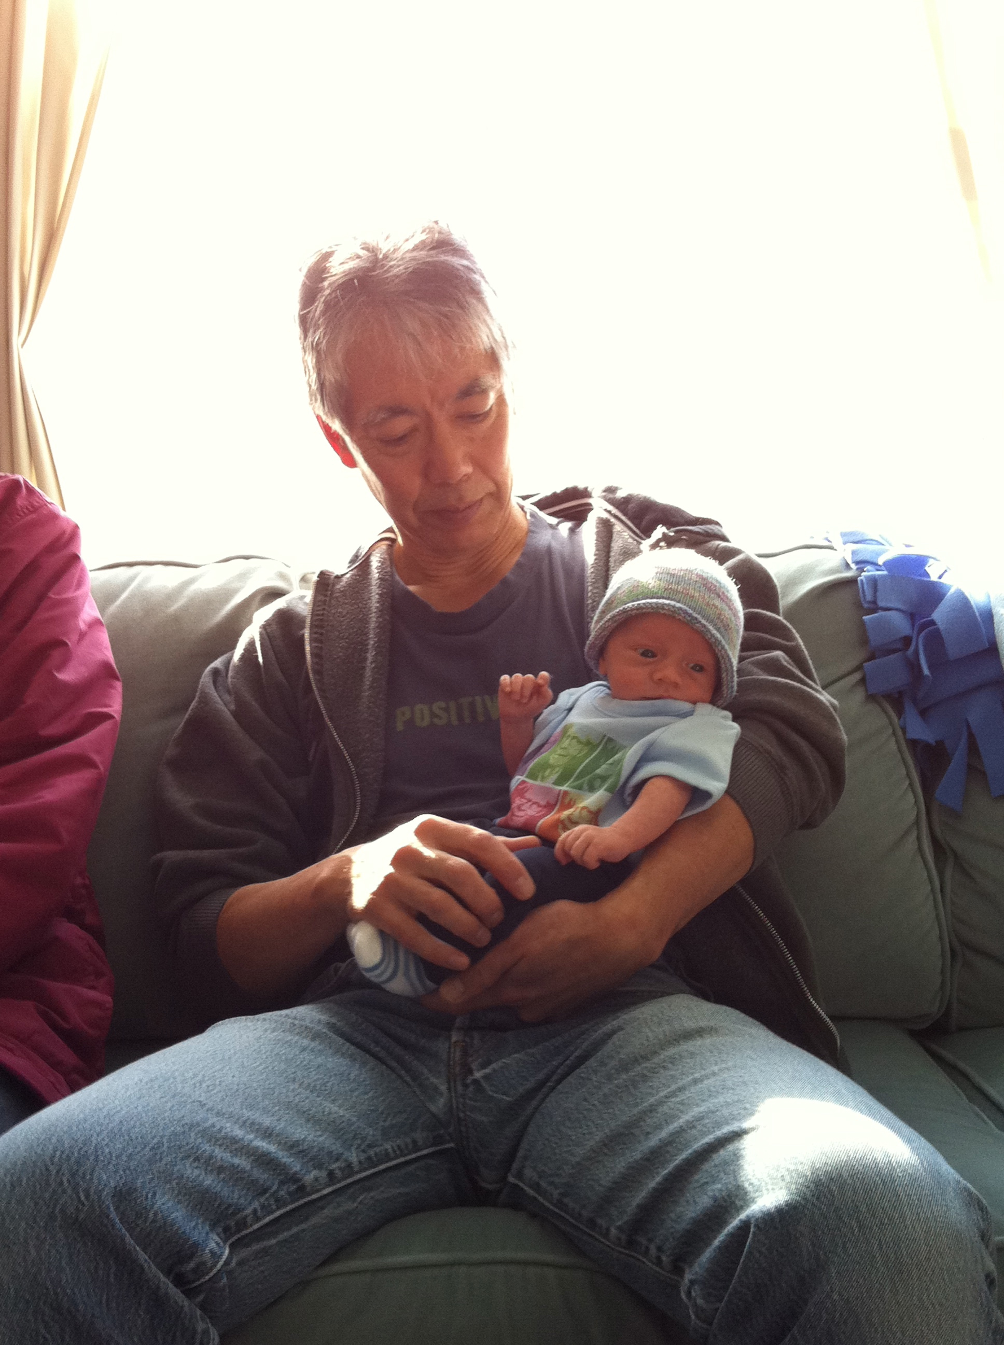
Behaviorism (e.g., Skinner) provided the foundation for…
SCHOOL-WIDE
BEHAVIOR INTERVENTIONS AND SUPPORTS

Slide 12
Critical Questions and Answers
Behavioral theory, applied behavioral analysis, and positive behavior support provide the foundation for positive behavior support.
What are the conceptual foundations of positive behavior support?
What are the basic principles (building blocks) of behavior?

Slide 13
Building Blocks of Behavior
Setting Event
Antecedent
Behavior
Consequence

Slide 14
Building Blocks of Behavior
Setting Event
Antecedent
Behavior
Consequence
Antecedent condition or event that temporarily alters the value of the consequence.
A “stimulus that precedes a behavior.”
An ”observable and measurable act of an individual (also called a response).”
A stimulus change that occurs contingent on a behavior.
(Alberto & Troutman, 2006)

Slide 15
Say it together…
OBSERVABLE AND MEASURABLE
  Antecedents are typically observable and measurable stimuli that precede a behavior
  Behaviors are typically observable and measurable acts
  Consequences are typically observable and measurable stimuli that contingently follow a behavior
So, the key questions to ask are:
  Can you see (or sense) it?
  Can you measure it?

Slide 16
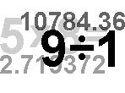
What’s the “antecedent”?
The teacher said, “line up,” and the students pushed in their chairs and made a line at the door.
The principal entered the room to observe math instruction, and the teacher increased the rate of opportunities to respond delivered.
She felt mad, so she hit.

Slide 17
One of these things is not like the other…
Which one is
NOT a behavior?
1.
Hits
Spits
Angry
Bites
2.
Hurts
Cries
Slaps
Whines
3.
Smiles
Laughs
Wiggles
Happy

Slide 18

What’s the “consequence”?
After the students lined up, they were allowed to go to recess.
When she hit, she felt bad.
After the teacher yelled at the class they were quiet.

Slide 19
ABC’s of Behavior
Now that we understand that antecedents, behaviors, and consequences are…
what?
…OBSERVABLE and MEASURABLE,
we can go into more depth with types of consequences and types of antecedents

Slide 20
Building Blocks of Behavior
Types of Consequences
4 Types of Consequences
Setting Event
Antecedent
Behavior
Consequence
Action
Give
Take
Putting it all together:
Future
Probability
Reinforcement
Positive
Negative
Effect on
Future Behavior
S^{R+}
S^{R-}
Future
Probability
Punishment
S^{P+}
S^{P-}
Notes:
Reinforcement: when a consequence of a behavior functions to increase the likelihood of future occurrences of that behavior
Punishment: when a consequence of a behavior functions to decrease the likelihood of future occurrences of that behavior

Slide 21
Reinforcement and Punishment
Give (+)
Take (-)
Action
Effect
Positive
Negative
Inc. ( )*
Reinforcement
Reinforcement
(S^{R+})
(S^{R-})
Positive
Negative
Dec. ( )*
Punishment
Punishment
(S^{P+})
(S^{P-})
* Future probability of behavior

Slide 22
Myth or Fact?
Fact:
Use of rewards following appropriate behavior is directly related to both initial, and durable academic and social success.
A review of the research literature indicates there is no evidence that external rewards are detrimental to intrinsic motivation
  “For high-interest tasks, verbal rewards are found to increase free choice and task interest.”
  “When tasks … are of low initial interest, rewards increase free-choice, and intrinsic motivation…”
Myth
Rewards are potentially detrimental to intrinsic motivation
(Akin-Little, Eckert Lovett & Little, 2004; Blaze, Olmi, Mercer, Dufrene, & Tingstorm, 2014; Cameron, Banko & Pierce, 2001; Reiss, 2005)

Slide 23
Effective use of reinforcement
Rewards are especially important for helping motivate a student to build early competence (fluency) with new skills.
Reward “behavior” not people.
Embed rewards in the activity/behavior you want to encourage.
Use many different kinds of rewards (objects, activities, privileges, attention, natural consequences) and ask kids what would motivate them.
Acquisition
Fluency
Maintenance
Generalization

Slide 24
Building Blocks of Behavior
Types of Antecedents
Setting Event
Antecedent
Behavior
Consequence
Which type of antecedent is the most likely to occasion the behavior?
Discriminative
Stimulus (S^{D})
Reinforcement
Response
S-Delta (S▵)
When most people say “antecedent,” they mean “discriminative stimulus, as they’re referring to the antecedent that occasions the behavior (due to prior history of S^{R} in its presence)
S^{D} Minus (S^{D-})
Punishment

Slide 25
“Adam”
When Adam is told that he must wait for a favorite activity, he screams, hits, kicks, head-butts, and destroys property. After this behavior, staff immediately allow him to do his favorite activity. In the future, Adam continues to scream, hit, etc., whenever he is told to wait.

Slide 26
Breakdown of Example: Adam
Antecedent(S^{D}):
Behavior(s):
Consequence:
  Action(+ or -):
  Effect(⬆ or ⬇):
  So it is:
When Adam is told to wait
he screams, kicks, head-butts, and destroys property
Adam’s staff allow him to access his favorite activity
Adam’s staff…give him access to the activity
In the future, Adam continues to “tantrum”
Positive reinforcement

Slide 27
“Nonya”
At home, Nonya has several chores (feed the dog, water the plants, and pick up her toys). On Monday, Nonya was tired. Her mom reminded her to do her chores, but Nonya said “No” and flopped on the floor. When Nonya’s favorite cartoon came on she was not allowed to watch because her chores were not done. (Her mom took her TV privileges away). In the future, Nonya is less likely to say no and flop on the floor.

Slide 28
Breakdown of Example: Nonya
Antecedent(S^{D}):
Behavior(s):
Consequence:
  Action(+ or -):
  Effect(⬆ or ⬇):
  So it is:
When Nonya is asked to do her chores
Nonya says “No” and flops on the floor
Nonya’s mom doesn’t allow her to watch TV.
Nonya’s mom…takes away her TV privileges
In the future, Nonya is less likely to refuse
Negative Punishment

Slide 29
Bus Duty
When the teacher is given an extra bus duty on a rainy day, he complains loudly to the principal. The principal covers the bus duty. In the future the teacher is more likely to complain loudly when asked to do an extra duty.

Slide 30
Breakdown of Example: Bus Duty
Antecedent(S^{D}):
Behavior(s):
Consequence:
  Action(+ or -):
  Effect(⬆ or ⬇):
  So it is:
The teacher is given an extra bus duty
He complains loudly to the principal
The principal takes the bus duty away
The principal…takes the duty away
In the future, the teacher continues to complain
Negative reinforcement

Slide 31
Daily Behavior Report
At the end of the day, the teacher sent home Brian’s daily behavior report. Brian’s mother sent the teacher an email “yelling” at the teacher for not supporting Brian enough. In the future, the teacher is less likely to send home Brian’s daily behavior report

Slide 32
Breakdown of Example: DPR
Antecedent(S^{D}):
Behavior(s):
Consequence:
  Action(+ or -):
  Effect(⬆ or ⬇):
  So it is:
End of the day (possibly following challenging behavior)
The teacher sent home the daily behavior report
Brian’s mother sent an angry email
Mother “gave” an email
less likely to send home behavior report
Positive punishment

Slide 33
Building Blocks of Behavior
Extinction
Setting Event
Antecedent
Behavior
Consequence
Response
Reinforcement
When the stimuli that function to reinforce a behavior (i.e., reinforcers) are withheld or prevented from occurring,
the behavior will eventually disappear. This is called extinction.
An extinction burst is a temporary increase in behavior following the removal of reinforcement.

Slide 34
“Adam” Revisited
After realizing that Adam was being positively reinforced for his problem behavior, staff decided to no longer give Adam his favorite activity when he engages in problem behavior. Over time, Adam eventually stopped engaging in problem behavior when he was asked to wait.

Slide 35
Breakdown of Example
Antecedent(S^{D}):
Behavior(s):
Consequence:
And this is called___________
When Adam is asked to wait
Adam would engage in a “tantrum”
Initially, Adam kept engaging in the same behavior…sometimes with greater intensity
an extinction burst
Over time, Adam stopped engaging in problem behavior when he was asked to wait.
And this is called...
Staff did not give access to activity
(contingent on tantrum)
Staff did not give access to activity
(contingent on tantrum)
extinction
Notes:
Sd: being asked to wait
B: problem behavior
C: took away previous reinforcers
this decreased his behavior and caused it to stop
Extinction

Slide 36
Bus Duty Revisited
After realizing that the teacher was being negatively reinforced for his problem behavior (complaining), the principal implemented a strategy in which she no longer took the bus duty away when the teacher complained
Initially, the teacher complained louder. Then, he decided to try a different approach: complaining to other staff about how unfair the principal was. Regardless of problem behavior, the principal continued to present the teacher with bus duty.
Over time, the teacher eventually stopped engaging in problem behavior when he was given bus duty.

Slide 37
Breakdown of Example
Antecedent(S^{D}):
Behavior(s):
Consequence:
And this is called___________
When the teacher is asked to do bus duty
Teacher complained loudly
Teacher complained louder and to more people
an extinction burst
Principal continued to present the duty
And this is called...
Over time, the teacher eventually stopped complaining when he was given bus duty.
Principal still continued to present the duty
extinction
Notes:
Sd: being asked to wait
B: problem behavior
C: took away previous reinforcers
this decreased his behavior and caused it to stop
Extinction

Slide 38
Function of Behavior
All behavior serves a function:
  Learners trying to get or obtain desired activities, tangible items, attention, or stimulation (S^{R+}).
  Learners trying to avoid or escape aversive activities, items, attention, or stimulation (S^{R-}).

Slide 39
Another look at function
Pos Reinf
Neg Reinf

Slide 40
Building Blocks of Behavior
Focus on Function of Behavior
Setting Event
Antecedent
Behavior
Consequence
Discriminative Stimulus (S^{D})
Behavior
Reinforcement
When an individual is exhibiting problematic (or any) behaviors, look at the function:
  What typically precedes the problematic behaviors?
  What typically follows the problematic behaviors?
  What function are the behaviors serving for that individual?

Slide 41
“Adam”
When Adam is told that he must wait for a favorite activity, he screams, hits, kicks, head-butts, and destroys property. After this behavior, staff immediately allow him to do his favorite activity. In the future, Adam continues to scream, hit, etc., whenever he is told to wait.
Get/Obtain Activity
Assuming this is a consistent pattern…
What is the function of Adam’s behavior?

Slide 42
Bus Duty
Escape/Avoid Activity
When the teacher is presented with bus duty, he complains loudly. In the past, the principal gets frustrated and takes the duty away. In the future, the teacher continues to complain whenever he is presented with a duty.
Assuming this is a consistent pattern…
What is the function of the teacher’s behavior?

Slide 43
Building Blocks of Behavior
Focus on Setting Events
Setting Event
Antecedent
Behavior
Consequence
Antecedent condition or event that temporarily alters the value of the consequence.
Can occur at the same time and/or same place as the S^{D}
Setting events may be environmental, physiological, or social
Setting events help explain variations in behavior
For our purposes, the terms setting event and motivating operations (MO) can be used interchangeably
You may be sick or tired in school when given a task, which may decrease the value of typical reinforcers for task completion (and increase value of nap)
Can occur earlier and/or in a different location from the S^{D}
If you fight with a family member before school, it may decrease the value of adult attention for appropriate social skills (and increase value of escape)

Slide 44
Critical Questions and Answers
Behavioral theory, applied behavioral analysis, and positive behavior support provide the foundation for positive behavior support.
What are the conceptual foundations of positive behavior support?
Setting Events, Antecedents, Behaviors, and Consequences are the building blocks of behavior.
What are the basic principles (building blocks) of behavior?
How do we (re)design environments to promote success?

Slide 45
Myth or Fact?
Fact:
The “power” or PBIS is in redesigning environments to set people up for success and providing explicit instruction to teach desired behavior.
In other words, we…
  emphasize positive, preventative antecedent strategies,
  teach behavior, and
  use effective consequences to increase desired behavior.
Myth
PBIS is all about providing tangible or token rewards

Slide 46
Building Blocks of Behavior
How do we (re)design environments
to promote success?
Setting Event
Antecedent
Behavior
Consequence
Antecedent condition or event that temporarily alters the value of the consequence.
A “stimulus that precedes a behavior.”
An ”observable and measurable act of an individual (also called a response).”
A stimulus change that occurs contingent on a behavior.
Although individuals (not groups) behave, we can apply basic principles of behavior to promote a positive and proactive environment that (a) occasions and increases the likelihood of desired behaviors and (b) prevents or decreases the likelihood of undesired behaviors.
(Alberto & Troutman, 2006)

Slide 47
Building Blocks of Behavior
Strategies to Address
Antecedents
Strategies to Address Setting Events
or Motivating Operations
Setting Event
Antecedent
Behavior
Consequence
Minimize the Likelihood
↑ S^{D}s for desired bx
Neutralize
↑ Prompts for desired bx
Withhold S^{D}
↓ S^{D-} for desired bx
Add Prompts
↓ S^{D}s & prompts for undesired Bx.
↑ S^{R} for Desired Behavior
Consider S^{D-} for undesired bx
(Horner, Vaughn, Day, & Ard, 1996)

Slide 48
Building Blocks of Behavior
Strategies to Address
Consequences
Setting Event
Antecedent
Behavior
Consequence
Contingent on Behavior
Minimize the Likelihood
↑ S^{D}s for desired bx
Planned Ignoring
Extinction
Neutralize
↑ Prompts for desired bx
Applications of S^{R+}
Praise
Withhold S^{D}
↓ S^{D-} for desired bx
Break
Applications of S^{R-}
Add Prompts
↓ S^{D}s & prompts for undesired Bx.
Time Out from S^{R+}
Applications of S^{P-}
↑ S^{R} for Desired Behavior
Consider S^{D-} for undesired bx
Applications of S^{P+}
Correction

Slide 49
Critical Questions and Answers
Behavioral theory, applied behavioral analysis, and positive behavior support provide the foundation for positive behavior support.
What are the conceptual foundations of positive behavior support?
Setting Events, Antecedents, Behaviors, and Consequences are the building blocks of behavior.
What are the basic principles (building blocks) of behavior?
Invest in antecedent strategies to prompt and occasion desired behaviors.
How do we (re)design environments to promote success?
How do we teach skills to increase fluency and promote generalization to expand success?

Slide 50
What behavioral procedures are involved in teaching?
What are typical outcomes of teaching?
Antecedent
Behavior
Consequence
Establishing Stimulus Control
Increase the likelihood that behaviors occur under the correct stimulus conditions
Teach simple behaviors
Shaping
Improve performance of behaviors
Prompting
Teach complex sequences of behavior
Task Analyzing
Chaining

Slide 51
What is the ultimate goal of all instruction?
Focus on phases of learning
Acquisition
Fluency
Maintenance
Generalization
“Increase accuracy of new skill”
“Increase rate of correct responses to ‘automatic’ or functional level”
“Perform skill overtime without reteaching”
“Stimulus generalization”
“Response adaptation”
(Simonsen & Myers, 2015)

Slide 52
Programming for Generalization
Generalization
“Select target behaviors that will meet naturally existing contingencies of reinforcement”
“Specify all desired variations of the behavior and the settings/situations where it should (and should not) occur”
(Cooper et al., 2007, pp. 623-624)

Slide 53
Programming for Generalization
Generalization
“Teach full range of relevant stimulus conditions and response requirements”
“Make the instructional setting similar to the generalization setting”
“Maximize contact with reinforcement in generalization setting”
“Mediate generalization”
“Train to generalize”
(Cooper et al., 2007, pp. 626-648)

Slide 54
Building Blocks of Behavior
Strategies to Address
Antecedents
Strategies to Address Setting Events
or Motivating Operations
Strategies to Teach
Behavior
Setting Event
Antecedent
Behavior
Consequence
Minimize the Likelihood
↑ S^{D}s for desired bx
Shaping
Extinction
Neutralize
↑ Prompts for desired bx
Task Analyzing
Applications of S^{R+}
Withhold S^{D}
↓ S^{D-} for desired bx
Chaining
Applications of S^{R-}
Add Prompts
↓ S^{D}s & prompts for undesired Bx.
Establishing Stimulus Control
Applications of S^{P-}
↑ S^{R} for Desired Behavior
Consider S^{D-} for undesired bx
Prompting
Applications of S^{P+}
(Horner, Vaughn, Day, & Ard, 1996)

Slide 55
Critical Questions and Answers
Behavioral theory, applied behavioral analysis, and positive behavior support provide the foundation for positive behavior support.
What are the conceptual foundations of positive behavior support?
Setting Events, Antecedents, Behaviors, and Consequences are the building blocks of behavior.
What are the basic principles (building blocks) of behavior?
Invest in antecedent strategies to prompt and occasion desired behaviors.
How do we (re)design environments to promote success?
Use behavioral teaching strategies and program for generalization to maximize success.
How do we teach skills to increase fluency and promote generalization to expand success?

Slide 56
Critical Questions and Answers
Behavioral theory, applied behavioral analysis, and positive behavior support provide the foundation for positive behavior support.
What are the conceptual foundations of positive behavior support?
Setting Events, Antecedents, Behaviors, and Consequences are the building blocks of behavior.
What are the basic principles (building blocks) of behavior?
Invest in antecedent strategies to prompt and occasion desired behaviors.
How do we (re)design environments to promote success?
Use behavioral teaching strategies and program for generalization to maximize success.
How do we teach skills to increase fluency and promote generalization to expand success?

Slide 57
Conceptual Foundations of PBIS
Behaviorism
ABA
PBS
PBIS

Slide 58
Building Blocks of Behavior
Review of “Big Ideas”
Setting Event
Antecedent
Behavior
Consequence
Antecedent condition or event that temporarily alters the value of the consequence.
A “stimulus that precedes a behavior.”
An ”observable and measurable act of an individual (also called a response).”
A stimulus change that occurs contingent on a behavior.
(Alberto & Troutman, 2006)

Slide 59
Strategies to Address
Consequences
Strategies to Address Setting Events
or Motivating Operations
Strategies to Teach
Behavior
Strategies to Address
Antecedents
Building Blocks of Behavior
Setting Event
Antecedent
Behavior
Consequence
Contingent on Behavior
Minimize the Likelihood
↑ S^{D}s for desired bx
Shaping
Planned Ignoring
Extinction
Neutralize
↑ Prompts for desired bx
Task Analyzing
Applications of S^{R+}
Praise
Withhold S^{D}
↓ S^{D-} for desired bx
Chaining
Break
Applications of S^{R-}
Add Prompts
↓ S^{D}s & prompts for undesired Bx.
Establishing Stimulus Control
Time Out from S^{R+}
Applications of S^{P-}
↑ S^{R} for Desired Behavior
Consider S^{D-} for undesired bx
Prompting
Applications of S^{P+}
Correction
(Horner, Vaughn, Day, & Ard, 1996)

Slide 60
Critical Questions and Answers
One more…
Where can I learn more?
Behavioral theory, applied behavioral analysis, and positive behavior support provide the foundation for positive behavior support.
What are the conceptual foundations of positive behavior support?
Setting Events, Antecedents, Behaviors, and Consequences are the building blocks of behavior.
What are the basic principles (building blocks) of behavior?
Invest in antecedent strategies to prompt and occasion desired behaviors.
How do we (re)design environments to promote success?
Use behavioral teaching strategies and program for generalization to maximize success.
How do we teach skills to increase fluency and promote generalization to expand success?

Slide 61
Where can I learn more?
UConn Graduate Certificate Program
On-line Training Programs
Other Graduate Programs

Slide 62
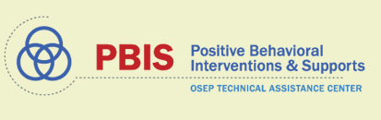
Thank you!
brandi.simonsen@uconn.edu
www.pbis.org
www.cber.org

