Slide 1

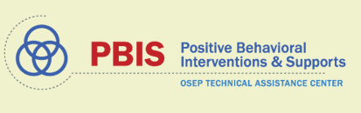
VTPBiS Classroom Behavior Practice Coaching:
Intensive Focus on Practices and Systems
Brandi Simonsen

Slide 2
Objectives
As a result of attending this training, you will be able to
Present the context in which positive classroom behavioral support (PCBS) practices are implemented.
Train critical positive classroom behavior support (PCBS) practices.
Implement the key elements of effective systems to support teachers’ implementation of practices.
Develop an action plan to support your implementation of VT Classroom Behavior Practice Coaching Model.

Slide 3

Overview of Materials
Supporting and Responding to Student Behavior
Classroom Management Practice Checklist
PBIS Technical Brief on Systems to Support Teachers’ Implementation of Positive Classroom Behavior Support
Self-Assessment of Systems to Support PCBS
Action Plan

Slide 4
Where do we start?
As a result of attending this training, you will be able to
Present the context in which positive classroom behavioral support (PCBS) practices are implemented.
Train critical positive classroom behavior support (PCBS) practices.
Implement the key elements of effective systems to support teachers’ implementation of practices.
Develop an action plan to support your implementation of VT Classroom Behavior Practice Coaching Model.
REVIEW

Slide 5
Behavior problems disrupt learning
Engaging learning prevents behavior problems
Goal of Teaching
Student Achievement
Classroom Management
Good Teaching
(Gest & Gest, 2005; Stronge, Ward and Grant, 2011)
Notes:
Our goal is not compliance it is student achievement BOTH good instruction and good behavior management are needed.

Slide 6
United States, we have a problem!
12% of public school teachers leave within their first 2 years
50% leave within the first 5 years
(Boyd, Grossman, Ing, Lankford, Loeb, & Wyckoff, 2011; DeAngelis, & Presley, 2011; Feng, 2006; Henke, Zahn, & Carroll, 2001; Ingersoll, 2001; Ingersol, Merril, May, 2012; Johnson & Birkeland, 2003; Ingersoll & Smith, 2003; Kaiser & National Center for Educational Statistics, 2011; Kukla-Acevedo, 2009; Luekens, Lyter, Fox, & Changler, 2004; Smith & Ingersoll, 2004; Torres, 2012; Zabel & Zabel, 2002)

Slide 7
Why do teachers leave?
Most consistently listed factors:
  Lack of pedagogical training
  School environment
  Poor student behavior and motivation
Teachers consistently report:
  Inadequate pre-service training on classroom management and
  Lack of support and training for handling student behaviors
(Boyd, Grossman, Ing, Lankford, Loeb, & Wyckoff, 2011; Chesley & Jordan, 2012; Feng, 2006; Halford, 1998; Henke, Zahn, & Carroll, 2001; Ingersoll, 2001; Ingersol, Merril, May, 2012; Johnson & Birkeland, 2003; Kukla-Acevedo, 2009; Lane, Wehby, & Barton-Arwood, 2005; Luekens, Lyter, Fox, & Changler, 2004; Stough, 2006; Torres, 2012; Zabel & Zabel, 2002)
Supporting teachers in classroom PBIS is critical
for our teachers, schools, and our state!
Notes:
Teachers typically receive little pre- or in-service training in classroom management
(Begeny & Martens, 2006; Freeman, Simonsen, Briere, & MacSuga, in press; Markow, Moessner, & Horowitz, 2006; Special Education Elementary Longitudinal Study, 2001, 2002, 2004; Wei, Darling-Hammond, & Adomson, 2010)
Multi-component training packages (didactic training + coaching + performance feedback + etc.) result in desired behavior change, especially when trained skills are effective
(Abbott et al., 1998; Hiralall & Martens, 1998; Madsen, Becker, & Thomas, 1968; Simonsen, MacSuga-Gage, Briere, Freeman, & Sugai, in preparation; The Metropolitan Area Child Study Research Group & Gorman-Smith, 2003;

Slide 8
We know a bit about what’s likely to work: Empirically-supported practices in classroom management
So we know what the “it” is.
(Simonsen, Fairbanks, Briesch, Myers, & Sugai, 2008)

Slide 9
But we don’t seem to be doing “it”
 | Specific Praise | General Praise | OTR | Corrective/Reprimand
Reinke et al. (2012)¹ | 0.13 | 0.43 | 1.43 | 0.67
Scott et al. (2011)² | 0.06 (overall positive) |  | 0.57 | 0.07
Hirn & Scott (2014)³ | 0.03 (overall positive) |  | 0.47 Group 0.06 Indiv. | 0.08
Pas et al. (2015)⁴ | 0.12 (approval) |  | 0.93 | 0.27
¹ Based on observations of 33 elementary teachers in schools implementing PBIS with fidelity
² Based on > 1000 observations of elementary and high school teachers in schools not identified as implementing PBIS
³ Based on 827 observations of high school teachers
⁴ Based on observations of 1262 high school teachers prior to PBIS implementation
Notes:
Scott, T. M., Alter, P. J., & Hirn, R. (2011). An examination of typical classroom context and instruction for students with and with­ out behavioral disorders. Education and Treatment of Children, 34, 619-642.
Calculated rate from Pas et al. by taking mean counts and dividing by 15 min. AND, for Pas, Corrective/Reprimand = (disapproval + reactive)

Slide 10
Why aren’t we doing “it”?
What do we know from the empirical literature?
Teachers typically receive little pre- or in-service training in classroom management
(Begeny & Martens, 2006; Freeman, Simonsen, Briere, & MacSuga, in press; Markow, Moessner, & Horowitz, 2006; Special Education Elementary Longitudinal Study, 2001, 2002, 2004; Wei, Darling-Hammond, & Adomson, 2010)
Multi-component training packages (didactic training + coaching + performance feedback + etc.) result in desired behavior change, especially when trained skills are effective
  (Abbott et al., 1998; Hiralall & Martens, 1998; Madsen, Becker, & Thomas, 1968; Freeman et al., in preparation; The Metropolitan Area Child Study Research Group & Gorman-Smith, 2003; Rollins et al., 1974)

Slide 11
*Categories not mutually exclusive (Freeman, Simonsen, et al., 2016)

Slide 12
We can do this!
We need to support teachers implementation of evidence based classroom management practices….. and we can!
  We know what evidence based classroom management practices look like.
  We have a science to support implementation.
  We have tools to describe and illustrate what implementing evidence based classroom management “looks like.”
So, what are we waiting for?

Slide 13
Let’s get started!
As a result of attending this training, you will be able to
Present the context in which positive classroom behavioral support (PCBS) practices are implemented.
Train critical positive classroom behavior support (PCBS) practices.
Implement the key elements of effective systems to support teachers’ implementation of practices.
Develop an action plan to support your implementation of VT Classroom Behavior Practice Coaching Model.
REVIEW

Slide 14
Acknowledgements for this Section
(Co-authors of Supporting and Responding to Student Behavior):
Brandi Simonsen
Jennifer Freeman
Steve Goodman
Barbara Mitchell
Jessica Swain-Bradway
Brigid Flannery
George Sugai
Heather George
Bob Putnam
Renee Bradley et al. (OSEP)

Slide 16
Interactive Map of Core Features
Hyperlink

Slide 17
Tables with Definitions, Examples, Non-Examples, and Resources

Slide 18
Decision Making Chart

Slide 19
PCBS Practices Decision-making Guide: 3 Key ?s
Are the foundations of effective PCBS in place?
Effectively design the physical environment of the classroom
+
Develop & teach predictable classroom routines.
+
Post, define, & teach 3-5 positive classroom expectations.
Are proactive and positive PCBS practices implemented consistently?
Provide high rates of varied opportunities to respond.
+
Use prompts and active supervision.
+
Acknowledge behavior with specific praise & other strategies.
Do data indicate that students are still engaging in problem behavior?

Slide 20
Are students still engaging in problem behavior?
Are behaviors minor or major expectation violations?
Well done! Monitor outcomes and adjust as needed
Use brief, specific error correction & other strategies
How many students are involved (many or few)?
Review, adjust & intensify CWPBIS. Ask for help!
Request additional (tier 2 & 3) support for students.
Yes
No
Minor
Major
Do data indicate that students are still engaging in problem behavior?
Many
Few

Slide 21
Complete Classroom Management Practices Checklist
Complete checklist for your own classroom or a classroom with which you are familiar.
Identify and be ready to discuss areas for support.

Slide 22
Now, turning our attention to supporting teachers.
As a result of attending this training, you will be able to
Present the context in which positive classroom behavioral support (PCBS) practices are implemented.
Train critical positive classroom behavior support (PCBS) practices.
Implement the key elements of effective systems to support teachers’ implementation of practices.
Develop an action plan to support your implementation of VT Classroom Behavior Practice Coaching Model.
FOUCS

Slide 23
Acknowledgements for this Section
(Co-authors of PBIS Technical Brief on Systems to Support Teachers’ Implementation of Positive Classroom Behavior Support):
Jennifer Freeman
Brandi Simonsen
Steve Goodman
Barbara Mitchell
Heather George
Jessica Swain-Bradway
Kathleen Lane
Jeff Sprague
Bob Putnam

Slide 24
PBIS Technical Brief on Systems to Support Teachers’ Implementation of Positive Classroom Behavior Support

Slide 25
Hyperlink
Guiding Questions

Slide 26
Tables with Details

Slide 27
School-Level Scenario

Slide 28
PCBS Systems Action Planning Guide:
3 Key Questions
Are the foundational systems in place to support PCBS practice implementation by all staff?
Do all staff know what PCBS practices to implement and if they’re doing it accurately?
Do data indicate that staff are implementing PCBS practices effectively?

Slide 29
PCBS Systems Action Planning Guide:
3 Key Questions
Are the foundational systems in place to support PCBS practice implementation by all staff?
PCPS implementation is a clear school and district priority
+
School and district resources are available to support PCBS implementation
+
School and district teams have considered alignment and integration of PCBS with other district priorities and initiatives
Do all staff know what PCBS practices to implement and if they’re doing it accurately?
Examples:
District and school administrators have communicated a clear priority for PCBS implementation.
Examples:
Dedicated time for training
Dedicated time for coaching functions
Regular data review
Celebration or recognition of staff implementation
Examples:
Implementation of PCBS connected to clear need in building
Implementation of PCBS connected to academic instruction
PCBS strategies adapted to ensure classroom contextual and cultural fit
Non-Examples:
No practices are prioritized for implementation, identified strategies lack evidence of effectiveness, and/or priority practices are not effectively disseminated among all staff.
Non-Examples:
No dedicated time or resources
Data not shared or not used in problem solving
Staff recognition not available or used to celebrate PCBS implementation
Non-Examples:
Data demonstrating need are not regularly shared
Academic strategies taught in isolation
Training on practices not connected to why it is important in the school
Do data indicate that staff are implementing PCBS practices effectively?

Slide 30
Turn, Talk, and Plan:
Review the critical features and topics we just discussed (and corresponding info in the systems brief.
Describe each key to your partner as you would to members of your PBIS team and identify questions or areas for clarification.
Identify needed action items and add note to your plan (to fully develop later).
Table 1. Foundations

Slide 31
PCBS Systems Action Planning Guide:
3 Key Questions
Are the foundational systems in place to support PCBS practice implementation by all staff?
Clear expectations and explicit training about practices that should be implemented by all staff.
Do all staff know what PCBS practices to implement and if they’re doing it accurately?
Examples:
Clearly stated outcomes
Explicit (model, lead, test) approach
Job-embedded
  Linked to school data
  Delivered in various contexts and connected to practice
Non-Examples:
PD focuses only on theory and assumes educators will discover practices
Full-day intensive training with no follow-up
Short trainings not connected to larger need, structure, etc.
Do data indicate that staff are implementing PCBS practices effectively?
Notes:
Does your school provide additional supports for new teachers? Is there a plan for addressing staff turnover? Is there a way to intensify coaching supports in your school?

Slide 32
Turn, Talk, and Plan:
Review the critical features and topics we just discussed (and corresponding info in the systems brief.
Describe each key to your partner as you would to members of your PBIS team and identify questions or areas for clarification.
Identify needed action items and add note to your plan (to fully develop later).
Table 2. Training (Row 1)

Slide 33
PCBS Systems Action Planning Guide:
3 Key Questions
Are the foundational systems in place to support PCBS practice implementation by all staff?
Clear expectations and explicit training about practices that should be implemented by all staff.
+
Coaching and/or regularly available performance feedback on the use of PCBS practices?
Do all staff know what PCBS practices to implement and if they’re doing it accurately?
Examples:
Prompts and reminders
Supportive data-based feedback
Supports may be delivered by
  Coach/mentor
  Peer/peer team
  Self
Non-Examples:
Data delivered in punitive evaluative fashion
Feedback delayed or not data-based
Do data indicate that staff are implementing PCBS practices effectively?
Notes:
Does your school provide additional supports for new teachers? Is there a plan for addressing staff turnover? Is there a way to intensify coaching supports in your school?

Slide 34
Table 2. Coaching

Slide 35
Turn, Talk, and Plan:
Review the critical features and topics we just discussed (and corresponding info in the systems brief.
Describe each key to your partner as you would to members of your PBIS team and identify questions or areas for clarification.
Identify needed action items and add note to your plan (to fully develop later).
Table 2. Coaching & PF

Slide 36
PCBS Systems Action Planning Guide:
3 Key Questions
Are staff implementing PCBS with fidelity?
Determine the number of classrooms needing support (many or a few)
Review and adjust universal support
Determine type and severity of implementation changes (minor or major)
Provide supplemental support to small groups of staff needing support
Consider individualized supports and other strategies for staff members needing intensified support.
Well done! Monitor outcomes and adjust as needed
Yes
No
Are the foundational systems in place to support PCBS practice implementation by all staff?
Minor
Major
Do all staff know what PCBS practices to implement and if they’re doing it accurately?
Many
Few
Do data indicate that staff are implementing PCBS practices effectively?
What data do we use to drive decision making?

Slide 37
Table 3. Data Tools

Slide 38
Turn, Talk, and Plan:
Review the critical features and topics we just discussed (and corresponding info in the systems brief.
Describe each key to your partner as you would to members of your PBIS team and identify questions or areas for clarification.
Identify needed action items and add note to your plan (to fully develop later).
Table 3. Data Tools

Slide 39
Multi-tiered Framework of Professional Development Support
Tier 3
Intensive PD: Data-driven Consultation
Tier 2
Targeted PD: Self-Management with Peer or Coaching Supports
Tier 1
Universal PD: Training & Self-Management
Progress Monitoring
Walk-through, Student Data Review, Teacher Collected Data
Universal Screening
Walk-through & Student Data Review
How can we approach intensifying our supports
for educators implementing PCBS?
(adapted from Simonsen, MasSuga, Briere, Freeman, Myers, Scott, & Sugai, 2013)

Slide 40
See Systems Brief

Slide 41
Turn, Talk, and Plan:
Review the critical features and topics we just discussed (and corresponding info in the systems brief.
Describe each key to your partner as you would to members of your PBIS team and identify questions or areas for clarification.
Identify needed action items and add note to your plan (to fully develop later).
Table 4. Intensifying

Slide 42
Multi-tiered Framework of Professional Development Support
EXAMPLES
Tier 3
Intensive PD: Data-driven Consultation
Tier 2
Targeted PD: Self-Management with Peer or Coaching Supports
Tier 1
Universal PD: Training & Self-Management
Progress Monitoring
Walk-through, Student Data Review, Teacher Collected Data
Universal Screening
Walk-through & Student Data Review
Self-management may be ONE way to approach this!
(adapted from Simonsen, MasSuga, Briere, Freeman, Myers, Scott, & Sugai, 2013)

Slide 43
Self Management: A promising component of effective and efficient PD support
Self-management: Individuals manage their own behavior in the same manner as they manage anyone else’s—“through the manipulation of variables of which behavior is a function” (Skiner, 1953, p. 228).
  Self-manipulation of antecedents
  Engaging in other (self-management) behaviors to affect probability of target behaviors
  Self-monitoring and self-evaluation
  Self-manipulation of consequences (e.g., self-reinforcement)
Notes:
Self-management interventions
are related to desired behavior changes in adults who are obese, have asthma, have depression, and experience insomnia
(Caplin & Creer, 2001; Creer, Caplin, & Holroyd, 2005; Creti, Libman, Bailes, & Frichman, 2005; Ngamvitroj & Kang, 2007Donaldson & Norman, 2009; Rokke, Tomhave, & Jocic, 2000)
result in better instructional decisions
(Allinder, Bolling, Oats, &Gagnon, 2000; Liberty, Heller, & D’Huyvetters, 1986)
result in increases in teachers’ use of praise
(Keller, Brady, & Taylor, 2005; Sutherland & Wehby, 2001; Workman, Watson, & Helton, 1982).

Slide 44


What does our initial research on self-management indicate?
Across three studies, we’ve found that self-management with email coaching prompts resulted in desired initial increases in specific classroom management skills across teachers. We are still working to enhance maintenance and generalization of effects.
(Simonsen, Freeman, Dooley, Maddock, & Kern, 2017)
  Teachers…
  Set a goal (criterion for self-reinforcement)
  Self-monitored daily
  Entered data into an Excel Spreadsheet, which automatically graphed daily praise rates relative to goal
  Self-evaluated and self-reinforced
  Received weekly email prompts to use specific praise and submit data
What did you say?
Show you the data?
OK!

Slide 45
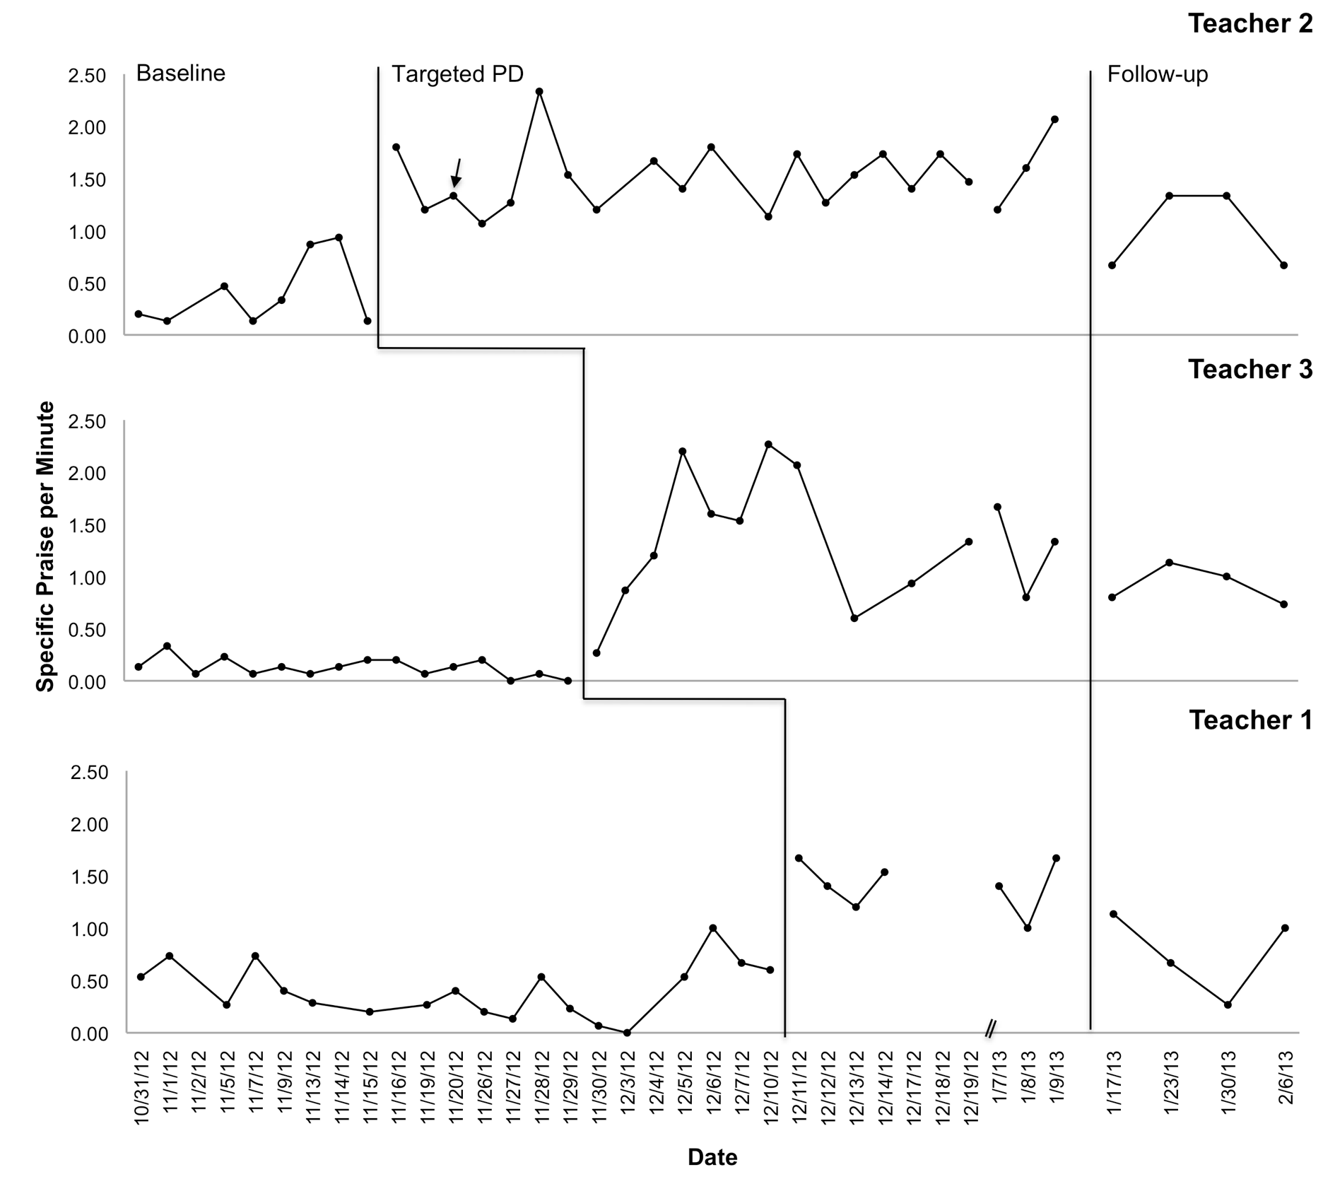
100% PND
93% PND
86% PND
Percent of non-overlapping data (PND) suggests that the intervention was effective (T1) or very effective (T2 and T3) for all teachers.
(Simonsen, Freeman, Dooley, Maddock, & Kern, 2017)

Slide 46
Then we replicated the prior study in a district with a few more challenges…
88% PND
100% PND
100% PND
Percent of non-overlapping data (PND) suggests that the intervention was effective (TG) or very effective (TJ and TH) for all teachers.
(Simonsen, Freeman, Dooley, Maddock, & Kern, 2017)

Slide 47
We’ve now tested the targeted-PD approach with:
…more teachers: 16 Teachers across two schools
…more skills:
  specific praise,
  prompts for social behavior, and
  academic opportunities to respond (OTRs)
…a group experimental design: counter-balanced interrupted time series design
  Randomly assigned to one of two cohorts
  Collected data before and after each skill-focused training
…and we’ve now replicated again with natural implementers
Let’s walk through what that actually looked like
Notes:
JEN STARTS HERE

Slide 48

Study Overview
Initial Training
Data
Skill 1 Training
Data
Skill 2 Training
Data
Skill 3 Training
Data
Final Review
Random Assignment
Final Data Collection
Group 1
Specific Praise
Prompts
OTRs
Group 2
Prompts
OTR
Specific Praise
SNEAK PEEK AT UNPBLISHED DATA!
Notes:
Click 1: There will be an initial training (today), followed by three skill-focused trainings, and ending with a final review.
Click 2: In between each training event, we will collect data on your use of each skill and your students’ behavior
Click 3: As we mentioned, you will be randomly assigned to a cohort group: groups 1 or 2. We will communicate about this over email.
Click 4: Group 1 will participate in training on specific praise.
Click 5: Followed by prompts.
Click 6: Followed by OTRs.
Click 7: Group 2 will participate in training on prompts.
Click 8: Followed by OTRs.
Click 9: Followed by specific praise.
Click 10: Then, we will collect our last data, and both groups will participate in the final review training.
Click 11: Remember, training dates have been scheduled throughout the year. Please make every effort to attend these scheduled trainings. If you do miss an event, we will work with you to make it up (either by attending the same event at another school or by receiving a 1:1 training with the same content).

Slide 49
Group Study Results- Teachers

Slide 50

What does our initial research on self-management indicate?
Across four studies, we’ve found that self-management with email coaching prompts resulted in desired initial increases in specific classroom management skills across teachers. We are still working to enhance maintenance and generalization of effects.
(Simonsen, Freeman, Dooley, Maddock, & Kern, in preparation)
Let’s go into a little more detail…
See classroom tab of nepbis.org for copies of the training scripts, email prompts, and spreadsheets we’ve developed for tracking
praise,
prompts, and
opportunities to respond.

Slide 51
Supporting Teachers with Targeted PD

Slide 52
Implementing Targeted Professional Development (PD)
Targeted PD may work as tier 1 or 2 PD support for teachers.
May be facilitated by a school-based behavior coach, instructional coach, or other school leader with behavioral expertise.

Slide 53
Targeted PD Includes
Brief didactic training (1:1 or group setting)
Teacher/staff self-management:
  Daily self-monitoring during brief (15 min) sample of instruction
  Daily self-evaluation (entering data, determining if goal was met)
  Self-reinforcement (celebrating on days when goal is met)
Weekly email reminders re: skill use and self-management strategies (by behavior coach)
Periodic (e.g., bi-weekly) “fidelity monitoring” of skill use and self-management (by behavior coach)

Slide 54
Didactic Training
Scripted training that provides:
  Definition of skill
  Rational for using the skill
  Examples/non-examples of the skill
  Activity to apply the skill in the natural context
  Definition of self-management
  Instruction in self-management (i.e., how to self-monitor, enter data, self-evaluate, and self-reinforce)
See example for specific praise in your handout and previewed next.

Slide 55
Presentation Example:
Specific Praise

Slide 56
Presentation: Specific Praise
  Definition
  Rationale
  Examples
  Critical features

Slide 57
Definitions
What is specific and contingent praise?
“Specific, contingent praise is a positive statement, typically provided by the teacher, when a desired behavior occurs (contingent) to inform students specifically what they did well.”
(Simonsen, Fairbanks, Briesch, Myers, & Sugai, 2008)

Slide 58
Rationale
Why provide contingent praise?
Delivering contingent praise for
  academic behavior increased participants’
    (a) correct responses (Sutherland & Wehby, 2001),
    (b) work productivity and accuracy (Craft, Alber, & Heward, 1998; Wolford, Heward, & Alber, 2001),
    (c) language and math performance on class work (Roca & Gross, 1996), and
    (d) academic performance (Good, Eller, Spangler, & Stone, 1981).
  appropriate social behavior increased participants’
    (a) on-task behavior (Ferguson, & Houghton, 1992),
    (b) student attention (Broden, Bruce, Mitchell, Carter, & Hall, 1970),
    (c) compliance (Wilcox, Newman, & Pitchford, 1988),
    (d) positive self-referent statements (Phillips, 1984), and
    (e) cooperative play (Serbin, Tonick, & Sternglanz, 1977).
(Simonsen, Fairbanks, Briesch, Myers, & Sugai, 2008)
Notes:
Paraphrase supporting studies…something like:
“Praise is associated in increases in desired academic and social behaviors, as you can read from the specific skills included in the above studies.”

Slide 59
Rationale
Why provide specific praise?
Increasing the number of behavior specific praise statements was associated with an increase in on-task behavior (Sutherland, Wehby, & Copeland, 2000).
Providing contingent praise in conjunction with either establishing classroom rules in isolation (Becker, Madsen, & Arnold, 1967) or classroom rules paired with ignoring inappropriate behavior (Yawkey, 1971) was associated with increased appropriate classroom behavior.
Bottom line, research indicates is a good idea!
(Simonsen, Fairbanks, Briesch, Myers, & Sugai, 2008)
Notes:
Paraphrase supporting studies…something like:
“Specific praise is ideal, and combining praise with other strategies is also effective.”
“Now, we’re going to turn to a quick activity to make sure we can all identify good examples of specific praise. If it’s a good example, show a thumbs up, and if it’s not an example show thumbs down.”

Slide 60


Examples & Non-examples
Is this specific praise?
Quick activity to check our understanding of specific praise.
If the scenario on the ppt is an example of specific praise, give us a “thumbs up.”
If the scenario is NOT an example of specific praise, give us a “thumbs down.”
Notes:
“Now, we’re going to turn to a quick activity to make sure we can all identify good examples of specific praise. If it’s a good example, show a thumbs up, and if it’s not an example show thumbs down.”

Slide 61
Examples & Non-examples
Is this specific praise?
During educator-directed instruction, a student raises her hand. The educator says, “Thank you for raising your hand.”
It’s a positive verbal statement that occurs immediately after and specifically names the expected behavior.
Notes:
“Now, we’re going to turn to a quick activity to make sure we can all identify good examples of specific praise. If it’s a good example, show a thumbs up, and if it’s not an example show thumbs down.”

Slide 62
Examples & Non-examples
Is this specific praise?
During educator-directed instruction, students are talking over the educator. The educator rolls his eyes and says, “Gee, thanks for listening.”
Why?
This is sarcasm, not specific praise.

Slide 63
Examples & Non-examples
Is this specific praise?
A student enters the class during educator-directed instruction; the student quietly walks to his seat. The educator walks over to the student and whispers, “Thank you for coming in the room quietly.”
It’s a positive verbal statement that occurs immediately after and specifically names the expected behavior.

Slide 64
Examples & Non-examples
Is this specific praise?
A student enters the class during educator-directed instruction; the student quietly walks to his seat. The educator gives the student a “thumbs up” to recognize the quiet entry.
Why?
This is general and non-verbal.

Slide 65
Examples & Non-examples
Is this specific praise?
During educator-directed instruction, one student is poking and attempting to talk with another student, who responds by showing the class “quiet symbol.” The educator immediately looks at the second student, gives a “thumbs up sign,” and mouths (moves lips without sound), “Thank you for paying attention.”
It’s a positive verbal statement that occurs immediately after and specifically names the expected behavior.

Slide 66
Examples & Non-examples
Is this specific praise?
During educator-directed instruction, one student is poking and attempting to talk with another student, who responds by showing the class “quiet symbol.” About 1 min later, the educator looks at a second student, smiles, and says “good job.”
Why?
This is general, and not clearly contingent.

Slide 67
Examples & Non-examples
Is this specific praise?
After an educator points to the consonant blend /th/, which is underlined in the word “through,” and says, “What sound?” a student responds by correctly pronouncing /th/. The educator says, “Nice pronunciation.”
It’s a positive verbal statement that occurs immediately after and specifically names the expected behavior.

Slide 68
Examples & Non-examples
Is this specific praise?
During a direct instruction lesson, the educator points to the consonant blend /th/, which is underlined in the word “though,” and says, “What sound?”
Why?
This is an opportunity to respond.

Slide 69
Critical Features
So, what is specific praise?
Verbal statement (i.e., not look or gesture)
Deliver immediately after the behavior
Specifically state the desired behavior demonstrated
If you use other rewards, remember to pair specific praise
with other rewards (e.g., delivery of tokens or points).

Slide 70
Activity: Specific Praise
How will you use specific praise in your classroom?
In your handout, write three (or more) specific praise statements that you will use during educator-directed instruction to recognize appropriate social behavior.

Slide 71
Developing Self-Management
How will you increase the likelihood that you will deliver specific praise for appropriate social behavior?
  Definition of self-management
  Description of self-management for this skill
  Review/discussion of materials needed to implement
  Practice using strategies

Slide 72
Definitions
What is self-management?
According to Skinner (1953), we manage our own behavior in the same manner as we manage anyone else’s—“through the manipulation of variables of which behavior is a function” (p. 228).
Self-management is engaging in one response (the self-management behavior) that affects the probability of a subsequent behavior (the target or desired behavior).
For example, keeping a “to do” list (self-management behavior) may increase the likelihood that you “do” the things on your list (target behaviors).
Notes:
Paraphrase definition…something like:
“With self-management, we manage our own behavior as we would someone else’s. In other words, we do one behavior to make it more likely that another behavior will occur. For example, we keep a to do list to increase the probability of doing things on our list.”

Slide 73
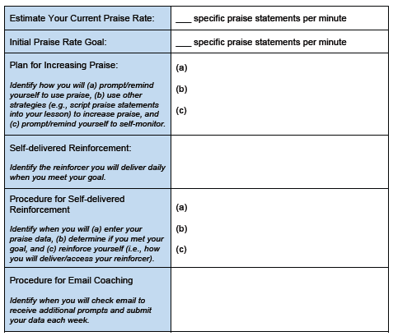
Develop Self-management Plan
See example for specific praise in your handout.

Slide 74
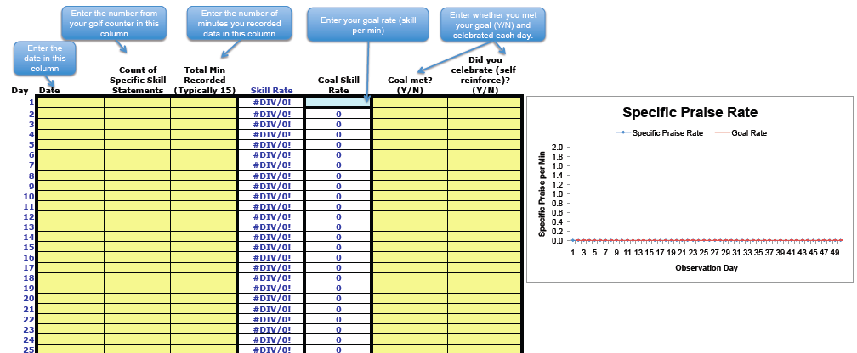
Use Self-management
Self-monitor
Use spreadsheet to enter data and self-evaluate
Self-reinforce
See examples on “classrooms” tab at nepbis.org.

Slide 75
Weekly Email Reminders
Brief email reminders about praise and skill use.
For example:
  Remember, specific praise is contingent (delivered immediately after the behavior), specific (names the desired behavior exhibited), and positive.
  ‘Nice hand raise’ and ‘Thank you for actively listening’ are examples of brief specific praise statements.
  Keep on counting, graphing, reviewing your data, and reinforcing yourself when you meet your goal!

Slide 76
Multi-tiered Framework of Professional Development Support
EXAMPLES
Tier 3
Intensive PD: Data-driven Consultation
Tier 2
Targeted PD: Self-Management with Peer or Coaching Supports
Tier 1
Universal PD: Training & Self-Management
Progress Monitoring
Walk-through, Student Data Review, Teacher Collected Data
Universal Screening
Walk-through & Student Data Review
Coaching/Mentoring may be ANOTHER way to approach this!
Self-management may be ONE way to approach this!
(adapted from Simonsen, MasSuga, Briere, Freeman, Myers, Scott, & Sugai, 2013)

Slide 77
What about other approaches?
Consultation approaches may provide intensive supports for new or in-service teachers.
(Briere, Simonsen, Myers, & Sugai, 2015; MacSuga & Simonsen, 2011)
  Another Research Example…
  Don Briere explored the effects of within-school consultation (self-monitoring + structured weekly meetings) on the specific praise rates of 3 new (induction) elementary school teachers

Slide 78
Teachers Specific Praise Rates Across Phases
100% PND
75% PND
100% PND
Percent of non-overlapping data (PND) suggests that the intervention was fairly effective (Jill) or very effective (Holly and Kim) for all teachers.
(Briere, Simonsen, Myers, & Sugai, 2015)

Slide 79
Multi-tiered Framework of Professional Development Support
EXAMPLES
Tier 3
Intensive PD: Data-driven Consultation
Tier 2
Targeted PD: Self-Management with Peer or Coaching Supports
Tier 1
Universal PD: Training & Self-Management
Progress Monitoring
Walk-through, Student Data Review, Teacher Collected Data
Universal Screening
Walk-through & Student Data Review
Peer Supports may be ANOTHER way to approach this!
Self-management, coaching, and/or mentoring may be ways to approach this!
(adapted from Simonsen, MasSuga, Briere, Freeman, Myers, Scott, & Sugai, 2013)

Slide 80
Complete Classroom Systems Assessment
Complete checklist for your own school or a school with which you are familiar.
Identify and be ready to discuss areas for support.

Slide 81
Now, turning our attention to supporting teachers.
As a result of attending this training, you will be able to
Present the context in which positive classroom behavioral support (PCBS) practices are implemented.
Train critical positive classroom behavior support (PCBS) practices.
Implement the key elements of effective systems to support teachers’ implementation of practices.
Develop an action plan to support your implementation of VT Classroom Behavior Practice Coaching Model.
FOUCS

Slide 82
Draft Action Plan to Support
Classroom Behavior Practice
Begin to draft strategies that you will put in place to support ALL educators (add to your school’s action plan or used provided template).
Consider ALL elements of the systems framework (see your self assessment of systems and notes from earlier).
This should be developed with your team, so you’re just identifying potential actions.

Slide 83
Quick Recap
As a result of attending this training, you should now be able to:
Present the context in which positive classroom behavioral support (PCBS) practices are implemented.
Train critical positive classroom behavior support (PCBS) practices.
Implement the key elements of effective systems to support teachers’ implementation of practices.
Develop an action plan to support your implementation of VT Classroom Behavior Practice Coaching Model.

Slide 84
PCBS Practices Decision-making Guide: 3 Key ?s
Are the foundations of effective PCBS in place?
Effectively design the physical environment of the classroom
+
Develop & teach predictable classroom routines.
+
Post, define, & teach 3-5 positive classroom expectations.
Are proactive and positive PCBS practices implemented consistently?
Provide high rates of varied opportunities to respond.
+
Use prompts and active supervision.
+
Acknowledge behavior with specific praise & other strategies.
Do data indicate that students are still engaging in problem behavior?

Slide 85
Are students still engaging in problem behavior?
Are behaviors minor or major expectation violations?
Well done! Monitor outcomes and adjust as needed
Use brief, specific error correction & other strategies
How many students are involved (many or few)?
Review, adjust & intensify CWPBIS. Ask for help!
Request additional (tier 2 & 3) support for students.
Yes
No
Minor
Major
Do data indicate that students are still engaging in problem behavior?
Many
Few

Slide 86
PCBS Systems Action Planning Guide:
3 Key Questions
Are the foundational systems in place to support PCBS practice implementation by all staff?
PCPS implementation is a clear school and district priority
+
School and district resources are available to support PCBS implementation
+
School and district teams have considered alignment and integration of PCBS with other district priorities and initiatives
Do all staff know what PCBS practices to implement and if they’re doing it accurately?
Clear expectations and explicit training about practices that should be implemented by all staff
+
Coaching and/or regularly available performance feedback on the use of PCBS practices
Do data indicate that staff are implementing PCBS practices effectively?

Slide 87
Are staff implementing PCBS with fidelity?
Determine the number of classrooms needing support (many or a few)
Review and adjust universal support
Determine type and severity of implementation changes (minor or major)
Provide supplemental support to small groups of staff needing support
Consider individualized supports and other strategies for staff members needing intensified support.
Well done! Monitor outcomes and adjust as needed
Yes
No
Minor
Major
Many
Few
Do data indicate that staff are implementing PCBS practices effectively?

Slide 88
Remember Your Resources
Supporting and Responding to Student Behavior
Classroom Management Practice Checklist
PBIS Technical Brief on Systems to Support Teachers’ Implementation of Positive Classroom Behavior Support
Self-Assessment of Systems to Support PCBS
Email, Discussion Board, & Webinar June 1
Action Plan

Slide 89
Thank you!
brandi.simonsen@uconn.edu
www.pbis.org
www.cber.org

