Slide 1
TRAINER INFORMATION
This free and accessible training material is provided through the Northeast PBIS Network and can be found at https://nepbis.org/.
School teams are highly encouraged to contact a
PBIS State Coordinator or an NEPBIS Endorsed Trainer
for training opportunities.
If you are an experienced trainer and would like access to to our coordinating trainer workbook which offers training guidance, please email us at nepbis@uconn.edu.

Slide 2
TRAINER NOTES
This is Day 9 of an 11 day, 3 year training sequence.
CONTENT
OUTCOMES
At the end of day nine, teams should understand how to:
prepare staff and students for crisis and emergency routines
use data to monitor classroom PBIS systems, implementation and student impact
evaluate and document their implementation annually
Crisis and Emergency Planning
Classroom PBIS Data
Annual Evaluation Plan
Plan to teach, prompt, and reinforce crisis expectations and routines
Provide differentiated wellness support
Complete Classroom Data self-assessment
Consider how to use data to monitor classroom PBIS systems, educator implementation and student outcomes
Develop a documented annual evaluation report that is shared with your school community
For more information and guidance related to training this content please see the NEPBIS trainers’ manual located here: https://nepbis.org/training-of-trainers-workbook-supplemental-materials/

Slide 3
SAMPLE AGENDA
8:30 | Introduction | 15 mins
8:45 | Quick Review | 15 mins
9:00 | Preparing for Crises and Emergencies | 45 mins
9:45 | Break | 15 mins
10:00 | Classroom Data | 75 mins
11:15 | Annual Evaluation Plan | 45 mins
12:00 | Lunch | 30 mins
12:30 | Quick Review | 15 mins
12:45 | Team Time | 165 mins
3:45 | Wrap Up | 15 mins

Slide 4
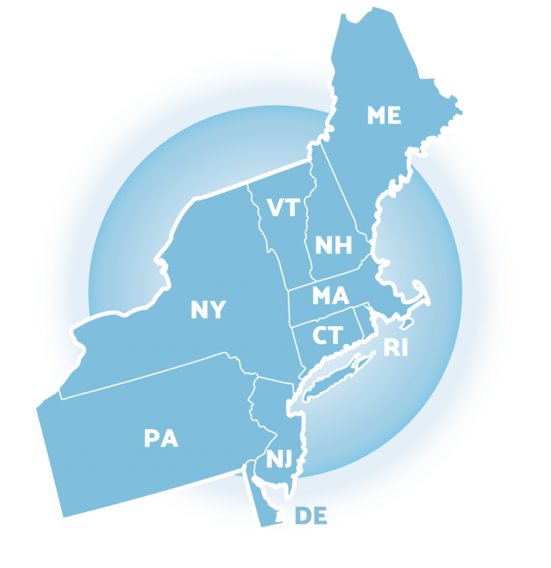
NEPBIS School-Wide Team Training
Year 1 Day 9
INSERT TRAINER NAMES HERE
with support from
Karen Robbie, Jen Freeman,
Brandi Simonsen, Katie Meyer,
Adam Feinberg & Susannah Everett
Notes:
Trainers: refer to training manual for:
Tips on presenting the overview content
Explanation for short activity periods and ideas for teaching this to teams
Ideas for facilitating review and team action planning

Slide 5
POSITIVE BEHAVIOR INTERVENTIONS & SUPPORTS (PBIS)

Slide 6
WHO'S HERE?
Who's here?
LIST SCHOOLS IN COHORT HERE
(List the schools in your cohort here)
Notes:
TRAINER NOTE: Give teams several minutes each to introduce themselves and their school- including any previous experiences with PBIS.

Slide 7
NEPBIS SCHOOL-WIDE TRAINING MODEL
Year 1
Exploration and Installation of 10 Getting Started Steps
Year 2
Initial Implementation of 10 Getting Started Steps
Year 3+
Full Implementation and Continuous Improvement of Implementation
6 days of team training + 3 days of coach training
3 days of team training + 3 days of coach meeting
Ongoing Professional Development and Support
(minimum of 2 days of team training + 2 days of coach training annually)

Slide 8
YEAR 1: Getting Started with PBIS
DAY 1
Step 1: Establish an effective leadership team
DAY 2
Step 2: Develop a brief statement of purpose & define outcomes
Step 3: Identify positive school-wide behavior expectations
Step 4: Develop procedures to teach school-wide expectations
DAY 3
Step 5: Develop procedures to teach class-wide expectations
Step 6: Develop a continuum of responses to increase use of SEB skills
DAY 4
Step 7: Develop a continuum or responses to decrease SEB errors
DAY 5
Step 8: Develop systems to support staff
DAY 6
Step 9: Use data for decision-making
Step 10: Promote sustainability

Slide 9
YEAR 2: Implement and Strengthen
DAY 7
DAY 8
Systems
DAY 9
Data
Practices
Tier 1 Check In
Family Engagement
Culture of Wellness
Crisis and Emergency Response Planning
Precise Problems and Outcomes
Equity Review
Evaluation
Strengthen
Classroom
Data-based Decision-Making

Slide 10
TRAINING SCHEDULE
TRAINERS:
USE THIS SLIDE TO INSERT YOUR TRAINING SCHEDULE FOR THE CURRENT YEAR

Slide 11
nepbis.org
TOOLS
Tier 1 Schoolwide
Tier 1 Team Training Materials
Tier 1 Supplemental Resources
School Team Implementation Guide
responses for activities
document plans
develop artifacts
Slides for each training day
Notes:
TRAINERS: Go directly to https://nepbis.org/ and demonstrate how to access relevant materials.

Slide 12
WEBSITES
pbisapps.org
pbis.org

Slide 13
LEGEND
ORGANIZATION
ACTIVITY
NEW
CONTENT
PREVIEW
REVIEW

Slide 14
LEGEND
Timing
Example
Activity
Non-example
Guidelines
Preview
Big Idea
Review
Organization

Slide 15
EXPECTATIONS
 | Individually | Working with Others
Respect Self | Participate Converse with others in lobbies and during breaks Stretch, break, stand as needed | Engage with the training content and activities
Respect Others | Complete assigned tasks Return from breaks on time | Provide room for every voice Reinforce participation
Respect Environment | Keep devices silent Have your computer charged and ready Keep necessary materials at hand | Maintain a neat, orderly work space

Slide 16
AGENDA AND ACTION STEPS
OUTCOMES
CONTENT
Plan to teach, prompt, and reinforce crisis expectations and routines
Provide differentiated wellness support
Crisis and Emergency Planning
Classroom PBIS Data
Annual Evaluation Plan
Complete Classroom Data self-assessment
Consider how to use data to monitor classroom PBIS systems, educator implementation and student outcomes
Develop a documented annual evaluation report that is shared with your school community

Slide 17
Quick Review

Slide 18
Continuum of School-Wide Instructional & Positive Behavior Support
What do we do for the FEW needing intensive support?
Tertiary Prevention:
Specialized
Individualized
Systems for Students with High-Risk Behavior
What do we do for ALL?
Primary Prevention:
School-/Classroom-
Wide Systems for
All Students,
Staff, & Settings
~5%
~15%
Secondary Prevention:
Specialized Group
Systems for Students with
At-Risk Behavior
What do we do for the SOME needing more support?
~80% of Students

Slide 19
Critical Features
Systems
Practices
Data
Equity
Outcomes

Slide 20
GETTING STARTED WITH PBIS
1
Establish an effective leadership team
6
Develop a continuum of responses to increase use of SEB skills
2
Develop a brief statement of purpose & define outcomes
7
Develop a continuum of responses to decrease SEB errors
3
Identify positive school-wide behavior expectations
8
Develop systems to support staff
4
Develop procedures to teach school-wide expectations
9
Use data for decision-making
5
Develop procedures to teach class-wide expectations
10
Promote sustainability

Slide 21
YEAR 2: Implement and Strengthen
DAY 7
DAY 8
Systems
DAY 9
Data
Practices
Tier 1 Check In
Family Engagement
Culture of Wellness
Crisis and Emergency Response Planning
Precise Problems and Outcomes
Equity Review
Evaluation
Strengthen
Classroom
Data-based Decision-Making

Slide 22
Family Engagement in PBIS
Including families in PBIS implementation means families and school personnel work together and share in the responsibility making educational decisions and improving student outcomes.
(Center on PBIS, 2017)
Notes:
Aligning and Integrating Family Engagement in Positive Behavioral Interventions and Supports: https://www.pbis.org/Common/Cms/files/pbisresources/Family%20Engagement%20in%20PBIS.pdf

Slide 23
How Do Teams Integrate Wellness into Tier 1?
Prioritize and enhance wellness for ALL
Use data to determine wellness strengths and needs
Integrate SEB competencies into Tier 1

Slide 24
You’ve Identified Inequity, Now What? Apply your problem-solving framework!
IDENTIFY PROBLEM
with precision
IDENTIFY GOAL
for change
IDENTIFY SOLUTION
and implementation plan
IMPLEMENT SOLUTION
with fidelity
MONITOR & EVALUATE
implementation fidelity and impact
MAKE DECISION
to maintain, modify, or terminate plan
Collect & Use
DATA
(Chaparro, E., et. al, 2022)

Slide 25
Are school community members experiencing equitable outcomes in our school regardless of individual characteristics and identities?
Gender/Gender Identity
Race/Ethnicity
Sexual Orientation
Grade Level
Socio-economic Status
Dis/ability Status
Emerging Bilingual

Slide 26
Supporting and Responding to Students’ SEB Needs
Practices
1. Create Positive Teaching and Learning Environments
Design a Safe Environment
2. Actively Promote SEB Growth
Engage Students in Relevant Learning
3. Monitor Fidelity and Use Data to Guide Implementation
Monitor Educator Implementation
4. Monitor Student Outcomes and Use Data to Guide Response
Establish Positive Connections
Develop Predictable Routines
Define and Teach Positive Expectations
Plan Relevant Instruction
Foster Positive Relationships
Prompt and Supervise SEB and Academic Skills
Provide Specific Feedback (> 5 : 1 Ratio)
Consider Other Response Strategies
Provide Training, Coaching, and Feedback
If data indicate implementation challenges...
Monitor Student Outcomes
Enhance Tier 1
If many students make ongoing SEB errors...
Enhance Tier 1 and Consider Tiers 2 and 3
If few students make ongoing SEB errors...

Slide 27
Steps to Support and Respond to Educators’ Needs
Systems
Data
1. Establish Foundations to Support Classroom Implementation
1.1 Establish Priority
1.2 Secure Resources
2. Explicitly Teach & Coach
2.1 Communicate Clear Expectations
2.2 Explicitly Teach
3. Monitor Systems Implementation & Use Problem-Solving Process
3.1 Monitor Team Implementation of Steps 1 & 2
4. Monitor Educator Implementation & Use Problem-solving Process
5. Monitor Equitable Student Benefit & Use Problem-Solving Process
1.3 Align & Integrate with Other Approaches
1.4 Promote a Culture of Wellness
2.3 Coach & Provide Supportive Feedback
2.4 Celebrate Success!
If system implementation challenges...
3.3 Revisit and Enhance Systems (Steps 1 & 2)
4.1 Monitor Educator Implementation & Acceptability
If educator implementation challenges...
4.3 Differentiate Training, Coaching, & Feedback
5.1 Monitor Valued Student Outcomes & Acceptability
If students do not benefit equitably...
5.3 Enhance SEB Support & Modify Training and Coaching
Day 8
3.2, 4.2, 5.2 Use Continuous Improvement Process
Notes:
Supporting and Responding to Educators’ Classroom PBIS Implementation Needs: https://www.pbis.org/resource/supporting-and-responding-to-educators-classroom-pbis-implementation-needs-guide-to-classroom-systems-and-data

Slide 28
Steps to Support and Respond to Educators’ Needs
3. Monitor Systems Implementation & Use Problem-Solving Process
3.1 Monitor Team Implementation of Steps 1 & 2
4. Monitor Educator Implementation & Use Problem-solving Process
5. Monitor Equitable Student Benefit & Use Problem-Solving Process
If system implementation challenges...
3.3 Revisit and Enhance Systems (Steps 1 & 2)
4.1 Monitor Educator Implementation & Acceptability
If educator implementation challenges...
4.3 Differentiate Training, Coaching, & Feedback
5.1 Monitor Valued Student Outcomes & Acceptability
If students do not benefit equitably...
5.3 Enhance SEB Support & Modify Training and Coaching
Day 9
3.2, 4.2, 5.2 Use Continuous Improvement Process

Slide 29
Preparing for Crises and Emergencies
How do we provide support to students and staff before, during and after practice opportunities?
Plan to teach, prompt, and reinforce crisis expectations and routines
Provide differentiated wellness support

Slide 30
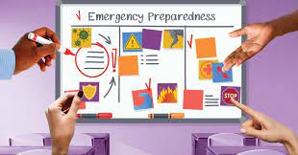
Preparing for School Crisis and Emergencies
Potential Crises and Emergencies
natural disasters
accidents
public health crises
environmental hazards
school and community violence

Slide 31
Preparing for School Crisis and Emergencies
Before
Define and teach schoolwide crisis response routines
During
Prompt expectations
Enact wellness support plan
After
Evaluate wellness support plan
Develop a wellness support plan
Reinforce expectations

Slide 32
Before
Define and teach schoolwide crisis response routines
Develop a wellness support plan
Before
Define and teach schoolwide crisis response routines
Develop a crisis support plan
Defining and Teaching School-wide Crisis Response Routines
Remember to explicitly teach these expectations,
including practice opportunities!
What are the expectations during crises, emergencies and drills?
Teaching Matrix |  | SETTING
 |  | All Settings | Hallways | Playground | Cafeteria | Library/ Computer Lab | Assembly | Bus | Emergency
 | Respect Ourselves | Be on task. Give your best effort. Be prepared. | Walk. | Have a plan. | Eat all your food. Select healthy foods. | Study, read, compute. | Sit in one spot. | Watch for your stop. | Use a calming strategy, if needed. Move to safety.
 | Respect Others | Be kind. Hands/feet to self. Help/share with others. | Use normal voice volume. Walk to right. | Play safe. Include others. Share equipment. | Practice good table manners | Whisper. Return books. | Listen/watch. Use appropriate applause. | Use a quiet voice. Stay in your seat. | Follow directions. Stay quiet. Help those in need.
 | Respect Property | Recycle. Clean up after self. | Pick up litter. Maintain physical space. | Use equipment properly. Put litter in garbage can. | Replace trays & utensils. Clean up eating area. | Push in chairs. Treat books carefully. | Pick up. Treat chairs appropriately. | Wipe your feet. Sit appropriately. | Walk calmly in a straight line. Keep your hands to yourself.
EXPECTATIONS

Slide 33
Develop a Wellness Support Plan
Before
Define and teach schoolwide crisis response routines
Develop a wellness support plan
Recognize that students and staff will have a range of responses to to crisis and emergency drills
Use existing data to identify those likely to need targeted or individualized support
Prepare for those responses through your continuum of support

Slide 34
Develop a Wellness Support Plan
Identify a support person(s)
Practice drills independently
Provide a private warning ahead of planned drills
Prepare a debrief check in
What do we do for the FEW needing intensive support?
What do we do for ALL?
Provide an initial scheduled and announced drill
Teach calming routines
Demonstrate how to signal a need for help
Remember to gather input from those most likely to need additional support
What do we do for the SOME needing more support?
Practice drills in small groups
Teach how to recognize and respond to trauma response

Slide 35
Prompt Expectations
During
Prompt expectations
Enact wellness support plan
We will have a safety drill sometime this afternoon. When the alarm goes off, everyone is expected to stop what they are doing right away.
As we move to our safety spot, remember to stay in a line with voices off.
That’s the alarm. Move quietly and remember to use your calming strategies as needed.

Slide 36
Enact Wellness Support Plan
During
Prompt expectations
Enact wellness support plan
Practice drill occurs
Put plan into action

Slide 37
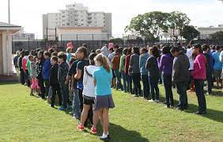
Reinforce Expectations
After
Evaluate wellness support plan
Reinforce expectations
You all followed directions really well during today’s fire drill! It helped everyone be safe. Nice work everyone!
To Sam’s family,
Our school had a safety drill today. Sam effectively used their calming strategy throughout the entire process! It was a great way to manage Sam’s anxiety. Hooray!
Lockdown drills can be scary. Thank you for being responsible with your bodies. Well done!

Slide 38
Evaluate Wellness Support Plan
After
Evaluate wellness support plan
Reinforce expectations
Fidelity check:
Did we do what we said we were going to do?
Outcome check:
Were people adequately and effectively supported?

Slide 39
Using Your PBIS Framework When Crises Occur

Slide 40
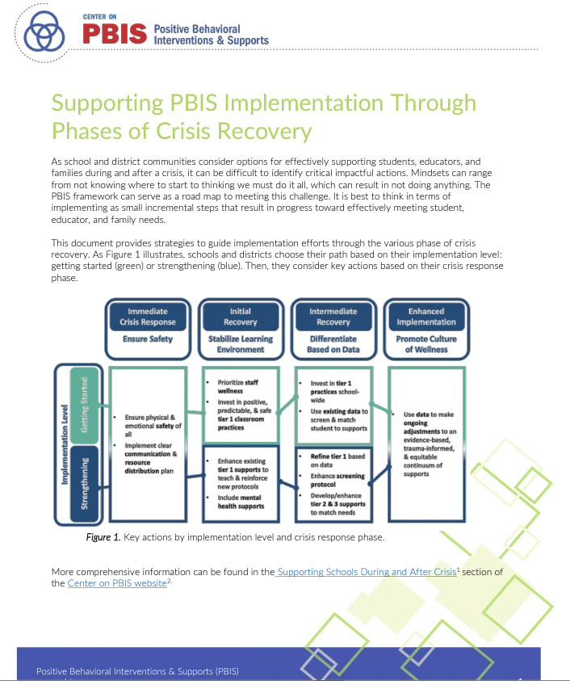
Resources to Support During and After Crisis
Share with your district support team!
This guide describes the use of a MTSS framework to support students, families, and educators during the transitions back to school during and following disruptions in a manner that prioritizes their health and safety, social and emotional needs, and behavioral and academic growth.
This practice brief provides strategies to guide implementation efforts through the various phase of crisis recovery for schools and districts that are (a) getting started or (b) strengthening and maintaining current implementation.
Notes:
A School Guide for Returning to School During and After Crisis: A Guide to Supporting Schools, Educators, and Students through a Multi-Tiered Systems of Support Framework: https://www.pbis.org/resource/a-school-guide-for-returning-to-school-during-and-after-crisis
Supporting PBIS Implementation Through Phases of Crisis Recovery: https://www.pbis.org/resource/supporting-pbis-implementation-through-phases-of-crisis-recovery

Slide 41
Key Messages
Lean on Existing Tier 1 Supports and Prioritize Classroom Implementation
Prioritize Wellness
Back to Basics, Less is More

Slide 42
Back to Basics, Less is More
A few key practices
(e.g. positive greetings at the door,
5+:1- feedback, active engagement)
do all of this!
Connect
Monitor
Screen
Positive, Predictable, & Safe Learning Environments
Students’ Social, Emotional, Behavioral, & Academic Growth
Teach
Support

Slide 43
Lean on Existing Tier 1 Supports and
Prioritize Classroom Implementation
Consider the following…
What, if any, adjustments need to be made?
What needs to be re-taught or strengthened?
What additional training is needed by staff to effectively support students?
1
Establish an effective leadership team
6
Develop a continuum of responses to increase use of SEB skills
2
Develop a brief statement of purpose & define outcomes
7
Develop a continuum of responses to decrease SEB errors
3
Identify positive school-wide behavior expectations
8
Develop systems to support staff
4
Develop procedures to teach school-wide expectations
9
Use data for decision-making
5
Develop procedures to teach class-wide expectations
10
Promote sustainability

Slide 44
Lean on Existing Tier 1 Supports
Focus on the place students spend the most time --- CLASSROOMS!
Ensure classrooms are proactive, positive, and predictable learning environments.
1. Create Positive Teaching and Learning Environments
Design a Safe Environment
2. Actively Promote SEB Growth
Engage Students in Relevant Learning
3. Monitor Fidelity and Use Data to Guide Implementation
Monitor Educator Implementation
4. Monitor Student Outcomes and Use Data to Guide Response
Establish Positive Connections
Develop Predictable Routines
Define and Teach Positive Expectations
Plan Relevant Instruction
Foster Positive Relationships
Prompt and Supervise SEB and Academic Skills
Provide Specific Feedback (> 5 : 1 Ratio)
Consider Other Response Strategies
Provide Training, Coaching, and Feedback
If data indicate implementation challenges...
Monitor Student Outcomes
Enhance Tier 1
If many students make ongoing SEB errors...
Enhance Tier 1 and Consider Tiers 2 and 3
If few students make ongoing SEB errors...
Notes:
Supporting and Responding to Students’ Social, Emotional, and Behavioral Needs: Evidence-Based Practices for Educators: https://www.pbis.org/resource/supporting-and-responding-to-behavior-evidence-based-classroom-strategies-for-teachers

Slide 45
Prioritize Wellness
After
Promote wellness
Use data to provide differentiated support
Reinforce and enhance Tier 1 supports
Prioritize and enhance wellness for ALL
Use data to determine wellness strengths and needs
Integrate SEB competencies into Tier 1

Slide 46
Guidelines for Preparing for Crisis and Emergencies
Define, teach, prompt and reinforce crisis and emergency expectations and routines as explicitly as other schoolwide expectations and routines.
Recognize that some staff and students will need additional support during practice drills.
Develop a wellness support plan to proactively address staff and student needs.
When a crisis occurs:
Go back to basics, remember less is more
Lean on your existing Tier 1 supports
Prioritize wellness

Slide 47
ACTIVITY:
As a team,
Draft school-wide expectations for crisis and emergency practice routines and a plan for teaching them explicitly.
Consider how you will identify those that will likely need additional support throughout practice routines.
Begin a wellness support plan to address staff and student needs.
Add to your action plan as needed.
Be prepared to share examples of crisis/emergency practice expectations and/or wellness support considerations.
10 minutes

Slide 48
WHOLE GROUP DEBRIEF:
What examples of crisis/emergency practice expectations and/or wellness support considerations did your team discuss?
What further support do you need to accomplish these steps?
5 minutes

Slide 49
Break

Slide 50
Classroom: Data
How do we know if our classroom environments are positive, proactive, predictable and equitable?
Complete Classroom Data self-assessment
Consider how to use data to monitor classroom PBIS systems, educator implementation and student outcomes

Slide 51
Supporting and Responding to Educators’ Classroom PBIS Implementation Needs
Systems
Data
Provides updated guidance on how to (a) develop systems to support educators’ implementation of evidence-based classroom practices and (b) use data to guide the development of implementation supports.
Center on PBIS. (2023). Supporting and Responding to Educators Classroom PBIS Implementation Needs: Guide to Classroom Systems and Data. Center on PBIS, University of Oregon. www.pbis.org.
Notes:
Supporting and Responding to Educators’ Classroom PBIS Implementation Needs: https://www.pbis.org/resource/supporting-and-responding-to-educators-classroom-pbis-implementation-needs-guide-to-classroom-systems-and-data

Slide 52
Continuum of Multi-tiered Professional Development Support
Tier 3
What do we do for the FEW staff needing intensive support?
Intensive Professional Development:
Data-driven Consultation
Performance Feedback:
Routine Walkthrough and Self-management Data Reviews
Tier 1
What do we do for
ALL Staff?
Universal Professional Development:
Training and Self-management
Universal Screening:
Walk-through and Student Data Review
~5%
~15%
Tier 2
What do for the SOME staff needing more support?
Targeted Professional Development:
Self-management with Peer or Coaching Support
Progress Monitoring:
Walkthrough, Student Data Review,
Teacher Collected Data
For now,
focus on providing ALL staff Tier 1 professional development
~80% of Staff

Slide 53
Steps to Support and Respond to Educators’ Needs
1. Establish Foundations to Support Classroom Implementation
1.1 Establish Priority
1.2 Secure Resources
2. Explicitly Teach & Coach
2.1 Communicate Clear Expectations
2.2 Explicitly Teach
3. Monitor Systems Implementation & Use Problem-Solving Process
3.1 Monitor Team Implementation of Steps 1 & 2
4. Monitor Educator Implementation & Use Problem-solving Process
5. Monitor Equitable Student Benefit & Use Problem-Solving Process
1.3 Align & Integrate with Other Approaches
1.4 Promote a Culture of Wellness
2.3 Coach & Provide Supportive Feedback
2.4 Celebrate Success!
If system implementation challenges...
3.3 Revisit and Enhance Systems (Steps 1 & 2)
4.1 Monitor Educator Implementation & Acceptability
If educator implementation challenges...
4.3 Differentiate Training, Coaching, & Feedback
5.1 Monitor Valued Student Outcomes & Acceptability
If students do not benefit equitably...
5.3 Enhance SEB Support & Modify Training and Coaching
3.2, 4.2, 5.2 Use Continuous Improvement Process

Slide 54
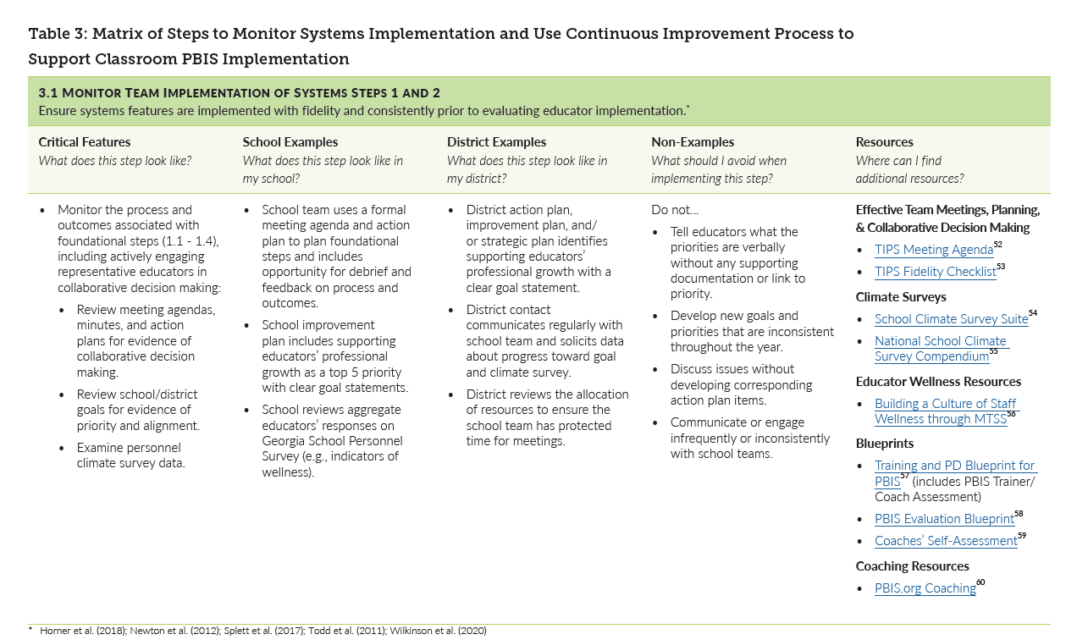

Slide 55
Steps to Support and Respond to Educators’ Needs
3. Monitor Systems Implementation & Use Problem-Solving Process
3.1 Monitor Team Implementation of Steps 1 & 2
4. Monitor Educator Implementation & Use Problem-solving Process
5. Monitor Equitable Student Benefit & Use Problem-Solving Process
If system implementation challenges...
3.3 Revisit and Enhance Systems (Steps 1 & 2)
4.1 Monitor Educator Implementation & Acceptability
If educator implementation challenges...
4.3 Differentiate Training, Coaching, & Feedback
5.1 Monitor Valued Student Outcomes & Acceptability
If students do not benefit equitably...
5.3 Enhance SEB Support & Modify Training and Coaching
Today’s Focus
3.2, 4.2, 5.2 Use Continuous Improvement Process

Slide 56
3. Monitor Systems Implementation & Use Problem-Solving Process
3.1 Monitor Team Implementation of Steps 1 & 2
If system implementation challenges...
3.3 Revisit and Enhance Systems (Steps 1 & 2)
Monitor Systems Implementation & Use Problem-Solving Process
3.2, 4.2, 5.2 Use Continuous Improvement Process

Slide 57
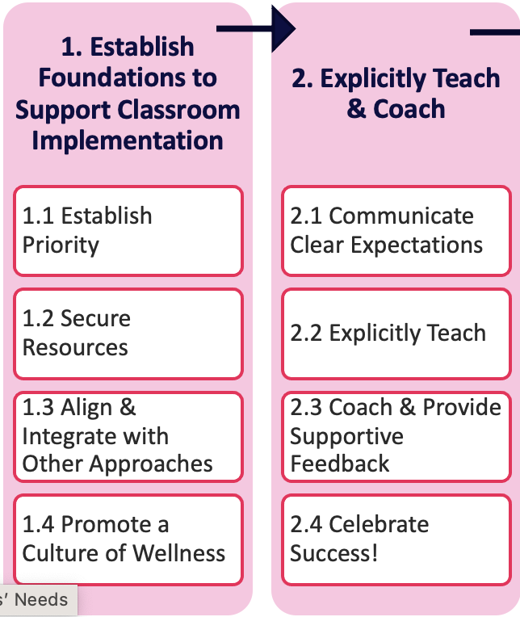
Ensure systems features are implemented
with fidelity and consistently
prior to evaluating educator implementation!
Monitor Team Implementation of Systems

Slide 58
Monitor Team Implementation of Systems
Monitor the process and outcomes associated with foundational steps,
including actively engaging representative educators in collaborative decision making
Is there evidence of collaborative decision making in our meeting agendas, minutes, and action plans?
Does implementation of classroom PBIS show up in our school/district goals?
What does our personnel climate survey data indicate about staff wellness?

Slide 59
Monitor Team Implementation of Systems
Monitor fidelity of training and coaching
Did we provide training in classroom PBIS as we intended?
Do staff have access to effective, knowledgeable and consistent coaching support?
Are we equitably and regularly recognizing and/or celebrating educators for their implementation efforts?

Slide 60
Use Your Continuous Improvement Process
IDENTIFY PROBLEM
with precision
IDENTIFY GOAL
for change
IDENTIFY SOLUTION
and implementation plan
IMPLEMENT SOLUTION
with fidelity
MONITOR & EVALUATE
implementation fidelity and impact
MAKE DECISION
to maintain, modify, or terminate plan
Collect & Use
DATA
(Chaparro, E., et. al, 2022)

Slide 61
Use Your Continuous Improvement Process
IDENTIFY PROBLEM
with precision
IDENTIFY GOAL
for change
IDENTIFY SOLUTION
and implementation plan
The school’s leadership team planned monthly PD on classroom PBIS. Since school began, the PD events were held only 25% of the time with more than 30% of staff missing each one due to other responsibilities such as IEP meetings, other committee meetings, etc.
Collect & Use
DATA
The team wanted to ensure 100% of school staff were accessing monthly, relevant, continuous training in classroom PBIS practices prior to the start of the next school year.
(Chaparro, E., et. al, 2022)

Slide 62
Revisit and Enhance Systems Features
Ensure systems features are in place with fidelity and sufficient intensity and focus before evaluating further educator or student outcomes.
Re-engage diverse educator voices in refining and communicating priority.
Engage leadership in resource mapping.
More intentionally align and integrate practices and systems.
Organize wellness practices within MTSS framework.

Slide 63
Revisit and Enhance Systems Features
Ensure systems features are in place with fidelity and sufficient intensity and focus before evaluating further educator or student outcomes.
Engage educators in clarifying and communicating expectations.
Enhance trainer supports, increase demonstrations, plan more relevant practice activities.
Consider adjustments to coaching mode, frequency/duration, or focus.
Engage educators in refining and enhancing plans to celebrate successes.

Slide 64
Use Your Continuous Improvement Process
IDENTIFY PROBLEM
with precision
IDENTIFY GOAL
for change
IDENTIFY SOLUTION
and implementation plan
The school PBIS coach, principal and special education director met to align their meeting schedules and protect a half-hour each month of PD time during an early release day that can be devoted to classroom PBIS training and support. This change was brought back to the leadership team and communicated to all staff through email.
Collect & Use
DATA
(Chaparro, E., et. al, 2022)

Slide 65
Use Your Continuous Improvement Process
The following months, classroom PBIS trainings were held focusing on explicit instruction of 1 new practice, opportunities for practice, individual goal setting and action planning. This occurred for 6 months (January –June).
IDENTIFY PROBLEM
with precision
IDENTIFY GOAL
for change
IDENTIFY SOLUTION
and implementation plan
IMPLEMENT SOLUTION
with fidelity
MONITOR & EVALUATE
implementation fidelity and impact
MAKE DECISION
to maintain, modify, or terminate plan
At each session, attendance was taken and educator feedback was gathered. The sessions were recorded so those that were absent could still access the training.
The trainings occurred 6 out of 6 times with at least 90% of staff attending.
Because high rates of positive educator feedback was received, the leadership team decided to continue this process into the new school year. PD topics changed based on needs, however, the structure and routine remained consistent.
Collect & Use
DATA
(Chaparro, E., et. al, 2022)

Slide 66
4.1 Monitor Educator Implementation & Acceptability
If educator implementation challenges...
4.3 Differentiate Training, Coaching, & Feedback
4. Monitor Educator Implementation & Use Problem-solving Process
Monitor Educator Implementation & Use Problem-Solving Process
3.2, 4.2, 5.2 Use Continuous Improvement Process

Slide 67
Monitor Educator Implementation & Acceptability
Measure the fidelity or extent to which each core feature of a practice or program is implemented.
Measure implementation in the natural context.
Use measures of quantity (e.g., direct count of practices) and quality (e.g., ratings of implementation effectiveness.
Gather multiple perspectives (e.g., team, coach, administrator, educator, students)
Assess the acceptability, usage, and satisfaction of classroom PBIS practices for students and educators.
Monitor equitable use of practices among all students and all subgroups.

Slide 68
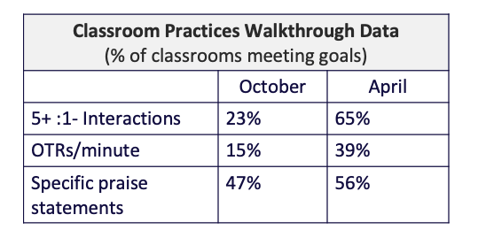
Classroom PBIS Fidelity Data Example
Classroom snapshot walkthroughs are done each fall and spring.
Peers are randomly paired to observe for 15 minutes and gather data on specific practices.
Data is shared with the school’s PBIS coach.
The team summarizes the data to share with the staff.

Slide 69
Use Your Continuous Improvement Process
IDENTIFY PROBLEM
with precision
IDENTIFY GOAL
for change
IDENTIFY SOLUTION
and implementation plan
IMPLEMENT SOLUTION
with fidelity
MONITOR & EVALUATE
implementation fidelity and impact
MAKE DECISION
to maintain, modify, or terminate plan
Collect & Use
DATA
(Chaparro, E., et. al, 2022)

Slide 70
Use Your Continuous Improvement Process
IDENTIFY PROBLEM
with precision
IDENTIFY GOAL
for change
IDENTIFY SOLUTION
and implementation plan
During a recent round of classroom walkthroughs, data indicated 20% of observed educators provided 0-1 specific praise statements during a 15-minute instructional block. The grade level of these educators varied, but all had less than 2 years experience in the school.
Collect & Use
DATA
100% of educators will provide 6+ specific praise statements throughout a 15-minute instructional block
(Chaparro, E., et. al, 2022)

Slide 71
Differentiate Training, Coaching and Feedback
If data indicate issues with individuals/a small number of people, gather more information to understand the cause of the issue(s)
Develop and provide supports based on information gathered regarding individual and small group issues.
Insufficient knowledge?
Mismatch between personal values/beliefs and practice?
Insufficient priority or support for practice implementation?

Slide 72
Use Your Continuous Improvement Process
IDENTIFY PROBLEM
with precision
IDENTIFY GOAL
for change
IDENTIFY SOLUTION
and implementation plan
Provide small group sessions to “new-to-the-school” educators on classroom PBIS practices, including specific praise, and teach the group how to self-monitor their rates. Assign 1 leadership team member to each “new-to-the-school” educator to serve as a coach/mentor. The coach/mentor observes the educator once each month and provides data-based performance feedback
Collect & Use
DATA
(Chaparro, E., et. al, 2022)

Slide 73
Use Your Continuous Improvement Process
During the next small group session, explicit instruction on specific praise is provided, each educator is asked to tally their specific praise statements for a 15-minute instructional block daily, and educators are paired with coaches/mentors who plan for the first observation.
IDENTIFY PROBLEM
with precision
IDENTIFY GOAL
for change
IDENTIFY SOLUTION
and implementation plan
IMPLEMENT SOLUTION
with fidelity
MONITOR & EVALUATE
implementation fidelity and impact
MAKE DECISION
to maintain, modify, or terminate plan
Three months later, time is provided in the agenda to check in with the coaches/mentors on the number of observations, how the support is being received, the feasibility and the frequency of meeting specific praise statement goals.
6 out of 8 of the “new-to-the-school” educators are consistently meeting the goal of 6+ specific praise statements during a 15-minute instructional block.
The team decides to modify the plan and begin bi-monthly observations for the 6 educators meeting the goal. The educators who are not meeting the goal are provided additional support from the PBIS coach, including a problem-solving interview.
Collect & Use
DATA
(Chaparro, E., et. al, 2022)

Slide 74
5.1 Monitor Valued Student Outcomes & Acceptability
If students do not benefit equitably...
5.3 Enhance SEB Support & Modify Training and Coaching
5. Monitor Equitable Student Benefit & Use Problem-Solving Process
Monitor Equitable Student Benefit & Use Problem-Solving Process
3.2, 4.2, 5.2 Use Continuous Improvement Process

Slide 75
Monitor Valued Student Outcomes & Acceptability
Ensure outcomes are locally meaningful and acceptable to students.
Operationally define student outcomes (behavior/skill) in observable, measurable, and specific terms.
Select the appropriate data collection strategy given features of the behavior/skill and context

Slide 76
Select the appropriate data collection strategy given features of the behavior/skill and context
Counting (frequency or rate)
Timing
(duration, latency, response time)
Sampling
(time-based estimates)
Other descriptive methods
Responding to questions
Raising hand
Time to start engaging in an assignment
Participating in group conversation
% of time on task
Talking with peers
Task completion
In/out of seat
Antecedent-Behavior-Consequence Analysis
Rating scales

Slide 77
Monitor Valued Student Outcomes & Acceptability
Ensure outcomes are locally meaningful and acceptable to students.
Operationally define student outcomes (behavior/skill) in observable, measurable, and specific terms.
Select the appropriate data collection strategy given features of the behavior/skill and context
Disaggregate data by subgroup (race/ethnicity, gender, language status, disability status) to monitor equitable outcomes.

Slide 78
Use Your Continuous Improvement Process
IDENTIFY PROBLEM
with precision
IDENTIFY GOAL
for change
IDENTIFY SOLUTION
and implementation plan
IMPLEMENT SOLUTION
with fidelity
MONITOR & EVALUATE
implementation fidelity and impact
MAKE DECISION
to maintain, modify, or terminate plan
Collect & Use
DATA
(Chaparro, E., et. al, 2022)

Slide 79
Use Your Continuous Improvement Process
IDENTIFY PROBLEM
with precision
IDENTIFY GOAL
for change
IDENTIFY SOLUTION
and implementation plan
Students with disabilities, in grades 3-5, are 1.5 times more likely to receive behavior referrals for disruption in the classroom than their non-disabled peers. The most frequent perceived motivation is avoiding tasks. This occurs most frequently during the literacy block
Collect & Use
DATA
Reduce the risk of behavior referrals for students with disabilities from disruptions in the classroom during literacy block to match their non-disabled peers.
(Chaparro, E., et. al, 2022)

Slide 80
Enhance SEB Support and Modify Training & Coaching
Upon reviewing student outcome data…
If MANY continue to demonstrate on-going SEB needs:
Enhance implementation of Tier 1
Implement strategies to enhance Tier 1 and develop student skills so they can better access and benefit from Tier 1 support
If FEW continue to demonstrate on-going SEB needs:
Enhance cultural responsiveness of implementation
Implement neutralizing routines to respond instructionally and equitably to SEB errors
Further differentiate implementation to meet the needs of all learners, including students with disabilities
Use data to guide further adjustments to student support
Access Tier 2 and Tier 3 supports as needed
Provide differentiated training, coaching and feedback to relevant educators

Slide 81
Use Your Continuous Improvement Process
IDENTIFY PROBLEM
with precision
IDENTIFY GOAL
for change
IDENTIFY SOLUTION
and implementation plan
After a problem-solving meeting with relevant special education and classroom teachers:
special education teachers began previewing assignments and verifying tasks matched the student’s individualized educational programming and/or accommodations
classroom teachers taught the students how to respectfully ask for help when needed and provided frequent prompts and reinforcement when students used the new skill
Collect & Use
DATA
(Chaparro, E., et. al, 2022)

Slide 82
Use Your Continuous Improvement Process
For the first 4 weeks, the literacy strategist (a member of the leadership team), checked in with each special education and classroom teacher to monitor fidelity and feasibility of the plan.
Teachers reported high fidelity and feasibility.
The leadership team reviewed behavior referral data the following month and noticed a drop in targeted referrals of 10%.
The plan continued to be implemented and monitored for 4 months.
IDENTIFY PROBLEM
with precision
IDENTIFY GOAL
for change
IDENTIFY SOLUTION
and implementation plan
IMPLEMENT SOLUTION
with fidelity
MONITOR & EVALUATE
implementation fidelity and impact
MAKE DECISION
to maintain, modify, or terminate plan
The plan began the following week.
Four months after implementation plan, the team determined the plan was having a positive impact. Students with disabilities were now receiving referrals for class disruption during literacy block equal to their non-disabled peers.
The team decided to maintain the plan.
Collect & Use
DATA
(Chaparro, E., et. al, 2022)

Slide 83
Guidelines for Using Data to Support Classroom PBIS Implementation
Once systems are in place to support classroom PBIS implementation:
monitor your systems implementation for fidelity and impact consistently
monitor educator implementation and acceptability data regularly
monitor student outcomes for impact, acceptability and equity continuously
when challenges occur, use your continuous improvement process and seek input from staff, students, and families involved

Slide 84
Classroom Data Self-Assessment

Slide 85
ACTIVITY: Classroom Data
As a team,
Complete the Classroom Data Self-Assessment.
Identify current implementation status of using data to monitor Classroom PBIS systems, educator implementation and student outcomes.
Identify which features are a priority for action planning.
Choose 1-2 high priority features to add to your action plan.
Be prepared to share which features you have added to your action plan and why they were chosen with the whole group.
15 minutes

Slide 86
WHOLE GROUP DEBRIEF:
What features did your team decide as an action planning priority? Why?
What further support do you need to move forward with next steps?
5 minutes

Slide 87
Annual Evaluation
Are you implementing your framework with fidelity?
Is it having its intended impact?
Develop a documented annual evaluation report that is shared with your school community

Slide 88
What data? How often? What do we use it for?
Assess fidelity of PBIS implementation at least annually
Review student behavior data at least monthly
Use school and community data regularly
Evaluate your plan annually
Develop, inform, and refine Tier 1

Slide 89
Evaluate and Document Annually!

Slide 90
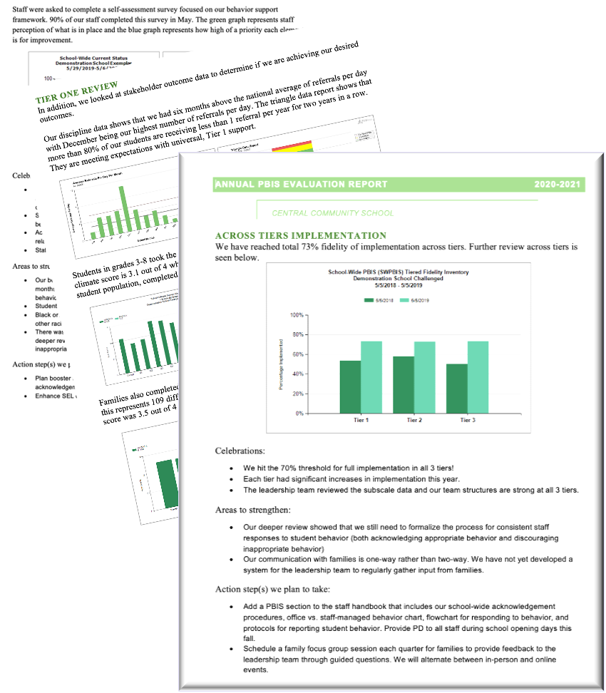
Evaluating your plan provides opportunities for your team to:
examine whether or not outcomes were achieved
celebrate accomplishments
identify areas to strengthen
share impact and insight with the school community

Slide 91
Use Your Established Data Routines and Identified Outcomes
As a result of implementing PBIS during the
20XX-20XY school year, student reports of school climate will improve by 20%
1. Identify the RIGHT data
Outcome data tied to goals
Fidelity data tied to evaluation plan
3. Identify the RIGHT people
Who needs to see these data to inform decisions? (e.g., PBIS team, grade level teams, family groups, other committees?)
4. Identify the RIGHT time & format
When/how often should these data be reviewed to inform decisions?
What format will facilitate decision making?
2. Assess data integrity
Consider staff training & engagement, systems, response rates
Based on data
Locally important and meaningful
Applicable to all (culturally equitable)
Students’ social competence and academic achievement
Staff implementation of critical skills
Observable and measurable
Written as a goal

Slide 92
Outcomes are our GOALS for implementation
Based on data
Locally important and meaningful
Applicable to all (culturally equitable)
Students’ social competence and academic achievement
Staff implementation of critical skills
Observable and measurable
Written as a goal
As a result of implementing PBIS during the
20XX-20XY school year, student reports of school climate will improve by 20%

Slide 93
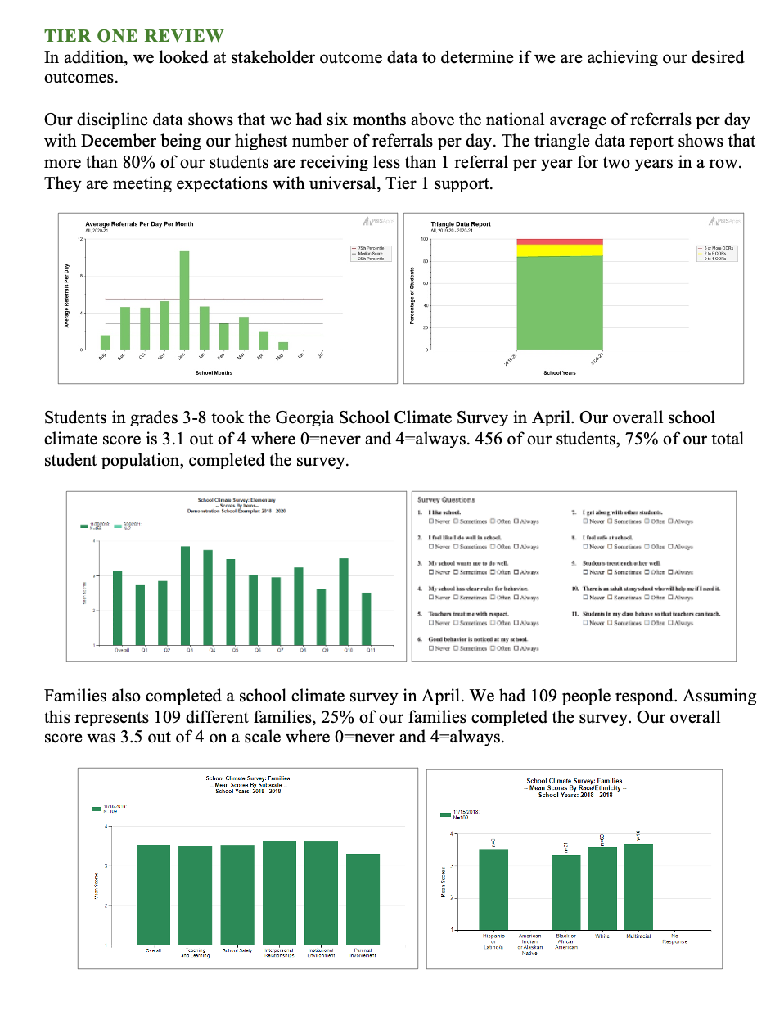
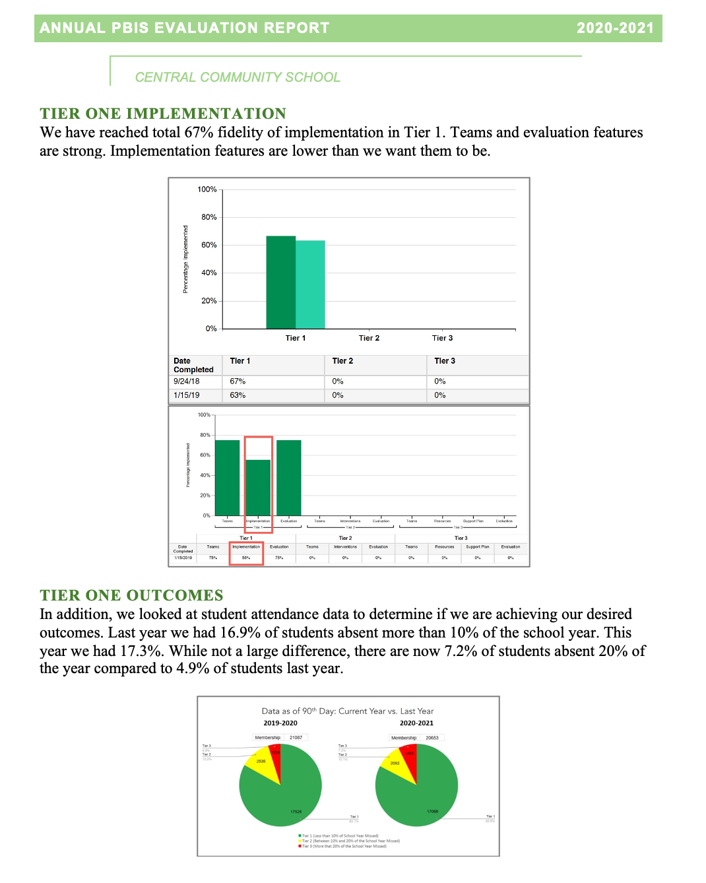
Annual Evaluation Report
Outcome Data
Fidelity Data
Celebrations
Areas to Strengthen
Action Steps

Slide 94
Fidelity Data
We have reached 67% total fidelity of implementation in Tier 1. Teams and evaluation features are string. Implementation features are an area for growth.

Slide 95
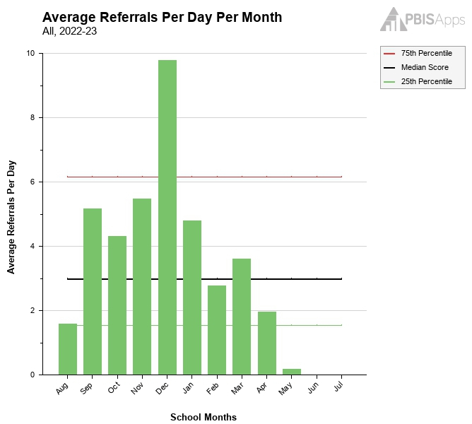
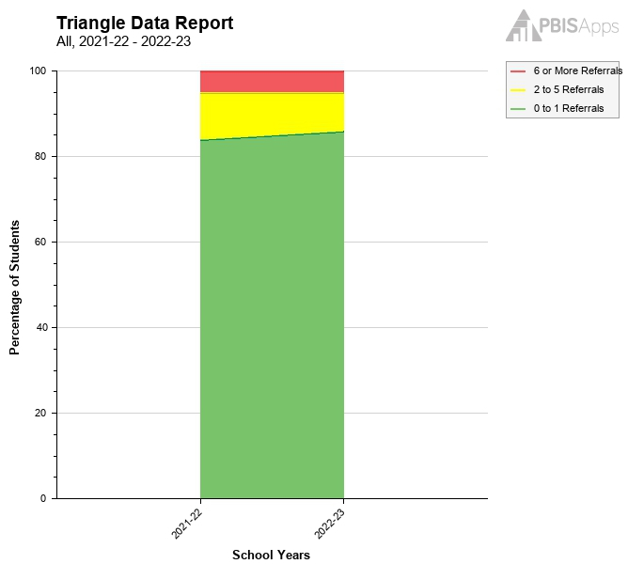
Outcome Data: Referrals
Our discipline data shows that we had six months above the national average of referrals per day with December being our highest number of referrals per day. The triangle data report shows that more than 80% of our students are receiving less than 1 referral per year for two years in a row. They are meeting expectations with universal, Tier 1 support.

Slide 96
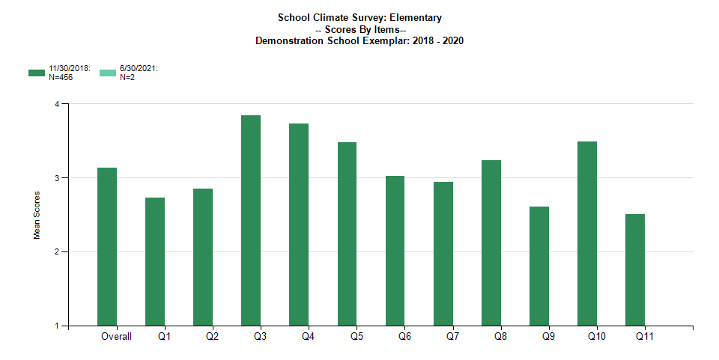
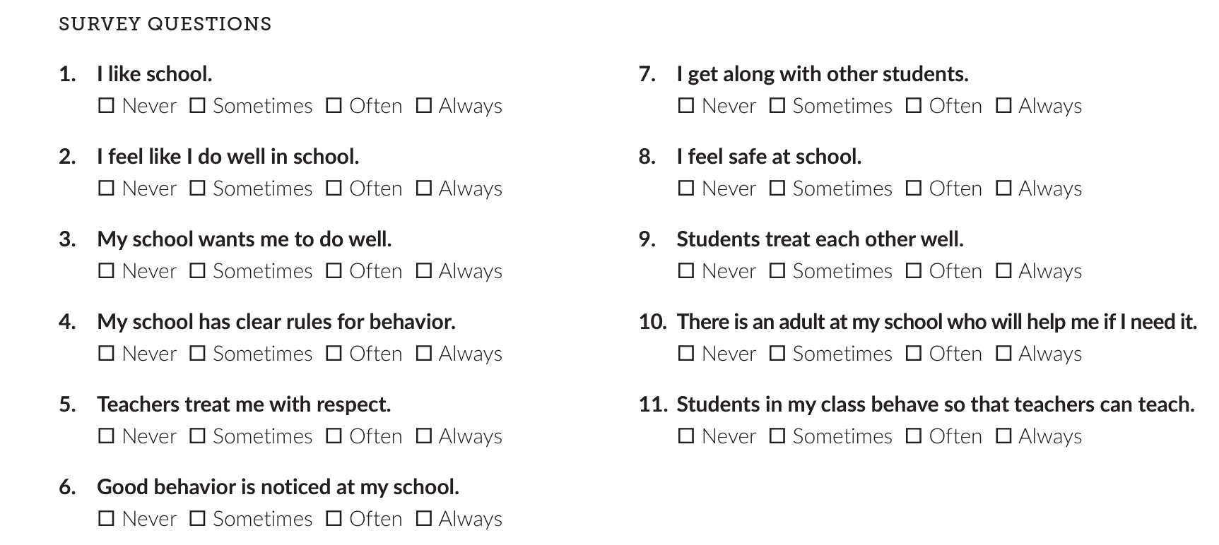
Outcome Data: Student School Climate Survey
Students in grades 3-8 took the Georgia School Climate Survey in April. Our overall school climate score is 3.1 out of 4 where 0=never and 4=always. 75% of our total student population, completed the survey.

Slide 97
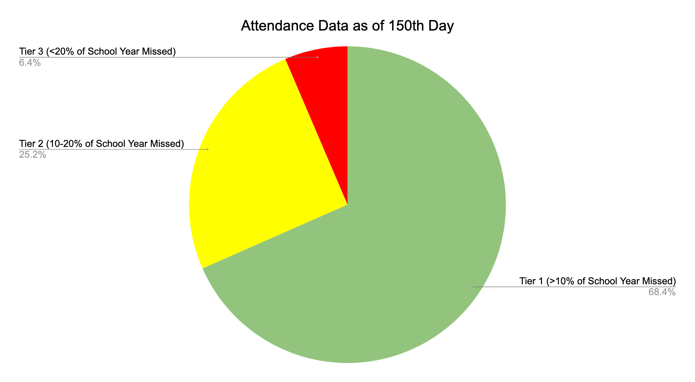
Outcome Data: Attendance
Additionally, we looked at student attendance data to determine if we are achieving our desired outcomes. 68% of our students were absent less than 10% of the school year. 25% were absent 10-20% of the time and 6% were absent more than 20% of the school year. We continue to improve attendance rates and identify effective supports for chronically absent students.

Slide 98
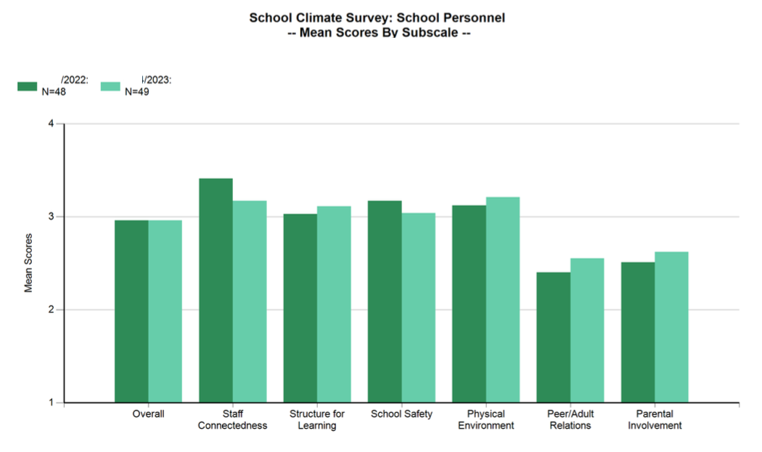
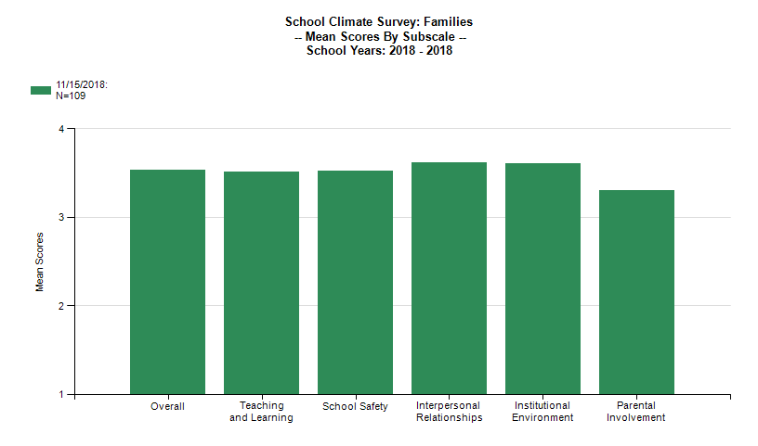
Outcome Data: Personnel and Family School Climate Surveys
School personnel and families also completed school climate surveys this year. In both cases, parental involvement scored lower than other areas. This will be a focus of our action planning efforts next year.

Slide 99
Outcome Data: Additional Options
Shared outcome data should reflect your identified outcome goals and match your context!
Achievement data
Classroom Practices data
Disaggregated data
Positive : corrective feedback
OTR rate
Specific praise rate
Test scores
Graduation rate
Benchmark Assessment
Risk ratio
Risk index
Rates per group

Slide 100
Summarize the Big Ideas
Celebrations:
We are almost at 70% fidelity (the benchmark for full fidelity)!
After the spike of challenging behavior in December, we retaught the school-wide expectations to all students and added a school-wide acknowledgement system. Challenging behaviors decreased in the months that followed!
Students recognize that we want them to do well and that we have clear expectations for behavior.
Across all school climate areas, families rated our school favorably with interpersonal relationships and institutional environment ranked highest.
Overall, staff experience connection at our school.
Areas to strengthen:
Our behavioral referral rates per day per month were higher than the national average 6 out of 10 months. A deeper review of the data by the leadership team found that a large portion of those behaviors occurred on the playground at the end of the day.
Student perceive their peers to be disruptive and not always treating each other well.
Families ranked parental involvement low compared to other school climate areas. A deeper review of the data indicated that Black or African-American families had less favorable perceptions of our school climate than any other racial/ethnic group.
Personnel rated peer/adult relationships higher this year than last year. However, it is still scored lower than other areas.

Slide 101
Summarize the Big Ideas
Action step(s) we plan to take:
Plan booster sessions for school-wide expectations following Thanksgiving break with a targeted acknowledgement plan for December. Details are still to be determined.
Intentionally embed SEB competencies into teaching matrices (school-wide and class-wide)
Ask families to participate in small focus groups to help us understand how to enhance parental involvement opportunities.
Survey staff to find out what would improve their peer/adult relationships.

Slide 102
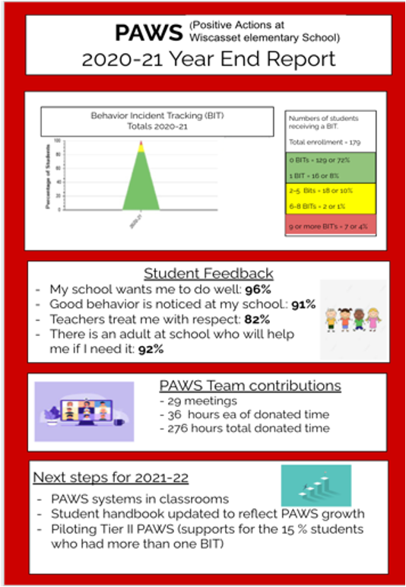
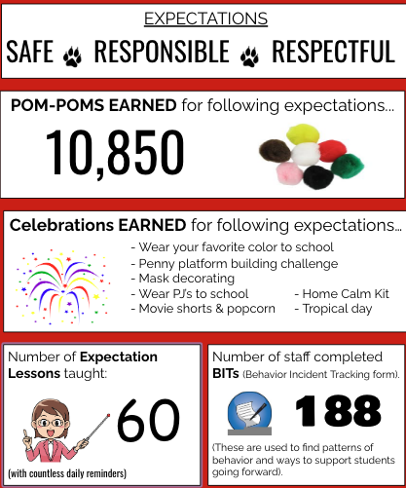
School Examples

Slide 103
Share Broadly and Gather Feedback!
Family and Community Newsletters
Staff Meetings
Focus Groups
School Board Meetings

Slide 104
Guidelines
Evaluate and document your framework annually
Use your existing data routines and identified outcomes
Develop an annual report that identifies celebrations, areas to strengthen and action steps
Share with your school community
Gather feedback from staff, students and families about the annual report

Slide 105
ACTIVITY: Annual Evaluation
As a team,
Identify the data you will use for your annual evaluation
Consider how you will document, share and gather feedback on your evaluation
Add to your action plan as needed.
Be ready to share out 1-2 big ideas from your conversation
10 minutes

Slide 106
WHOLE GROUP DEBRIEF: Annual Evaluation
What data will your team use for your annual evaluation?
How will you document, share and gather feedback?
What further support do you need to move forward?
5 minutes

Slide 107
Lunch

Slide 108
Quick Review

Slide 109
Preparing for School Crisis and Emergencies
Before
Define and teach schoolwide crisis response routines
During
Prompt expectations
Enact wellness support plan
After
Evaluate wellness support plan
Develop a wellness support plan
Reinforce expectations

Slide 110
Steps to Support and Respond to Educators’ Needs
1. Establish Foundations to Support Classroom Implementation
1.1 Establish Priority
1.2 Secure Resources
2. Explicitly Teach & Coach
2.1 Communicate Clear Expectations
2.2 Explicitly Teach
3. Monitor Systems Implementation & Use Problem-Solving Process
3.1 Monitor Team Implementation of Steps 1 & 2
4. Monitor Educator Implementation & Use Problem-solving Process
5. Monitor Equitable Student Benefit & Use Problem-Solving Process
1.3 Align & Integrate with Other Approaches
1.4 Promote a Culture of Wellness
2.3 Coach & Provide Supportive Feedback
2.4 Celebrate Success!
If system implementation challenges...
3.3 Revisit and Enhance Systems (Steps 1 & 2)
4.1 Monitor Educator Implementation & Acceptability
If educator implementation challenges...
4.3 Differentiate Training, Coaching, & Feedback
5.1 Monitor Valued Student Outcomes & Acceptability
If students do not benefit equitably...
5.3 Enhance SEB Support & Modify Training and Coaching
3.2, 4.2, 5.2 Use Continuous Improvement Process

Slide 111
Annual Evaluation Report
Outcome Data
Fidelity Data
Celebrations
Areas to Strengthen
Action Steps

Slide 112
Team
Action Planning Time

Slide 113
Use this time to continue working on...
Crisis and Emergency Planning
Classroom PBIS Data
Annual Evaluation Plan
Plan to teach, prompt, and reinforce crisis expectations and routines
Provide differentiated wellness support
Complete Classroom Data self-assessment
Consider how to use data to monitor classroom PBIS systems, educator implementation and student outcomes
Develop a documented annual evaluation report that is shared with your school community
165 mins

Slide 114
WHOLE GROUP DEBRIEF: Action Planning
Plan to teach, prompt, and reinforce crisis expectations and routines
Provide differentiated wellness support
Share one or more team accomplishments from today.
What further support will you need to complete these action steps?
Complete Classroom Data self-assessment
Consider how to use data to monitor classroom PBIS systems, educator implementation and student outcomes
Develop a documented annual evaluation report that is shared with your school community
5 minutes

Slide 115
Review

Slide 116
YEAR 2: Implement and Strengthen
DAY 7
DAY 8
DAY 9
Data
Practices
Tier 1 Check In
Family Engagement
Culture of Wellness
Crisis and Emergency Response
Precise Problems and Outcomes
Equity Review
Evaluation
Systems
Strengthen
Classroom
Data-based Decision-Making

Slide 117
Preparing for School Crisis and Emergencies
Before
Define and teach schoolwide crisis response routines
During
Prompt expectations
Enact wellness support plan
After
Evaluate wellness support plan
Develop a wellness support plan
Reinforce expectations

Slide 118
Steps to Support and Respond to Educators’ Needs
1. Establish Foundations to Support Classroom Implementation
1.1 Establish Priority
1.2 Secure Resources
2. Explicitly Teach & Coach
2.1 Communicate Clear Expectations
2.2 Explicitly Teach
3. Monitor Systems Implementation & Use Problem-Solving Process
3.1 Monitor Team Implementation of Steps 1 & 2
4. Monitor Educator Implementation & Use Problem-solving Process
5. Monitor Equitable Student Benefit & Use Problem-Solving Process
1.3 Align & Integrate with Other Approaches
1.4 Promote a Culture of Wellness
2.3 Coach & Provide Supportive Feedback
2.4 Celebrate Success!
If system implementation challenges...
3.3 Revisit and Enhance Systems (Steps 1 & 2)
4.1 Monitor Educator Implementation & Acceptability
If educator implementation challenges...
4.3 Differentiate Training, Coaching, & Feedback
5.1 Monitor Valued Student Outcomes & Acceptability
If students do not benefit equitably...
5.3 Enhance SEB Support & Modify Training and Coaching
3.2, 4.2, 5.2 Use Continuous Improvement Process

Slide 119
Annual Evaluation Report
Outcome Data
Fidelity Data
Celebrations
Areas to Strengthen
Action Steps

