Slide 1
TRAINER INFORMATION
This free and accessible training material is provided through the Northeast PBIS Network and can be found at https://nepbis.org/.
School teams are highly encouraged to contact a
PBIS State Coordinator or an NEPBIS Endorsed Trainer
for training opportunities.
If you are an experienced trainer and would like access to to our coordinating trainer workbook which offers training guidance, please email us at nepbis@uconn.edu.

Slide 2
TRAINER NOTES
This is Day 8 of an 11 day, 3 year training sequence.
CONTENT
OUTCOMES
At the end of day eight, teams should understand how to:
Embed wellness for all into Tier 1
Develop systems of support for classroom PBIS implementation
Recognize inequitable outcomes and use the problem-solving framework to improve
Developing a Culture of Wellness for all
Classroom PBIS Systems
Equity Review
Enhance and adjust current features to promote wellness within Tier 1
Complete Classroom Systems self-assessment
Begin to develop support systems for classroom implementation
Understand the role of equity within data review.
Identify a goal and use the problem-solving framework to improve equity
For more information and guidance related to training this content please see the NEPBIS trainers’ manual located here: https://nepbis.org/training-of-trainers-workbook-supplemental-materials/

Slide 3
SAMPLE AGENDA
8:30 | Introduction | 15 mins
8:45 | Quick Review | 15 mins
9:00 | Developing a Culture of Wellness | 45 mins
9:45 | Break | 15 mins
10:00 | Classroom Systems | 75 mins
11:15 | Equity Data Review | 60 mins
12:15 | Lunch | 30 mins
12:45 | Quick Review | 15 mins
1:00 | Equity Data Review Activity | 30 mins
1:30 | Team Time | 135 mins
3:45 | Wrap Up | 15 mins

Slide 4
NEPBIS School-Wide Team Training
Year 1 Day 8
INSERT TRAINER NAMES HERE
with support from
Karen Robbie, Jen Freeman,
Brandi Simonsen, Katie Meyer,
Adam Feinberg & Susannah Everett
Notes:
Trainers: refer to training manual for:
Tips on presenting the overview content
Explanation for short activity periods and ideas for teaching this to teams
Ideas for facilitating review and team action planning

Slide 5
POSITIVE BEHAVIOR INTERVENTIONS & SUPPORTS (PBIS)

Slide 6
WHO'S HERE?
Who's here?
LIST SCHOOLS IN COHORT HERE
(List the schools in your cohort here)
Notes:
TRAINER NOTE: Give teams several minutes each to introduce themselves and their school- including any previous experiences with PBIS.

Slide 7
NEPBIS SCHOOL-WIDE TRAINING MODEL
Year 1
Exploration and Installation of 10 Getting Started Steps
Year 2
Initial Implementation of 10 Getting Started Steps
Year 3+
Full Implementation and Continuous Improvement of Implementation
6 days of team training + 3 days of coach training
3 days of team training + 3 days of coach meeting
On-going Professional Development and Support
(minimum of 2 days of team training + 2 days of coach training annually)

Slide 8
YEAR 1: Getting Started with PBIS
DAY 1
Step 1: Establish an effective leadership team
DAY 2
Step 2: Develop a brief statement of purpose & define outcomes
Step 3: Identify positive school-wide behavior expectations
Step 4: Develop procedures to teach school-wide expectations
DAY 3
Step 5: Develop procedures to teach class-wide expectations
Step 6: Develop a continuum of responses to increase use of SEB skills
DAY 4
Step 7: Develop a continuum or responses to decrease SEB errors
DAY 5
Step 8: Develop systems to support staff
DAY 6
Step 9: Use data for decision-making
Step 10: Promote sustainability

Slide 9
YEAR 2: Implement and Strengthen
DAY 7
DAY 8
Systems
DAY 9
Data
Practices
Tier 1 Check In
Family Engagement
Culture of Wellness
Crisis and Emergency Response Planning
Precise Problems and Outcomes
Equity Review
Evaluation
Strengthen
Classroom
Data-based Decision-Making

Slide 10
TRAINING SCHEDULE
TRAINERS:
USE THIS SLIDE TO INSERT YOUR TRAINING SCHEDULE FOR THE CURRENT YEAR

Slide 11
nepbis.org
TOOLS
Tier 1 Schoolwide
Tier 1 Team Training Materials
Tier 1 Supplemental Resources
School Team Implementation Guide
responses for activities
document plans
develop artifacts
Slides for each training day
Notes:
TRAINERS: Go directly to https://nepbis.org/ and demonstrate how to access relevant materials.

Slide 12
WEBSITES
pbisapps.org
pbis.org

Slide 13
LEGEND
ORGANIZATION
ACTIVITY
NEW
CONTENT
PREVIEW
REVIEW

Slide 14
LEGEND
Timing
Example
Activity
Non-example
Guidelines
Preview
Big Idea
Review
Organization

Slide 15
EXPECTATIONS
 | Individually | Working with Others
Respect Self | Participate Converse with others in lobbies and during breaks Stretch, break, stand as needed | Engage with the training content and activities
Respect Others | Complete assigned tasks Return from breaks on time | Provide room for every voice Reinforce participation
Respect Environment | Keep devices silent Have your computer charged and ready Keep necessary materials at hand | Maintain a neat, orderly work space

Slide 16
AGENDA AND ACTION STEPS
OUTCOMES
CONTENT
Developing a Culture of Wellness for all
Classroom PBIS Systems
Equity Review
Enhance and adjust current features to promote wellness within Tier 1
Complete Classroom Systems self-assessment
Begin to develop support systems for classroom implementation
Understand the role of equity within data review.
Identify a goal and use the problem-solving framework to improve equity

Slide 17
Quick Review

Slide 18
Continuum of School-Wide Instructional & Positive Behavior Support
What do we do for the FEW needing intensive support?
Tertiary Prevention:
Specialized
Individualized
Systems for Students with High-Risk Behavior
What do we do for ALL?
Primary Prevention:
School-/Classroom-
Wide Systems for
All Students,
Staff, & Settings
~5%
~15%
What do we do for the SOME needing more support?
Secondary Prevention:
Specialized Group
Systems for Students with
At-Risk Behavior
~80% of Students

Slide 19
Critical Features
Systems
Practices
Data
Equity
Outcomes

Slide 20
GETTING STARTED WITH PBIS
1
Establish an effective leadership team
6
Develop a continuum of responses to increase use of SEB skills
2
Develop a brief statement of purpose & define outcomes
7
Develop a continuum of responses to decrease SEB errors
3
Identify positive school-wide behavior expectations
8
Develop systems to support staff
4
Develop procedures to teach school-wide expectations
9
Use data for decision-making
5
Develop procedures to teach class-wide expectations
10
Promote sustainability

Slide 21
8
Develop systems to support staff
Promoting and Sustaining Staff Engagement
Continuous Action Planning
Team-Based Implementation
Systems
Embedded and Ongoing Professional Development
Staff Recognition
Data Routines

Slide 22
9
Use data for decision-making
Data
Assess fidelity of PBIS implementation at least annually
Review student behavior data at least monthly
Use school and community data regularly
Evaluate your plan annually
Develop, inform, and refine Tier 1

Slide 23
10
Promote sustainability
Systems

Slide 24
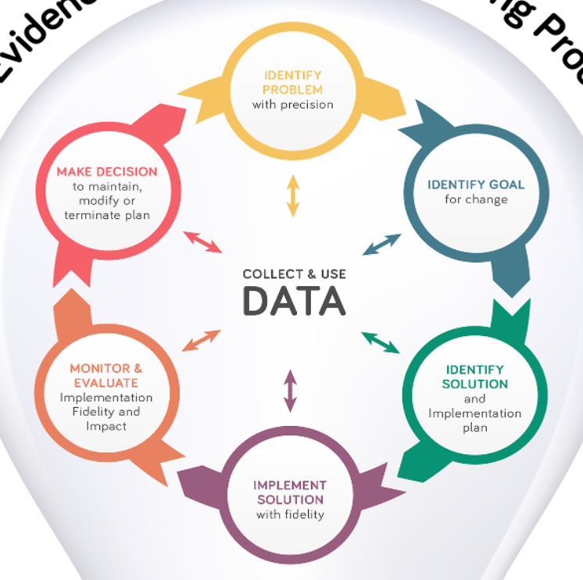
Once data routines are established…
1. Identify the RIGHT data
Outcome data tied to goals
Fidelity data tied to evaluation plan
3. Identify the RIGHT people
Who needs to see these data to inform decisions? (e.g., PBIS team, grade level teams, family groups, other committees?)
4. Identify the RIGHT time & format
When/how often should these data be reviewed to inform decisions?
What format will facilitate decision making?
2. Assess data integrity
Consider staff training & engagement, systems, response rates
…use the data to guide decision-making!

Slide 25
Supporting and Responding to Students’ SEB Needs
1. Create Positive Teaching and Learning Environments
Design a Safe Environment
2. Actively Promote SEB Growth
Engage Students in Relevant Learning
3. Monitor Fidelity and Use Data to Guide Implementation
Monitor Educator Implementation
4. Monitor Student Outcomes and Use Data to Guide Response
Establish Positive Connections
Develop Predictable Routines
Define and Teach Positive Expectations
Plan Relevant Instruction
Foster Positive Relationships
Prompt and Supervise SEB and Academic Skills
Provide Specific Feedback (> 5 : 1 Ratio)
Consider Other Response Strategies
Provide Training, Coaching, and Feedback
If data indicate implementation challenges...
Monitor Student Outcomes
Enhance Tier 1
If many students make ongoing SEB errors...
Enhance Tier 1 and Consider Tiers 2 and 3
If few students make ongoing SEB errors...

Slide 26
Family Engagement in PBIS
Including families in PBIS implementation means families and school personnel work together and share in the responsibility making educational decisions and improving student outcomes.
(Center on PBIS, 2017)
Notes:
Aligning and Integrating Family Engagement in Positive Behavioral Interventions and Supports: https://www.pbis.org/Common/Cms/files/pbisresources/Family%20Engagement%20in%20PBIS.pdf

Slide 27
Establishing a
Culture of Wellness
for All
How do we ensure that our school promotes SEB, academic and mental health wellness?
Enhance and adjust current features to promote wellness within Tier 1

Slide 28
Wellness has been identified as a priority!
We have resources to guide us!
Notes:
US DOE: https://www2.ed.gov/documents/students/supporting-child-student-social-emotional-behavioral-mental-health.pdf
Surgeon General’s Advisory Group: https://www.hhs.gov/sites/default/files/surgeon-general-youth-mental-health-advisory.pdf
World Health Organization (WHO): https://www.who.int/publications/i/item/9789240031029
Culture of Staff Wellness: https://www.pbis.org/resource/building-a-culture-of-staff-wellness-through-multi-tiered-system-of-supports
Center on PBIS’ Mental Health/Wellbeing page: https://www.pbis.org/mental-health-social-emotional-well-being
Interconnected Systems Framework Guide: https://www.pbis.org/resource/interconnecting-school-mental-health-and-pbis-volume-2

Slide 29
What is Wellness?
According to the CDC,
there is no consensus around a single definition of well-being
positive emotions and moods (e.g., contentment, happiness)
the absence of negative emotions (e.g., depression, anxiety)
satisfaction with life
fulfillment
positive functioning
There is general agreement that at minimum,
well-being includes:
Well-being can simply be described as judging life positively and feeling good.
Retrieved from https://www.cdc.gov/hrqol/wellbeing.htm#three

Slide 30
What is Wellness?
Researchers from different disciplines have examined different aspects of well-being that include the following:
Physical well-being
Economic well-being
Social well-being
Development and activity
Emotional well-being
Psychological well-being
Life satisfaction
Domain specific satisfaction
Engaging activities and work
Retrieved from https://www.cdc.gov/hrqol/wellbeing.htm#three

Slide 31
Why Integrate Wellness into Tier 1?
59% of educators reported experiencing burn out (Steiner et al., 2022)
91% of district leaders rated educator mental health as a concern (Diliberti & Schwartz, 2022)
78% of educators report frequent job-related stress compared to 40% of other working adults. (Steiner & Woo, 2021)
Employees in good health are more likely to deliver optimal performance in the workplace. (CDC, 2022)
Educator Considerations

Slide 32
Why Integrate Wellness into Tier 1?
Student Considerations
Supporting SEB development may reduce the need for prolonged intervention (Yoshikawa et al. 2013; Bierman et al., 2018).
Pre-pandemic, 1 in 5 children experienced a mental, emotional, developmental, or behavioral disorder. About 50% did not receive needed treatment. (Office of Surgeon General, 2021)
20% of young people report that the pandemic had a significant negative impact on their mental health (NAMI, 2022)
19% of high school students have thought about suicide. Significantly higher rates for marginalized subgroups such as LGBTQIA+, youth of color, lower income, students with disabilities (NAMI, 2022; US Department of Education, 2021)

Slide 33
Why Integrate Wellness into Tier 1?
less able to support students' SEB development
implement fewer evidence-based practices
increased use of reactive strategies
Negative impact on outcomes for both educators and students
report lower efficacy
Lower student engagement and greater noncompliance or undesired behavior
Unmet needs may result in student SEB challenges
Increased chance of reactive and exclusionary discipline practices (e.g., suspensions, expulsions)
Exacerbates mental health concerns
Interrupts access to and participation in learning
Limits opportunities for support
Unwell educators
Educator and student wellness needs are interconnected
(e.g., Harding et al. 2019; Herman et al., 2018, 2020; Gilmour et al., 2022)

Slide 34
Why Integrate Wellness into Tier 1?
Better able to support students' SEB development
implement evidence-based practices more frequently
increased use of proactive strategies
Positive impact on outcomes for both educators and students
report higher efficacy
Higher student engagement and on-task behavior
Students’ SEB needs are met
Increased student time in classroom
Well educators
Higher rates of academic achievement
Improved classroom climate
Positive educator-student relationships
Educator and student wellness needs are interconnected
(e.g., Center on PBIS, 2023; Herman et al., 2020; Reinke et al., 2013)

Slide 35
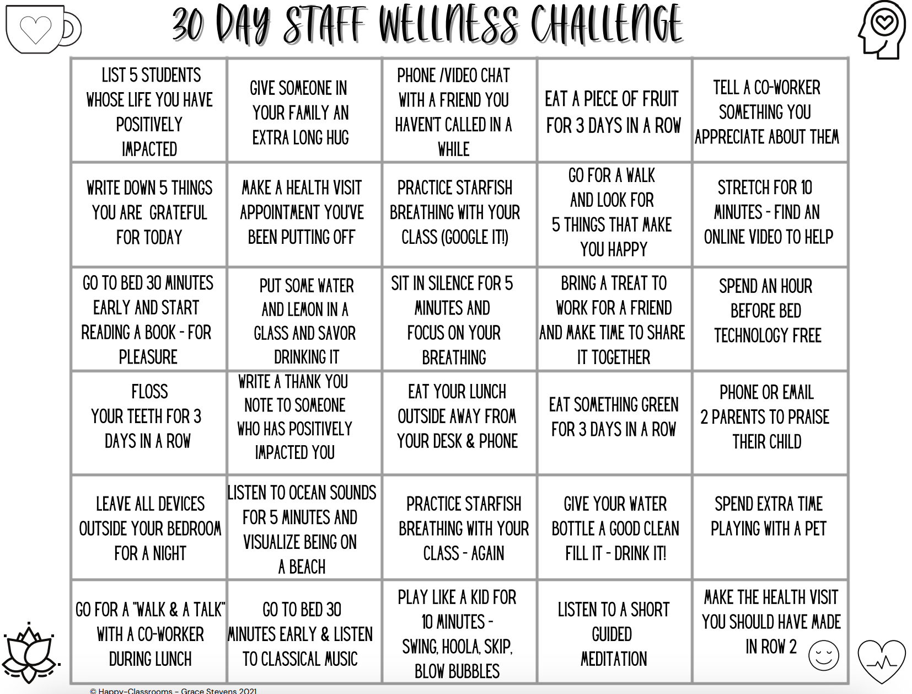
Wellness is not another thing to add…
…rather it should be embedded into your PBIS framework

Slide 36
How Do Teams Integrate Wellness into Tier 1?
Prioritize and enhance wellness for ALL
Use data to determine wellness strengths and needs
Integrate SEB competencies into Tier 1

Slide 37
Consider existing school data sources
Adjust Tier 1 support based on relevant wellness data
Integrate district and community data in decision-making
Use data to determine wellness strengths and needs

Slide 38
Use data to determine wellness strengths and needs by…
CONSIDERING EXISTING SCHOOL DATA SOURCES
School Climate Surveys for staff, students and families
Feedback and Input Survey
Patterns of staff/student absences and/or turnover
Universal Screening
Nurse and counselor visits
Notes:
PBISApps: https://www.pbisapps.org/
Best Practices In Universal Social, Emotional, and Behavioral Screening: An Implementation Guide: https://www.pbis.org/resource/best-practices-in-universal-social-emotional-and-behavioral-screening-an-implementation-guide
Systematic Screening Tools: Universal Behavior Screeners: https://www.pbis.org/resource/systematic-screening-tools-universal-behavior-screeners

Slide 39
Use data to determine wellness strengths and needs by…
INTEGRATING DISTRICT AND COMMUNITY DATA IN DECISION-MAKING
Community Demographics
Food Pantry Visits
Poverty Rate
Calls to Crisis Centers, Hospital Visits
Employee Assistance Program Use
Quality of Life Surveys

Slide 40
Use data to determine wellness strengths and needs by…
ADJUSTING TIER 1 SUPPORT BASED ON RELEVANT WELLNESS DATA
Majority of students receiving free/reduced lunch?
Embed free breakfast into start of day routines
Low scores on school connectedness?
Ask school community members what would meaningful connections would be
High rates of stress among staff?
Limit new demands and encourage use of personal days
Remember to focus on only a few, impactful, data-driven interventions

Slide 41
How Do Teams Integrate Wellness into Tier 1?
Prioritize and enhance wellness for ALL
Use data to determine wellness strengths and needs
Integrate SEB competencies into Tier 1

Slide 42
Promote healthy habits
Emphasize systems to support implementation
Build awareness
Prioritize and enhance wellness for ALL

Slide 43
Prioritize and enhance wellness for ALL by…
BUILDING AWARENESS
Model understanding and appreciation for mental health
Engage in routine check ins
Teach how to recognize signs and symptoms of SEB needs
Normalize asking for and explicitly teach how to get help

Slide 44
Resources for Building Awareness
NAMI
Classroom WISE
Warning signs and symptoms
Education and awareness materials
Connection to local organizations
SAMHSA
Practitioner training
Evidence-based Practice Resource Center
Mental health literacy materials
Professional development
Video library
Notes:
NAMI:https://www.nami.org/Home
SAMHSA:https://www.samhsa.gov/
SAMHSA Evidence-Based Practices Resource Center: https://www.samhsa.gov/resource-search/ebp
Classroom WISE: https://www.classroomwise.org/

Slide 45
Prioritize and enhance wellness for ALL by…
PROMOTING HEALTHY HABITS
Movement routines
Quiet spaces
Debriefing after stressful events
Opportunities for connection
Realistic workloads
Use your data to guide what needs to be promoted in your school

Slide 46
Prioritize and enhance wellness for ALL by…
EMPHASIZING SYSTEMS TO SUPPORT IMPLEMENTATION
2-way, transparent, valued communication loops
Representative team with wellness expertise
Continuous professional development and coaching
Recognize and respond to SEB challenges through a consistent continuum of support
Eliminate ineffective or redundant practices, teams, and systems

Slide 47
How Do Teams Integrate Wellness into Tier 1?
Prioritize and enhance wellness for ALL
Use data to determine wellness strengths and needs
Integrate SEB competencies into Tier 1

Slide 48
Align initiatives to promote consistency
Embed SEB competencies into teaching matrices
Integrate SEB skills into academic instruction
Integrate SEB competencies into Tier 1

Slide 49
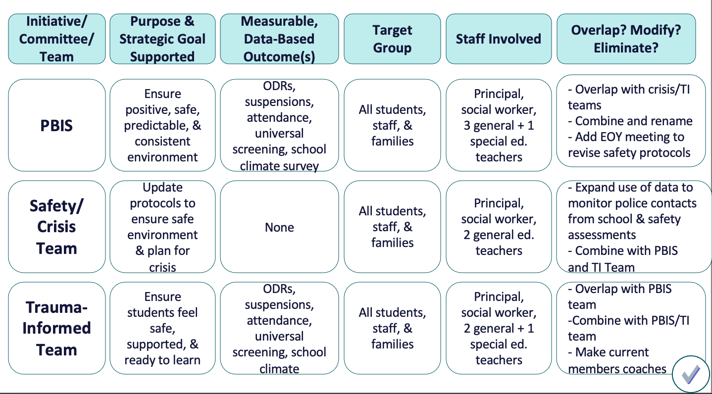
Integrate SEB competencies into Tier 1 by…
ALIGNING INITIATIVES TO PROMOTE CONSISTENCY
SEL Curriculum
Restorative Practices
Trauma Informed Practices
Robust Tier 1 to support wellness

Slide 50
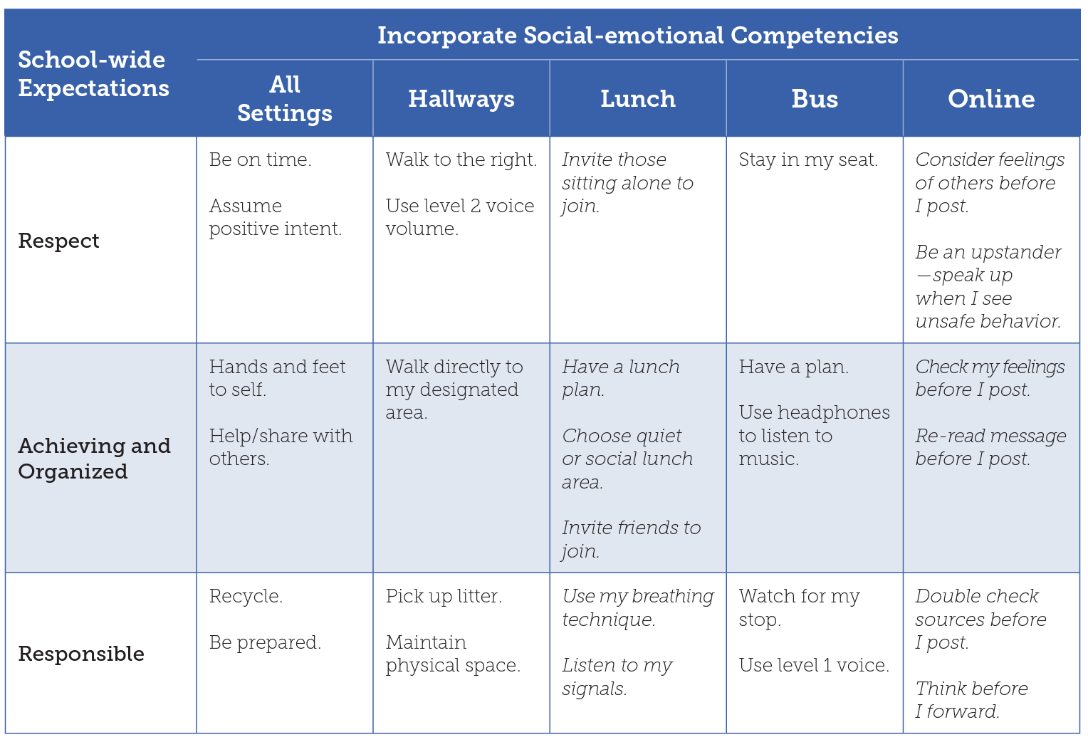
Integrate SEB competencies into Tier 1 by…
EMBEDDING SEB COMPETENCIES INTO TEACHING MATRICES
Invite those sitting alone to join.
Have a lunch plan. Choose quiet or social lunch area. Invite friends to join.
Use my breathing technique. Listen to my signals.
Be an upstander-speak up when I see unsafe behavior.
Check my feelings before I post. Re-read message before I post.
Double-check sources before I post.
Notes:
Teaching Social-Emotional Competencies within a PBIS Framework: https://www.pbis.org/resource/teaching-social-emotional-competencies-within-a-pbis-framework

Slide 51
Integrate SEB competencies into Tier 1 by…
INTEGRATING SEB SKILLS INTO ACADEMIC INSTRUCTION
Prompt SEB skills at the start of instruction
Highlight examples and non-examples of SEB skills in curricular materials
Provide opportunities to demonstrate SEB skills within academic routines
Deliver feedback and acknowledgement for use of SEB skills across instructional activities

Slide 52
Guidelines for Integrating Wellness into Tier 1
Use your PBIS framework to:
Prioritize and enhance wellness for all school community members
Use data to determine wellness strengths and needs
Integrate SEB competencies into Tier 1
Avoid isolated wellness events and activities

Slide 53
ACTIVITY:
As a team, identify:
What are you currently doing to support wellness for both students and staff?
What data will you use to determine needs?
How can wellness be prioritized and enhanced?
How can SEB competencies be integrated in your Tier 1 supports?
Add to your action plan as needed.
Be prepared to share 1-2 next steps you will take to build a culture of wellness in your school community.
10 minutes

Slide 54
WHOLE GROUP DEBRIEF:
What 1-2 next steps you will take to build a culture of wellness in your school community?
What further support do you need to accomplish these steps?
5 minutes

Slide 55
Break

Slide 56
Classroom:
Systems
How do we support educators with use of evidence-based practices to support and respond to student behavior?
Complete Classroom Systems self-assessment
Begin to develop support systems for classroom implementation

Slide 57
Supporting and Responding to Students’ SEB Needs
Practices
Summarizes evidence-based, positive, and proactive practices that support and respond to students’ social, emotional, and behavioral (SEB) needs in classrooms.
Center on PBIS. (2022). Supporting and responding to student’s social, emotional, and behavioral needs: Evidence-based practices for educators (Version 2.0). Center on PBIS, University of Oregon. www.pbis.org.

Slide 58
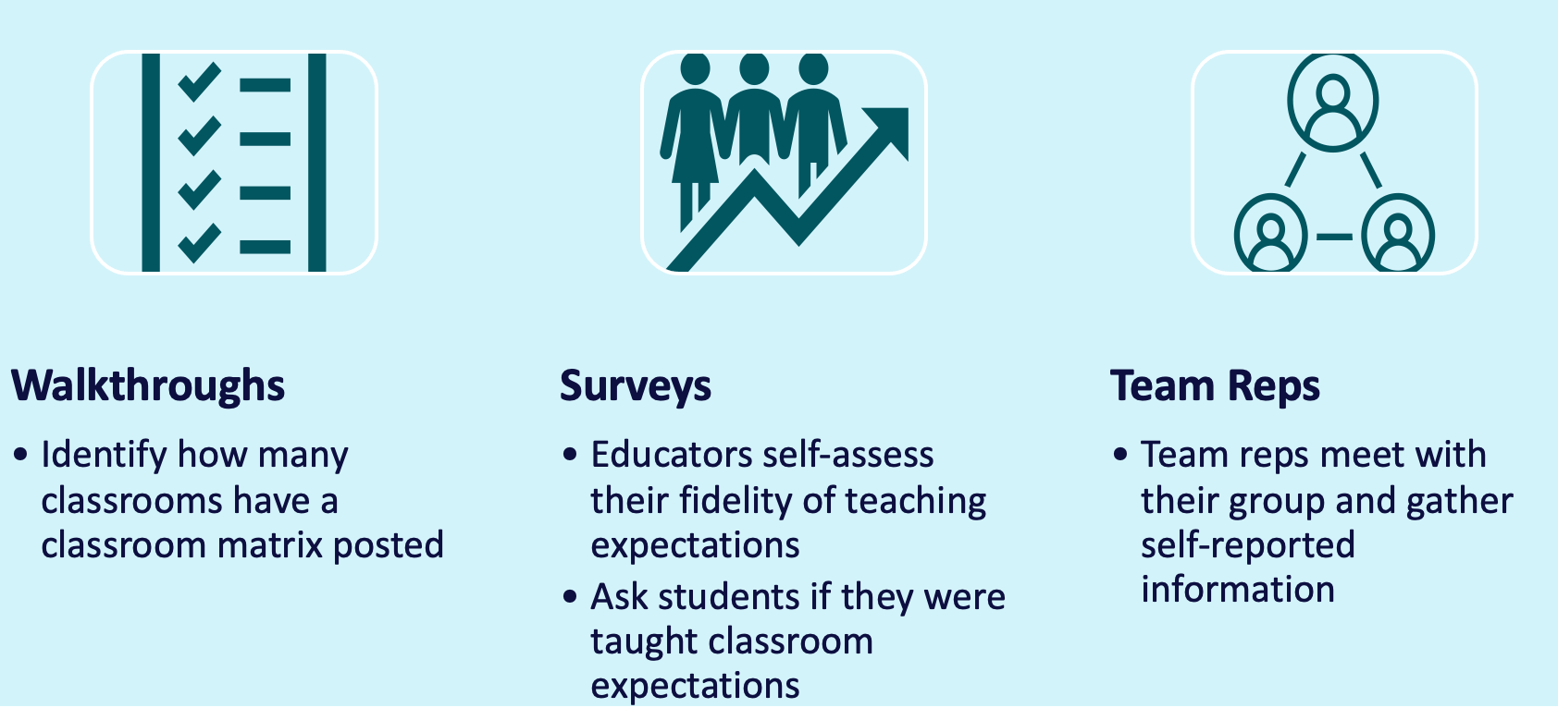
INITIAL STEP: Monitor Fidelity
As a team,
Consider how you can gather data on classroom educator fidelity with
aligning classroom expectations with schoolwide expectations
posting classroom expectations
explicit teaching of classroom expectations
From Day 7
How did it go?

Slide 59
DISCUSSION: Classroom Fidelity Data Review
As a team, review the data you gathered on classroom expectations fidelity.
Were you able to gather the relevant data efficiently and accurately?
What worked well?
What can be enhanced?
What did your team learn from the data?
How does this inform your next action planning steps?
Be ready to share 1-2 big ideas with the whole group.
10 minutes

Slide 60
WHOLE GROUP DEBRIEF:
What did your team discover by collecting classroom expectations fidelity data?
What further support do you need?
5 minutes

Slide 61
Supporting and Responding to Educators’ Classroom PBIS Implementation Needs
Systems
Data
Provides updated guidance on how to (a) develop systems to support educators’ implementation of evidence-based classroom practices and (b) use data to guide the development of implementation supports.
Center on PBIS. (2023). Supporting and Responding to Educators Classroom PBIS Implementation Needs: Guide to Classroom Systems and Data. Center on PBIS, University of Oregon. www.pbis.org.
Notes:
Supporting and Responding to Educators’ Classroom PBIS Implementation Needs: https://www.pbis.org/resource/supporting-and-responding-to-educators-classroom-pbis-implementation-needs-guide-to-classroom-systems-and-data

Slide 62
Continuum of Multi-tiered Professional Development Support
Tier 3
What do we do for the FEW staff needing intensive support?
Intensive Professional Development:
Data-driven Consultation
Performance Feedback:
Routine Walkthrough and Self-management Data Reviews
Tier 1
What do we do for
ALL Staff?
Universal Professional Development:
Training and Self-management
Universal Screening:
Walk-through and Student Data Review
~5%
~15%
Tier 2
What do for the SOME staff needing more support?
Targeted Professional Development:
Self-management with Peer or Coaching Support
Progress Monitoring:
Walkthrough, Student Data Review,
Teacher Collected Data
For now,
focus on providing ALL staff Tier 1 professional development
~80% of Staff

Slide 63
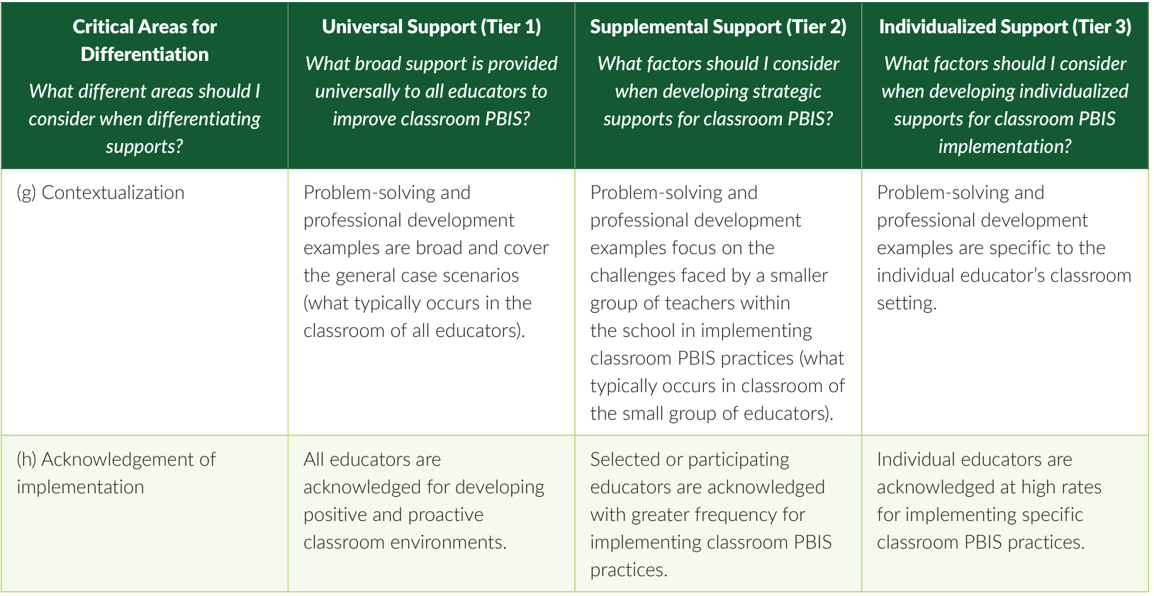
Continuum of Multi-tiered Professional Development Support

Slide 64
Steps to Support and Respond to Educators’ Needs
1. Establish Foundations to Support Classroom Implementation
1.1 Establish Priority
1.2 Secure Resources
2. Explicitly Teach & Coach
2.1 Communicate Clear Expectations
2.2 Explicitly Teach
3. Monitor Systems Implementation & Use Problem-Solving Process
3.1 Monitor Team Implementation of Steps 1 & 2
4. Monitor Educator Implementation & Use Problem-solving Process
5. Monitor Equitable Student Benefit & Use Problem-Solving Process
1.3 Align & Integrate with Other Approaches
1.4 Promote a Culture of Wellness
2.3 Coach & Provide Supportive Feedback
2.4 Celebrate Success!
If system implementation challenges...
3.3 Revisit and Enhance Systems (Steps 1 & 2)
4.1 Monitor Educator Implementation & Acceptability
If educator implementation challenges...
4.3 Differentiate Training, Coaching, & Feedback
5.1 Monitor Valued Student Outcomes & Acceptability
If students do not benefit equitably...
5.3 Enhance SEB Support & Modify Training and Coaching
3.2, 4.2, 5.2 Use Continuous Improvement Process

Slide 66
Steps to Support and Respond to Educators’ Needs
1. Establish Foundations to Support Classroom Implementation
1.1 Establish Priority
1.2 Secure Resources
2. Explicitly Teach & Coach
2.1 Communicate Clear Expectations
2.2 Explicitly Teach
1.3 Align & Integrate with Other Approaches
1.4 Promote a Culture of Wellness
2.3 Coach & Provide Supportive Feedback
2.4 Celebrate Success!
Today’s Focus

Slide 67
1. Establish Foundations to Support Classroom Implementation
1.1 Establish Priority
1.2 Secure Resources
1.3 Align & Integrate with Other Approaches
1.4 Promote a Culture of Wellness
Establish Foundations to Support Classroom Implementation

Slide 68
Establish Priority
District and school leaders jointly communicate a clear and ongoing priority for classroom PBIS implementation to educators.
District and school leaders use data to demonstrate the need for effective implementation of classroom PBIS.

Slide 69
Secure Resources
School and district resources (e.g., time, coaching expertise, funding) are available to support classroom PBIS implementation.
Time is provided for classroom PBIS data collection and analysis.

Slide 70
Sound familiar?
Bring this schoolwide concept into classrooms, too!
Align & Integrate with Other Approaches
School and district teams have considered alignment and integration of classroom PBIS with other district priorities, needs, and SEB initiatives.
Implementation of classroom PBIS is connected to academic instructional practices.
Classroom PBIS strategies are adapted to ensure classroom contextual fit.

Slide 71
Promote a Culture of Wellness
Sound familiar?
Bring this schoolwide concept into classrooms, too!
Health and wellness needs are determined by gathering and reviewing relevant data.
Prioritize and enhance wellness for ALL
Integrate wellness into Tier 1

Slide 72
Systems Require a Comprehensive Approach
District
Provides the necessary structure and resources to support staff with implementation throughout the schools
School
Provides training, coaching, performance feedback to educators who are implementing in the classrooms
Classroom
Educators effectively and equitably implement Classroom PBIS practices to support SEB growth in students

Slide 73
1. Establish Foundations to Support Classroom Implementation
1.1 Establish Priority
1.2 Secure Resources
1.3 Align & Integrate with Other Approaches
1.4 Promote a Culture of Wellness
A school-wide leadership team inventories existing initiatives/programs to consider how new initiatives/ programs complement, compete, or replace existing ones, including classroom PBIS.
The school leadership teams include a representative group of educators, students, and families. Each member has opportunities to share perspectives, be included in decision-making, and experience a sense of being valued.
Establishing Foundations: School Level
Classroom PBIS implementation is documented as one of the top 3–5 building goals.
Time is allotted for coaches and peers to observe instructional periods to support implementation, collect data, and provide performance feedback.

Slide 74
2. Explicitly Teach & Coach
2.1 Communicate Clear Expectations
2.2 Explicitly Teach
2.3 Coach & Provide Supportive Feedback
2.4 Celebrate Success!
Explicitly
Teach & Coach

Slide 75
Communicate Clear Expectations
Clarify coaching role, process, and relationship; collaborative, non-evaluative, confidential, and bidirectional communication.
System of support (formal and informal) is clearly defined and communicated to educators (e.g., educators know how to access nonevaluative support).
Desired implementation outcomes and expectations are clearly communicated to all faculty.

Slide 76
Explicitly Teach
PD is targeted, data-driven, on-going, job embedded, connected with identified practices, and provides systemic supports.
PD sessions consistently include model, lead & test components
Professional development (PD) clearly defines critical features of classroom PBIS practices and provides a rationale for each.

Slide 77
Coach & Provide Supportive Feedback
Prompts and supportive feedback may be delivered by internal or external coach, mentor, peer, or self.
Provide educators preferred ways to deliver supportive data-based feedback and suggestions for improving implementation.
Provide educators preferred ways to prompt and remind to use targeted strategies, with prompts delivered by coaches, peers, self, or technology.

Slide 78
Coaching Support
COACH
School or district coach sends regular reminders to educators of the critical features of classroom PBIS strategies
PEER
Educators commit to being a dedicated coach for at least one strategy and a dedicated learner of a new strategy.
SELF
Educators set a goal for improvement and are provided with a tool for data collection and evaluation.
District supports coaches and mentors with PD on effective coaching approach
District provides clear expectations, guidance, & resources to support use of grade level/ department team time to focus on targeted practices.
District provides clear expectations, guidance, and resources to support selfassessment or self-reflection as part of feedback

Slide 79
Celebrate Success
Formal educator acknowledgment systems are defined and taught.
Acknowledgment or celebration systems are differentiated and implemented in a culturally responsive manner.

Slide 80
2. Explicitly Teach & Coach
2.1 Communicate Clear Expectations
2.2 Explicitly Teach
2.3 Coach & Provide Supportive Feedback
2.4 Celebrate Success!
A coach works with a grade level PLC to build coaching capacity of team members to support one another with implementation (e.g., datainformed feedback, use of open-ended questions).
Explicitly Teach & Coach: School Level
Professional development plans reflect the prioritized or targeted classroom practices and is aligned to district plan.
Professional development sessions are delivered and followed up on in a variety of instructional contexts including, all educators, grade level teams, Professional Learning Communities, on-demand resources, book studies, observations in other classrooms, or content/ department areas.
School leadership shares data during educator meeting to celebrate progress and improvement of implementation efforts and student outcomes

Slide 81
Guidelines for Systems to Support Classroom PBIS Implementation
Develop systems that are effective, feasible and relevant to your school
Continuously gather staff input and feedback
Gather data to provide supportive performance feedback and progress monitor
Explicitly teach evidence-based practices to all
Provide data-based differentiated levels of support, coaching and acknowledgement

Slide 82
Classroom Systems Self-Assessment

Slide 83
ACTIVITY: Classroom Systems
As a team,
Complete the Classroom Systems Self-Assessment.
Identify current implementation status of establishing foundations and explicit training and coaching features.
Identify which features are a priority for action planning.
Choose 1-2 high priority features to add to your action plan.
Be prepared to share which features you have added to your action plan and why they were chosen with the whole group.
15 minutes

Slide 84
WHOLE GROUP DEBRIEF:
What features did your team decide as an action planning priority? Why?
What further support do you need to move forward with next steps?
5 minutes

Slide 85
Steps to Support and Respond to Educators’ Needs
3. Monitor Systems Implementation & Use Problem-Solving Process
3.1 Monitor Team Implementation of Steps 1 & 2
4. Monitor Educator Implementation & Use Problem-solving Process
5. Monitor Equitable Student Benefit & Use Problem-Solving Process
If system implementation challenges...
3.3 Revisit and Enhance Systems (Steps 1 & 2)
4.1 Monitor Educator Implementation & Acceptability
If educator implementation challenges...
4.3 Differentiate Training, Coaching, & Feedback
5.1 Monitor Valued Student Outcomes & Acceptability
If students do not benefit equitably...
5.3 Enhance SEB Support & Modify Training and Coaching
Day 9
3.2, 4.2, 5.2 Use Continuous Improvement Process

Slide 86
Equity
Review
Are all sub-groups of our school community experiencing equitable outcomes as a result of our implementation?
Understand the role of equity within data review.
Identify a goal and use the problem-solving framework to improve equity

Slide 87
Critical Features of PBIS
Systems
Practices
Data
Equity
Outcomes

Slide 88
Prioritize equity. MTSS is for all students, families, and educators. Use the MTSS framework to differentiate supports for students and monitor to ensure equitable outcomes are observed.
Equity

Slide 89
What is EQUITY in Education?
Educational policies, practices, interactions, and resources are
representative of
Each individual
has access to
High-quality learning experiences that
empower them towards self-determination
constructed by
responsive
to
can meaningfully participate in
make progress within
reduce disparities in outcomes
Regardless of individual characteristics and cultural identities
ALL
ALL includes each
and every individual
irrespective of:
race/ethnicity
class
gender
sexual orientation
country of origin
dis/ability
cultural
political
religious
or other group affiliations
(Fraser, 2008; Great Lakes Equity Center, 2012)
Retrieved from www.pbis.org.

Slide 90
WHAT DOES DISPROPORTIONALITY MEAN?
Disproportionality refers to a group’s representation in a particular category that exceeds expectations for that group, or differs substantially from the representation of others in that category.
- www.nasponline.org
10% of population is referred for special education services
Proportional Outcome
Disproportional Outcome
100 students
50 males = 50%
50 females = 50%
10 students
8 males = 80%
2 females = 20%
10 students
5 males = 50%
5 females = 50%
Notes:
TRAINER NOTE: Important to add that there is no evidence supporting males are more likely to need special education services than females.

Slide 91
PBIS centers equity in all decisions...
Access
Representation
Meaningful Participation
Positive Outcomes
How is that going so far?
Are we doing what we intended to do?
Is it working for everyone?
Notes:
https://www.pbis.org/topics/equity

Slide 92
Are school community members experiencing equitable outcomes in our school regardless of individual characteristics and identities?
Gender/Gender Identity
Race/Ethnicity
Sexual Orientation
Grade Level
Socio-economic Status
Dis/ability Status
Emerging Bilingual

Slide 93
Some considerations…
Many LGBTQ students feel unsafe at school:
59% because of their sexual orientation
43% because of their gender expression
(Kosciw et al., 2020)
80% of students subjected to physical restraint and 77% of students subjected to seclusion
are students with disabilities
(Office of Civil Rights, 2020)
Black male students are more likely to receive more negative interactions with their teachers, regardless of their behavior.
(Scott et al., 2019)
The classroom is the location with the highest rates of both exclusionary and disproportionate discipline
(Gion et al., 2014; Smolkowski et al., 2016)
Black students are more than 3x likely to be suspended than White students
(U.S. Department of Education,
Office for Civil Rights, 2018)
White students are more likely to receive referrals for more objective behaviors
(e.g., physical aggression, substance use).
Black students are more likely to receive referrals for more subjective behaviors
(e.g., disrespect, defiance, disruption).
(Girvan et al, 2017)
Pre-school students with disabilities account for
23% of total pre-school enrollment but
accounted for 57% of expulsions.
(Office of Civil Rights, 2021)
Students with disabilities are 2x more likely to be suspended as students without disabilities
(Harper et al., 2019)

Slide 94
Data Sources to Guide Our Understanding and Action Planning
Academic Achievement
Grades
Standardized Test Scores
Graduation Rates
Access/Participation in School-wide Programming
Advanced Level Courses
Athletics/ Clubs
Attendance
Special Education
Disciplinary Patterns
Referrals
Suspensions
Expulsions
School Community (Students, staff, families) Perceptions
School Climate Survey
Feedback and Input Survey
Quality of Life Surveys
Focus Groups/ Community Forums
Restraints/ Seclusions
School Related Arrests
Positive, Proactive Educator Practices

Slide 95
Today’s Focus
Office Discipline Referrals
School Climate Survey
Why these 2?
Data is already available as part of your Tier 1 evaluation plan and can be disaggregated for various sub-groups
So, I don’t need to look at other data sources?
No! Use the examples to review other data sources relevant to your identified outcome goals.
Both have ripple effects on critical student outcomes

Slide 96
Why should we look at referrals?
differences in academic achievement (Morris & Perry, 2016)
lower ratings of safety and positive relationships with adults (Gage, et al., 2016).
Exclusionary disciplinary practices (suspensions, expulsions, referrals) may lead to..
decreases in student engagement (Dishion & Snyder, 2016)
reduced instructional time (McIntosh & Goodman, 2016)

Slide 97
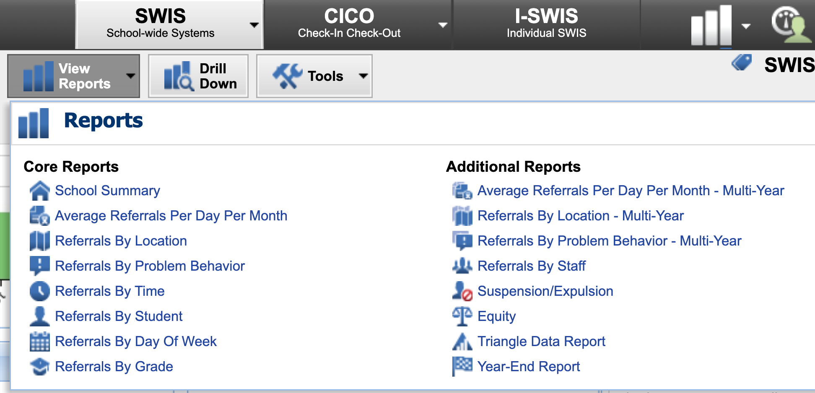
SWIS’ Equity Report makes data review easy
View Reports
Equity
Notes:
Overview Announcement: https://www.pbisapps.org/articles/the-swis-equity-report-is-here
Training: https://training.pbisapps.org/w/courses/4-swis-equity-reports-and-the-data-drill-down-process

Slide 98
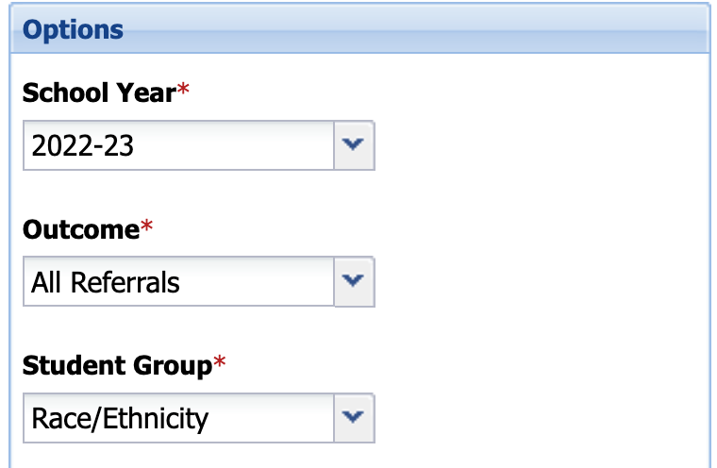
You can look at outcomes and subgroups
All Referrals
Staff-managed
Administrator-managed
Out of School Suspensions
Race/Ethnicity
English Learner Status
Gender
IEP Status

Slide 99
Report Types
Risk Index
“How many students in each group receive the identified outcome?”
Risk Ratio
“How likely is a group to have an identified outcome compared to other groups?”
Rate by Group
Percentage of students within each group with at least one identified outcome
Likelihood for a specific group to receive at least one identified outcome when compared to a different group of students
Average number of identified outcomes received per student in each group
“Are the subgroups’ percentages of enrollment and percentages of students with this outcome comparable?”

Slide 100
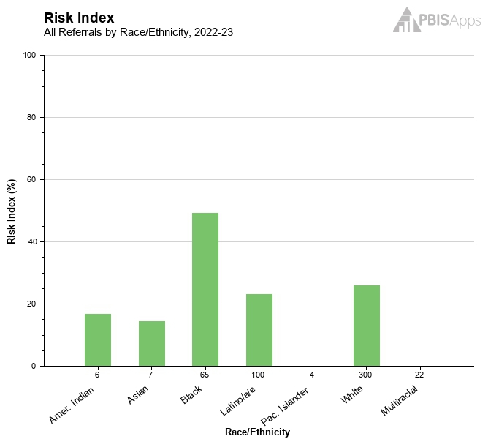
Each report provides…
The Risk Index report displays the percentage of students within each group with at least one referral.
Teams analyzing this report look to answer the question: What is the risk for students within each group to receive the selected outcome?
Of the 6 students identified as American Indian/Alaskan Native, 17% have at least one referral.
Of the 7 students identified as Asian, 14% have at least one referral.
Of the 65 students identified as Black/African American, 49% have at least one referral.
Of the 100 students identified as Hispanic/Latino/a/e, 23% have at least one referral.
Of the 4 students identified as Pacific Islander/Native Hawaiian, 0% have at least one referral.
Of the 300 students identified as White, 26% have at least one referral.
Of the 22 students identified as Multiracial, 0% have at least one referral.

Slide 101
Risk Index
Examples:
Of the 65 students identified as Black/African American, 49% have at least one referral.
Of the 300 students identified as White, 26% have at least one referral.
Significant variability indicates inequitable outcomes

Slide 102
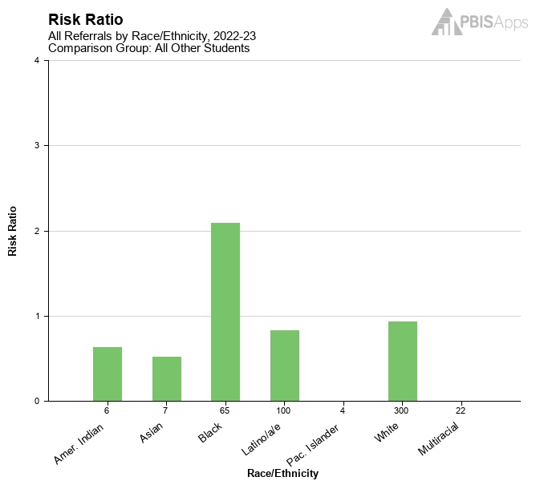
Risk Ratio
Examples:
Students identified as Black/African American have 2.09 times the risk of receiving at least one referral as all other students.
Students identified as White have 0.93 times the risk of receiving at least one referral as all other students.
Equitable outcomes are achieved when all subgroups equal 1

Slide 103
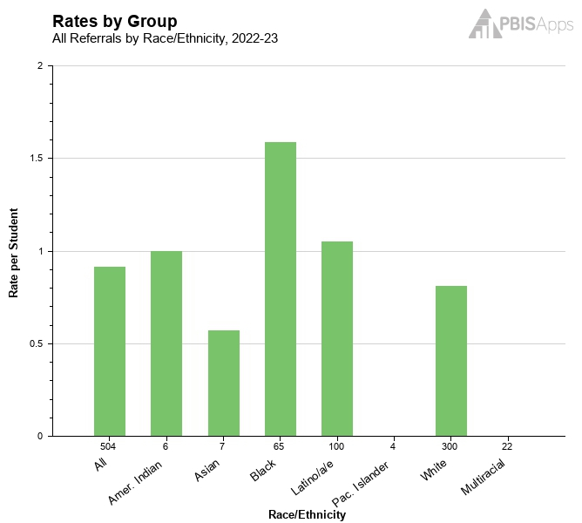
Rates by Group
Examples
Students identified as Black/African American receive an average of 1.58 referrals per student in the 2022-23 school year.
Students identified as White receive an average of 0.81 referrals per student in the 2022-23 school year.
Significant variability indicates inequitable outcomes

Slide 104
Don’t have SWIS? Use Our Excel Template!
Metrics can be applied to other outcomes, too!

Slide 105
You’ve Identified Inequity, Now What? Apply your problem-solving framework!
IDENTIFY PROBLEM
with precision
IDENTIFY GOAL
for change
IDENTIFY SOLUTION
and implementation plan
IMPLEMENT SOLUTION
with fidelity
MONITOR & EVALUATE
implementation fidelity and impact
MAKE DECISION
to maintain, modify, or terminate plan
Collect & Use
DATA
(Chaparro, E., et. al, 2022)

Slide 106
IDENTIFY PROBLEM
with precision
After looking at their equity reports and using the drill down tool, Longwood Middle School’s PBIS team discovered:
Students identified as Black/African American (Who) were 2.09 times more likely to receive at least one referral as all other students and 85% of the referrals delivered to this sub-group were the result of subjective behaviors (e.g. disprespect, defiance, or disruption). (What) These referrals were most frequently given in the hallways (Where) during transition times (e.g. after lunch, dismissal). (When) The majority of referrals indicated unknown as the perceived motivation. (Why)
Drill Down

Slide 107
IDENTIFY GOAL
for change
The team, recognizing that changing the risk of student referral outcomes will require systemic change, sets a year long goal to reduce the likelihood of Black/African American students receiving a referral compared to all students:
By October of the next year, Black/African American students will have 1 time the risk of receiving one referral as all other students.

Slide 108
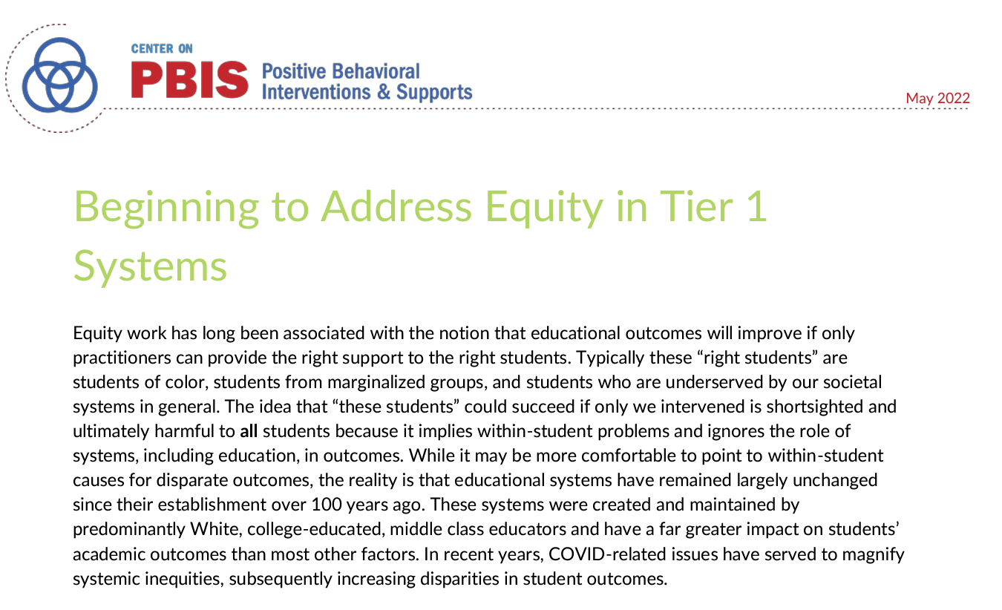
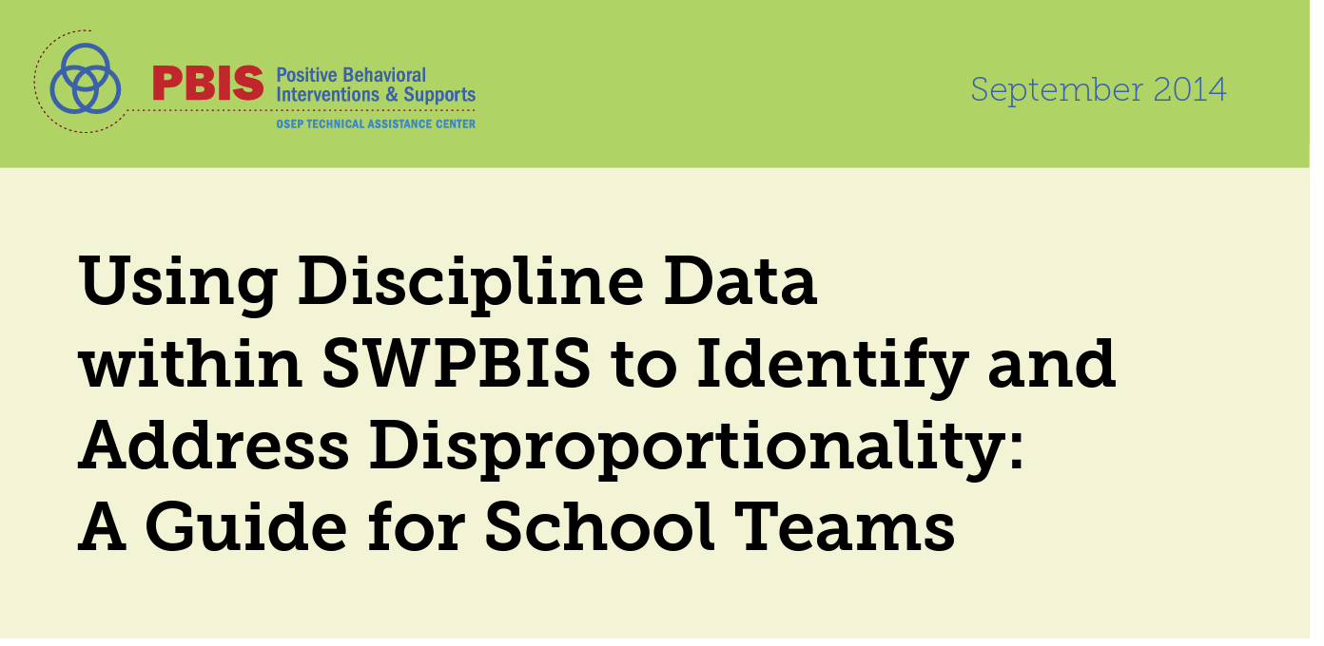
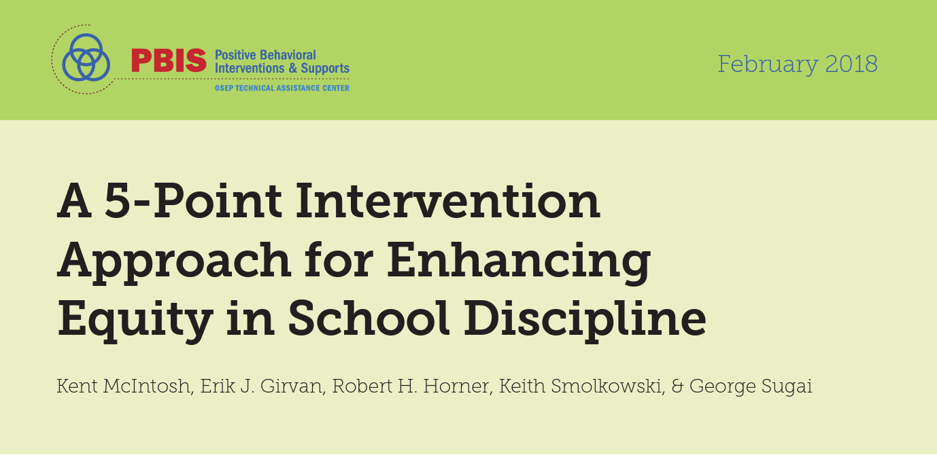
Wanting to use evidence-based practices to address the problem, the team went to PBIS.org’s Equity page to learn about what can be done to effectively reduce disproportionality within student discipline outcomes. They discovered several resources to guide them.
Beginning to Address Equity in Tier 1
IDENTIFY SOLUTION
and implementation plan
Notes:
Beginning to Address Equity in Tier 1: https://www.pbis.org/resource/beginning-to-address-equity-in-tier-1-systems
Using Discipline Data within SWPBIS to Identify and Address Disproportionality: https://www.pbis.org/resource/a-5-point-intervention-approach-for-enhancing-equity-in-school-discipline
A 5-Point Intervention Approach for Enhancing Equity in School Discipline: https://www.pbis.org/resource/using-discipline-data-within-swpbis-to-identify-and-address-disproportionality-a-guide-for-school-teams
PBIS Cultural Responsiveness Field Guide: https://www.pbis.org/resource/pbis-cultural-responsiveness-field-guide-resources-for-trainers-and-coaches

Slide 109
IDENTIFY SOLUTION
and implementation plan
After reviewing resources,
the team decided to use the
5-Point Intervention Approach for Enhancing Equity in School Discipline guide
to inform their action planning because it best matched their context and needs.

Slide 110
IDENTIFY SOLUTION
and implementation plan
Implement SWPBIS as part of a preventative, multi-tiered, culturally responsive behavior framework
Collect, use, and report disaggregated student discipline data
Develop policies with accountability for disciplinary equity
Use engaging instruction to reduce the opportunity gap
Teach strategies for neutralizing implicit bias in discipline decisions
In progress
In progress
In progress
In progress
Area for Growth

Slide 111
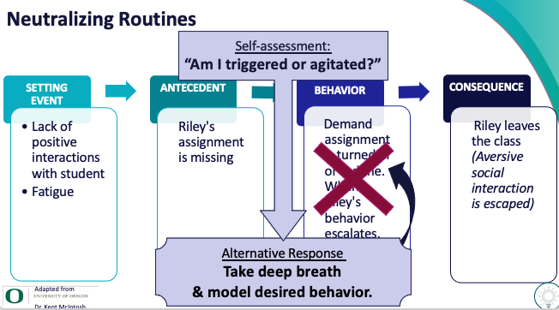
IDENTIFY SOLUTION
and implementation plan
The team decided to:
show staff their referral Risk Ratio data and gather staff insight about what may contributing to vulnerable decision points (VDPs) during transition times
reteach implicit bias and neutralizing routines from Day 4’s Team Training in an upcoming PD session with staff
develop a series of email prompts to send staff each Monday including sample neutralizing routines to try out
contact their external coach to gather resources about identity awareness work

Slide 112
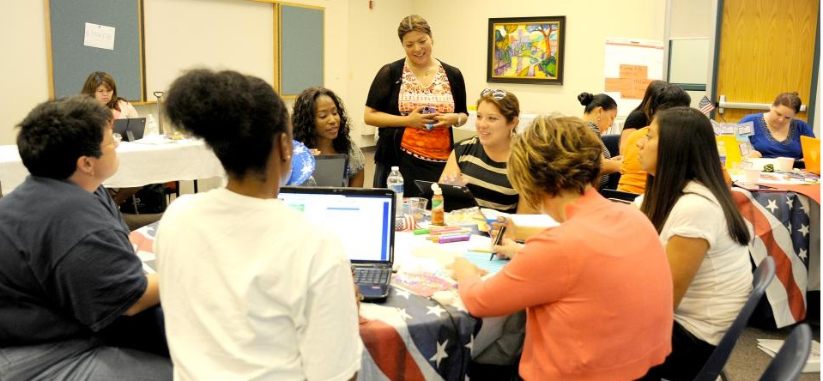
The team put their plan into action.
IMPLEMENT SOLUTION
with fidelity

Slide 113
Over the next several months, the team checked on implementation during their regular leadership team meetings.
If actions were not being completed as intended, the team adjusted the plan or strengthened the level of support to get the actions accomplished.
They also monitored referrals delivered during transition times for types of behavior. Targeted support about VDPs and neutralizing routines was provided to staff if they frequently delivered referrals for subjective behaviors.
The team decided to:
show staff their referral Risk Ratio data and gather staff insight about what may contributing to vulnerable decision points
reteach implicit bias and neutralizing routines from Day 4’s Team Training in an upcoming PD session with staff
develop a series of email prompts to send staff each Monday including sample neutralizing routines to try
contact their external coach to gather resources about identity awareness work
MONITOR & EVALUATE
implementation fidelity and impact

Slide 114
MONITOR & EVALUATE
implementation fidelity and impact
Reviewing their SWIS Equity Reports, particularly the Risk Ratio report became a routine part of their regular monthly leadership team meetings.
They watched for decreased disproportionality trends.
When needed, they used the drill down tool to gain more insight into both challenges and successes so the team could adjust accordingly.
Drill Down

Slide 115
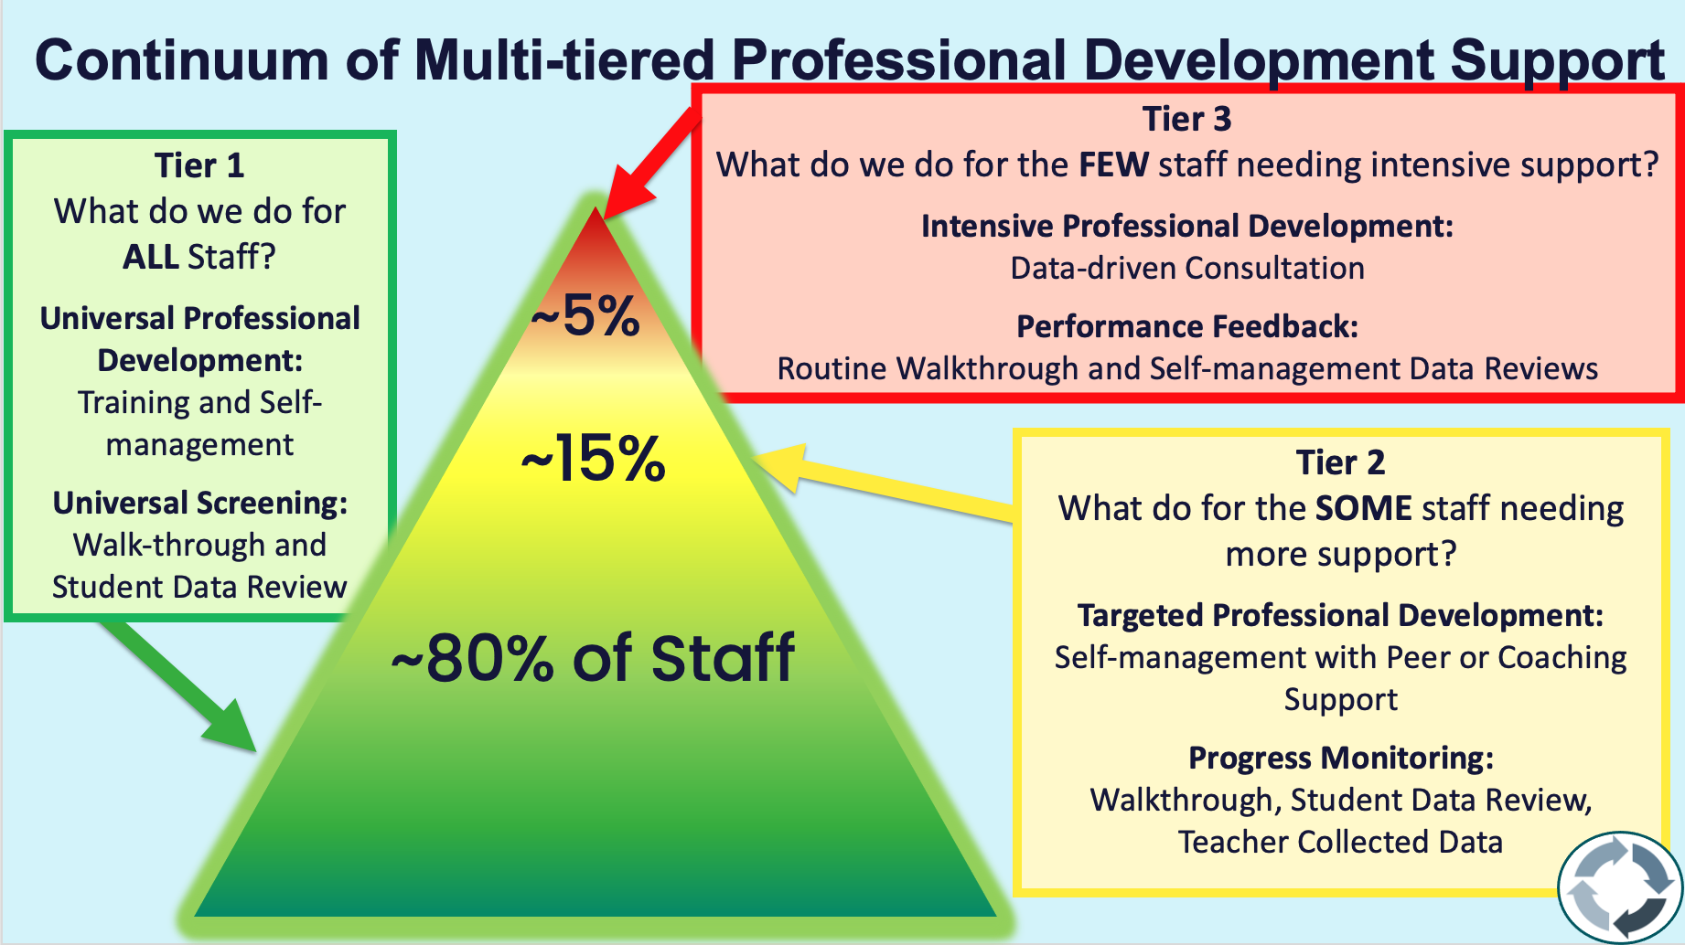
One year after enacting the plan, the team found that while they had not achieved the target of
Black/African American students will have 1 time the risk of receiving one referral as all other students
disproportionality had improved.
They decided to maintain the plan but also:
ensure new staff had access to training and support
deliver a booster session to staff
provide targeted support to staff experiencing challenges
continue to examine SWIS equity reports at monthly leadership team meetings
MAKE DECISION
to maintain, modify, or terminate plan

Slide 116
Why should we look at School Climate?
Positive school climate has been linked to several important outcomes, including…
student self- esteem and self-concept
decreased absenteeism
enhanced risk prevention
reduced behavioral problems and disciplinary actions
increased school completion
(Bear et al., 2011; Lindstrom Johnson et al., 2016)
(LaSalle, 2022)

Slide 117
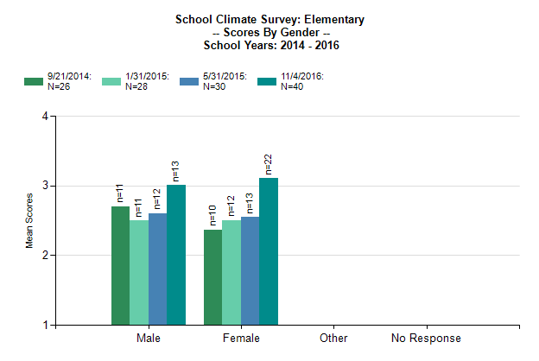
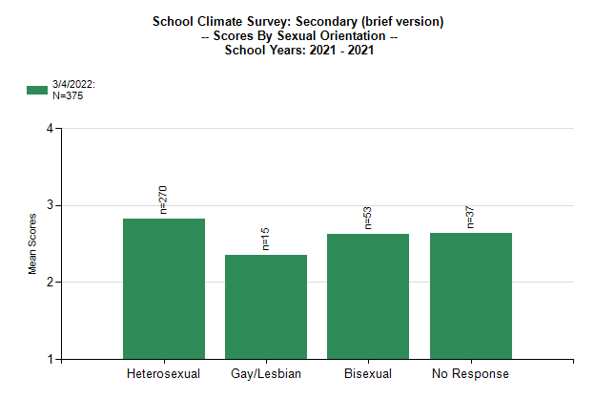
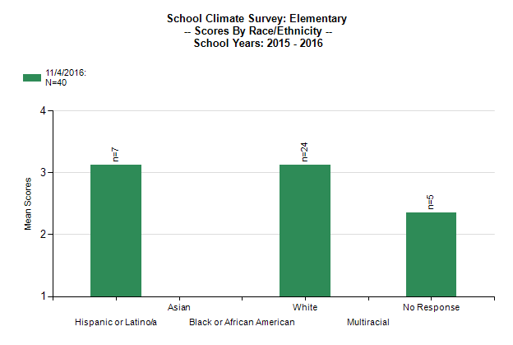
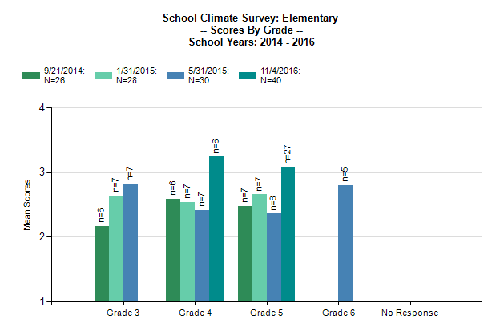
School Climate Survey Reports make disaggregated data review easy
Review survey data for different groups:
Gender Identity
Sexual Orientation (Middle/High Schools)
Grade
Race/Ethnicity
Provides total
climate score

Slide 118
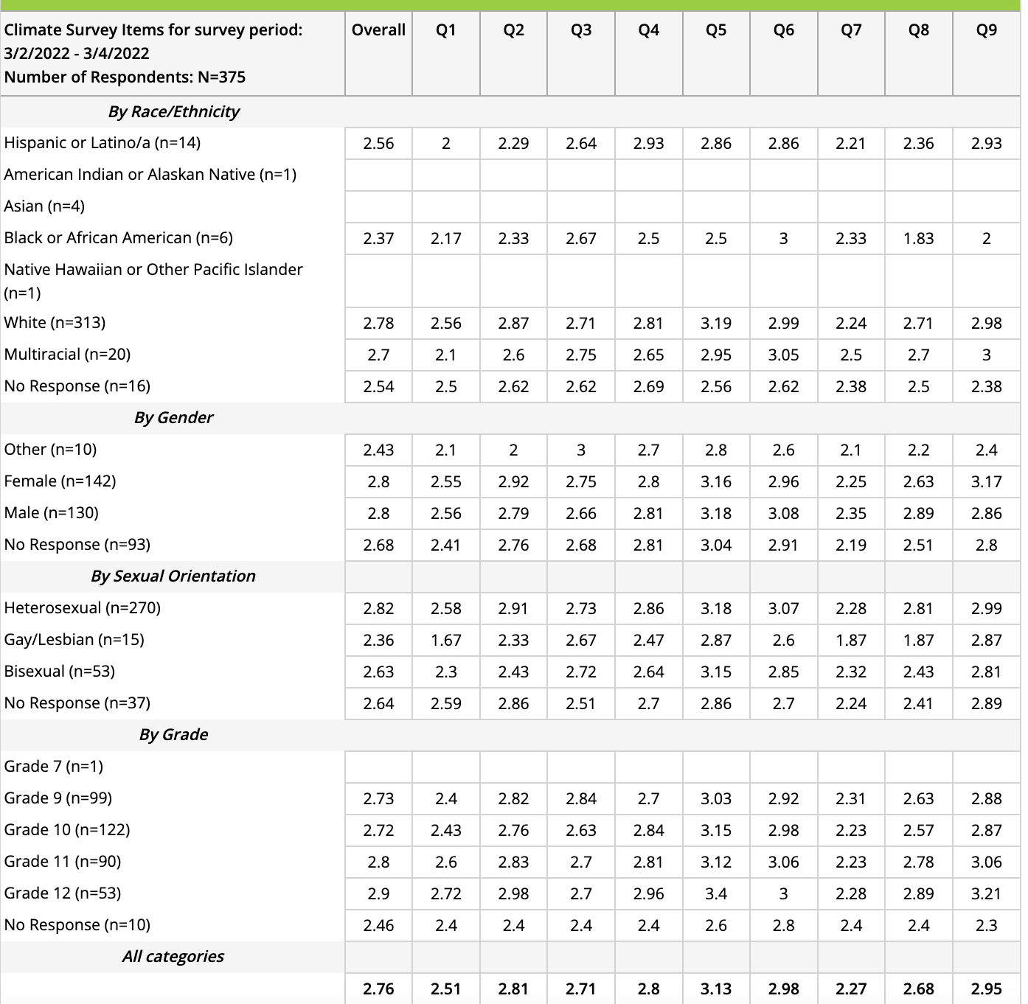
Items Report lets you go even deeper…
Scores for each question broken down by:
race/ethnicity
gender identity
sexual orientation
grade

Slide 119
You’ve identified some sub-groups perceive less positive school climate than others, now what? Back to your problem-solving framework!
IDENTIFY PROBLEM
with precision
IDENTIFY GOAL
for change
IDENTIFY SOLUTION
and implementation plan
IMPLEMENT SOLUTION
with fidelity
MONITOR & EVALUATE
implementation fidelity and impact
MAKE DECISION
to maintain, modify, or terminate plan
Collect & Use
DATA
(Chaparro, E., et. al, 2022)

Slide 120
IDENTIFY PROBLEM
with precision
After reviewing their school climate survey data,
Eagle High School realized
Students who identified as gay/lesbian (Who) were experiencing school less favorably, supportively, and safely than other sub-groups. (What)
By disaggregating further, they discovered greater disparities among 9th graders who identify as gay/lesbian than any other grade.
Q1: I like school.
Q7: I know an adult at school I can talk with if I need help.
Q8: School is a place at which I feel safe.

Slide 121
IDENTIFY GOAL
for change
Considering the significant discrepancies in perceptions of students who identify as gay/lesbian, especially within the 9th grade, the team wanted to improve the sense of safety and connection for this group of students. They developed the following goal:
By the next administration of our student school climate survey, 6 months from now, the scores of questions 1, 7 and 8 will increase by 20% for students who identify as gay/lesbian.

Slide 122
Having limited knowledge of evidence-based practices to improve the sense of belonging and safety for students who identify as gay/lesbian in schools, the leadership team searched for resources on reputable, research-driven websites such as GLSEN and the Trevor Project.
IDENTIFY SOLUTION
and implementation plan

Slide 123
IDENTIFY SOLUTION
and implementation plan
The team learned that according to GLSEN’s research, presence of certain factors may help to promote a safer climate and more positive school experiences for students who identify as gay/lesbian
student clubs that address issues for LGBTQ+ students
school personnel who are supportive of LGBTQ+ students
LGBTQ+ inclusive curricular materials
inclusive, supportive school policies, such as inclusive anti-bullying policies and policies supporting transgender and nonbinary students
Notes:
https://www.glsen.org/research/2021-national-school-climate-survey

Slide 124
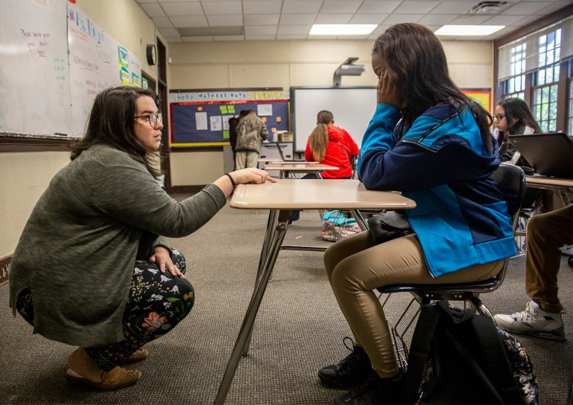
IDENTIFY SOLUTION
and implementation plan
The school leadership team decided to focus on demonstrating that school personnel are supportive of LGBTQ+ students. To do this they:
surveyed all students asking what it looks like and sounds like when school personnel are being supportive
invited students, particularly those who identify as gay/lesbian and/or in the 9th grade, to participate in focus groups to further understand the problem
planned a PD session for staff to review the data, offer input, and suggest solutions for strengthening support
ordered Safe Space Kits for staff to put up in their classrooms
adjusted 9th grade orientation plans to include explicit teaching and awareness of belonging for all
school personnel who are supportive of LGBTQ+ students

Slide 125
The leadership team put the plan into action by delegating responsibilities for action steps to various team members, including students.
IMPLEMENT SOLUTION
with fidelity

Slide 126
For the next several months, time was allotted at monthly meetings to review data from the student survey, focus groups, and staff input.
That data was summarized and shared with staff to determine how to improve the perception of supportive staff for students who identify as LGBTQ+.
Staff were encouraged to use this information in their daily interactions with students and to put up Safe Space stickers in their classrooms.
School Climate Surveys were administered to students 6 months after the plan was developed.
MONITOR & EVALUATE
implementation fidelity and impact

Slide 127
Q1: I like school.
Q7: I know an adult at school I can talk with if I need help.
Q8: School is a place at which I feel safe.
Increased by 5%
Increased by 12%
Increased by 7%
Student school climate surveys showed improvement after the plan was implemented. However, they did not achieve their desired goal and discrepancies between student groups still existed.
After returning to the evidence-based guidance, the team decided to explore inclusive, supportive school policies, such as inclusive anti-bullying policies and policies supporting transgender and nonbinary students. Beginning by reviewing existing policies….
MAKE DECISION
to maintain, modify, or terminate plan
To be effective, teams must engage in Continuous Improvement

Slide 128
School Climate Survey Resources
The purpose of this brief is to provide information about how to evaluate school climate at the primary and secondary levels.
This brief is intended to guide how districts and schools collect and disaggregate school climate data at the personnel and parent level to support data-based decision making.

Slide 129
Once You Review Referrals and School Climate Data, Consider Additional Outcomes Across Sub-groups
Academic Achievement
Grades
Standardized Test Scores
Graduation Rates
Access/ Participation in School-wide Programming
Advanced Level Courses
Athletics/ Clubs
Attendance
Special Education
Disciplinary Patterns
Referrals
Suspensions
Expulsions
School Community (Students, staff, families) Perceptions
School Climate Survey
Feedback and Input Survey
Quality of Life Surveys
Focus Groups/ Community Forums
Restraints/ Seclusions
School Related Arrests
Positive, Proactive Educator Practices
Gender/Gender Identity
Race/ Ethnicity
Sexual Orientation
Grade Level
Socio-economic Status
Dis/ability Status
Emerging Bilingual

Slide 130
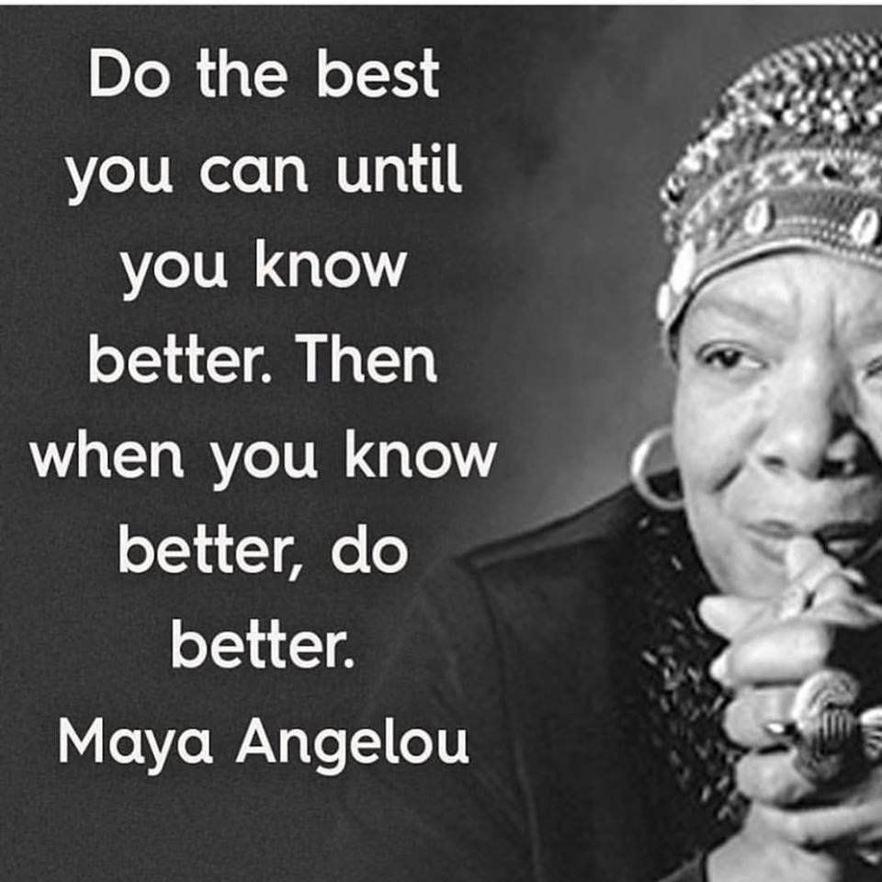
Looking deeply into data, allows your team to be even better at promoting a positive, predictable, effective, equitable environment for all.

Slide 131
Guidelines for Equity Review
Disaggregate data by a range of sub-groups and across varied outcomes
Use evidence-based practices to reduce disproportionality
Gather input from people who are impacted by the inequity
Share the data with your school community
Provide a welcoming, safe space for critical discussions
Embed equity review into your data review routines
Use your problem-solving framework to continuously improve your school’s environment

Slide 132
DISCUSSION: Equity Review
As a team,
Identify how equity is, or is not, currently promoted within your school
Consider how you will support staff with understanding equity
Decide on one area to examine data for equity
Identify how your team will embed equity reviews into your meeting routines
Add to your action plan as needed.
Be ready to share out 1-2 big ideas from your conversation
10 minutes

Slide 133
WHOLE GROUP DEBRIEF:
How will you support staff with understanding equity?
Which data will you use for an equity review?
What further support do you need to move forward?
5 minutes

Slide 134
Lunch

Slide 135
Quick Review

Slide 136
How Do Teams Integrate Wellness into Tier 1?
Prioritize and enhance wellness for ALL
Use data to determine wellness strengths and needs
Integrate SEB competencies into Tier 1

Slide 137
Steps to Support and Respond to Educators’ Needs
1. Establish Foundations to Support Classroom Implementation
1.1 Establish Priority
1.2 Secure Resources
2. Explicitly Teach & Coach
2.1 Communicate Clear Expectations
2.2 Explicitly Teach
3. Monitor Systems Implementation & Use Problem-Solving Process
3.1 Monitor Team Implementation of Steps 1 & 2
4. Monitor Educator Implementation & Use Problem-solving Process
5. Monitor Equitable Student Benefit & Use Problem-Solving Process
1.3 Align & Integrate with Other Approaches
1.4 Promote a Culture of Wellness
2.3 Coach & Provide Supportive Feedback
2.4 Celebrate Success!
If system implementation challenges...
3.3 Revisit and Enhance Systems (Steps 1 & 2)
4.1 Monitor Educator Implementation & Acceptability
If educator implementation challenges...
4.3 Differentiate Training, Coaching, & Feedback
5.1 Monitor Valued Student Outcomes & Acceptability
If students do not benefit equitably...
5.3 Enhance SEB Support & Modify Training and Coaching
3.2, 4.2, 5.2 Use Continuous Improvement Process

Slide 138
Are school community members experiencing equitable outcomes in our school regardless of individual characteristics and identities?
Gender/Gender Identity
Race/Ethnicity
Sexual Orientation
Grade Level
Socio-economic Status
Dis/ability Status
Emerging Bilingual

Slide 139
You’ve Identified Inequity, Now What? Apply your problem-solving framework!
IDENTIFY PROBLEM
with precision
IDENTIFY GOAL
for change
IDENTIFY SOLUTION
and implementation plan
IMPLEMENT SOLUTION
with fidelity
MONITOR & EVALUATE
implementation fidelity and impact
MAKE DECISION
to maintain, modify, or terminate plan
Collect & Use
DATA
(Chaparro, E., et. al, 2022)

Slide 140
DISCUSSION: Equity Review
As a team,
Review either your referrals or school climate survey data.
Identify 1 sub-group experiencing an inequitable outcome.
Use your problem-solving framework to:
Develop a precise problem statement
Identify a goal
Explore a possible solution
Begin developing an implementation plan
Add to your action plan as needed.
Be ready to share out what you discovered and your goal.
20 minutes

Slide 141
WHOLE GROUP DEBRIEF:
What did your team discover by reviewing your data for equity?
What is your goal?
What further support do you need to move forward?
5 minutes

Slide 142
Team
Action Planning Time

Slide 143
Use this time to continue working on...
Developing a Culture of Wellness for all
Classroom PBIS Systems
Equity Data Review
Enhance and adjust current features to promote wellness within Tier 1
Complete Classroom Systems self-assessment
Begin to develop support systems for classroom implementation
Understand the role of equity within data review.
Identify a goal and use the problem-solving framework to improve equity
135 mins

Slide 144
WHOLE GROUP DEBRIEF: Action Planning
Enhance and adjust current features to promote wellness within Tier 1
Share one or more team accomplishments from today.
What further support will you need to complete these action steps?
Complete Classroom Systems self-assessment
Begin to develop support systems for classroom implementation
Understand the role of equity within data review.
Identify a goal and use the problem-solving framework to improve equity
5 minutes

Slide 145
Review

Slide 146
How Do Teams Integrate Wellness into Tier 1?
Prioritize and enhance wellness for ALL
Use data to determine wellness strengths and needs
Integrate SEB competencies into Tier 1

Slide 147
Steps to Support and Respond to Educators’ Needs
1. Establish Foundations to Support Classroom Implementation
1.1 Establish Priority
1.2 Secure Resources
2. Explicitly Teach & Coach
2.1 Communicate Clear Expectations
2.2 Explicitly Teach
3. Monitor Systems Implementation & Use Problem-Solving Process
3.1 Monitor Team Implementation of Steps 1 & 2
4. Monitor Educator Implementation & Use Problem-solving Process
5. Monitor Equitable Student Benefit & Use Problem-Solving Process
1.3 Align & Integrate with Other Approaches
1.4 Promote a Culture of Wellness
2.3 Coach & Provide Supportive Feedback
2.4 Celebrate Success!
If system implementation challenges...
3.3 Revisit and Enhance Systems (Steps 1 & 2)
4.1 Monitor Educator Implementation & Acceptability
If educator implementation challenges...
4.3 Differentiate Training, Coaching, & Feedback
5.1 Monitor Valued Student Outcomes & Acceptability
If students do not benefit equitably...
5.3 Enhance SEB Support & Modify Training and Coaching
3.2, 4.2, 5.2 Use Continuous Improvement Process

Slide 148
Are school community members experiencing equitable outcomes in our school regardless of individual characteristics and identities?
Gender/Gender Identity
Race/Ethnicity
Sexual Orientation
Grade Level
Socio-economic Status
Dis/ability Status
Emerging Bilingual

Slide 149
You’ve Identified Inequity, Now What? Apply your problem-solving framework!
IDENTIFY PROBLEM
with precision
IDENTIFY GOAL
for change
IDENTIFY SOLUTION
and implementation plan
IMPLEMENT SOLUTION
with fidelity
MONITOR & EVALUATE
implementation fidelity and impact
MAKE DECISION
to maintain, modify, or terminate plan
Collect & Use
DATA
(Chaparro, E., et. al, 2022)

Slide 150
Preview of
Day 9

Slide 151
YEAR 2: Implement and Strengthen
DAY 7
DAY 8
DAY 9
Data
Practices
Tier 1 Check In
Family Engagement
Culture of Wellness
Crisis and Emergency Response
Precise Problems and Outcomes
Equity Review
Evaluation
Systems
Strengthen
Classroom
Data-based Decision-Making

