Slide 1

TRAINER INFORMATION
This free and accessible training material is provided through the Northeast PBIS Network and can be found at https://nepbis.org/.
School teams are highly encouraged to contact a
PBIS State Coordinator or an NEPBIS Endorsed Trainer
for training opportunities.
If you are an experienced trainer and would like access to to our coordinating trainer workbook which offers training guidance, please email us at nepbis@uconn.edu.

Slide 2
TRAINER NOTES
This is Day 7 of an 11 day, 3 year training sequence.
CONTENT
OUTCOMES
At the end of day seven, teams should understand how to:
strengthen implementation through progress monitoring, action planning, data, and family engagement
develop precise problem and outcome statements
support classroom educators with positive, proactive practices
Strengthening Implementation
  Progress monitoring
  Data sources and routines
  Family engagement
Data-based Decision-making
  Precise problems
  Outcomes
Classroom PBIS
  Practices
TFI Self-Assessment to check on implementation
Incorporate data routines into team meetings
Plan for School Climate Surveys
Complete Family-School Practices survey
Identify action steps
Identify 1-2 precise problems, outcomes, solutions and implementation plans
Plan explicit training for classroom educators
Gather fidelity data on classroom expectations
For more information and guidance related to training this content please see the NEPBIS trainers’ manual located here: https://nepbis.org/training-of-trainers-workbook-supplemental-materials/

Slide 3
SAMPLE AGENDA
8:30 | Introduction | 15 mins
8:45 | Year 1 Review and TFI Self-Assessment | 60 mins
9:45 | Break | 15 mins
10:00 | Data Routines | 15 mins
10:15 | Data-Based Decision Making: Precise Problems and Outcomes | 60 mins
11:15 | Classroom Practices | 60 mins
12:15 | Lunch | 30 mins
12:45 | Quick Review | 15 mins
1:00 | Family Engagement | 30 mins
1:30 | Team Time | 135 mins
3:45 | Wrap Up | 15 mins

Slide 4
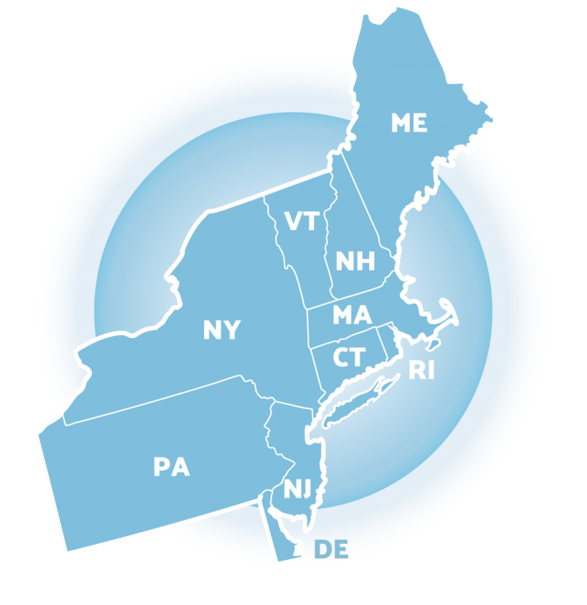
NEPBIS
School-Wide
Team Training
Year 1
Day 7
INSERT TRAINER NAMES HERE
with support from
Karen Robbie, Jen Freeman,
Brandi Simonsen, Katie Meyer,
Adam Feinberg & Susannah Everett
Notes:
Trainers: refer to training manual for:
Tips on presenting the overview content
Explanation for short activity periods and ideas for teaching this to teams
Ideas for facilitating review and team action planning

Slide 5
POSITIVE BEHAVIOR INTERVENTIONS & SUPPORTS
(PBIS)

Slide 6

WHO'S HERE?
Who's here?
LIST SCHOOLS IN COHORT HERE
(List the schools in your cohort here)
Notes:
TRAINER NOTE: Give teams several minutes each to introduce themselves and their school- including any previous experiences with PBIS.

Slide 7
NEPBIS SCHOOL-WIDE TRAINING MODEL
Year 1
Exploration and Installation of 10 Getting Started Steps
Year 2
Initial Implementation of 10 Getting Started Steps
Year 3+
Full Implementation and Continuous Improvement of Implementation
6 days of team training + 3 days of coach training
3 days of team training + 3 days of coach meeting
On-going Professional Development and Support
(minimum of 2 days of team training + 2 days of coach training annually)

Slide 8
YEAR 1: Getting Started with PBIS
DAY 1
Step 1: Establish an effective leadership team
DAY 2
Step 2: Develop a brief statement of purpose & define outcomes
Step 3: Identify positive school-wide behavior expectations
Step 4: Develop procedures to teach school-wide expectations
DAY 3
Step 5: Develop procedures to teach class-wide expectations
Step 6: Develop a continuum of responses to increase use of SEB skills
DAY 4
Step 7: Develop a continuum or responses to decrease SEB errors
DAY 5
Step 8: Develop systems to support staff
DAY 6
Step 9: Use data for decision-making
Step 10: Promote sustainability

Slide 9
YEAR 2: Implement and Strengthen
DAY 7
DAY 8
Systems
DAY 9
Data
Practices
Tier 1 Check In
Family Engagement
Culture of Wellness
Crisis and Emergency Response Planning
Precise Problems and Outcomes
Equity Review
Evaluation
Strengthen
Classroom
Data-based Decision-Making

Slide 10
TRAINING SCHEDULE
TRAINERS:
USE THIS SLIDE TO INSERT YOUR TRAINING SCHEDULE FOR THE CURRENT YEAR

Slide 11
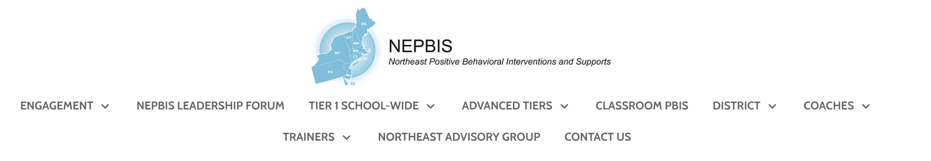


nepbis.org
TOOLS
Tier 1 Schoolwide
Tier 1 Team Training Materials
Tier 1 Supplemental Resources
School Team Implementation Guide
responses for activities
document plans
develop artifacts
Slides for each training day
Notes:
TRAINERS: Go directly to https://nepbis.org/ and demonstrate how to access relevant materials.

Slide 12


WEBSITES
pbisapps.org
pbis.org

Slide 13






LEGEND
ORGANIZATION
ACTIVITY
NEW
CONTENT
PREVIEW
REVIEW

Slide 14




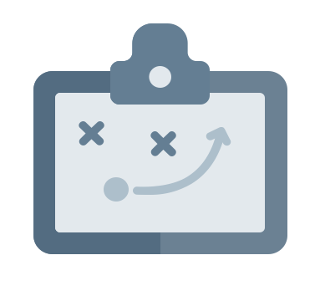

LEGEND
Timing
Example
Activity
Non-example
Guidelines
Preview
Big Idea
Review
Organization

Slide 15
EXPECTATIONS
 | Individually | Working with Others
Respect Self | Participate Converse with others in lobbies and during breaks Stretch, break, stand as needed | Engage with the training content and activities
Respect Others | Complete assigned tasks Return from breaks on time | Provide room for every voice Reinforce participation
Respect Environment | Keep devices silent Have your computer charged and ready Keep necessary materials at hand | Maintain a neat, orderly work space

Slide 16
AGENDA AND ACTION STEPS
OUTCOMES
CONTENT
Strengthening Implementation
  Progress monitoring
  Data sources and routines
  Family engagement
Data-based Decision-making
  Precise problems
  Outcomes
Classroom PBIS
  Practices
TFI Self-Assessment to check on implementation
Incorporate data routines into team meetings
Plan for School Climate Surveys
Complete Family-School Practices survey
Identify action steps
Identify 1-2 precise problems, outcomes, solutions and implementation plans
Plan explicit training for classroom educators
Gather fidelity data on classroom expectations

Slide 17
Progress Monitoring Implementation
TFI Self-Assessment to check on implementation

Slide 18
Year 1
Review

Slide 19
WHY PBIS?
“Getting tough” doesn’t work
Context matters
Schools asked to do more with less
PBIS works
Provides a framework to promote equity
PBIS supports mental health

Slide 20
PBIS is...
Framework for enhancing adoption & implementation of
Continuum of evidence-based interventions to achieve
Academically & behaviorally important outcomes for
All students

Slide 21
Continuum of School-Wide Instructional
& Positive Behavior Support
What do we do for the FEW needing intensive support?
Tertiary Prevention:
Specialized
Individualized
Systems for Students with High-Risk Behavior
What do we do for ALL?
Primary Prevention:
School-/Classroom-
Wide Systems for
All Students,
Staff, & Settings
~5%
~15%
What do we do for the SOME needing more support?
Secondary Prevention:
Specialized Group
Systems for Students with
At-Risk Behavior
~80% of Students

Slide 22
Critical Features
Systems
Practices
Data
Equity
Outcomes

Slide 23
Prioritize equity. MTSS is for all students, families, and educators. Use the MTSS framework to differentiate supports for students and monitor to ensure equitable outcomes are observed.
Equity

Slide 24
Equity
Make student growth and benefit central to all decisions. Student outcomes that reflect equitable learning opportunities must be the ultimate criteria for all decisions.
Outcomes

Slide 25
Outcomes are our GOALS for implementation
What outcome does your team want to achieve?
what practices are being implemented for it?
what systems are in place to support staff with implementation?
what data is being used to monitor?
how are you centering equity in your action planning?
Based on data
Locally important and meaningful
Applicable to all (culturally equitable)
  Students’ social competence and academic achievement
  Staff implementation of critical skills
Observable and measurable
Written as a goal
As a result of implementing PBIS during the
20XX-20XY school year, student reports of school climate will improve by 20%

Slide 26
Systems
Data
Data
Use data to inform decisions about which students, families, and educators need which supports, as well as whether supports should be continued, adjusted, or faded. Data should be used to ensure that all recipients experience benefit and that supports are implemented with fidelity.
Equity
Outcomes

Slide 27
SCHOOL EVALUATION PLAN
Measure | Year 1 Training |  | Year 2 Training |  |  | Year 3 Training
 | Winter | Spring | Fall | Winter | Spring | Fall | Winter | Spring
Tiered Fidelity Inventory (TFI) |  | X | X |  | X | X |  | X
School Climate Surveys | X | X | X |  | X | X |  | X
Schoolwide Behavior Data (e.g. SWIS) | Weekly | Weekly | Weekly | Weekly | Weekly | Weekly | Weekly | Weekly
Additional Student Outcome (e.g. Attendance) | Weekly | Weekly | Weekly | Weekly | Weekly | Weekly | Weekly | Weekly
Fidelity
Outcome

Slide 28
School-wide Behavior Data Requirements
Organized across the school by:
Behavior type
Frequency of events over time (per day per month)
Location
Time of day
Consequence
Individual student
Behavior Incident Information:
Student’s name
Date
Time of incident
Student’s grade level
Referring staff
Location of incident
Problem behavior
Perceived motivation
Others involved
Action taken
If your current data system does not do this or allow the team immediate access, talk to your trainer today about getting SWIS at your school!

Slide 29
Practices
Data
Prioritize the most efficient and effective practices. Do a few important and relevant practices well. Emphasize practices that are supported by evidence, match the local culture and current context, and promote high-quality implementation across time. Integrate, align, and connect practices.
Equity
Outcomes

Slide 30
Categories of PBIS Practices
Practices
Schoolwide
Classroom
Non-classroom
Student
Family
Smallest Number
Evidence-based
Biggest, Durable Effect

Slide 31
Systems
Practices
Data
Continue to invest in systems to support high-fidelity implementation over time. Leverage existing leadership teams to guide planning and implementation, and consider effective means to support educators’ professional learning and wellness given current resources, experience, and expertise.
Equity
Outcomes

Slide 32
Systems SUPPORT implementation to occur with fidelity
Promoting and Sustaining Staff Engagement
Continuous Action Planning
Team-Based Implementation
Embedded and Ongoing Professional Development
Staff Recognition
Data Routines

Slide 33
GETTING STARTED WITH PBIS
1
Establish an effective leadership team
6
Develop a continuum of responses to increase use of SEB skills
2
Develop a brief statement of purpose & define outcomes
7
Develop a continuum of responses to decrease SEB errors
3
Identify positive school-wide behavior expectations
8
Develop systems to support staff
4
Develop procedures to teach school-wide expectations
9
Use data for decision-making
5
Develop procedures to teach class-wide expectations
10
Promote sustainability

Slide 34
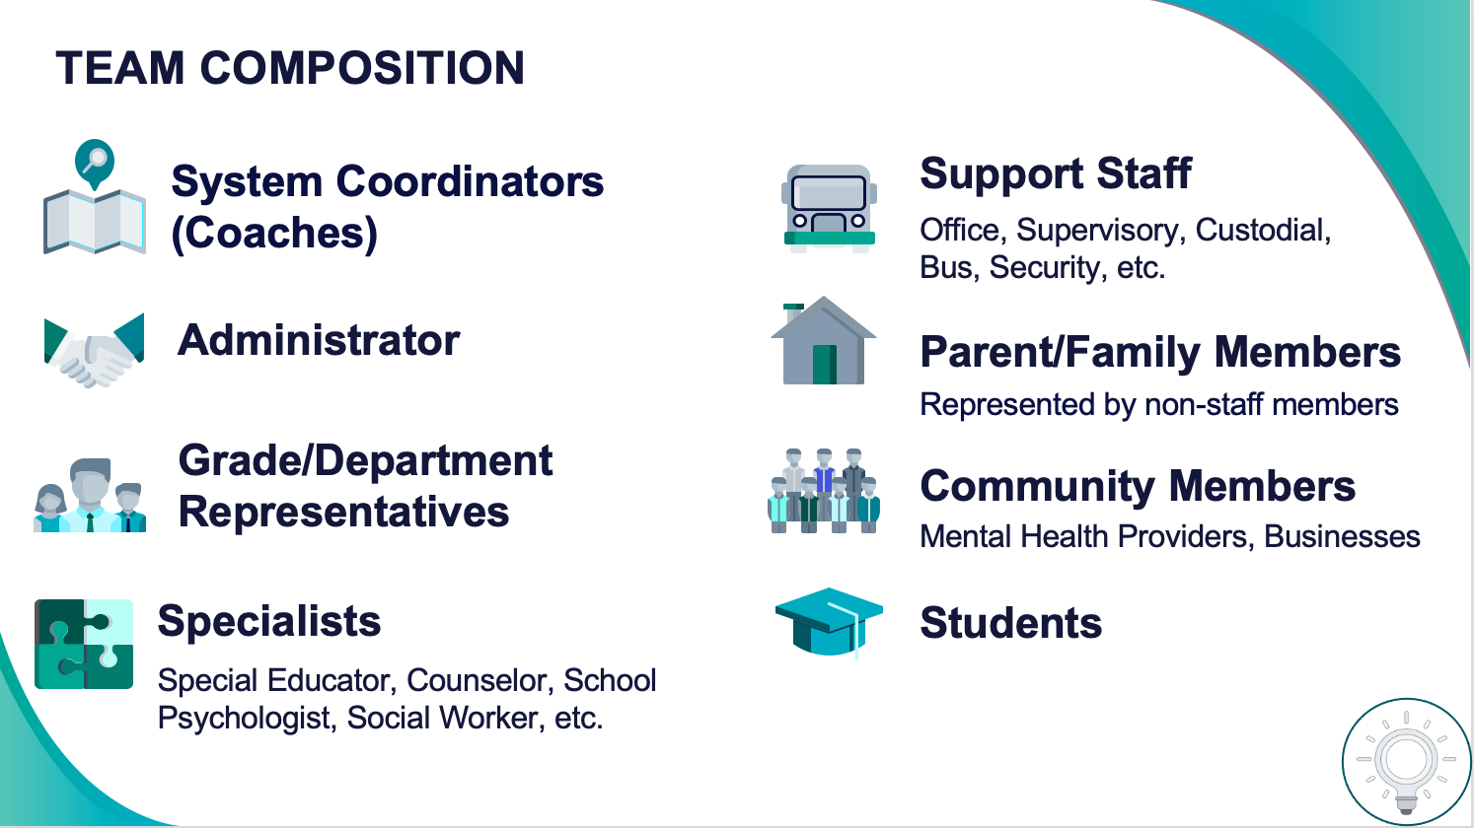
1
Establish an effective leadership team
Systems
Supports Relevance & Equity
Improves student outcomes
Promotes Engagement
Is your team representative of your school community?
Have staffing changes caused a need to update your team?
Notes:
Your first step is to create a representative team to lead your school’s PBIS efforts.

Slide 35
Initiative/
Committee/ Team
Purpose & Strategic Goal Supported
Measurable, Data-Based Outcome(s)
Target Group
Staff Involved
Overlap? Modify? Eliminate?
PBIS
Ensure positive, safe, predictable, & consistent environment
Referrals, suspensions, attendance, universal screening, school climate survey
All students, staff, & families
Principal, social worker, 3 general + 1 special ed. teachers
Similar purpose/goal, data-based outcome,
target group, staff involved!
Can the teams be combined into one team?
Safety/
Crisis Team
Update protocols to ensure safe environment & plan for crisis
None
All students, staff, & families
Principal, social worker, 2 general ed. teachers
- Expand use of data to monitor police contacts from school & safety assessments
Trauma-Informed Team
Ensure students feel safe, supported, & ready to learn
Referrals, suspensions, attendance, universal screening, school climate
  All students, staff, & families
Principal, social worker, 2 general + 1 special ed. teachers

Slide 36
2
Develop a brief statement of purpose & define outcomes
Practices
What do we hope to achieve by implementing PBIS?
"Our mission is to provide a positive, safe, healthy, nurturing and respectful environment in which all students have the opportunity to become productive members of society."
Purpose
“As a result of implementing PBIS during the 20XX-20XY school year, student reports of school climate will improve by 20%.”
Outcome
Notes:
You’ll then focus your school’s PBIS efforts by creating a statement of purpose to identify your hopes and goals for PBIS implementation.

Slide 37
Purpose statement identifies WHY you are implementing PBIS at your school
Ensure all students develop the social-emotional-behavioral (SEB) skills needed to be effective learners through the implementation of evidence-based interventions and use of data to inform decisions.
State positively
Keep at 2 to 3 sentences in length
Be supportive of academic achievement and social-emotional-behavioral (SEB) health
Be comprehensive in scope (relevant to all students, staff & settings)

Slide 38
Outcomes tell us if we achieve our purpose and guide framework implementation
As a result of implementing PBIS during the 20XX-20XY school year, student reports of school climate will improve by 20%
Use data
Be locally important and meaningful
Apply to all (culturally equitable)
  Students’ social competence and academic achievement
  Staff implementation of critical skills
Be observable and measurable
Write as a goal

Slide 39
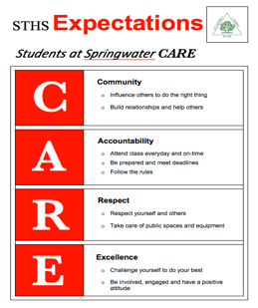


3
Identify positive school-wide behavior expectations
Practices
Notes:
Your team will work with your school community to uncover what you value and use those values to identify your schoolwide expectations

Slide 40
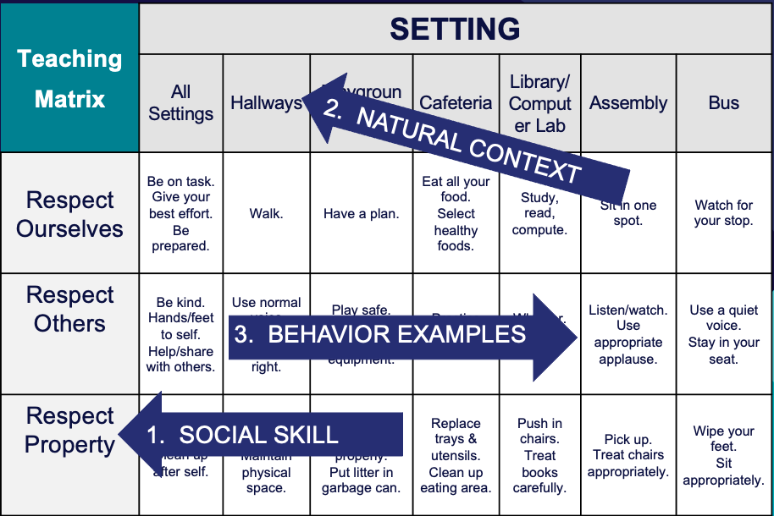
4
Develop procedures to teach school-wide expectations
Practices
Define
Teach
Prompt
Monitor
Evaluate
Notes:
Using those identified expectations, you’ll define what those expectations look and sound like in key routines/settings throughout your school. This is organized through a behavioral matrix. Using the schoolwide matrix, your team will develop lessons that will be explicitly taught to students at the beginning of the year (and boosted throughout the year) so that they know how to be successful within each context (like the hallway, cafeteria, assemblies, etc.)

Slide 41
Teaching Matrix |  | SETTING
 |  | All Settings | Hallways | Playgrounds | Cafeteria | Library/ Computer Lab | Assembly | Bus
 | Respect Ourselves | Be on task. Give your best effort. Be prepared. | Walk. | Have a plan. | Eat all your food. Select healthy foods. | Study, read, compute. | Sit in one spot. | Watch for your stop.
 | Respect Others | Be kind. Hands/feet to self. Help/share with others. | Use normal voice volume. Walk to right. | Play safe. Include others. Share equipment. | Practice good table manners | Whisper. Return books. | Listen/watch. Use appropriate applause. | Use a quiet voice. Stay in your seat.
 | Respect Property | Recycle. Clean up after self. | Pick up litter. Maintain physical space. | Use equipment properly. Put litter in garbage can. | Replace trays & utensils. Clean up eating area. | Push in chairs. Treat books carefully. | Pick up. Treat chairs appropriately. | Wipe your feet. Sit appropriately.
1. SOCIAL SKILL
2. NATURAL CONTEXT
EXPECTATIONS
3. BEHAVIOR EXAMPLES

Slide 42
Guidelines for Teaching Expected Behaviors (Social Skills)
Consider main school settings/contexts
Consider lessons that already exist
Specificy 2-3 observable, positive examples for each expectation within each setting/context
Teach social behavior like academic skill
Provide prompts, reminders, or precorrections in natural context
Provide specific feedback in natural context
Develop a schedule for:
  introducing teaching plan to staff and getting feedback on lesson plans
  initial student instruction in natural/typical context
  regular review, practice, and follow-up
Develop procedures for identifying/supporting students whose behaviors do not respond to instruction
What worked well as your staff explicitly taught school-wide expectations?
What challenges came up and how can they be overcome?
How are you monitoring fidelity?

Slide 43
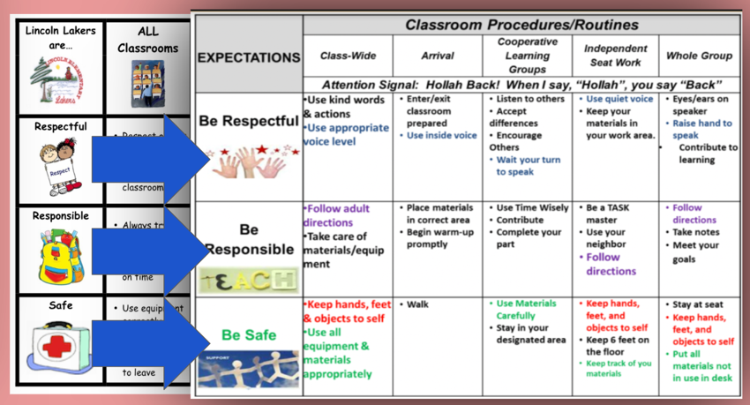
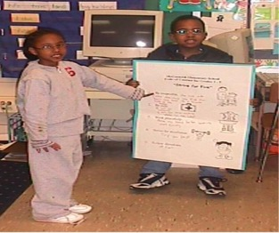
5
Develop procedures to teach class-wide expectations
Practices
Notes:
Once the schoolwide expectations have been determined, classroom educators will apply the behavior matrix format to the routines and settings within their classrooms. They will also explicitly teach the expectations to their students throughout the year.s

Slide 44
Guidelines for Teaching Class-Wide Expectations
Practices
Support classroom educators to:
Develop teaching matrices, procedures, and schedules for explicitly teaching school-wide behavior expectations in typical classroom contexts and routines
Consistently use prompts for display of expected behaviors in natural contexts
Provide specific feedback for displays of behaviors in natural context
Develop:
A school-wide action plan for supporting classroom educators to implement positive and proactive classroom practices and procedures based on data (self-assessment)

Slide 45
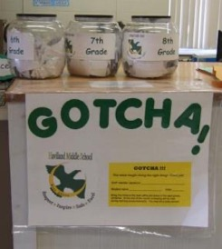
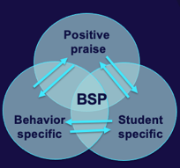
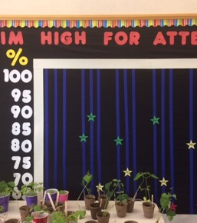
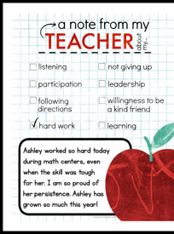
6
Develop a continuum of responses to increase use of SEB skills
Practices
Notes:
To encourage contextually appropriate behaviors to occur, you'll support educators to provide frequent specific feedback and praise. To promote this critical practice, you’ll develop recognition/acknowledgement systems for both students and staff.

Slide 46
Types of Acknowledgements
High Frequency
Provided daily
Predictable
Specific Praise
Tickets/Notes
Coupons to school store
Announcements
Intermediately
Provided weekly, quarterly, monthly
Student of the Month
Class Pizza Party
Recognition at School Assembly
Long Term
Few times per year
Involves groups of students
Whole school pajama day
Honors banquet
Freshmen class picnic
(adapted from MO-PBS)

Slide 47
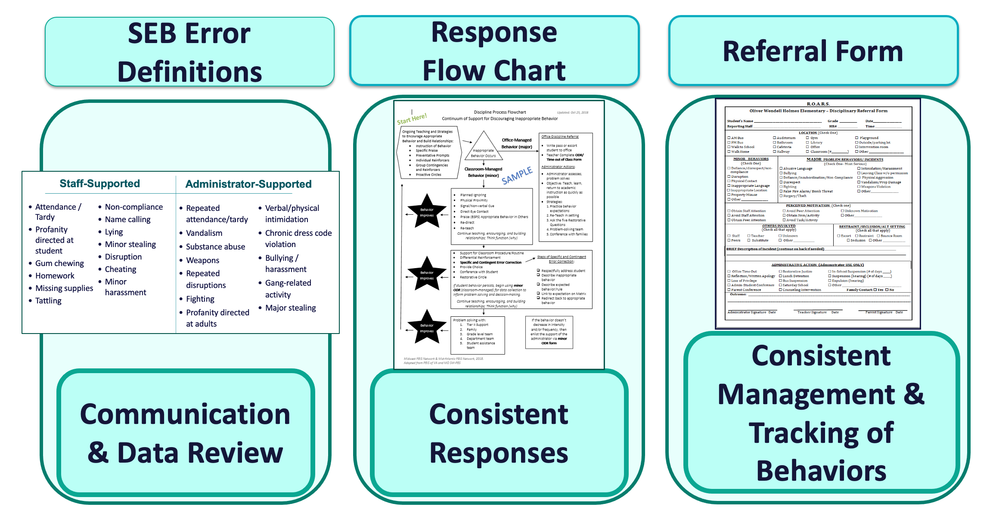
7
Develop a continuum of responses to decrease SEB errors
Practices
Notes:
You will also clarify how staff should respond when contextually inappropriate behaviors occur by clearly defining, determining who’s responsible for responding, identifying clear responses, and recording the behaviors.

Slide 48
Organizing Responses: 3 Important Components
Clearly Defined Behaviors
Discipline
Flow Chart
Discipline Referral Form
Are all staff consistent with how SEB errors are labeled?
Are all staff knowledgeable on what responses are appropriate and the process for responding to SEB errors?
Are all staff consistent with recording and monitoring information when SEB errors occur?
Consistent Management & Tracking of Behaviors
Communication & Data Review
Consistent Responses

Slide 49
8
Develop systems to support staff
Promoting and Sustaining Staff Engagement
Continuous Action Planning
Team-Based Implementation
Systems
Embedded and Ongoing Professional Development
Staff Recognition
Data Routines

Slide 50

What are SYSTEMS?
How are systems being used to ensure staff can effectively implement PBIS within your school?
The way schools operate are their foundational systems.
In PBIS, these systems support:
accurate, durable implementation of practices
the effective use of data to achieve better outcomes
(pbis.org)
In other words…
systems are what we do to support the adults!

Slide 51
9
Use data for decision-making
Data
Assess fidelity of PBIS implementation at least annually
Review student behavior data at least monthly
Use school and community data regularly
Evaluate your plan annually
Develop, inform, and refine Tier 1

Slide 52
IDENTIFY PROBLEM
with precision
IDENTIFY GOAL
for change
IDENTIFY SOLUTION
and implementation plan
IMPLEMENT SOLUTION
with fidelity
MONITOR & EVALUATE
implementation fidelity and impact
MAKE DECISION
to maintain, modify, or terminate plan
Collect & Use
DATA
(Chaparro, E., et. al, 2022)

Slide 53


10
Promote sustainability
Systems

Slide 54

How do we keep the pieces all going?
How are you ensuring your systems, routines, and resources can endure long-term?
Mark your calendars
Organize resources
Work smarter, not harder

Slide 55
TFI
Self-Assessment

Slide 56

The purpose of the SWPBIS Tiered Fidelity Inventory (TFI) is to provide a valid, reliable, and efficient measure of the extent to which school personnel are applying the core features of school-wide positive behavioral interventions and supports.
Only Tier 1 will be required for this training.
Your team can choose to complete the additional tiers.
Tier 1 Subscales:
Teams
Implementation
Evaluation
Tier 2 Subscales:
Teams
Interventions
Evaluation
Tier 3 Subscales:
Teams
Resources
Support Plans
Evaluation

Slide 57
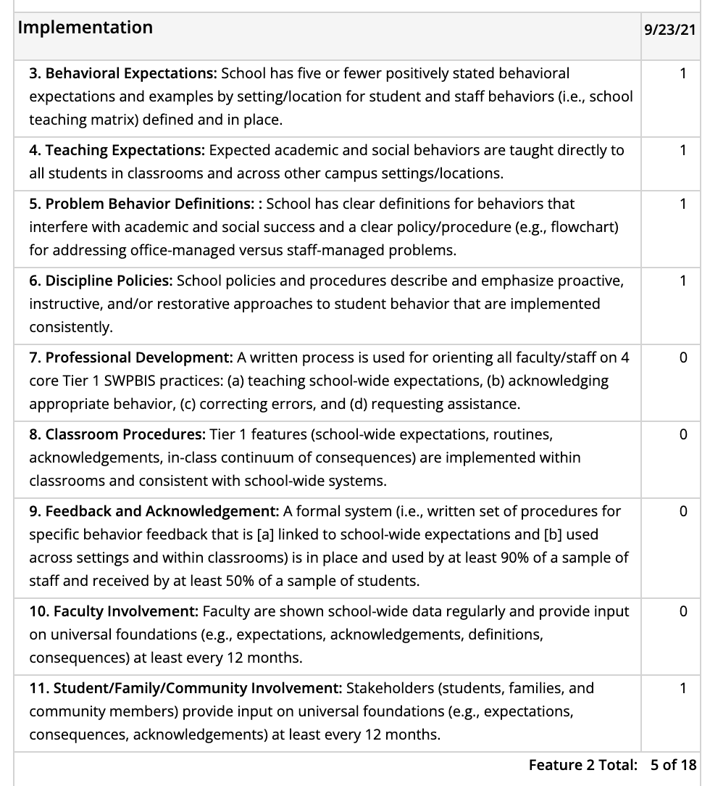
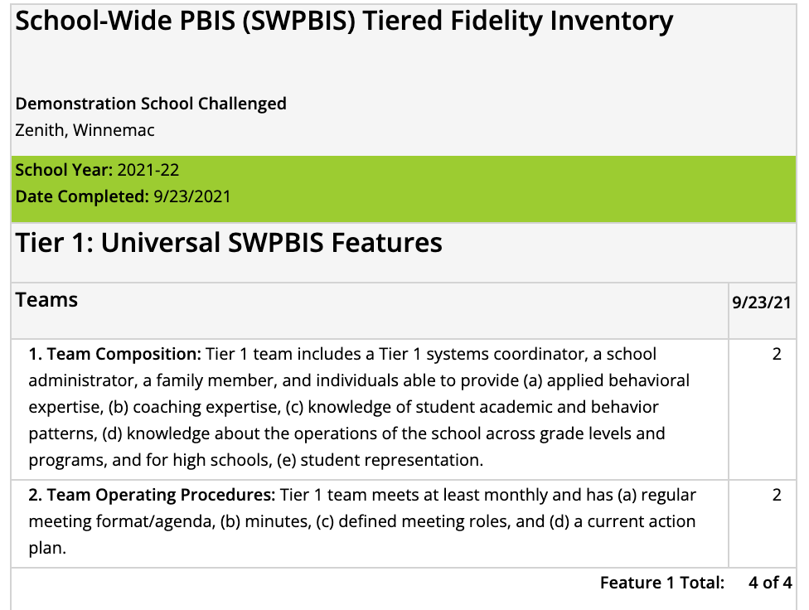
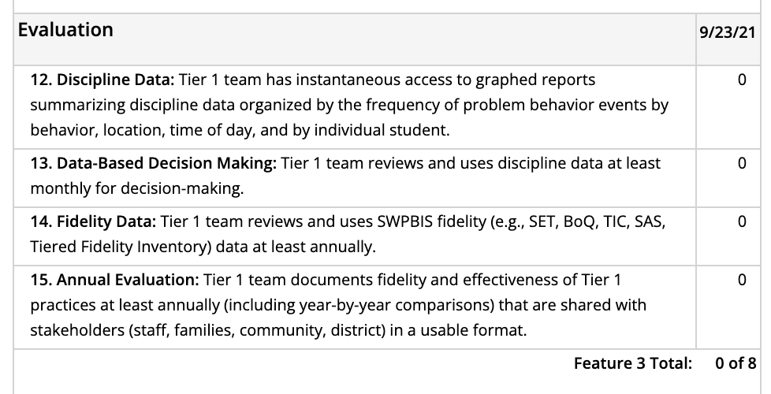
Individual items

Slide 58
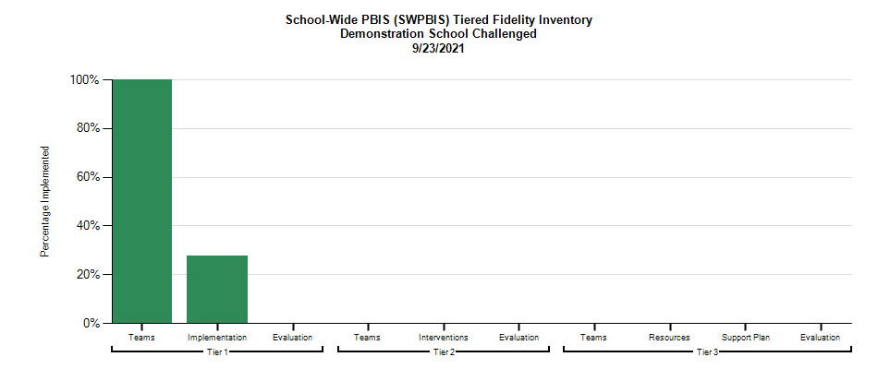
Select action steps based upon data from the TFI AND
your identified outcomes!
behavior incidents will decrease by __% relative to the same period as the prior year.
incidents of exclusionary discipline (suspension/expulsion) will decrease by __ % relative to the same period as the prior year

Slide 59
behavior incidents will decrease by __% relative to the same period as the prior year.
incidents of exclusionary discipline (suspension/expulsion) will decrease by __ % relative to the same period as the prior year
Implementing these features can support us to achieve our identified outcomes.
What do we need to do?
How? Who? By when?
1
4. Teaching Expectations
5. Problem Behavior Definitions
1
6. Discipline Policies
1
7. Professional Development
0

Slide 60
ACTIVITY: Using the TFI to Self-Assess and Action Plan
Coaches:
Go to www.pbisapps.org
Click on PBIS Assessment in the black navigation bar
Locate the TFI on your dashboard
Click on Take Survey
As a team:
Complete the Tier 1 section of the survey
Consider the following recommendations:
  When in doubt, score lower rather than higher
  If unable to come to consensus, vote and move on
  Unless you have walkthrough/survey data, the maximum score on items requiring data (1.3, 1.4 and 1.9) is 1
Add items to your action plan as needed
This is a baseline self-assessment and will be completed throughout implementation to promote fidelity and action planning
20 minutes
Notes:
TFI: www. pbisapps.org

Slide 61
WHOLE GROUP DEBRIEF:
Using the TFI to Self-Assess and Action Plan
What did your team identify as strengths as a result of completing this self-assessment?
What action steps will you take achieve your outcomes?
5 minutes

Slide 62
Break

Slide 63
DATA-BASED DECISION-MAKING FOUNDATIONS
How do we use relevant data effectively and efficiently?
Incorporate data routines into team meetings
Plan for School Climate Surveys

Slide 64
Shift in Team Meeting Focus
Year 1
Building components and systems
Year 2
Using data to enhance, revise and problem-solve

Slide 65
What data? How often? What do we use it for?
Assess fidelity of PBIS implementation at least annually
Review student behavior data at least monthly
Use school and community data regularly
Evaluate your plan annually
Develop, inform, and refine Tier 1

Slide 66
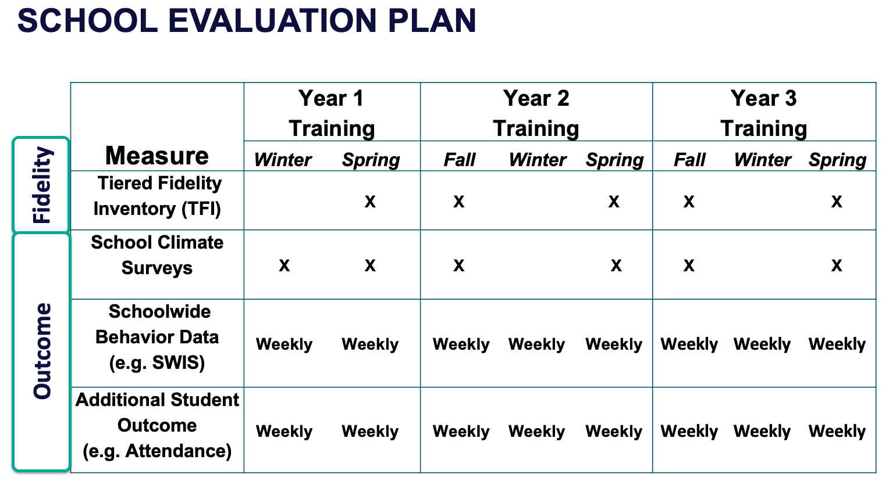
Strengthen Routines to Gather Fidelity and Outcome Data

Slide 67

School Climate Survey
Assesses students’, staffs’, and families’ perspective of the overall climate in the building.
Students:
  Elementary: grades 3-5
  Middle/high: grades 6-12
    Brief or extended option
Staff
Family
Make a plan!
Completed in
fall and spring
Notes:
https://www.pbis.org/resource/school-climate-survey-suite

Slide 68
Developing Data Routines
Data Source | Date(s) for administration | Who brings data to team meeting | Meeting date to review data | Plan to share data
TFI (Self-assessment)
TFI (With Trainer)
Referrals
School Climate
Other Outcome
Establishing consistent, efficient data routines enhances
your team’s ability to effectively use data for decision-making!

Slide 69
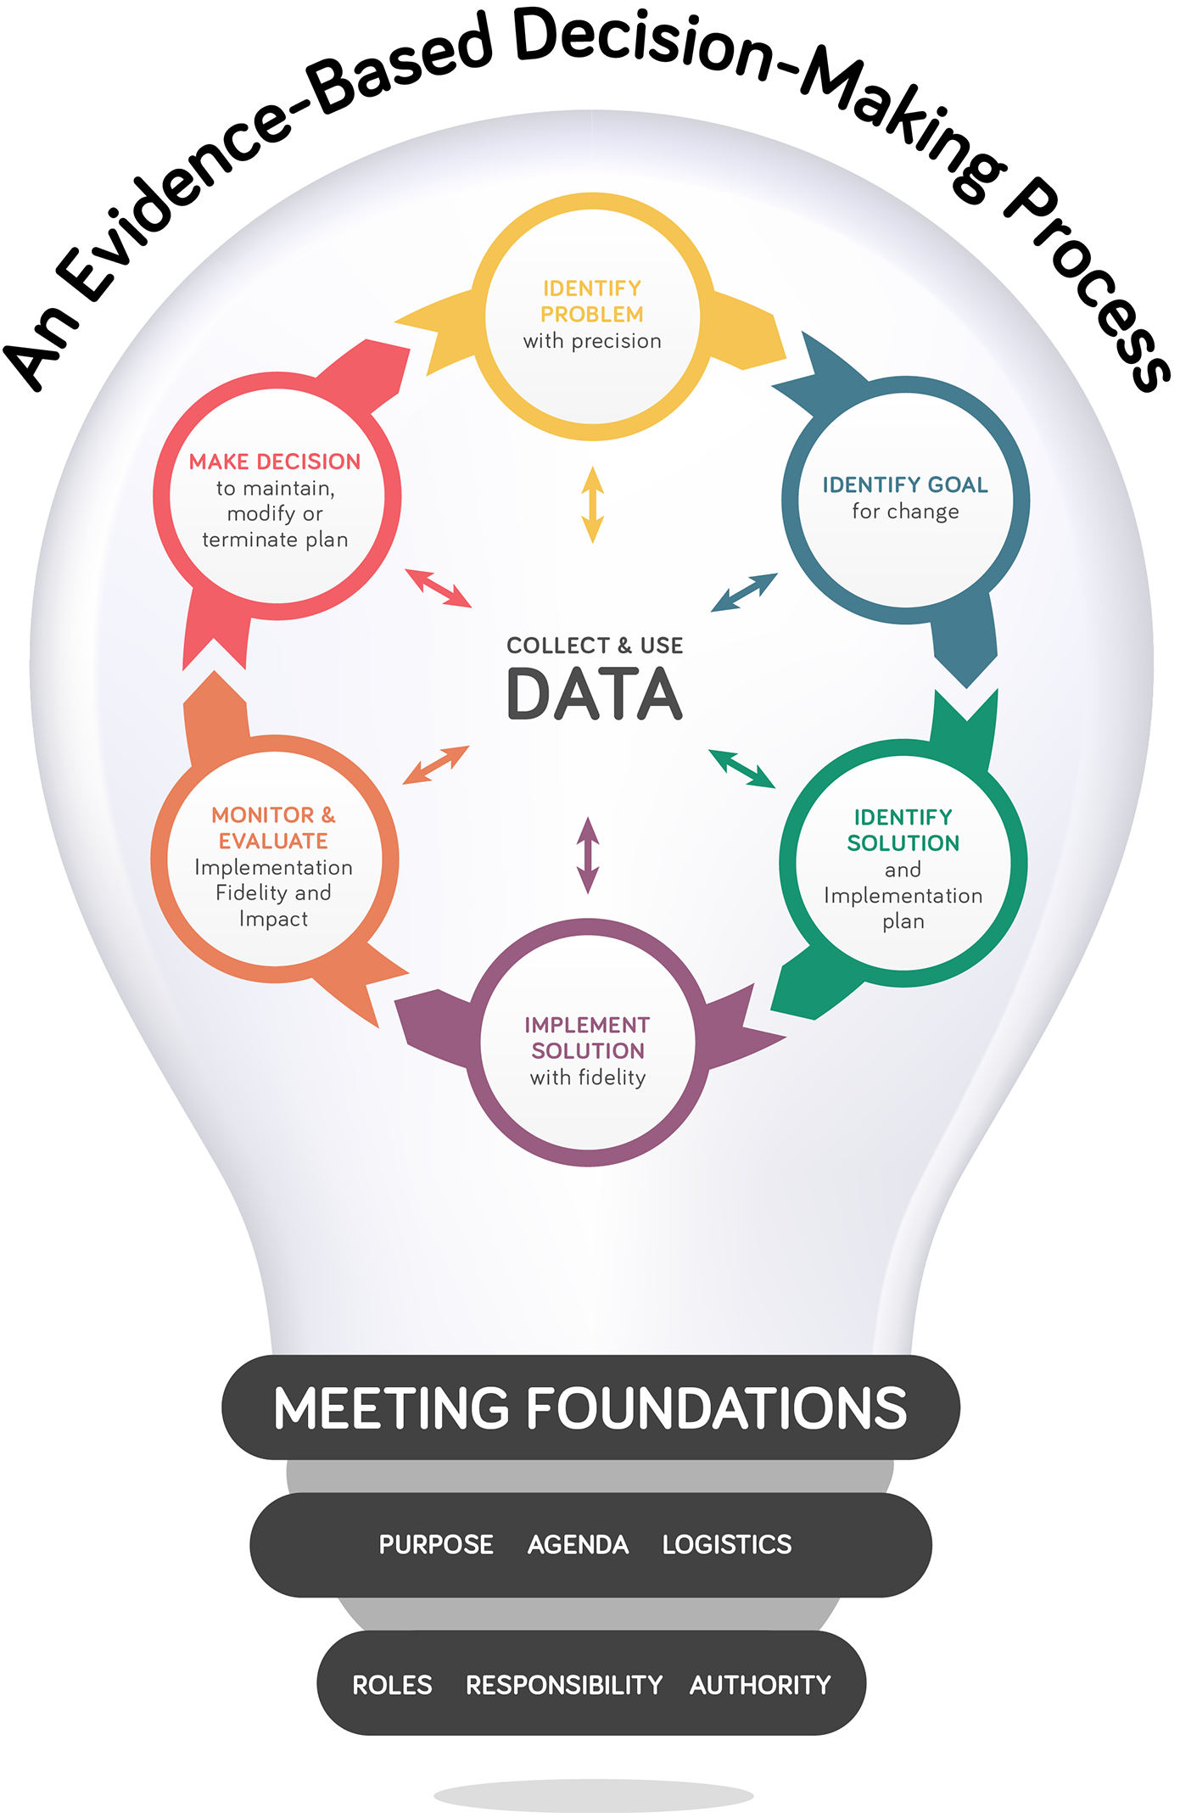

(Chaparro, E., et. al, 2022)
Notes:
How School Teams Use Data to Make Effective Decisions: https://www.pbis.org/resource/how-school-teams-use-data-to-make-effective-decisions-team-initiated-problem-solving-tips

Slide 70
Establish and Strengthen Data Routines
1. Identify the RIGHT data
Outcome data tied to goals
Fidelity data tied to evaluation plan
3. Identify the RIGHT people
Who needs to see these data to inform decisions? (e.g., PBIS team, grade level teams, family groups, other committees?)
4. Identify the RIGHT time & format
When/how often should these data be reviewed to inform decisions?
What format will facilitate decision making?
2. Assess data integrity
Consider staff training & engagement, systems, response rates

Slide 71
ACTIVITY: Strengthening Data Routines
As a team:
Identify how you will incorporate data routines into team meetings.
Plan for:
  Administration of school climate surveys for students, families, staff
  Regular review of student outcome data
    School-wide behavior
    Other (e.g. attendance)
Add items to your action plan as needed
Be ready to share with whole group.
5 minutes
Notes:
TFI: www. pbisapps.org

Slide 72
WHOLE GROUP DEBRIEF:
Strengthening Data Routines
What did your team identify as an action step to strengthen your data routines?
What further support do you need to do this?
5 minutes

Slide 73
DATA-BASED DECISION-MAKING:
PRECISE PROBLEMS AND OUTCOMES
How do we identify what we want to change and/or improve?
Identify 1-2 precise problems, outcomes, solutions and implementation plans

Slide 74
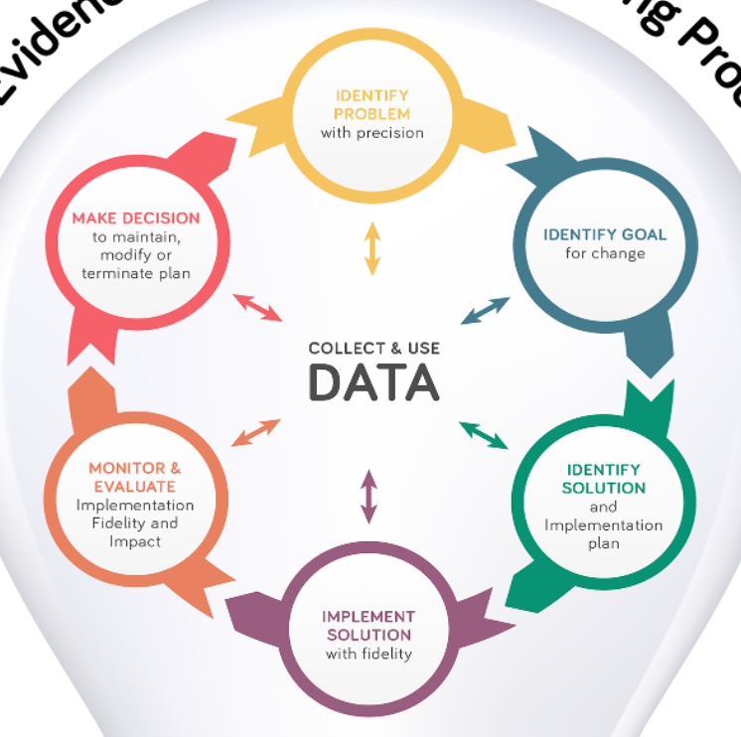
Once data routines are established…
1. Identify the RIGHT data
Outcome data tied to goals
Fidelity data tied to evaluation plan
3. Identify the RIGHT people
Who needs to see these data to inform decisions? (e.g., PBIS team, grade level teams, family groups, other committees?)
4. Identify the RIGHT time & format
When/how often should these data be reviewed to inform decisions?
What format will facilitate decision making?
2. Assess data integrity
Consider staff training & engagement, systems, response rates
…use the data to guide decision-making!

Slide 75
IDENTIFY PROBLEM
with precision
IDENTIFY GOAL
for change
IDENTIFY SOLUTION
and implementation plan
IMPLEMENT SOLUTION
with fidelity
MONITOR & EVALUATE
implementation fidelity and impact
MAKE DECISION
to maintain, modify, or terminate plan
Collect & Use
DATA
(Chaparro, E., et. al, 2022)

Slide 76
Developing Precision Problem Statements
IDENTIFY PROBLEM
with precision
What?
Where?
When?
Who?
How often? Why?
Questions to Consider:
What is our current reality or big picture?
Is there a problem (red flag)?
What is the precise context & function of the problem?
(PBISApps, 2019)

Slide 77
IDENTIFY PROBLEM
with precision
Dismissal time is too loud.
What?
Where?
When?
Who?
How often?
Why?
Too loud
???
Dismissal
???
???
???
We don’t have enough information to identify a goal and intervention!

Slide 78
According to SWIS data, incidents of inappropriate language use are increasing in grade 9.
This behavior occurs almost daily in the hallway after lunch and the referring staff members have indicated that students want to gain peer attention.
IDENTIFY PROBLEM
with precision
What?
Where?
When?
Who?
How often?
Why?
Inappropriate language
Hallway
After lunch
7th and 8th graders
Almost daily
Access to peer attention
Now we can identify a goal for change and intervene!

Slide 79
IDENTIFY PROBLEM
with precision
IDENTIFY GOAL
for change
IDENTIFY SOLUTION
and implementation plan
IMPLEMENT SOLUTION
with fidelity
MONITOR & EVALUATE
implementation fidelity and impact
MAKE DECISION
to maintain, modify, or terminate plan
Collect & Use
DATA
(Chaparro, E., et. al, 2022)

Slide 80
Identify Goal for Change
IDENTIFY GOAL
for change
Identifying an observable, measurable goal:
builds agreement
ensures a way of measuring success
Questions to Consider:
What do you want to change?
By when?
Where will the change happen (context or condition)?
How it will be measured?
(Chaparro, E., et. al, 2022)

Slide 81
Identify Goal for Change
Dismissal time is too loud.
IDENTIFY GOAL
for change
Questions to Consider:
What do you want to change? Decrease volume at dismissal
By when? Next month
Where will the change happen (context or condition)? All hallways
How it will be measured? ???
Students will be quieter during dismissal.
How do we know if this is happening?
(Chaparro, E., et. al, 2022)

Slide 82
Identify Goal for Change
IDENTIFY GOAL
for change
According to SWIS data, incidents of inappropriate language use are increasing in grade 9. This behavior occurs almost daily in the hallway after lunch and the referring staff members have indicated that students want to gain peer attention.
Questions to Consider:
What do you want to change? incidents of inappropriate language in grade 9
By when? next month
Where will the change happen (context or condition)? during the hallway after lunch
How it will be measured? behavior referrals
By the end of November, behavior referrals for 9th graders related to inappropriate language occurring in the hallway after lunch will decrease by 20% compared to September.
Now we can plan how to intervene!
(Chaparro, E., et. al, 2022)

Slide 83
ACTIVITY: Precise Problem and Outcome Statements
As a team:
Review your available data (e.g. behavior, school climate, attendance)
Develop 1-2 precise problem statements
Identify an observable, measurable goal for each precise problem statement
Add items to your action plan as needed
Be ready to share with whole group.
10 minutes
Notes:
TFI: www. pbisapps.org

Slide 84
WHOLE GROUP DEBRIEF:
Precise Problem and Outcome Statements
What did your team identify as precise problem and outcome statements?
What further support do you need to do this?
5 minutes

Slide 85
IDENTIFY PROBLEM
with precision
IDENTIFY GOAL
for change
IDENTIFY SOLUTION
and implementation plan
IMPLEMENT SOLUTION
with fidelity
MONITOR & EVALUATE
implementation fidelity and impact
MAKE DECISION
to maintain, modify, or terminate plan
Collect & Use
DATA
(Chaparro, E., et. al, 2022)

Slide 86
As you seek to identify a solution, remember to consider:
IDENTIFY SOLUTION
and implementation plan
What is happening before the behavior (antecedent)
What is happening after the behavior to reinforce it (consequence)
Why the behavior is likely happening (function)
Then…
How can the behavior be prevented?
What can be taught?
How can the new behavior be reinforced?

Slide 87
To determine function of behavior...
What typically precedes?
What do the behaviors look like?
What typically follows?
Antecedent
Behavior
Consequence
Based on observing patterns across time,
we can infer the probable function of behavior.

Slide 88
All behavior serves a function...
Get/Obtain
desired activities
tangible items
Avoid/Escape
aversive activities
tangible items
attention
sensory stimulation
attention
sensory stimulation
“Function” = outcome, result, purpose, consequence

Slide 89
By understanding function, we can intervene more effectively.
How can we prevent?
What should we teach the student to do instead?
How do we respond to make sure the new skill “works”?
Prevent
Teach
Respond
We can make simple tweaks to the antecedents, behaviors, and consequences, to prevent, teach, and respond, respectively.

Slide 90
Also consider…
IDENTIFY SOLUTION
and implementation plan
Solutions need to
be evidence-based
be practical and efficient
match the culture and organization of the school
match the needs of the students involved
Use strategies to
prevent future occurrence of the problem
teach social, emotional, and behavioral (SEB) skills
provide explicit feedback
reduce unintentional rewards for problem behavior
acknowledge positive SEB skills
Consider
what school personnel already do well
skills, values, resources, and support available
needs, skills, and behavioral function of the targeted student(s).
(Chaparro, E., et. al, 2022)

Slide 91
By the end of November, behavior referrals for 9th graders related to inappropriate language occurring in the hallway after lunch will decrease by 20% compared to September.
IDENTIFY SOLUTION
and implementation plan
Perceived motivation is peer attention
(function)
How can they get peer attention more appropriately?
(teach)
Precorrections are known to work to reduce problem behavior (prevent)
During the first week of November, advisory periods will reteach students how to interact with peers respectfully, including how to enter a conversation that is already underway. 9th grade staff will actively supervise hallways near their classrooms and provide specific feedback to students about their peer interactions. Lunch monitors will provide a precorrection before students are dismissed from the cafeteria.
The staff know how to provide specific feedback
(reinforce)

Slide 92
Implementation Plan
IDENTIFY SOLUTION
and implementation plan
Operationally describes
what will occur
who will be responsible for it
when, where, and how often it will happen
how fidelity will be monitored
Indicates
how activities that are done infrequently will be accomplished
sets up a schedule for how regular activities will be done
Establishes a schedule to regularly check
if they are doing the plan as intended
if the desired outcomes are being achieved
(Chaparro, E., et. al, 2022)

Slide 93
Implementation Plan
IDENTIFY SOLUTION
and implementation plan
What | Who | By When | How to Monitor Fidelity
Develop booster lessons about respectful peer interactions | Team | October 23rd | Check during our team meeting on October 23
Communicate plan to 9th grade staff and cafeteria monitors | Coach | October 15th | Report back to team on October 23
Teach booster lessons | 9th grade advisory teachers | First week of November | 9th grade Leadership team rep will ask each 9th grade teacher
Actively supervise and provide specific feedback in hallways after lunch | 9th grade staff | Throughout November | Coach will observe at least 2x/week
Provide precorrections about appropriate language before students leave the cafeteria | Cafeteria monitors | Throughout November | Coach will observe at least 2x/week

Slide 94
IDENTIFY PROBLEM
with precision
IDENTIFY GOAL
for change
IDENTIFY SOLUTION
and implementation plan
IMPLEMENT SOLUTION
with fidelity
MONITOR & EVALUATE
implementation fidelity and impact
MAKE DECISION
to maintain, modify, or terminate plan
Collect & Use
DATA
(Chaparro, E., et. al, 2022)

Slide 95
Implementation and Adaptation
IMPLEMENT SOLUTION
with fidelity
MONITOR & EVALUATE
implementation fidelity and impact
MAKE DECISION
to maintain, modify, or terminate plan
Iterative process
Continuously review implementation
Modify or adapt in response to feedback from students, faculty, staff, and families
(Chaparro, E., et. al, 2022)

Slide 96
Implementation and Adaptation
Feature to Monitor Fidelity | Data to be Gathered | Reporting and Sharing
Teach booster lessons | 9th grade Leadership team rep will ask each 9th grade teacher | Team meeting on November 18 Email to 9th grade staff on Monday of second week of November
Actively supervise and provide specific feedback in hallways after lunch | Coach will observe at least 2x/week and identify: number of staff present % of staff providing specific feedback | Team meeting on November 18 9th grade level meeting on November 21
Provide precorrections about appropriate language before students leave the cafeteria | Coach will observe at least 2x/week and record whether or not a precorrection was given prior to dismissal | Team meeting on November 18 Email summary to monitors in mid-November
Define the solution features
Develop and use a system for gathering, reporting, and sharing data on the extent to which what should be happening is happening
IMPLEMENT SOLUTION
with fidelity
(Chaparro, E., et. al, 2022)

Slide 97
Implementation and Adaptation
At the November 18th team meeting:
9th grade rep reported 100% of advisory teachers taught the booster lessons during the 1st week of November
The PBIS coach reported:
  During 4 out of 5 hallway observation times, 88% of 9th grade staff actively supervised and provided specific feedback
    1 staff member was not engaging. The PBIS coach provided individual support.
  Cafeteria monitors provided precorrections 50% of the time
    After a visual cue was provided precorrections increased to 95% of the time
The team reviewed behavior referrals in December.
Behavior referrals for 9th graders related to inappropriate language occurring in the hallway after lunch decrease by 40% compared to September!
Goal was met!
Review collected data
Determine:
  Has the problem has changed?
  Has the goal has been achieved?
MONITOR & EVALUATE
implementation fidelity and impact

Slide 98
Implementation and Adaptation
Team decides if the problem
improvement matches the goal
improvement happened, but goal was not met
did not improve
Then, decides to continue, adapt, or end the plan.
MAKE DECISION
to maintain, modify, or terminate plan
The goal of reducing behavior referrals for 9th graders related to inappropriate language occurring in the hallway after lunch decrease by 20% compared to September was exceeded.
The team decided to continue the plan.

Slide 99
ACTIVITY: Identify Solution, Implementation and Evaluation Plan
As a team:
Identify an evidence-based, practical solution for your identified goal(s).
Then, decide how the solution will be implemented, monitored and evaluated.
Add items to your action plan as needed
Be ready to share with whole group.
10 minutes

Slide 100
WHOLE GROUP DEBRIEF: Identify Solution, Implementation and Evaluation Plan
What is your team considering as a solution to meet your goal?
How will it be implemented, monitored, and evaluated?
What further support will you need to do this?
5 minutes

Slide 101
CLASSROOM:
PRACTICES
What do classroom educators need to do to effectively support students?
Plan explicit training for classroom educators
Gather fidelity data on classroom expectations

Slide 102

Supporting and Responding to Students’ SEB Needs
Practices
Summarizes evidence-based, positive, and proactive practices that support and respond to students’ social, emotional, and behavioral (SEB) needs in classrooms.
Center on PBIS. (2022). Supporting and responding to student’s social, emotional, and behavioral needs: Evidence-based practices for educators (Version 2.0). Center on PBIS, University of Oregon. www.pbis.org.

Slide 103
Supporting and Responding to Students’ SEB Needs
1. Create Positive Teaching and Learning Environments
Design a Safe Environment
2. Actively Promote SEB Growth
Engage Students in Relevant Learning
3. Monitor Fidelity and Use Data to Guide Implementation
Monitor Educator Implementation
4. Monitor Student Outcomes and Use Data to Guide Response
Establish Positive Connections
Develop Predictable Routines
Define and Teach Positive Expectations
Plan Relevant Instruction
Foster Positive Relationships
Prompt and Supervise SEB and Academic Skills
Provide Specific Feedback (> 5 : 1 Ratio)
Consider Other Response Strategies
Provide Training, Coaching, and Feedback
If data indicate implementation challenges...
Monitor Student Outcomes
Enhance Tier 1
If many students make ongoing SEB errors...
Enhance Tier 1 and Consider Tiers 2 and 3
If few students make ongoing SEB errors...
Remember these from Day 3?

Slide 104
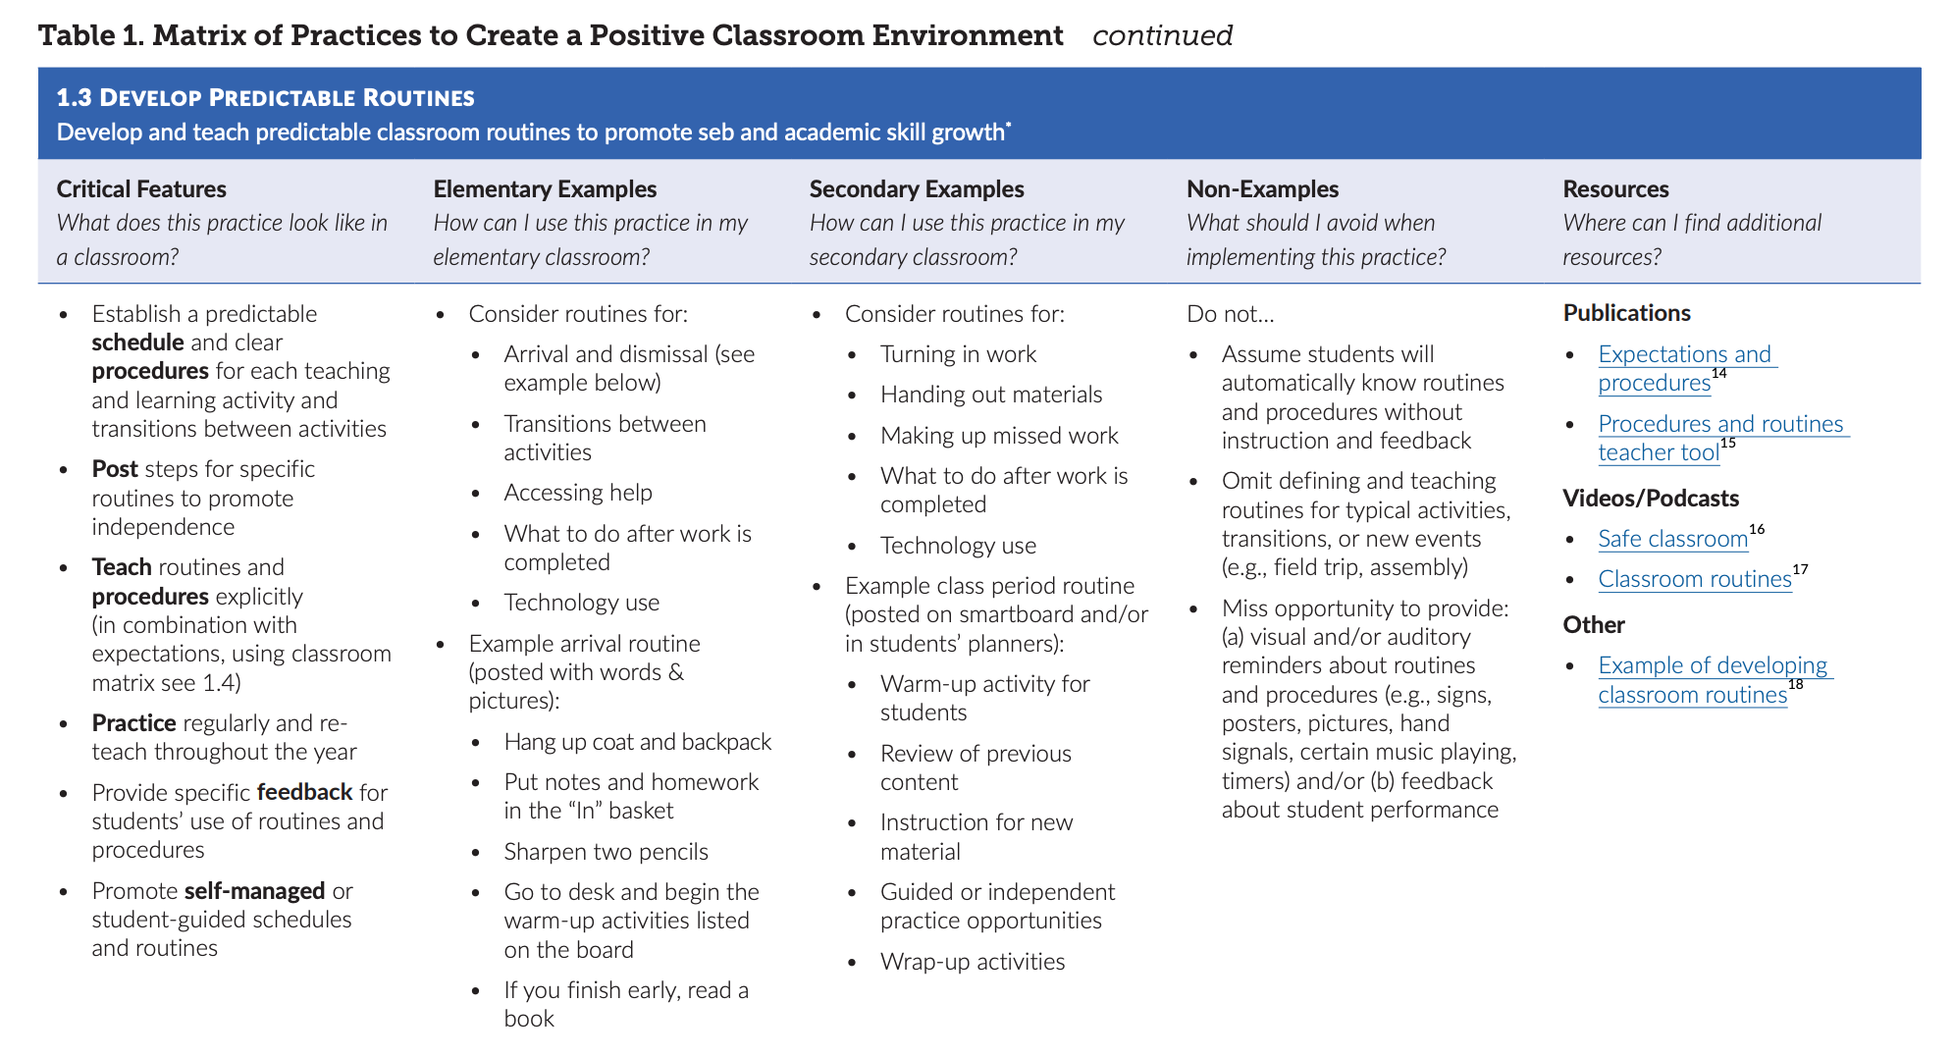

Slide 105
1. Create Positive Teaching and Learning Environments
Design a Safe Environment
Establish Positive Connections
Develop Predictable Routines
Define and Teach Positive Expectations
Plan Relevant Instruction
Practices to Create
Positive Teaching and Learning Environments

Slide 106
Design a Safe Environment
Match classroom layout to common instructional activities
Arrange furniture for smooth traffic flow by teachers and students
Maintain neat, orderly, accessible instructional materials for all students
Consider unique student needs and ensure accessibility
Post visuals to support critical content and reflect diversity of classroom community

Slide 107
Establish Positive Connections
Engage in purposeful communication with students and families
Build in regular opportunities for positive connection throughout the year
Use formal and informal approaches to learn about students and their learning histories, identities, and preferences
Authentically engage families as partners in learning
Validate and affirm personal and cultural learning histories

Slide 108
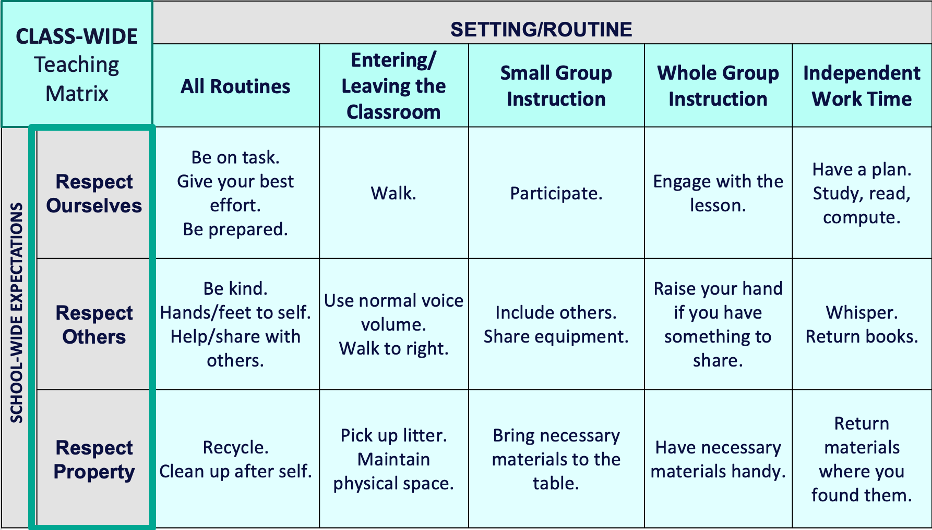
Develop Predictable Routines
Establish a predictable schedule and clear procedures for each activity and transition
For each routine/procedure:
Post steps to promote independence
Teach explicitly
Practice regularly and reteach frequently
Provide specific feedback on student use

Slide 109
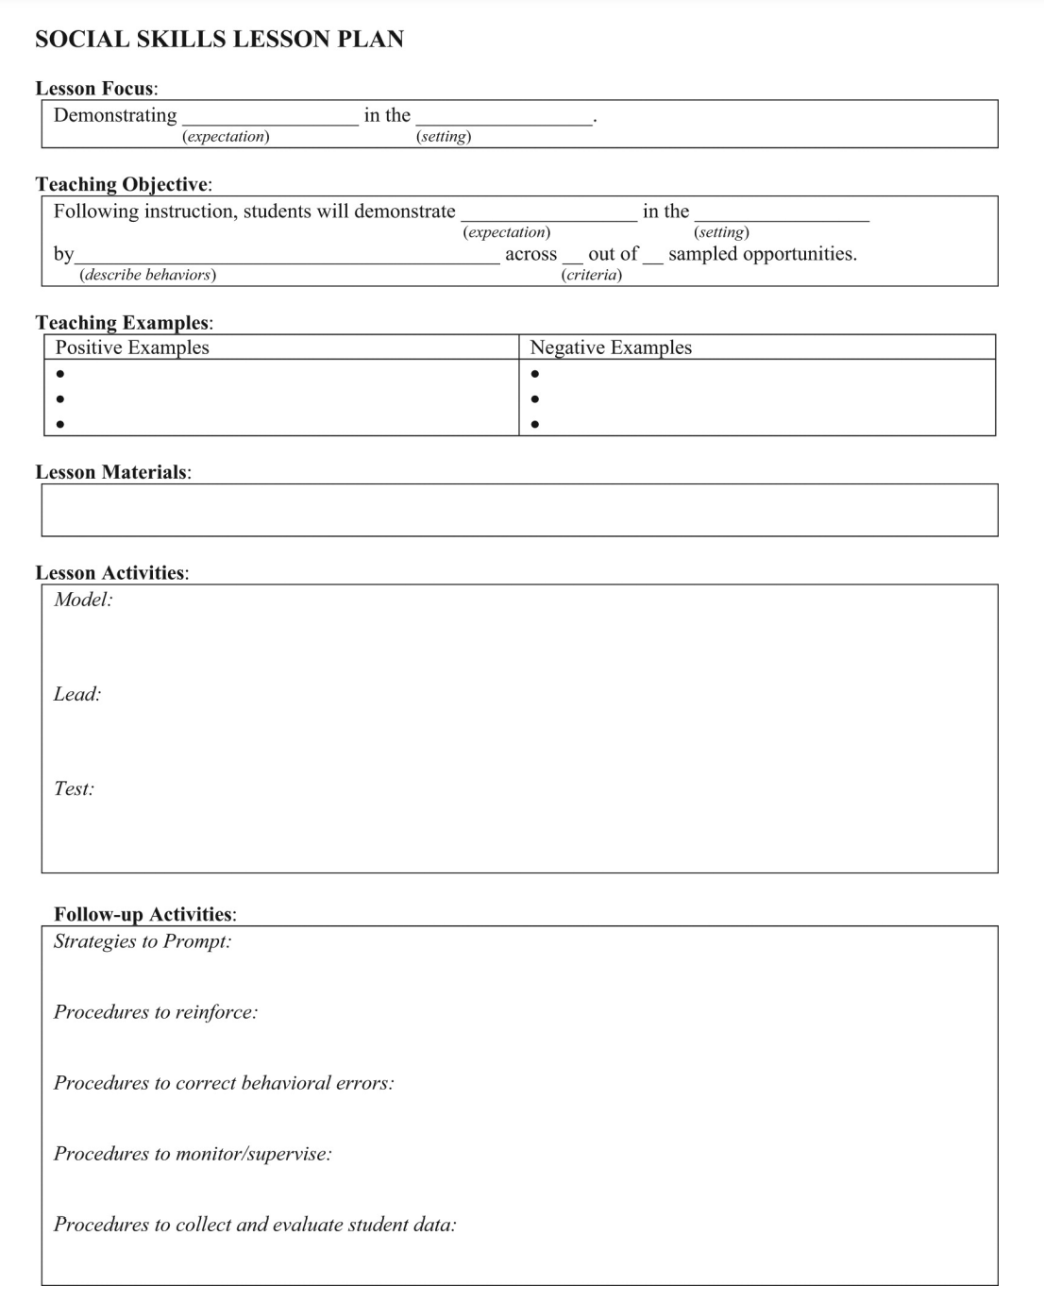
Define and Teach Positive Expectations
Define
Teach
Prompt
Monitor
Evaluate

Slide 110
Plan Relevant Instruction
Ensure instructional materials and activities celebrate diversity of students and families
Select curricula (or adapt existing curricula) and activities that are relevant for your students’ learning history and needs
Consider various dimensions of each activity (e.g., difficulty, duration of task, choice, communication needs)
Plan differentiation to meet the needs of all learners

Slide 111
1. Create Positive Teaching and Learning Environments
Design a Safe Environment
2. Actively Promote SEB Growth
Engage Students in Relevant Learning
Establish Positive Connections
Develop Predictable Routines
Define and Teach Positive Expectations
Plan Relevant Instruction
Foster Positive Relationships
Prompt and Supervise SEB and Academic Skills
Provide Specific Feedback (> 5 : 1 Ratio)
Consider Other Response Strategies
Practices to Actively Promote SEB Growth

Slide 112
Engage Students in Relevant Instruction
Use explicit instruction (“I do, We do, You do”)
Provide high rates of varied opportunities to respond
Differentiate to ensure equitable benefit

Slide 113

Examples of OTRs
Explicit, Direct
Instruction
Choral
Responding
Class-wide Peer Tutoring
Electronic
Clickers
Response
Cards
Computer Assisted Instruction
Guided
Notes
Non-Verbal
Responses

Slide 114

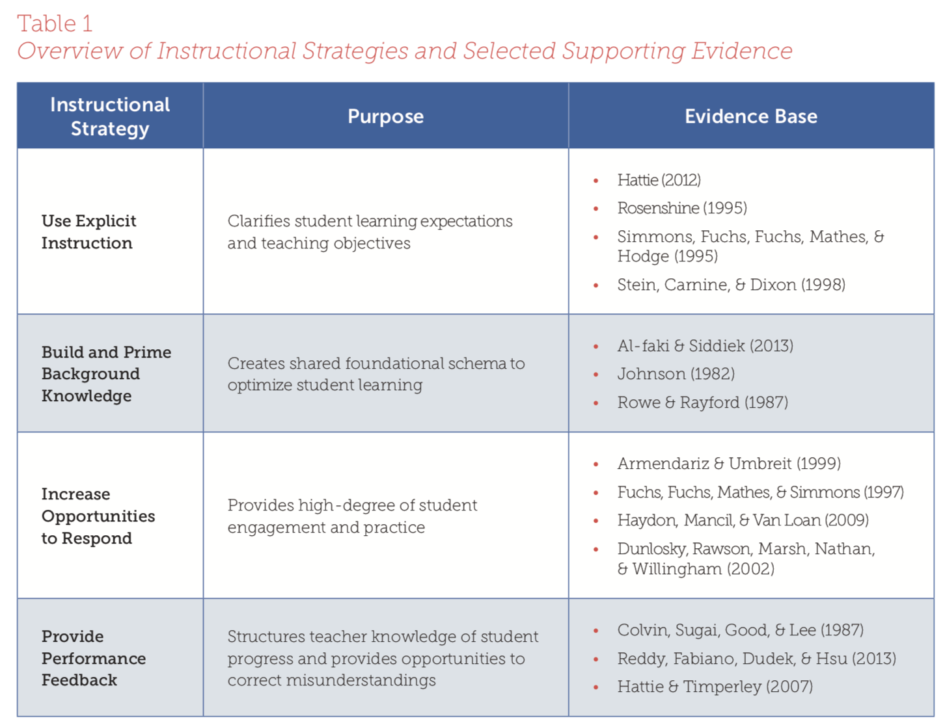
Additional Resources
Notes:
Explicit Instruction Modules: https://intensiveintervention.org/intensive-intervention-features-explicit-instruction
Anita Archer on Explicit Instruction: https://www.youtube.com/watch?v=l0I02o_YLnM&feature=youtu.be
Examples of Engaging Instruction to Increase Equity in Instruction: https://www.pbis.org/resource/examples-of-engaging-instruction-to-increase-equity-in-education

Slide 115
Foster Positive Relationships
Positively greet students as they enter the classroom
Provide structured and unstructured peer engagement opportunities
Incorporate student preferences into learning
Engage in verbal and non-verbal positive interactions

Slide 116
What is it?
Positive Greetings at the Door:
Increase student time on task
Decrease disruptions
Build positive relationships
(Allday & Pakurar, 2007; Cook et al., 2018)
Positive Greetings at the Door
Stand just inside or outside of the door and...
Greet each student by name
Have a short positive interaction (e.g., praise, friendly comment, question)
Direct them to the first activity
Prompt classroom norms
https://www.pbis.org/resource/positive-greetings-at-the-door

Slide 117
Prompt and Supervise SEB and Academic Skills
Remind students BEFORE the skill is expected
Teach and emphasize self-managed prompts
Actively supervise and monitor
Provide individual prompts if needed

Slide 118
What is it?
A verbal prompt is a reminder of previously taught behaviors, delivered before the behavior, that explicitly states the expected behavior.
Delivered before behavior
State expected behavior
Reminder of previously taught behaviors

Slide 119
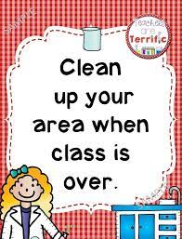


Classroom Prompt Examples
Verbal reminders
Gestural reminders
“As you head out, remember to talk quietly in the hallway."
Visual reminders

Slide 120
Provide Specific Feedback (>5⁺ : 1⁻ ratio)
Use specific praise to encourage SEB and academic skills
Use brief specific corrections to reduce errors
Provide at least 5 praise statements for each correction
Engage students in providing specific praise to one another

Slide 121
That was a hard problem and you stuck with it.
Great job!
What is specific feedback?
Behavior Specific Praise
  “a positive statement, typically provided by the teacher, when a desired behavior occurs (contingent) to inform students specifically what they did well.”
You asked for help when you needed it! Terrific!
Helping your friend was a kind thing to do.
(Simonsen et al. 2008, pp. 362, 364, emphasis added)

Slide 122
Instead of talking out, please raise your hand.
What is specific feedback?
Specific Error Corrections or Redirections
  “an informative statement, typically provided by the teacher, that is given when an undesired behavior occurs (contingent), states the observed behavior, and tells the student exactly what they should do in the future in a brief, concise manner..”
That sound is /ā/. What sound?
Yes, /ā/.
Rather than laughing, please help your friend clean up the mess
(Simonsen et al. 2008, pp. 362, 364, emphasis added)

Slide 123

Why do it?
  It works!
  Decades of research support the relationship between positive and specific feedback and student outcomes
  Positive climate & relationships
  Providing positive feedback helps to create a positive classroom climate & develop positive relationships
  It’s all about the ratio!
  Maintain a favorable ratio of positive to corrective feedback
  Provide at least 5 positive statements for every 1 corrective (5⁺:1⁻)
5⁺:1⁻
(Cook et al., 2020; Floress et al., 2017; Simonsen et al. 2008)

Slide 124
Consider Other Response Strategies
Adopt procedures that celebrate, acknowledge, and reinforce (increase) use of SEB skills, academic skills, and contextually appropriate behavior
Adopt procedures that prevent or respond instructionally, respectfully, and supportively to SEB errors, academic errors, and contextually inappropriate behavior
Group contingencies
Good Behavior Game
Token Economy
Non-contingent reinforcement
Differential reinforcement
Self-management

Slide 125
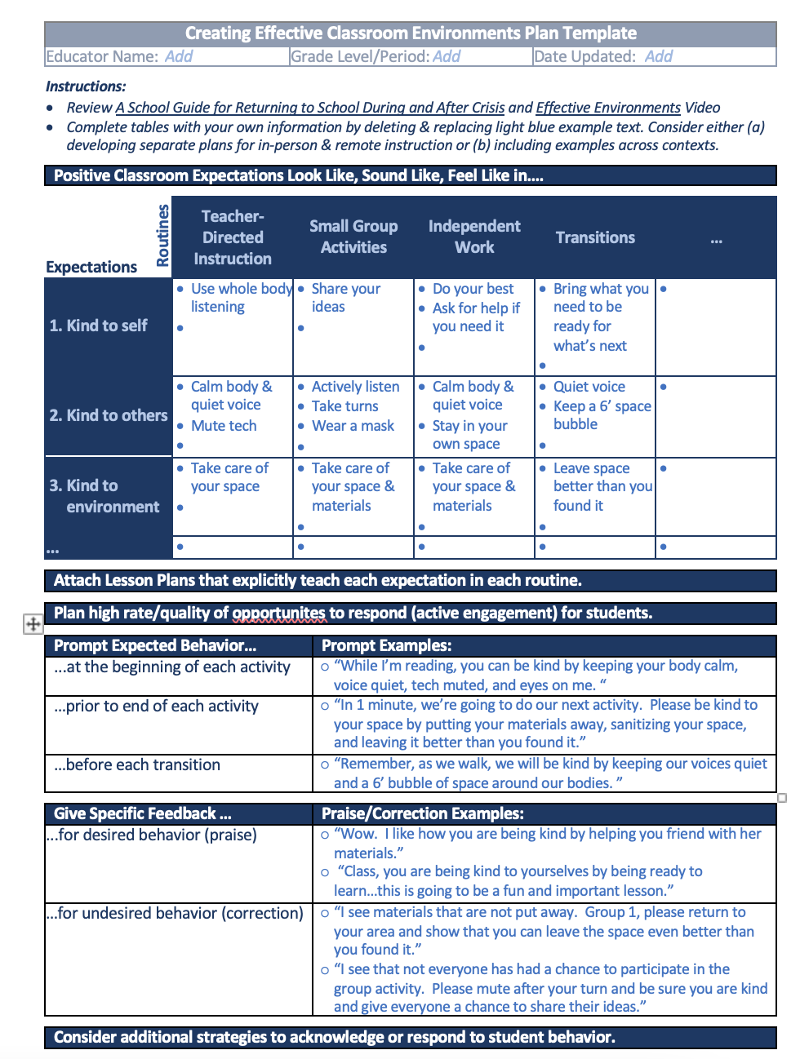
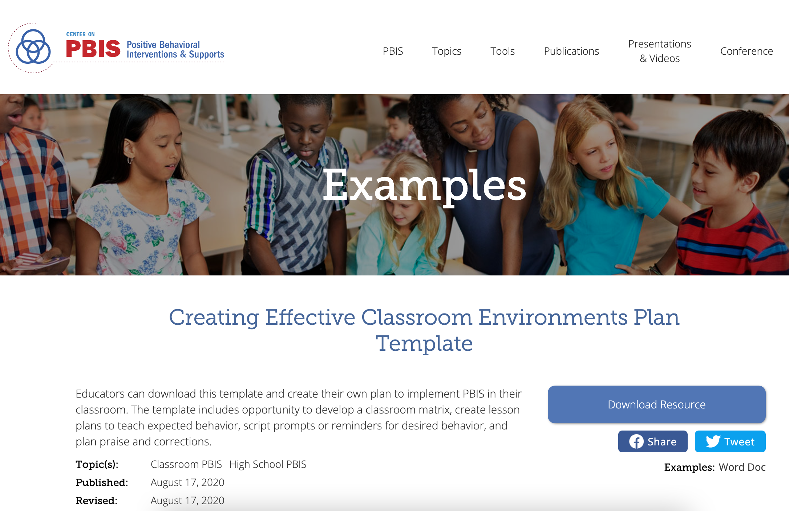
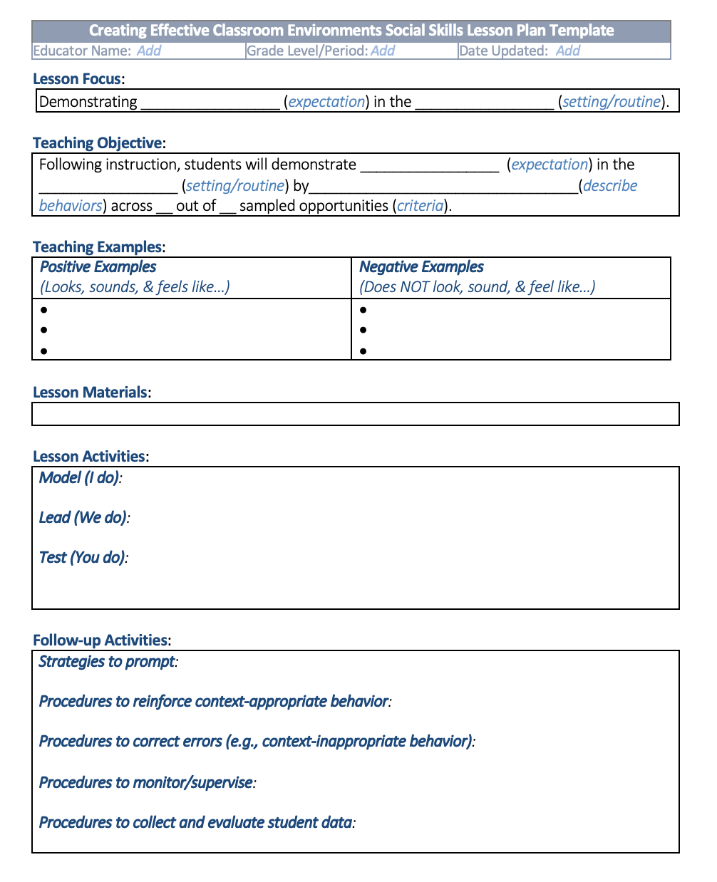
Helpful Resource
Creating Effective Classroom Environments Plan Template
Educators can download this template and create their own plan to implement PBIS in their classroom. The template includes opportunity to develop a classroom matrix, create lesson plans to teach expected behavior, script prompts or reminders for desired behavior, and plan praise and corrections.
Notes:
https://www.pbis.org/resource/creating-effective-classroom-environments-plan-template

Slide 126

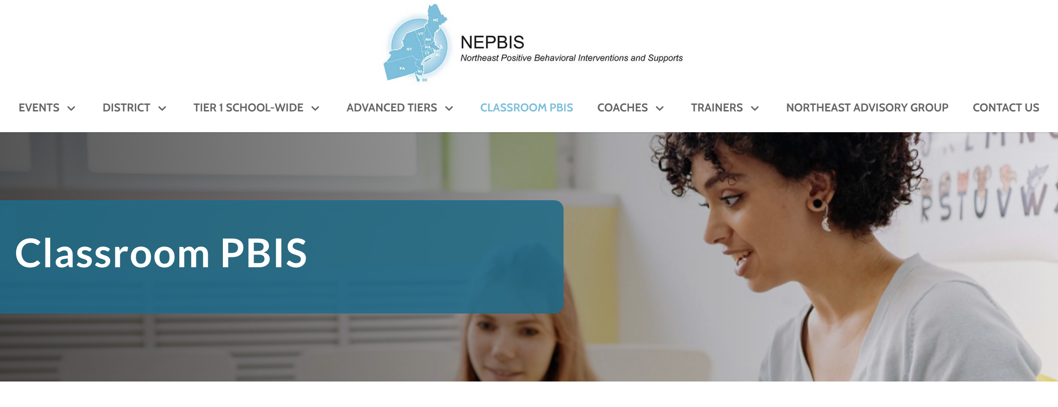
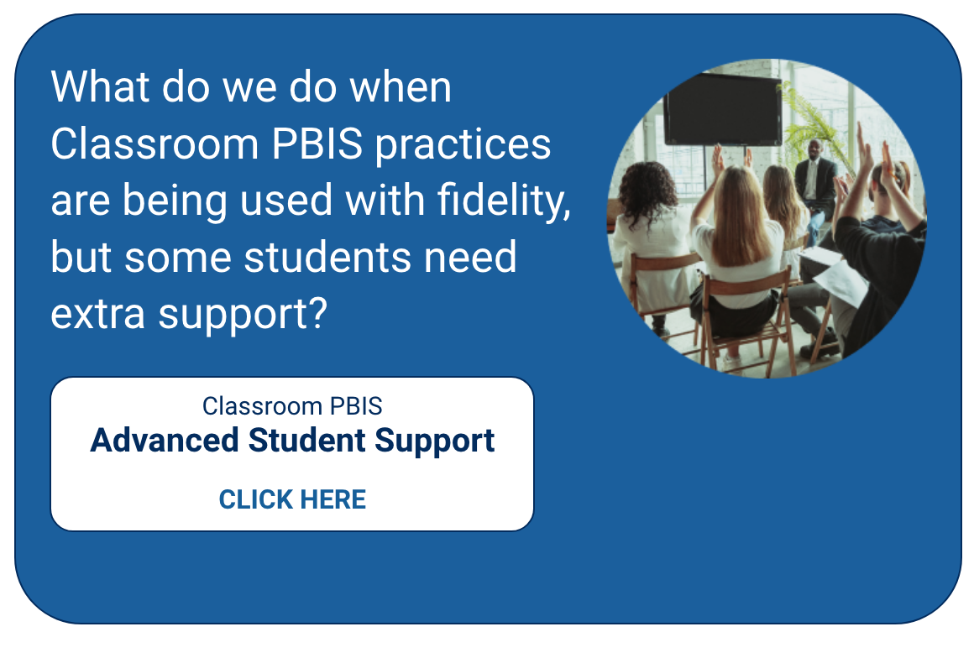
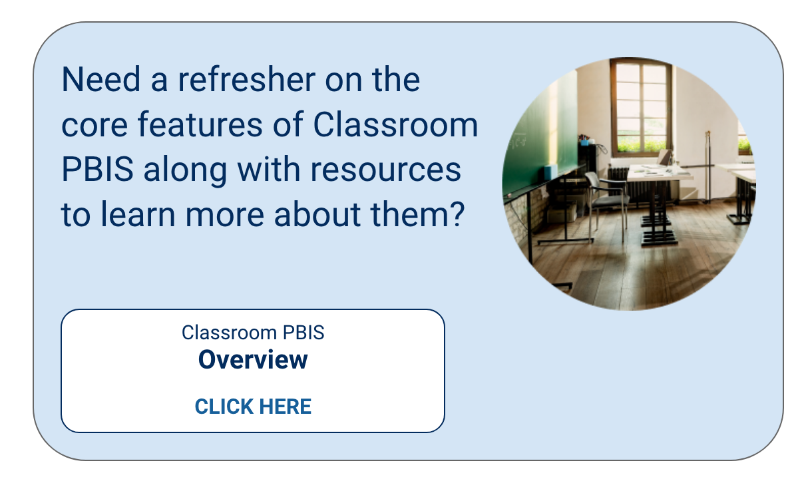
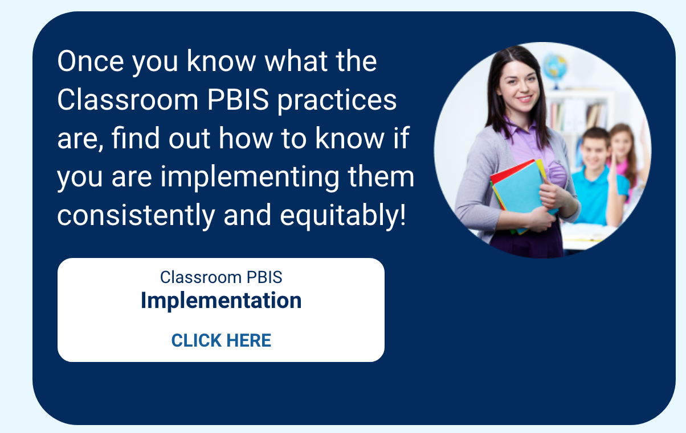
Learn More
Notes:
https://nepbis.org/classroom-pbis/

Slide 127
ACTIVITY: Promoting Positive, Proactive Classroom Practices with Staff
As a team,
Plan how you will explicitly train staff in positive, proactive classroom practices.
Add items to your action plan.
Be ready to share with the whole group.
10 minutes

Slide 128
WHOLE GROUP DEBRIEF: Promoting Positive, Proactive Classroom Practices with Staff
How will your team provide your staff with explicit training in positive, proactive classroom practices?
What further support do you need to do this?
5 minutes

Slide 129
Supporting and Responding to Students’ SEB Needs
3. Monitor Fidelity and Use Data to Guide Implementation
Monitor Educator Implementation
4. Monitor Student Outcomes and Use Data to Guide Response
Provide Training, Coaching, and Feedback
If data indicate implementation challenges...
Monitor Student Outcomes
Enhance Tier 1
If many students make ongoing SEB errors...
Enhance Tier 1 and Consider Tiers 2 and 3
If few students make ongoing SEB errors...
MORE TO COME IN DAYS 8 AND 9

Slide 130
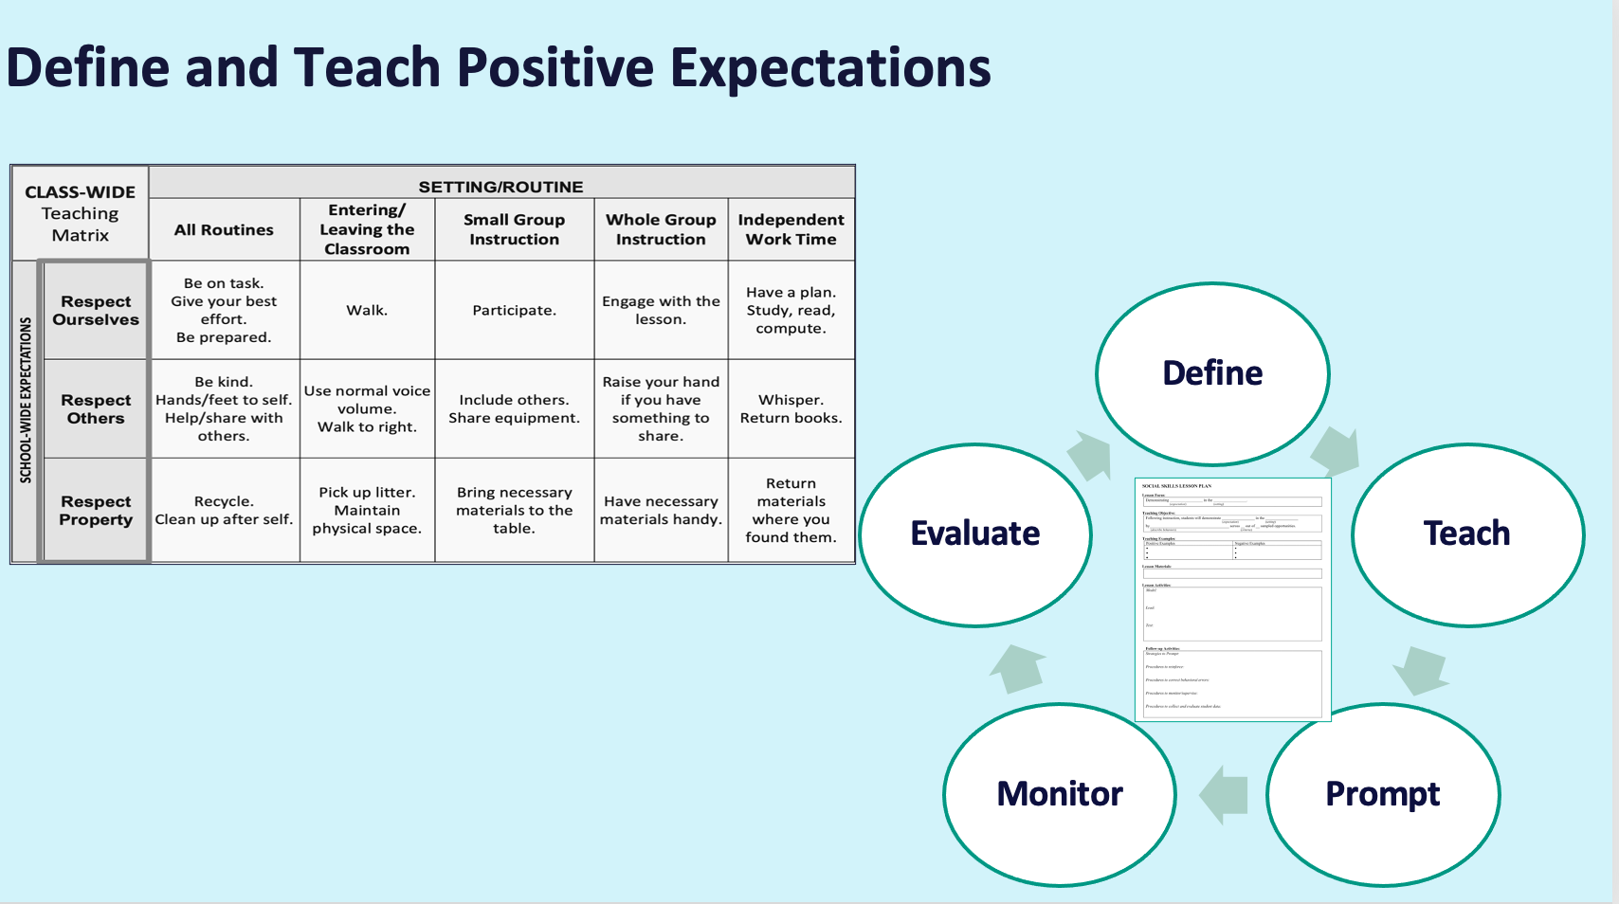
INITIAL STEP: Monitor Fidelity
Did this actually happen?
How can we know?
As part of rollout, classroom educators
align their classroom expectations with the schoolwide expectations
explicitly teach classroom expectations to students

Slide 131
INITIAL STEP: Monitor Fidelity
Walkthroughs
Surveys
Team Reps
Identify how many classrooms have a classroom matrix posted
Educators self-assess their fidelity of teaching expectations
Ask students if they were taught classroom expectations
Team reps meet with their group and gather self-reported information

Slide 132
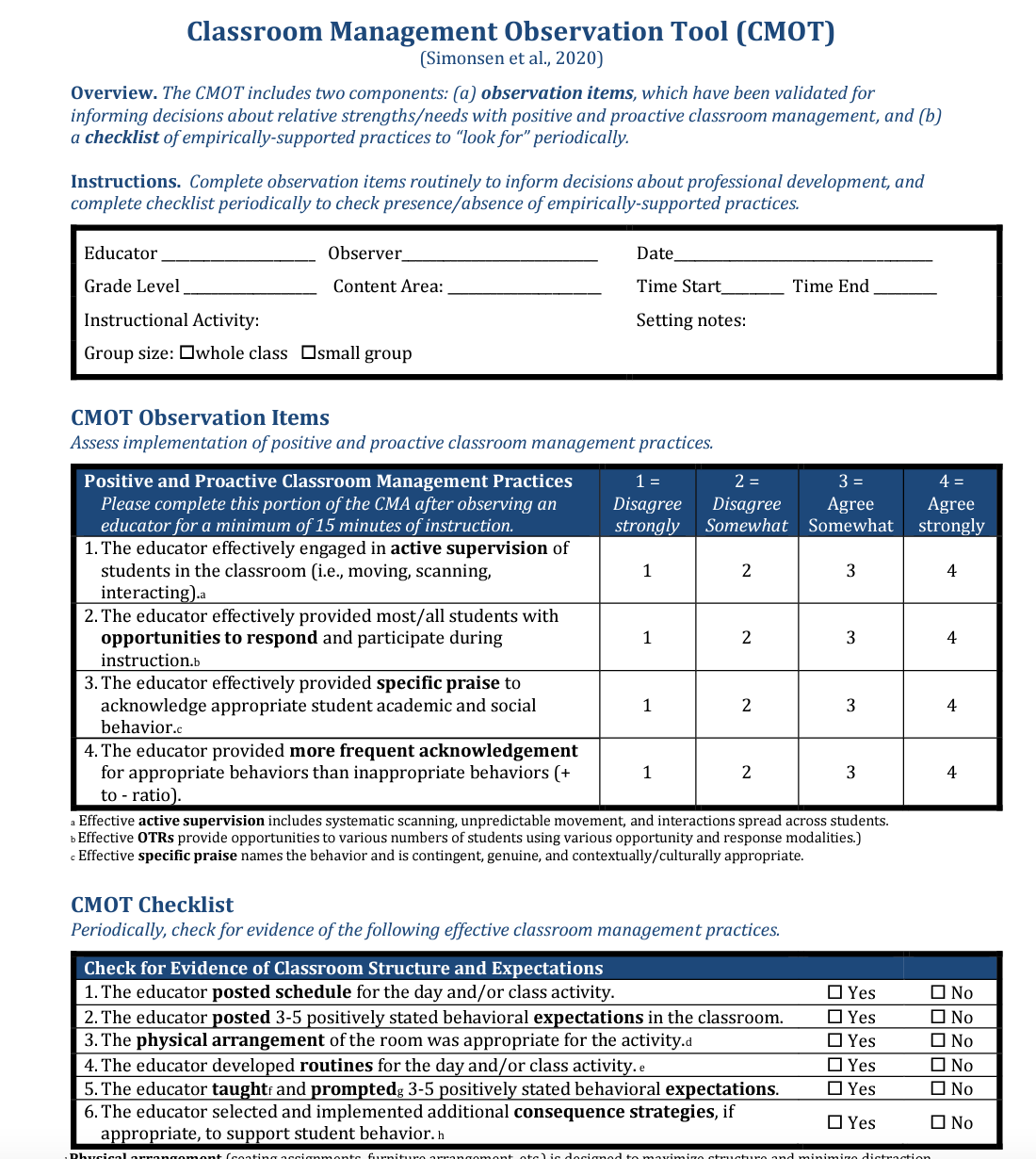
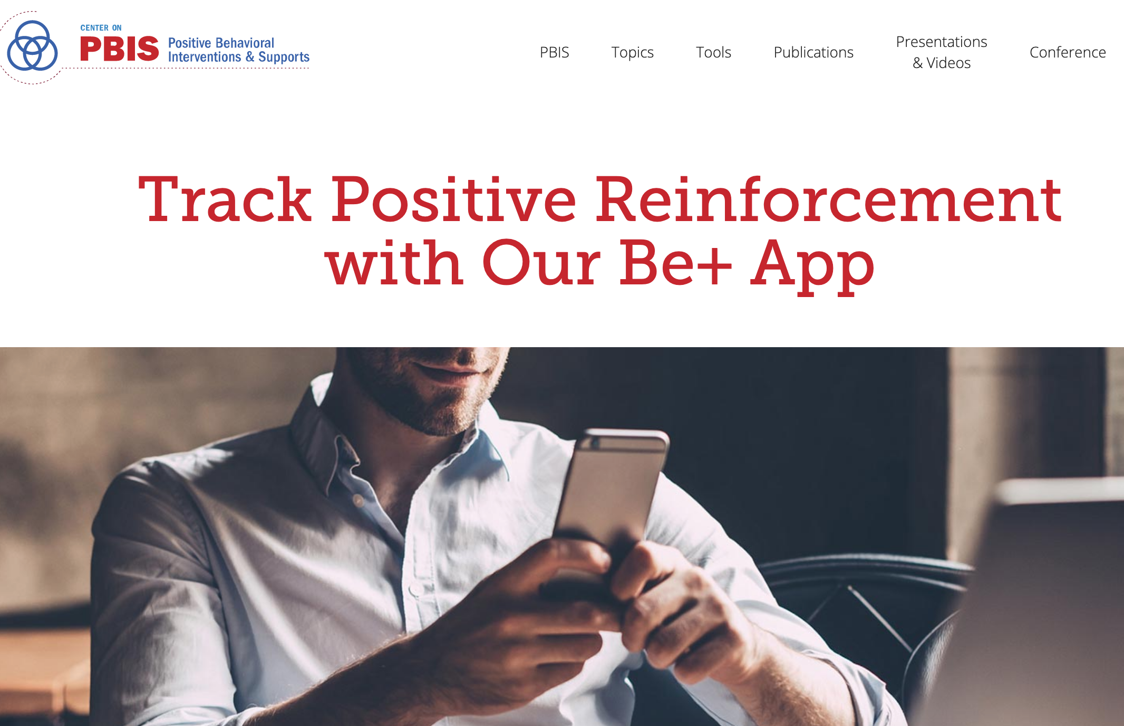
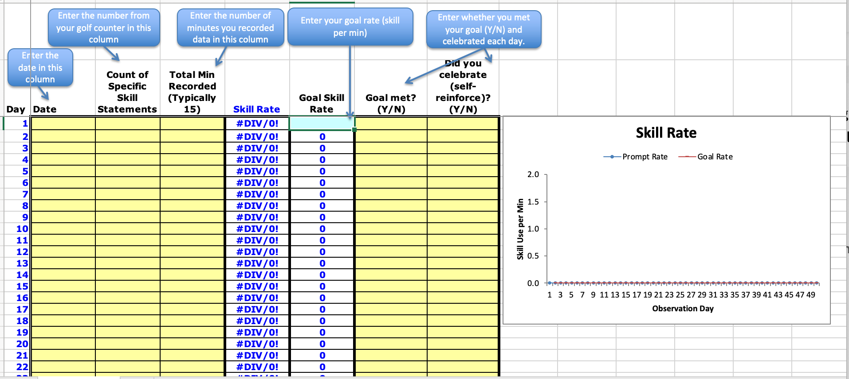

Tools to Help
Classroom Management Observation Tool
Be + App
Self-Management Data Collection Tool
Notes:
https://nepbi s.org/classroom-pbis/implementation/

Slide 133
ACTIVITY: Monitor Fidelity
As a team,
Consider how you can gather data on classroom educator fidelity with
aligning classroom expectations with schoolwide expectations
posting classroom expectations
explicit teaching of classroom expectations
Add items to your action plan
Be ready to share out with the whole group.
You will need this data on Day 8!
10 minutes

Slide 134
WHOLE GROUP DEBRIEF:
Monitor Fidelity
How will your team gather classroom educator fidelity on classroom expectations and explicit teaching of those expectations?
What further support will you need to do this?
5 minutes

Slide 135
Lunch

Slide 136
Quick Review

Slide 137
GETTING STARTED WITH PBIS
1
Establish an effective leadership team
6
Develop a continuum of responses to increase use of SEB skills
2
Develop a brief statement of purpose & define outcomes
7
Develop a continuum of responses to decrease SEB errors
3
Identify positive school-wide behavior expectations
8
Develop systems to support staff
4
Develop procedures to teach school-wide expectations
9
Use data for decision-making
5
Develop procedures to teach class-wide expectations
10
Promote sustainability

Slide 138
Once data routines are established…
1. Identify the RIGHT data
Outcome data tied to goals
Fidelity data tied to evaluation plan
3. Identify the RIGHT people
Who needs to see these data to inform decisions? (e.g., PBIS team, grade level teams, family groups, other committees?)
4. Identify the RIGHT time & format
When/how often should these data be reviewed to inform decisions?
What format will facilitate decision making?
2. Assess data integrity
Consider staff training & engagement, systems, response rates
…use the data to guide decision-making!

Slide 139
Supporting and Responding to Students’ SEB Needs
1. Create Positive Teaching and Learning Environments
Design a Safe Environment
2. Actively Promote SEB Growth
Engage Students in Relevant Learning
3. Monitor Fidelity and Use Data to Guide Implementation
Monitor Educator Implementation
4. Monitor Student Outcomes and Use Data to Guide Response
Establish Positive Connections
Develop Predictable Routines
Define and Teach Positive Expectations
Plan Relevant Instruction
Foster Positive Relationships
Prompt and Supervise SEB and Academic Skills
Provide Specific Feedback (> 5 : 1 Ratio)
Consider Other Response Strategies
Provide Training, Coaching, and Feedback
If data indicate implementation challenges...
Monitor Student Outcomes
Enhance Tier 1
If many students make ongoing SEB errors...
Enhance Tier 1 and Consider Tiers 2 and 3
If few students make ongoing SEB errors...

Slide 140
INITIAL STEP: Monitor Fidelity
Did this actually happen?
How can we know?
As part of rollout, classroom educators
align their classroom expectations with the schoolwide expectations
explicitly teach classroom expectations to students

Slide 141
PRACTICES:
FAMILY ENGAGEMENT
How do we ensure families are actively participating in our framework?
Complete Family-School Practices survey
Identify action steps

Slide 142

What is family engagement?
Including families in PBIS implementation means families and school personnel work together and share in the responsibility making educational decisions and improving student outcomes.
(Center on PBIS, 2022)

Slide 143
Why family engagement? Students benefit!
Student Achievement (Fan & Chen, 2001)
Attendance (Simon, 2001)
xxx
Social-emotional-behavioral Outcomes (Fantuzzo et al., 2004; Garbacz & McIntyre, 2016)
Peer Group Affiliations (Garbacz et al., 2018)
xxx
School drop-out (Barnard, 2004)
Behavior Problems (Garbacz et al., 2020)
Notes:
Parents and teachers also benefit from working together. Parents’ report improvements in their efficacy for helping their children with schoolwork and their trust of teachers.
Teachers report improved job satisfaction and tend to request fewer transfers.
When parents and teachers collaborate to support children’s behavior, child behavior improves, parents and teachers report improvements in their problem-solving competences, and the relationship parents and teachers share improves.

Slide 144
Why family engagement? Parents and teachers benefit, too!
xxx
Parent efficacy and competence (Semke et al., 2010; Sheridan et al., 2012)
Parent trust of teachers (Santiago et al., 2016)
Teacher job satisfaction (Christenson, 1995)
Parent-teacher relationship (Sheridan et al., 2017)

Slide 145
What are the foundational elements of family engagement?
Two-Way Communication
Equity, Access, Representation
Meaningful Decision-Making
Intentionally obtain diverse and proportional input
Provide diverse range of opportunities for families to make shared decisions about PBIS systems and practices
Recognize family needs
Positive Relationships
Value cultural differences
Collect data on perceptions of home-school relationships
Engage in meaningful, two-way communication
Provide multiple avenues for families receive and provide information
Empower families with knowledge and skills to effectively support student learning
Cultivate social connections and networks among families
Effectively engage families in advanced student behavior supports
(Center on PBIS, 2022)

Slide 146

Family Engagement in PBIS
Reviews the reasons for family engagement in schools
Identifies practical strategies for promoting and supporting family engagement
Considers family engagement across diverse contexts and groups
(Center on PBIS, 2017)
Notes:
Aligning and Integrating Family Engagement in Positive Behavioral Interventions and Supports: https://www.pbis.org/Common/Cms/files/pbisresources/Family%20Engagement%20in%20PBIS.pdf

Slide 147
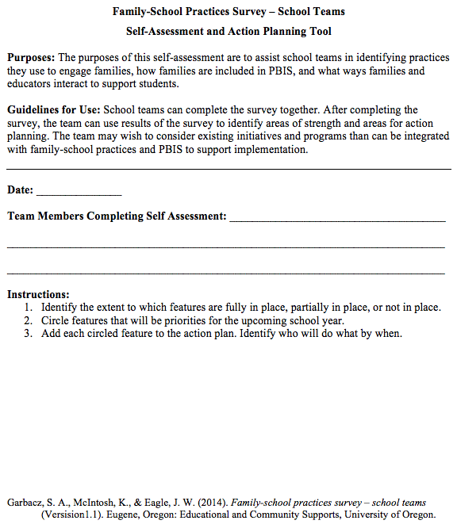
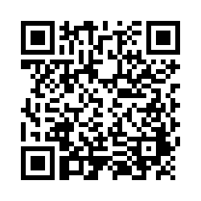
Examining School Approaches to Family Engagement in PBIS
The Family-School Practices Survey for school teams is a self-assessment and action planning tool.
Approaches to family engagement are assessed in several areas:
Communication
Family-School Activities
PBIS Practices at Home and School
Decision-Making/Shared-Ownership
Resources
(Garbacz, McIntosh, & Eagle, 2014)
Notes:
Take a few minutes to complete the self-assessment, identify areas of strength and need, and complete the action plan at the end of the tool to target areas of need that build on strengths
Link to assessment: https://uconn.co1.qualtrics.com/jfe/form/SV_4U9QPw9ASvLr83z

Slide 148
ACTIVITY: Family-School Practices Survey
As a team:
Complete the Family-School Practices Survey
Add 2 to 3 items to your action plan based on priorities discussed while completing the survey
Identify one person who will present big ideas from action planning for your group
20 minutes
Notes:
Family School Practices Survey: https://uconn.co1.qualtrics.com/jfe/form/SV_4U9QPw9ASvLr83z

Slide 149
WHOLE GROUP DEBRIEF:
Family-School Practices Survey
What did your team identify as strengths as a result of completing this self-assessment?
What action steps will you take to enhance family engagement at your school?
5 minutes

Slide 150
Team
Action Planning Time

Slide 151
Use this time to continue working on...
Strengthening Implementation
  Progress monitoring
  Data sources and routines
  Family engagement
Data-based Decision-making
  Precise problems
  Outcomes
Classroom PBIS
  Practices
TFI Self-Assessment to check on implementation
Incorporate data routines into team meetings
Plan for School Climate Surveys
Complete Family-School Practices survey
Identify action steps
Identify 1-2 precise problems, outcomes, solutions and implementation plans
Plan explicit training for classroom educators
Gather fidelity data on classroom expectations
135 mins

Slide 152
WHOLE GROUP DEBRIEF: Action Planning
Strengthening Implementation
  Progress monitoring
  Data sources and routines
  Family engagement
Data-based Decision-making
  Precise problems
  Outcomes
Classroom PBIS
  Practices
Share one or more team accomplishments from today.
What further support will you need to complete these action steps?
TFI Self-Assessment to check on implementation
Incorporate data routines into team meetings
Plan for School Climate Surveys
Complete Family-School Practices survey
Identify action steps
Identify 1-2 precise problems, outcomes, solutions and implementation plans
5 minutes
Plan explicit training for classroom educators
Gather fidelity data on classroom expectations

Slide 153
Review

Slide 154
Critical Features
Systems
Practices
Data
Equity
Outcomes

Slide 155
GETTING STARTED WITH PBIS
1
Establish an effective leadership team
6
Develop a continuum of responses to increase use of SEB skills
2
Develop a brief statement of purpose & define outcomes
7
Develop a continuum of responses to decrease SEB errors
3
Identify positive school-wide behavior expectations
8
Develop systems to support staff
4
Develop procedures to teach school-wide expectations
9
Use data for decision-making
5
Develop procedures to teach class-wide expectations
10
Promote sustainability

Slide 156
Once data routines are established…
1. Identify the RIGHT data
Outcome data tied to goals
Fidelity data tied to evaluation plan
3. Identify the RIGHT people
Who needs to see these data to inform decisions? (e.g., PBIS team, grade level teams, family groups, other committees?)
4. Identify the RIGHT time & format
When/how often should these data be reviewed to inform decisions?
What format will facilitate decision making?
2. Assess data integrity
Consider staff training & engagement, systems, response rates
…use the data to guide decision-making!

Slide 157
Supporting and Responding to Students’ SEB Needs
1. Create Positive Teaching and Learning Environments
Design a Safe Environment
2. Actively Promote SEB Growth
Engage Students in Relevant Learning
3. Monitor Fidelity and Use Data to Guide Implementation
Monitor Educator Implementation
4. Monitor Student Outcomes and Use Data to Guide Response
Establish Positive Connections
Develop Predictable Routines
Define and Teach Positive Expectations
Plan Relevant Instruction
Foster Positive Relationships
Prompt and Supervise SEB and Academic Skills
Provide Specific Feedback (> 5 : 1 Ratio)
Consider Other Response Strategies
Provide Training, Coaching, and Feedback
If data indicate implementation challenges...
Monitor Student Outcomes
Enhance Tier 1
If many students make ongoing SEB errors...
Enhance Tier 1 and Consider Tiers 2 and 3
If few students make ongoing SEB errors...

Slide 158
INITIAL STEP: Monitor Fidelity
Did this actually happen?
How can we know?
As part of rollout, classroom educators
align their classroom expectations with the schoolwide expectations
explicitly teach classroom expectations to students

Slide 159
Family Engagement in PBIS
Reviews the reasons for family engagement in schools
Identifies practical strategies for promoting and supporting family engagement
Considers family engagement across diverse contexts and groups
(Center on PBIS, 2017)
Notes:
Aligning and Integrating Family Engagement in Positive Behavioral Interventions and Supports: https://www.pbis.org/Common/Cms/files/pbisresources/Family%20Engagement%20in%20PBIS.pdf

Slide 160
Preview of
Day 8

Slide 161
YEAR 2: Implement and Strengthen
DAY 7
DAY 8
Systems
DAY 9
Data
Practices
Tier 1 Check In
Family Engagement
Culture of Wellness
Crisis and Emergency Response Planning
Precise Problems and Outcomes
Equity Review
Evaluation
Strengthen
Classroom
Data-based Decision-Making

