Slide 1
TRAINER INFORMATION
This free and accessible training material is provided through the Northeast PBIS Network and can be found at https://nepbis.org/.
School teams are highly encouraged to contact a
PBIS State Coordinator or an NEPBIS Endorsed Trainer
for training opportunities.
If you are an experienced trainer and would like access to to our coordinating trainer workbook which offers training guidance, please email us at nepbis@uconn.edu.

Slide 2
TRAINER NOTES
This is Day 6 of an 11 day, 3 year training sequence.
CONTENT
OUTCOMES
At the end of day six, teams should understand:
how to gather relevant data to inform continuous decision-making about Tier 1 practices and implementation
how to promote sustained implementation
Step 9: Using Data for Decision-Making
Student behavior data
School and community data
Fidelity of PBIS implementation
Evaluation of plan
Step 10: Promoting Sustainability
identify a schoolwide behavior problem and potential solution
evaluate perceptions of school climate for students, staff, families
assess and evaluate PBIS fidelity of implementation
plan for ongoing implementation
For more information and guidance related to training this content please see the NEPBIS trainers’ manual located here: https://nepbis.org/training-of-trainers-workbook-supplemental-materials/

Slide 3
SAMPLE AGENDA
8:30 | Introduction and Review | 15
8:45 | Data Based Decision Making (Step 9) and Break | 150
11:15 | Promoting Sustainability (Step 10) | 60
12:15 | Lunch | 30
12:45 | Quick Review | 15
1:00 | Team Time | 165
3:45 | Wrap Up | 15

Slide 4
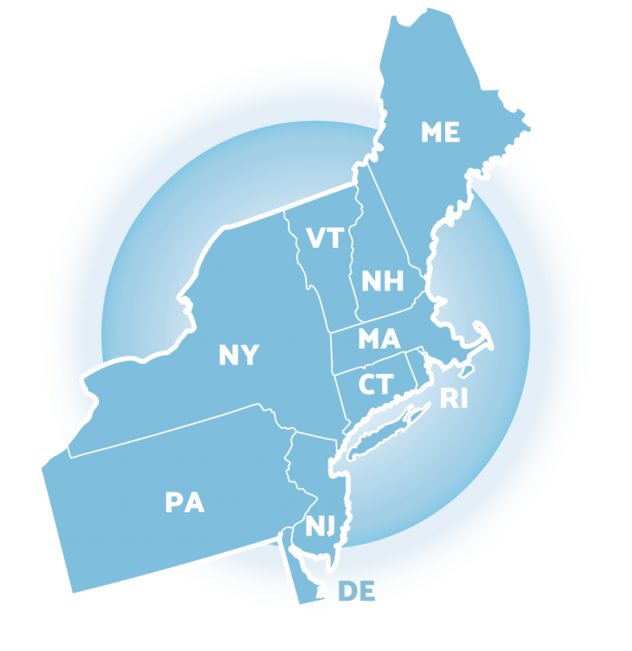
NEPBIS School-Wide Team Training
Year 1 Day 6
INSERT TRAINER NAMES HERE
with support from
Karen Robbie, Jen Freeman,
Brandi Simonsen, Katie Meyer,
Adam Feinberg & Susannah Everett
Notes:
Trainers: refer to training manual for:
Tips on presenting the overview content
Explanation for short activity periods and ideas for teaching this to teams
Ideas for facilitating review and team action planning

Slide 5
POSITIVE BEHAVIOR INTERVENTIONS & SUPPORTS (PBIS)

Slide 6
WHO'S HERE?
Who's here?
LIST SCHOOLS IN COHORT HERE
(List the schools in your cohort here)
Notes:
TRAINER NOTE: Give teams several minutes each to introduce themselves and their school- including any previous experiences with PBIS.

Slide 7
NEPBIS SCHOOL-WIDE TRAINING MODEL
Year 1
Exploration and Installation of 10 Getting Started Steps
Year 2
Initial Implementation of 10 Getting Started Steps
Year 3+
Full Implementation and Continuous Improvement of Implementation
6 days of team training + 3 days of coach training
3 days of team training + 3 days of coach meeting
On-going Professional Development and Support
(minimum of 2 days of team training + 2 days of coach training annually)

Slide 8
YEAR 1: Getting Started with PBIS
DAY 1
Step 1: Establish an effective leadership team
DAY 2
Step 2: Develop a brief statement of purpose & define outcomes
Step 3: Identify positive school-wide behavior expectations
Step 4: Develop procedures to teach school-wide expectations
DAY 3
Step 5: Develop procedures to teach class-wide expectations
Step 6: Develop a continuum of responses to increase use of SEB skills
DAY 4
Step 7: Develop a continuum or responses to decrease SEB errors
DAY 5
Step 8: Develop systems to support staff
DAY 6
Step 9: Use data for decision-making
Step 10: Promote sustainability

Slide 9
TRAINING SCHEDULE
TRAINERS:
USE THIS SLIDE TO INSERT YOUR TRAINING SCHEDULE FOR THE CURRENT YEAR

Slide 10
nepbis.org
TOOLS
Tier 1 Schoolwide
Tier 1 Team Training Materials
Tier 1 Supplemental Resources
School Team Implementation Guide
responses for activities
document plans
develop artifacts
Slides for each training day
Notes:
TRAINERS: Go directly to https://nepbis.org/ and demonstrate how to access relevant materials.

Slide 11
WEBSITES
pbisapps.org
pbis.org

Slide 12
LEGEND
ORGANIZATION
ACTIVITY
NEW
CONTENT
PREVIEW
REVIEW

Slide 13
LEGEND
Timing
Example
Activity
Non-example
Guidelines
Preview
Big Idea
Review
Organization

Slide 14
EXPECTATIONS
 | Individually | Working with Others
Respect Self | Participate Converse with others in lobbies and during breaks Stretch, break, stand as needed | Engage with the training content and activities
Respect Others | Complete assigned tasks Return from breaks on time | Provide room for every voice Reinforce participation
Respect Environment | Keep devices silent Have your computer charged and ready Keep necessary materials at hand | Maintain a neat, orderly work space

Slide 15
AGENDA AND ACTION STEPS
Step 9: Using Data for Decision-Making
Student behavior data
School and community data
Fidelity of PBIS implementation
Plan evaluation
Step 10: Promoting Sustainability
identify a schoolwide behavior problem and potential solution
evaluate perceptions of school climate for students, staff, families
assess and evaluate PBIS fidelity of implementation
plan for ongoing implementation

Slide 16
Quick Review

Slide 17
Continuum of School-Wide Instructional & Positive Behavior Support
What do we do for the FEW needing intensive support?
Tertiary Prevention:
Specialized
Individualized
Systems for Students with High-Risk Behavior
What do we do for ALL?
Primary Prevention:
School-/Classroom-
Wide Systems for
All Students,
Staff, & Settings
~5%
~15%
What do we do for the SOME needing more support?
Secondary Prevention:
Specialized Group
Systems for Students with
At-Risk Behavior
~80% of Students

Slide 18
Critical Features
Systems
Practices
Data
Equity
Outcomes

Slide 19
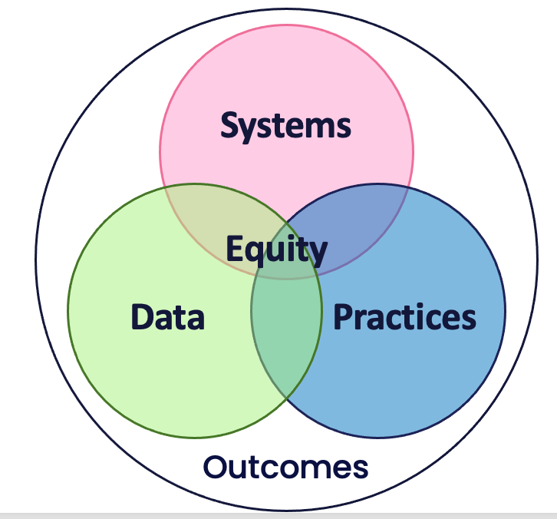
Culture and Context of the School Community

Slide 20
GETTING STARTED WITH PBIS
1
Establish an effective leadership team
6
Develop a continuum of responses to increase use of SEB skills
2
Develop a brief statement of purpose & define outcomes
7
Develop a continuum of responses to decrease SEB errors
3
Identify positive school-wide behavior expectations
8
Develop systems to support staff
4
Develop procedures to teach school-wide expectations
9
Use data for decision-making
5
Develop procedures to teach class-wide expectations
10
Promote sustainability

Slide 21
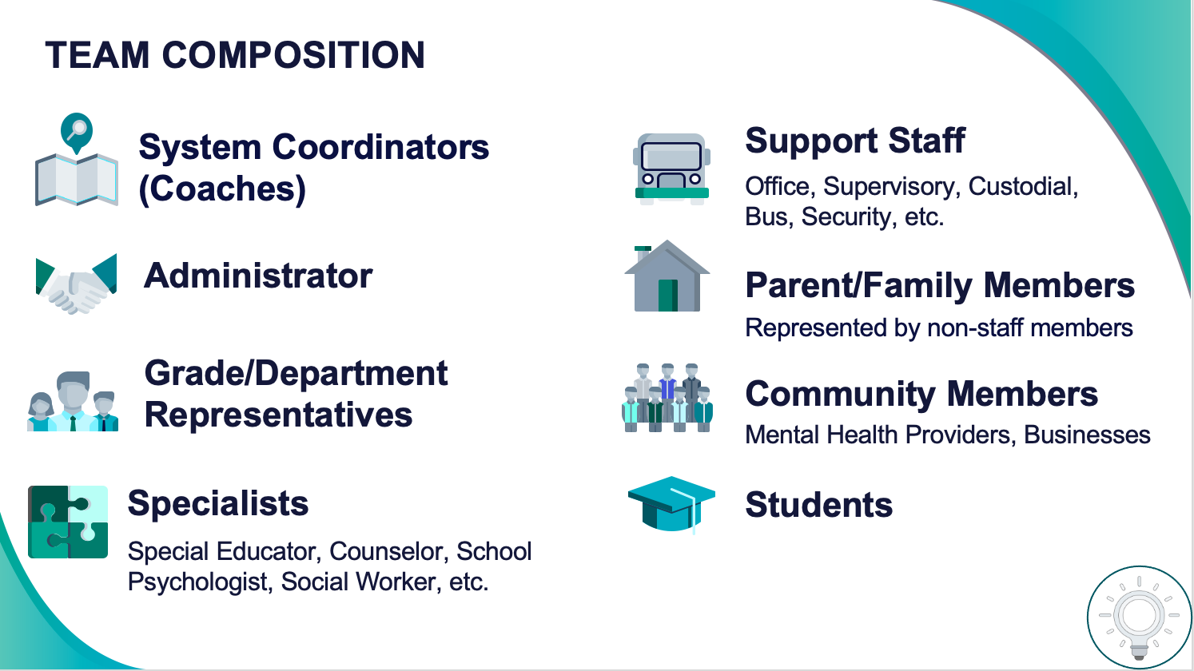
1
Establish an effective leadership team
Systems
Supports Relevance & Equity
Improves student outcomes
Promotes Engagement
Notes:
Your first step is to create a representative team to lead your school’s PBIS efforts.

Slide 22
2
Develop a brief statement of purpose & define outcomes
Practices
What do we hope to achieve by implementing PBIS?
"Our mission is to provide a positive, safe, healthy, nurturing and respectful environment in which all students have the opportunity to become productive members of society."
Purpose
“As a result of implementing PBIS during the 20XX-20XY school year, student reports of school climate will improve by 20%.”
Outcome
Notes:
You’ll then focus your school’s PBIS efforts by creating a statement of purpose to identify your hopes and goals for PBIS implementation.

Slide 23
3
Identify positive school-wide behavior expectations
Practices
Notes:
Your team will work with your school community to uncover what you value and use those values to identify your schoolwide expectations

Slide 24
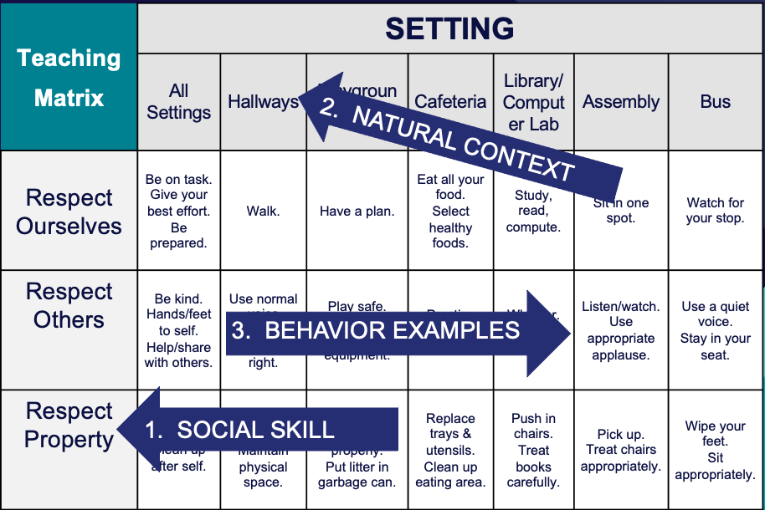
4
Develop procedures to teach school-wide expectations
Practices
Define
Teach
Prompt
Monitor
Evaluate
Notes:
Using those identified expectations, you’ll define what those expectations look and sound like in key routines/settings throughout your school. This is organized through a behavioral matrix. Using the schoolwide matrix, your team will develop lessons that will be explicitly taught to students at the beginning of the year (and boosted throughout the year) so that they know how to be successful within each context (like the hallway, cafeteria, assemblies, etc.)

Slide 25
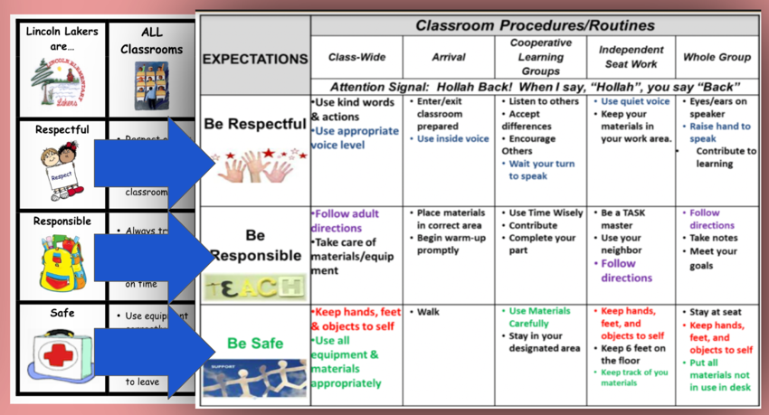
5
Develop procedures to teach class-wide expectations
Practices
Notes:
Once the schoolwide expectations have been determined, classroom educators will apply the behavior matrix format to the routines and settings within their classrooms. They will also explicitly teach the expectations to their students throughout the year.

Slide 26
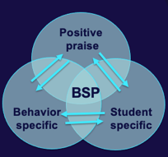
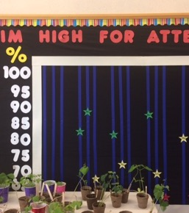
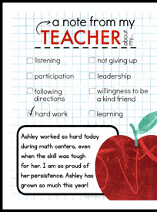
6
Develop a continuum of responses to increase use of SEB skills
Practices
Notes:
To encourage contextually appropriate behaviors to occur, you'll support educators to provide frequent specific feedback and praise. To promote this critical practice, you’ll develop recognition/acknowledgement systems for both students and staff.

Slide 27
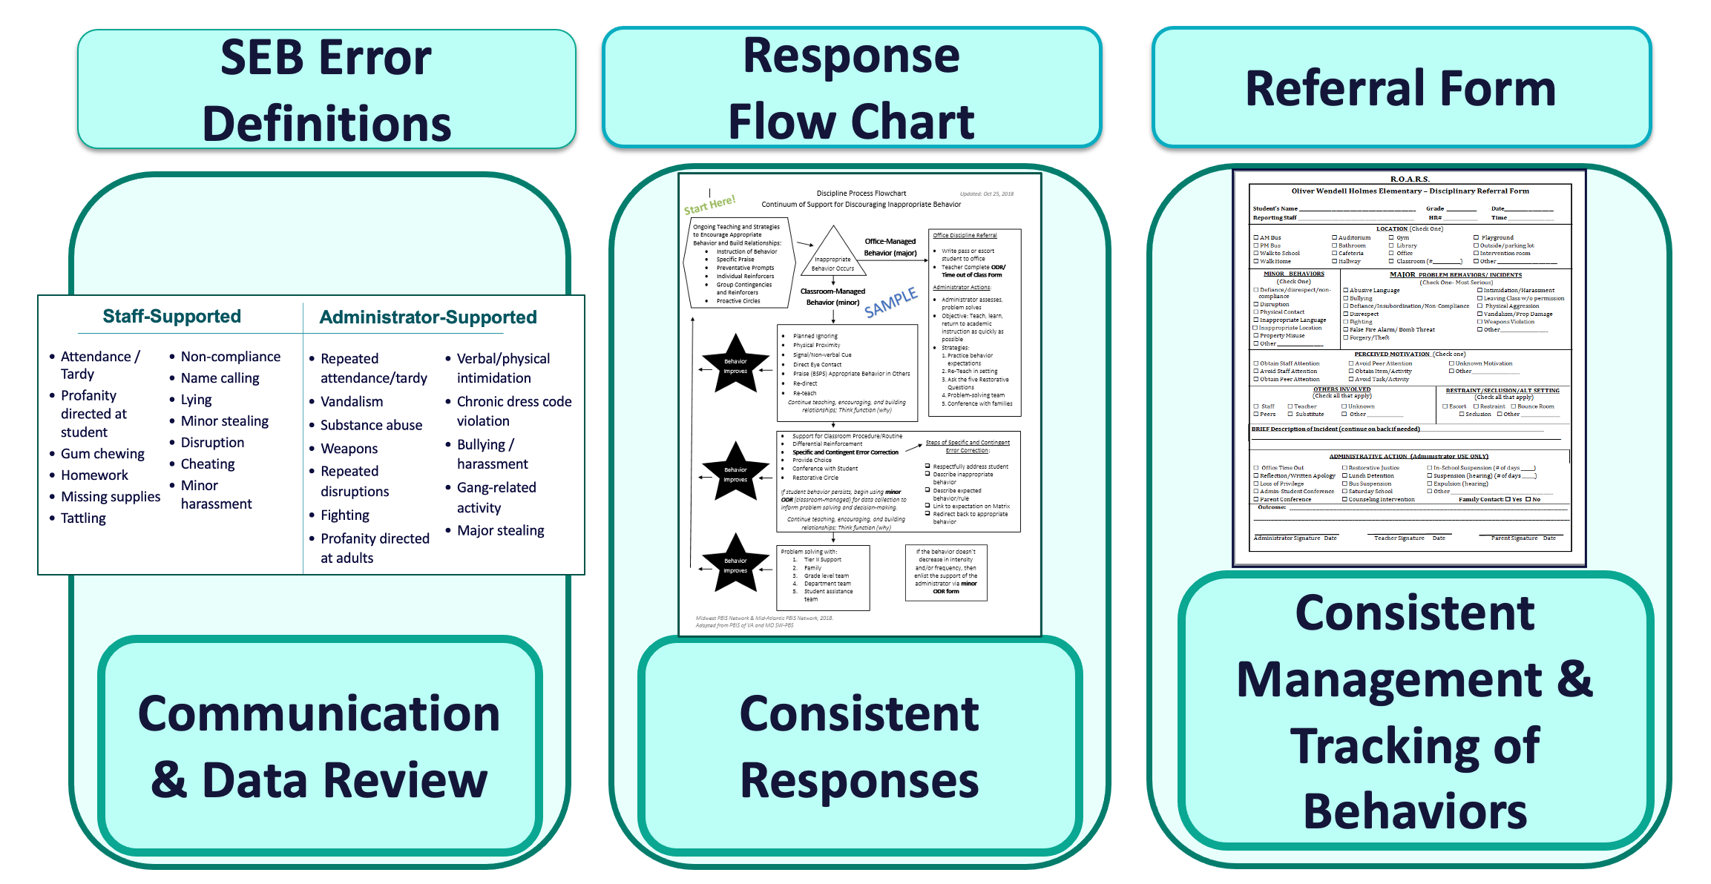
7
Develop a continuum of responses to decrease SEB errors
Practices
Notes:
You will also clarify how staff should respond when contextually inappropriate behaviors occur by clearly defining, determining who’s responsible for responding, identifying clear responses, and recording the behaviors.

Slide 28
8
Develop systems to support staff
Promoting and Sustaining Staff Engagement
Continuous Action Planning
Team-Based Implementation
Systems
Embedded and Ongoing Professional Development
Staff Recognition
Data Routines

Slide 29
9
Use data for decision-making
Data
Assess fidelity of PBIS implementation at least annually
Review student behavior data at least monthly
Use school and community data regularly
Evaluate your plan annually
Develop, inform, and refine Tier 1
TODAY'S FOCUS

Slide 30
10
Promote sustainability
Systems
TODAY'S FOCUS

Slide 31
Regularly using data for decision making is one of the key predictors of reduced disproportionality!
Data
STEP 9:
USING DATA FOR
DECISION-MAKING
How do we know if we are doing what we planned to do and if it is having the impact we hoped to have?
assess and evaluate PBIS fidelity of implementation
identify a schoolwide behavior problem and potential solution
evaluate perceptions of school climate for students, staff and families

Slide 32
Why Use Data for Decision Making?
Decisions are more likely to be
effective and efficient when they are based on data.
The quality of decision making depends most on defining problems with precision & clarity.
Data help
place the “problem” in the context
rather than in the students.
Use data to:
identify problems
refine problems
define the questions that lead to a solution
monitor implementation and outcomes
guide implementation
engage in problem solving

Slide 33
Why use data for decision-making?
To continuously improve
your Tier 1 framework!
Are we achieving our desired outcomes?
Which groups are benefiting from our plan? Which are not?
Are we implementing as planned?
What needs to be strengthened? Revised?
Are students receiving adequate support to achieve positive outcomes?

Slide 34
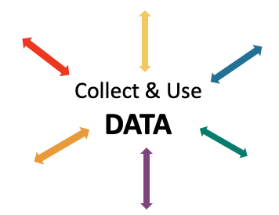
Data INFORMS and GUIDES your work
IDENTIFY PROBLEM
with precision
IDENTIFY GOAL
for change
IDENTIFY SOLUTION
and implementation plan
IMPLEMENT SOLUTION
with fidelity
MONITOR & EVALUATE
implementation fidelity and impact
MAKE DECISION
to maintain, modify, or terminate plan
(Chaparro, E., et. al, 2022)

Slide 35
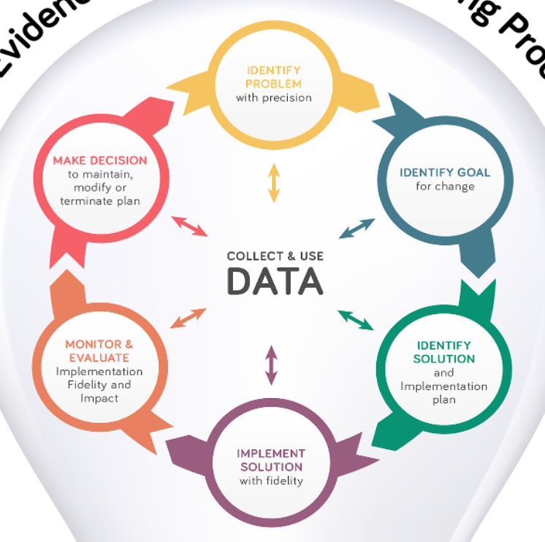
Once data routines are established…
1. Identify the RIGHT data
Outcome data tied to goals
Fidelity data tied to evaluation plan
3. Identify the RIGHT people
Who needs to see these data to inform decisions? (e.g., PBIS team, grade level teams, family groups, other committees?)
4. Identify the RIGHT time & format
When/how often should these data be reviewed to inform decisions?
What format will facilitate decision making?
2. Assess data integrity
Consider staff training & engagement, systems, response rates
…use the data to guide decision-making!

Slide 36
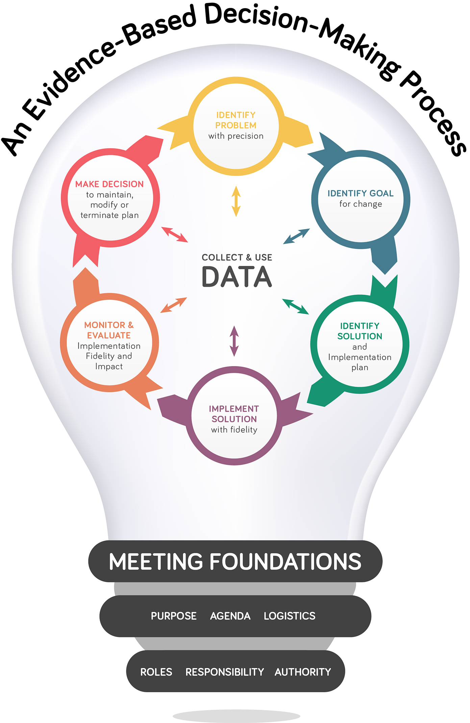
(Chaparro, E., et. al, 2022)
Notes:
How School Teams Use Data to Make Effective Decisions: https://www.pbis.org/resource/how-school-teams-use-data-to-make-effective-decisions-team-initiated-problem-solving-tips

Slide 37
IDENTIFY PROBLEM
with precision
IDENTIFY GOAL
for change
IDENTIFY SOLUTION
and implementation plan
IMPLEMENT SOLUTION
with fidelity
MONITOR & EVALUATE
implementation fidelity and impact
MAKE DECISION
to maintain, modify, or terminate plan
Collect & Use
DATA
(Chaparro, E., et. al, 2022)

Slide 38
What data? How often? What do we use it for?
Assess fidelity of PBIS implementation at least annually
Review student behavior data at least monthly
Use school and community data regularly
Evaluate your plan annually
Develop, inform, and refine Tier 1

Slide 39
Assess Fidelity of PBIS Implementation at Least Annually

Slide 40
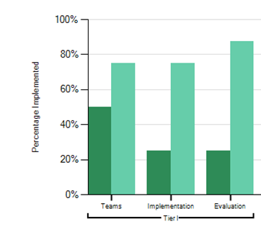
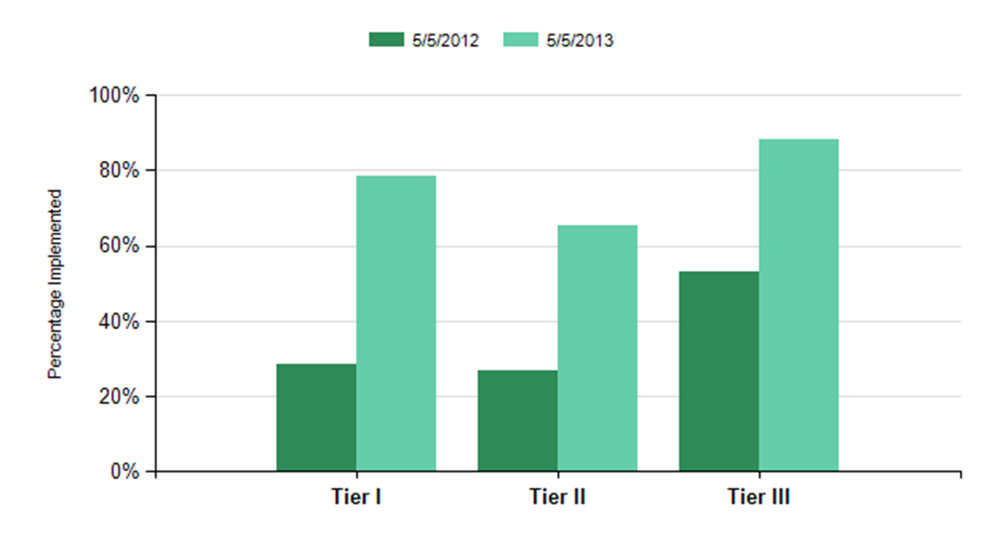
Tiered Fidelity Inventory (TFI)
Why? | Assess evidence of critical features of school-wide PBIS implementation Monitor progress over time Helps team make data-based decisions on intervention and program efficacy Guides action-planning
What? | Survey ratings of features in place. About 30-45 mins per tier.
Who? | Team members with the coaches. Walkthrough tool completed by external coach.

Slide 41
ACTIVITY: Assess Fidelity of PBIS Implementation at Least Annually
Review your school’s most recent Tiered Fidelity Inventory (TFI) data as a team.
What feature(s) are highest priority for improvement for your team? How will move your implementation forward in those key areas?
Add items to your Action Plan as necessary.
Be ready to present 2-3 “big ideas” from your discussion.
10 minutes

Slide 42
WHOLE GROUP DEBRIEF: Assess Fidelity of PBIS Implementation at Least Annually
What TFI features are high priority for your team?
What action planning is required?
What further support will you need to do this?
5 minutes

Slide 43
Review Student Behavior Data at Least Monthly

Slide 44
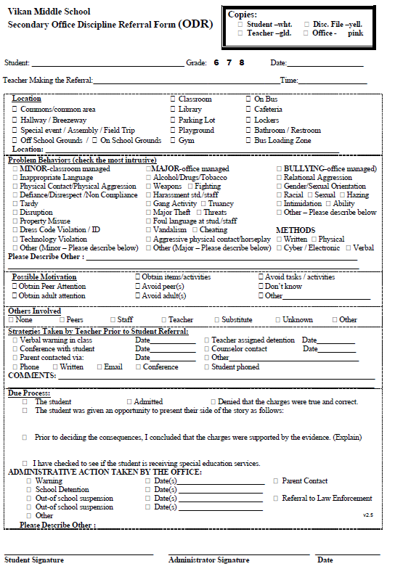
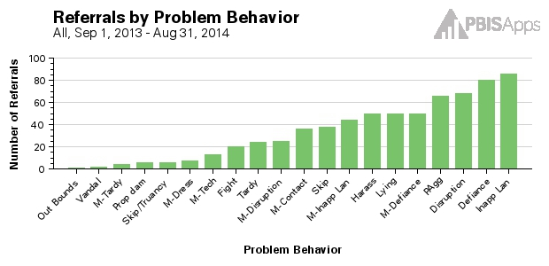
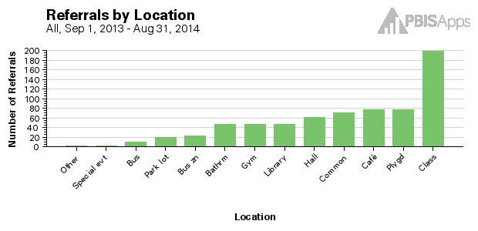
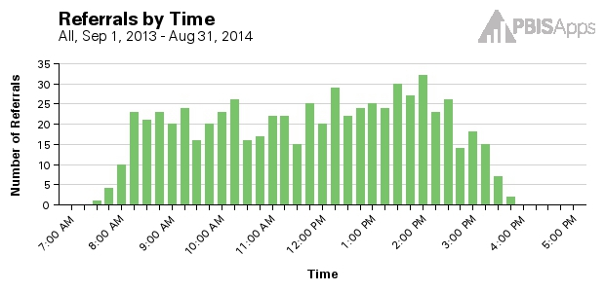
Gather Incidents
Analyze Trends
Referrals by Problem Behavior
Referrals by Location
Referrals by Time of Day
…Ask Questions

Slide 45
Average Referrals Per day Per Month
Referrals Per Location
Do we have a school wide problem with behavior
(Tier 1)?
Where is our big problem area?

Slide 46
Referrals by Problem Behavior
Referrals by Grade
What contextually inappropriate behavior happens most frequently?
What grade levels need more support?

Slide 47
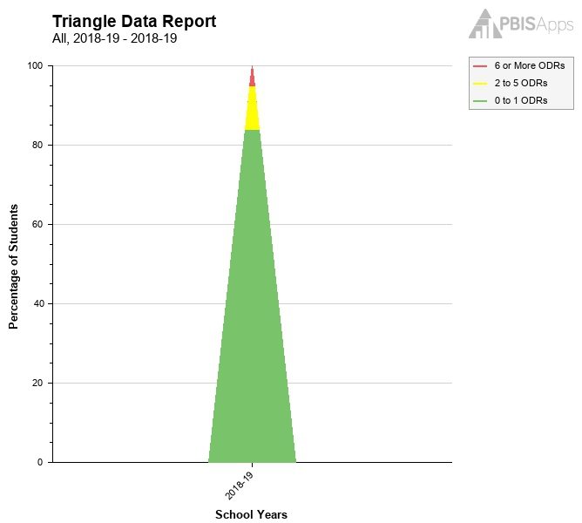
Triangle Report
Referrals by Time of Day
When do problems occur?
Are students responding to our systems?

Slide 48
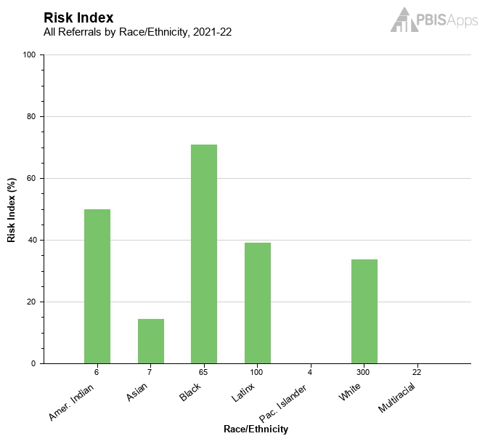
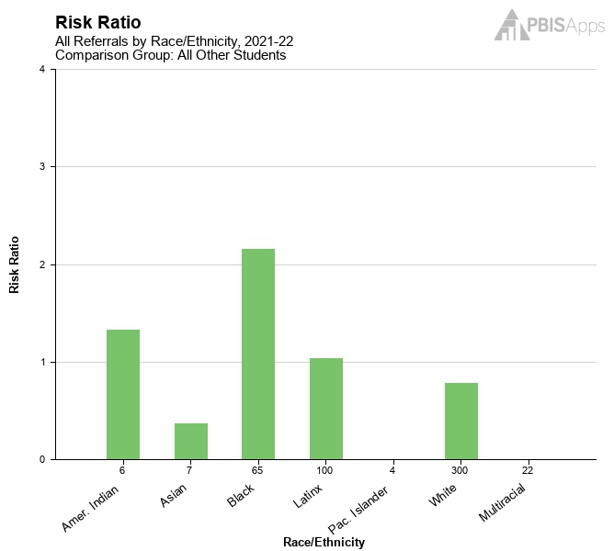
Risk Index
Risk Ratio
What is the risk for students within each group to receive a referral?
For a given group of students, how much more or less likely are they to receive at least one referral than students from another group?

Slide 49
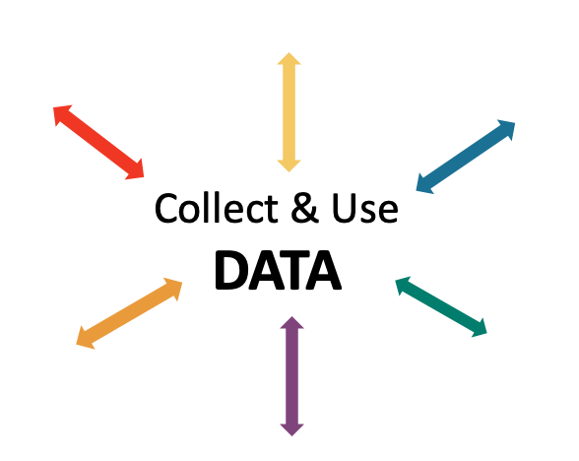
Problem Solve
IDENTIFY PROBLEM
with precision
IDENTIFY GOAL
for change
IDENTIFY SOLUTION
and implementation plan
IMPLEMENT SOLUTION
with fidelity
MONITOR & EVALUATE
implementation fidelity and impact
MAKE DECISION
to maintain, modify, or terminate plan
(Chaparro, E., et. al, 2022)

Slide 50
EXAMPLE: Reviewing & Analyzing School-wide Behavior Data to Develop, Inform, and Refine Tier 1
IDENTIFY PROBLEM
IDENTIFY GOAL
IDENTIFY SOLUTION
IMPLEMENT SOLUTION
MONITOR & EVALUATE
MAKE DECISION
Most referrals were given when students didn’t throw away trash.
Booster lessons, prompts and acknowledgement continued
Increase rate of students throwing away trash
During a monthly meeting PBIS Leadership Team at Miller Middle School, the data analyst showed that referrals from the cafeteria had doubled from the previous month. Upon further review, 75% of the referrals were for disrespect.
Teach students clean up procedures; provide frequent prompts and acknowledgement
Referrals from the cafeteria were reviewed by the team for the next 3 months; referrals for disrespect steadily decreased
PBIS team members paired with the cafeteria monitors during lunch blocks to teach, prompt, acknowledge

Slide 51
NON-EXAMPLE: Reviewing & Analyzing School-wide Behavior Data to Develop, Inform, and Refine Tier 1
At Portview High School, an increasing number of students were late to advisory block.
Because there were no systems to set up to monitor implementation or evaluate impact, there was a small decrease in late arrivals but, after a week previous patterns returned.
IDENTIFY PROBLEM
IMPLEMENT SOLUTION
Students were late to advisory
Staff were asked to prompt students lingering in the hall

Slide 52
EXAMPLE: Reviewing & Analyzing School-wide Behavior Data to Develop, Inform, and Refine Tier 1
Average daily support request calls due to safety concerns from the playground > 5.
IDENTIFY PROBLEM
IDENTIFY GOAL
IDENTIFY SOLUTION
IMPLEMENT SOLUTION
MONITOR & EVALUATE
MAKE DECISION
Support call requests decreased slightly. Team modifys plan by providing booster PD on active supervision to all duty teachers
Students demonstrate safety while on the playground
At Central School, behavior support staff were being called to the playground several times each day due to safety concerns.
Increase active supervision and reinforce students who demonstrate safe behavior
Rates of average daily support request calls are reviewed weekly by the PBIS coach
Duty teachers asked to deliver 5 schoolwide acknowledgement tickets each recess. Tickets are entered into a weekly raffle for students and staff.

Slide 53
ACTIVITY: Using School-wide Behavior Data for Decision-Making
Review your school-wide behavior data.
Apply the decision-making steps to 1 current problem in your school.
Add to your action plan, as needed.
Be prepared to share 2-3 big ideas with the group.
IDENTIFY PROBLEM
IDENTIFY GOAL
IDENTIFY SOLUTION
IMPLEMENT SOLUTION
MONITOR & EVALUATE
MAKE DECISION
10 minutes

Slide 54
WHOLE GROUP DEBRIEF: Using School-wide Behavior Data for Decision-Making
What problem did you identify within your school?
What data was used to identify the problem?
What data will be used to determine if your implemented solution has an impact?
What further support will you need to do this?
5 minutes

Slide 55
Break

Slide 56
Use School and Community Data Regularly

Slide 57
Sources of data in school
At least...
School climate surveys
(see pbisapps.org)
Office discipline referrals
(see swis.org)
Plus, another existing...
Grades
Attendance
Rates of students referred for additional support and/or identified with disabilities
Academic performance
(e.g., scores on state and district-wide assessments)
Visits to the nurse/counselor
Universal screening

Slide 58
School Climate Survey
Assesses students’, staffs’, and families’ perspective of the overall climate in the building.
Students:
Elementary: grades 3-5
Middle/high: grades 6-12
Brief or extended option
Staff
Family
Make a plan!
Completed in
fall and spring
Notes:
https://www.pbis.org/resource/school-climate-survey-suite

Slide 59
Sources of community data
basic needs (e.g., food and housing)
community resource profiles
health care access
community events
and more…
MORE TO COME

Slide 60
EXAMPLE: Reviewing & Analyzing School and Community Data to Develop, Inform, and Refine Tier 1
Feeling supported by and connected to other teachers at the school were rated lower than other categories.
IDENTIFY PROBLEM
IDENTIFY GOAL
IDENTIFY SOLUTION
IMPLEMENT SOLUTION
MONITOR & EVALUATE
MAKE DECISION
PLCs were prioritized in the next year’s schedule and booster sessions for bolstering effective PLCs were provided.
Increase staff connectedness
On multiple occasions, school personnel at Milton School reported not feeling connected to the school community.
All staff were asked to complete a School Climate Survey in Septemeber.
Provide PD on using a team approach to problem solving and protect time for professional learning communities in the monthly meeting schedule
All staff were asked to complete the school climate survey again in May. Targeted categories showed improvement by 10%
PD was delivered by school counselor and the meeting schedule was rearranged for cross-department PLCs to occur monthly

Slide 61
NON-EXAMPLE: Reviewing & Analyzing School & Community Data to Develop, Inform, and Refine Tier 1
In a family advisory meeting, a few vocal parents raised concerns about not receiving communication from classroom teachers often enough.
Are most families having this experience?
Do specific gaps in classroom-family communication need to be addressed?
IDENTIFY PROBLEM
IMPLEMENT SOLUTION
Increase communication between families and classrooms
All classroom teachers mandated to send out a weekly classroom newsletter

Slide 62
EXAMPLE: Reviewing & Analyzing School and Community Data to Develop, Inform, and Refine Tier 1
Based upon teacher monitoring, students reporting hunger each day doubled compared to the previous month
IDENTIFY PROBLEM
IDENTIFY GOAL
IDENTIFY SOLUTION
IMPLEMENT SOLUTION
MONITOR & EVALUATE
MAKE DECISION
One month after the snacks were provided, daily reports from teachers showed that students reporting being hungry were less that 5%
Provide universal, daily, mid-morning snacks
After a local paper mill closed, many people in town experienced job loss and unemployment. Over time, more and more students came to school without snacks and were complaining about being hungry.
Collaborate with the local social service agency to provide healthy snacks for all students
Classroom teachers continued to record the number of students reporting being hungry each day
A self-serve healthy snack station was set up in each wing of the school from 9-10:30 AM

Slide 63
ACTIVITY: Using School and Community Data for Decision-Making
Identify what school and community data is needed for your team to develop, inform, and refine Tier 1 in your school.
Apply the decision-making steps to 1 current problem in your school.
Add to your action plan, as needed.
Be prepared to share 2-3 big ideas with the group.
IDENTIFY PROBLEM
IDENTIFY GOAL
IDENTIFY SOLUTION
IMPLEMENT SOLUTION
MONITOR & EVALUATE
MAKE DECISION
10 minutes

Slide 64
WHOLE GROUP DEBRIEF: Using School and Community Data for Decision-Making
What problem did you identify within your school?
What data was used to identify the problem?
What data will be used to determine if your implemented solution has an impact?
What further support will you need to do this?
5 minutes

Slide 65
Evaluate Your Plan at Least Annually
Notes:
Preview this only and show them that it will be a part of next year

Slide 66
Evaluating your plan provides opportunities for your team to:
examine whether or not outcomes were achieved
celebrate accomplishments
identify areas to strengthen
share impact and insight with partners

Slide 67
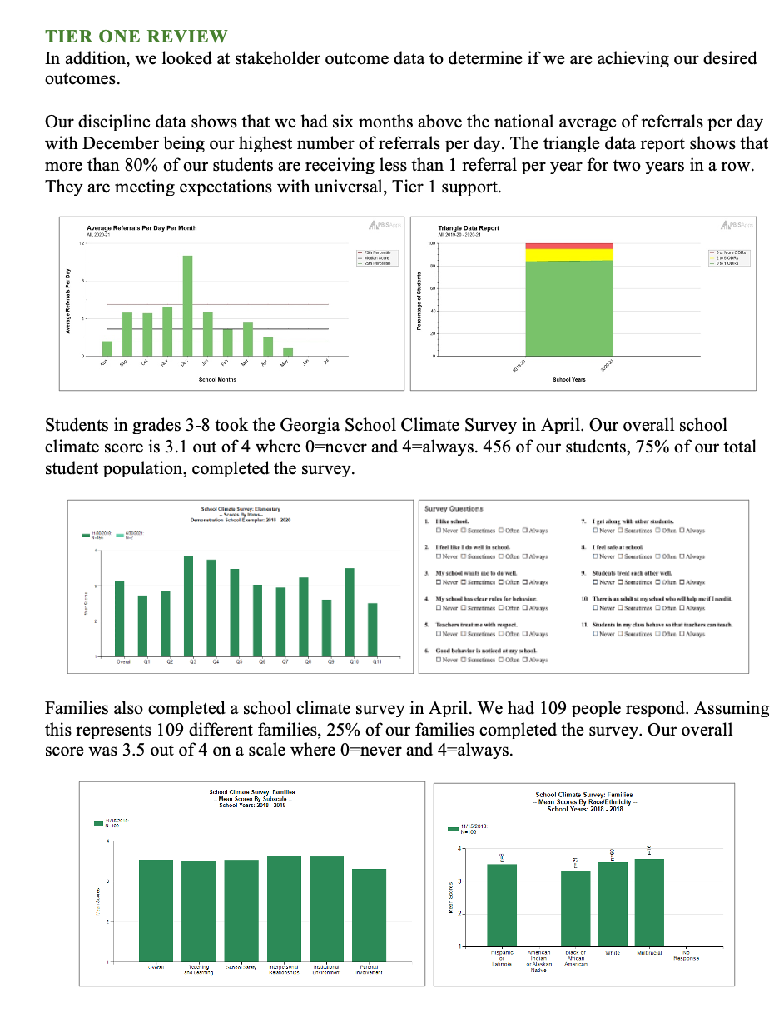
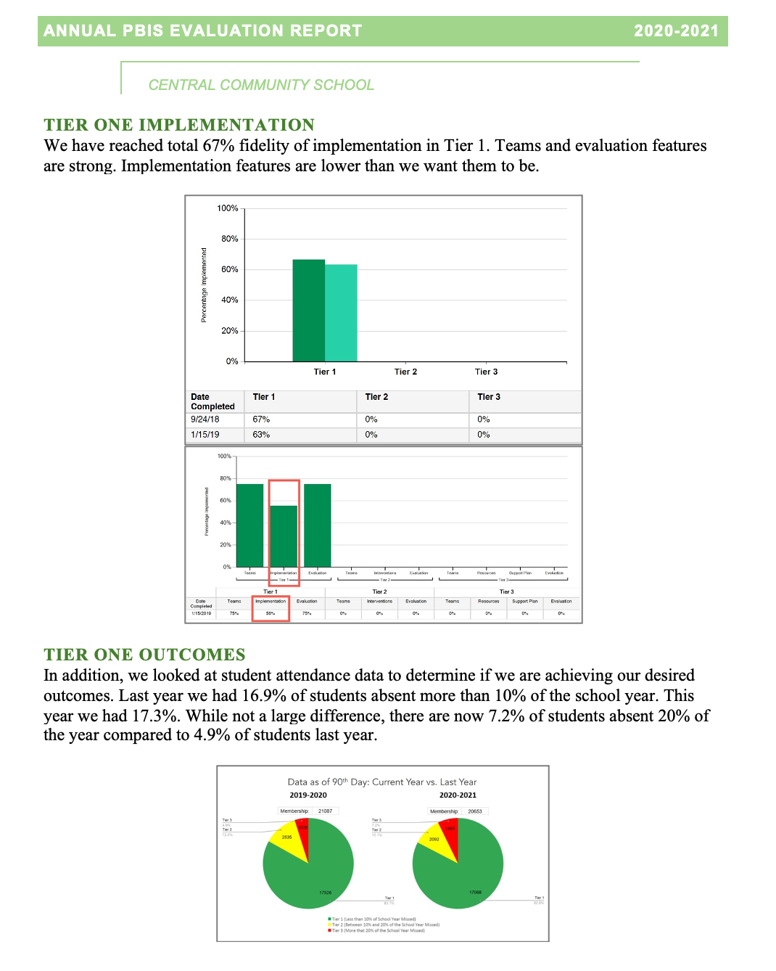
Annual Evaluation Report
Outcome Data
Fidelity Data
Celebrations
Areas to Strengthen
Action Steps

Slide 68
What data? How often? What do we use it for?
Assess fidelity of PBIS implementation at least annually
Review student behavior data at least monthly
Use school and community data regularly
Evaluate your plan annually
Develop, inform, and refine Tier 1

Slide 69
DISCUSSION: Using Data for Decision-Making
What data will your team plan to report out next year?
What systems/routines need to be strengthened to effectively support data-based decision-making?
Add items to your action plan as needed.
Be prepared to report out to the larger group.
Assess fidelity of PBIS implementation at least annually
Review student behavior data at least monthly
Use school and community data regularly
Evaluate your plan annually
Develop, inform, and refine Tier 1
5 minutes

Slide 70
WHOLE GROUP DEBRIEF: Using Data for Decision-Making
What data will your team report out next year?
How will you strengthen your systems/routines to support effective data-based decision-making?
What further support will you need to do this?
5 minutes

Slide 71
STEP 10:
PROMOTING SUSTAINABLITY
How do we keep PBIS going
within our school?
plan for ongoing implementation

Slide 72
GETTING STARTED WITH PBIS
1
Establish an effective leadership team
6
Develop a continuum of responses to increase use of SEB skills
Now what?
2
Develop a brief statement of purpose & define outcomes
7
Develop a continuum of responses to decrease SEB errors
3
Identify positive school-wide behavior expectations
8
Develop systems to support staff
4
Develop procedures to teach school-wide expectations
9
Use data for decision-making
5
Develop procedures to teach class-wide expectations
10
Promote sustainability

Slide 73
How do we keep the pieces all going?
Mark your calendars
Organize resources
Work smarter, not harder

Slide 74
Maintain a school-wide shared calendar including:
Mark your calendar!
Leadership team meeting times
(at least monthly)
School-wide Expectations Teaching and Booster Schedule
(Start Day 1!)
Professional development
Staff updates
(at least quarterly)
Evaluation Plan Routines
“Time is the scarcest resource and unless it is managed nothing else can be managed.” ~Peter F. Drucker

Slide 75
Organize Your Resources
For Staff
Description of PBIS
SW Expectations
School Matrix
Lesson Plans
Overview of Acknowledgement System
Overview of Consequences
Problem behavior definitions
Discipline flowchart
Office Referral form
Request for Assistance form
For Students and Families
Description of PBIS
SW Expectations
School Matrix
Sample Home Matrix
Overview of Acknowledgement System
Problem Behavior Definitions
Overview of Consequences

Slide 76
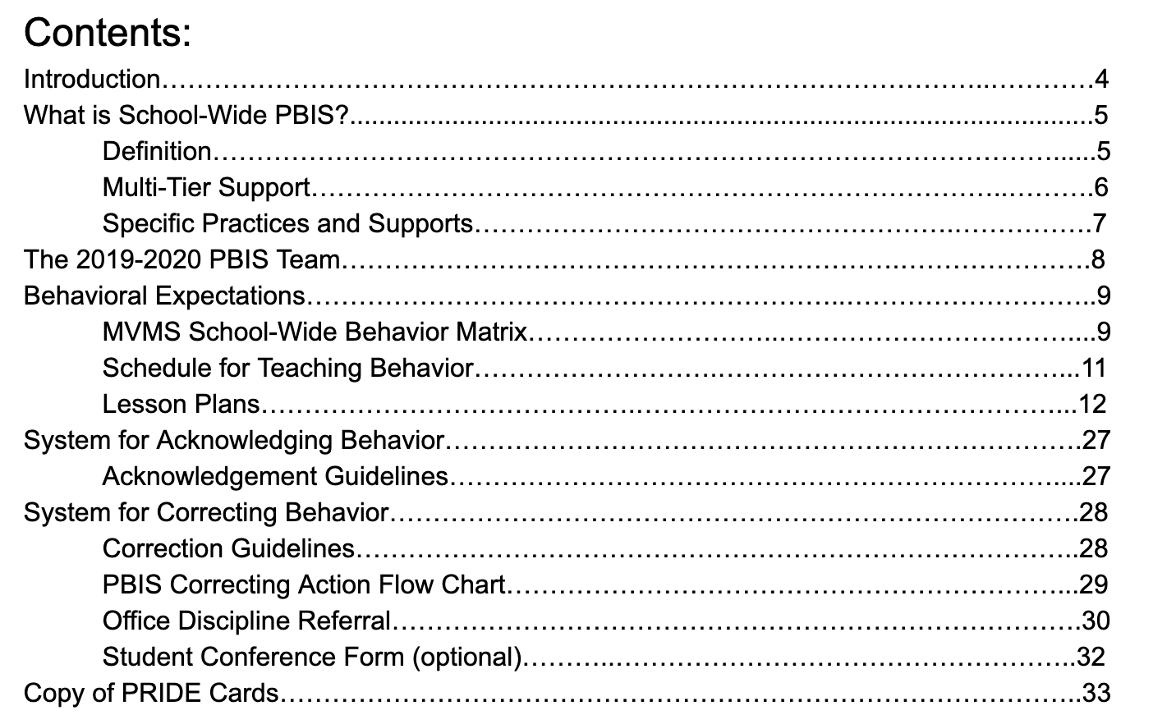
Ensure staff have access to what they need…

Slide 77
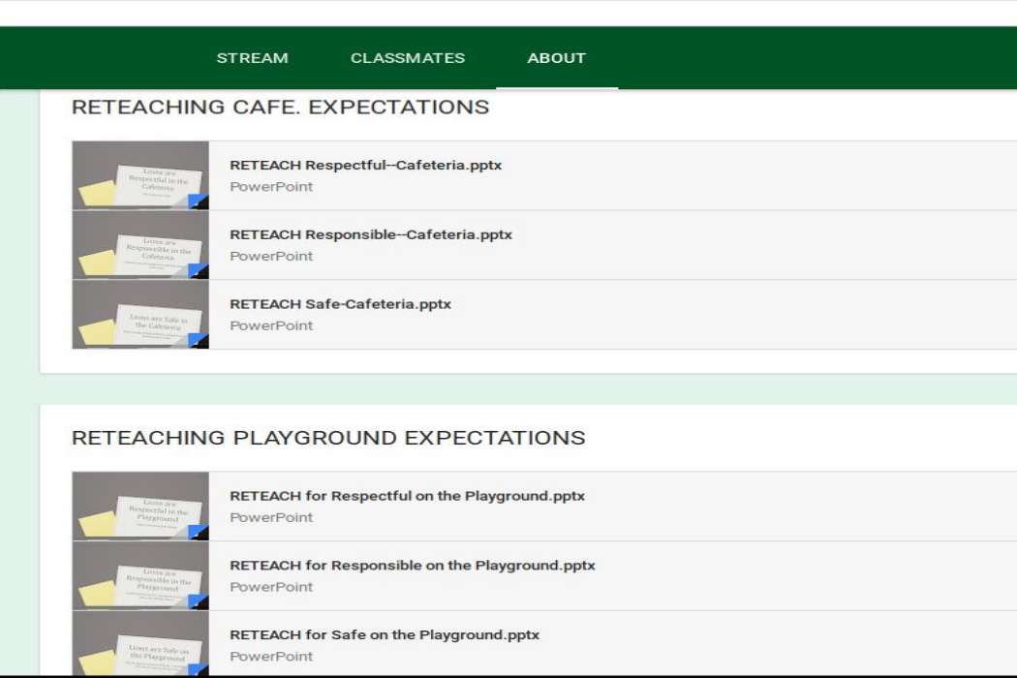
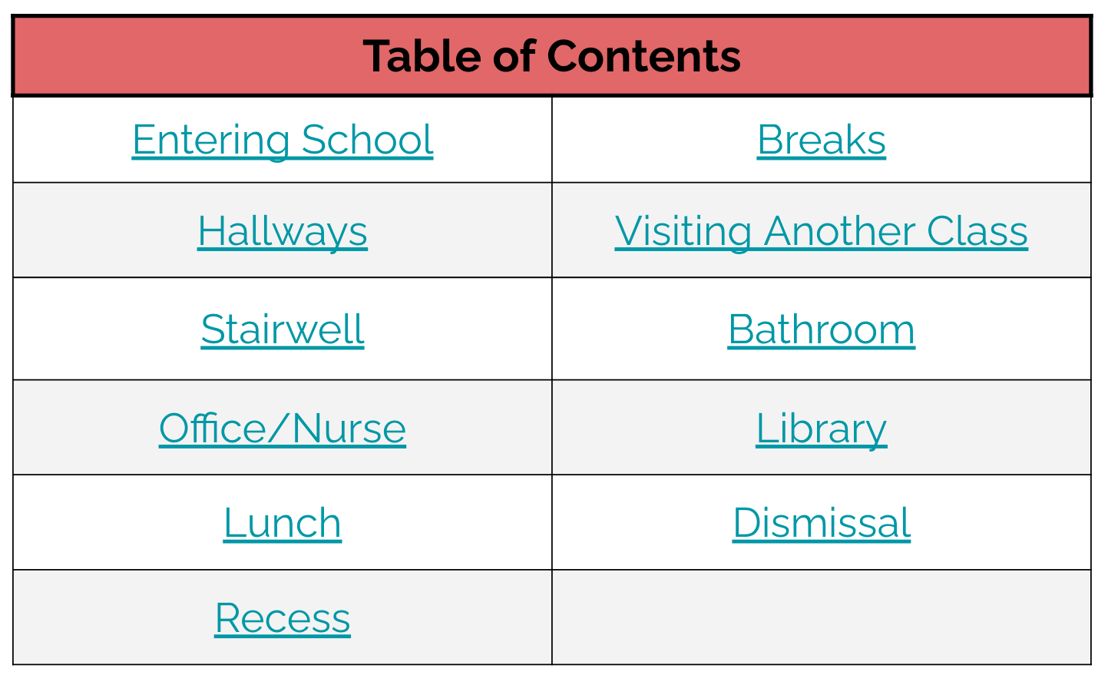
Website with All Resources
Google Classroom
for Staff Only
Shared Doc with Hyperlinks to Resources

Slide 78
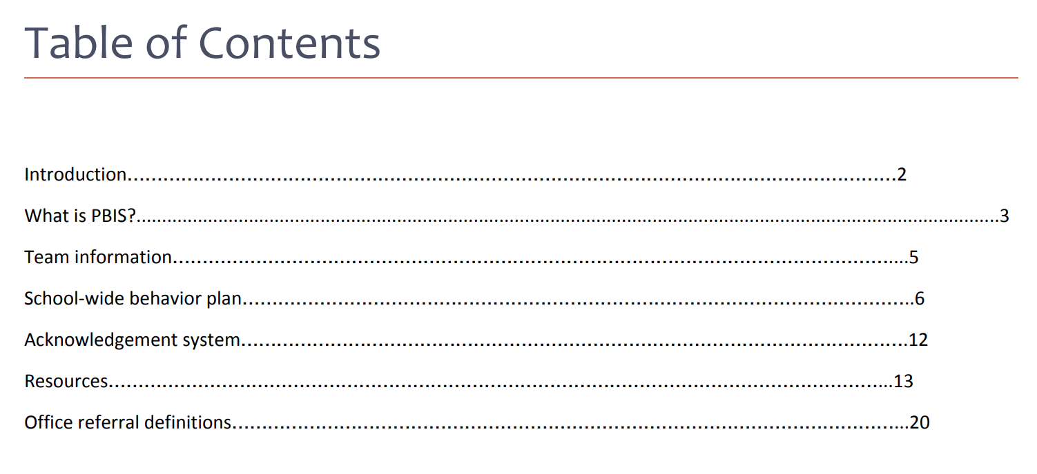
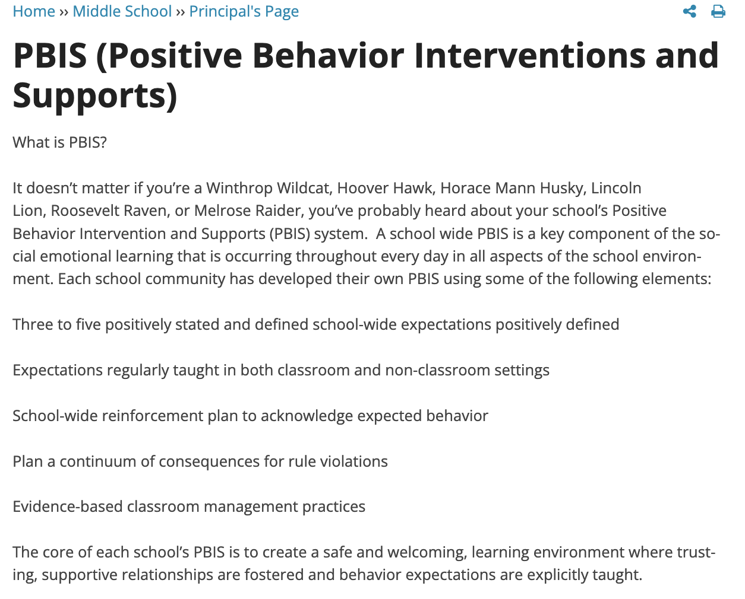
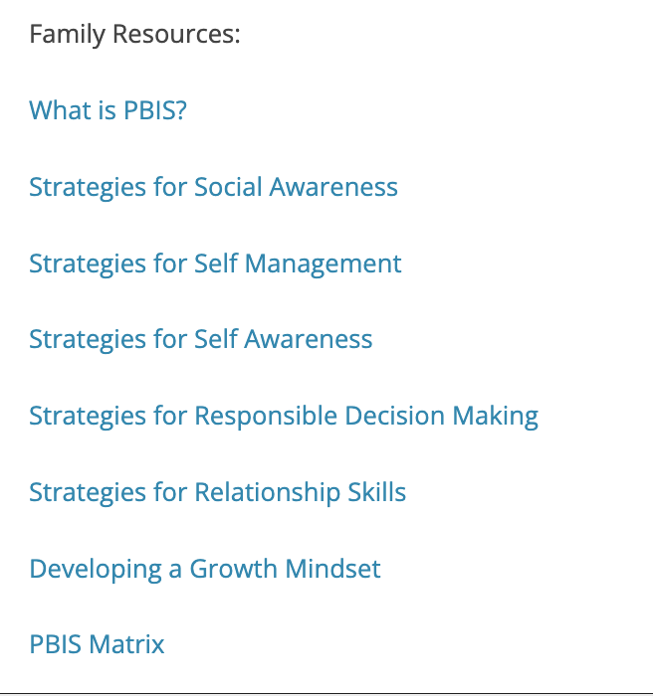
Students and families too…
Student Handbook
(Shared with Families)
School Website

Slide 79
Tri-fold Brochure

Slide 80
Do it once
Do LESS better!
Be strategic
Invest in clear outcomes
Invest in a sure thing
Work SMARTER,
Not HARDER!

Slide 81
Initiative/
Committee/ Team
Purpose & Strategic Goal Supported
Measurable, Data-Based Outcome(s)
Target Group
Staff Involved
Overlap? Modify? Eliminate?
PBIS
Ensure positive, safe, predictable, & consistent environment
Referrals, suspensions, attendance, universal screening, school climate survey
All students, staff, & families
Principal, social worker, 3 general + 1 special ed. teachers
Similar purpose/goal, data-based outcome,
target group, staff involved!
Can the teams be combined into one team?
Safety/
Crisis Team
Update protocols to ensure safe environment & plan for crisis
None
All students, staff, & families
Principal, social worker, 2 general ed. teachers
- Expand use of data to monitor police contacts from school & safety assessments
Remember this from Day 1?
Use what you’ve learned to review, reconsider, & revise as needed!
Trauma-Informed Team
Ensure students feel safe, supported, & ready to learn
Referrals, suspensions, attendance, universal screening, school climate
All students, staff, & families
Principal, social worker, 2 general + 1 special ed. teachers

Slide 82
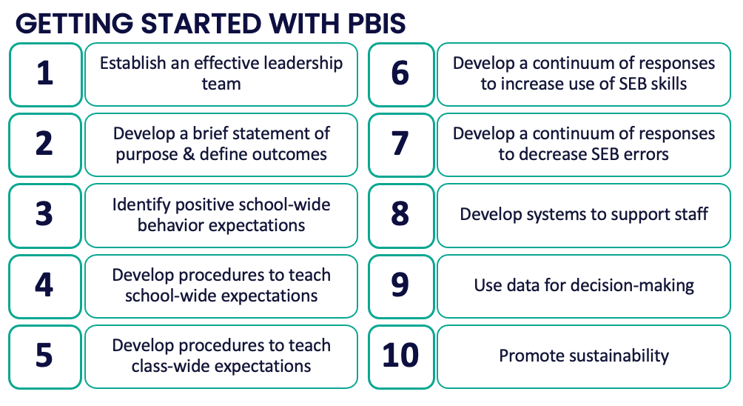
Ready
Set
Go

Slide 83
Planning for Rollout
Consider the needs of:
staff
students
families
community
Have you established training/teaching
content and routines
to support each audience?
How will you orient students, staff, and families that arrive in your school throughout the year?

Slide 84
Key Factors for Sustaining PBIS
Maintain a strong team
Use your fidelity of implementation data to improve your systems
Use your school discipline data
Implement PBIS in the classroom
Step 1
Step 9
Steps 7 & 9
Step 5
McIntosh, K., Mercer, S. H., Nese, R. N., Strickland-Cohen, M. K., & Hoselton, R. (2016). Predictors of sustained implementation of school-wide positive behavioral interventions and supports. Journal of Positive Behavior Interventions, 18(4), 209-218.

Slide 85
Guidelines for Promoting Sustainability
Work as a team.
Make decisions based upon data.
Consider needs of each and every student.
Support staff with implementation.
Integrate PBIS activities into other initiatives and projects.
Begin teaching, learning, and behavioral expectations on the first day.
Involve students, staff, parents, and community at all steps.

Slide 86
ACTIVITY: Promoting Sustainability
As a team,
Schedule necessary activities (meetings, teaching expectations, PD, evaluation plan, etc.).
Organize your resources and plan documents.
Revisit your Working Smarter matrix from Day 1 and revise as needed.
Consider what needs still exist for rollout.
Add items to your action plan as needed.
Be prepared to report out to the larger group.
20 minutes

Slide 87
WHOLE GROUP DEBRIEF: Promoting Sustainability
How did your team schedule, organize, and plan to keep PBIS going in your school?
What further support will you need to do this?
5 minutes

Slide 88
Lunch

Slide 89
Quick Review

Slide 90
What data? How often? What do we use it for?
Assess fidelity of PBIS implementation at least annually
Review student behavior data at least monthly
Use school and community data regularly
Evaluate your plan annually
Develop, inform, and refine Tier 1

Slide 91
Once data routines are established…
1. Identify the RIGHT data
Outcome data tied to goals
Fidelity data tied to evaluation plan
3. Identify the RIGHT people
Who needs to see these data to inform decisions? (e.g., PBIS team, grade level teams, family groups, other committees?)
4. Identify the RIGHT time & format
When/how often should these data be reviewed to inform decisions?
What format will facilitate decision making?
2. Assess data integrity
Consider staff training & engagement, systems, response rates
…use the data to guide decision-making!

Slide 92
How do we keep the pieces all going?
Mark your calendars
Organize resources
Work smarter, not harder

Slide 93
Planning for Rollout
Consider the needs of:
staff
students
families
community
Have you established training/teaching
content and routines
to support each audience?
How will you orient students, staff, and families that arrive in your school throughout the year?

Slide 94
Team
Action Planning Time

Slide 95
Use this time to continue working on...
DAY 5
Step 8: Developing Systems to Support Staff
Step 9: Using Data for Decision-Making
Student behavior data
School and community data
Fidelity of PBIS implementation
Evaluation of plan
Step 10: Promoting Sustainability
TODAY
ensure team and action planning systems are in place
identify a schoolwide behavior problem and potential solution
strengthen staff engagement
evaluate perceptions of school climate for students, staff, families
160 mins
develop systems to provide professional development/coaching
assess and evaluate PBIS fidelity of implementation
install a staff recognition system
establish data routines
plan for ongoing implementation

Slide 96
WHOLE GROUP DEBRIEF: Action Planning
Step 9: Using Data for Decision-Making
Student behavior data
School and community data
Fidelity of PBIS implementation
Evaluation of plan
Step 10: Promoting Sustainability
Share one or more team accomplishments from today.
What further support will you need to complete these action steps?
identify a schoolwide behavior problem and potential solution
evaluate perceptions of school climate for students, staff, families
assess and evaluate PBIS fidelity of implementation
5 minutes
plan for ongoing implementation

Slide 97
Review
of PBIS
and
Getting Started Steps #1- 10

Slide 98
Continuum of School-Wide Instructional & Positive Behavior Support
What do we do for the FEW needing intensive support?
Tertiary Prevention:
Specialized
Individualized
Systems for Students with High-Risk Behavior
What do we do for ALL?
Primary Prevention:
School-/Classroom-
Wide Systems for
All Students,
Staff, & Settings
~5%
~15%
What do we do for the SOME needing more support?
Secondary Prevention:
Specialized Group
Systems for Students with
At-Risk Behavior
~80% of Students

Slide 99
Critical Features
Systems
Practices
Data
Equity
Outcomes

Slide 100
Culture and Context of the School Community

Slide 101
GETTING STARTED WITH PBIS
1
Establish an effective leadership team
6
Develop a continuum of responses to increase use of SEB skills
2
Develop a brief statement of purpose & define outcomes
7
Develop a continuum of responses to decrease SEB errors
3
Identify positive school-wide behavior expectations
8
Develop systems to support staff
4
Develop procedures to teach school-wide expectations
9
Use data for decision-making
5
Develop procedures to teach class-wide expectations
10
Promote sustainability

Slide 102
1
Establish an effective leadership team
Systems
Supports Relevance & Equity
Improves student outcomes
Promotes Engagement
Notes:
Your first step is to create a representative team to lead your school’s PBIS efforts.

Slide 103
2
Develop a brief statement of purpose & define outcomes
Practices
What do we hope to achieve by implementing PBIS?
"Our mission is to provide a positive, safe, healthy, nurturing and respectful environment in which all students have the opportunity to become productive members of society."
Purpose
“As a result of implementing PBIS during the 20XX-20XY school year, student reports of school climate will improve by 20%.”
Outcome
Notes:
You’ll then focus your school’s PBIS efforts by creating a statement of purpose to identify your hopes and goals for PBIS implementation.

Slide 104
3
Identify positive school-wide behavior expectations
Practices
Notes:
Your team will work with your school community to uncover what you value and use those values to identify your schoolwide expectations

Slide 105
4
Develop procedures to teach school-wide expectations
Practices
Define
Teach
Prompt
Monitor
Evaluate
Notes:
Using those identified expectations, you’ll define what those expectations look and sound like in key routines/settings throughout your school. This is organized through a behavioral matrix. Using the schoolwide matrix, your team will develop lessons that will be explicitly taught to students at the beginning of the year (and boosted throughout the year) so that they know how to be successful within each context (like the hallway, cafeteria, assemblies, etc.)

Slide 106
5
Develop procedures to teach class-wide expectations
Practices
Notes:
Once the schoolwide expectations have been determined, classroom educators will apply the behavior matrix format to the routines and settings within their classrooms. They will also explicitly teach the expectations to their students throughout the year.

Slide 107
6
Develop a continuum of responses to increase use of SEB skills
Practices
Notes:
To encourage contextually appropriate behaviors to occur, you'll support educators to provide frequent specific feedback and praise. To promote this critical practice, you’ll develop recognition/acknowledgement systems for both students and staff.

Slide 108
7
Develop a continuum of responses to decrease SEB errors
Practices
Notes:
You will also clarify how staff should respond when contextually inappropriate behaviors occur by clearly defining, determining who’s responsible for responding, identifying clear responses, and recording the behaviors.

Slide 109
8
Develop systems to support staff
Promoting and Sustaining Staff Engagement
Continuous Action Planning
Team-Based Implementation
Systems
Embedded and Ongoing Professional Development
Staff Recognition
Data Routines

Slide 110
9
Use data for decision-making
Data
Assess fidelity of PBIS implementation at least annually
Review student behavior data at least monthly
Use school and community data regularly
Evaluate your plan annually
Develop, inform, and refine Tier 1

Slide 111
10
Promote sustainability
Systems

Slide 112
Preview of
Year 2

Slide 113
YEAR 2: Implement and Strengthen
DAY 7
DAY 8
Systems
DAY 9
Data
Practices
Tier 1 Check In
Family Engagement
Culture of Wellness
Crisis and Emergency Response Planning
Precise Problems and Outcomes
Equity Review
Evaluation
Strengthen
Classroom
Data-based Decision-Making

