Slide 1
TRAINER INFORMATION
This free and accessible training material is provided through the Northeast PBIS Network and can be found at https://nepbis.org/.
School teams are highly encouraged to contact a
PBIS State Coordinator or an NEPBIS Endorsed Trainer
for training opportunities.
If you are an experienced trainer and would like access to to our coordinating trainer workbook which offers training guidance, please email us at nepbis@uconn.edu.

Slide 2
TRAINER NOTES
This is Day 5 of an 11 day, 3 year training sequence.
CONTENT
OUTCOMES
At the end of day five, teams should understand
the critical role that effective and efficient systems play in durable implementation.
Step 8: Develop Systems to Support Staff
Team-based Implementation
Action Planning
Staff Engagement
Professional Development
Staff Recognition
Data Routines
ensure team and action planning systems are in place
strengthen staff engagement
develop systems for professional development/coaching
install a staff recognition system
establish data routines
For more information and guidance related to training this content please see the NEPBIS trainers’ manual located here: https://nepbis.org/training-of-trainers-workbook-supplemental-materials/

Slide 3
SAMPLE AGENDA
8:30 | Introduction and Review | 30
9:00 | Systems to Support Staff (Step 8) and Break | 180
12:00 | Lunch | 30
1:00 | Quick Review | 15
1:15 | Team Time | 150
3:45 | Wrap Up | 15

Slide 4
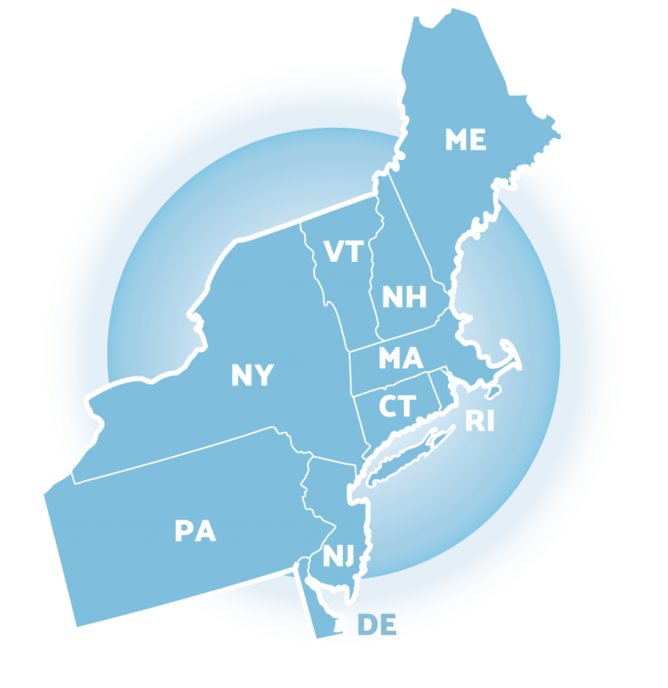
NEPBIS School-Wide Team Training
Year 1 Day 5
INSERT TRAINER NAMES HERE
with support from
Karen Robbie, Jen Freeman,
Brandi Simonsen, Katie Meyer,
Adam Feinberg & Susannah Everett
Notes:
Trainers: refer to training manual for:
Tips on presenting the overview content
Explanation for short activity periods and ideas for teaching this to teams
Ideas for facilitating review and team action planning

Slide 5
POSITIVE BEHAVIOR INTERVENTIONS & SUPPORTS (PBIS)

Slide 6
WHO'S HERE?
Who's here?
LIST SCHOOLS IN COHORT HERE
(List the schools in your cohort here)
Notes:
TRAINER NOTE: Give teams several minutes each to introduce themselves and their school- including any previous experiences with PBIS.

Slide 7
NEPBIS SCHOOL-WIDE TRAINING MODEL
Year 1
Exploration and Installation of 10 Getting Started Steps
Year 2
Initial Implementation of 10 Getting Started Steps
Year 3+
Full Implementation and Continuous Improvement of Implementation
6 days of team training + 3 days of coach training
3 days of team training + 3 days of coach meeting
On-going Professional Development and Support
(minimum of 2 days of team training + 2 days of coach training annually)

Slide 8
YEAR 1: Getting Started with PBIS
DAY 1
Step 1: Establish an effective leadership team
DAY 2
Step 2: Develop a brief statement of purpose & define outcomes
Step 3: Identify positive school-wide behavior expectations
Step 4: Develop procedures to teach school-wide expectations
DAY 3
Step 5: Develop procedures to teach class-wide expectations
Step 6: Develop a continuum of responses to increase use of SEB skills
DAY 4
Step 7: Develop a continuum or responses to decrease SEB errors
DAY 5
Step 8: Develop systems to support staff
DAY 6
Step 9: Use data for decision-making
Step 10: Promote sustainability

Slide 9
TRAINING SCHEDULE
TRAINERS:
USE THIS SLIDE TO INSERT YOUR TRAINING SCHEDULE FOR THE CURRENT YEAR

Slide 10
nepbis.org
TOOLS
Tier 1 Schoolwide
Tier 1 Team Training Materials
Tier 1 Supplemental Resources
School Team Implementation Guide
responses for activities
document plans
develop artifacts
Slides for each training day
Notes:
TRAINERS: Go directly to https://nepbis.org/ and demonstrate how to access relevant materials.

Slide 11
WEBSITES
pbisapps.org
pbis.org

Slide 12
LEGEND
ORGANIZATION
ACTIVITY
NEW
CONTENT
PREVIEW
REVIEW

Slide 13
LEGEND
Timing
Example
Activity
Non-example
Guidelines
Preview
Big Idea
Review
Organization

Slide 14
EXPECTATIONS
 | Individually | Working with Others
Respect Self | Participate Converse with others in lobbies and during breaks Stretch, break, stand as needed | Engage with the training content and activities
Respect Others | Complete assigned tasks Return from breaks on time | Provide room for every voice Reinforce participation
Respect Environment | Keep devices silent Have your computer charged and ready Keep necessary materials at hand | Maintain a neat, orderly work space

Slide 15
AGENDA AND ACTION STEPS
Step 8: Develop Systems to Support Staff
Team-based Implementation
Action Planning
Staff Engagement
Professional Development
Staff Recognition
Data Routines
ensure team and action planning systems are in place
strengthen staff engagement
develop systems to provide professional development/coaching
install a staff recognition system
establish data routines

Slide 16
Quick Review

Slide 17
Continuum of School-Wide Instructional & Positive Behavior Support
What do we do for the FEW needing intensive support?
Tertiary Prevention:
Specialized
Individualized
Systems for Students with High-Risk Behavior
What do we do for ALL?
Primary Prevention:
School-/Classroom-
Wide Systems for
All Students,
Staff, & Settings
~5%
~15%
What do we do for the SOME needing more support?
Secondary Prevention:
Specialized Group
Systems for Students with
At-Risk Behavior
~80% of Students

Slide 18
Critical Features
Systems
Practices
Data
Equity
Outcomes

Slide 19
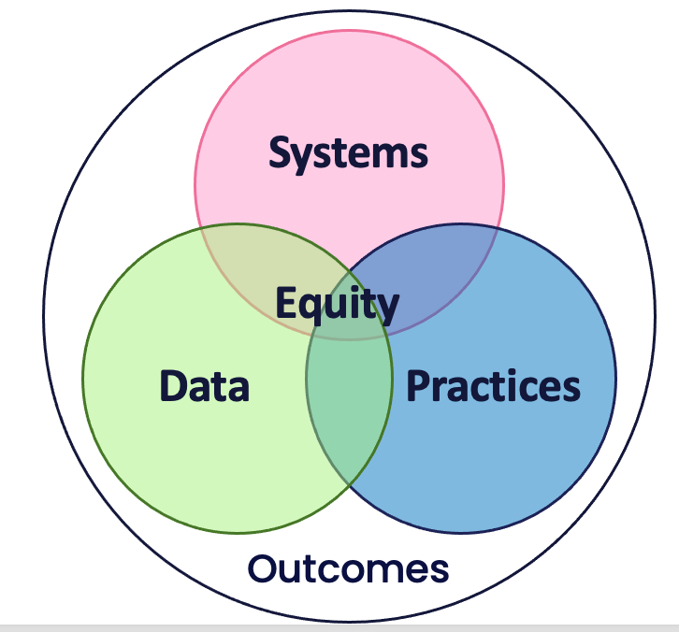
Culture and Context of the School Community

Slide 20
GETTING STARTED WITH PBIS
1
Establish an effective leadership team
6
Develop a continuum of responses to increase use of SEB skills
2
Develop a brief statement of purpose & define outcomes
7
Develop a continuum of responses to decrease SEB errors
3
Identify positive school-wide behavior expectations
8
Develop systems to support staff
4
Develop procedures to teach school-wide expectations
9
Use data for decision-making
5
Develop procedures to teach class-wide expectations
10
Promote sustainability

Slide 21
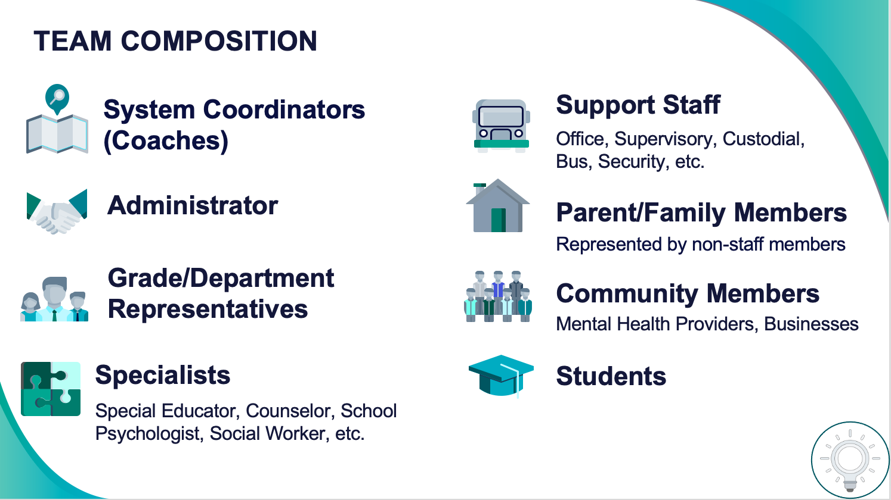
1
Establish an effective leadership team
Systems
Supports Relevance & Equity
Improves student outcomes
Promotes Engagement
Notes:
Your first step is to create a representative team to lead your school’s PBIS efforts.

Slide 22
2
Develop a brief statement of purpose & define outcomes
Practices
What do we hope to achieve by implementing PBIS?
"Our mission is to provide a positive, safe, healthy, nurturing and respectful environment in which all students have the opportunity to become productive members of society."
Purpose
“As a result of implementing PBIS during the 20XX-20XY school year, student reports of school climate will improve by 20%.”
Outcome
Notes:
You’ll then focus your school’s PBIS efforts by creating a statement of purpose to identify your hopes and goals for PBIS implementation.

Slide 23
3
Identify positive school-wide behavior expectations
Practices
Notes:
Your team will work with your school community to uncover what you value and use those values to identify your schoolwide expectations

Slide 24
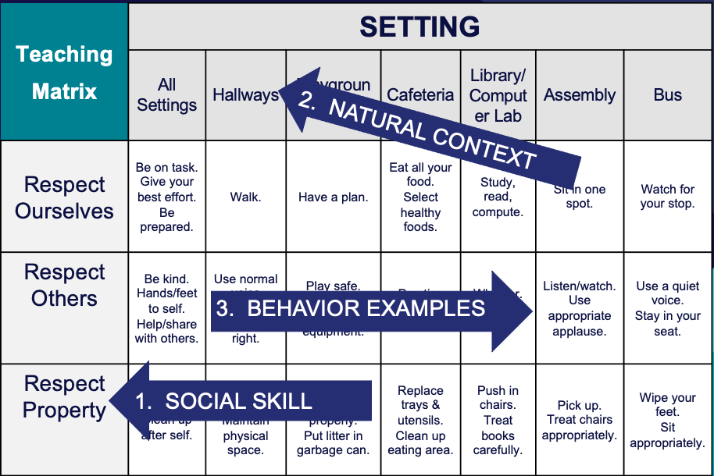
4
Develop procedures to teach school-wide expectations
Practices
Define
Teach
Prompt
Monitor
Evaluate
Notes:
Using those identified expectations, you’ll define what those expectations look and sound like in key routines/settings throughout your school. This is organized through a behavioral matrix. Using the schoolwide matrix, your team will develop lessons that will be explicitly taught to students at the beginning of the year (and boosted throughout the year) so that they know how to be successful within each context (like the hallway, cafeteria, assemblies, etc.)

Slide 25
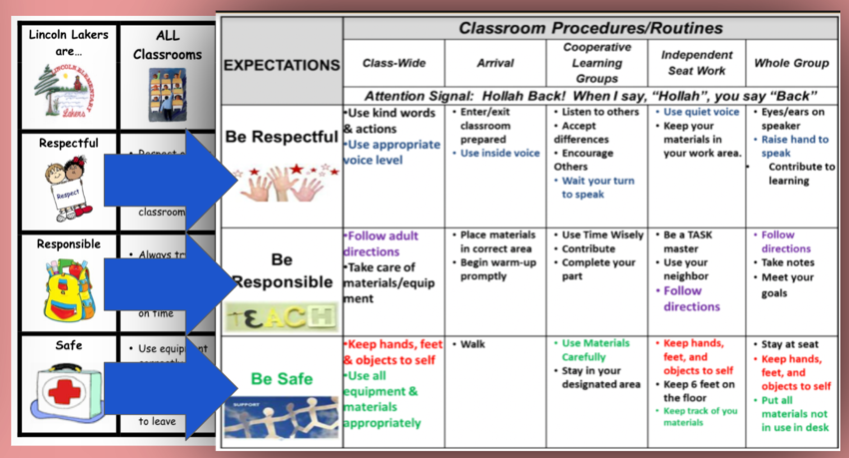
5
Develop procedures to teach class-wide expectations
Practices
Notes:
Once the schoolwide expectations have been determined, classroom educators will apply the behavior matrix format to the routines and settings within their classrooms. They will also explicitly teach the expectations to their students throughout the year.

Slide 26
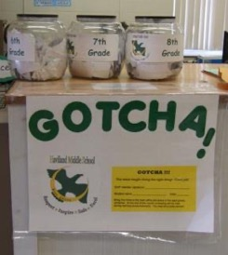
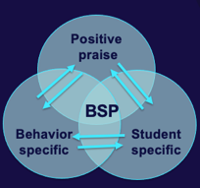
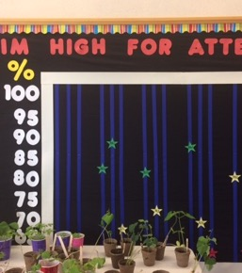
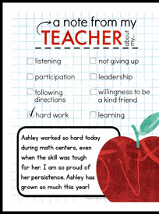
6
Develop a continuum of responses to increase use of SEB skills
Practices
Notes:
To encourage contextually appropriate behaviors to occur, you'll support educators to provide frequent specific feedback and praise. To promote this critical practice, you’ll develop recognition/acknowledgement systems for both students and staff.

Slide 27
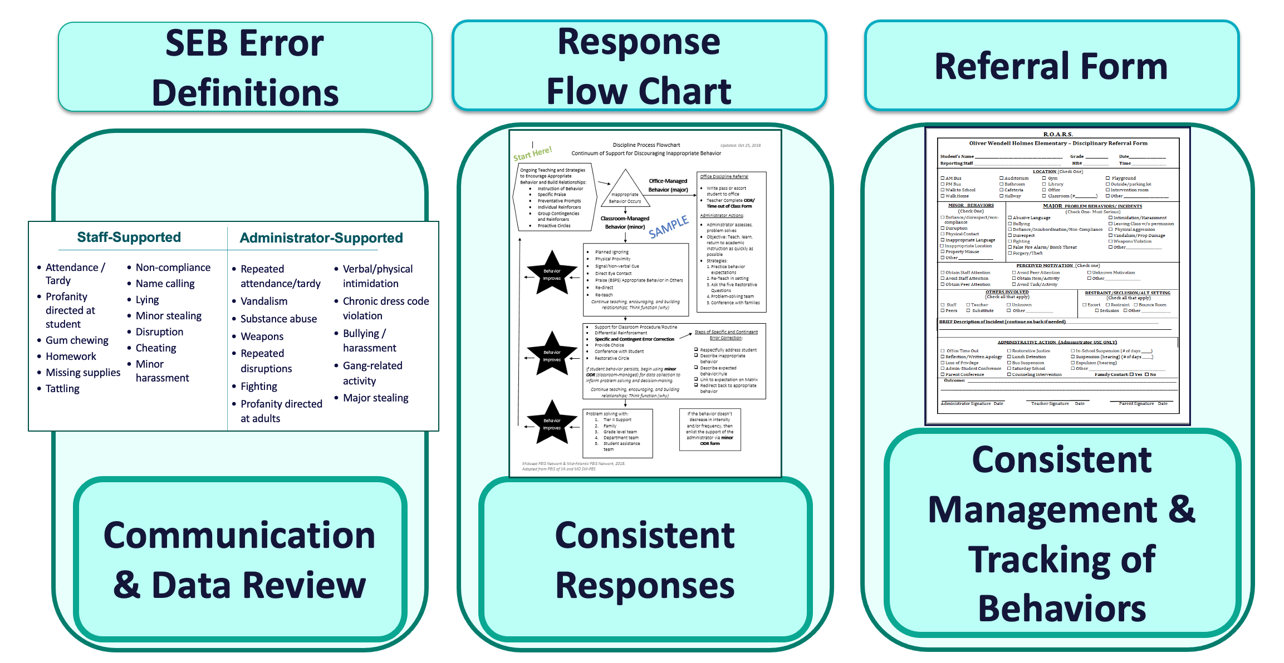
7
Develop a continuum of responses to decrease SEB errors
Practices
Notes:
You will also clarify how staff should respond when contextually inappropriate behaviors occur by clearly defining, determining who’s responsible for responding, identifying clear responses, and recording the behaviors.

Slide 28
TEAM DISCUSSION: Checking in
Discuss with your group and identify
1-2 accomplishments
1-2 questions or concerns shared by most members of team
Be ready to share 1 accomplishment and 1 question/concern from your discussion.
5 minutes

Slide 29
WHOLE GROUP DEBRIEF: Checking In
Share 1 accomplishment and 1 question/concern from your team discussion.
10 minutes

Slide 30
Step 8: Develop Systems to Support Staff
Systems
Promoting and Sustaining Staff Engagement
Continuous Action Planning
Team-Based Implementation
Embedded and Ongoing Professional Development
Staff Recognition
Data Routines
TODAY'S FOCUS

Slide 31
Systems
STEP 8:
DEVELOP SYSTEMS TO SUPPORT STAFF
How do we support staff to successfully implement PBIS
in our school?
ensure team and action planning systems are in place
strengthen staff engagement
develop systems for professional development/coaching
install a staff recognition system
establish data routines

Slide 32
Systems
Practices
Data
Continue to invest in systems to support high-fidelity implementation over time. Leverage existing leadership teams to guide planning and implementation, and consider effective means to support educators’ professional learning and wellness given current resources, experience, and expertise.
Equity
Outcomes

Slide 33
What are SYSTEMS?
The way schools operate are their foundational systems.
In PBIS, these systems support:
accurate, durable implementation of practices
the effective use of data to achieve better outcomes
(pbis.org)
In other words…
systems are what we do to support the adults!

Slide 34
Systems SUPPORT implementation fidelity
Promoting and Sustaining Staff Engagement
Continuous Action Planning
Team-Based Implementation
Embedded and Ongoing Professional Development
Staff Recognition
Data Routines

Slide 35
Team-Based Implementation

Slide 36
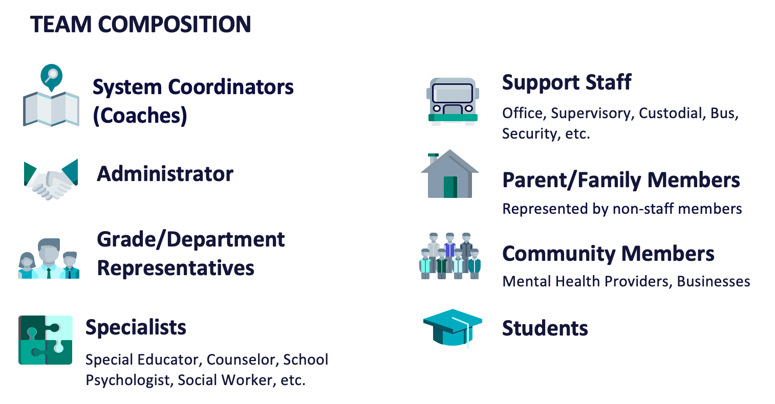
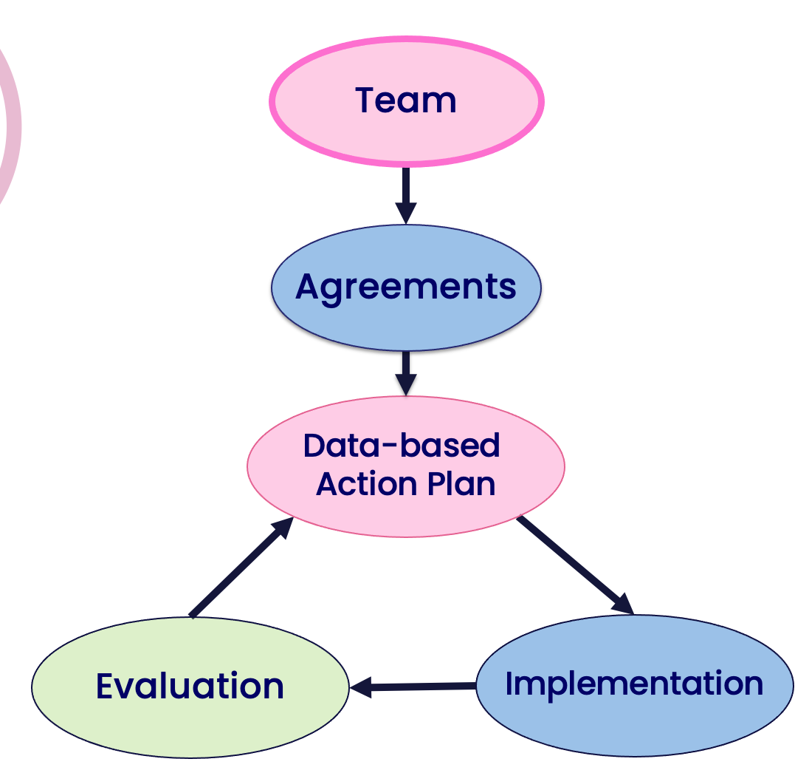
Use systems to prioritize continuous effective team composition and routines!
Procedures to fill team vacancies
Prompts to team members to support regular attendance at meetings
Establish routines to promote meeting efficiency

Slide 37
Continuous Action Planning

Slide 38
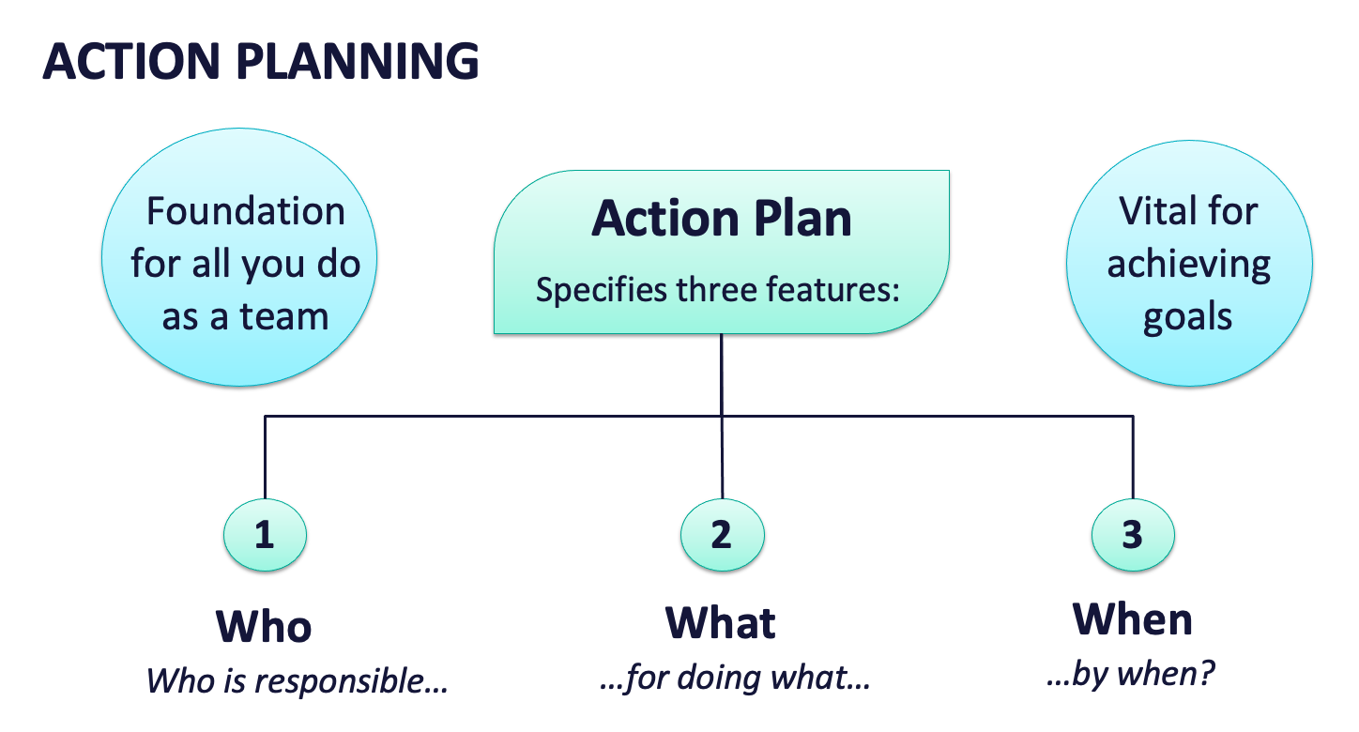
Use systems to prioritize your team’s effective action planning!
Accessible to all on the team
Review action plan at each meeting
Use data to identify next steps
Align to desired outcomes

Slide 39
ACTIVITY: Teaming and Action Planning
As a team, reflect on your teaming procedures including:
effective meeting routines (scheduling, agendas, minutes, etc.)
maintaining a representative, active team membership
accessible, fucnctional action planning
Identify what worked well and what can be improved.
Add items to your Action Plan as necessary.
Be ready to present 2-3 “big ideas” from your discussion.
10 minutes

Slide 40
WHOLE GROUP DEBRIEF: Training and Action Planning
What is something your team identified as doing well and something to improve?
What further support will you need to strengthen your teaming systems?
5 minutes

Slide 41
Promoting and Sustaining Staff
Engagement

Slide 42
Staff Engagement is Critical for Implementation!
significant factor driving sustaining implementation (McIntosh et al., 2013)
top thing that makes everything fall apart when it was missing (Pinkelman et al., 2015)
lack of staff buy-in most commonly reported reason for abandonment (Kittleman et al., 2020)

Slide 43
Strategies to Promote and Sustain Staff Engagement
Develop a common purpose
Continually engage staff, student and family voices in co-designing and actively revising the framework
Share data to support initial and continual need for PBIS

Slide 44
Purpose statement identifies WHY you are implementing PBIS at your school
Does your purpose statement accurately reflect your school improvement goals?
Can school community members identify how PBIS supports your school improvement goals?
Purpose Statement
Action Plan Outcome Goals
School/District Improvement Plans
Working Smarter Matrix (e.g. resource allocation)

Slide 45
Continuously engage partners
Effective Messenger(s)
Engagement!
Staff
Students
Families
Effective
Team…
Info & Drafts
Feedback
…powered
by Data
Effective Leadership

Slide 46
Engage partners by co-designing and revising features based on data
Schoolwide Teaching Matrix
TEAM develops a draft at a team training
STAFF review the draft and provide input
STUDENTS compare school expectations to home and community expectations
FAMILY advisory group provides feedback about cultural relevancy
Similar process is completed for other features (acknowledgement, flowchart, etc.)

Slide 47
Share relevant data with staff often and regularly
The factor most related to high sustainability of PBIS…
The frequency data is shown to all staff!
(Pinkelman et al., 2015)
Referral Data
Average per day/month
Location
Risk ratio
School Climate Survey Data
Student
Staff
Families
Fidelity Data
TFI scores
% of staff/students able to identify expectations
% of classrooms with expectations teaching matrix posted
MORE TO COME

Slide 48
Guidelines for Staff Engagement
Use data to establish need
Self-assessment
Baseline discipline/behavior/climate data
Maintain an effective team with active administrator participation
Present information in clear and efficient way(s)
Obtain and incorporate feedback on all elements of SWPBIS from staff
Start small and demonstrate success

Slide 49
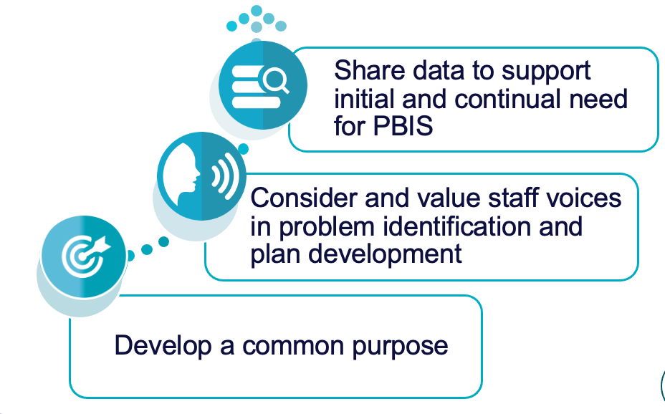
Activity: Promoting and Sustaining Staff Engagement
As a team, discuss how you will promote and sustain staff engagement by:
Reinforcing your common purpose
Enhancing staff voice throughout implementation efforts
Continuously sharing relevant data
Add items to your Action Plan as necessary.
Be ready to present 2-3 “big ideas” from your discussion.
10 minutes

Slide 50
WHOLE GROUP DEBRIEF: Promoting and Sustaining Staff Engagement
How will you promote and sustain staff engagement within you school?
What further support will you need to do this?
5 minutes

Slide 51
Embedded and Ongoing Professional Development

Slide 52
Provide Universal Professional Development to ALL Staff instead of ”Training and Hoping”
Sound familiar?
We can do better!
REACT to problem behavior
Select and ADD Practice
Hire EXPERT to Train Practice
Expect, but HOPE for, Implementation
WAIT for New Problem

Slide 53
Continuum of Multi-tiered Professional Development Support
Tier 3
What do we do for the FEW staff needing intensive support?
Intensive Professional Development:
Data-driven Consultation
Performance Feedback:
Routine Walkthrough and Self-management Data Reviews
Tier 1
What do we do for
ALL Staff?
Universal Professional Development:
Training and Self-management
Universal Screening:
Walk-through and Student Data Review
~5%
~15%
Tier 2
What do for the SOME staff needing more support?
Targeted Professional Development:
Self-management with Peer or Coaching Support
Progress Monitoring:
Walkthrough, Student Data Review,
Teacher Collected Data
For now,
focus on providing ALL staff Tier 1 professional development
~80% of Staff

Slide 54
Embedded and Ongoing Professional Development
First, identify what staff need to know, then, provide…
Coaching/
Prompting
Explicit Training
Performance Feedback

Slide 55
CRITICAL TOPICS FOR STAFF PD
PBIS Rationale and Purpose
Expectations Matrix
Lesson Plans and Teaching Schedule
Acknowledgement Procedures
Consequence Procedures

Slide 56
ADDITIONAL STAFF PD CONSIDERATIONS
Behavioral principles to understand and support student behavior
Mental health and trauma informed care foundations
Community culture, values, and historical perspectives (in partnership with families & local community supports)
Effectively applying core practices with cultural competence
If your data from staff, student, family surveys or outcomes indicate a need, these areas may also be beneficial PD topics
Integrated TFI Companion Guide, 2021

Slide 57
Embedded and Ongoing Professional Development
First, identify what staff need to know, then, provide…
Coaching/
Prompting
Explicit Training
Performance Feedback

Slide 58
Embedded and Ongoing Professional Development
First, identify what staff need to know, then, provide…
Coaching/
Prompting
Explicit Training
Performance Feedback
Model, lead, test format
Demonstrate desired skill (I do)
Provide effective examples/non-examples
Provide sufficient group practice (We do)
Provide opportunities to demonstrate and receive feedback (You do)
Connected to/embedded in typical practice/routines
Brief training/practice spaced out

Slide 59
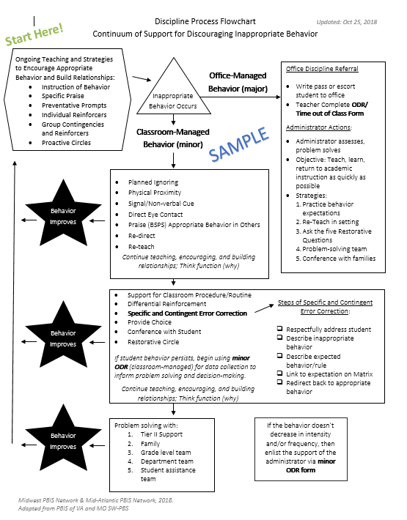
Train and Hope Method
Leadership Team shares the newly developed discipline flowchart with staff over email and asks everyone to start using it.

Slide 60
Explicit Training Example
Center School’s PBIS Leadership Team shares the finalized Discipline Flowchart (developed with staff input) to ALL staff.
A student scenario is provided and a team member performs a “think aloud” to model her interaction with a student. (I do)
Additional examples and non-examples of student-staff interactions are provided with opportunities for questions to be asked.
Another scenario is provided and small groups of staff discuss how to use the flowchart as a guide to their response. (We do)
One more scenario is provided. Each staff member writes down how they would respond and then shares the response with a colleague. (You do)
All staff are provided laminated copies of the Discipline Flowchart and are asked to focus on using it during dismissal time.
Next month…
each person writes an example of how they used the flowchart during dismissal and adds it to a Jamboard.
Staff are then asked to use the Discipline Flowchart throughout their daily routines.

Slide 61
Embedded and Ongoing Professional Development
First, identify what staff need to know, then, provide…
Coaching/
Prompting
Explicit Training
Performance Feedback
Prompt and remind educators of targeted practices implementation.
Provide supportive data-based feedback and suggestions for improving implementation.
Consider function not form: Supports may be delivered by internal or external coach, mentor, peer, or self).

Slide 62
Coaching Support
COACH
School/district coach conducts walkthrough observations and provides specific, supportive feedback
Mentors assigned to new educators provide feedback on use of PBIS practices
PEER
Educator pairs visit each other during instruction to gather data on specific practices and provide specific feedback/ support to one another
Communities of Practice are created to review critical features, share experiences, gather examples of core PBIS practices
SELF
Individuals commit to being a coach and providing support for 1 identified practice
Educators choose 1 practice to set goals for themselves, self-monitor (with a provided data collection tool) and self-reinforce when they meet their goal

Slide 63
Additional Coaching/Prompting Examples
For 8 weeks, a weekly email is sent out to staff reminding them to use the discipline flowchart when responding to student behavior incidents.
During grade level/ department meetings, teams discuss using the discipline flowchart and what works well and how to overcome barriers.
When staff follow the flowchart procedures for office-supported incidents, the administrator provides specific praise to the staff member.

Slide 64
Embedded and Ongoing Professional Development
First, identify what staff need to know, then, provide…
Coaching/
Prompting
Explicit Training
Performance Feedback
Data-based feedback (based on self-, peer-, or consultant collected data)
Summary of key observations
Delivered frequently (daily or weekly)
Specific suggestions for improvement or acknowledgements of good performance

Slide 65
Performance Feedback Example
After 3 months of a trial period, the Leadership Team shows staff referral data and compares before and after PBIS implementation.
Staff receive specific, supportive feedback and targeted coaching support, as needed, to promote consistency with following procedures.

Slide 66
Align PBIS Practices to Evaluation Procedures
FIRST...
THEN...
Provide explicit training, coaching/prompting, and performance feedback
Consider adding PBIS practices in evaluation procedures
Gather positive-to-corrective educator/student interaction ratio data
Share amount of time spent actively supervising during cafeteria duty
Count number of specific praise statements provided during a lesson

Slide 67
NEPBIS.org
CLASSROOM PBIS
Provides links to more information about systems to support educators!
Educator Support
CLICK HERE

Slide 68
Embedded and Ongoing Professional Development
First, identify what staff need to know, then, provide…
Coaching/
Prompting
Explicit Training
Performance Feedback
We need to provide staff with universal training and support for all components of the PBIS framework if we want them to implement!

Slide 69
Professional Development Planning
What content? | When will it be explicitly taught? | By who? | How will prompting and coaching occur? | How will staff be provided performance feedback?

Slide 70
Guidelines for Embedded and Ongoing Professional Development
Ensure PD includes explicit training, performance feedback and ongoing coaching
Develop a PBIS PD Calendar and routines (e.g. 15 minutes of every staff meeting, 1 hour of early release days)
Align staff evaluation procedures with expected practices where possible

Slide 71
ACTIVITY: Developing a System of Embedded and Ongoing Professional Development
Consider how you will provide embedded and ongoing professional development to staff that includes:
Explicit training
Coaching/prompting
Performance feedback
Add items to your Action Plan as necessary.
Be ready to present 2-3 “big ideas” from your discussion.
10 minutes

Slide 72
WHOLE GROUP DEBRIEF: Developing a System of Embedded and Ongoing Professional Development
What are some next steps your team will take to develop a system of embedded and ongoing professional development within your school?
What further support will you need to do this?
5 minutes

Slide 73
Break

Slide 74
Staff Recognition

Slide 75
Adults need and deserve recognition for their PBIS implementation efforts!
Just as we want to promote contextually appropriate behavior with our students, we also want to acknowledge adults for:
positively and proactively engaging with students
implementing PBIS practices
providing valuable input
…and so much more!

Slide 76
Provide verbal and/or written relevant and sincere specific praise often!
Your students really know and demonstrate our schoolwide expectations. You must have worked hard at teaching them. Well done!
Wow! You did a great job interacting with students and recognizing from for doing things well during dismissal!
PBIS Superstar Notice!
Your students have all earned at least 1 Pride card this month. You are using our acknowledgement system really effectively! Thank you for helping improve our school climate!

Slide 77
Gather Staff Feedback!
Solicit input from staff on what is reinforcing!
Remember, what is reinforcing to some, may not be reinforcing to all.
Having a class covered, but still needing to provide plans may create added work.
Someone with dietary restrictions may be turned off with a consumable reward.
Some people may feel uncomfortable being acknowledged in public.

Slide 78
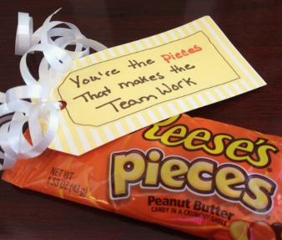
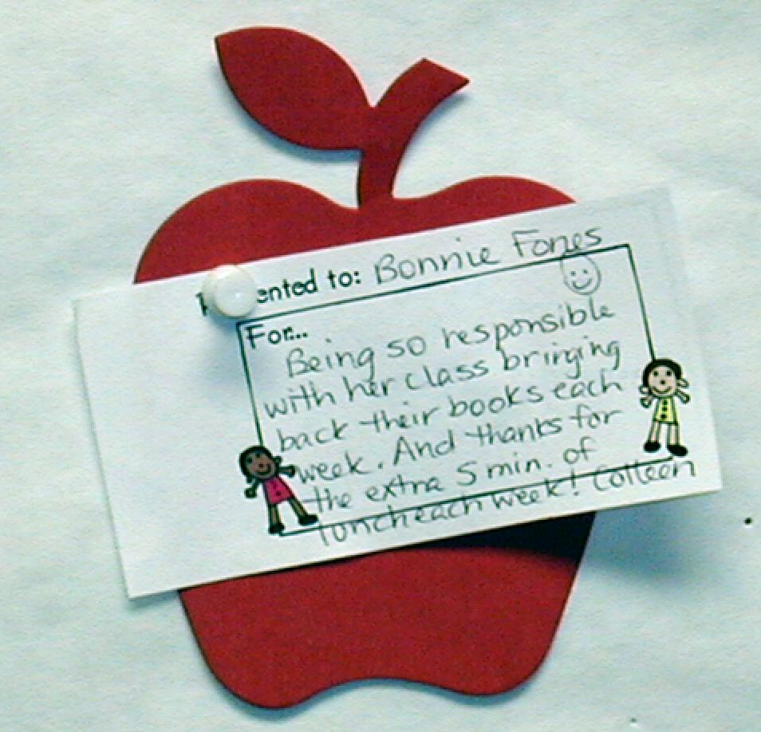
Staff Recognition Examples
Specific praise (written or verbal)
Special parking spot
Duty/class period coverage
Celebrating the staff member who gave out the 'winning' student ticket
Monthly staff appreciation breakfast
Staff raffles at staff meetings
Staff appreciation days when students give staff tickets

Slide 79
Guidelines for Staff Recognition
Develop easy and quick forms of acknowledgement
Consider strategies/processes that already exist
Ensure the name and form of acknowledgment is culturally, developmentally, and contextually appropriate
Consider back-up or follow-up acknowledgements
Schedule an initial introduction of acknowledgements and regular boosters or reimplementation of acknowledgements

Slide 80
ACTIVITY: Developing a Staff Recognition System
As a team,
Brainstorm ideas for recognizing your staff’s implementation efforts
Consider how you will gather staff feedback on the plan
Add items to your Action Plan as necessary.
Be ready to present 2-3 “big ideas” from your discussion.
10 minutes

Slide 81
WHOLE GROUP DEBRIEF: Develping a Staff Recognition System
What are some ways you are considering providing staff recognition?
What further support will you need to do this?
5 minutes

Slide 82
Data
Routines

Slide 83
Systems
Data
Data
Use data to inform decisions about which students, families, and educators need which supports, as well as whether supports should be continued, adjusted, or faded. Data should be used to ensure that all recipients experience benefit and that supports are implemented with fidelity.
Equity
Outcomes

Slide 84
Data used in PBIS implementation
Data
Fidelity Data
Did we implement the systems and practices we agreed upon?
Outcome Data
Is the plan resulting in progress towards our goals (student benefit)

Slide 85
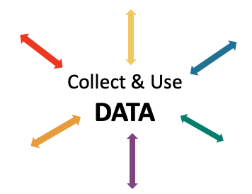
Data INFORMS and GUIDES your work
IDENTIFY PROBLEM
with precision
IDENTIFY GOAL
for change
IDENTIFY SOLUTION
and implementation plan
IMPLEMENT SOLUTION
with fidelity
MONITOR & EVALUATE
implementation fidelity and impact
MAKE DECISION
to maintain, modify, or terminate plan
(Chaparro, E., et. al, 2022)

Slide 86
Why develop data routines?
To continuously improve
your Tier 1 framework!
Are we achieving our desired outcomes?
Which groups are benefiting from our plan? Which are not?
Are we implementing as planned?
What needs to be strengthened? Revised?
Are students receiving adequate support to achieve positive outcomes?

Slide 87
Strengthen Routines to Gather Fidelity and Outcome Data

Slide 88
Establish and Strengthen Data Routines
1. Identify the RIGHT data
Outcome data tied to goals
Fidelity data tied to evaluation plan
3. Identify the RIGHT people
Who needs to see these data to inform decisions? (e.g., PBIS team, grade level teams, family groups, other committees?)
4. Identify the RIGHT time & format
When/how often should these data be reviewed to inform decisions?
What format will facilitate decision making?
2. Assess data integrity
Consider staff training & engagement, systems, response rates

Slide 89
EXAMPLE: School-wide Behavior Data
1. Identify the RIGHT data
Office discipline referrals
3. Identify the RIGHT people
PBIS Leadership Team
4. Identify the RIGHT time & format
Team’s data analyst provides monthly report at meeting
Core SWIS reports reviewed each month and compared to previous years
2. Assess data integrity
Staff trained and coached on completing referral forms and following discipline procedures
Data shown to whole staff to determine if it matches their perceptions

Slide 90
NON-EXAMPLE: School-wide Behavior Data
September
Student Behavior Data System Established
June
Referral data for the year shared at a PBIS Leadership meeting for the first time all year

Slide 91
EXAMPLE: Student Attendance
1. Identify the RIGHT data
Student attendance records
3. Identify the RIGHT people
PBIS Leadership Team
4. Identify the RIGHT time & format
Team’s data analyst provides monthly report at meeting
Table of students who have missed more than 5%, 10%, 20% of cumulative school days
2. Assess data integrity
Completed by homeroom staff and checked by administrative assistant daily

Slide 92
Establish Routines to Share Data with Partners Regularly
The frequency that data are presented to all school staff is the factor most related to high levels of sustainability!
(Pinkelman et al., 2015)
School Board Families
Student Community
Share with other partners to increase commitment, accountability, and support

Slide 93
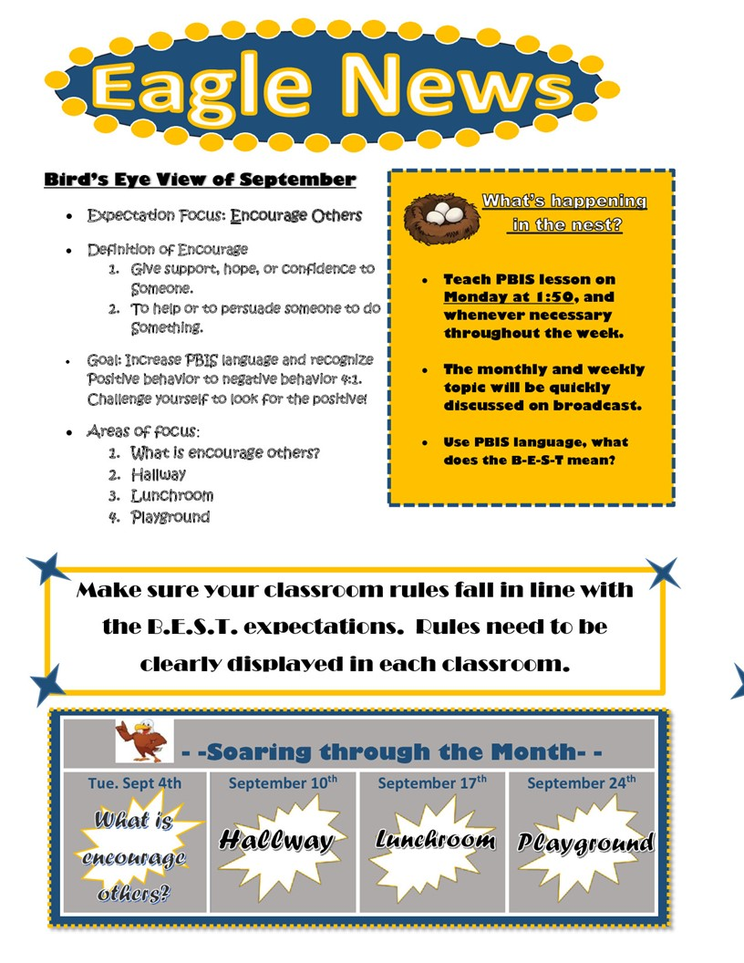
Ideas for Sharing Data
1. Share Annual Outcome Goals:
When everyone understands the goals and sees progress from their efforts, partners are more likely to engage with interventions to meet those goals.
2. Email a Monthly/Quarterly Report:
Give context, provide connections, suggest next steps
Examples:
Referrals from the hallway, month by month pre/post intervention
Number of days since last playground referral

Slide 94
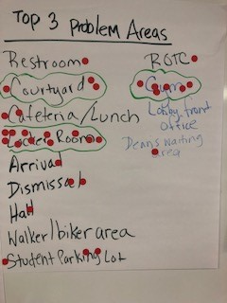
Ideas for Sharing Data
3. Create a data wall focusing on data related to school-wide goals:
Display data related to school-wide goals so everyone walking through can see the progress
4. Share data at monthly staff/PTO/student council meetings
Invite members to actively participate in generating solutions

Slide 95
Developing Data Routines
Data Source | Date(s) for administration | Who brings data to team meeting | Meeting date to review data | Plan to share data
TFI
Referral
School Climate
Other Outcome
Establishing consistent, efficient data routines will enhance your team’s ability to effectively use data for decision-making! More to come in Step 9!

Slide 96
Guidelines for Efficient Data Collection Routines
What Data?
Limit to information that answers important student, classroom, and school questions
How should information be gathered?
Integrate data collection procedures into typical routines (e.g., referrals, attendance, behavior incident reports)
Schedule data collection and staffing to ensure that data are current
When?
Use no more than 1% of time each day for managing data
By whom?
Ensure access to all necessary information (e.g., student records)
Check data collection reports regularly for accuracy

Slide 97
Guidelines for Efficient Data Review Routines
Protect team time to review data monthly
Identify 2-3 staff members to:
manage data systems
provide efficient, timely, and graphic displays of data
Establish structures and routines for staff members to receive weekly/monthly data reports about status of SW discipline

Slide 98
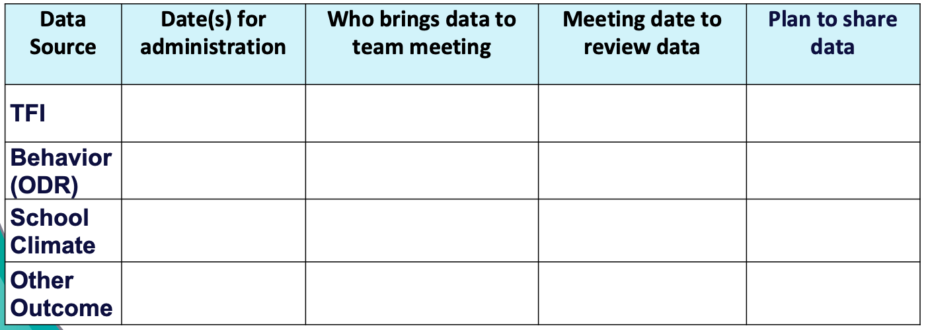
ACTIVITY: Data Routines
As a team,
Review your evaluation plan and identify what still needs to be completed this year.
Plan your data routines for the year ahead.
Add items to your Action Plan as necessary.
Be ready to present 2-3 “big ideas” from your discussion.
10 minutes

Slide 99
WHOLE GROUP DEBRIEF: Routines for Gathering and Reviewing Data
How will you:
Develop and maintain your evaluation plan
Identify and progress monitor your outcome goals
Share data with partners?
What further support will you need to implement these routines?
5 minutes

Slide 100
Lunch

Slide 101
Quick Review

Slide 102
Systems SUPPORT implementation to occur with fidelity
Promoting and Sustaining Staff Engagement
Continuous Action Planning
Team-Based Implementation
Embedded and Ongoing Professional Development
Staff Recognition
Data Routines

Slide 103
Continuous Action Planning
Team-Based Implementation

Slide 104
Develop a common purpose
Continually engage staff, student and family voices in co-designing and actively revising the framework
Share data to support initial and continual need for PBIS
Promoting and Sustaining Staff Engagement

Slide 105
Embedded and Ongoing Professional Development
First, identify what staff need to know, then, provide…
Coaching/
Prompting
Explicit Training
Performance Feedback

Slide 106
Adults need and deserve recognition for their efforts!
Staff Recognition
Provide verbal and/or written relevant and sincere specific praise often!
Wow! You did a great job interacting with students and recognizing from for doing things well during dismissal!
Your students really know and demonstrate our schoolwide expectations. You must have worked hard at teaching them. Well done!
PBIS Superstar Notice!
Your students have all earned at least 1 Pride card this month. You are using our acknowledgement system really effectively! Thank you for helping improve our school climate!

Slide 107
Data Routines
1. Identify the RIGHT data
Outcome data tied to goals
Fidelity data tied to evaluation plan
3. Identify the RIGHT people
Who needs to see these data to inform decisions? (e.g., PBIS team, grade level teams, family groups, other committees?)
4. Identify the RIGHT time & format
When/how often should these data be reviewed to inform decisions?
What format will facilitate decision making?
2. Assess data integrity
Consider staff training & engagement, systems, response rates

Slide 108
Team
Action Planning Time

Slide 109
Use this time to continue working on...
Step 8: Develop Systems to Support Staff
Team-based Implementation
Action Planning
Staff Engagement
Professional Development
Staff Recognition
Data Routines
TODAY
ensure team and action planning systems are in place
strengthen staff engagement
150 mins
develop systems to provide professional development/coaching
install a staff recognition system
establish data routines

Slide 110
WHOLE GROUP DEBRIEF: Action Planning
Step 8:
Developing Systems to Support Staff
Share one or more team accomplishments from today.
What further support will you need to complete these action steps?
ensure team and action planning systems are in place
strengthen staff engagement
develop systems to provide professional development/coaching
install a staff recognition system
establish data routines
5 minutes

Slide 111
Review
of PBIS
and
Getting Started Steps #1- 8

Slide 112
Continuum of School-Wide Instructional & Positive Behavior Support
What do we do for the FEW needing intensive support?
Tertiary Prevention:
Specialized
Individualized
Systems for Students with High-Risk Behavior
What do we do for ALL?
Primary Prevention:
School-/Classroom-
Wide Systems for
All Students,
Staff, & Settings
~5%
~15%
What do we do for the SOME needing more support?
Secondary Prevention:
Specialized Group
Systems for Students with
At-Risk Behavior
~80% of Students

Slide 113
Critical Features
Systems
Practices
Data
Equity
Outcomes

Slide 114
Culture and Context of the School Community

Slide 115
GETTING STARTED WITH PBIS
1
Establish an effective leadership team
6
Develop a continuum of responses to increase use of SEB skills
2
Develop a brief statement of purpose & define outcomes
7
Develop a continuum of responses to decrease SEB errors
3
Identify positive school-wide behavior expectations
8
Develop systems to support staff
4
Develop procedures to teach school-wide expectations
9
Use data for decision-making
5
Develop procedures to teach class-wide expectations
10
Promote sustainability

Slide 116
1
Establish an effective leadership team
Systems
Supports Relevance & Equity
Improves student outcomes
Promotes Engagement
Notes:
Your first step is to create a representative team to lead your school’s PBIS efforts.

Slide 117
2
Develop a brief statement of purpose & define outcomes
Practices
What do we hope to achieve by implementing PBIS?
"Our mission is to provide a positive, safe, healthy, nurturing and respectful environment in which all students have the opportunity to become productive members of society."
Purpose
“As a result of implementing PBIS during the 20XX-20XY school year, student reports of school climate will improve by 20%.”
Outcome
Notes:
You’ll then focus your school’s PBIS efforts by creating a statement of purpose to identify your hopes and goals for PBIS implementation.

Slide 118
3
Identify positive school-wide behavior expectations
Practices
Notes:
Your team will work with your school community to uncover what you value and use those values to identify your schoolwide expectations

Slide 119
4
Develop procedures to teach school-wide expectations
Practices
Define
Teach
Prompt
Monitor
Evaluate
Notes:
Using those identified expectations, you’ll define what those expectations look and sound like in key routines/settings throughout your school. This is organized through a behavioral matrix. Using the schoolwide matrix, your team will develop lessons that will be explicitly taught to students at the beginning of the year (and boosted throughout the year) so that they know how to be successful within each context (like the hallway, cafeteria, assemblies, etc.)

Slide 120
5
Develop procedures to teach class-wide expectations
Practices
Notes:
Once the schoolwide expectations have been determined, classroom educators will apply the behavior matrix format to the routines and settings within their classrooms. They will also explicitly teach the expectations to their students throughout the year.

Slide 121
6
Develop a continuum of responses to increase use of SEB skills
Practices
Notes:
To encourage contextually appropriate behaviors to occur, you'll support educators to provide frequent specific feedback and praise. To promote this critical practice, you’ll develop recognition/acknowledgement systems for both students and staff.

Slide 122
7
Develop a continuum of responses to decrease SEB errors
Practices
Notes:
You will also clarify how staff should respond when contextually inappropriate behaviors occur by clearly defining, determining who’s responsible for responding, identifying clear responses, and recording the behaviors.

Slide 123
8
Develop systems to support staff
Promoting and Sustaining Staff Engagement
Continuous Action Planning
Team-Based Implementation
Systems
Embedded and Ongoing Professional Development
Staff Recognition
Data Routines

Slide 124
Preview of
Day 6
(Getting Started Steps #9 -10)

Slide 125
GETTING STARTED WITH PBIS
1
Establish an effective leadership team
6
Develop a continuum of responses to increase use of SEB skills
2
Develop a brief statement of purpose & define outcomes
7
Develop a continuum of responses to decrease SEB errors
3
Identify positive school-wide behavior expectations
8
Develop systems to support staff
4
Develop procedures to teach school-wide expectations
9
Use data for decision-making
5
Develop procedures to teach class-wide expectations
10
Promote sustainability

Slide 126
9
Use data for decision-making
Data
Assess fidelity of PBIS implementation at least annually
Review student behavior data at least monthly
Use school and community data regularly
Evaluate your plan annually
Develop, inform, and refine Tier 1

Slide 127
10
Promote sustainability
Systems

