Slide 1

TRAINER INFORMATION
This free and accessible training material is provided through the Northeast PBIS Network and can be found at https://nepbis.org/.
School teams are highly encouraged to contact a
PBIS State Coordinator or an NEPBIS Endorsed Trainer
for training opportunities.
If you are an experienced trainer and would like access to to our coordinating trainer workbook which offers training guidance, please email us at nepbis@uconn.edu.

Slide 2
TRAINER NOTES
This is Day 4 of an 11 day, 3 year training sequence.
CONTENT
OUTCOMES
Step 7: Developing a Continuum of Response to Decrease SEB Errors
  Building Behavioral Capacity
  Components of a Response Continuum
  De-escalating Behavior
At the end of day four, teams should understand:
basic foundations of behavioral science
how developing a continuum of responses promotes equity, consistency and predictability
Understand function-based logic for responding to contextually inappropriate behavior
Develop:
Clearly defined SEB error definitions
Response Procedure Flowchart
Referral Form
Understand strategies for de-escalating and avoiding power struggles
For more information and guidance related to training this content please see the NEPBIS trainers’ manual located here: https://nepbis.org/training-of-trainers-workbook-supplemental-materials/

Slide 3
SAMPLE AGENDA
8:30 | Introduction and Review | 30
9:00 | Building Behavioral Capacity | 60
10:00 | Break | 15
10:15 | Developing a Continuum of Responses to Decrease SEB Errors | 90
11:45 | De-escalating Behavior | 45
12:30 | Lunch | 30
1:00 | Quick Review | 15
1:15 | Team Time | 150
3:45 | Wrap Up | 15

Slide 4
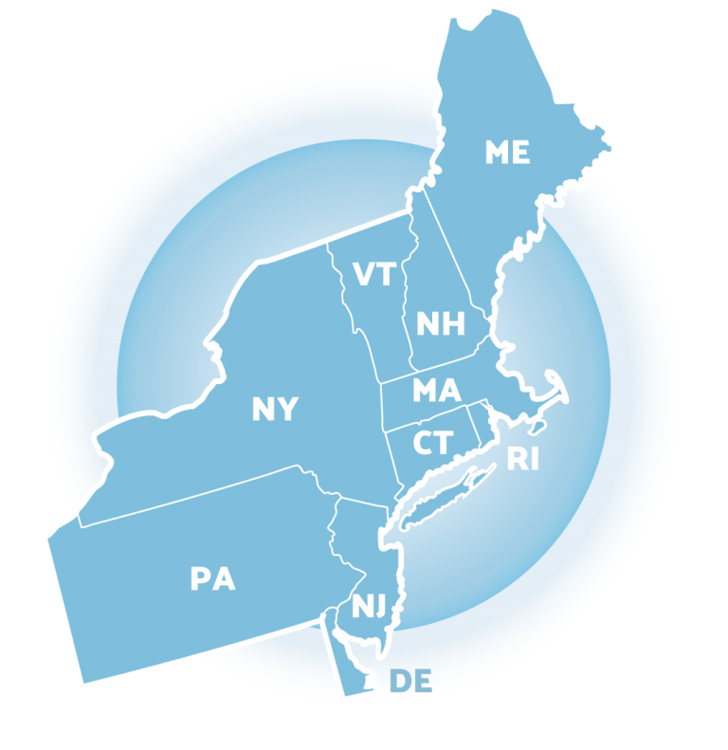
NEPBIS
School-Wide
Team Training
Year 1
Day 4
INSERT TRAINER NAMES HERE
with support from
Karen Robbie, Jen Freeman,
Brandi Simonsen, Katie Meyer,
Adam Feinberg & Susannah Everett
Notes:
Trainers: refer to training manual for:
Tips on presenting the overview content
Explanation for short activity periods and ideas for teaching this to teams
Ideas for facilitating review and team action planning

Slide 5
POSITIVE BEHAVIOR INTERVENTIONS & SUPPORTS
(PBIS)

Slide 6

WHO'S HERE?
Who's here?
LIST SCHOOLS IN COHORT HERE
(List the schools in your cohort here)
Notes:
TRAINER NOTE: Give teams several minutes each to introduce themselves and their school- including any previous experiences with PBIS.

Slide 7
NEPBIS SCHOOL-WIDE TRAINING MODEL
Year 1
Exploration and Installation of 10 Getting Started Steps
Year 2
Initial Implementation of 10 Getting Started Steps
Year 3+
Full Implementation and Continuous Improvement of Implementation
6 days of team training + 3 days of coach training
3 days of team training + 3 days of coach meeting
On-going Professional Development and Support
(minimum of 2 days of team training + 2 days of coach training annually)

Slide 8
YEAR 1: Getting Started with PBIS
DAY 1
Step 1: Establish an effective leadership team
DAY 2
Step 2: Develop a brief statement of purpose & define outcomes
Step 3: Identify positive school-wide behavior expectations
Step 4: Develop procedures to teach school-wide expectations
DAY 3
Step 5: Develop procedures to teach class-wide expectations
Step 6: Develop a continuum of responses to increase use of SEB skills
DAY 4
Step 7: Develop a continuum or responses to decrease SEB errors
DAY 5
Step 8: Develop systems to support staff
DAY 6
Step 9: Use data for decision-making
Step 10: Promote sustainability

Slide 9
TRAINING SCHEDULE
TRAINERS:
USE THIS SLIDE TO INSERT YOUR TRAINING SCHEDULE FOR THE CURRENT YEAR

Slide 10
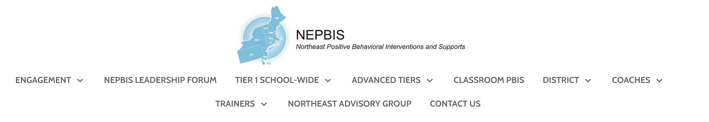


nepbis.org
TOOLS
Tier 1 Schoolwide
Tier 1 Team Training Materials
Tier 1 Supplemental Resources
School Team Implementation Guide
responses for activities
document plans
develop artifacts
Slides for each training day
Notes:
TRAINERS: Go directly to https://nepbis.org/ and demonstrate how to access relevant materials.

Slide 11


WEBSITES
pbisapps.org
pbis.org

Slide 12






LEGEND
ORGANIZATION
ACTIVITY
NEW
CONTENT
PREVIEW
REVIEW

Slide 13




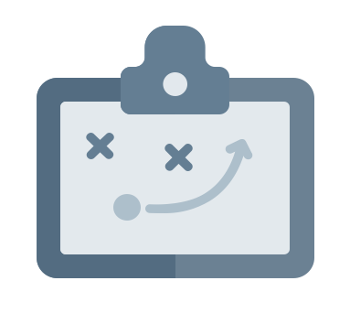

LEGEND
Timing
Example
Activity
Non-example
Guidelines
Preview
Big Idea
Review
Organization

Slide 14
EXPECTATIONS
 | Individually | Working with Others
Respect Self | Participate Converse with others in lobbies and during breaks Stretch, break, stand as needed | Engage with the training content and activities
Respect Others | Complete assigned tasks Return from breaks on time | Provide room for every voice Reinforce participation
Respect Environment | Keep devices silent Have your computer charged and ready Keep necessary materials at hand | Maintain a neat, orderly work space

Slide 15
AGENDA AND ACTION STEPS
Step 7: Developing a Continuum of Responses to Decrease SEB Errors
  Building Behavioral Capacity
  De-escalating Behavior
  Components of a Response Continuum
Understand function based logic for responding to contextually inappropriate behavior
Understand strategies for de-escalating and avoiding power struggles
Develop:
Clearly defined SEB error definitions
Response Procedure Flowchart
Referral Form

Slide 16
Quick
Review

Slide 17
Continuum of School-Wide Instructional
& Positive Behavior Support
What do we do for the FEW needing intensive support?
Tertiary Prevention:
Specialized
Individualized
Systems for Students with High-Risk Behavior
What do we do for ALL?
Primary Prevention:
School-/Classroom-
Wide Systems for
All Students,
Staff, & Settings
~5%
~15%
What do we do for the SOME needing more support?
Secondary Prevention:
Specialized Group
Systems for Students with
At-Risk Behavior
~80% of Students

Slide 18
Critical Features
Systems
Practices
Data
Equity
Outcomes

Slide 19
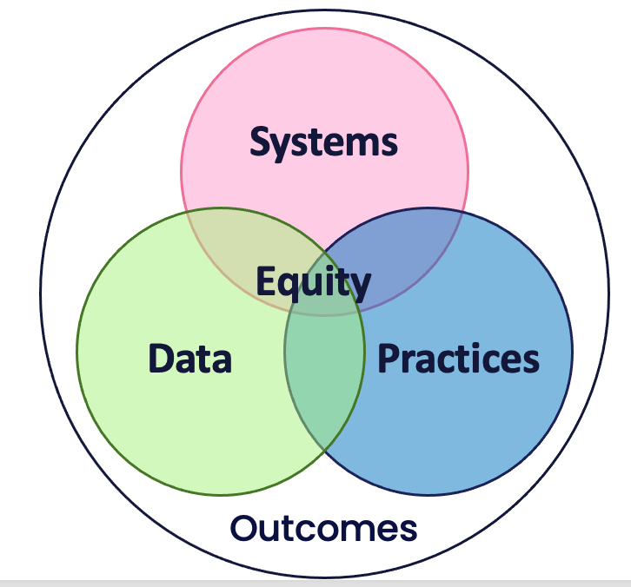
Culture and Context of the School Community

Slide 20
GETTING STARTED WITH PBIS
1
Establish an effective leadership team
6
Develop a continuum of responses to increase use of SEB skills
2
Develop a brief statement of purpose & define outcomes
7
Develop a continuum of responses to decrease SEB errors
3
Identify positive school-wide behavior expectations
8
Develop systems to support staff
4
Develop procedures to teach school-wide expectations
9
Use data for decision-making
5
Develop procedures to teach class-wide expectations
10
Promote sustainability

Slide 21
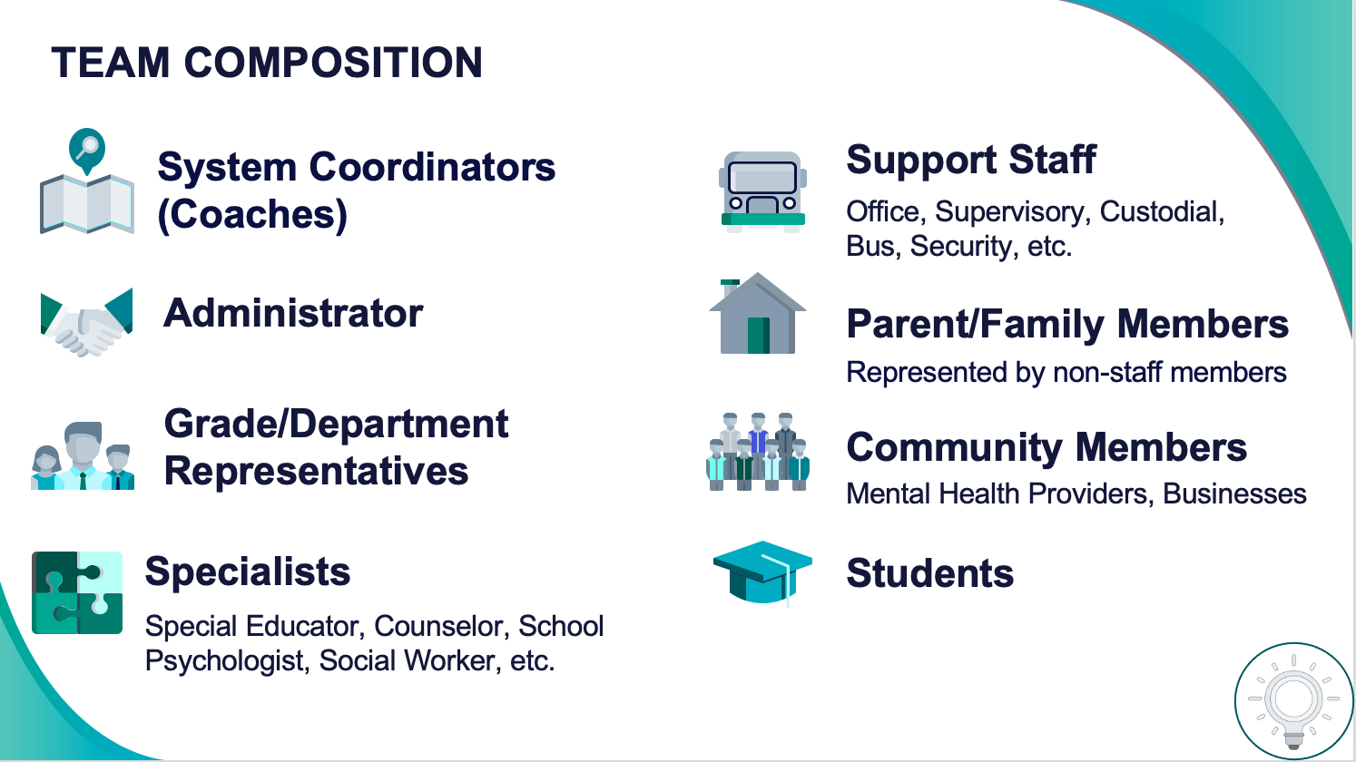
1
Establish an effective leadership team
Systems
Supports Relevance & Equity
Improves student outcomes
Promotes Engagement
Notes:
Your first step is to create a representative team to lead your school’s PBIS efforts.

Slide 22
2
Develop a brief statement of purpose & define outcomes
Practices
What do we hope to achieve by implementing PBIS?
"Our mission is to provide a positive, safe, healthy, nurturing and respectful environment in which all students have the opportunity to become productive members of society."
Purpose
“As a result of implementing PBIS during the 20XX-20XY school year, student reports of school climate will improve by 20%.”
Outcome
Notes:
You’ll then focus your school’s PBIS efforts by creating a statement of purpose to identify your hopes and goals for PBIS implementation.

Slide 23
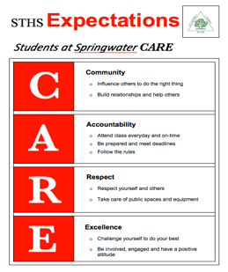
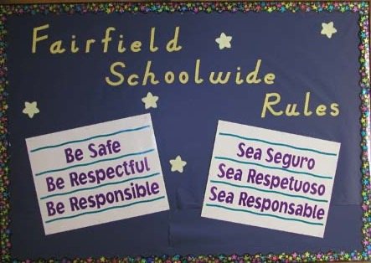

3
Identify positive school-wide behavior expectations
Practices
Notes:
Your team will work with your school community to uncover what you value and use those values to identify your schoolwide expectations

Slide 24
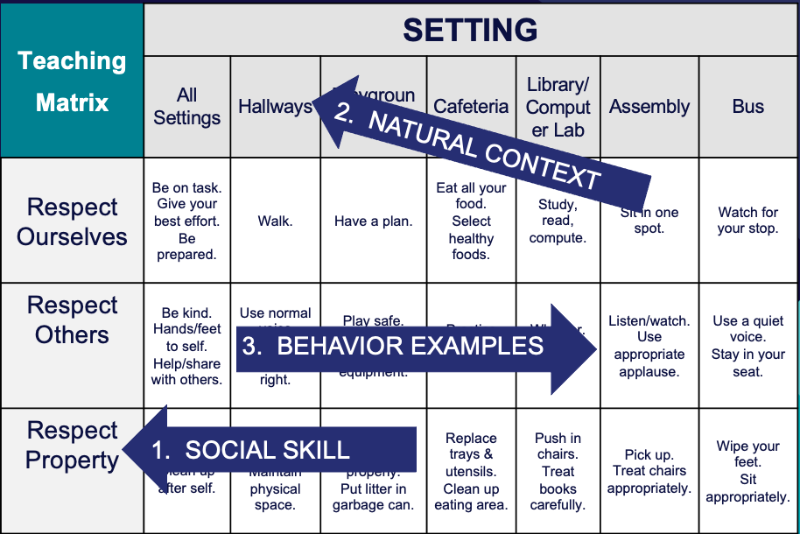
4
Develop procedures to teach school-wide expectations
Practices
Define
Teach
Prompt
Monitor
Evaluate
Notes:
Using those identified expectations, you’ll define what those expectations look and sound like in key routines/settings throughout your school. This is organized through a behavioral matrix. Using the schoolwide matrix, your team will develop lessons that will be explicitly taught to students at the beginning of the year (and boosted throughout the year) so that they know how to be successful within each context (like the hallway, cafeteria, assemblies, etc.)

Slide 25
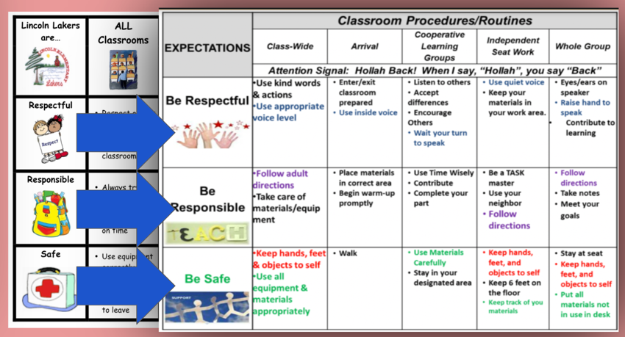
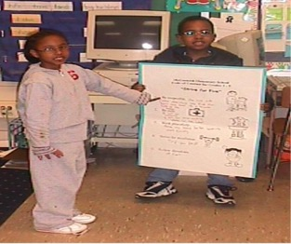
5
Develop procedures to teach class-wide expectations
Practices
Notes:
Once the schoolwide expectations have been determined, classroom educators will apply the behavior matrix format to the routines and settings within their classrooms. They will also explicitly teach the expectations to their students throughout the year.

Slide 26
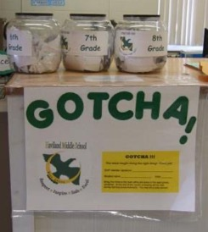
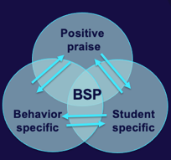
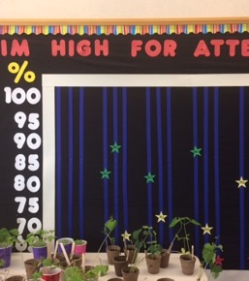
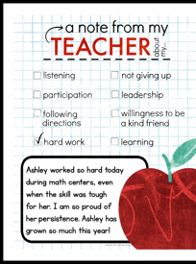
6
Develop a continuum of responses to increase use of SEB skills
Practices
Notes:
To encourage contextually appropriate behaviors to occur, you'll support educators to provide frequent specific feedback and praise. To promote this critical practice, you’ll develop recognition/acknowledgement systems for both students and staff.

Slide 27
TEAM DISCUSSION: Checking in
Discuss with your group and identify
  1-2 accomplishments
  1-2 questions or concerns shared by most members of team
Be ready to share 1 accomplishment and 1 question/concern from your discussion.
5 minutes

Slide 28
WHOLE GROUP DEBRIEF: Checking In
Share 1 accomplishment and 1 question/concern from your team discussion.
5 minutes

Slide 29
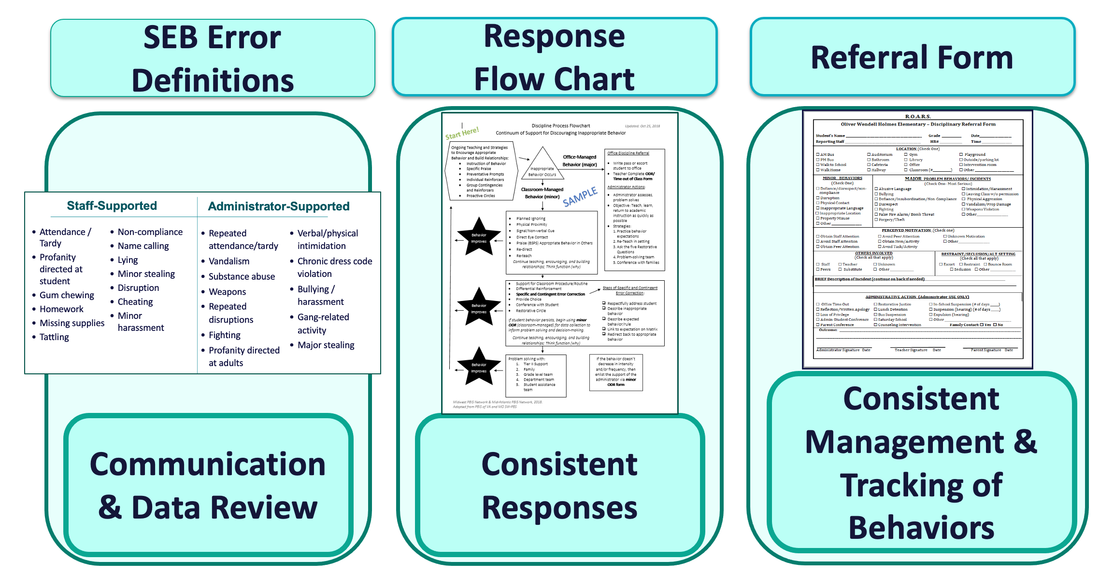
7
Develop a continuum of responses to decrease SEB errors
Practices
Notes:
You will also clarify how staff should respond when contextually inappropriate behaviors occur by clearly defining, determining who’s responsible for responding, identifying clear responses, and recording the behaviors.

Slide 30
Practices
STEP 7:
DEVELOP A CONTINUUM OF RESPONSES TO DECREASE SEB ERRORS
How do we develop consistent responses to SEB errors ?
Understand function-based logic for responding to contextually inappropriate behavior
Develop components of a response continuum
Understand strategies for de-escalating and avoiding power struggles

Slide 31
Before we begin…
What does contextually inappropriate behavior mean?
Behaviors or actions that are inappropriate in a given context but may be appropriate in another context.
We intentionally use the term contextually inappropriate behavior rather than unwanted or inappropriate behavior to emphasize the role of context in judgments about what behaviors are and are not accepted.
Calling out
While others are speaking
Replying to a choral response
Inappropriate
Appropriate
Yelling
In classroom
At recess
Inappropriate
Appropriate
Getting help from peers
During a test
During group work
Inappropriate
Appropriate

Slide 32
Identifying, teaching and reinforcing our school-wide and class-wide expectations is critical!
But, we also need to prepare staff for responding to contextually inappropriate behavior...
This requires :
understanding the science of behavior
developing awareness of implicit biases
recognizing vulnerable decision points
learning neutralizing routines
establishing consistent school-wide responses

Slide 33
Building Behavioral Capacity

Slide 34
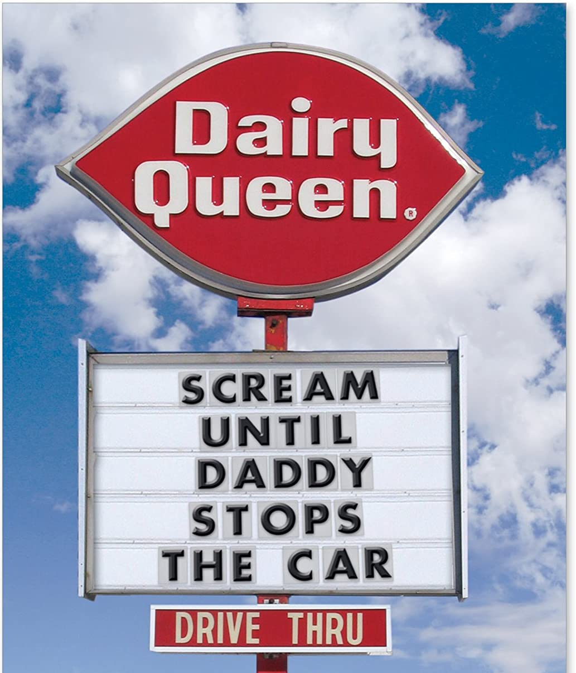
Before we can effectively encourage or discourage behavior, we need to understand why behavior happens AND how to identify why the behavior is continuing!

Slide 35
A basic understanding of the science of behavior change:
Gives us tools to observe, measure, teach, and correct behaviors effectively and efficiently.
Moves us away from perceptions, opinions, and assumptions about motivations or intentions
Shares the following assumptions (see right)
Behavior is communication.
Behavior occurs in the context of an antecedent and consequence.
Behavior is learned (function).
Behavior is lawful (function).
Behavior is escalated through successive interactions (practice).
Behavior can be changed through an instructional approach.
(Colvin & Sugai, 1989)

Slide 36
BUILDING BLOCKS OF BEHAVIOR: Three Term Contingency
Antecedent
“Stimulus that precedes a behavior”
Behavior
”Observable and measurable act of an individual (also called a response)”
Consequence
Stimulus change that occurs contingent on a behavior

Slide 37
EXAMPLE: Jamie
ANTECEDENT
BEHAVIOR
CONSEQUENCE
When asked to complete an independent assignment,
Jamie disrupts peers and refuses to begin the assignment.
After this behavior, the teacher immediately sits with Jamie and helps complete the work.

Slide 38
REINFORCEMENT & PUNISHMENT
Reinforcement
Punishment
when a consequence of a behavior functions to INCREASE the likelihood of future occurrences of that behavior
when a consequence of a behavior functions to DECREASE the likelihood of future occurrences of that behavior

Slide 39
Back to Jamie...
ANTECEDENT
BEHAVIOR
CONSEQUENCE
When asked to complete an independent assignment,
Jamie disrupts peers and refuses to begin the assignment.
After this behavior, the teacher immediately sits with Jamie to help complete the work.
During the next independent assignment, Jamie's behavior repeated because it was REINFORCED.

Slide 40
All behavior serves a function...
Get/Obtain
desired activities
tangible items
Avoid/Escape
aversive activities
tangible items
attention
sensory stimulation
attention
sensory stimulation
“Function” = outcome, result, purpose, consequence

Slide 41
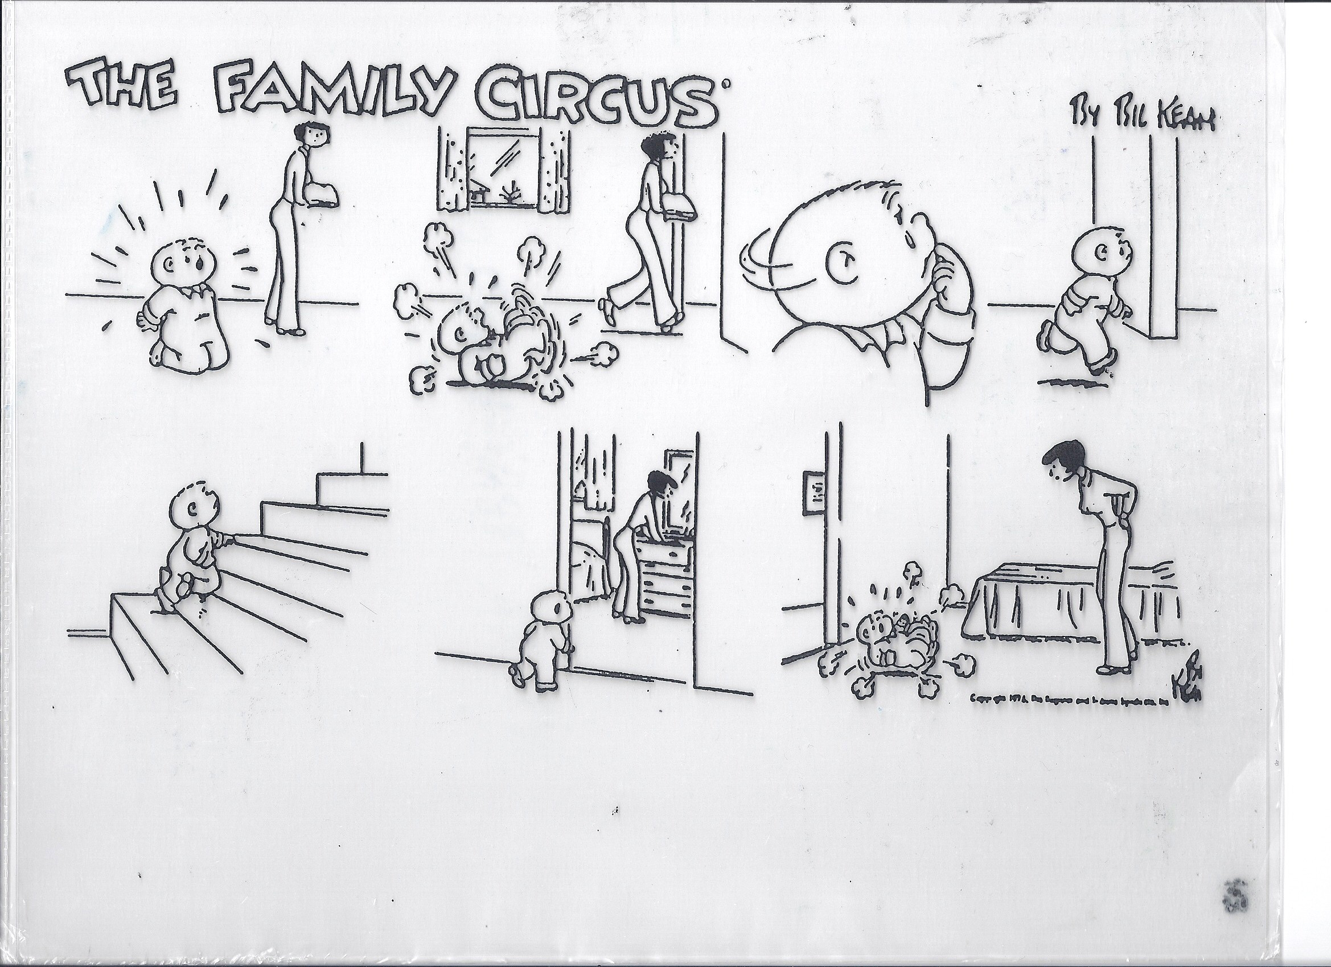
What's the function?

Slide 42
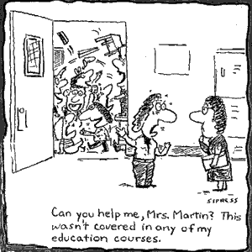
What's the function?
I’m sending my whole class to the office!

Slide 43
Non-examples of Function-Based Approach
“Lantana, you skipped 2 school days, so we’re going to suspend you for 2 more.”
“Phebe, I’m taking your book away because you obviously aren’t ready to learn.”
Why are these
NON-examples of a
function-based approach?
  “You want my attention?! I’ll show you attention…
  let’s take a walk down to the office & have a little chat with the principal.”

Slide 44
To determine function of behavior...
What typically precedes?
What do the behaviors look like?
What typically follows?
Antecedent
Behavior
Consequence
Based on observing patterns across time,
we can infer the probable function of behavior.

Slide 45
Let's practice...
During teacher lecture, Martha repeatedly and loudly calls out (without raising her hand). Each time, the teacher gives her a look, a redirection, or occasionally calls on her.
Teacher lecture (limited attention)
Calling out repeatedly
Teacher attention
Antecedent?
Behavior?
Consequence?
What Function?
Get/obtain Attention

Slide 46
When given a difficult writing assignment Susannah regularly throws her pencil down, rips up her paper, and puts her head down. Her teacher ignores this behavior (and Susannah never completes her assignment).
Difficult writing assignment
Throw pencil, rip paper, head down
Nothing (doesn’t do assignment)
Antecedent?
Behavior?
Consequence?
What Function?
Escape task

Slide 47
A 6th grade teacher found that over 30% of the behavioral incident reports coming from her classroom occurred as students were being dismissed from class.
Physical contact & arguing
Getting to the hallway
Too many students leaving the room at once & confusion over where to turn in work
Antecedent?
Behavior?
Consequence?
What Function?
Getting access to peers in hallway

Slide 48
By understanding function, we can intervene more effectively.
How can we prevent?
What should we teach the student to do instead?
How do we respond to make sure the new skill “works”?
Prevent
Teach
Respond
We can make simple tweaks to the antecedents, behaviors, and consequences, to prevent, teach, and respond, respectively.

Slide 49


Slide 50
Let’s practice
During teacher lecture, Martha repeatedly and loudly calls out (without raising her hand). Each time, the teacher gives her a look, a redirection, or occasionally calls on her.
Provide attention ahead of lecture and frequent eye contact during
Teach and prompt hand raising
Call on her ONLY when she raises her hand (otherwise ignore)
Prevent?
Teach?
Respond/
Reinforce?
Simple strategies like this are part of effective
“Tier 1” responses to minor contextually inappropriate behavior.

Slide 51
When given a difficult writing assignment Susannah regularly throws her pencil down, rips up her paper, and puts her head down. Her teacher ignores this behavior (and Susannah never completes her assignment)
Modify writing assignment
Teach and prompt her to ask for help/break
Give immediate help/break when asked. Otherwise, redirect to task.
Prevent?
Teach?
Respond/
Reinforce?
With these simple tweaks, we’ve made it less likely for her to
engage in contextually inappropriate behavior to escape difficult tasks.

Slide 52
A 6th grade teacher found that over 30% of the behavioral incident reports coming from her classroom occurred as students were being dismissed from class.
Dismiss one table or row at a time.
Collect student work before dismissal.
Teach and prompt waiting behavior (how to keep busy while waiting) and traffic flow routines.
Provide acknowledgement to students waiting, walking, and using accurate traffic flow patterns.
Prevent?
Teach?
Respond/
Reinforce?
With these strategies, we’ve reduced opportunities for crowding, taught
the expectations and reinforced students for meeting the expectations.

Slide 53
Function Based Support
Foundations in behavioral theory, ABA, and PBIS
Attention to environmental context
Emphasis on purpose (or history of reinforcement) of behavior
Focus on teaching behaviors
Attention to implementers (adult behaviors) & redesign of teaching & learning environments

Slide 54
Why is function important?
Function-based behavior support plans are not only effective, they are more effective than similarly intensive and individualized plans that are not function-based.
(e.g., Ingram, Palmer, & Sugai, 2005)

Slide 55
ACTIVITY: Function of Behavior
Practice applying a function-based approach to a Tier 1 problem:
  Identify a common problem behavior in a non-classroom or classroom setting (e.g. students pushing one another while waiting in cafeteria line; many students not completing assignments)
  Describe the “ABCs”
  Identify strategies to prevent, teach, and respond/reinforce
Consider how you will teach function-based thinking to your staff and add items to your Action Plan as necessary.
Be ready to present 2-3 “big ideas” from your discussion.
15 minutes

Slide 56
WHOLE GROUP DEBRIEF: Function of Behavior
Share 1-2 highlights from your team discussion.
What support will you need to promote function-based thinking within your school?
5 minutes

Slide 57
Break

Slide 58
Developing a Continuum of Responses to Decrease SEB Errors

Slide 59
Why a Continuum of Consequences?
To ensure that the same consequence is not applied to all SEB errors occurring in a school.
To establish a hierarchy from least to most severe consequences that are aligned with SEB errors.
To better address the needs of a variety of students.

Slide 60
Critical Features of a
Continuum of Responses to Decrease SEB Errors
Relate to the function of the behavior!
Align with clearly defined school-wide expectations
Exist as one component of a larger system of behavior change for the student.
  Teaching expectations
  Acknowledging appropriate behaviors
System of support exists including review, teaching, and monitoring of current responses to problem behavior

Slide 61
District and Building Discipline Procedures
Most schools outline their consequences in “Codes of Conduct” or written policies for behavior
Codes of Conduct developed to clearly communicate discipline procedures to prevent problems (NSRN, 1980)
Over time, Codes of Conduct have focused on punitive responses and student removal

Slide 62
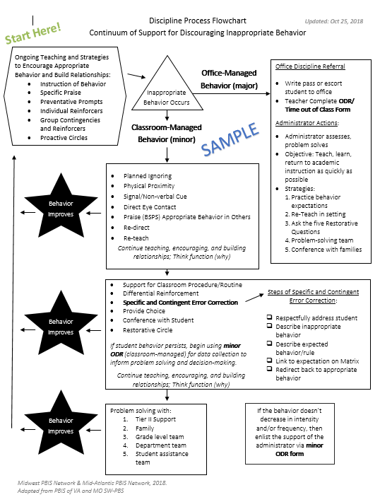
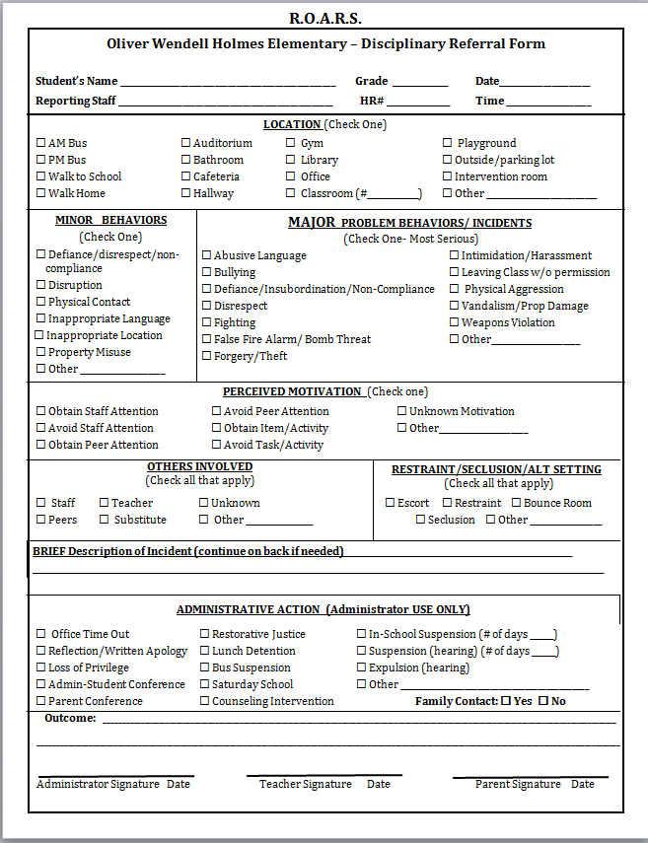
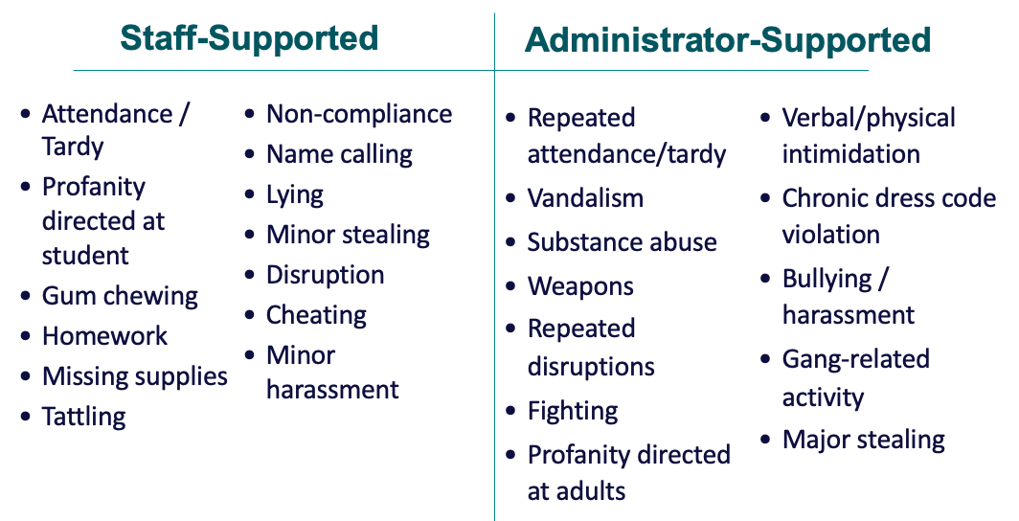
Organizing Responses: 3 Important Components
SEB Error Definitions
Response
Flow Chart
Referral Form
Consistent Management & Tracking of Behaviors
Communication & Data Review
Consistent Responses

Slide 63
Considerations for Discipline Procedures
Discipline without a positive, proactive, & instructional approach results in increased:
Aggression
Vandalism
Truancy
Dropouts
Mayer & Sulzer-Azaroff, 1990; Skiba, Peterson, & Williams, 1997
Treat behavioral errors like academic errors!
Removing students struggling with reading from the classroom will not improve their reading!

Slide 64
Organizing Responses: 3 Important Components
SEB Error Definitions
Flow Chart
Referral Form
Are all staff consistent with how SEB errors are labeled?
Are all staff knowledgeable on what responses are appropriate and the process for responding to SEB errors?
Are all staff consistent with recording and monitoring information when SEB errors occur?
Consistent Management & Tracking of Behaviors
Communication & Data Review
Consistent Responses

Slide 65
Clearly Defined Behaviors
SEB Error Definitions
Clearly define your responses around those that are staff-supported & those that are administrator-supported
Are all staff consistent with how SEB errors are labeled?
Staff-Supported
SEB Errors
Define those behaviors that generally should be supported within the classroom
frequent, low intensity behaviors
Administrator-Supported
SEB Errors
Define those behaviors that generally should be supported by the administrator
in-frequent, high intensity behaviors
Communication & Data Review

Slide 66
T-Chart of Behavior
Staff-Supported
Administrator-Supported
  Supported by staff member
  No administrative action needed
  May still want documentation to track trends
  Supported by an administrator
  Administrative action needed

Slide 67
T-Chart of Behavior
Staff-Supported
Administrator-Supported
Attendance / Tardy
Profanity directed at student
Gum chewing
Homework
Missing supplies
Tattling
Non-compliance
Name calling
Lying
Minor stealing
Disruption
Cheating
Minor harassment
Repeated attendance/tardy
Vandalism
Substance abuse
Weapons
Repeated disruptions
Fighting
Profanity directed at adults
Verbal/physical intimidation
Chronic dress code violation
Bullying / harassment
Gang-related activity
Major stealing

Slide 68
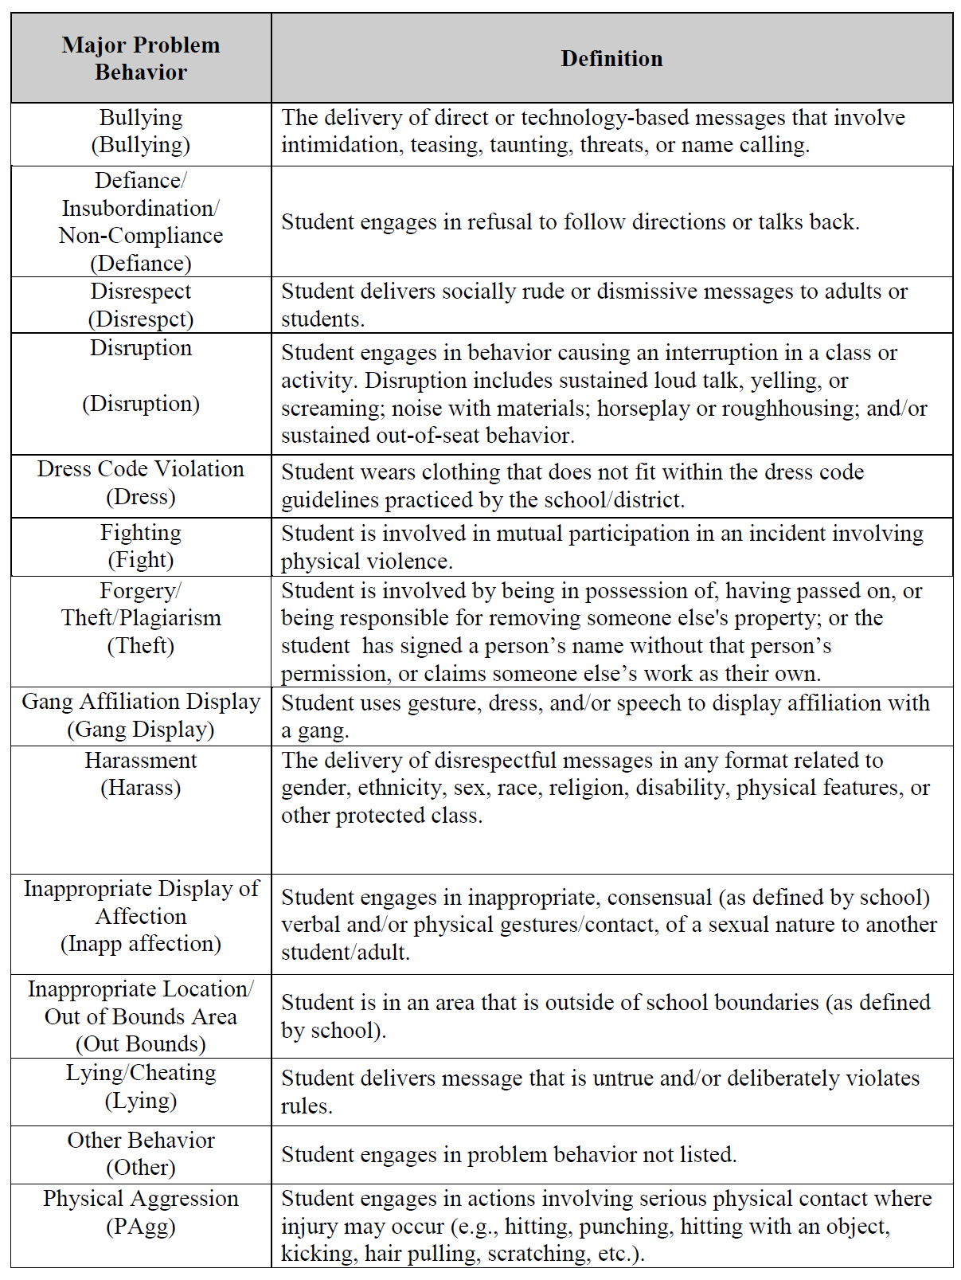
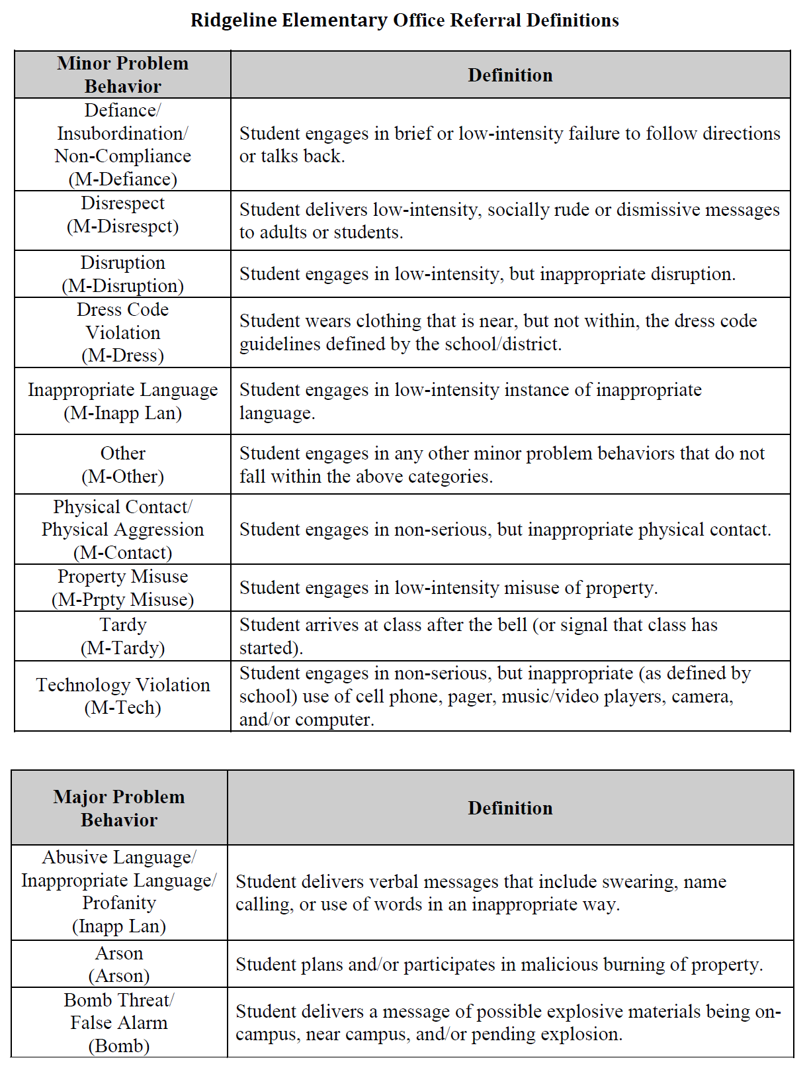
SWIS Definitions
Administrator-Supported Behaviors | Definition
Staff-Supported Behaviors | Definition
Administrator-Supported Behaviors | Definition
More information and examples are available at www.pbisapps.org in the SWIS Resources section.

Slide 69
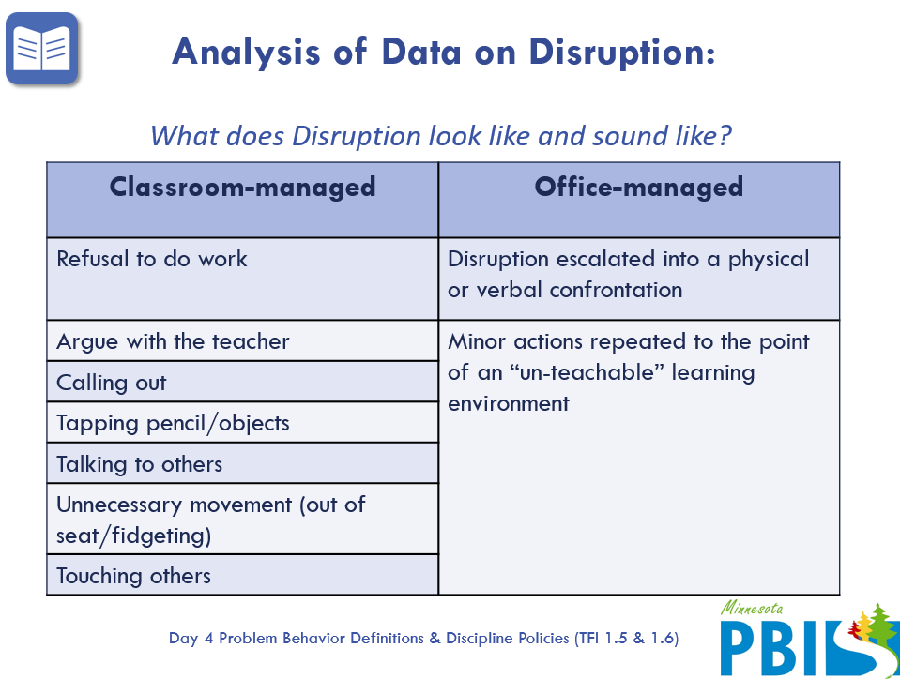
Clarify the differences!

Slide 70
Identifies categories of SEB errors
Warning/Reteach | Staff-Supported | Administrator-Supported
Teacher handled, no documentation required, teacher discretion for consequences and personal documentation | Teacher supported, referral form completed, teacher assigns own or building consequence (building consequence examples: lunch or after school detention, time in office, community service, etc.) | Referral form completed. Administrator assigns consequence (with teacher input). Administrator communicates to teacher about situation.
LANGUAGE
Offensive remarks or gestures in a casual manner inappropriate sexual connotations; putdowns to a particular subgroup | Repeated pattern of any inappropriate language | Swearing used to harass, intimidate, show defiance, create an unsafe climate
DISRUPTION
Noise making; talk-outs/side-talk; attention-getting behaviors (silly answers, class clowning, etc.); bugging others | Repeated pattern of any disruptive behaviors; misuse of cell phone/electronic devices in class [Phones and electronic devices to be confiscated and taken to office] | Behavior that stops the learning in class; defiant repetition of behavior following correction
Provides examples of SEB error within each category

Slide 71
Guidelines for a
Continuum of Responses to Decrease SEB Errors
As you develop SEB Error Definitions, ensure definitions are:
  contextually appropriate
  representative of a continuum of severity (e.g.,staff-supported, administrator-supported, illegal)
  comprehensive in scope (school-wide)
  written in measurable terms
  mutually exclusive (minimal overlap)
And…develop agreement regarding office/administrative vs. teacher/staff responsibilities

Slide 72
ACTIVITY: Clearly Defining Behaviors
Get started on Defining SEB errors (Staff vs Administrator- Managed).
Add items to your Action Plan to complete these activities with your team.
Prepare to present 1-2 “big idea” from your group.
Warning/Reteach | Staff-Supported | Administrator-Supported
Teacher handled, no documentation required, teacher discretion for consequences and personal documentation | Teacher supported, referral form completed, teacher assigns own or building consequence (building consequence examples: lunch or after school detention, time in office, community service, etc.) | Referral form completed. Administrator assigns consequence (with teacher input). Administrator communicates to teacher about situation.
LANGUAGE
Offensive remarks or gestures in a casual manner inappropriate sexual connotations; putdowns to a particular subgroup | Repeated pattern of any inappropriate language | Swearing used to harass, intimidate, show defiance, create an unsafe climate
DISRUPTION
Noise making; talk-outs/side-talk; attention-getting behaviors (silly answers, class clowning, etc.); bugging others | Repeated pattern of any disruptive behaviors; misuse of cell phone/electronic devices in class [Phones and electronic devices to be confiscated and taken to office] | Behavior that stops the learning in class; defiant repetition of behavior following correction
10 minutes

Slide 73
WHOLE GROUP DEBRIEF: Clearly Defining Behavior
Share 1-2 highlights from your team discussion.
What further support do you need to clearly define behaviors at your school?
5 minutes

Slide 74
Organizing Responses: 3 Important Components
SEB Error Definitions
Flow Chart
Referral Form
Are all staff consistent with how SEB errors are labeled?
Are all staff knowledgeable on what responses are appropriate and the process for responding to SEB errors?
Are all staff consistent with recording and monitoring information when SEB errors occur?
Consistent Management & Tracking of Behaviors
Communication & Data Review
Consistent Responses

Slide 75
Flow Chart
Clearly outline process for responding to SEB errors as well as how we track student / staff behavior
Flow Chart
Are all staff knowledgeable on what responses are appropriate and the process for responding to SEB errors?
Behavior Tracking
Outline what information is tracked at which points and where that data will be collected and housed.
Staff Responses
Outline responses linked to various levels of behavior and a process for both staff and administrator-managed behavior that is clear to both staff and students.
Consistent Responses

Slide 76
Response Procedures
What
(Product)
Why
(Rationale)
Makes the response process transparent & predictable
Improves consistency between adults
How
(Implementation)
Include in handbook for students, families
Flowchart of referral process
Builds trust & communication (staff, students, families)
Process/ considerations checklist

Slide 77
Response Process Considerations/Checklist
What is the process?
How do I refer an incident?
How do I complete the referral form?
What is the purpose of the referral form?
What should I expect to happen when I complete a referral?
How does it get to the office (administrator and/or data entry person)?
When/ how should I expect to hear back from the office/administrator?
Do we track staff-managed offenses?
Is the referral form different for staff vs administrator-managed errors?
At what point are students and/or families included in the process?
What do I do in a crisis situation (not just lockdown, but also safety situations)?

Slide 78
Flowchart Examples

Slide 79
High School Example
Is the behavior office managed?
Administration
Teacher
Contact front desk at x1100 with details of immediate event OR fill out SWIS referral.
No
Yes
Review expectation and redirect to activity
Administrator comes to class and escorts student to temporary placement OR will process referral.
Resolved
Not Resolved
Inappropriate language
Physical contact
Defiance
Disrespect
Class disruptions
School property misuse
Dress Code violation
Misuse of technology
Student wandering in hallways
Lying for avoidance or attention
Misuse of hallway pass
Class absence/tardy
Cheating/Plagiarism *
Abusive or racist, sexist, homophobic language
Fighting/Physical aggression
Aggressive defiance
Harassment/Bullying
Sustained disruption
Chronic absenteeism/truancy
Forgery/theft
Cheating/Plagiarism
Tobacco/Drugs/Alcohol
Vandalism/Property damage
Threat to self and/or others
Chronic misuse of technology
Insubordination in hallways
Teacher
Administration
Utilize Classroom Strategies
Teach/Review/Re-teach Expectations
Behavior Contract
Change of Seat
Phone call home
Differentiated instruction
Collaborate with student’s other teachers, liaison, adj. counselors, housemaster
10-minute maximum time on passes
Teacher fills out SWIS referral form by end of day. Administrator collects more information & conducts student/teacher interviews.
Administrator determines need for further consequence.
Resolved
Not Resolved
Administrator contacts teacher & home about action
After multiple interventions for the same behavior over time
Refer to Administrator, Support Staff, and/or CST
Gray area? Refer to adjustment counselor, administration, or support staff
Resolution with student, teacher, & others occurs.
*Teacher determines severity.

Slide 80
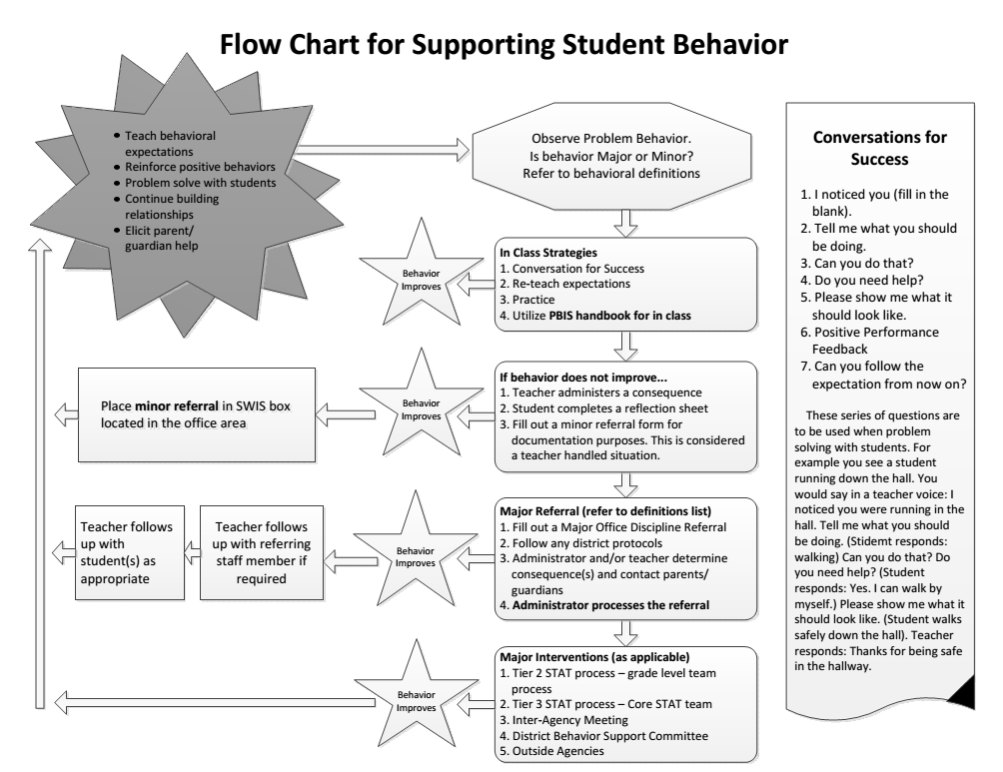

Slide 81
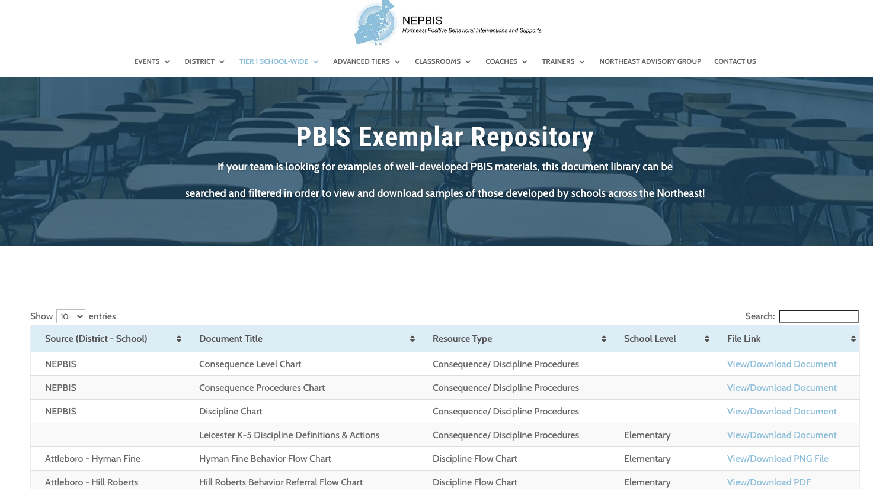
For more examples from schools across the state, check out the
Exemplar Repository
Includes examples of teaching matrices, lesson plans, recognition systems, flow charts, etc.

Slide 82
Guidelines for a
Continuum of Responses to Decrease SEB Errors
As you develop Response Procedures for SEB errors, establish:
Agreement regarding options for continuum of consequences
Series of responses that support students’ quick return to instructional activities
Schedule for regular review of use and effectiveness
Means for keeping track of number of acknowledgments vs. referrals or other disciplinary actions
Procedures for identifying and supporting students whose behaviors are not responsive

Slide 83
ACTIVITY: Developing Response Procedures
Get started on SEB Errors Flowchart with a continuum of staff responses for addressing SEB errors both in and out of the classroom.
Add items to your Action Plan to complete these activities with your team.
Prepare to present 1-2 “big idea” from your group.
10 minutes

Slide 84
WHOLE GROUP DEBRIEF: Developing Response Procedures
Share 1-2 highlights from your team discussion.
What further support do you need to develop response procedures at your school?
5 minutes

Slide 85
Organizing Responses: 3 Important Components
SEB Error Definitions
Flow Chart
Referral Form
Are all staff consistent with how SEB errors are labeled?
Are all staff knowledgeable on what responses are appropriate and the process for responding to SEB errors?
Are all staff consistent with recording and monitoring information when SEB errors occur?
Consistent Management & Tracking of Behaviors
Communication & Data Review
Consistent Responses

Slide 86
Referral Form
Clearly outline a system for tracking SEB errors that will support decision making.
Referral Form
Referral Form(s)
Develop referral forms with adequate specificity to support data-based decision making at the universal level.
System to Support Fidelity
Ensure language is consistent with SEB error definitions and flow chart, form can be completed quickly, and staff are trained and supported with use.
Are all staff consistent with recording and monitoring information when SEB errors occur?
Consistent Management & Tracking of Behaviors

Slide 87
Response Procedures
What
(Product)
Why
(Rationale)
Provides documentation of an incident to be used for planning and support
How
(Implementation)
Referral: administrator-managed
Paper form or paperless
Referral: staff-managed
Referral: combined
Separate forms or combined?
Include required fields for problem solving (e.g. behavior, location, time of day, student, perceived motivation)

Slide 88
Referral Form
IT IS…
An interaction between Kid - Staff Member - Administrator
IT IS NOT…
Punishment
Clear, mutually exclusive, exhaustive definitions
Underestimation of actual behavior
Piece of information used to make decisions
A reflection on teacher’s skills
A way to change or re-teach behavior
A first attempt at correcting behavior

Slide 89
Referral Form:
Required Fields for Effective Problem Solving
Student’s name
Date
Time of incident
Student’s grade level
Referring staff
Location of incident
Behavior
Perceived motivation
Others involved
Action taken
Other notes

Slide 90
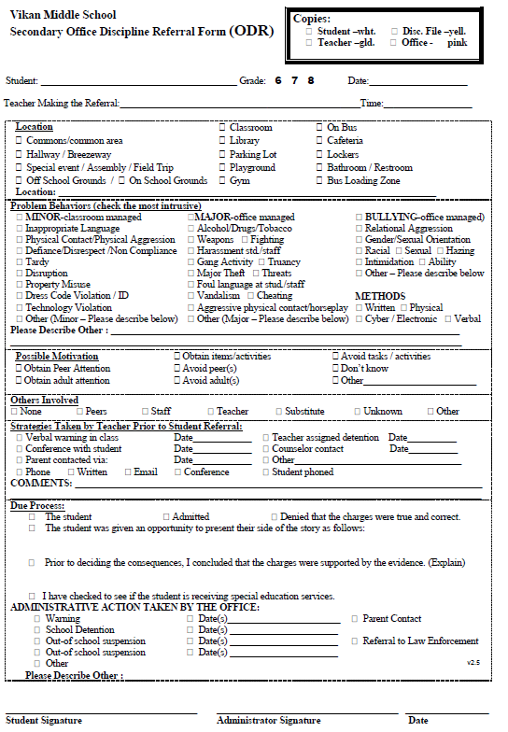
Categorical options with checkboxes and less narrative allows for efficient completion and less confusion.
Referral Form Example

Slide 91
Referral Form Example

Slide 92
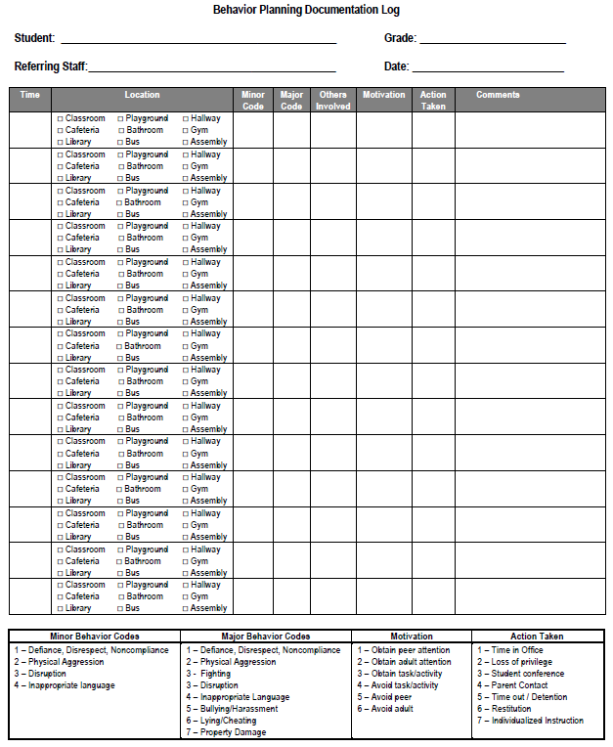
Referral Form Example

Slide 93
Referral Form Example

Slide 94
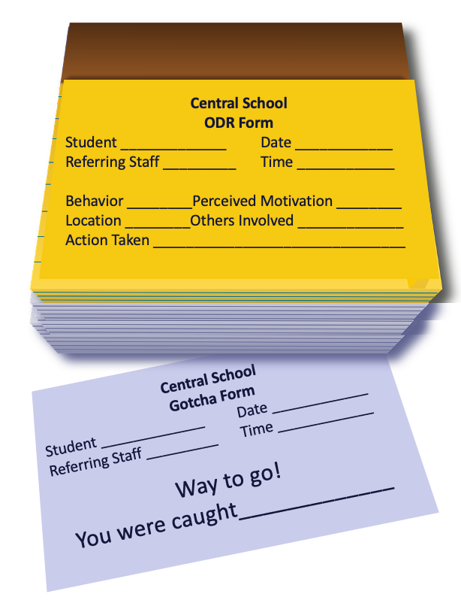
~10 positive : 1 correction

Slide 95
Guidelines for a
Continuum of Responses to Decrease SEB Errors
The referral form for tracking SEB errors specifies:
Who:
engaged in the SEB error
observed and responded
else was involved?
When (day/time)?
Where?
What:
expectation was violated
was the possible motivation?
As you develop a Referral Form for SEB errors, ensure:

Slide 96
ACTIVITY: Developing a Referral Form
Get started on revising or developing a Referral Form, as needed.
Consider how you will train staff to use the referral form & how to assess the effectiveness, efficiency, & accuracy of the system
Add items to your Action Plan to complete these activities with your team.
Prepare to present 1-2 “big idea” from your group.
10 minutes

Slide 97
WHOLE GROUP DEBRIEF: Developing a Referral Form
Share 1-2 highlights from your team discussion.
What further support do you need to develop a referral form to use at your school?
5 minutes

Slide 98
Engage partners by co-designing and revising all 3 components of your response continuum based on data
SEB Error Definitions
Flowchart
Referral Form
TEAM develops drafts at a team training
STAFF review the drafts and provide input
STUDENTS provide insight into which behaviors are more problematic than others, potential support needs, etc.
FAMILY advisory group provides feedback about cultural relevancy

Slide 99
De-Escalating Behavior

Slide 100
Ever experience a scene like this?
Riley, please turn in your assignment.
What assignment?
The assignment you didn’t finish during class.
I finished it.
Great, please turn it in now.
I don’t have it with me now.
You have a choice…..turn it in or do it again.
You never believe me.
I guess you’ve made the choice to do it again.
Make me.
That’s disrespect…go to the office.
F_____ you!
Moves closer…& puts hand on Riley's shoulder.
Pulls away, glares, & raises fist as if to strike.
(Colvin & Sugai, 1989)

Slide 101
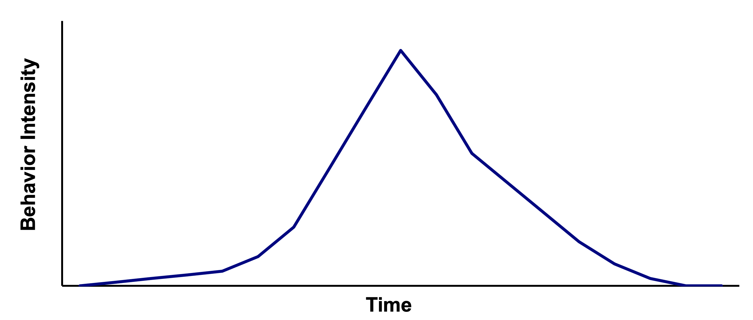

Escalation & De-escalation
High
Peak
Acceleration
De-escalation
PREVENTION
Agitation
Trigger
Recovery
Low
Calm
(Colvin & Sugai, 1989)

Slide 102
Key Prevention Strategies
Identification of how to intervene early in an escalation.
Identification of environmental factors that can be manipulated.
Identification of replacement behaviors that can be taught (& serve same function as problem).
When Riley claimed to not have the assignment, the teacher could have said...
I'm glad to hear you completed it, but sorry you don’t have it with you.
You have a choice…..you can try to find it and turn it in, or you can do it again during review time.
(Colvin & Sugai, 1989)

Slide 103
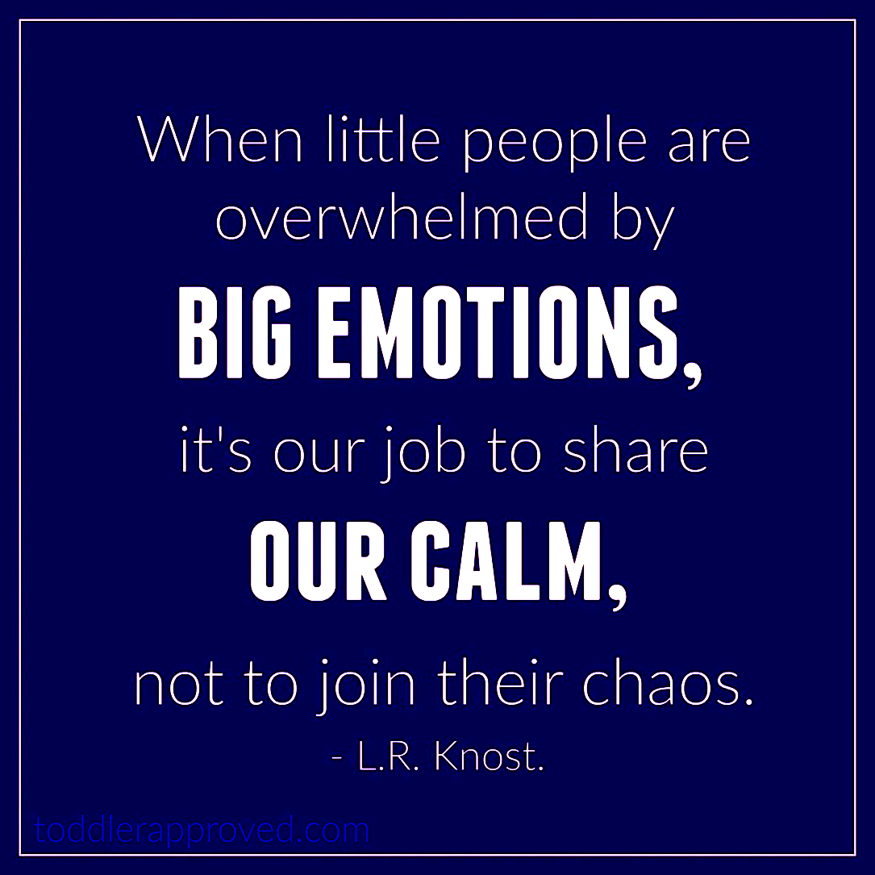
Remember that adults have a role to play...
When people are
Developing a neutralizing routine is another key prevention strategy to help adults do this!
Adapted from
Dr. Kent McIntosh

Slide 104


Self Management/Control
We all need a plan to maintain self-control during a crisis or power struggle (and other times too).
Typically, your body reacts to a crisis in a “fight or flight” response.
Our goal is to counteract that response by remaining calm and regaining “emotional balance.”
Adapted from Smith et al. (2000)

Slide 105
Two-step Neutralizing Routine:
When you see contextually inappropriate behavior
or the start to a power struggle...
Am I triggered or agitated?
By this student/situation?
By an outside factor (e.g., not feeling well that day)?
If so, use an agreed-upon, predetermined
alternative response
stop and ask yourself...
Adapted from
Dr. Kent McIntosh

Slide 106
Neutralizing Routines
Self-assessment:
“Am I triggered or agitated?”
ANTECEDENT
CONSEQUENCE
SETTING EVENT
Lack of positive interactions with student
Fatigue
Riley's assignment is missing
Demand assignment is turned in or redone. When Riley's behavior escalates, send Riley to the office
BEHAVIOR
Riley leaves the class (Aversive social interaction is escaped)
Alternative Response
Take deep breath
& model desired behavior.
Adapted from
Dr. Kent McIntosh

Slide 107
What makes a good neutralizing routine?
If-then statement
Brief
Clear steps
Doable
Interrupts the chain of events
Dr. Kent McIntosh

Slide 108
Neutralizing Routine Examples
When you are triggered or agitated, you can...
Delay decision until you can think clearly
“See me after class/at the next break”
ask the student to reflect on their feelings/behavior
am I acting in line with my values?
Reframe the situation
“I respect you, but that behavior is not ok”
“How do we do that at school?”
assume student’s best effort at getting needs met
respond as if the student was physically injured
Take care of yourself
take two deep breaths
recognize my upset feelings and let them go
model classwide cool-down strategy
Adapted from
Dr. Kent McIntosh

Slide 109
Sample Neutralizing Routine
T-R-Y
For adults:
  Take a deep breath
  Reflect on your emotions
  Youth’s best interest
    “Let’s TRY that again.”
    “Let’s TRY it a different way.”
    “Let’s TRY it how we do it at school.”
For students:
    Take three deep breaths
    Reflect on your emotions
    You got this!
    Social-emotional Theme
      "Mistakes are part of the learning process"
      "We won’t always do it right the first time"
      "We can’t succeed unless we TRY."
Adapted from
Dr. Kent McIntosh

Slide 110
ACTIVITY: De-escalating Behavior
Discuss the extent to which de-escalating behavior is or could be an issue in your school.
Identify 2-3 examples of neutralizing routines that could be shared with staff.
Add items to your Action Plan as necessary
Be ready to present 2-3 “big ideas” from your discussion.
Key Strategies:
Identify how to intervene early in an escalation.
Identify environmental factors that can be manipulated.
Identify replacement behaviors that can be taught (& serve same function as problem).
Identify a neutralizing routine.
15 minutes

Slide 111
WHOLE GROUP DEBRIEF: De-escalating Behavior
Share 1-2 highlights from your team discussion.
What support will you need to promote using neutralizing routines within your school?
5 minutes

Slide 112
Clarifying which behaviors are
contextually inappropriate, staff-managed, and administrator-managed can:
promote consistency
lessen ambiguity
reduce implicit bias

Slide 113
What is Implicit Bias?
Unconscious, automatic
Based on stereotypes
  We all have it (even those affected by it)
  Generally not an indication of what we believe or would endorse
More likely to influence:
  Snap decisions
  Decisions that are ambiguous
Adapted from
Dr. Kent McIntosh

Slide 114
A Multi-Dimensional View of Bias
Racial Bias
Disproportionate Discipline
SITUATION
Adapted from
Dr. Kent McIntosh
Notes:
TRAINER NOTE:
This simplified model of the research indicates that racial bias, even when it is implicit, has a direct and disproportionate impact on student discipline outcomes.
But this model has 2 problems:
1. it focuses solely on one variable that has been shown in many studies to be highly resistant to change (Racial bias)
2. fails to consider contextual variables that may be as critical to biased decision making but are much more malleable.
CLICK
However, when we recognize that the context or situation can influence someone’s response and that individuals may selectively show racial bias in different decision situations, we develop a multidimensional view of bias that can be altered with intervention. For example, a teacher may make more equitable discipline decisions at the start of the day but be more likely to send students of color to the office at the end of the day

Slide 115
EQUITABLE vs. VULNERABLE Decision Points
EQUITABLE Decision Point
A specific decision in which school/district data shows
LITTLE TO NO disproportionality
VULNERABLE Decision Point
A specific decision that is more vulnerable to the effects of implicit bias
Two parts:
Elements of the SITUATION
The person’s DECISION STATE (internal state)
Examples:
Responding to behavior
Determining disciplinary consequences
Student access to privileges
Adapted from
Dr. Kent McIntosh

Slide 116

Decision States: Resource Depletion
As we become fatigued, our filters for appropriate behavior can be affected
Effects of hunger (Gailliot et al., 2009)
E.g., The best time to go before a judge is first thing in the morning or right after lunch
Decreases in willpower later in day
“The Morning Morality Effect” (Kouchaki & Smith, 2014)
E.g., Handwashing compliance drops 8.7% over the course of a 12-hr shift
Adapted from
Dr. Kent McIntosh
Notes:
MAIN IDEA: We’re all prone to vulnerable decision states, the key is recognizing them so we don’t act on impulse.

Slide 117
Reduce Effects of Implicit Bias through Specific Training
Reduce ambiguity in SEB error definitions and processes
Clear guidelines for staff vs. administrator-supported behaviors
Avoid rules that result in disproportionate exclusion
Identify specific vulnerable decision points
General
Local (school)
Teach a neutralizing routine
Self-assess presence of VDP
Use alternative response
Adapted from
Dr. Kent McIntosh

Slide 118
VDPs from National Referral Data
Potential
Causes
Ambiguity
Lack of contact
Demands
Relevance
Fatigue
Subjective problem behavior
  Defiance, Disrespect, Disruption
  Staff vs. Administrator-supported
Non-classroom areas
  Hallways
Classrooms
Afternoons
Adapted from
Dr. Kent McIntosh

Slide 119
Two-step Neutralizing Routine:
When you see contextually inappropriate behavior
or the start to a power struggle...
Is this a VDP?
What is my internal decision state?
If so, use an agreed-upon, predetermined
alternative response
stop and ask yourself...
What are the elements of the situation?
Adapted from
Dr. Kent McIntosh

Slide 120
DISCUSSION: VDPs AT YOUR SCHOOL
Reflect on your school setting…
What are some potential triggers that may lead to VDPs for staff?
How could those triggers be minimized?
Which contexts within your school are ambiguous and more likely to contribute to VDPs?
How can those contexts be altered to reduce ambiguity and/or promote neutralizing routines?
5 minutes

Slide 121
WHOLE GROUP DEBRIEF: VDP's at Your School
Share 1-2 highlights from your team discussion.
What support will you need to increase awareness of VDP's at your school?
5 minutes

Slide 122
Lunch

Slide 123
Quick Review

Slide 124
All behavior serves a function...
Get/Obtain
desired activities
tangible items
Avoid/Escape
aversive activities
tangible items
attention
sensory stimulation
attention
sensory stimulation
“Function” = outcome, result, purpose, consequence

Slide 125
Function Based Support
Foundations in behavioral theory, ABA, and PBIS
Attention to environmental context
Emphasis on purpose (or history of reinforcement) of behavior
Focus on teaching behaviors
Attention to implementers (adult behaviors) & redesign of teaching & learning environments

Slide 126
Organizing Responses: 3 Important Components
SEB Error Definitions
Flow Chart
Referral Form
Are all staff consistent with how SEB errors are labeled?
Are all staff knowledgeable on what responses are appropriate and the process for responding to SEB errors?
Are all staff consistent with recording and monitoring information when SEB errors occur?
Consistent Management & Tracking of Behaviors
Communication & Data Review
Consistent Responses

Slide 127
Escalation & De-escalation
High
Peak
Acceleration
De-escalation
PREVENTION
Agitation
Trigger
Recovery
Low
Calm
(Colvin & Sugai, 1989)

Slide 128
Reduce Effects of Implicit Bias through Specific Training
Reduce ambiguity in SEB error definitions and processes
Clear guidelines for staff vs. administrator-supported behaviors
Avoid rules that result in disproportionate exclusion
Identify specific vulnerable decision points
General
Local (school)
Teach a neutralizing routine
Self-assess presence of VDP
Use alternative response

Slide 129
Team
Action Planning Time

Slide 130
Use this time to continue working on...
Step 5: Developing Procedures to Teach Class-wide Expectations
Step 6: Developing a Continuum to Strengthen Demonstrations of Expectations
Step 7: Developing a Continuum of Responses to Decrease SEB Errors
    Building Behavioral Capacity
    Components of a Response Continuum
    De-escalating Behavior
YESTERDAY
TODAY
Draft sample classroom matrix and examples of 3 key practices
Plan ways to share classroom PBIS features with staff
Understand function-based logic for responding to contextually inappropriate behavior
150 mins
Develop:
Clearly defined SEB error definitions
Response Procedure Flowchart
Referral Form
Begin planning a school-wide acknowledgement system
Understand strategies for de-escalating and avoiding power struggles

Slide 131
WHOLE GROUP DEBRIEF: Action Planning
Step 7: Developing a Continuum of Responses to Decrease SEB Errors
    Building Behavioral Capacity
    Components of a Response Continuum
    De-escalating Behavior
Share one or more team accomplishments from today.
What further support will you need to complete these action steps?
Understand function-based logic for responding to contextually inappropriate behavior
Develop:
Clearly defined SEB error definitions
Response Procedure Flowchart
Referral Form
Understand strategies for de-escalating and avoiding power struggles
5 minutes

Slide 132
Review
of PBIS
and
Getting Started Steps #1- 7

Slide 133
Continuum of School-Wide Instructional
& Positive Behavior Support
What do we do for the FEW needing intensive support?
Tertiary Prevention:
Specialized
Individualized
Systems for Students with High-Risk Behavior
What do we do for ALL?
Primary Prevention:
School-/Classroom-
Wide Systems for
All Students,
Staff, & Settings
~5%
~15%
What do we do for the SOME needing more support?
Secondary Prevention:
Specialized Group
Systems for Students with
At-Risk Behavior
~80% of Students

Slide 134
Critical Features
Systems
Practices
Data
Equity
Outcomes

Slide 135
Culture and Context of the School Community

Slide 136
GETTING STARTED WITH PBIS
1
Establish an effective leadership team
6
Develop a continuum of responses to increase use of SEB skills
2
Develop a brief statement of purpose & define outcomes
7
Develop a continuum of responses to decrease SEB errors
3
Identify positive school-wide behavior expectations
8
Develop systems to support staff
4
Develop procedures to teach school-wide expectations
9
Use data for decision-making
5
Develop procedures to teach class-wide expectations
10
Promote sustainability

Slide 137
1
Establish an effective leadership team
Systems
Supports Relevance & Equity
Improves student outcomes
Promotes Engagement
Notes:
Your first step is to create a representative team to lead your school’s PBIS efforts.

Slide 138
2
Develop a brief statement of purpose & define outcomes
Practices
What do we hope to achieve by implementing PBIS?
"Our mission is to provide a positive, safe, healthy, nurturing and respectful environment in which all students have the opportunity to become productive members of society."
Purpose
“As a result of implementing PBIS during the 20XX-20XY school year, student reports of school climate will improve by 20%.”
Outcome
Notes:
You’ll then focus your school’s PBIS efforts by creating a statement of purpose to identify your hopes and goals for PBIS implementation.

Slide 139
3
Identify positive school-wide behavior expectations
Practices
Notes:
Your team will work with your school community to uncover what you value and use those values to identify your schoolwide expectations

Slide 140
4
Develop procedures to teach school-wide expectations
Practices
Define
Teach
Prompt
Monitor
Evaluate
Notes:
Using those identified expectations, you’ll define what those expectations look and sound like in key routines/settings throughout your school. This is organized through a behavioral matrix. Using the schoolwide matrix, your team will develop lessons that will be explicitly taught to students at the beginning of the year (and boosted throughout the year) so that they know how to be successful within each context (like the hallway, cafeteria, assemblies, etc.)

Slide 141
5
Develop procedures to teach class-wide expectations
Practices
Notes:
Once the schoolwide expectations have been determined, classroom educators will apply the behavior matrix format to the routines and settings within their classrooms. They will also explicitly teach the expectations to their students throughout the year.

Slide 142
6
Develop a continuum of responses to increase use of SEB skills
Practices
Notes:
To encourage contextually appropriate behaviors to occur, you'll support educators to provide frequent specific feedback and praise. To promote this critical practice, you’ll develop recognition/acknowledgement systems for both students and staff.

Slide 143
7
Develop a continuum of responses to decrease SEB errors
Practices
Notes:
You will also clarify how staff should respond when contextually inappropriate behaviors occur by clearly defining, determining who’s responsible for responding, identifying clear responses, and recording the behaviors.

Slide 144
Preview of
Days 5 and 6
(Getting Started Steps # 8 -10)

Slide 145
GETTING STARTED WITH PBIS
1
Establish an effective leadership team
6
Develop a continuum of responses to increase use of SEB skills
2
Develop a brief statement of purpose & define outcomes
7
Develop a continuum of responses to decrease SEB errors
3
Identify positive school-wide behavior expectations
8
Develop systems to support staff
4
Develop procedures to teach school-wide expectations
9
Use data for decision-making
5
Develop procedures to teach class-wide expectations
10
Promote sustainability

Slide 146
8
Develop systems to support staff
Promoting and Sustaining Staff Engagement
Continuous Action Planning
Team-Based Implementation
Systems
Embedded and Ongoing Professional Development
Staff Recognition
Data Routines

Slide 147
9
Use data for decision-making
Data
Assess fidelity of PBIS implementation at least annually
Review student behavior data at least monthly
Use school and community data regularly
Evaluate your plan annually
Develop, inform, and refine Tier 1

Slide 148


10
Promote sustainability
Systems

Slide 149
Goals between now and then...
Step 5: Developing Procedures to Teach Class-wide Expectations
Step 6: Developing a Continuum to Strengthen Demonstrations of Expectations
Step 7: Developing a Continuum of Responses to Decrease SEB Errors
    Building Behavioral Capacity
    Components of a Response Continuum
    De-escalating Behavior
YESTERDAY
TODAY
Draft sample classroom matrix and examples of 3 key practices
Plan ways to share classroom PBIS features with staff
Understand function-based logic for responding to contextually inappropriate behavior
Develop:
Clearly defined SEB error definitions
Response Procedure Flowchart
Referral Form
Begin planning a school-wide acknowledgement system
Understand strategies for de-escalating and avoiding power struggles

