Slide 1

TRAINER INFORMATION
This free and accessible training material is provided through the Northeast PBIS Network and can be found at https://nepbis.org/.
School teams are highly encouraged to contact a
PBIS State Coordinator or an NEPBIS Endorsed Trainer
for training opportunities.
If you are an experienced trainer and would like access to to our coordinating trainer workbook which offers training guidance, please email us at nepbis@uconn.edu.

Slide 2
TRAINER NOTES
This is Day 3 of an 11 day, 3 year training sequence.
CONTENT
OUTCOMES
Step 5: Developing Procedures to Teach Class-wide Expectations
  Class-wide Teaching Matrix
  Teaching Expectations
  Supporting and Responding to Students' SEB Needs
Step 6: Developing a Continuum of Responses to Increase Use of SEB Skills
  School-wide Acknowledgement Systems
At the end of day three, teams should understand:
why classroom PBIS practices play a critical role in implementation
why school-wide continuums to both encourage and discourage behavior is necessary
Begin to develop:
Classroom teaching matrix example
Classroom lesson plan example
System for classroom lesson plan delivery
Begin planning a school-wide acknowledgement system
For more information and guidance related to training this content please see the NEPBIS trainers’ manual located here: https://nepbis.org/training-of-trainers-workbook-supplemental-materials/

Slide 3
SAMPLE AGENDA
8:30 | Introduction and Review | 20 mins
8:50 | Step 5: Teaching Classroom Expectations | 80 mins
10:10 | Break | 15 mins
10:25 | Positive and Proactive Practices in the Classroom | 55 mins
11:20 | Step 6: Continuum to Strengthen Behavior | 60 mins
12:20 | Lunch | 30 mins
12:50 | Quick Review | 10 mins
1:00 | Team Time | 165 mins
3:45 | Wrap Up | 15 mins

Slide 4
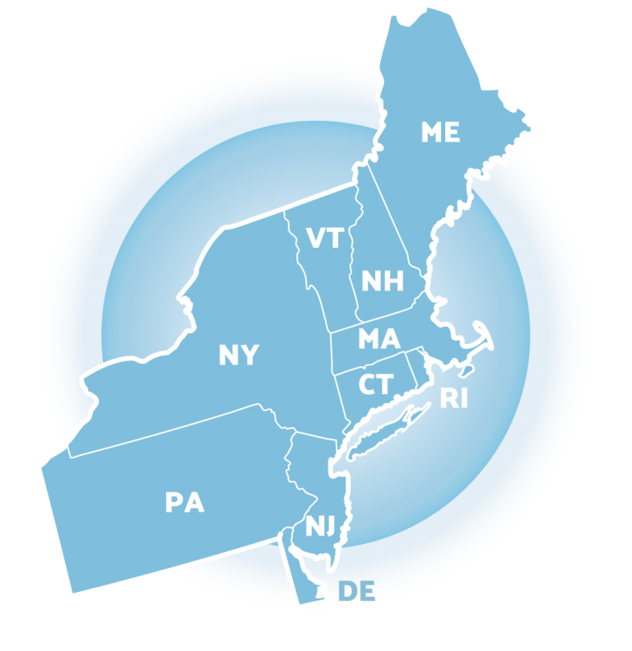
NEPBIS
School-Wide
Team Training
Year 1
Day 3
INSERT TRAINER NAMES HERE
with support from
Karen Robbie, Jen Freeman,
Brandi Simonsen, Katie Meyer,
Adam Feinberg & Susannah Everett
Notes:
Trainers: refer to training manual for:
Tips on presenting the overview content
Explanation for short activity periods and ideas for teaching this to teams
Ideas for facilitating review and team action planning

Slide 5
POSITIVE BEHAVIOR INTERVENTIONS & SUPPORTS
(PBIS)

Slide 6

WHO'S HERE?
Who's here?
LIST SCHOOLS IN COHORT HERE
(List the schools in your cohort here)
Notes:
TRAINER NOTE: Give teams several minutes each to introduce themselves and their school- including any previous experiences with PBIS.

Slide 7
NEPBIS SCHOOL-WIDE TRAINING MODEL
Year 1
Exploration and Installation of 10 Getting Started Steps
Year 2
Initial Implementation of 10 Getting Started Steps
Year 3+
Full Implementation and Continuous Improvement of Implementation
6 days of team training + 3 days of coach training
3 days of team training + 3 days of coach meeting
On-going Professional Development and Support
(minimum of 2 days of team training + 2 days of coach training annually)

Slide 8
YEAR 1: Getting Started with PBIS
DAY 1
Step 1: Establish an effective leadership team
DAY 2
Step 2: Develop a brief statement of purpose & define outcomes
Step 3: Identify positive school-wide behavior expectations
Step 4: Develop procedures to teach school-wide expectations
DAY 3
Step 5: Develop procedures to teach class-wide expectations
Step 6: Develop a continuum of responses to increase use of SEB skills
DAY 4
Step 7: Develop a continuum or responses to decrease SEB errors
DAY 5
Step 8: Develop systems to support staff
DAY 6
Step 9: Use data for decision-making
Step 10: Promote sustainability

Slide 9
TRAINING SCHEDULE
TRAINERS:
USE THIS SLIDE TO INSERT YOUR TRAINING SCHEDULE FOR THE CURRENT YEAR

Slide 10
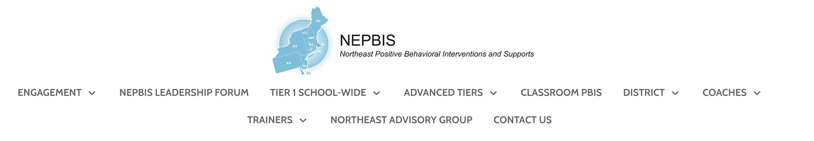


nepbis.org
TOOLS
Tier 1 Schoolwide
Tier 1 Team Training Materials
Tier 1 Supplemental Resources
School Team Implementation Guide
responses for activities
document plans
develop artifacts
Slides for each training day
Notes:
TRAINERS: Go directly to https://nepbis.org/ and demonstrate how to access relevant materials.

Slide 11


WEBSITES
pbisapps.org
pbis.org

Slide 12






LEGEND
ORGANIZATION
ACTIVITY
NEW
CONTENT
PREVIEW
REVIEW

Slide 13




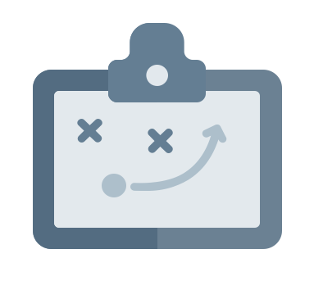

LEGEND
Timing
Example
Activity
Non-example
Guidelines
Preview
Big Idea
Review
Organization

Slide 14
EXPECTATIONS
 | Individually | Working with Others
Respect Self | Participate Converse with others in lobbies and during breaks Stretch, break, stand as needed | Engage with the training content and activities
Respect Others | Complete assigned tasks Return from breaks on time | Provide room for every voice Reinforce participation
Respect Environment | Keep devices silent Have your computer charged and ready Keep necessary materials at hand | Maintain a neat, orderly work space

Slide 15
AGENDA AND OUTCOMES
Step 5: Developing Procedures to Teach Class-wide Expectations
  Class-wide Teaching Matrix
  Teaching Expectations
  Positive and Proactive Classroom Practices
Step 6: Developing a Continuum to Increase Use of SEB Skills
  School-wide Acknowledgement Systems
Begin to develop:
Classroom teaching matrix example
Classroom lesson plan example
System for classroom lesson plan delivery
Begin planning a school-wide acknowledgement system

Slide 16
Quick
Review

Slide 17
PBIS is...
Framework for enhancing adoption & implementation of
Continuum of evidence-based interventions to achieve
Academically & behaviorally important outcomes for
All students

Slide 18
Continuum of School-Wide Instructional
& Positive Behavior Support
What do we do for the FEW needing intensive support?
Tertiary Prevention:
Specialized
Individualized
Systems for Students with High-Risk Behavior
What do we do for ALL?
Primary Prevention:
School-/Classroom-
Wide Systems for
All Students,
Staff, & Settings
~5%
~15%
What do we do for the SOME needing more support?
Secondary Prevention:
Specialized Group
Systems for Students with
At-Risk Behavior
~80% of Students

Slide 19
Critical Features
Systems
Practices
Data
Equity
Outcomes

Slide 20
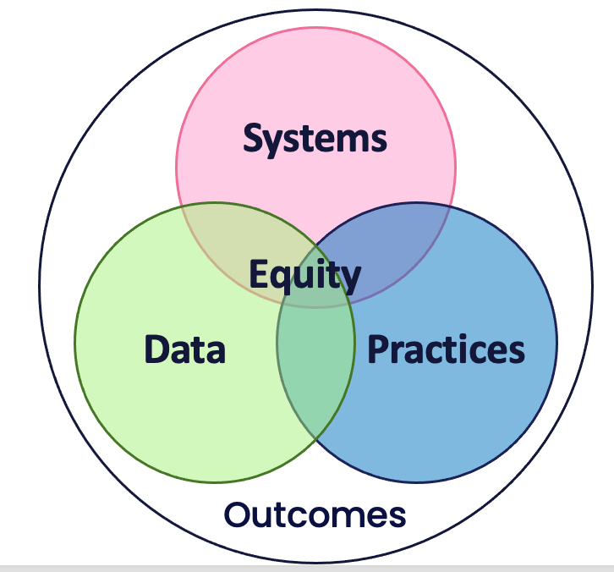
Culture and Context of the School Community

Slide 21
GETTING STARTED WITH PBIS
1
Establish an effective leadership team
6
Develop a continuum of responses to increase use of SEB skills
2
Develop a brief statement of purpose & define outcomes
7
Develop a continuum of responses to decrease SEB errors
3
Identify positive school-wide behavior expectations
8
Develop systems to support staff
4
Develop procedures to teach school-wide expectations
9
Use data for decision-making
5
Develop procedures to teach class-wide expectations
10
Promote sustainability

Slide 22
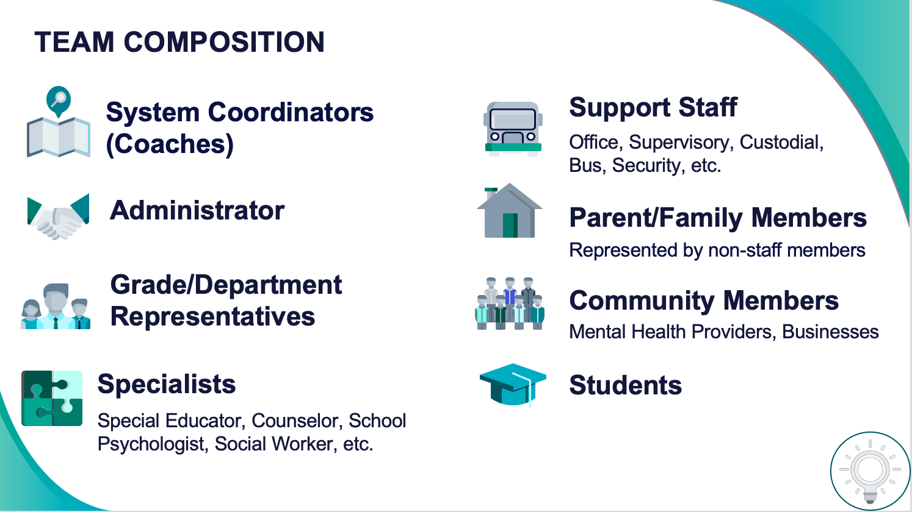
1
Establish an effective leadership team
Systems
Supports Relevance & Equity
Improves student outcomes
Promotes Engagement
Notes:
Your first step is to create a representative team to lead your school’s PBIS efforts.

Slide 23
2
Develop a brief statement of purpose & define outcomes
Practices
What do we hope to achieve by implementing PBIS?
"Our mission is to provide a positive, safe, healthy, nurturing and respectful environment in which all students have the opportunity to become productive members of society."
Purpose
“As a result of implementing PBIS during the 20XX-20XY school year, student reports of school climate will improve by 20%.”
Outcome
Notes:
You’ll then focus your school’s PBIS efforts by creating a statement of purpose to identify your hopes and goals for PBIS implementation.

Slide 24
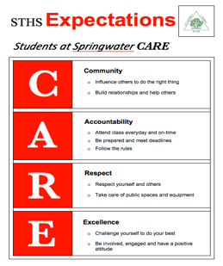
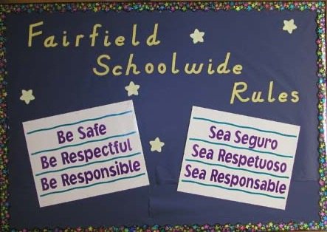

3
Identify positive school-wide behavior expectations
Practices
Notes:
Your team will work with your school community to uncover what you value and use those values to identify your schoolwide expectations

Slide 25
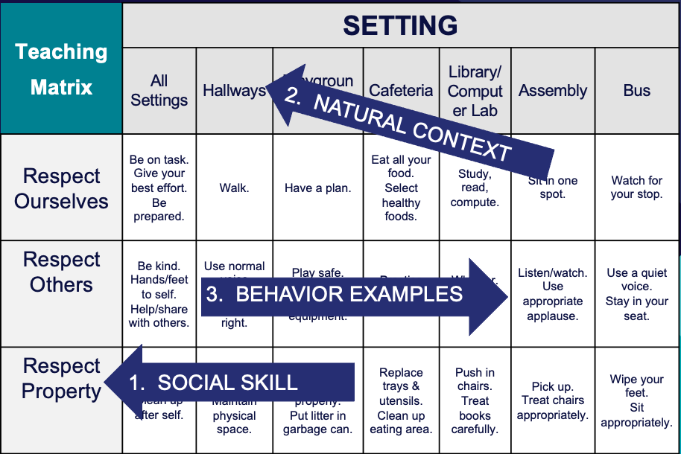
4
Develop procedures to teach school-wide expectations
Practices
Define
Teach
Prompt
Monitor
Evaluate
Notes:
Using those identified expectations, you’ll define what those expectations look and sound like in key routines/settings throughout your school. This is organized through a behavioral matrix. Using the schoolwide matrix, your team will develop lessons that will be explicitly taught to students at the beginning of the year (and boosted throughout the year) so that they know how to be successful within each context (like the hallway, cafeteria, assemblies, etc.)

Slide 26
School-wide implementation of classroom practices is a
key predictor of reduced disproportionality!
Practices
STEP 5:
DEVELOP PROCEDURES TO TEACH
CLASS-WIDE EXPECTATIONS
What do we expect in the classroom?
Begin to develop:
Classroom teaching matrix example
Classroom lesson plan example
System for classroom lesson plan delivery

Slide 27
GETTING STARTED WITH PBIS
1
Establish an effective leadership team
6
Develop a continuum of responses to increase use of SEB skills
2
Develop a brief statement of purpose & define outcomes
7
Develop a continuum of responses to decrease SEB errors
3
Identify positive school-wide behavior expectations
8
Develop systems to support staff
4
Develop procedures to teach school-wide expectations
9
Use data for decision-making
5
Develop procedures to teach class-wide expectations
10
Promote sustainability

Slide 28
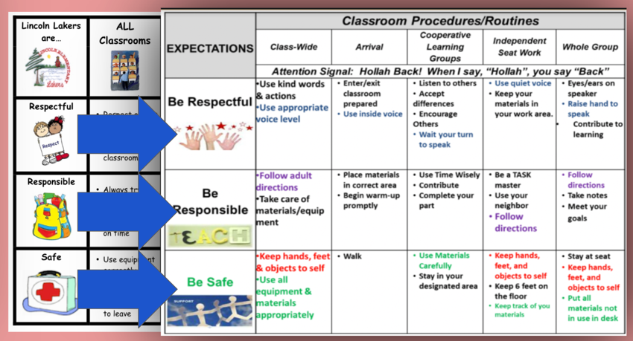
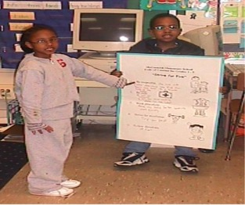
5
Develop procedures to teach class-wide expectations
Practices
Notes:
Once the schoolwide expectations have been determined, classroom educators will apply the behavior matrix format to the routines and settings within their classrooms. They will also explicitly teach the expectations to their students throughout the year.

Slide 29
Begin by defining your class-wide expectations
Define
Teach
Prompt
Monitor
Evaluate
Notes:
Sarah

Slide 30




Behavioral Expectations within settings
Define
General description of what each expectation looks like & sounds like.
Start with your operational definition of the school-wide expectations or norms
Consider environmental design (i.e., physical features of the setting)
Consider routines needed to navigate the environment
Identify examples of how to:
  navigate the environment
  engage in the routines in a way that is consistent with school-wide expectations/norms
Consider effective environmental design to promote desired behavior
What steps do students need to take to navigate the environment successfully?
What are a few examples that sample the range of expected behaviors (social skills)?

Slide 31
Behavioral Expectations
Define
 | Entering Class | Lecture/ Presentation | Work Time | Electronics | Leaving Class
Be Respectful | Enter calmly. Be seated before the bell rings. Keep hands off other people’s property. Leave desks and chairs in place. | Listen attentively. Wait for your turn. Have a positive attitude. Keep feet on the floor. | Work quietly. Do your share in group projects. Be cooperative. Keep area clean. | Keep off until needed. Turn off volume. Use gently and carefully. Download large files after school. | Stay in your seat. Clean up around your desk. Push chairs in.
Be Responsible | Have books and materials out and ready to go. | Take notes. Meet deadlines. Focus on your learning. | Follow directions. Get help when needed. Do your own work. | Stay on task. Text/call people only during allowed times. | Return supplies. Report accidents promptly.
Be Safe | Walk | Be thoughtful and considerate of others. | Let others do their work. | Model digital citizenship. | Leave calmly when dismissed.
Be Prepared | Bring all materials. | Remain in your seat. | Use time wisely. | Have computer charged and ready to use. | Know expectations for next class.
Operationally define what expectations look like across all the routines and settings in your classroom.
One way to do this is in a matrix format.

Slide 32
SCHOOL-WIDE Teaching Matrix |  | SETTING/ROUTINE
 |  | All Settings | Hallways | Playgrounds | Cafeteria | Library/ Computer Lab | Assembly | Bus
 | Respect Ourselves | Be on task. Give your best effort. Be prepared. | Walk. | Have a plan. | Eat all your food. Select healthy foods. | Study, read, compute. | Sit in one spot. | Watch for your stop.
 | Respect Others | Be kind. Hands/feet to self. Help/share with others. | Use normal voice volume. Walk to right. | Play safe. Include others. Share equipment. | Practice good table manners | Whisper. Return books. | Listen/watch. Use appropriate applause. | Use a quiet voice. Stay in your seat.
 | Respect Property | Recycle. Clean up after self. | Pick up litter. Maintain physical space. | Use equipment properly. Put litter in garbage can. | Replace trays & utensils. Clean up eating area. | Push in chairs. Treat books carefully. | Pick up. Treat chairs appropriately. | Wipe your feet. Sit appropriately.
CLASS-WIDE
Teaching Matrix
All Routines | Entering/ Leaving the Classroom | Small Group Instruction | Whole Group Instruction | Independent Work Time
Be on task. Give your best effort. Be prepared. | Walk. | Participate. | Engage with the lesson. | Have a plan. Study, read, compute.
Be kind. Hands/feet to self. Help/share with others. | Use indoor voice volume. Walk to right. | Include others. Share equipment. | Raise your hand if you have something to share. | Whisper. Return books.
Recycle. Clean up after self. | Pick up litter. Maintain physical space. | Bring necessary materials to the table. | Have necessary materials handy. | Return materials where you found them.
1. SOCIAL SKILL
2. NATURAL CONTEXT
SCHOOL-WIDE EXPECTATIONS
3. BEHAVIOR EXAMPLES

Slide 33
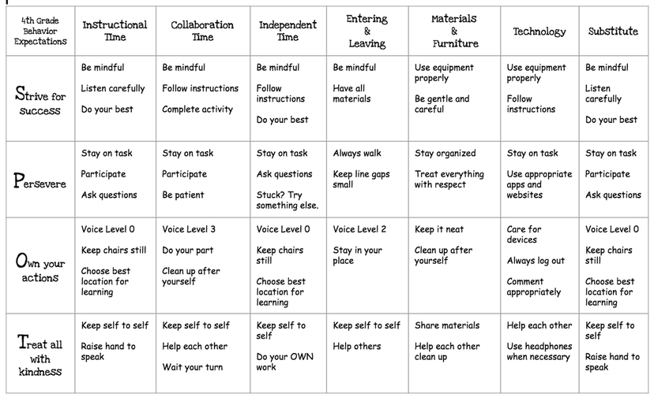

Slide 35
Expectation | Start of class | During individual tests | During lecture in class | Outside of class time preparation
Be here and ready On time Prepared | Arrive on time to class. Bring your notebook and writing materials. Listen for when class begins. | Be focused on the current unit tests. Remember to follow procedures for individual tests. Organize and get to work promptly. | Be focused on the current unit of instruction. Use your notebook for taking notes. | Review prior class notes before next class. Adequately prepare by doing readings and assignments. Keep your materials organized.
Be responsible Quality work Collaborate | Arrive on time to class. Come prepared by completing all assignments and readings. Follow all procedures in course organizer if you miss a class. | Remember to follow procedures for individual tests. Organize and get to work promptly Make a good effort on each question. Be on task and ask for clarification as needed | Listen and think about points raised in the lecture. Ask questions and respond to questions. Share your perspective on relevant issues to the topic at hand | Keep your materials organized.
Be respectful Encourage others Recognize others | Politely greet classmates and teacher when arriving to class. Ask others how things are going. Provide guidance to classmates who may have been absent from last class. | Get to work quickly on individual tests. Work quietly. | Follow along when someone is speaking . Think about the concepts and practices being described; get the most you can out of class. | Be patient when emailing your teacher with questions or concerns.
(adapted from Knoster, 2019)

Slide 36
Enhance student voice by co-constructing the classroom matrix
Ms. L's Room | Entering | Group Work | Whole Group Instruction | Independent Work Time
Be Prepared
Be Safe
Be Respectful
Educators can engage students in identifying examples of what it looks and sounds like to meet expectations during each routine.
Students can also add routines that need to be added to the matrix

Slide 37
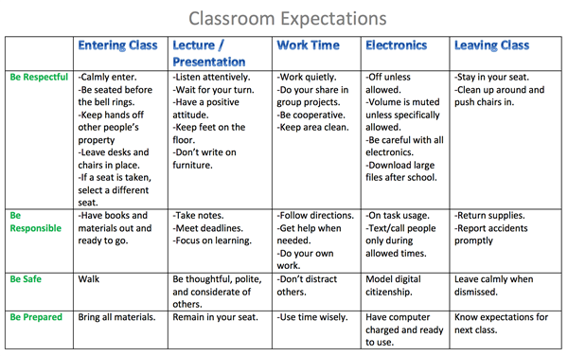
ACTIVITY: Teaching Classwide Expectations
Draft a SAMPLE Class-Wide Teaching Matrix to share with your staff.
  Write in your school-wide expectations
  Identify typical contexts/ routines in classrooms
  Identify 1-2 observable, measurable, and positively stated behaviors for ONE cross-section
Add items to your Action Plan as necessary
Be ready to present 2-3 “big ideas” from your discussion.
15 minutes

Slide 38
WHOLE GROUP DEBRIEF: Teaching Classwide Expectations
Share 1-2 highlights from your team discussion.
What support will you need to prepare teaching staff at your school to complete their own class-wide matrices?
5 minutes

Slide 39
Here is an opportunity to get input from students!
Have our implicit biases impacted our classwide expectations?
Do our expectations reflect the cultural values of the surrounding community?
How can we involve staff and students in developing expectations?
Do expectations serve a legitimate purpose within the setting,
as opposed to simply tradition or maintaining the status quo?

Slide 40


Behavioral Expectations in Classroom Settings
Take expectations and have students:
  Apply expectations to their home setting
  2. Apply expectations to their community

Slide 41
Expectation | At SCHOOL it looks like… | At HOME it looks like… | With my FRIENDS it looks like…
Be Safe | Keep hands and feet to self Tell an adult if there is a problem
Be Respectful | Treat others how you want to be treated Include others Listen to adults
Be Responsible | Do my own work Personal best Follow directions Clean up messes
Provides the opportunities for students to:
articulate their expectations at home & community
discuss similarities & differences

Slide 42
Steps for a Personal Matrix Activity
Ask students about the purpose of expectations.
Ask students to write down multiple examples of how their friends expect them to behave.
Ask students to share similarities and differences in expectations across settings.
Review the school-wide expectations and specific examples with students.
Ask students to write down multiple examples of following each of the expectations at home.
Have students turn in matrices for staff review.
Return the matrices to students for their personal reference.

Slide 43
Expectation | At SCHOOL it looks like… | At HOME it looks like… | With my FRIENDS it looks like…
Be Safe | Keep hands and feet to self Tell an adult if there is a problem | Protect your friends and family Don’t talk back | Stick up for your friends Don’t back down Look the other way
Be Respectful | Treat others how you want to be treated Include others Listen to adults | Do exactly what adults tell you to do Don’t stand out Don’t bring shame | Text back within 30 seconds Be nice to friends’ parents Share food
Be Responsible | Do my own work Personal best Follow directions Clean up messes | Help your family out first Own your mistakes Share credit for successes | Have each other’s backs Own your mistakes Check in about what to do
Notes:
Here is a sample completed matrix in perfect comic sans writing

Slide 44
Considering Students’ Personal Matrix
For the differences between school and other settings, are the “different” school expectations necessary for positive student development?
NO
YES
Change the expectations to align more with home and neighborhood
Acknowledge explicitly and provide additional teaching, practice, and acknowledgment

Slide 45
EXAMPLE
Are the different classroom expectations necessary for positive student development?
Expectation | At SCHOOL it looks like… | At HOME it looks like… | With my FRIENDS it looks like…
Be Safe | Keep hands and feet to self Tell an adult if there is a problem | Protect your friends and family Don’t talk back | Stick up for your friends Don’t back down Look the other way
  YES: Acknowledge explicitly and provide additional teaching, practice, and acknowledgment

Slide 46
EXAMPLE
Are the different classroom expectations necessary for positive student development?
Expectation | At SCHOOL it looks like… | At HOME it looks like… | With my FRIENDS it looks like…
Be Responsible | Do my own work Personal best Follow directions Clean up messes | Help your family out first Own your mistakes Share credit for successes | Have each other’s backs Own your mistakes Check in about what to do
  NO: Change the expectations to align more with home and neighborhood

Slide 47
ACTIVITY: Considering Students' Personal Matrices
For the differences between school and other settings, are the “different” school expectations necessary for positive student development?
NO
YES
Change the expectations to align more with home and neighborhood
Acknowledge explicitly and provide additional teaching, practice, and acknowledgment
Review the steps to the Personal Matrix activity.
Plan when and how you could:
try this activity with staff
train staff to complete this activity with their students to inform the development of their classroom matrix.
Add items to your Action Plan as necessary
Be ready to present 2-3 “big ideas” from your team's discussion.
10 minutes

Slide 48
WHOLE GROUP DEBRIEF: Personal Matrix
How will teachers be trained to complete this activity with their class? Will the resulting information be shared with the team to inform the schoolwide matrix?
What support do you need to complete this activity at your school?

Slide 49
Define
Teach
Prompt
Monitor
Evaluate

Slide 50
Teach
rules in the context of routines
Teach expectations directly.
  Define rule in operational terms—tell students what the rule looks like within routine.
  Provide students with examples and non-examples of rule-following within routine.
Actively involve students in lesson—game, role-play, etc. to check for their understanding.
Provide opportunities to practice rule following behavior in the natural setting.

Slide 51
Define
Teach
Prompt
Monitor
Evaluate
Notes:
Sarah

Slide 52
Prompt
or remind students of the rule
Use pre-corrections, which include “verbal reminders, behavioral rehearsals, or demonstrations of rule-following or socially appropriate behaviors that are presented in or before settings where problem behavior is likely”
- Colvin, Sugai, Good, & Lee (1997)

Slide 53
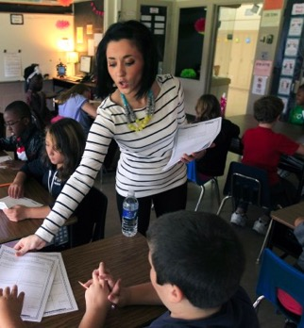
Prompts happen BEFORE opportunities for errors begin!
If you need help during this work,
raise your hand.
Before sending students off to work in small groups, provide a quick reminder about the expectations

Slide 54
Define
Teach
Prompt
Monitor
Evaluate

Slide 55
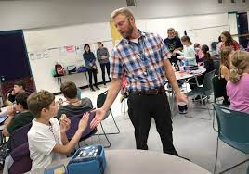
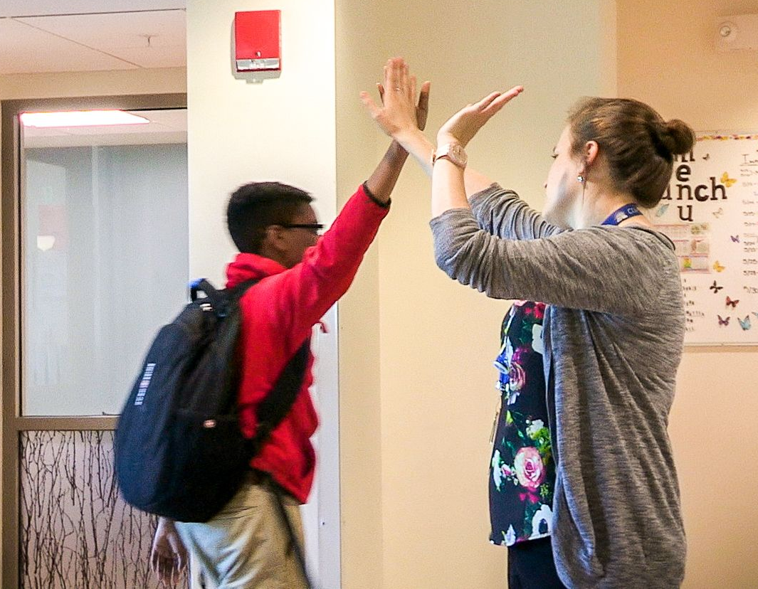
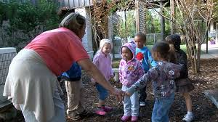
Monitor
students’ behavior in natural context
Think about your classroom.
How do the adults MONITOR
student behavior?
Use Active Supervision
    Move around
    Look around (Scan)
    Interact with students
        Reinforce
        Correct
(Colvin, Sugai, Good, Lee, 1997)

Slide 56
Define
Teach
Prompt
Monitor
Evaluate
Notes:
Sarah

Slide 57
Data used in PBIS implementation
Data
Fidelity Data
Did we implement the systems and practices we agreed upon?
Outcome Data
Is the plan resulting in progress towards our goals (desired outcomes)

Slide 58
Evaluate
the fidelity of implementation
Collect data
Are we doing what we said we’d do?
  How will we support lessons taught within routines?
  How will we know when lessons are taught?
  How will we know when and where we might need boosters?
Summarize data (look for patterns)
Use data to make decisions
Fidelity Data
  Did we implement the systems and practices we agreed upon?

Slide 59
Evaluate
the fidelity of implementation
Randomly interview 10% of classroom teachers and ask
if classroom expectations, aligned to schoolwide expectations, were taught in the context of classroom routines (Class-wide matrix).
Teachers are asked to develop class-wide matrices, aligned with the schoolwide expectations, with their classes at the beginning of the year.
Conduct classroom walkthroughs and identify:
the number of classrooms with class-wide matrices posted.
the ratio of positive: corrective feedback provided to students

Slide 60
Evaluate
the effect of instruction (Student Outcome Data)
Collect data
Are rules being followed?
If there are errors...
  who is making them?
  where are the errors occurring?
  what kind of errors are being made?
Summarize data (look for patterns)
Use data to make decisions
Outcome Data
  Is the plan resulting in progress towards our goals
  (desired outcomes)

Slide 61
Evaluate
the effect of instruction (Student Outcome Data)
After teaching a lesson on how to enter the classroom responsibly, the teacher will greet students at the door during the next 3 transitions into the classroom and note whether each student is able to enter the classroom responsibly.
If <80% of the students consistently demonstrate this skill, the educator will reteach and increase prompts and feedback.
If >80% of students are meeting this expectation, the educator will begin to fade prompts and feedback for most, while providing more targeted support for a few students, if needed based on data.
At monthly grade level/department meetings, teachers review student behavior data to identify trends indicating a need for reteaching/booster sessions of class-wide expectations.
According to student school climate survey data, students in our school agree that student behavior in classes allow teachers to teach comparable to the national average.
Classroom teachers report that students are doing a better job behaving.

Slide 62
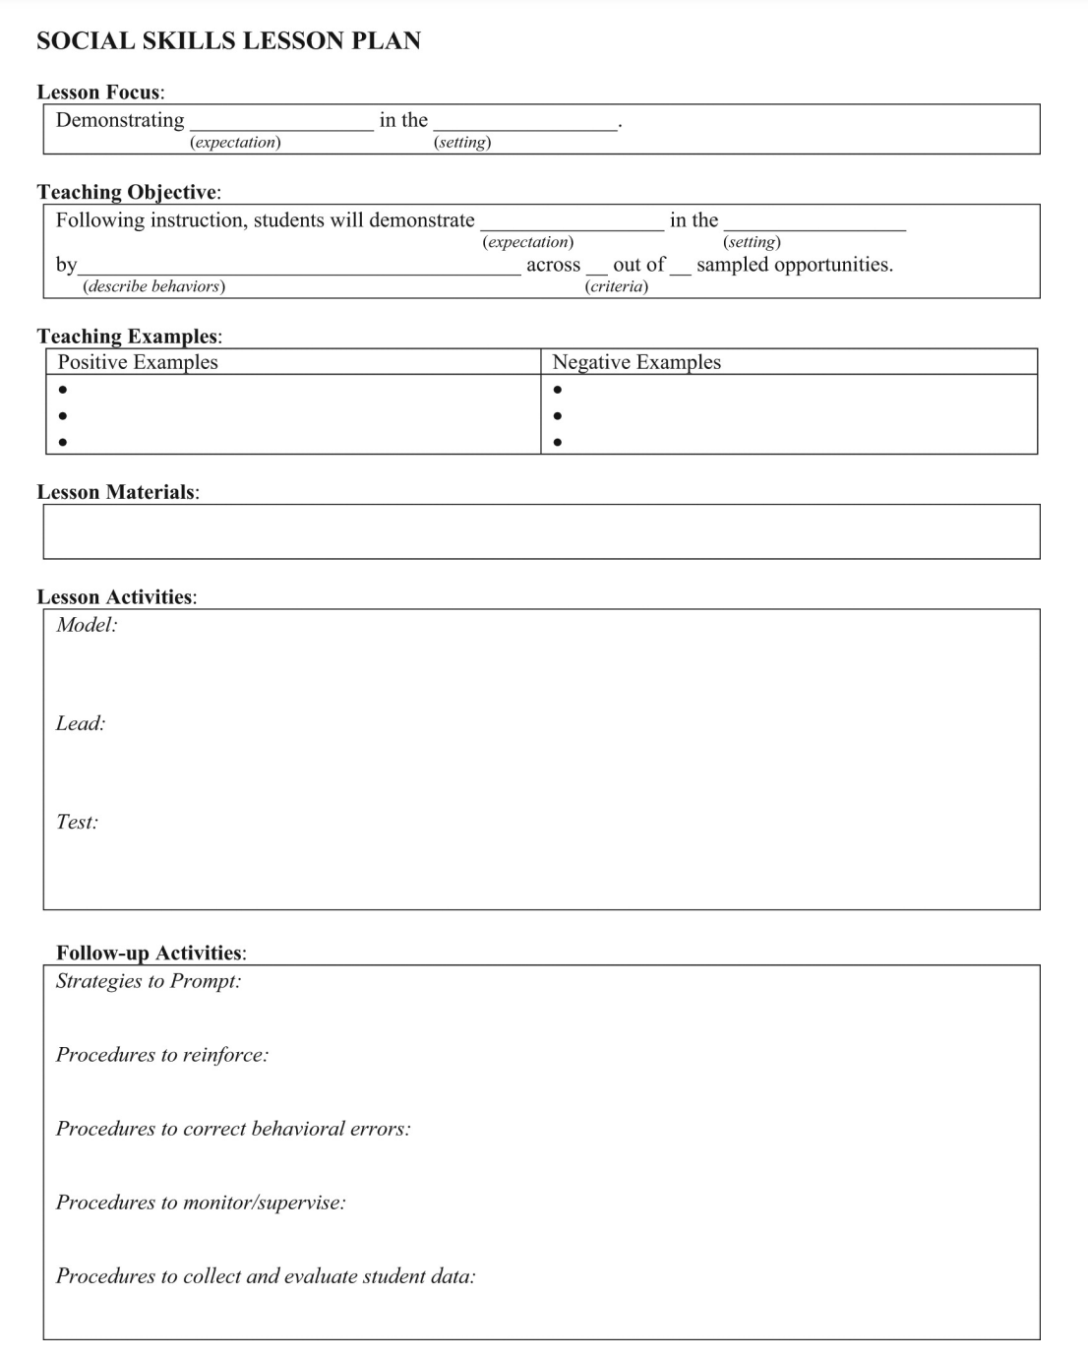
A lesson plan that prompts the critical features just described
Define
Teach
Prompt
Monitor
Evaluate

Slide 63
Guidelines for Teaching Class-Wide Expectations
Practices
Support classroom educators to:
Develop teaching matrices, procedures, and schedules for explicitly teaching school-wide behavior expectations in typical classroom contexts and routines
Consistently use prompts for display of expected behaviors in natural contexts
Provide specific feedback for displays of behaviors in natural context
Develop:
A school-wide action plan for supporting classroom educators to implement positive and proactive classroom practices and procedures based on data (self-assessment)

Slide 64
ACTIVITY: Teaching Classwide Expectations
Draft a SAMPLE lesson plan to share with your staff.
  Develop a plan to explicitly teach 1 expectation within one routine
  Draft meaningful examples and non examples
  Draft initial lesson activities
Add items to your Action Plan as necessary
Be ready to present 2-3 “big ideas” from your discussion.
15 minutes

Slide 65
WHOLE GROUP DEBRIEF: Teaching Classwide Expectations
Share 1-2 highlights from your team discussion.
What support will you need to prepare teaching staff at your school to complete their own class-wide matrices?
5 minutes

Slide 66
Break

Slide 67
Practices
Positive and Proactive Practices in the Classroom

Slide 68

Supporting and Responding to Students’ SEB Needs
Practices
Summarizes evidence-based, positive, and proactive practices that support and respond to students’ social, emotional, and behavioral (SEB) needs in classrooms.
Center on PBIS. (2022). Supporting and responding to student’s social, emotional, and behavioral needs: Evidence-based practices for educators (Version 2.0). Center on PBIS, University of Oregon. www.pbis.org.
Notes:
https://www.pbis.org/resource/supporting-and-responding-to-behavior-evidence-based-classroom-strategies-for-teachers

Slide 69
Supporting and Responding to Students’ SEB Needs
1. Create Positive Teaching and Learning Environments
Design a Safe Environment
2. Actively Promote SEB Growth
Engage Students in Relevant Learning
3. Monitor Fidelity and Use Data to Guide Implementation
Monitor Educator Implementation
4. Monitor Student Outcomes and Use Data to Guide Response
Establish Positive Connections
Develop Predictable Routines
Define and Teach Positive Expectations
Plan Relevant Instruction
Foster Positive Relationships
Prompt and Supervise SEB and Academic Skills
Provide Specific Feedback (> 5 : 1 Ratio)
Consider Other Response Strategies
Provide Training, Coaching, and Feedback
If data indicate implementation challenges...
Monitor Student Outcomes
Enhance Tier 1
If many students make ongoing SEB errors...
Enhance Tier 1 and Consider Tiers 2 and 3
If few students make ongoing SEB errors...

Slide 70
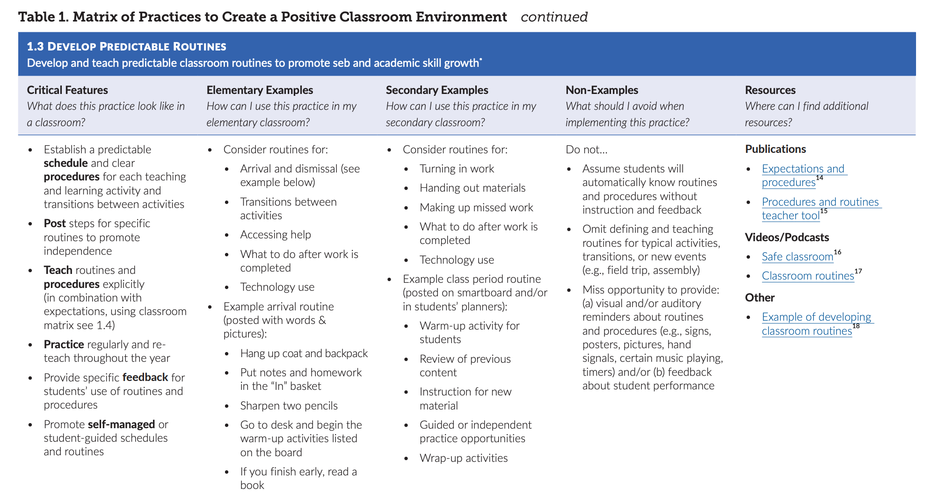

Slide 71
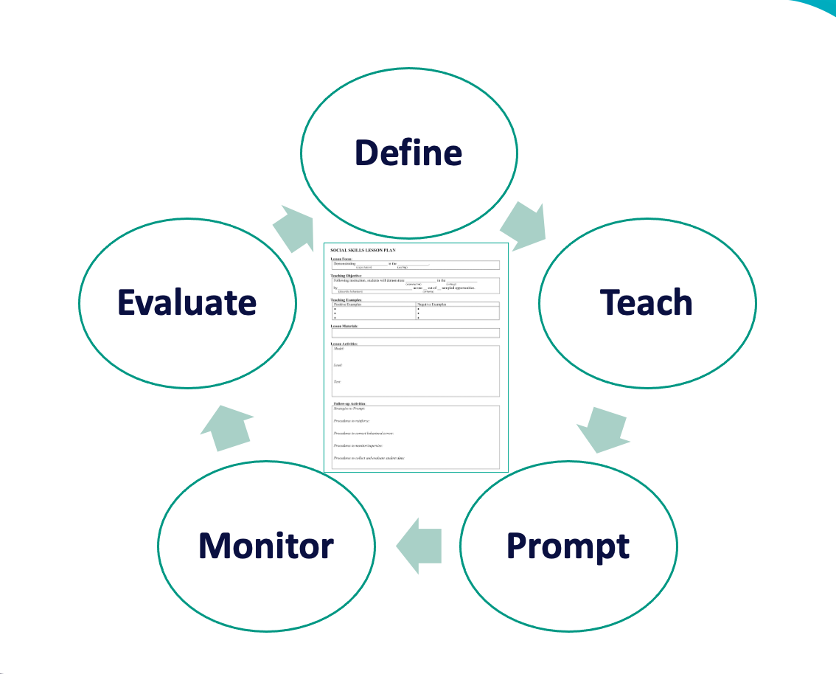
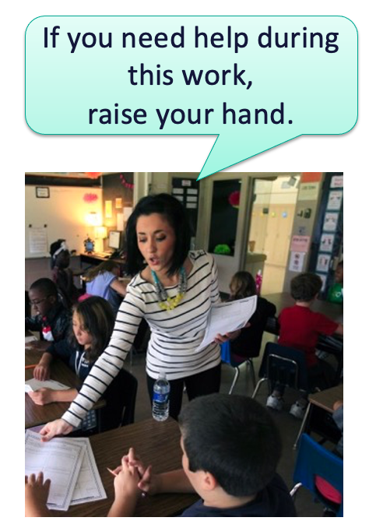
1. Create Positive Teaching and Learning Environments
Design a Safe Environment
2. Actively Promote SEB Growth
Engage Students in Relevant Learning
Establish Positive Connections
Develop Predictable Routines
Define and Teach Positive Expectations
Plan Relevant Instruction
Foster Positive Relationships
Prompt and Supervise SEB and Academic Skills
Provide Specific Feedback (> 5 : 1 Ratio)
Consider Other Response Strategies
Some of these strategies were already discussed!

Slide 72
3 Key Positive and Proactive Practices
Let’s introduce a few others!
1. Create Positive Teaching and Learning Environments
Design a Safe Environment
2. Actively Promote SEB Growth
Engage Students in Relevant Learning
Establish Positive Connections
Develop Predictable Routines
Define and Teach Positive Expectations
Foster Positive Relationships
Prompt and Supervise SEB and Academic Skills
Provide Specific Feedback (> 5 : 1 Ratio)
Consider Other Response Strategies
Plan Relevant Instruction
Prompts
Opportunities to Respond
Specific Praise

Slide 73
Prompts

Slide 74
What is it?
A verbal prompt is a reminder of previously taught behaviors, delivered before the behavior, that explicitly states the expected behavior.
Delivered before behavior
State expected behavior
Reminder of previously taught behaviors

Slide 75

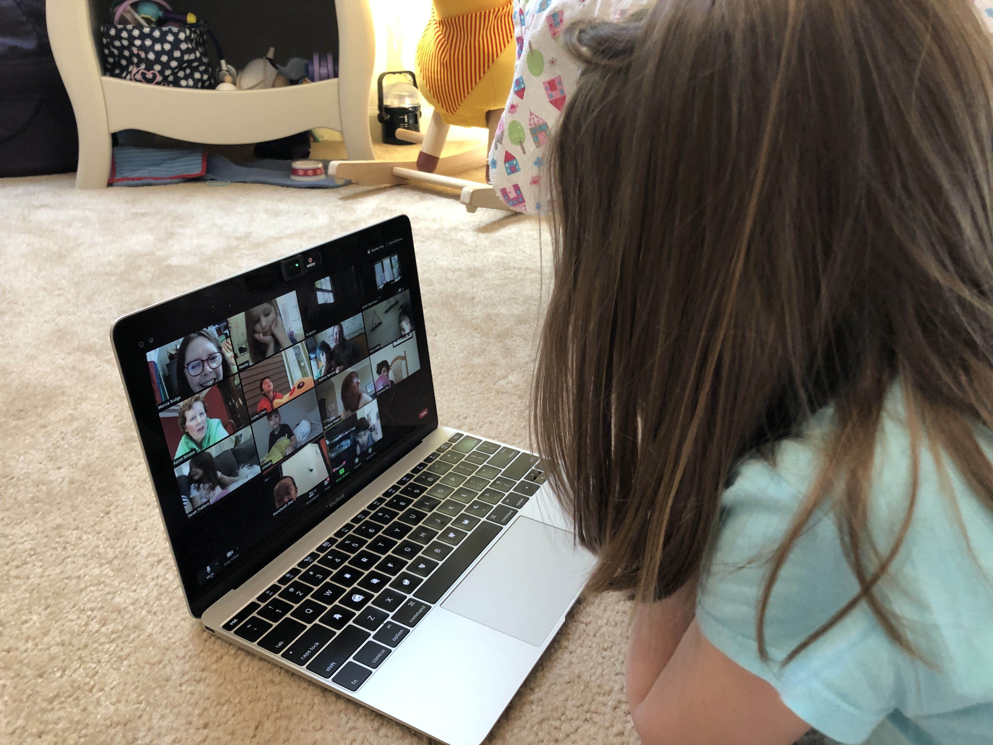
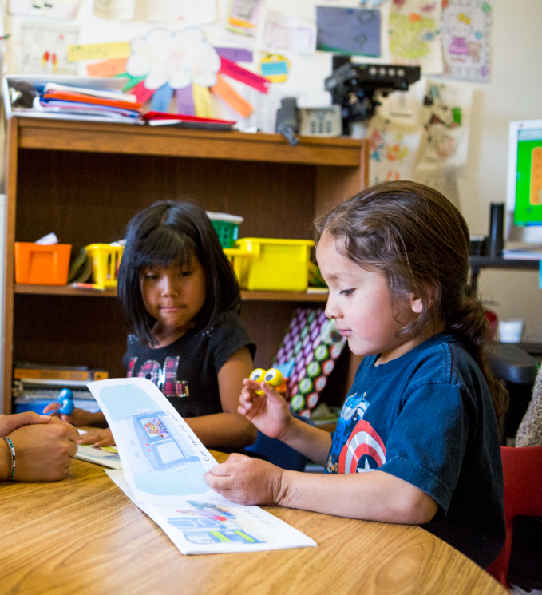
Classroom Prompt Examples
“As you head out, remember to use talk quietly in the hallway."
Verbal reminders
“Remember to mute unless its your turn”
McCormick Elementary, MD
“Remember to read to yourself”

Slide 76

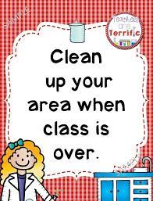
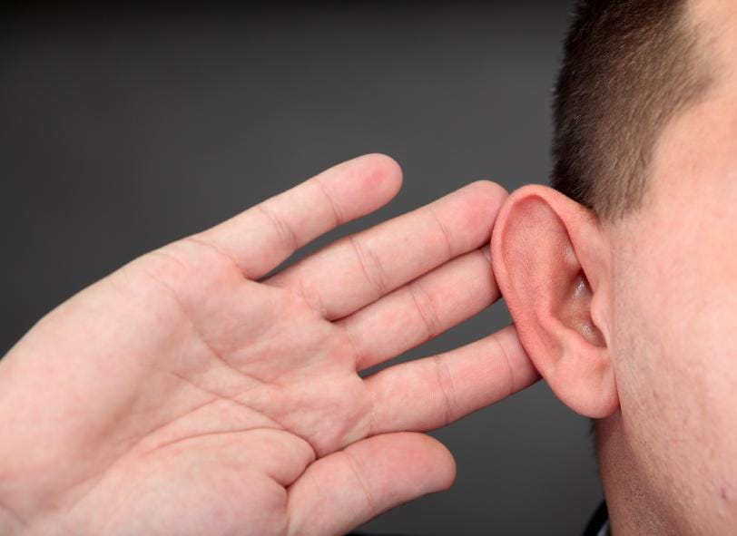
Classroom Prompt Examples
WELCOME
As you come in,
did you remember:
something to write with?
your homework?
your planner?
our textbook?
Gestural reminders
Visual reminders

Slide 77
Opportunities to Respond

Slide 78

What is it?
(OTRs)
“An Opportunity to Respond (OTR) is a teacher behavior that…solicits a student response (e.g., asking a question, presenting a demand).”
Provide high rates of opportunities to respond (OTRs)
Consider various observable ways to engage students
Link engagement with outcome objectives
(Simonsen, Fairbanks, Briesch, Myers, & Sugai, 2008)

Slide 79

Examples of OTRs
Explicit, Direct
Instruction
Choral
Responding
Class-wide Peer Tutoring
Electronic
Clickers
Response
Cards
Computer Assisted Instruction
Guided
Notes
Non-Verbal
Responses

Slide 80
Specific Praise

Slide 81
What is it?
Behavior Specific Praise
  “a positive statement, typically provided by the teacher, when a desired behavior occurs (contingent) to inform students specifically what they did well.”
(Simonsen et al. 2008, pp. 362, 364, emphasis added)

Slide 82
Examples
"That was a hard problem and you stuck with it.
Great job!
"Nice hand raise!"
"You walked to get into line. Way to go!"
"Clear pronunciation. Well done."
"You asked for help when you needed it! Terrific!"
"It was kind to help your friend like that!"

Slide 83
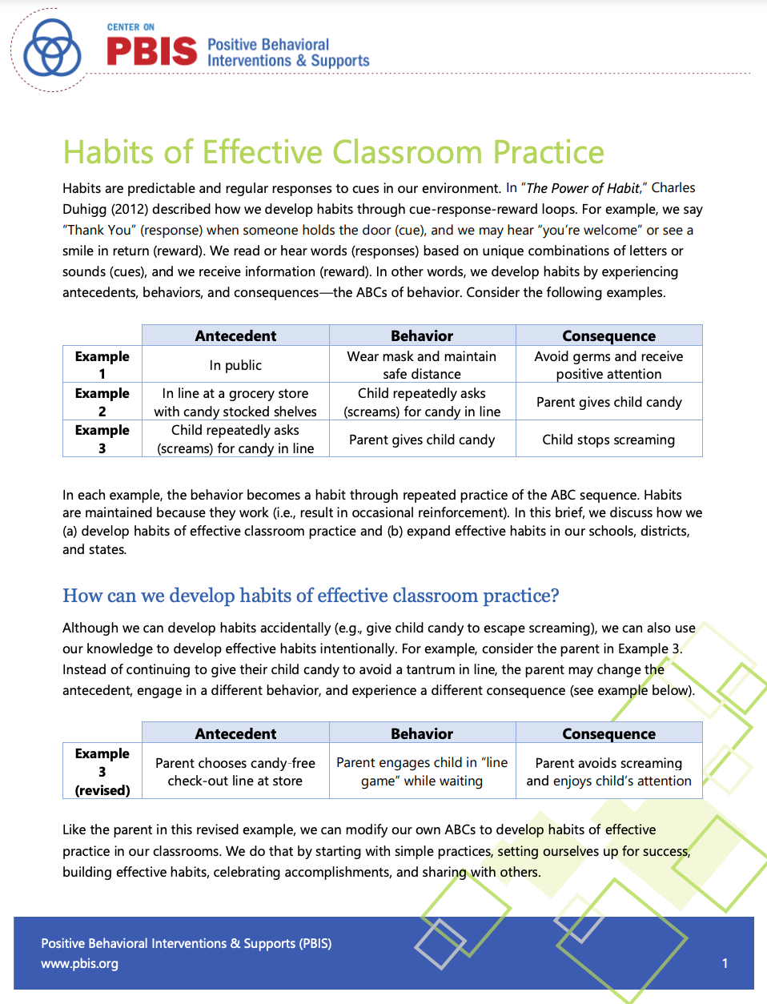
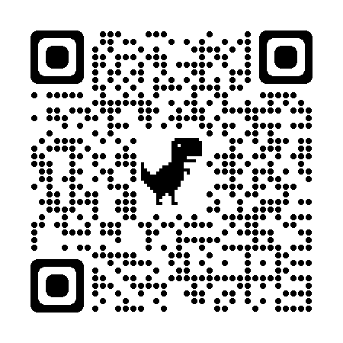
Strengthen these practices by building effective habits...
Habits of Effective Classroom Practice
This practice brief describes how we:
develop habits of effective classroom practice
expand effective habits in our schools, districts, and states.
Notes:
https://www.pbis.org/resource/habits-of-effective-classroom-practice

Slide 84
ACTIVITY: 3 Key Classroom Practices
As a team, return to your draft classroom lesson plan from the previous activity
Draft examples of prompts, OTRs, and praise that you can embed into your plan
Add items to your Action Plan as necessary
Be ready to present 2-3 “big ideas” from your discussion.
15 minutes

Slide 85
WHOLE GROUP DEBRIEF: 3 Key Classroom Practices
Share:
Examples of how you embedded these positive and proactive practices into your lesson plan
1-2 highlights from your team discussion.
What support will you need to support educators in the development of effective classroom lesson plans?
5 minutes

Slide 86
Supporting and Responding to Students’ SEB Needs
1. Create Positive Teaching and Learning Environments
Design a Safe Environment
2. Actively Promote SEB Growth
Engage Students in Relevant Learning
3. Monitor Fidelity and Use Data to Guide Implementation
Monitor Educator Implementation
4. Monitor Student Outcomes and Use Data to Guide Response
Establish Positive Connections
Develop Predictable Routines
Define and Teach Positive Expectations
Plan Relevant Instruction
Foster Positive Relationships
Prompt and Supervise SEB and Academic Skills
Provide Specific Feedback (> 5 : 1 Ratio)
Consider Other Response Strategies
Provide Training, Coaching, and Feedback
If data indicate implementation challenges...
Monitor Student Outcomes
Enhance Tier 1
If many students make ongoing SEB errors...
Enhance Tier 1 and Consider Tiers 2 and 3
If few students make ongoing SEB errors...
More to come in Day 5 and Year 2

Slide 87
ACTIVITY: Team Discussion
  How will these practices be introduced to classroom educators?
  What resources (including time) will they need to do this?
As a team, discuss how you can support classroom educators with...
drafting their own matrices and lesson plans
a plan for initial roll out including explicitly teaching from lesson plans at the beginning of the year and/or as new routines are introduced
developing a plan to review/reteach in the classroom (along with non-classroom settings) at key points during the year
Also, consider how you will use data to guide decisions about when else to review/reteach or increase supports (More details in Step 9:Use data for decision-making)
Add items to your Action Plan as necessary
Be ready to present 2-3 “big ideas” from your discussion.
15 minutes

Slide 88
WHOLE GROUP DEBRIEF: Teaching Classwide Expectations
Share:
What are some ways you will support educators to develop and implement classroom matrices and lesson plans?
What further support will you need to support educators with this work?
5 minutes

Slide 89
A formal acknowledgement system is a key predictor of reduced disproportionality!
Practices
STEP 6:
DEVELOP A CONTINUUM
TO INCREASE USE OF
SEB SKILLS
How do we consistently respond so students are encouraged to demonstrate our schoolwide expectations?
Begin planning a school-wide acknowledgement system

Slide 90
GETTING STARTED WITH PBIS
1
Establish an effective leadership team
6
Develop a continuum of responses to increase use of SEB skills
2
Develop a brief statement of purpose & define outcomes
7
Develop a continuum of responses to decrease SEB errors
3
Identify positive school-wide behavior expectations
8
Develop systems to support staff
4
Develop procedures to teach school-wide expectations
9
Use data for decision-making
5
Develop procedures to teach class-wide expectations
10
Promote sustainability

Slide 91
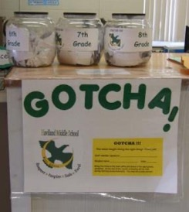
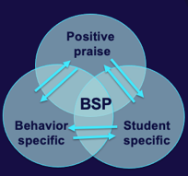
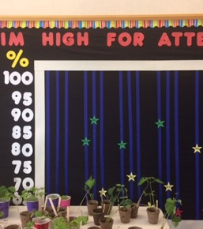
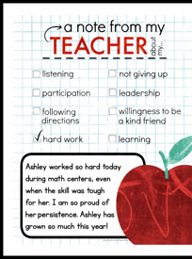
6
Develop a continuum of responses to increase use of SEB skills
Practices
Notes:
To encourage contextually appropriate behaviors to occur, you'll support educators to provide frequent specific feedback and praise. To promote this critical practice, you’ll develop recognition/acknowledgement systems for both students and staff.

Slide 92
Behavior is likely to occur again when it is reinforced…
When a student experiences something desirable following a behavior, that behavior is strengthened and more likely to occur again.
If a student is given verbal praise for persisting with a difficult assignment, the student is likely to persist on later difficult assignments.
  If a student is removed from the classroom after refusing to do a difficult assignment, the student will likely act up later when he does not want to (or cannot) complete work.
We need to be intentional about which behaviors are reinforced!

Slide 93

Praise is perhaps the most powerful and important type of acknowledgement.
Therefore, any acknowledgement system needs to be paired with specific praise!
"You read that whole passage yourself! Way to go.
You earned a point for that!"

Slide 94
Key Features of Acknowledgement Systems
Relevant
Efficiently Delivered
  Tied to school-wide expectations
  Age appropriate and culturally relevant (get feedback from students, staff, families at least annually)
  Varied types that are valuable to diverse groups of students (tangible, social, privilege) (individual and group contingencies)
  Allow for choice – at least in some parts of the system
  Fit into daily activities - Avoids interrupting instructional time
  Easy to teach, implement, etc.
Predictable and Dense Schedule
  Allow for all students to be eligible to earn acknowledgements daily
  Layered: daily, weekly, monthly, quarterly, etc.
Available to Both Students and Staff

Slide 95
Types of Acknowledgements
High Frequency
Provided daily
Predictable
Specific Praise
Tickets/Notes
Coupons to school store
Announcements
Intermittent
Provided weekly, quarterly, monthly
Student of the Month
Class Pizza Party
Recognition at School Assembly
Long Term
Few times per year
Involves groups of students
Whole school pajama day
Honors banquet
Freshmen class picnic
(adapted from MO-PBS)

Slide 96
Benefits of Acknowledgement Systems
Creates positive student-to-teacher interactions
Clarifies school expectations for appropriate behavior
Increases the likelihood that desired behaviors will be repeated by letting students know what they are doing “right”
Reduces the need for engaging in time-consuming disciplinary measures

Slide 97

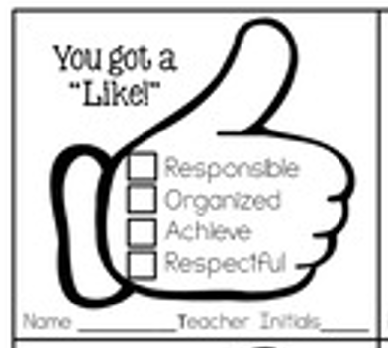


Examples of Acknowledgement Systems
Providing staff with tangible ways to acknowledge students prompts them to notice the students demonstrating expectations AND lets students know what they were doing so they can do it more often!
Tangible forms/tickets can be collected and entered into a drawing for further recognition.
The more you earn, the more likely you are to access further recognition!

Slide 98
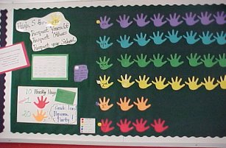
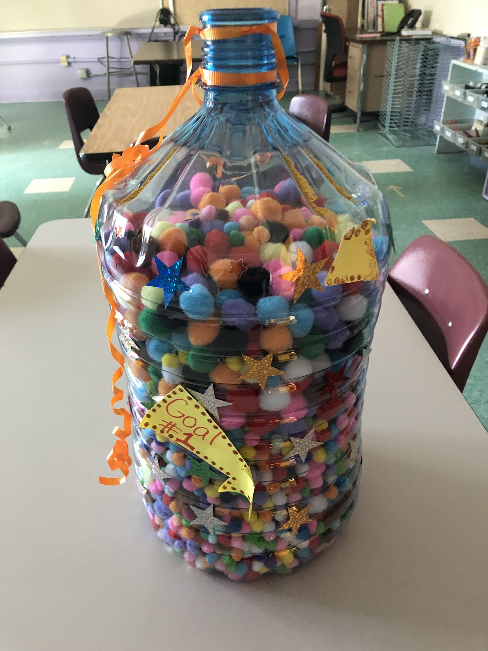
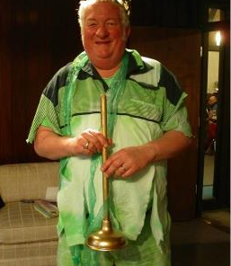
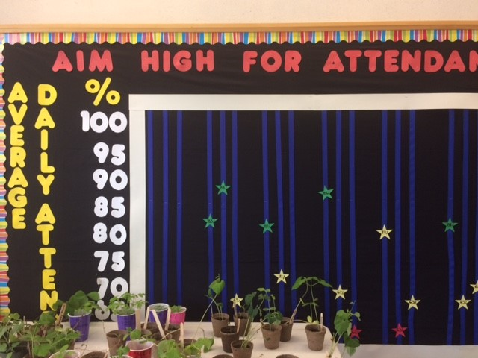
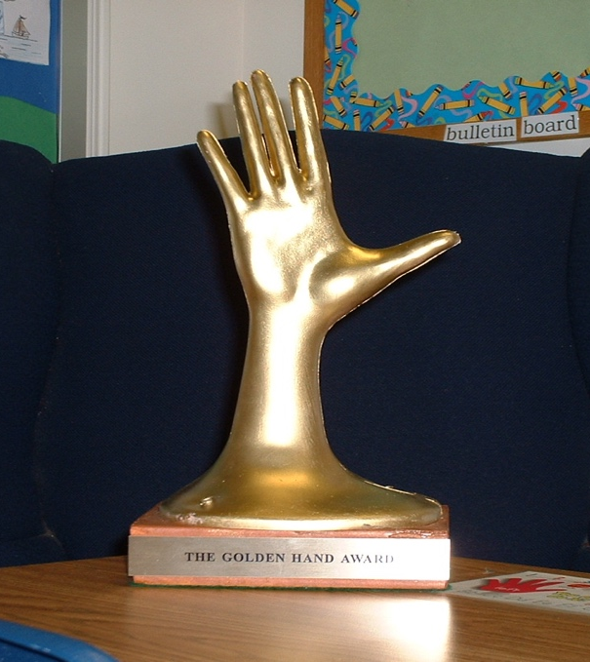
And the Golden Plunger goes to....
the wing with the cleanest bathroom!
Groups of students (classes, grades, teams, etc.) can work together towards a common goal!
You were seen giving a helping hand!
Thank you!

Slide 99
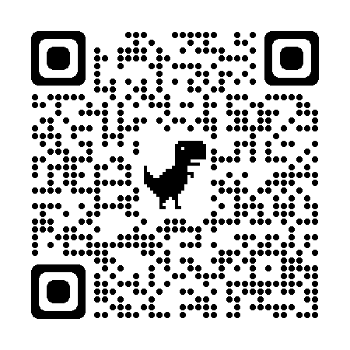
Consider these no or low cost options
(*Full list compiled by Laura Riffel)
Assist school staff (e.g., cleaning, office work, announcements, job shadow, keep score)
Be a leader (e.g., first in line, lead game)
Choice (e.g., class job, book to read)
Privileges (e.g., partial assignment, access/pass to special class/school activity, music between classes)
Social privileges (e.g., eat with preferred peers or staff)
Positive recognition (e.g., recommendation letter)
* http://behaviordoctor.org/wp-content/uploads/2019/10/fy20freelowcostreinforcers.pdf

Slide 100
Engage partners by co-designing and revising your acknowledgement system based on data
Schoolwide Acknowledgement System
TEAM develops a draft at a team training
STAFF review the draft and provide input
STUDENTS share ideas about what is and is not reinforcing to them
FAMILY advisory group provides feedback about cultural relevancy

Slide 101
Acknowledgement Systems for Older Students?
Adolescents typically have a heightened flight or fight response and may perceive neutral interactions as threatening (Blakemore et al., 2007).
Adolescents typically need a more intense experience to recognize it as rewarding (Sprague, 2008).
Adolescents may need acknowledgement that is:
  Frequent
  Varied
  Meaningful
  Specific & genuine
  As soon after the expected behavior is displayed as possible
A school-wide system ensures all students have access to acknowledgements and prompts adults to engage in this critical practice.

Slide 102
High schools already recognize students
Honor roll acknowledgement breakfast
Athletic award assemblies
PA announcements
Newsletters home
Teacher to student kudos
Consider how to address
ALL behaviors
and
ALL students!

Slide 103
Acknowledgment Systems
Design structures and mechanisms for regular recognition of positive behaviors, events, and activities of the school
  Staff-Student – Develop ways to identify, communicate and publicly recognize excellence
  Staff-Staff – Create and promote opportunities for staff/admin to recognize and appreciate other staff
  Student-Staff – Create ways for students to share appreciation of staff
  School-Student – Attendance, grades, behavior, state assessment, improvement, etc. (i.e. Attendance Campaign)

Slide 104
Are “Rewards” Dangerous?
“…our research team has conducted a series of reviews and analysis of (the reward) literature; our conclusion is that there is no inherent negative property of reward. Our analyses indicate that the argument against the use of rewards is an overgeneralization based on a narrow set of circumstances.”
(Cameron, 2002; Cameron & Pierce, 1994, 2002; Cameron et al., 2001)

Slide 105
Considerations for the Effective Use of Rewards
Provide reinforcement consistent with students’ phase of learning (e.g., more reinforcement when a skill is new)
Provide reinforcement in a manner that is considerate of the student’s developmental and cultural characteristics and learning history
Ensure ALL students have access to acknowledgement system
Be Specific!
Provide greater attention for the contextually appropriate social skill than for the problem behavior
Do not use withholding or removal of positive feedback as a threat or bribe, to “encourage” social skills

Slide 106
ACTIVITY:
School-Wide Acknowledgements Discussion
Consider how you would respond to the following questions about acknowledgement. Your team should have a consistent message.
  Is it fair to all students?
  They are in high school, students don’t need to be acknowledged.
  It’s bribery!
  Why can’t we just tell them they’re doing a good job?
  You’re building a token society.
  Why are we rewarding them for what they’re supposed to do?
Add items to your Action Plan as necessary
Be ready to present 2-3 “big ideas” from your discussion.
10 minutes

Slide 107
WHOLE GROUP DEBRIEF:
Schoolwide Acknowledgements Discussion
Share 1-2 highlights from your team discussion.
What additional questions do you have or resources will you need to address these questions?
5 minutes

Slide 108
Guidelines for
Continuum of Responses to Increase Use of SEB Skills
Develop:
Easy and quick forms of acknowledgement linked to SW-expectations and used across all settings (non-classroom and classroom) which is considerate of strategies/processes that already exist
Culturally, developmentally, contextually appropriate/relevant name and form of acknowledgement
Written procedures for delivering acknowledgements
Back-up or follow-up acknowledgements
Means for keeping track of the ratio of acknowledgements to referrals or corrective actions

Slide 109
School-wide Acknowledgement System Worksheet
 | High-Frequency | Intermittent | Long-term
Name of Acknowledgement
Description
Criteria for Receipt
Resources Needed
Deliver by Who?
When and Where?
How Often?
Staff communication: What? By who? When?
How will staff be supported to implement this with fidelity?
Goal for this practice
How will you know if you have reached your goal?
Use this worksheet to help support your team with acknowledgement system action planning.

Slide 110
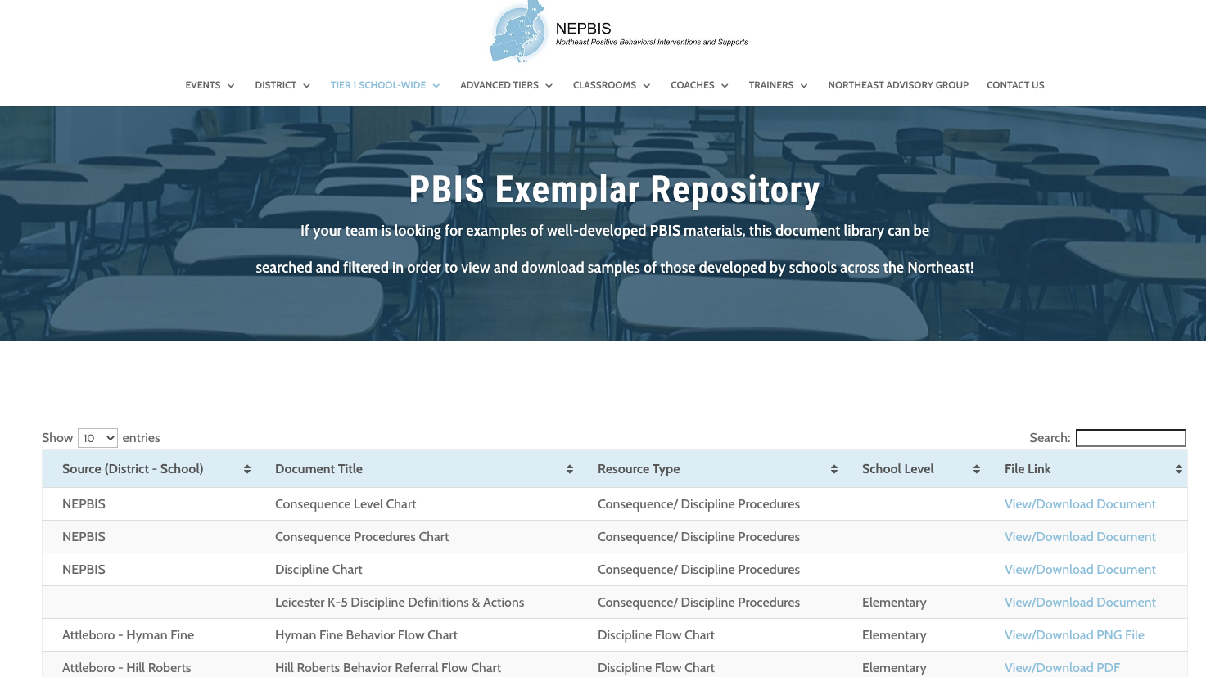
nepbis.org
For more examples from schools across the state, check out the
Exemplar Repository
Includes examples of teaching matrices, lesson plans, recognition systems, discipline flow charts, etc.

Slide 111
ACTIVITY: School-Wide Acknowledgements
 | High-Frequency | Intermittent | Long-term
Name of Acknowledgement
Description
Criteria for Receipt
Resources Needed
Deliver by Who?
When and Where?
How Often?
Staff communication: What? By who? When?
How will staff be supported to implement this with fidelity?
Goal for this practice
How will you know if you have reached your goal?
As a team:
Begin drafting your Acknowledgements Worksheet.
Add items to your Action Plan as necessary.
Present 2-3 “big ideas” from your group (1 min. reports)
15 minutes

Slide 112
WHOLE GROUP DEBRIEF:
Schoolwide Acknowledgements Discussion
Share 1-2 highlights from your team discussion.
What additional support do you need to develop a school-wide continuum of acknowledgement?
5 minutes

Slide 113
Lunch

Slide 114
Quick
Review

Slide 115
GETTING STARTED WITH PBIS
1
Establish an effective leadership team
6
Develop a continuum of responses to increase use of SEB skills
2
Develop a brief statement of purpose & define outcomes
7
Develop a continuum of responses to decrease SEB errors
3
Identify positive school-wide behavior expectations
8
Develop systems to support staff
4
Develop procedures to teach school-wide expectations
9
Use data for decision-making
5
Develop procedures to teach class-wide expectations
10
Promote sustainability

Slide 116
5
Develop procedures to teach class-wide expectations
Practices
Notes:
Once the schoolwide expectations have been determined, classroom educators will apply the behavior matrix format to the routines and settings within their classrooms. They will also explicitly teach the expectations to their students throughout the year.

Slide 118
Supporting and Responding to Students’ SEB Needs
1. Create Positive Teaching and Learning Environments
Design a Safe Environment
2. Actively Promote SEB Growth
Engage Students in Relevant Learning
3. Monitor Fidelity and Use Data to Guide Implementation
Monitor Educator Implementation
4. Monitor Student Outcomes and Use Data to Guide Response
Establish Positive Connections
Develop Predictable Routines
Define and Teach Positive Expectations
Plan Relevant Instruction
Foster Positive Relationships
Prompt and Supervise SEB and Academic Skills
Provide Specific Feedback (> 5 : 1 Ratio)
Consider Other Response Strategies
Provide Training, Coaching, and Feedback
If data indicate implementation challenges...
Monitor Student Outcomes
Enhance Tier 1
If many students make ongoing SEB errors...
Enhance Tier 1 and Consider Tiers 2 and 3
If few students make ongoing SEB errors...

Slide 119
3 Key Practices
1. Create Positive Teaching and Learning Environments
Design a Safe Environment
2. Actively Promote SEB Growth
Engage Students in Relevant Learning
Establish Positive Connections
Develop Predictable Routines
Define and Teach Positive Expectations
Plan Relevant Instruction
Foster Positive Relationships
Prompt and Supervise SEB and Academic Skills
Provide Specific Feedback (> 5 : 1 Ratio)
Consider Other Response Strategies
Positive Greetings at the Door
Active Engagement
Specific Feedback ( >5⁺ : 1⁻ Ratio)

Slide 120
6
Develop a continuum of responses to increase use of SEB skills
Practices
Notes:
To encourage contextually appropriate behaviors to occur, you'll support educators to provide frequent specific feedback and praise. To promote this critical practice, you’ll develop recognition/acknowledgement systems for both students and staff.

Slide 121
Types of Acknowledgements
High Frequency
Provided daily
Predictable
Specific Praise
Tickets/Notes
Coupons to school store
Announcements
Intermittent
Provided weekly, quarterly, monthly
Student of the Month
Class Pizza Party
Recognition at School Assembly
Long Term
Few times per year
Involves groups of students
Whole school pajama day
Honors banquet
Freshmen class picnic

Slide 122
Team
Action Planning Time

Slide 123
Use this time to continue working on...
DAY 1
TODAY
Step 5: Developing Procedures to Teach Class-wide Expectations
Step 6: Developing a Continuum ofResponses to Increase Use of SEB Skills
Previous action item priorities
Begin to develop:
Classroom teaching matrix example
Classroom lesson plan example
System for classroom lesson plan delivery
150 mins
Begin planning a school-wide acknowledgement system

Slide 124
WHOLE GROUP DEBRIEF: Action Planning
Step 5: Developing Procedures to Teach Class-wide Expectations
Step 6: Developing a Continuum to Increase Use of SEB Skills
Share one or more team accomplishments from today.
What further support will you need to complete these action steps?
Begin to develop:
Classroom teaching matrix example
Classroom lesson plan example
System for classroom lesson plan delivery
Begin planning a school-wide acknowledgement system
5 minutes

Slide 125
Review
of PBIS
and
Getting Started Steps #1- 6

Slide 126
Continuum of School-Wide Instructional
& Positive Behavior Support
What do we do for the FEW needing intensive support?
Tertiary Prevention:
Specialized
Individualized
Systems for Students with High-Risk Behavior
What do we do for ALL?
Primary Prevention:
School-/Classroom-
Wide Systems for
All Students,
Staff, & Settings
~5%
~15%
What do we do for the SOME needing more support?
Secondary Prevention:
Specialized Group
Systems for Students with
At-Risk Behavior
~80% of Students

Slide 127
Critical Features
Systems
Practices
Data
Equity
Outcomes

Slide 128
Culture and Context of the School Community

Slide 129
GETTING STARTED WITH PBIS
1
Establish an effective leadership team
6
Develop a continuum of responses to increase use of SEB skills
2
Develop a brief statement of purpose & define outcomes
7
Develop a continuum of responses to decrease SEB errors
3
Identify positive school-wide behavior expectations
8
Develop systems to support staff
4
Develop procedures to teach school-wide expectations
9
Use data for decision-making
5
Develop procedures to teach class-wide expectations
10
Promote sustainability

Slide 130
1
Establish an effective leadership team
Systems
Supports Relevance & Equity
Improves student outcomes
Promotes Engagement
Notes:
Your first step is to create a representative team to lead your school’s PBIS efforts.

Slide 131
2
Develop a brief statement of purpose & define outcomes
Practices
What do we hope to achieve by implementing PBIS?
"Our mission is to provide a positive, safe, healthy, nurturing and respectful environment in which all students have the opportunity to become productive members of society."
Purpose
“As a result of implementing PBIS during the 20XX-20XY school year, student reports of school climate will improve by 20%.”
Outcome
Notes:
You’ll then focus your school’s PBIS efforts by creating a statement of purpose to identify your hopes and goals for PBIS implementation.

Slide 132
3
Identify positive school-wide behavior expectations
Practices
Notes:
Your team will work with your school community to uncover what you value and use those values to identify your schoolwide expectations

Slide 133
4
Develop procedures to teach school-wide expectations
Practices
Define
Teach
Prompt
Monitor
Evaluate
Notes:
Using those identified expectations, you’ll define what those expectations look and sound like in key routines/settings throughout your school. This is organized through a behavioral matrix. Using the schoolwide matrix, your team will develop lessons that will be explicitly taught to students at the beginning of the year (and boosted throughout the year) so that they know how to be successful within each context (like the hallway, cafeteria, assemblies, etc.)

Slide 134
5
Develop procedures to teach class-wide expectations
Practices
Notes:
Once the schoolwide expectations have been determined, classroom educators will apply the behavior matrix format to the routines and settings within their classrooms. They will also explicitly teach the expectations to their students throughout the year.

Slide 135
6
Develop a continuum of responses to increase use of SEB skills
Practices
Notes:
To encourage contextually appropriate behaviors to occur, you'll support educators to provide frequent specific feedback and praise. To promote this critical practice, you’ll develop recognition/acknowledgement systems for both students and staff.

Slide 136
Preview of
Day 4
(Getting Started Step # 7)

Slide 137
GETTING STARTED WITH PBIS
1
Establish an effective leadership team
6
Develop a continuum of responses to increase use of SEB skills
2
Develop a brief statement of purpose & define outcomes
7
Develop a continuum of responses to decrease SEB errors
3
Identify positive school-wide behavior expectations
8
Develop systems to support staff
4
Develop procedures to teach school-wide expectations
9
Use data for decision-making
5
Develop procedures to teach class-wide expectations
10
Promote sustainability

Slide 138
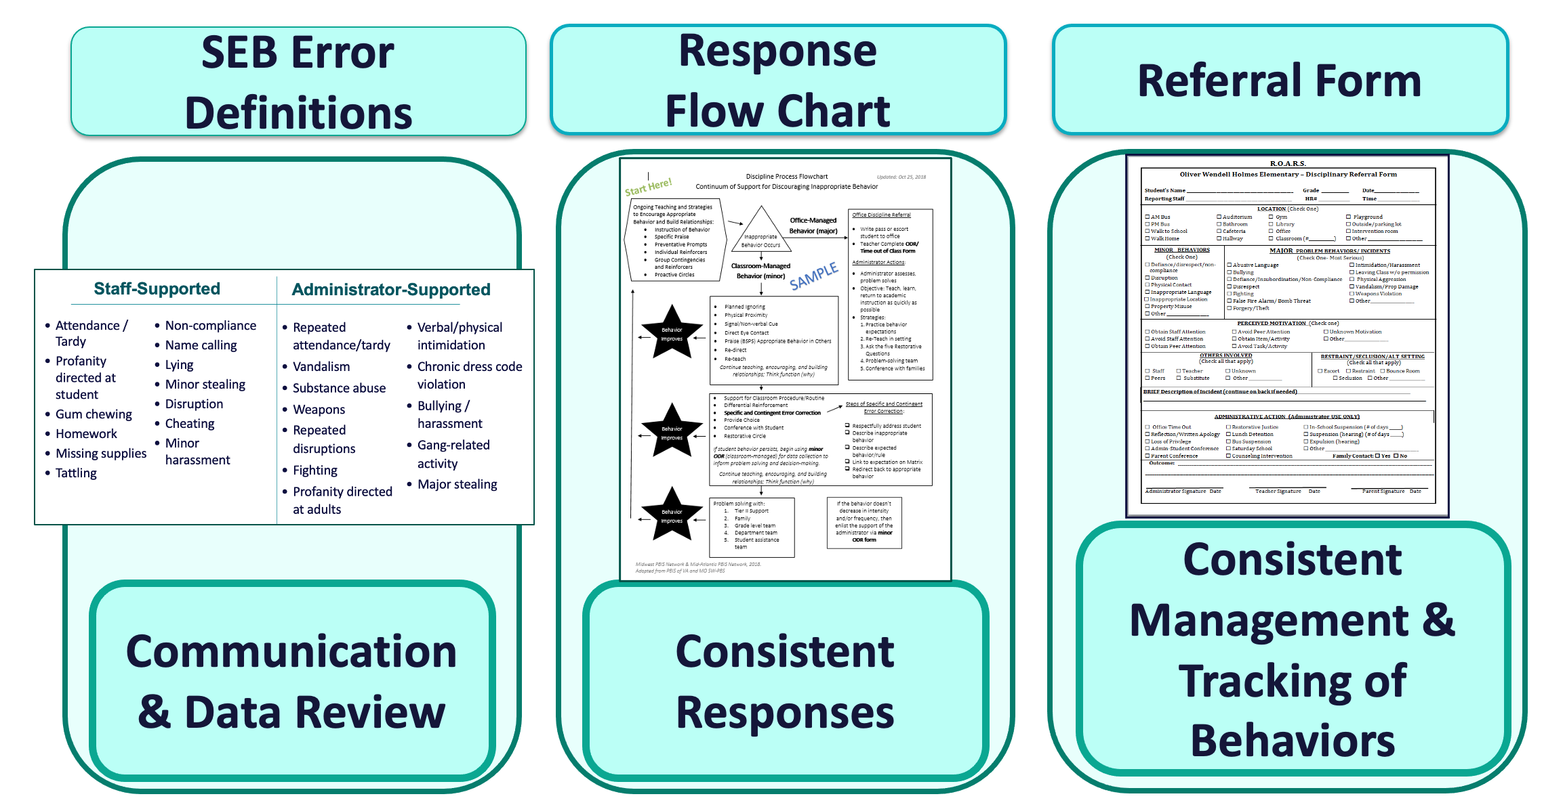
7
Develop a continuum of responses to decrease SEB errors
Practices
Notes:
You will also clarify how staff should respond when contextually inappropriate behaviors occur by clearly defining, determining who’s responsible for responding, identifying clear responses, and recording the behaviors.

