Slide 1

TRAINER INFORMATION
This free and accessible training material is provided through the Northeast PBIS Network and can be found at https://nepbis.org/.
School teams are highly encouraged to contact a
PBIS State Coordinator or an NEPBIS Endorsed Trainer
for training opportunities.
If you are an experienced trainer and would like access to to our coordinating trainer workbook which offers training guidance, please email us at nepbis@uconn.edu.

Slide 2
TRAINER NOTES
This is Day 2 of an 11 day, 3 year training sequence.
CONTENT
OUTCOMES
At the end of day two, teams should understand the benefits of:
having common schoolwide expectations developed with input from partners
using systems to support staff with teaching schoolwide expectations
Step 3: Identifying Positive SW Expectations
  Identifying Culturally Responsive SW Expectations
Step 4: Developing Procedures for Teaching SW Expectations
  Teaching Schoolwide Expectations
  Supporting Staff with Teaching Schoolwide Expectations
Using the TFI to Self-Assess and Action Plan
Identify schoolwide expectations
Consider ways to gather input
Begin to develop:
teaching matrix
lesson plan example
system for lesson plan delivery
Complete TFI as a self-assessment
Use TFI data to support action planning to achieve identified outcomes
For more information and guidance related to training this content please see the NEPBIS trainers’ manual located here: https://nepbis.org/training-of-trainers-workbook-supplemental-materials/

Slide 3
SAMPLE AGENDA
8:30 | Introduction and Review of Day 1 | 15 mins
8:45 | Identifying Positive SW Expectations | 60 mins
9:45 | Break | 15 mins
10:00 | Developing Procedures for Teaching SW Expectations | 120 mins
12:00 | Lunch | 30 mins
12:30 | Quick Review and Self-Assessment Using the TFI | 60 mins
1:30 | Team Time | 135 mins
3:45 | Wrap Up | 15 mins

Slide 4
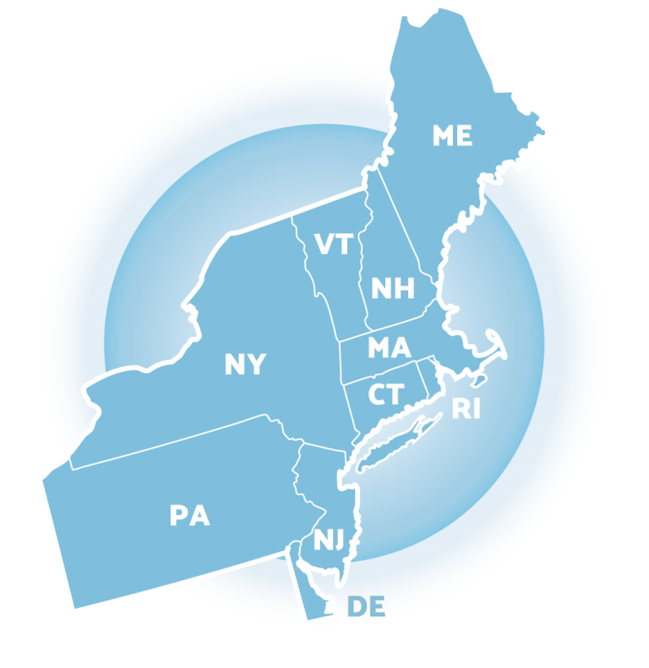
NEPBIS
School-Wide
Team Training
Year 1
Day 2
INSERT TRAINER NAMES HERE
with support from
Karen Robbie, Jen Freeman,
Brandi Simonsen, Katie Meyer,
Adam Feinberg & Susannah Everett
Notes:
Trainers: refer to training manual for:
Tips on presenting the overview content
Explanation for short activity periods and ideas for teaching this to teams
Ideas for facilitating review and team action planning

Slide 5
POSITIVE BEHAVIOR INTERVENTIONS & SUPPORTS
(PBIS)

Slide 6

WHO'S HERE?
Who's here?
LIST SCHOOLS IN COHORT HERE
(List the schools in your cohort here)
Notes:
TRAINER NOTE: Give teams several minutes each to introduce themselves and their school- including any previous experiences with PBIS.

Slide 7
NEPBIS SCHOOL-WIDE TRAINING MODEL
Year 1
Exploration and Installation of 10 Getting Started Steps
Year 2
Initial Implementation of 10 Getting Started Steps
Year 3+
Full Implementation and Continuous Improvement of Implementation
6 days of team training + 3 days of coach training
3 days of team training + 3 days of coach meeting
On-going Professional Development and Support
(minimum of 2 days of team training + 2 days of coach training annually)

Slide 8
YEAR 1: Getting Started with PBIS
DAY 1
Step 1: Establish an effective leadership team
DAY 2
Step 2: Develop a brief statement of purpose & define outcomes
Step 3: Identify positive school-wide behavior expectations
Step 4: Develop procedures to teach school-wide expectations
DAY 3
Step 5: Develop procedures to teach class-wide expectations
Step 6: Develop a continuum of responses to increase use of SEB skills
DAY 4
Step 7: Develop a continuum or responses to decrease SEB errors
DAY 5
Step 8: Develop systems to support staff
DAY 6
Step 9: Use data for decision-making
Step 10: Promote sustainability

Slide 9
TRAINING SCHEDULE
TRAINERS:
USE THIS SLIDE TO INSERT YOUR TRAINING SCHEDULE FOR THE CURRENT YEAR

Slide 10
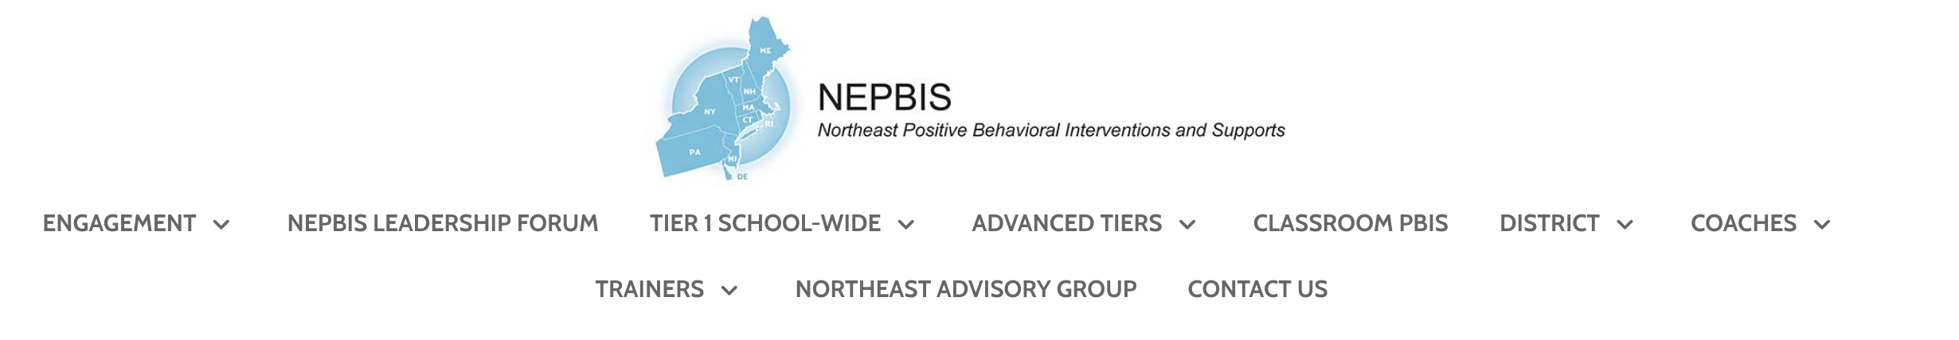


nepbis.org
TOOLS
Tier 1 Schoolwide
Tier 1 Team Training Materials
Tier 1 Supplemental Resources
School Team Implementation Guide
responses for activities
document plans
develop artifacts
Slides for each training day
Notes:
TRAINERS: Go directly to https://nepbis.org/ and demonstrate how to access relevant materials.

Slide 11


WEBSITES
pbisapps.org
pbis.org

Slide 12






LEGEND
ORGANIZATION
ACTIVITY
NEW
CONTENT
PREVIEW
REVIEW

Slide 13






LEGEND
Timing
Example
Activity
Non-example
Guidelines
Preview
Big Idea
Review
Organization

Slide 14
EXPECTATIONS
 | Individually | Working with Others
Respect Self | Participate Converse with others in lobbies and during breaks Stretch, break, stand as needed | Engage with the training content and activities
Respect Others | Complete assigned tasks Return from breaks on time | Provide room for every voice Reinforce participation
Respect Environment | Keep devices silent Have your computer charged and ready Keep necessary materials at hand | Maintain a neat, orderly work space

Slide 15
AGENDA AND OUTCOMES
Step 3: Identifying Positive SW Expectations
  Identifying Culturally Responsive SW Expectations
Step 4: Developing Procedures for Teaching SW Expectations
  Teaching Schoolwide Expectations
  Supporting Staff with Teaching Schoolwide Expectations
Using the TFI to Self-Assess and Action Plan
Identify schoolwide expectations
Consider ways to gather input
Begin to develop:
teaching matrix
lesson plan example
system for lesson plan delivery
Complete TFI as a self-assessment
Use TFI data to support action planning to achieve identified outcomes

Slide 16
Quick
Review

Slide 17
PBIS is...
Framework for enhancing adoption & implementation of
Continuum of evidence-based interventions to achieve
Academically & behaviorally important outcomes for
All students

Slide 18
Continuum of School-Wide Instructional
& Positive Behavior Support
What do we do for the FEW needing intensive support?
Tertiary Prevention:
Specialized
Individualized
Systems for Students with High-Risk Behavior
What do we do for ALL?
Primary Prevention:
School-/Classroom-
Wide Systems for
All Students,
Staff, & Settings
~5%
~15%
What do we do for the SOME needing more support?
Secondary Prevention:
Specialized Group
Systems for Students with
At-Risk Behavior
~80% of Students

Slide 19
Critical Features
Systems
Practices
Data
Equity
Outcomes

Slide 20
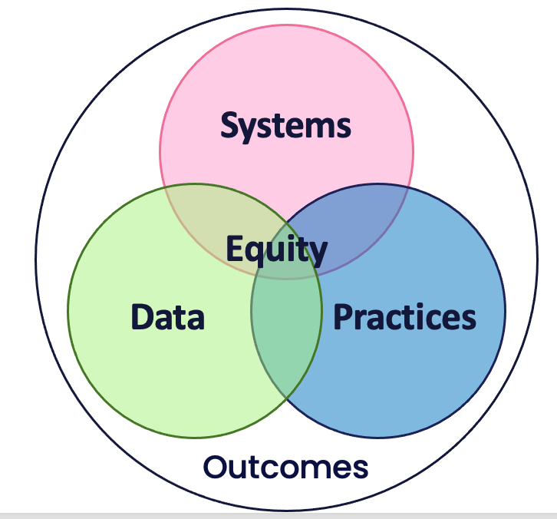
Culture and Context of the School Community

Slide 21
GETTING STARTED WITH PBIS
1
Establish an effective leadership team
6
Develop a continuum of responses to increase use of SEB skills
2
Develop a brief statement of purpose & define outcomes
7
Develop a continuum of responses to decrease SEB errors
3
Identify positive school-wide behavior expectations
8
Develop systems to support staff
4
Develop procedures to teach school-wide expectations
9
Use data for decision-making
5
Develop procedures to teach class-wide expectations
10
Promote sustainability

Slide 22
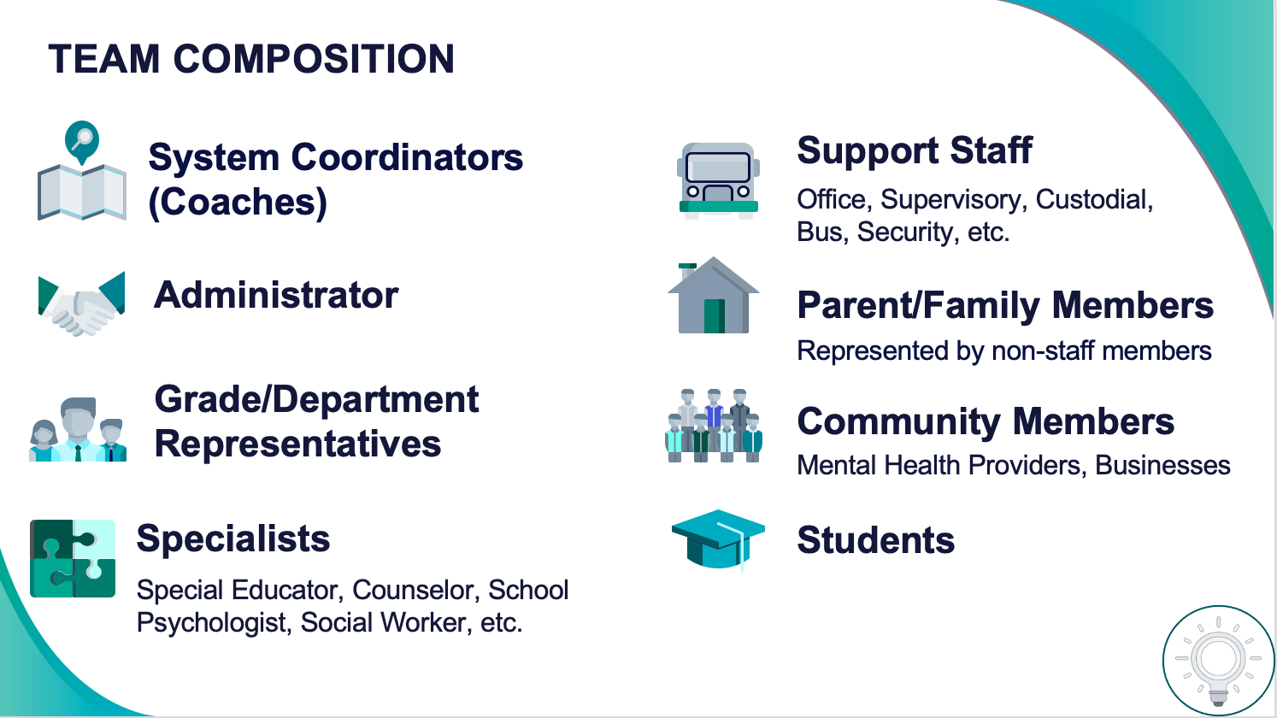
1
Establish an effective leadership team
Systems
Supports Relevance & Equity
Improves student outcomes
Promotes Engagement
Notes:
Your first step is to create a representative team to lead your school’s PBIS efforts.

Slide 23
2
Develop a brief statement of purpose & define outcomes
Practices
What do we hope to achieve by implementing PBIS?
"Our mission is to provide a positive, safe, healthy, nurturing and respectful environment in which all students have the opportunity to become productive members of society."
Purpose
“As a result of implementing PBIS during the 20XX-20XY school year, student reports of school climate will improve by 20%.”
Outcome
Notes:
You’ll then focus your school’s PBIS efforts by creating a statement of purpose to identify your hopes and goals for PBIS implementation.

Slide 24
Practices
STEP 3:
IDENTIFYING SCHOOLWIDE BEHAVIOR EXPECTATIONS
What do we expect?
Identify schoolwide expectations
Consider ways to gather input

Slide 25
GETTING STARTED WITH PBIS
1
Establish an effective leadership team
6
Develop a continuum of responses to increase use of SEB skills
2
Develop a brief statement of purpose & define outcomes
7
Develop a continuum of responses to decrease SEB errors
3
Identify positive school-wide behavior expectations
8
Develop systems to support staff
4
Develop procedures to teach school-wide expectations
9
Use data for decision-making
5
Develop procedures to teach class-wide expectations
10
Promote sustainability

Slide 26
Identifying Culturally Responsive Schoolwide Expectations

Slide 27
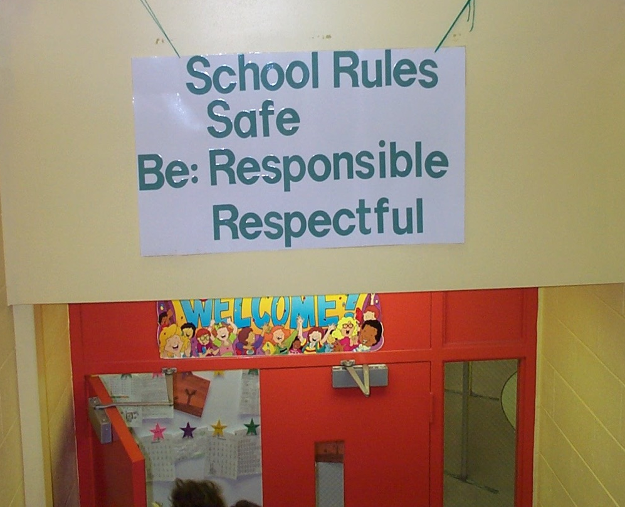
Redesign Learning & Teaching Environment
School Expectations
BE Safe
BE Responsible
BE Respectful
School Expectations
NO Food
NO Weapons
NO Backpacks
NO Drugs/Smoking
NO Bullying

Slide 28
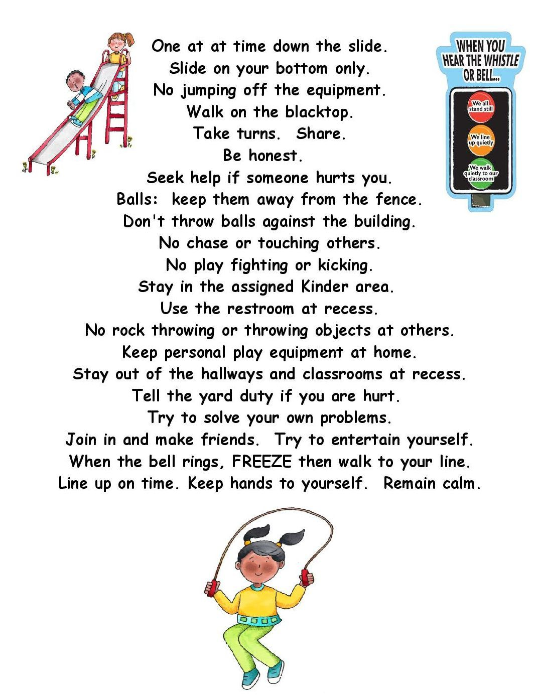
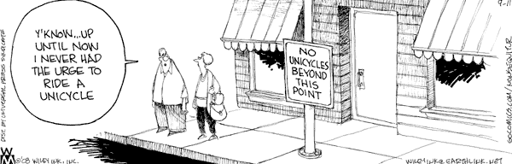
Guidelines for Expectations
Link to social culture of school
Consider already existing social skills
Establish only 3-5 expectations
Use 1-3 words per expectation
State expectations positively
Support academic achievement
Ensure expectations are mutually exclusive (minimal overlap)
Practices

Slide 29
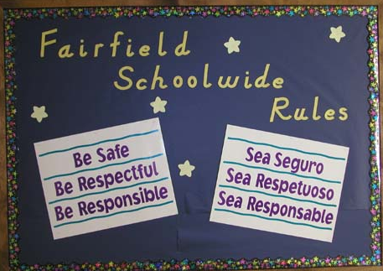
Consider the languages most prominent in your school

Slide 30
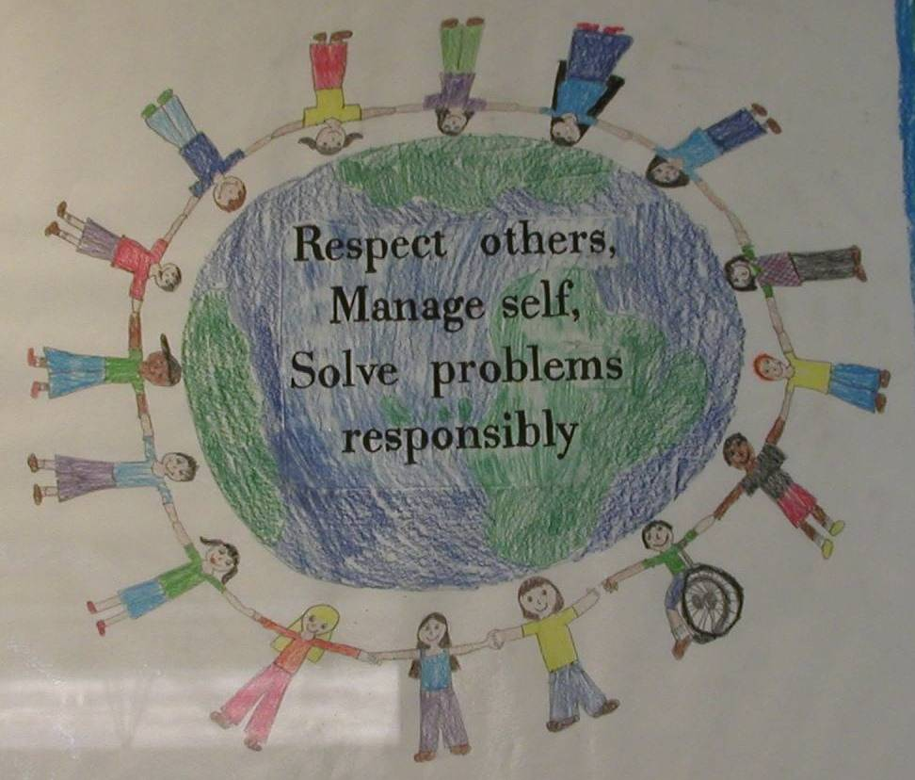
Involve the students in promoting your expectations
Respect others,
Manage self,
Solve problems responsibly

Slide 31

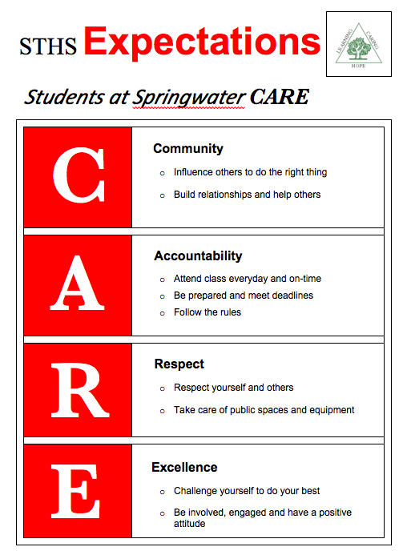
Catchy Acronyms may help with recall

Slide 32
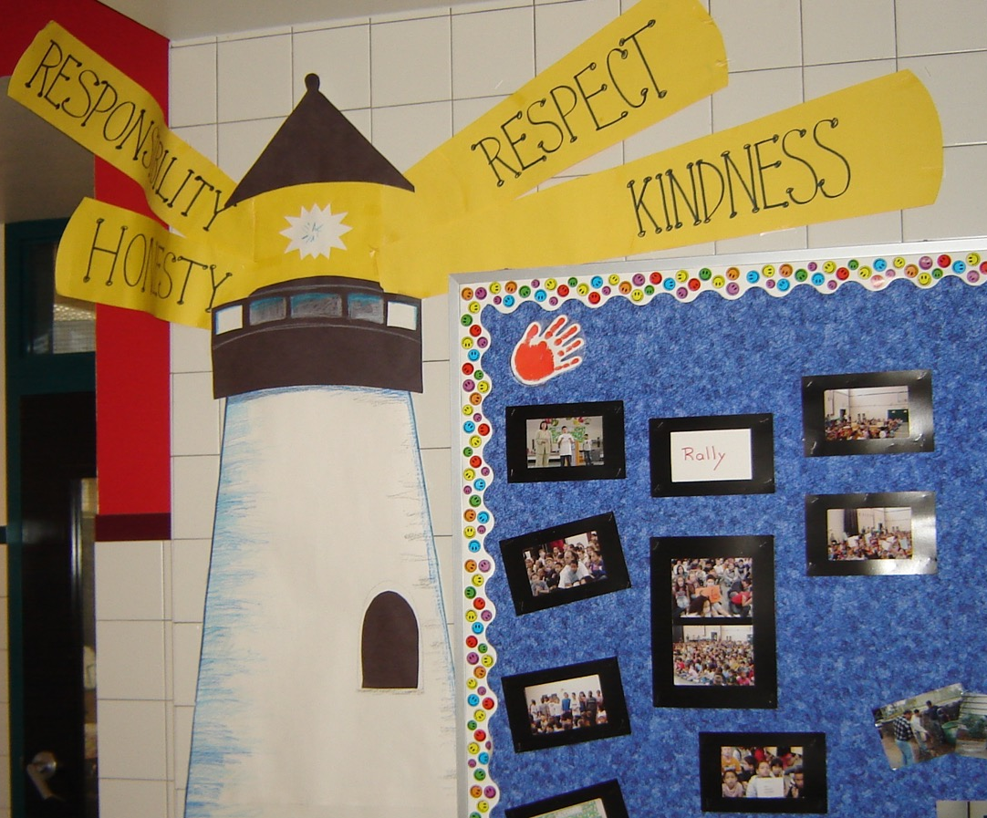
Connect to local landmarks

Slide 33

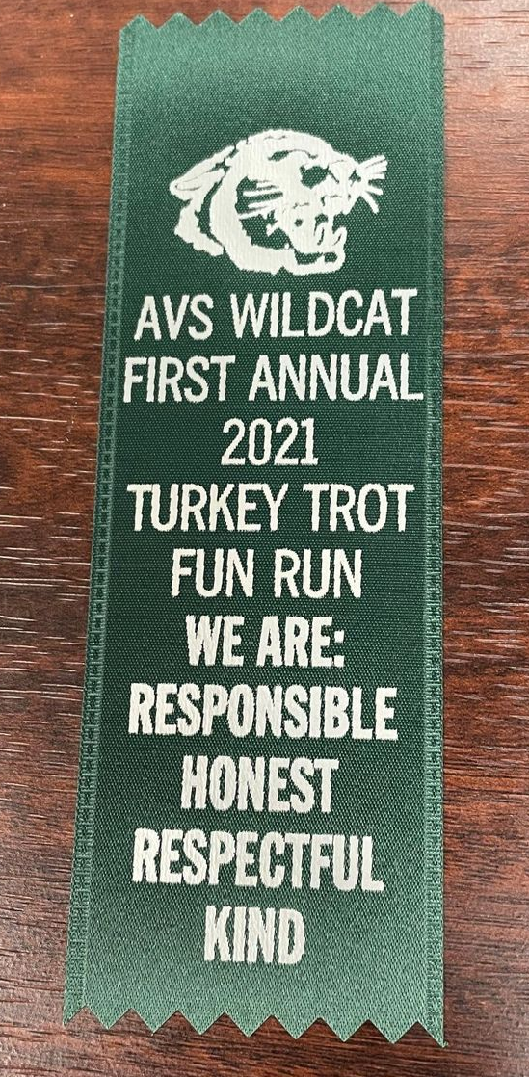
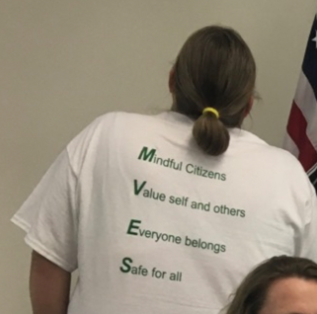
School Wide Expectations Everywhere!
School website
Building entrances
Computer wallpaper
TV screens
School newspaper
Hallways
Classrooms
Sporting Events
Dances

Slide 34
ACTIVITY: Identifying Behavioral Expectations
As a team, BEGIN
Step 3: Identifying Positive Schoolwide Expectations
Draft School-Wide Behavior Expectations
Add items to your Action Plan as necessary
Be ready to present 2-3 “big ideas” to the whole group
Link to social culture of school
Consider already existing social skills
Establish only 3-5 comprehensive expectations
Use 1-3 words per expectation
State expectations positively
Support academic achievement
Ensure expectations are mutually exclusive (minimal overlap)
10 minutes
Notes:
Workbook pg. 60

Slide 35
WHOLE GROUP DEBRIEF:
Identifying Behavioral Expectations
Link to social culture of school
Consider already existing social skills
Establish only 3-5 comprehensive expectations
Use 1-3 words per expectation
State expectations positively
Support academic achievement
Ensure expectations are mutually exclusive (minimal overlap)
Share your schoolwide expectations with the group.
What support will you need to complete this activity?
5 minutes

Slide 36
Break

Slide 37
Practices
STEP 4:
TEACHING SCHOOLWIDE BEHAVIOR EXPECTATIONS
How do we teach social behavior as explicitly as academics?
Begin to develop:
teaching matrix
lesson plan example
system for lesson plan delivery

Slide 38
GETTING STARTED WITH PBIS
1
Establish an effective leadership team
6
Develop a continuum of responses to increase use of SEB skills
2
Develop a brief statement of purpose & define outcomes
7
Develop a continuum of responses to decrease SEB errors
3
Identify positive school-wide behavior expectations
8
Develop systems to support staff
4
Develop procedures to teach school-wide expectations
9
Use data for decision-making
5
Develop procedures to teach class-wide expectations
10
Promote sustainability

Slide 39
Teaching Schoolwide Expectations

Slide 40
Teaching Academic & Social Behaviors
ADJUST for Efficiency
DEFINE Simply
MODEL
PRACTICE in Setting
MONITOR & ACKNOWLEDGE Continuously

Slide 41
Teaching academic skills calculating the hypotenuse of a triangle
“C² = A² + B² where C is side opposite right angle….”
ADJUST for Efficiency
MODEL
PRACTICE in Setting
MONITOR & ACKNOWLEDGE Continuously
DEFINE Simply
“Watch me,…If A = 3 & B = 4, then C² = 25, & C = 5….”
“Work w/ another partner & do these 4 examples….”
“I noticed that everyone got #1 & #3 correct. #2 was tricky because no right angle….”
“Work w/ your partner & calculate hypotenuse of triangle for these 3 examples……”

Slide 42
Teaching social behaviors like academic skills
“If someone won’t stop teasing your friend, you should look cool & walk away w/ your friend…”
ADJUST for Efficiency
MODEL
PRACTICE in Setting
MONITOR & ACKNOWLEDGE Continuously
DEFINE Simply
“Watch. This is how I would do it at a concert.”
“You got it. Tomorrow let’s figure out how to handle cyber-teasing.”
“That was great. What would that look like if you were stuck on the bus? In the classroom?”
“Tell me how you would do it if you were in hallway.” “At school dance.”

Slide 43
Define
Teach
Prompt
Monitor
Evaluate

Slide 44
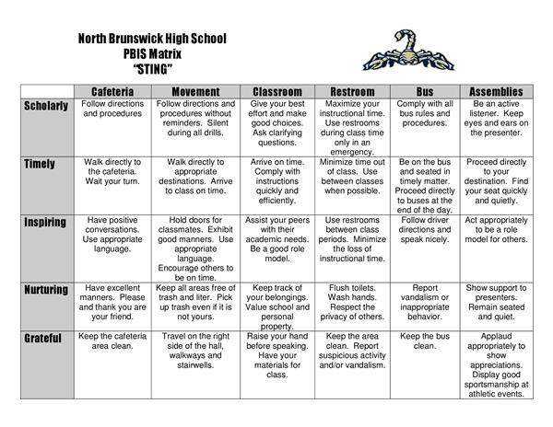
Behavioral Expectations
Define
Operationally define what expectations look like across all the settings in your school.
One way to do this is in a matrix format.

Slide 45
Teaching Matrix |  | SETTING
 |  | All Settings | Hallways | Playgrounds | Cafeteria | Library/ Computer Lab | Assembly | Bus
 | Respect Ourselves | Be on task. Give your best effort. Be prepared. | Walk. | Have a plan. | Eat all your food. Select healthy foods. | Study, read, compute. | Sit in one spot. | Watch for your stop.
 | Respect Others | Be kind. Hands/feet to self. Help/share with others. | Use normal voice volume. Walk to right. | Play safe. Include others. Share equipment. | Practice good table manners | Whisper. Return books. | Listen/watch. Use appropriate applause. | Use a quiet voice. Stay in your seat.
 | Respect Property | Recycle. Clean up after self. | Pick up litter. Maintain physical space. | Use equipment properly. Put litter in garbage can. | Replace trays & utensils. Clean up eating area. | Push in chairs. Treat books carefully. | Pick up. Treat chairs appropriately. | Wipe your feet. Sit appropriately.
1. SOCIAL SKILL
2. NATURAL CONTEXT
EXPECTATIONS
3. BEHAVIOR EXAMPLES

Slide 46





Behavioral Expectations within settings
Define
General description of what each expectation looks like & sounds like.
Start with your operational definition of the school-wide expectations or norms
Consider environmental design (i.e., physical features of the setting)
Consider routines needed to navigate the environment
Identify examples of how to (a) navigate the environment and (b) engage in the routines in a way that is consistent with school-wide expectations/norms
Incorporate any existing expectations or rules
Consider effective environmental design to promote desired behavior
What steps do students need to take to navigate the environment successfully?
What are a few examples that sample the range of expected behaviors (social skills)?
Check posters in the school and staff and student handbook.

Slide 47
RAH – at Adams City High School
RAH | Classroom | Hallway/ Commons | Cafeteria | Bathrooms
Respect | Be on time; attend regularly; follow class expectations | Keep location neat, keep to the right, use appropriate lang., monitor noise level, allow others to pass | Put trash in cans, push in your chair, be courteous to all staff and students | Keep area clean, put trash in cans, be mindful of others’ personal space, flush toilet
Achievement | Do your best on all assignments and assessments, take notes, ask questions | Keep track of your belongings, monitor time to get to class | Check space before you leave, keep track of personal belongings | Be a good example to other students, leave the room better than you found it
Honor | Do your own work; tell the truth | Be considerate of yours and others’ personal space | Keep your own place in line, maintain personal boundaries | Report any graffiti or vandalism

Slide 48
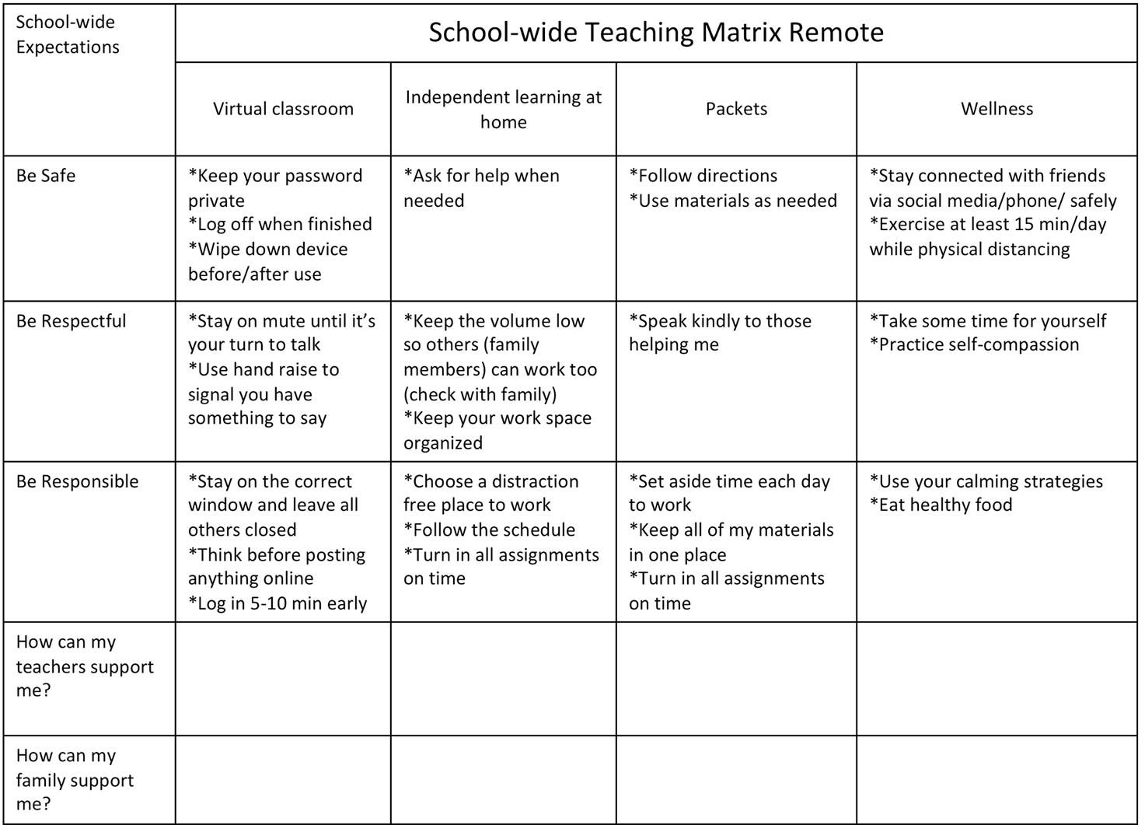
Adapted for remote instruction

Slide 49
E’ Ola Pono - to live the proper way
 | All Settings | Walkways | Playground/ Recess/P.E. | Cafeteria | Restrooms | Arrival/ Dismissal | Assembly | Field Trips
Kuleana Be Responsible | Be on time Be prepared w/ necessary supplies Be accountable for choices Respond to/complete tasks Keep area clean & litter free | Plan ahead Walk directly to destination | Take care of equipment/facilities Plan appropriate times for drinks/ restroom visits | Have lunch card ready Be orderly in all lines | Flush Turn off water Use restroom at designated times Use facilities for intended purposes | Have money/pass ready Be on time | Listen attentively Keep hands and feet to yourself | Turn in paperwork/$ on time Wear appropriate footwear/clothing Bring home lunch
Ho’ihi Be Respectful | Use appropriate voice Listen to/follow directions of staff Respect self, others property Be polite/use manners Express appreciation Accept/respect differences in people | Use quiet voices when classes are in session | Be a good sport Include others in your play | Use proper table manners Eat your own food | Observe privacy of others Use polite words and actions | Listen to JPO’s supervisors and bus driver Use quiet voice and polite words on bus | Focus on program Sit quietly Clap at appropriate times | Care for the field trip site Listen to speakers
Laulima Be Cooperative | Be helpful Participate with a positive attitude Be patient; share/ wait your turn Acknowledge others Play in designated areas only | Keep movement flowing Share equipment and play space | Follow procedures | Wait patiently/ quietly | Wait patiently/ quietly | Enter/exit vehicles in an orderly fashion Share bus seats | Sit properly in designated area Enter/exit in an orderly fashion Remain seated unless asked to do otherwise | Stay with your chaperone/group
Malama Be Safe | Immediately report dangerous situations Remain in designated areas Practice healthy behaviors/universal precautions Use appropriate footwear Follow safety rules in all areas | Walk at all times | Avoid rough, dangerous play Use equipment properly | Walk at all times Wash hands Chew food well; don’t rush | Use designated restroom Walk | Wait in designated area Remain seated when riding the bus Watch out for traffic Use crosswalk only | Be careful when approaching or leaving the stage area | Use the buddy system Follow school/bus procedures

Slide 50
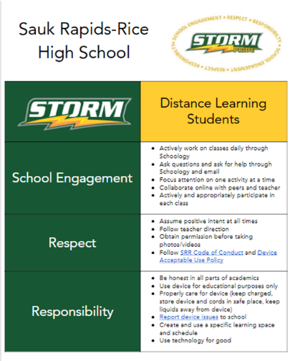
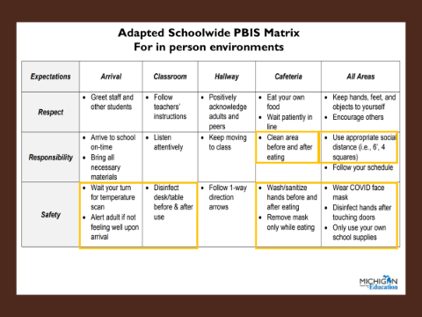

Slide 51
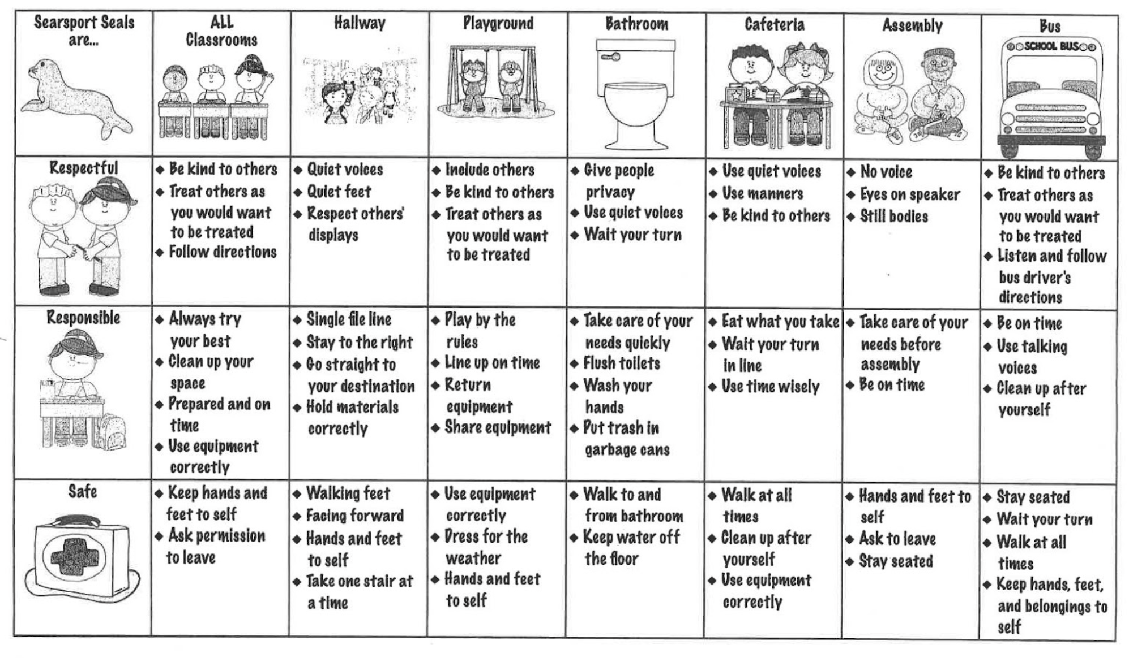
Picture clues can be helpful!

Slide 52
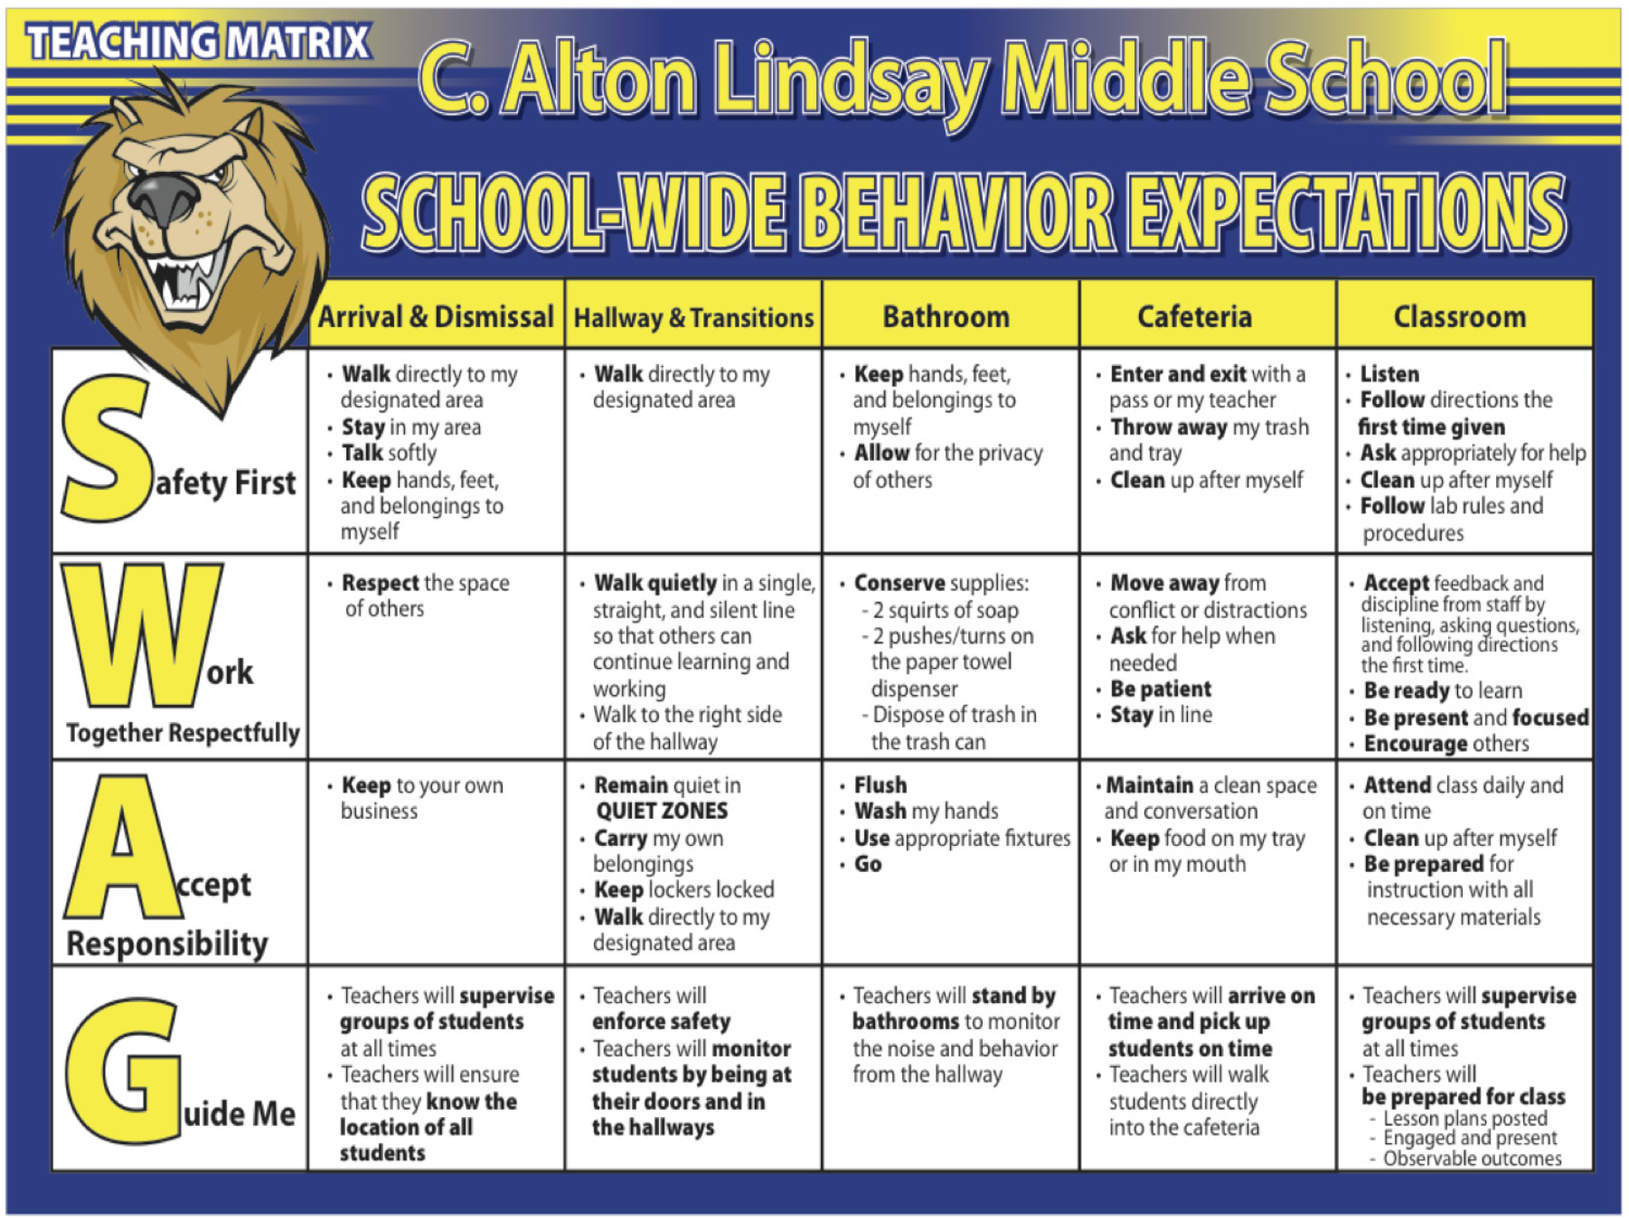
Lindsay Middle School incorporated student feedback and language into their SW matrix.
Includes how staff will support students

Slide 53

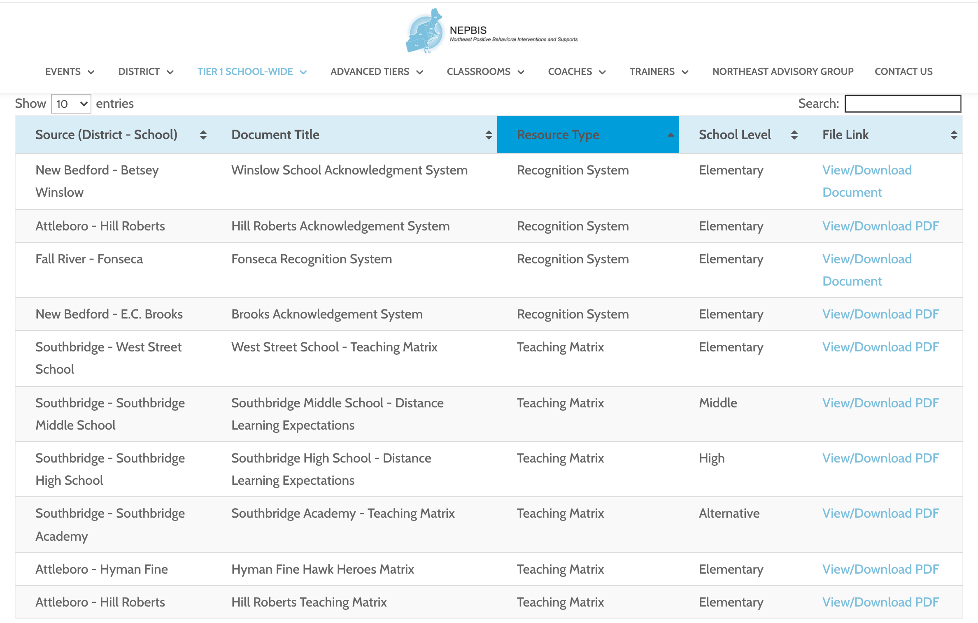
nepbis.org
For more examples drawn from schools across the state, check out the
Exemplar Repository
    Includes examples of teaching matrices, lesson plans, recognition systems, discipline flow charts, etc.

Slide 54
ACTIVITY: Behavior Matrix
As a team, BEGIN
Step 4: Developing Procedures to Teach Schoolwide Expectations
Draft your School-Wide Teaching Matrix
Write in your school-wide expectations
Identify typical settings/contexts in your school
Choose 1 column to complete today.
Identify 1-2 observable, measurable, and positively stated behaviors for each row within that column.
If time allows, complete 1 row across settings.
Add items to your Action Plan as necessary
Be ready to present 2-3 “big ideas” from your team's discussion.
15 minutes

Slide 55
WHOLE GROUP DEBRIEF: Behavior Matrix
What big ideas were captured as your team began to draft a behavior matrix?
What support will you need to complete this activity?
5 minutes

Slide 56
Engage partners by co-designing and revising your matrix based on data
Schoolwide Teaching Matrix
TEAM develops a draft at a team training
STAFF review the draft and provide input
STUDENTS compare school expectations to home and community expectations
FAMILY advisory group provides feedback about cultural relevancy

Slide 57
Get input from partners before rolling out!
1.
Identify any existing expectations or matrices
2.
Get input from students and families on what they think of the (existing or proposed) expectations
3.
Revise expectations & matrix based on feedback
4.
Get input from staff
5.
Agree on expectations & matrix

Slide 58
Get input from students & families
See Appendix D of the Cultural Responsiveness Field Guide for more ideas!
2.
Survey families
Rules gallery walk
Blank matrix activity
Consider multiple methods: At a school event, through email, mail, website
Students document any posted "rules" they can find around the school
Collect & post in large common area with a set of questions below each on flipchart paper
Provide students with school matrix with rows & columns complete (expectations & setting) but examples blank
Ask them to write (or draw) specific examples for each setting
Notes:
Culturally Responsiveness Field Guide: https://www.pbis.org/resource/pbis-cultural-responsiveness-field-guide-resources-for-trainers-and-coaches

Slide 59
Example Family Survey
2.

Slide 60
Get input from staff
4.
For expectations,
ask staff if they are:
Positively stated
Broad
For the matrix,
ask staff if it:
Includes all necessary settings
Small in number (3-5)
Memorable
Apply to both students and staff
Provides 2-5 specific examples per box
Examples include positive alternative to most common problems
Examples are active
Written in student-friendly language

Slide 61
ACTIVITY: Getting Input on Expectations & Matrix
1.
Identify any existing expectations or matrices
2.
Get input from students and families on what they think of the expectations
3.
Revise expectations & matrix based on feedback
4.
Get input from staff
5.
Agree on expectations & matrix
Plan when and how you will get input from partners (e.g., students, families, and staff) on your schoolwide expectations and matrix.
Add items to your Action Plan as necessary
Be ready to present 2-3 “big ideas” from your team's discussion.
15 minutes

Slide 62
WHOLE GROUP DEBRIEF: Getting Input
Share 2-3 ideas for getting input from students, families, and/or staff on your schoolwide expectations and matrix (How? When? What? Who?).
How will input be used to make adjustments?
What support do you need to complete this activity at your school?

Slide 63
In other words… follow these key steps
Define
Teach
Prompt
Monitor
Evaluate

Slide 64
"By the time students are in 3rd grade/middle school/high school they should know how to behave in school!"
This assumption does not consider:
  changing contexts
  cultural responsiveness
  need for reteaching/prompting
  developmental growth
  skill deficits

Slide 65
Teach
expectations in the context of school-wide settings
Teach expectations directly.
  Define expectation in operational terms—tell students what the expectation looks like within each setting.
  Provide students with examples and non-examples of expectation following within each setting.
Actively involve students in lesson—game, role-play, etc. to check for their understanding.
Provide opportunities to practice expectation following behavior in the natural setting.

Slide 66
“Cool Tool”
Skill Name
Getting Help (How to ask for assistance for difficulty tasks)
Teaching Examples
1. When you’re working on a math problem that you can’t figure out, raise your hand and wait until the teacher can help you. 2. You and a friend are working together on a science experiment but you are missing a piece of lab equipment, ask the teacher for the missing equipment. 3. You are reading a story but you don’t know the meaning of most of the words, ask the teacher to read and explain the word.
Kid Activity
1. Ask 2-3 students to give an example of a situation in which they needed help to complete a task, activity, or direction. 2. Ask students to indicate or show how they could get help. 3. Encourage and support appropriate discussion/responses. Minimize attention for inappropriate responses.
After the Lesson (During the Day)
1. Just before giving students difficult or new task, direction, or activity, ask them to tell you how they could get help if they have difficulty (precorrection). 2. When you see students having difficulty with a task (e.g., off task, complaining), ask them to indicate that they need help (reminder). 3. Whenever a student gets help the correct way, provide specific praise to the student.

Slide 67
Teach
expectations in the context of school-wide settings
Teach expectations directly.
  Define expectation in operational terms—tell students what the expectation looks like within each setting.
  Provide students with examples and non-examples of expectation-following within each setting.
Actively involve students in lesson—game, role-play, etc. to check for their understanding.
Provide opportunities to practice expectation following behavior in the natural setting.

Slide 68
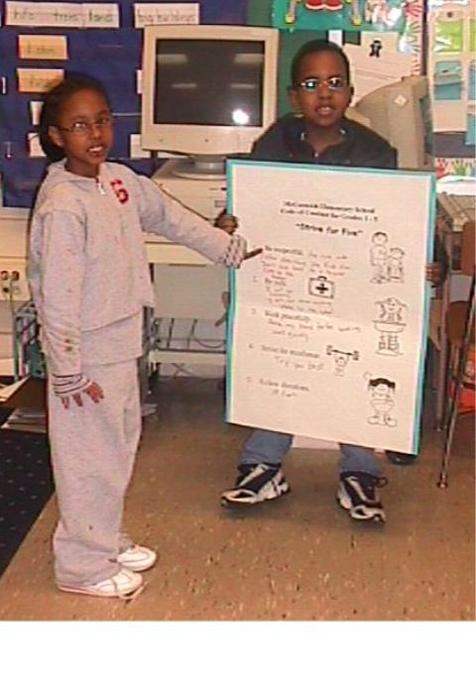
Reviewing Strive for Five
Be respectful.
Be safe.
Work peacefully.
Strive for excellence.
Follow directions.
McCormick Elem. MD 2003

Slide 69
Teach
expectations in the context of each school-wide setting
Teach expectations directly.
  Define expectation in operational terms—tell students what the expectation looks like within each setting.
  Provide students with examples and non-examples of expectation-following within each setting.
Actively involve students in lesson—game, role-play, etc. to check for their understanding.
Provide opportunities to practice expectation following behavior in the natural setting.

Slide 70
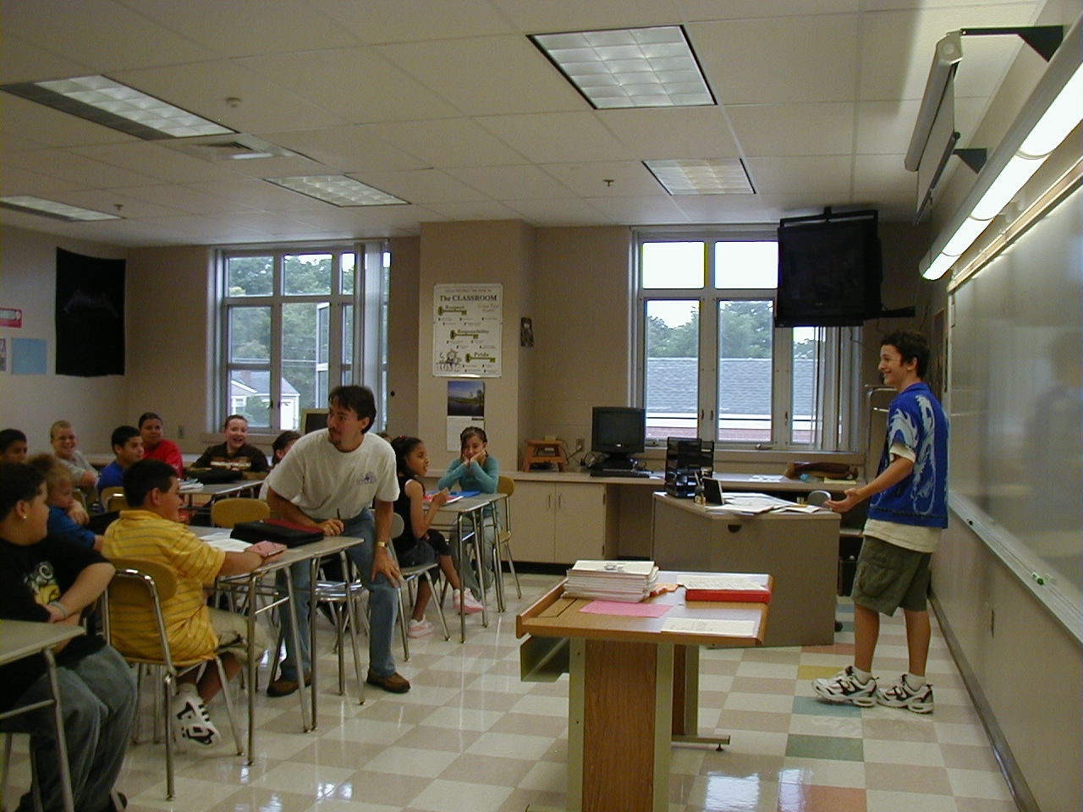
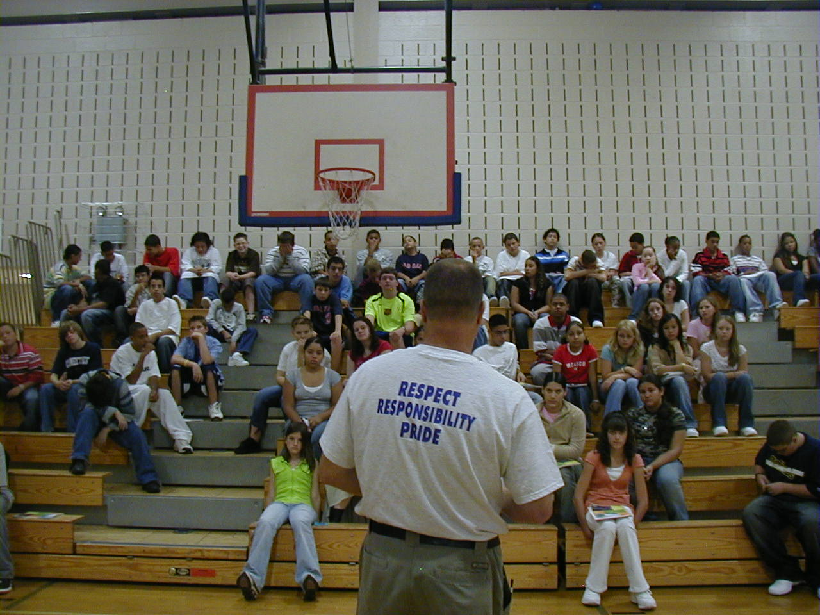

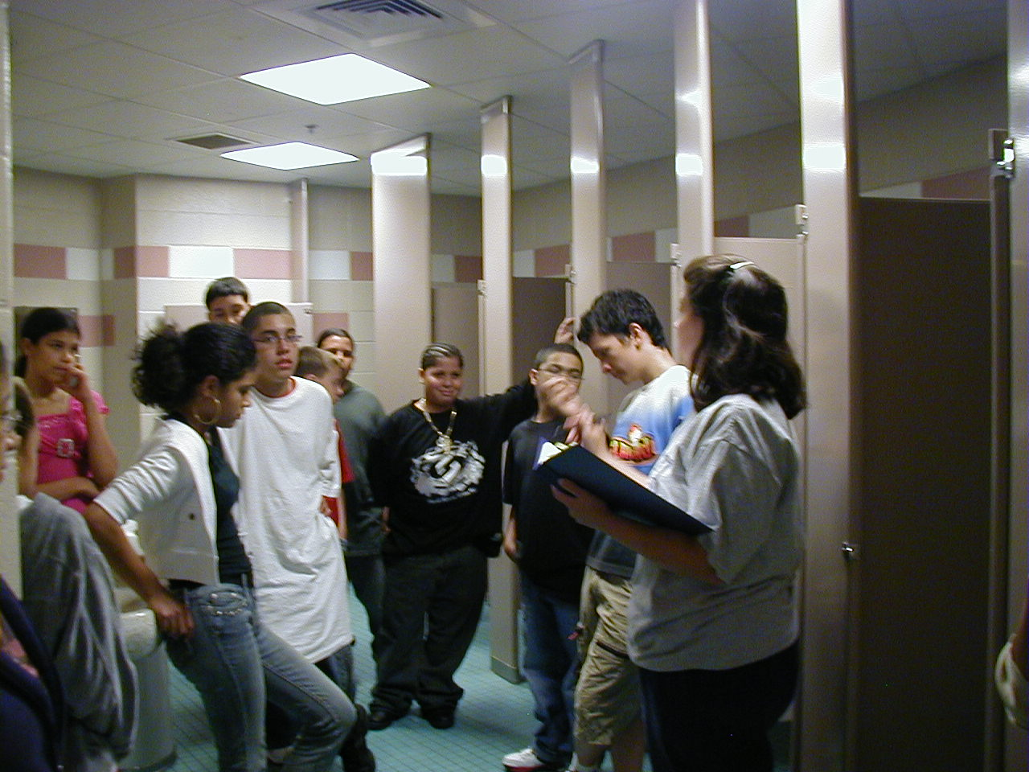
Expectations & behavioral skills are taught & recognized in natural context

Slide 71
In other words… follow these key steps
Define
Teach
Prompt
Monitor
Evaluate
Notes:
Sarah

Slide 72
Prompt
or remind students of the expectation
Use pre-corrections, which include “verbal reminders, behavioral rehearsals, or demonstrations of expectation following or socially appropriate behaviors that are presented in or before settings where problem behavior is likely”
- Colvin, Sugai, Good, & Lee (1997)

Slide 73
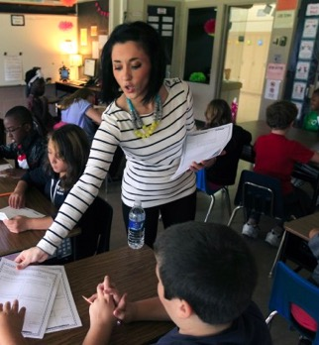
Prompts happen BEFORE opportunities for errors begin!
If you need help during this work,
raise your hand.
Before sending students off to work in small groups, provide a quick reminder about the expectations

Slide 74
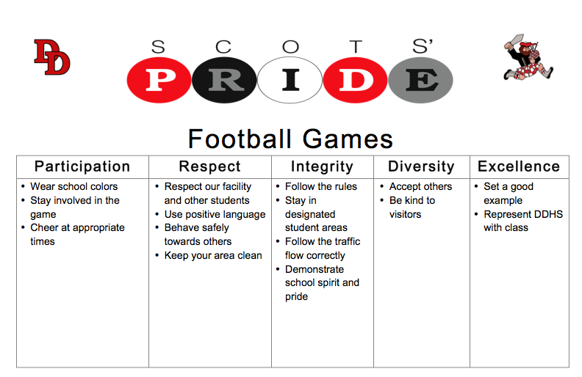

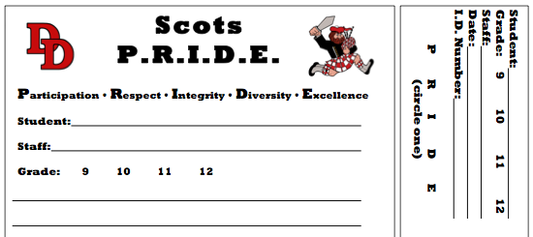
Provide students with visual prompts (e.g., posters, illustrations, etc).

Slide 75
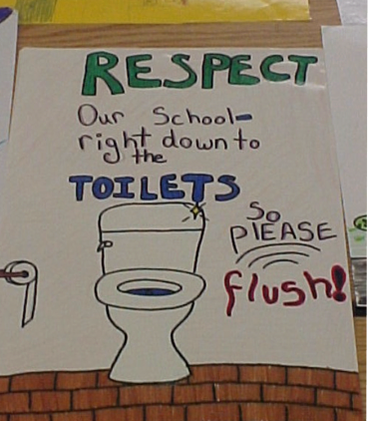
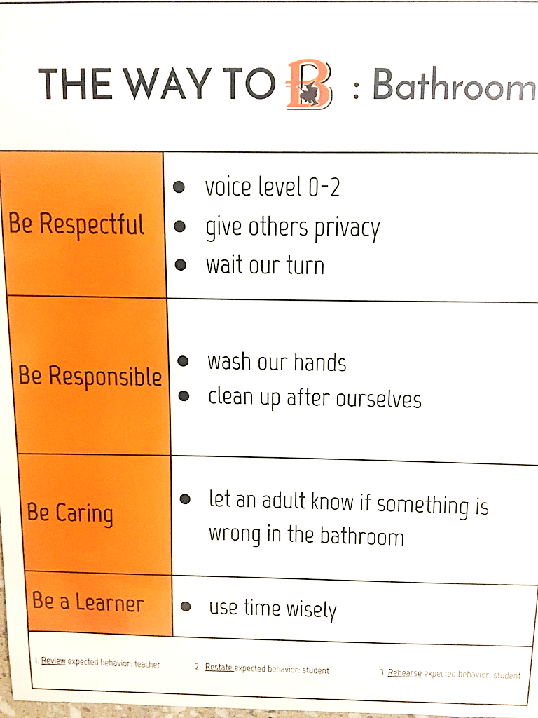

Slide 76
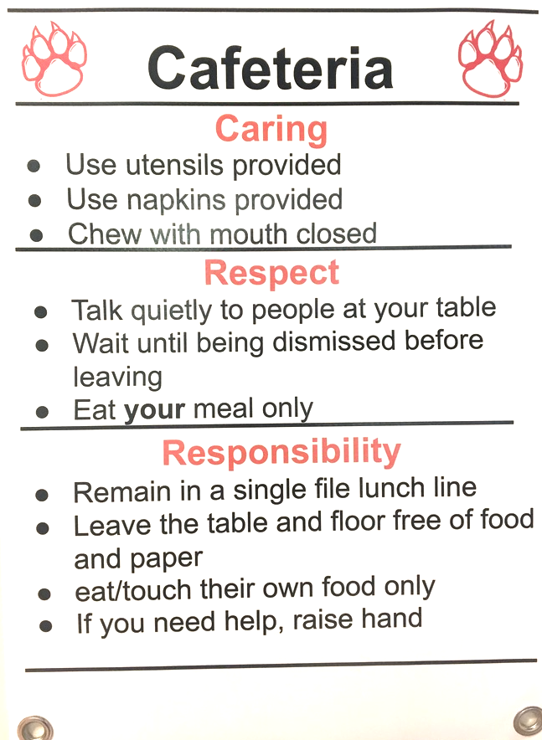
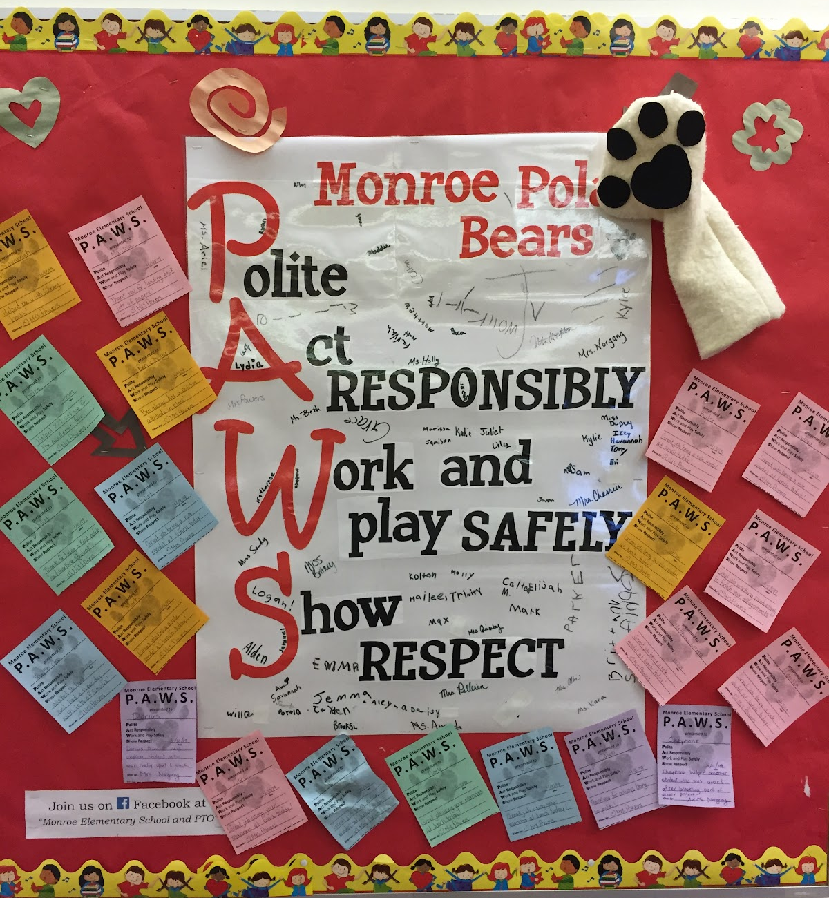

Slide 77
In other words… follow these key steps
Define
Teach
Prompt
Monitor
Evaluate
Notes:
Sarah

Slide 78
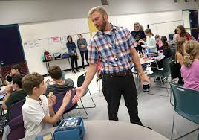
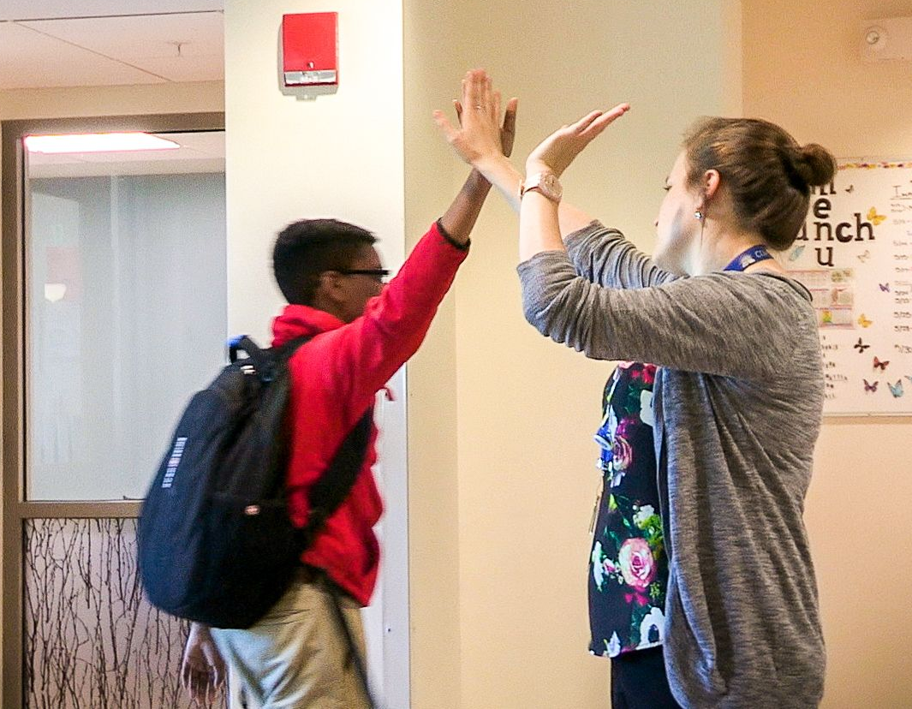
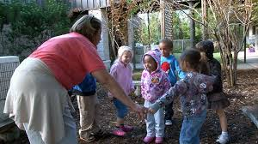
Monitor
students’ behavior in natural context
Use Active Supervision
  Move around
  Look around (Scan)
  Interact with students
      Reinforce
      Correct
    Acknowledge and Provide Feedback
      Provide higher rate of positive interactions than corrective >5⁺ : 1⁻
Think about non-classroom areas of your school.
How do the adults MONITOR
student behavior in those settings?
(Colvin, et al., 1997; Haydon et al., 2019)

Slide 79

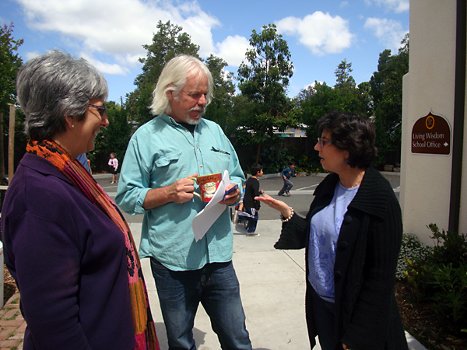

Missed Opportunities
If staff use less structured time
in non-classroom settings
(e.g. hallways, cafeterias, playgrounds)
to connect with other staff
or complete tasks,
opportunities to be
proactive and develop connections
with students
are missed.

Slide 80

All school staff need to be involved
Students greatly outnumber staff. Every adult role is critical.
Adult presence:
  Prompts desired behavior
  Deters problem behavior
  Contributes to positive school climate

Slide 81
Active Supervision is an Evidence-based Strategy
Active supervision skills can be effectively learned through:
low-intensity training processes
brief presentations for faculty and staff
individual conversations
role-played examples and nonexamples
Contextually inappropriate student behavior decreases across settings and grade levels when active supervision is used with fidelity.
(Allen, G. E., Common, E. A., Germer, K. A., Lane, K. L., Buckman, M. M., Oakes, W. P., & Menzies, H. M. (2020). A Systematic Review of the Evidence Base for Active Supervision in Pre-K–12 Settings. Behavioral Disorders, 45(3), 167–182. https://doi.org/)10.1177/0198742919837646

Slide 82
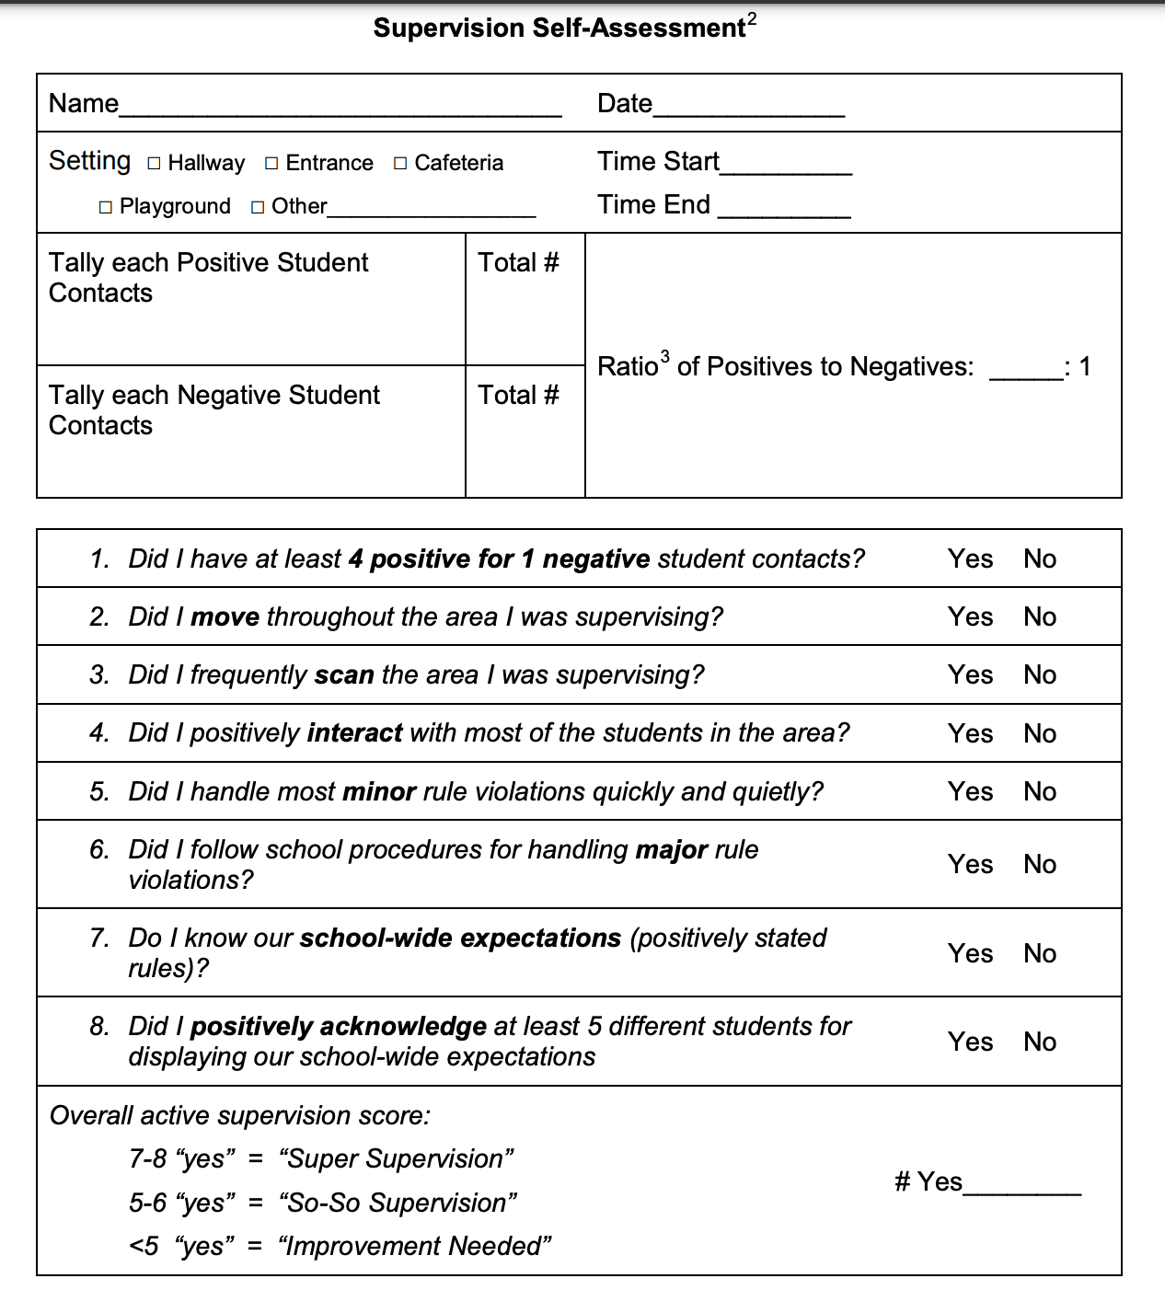
Resource for Supporting Staff with Active Supervision
Did I have at least 5 positive for 1 corrective student contacts?
Did I move throughout the area I was supervising?
Did I frequently scan the area
I was supervising?
Did I positively interact with most of the students in the area?
Did I handle most staff-managed SEB errors quickly and quietly?
Did I follow school procedures for handling administrator-managed SEB errors?
Do I know our positively stated school-wide expectations?
Did I positively acknowledge at least 5 different students for displaying school-wide expectations?
Self-Assessment

Slide 83
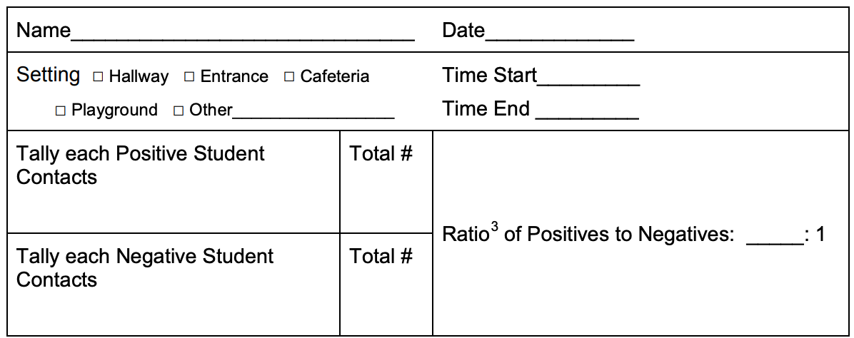
Resource for Supporting Staff with Active Supervision
Self-Assessment
Data Collection Opportunity!

Slide 84
School-wide Active Supervision Examples
Students reported using nurses’ station because it was cleaner and safer
All staff members “adopted a bathroom” and agreed to visit, not necessarily use, their bathroom at least three times daily.
Students were acknowledged for respecting privacy, good hygiene, etc.
Lack of supervision was identified as problem.
Big school so every bathroom was visited numerous times by different faculty members.
Rate of students requesting to use nurse's bathroom decreased
A high school nurse indicated that “too many students were asking to use her restroom” during class transitions.

Slide 85
School-wide Active Supervision Examples
An elementary school principal found that over 45% of their behavioral incident reports were coming from the playground.
Rate of behavior incidents decreased
Upon examining their school-wide behavior data, the school found out that most incidents were teasing that escalated.
All students are taught a social skill lesson called "Talk, Walk, Squawk” (TWS)
Walk: If teasing ends, look cool and walk away…don’t say anything.
Squawk: If teasing continues, ask an adult to mediate a solution.
Staff were prompted to promote use of TWS and were acknowledged for increasing their active supervision
Students were acknowledged for practicing and using TWS
Talk: When someone teases you, say “I don’t like it when you say those things. Stop.”

Slide 86
Systems Features of Active Supervision Examples
School-wide implementation
  All staff
  Direct teaching of staff
  Regular review, practice, & positive reinforcement
Team-based identification, implementation, & evaluation
Data-based decision making

Slide 87
In other words… follow these key steps
Define
Teach
Prompt
Monitor
Evaluate
Notes:
Sarah

Slide 88
Data used in PBIS implementation
Data
Fidelity Data
Did we implement the systems and practices we agreed upon?
Outcome Data
Is the plan resulting in progress towards our goals (desired outcomes)

Slide 89
Evaluate
the fidelity of implementation
Collect data
Are we doing what we said we’d do?
  How will we support lessons taught within school-wide settings?
  How will we know when lessons are taught?
  How will we know when and where we might need boosters?
Summarize data (look for patterns)
Use data to make decisions
Fidelity Data
  Did we implement the systems and practices we agreed upon?

Slide 90
Evaluate
the fidelity of implementation
The PBIS Leadership Team develops lesson plans for teaching schoolwide expectations and distributes the lesson plans to staff.
A school-wide teaching calendar is developed with support staff teaching expectations in non-classroom settings (e.g. cafeteria, hallway, bus, bathroom, etc.) to rotating groups of students. A checklist of classes attending each session is maintained.
Randomly survey 10% of staff and students and ask if schoolwide expectations:
can be identified
were taught
(This is part of the Tiered Fidelity Inventory-more details ahead)

Slide 91
Evaluate
the effect of instruction (Student Outcome Data)
Collect data
Are expectations being followed?
If there are errors...
  who is making them?
  where are the errors occurring?
  what kind of errors are being made?
Summarize data (look for patterns)
Use data to make decisions
Outcome Data
  Is the plan resulting in progress towards our goals
  (desired outcomes)

Slide 92
Evaluate
the effect of instruction (Student Outcome Data)
According to student school climate survey data, students in our school agree that the school has clear expectations for student behavior comparable to the national average.
Cafeteria, playground, and bus support staff report that students are doing a better job behaving.
The PBIS Leadership team reviews student behavior data monthly and identifies a decrease in referrals in non-classroom settings after booster sessions were provided.

Slide 93
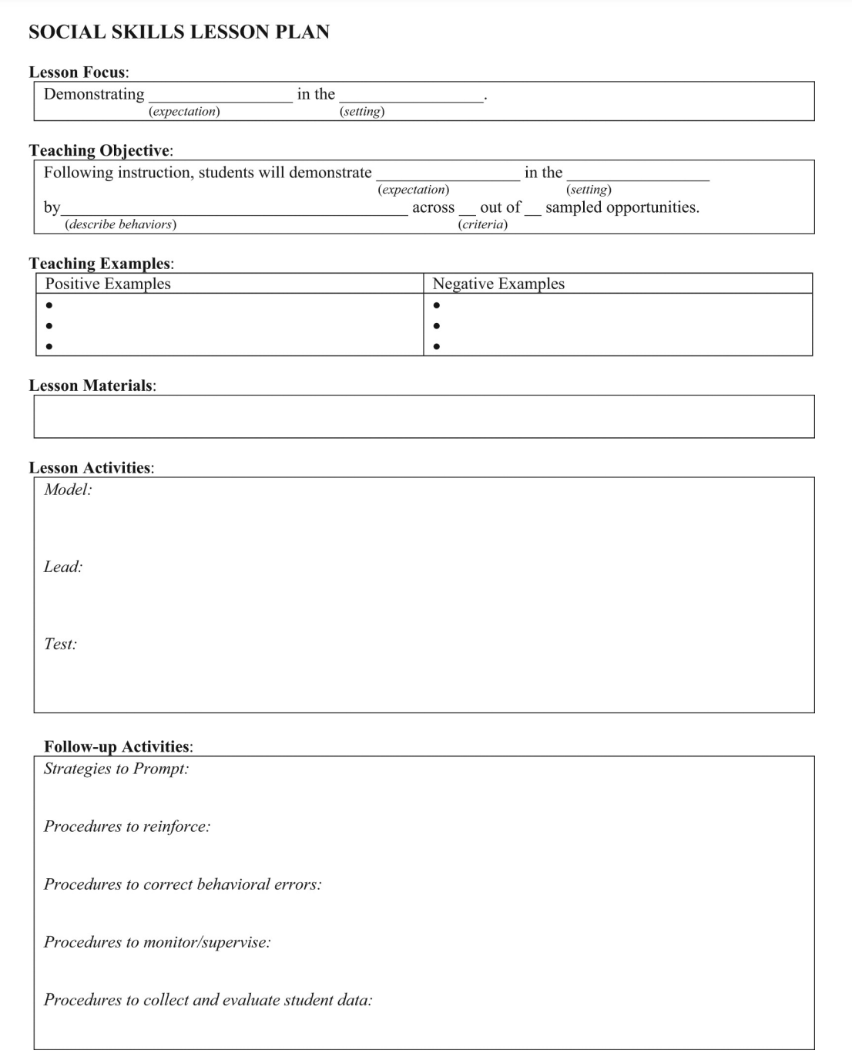
A lesson plan that prompts the critical features just described
Define
Teach
Prompt
Monitor
Evaluate

Slide 94
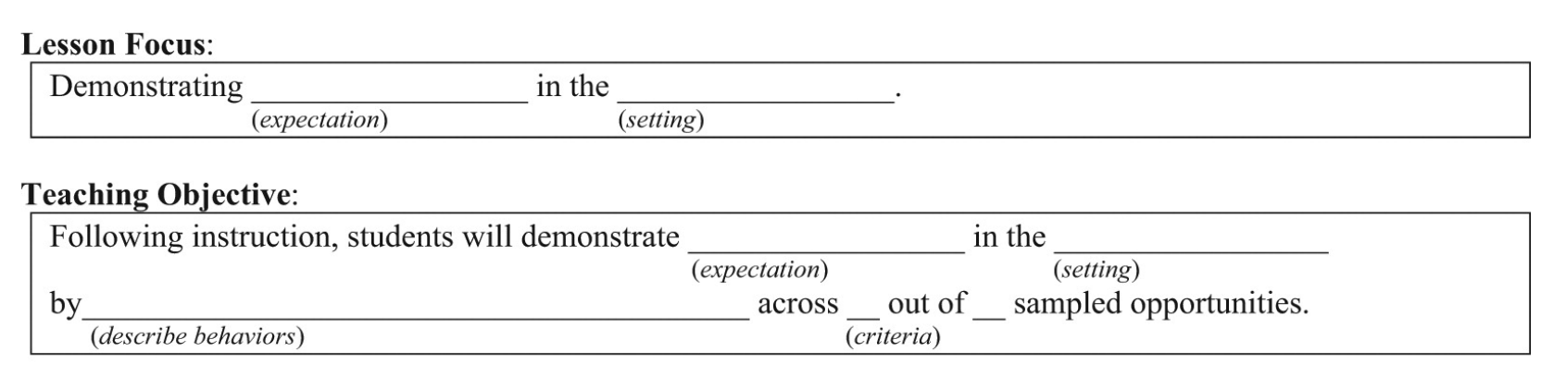
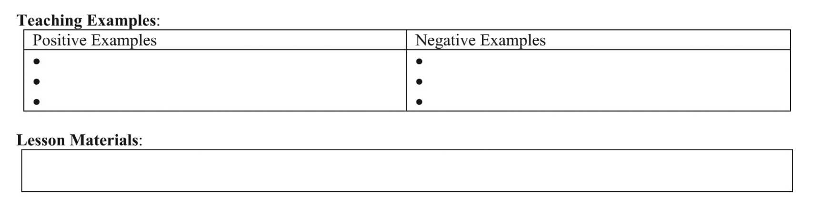
Simonsen, Myers, Everett, Sugai, Spencer, & LaBreck (2012)
Notes:
Explicitly teaching social skills school-wide: Using a matrix to guide instruction. Intervention in School and Clinic, 47, 259-266. doi: 10.1177/1053451211430121
The last authors were folks from the central MA cohort of PBIS schools we trained!!!!!

Slide 95
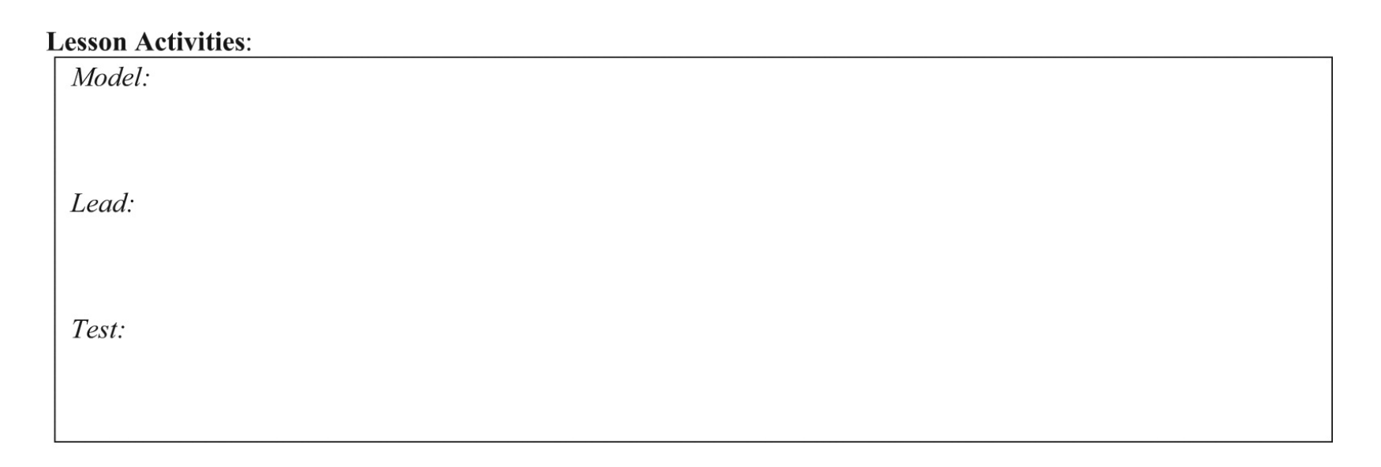
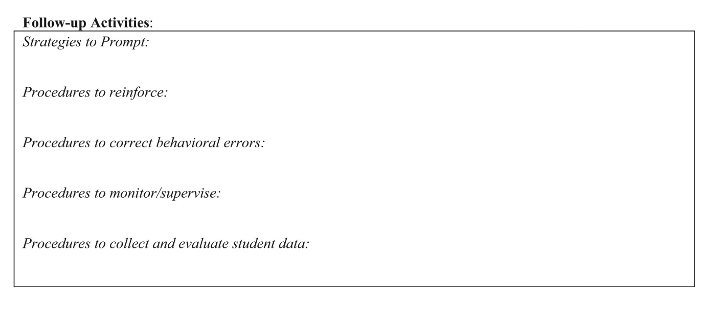

Slide 96
nepbis.org
For more examples drawn from schools across the state, check out the
Exemplar Repository
    Includes examples of teaching matrices, lesson plans, recognition systems, discipline flow charts, etc.

Slide 97
Guidelines for Teaching Expected Behaviors (Social Skills)
Consider main school settings/contexts
Consider lessons that already exist
Specificy 2-3 observable, positive examples for each expectation within each setting/context
Teach social behavior like academic skill
Provide prompts, reminders, or precorrections in natural context
Provide specific feedback in natural context
Develop a schedule for:
  introducing teaching plan to staff and getting feedback on lesson plans
  initial student instruction in natural/typical context
  regular review, practice, and follow-up
Develop procedures for identifying/supporting students whose behaviors do not respond to instruction

Slide 98
ACTIVITY: Teaching Expectations
Review guidelines for teaching expectations.
Draft components of a social skills lesson plan for one box on your matrix using provided template.
Add items to your Action Plan as necessary
Be ready to present 2-3 “big ideas” from your discussion.
15 minutes

Slide 99
WHOLE GROUP DEBRIEF: Teaching Expectations
Share 1-2 highlights from your team discussion.
What support will you need to complete this activity for the remainder of your schoolwide lessons?
5 minutes

Slide 100
Developing Procedures to Support Staff with Teaching Schoolwide Expectations

Slide 101

Supporting Staff to Teach and Reteach Schoolwide Expectations
Expectations Created
Teaching Matrix Developed
Lesson Plans Written and Shared

Slide 102
Now Apply PBIS' Critical Features!
All staff will teach the lessons developed by the PBIS Team within their appropriate setting (e.g. cafeteria monitors teach the cafeteria column, classroom teachers teach the hallway column, librarians teach the library column, etc.
100% of students will receive direct instruction in our School-wide Expectations at the start of the school year and be retaught the expectations after each break.

Slide 103
Develop SYSTEMS to support staff to teach the lessons
Be sure lesson plans are readily available
Develop a calendar of expected teaching windows (e.g. All staff are expected to reteach SW expectations on the day after holiday break)
Plan whole school SW expectations teaching events
Send weekly/monthly email prompts to staff

Slide 104
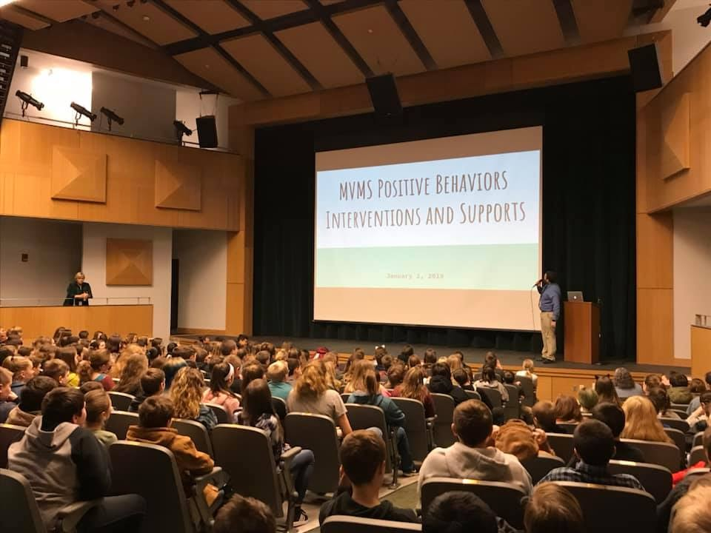
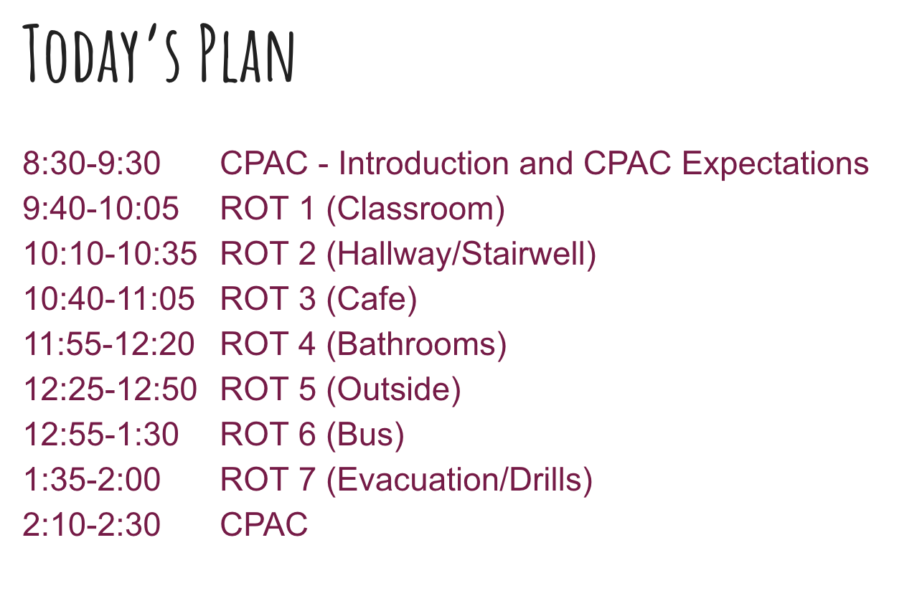
EXAMPLES
Student groups rotate through areas of the school to learn and practice expectations

Slide 105

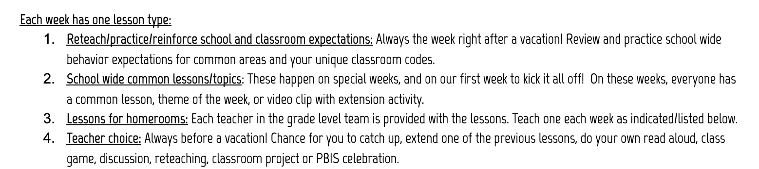
EXAMPLES
Guidance and schedule for teaching lessons throughout the year
Always the week right after a vacation!
Happen on special weeks &
first week of school!
Teach 1 each week as indicated below
Always before a vacation.
Chance to catch up!

Slide 106
How will you know if lessons are actually being taught?
Gather data!
Conduct a sample survey of staff and students
Do walkthroughs during expected teaching times
Monitor discipline referrals

Slide 107
ACTIVITY: Developing Procedures for Teaching Expectations
Identify procedures (systems) to support staff with teaching schoolwide expectations.
Identify the data you will gather to monitor progress.
Add items to your Action Plan as necessary
Be ready to present 2-3 “big ideas” from your discussion.
15 minutes

Slide 108
WHOLE GROUP DEBRIEF: Teaching Expectations
What examples can you share of procedures (systems) and/or data you will gather?
What support will you need to complete this activity?
5 minutes

Slide 109
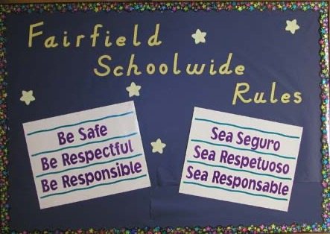

Identify Schoolwide Expectations

Slide 110
Develop Procedures to
Teach Schoolwide Expectations
Define
Teach
Prompt
Monitor
Evaluate

Slide 111
Lunch

Slide 112
Quick
Review

Slide 113
Culture and Context of the School Community

Slide 114
GETTING STARTED WITH PBIS
1
Establish an effective leadership team
6
Develop a continuum of responses to increase use of SEB skills
2
Develop a brief statement of purpose & define outcomes
7
Develop a continuum of responses to decrease SEB errors
3
Identify positive school-wide behavior expectations
8
Develop systems to support staff
4
Develop procedures to teach school-wide expectations
9
Use data for decision-making
5
Develop procedures to teach class-wide expectations
10
Promote sustainability

Slide 115

3
Identify positive school-wide behavior expectations
Practices
Notes:
Your team will work with your school community to uncover what you value and use those values to identify your schoolwide expectations

Slide 116
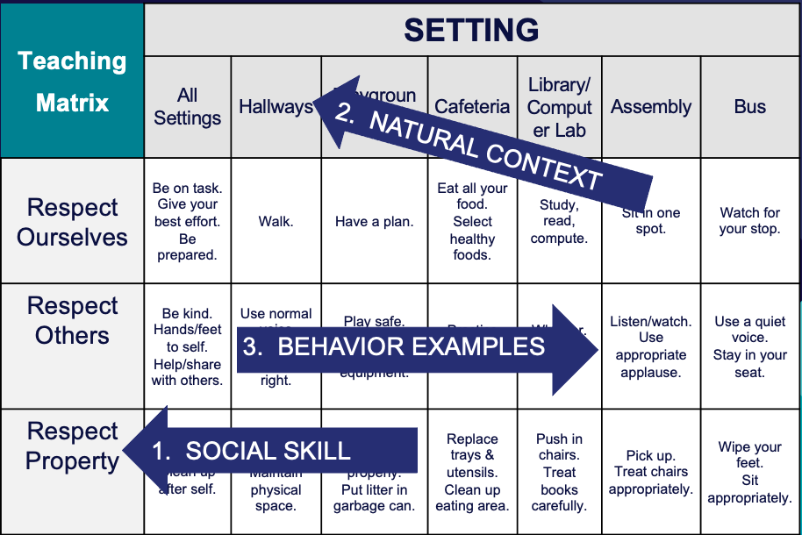
4
Develop procedures to teach school-wide expectations
Practices
Define
Teach
Prompt
Monitor
Evaluate
Notes:
Using those identified expectations, you’ll define what those expectations look and sound like in key routines/settings throughout your school. This is organized through a behavioral matrix. Using the schoolwide matrix, your team will develop lessons that will be explicitly taught to students at the beginning of the year (and boosted throughout the year) so that they know how to be successful within each context (like the hallway, cafeteria, assemblies, etc.)

Slide 117
Using the TFI to
Self-Assess and
Action Plan
Data
Complete TFI as a self-assessment
Use TFI data to support action planning to achieve identified outcomes

Slide 118

The purpose of the SWPBIS Tiered Fidelity Inventory (TFI) is to provide a valid, reliable, and efficient measure of the extent to which school personnel are applying the core features of school-wide positive behavioral interventions and supports.
Only Tier 1 will be required for this training.
Your team can choose to complete the additional tiers.
Tier 1 Subscales:
Teams
Implementation
Evaluation
Tier 2 Subscales:
Teams
Interventions
Evaluation
Tier 3 Subscales:
Teams
Resources
Support Plans
Evaluation

Slide 119
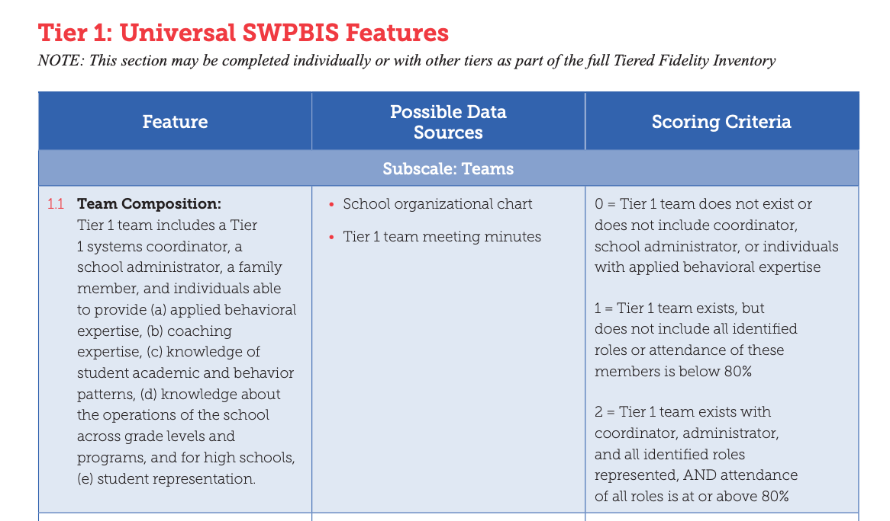
0
1
2
Notes:
Link to TFI: https://www.pbisapps.org/resource/tfi

Slide 120
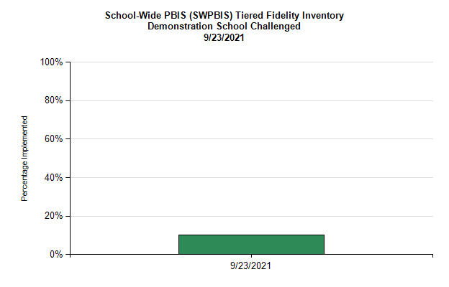
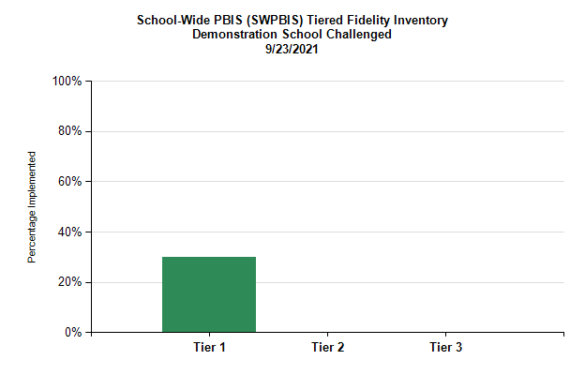
Total at each tier
Total across all 3 tiers

Slide 121

Subscales for each tier

Slide 122



Individual items

Slide 123
Select action steps based upon data from the TFI AND
your identified outcomes!
behavior incidents will decrease by __% relative to the same period as the prior year.
incidents of exclusionary discipline (suspension/expulsion) will decrease by __ % relative to the same period as the prior year

Slide 124
behavior incidents will decrease by __% relative to the same period as the prior year.
incidents of exclusionary discipline (suspension/expulsion) will decrease by __ % relative to the same period as the prior year
Implementing these features can support us to achieve our identified outcomes.
What do we need to do?
How? Who? By when?
1
4. Teaching Expectations
5. Problem Behavior Definitions
1
6. Discipline Policies
1
7. Professional Development
0

Slide 125
ACTIVITY: Using the TFI to Self-Assess and Action Plan
Coaches:
Go to www.pbisapps.org
Click on PBIS Assessment in the black navigation bar
Locate the TFI on your dashboard
Click on Take Survey
As a team:
Complete the Tier 1 section of the survey
Consider the following recommendations:
  When in doubt, score lower rather than higher
  If unable to come to consensus, vote and move on
  Unless you have walkthrough/survey data, the maximum score on items requiring data (1.3, 1.4 and 1.9) is 1
Add items to your action plan as needed
This is a baseline self-assessment and will be completed throughout implementation to promote fidelity and action planning
30 minutes
Notes:
TFI: www. pbisapps.org

Slide 126
WHOLE GROUP DEBRIEF:
Using the TFI to Self-Assess and Action Plan
What did your team learn as a result of completing this self-assessment?
How will this data support your action planning and achieving your outcomes?
5 minutes

Slide 127
Team
Action Planning Time

Slide 128
Use this time to continue working on...
DAY 1
Step 3: Identifying Positive SW Expectations
Step 4: Developing Procedures for Teaching SW Expectations
Using the TFI to Self-Assess and Action Plan
Overview of PBIS
Step 1: Effective Teaming
Step 2: Purpose & Outcomes
TODAY
Describe why PBIS is important for your school and what it is
Identify schoolwide expectations
Consider ways to gather input
Establish a representative team
Establish effective team procedures and agreements
Begin committee alignment
135 mins
Begin to develop:
teaching matrix
lesson plan example
system for lesson plan delivery
Identify purpose for implementation and define a clear outcome statement
Complete TFI as a self-assessment
Use TFI data to support action planning to achieve identified outcomes

Slide 129
WHOLE GROUP DEBRIEF: Action Planning
Step 3: Identifying Positive SW Expectations
Step 4: Developing Procedures for Teaching SW Expectations
Using the TFI to Self-Assess and Action Plan
Share one or more team accomplishments from today.
What further support will you need to complete these action steps?
Identify schoolwide expectations
Consider ways to gather input
Begin to develop:
teaching matrix
lesson plan example
system for lesson plan delivery
Complete TFI as a self-assessment
Use TFI data to support action planning to achieve identified outcomes
5 minutes

Slide 130
Review
of PBIS
and
Getting Started Steps #1- 4

Slide 131
Continuum of School-Wide Instructional
& Positive Behavior Support
What do we do for the FEW needing intensive support?
Tertiary Prevention:
Specialized
Individualized
Systems for Students with High-Risk Behavior
What do we do for ALL?
Primary Prevention:
School-/Classroom-
Wide Systems for
All Students,
Staff, & Settings
~5%
~15%
What do we do for the SOME needing more support?
Secondary Prevention:
Specialized Group
Systems for Students with
At-Risk Behavior
~80% of Students

Slide 132
Critical Features
Systems
Practices
Data
Equity
Outcomes

Slide 133
Culture and Context of the School Community

Slide 134
GETTING STARTED WITH PBIS
1
Establish an effective leadership team
6
Develop a continuum of responses to increase use of SEB skills
2
Develop a brief statement of purpose & define outcomes
7
Develop a continuum of responses to decrease SEB errors
3
Identify positive school-wide behavior expectations
8
Develop systems to support staff
4
Develop procedures to teach school-wide expectations
9
Use data for decision-making
5
Develop procedures to teach class-wide expectations
10
Promote sustainability

Slide 135
1
Establish an effective leadership team
Systems
Supports Relevance & Equity
Improves student outcomes
Promotes Engagement
Notes:
Your first step is to create a representative team to lead your school’s PBIS efforts.

Slide 136
2
Develop a brief statement of purpose & define outcomes
Practices
What do we hope to achieve by implementing PBIS?
"Our mission is to provide a positive, safe, healthy, nurturing and respectful environment in which all students have the opportunity to become productive members of society."
Purpose
“As a result of implementing PBIS during the 20XX-20XY school year, student reports of school climate will improve by 20%.”
Outcome
Notes:
You’ll then focus your school’s PBIS efforts by creating a statement of purpose to identify your hopes and goals for PBIS implementation.

Slide 137
3
Identify positive school-wide behavior expectations
Practices
Notes:
Your team will work with your school community to uncover what you value and use those values to identify your schoolwide expectations

Slide 138
4
Develop procedures to teach school-wide expectations
Practices
Define
Teach
Prompt
Monitor
Evaluate
Notes:
Using those identified expectations, you’ll define what those expectations look and sound like in key routines/settings throughout your school. This is organized through a behavioral matrix. Using the schoolwide matrix, your team will develop lessons that will be explicitly taught to students at the beginning of the year (and boosted throughout the year) so that they know how to be successful within each context (like the hallway, cafeteria, assemblies, etc.)

Slide 139
Preview of
Days 3 & 4
(Getting Started Steps # 5 - 7)

Slide 140
YEAR 1: Getting Started with PBIS
DAY 1
Step 1: Establish an effective leadership team
DAY 2
Step 2: Develop a brief statement of purpose & define outcomes
Step 3: Identify positive school-wide behavior expectations
Step 4: Develop procedures to teach school-wide expectations
DAY 3
Step 5: Develop procedures to teach class-wide expectations
Step 6: Develop a continuum of responses to increase use of SEB skills
DAY 4
Step 7: Develop a continuum or responses to decrease SEB errors
DAY 5
Step 8: Develop systems to support staff
DAY 6
Step 9: Use data for decision-making
Step 10: Promote sustainability

Slide 141
GETTING STARTED WITH PBIS
1
Establish an effective leadership team
6
Develop a continuum of responses to increase use of SEB skills
2
Develop a brief statement of purpose & define outcomes
7
Develop a continuum of responses to decrease SEB errors
3
Identify positive school-wide behavior expectations
8
Develop systems to support staff
4
Develop procedures to teach school-wide expectations
9
Use data for decision-making
5
Develop procedures to teach class-wide expectations
10
Promote sustainability

Slide 142


5
Develop procedures to teach class-wide expectations
Practices
Notes:
Once the schoolwide expectations have been determined, classroom educators will apply the behavior matrix format to the routines and settings within their classrooms. They will also explicitly teach the expectations to their students throughout the year.s

Slide 143




6
Develop a continuum of responses to increase use of SEB skills
Practices
Notes:
To encourage contextually appropriate behaviors to occur, you'll support educators to provide frequent specific feedback and praise. To promote this critical practice, you’ll develop recognition/acknowledgement systems for both students and staff.

Slide 144

7
Develop a continuum of responses to decrease SEB errors
Practices
Notes:
You will also clarify how staff should respond when contextually inappropriate behaviors occur by clearly defining, determining who’s responsible for responding, identifying clear responses, and recording the behaviors.

Slide 145
Goals Between Now and Then...
DAY 1
Step 3: Identifying Positive SW Expectations
Step 4: Developing Procedures for Teaching SW Expectations
Using the TFI to Self-Assess and Action Plan
Overview of PBIS
Step 1: Effective Teaming
Step 2: Purpose & Outcomes
TODAY
Describe why PBIS is important for your school and what it is
Identify schoolwide expectations
Consider ways to gather input
Establish a representative team
Establish effective team procedures and agreements
Begin committee alignment
Begin to develop:
teaching matrix
lesson plan example
system for lesson plan delivery
Identify purpose for implementation and define a clear outcome statement
Complete TFI as a self-assessment
Use TFI data to support action planning to achieve identified outcomes

