Slide 1

TRAINER INFORMATION
This free and accessible training material is provided through the Northeast PBIS Network and can be found at https://nepbis.org/.
School teams are highly encouraged to contact a
PBIS State Coordinator or an NEPBIS Endorsed Trainer
for training opportunities.
If you are an experienced trainer and would like access to to our coordinating trainer workbook which offers training guidance, please email us at nepbis@uconn.edu.

Slide 2
TRAINER NOTES
This is Day 1 of an 11 day, 3 year training sequence.
Overview of PBIS
  Why PBIS
  What is PBIS?
  Critical Features
  Preview of Getting Started Steps
Step 1: Effective Teaming
  Team Composition
  Team Operating Procedures
  Action Planning (What and Why)
  Committee Alignment
Step 2: Purpose & Outcomes
  Why are we doing this?
  How will we get there?
CONTENT
At the end of day one, teams should understand:
Why PBIS is a beneficial organizational framework
The big idea of what PBIS is
The critical features of an effective leadership team
How to identify desired purpose and outcomes for the work ahead
Describe why PBIS is important for your school and what it is
Identify the outcome data you will gather and monitor
Establish a representative team
Establish effective team procedures and agreements
Begin committee alignment
Identify purpose for implementation and define clear outcome statements
For more information and guidance related to training this content please see the NEPBIS trainers’ manual located here: https://nepbis.org/training-of-trainers-workbook-supplemental-materials/

Slide 3
SAMPLE AGENDA
8:30 | Introduction | 15 mins
8:45 | Why PBIS? | 45 mins
9:30 | Break | 15 mins
9:45 | What is PBIS? | 75 mins
11:00 | Preview of 10 Getting Started Steps | 15 mins
11:15 | Step 1: Effective Teaming Team Composition Team Operating Procedures and Agreements Action Planning Committee Alignment/Working Smarter | 60 mins
12:15 | Lunch | 30 mins
12:45 | Step 2: Purpose and Outcome Statements | 60 mins
1:45 | Team Time | 120 mins
3:45 | Wrap Up | 15 mins

Slide 4

NEPBIS
School-Wide
Team Training
Year 1
Day 1
INSERT TRAINER NAMES HERE
with support from
Karen Robbie, Jen Freeman,
Brandi Simonsen, Katie Meyer,
Adam Feinberg & Susannah Everett
Notes:
Trainers: refer to training manual for:
Tips on presenting the overview content
Explanation for short activity periods and ideas for teaching this to teams
Ideas for facilitating review and team action planning

Slide 5
POSITIVE BEHAVIOR INTERVENTIONS & SUPPORTS
(PBIS)

Slide 6

WHO'S HERE?
Who's here?
LIST SCHOOLS IN COHORT HERE
(List the schools in your cohort here)
Notes:
TRAINER NOTE: Give teams several minutes each to introduce themselves and their school- including any previous experiences with PBIS.

Slide 7
NEPBIS SCHOOL-WIDE TRAINING MODEL
Year 1
Exploration and Installation of 10 Getting Started Steps
Year 2
Initial Implementation of 10 Getting Started Steps
Year 3+
Full Implementation and Continuous Improvement of Implementation
6 days of team training + 3 days of coach training
3 days of team training + 3 days of coach meeting
On-going Professional Development and Support
(minimum of 2 days of team training + 2 days of coach training annually)

Slide 8
TRAINING SCHEDULE
TRAINERS:
USE THIS SLIDE TO INSERT YOUR TRAINING SCHEDULE FOR THE CURRENT YEAR

Slide 9
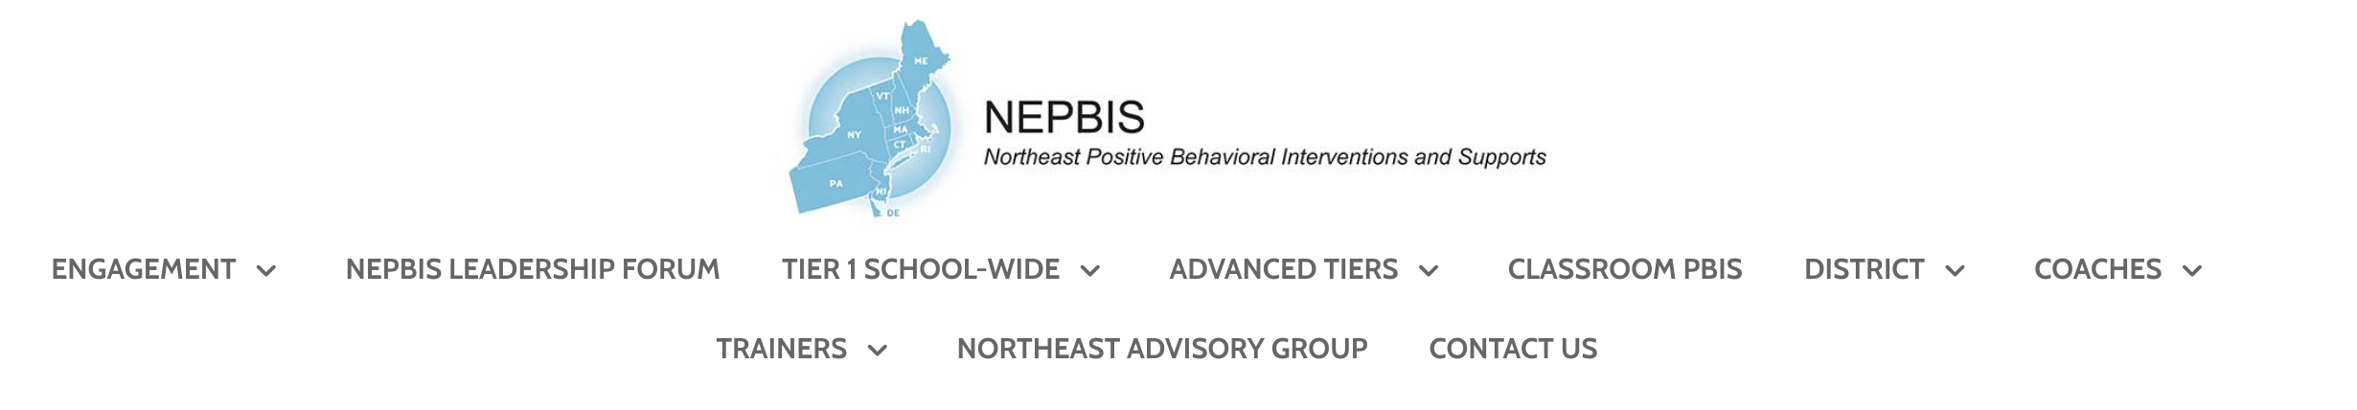


nepbis.org
TOOLS
Tier 1 Schoolwide
Tier 1 Team Training Materials
Tier 1 Supplemental Resources
School Team Implementation Guide
responses for activities
document plans
develop artifacts
Slides for each training day
Notes:
TRAINERS: Go directly to https://nepbis.org/ and demonstrate how to access relevant materials.

Slide 10


WEBSITES
pbisapps.org
pbis.org

Slide 11






LEGEND
ORGANIZATION
ACTIVITY
NEW
CONTENT
PREVIEW
REVIEW

Slide 12






LEGEND
Timing
Example
Activity
Non-example
Guidelines
Preview
Big Idea
Review
Organization

Slide 13
EXPECTATIONS
 | Individually | Working with Others
Respect Self | Participate Converse with others in lobbies and during breaks Stretch, break, stand as needed | Engage with the training content and activities
Respect Others | Complete assigned tasks Return from breaks on time | Provide room for every voice Reinforce participation
Respect Environment | Keep devices silent Have your computer charged and ready Keep necessary materials at hand | Maintain a neat, orderly work space

Slide 14
AGENDA AND ACTION STEPS
Describe why PBIS is important for your school and what it is
Identify the outcome data you will gather and monitor
Overview of PBIS
  Why PBIS
  What is PBIS?
  Critical Features
  Preview of Getting Started Steps
Step 1: Effective Teaming
  Team Composition
  Team Operating Procedures
  Action Planning (What and Why)
  Committee Alignment
Step 2: Purpose & Outcomes
  Why are we doing this?
  How will we get there?
Establish a representative team
Establish effective team procedures and agreements
Begin committee alignment
Identify purpose for implementation and define clear outcome statements

Slide 15
OVERVIEW OF PBIS
Why PBIS?
What is PBIS?
Preview of Getting Started Steps
Describe why PBIS is important for your school and what it is
Identify the outcome data you will gather and monitor

Slide 16
Why PBIS?

Slide 17
WHY PBIS?
“Getting tough” doesn’t work
Context matters
Schools asked to do more with less
PBIS works
Provides a framework to promote equity
PBIS supports mental health

Slide 18

Think about a student who has engaged in challenging behavior.
How did adults respond?

Slide 19
Immediate & seductive solution...“Get Tough!”
Some students’ behaviors improve (“respond”),
but other students’ behaviors continue…
Predictable, reactive response...
We experience aversive situation,
we intervene to get immediate relief
  Remove student
  Remove ourselves
  Modify physical environment
  Assign responsibility for change to student and/or others
Give initial “aversive” consequence
  Say “no”
  Remove privilege
  Send to “think seat”

Slide 20
Immediate & seductive solution...“Get Tough!”
Again, some students’ behaviors improve (“respond”),
Other students’ behaviors continue…
Give additional and more “aversive” consequences
Give initial “aversive” consequence
  Repeat “NO” louder
  Move closer and point
  Complete ODR
  Threaten and establish bottom line
  Send to in-school detention

Slide 21
Immediate & seductive solution...“Get Tough!”
Behavior escalates in intensity, frequency, and duration to levels that interfere with teaching and learning
Increase intensity, frequency, and duration of “aversive” consequences
Give additional and more “aversive” consequences
Give initial “aversive” consequence
  Zero tolerance policies
  Increased monitoring and security
  Physically assist or intervene
  Give out of school suspension

Slide 22
False sense of
safety and security!
Fosters environments of control
Triggers & reinforces antisocial behavior
Shifts accountability away from school
Devalues child-adult relationship
Weakens relationship between academic & social behavior programming
Increase intensity, frequency, and duration of “aversive” consequences
Give additional and more “aversive” consequences
Give initial “aversive” consequence

Slide 23
Science of Behavior has Taught Us, Students...
Erroneous Assumptions...
student is inherently "bad" and must prove they deserve to be part of class
aversive consequences teach
some kids improve (even temporarily), so all will
are NOT born with “bad behaviors”
do NOT learn when presented contingent aversive consequences
do learn better ways of behaving by being taught directly & receiving positive feedback
The power of PBIS is not in the rewards,
it is in the teaching!

Slide 24
WHY PBIS?
“Getting tough” doesn’t work
Context matters
Schools asked to do more with less
PBIS works
Provides a framework to promote equity
PBIS supports mental health

Slide 25
Consider Kennedy and Kennedy's Teacher...
Kennedy frequently displays a number of oppositional behaviors
Kennedy's contextually inappropriate behavior increases when usual routines unexpectedly change
(assemblies, fire drills, etc.)
Kennedy's teacher is unable to convince Kennedy to return to class
  refuses to remain in seat when asked
  walks out of classroom without permission
  talks during independent seatwork
  walks out of class
  yells
  swears at peers
  How would you support Kennedy if Kennedy was your only student?
  What barriers prevent you from doing that?
  What support would you need?

Slide 26
Fortunately, we have science that guides us to…
All in ways that match the culture & context of the school and community!
Assess these situations
Develop behavior intervention plans based on our assessment
Monitor student progress & make enhancements
(Crone & Horner, 2003)

Slide 27

Consider Central School...
880 students
nearly 2/3 of all students have received at least one referral
over 5,100 referrals in one academic year
each referral requires
~15 minutes of administrator time

Slide 28
Consider Central School...
5,100 referrals
76,500 minutes
1,275 hours
159 days!
15 minutes each
Kennedy and Kennedy's teacher
are in this school!

Slide 29
PBIS Message!
Successful individual student behavior support is linked to host environments or school climates that are effective, efficient, relevant, & durable.
(Zins & Ponti, 1990)

Slide 30
WHY PBIS?
“Getting tough” doesn’t work
Context matters
Schools asked to do more with less
PBIS works
Provides a framework to promote equity
PBIS supports mental health

Slide 31

Competing Goals with Limited Time
Teach standards
Improve academic skills
Eliminate bullying
Prevent drug use
Support social-emotional learning
Promote college & career readiness
Reduce at-risk, antisocial behavior
Create positive learning environment
…and more

Slide 32





PBIS provides an evidence-based framework for addressing ongoing needs
Returning to School During and After Crisis
Improving Attendance and Chronic Absenteeism
Supporting College and Career Readiness
Discussing Race, Racism and Important Current Events
Building a Culture of
Staff Wellness

Slide 33
WHY PBIS?
“Getting tough” doesn’t work
Context matters
Schools asked to do more with less
PBIS works
Provides a framework to promote equity
PBIS supports mental health

Slide 34

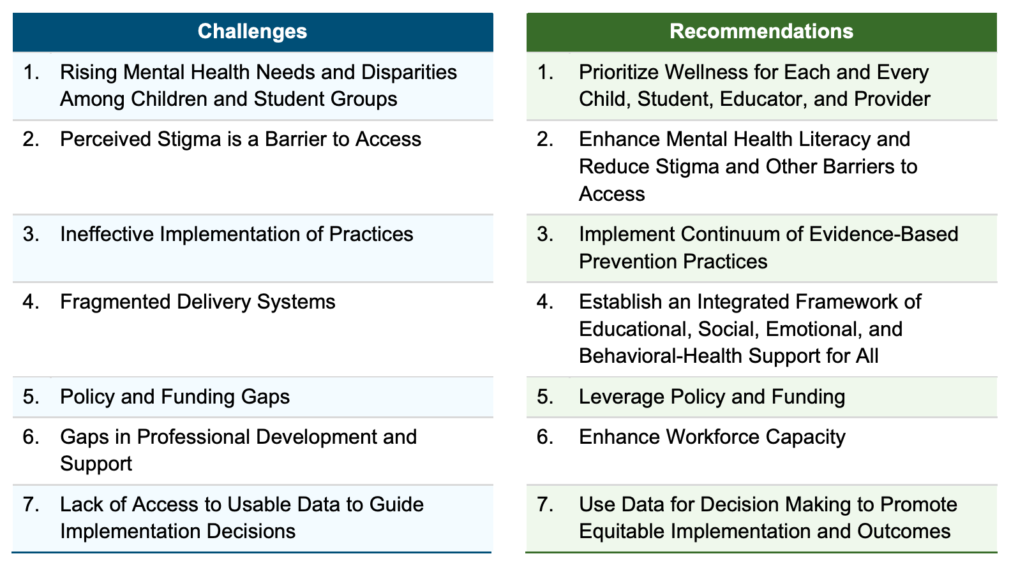
We need to start with designing a positive school environment
where the majority of social-emotional-behavioral needs are met.
Notes:
US DOE Guidance : https://www2.ed.gov/documents/students/supporting-child-student-social-emotional-behavioral-mental-health.pdf
TRAINER NOTE: Please highlight this resource from US DOE and point out how the recommendations (specifically 1,3,4,6 & 7) align with the PBIS framework they are beginning to implement

Slide 35

PBIS is a Mental Health Initiative
"Mental health includes our emotional, psychological, and social well-being.
It affects how we think, feel, and act.
It also helps determine how we handle stress, relate to others, and make healthy choices.
Mental health is important at every stage of life, from childhood and adolescence through adulthood."

Slide 36



In other words, mental health is….
How we connect
Social
How we feel
Emotional
How we act
Behavioral
SEB described by Dr. Sandy Chafouleas
https://www.psychologytoday.com/us/blog/promoting-student-well-being/202008/4-questions-ask-now-in-preparing-your-child-school
Notes:
Chafouleas, S. (August 2020). Four questions to ask now in preparing your child for school. Psychology Today. https://www.psychologytoday.com/us/blog/promoting-student-well-being/202008/4-questions-ask-now-in-preparing-your-child-school

Slide 37
WHY PBIS?
“Getting tough” doesn’t work
Context matters
Schools asked to do more with less
PBIS works
Provides a framework to promote equity
PBIS supports mental health

Slide 38
What is EQUITY in Education?
Educational policies, practices, interactions, and resources are
representative of
Each individual
has access to
High-quality learning experiences that
empower them towards self-determination
constructed by
responsive
to
can meaningfully participate in
make progress within
reduce disparities in outcomes
Regardless of individual characteristics and cultural identities
ALL
ALL includes each
and every individual
irrespective of:
race/ethnicity
class
gender
sexual orientation
country of origin
dis/ability
cultural
political
religious
or other group affiliations
(Fraser, 2008; Great Lakes Equity Center, 2012)
Retrieved from www.pbis.org.

Slide 39

PBIS centers equity in all decisions...
Throughout your training and implementation,
  Access
  Representation
  Meaningful Participation
  Positive Outcomes
will be highlighted as well as the systems needed to promote and sustain equity for each and every individual.
Notes:
https://www.pbis.org/topics/equity

Slide 40
Significant Predictors of Equitable Outcomes
Data-based decision making
Classroom PBIS Systems
Formal reward systems
Tobin & Vincent (2011)
Tobin & Vincent (2011)
Barclay (2017),
Tobin & Vincent (2011)

Slide 41
WHY PBIS?
“Getting tough” doesn’t work
Context matters
Schools asked to do more with less
PBIS works
Provides a framework to promote equity
PBIS supports mental health

Slide 42
Decades of evidence shows PBIS leads to a positive outcomes when implemented with fidelity...
Improved Student Outcomes
academic performance^{6,8,13}
decreased rates of student-reported drug and alcohol abuse^{1,5}
Reduced Exclusionary Discipline
Improved Teacher Outcomes
school organizational health and school climate ^{2,3}
social-emotional competence^{5,8,13}
reduced bullying behavior ^{11, 14}
perception of teacher efficacy^{7,11}
perception of school safety⁶
office discipline referrals^{4,5,6}
suspensions⁴
restraint and seclusion^{9,12}
¹Bastable, Kittelman, McIntosh, & Hoselton, 2015  ²Bradshaw, Koth, Bevans, Ialongo, & Leaf, 2008  ³Bradshaw, Koth, Thornton, & Leaf, 2009  ⁴Bradshaw, Mitchell, & Leaf, 2010  ⁵Bradshaw, Waasdorp, & Leaf, 2012  ⁶Horner et al., 2009  ⁷Kelm & McIntosh, 2012  ⁸Lewis, 2017  ⁹Reynolds et al., 2016  ¹⁰Ross & Horner, 2009  ¹¹Ross, Romer, & Horner, 2012  ¹²Simonsen, Britton, & Young, 2010  ¹³Tobin, Horner, Vincent, & Swain-Bradway, 2012  ¹⁴Waasdorp, Bradshaw, & Leaf, 2012
Notes:
¹Bastable, Kittelman, McIntosh, & Hoselton, 2015  ²Bradshaw, Koth, Bevans, Ialongo, & Leaf, 2008  ³Bradshaw, Koth, Thornton, & Leaf, 2009  ⁴Bradshaw, Mitchell, & Leaf, 2010  ⁵Bradshaw, Waasdorp, & Leaf, 2012  ⁶Horner et al., 2009  ⁷Kelm & McIntosh, 2012  ⁸Lewis, 2017  ⁹Reynolds et al., 2016  ¹⁰Ross & Horner, 2009  ¹¹Ross, Romer, & Horner, 2012  ¹²Simonsen, Britton, & Young, 2010  ¹³Tobin, Horner, Vincent, & Swain-Bradway, 2012  ¹⁴Waasdorp, Bradshaw, & Leaf, 2012

Slide 43
TEAM DISCUSSION: Why PBIS at your school?
"Which of these reasons do you think will resonate or be most meaningful in your school?"
Discuss as a team.
Be prepared to share big ideas from your discussion.
“Getting tough” doesn’t work
Context matters
Schools asked to do more with less
PBIS works
Provides a framework to promote equity
PBIS supports mental health
5 minutes

Slide 44
Whole Group Debrief: Why PBIS?
“Getting tough” doesn’t work
Context matters
Schools asked to do more with less
PBIS works
Provides a framework to promote equity
PBIS supports mental health
Which messages did you identify as being most important to your school? Why?
Which messages do you need more support to articulate?
5 minutes

Slide 45
Break

Slide 46
What is PBIS?

Slide 47
PBIS is...
Framework for enhancing adoption & implementation of
Continuum of evidence-based interventions to achieve
Academically & behaviorally important outcomes for
All students

Slide 48
PBIS provides the organizational (framework) needed to...
Support social-emotional-behavioral (SEB) needs
Integrate academic and behavior initiatives
Decrease reactive management
Maximize academic achievement
Improve classroom & school climate

Slide 49
Conceptual Foundations of PBIS
ABA
PBS
PBIS
Behaviorism
Behavior is learned, lawful, and malleable
Apply to socially important problems in applied settings
Consider larger context of improving quality of life
Apply to school settings

Slide 50
Elements of Effective Organizations
POSITIVE SCHOOL-WIDE CLIMATE
FOR ALL
(Students, Family, School, Community)
Quality Leadership
Common Language
Common Experience
Common Vision/Values

Slide 51
Critical Features of PBIS

Slide 52
Critical Features of PBIS
Systems
Practices
Data
Equity
Outcomes

Slide 53
Prioritize equity. MTSS is for all students, families, and educators. Use the MTSS framework to differentiate supports for students and monitor to ensure equitable outcomes are observed.
Equity

Slide 54
Support Educators
through Equity-focused PD
Systems
Practices
Data
Equity
Disaggregate
All Data by
Student Group
Adapt Practices
to Meet
Needs and Values
Outcomes
High Expectations for Each Student

Slide 55
Equity
Make student growth and benefit central to all decisions. Student outcomes that reflect equitable learning opportunities must be the ultimate criteria for all decisions.
Outcomes

Slide 56
Outcomes are our GOALS for implementation
As a result of implementing PBIS during the
20XX-20XY school year, student reports of school climate will improve by 20%
Based on data
Locally important and meaningful
Applicable to all (culturally equitable)
  Students’ social competence and academic achievement
  Staff implementation of critical skills
Observable and measurable
Written as a goal
MORE TO COME!

Slide 57
Systems
Data
Data
Use data to inform decisions about which students, families, and educators need which supports, as well as whether supports should be continued, adjusted, or faded. Data should be used to ensure that all recipients experience benefit and that supports are implemented with fidelity.
Equity
Outcomes

Slide 58
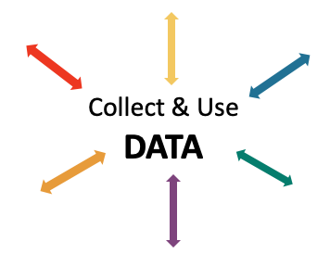
Data INFORMS and GUIDES your work
IDENTIFY PROBLEM
with precision
IDENTIFY GOAL
for change
IDENTIFY SOLUTION
and implementation plan
IMPLEMENT SOLUTION
with fidelity
MONITOR & EVALUATE
implementation fidelity and impact
MAKE DECISION
to maintain, modify, or terminate plan
(Chaparro, E., et. al, 2022)

Slide 59
Data used in PBIS implementation
Data
Fidelity Data
Did we implement the systems and practices we agreed upon?
Outcome Data
Is the plan resulting in progress towards our goals (student benefit)

Slide 60
SCHOOL EVALUATION PLAN
Measure | Year 1 Training |  | Year 2 Training |  |  | Year 3 Training
 | Winter | Spring | Fall | Winter | Spring | Fall | Winter | Spring
Tiered Fidelity Inventory (TFI) |  | X | X |  | X | X |  | X
School Climate Surveys | X | X | X |  | X | X |  | X
Schoolwide Behavior Data (e.g. SWIS) | Weekly | Weekly | Weekly | Weekly | Weekly | Weekly | Weekly | Weekly
Additional Student Outcome (e.g. Attendance) | Weekly | Weekly | Weekly | Weekly | Weekly | Weekly | Weekly | Weekly
Fidelity
Outcome
Notes:
Add one other piece (attendance)
Fidelity: TFI
Outcome: ODRs, School Climate, Attendance (something else)
Expand this section to include these things

Slide 61

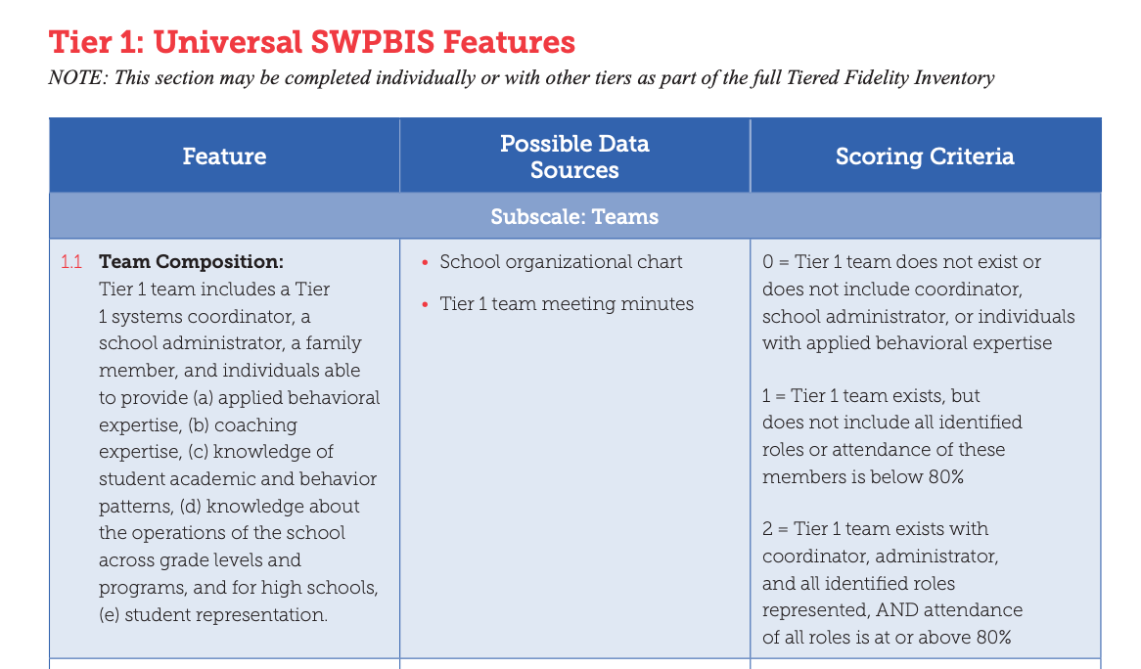
Tiered Fidelity Inventory (TFI)
Provides a valid, reliable, and efficient measure of the extent to which school personnel are applying the core features of school-wide positive behavioral interventions and supports.
Self-assessment completed on Day 2
Your trainer will visit your school between Days 4 & 5 to complete it with your team
Your district team will also complete the
District Systems Fidelity Inventory annually
Notes:
Link to TFI: https://www.pbisapps.org/resource/tfi

Slide 62

School Climate Survey
Assesses students’, staffs’, and families’ perspective of the overall climate in the building.
Students:
  Elementary: grades 3-5
  Middle/high: grades 6-12
    Brief or extended option
Staff
Family
Completed in
fall and spring
Notes:
https://www.pbis.org/resource/school-climate-survey-suite

Slide 63
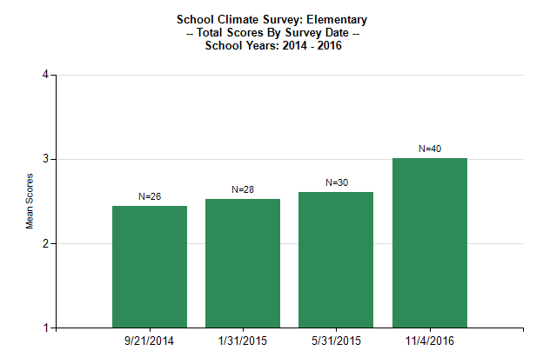
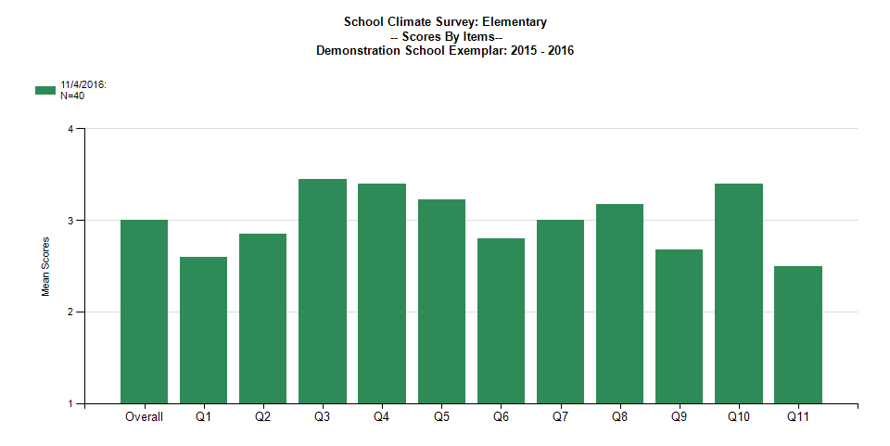
School Climate Survey Student Reports

Slide 64
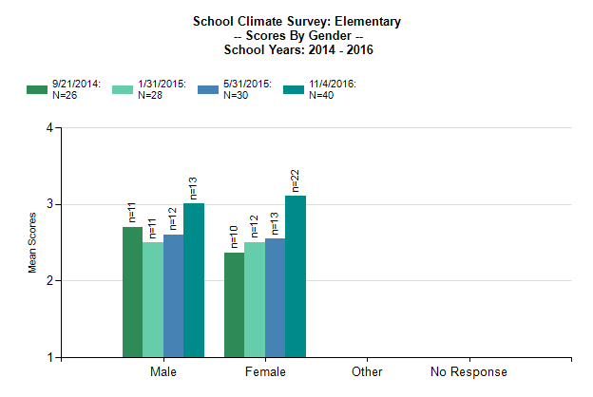
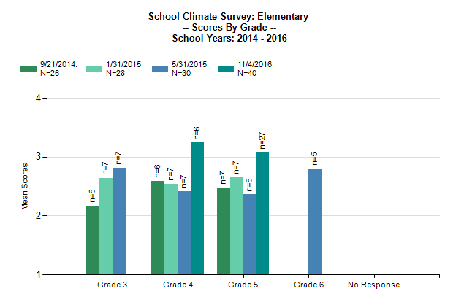
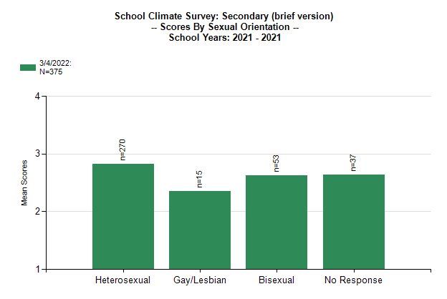
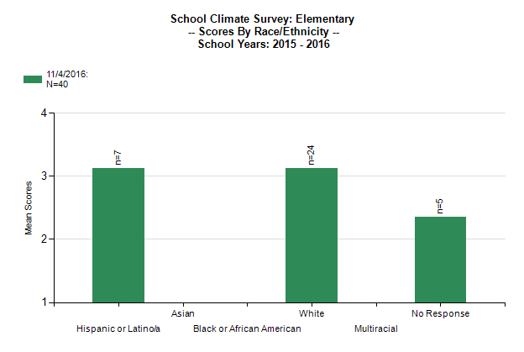
School Climate Survey Student Reports
Disaggregated by groups:
Gender Identity
Grade
Sexual Orientation (Middle/High Schools)
Race/Ethnicity
Provides total
climate score

Slide 65
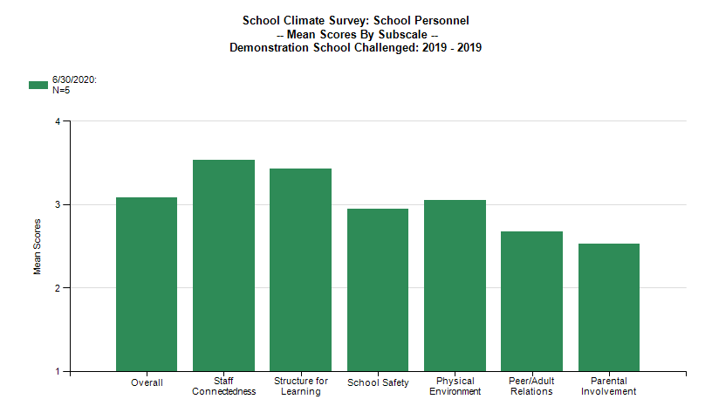
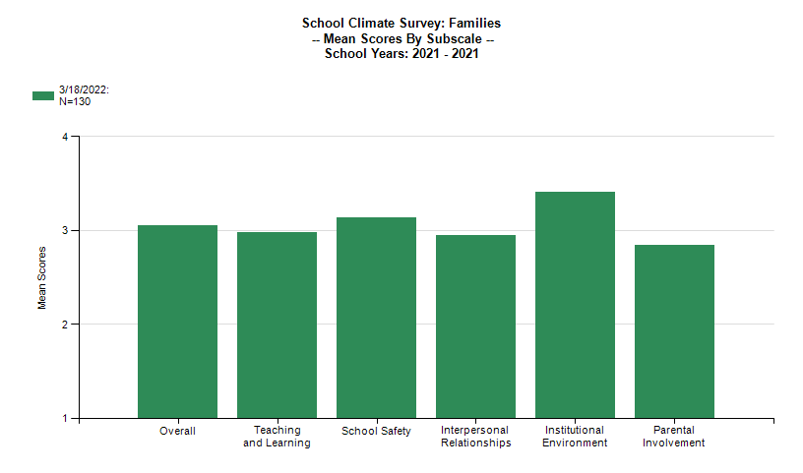
Staff and Family Reports

Slide 66

Gathering and analyzing schoolwide behavior data is a critical element of implementing PBIS with fidelity!
SWIS (Schoolwide Information System)
is set up to do so
efficiently and effectively with
easy to access, relevant graphs to support
data-based decision-making!

Slide 67
What is the School-Wide Information System (SWIS)?
The School-Wide Information System (SWIS) is a web-based decision system used to improve behavior support in schools and other educational facilities by providing school personnel with accurate, timely, and practical information for making decisions about school environments.

Slide 68
School-wide Behavior Data Requirements
Organized across the school by:
Behavior type
Frequency of events over time (per day per month)
Location
Time of day
Consequence
Individual student
Behavior Referral Information:
Student’s name
Date
Time of incident
Student’s grade level
Referring staff
Location of incident
Behavior
Perceived motivation
Others involved
Action taken
If your current data system does not do this or allow the team immediate access, talk to your trainer today about getting SWIS at your school!

Slide 69
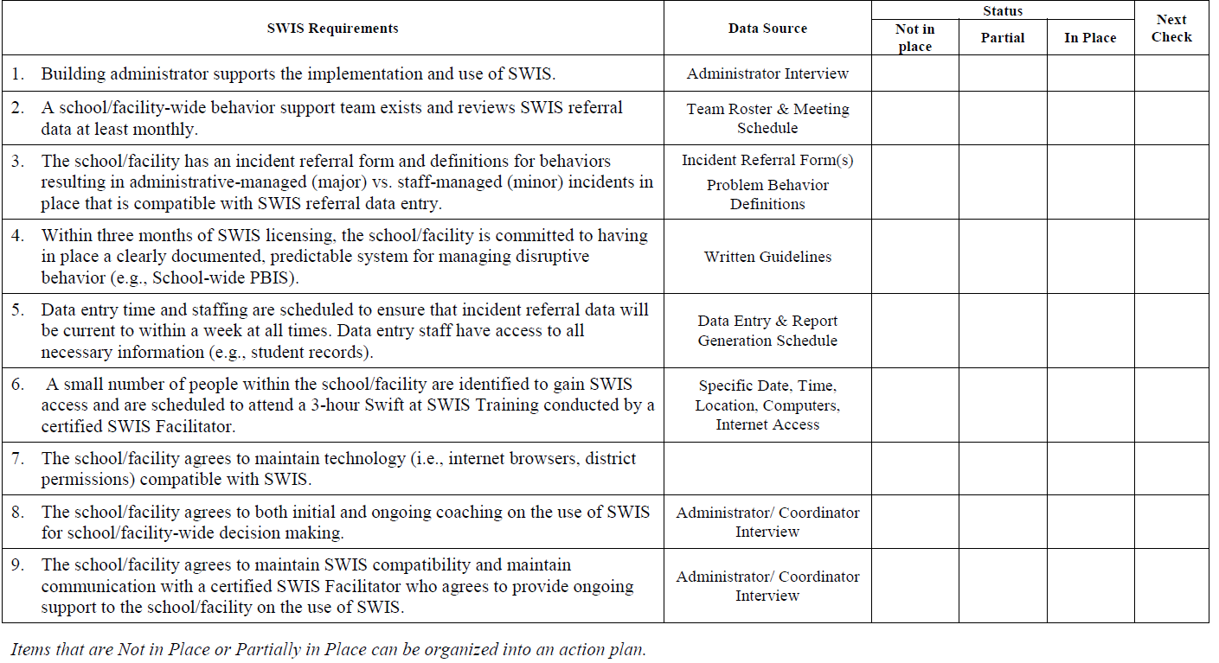
SWIS
Implementation Readiness
Requirements
Notes:
SWIS Readiness Checklist: https://www.pbisapps.org/resource/swis-readiness-checklist

Slide 70
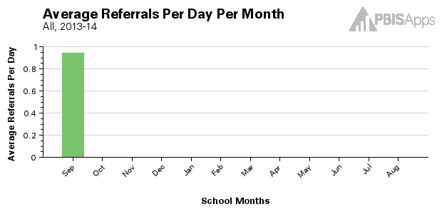
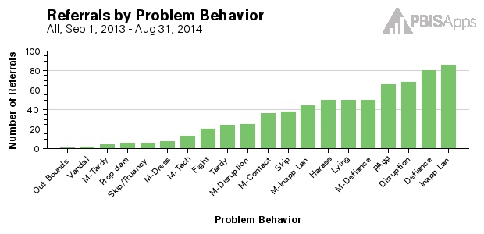
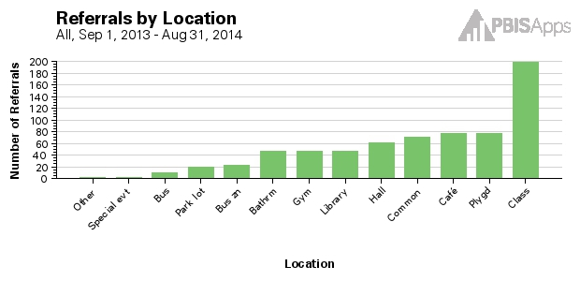
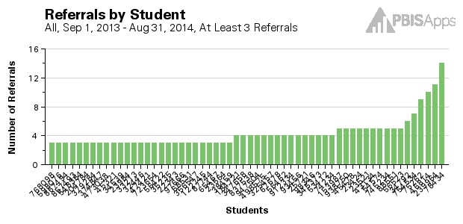
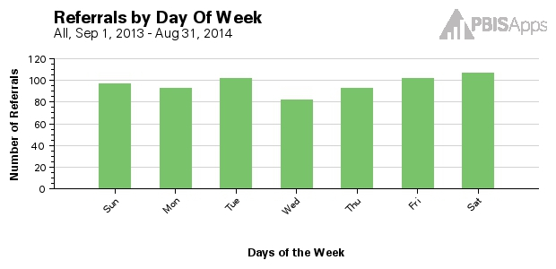
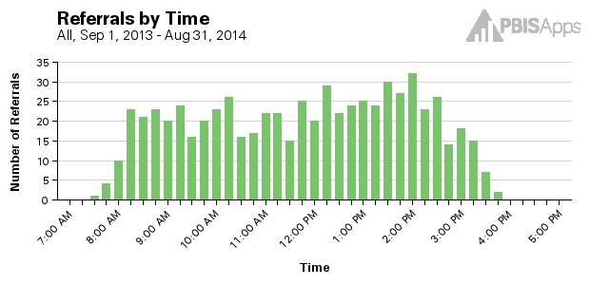
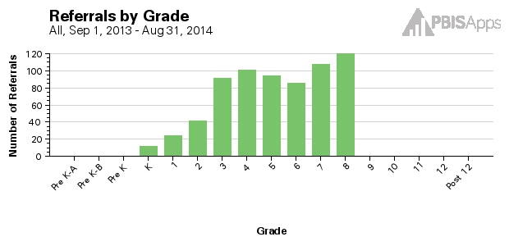
Core SWIS Reports
Average Referrals
Per Day Per Month
Referrals by Behavior
Referrals by Location
Referrals by Time of Day
Referrals by Student
Referrals by Day of Week
Referrals by Grade

Slide 71
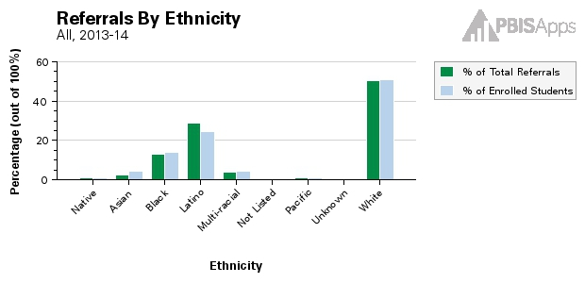
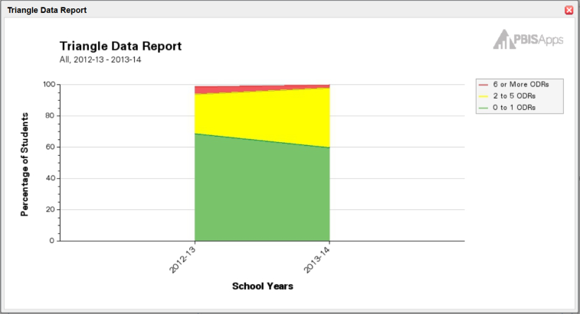
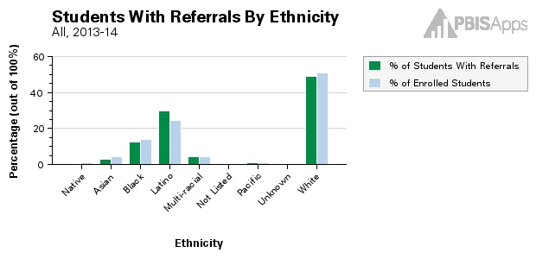
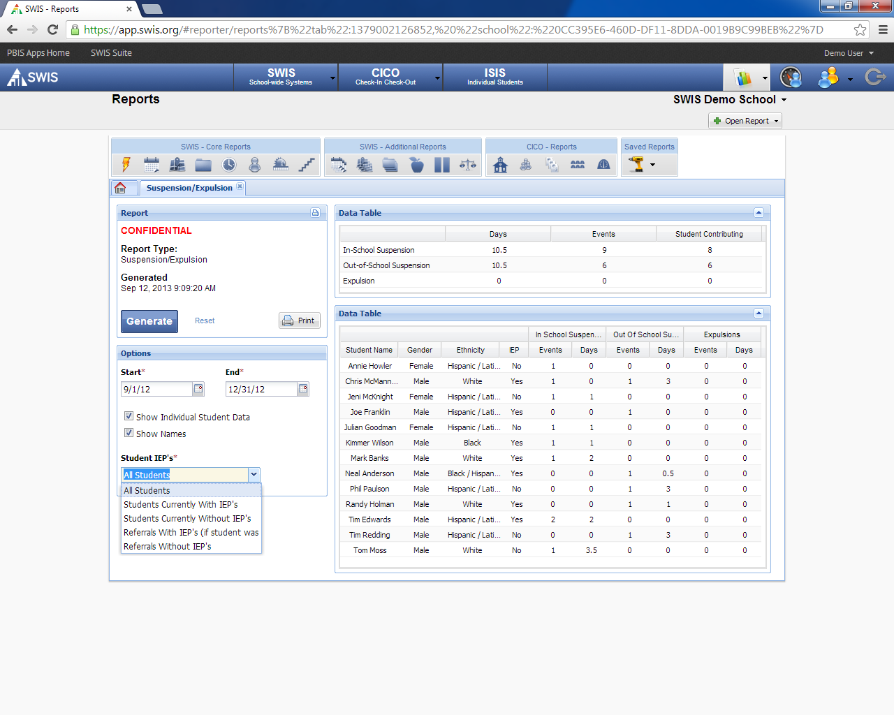
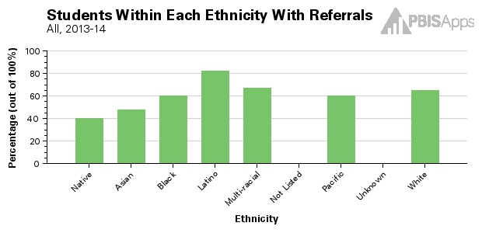
Additional SWIS Reports
Triangle Report
Disaggregated Reports by:
Ethnicity
Gender
IEP Status
Suspension/Expulsion

Slide 72
Additional sources of outcome data
Grades
Attendance
Rates of students referred for additional support and/or identified with disabilities
Academic performance
(e.g., scores on state and district-wide assessments)
Visits to the nurse/counselor
Your team will choose at least 1 to monitor throughout your PBIS training

Slide 73
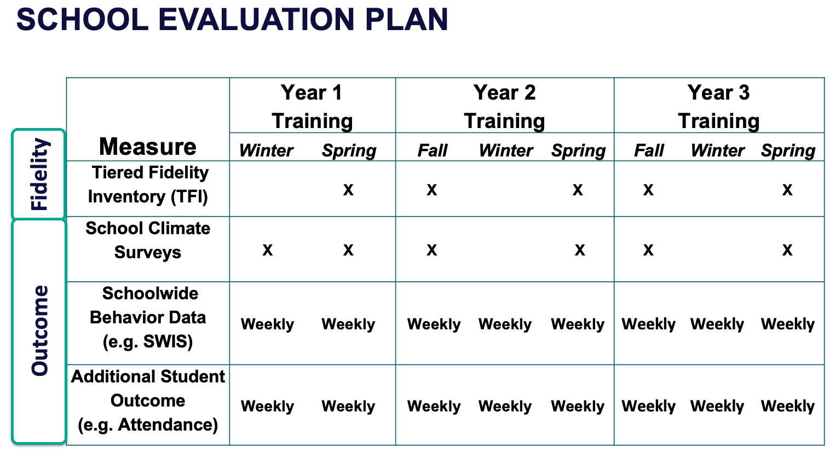
ACTIVITY: Outcome Data Collection
As a team identify:
School-wide Behavior Data (SWIS is highly recommended):
How will you gather and organize your school-wide behavior data?
If your existing system meets the defined needs, verify your team can get immediate access to graphs, etc.
School Climate Data:
When will you administer your school climate surveys to students, staff and families this fall?
Second Student Outcome Data:
What student outcome (besides behavior) will your team monitor?
How will you gather the data?
Be prepared to share out with the larger group.
10 minutes

Slide 74
WHOLE GROUP DEBRIEF:
Outcome Data Collection
What decisions have you made about collecting outcome data including behavior, student climate, and one other?
What further steps do you need to take to put your plan into action?
What additional support do you need?
5 minutes

Slide 75
Practices
Data
Prioritize the most efficient and effective practices. Do a few important and relevant practices well. Emphasize practices that are supported by evidence, match the local culture and current context, and promote high-quality implementation across time. Integrate, align, and connect practices.
Equity
Outcomes

Slide 76
Categories of PBIS Practices
Practices
Schoolwide
Classroom
Non-classroom
Student
Family
Smallest Number
Evidence-based
Biggest, Durable Effect

Slide 77
We use practices that are:
Evidence-based
Connected to the school climate and behavior priorities of the school
Informed by students, family, and staff input
Inclusive of language, images, messages, etc. across cultural groups and school contexts
Monitored continuously for implementation fidelity and student benefit
Focused on prevention and a continuum of timely support
Documented as effective and/or adaptable with varied contextual and cultural learning histories

Slide 78
Key School-wide Practices
Practices
Promotes CONSISTENT and EQUITABLE
vision, values, language and
experiences
which lead to a
POSITIVE and PREDICTABLE CLIMATE
Leadership team
Common purpose & approach to discipline
Clear set of positive expectations & behaviors
Procedures for teaching expected behavior school- and class-wide
Continuum of responses to increase use of SEB skills
Continuum of responses to decrease SEB errors
Procedures for on-going monitoring & evaluation
MORE TO COME!

Slide 79
What is the PBIS Continuum of Support

Slide 80
Continuum of School-Wide Instructional
& Positive Behavior Support
What do we do for the FEW needing intensive support?
Tertiary Prevention:
Specialized
Individualized
Systems for Students with High-Risk Behavior
What do we do for ALL?
Primary Prevention:
School-/Classroom-
Wide Systems for
All Students,
Staff, & Settings
~5%
~15%
What do we do for the SOME needing more support?
Secondary Prevention:
Specialized Group
Systems for Students with
At-Risk Behavior
~80% of Students

Slide 81
Provide a continuum of support for each and every individual
Intensive
Math
Science
Targeted
Tiers organize support and needs, NOT people!
Spanish
Social skills
Reading
Universal
Social Studies
Basketball

Slide 82
Integrated Continuum
Behavior Support Continuum
Academic
Support Continuum
Critical Features of MTSS
Continuum of evidence-based interventions
Focus on prevention and early intervention
Tiered continuum of supports with increasing intensity based on need
Universal screening for early intervention
Use of a problem solving model and data-based decision rules
Continuous progress monitoring
Focus on teaming
Emphasis on improving quality of implementation
Embedded into school improvement plan

Slide 83
Systems
Practices
Data
Continue to invest in systems to support high-fidelity implementation over time. Leverage existing leadership teams to guide planning and implementation, and consider effective means to support educators’ professional learning and wellness given current resources, experience, and expertise.
Equity
Outcomes

Slide 84
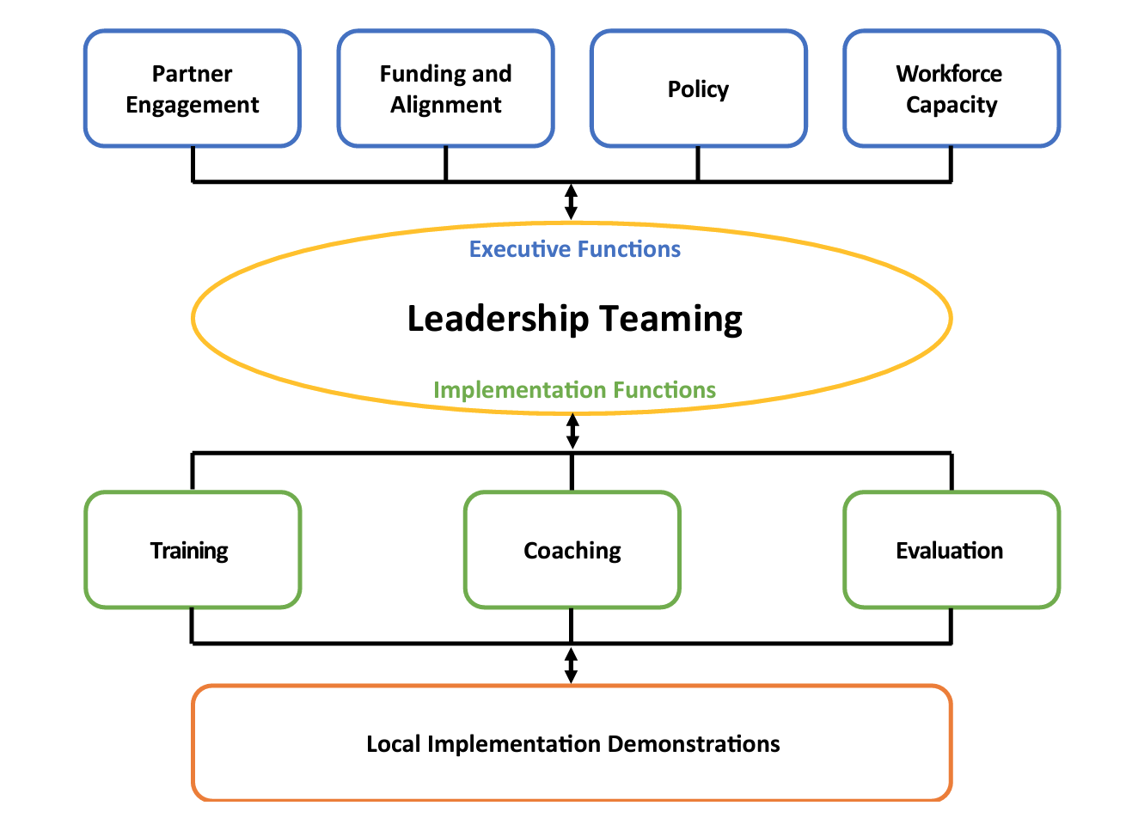
PBIS Systems Implementation Logic

Slide 85
Basic PBIS Implementation
District Team
PBIS practices, data, systems
School Team
2 yr. action plan
School Staff
PBIS
CWPBIS
Data plan
Small group
Individual student
Leadership
Student Benefit
Academic
Social skills
Self-management
Expectations & routines
Policy, funding, leadership, priority, agreement
Team meeting schedule
Regional/State Leadership
Internal Coaching Support
External Coaching Support
Team Support

Slide 86
Systems SUPPORT implementation to occur with fidelity
Promoting and Sustaining Staff Engagement
Continuous Action Planning
Team-Based Implementation
Embedded and Ongoing Professional Development
Staff Recognition
Data Routines
MORE TO COME!

Slide 87
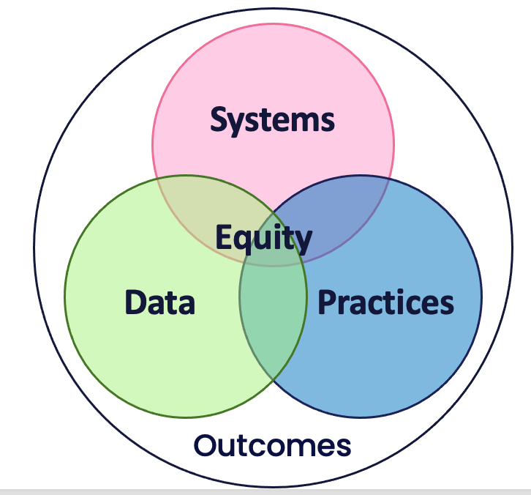
DATA
Fidelity
  Did we implement what we agreed upon?
Outcomes
  Are we making the impact we hoped to make?
SYSTEMS
Supports implementation to occur with fidelity
Team-based Implementation
Embedded and Ongoing Professional Development
PRACTICES
What we do to promote consistent and equitable learning environment
Evidence-based
Fewest number
High impact
OUTCOMES
~80% of students with 0-1 major ODRs
~1 ODR per 500 students per day
Decreasing % of students suspended or expelled
Culture and Context of the School Community

Slide 88
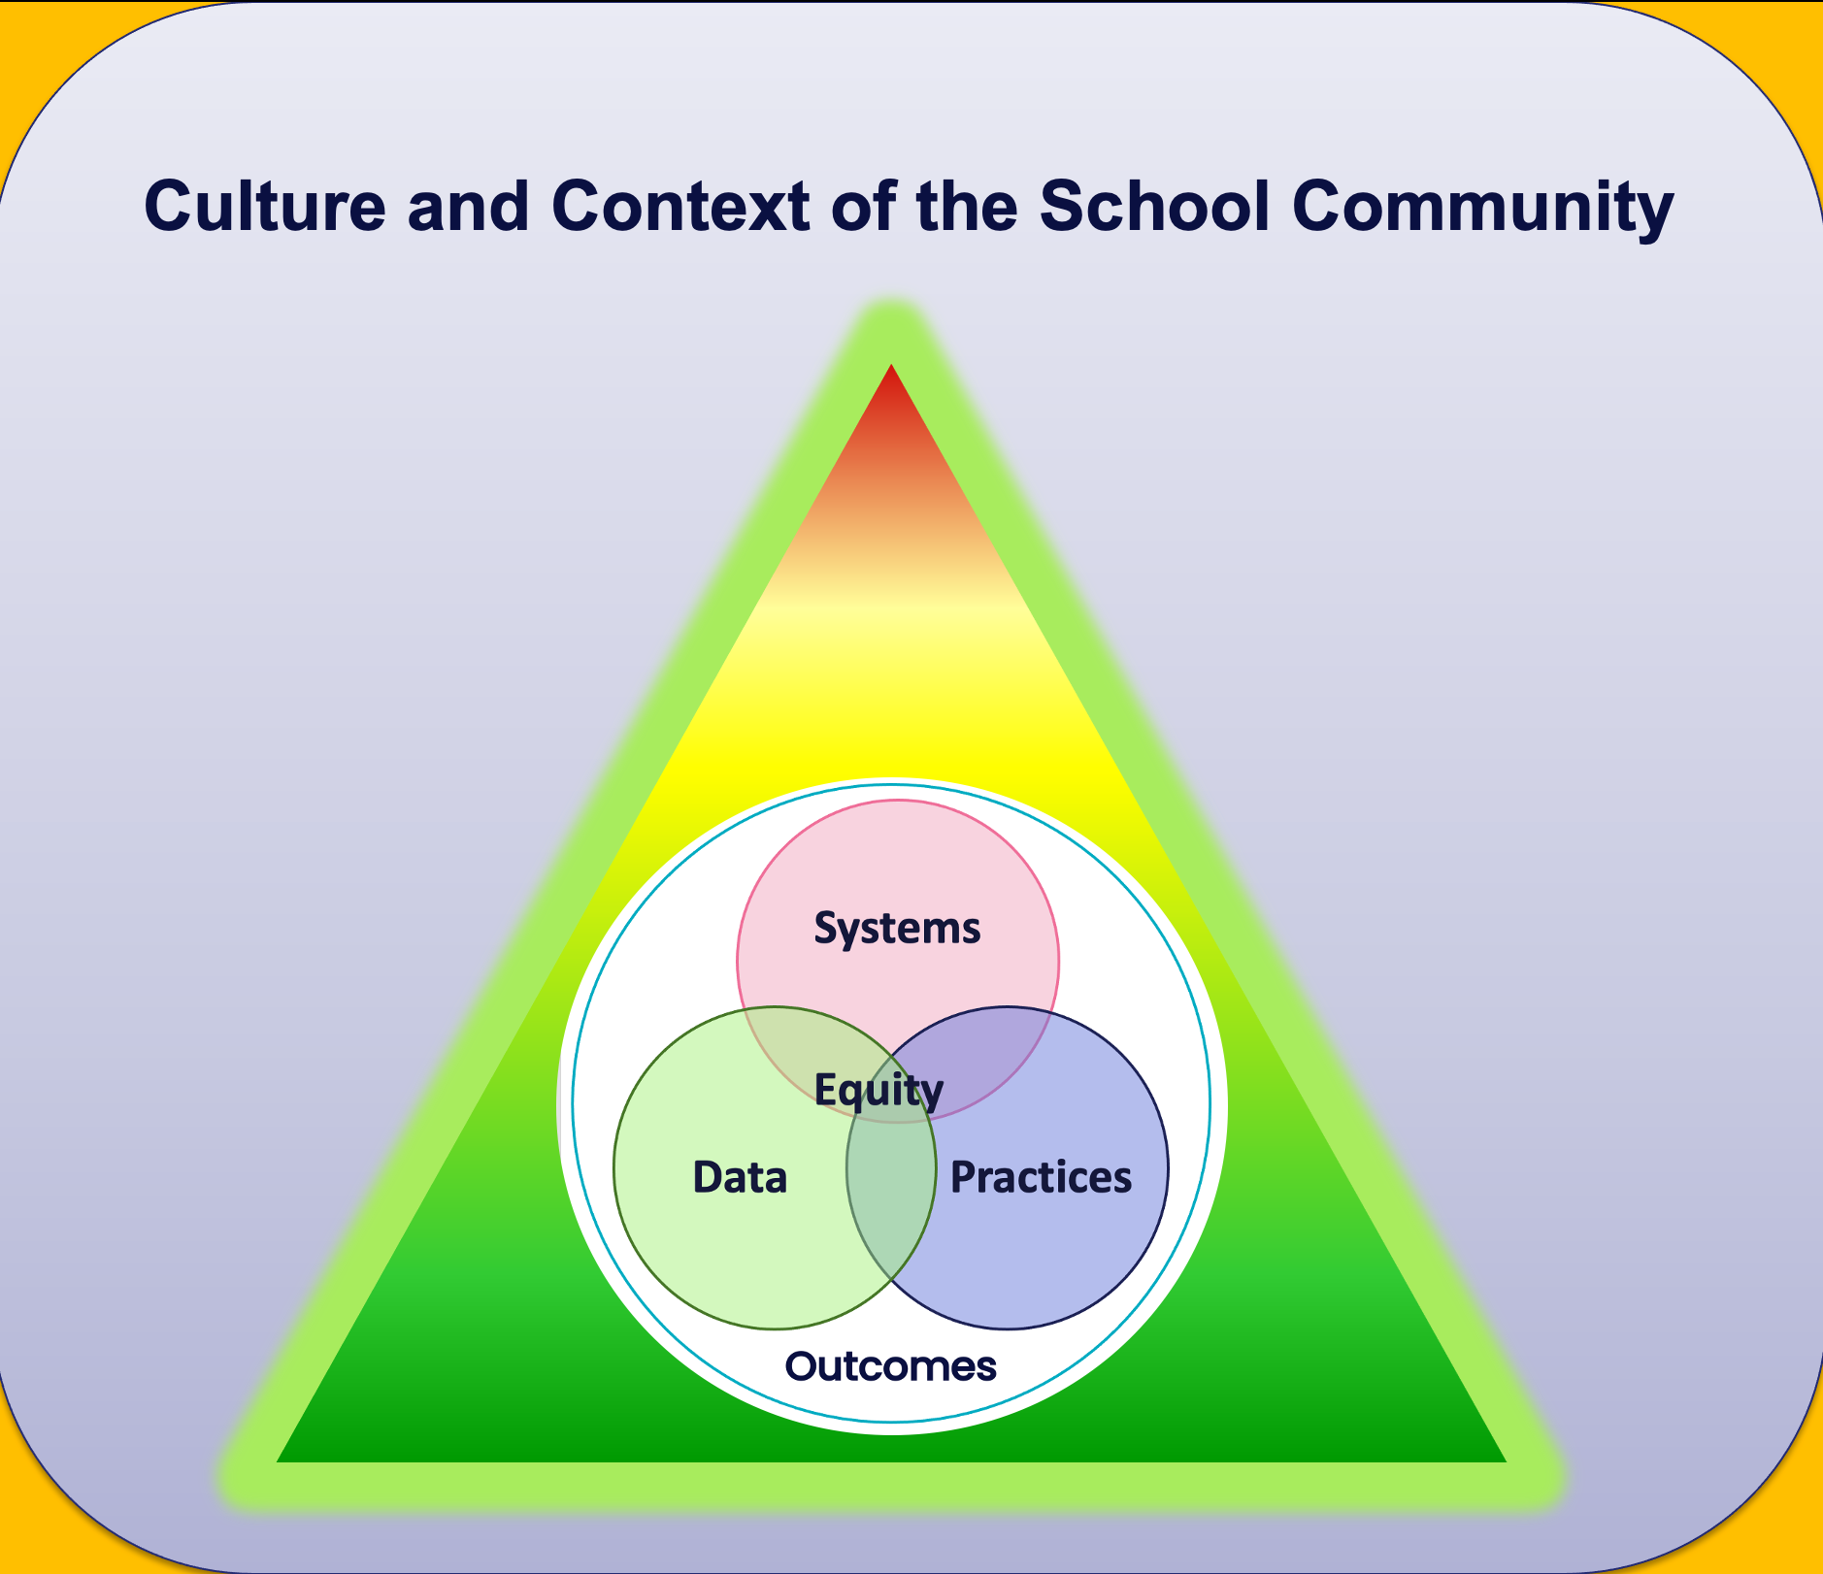
TEAM DISCUSSION: What is PBIS?
When you return to school, a colleague asks you,
"What is PBIS?
What will it look like at our school?"
How would you respond?
How will you incorporate the big ideas and critical features of PBIS into your response?
5 minutes

Slide 89
WHOLE GROUP DEBRIEF: What is PBIS?
What features of PBIS were you able to clearly describe?
What features of PBIS do you need more clarity to describe?
5 minutes

Slide 90
Preview of
10 Getting Started Steps

Slide 91
GETTING STARTED WITH PBIS
1
Establish an effective leadership team
6
Develop a continuum of responses to increase use of SEB skills
2
Develop a brief statement of purpose & define outcomes
7
Develop a continuum of responses to decrease SEB errors
3
Identify positive school-wide behavior expectations
8
Develop systems to support staff
4
Develop procedures to teach school-wide expectations
9
Use data for decision-making
5
Develop procedures to teach class-wide expectations
10
Promote sustainability

Slide 92
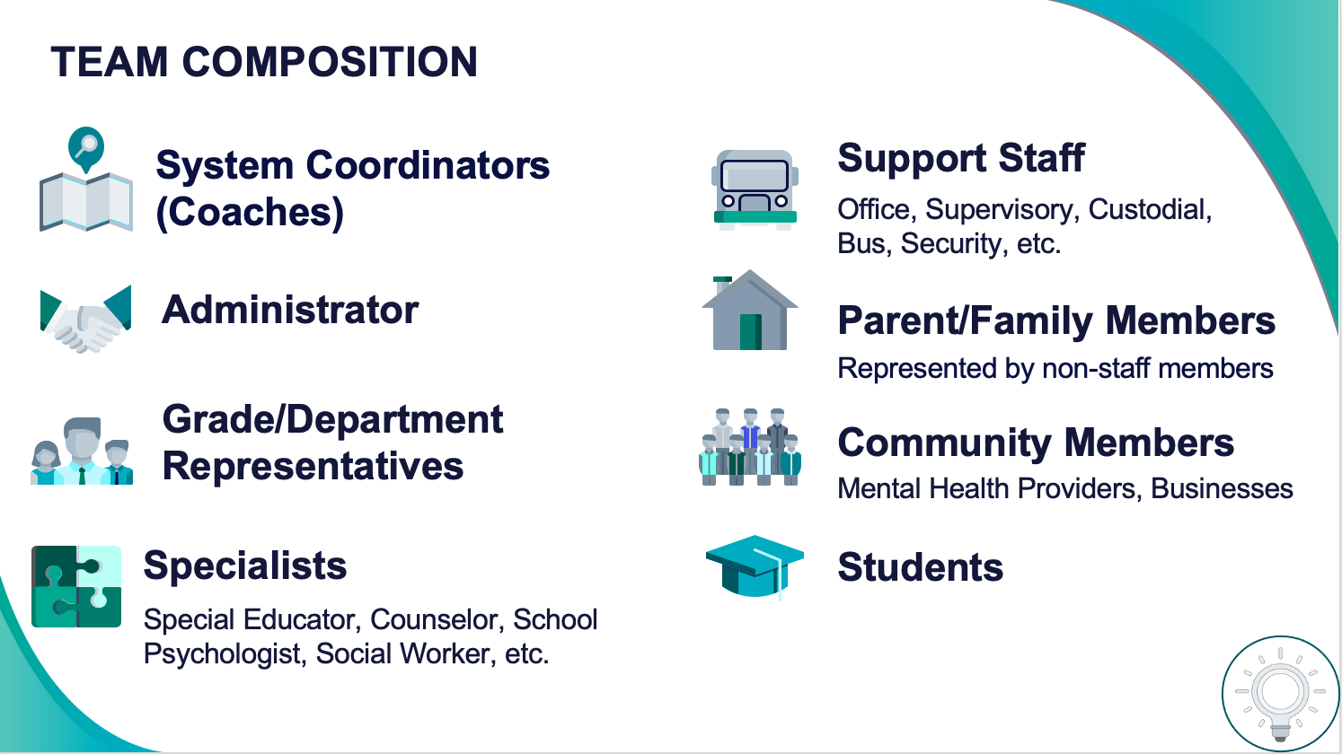
1
Establish an effective leadership team
Systems
Supports Relevance & Equity
Improves student outcomes
Promotes Engagement
Notes:
Your first step is to create a representative team to lead your school’s PBIS efforts.

Slide 93
2
Develop a brief statement of purpose & define outcomes
Practices
What do we hope to achieve by implementing PBIS?
"Our mission is to provide a positive, safe, healthy, nurturing and respectful environment in which all students have the opportunity to become productive members of society."
Purpose
“As a result of implementing PBIS during the 20XX-20XY school year, student reports of school climate will improve by 20%.”
Outcome
Notes:
You’ll then focus your school’s PBIS efforts by creating a statement of purpose to identify your hopes and goals for PBIS implementation.

Slide 94



3
Identify positive school-wide behavior expectations
Practices
Notes:
Your team will work with your school community to uncover what you value and use those values to identify your schoolwide expectations

Slide 95
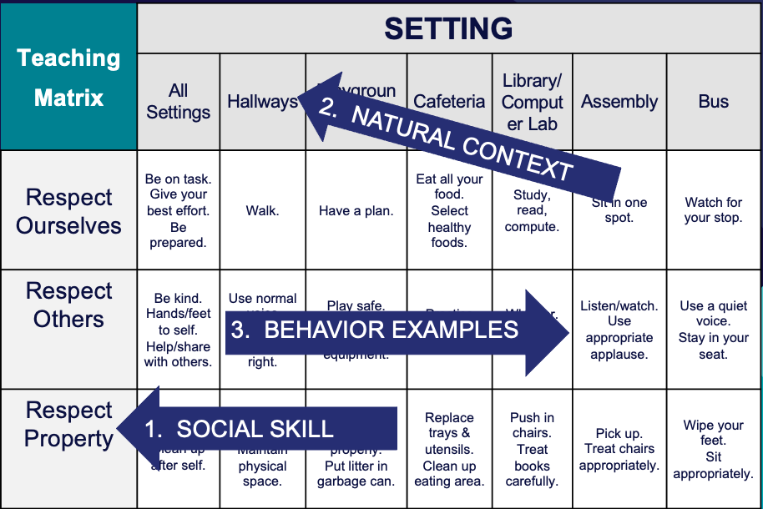
4
Develop procedures to teach school-wide expectations
Practices
Define
Teach
Prompt
Monitor
Evaluate
Notes:
Using those identified expectations, you’ll define what those expectations look and sound like in key routines/settings throughout your school. This is organized through a behavioral matrix. Using the schoolwide matrix, your team will develop lessons that will be explicitly taught to students at the beginning of the year (and boosted throughout the year) so that they know how to be successful within each context (like the hallway, cafeteria, assemblies, etc.)

Slide 96
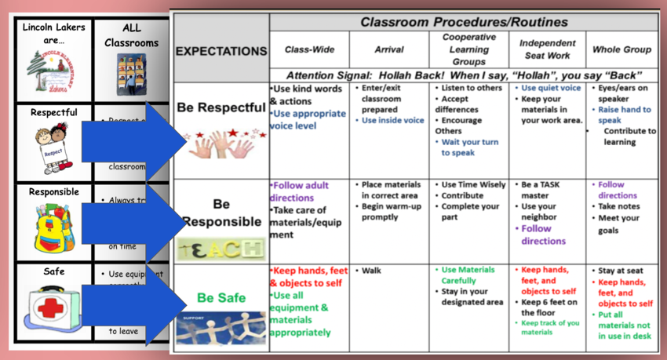
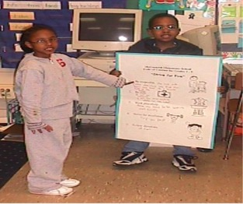
5
Develop procedures to teach class-wide expectations
Practices
Notes:
Once the schoolwide expectations have been determined, classroom educators will apply the behavior matrix format to the routines and settings within their classrooms. They will also explicitly teach the expectations to their students throughout the year.

Slide 97
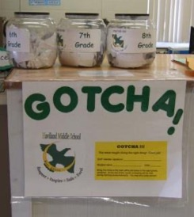
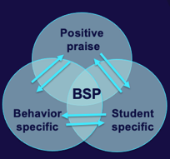
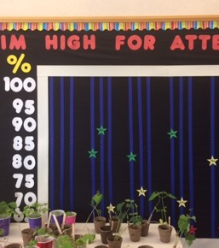
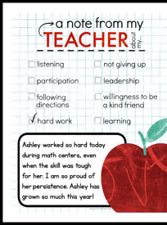
6
Develop a continuum of responses to increase use of SEB skills
Practices
Notes:
To encourage contextually appropriate behaviors to occur, you'll support educators to provide frequent specific feedback and praise. To promote this critical practice, you’ll develop recognition/acknowledgement systems for both students and staff.

Slide 98
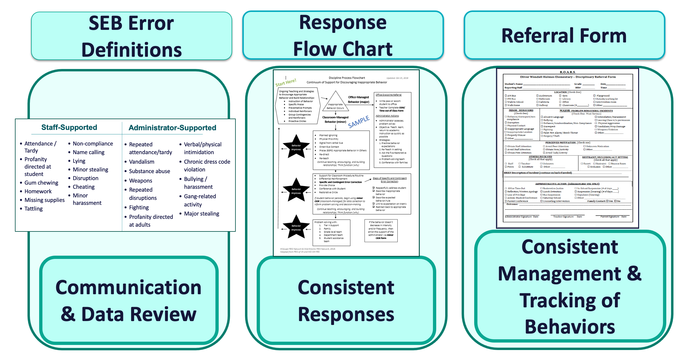
7
Develop a continuum of responses to decrease SEB errors
Practices
Notes:
You will also clarify how staff should respond when contextually inappropriate behaviors occur by clearly defining, determining who’s responsible for responding, identifying clear responses, and recording the behaviors.

Slide 99
8
Develop systems to support staff
Promoting and Sustaining Staff Engagement
Continuous Action Planning
Team-Based Implementation
Systems
Embedded and Ongoing Professional Development
Staff Recognition
Data Routines

Slide 100
9
Use data for decision-making
Data
Assess fidelity of PBIS implementation at least annually
Review student behavior data at least monthly
Use school and community data regularly
Evaluate your plan annually
Develop, inform, and refine Tier 1

Slide 101


10
Promote sustainability
Systems

Slide 102
YEAR 1: Getting Started with PBIS
DAY 1
Step 1: Establish an effective leadership team
DAY 2
Step 2: Develop a brief statement of purpose & define outcomes
Step 3: Identify positive school-wide behavior expectations
Step 4: Develop procedures to teach school-wide expectations
DAY 3
Step 5: Develop procedures to teach class-wide expectations
Step 6: Develop a continuum of responses to increase use of SEB skills
DAY 4
Step 7: Develop a continuum or responses to decrease SEB errors
DAY 5
Step 8: Develop systems to support staff
DAY 6
Step 9: Use data for decision-making
Step 10: Promote sustainability

Slide 103
Systems
STEP 1:
EFFECTIVE TEAMING
Team Composition
Team Operating Procedures
Action Planning
Committee Alignment
Establish a representative team
Establish effective team procedures and agreements
Begin committee alignment

Slide 104
GETTING STARTED WITH PBIS
1
Establish an effective leadership team
6
Develop a continuum of responses to increase use of SEB skills
2
Develop a brief statement of purpose & define outcomes
7
Develop a continuum of responses to decrease SEB errors
3
Identify positive school-wide behavior expectations
8
Develop systems to support staff
4
Develop procedures to teach school-wide expectations
9
Use data for decision-making
5
Develop procedures to teach class-wide expectations
10
Promote sustainability

Slide 105
The Leadership Team is what makes implementation happen!
Team
and requires...
Appropriate priority relative to school/district goals
Integration with other behavior related initiatives and programs
Agreements
Data-based
Action Plan
Evaluation
Implementation

Slide 106
Team Composition

Slide 107
TEAM COMPOSITION
Support Staff
Parent/Family Members
Administrator
Grade/Department Representatives
Community Members
Specialists
System Coordinators
(Coaches)
Office, Supervisory, Custodial, Bus, Security, etc.
Represented by non-staff members
Mental Health Providers, Businesses
Students
Special Educator, Counselor, School Psychologist, Social Worker, etc.

Slide 108
TEAM COMPOSITION
Having an ACTIVE administrator on your team is essential for your team!
This vital role provides:
critical insight to district/school vision and goals
access to resource allocation
decision-making capacity
overview of school operations across grade levels/departments
communication link to district leadership
Administrator
The administrator should be consistently present at team training events and meetings

Slide 109
TEAM COMPOSITION
Parent/Family Members
Community Members
These required, valuable roles provide essential voice to implementation efforts.
Consider reaching out to:
advisory groups
student councils
PTOs
Chamber of Commerce
professional organizations
etc.
Represented by non-staff members
Mental Health Providers, Businesses
Students
expand the voices on your team by also engaging
families, students, and community members in
subcommittees, focus groups, and surveys

Slide 110
Family and Student Voice Considerations
Ensure the family/student role is clearly outlined, defined, and understood
Actively engage students and families in co-designing PBIS practices and systems
Ask families to assist in reporting team discussions & data
Seek family/student feedback regarding school processes
Supports Relevance & Equity
Improves student outcomes
Promotes Engagement

Slide 111
Guidelines for Team Composition
If team is too large, remember 1 team member may provide multiple areas of expertise or play more than 1 role!
The school counselor may serve as both the coach AND a specialist
A special education teacher may serve as BOTH a grade level representative AND someone with behavioral expertise
EXCEPTION
The family member role must be filled by someone who is NOT a staff member in the school
Include individuals who provide expertise in:
applied behavior support (expertise in FBA and function-based support)
mental health and trauma
academic instruction
coaching
equity
physical health and wellness (e.g., nurse, health teacher)
data systems and information regarding system and student academic and SEB strengths and needs
operations of the school across grade levels and programs
Ensure representation of:
school/community demographics
marginalized groups

Slide 112
Team
Operating Procedures & Agreements

Slide 113
Effective Teaming Operating Procedures
regular meeting format/agenda that prompts the regular review of tier 1 practices, systems, and data
minutes available to all staff for review
established and regularly used team norms
defined meeting roles
current action plan accessible to all team members
regular (e.g., quarterly) two-way data sharing and communication with advanced tiers teams to inform decision making

Slide 114
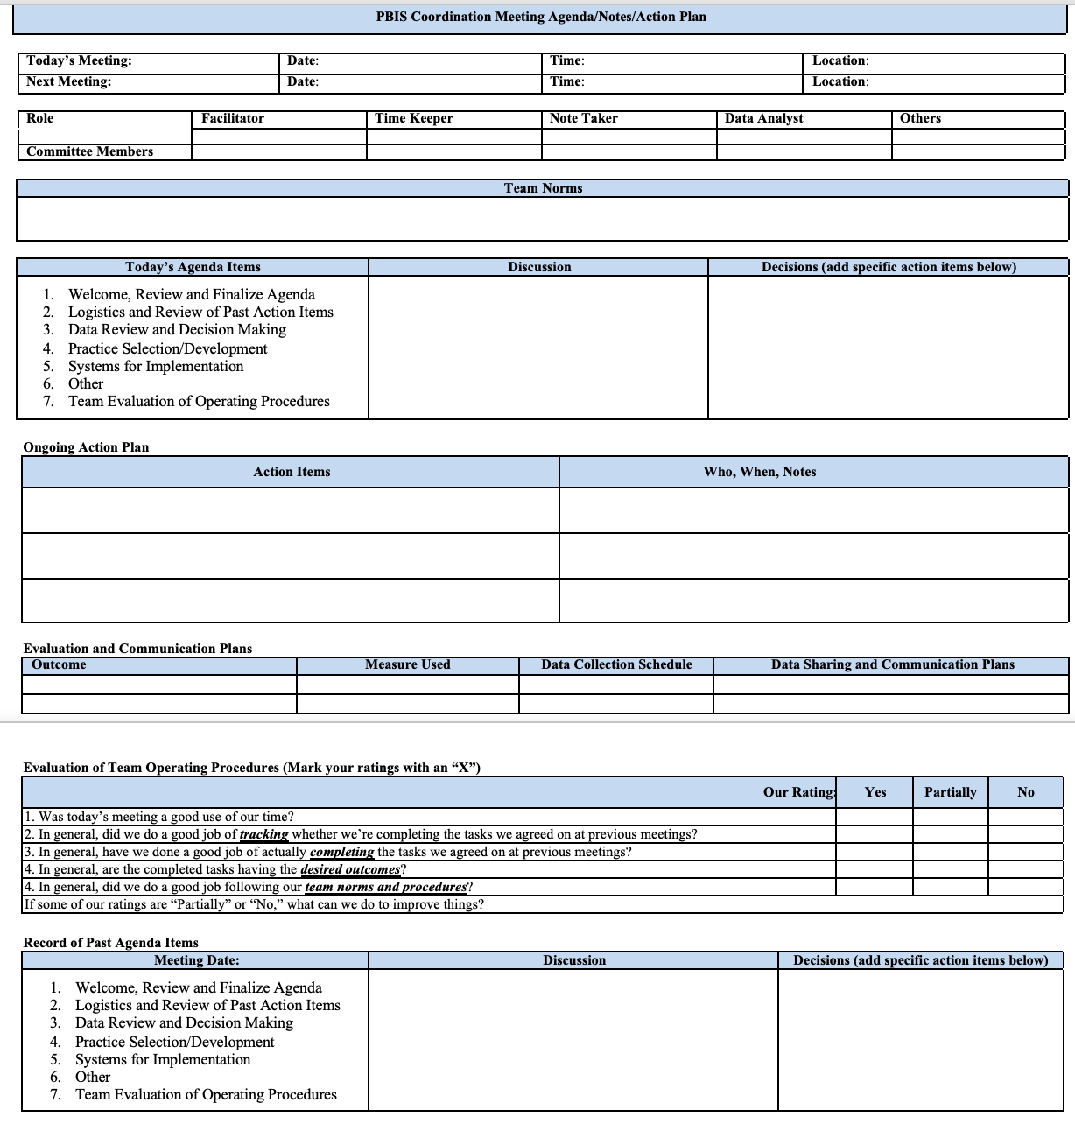
Meeting Format/Agenda
This example prompts the regular review of tier 1 practices, systems, and data.
If your team has a preference for a different version of a meeting form,
ensure that appropriate prompts (sections) are included.

Slide 115
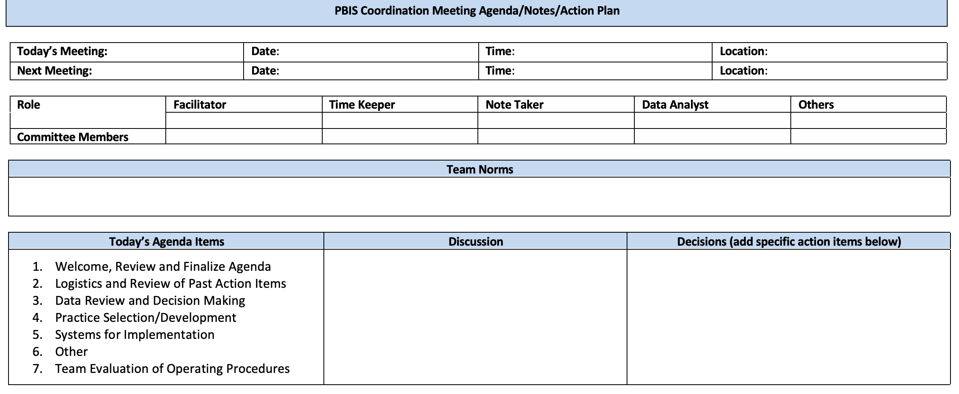
Meeting Format/Agenda
Meeting Logistics and Team Roles

Slide 116
Team Roles
These key roles support your team to effective, efficient, and predictable.
Decide if roles remain the same or rotate.
Have a back up for each role.
Determine roles based on your team's culture.
Facilitator
Recorder
Time Keeper
Data Analyst
Norm Keeper
Action Plan Monitor

Slide 117
Team Norm Guidelines
Be Respectful:
Listen to others
Limit side conversations
Be Responsible:
Be on time
Bring required materials
Be a Problem Solver:
Discuss concerns with the team
Brainstorm solutions
Meetings will begin and end on time.
All voices and input will be valued
Speak respectfully to each other.
Bring group concerns before the whole group
Come to meetings prepared
Identify team behaviors to:
  promote team values
  ensure clear expectations
  increase productivity
  help to avoid conflict
  allow team to evaluate performance
Establish by the team
State positively
Be behavior specific
Review at each meeting
Post visibly during meetings
Use to evaluate team performance after meetings
Revise as needed
Don't be late for meetings
Don't interrupt the speaker
Try to be prepared for meetings
Team Norms
(MOPBIS, 2019)

Slide 118
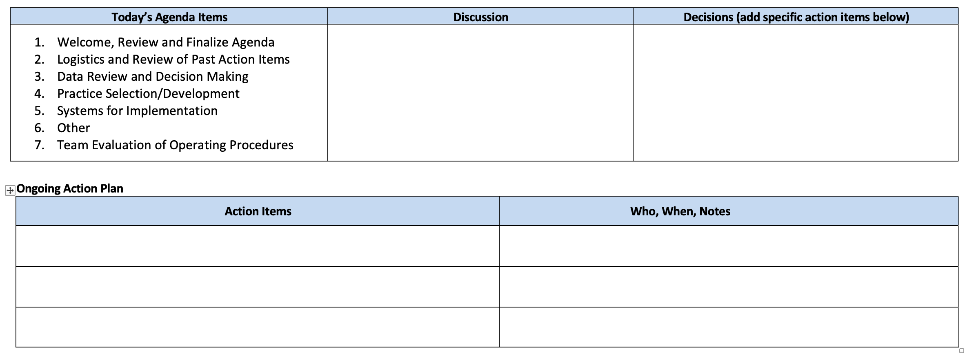
Meeting Format/Agenda
Agenda with Discussion and Decision Prompts
Action Plan Prompts
(REMEMBER-
Action items connect to outcomes!)

Slide 119
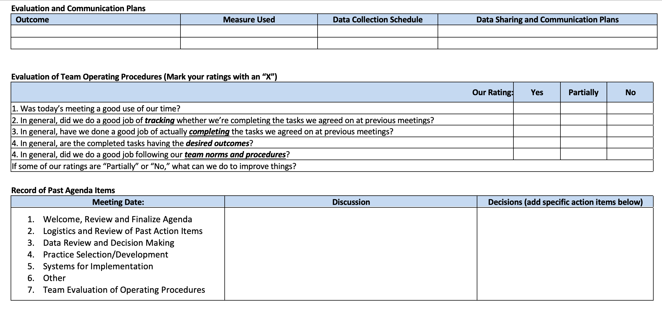
Meeting Format/Agenda
Evaluation and Communication Plans
connected to Outcomes
Evaluation of Team Operating Procedures

Slide 120
Meeting Format/Agenda
Record of
Past Agenda Items

Slide 121
Accessible Team Materials
Where will team materials be stored so all team members can have access?
Action plan
Meeting Agendas/Minutes
Relevant Documents
Dropbox
Shared Google Drive
Google Classroom
Sharepoint Folder
Teams
Padlet

Slide 122
Action
Planning

Slide 123
Action Planning
Definition:
The process of organizing resources to enable individuals to engage in activities designed to achieve specific and important outcomes.

Slide 124
ACTION PLANNING
Foundation for all you do as a team
Action Plan
Vital for achieving goals
Specifies three features:
1
2
3
Who
What
When
Who is responsible…
…for doing what…
…by when?

Slide 125
Meeting Format/Agenda
Action Plan Prompts
(REMEMBER-
Action items connect to outcomes!)

Slide 126
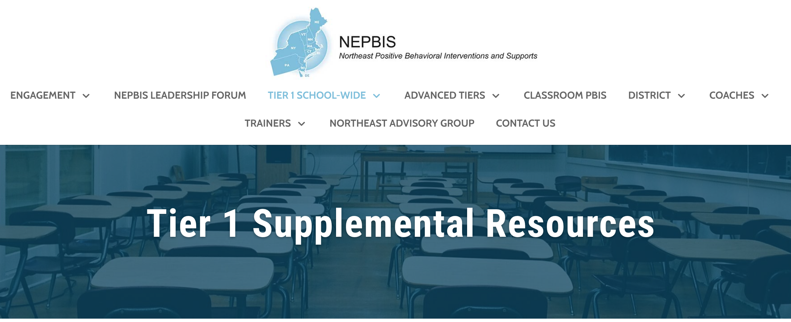
If you want an action plan as a separate document from your meeting plan/agenda, choose an action plan template that works for
your team and
stage of implementation!
Find templates for:
Meeting agendas/notes
Action plans
Notes:
https://nepbis.org/

Slide 127
ACTIVITY: Developing an Effective Leadership Team
As a team, BEGIN the Step 1: Developing an Effective Leadership Team Activity
Collaborate with your team to identify the following team procedures and agreements:
Composition
Meeting format/agenda
Roles
Meeting schedule
Norms
Action Plan Form (If using a separate document from meeting template)
Accessible location for materials
15 minutes

Slide 128
WHOLE GROUP DEBRIEF:
Developing an Effective Leadership Team
Share 1-2 highlights from your team discussion
What support will you need to complete this activity?
5 minutes

Slide 129
Committee Alignment/
Working Smarter

Slide 130
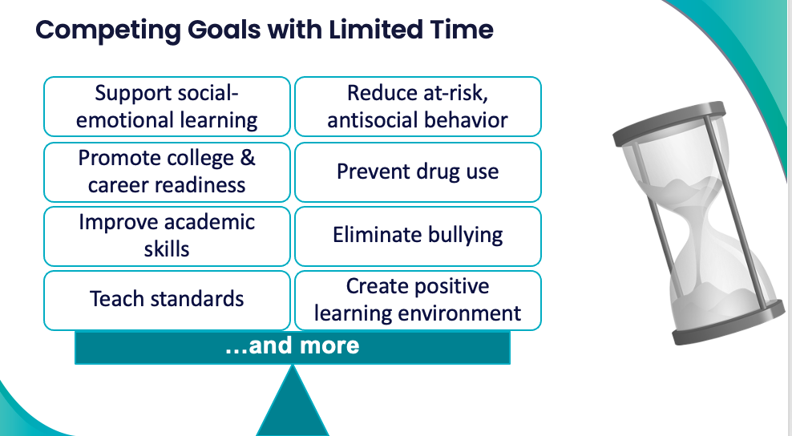
How many teams does your school have with similar goals?
What if the same people are on every team?
What data is being used to guide those teams?
Remember this?

Slide 131
Do it once
Do LESS better!
Be strategic
Invest in clear outcomes
Invest in a sure thing
Work SMARTER,
Not HARDER!

Slide 132
ALIGNING SEB COMMITTEES
Purpose:
Provide an overall picture of existing teams within your school and determine the need for merging or aligning these teams
Initiative/
Committee/ Team
Purpose & Strategic Goal Supported
Measurable, Data-Based Outcome(s)
Target Group
Staff Involved
Overlap? Modify? Eliminate?

Slide 133
Initiative/
Committee/ Team
Purpose & Strategic Goal Supported
Measurable, Data-Based Outcome(s)
Target Group
Staff Involved
Overlap? Modify? Eliminate?
PBIS
Ensure positive, safe, predictable, & consistent environment
ODRs, suspensions, attendance, universal screening, school climate survey
All students, staff, & families
Principal, social worker, 3 general + 1 special ed. teachers
- Overlap with crisis/TI teams
- Combine and rename
- Add EOY meeting to revise safety protocols
Safety/
Crisis Team
Update protocols to ensure safe environment & plan for crisis
None
All students, staff, & families
Principal, social worker, 2 general ed. teachers
- Expand use of data to monitor police contacts from school & safety assessments
- Combine with PBIS and TI Team
Trauma-Informed Team
Ensure students feel safe, supported, & ready to learn
ODRs, suspensions, attendance, universal screening, school climate
  All students, staff, & families
Principal, social worker, 2 general + 1 special ed. teachers
- Overlap with PBIS team
-Combine with PBIS/TI team
- Make current members coaches

Slide 134
Initiative/
Committee/ Team
Purpose & Strategic Goal Supported
Measurable, Data-Based Outcome(s)
Target Group
Staff Involved
Overlap? Modify? Eliminate?
PBIS
Ensure positive, safe, predictable, & consistent environment
ODRs, suspensions, attendance, universal screening, school climate survey
All students, staff, & families
Principal, social worker, 3 general + 1 special ed. teachers
Similar purpose/goal, data-based outcome,
target group, staff involved!
Can the teams be combined into one team?
Safety/
Crisis Team
Update protocols to ensure safe environment & plan for crisis
None
All students, staff, & families
Principal, social worker, 2 general ed. teachers
- Expand use of data to monitor police contacts from school & safety assessments
Trauma-Informed Team
Ensure students feel safe, supported, & ready to learn
ODRs, suspensions, attendance, universal screening, school climate
  All students, staff, & families
Principal, social worker, 2 general + 1 special ed. teachers

Slide 135
Initiative/
Committee/ Team
Purpose & Strategic Goal Supported
Measurable, Data-Based Outcome(s)
Target Group
Staff Involved
Overlap? Modify? Eliminate?
Ensure positive, safe, predictable, & consistent environment
ODRs, suspensions, attendance, universal screening, school climate survey
All students, staff, & families
- Overlap with crisis/TI teams
- Combine and rename
- Add EOY meeting to revise safety protocols
If there is no data gathered or the data gathered is insufficient...
what data can be added?
can the team be eliminated?
can the team be combined with a team with relevant data?
PBIS
Principal, social worker, 3 general + 1 special ed. teachers
Safety/
Crisis Team
Update protocols to ensure safe environment & plan for crisis
None
All students, staff, & families
Principal, social worker, 2 general ed. teachers
- Expand use of data to monitor police contacts from school & safety assessments
Trauma-Informed Team
Ensure students feel safe, supported, & ready to learn
ODRs, suspensions, attendance, universal screening, school climate
  All students, staff, & families
Principal, social worker, 2 general + 1 special ed. teachers
- Overlap with PBIS team
Combine team
- Make current members coaches

Slide 136
Initiative/
Committee/ Team
Purpose & Strategic Goal Supported
Measurable, Data-Based Outcome(s)
Target Group
Staff Involved
Overlap? Modify? Eliminate?
PBIS
Ensure positive, safe, predictable, & consistent environment
ODRs, suspensions, attendance, universal screening, school climate survey
All students, staff, & families
Principal, social worker, 3 general + 1 special ed. teachers
Overlap with safety/crisis & TI teams
Combine teams and rename
Add EOY meeting to revise safety protocols
Safety/
Crisis Team
Update protocols to ensure safe environment & plan for crisis
None
All students, staff, & families
Principal, social worker, 2 general ed. teachers
Overlap with PBIS & TI teams
Combine teams and rename
Expand use of data to monitor police contacts from school & safety assessments
Trauma-Informed Team
Ensure students feel safe, supported, & ready to learn
ODRs, suspensions, attendance, universal screening, school climate
  All students, staff, & families
Principal, social worker, 2 general + 1 special ed. teachers
Overlap with PBIS & Safety/Crisis teams
Combine teams and rename
Make current members coaches

Slide 137
ACTIVITY: COMMITTEE AUDIT (WORKING SMARTER)
BEGIN the Committee Audit/Working Smarter Activity:
Identify current teams (e.g., discipline, instruction, climate, etc.) and initiatives (e.g., Second Step, Character Counts, Spirit Committee, etc.) in place
Complete the Working Smarter Table
Review data on the Working Smarter Table to develop an action plan for eliminating or modifying teams as needed.
Initiative/
Committee/ Team
Purpose & Strategic Goal Supported
Measurable, Data-Based Outcome(s)
Target Group
Staff Involved
Overlap? Modify? Eliminate?
15 minutes

Slide 138
WHOLE GROUP DEBRIEF:
Committee Audit (Working Smarter)
What questions do you have about the committee audit activity?
What support will you need to complete it?
5 minutes

Slide 139
Lunch

Slide 140
Quick
Review

Slide 141
Culture and Context of the School Community

Slide 142
GETTING STARTED WITH PBIS
1
Establish an effective leadership team
6
Develop a continuum of responses to increase use of SEB skills
2
Develop a brief statement of purpose & define outcomes
7
Develop a continuum of responses to decrease SEB errors
3
Identify positive school-wide behavior expectations
8
Develop systems to support staff
4
Develop procedures to teach school-wide expectations
9
Use data for decision-making
5
Develop procedures to teach class-wide expectations
10
Promote sustainability
Notes:
You will also clarify how staff should respond when contextually inappropriate behaviors occur by clearly defining, determining who’s responsible for responding, identifying clear responses, and recording the behaviors.

Slide 143
The Leadership Team is what makes implementation happen!
Team
and requires...
Appropriate priority relative to school/district goals
Integration with other behavior related initiatives and programs
Agreements
Data-based
Action Plan
Evaluation
Implementation

Slide 144
Practices
STEP 2:
PURPOSE STATEMENT
Why are we doing this?
How will we get there?
Identify purpose for implementation and define a clear outcome statements

Slide 145
Why are we doing this?

Slide 146
GETTING STARTED WITH PBIS
1
Establish an effective leadership team
6
Develop a continuum of responses to increase use of SEB skills
2
Develop a brief statement of purpose & define outcomes
7
Develop a continuum of responses to decrease SEB errors
3
Identify positive school-wide behavior expectations
8
Develop systems to support staff
4
Develop procedures to teach school-wide expectations
9
Use data for decision-making
5
Develop procedures to teach class-wide expectations
10
Promote sustainability

Slide 147
Purpose Statement Considerations
Purpose Statement
Action Plan Outcome Goals
School/District Improvement Plans
Working Smarter Matrix (e.g. resource allocation)
Notes:
SIP = School Improvement Plan

Slide 148
Purpose statement identifies WHY you are implementing PBIS at your school
Ensure all students develop the social-emotional-behavioral (SEB) skills needed to be effective learners through the implementation of evidence-based interventions and use of data to inform decisions.
State positively
Keep at 2 to 3 sentences in length
Be supportive of academic achievement and social-emotional-behavioral (SEB) health
Be comprehensive in scope (relevant to all students, staff & settings)
We will have a positive climate.
To develop and implement universal systems and interventions supporting the academic and social success of each student.

Slide 149
ACTIVITY: PURPOSE STATEMENT
State positively
Keep at 2 to 3 sentences in length
Be supportive of academic achievement and social-emotional-behavioral (SEB) health
Be comprehensive in scope (relevant to all students, staff & settings)
DRAFT your School-Wide Social-Emotional-Behavioral Purpose Statement based on the guidelines.
Add items to your action plan as needed.
Be prepared to share a draft (or start of a draft) with the whole group.
15 minutes

Slide 150
WHOLE GROUP DEBRIEF: Purpose Statement
What big ideas were captured in your purpose statement?
What support will you need to complete this activity?
State positively
Keep at 2 to 3 sentences in length
Be supportive of academic achievement and social-emotional-behavioral (SEB) health
Be comprehensive in scope (relevant to all students, staff & settings)
5 minutes

Slide 151
How will we get there?

Slide 152
Outcomes tell us if we achieve our purpose
and guide framework implementation
As a result of implementing PBIS during the 20XX-20XY school year, student reports of school climate will improve by 20%
Use data
Be locally important and meaningful
Apply to all (culturally equitable)
  Students’ social competence and academic achievement
  Staff implementation of critical skills
Be observable and measurable
Write as a goal

Slide 153
Purpose Statement
What would it look like if all students developed the SEB skills needed to be effective learners?
Ensure all students develop the social-emotional-behavioral (SEB) skills needed to be effective learners through the implementation of evidence-based interventions and use of data to inform decisions.
behavior referrals and exclusionary discipline would decrease
disproportionate discipline would decrease
students would be in class consistently
all students would meet academic standards

Slide 154
What would it look like if all students developed the SEB skills needed to be effective learners?
As a result of implementing PBIS during the 20XX-20XY school year:
behavior incidents will decrease by __% relative to the same period as the prior year.
incidents of exclusionary discipline (suspension/expulsion) will decrease by __ % relative to the same period as the prior year
Behavior referrals and exclusionary discipline would decrease
disproportionate discipline would decrease
students would be in class consistently
all students would meet academic standards
use of disproportionate discipline will decrease by __%
% of students who are chronically absent will decrease by __%
% of students meeting grade level academic standards will increase by __%

Slide 155
ACTIVITY: Define Outcomes
Use data
Be locally important and meaningful
Apply to all (culturally equitable)
  Students’ social competence and academic achievement
  Staff implementation of critical skills
Be observable and measurable
Write as a goal
Draft 2-3 observable, measurable outcome statements for your school.
Add items to your action plan as needed.
15 minutes

Slide 156
WHOLE GROUP DEBRIEF: Identifying Outcomes
Use data
Be locally important and meaningful
Apply to all (culturally equitable)
  Students’ social competence and academic achievement
  Staff implementation of critical skills
Be observable and measurable
Write as a goal
Share one or more of your draft outcome statements with the group
What support will you need to complete this activity?
5 minutes

Slide 157
Team
Action Planning Time

Slide 158
Use this time to continue working on...
Overview of PBIS
Step 1: Effective Teaming
Step 2: Purpose & Outcomes
Describe why PBIS is important for your school and what it is
Identify the outcome data you will gather and monitor
120 minutes
Establish a representative team
Establish effective team procedures and agreements
Begin committee alignment
Identify purpose for implementation and define a clear outcome statement

Slide 159
WHOLE GROUP DEBRIEF: Action Planning
Overview of PBIS
Step 1: Effective Teaming
Step 2: Purpose & Outcomes
Describe why PBIS is important for your school and what it is
Identify the outcome data you will gather and monitor
Share one or more team accomplishments from today
What further support will you need to complete these action steps?
Establish a representative team
Establish effective team procedures and agreements
Begin committee alignment
Identify purpose for implementation and define a clear outcome statement
5 minutes

Slide 160
Review
of
PBIS

Slide 161
PBIS is...
Framework for enhancing adoption & implementation of
Continuum of evidence-based interventions to achieve
Academically & behaviorally important outcomes for
All students

Slide 162
Continuum of School-Wide Instructional
& Positive Behavior Support
What do we do for the FEW needing intensive support?
Tertiary Prevention:
Specialized
Individualized
Systems for Students with High-Risk Behavior
What do we do for ALL?
Primary Prevention:
School-/Classroom-
Wide Systems for
All Students,
Staff, & Settings
~5%
~15%
What do we do for the SOME needing more support?
Secondary Prevention:
Specialized Group
Systems for Students with
At-Risk Behavior
~80% of Students

Slide 163
Critical Features
Systems
Practices
Data
Equity
Outcomes

Slide 164
The Leadership Team is what makes implementation happen!
Team
and requires...
Appropriate priority relative to school/district goals
Integration with other behavior related initiatives and programs
Agreements
Data-based
Action Plan
Evaluation
Implementation

Slide 165
GETTING STARTED WITH PBIS
1
Establish an effective leadership team
6
Develop a continuum of responses to increase use of SEB skills
2
Develop a brief statement of purpose & define outcomes
7
Develop a continuum of responses to decrease SEB errors
3
Identify positive school-wide behavior expectations
8
Develop systems to support staff
4
Develop procedures to teach school-wide expectations
9
Use data for decision-making
5
Develop procedures to teach class-wide expectations
10
Promote sustainability
Notes:
You will also clarify how staff should respond when contextually inappropriate behaviors occur by clearly defining, determining who’s responsible for responding, identifying clear responses, and recording the behaviors.

Slide 166
TODAY'S AGENDA AND ACTION STEPS
Describe why PBIS is important for your school and what it is
Identify the outcome data you will gather and monitor
Overview of PBIS
  Why PBIS
  What is PBIS?
  Critical Features
  Preview of Getting Started Steps
Step 1: Effective Teaming
  Team Composition
  Team Operating Procedures
  Action Planning (What and Why)
  Committee Alignment
Step 2: Purpose & Outcomes
  Why are we doing this?
  How will we know when we get there?
Establish a representative team
Establish effective team procedures and agreements
Begin committee alignment
Identify purpose for implementation and define a clear outcome statement

Slide 167
Preview of
Day 2
(Getting Started Steps # 3 & 4)

Slide 168
3
Identify positive school-wide behavior expectations
Practices
Notes:
Your team will work with your school community to uncover what you value and use those values to identify your schoolwide expectations

Slide 169
4
Develop procedures to teach school-wide expectations
Practices
Define
Teach
Prompt
Monitor
Evaluate
Notes:
Using those identified expectations, you’ll define what those expectations look and sound like in key routines/settings throughout your school. This is organized through a behavioral matrix. Using the schoolwide matrix, your team will develop lessons that will be explicitly taught to students at the beginning of the year (and boosted throughout the year) so that they know how to be successful within each context (like the hallway, cafeteria, assemblies, etc.)

