Slide 1
School-Wide Positive Behavioral Interventions and Supports (SWPBIS)
Northeast PBIS (NEPBIS) School-Wide Team Training
Day 10
INSERT TRAINER NAMES
with support from Brandi Simonsen, Jen Freeman,
Susannah Everett, Adam Feinberg, & George Sugai
Notes:
Add trainer names for your event

Slide 2

Advance Organizer
Quick Recap of Day 7-9 Training
Guest Speaker
Roundtable Discussions
TIC & Action Planning

Slide 3
Tier 1 Leadership Team & Coaches Meetings
WHAT | WHO
6 days of Team Training | Minimum membership: administrator, grade level representatives, support staff
3 days Coaches Meetings | 2 Coaches
2 days of TA per district | Admin, Coach, Data Entry
YEAR 1
3 days of Team Training | Same above
3 days Coaches Meetings | Same above
2 days of TA per district | Same above
YEAR 2
2 days of Team Training | Same above
3 days Coaches Meetings | Same above
2 days of TA per district | Same above
YEAR 3+
Tier 2 Training will also be offered to schools implementing Tier 1 with fidelity.

Slide 4
MAIN TRAINING OBJECTIVES in YEAR 3
Enhance leadership team
Maintain staff agreements
Enhance knowledge of SWPBIS outcomes, data, practices, and systems
Refine individualized action plan for SWPBIS
Enhance and sustain implementation in future years

Slide 5
Training Expectations:
RESPECT…
SELF
Self-monitor (Are you participating? Engaged as a learner? Talking during allotted times?)
Stretch, break, stand as needed
OTHERS
Cell phones (inaudible): Converse in lobbies and breaks
ENVIRONMENT
Recycle
Work as a team: Room for every voice, reinforce participation
Maintain neat working area

Slide 6



Tools!
nepbis.org
pbis.org
School-wide PBIS Workbook and Appendices
Evaluation Plan
Action Plan

Slide 7

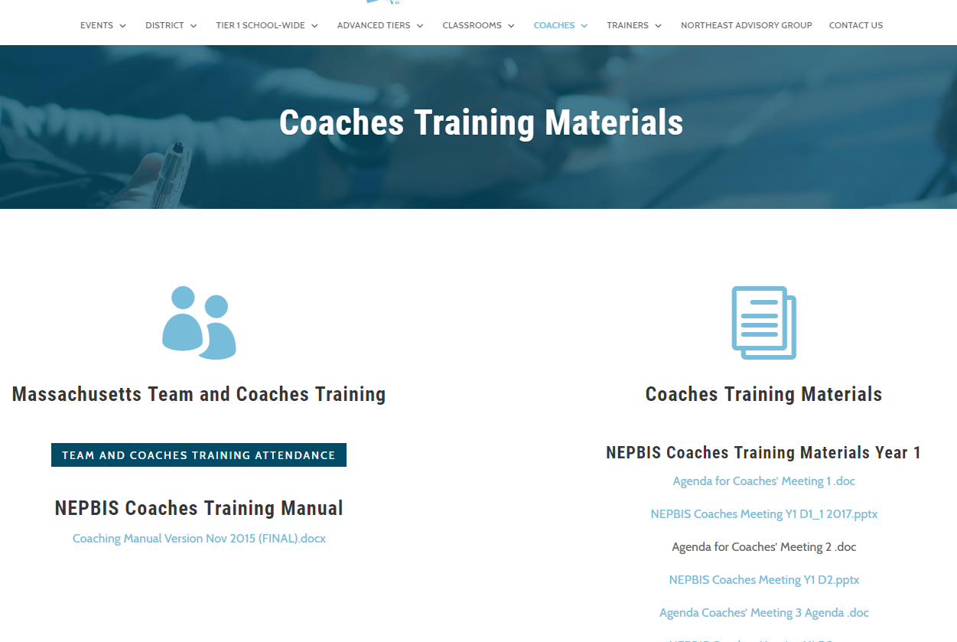
Activity:
Please Enter Attendance
1 min
Please login on nepbis.org, go to the coaches’ tab, and click on the Team Training Attendance Link. Follow prompts to enter team attendance.

Slide 8





Legend
New Content
Review
Guidelines
+Ex
-Ex
Training Organization
Activity

Slide 9


Legend
Section Header (I.A)
Chapter Header (e.g., I)

Slide 10
Review of SWPBIS

Slide 11
Critical Features of PBIS
Supporting Culturally Equitable
Social Competence & Academic Achievement
OUTCOMES
Supporting
Culturally
Knowledgeable
Staff Behavior
Supporting
Culturally Valid
Decision
Making
SYSTEMS
DATA
(Vincent, Randal, Cartledge, Tobin, & Swain-Bradway, 2011; Sugai, O’Keefe, & Fallon 2012 ab)
PRACTICES
I.C
Supporting Culturally Relevant
Evidence-based Interventions
Notes:
Use data
Focus on outcomes: Academic & behavior success
On-going evaluation
Ensure cultural and contextual fit
Invest in systems
Organize research-validated practices within a continuum
Instructional & preventative approach
Integration
Tier 1 for all

Slide 12
Multi-tiered Framework of Professional Development Support
Tier 3
Intensive PD: Data-driven Consultation
Tier 2
Targeted PD: Self-Management with Peer or Coaching Supports
Tier 1
Universal PD: Training & Self-Management
Progress Monitoring
Walk-through, Student Data Review, Teacher Collected Data
Universal Screening
Walk-through & Student Data Review
(adapted from Simonsen, MacSuga, Briere, Freeman, Myers, Scott, & Sugai, 2013)

Slide 13

MA PBIS Academy Year 3 Goals
Support implementation and sustainability of the PBIS framework
  Review current school implementation related to specific framework principles
  Gather information on other exemplars of implementation of framework principles.
Build coaching knowledge and fluency with PBIS content
  Connect specific school systems, features, or practices with PBIS content principles
  Practice communicating important framework features present or needed in your school

Slide 14
MA PBIS Academy Year 3 Activities
Training Day 10
  Guest Speaker on School Climate: Dr. Tamika La Salle
  Roundtable Discussions w/School Leaders
  Action Planning
Training Day 11
  Guest Speaker on Sustainability: Dr. Adam Feinberg
  Poster Session
  Action Planning

Slide 15
Roundtable Discussions
Target Goal:
  Networking across districts and schools through sharing examples of PBIS framework implementation
Roundtable Discussions (75 Minutes)
Elementary: Systems
Elementary: Data
Elementary: Practices
Middle / High: Systems
Middle / High: Practices
Middle / High: Data

Slide 16
Roundtable Discussions
Structure (75 Minutes)
  5 to 6 separate tables / groups with each table having a discussion focus on implementation
  Each school team will divide up and send team members to two or three tables.
  Peer leaders from schools in your Cohort that will be identified to lead discussions.
  After roundtable discussions, teams will have action planning time to process content discussed previously.
Elementary: Systems
Elementary: Data
Elementary: Practices
Middle / High: Systems
Middle / High: Practices
Middle / High: Data

Slide 17
Roundtable Discussions
Sample Roundtable Discussion Format
  First 10 minutes: School exemplar discussion leaders will review current features present in their school related to the table’s topic
  Second 65 minutes: Tables will engage in a discussion sharing examples of features relative to the tables topic including…
    Asking questions of school exemplar discussion leaders on the content initially reviewed.
    Other round table participants share other examples of features from their school as comparision

Slide 18
Roundtable Discussions
Roundtable Discussion Format
  Table members discuss at-large questions provided at the table
    At-large questions will be previously drafted by having school teams earlier in the day draft questions they have for that domain.
    School teams will be given time to write down questions for round table discussion that will occur later in the day.
    These questions will be collected and distributed later for table discussions
    Roundtable discussions structure will include (1) exemplar school discussion related to topic, (2) questions from table participants, and (3) discussion based on submited questions.

Slide 19
MA PBIS Academy Year 3 Activities
Training Day 10
  Guest Speaker on School Climate: Dr. Tamika La Salle
  Roundtable Discussions w/School Leaders
  Action Planning
Training Day 11
  Guest Speaker on Sustainability: Dr. Adam Feinberg
  Poster Session
  Action Planning

Slide 20
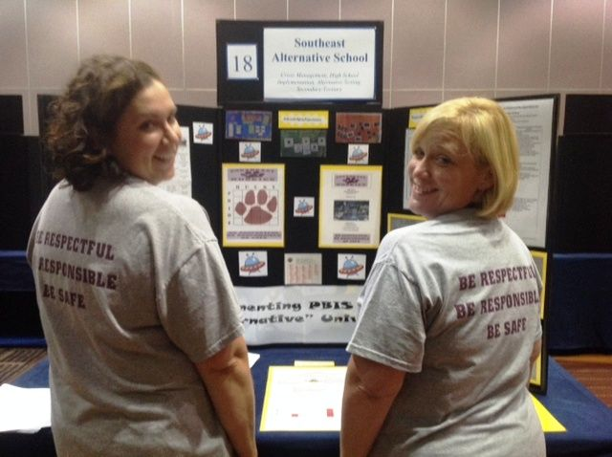
Poster Session
Target Goal:
  Share examples of implementation of the PBIS Framework across districts and schools
Structure
  Show off! Each school will present a
  poster and have at least 1 or 2 team
  members present at poster during the
  session
  Take turns! Other team members walk
  around browse other posters to review
  PBIS features of other schools
  Get ideas! Bring ideas back to your
  school for follow up action planning

Slide 21
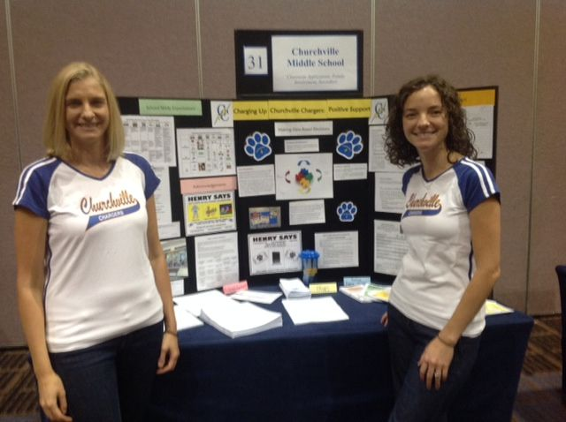
What to include in your Poster?
Ideas Examples of Systems, Data, and Practices!
  Data Examples:
    Fidelity Data (e.g., TFI or TIC)
    Outcome Data (e.g., ODR or attendance)
  System Examples
    Team action plans
    Staff Survey
  Practice Examples
    Lesson plan
    Teaching Matrix
    Consequence Flow-chart
Please include data as part of your poster!

Slide 22
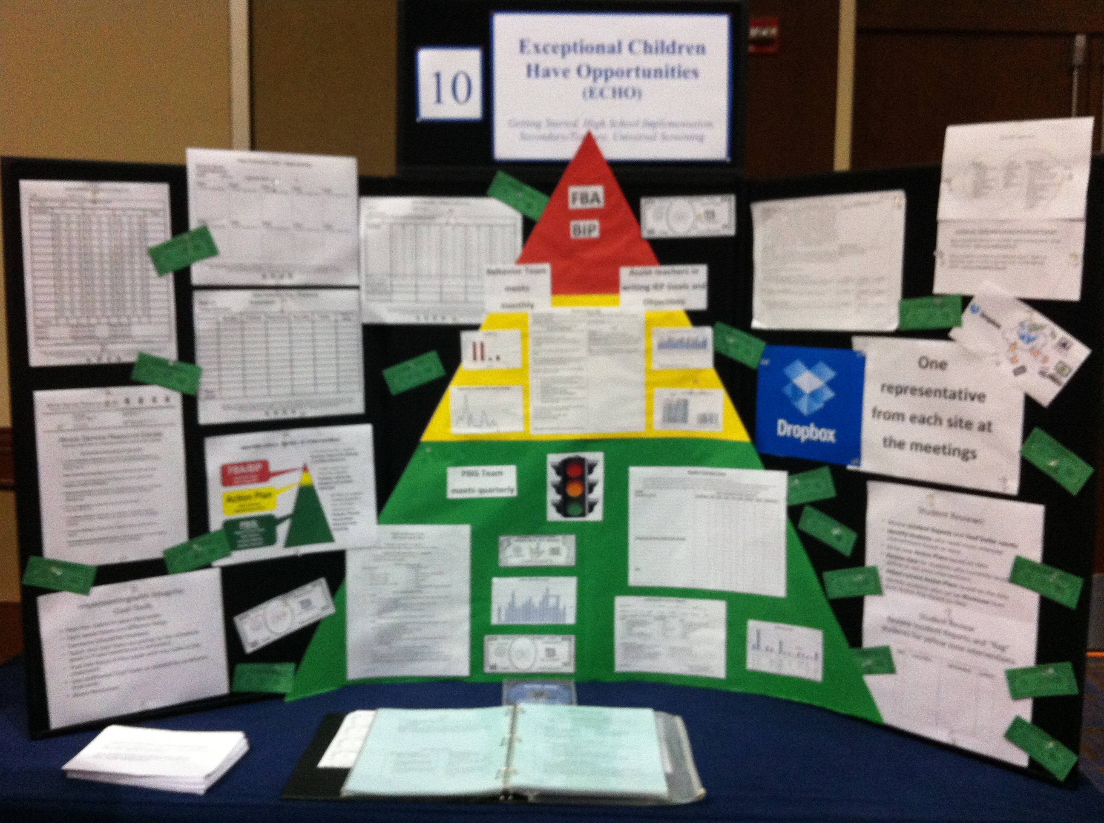
Poster Session
Invite your colleagues and administrators:
  We will email you in the winter to
  alert you of the time of the poster
  sessions.
  Please invite colleagues with whom
  you want to share your work with.
  Consider important stakeholders!
  (e.g., school board, PTO, etc.)
  Consider inviting relevant
  administrators

Slide 23
Guest Speaker

Slide 24
Guest Speaker Activity & Action Planning

Slide 25
Roundtable Discussions

Slide 26
Activity:
Roundtable Discussions
Work as team for 75 min
Roundtable Discussion Leaders initially move to tables labeled by your discussion topic.
Remaining school teams determine who will participate in which table discussions (divide up and get the most info)
In a few minutes move to roundtable tables according to your topic.
Bring information back for discussions with your team during action planning time.

Slide 27
SWPBIS Action Planning with the TIC

Slide 28
Activity:
Action Planning
Work as team for 75 min
Complete the Team Implementation Checklist
Return to your Action Plan
Focus on items in your action plan, new ideas from roundtable discussions, as well as content reviewed today.
Identify relevant resources and steps to help move your school forward.
Present 2-3 “big ideas” from your group (1 min. reports)

Slide 29
School
“Show and Tell”

Slide 30
Activity:
Show, Tell, and Ask
Work as team for 10 min
Review your action plan and identify
  1-2 accomplishments since last time we met
  1-2 questions or concerns shared by most members of team
You’ll have 3-5 min to show, tell, and ask!

Slide 31
Tier 1 Leadership Team & Coaches Meetings
WHAT | WHO
6 days of Team Training | Minimum membership: administrator, grade level representatives, support staff
3 days Coaches Meetings | 2 Coaches
2 days of TA per district | Admin, Coach, Data Entry
YEAR 1
3 days of Team Training | Same above
3 days Coaches Meetings | Same above
2 days of TA per district | Same above
YEAR 2
2 days of Team Training | Same above
3 days Coaches Meetings | Same above
2 days of TA per district | Same above
YEAR 3+
Tier 2 Training will also be offered to schools implementing Tier 1 with fidelity.
Notes:
Modify as appropriate to match your training approach (e.g., change number of TA days, but not training days)

Slide 32
MA PBIS Academy Year 3 Activities
Training Day 10
  Guest Speaker on School Climate: Dr. Tamika La Salle
  Roundtable Discussions w/School Leaders
  Action Planning
Training Day 11
  Guest Speaker on Sustainability: Dr. Adam Feinberg
  Poster Session
  Action Planning

Slide 33
Poster Session
Target Goal:
  Share examples of implementation of the PBIS Framework across districts and schools
Structure
  Show off! Each school will present a
  poster and have at least 1 or 2 team
  members present at poster during the
  session
  Take turns! Other team members walk
  around browse other posters to review
  PBIS features of other schools
  Get ideas! Bring ideas back to your
  school for follow up action planning

Slide 34
What to include in your Poster?
Ideas Examples of Systems, Data, and Practices!
  Data Examples:
    Fidelity Data (e.g., TFI or TIC)
    Outcome Data (e.g., ODR or attendance)
  System Examples
    Team action plans
    Staff Survey
  Practice Examples
    Lesson plan
    Teaching Matrix
    Consequence Flow-chart
Please include data as part of your poster!

Slide 35
Poster Session
Invite your colleagues and administrators:
  We will email you in the winter to
  alert you of the time of the poster
  sessions.
  Please invite colleagues with whom
  you want to share your work with.
  Consider important stakeholders!
  (e.g., school board, PTO, etc.)
  Consider inviting relevant
  administrators

Slide 36
Review of SWPBIS

Slide 37
Critical Features of PBIS
Supporting Culturally Equitable
Social Competence & Academic Achievement
OUTCOMES
Supporting
Culturally
Knowledgeable
Staff Behavior
Supporting
Culturally Valid
Decision
Making
SYSTEMS
DATA
(Vincent, Randal, Cartledge, Tobin, & Swain-Bradway, 2011; Sugai, O’Keefe, & Fallon 2012 ab)
PRACTICES
I.C
Supporting Culturally Relevant
Evidence-based Interventions
Notes:
Use data
Focus on outcomes: Academic & behavior success
On-going evaluation
Ensure cultural and contextual fit
Invest in systems
Organize research-validated practices within a continuum
Instructional & preventative approach
Integration
Tier 1 for all

Slide 38
Consider Tattoos!
4 PBIS Elements
School Systems
Supporting Social Competence &
Academic Achievement
OUTCOMES
School-wide
Classroom
SWPBIS
SYSTEMS
DATA
Supporting
Decision
Making
Supporting
Staff Behavior
Non-classroom
Family
PRACTICES
Tertiary Prevention:
Specialized
Individualized
Systems for Students with High-Risk Behavior
~5%
Student
Supporting
Student Behavior
Primary Prevention:
School-/Classroom-
Wide Systems for
All Students,
Staff, & Settings
~15%
Secondary Prevention:
Specialized Group
Systems for Students with At-Risk Behavior
~80% of Students

Slide 39
Next Steps

Slide 40
Implement Action Plan
Communicate information to staff
Meet monthly with team
  Review school data
  Review/update action plan including aspects of sustainability.
Implement activities on action plan
Use fidelity (e.g., TFI) and outcome (e.g., ODR) data to guide your decision making

Slide 41
Future Support
Use your action plan, data, TIC, and TFI to hold your team accountable (and share info with us).
Keep in touch with us.
Share your examples with other schools in / and across your district(s).
Start on your posters, contact us to get feedback on what you will include?

Slide 42
Consider Tattoos!
4 PBIS Elements
School Systems
Supporting Social Competence &
Academic Achievement
OUTCOMES
School-wide
Classroom
SWPBIS
SYSTEMS
DATA
Supporting
Decision
Making
Supporting
Staff Behavior
Non-classroom
Family
PRACTICES
Tertiary Prevention:
Specialized
Individualized
Systems for Students with High-Risk Behavior
~5%
Student
Supporting
Student Behavior
Primary Prevention:
School-/Classroom-
Wide Systems for
All Students,
Staff, & Settings
~15%
Secondary Prevention:
Specialized Group
Systems for Students with At-Risk Behavior
~80% of Students

Slide 43

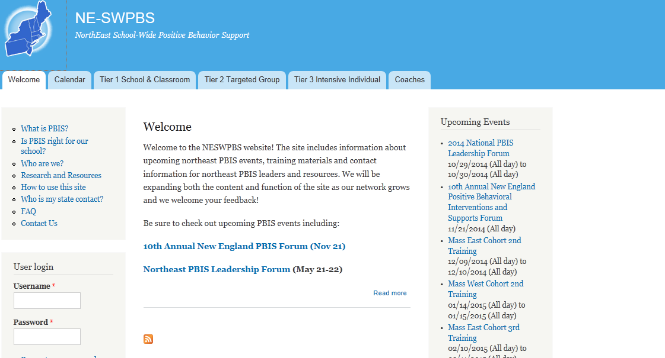
pbis.org
neswpbs.org

