Slide 1
School-Wide Positive Behavioral Interventions and Supports (SWPBIS)
Northeast PBIS (NEPBIS) School-Wide Team Training
Day 9
INSERT TRAINER NAMES
with support from Brandi Simonsen, Jen Freeman,
Susannah Everett, & George Sugai
Notes:
Add trainer names for your event

Slide 2

Advance Organizer
Quick Recap of Day 7-8 Training
Celebrate Accomplishments
Preview of Tiers 2/3
Revisiting Family Engagement and PBIS
Action Planning

Slide 3
Tier 1 Leadership Team & Coaches Meetings
WHAT | WHO
6 days of Team Training | Minimum membership: administrator, grade level representatives, support staff
3 days Coaches Meetings | 2 Coaches
2 days of TA per district | Admin, Coach, Data Entry
YEAR 1
3 days of Team Training | Same above
3 days Coaches Meetings | Same above
2 days of TA per district | Same above
YEAR 2
2 days of Team Training | Same above
3 days Coaches Meetings | Same above
2 days of TA per district | Same above
YEAR 3+
Tier 2 Training will also be offered to schools implementing Tier 1 with fidelity.
Notes:
Modify as appropriate to match your training approach (e.g., change number of TA days, but not training days)

Slide 4
MAIN TRAINING OBJECTIVES in YEAR 2
Enhance leadership team
Maintain staff agreements
Enhance knowledge of SWPBIS outcomes, data, practices, and systems
Refine individualized action plan for SWPBIS
Enhance and sustain implementation in future years

Slide 5
Training Expectations:
RESPECT…
SELF
Self-monitor (Are you participating? Engaged as a learner? Talking during allotted times?)
Stretch, break, stand as needed
OTHERS
Cell phones (inaudible): Converse in lobbies and breaks
ENVIRONMENT
Recycle
Work as a team: Room for every voice, reinforce participation
Maintain neat working area

Slide 6

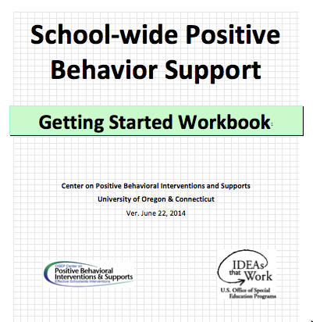

Tools!
nepbis.org
pbis.org
School-wide PBIS Workbook and Appendices
Evaluation Plan
Action Plan

Slide 7






Legend
New Content
Review
Guidelines
+Ex
-Ex
Training Organization
Activity

Slide 8


Legend
Section Header (I.A)
Chapter Header (e.g., I)

Slide 9
Review of Days 7-8

Slide 10
Critical Features of PBIS
We reviewed guidelines, examples, and did a
self-check for critical implementation steps
Supporting Culturally Equitable
Social Competence & Academic Achievement
OUTCOMES
Supporting
Culturally
Knowledgeable
Staff Behavior
Supporting
Culturally Valid
Decision
Making
SYSTEMS
DATA
(Vincent, Randal, Cartledge, Tobin, & Swain-Bradway, 2011; Sugai, O’Keefe, & Fallon 2012 ab)
PRACTICES
I.C
Supporting Culturally Relevant
Evidence-based Interventions
Notes:
Use data
Focus on outcomes: Academic & behavior success
On-going evaluation
Ensure cultural and contextual fit
Invest in systems
Organize research-validated practices within a continuum
Instructional & preventative approach
Integration
Tier 1 for all

Slide 11
We Previewed Two
New Tier 1 Topics:
    Equity
    Integrating Initiatives: Bully Prevention

Slide 12
Equity
(adapted from Kent McIntosh)

Slide 13
5-point Intervention to Enhance Equity in School Discipline
(McIntosh et al., 2014)
Use effective instruction to reduce the achievement gap
Implement SWPBIS to build a foundation of prevention
Collect, use, and report disaggregated student discipline data
Develop policies with accountability for disciplinary equity
Teach neutralizing routines for vulnerable decision points
http://www.pbis.org/school/equity-pbis
Notes:
Step 5 teach neutralizing routines – this will be guided by data!

Slide 14
Integrating Initiatives:
Bully Prevention in PBIS
(adapted from George Sugai, Aug 2010)

Slide 15
PBIS Prevention Goals & Bullying Behavior
Goal 1
Establish positive, predictable, consistent, rewarding school culture for all across all settings
Goal 2
Teach social skills that work at least as well as or better than problem behavior
Goal 3
Respond to nonresponsive behavior proactively & differently, rather than reactively & more of same
Goal 4
Actively supervise & precorrect for problem behaviors & settings, especially nonclassroom

Slide 16
We focused on classroom practices and systems
School-wide
Classroom
Non-classroom
Family
Student

Slide 17
Evidence Based Practices in Classroom Management
Maximize structure in your classroom.
Post, teach, review, monitor, and reinforce a small number of positively stated expectations.
Actively engage students in observable ways.
Establish a continuum of strategies to acknowledge appropriate behavior.
Establish a continuum of strategies to respond to inappropriate behavior.
(Simonsen, Fairbanks, Briesch, Myers, & Sugai, 2008)

Slide 18

Another useful resource from OSEP and pbis.org

Slide 19
We shifted our focus to systems and discussed one way to start organizing our implementation supports
Context
It:
EBP
Who:
Implementation “Supporters”
How:
Train, prompt, use data
Where:
Teacher / Classroom
We know what these are!
We know where!
But…
?
?
Expert
Self
How often?
Who needs what?
Peer
On what?
(Adapted from Fixsen, Naoom, Blasé, Friedman, & Wallace, 2005, p.12)
Notes:
Fixsen, D. L., Naoom, S. F., Blase, K. A., Friedman, R. M. & Wallace, F. (2005). Implementation Research: A Synthesis of the Literature. Tampa, FL: University
of South Florida, Louis de la Parte Florida Mental Health Institute, The National Implementation Research Network (FMHI Publication #231).

Slide 20
Multi-tiered Framework of Professional Development Support
Tier 3
Intensive PD: Data-driven Consultation
Tier 2
Targeted PD: Self-Management with Peer or Coaching Supports
Tier 1
Universal PD: Training & Self-Management
Progress Monitoring
Walk-through, Student Data Review, Teacher Collected Data
Universal Screening
Walk-through & Student Data Review
(adapted from Simonsen, MasSuga, Briere, Freeman, Myers, Scott, & Sugai, 2013)

Slide 21
School
“Show and Tell”

Slide 22
Activity:
Show, Tell, and Ask
Work as team for 10 min
Review your action plan and identify
  1-2 accomplishments since last time we met
  1-2 questions or concerns shared by most members of team
You’ll have 3-5 min to show, tell, and ask!

Slide 23
Preview of
Advanced Tiers
See new Chapter 5 in your workbook
(download updated version at nepbis.org)
V

Slide 24

Preview of Tier II
V.C.i

Slide 25
Continuum of School-Wide
Instructional and Positive Behavior Support
TIER 1:
School-/Classroom-
Wide Systems for
All Students,
Staff, & Settings
~15%
TIER 2:
Specialized Group
Systems for Students with At-Risk Behavior
~80% of Students

Slide 26
What is needed to consider secondary intervention?
SWPBS Systems established, including:
SWPBS Practices established, including:
School board/district/regional support
SWPBS Leadership Team
Administrator endorsement and active participation
Continuous, data-based professional development (training and coaching)
Recognition of staff behavior, contributions, and/or accomplishments
School-wide data system
3-5 positively stated and defined school-wide expectations
Expectations regularly taught in both classroom and non-classroom settings
School-wide reinforcement plan to acknowledge expected behavior
Plan and continuum of consequences for rule violations
Evidence-based classroom management practices
V.C.i

Slide 27
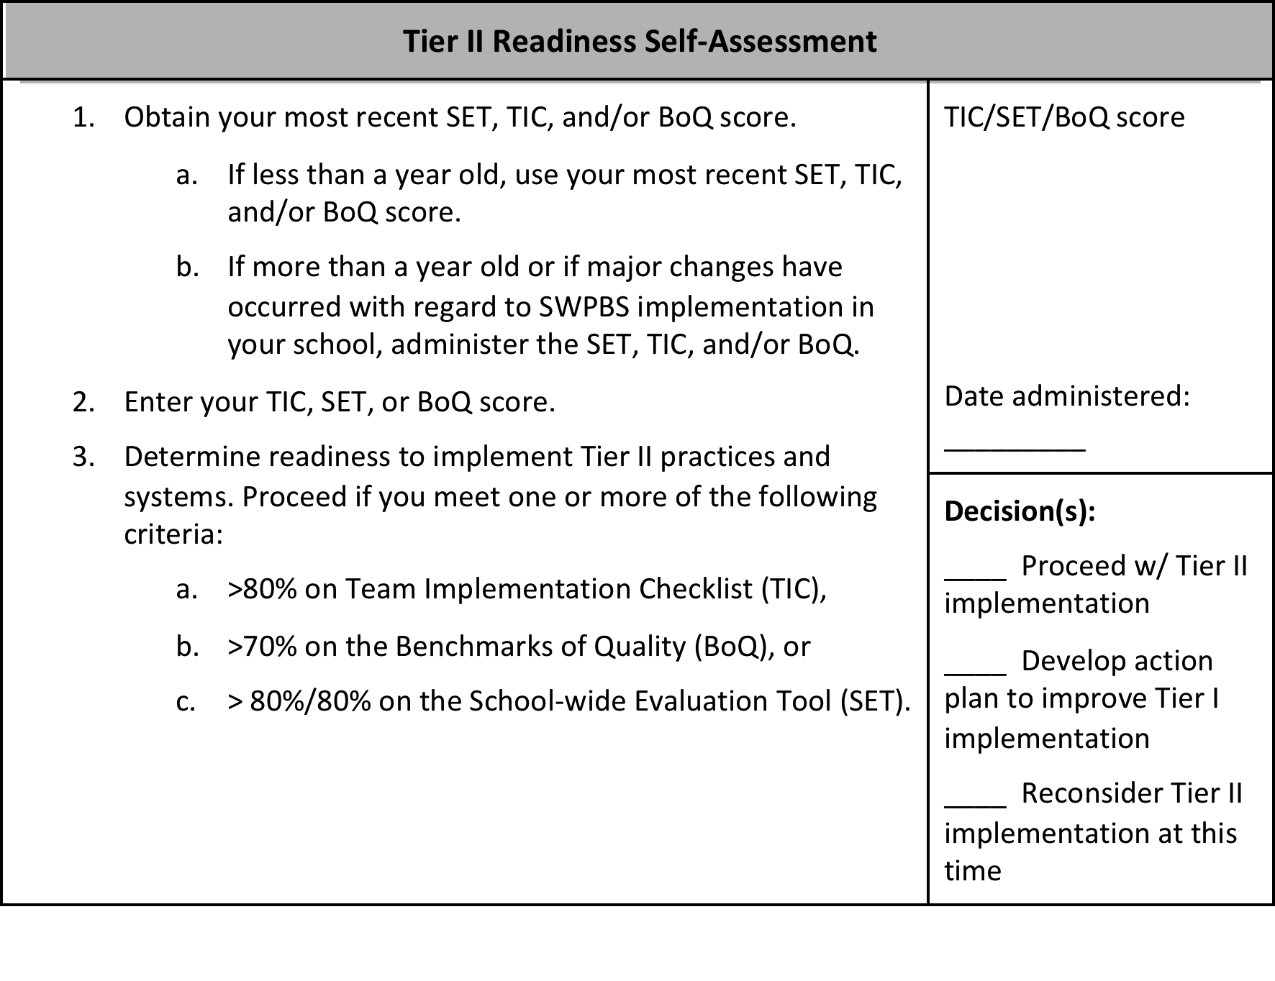
STOP
V.C
If Tier I practices and systems are not firmly in place, reconsider implementation of Tier II practices and systems at this time.

Slide 28
Common Secondary Intervention Features
Consistent, standardized implementation across students
Easily accessible (e.g., within a few days of referral)
Continuous availability
Implemented by all school staff
Consistent with and extra doses of school-wide expectations and interventions
Continuous utilization of data for decision-making (e.g., progress monitoring)
(Crone, Horner, & Hawken, 2010)
V.C.i

Slide 29
Possible Solution
Check-In Check-Out (CICO) is a commonly utilized and well-researched Tier II intervention
(Crone, Horner, & Hawken, 2010)

Slide 30
CICO Cycle
(Crone, Horner, & Hawken, 2004)
Referral,
Assessment,
& Orientation
CICO Plan
All of this is managed by a Specialized Support Team
Morning Check-In
Weekly BEP Meeting
9 Week Graph Sent
Home Check-In
Daily Teacher Evaluation
Program Update
Afternoon Check-In
EXIT

Slide 31
Specialized Support Team:
Roles, Responsibilities, & Functions
Provide training and support to school staff regarding the program(s)
Provide specialized behavioral assessment strategies, interventions, and supports
Meet regularly (e.g., weekly or biweekly) to review the program, monitor individual student progress, and review new referrals
Coordinate school-wide implementation of the overall Tier II practices and systems
Develop screening procedures and data-based decision rules for referring students to intervention
Develop data-based decision rules (including time frames) for placing students, monitoring progress, and fading the intervention
Summarize and review data
V.C.i

Slide 32
Specialized Support Team:
Membership Examples
Representative from SWPBS Leadership Team
Tier II Intervention Coordinator
School Administrator
Behavior Specialists (e.g., school counselor, school psychologist, social worker, special educator)

Slide 33
TAKE AWAY MESSAGE
Secondary systems efficiently support a small group of students by increasing prompts, structure, and opportunities for reinforcement.

Slide 34
Preview of Tier III
V.C.ii

Slide 35
Continuum of School-Wide
Instructional and Positive Behavior Support
Tier 3:
Specialized
Individualized
Systems for Students with High-Risk Behavior
~5%
TIER 1:
School-/Classroom-
Wide Systems for
All Students,
Staff, & Settings
~15%
TIER 2:
Specialized Group
Systems for Students with At-Risk Behavior
~80% of Students

Slide 36

Individual’s Movement Throughout the Continuum of Supports
Events in Bean’s life are associated with an increase in severe behaviors.
Bean is successfully faded from staff-managed to self-managed Tier 2 supports.
Then, Bean starts to display at-risk behaviors and needs additional (Tier 2) support to be successful.
Luckily, Bean receives comprehensive function-based supports, which are eventually faded and is again able to be successful with Tier 1 supports.
Initially, Bean is successful with Tier 1 supports.
Reminder: Supports, NOT KIDS, are organized in tiers.

Slide 37
Individual Student Systems
Behavioral competence at school & district levels
Team- & data-based decision making
Targeted social skills & self-management instruction
Individualized instructional & curricular accommodations
Function-based behavior support planning
Comprehensive person-centered planning & wraparound processes
V.C.ii
Notes:
SAY: If we are successful in establishing effective school-wide, classroom, and non-classroom practices and systems, we can support a majority of students and staff. However, some students will require more specialized, intensive, and possibly individualized PBS.
To be effective in supporting high-need students, behavior specialists must have access to and fluent knowledge about tertiary level interventions and systems as characterized by these 6 sample items. They also must be fluent in the use and facilitation of these skills.
One of the main objectives of school-wide PBS is to facilitate the accurate and sustained implementation of tertiary level interventions with student who display the most challenging problem behaviors.
An important element of individual student systems is adopting a “function-based approach” which generally means using information about what triggers and maintains problem behaviors to build effective behavior intervention plans. Functional behavioral assessments are conducted to build and serve as the backbone of these plans. Two checklists can be used to validate the completeness and accuracy of functional behavioral assessments and behavior intervention plans (see Appendices 7 & 8, respectively).

Slide 38
Individualized Behavioral Interventions
Students benefit from function-based support (e.g., Crone & Horner, 2003)
  All behavior occurs in a context.
  By looking at the behavior in context, we can hypothesize about the function of a student’s behavior.

Slide 39
Behavior Support Elements
*Response class
*Routine analysis
*Hypothesis statement
*Function
V.C
*Alternative behaviors
*Competing behavior analysis
*Contextual fit
*Strengths, preferences, & lifestyle outcomes
*Evidence-based interventions
Problem Behavior
Functional Assessment
Team-based
Behavior competence
*Implementation support
*Data plan
Intervention & Support Plan
*Continuous improvement
*Sustainability plan
Fidelity of Implementation
Impact on Behavior & Lifestyle

Slide 40
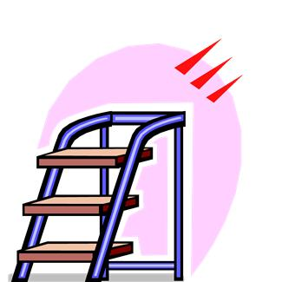
3 Basic Steps:
Developing interventions for Individual Students
3. Develop intervention strategies
Training
Required
2. Choose replacement behaviors
1. Look at the function of behavior

Slide 41
Remember Functions
S^{R+}
S^{R-}

Slide 42
1. Look at the Function of Behavior
What typically precedes?
What do the behaviors look like?
What typically follows?
Based on observing these patterns across time, what is the probable function of the behavior?

Slide 43
Introduction to FBA
We look at the function of the problem behavior and teach the learner a more appropriate way to get their needs met.
We do this by conducting a Functional Behavioral Assessment (FBA) and building a Behavior Intervention Plan (BIP) on the information we collect.

Slide 44
FBA: Collecting Information
An FBA involves collecting information from multiple sources through a variety of methods across time, including:
Records Reviews
Interviews
Direct Observations
Experimental Analysis (Structural/Functional)
Review relevant school records to look for patterns across time
Interview parents, teachers, staff, and student about patterns
Systematically observe behaviors and the context in which they occur
Occasionally, a trained person will need to conduct additional analyses

Slide 45
FBA: Collecting Information
An FBA involves collecting information from multiple sources through a variety of methods across time, including:
Records Reviews
Interviews
Direct Observations
Experimental Analysis (Structural/Functional)
Training
Required

Slide 46
Outcome of FBA
Thus the outcome of the entire FBA process is a supported hypothesis statement, now referred to as a summary statement, which specifies the supported antecedents, behaviors, and function.
That is:
Setting Event
Triggering Antecedent
Problem Behavior(s)
Maintaining Consequences

Slide 47
3 Basic Steps:
Developing interventions for Individual Students
3. Develop intervention strategies
Training
Required
2. Choose replacement behaviors
1. Look at the function of behavior

Slide 48
Fundamental Rule
“You should not propose to reduce a problem behavior without also identifying alternative, desired behaviors person should perform instead of problem behavior”
(O’Neill et al., 1997, p. 71).

Slide 49

2. Choose a Desired Behavior
The desired behavior should be what is expected given the same antecedent event/condition. It likely results in different consequences.
DESIRED BEHAVIOR
NATURAL CONSEQUENCE
(in typical instructional conditions)
PROBLEM BEHAVIOR
MAINTAINING CONSEQUENCE (FUNCTION)

Slide 50
2. Choose a Replacement Behavior
The replacement behavior should be more efficient and effective at achieving maintaining reinforcer (i.e., meeting the same function).
PROBLEM BEHAVIOR
MAINTAINING CONSEQUENCE (FUNCTION)
REPLACEMENT BEHAVIOR
HELP

Slide 51
3 Basic Steps:
Developing interventions for Individual Students
3. Develop intervention strategies
Training
Required
2. Choose replacement behaviors
1. Look at the function of behavior

Slide 52
3. Develop Intervention Strategies
Based on our understanding of the context of problem behavior, we then begin to develop intervention strategies.
ANTECEDENT
MANIPULATIONS
instructional STRATEGIES
CONSEQUENCE
MANIPULATIONS
Ways to prevent the occurrence of behavior
Ways to teach replacement behavior AND shape replacement behavior into desired behavior
Ways to (a) increase occurrences of replacement and desired behaviors and (b) decrease occurrences of target behaviors
…to make the problem behavior
IRRELEVANT
…to make the problem behavior
INEFFICIENT
…to make the problem behavior
INEFFECTIVE

Slide 53
More specifically…
SE or MO
MANIPULATIONS
ANTECEDENT
MANIPULATIONS
WAYS TO TEACH
BEHAVIORS
CONSEQUENCE
MANIPULATIONS
Minimize the likelihood
Neutralize
Withhold S^{D}
Add prompts
Increase reinforcement for desired behavior
Redesign the environment
  Physical arrangement
  Predictability
  Choice
  Instructional variables
Add Prompts and/or pre-corrections
Develop objectives
Teach replacement behavior
Shift from replacement to desired behavior
Increase function-based reinforcement for replacement behavior
Increase reinforcement for desired behavior
Prevent reinforcement for problem behaviors
Training
Required

Slide 54
FBA
Definition of
Problem Behavior
or Class
Testable
Hypothesis
Tier III
Elements
Contextually
Appropriate
Support
Function
Statement
Behavior
Intervention
Plan
Supporting
Data
Competing
Path
Analysis
BSP
See Checklists included in Appendices.
Appendix
G
Appendix
H

Slide 55
TAKE AWAY MESSAGE
Tertiary interventions are intensive, function-based supports for individual students.
The focus is on redesigning environments and teaching functional skills.

Slide 56
Family Engagement
(supported by Andrew Garbacz)

Slide 57
Family Engagement
Families and educators coordinating and collaborating to support children
Embedded in cultural beliefs and ideologies
Active, interactive, and dynamic
  Active: Equal partners in planning, decision-making, and implementation
  Interactive: Work with other stakeholders
  Dynamic: Changes over time
Eccles & Harold; Epstein & Dauber, 1991; Fette et al., 2009; Garbacz (in press); Hill, 2010; Leverson, Smith, McIntosh, Rose, & Pinkelman, 2016; Sheridan, Clarke, & Christenson, 2014; Sheridan, Rispoli, & Holmes, 2014
Notes:
At its core, family engagement involves families and educators coordinating and collaborating to support children. The focus is on coordinating goals and activities across home and school. Collaboration includes families and educators making decisions together and working as partners.
Family engagement is embedded in cultural beliefs and ideologies. Families have different beliefs about education and their role in supporting their child. Part of working together as partners is clearly defining role expectations in a manner that is congruent with family culture and expectations.
Family engagement is active, interactive, and dynamic.
When families are engaged as partners, there is an expectation that family members and educators are active in making plans, setting goals, and carrying out activities to address goals.
Family engagement is also interactive. Collaboration involves working together as a team rather than in isolation.
Family engagement changes over time. Evidence indicates that family engagement is important for children, families, and schools in early childhood, elementary school, middle school, and through high school. However, the nature of how families and educators collaborate as children progress through school changes. For example, as children transition to middle school, families may provide less direct support for homework, but rather will establish systems that support their child to self-monitor during homework time with check-ins, and acknowledgements for appropriate behavior.

Slide 58
Research supports Family Engagement
Students
Achievement (Fan & Chen, 2001)
Attendance (Simon, 2001)
School drop-out (Barnard, 2004)
Social behavior (Fantuzzo, McWayne, Perry, & Childs, 2004; Garbacz & McIntyre, 2016)
Peer affiliations (Garbacz, Zerr, Dishion, Seeley, & Stormshak, in press)
Parents and Teachers
Parent efficacy and competence (Semke, Garbacz, Kwon, Sheridan, & Woods, 2010; Sheridan et al., 2012)
Parent trust of teachers (Santiago, Garbacz, Beattie, & Moore, 2016)
Teachers improved job satisfaction and fewer transfer requests (Christenson, 1995)
Parent-teacher relationship (Sheridan et al., 2017)
Notes:
Decades of research supports the positive associations between family engagement and outcomes for students, parents, and teachers.
Schoolwide family engagement is positively associated with student achievement, school attendance, peer group affiliations, and negatively associated with school drop out, and behavior problems.
Parents and teachers also benefit from working together. Parents’ report improvements in their efficacy for helping their children with schoolwork and their trust of teachers.
Teachers report improved job satisfaction and tend to request fewer transfers.
When parents and teachers collaborate to support children’s behavior, child behavior improves, parents and teachers report improvements in their problem-solving competences, and the relationship parents and teachers share improves.

Slide 59
Key Family Engagement Approaches
Define family engagement at the school and district level that is linked to systems and practices
Improve proactive outreach to families and strengthen multidirectional communication
Differentiate approaches so all families can access information and engage
Assume that the most effective and efficient support for a student is from their family
Dishion (2011); Garbacz (in press); Horner (2017); Mapp & Hong (2010); Moore et al. (2016)
Notes:
Research results suggest support for a few key family engagement approaches.
One of the first things to focus on is creating support for family engagement at the district and school level. It is important to clarify the district’s approach to family engagement with role definitions for schools and families.
In addition, evidence indicates families typically wait for schools to contact them about working together. Thus, it is important for schools to reach out proactively to families to initiate a collaborative relationship. Such an approach is also an opportunity to establish communication pathways. Common approaches to communication include sending material or notices home to families (e.g., approval for a field trip) rather that establish communication systems that support multidirectional communication, or communication that can initiate from families or schools and flow easily back-and-forth.
We know that families differ with regard to their beliefs about education, expectations for schooling, and availability and motivation to collaborate. Thus, family engagement systems support activities and practices that provide a range of opportunities and experiences for families to collaborate. Logistically, this can include holding school events at community centers that may be easier for families to attend. It also means holding events at different times over months and years. Although such approaches require an investment in educator time, they reflect a commitment to working with all families in the school community.
Finally, collaborating with families is often viewed as something extra or an add-on that requires an investment in resources without an associated tangible benefit for students. However, the most efficient and effective support for students is their family. By organizing systems to support families use of evidence-based approaches at home with their children and through coordinating home and school supports, we can actually positively influence child development and promote academic, behavior, and life success.

Slide 60

Approaches to Family Engagement in PBIS
Engage families in PBIS at school
Support families to use positive behavior support at home
Coordinate practices across home and school
Garbacz (in press)
Notes:
There are several research informed approaches to engage families in PBIS. These approaches emphasize engaging families in PBIS at school, extending the core features of positive behavior support to the home setting, and coordinating support across home and school.
The next three slides describe each family engagement domain in depth.
If you would like to learn more after this session, you can download an e-book from pbis.org, ”Aligning and Integrating Family Engagement in Positive Behavioral Interventions and Supports.”
LINK: https://www.pbis.org/Common/Cms/files/pbisresources/Family%20Engagement%20in%20PBIS.pdf

Slide 61
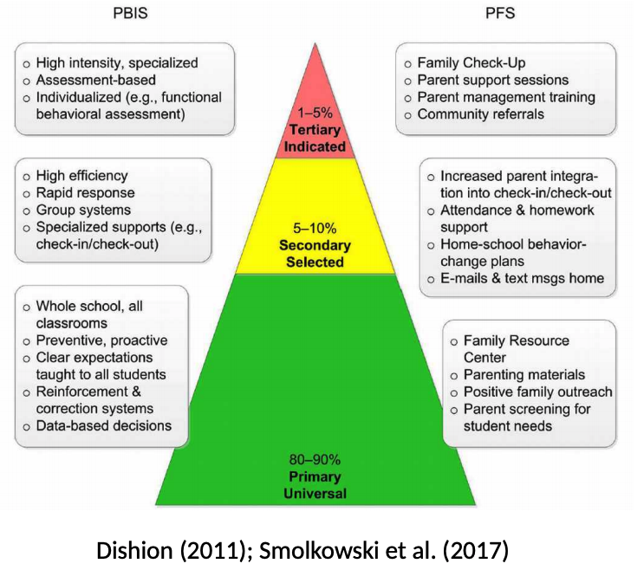
Family-School Partnerships embedded in PBIS

Slide 62
Collaborate with Families in PBIS
Build Systems
Use Data
Implement Practices
Problem Solving collaboration
Communication
Resources and support
Family-school engagement
Home-school relationships
Student social behavior
Student academic performance
School approaches
Home and community
Home-school-community

Slide 63

Engage Families in PBIS at School
Establish family representation on the Tier 1 team
  Consider including two family members on the team
Make PBIS materials family friendly
  PBIS materials for families could include brochures, videos, and parenting handouts
Create a family advisory group that can advise administration and the Tier 1 team
  The family advisory group includes families at all school levels
Garbacz (in press)
Notes:
There are a few strategies that may be helpful to engage families in PBIS at school
Establishing family representation on the Tier 1 team allows families to have a voice in decision making. Many schools choose to have two family members on the team, one with a child in special education and one with a child who is not in special education.
The family member can help support the Tier 1 team to focus on Tier 1 rather than student level issues.
Another useful strategy is to make PBIS materials family friendly so families understand PBIS and how it is used at school. Helping families understand PBIS will make it easier for them to provide advice and feedback.
A family advisory group at the school may be helpful to prepare materials, and advise administration and the Tier 1 team. Such an advisory group includes a small group of families (e.g., 5-7) that represent all grades in a school.

Slide 64

Approaches to Engage Families in PBIS: Support Families to use PBIS at Home
Create and roll out a home matrix
  Create home matrices with families at a school event and make examples available
Distribute parenting materials and resources
  Consider brochures and videos about using positive behavior support at home, such as setting expectations and using acknowledgements
Hold parenting sessions at school to provide training in positive parenting
  Parenting sessions can be scoped and sequenced to provide a range of skill-building
Garbacz (in press)
Notes:
Supporting family use of positive behavior support at home includes a few key features.
First, the school can work with families to create and roll out a home matrix. Many schools create the matrix with families so they are individualized to each family’s home. One idea is to hold an event at the school with dinner and after the meal Tier 1 team members can work with families at table groups as they create a home matrix.
It is also helpful to have example matrices available for families who cannot attend the school event.
Second, parenting materials in the form of brochures, videos, or handouts (e.g., supporting homework time) can be created and shared with families.
Parenting materials can focus on the core features of positive behavior support, such as setting expectations, using acknowledgements, and setting limits
Third, parenting sessions at the school and community can build parent knowledge and skills in positive parenting. Parenting sessions can be included in a scope and sequence so families can build their knowledge and skills in each component of positive behavior support.

Slide 65
Example Home Matrix
 | All settings | Morning routine | Homework | Meals | Evening routine
Be responsible | Complete daily tasks Talk to an adult when you have a question Be prepared | Follow morning routine Have all materials for school Complete routine on time schedule | Organize materials Complete assignments Check in with an adult to review progress and ask questions | Complete preparations, as instructed Clean up the area when done, as instructed | Follow the evening routine Go to bed on time
Be respectful | Help others in the home Clean up shared spaces Use kind words and gestures | Follow the time schedule Help others get ready after you are ready Use greetings | Be kind when working with others Clean up the area when finished Start and finish on time | Use kind words and gestures during the meal Help others who need assistance | Be considerate to others who are sleeping Use quiet voices
Be safe | Follow directions Wait your turn Use household materials properly | Watch where you are going Keep objects to self Keep materials clear of shared space | Use materials appropriately Ask for permission before working with others | Clean up before meals Treat hot objects with care Use meal items and objects appropriately | Wait for others Use bedtime items appropriately Stay in assigned area, but ask for help if needed
Garbacz (in press)
Notes:
This table shows an abbreviated home matrix that could be adapted for your school and families.
Columns depict settings at home
Rows reflect schoolwide expectations.

Slide 66

Approaches to Engage Families in PBIS: Coordinate Practices Across Home and School
Proactively reach out to families
  Consider a beginning of the year parent readiness screener
Hold events at the school and in the community
  A family-school-community event can build connections between families and community stakeholders
Establish systems to support multidirectional communication
  The beginning of the year readiness screener could set a course for multidirectional communication
Garbacz (in press); Garbacz, Beattie, Masser, & DeGarmo (in press); Moore et al. (2016); Smolkowski et al. (2017)
Notes:
A key area of emphasis in family engagement is creating consistency across home and school. In this way, students experience their two primary settings as safe, positive, predictable, and congruent.
Proactive outreach to families allows schools to have a first positive contact to establish a collaborative relationship. This could be paired with a parent screener that allows parents to report on academic and behavior strengths and needs. Schools can use the information parents provide to support home-school collaboration and student behavior across the school year.
Events at the school and in the community promotes relationship-building among parents and across parents and educators. A community event at the school can build connections among families and with community organizations and stakeholders.
Finally, multidirectional communication systems give families and educators equal opportunities to initiate contact with minimal response effort. Then, the parties can exchange information back-and-forth. An emphasis on multidirectional communication perpetuates a focus on collaboration rather than one-directional communication, such as from the school to the home.

Slide 67

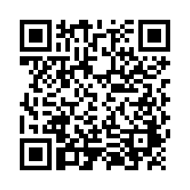
Examining School Approaches to Family Engagement in PBIS
The family-school practices survey for school teams is a self-assessment and action planning tool.
Implementation of school approaches to family engagement are assessed in several areas:
  Communication
  Family-School Activities
  PBIS Practices at Home and School
  Decision-Making/Shared-Ownership
  Resources
Garbacz, McIntosh, & Eagle (2014)
Notes:
The family-school practices survey was designed for school teams to use as a self-assessment and action planning tool.
The tool allows school teams to rate implementation of school approaches to engaging families in PBIS across several dimensions
Dimensions on the tool include
Systems-level problem solving, which assesses team activities to promote family engagement
Data-based decision making
School-home communication about PBIS
Resources to support family engagement, and
PBIS practices at home and school
Take a few minutes to complete the self-assessment, identify areas of strength and need, and complete the action plan at the end of the tool to target areas of need that build on strengths
Link to assessment: https://uconn.co1.qualtrics.com/jfe/form/SV_4U9QPw9ASvLr83z

Slide 68
Activity:
Examine your Family-School Practices
Work as team for 20 min
Review all content
Complete and use the Family-School Practices Survey
Add 2 to 3 items to your action plan based on priorities discussed while completing the survey
Identify one person who will present big ideas from action planning for your group

Slide 69
Activity:
Tier 1 Questions and Answers
Work as team for 15 min
Time to refocus on Tier 1 implementation!
With your group brainstorm 2-3 questions that you still have related to Tier 1.
Share questions, responses, and solutions as a large group.

Slide 70
SWPBIS Action Planning with the TIC

Slide 71
Activity:
Action Planning
Work as team for 75 min
Complete the Team Implementation Checklist
Return to your Action Plan
Focus on classroom practices and systems discussed today, and review classroom data summarized by your coach.
Identify relevant resources and steps to help move your school forward.
Present 2-3 “big ideas” from your group (1 min. reports)

Slide 72
Review of SWPBIS

Slide 73
Critical Features of PBIS
Supporting Culturally Equitable
Social Competence & Academic Achievement
OUTCOMES
Supporting
Culturally
Knowledgeable
Staff Behavior
Supporting
Culturally Valid
Decision
Making
SYSTEMS
DATA
(Vincent, Randal, Cartledge, Tobin, & Swain-Bradway, 2011; Sugai, O’Keefe, & Fallon 2012 ab)
PRACTICES
I.C
Supporting Culturally Relevant
Evidence-based Interventions
Notes:
Use data
Focus on outcomes: Academic & behavior success
On-going evaluation
Ensure cultural and contextual fit
Invest in systems
Organize research-validated practices within a continuum
Instructional & preventative approach
Integration
Tier 1 for all

Slide 74
Multi-tiered Framework of Professional Development Support
Tier 3
Intensive PD: Data-driven Consultation
Tier 2
Targeted PD: Self-Management with Peer or Coaching Supports
Tier 1
Universal PD: Training & Self-Management
Progress Monitoring
Walk-through, Student Data Review, Teacher Collected Data
Universal Screening
Walk-through & Student Data Review
(adapted from Simonsen, MasSuga, Briere, Freeman, Myers, Scott, & Sugai, 2013)

Slide 75
Continuum of School-Wide
Instructional and Positive Behavior Support
~15%
TIER 2:
Specialized Group
Systems for Students with At-Risk Behavior
~80% of Students

Slide 76
CICO Cycle
(Crone, Horner, & Hawken, 2004)
Referral,
Assessment,
& Orientation
CICO Plan
All of this is managed by a Specialized Support Team
Morning Check-In
Weekly BEP Meeting
9 Week Graph Sent
Home Check-In
Daily Teacher Evaluation
Program Update
Afternoon Check-In
EXIT

Slide 77
Continuum of School-Wide
Instructional and Positive Behavior Support
Tier 3:
Specialized
Individualized
Systems for Students with High-Risk Behavior
~5%
~15%
~80% of Students

Slide 78
Behavior Support Elements
*Response class
*Routine analysis
*Hypothesis statement
*Function
*Alternative behaviors
*Competing behavior analysis
*Contextual fit
*Strengths, preferences, & lifestyle outcomes
*Evidence-based interventions
Problem Behavior
Functional Assessment
Team-based
Behavior competence
*Implementation support
*Data plan
Intervention & Support Plan
*Continuous improvement
*Sustainability plan
Fidelity of Implementation
Impact on Behavior & Lifestyle

Slide 79
Consider Tattoos!
4 PBIS Elements
School Systems
Supporting Social Competence &
Academic Achievement
OUTCOMES
School-wide
Classroom
SWPBIS
SYSTEMS
DATA
Supporting
Decision
Making
Supporting
Staff Behavior
Non-classroom
Family
PRACTICES
Tertiary Prevention:
Specialized
Individualized
Systems for Students with High-Risk Behavior
~5%
Student
Supporting
Student Behavior
Primary Prevention:
School-/Classroom-
Wide Systems for
All Students,
Staff, & Settings
~15%
Secondary Prevention:
Specialized Group
Systems for Students with At-Risk Behavior
~80% of Students

Slide 80
Next Steps

Slide 81
Implement Action Plan
Communicate information to staff
Meet monthly with team
  Review school data
  Review/update action plan
Implement activities on action plan
Use fidelity (e.g., TFI) and outcome (e.g., ODR) data to guide your decision making

Slide 82
Future Support
Use your action plan, data, TIC, and TFI to hold your team accountable (and share info with us).
Keep in touch with us.
Teams will still meet twice next year.
Have a great spring and summer!

Slide 83
Consider Tattoos!
4 PBIS Elements
School Systems
Supporting Social Competence &
Academic Achievement
OUTCOMES
School-wide
Classroom
SWPBIS
SYSTEMS
DATA
Supporting
Decision
Making
Supporting
Staff Behavior
Non-classroom
Family
PRACTICES
Tertiary Prevention:
Specialized
Individualized
Systems for Students with High-Risk Behavior
~5%
Student
Supporting
Student Behavior
Primary Prevention:
School-/Classroom-
Wide Systems for
All Students,
Staff, & Settings
~15%
Secondary Prevention:
Specialized Group
Systems for Students with At-Risk Behavior
~80% of Students

Slide 84

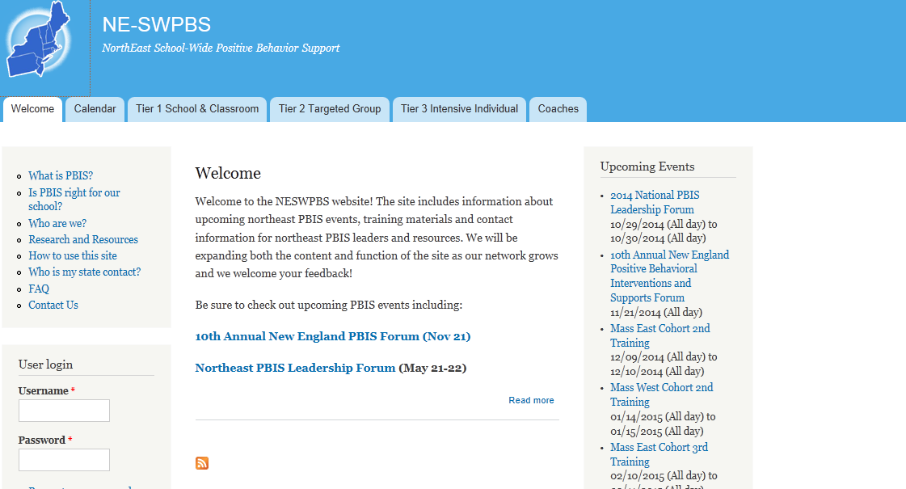
pbis.org
neswpbs.org

