Slide 1
School-Wide Positive Behavioral Interventions and Supports (SWPBIS)
Northeast PBIS (NEPBIS) School-Wide Team Training
Day 3
[Add Trainer Names Here]
with support from Brandi Simonsen, Jen Freeman,
Susannah Everett, & George Sugai
Wireless: Mechanics Hall
Password: mhall1857
Notes:
Add trainer names for your event

Slide 2

Advance Organizer
Review
Getting Started with SWPBIS (steps 7-10)
Action Planning

Slide 3
MAIN TRAINING OBJECTIVES
Establish leadership team
Establish staff agreements
Build working knowledge of SWPBIS outcomes, data, practices, and systems
Develop individualized action plan for SWPBIS
Organize for upcoming school year

Slide 4
Training Expectations:
RESPECT…
SELF
Self-monitor (Are you participating? Engaged as a learner? Talking during allotted times?)
Stretch, break, stand as needed
OTHERS
Cell phones (inaudible): Converse in lobbies and breaks
ENVIRONMENT
Recycle
Work as a team: Room for every voice, reinforce participation
Maintain neat working area

Slide 5



Tools!
nepbis.org
pbis.org
School-wide PBIS Workbook and Appendices
Evaluation Plan
Action Plan

Slide 6


Activity:
Please Enter Attendance
1 min
Please login on nepbis.org, go to the coaches’ tab, and click on the Team Training Attendance Link. Follow prompts to enter team attendance.

Slide 7

Review
Overview & Getting Started with SWPBIS
(Days 1-2)

Slide 8
Overview of School-wide Positive Behavior Support
(Chapter I)

Slide 9

SWPBIS is
Framework for enhancing adoption & implementation of
Continuum of evidence-based interventions to achieve
Academically & behaviorally important outcomes for
All students
I.B.i

Slide 10
SWPBIS Message!
Successful individual student behavior support is linked to host environments or school climates that are effective, efficient, relevant, & durable.
(Zins & Ponti, 1990)
I.A.i

Slide 11
Critical Features of SWPBIS
Supporting Culturally Equitable
Social Competence & Academic Achievement
OUTCOMES
Supporting
Culturally
Knowledgeable
Staff Behavior
Supporting
Culturally Valid
Decision
Making
SYSTEMS
DATA
(Vincent, Randal, Cartledge, Tobin, & Swain-Bradway, 2011; Sugai, O’Keefe, & Fallon 2012 ab)
PRACTICES
I.C
Supporting Culturally Relevant
Evidence-based Interventions
Notes:
Use data
Focus on outcomes: Academic & behavior success
On-going evaluation
Ensure cultural and contextual fit
Invest in systems
Organize research-validated practices within a continuum
Instructional & preventative approach
Integration
Tier 1 for all

Slide 12

Guidelines for Good Outcomes
OUTCOMES
Based on data
Locally important and meaningful
Applicable to all (culturally equitable)
  Students’ social competence and academic achievement
  Staff implementation of critical skills
Observable and measurable
Write as goal
I.C.i

Slide 13
Evaluation plan
DATA
DISTRICTS/SCHOOLS IN TRAINING |  |  | SCHEDULE
Purpose | Measure | Function | Year 1 Training |  | Year 2 Training
 |  |  | Winter | Spring | Fall | Winter | Spring
Capacity Building—District Level | District Capacity Assessment (DCA) | Completed by district leadership team (with the support of a trained facilitator) to assess district capacity and to guide Action Planning. |  | X |  |  | X
Fidelity of Implementation—Building Level | PBIS Tiered Fidelity Inventory (TFI) | Leadership team self-evaluation (with support of external coach) to assess the critical features of PBIS across Tiers I, II, and III. |  | X | X |  | X
Progress Monitoring—Building Level | Self-Assessment Survey (SAS) | Used by school staff for initial and annual assessment of effective behavior support systems in their school and to guide Action Planning. |  | X |  |  | X
Progress Monitoring—Team Level | Team Implementation Checklist (TIC) | A self-assessment tool that serves as a multi-level guide for creating School-Wide PBIS Action Plans and evaluating the status of implementation activities. | X | X | X | X | X
School Climate | Georgia School Climate Surveys | An annual survey that assesses student (grades 3-12), teacher, and parent perceptions of school climate. The middle and high school surveys also include items about adolescent drug/alcohol/tobacco use, self-harm ideation and behaviors, school dropout, and parental involvement. The survey provides information to determine training support needs related to school climate, safety, and violence prevention. |  | X | X
Student Outcomes | School-wide Information System (SWIS) | Office discipline referrals (ODR) provide data for monthly team reviews and decision-making by teachers, administrators, and other staff to guide prevention efforts and Action Planning. | Weekly | Weekly | Weekly | Weekly | Weekly
…and tools available at:

Slide 14
SWPBIS
Practices
PRACTICES
School-wide
Classroom
Smallest #
Evidence-based
Biggest, durable effect
Non-classroom
Family
Student
I.C.iii

Slide 15
Universal
Targeted
Intensive
Continuum of Support for ALL
PRACTICES
Few
Some
All
I.C.iii
(Sugai, Dec 7, 2007)
Notes:
NOTICE GREEN GOES FOR “ALL”
Focus on Tier 1- important to build a solid tier 1 first!! Resist the push to do tier 2/3 first!

Slide 16
Key Systems Features
SYSTEMS
Staff Buy-in
Embedded Professional Development
Staff Recognition for Implementation
Team-based Implementation
Clear Action Plan
I.C.iv
Notes:
Build section numbers, color coding, and structure into ppt.

Slide 17
GENERAL IMPLEMENTATION PROCESS
Team
SYSTEMS
Agreements
Data-based
Action Plan
Evaluation
Implementation
I.C.iv
Notes:
SAY: In general, the implementation of a school-wide PBS approach at the school level is built around five main implementation steps.
Example- this process stays with you the whole time!

Slide 18
Guidelines for Systems
SYSTEMS
For each item in your action plan, ensure…
Agreement by >80% faculty and staff
Include procedures for informing others (e.g. families, community, district administrators, substitute teachers & staff)
Includes procedures for providing instruction to new faculty, staff, students, etc.
Schedule continuous evaluation of effectiveness, efficiency, and relevance
Include in school publications (e.g., handbook, posters, newsletters)
I.C.iv
Notes:
This will come back every time we talk about adding a practice!

Slide 19
Guidelines for Culture & Context
Culture & Context
For each item in your action plan, ensure…
Involve staff, students, & families in development
Contextually/culturally appropriate (e.g., age, level, language)
Examine disaggregated data to ensure implementation of each feature works for all subgroups of students
I.C.v
Notes:
This will also come back every time we introduce a new practice data source or system.

Slide 20
Overview of School-wide Positive Behavior Support
(Chapter II)

Slide 21
Getting Started with SWPBIS
Establish an effective leadership team
Develop brief statement of behavioral purpose
Identify positive SW behavioral expectations
Develop procedures for teaching SW expectations
Develop procedures for teaching class-wide expectations
Develop continuum for strengthening appropriate behavior
Develop continuum for discouraging violations of expectations
Develop data-based procedures for monitoring
Develop systems to support staff
Build routines to ensure on-going implementation
Day 1
Day 2
Day 3
Notes:
Today is your day to check the first steps. – make sure you have good family and student voice,

Slide 22
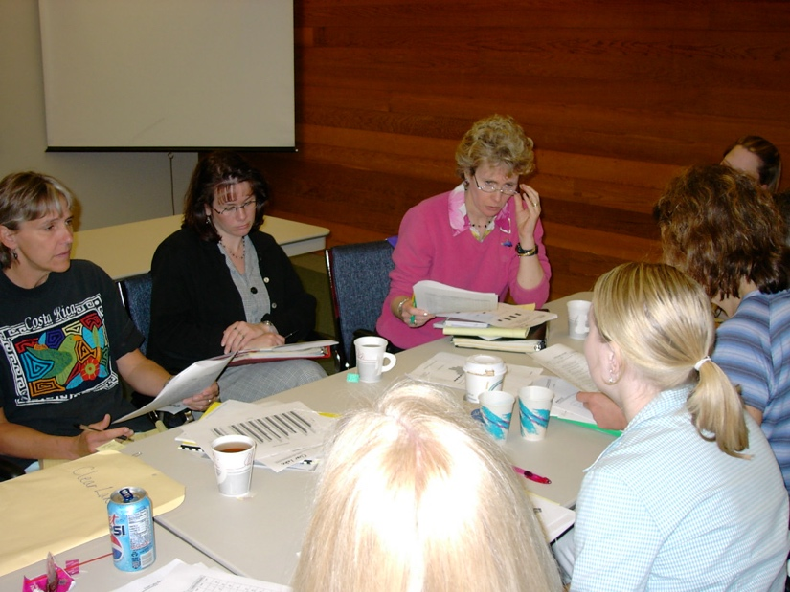
Getting Started with SWPBIS
Establish an effective leadership team
Develop brief statement of behavioral purpose
Identify positive SW behavioral expectations
Develop procedures for teaching SW expectations
Develop procedures for teaching class-wide expectations
Develop continuum for strengthening appropriate behavior
Develop continuum for discouraging violations of expectations
Develop data-based procedures for monitoring
Develop systems to support staff
Build routines to ensure on-going implementation
Start with a representative team, including admin, that “works.”
And…if the same people always work…work smarter!
Do less…better
Do it once
Invest in clear outcomes
Invest in a sure thing
Be strategic about problem solving
SYSTEMS
II.B.1
Notes:
GO back and re-visit the getting smarter activity regularly

Slide 23
Getting Started with SWPBIS
Establish an effective leadership team
Develop brief statement of behavioral purpose
Identify positive SW behavioral expectations
Develop procedures for teaching SW expectations
Develop procedures for teaching class-wide expectations
Develop continuum for strengthening appropriate behavior
Develop continuum for discouraging violations of expectations
Develop data-based procedures for monitoring
Develop systems to support staff
Build routines to ensure on-going implementation
At Abrigato School, we treat each other with respect, take responsibility for our learning, and strive for a safe and positive school for all!
PRACTICES
II.B.ii
Notes:
How many have gotten staff student and family input on your behavioral purpose statement.

Slide 24
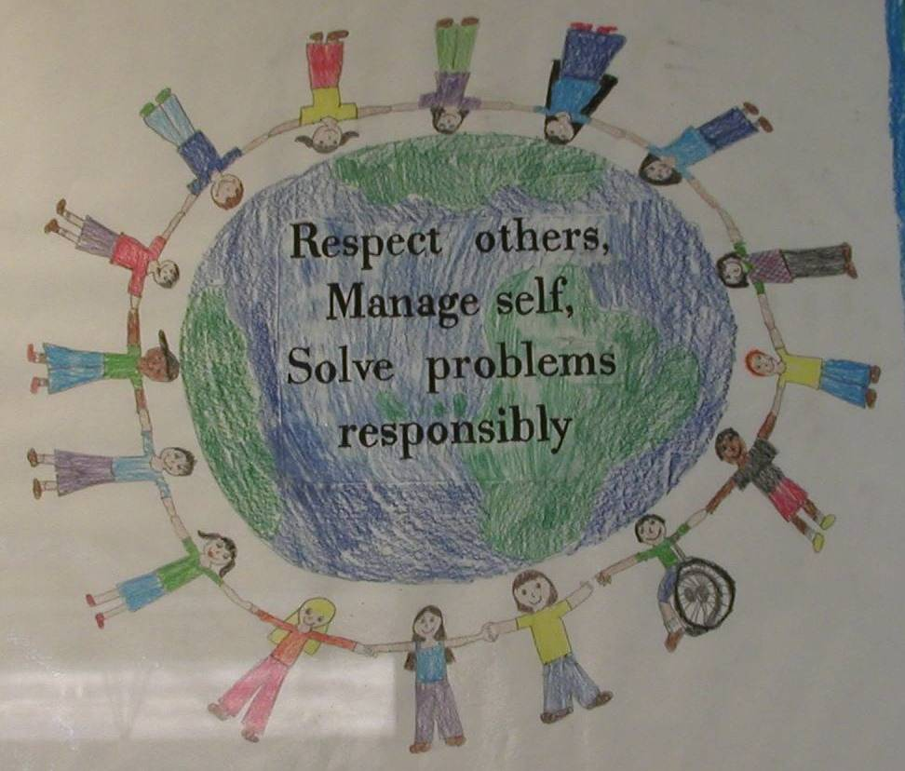
Getting Started with SWPBIS
Establish an effective leadership team
Develop brief statement of behavioral purpose
Identify positive SW behavioral expectations
Develop procedures for teaching SW expectations
Develop procedures for teaching class-wide expectations
Develop continuum for strengthening appropriate behavior
Develop continuum for discouraging violations of expectations
Develop data-based procedures for monitoring
Develop systems to support staff
Build routines to ensure on-going implementation
PRACTICES
II.B.iii
Notes:
How many have expectations, how many have staff input? Student in put? Family input?

Slide 25
Getting Started with SWPBIS
Establish an effective leadership team
Develop brief statement of behavioral purpose
Identify positive SW behavioral expectations
Develop procedures for teaching SW expectations
Develop procedures for teaching class-wide expectations
Develop continuum for strengthening appropriate behavior
Develop continuum for discouraging violations of expectations
Develop data-based procedures for monitoring
Develop systems to support staff
Build routines to ensure on-going implementation
Teaching social behavior explicitly?
Like academic behavior
PRACTICES
II.B.iv
Notes:
How is this going? This is the power of PBIS- spend time here!!
We know this is a key to successful implementation
Do you have your draft? Feedback from staff? Students? Family?
Q- if we haven’t gotten feedback yet do we have to start over? No collect feedback especially on how you teach this and suggest that you can incorporate this feedback into your next drafts

Slide 26

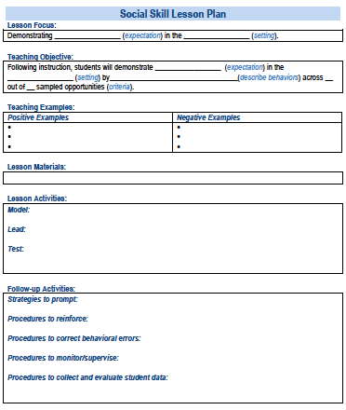

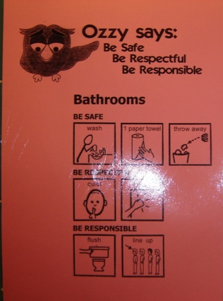
In other words…we discussed that you should follow these key steps
Define
Teach
Prompt
Monitor
Evaluate
II.B.iv
Notes:
How many of you have drafted lesson plans? Working on creating prompts, working on active supervision? Data collection systems

Slide 27
Getting Started with SWPBIS
Establish an effective leadership team
Develop brief statement of behavioral purpose
Identify positive SW behavioral expectations
Develop procedures for teaching SW expectations
Develop procedures for teaching class-wide expectations
Develop continuum for strengthening appropriate behavior
Develop continuum for discouraging violations of expectations
Develop data-based procedures for monitoring
Develop systems to support staff
Build routines to ensure on-going implementation
Same deal…in context of classroom settings and routines
PRACTICES
II.B.v
Notes:
This is the non-negotiable is teachers teaching the expectations in their classrooms

Slide 28
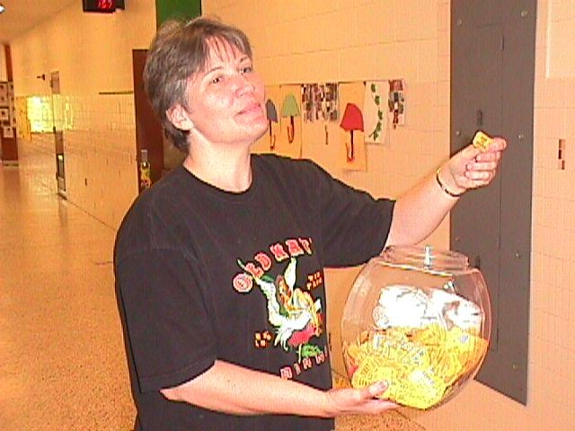
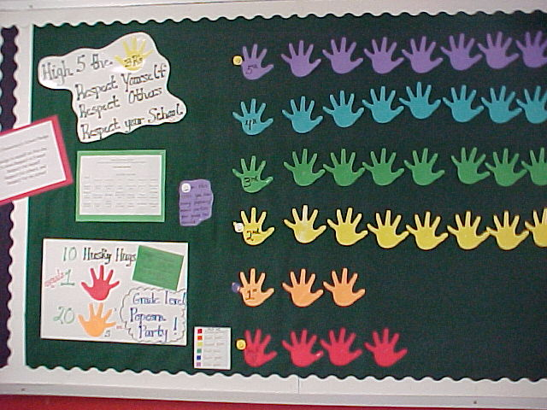
Getting Started with SWPBIS
Establish an effective leadership team
Develop brief statement of behavioral purpose
Identify positive SW behavioral expectations
Develop procedures for teaching SW expectations
Develop procedures for teaching class-wide expectations
Develop continuum for strengthening appropriate behavior
Develop continuum for discouraging violations of expectations
Develop data-based procedures for monitoring
Develop systems to support staff
Build routines to ensure on-going implementation
PRACTICES
II.B.vi
Notes:
Praise is the non-negotiable. Use a token system to make praise more likely think about this contextually and think about how to translate this up for older kids

Slide 29
Getting Started with SWPBIS
Establish an effective leadership team
Develop brief statement of behavioral purpose
Identify positive SW behavioral expectations
Develop procedures for teaching SW expectations
Develop procedures for teaching class-wide expectations
Develop continuum for strengthening appropriate behavior
Develop continuum for discouraging violations of expectations
Develop data-based procedures for monitoring
Develop systems to support staff
Build routines to ensure on-going implementation
II.B
We’ll discuss these today.

Slide 30
Activity:
Share Accomplishments
Talk as team for 5 min
Discuss with your group and identify
  1-2 accomplishments
  1-2 questions or concerns shared by most members of team
Notes:
Throughout this activity, emphasize the critical features (data use, staff buy-in, fidelity, etc.) that are reflected in teams’ reports.

Slide 31
Getting Started with SWPBIS
Establish an effective leadership team
Develop brief statement of behavioral purpose
Identify positive SW behavioral expectations
Develop procedures for teaching SW expectations
Develop procedures for teaching class-wide expectations
Develop continuum for strengthening appropriate behavior
Develop continuum for discouraging violations of expectations
Develop data-based procedures for monitoring
Develop systems to support staff
Build routines to ensure on-going implementation
PRACTICES
II.B.vii

Slide 32
Why a Continuum of Consequences
To ensure that the same consequence is not applied to all rule violations occurring in a school
To establish a hierarchy from least to most severe consequences that are aligned with rule violations
To better address the needs of a variety of students
Notes:
Notes:
Provide examples of matching consequences to discipline infractions, both examples and non-examples (2nd bullet)
Example: a student who is tardy to class might have to serve a lunch detention
Non-example: a student who is tardy to class might be suspended for 3 days
For example, all students should not serve in-school suspensions for every rule violation, regardless of the severity. The study who copies on a test (more severe violation) should not receive the same consequences as the student who forgot their homework (less severe violation)
In the hierarchy of consequences, the least severe consequences should match the behaviors/rule violations that are deemed least severe; the most severe consequences should be reserved for the most severe rule violations

Slide 33
Critical Features of Continuum for Discouraging
Inappropriate Behaviors
Relate to the function of the behavior!
Align with school-wide expectations and clearly defined rules
Exist alongside procedures for
  Teaching expectations and rules
  Acknowledging appropriate behaviors
Notes:
Notes:
Function- this is why the student does the behavior – what is it that he/she gets or avoids…. Tardy – to get time with peers or to get out of a class not prepared for
Non-example (bullet one): If a student tries to avoid a task by disrupting and the teacher sends him to the office or to time out, then…
the behavior has served it’s function
the task has been avoided, and
the student will see no need to change

Slide 34
District and Building
Discipline Procedures
Most schools outline their consequences in “Codes of Conduct” or written policies for behavior
Codes of Conduct developed to clearly communicate discipline procedures to prevent problems (NSRN, 1980)
Over time, Codes of Conduct have focused on punitive responses and student removal
Notes:
Notes:
When dealing with discipline procedures need to add school board and possibly legal team-when we start talking about consequences and potential removal, the board lawyers often get involved. PBS team needs this level of input-not possible for them to make these types of decisions on their own-

Slide 35
Activity:
Review Current Practices
Talk as team for 10 min
Review your District Code of Conduct- What does your district have in place
Examine of how behavior is currently defined/handled on a district and building basis in Codes of Conduct
Discipline procedures are typically tied to a data collection system
  Are behavioral definitions and consequences aligned with written policies?
  Are behaviors in policies tied to data collection – ODR systems?
  Are procedures clearly articulated?
Identify who needs to be at the table in your district when revisions are made to a code of conduct
Add relevant items to your action plan
Notes:
Throughout this activity, emphasize the critical features (data use, staff buy-in, fidelity, etc.) that are reflected in teams’ reports.

Slide 36
Guidelines for Continuum of Procedures to Decrease Behavior
PRACTICES
Specify Definitions for Violations of SW Expectations
  Contextually appropriate labels/names
  Definitions represent continuum of severity (e.g., minor, major, illegal)
  Definitions comprehensive in scope (school-wide)
  Definitions in measurable terms
  Mutually exclusive (minimal overlap)
Notes:
Really important to clarify definitions, especially around “softer” or more subjective behaviors (e.g., disrespect, defiance, disruption).
Also critical for students to experience consistent “bars” (similar levels of expectations) as they move from setting to setting throughout the school day.

Slide 37
Guidelines for Continuum of Procedures to Decrease Behavior
PRACTICES
Specify Procedures for Processing Violations of SW Expectations
  Agreement regarding office staff vs. teacher/staff responsibilities
  ODR form for tracking discipline event specifies:
    Who (i) violated rule, (ii) observed and responded to violation of expectation, and (iii) else was involved
    When (day/time)
    Where
    What (i) expectation was violated and (ii) was the possible motivation
  Agreement regarding options for continuum of consequences
  Data decision rules for intervention and support selection
Notes:
Review specific procedures and prompt key features of the ODR (again referencing resources available from SWIS regardless of whether teams are using it).
Review examples from SWIS (next several slides).

Slide 38
Warning/Reteach | Minor Offense | Major Offense | Expected Behaviors
Teacher handled, no documentation required, teacher discretion for consequences and personal documentation | Teacher handled, referral form completed, teacher assigns own or building consequence (building consequence examples: lunch or after school detention, time in office, community service, etc.) | Referral form completed. Administrator assigns consequence (with teacher input). Administrator communicates to teacher about situation.
LANGUAGE
Offensive remarks or gestures in a casual manner inappropriate sexual connotations; putdowns to a particular subgroup | Repeated pattern of any inappropriate language | Swearing used to harass, intimidate, show defiance, create an unsafe climate | Language that is socially appropriate I am frustrated. I don’t like that. I hate it when that happens. That’s different.
DISRUPTION
Noise making; talk-outs/side-talk; attention-getting behaviors (silly answers, class clowning, etc.); bugging others | Repeated pattern of any disruptive behaviors; misuse of cell phone/electronic devices in class [Phones and electronic devices to be confiscated and taken to office] | Behavior that stops the learning in class; defiant repetition of behavior following correction | Cooperative behaviors Turn taking Contributing appropriately to class discussions and activities Cell phones off & away during instructional time

Slide 39
DEFIANCE
Passive refusal to participate; extremely slow in response to request (limit-testing) | Ignoring reasonable request to stop low-level disruption; overt refusal to participate | Repeated refusal; ignoring reasonable request that leads to escalation to an unsafe situation | Acting in a cooperative manner respectful of school and classroom expectations. Responding appropriately when addressed.
TEASING | DEMEANING BEHAVIOR | HARASSMENT
Annoying on purpose; altering names; | “Put downs”; threatening and/or disrespectful body language/posturing; targeted insults | Threat/extortion; racist/SES/sexual/religious /disability/ethnicity/ sexual orientation/ cultural remarks; continued pattern of Tier 2 behaviors; continued proximity after separation; cyber-bullying/intimidation | Language that honors and validates others and their values and beliefs.
OVERLY PHYSICAL | ROUGHNESS | FIGHTING/AGGRESSION
Rough play | Pre-fight aggressive posturing, wrestling, bumping into others, “horse play” | Hitting or kicking; encouraging another to fight; retaliating | Respect for others personal space. Walking away from and reporting possible conflicts.

Slide 40
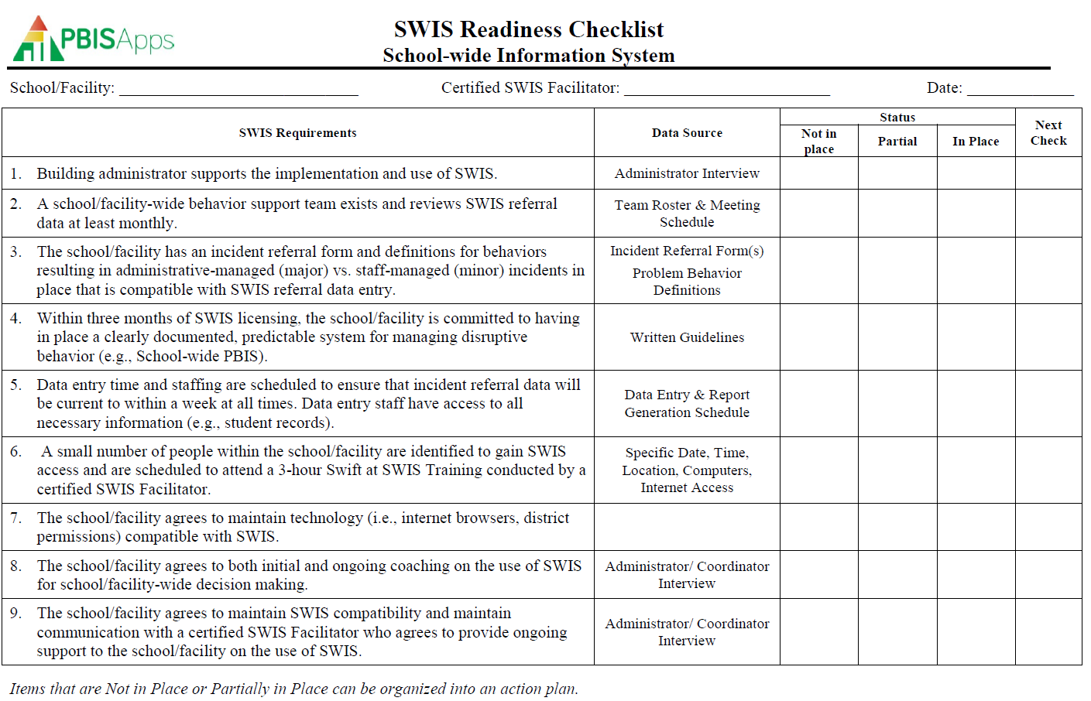
SWIS Implementation Readiness
Notes:
Trainer Note:
For our time today, we focused on requirements 3 and 4 because they tend to be the major components for implementation.

Slide 41
SWIS Implementation Readiness
SWIS Readiness Requirement 3
  The school/facility has an incident referral form and definitions for behaviors resulting in administrative-managed (major) vs. staff-managed (minor) incidents in place that is compatible with SWIS referral data entry.
Notes:
Trainer Note: A SWIS facilitator is responsible for guiding and supporting schools as they establish procedures for documenting referrals.

Slide 42
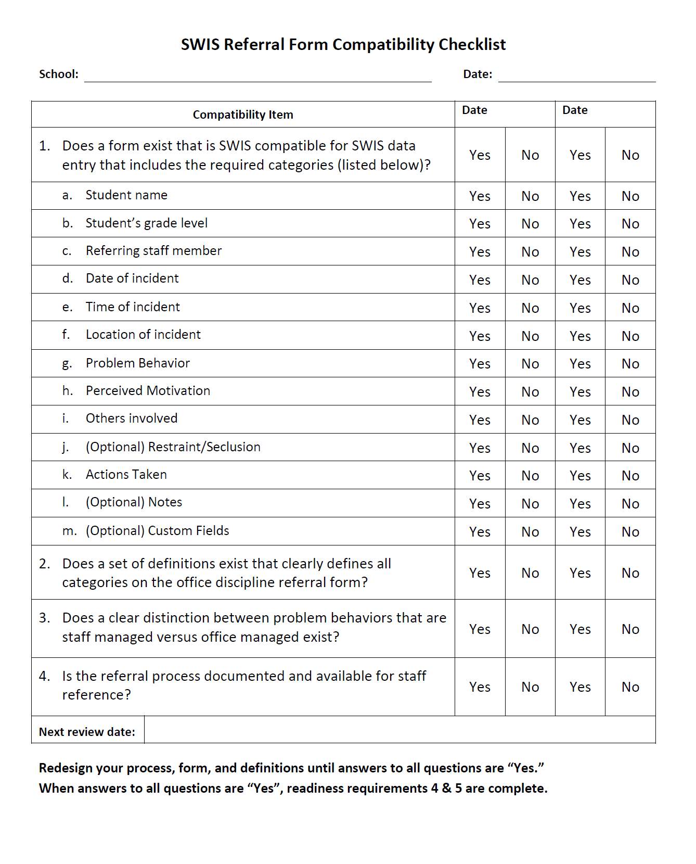
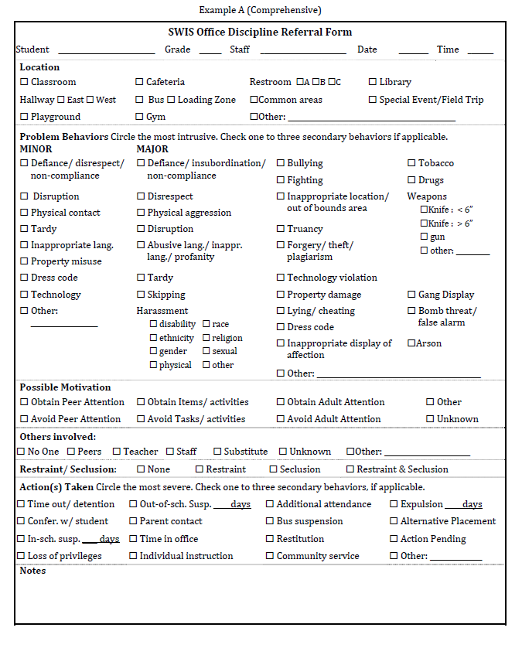
Readiness for Licensing
More information and examples are available at www.pbisapps.org in the SWIS Resources section.
Notes:
Trainer Note: Walk through the displayed forms.
The form on the left is the SWIS Referral Form Compatibility Checklist, and the form on the right is an example Office Discipline Referral Form.
Demonstrate how the example of an office discipline referral form meets the requirements on the compatibility checklist.
More information and examples are available at www.pbisapps.org in the SWIS Resources section.

Slide 43


SWIS Compatible Referral Forms
Things to Consider:
Identify Major and/or Minor Problem Behaviors to be included.
Define all problem behaviors using SWIS Definitions as a guide.
  Identify any problem behavior sub-categories for customized fields.
  Determine the number of secondary behaviors to collect (Default: 0).
  Identify how primary and secondary behaviors will be recorded on the form.
  Identify all Locations to include on the form from the SWIS list.
  Identify any location sub-categories for customized fields (e.g. east hallway, west hallway).
  Discuss staff confidence levels around identifying the Perceived Motivation.
  Identify list of Actions Taken used at the school and to be included on the referral form.
  Identify any sub-categories for customized field (e.g., call home, email sent, letter sent).
  Determine the number of secondary actions to collect (Default: 0).
  Identify how primary and secondary actions will be recorded on the form.
  Use the Compatibility Checklist to ensure that other required information fields are included on the form.
Notes:
Trainer Note: This is an example of a discussion outline facilitators may use when helping teams revise/design their referral forms to meet SWIS readiness.

Slide 44
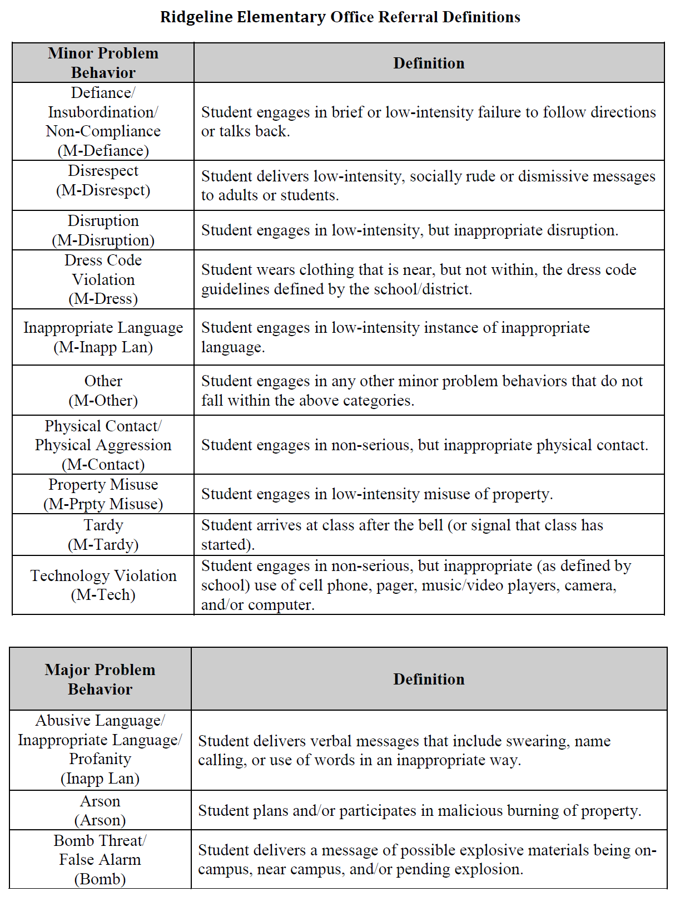
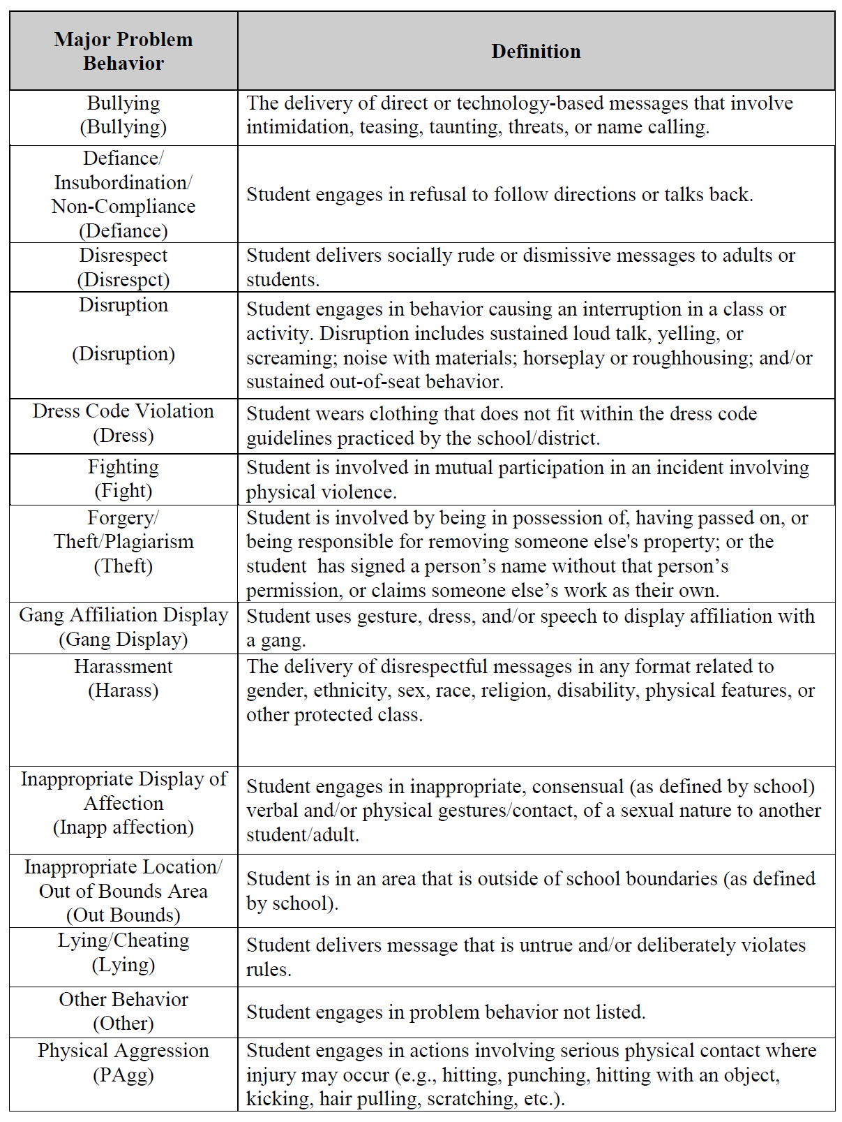
SWIS Referral Definitions
More information and examples are available at www.pbisapps.org in the SWIS Resources section.
Notes:
More information and examples of referral forms are available at www.pbisapps.org in the SWIS Resources section. A school/facility would want to access these resources to guide them through meeting their readiness requirements.

Slide 45
SWIS Implementation Readiness
SWIS Readiness Requirement 4
  Within three months of SWIS licensing, the school/facility is committed to having in place a clearly documented and predictable system for managing disruptive behavior (e.g., school-wide PBIS).
Notes:
Trainer Note: Along with Readiness Requirement 3, this requirement can require a significant investment of time. A SWIS facilitator is responsible for guiding and supporting schools as they establish a clear and predictable system for responding to behavior (e.g., School-wide PBIS).

Slide 46
SWIS Implementation Readiness
Staff Managed are Minors | Office Managed are Majors
Minors Inappropriate Language Physical Contact Defiance/Insubordination/ Non-Compliance Disrespect Disruption Dress Code Technology Violation Property Misuse Tardy Consequences are determined by staff | Majors Abusive/Inappropriate Language Fighting Physical Aggression Defiance/Insubordination Harassment/Intimidation Inappropriate Display of Affection Vandalism/Property Destruction Lying/Cheating Skipping Technology Violation Dress Code Theft Arson Weapons Tobacco Alcohol/Drugs
Example
Notes:
Trainer Note: One example of how a school/facility may choose to demonstrate their system of staff managed vs. office managed behaviors.
More information and examples are available at www.pbisapps.org in the SWIS Resources section.

Slide 47
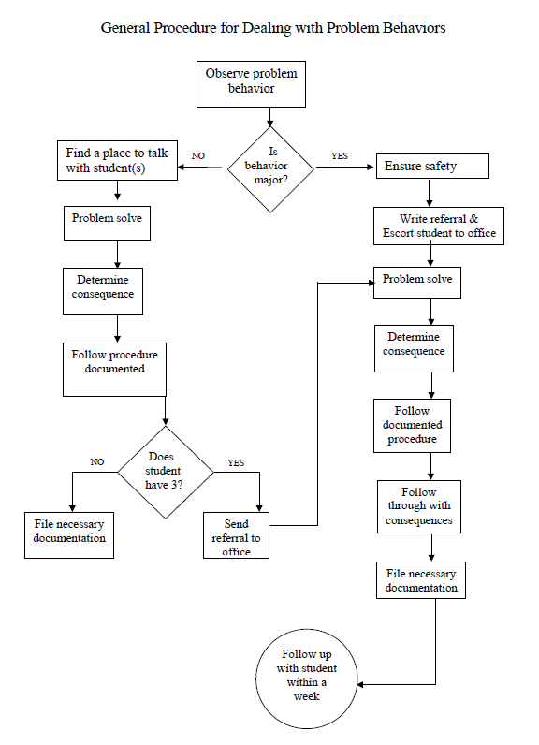
SWIS Implementation Readiness
General Process
&
Predictable System
More information and examples are available at www.pbisapps.org in the SWIS Resources section
Notes:
Trainer Note: Another example of how a school/facility may choose to demonstrate their system of staff managed vs. office managed behaviors. This example is displayed as a flow chart.
The goal is for schools/facilities to have a predictable system to support all staff in responding to behavior.
More information and examples are available at www.pbisapps.org in the SWIS Resources section.

Slide 48
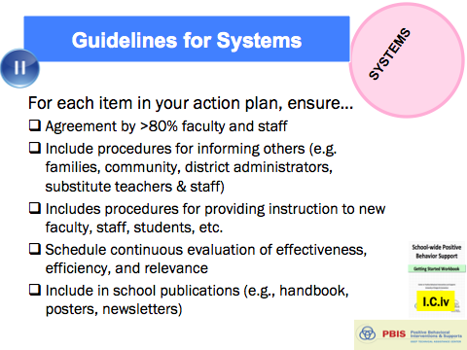
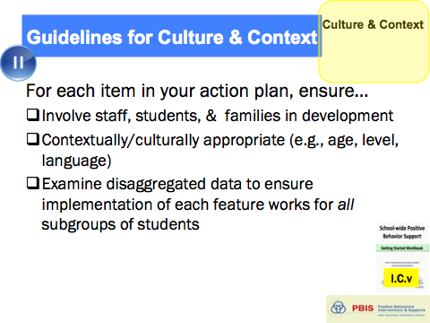
Guidelines for Continuum of Procedures to Decrease Behavior
PRACTICES
Implement procedures
  Use by all staff
  Schedule for regular review of use and effectiveness
  Means for keeping track of number of acknowledgments vs. ODRs or other disciplinary actions
  Schedule and procedures for regular review and enhancement of acknowledgements
  Procedures in place for identifying and supporting students whose behaviors are not responsive
And always remember to consider systems, culture, & context:
Notes:
One of the most powerful ways you can get staff to use the procedures is to share the data back with them.
After reviewing key features of implementing procedures, remind staff to pause to ensure that (a) you have ensured systems are in place to support implementation and (b) practices and systems feature are culturally and contextually relevant.

Slide 49
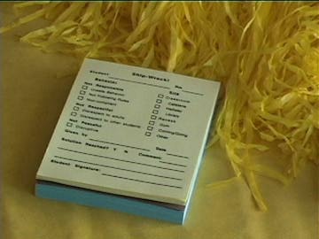
~10 positive : 1 correction

Slide 50
Activity:
School-Wide Expectation Violations
Work as team for 15 min
Complete Behavior Expectation Violations Worksheet
  Name levels of expectation violations
  Define each level
  Provide examples of each
  Draft procedures for each
Add items to your Action Plan as necessary
Present 2-3 “big ideas” from your group (1 min. reports)
Notes:
Prompt teams to start worksheet in workbook.

Slide 51

Break

Slide 52
Getting Started with SWPBIS
Establish an effective leadership team
Develop brief statement of behavioral purpose
Identify positive SW behavioral expectations
Develop procedures for teaching SW expectations
Develop procedures for teaching class-wide expectations
Develop continuum for strengthening appropriate behavior
Develop continuum for discouraging violations of expectations
Develop data-based procedures for monitoring
Develop systems to support staff
Build routines to ensure on-going implementation
DATA
II.B.viii
Notes:
Review where we just were (coming up with procedures to discourage inappropriate behavior, and developing and using procedures for office discipline referrals).

Slide 53
Why Use Data For Decision Making?
Decisions are more likely to be effective and efficient when they are based on data.
The quality of decision making depends most on the first step (defining the problem to be solved).
    Define problems with precision and clarity
Notes:
NEPBIS Notes: Data is a central element in implementing PBIS, and we’re going to use data to make decisions about what and how to implement practices and systems. And, the quality of decisions your team makes is directly related to the quality of your data.
SWIS Trainer Notes:
Understanding what data-based decision making is and how it is useful is one of the essential learner outcomes (i.e., learning targets) for this module. This slide and the seven slides that follow are designed to help participants understand what data-based decision making is, why it should be used, and how SWIS can help.
On this slide, highlight for participants that informed decisions are the most effective decisions. When a decision is based upon information, especially data, it is more likely to effectively address the true problem. Using data for decision making involves defining the problem to be solved and clarifying what decision is to be made.
Analogy: when you go to the doctor’s office or the ER, they do not simply take your blood pressure and then decide to remove your appendix. Quite the contrary. They make informed decisions based upon the data and define the problem with precision to clarify the solution.

Slide 54
Why Use Data For Decision Making?
Data help us ask the right questions…they do not provide the answers. Use data to:
  Identify problems
  Refine problems
  Define the questions that lead to a solution
Data help place the “problem” in the context rather than in the students.
Notes:
NEPBIS Notes: Use SWIS trainer notes, and emphasize using data to help us improve supports rather than trying to fix kids.
SWIS Trainer Notes:
Highlight the fact that data help us ask the right questions so we can design the right solutions. Data present for us “red flags” that may be issues and need further inquiry.
Analogy: When you go to the Emergency Room or the doctor’s office, the first thing they do is check your vital signs. By checking blood pressure, heart rate, respiratory rate, and temperature the physician has a better indicators of overall health and well-being. By collecting this information, the doctor is better equipped to respond when you say “I don’t feel good” or “I have a problem”.
By gathering data to use in our decision making, we get context. We reframe the problem and begin thinking about factors such as location, time, and specific behavior as opposed to merely identifying problem students and repeat offenders.

Slide 55
Steps for Selecting, Monitoring, and Evaluating SWPBIS Practices
Step 1: Develop evaluation questions.
What do you want to know?
II.B.viii
Notes:
Your outcome statements are a really good place to start framing your evaluation questions.

Slide 56
Questions to ask your data
Scope of Problem
All students
Small group
1 student
Type of problem
  Academic errors
  Attendance issues
  Behavioral issues
    Time
    Location
    Topography
    Etc.
See Appendix K
Appendix
K
Notes:
Think about the evaluation questions in two ways: scope and type of the problem.
Remind teams workbook appendices are also posted on nepbis.org

Slide 57
Steps for Selecting, Monitoring, and Evaluating SWPBIS Practices
Step 1: Develop evaluation questions.
Step 2: Identify indicators or measures.
What do you want to know?
What information can be collected?
II.B.viii

Slide 58
Sources of data in school
Office discipline referrals (see swis.org)
School climate surveys (see pbisapps.org)
Fidelity tools (see pbisapps.org)
Other school outcome indicators (use local resources)
  Grades
  Attendance
  Rates of students referred for additional support and/or identified with disabilities
  Academic performance (e.g., scores on state and district-wide assessments)
___________
___________

Slide 59
Steps for Selecting, Monitoring, and Evaluating SWPBIS Practices
Step 1: Develop evaluation questions.
Step 2: Identify indicators or measures.
Step 3: Develop methods for collecting and analyzing indicators.
Step 4: Make decisions and action plan from analysis of indicators.
What do you want to know?
What information can be collected?
How/when should information be gathered?
How was the question answered and what should be done next?
II.B.viii

Slide 60

Why Use Data For Decision Making?
Decisions are more likely to be effective and efficient when they are based on data.
The quality of decision making depends most on the first step; defining the problem to be solved with precision and clarity.
Notes:
Trainer Notes:
Understanding what data-based decision making is and how it is useful is one of the essential learner outcomes (i.e., learning targets) for this module. This slide and the seven slides that follow are designed to help participants understand what data-based decision making is, why it should be used, and how SWIS can help.
On this slide, highlight for participants that informed decisions are the most effective decisions. When a decision is based upon information, especially data, it is more likely to effectively address the true problem. Using data for decision making involves defining the problem to be solved and clarifying what decision is to be made.
Analogy: When you go to the doctor’s office or the ER, they do not simply take your blood pressure and then decide to remove your appendix. Quite the contrary. They make informed decisions based upon the data and define the problem with precision to clarify the solution.

Slide 61

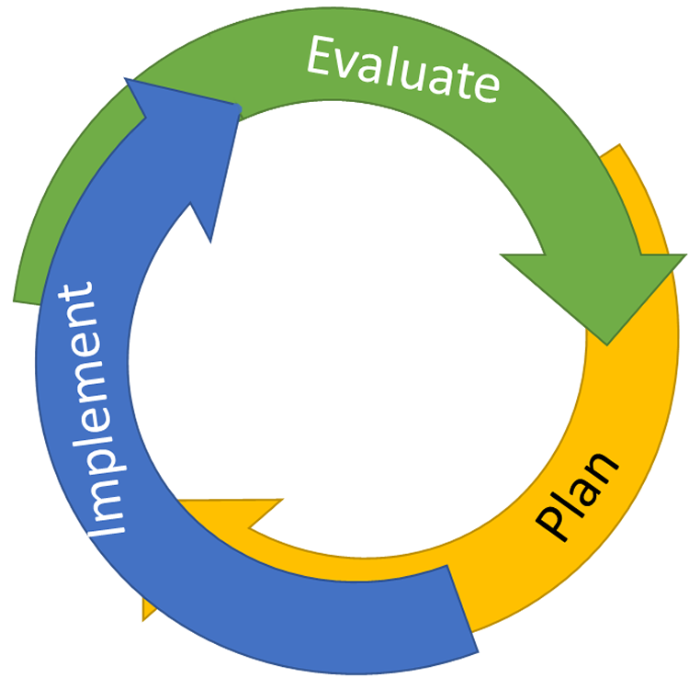
Continuous Quality Improvement
Reassess and revise solution(s) as needed
Identify problems
with precision
Monitor outcomes and compare
to goal(s)
DATA
Establish goal(s)
Develop solution(s)
Implement solution(s)
with integrity and fidelity
Notes:
Trainer Note: We want to interrupt the traditional cycle of admiring the problem, by talking and talking about the problem before quickly launching into determining solutions.
We can do this by building a system for improved decision making.

Slide 62
Why Use Data For Decision Making?
Data help us ask the right questions…they do not provide the answers. Use data to:
  Identify problems
  Refine problems
  Define the questions that lead to a solution
Data help place the “problem” in the context rather than in the students.
Notes:
Trainer Notes:
Highlight the fact that data help us ask the right questions so we can design the right solutions. Data present for us “red flags” that may be issues and need further inquiry.
Analogy: When you go to the Emergency Room or the doctor’s office, the first thing they do is check your vital signs. By checking blood pressure, heart rate, respiratory rate, and temperature the physician has a better indicators of overall health and well-being. By collecting this information, the doctor is better equipped to respond when you say “I don’t feel good,” or “I have a problem”.
By gathering data to use in our decision making, we get context. We reframe the problem and begin thinking about factors such as location, time, and specific behavior as opposed to merely identifying problem students and repeat offenders.

Slide 63
Identifying Problems/Issues
What data to monitor
  ODRs per day per month
  OSS, ISS, attendance, teacher reports
  Fidelity of implementation TIC / SET / BoQ / TFI
    Are we doing what we planned to do?
What question to answer
  Do we have a problem?
What questions to ask of Level, Trend, Peaks
  How do our data compare with last year?
  How do our data compare with national/regional norms?
  How do our data compare with our preferred/expected status?
If a problem is identified, then ask
  What are the data we need to make a good decision?
Notes:
Trainer Notes:
When reviewing multiple pieces of data, the goal is to identify connections among the data and begin to develop a problem statement that clearly defines the problem.
As schools/facilities are reviewing their data, they want to think about:
What data do we look at/monitor?
Do we see problem indicators?
How does the data compare?
What additional information is needed to make an effective decision?

Slide 64
Improving Decision Making
Problem
Solution
Problem
Problem Solving
Solution
Action Planning

Slide 65
Using Data to Refine Problem Statements
The statement of a problem is important for team-based problem solving.
    Everyone must be working on the same problem with the same assumptions.
Problems often are framed in a “primary” form. That form creates concern, but it is not a useful form for problem solving.
    Frame primary problems based on initial review of data
    Use more detailed review of data to build “Solvable Problem Statements.”
Notes:
Trainer Notes:
Problem statements are critical for solution success. Schools/Facilities must clearly identify and define the problem with precision so that everyone is working on the same problem in the same way.
Initially, problem statements are framed in a “primary” form after a surface-level or initial review of the data.
Primary problem statements tell us, “We feel there is a problem.”
Precise problem statements tell us exactly what the problem is.

Slide 66
Precise Problem Statements
What are the data we need for a decision?
Precise problem statements include information about the following questions:
  What is the problem behavior?
  How often is the problem happening?
  Where is the problem happening?
  Who is engaged in the behavior?
  When is the problem most likely to occur?
  Why is the problem sustaining?
Notes:
Trainer Notes:
When reviewing data and developing a problem statement with precision, schools/facilities want to think about:
What is the problem behavior?
How often is the problem happening?
Where is the problem happening?
Who is engaged in the behavior?
When is the problem most likely to occur?
Why is the problem sustaining?

Slide 67
Primary vs. Precision Statements
Primary Statements
Precision Statement
Too many referrals
September has more suspensions than last year.
Gang behavior is increasing.
The cafeteria is out of control.
Student disrespect is out of control.
There are more ODRs for aggression on the playground than last year. These are most likely to occur during first recess, with a large number of students, and the aggression is related to getting access to the new playground equipment.
Notes:
Trainer Notes:
Here are examples of several primary statements and a precision statement.
Emphasize that the difference is not because the precision statement is longer. The difference is that the precision statement describes for the team the “who, what, when, where, and why” of the problem situation.

Slide 68
Precision Statement Example
There are more ODRs for aggression on the playground than last year. These are most likely to occur during first recess, with a large number of students, and the aggression is related to getting access to the new playground equipment.
  What? more ODRs for aggression
  Where? on the playground
  Who? a large number of students
  When? first recess
  Why? to get access to the new playground equipment
Notes:
Trainer Notes:
A precise problem statement answers the questions:
Who?
What?
When?
Where?
Why?

Slide 69
Prioritization
A team’s judgment about the significance of a problem and whether to address it now will likely be a function of the problem behavior’s:
  Severity/intensity – How dangerous it is (e.g., aggression vs. inappropriate language)
  Frequency – How often it is currently occurring
  Trend – Whether its frequency is decreasing, staying the same, or increasing
This may come into play when reviewing more than one potential problem.
TIPS II Training Manual (2013)
Notes:
Trainer notes:
Teams will often notice multiple “red flags” or potential problems and may want to prioritize their efforts instead of trying to address all the issues at one time.

Slide 70
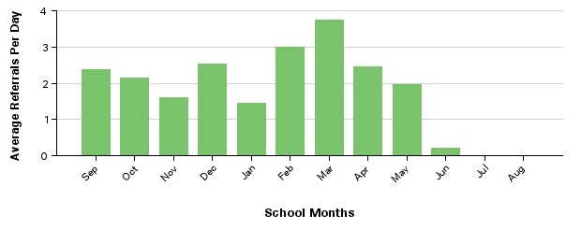
What is the Narrative?
Questions to Ask
What is happening?
What is typical?
What is possible?
What is needed?
75th Percentile
Median
25th Percentile
Notes:
Trainer Notes:
***This slide is designed to be an example and to be moved through quickly***
Here is an example of a graph displaying Average Referrals Per Day Per Month. When looking at this data, there are several questions that should be asked. What is happening? What is typical? What is possible? What is needed?
The data should be reviewed for trends and peaks. The data should be compared to the national data in terms of medians and percentiles.
This data and the answers to the reflective questions help tell the story or the narrative.
Here we can see that we have an upward trend from November to March with peaks in December, February, and March. When we compare to the national average we can see that each month this year has been above the national median and in only two months out of the year were we below the 75th percentile.

Slide 71
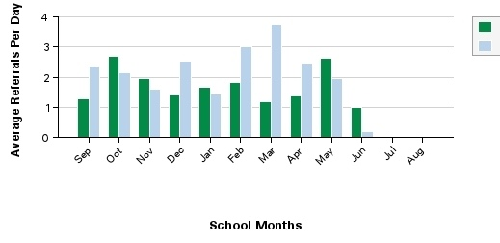
Multi-Year Example
Describe the narrative for this school.
Year One
Year Two
Median
Notes:
Trainer Notes:
***This slide is designed to be an example and to be moved through quickly.***
This slide displays example Multi-Year Average Referrals Per Day Per Month graphs. Encourage participants to describe the narrative. These examples are designed to be quickly moved through. Once the examples are displayed encourage participants to share their answer and then quickly discuss.
Think about trends? Peaks? Valleys? National comparisons?

Slide 72
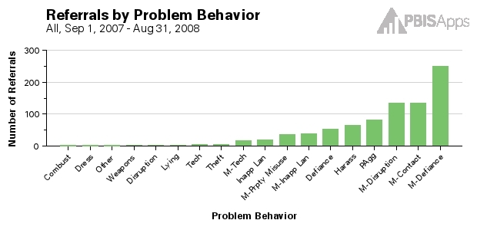
Asking the Right Questions
Questions to ask about Referrals by Problem Behavior
  Is there one major problem behavior or multiple problem behaviors?
  Do they appear to be student-to-student problem behaviors or student-to-adult?
  Are there similarities in the types of behaviors?
  Are they major or minor problem behaviors?
Example 1
Notes:
Trainer Notes:
***This slide is designed to be an example and to be moved through quickly.***
Use this slide as an example for how to think through and reflect on the Referrals By Problem Behavior graph.
Think Aloud: Demonstrate for participants how you would think through this graph.
Example Think Aloud:
“In looking at this graph for Referrals by Problem Behavior, I can see that that majority of problem behaviors are minor referrals for defiance. I know that a minor referral would be a staff-managed referral, and defiance is refusing to do something that an adult has requested or instructed – an office-managed behavior. This graph tells me that our staff members are dealing with a lot of refusal, non-compliance, and generally defiant behavior.”

Slide 73
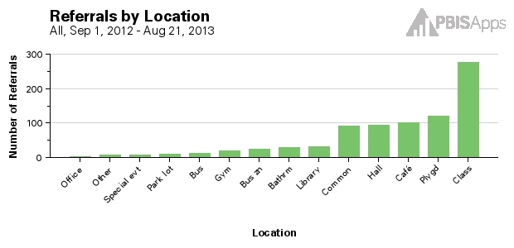
Asking the Right Questions
Questions to ask about Referrals by Location
  Where are the problems occurring?
  Are there problems in:
    Many locations?
    Clusters of locations?
    One location?
Many problems on the playground and in the cafeteria, hallways, and common areas.
Example 2
Notes:
Trainer Notes:
***This slide is designed to be an example and to be moved through quickly.***
Use this slide as an example for how to think through and reflect on the Referrals By Location graph.
Think Aloud: Demonstrate for participants how you would think through this graph.
Example Think Aloud:
“In looking at this graph for Referrals by Location, I can see that that the majority of problem behaviors are from the classroom. This makes sense because students spend the majority of their day in classrooms. However, I see that the non-classroom settings of playground, cafeteria, hallways, and common areas are all about the same. This requires closer examination because it seems as if the structure or lack of structure in these settings is making it likely for behaviors to occur.”

Slide 74
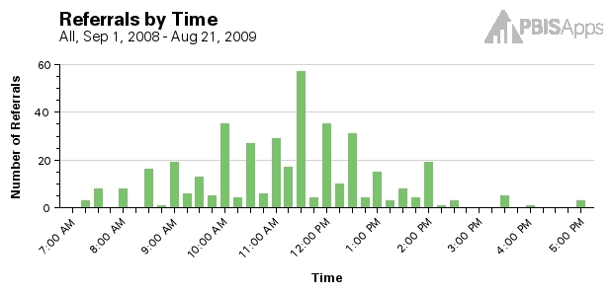
Asking the Right Questions
Questions to ask about Referrals by Time
  When are the problem behaviors occurring?
  How do those times match with the daily activities?
  How does this information match up to Referrals by Location?
Most problems are occurring at
11:30 a.m..
Example 1
Notes:
Trainer Notes:
***This slide is designed to be an example and to be moved through quickly.***
Use this slide as an example for how to think through and reflect on the Referrals By Time graph.
Think Aloud: Demonstrate for participants how you would think through this graph. Use the pop-up-notes to help you demonstrate how you would think and reflect on this graph.
Example Think Aloud:
“In looking at this graph, I see the majority of referrals are happening at 11:30. I need to check our daily schedule and see what activities are happening at that time. Which students are where at 11:30?”

Slide 75
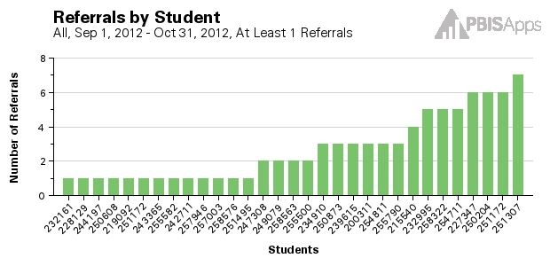
Asking the Right Questions
Questions to ask about Referrals by Student
  What proportion of students have 0 – 1 Office Discipline Referrals (ODRs)?
  What proportion of students have 2 – 5 ODRs?
  What proportion of students have 6+ ODRs?
Example 1
Student 251307 may benefit from individualized support.
14 students may need some targeted, small-group supports.
Notes:
Trainer Notes:
***This slide is designed to be an example and to be moved through quickly.***
Use this slide as an example for how to think through and reflect on the Referrals By Student graph.
Think Aloud: Demonstrate for participants how you would think through this graph. Use the pop-up-notes to help you demonstrate how you would think and reflect on this graph.
**Discuss the question about how some schools ask to “remove” students with many behaviors out of their SWIS Dashboard Report – all students in the school are part of the school environment.

Slide 76
Defining Goals
Define the problem with precision
Define the measure of the problem (level, amount)
Define what would be considered “good”
Use the goal to guide the solution
  How can we move from where we are to where we want to be?
Notes:
Trainer Notes:
The problem solving process is multi-faceted. We do not just want to make snap judgments based upon perceptual data alone. Acting solely on our day-to-day experiences, feelings, and assumptions is ineffective. Best practice involves using data to make informed decisions.
Best practice involves:
Using data to define a problem with precision
Use the data to define the current measure of the problem. How many? How often?
Use the current measure of the problem to define what is considered “good” or what a SMART goal would be.
Use the SMART goal to guide solution steps.
SMART goals are: Specific, Measurable, Achievable, Realistic, and Timely

Slide 77
Defining Goals
Problem | Current Status | Goal
Many students are leaving garbage in the cafeteria resulting in conflict and ODRs. The behavior is maintained by task avoidance. | 22 ODRs per month from the cafeteria Heidi (café supervisor) rates cafeteria as “1” (low) on a 1-5 scale of cleanliness. | Less than 5 ODRs per month from the cafeteria. Heidi rates cafeteria as greater than 4 for cleanliness two weeks in a row.
Notes:
Trainer Notes:
***This slide is designed to be an example and to be moved through quickly.***
Use this slide as an example for how to think through designing appropriate goals.
Think Aloud: Demonstrate for participants how you would use data and a precise problem statement to design appropriate goals.
Example Think Aloud:
“OK, I first define my problem with precision. I know that many students are leaving garbage in the cafeteria because it is easy to do and this results in conflict with adults and ODRs from the cafeteria supervisors. I know that we have an average of 22 ODRs per month from the cafeteria, and the supervisors rate the cleanliness at a low-1. That’s my level. With this information, I can design an appropriate goal. We need to decrease to less than 5 ODRs per month from the cafeteria, and we need cafeteria supervisors to rate the cleanliness at a 4 or higher for two, consecutive weeks.”
First, define the problem with precision (Level/amount). Then, define what would be the goal to work towards. Once the goal is defined, use the goal to guide the solution development.

Slide 78
Defining Goals
Problem | Current Status | Goal
7th Grade students are tardy for 5th period classes after their lunch. Tardiness is rewarded by peer attention and no consequences in the classroom. | 5 out of 6 of the 7th grade teachers indicate they have more than 3 students tardy on a regular basis for 5th period. Estimated 18, 7th grade students tardy for 5th period last week. | Less than 10 referrals for tardiness in the 7th grade per month
Notes:
Trainer Notes:
***This slide is designed to be an example and to be moved through quickly.***
Use this slide as an example for how to think through designing appropriate goals.
Think Aloud: Demonstrate for participants how you would use data and a precise problem statement to design appropriate goals. Give them a chance to share aloud what the goals could be.
Example Think Aloud:
“OK, I first define my problem with precision. I know that seventh grade students are tardy for their class right after lunch. They keep this behavior going because of a lack of consequences, and it gets attention from their peers. Currently, 5 of the 6 seventh grade teachers say that on average more than 3 students are regularly tardy, and we have about 18 seventh grade students who were tardy last week alone.”
Encourage participants to use the current level to identify what “good” would look like and identify an appropriate, SMART goal.
SMART goals are: Specific, Measurable, Achievable, Realistic, and Timely

Slide 79
Using Data to Develop Solutions
Prevention—How can we avoid the problem context?
  Schedule change, curriculum change, etc.
Teaching—How can we define, teach, and monitor what we want?
  Teach appropriate behavior
  Use problem behavior as negative example
Recognition—How can we systematically reward positive behavior?
Extinction—How can we prevent problem behavior from being rewarded?
Consequences—How can we systematically correct problem behavior?
How will we collect and use data to evaluate:
  Implementation fidelity
  Impact on student outcomes
Notes:
Trainer Notes:
Once an appropriate goal has been identified, there are several, critical components of solution development that should be addressed to effectively solve the problem. Remember, we want a minimum level of energy, effort, or intervention that will produce the maximum level of effect. Keep it simple!
Solution development involves:
Prevention—How can we avoid the problem context entirely?
Teaching—How can we define, teach, and monitor what we want to happen?
Recognition—How can systematically acknowledge appropriate behavior?
Extinction—How can we prevent problem behavior from being rewarded?
Consequences—What are efficient, consistent consequences for inappropriate behavior?
Data Collection—How will we use data to monitor our efforts?

Slide 80
Solution Development
Solution Component | Action Step(s)
Prevention
Teaching
Recognition
Extinction
Corrective Consequence
Data collection | What data will we look at? Who is responsible for gathering the data? When/How often will data be gathered? Where will the data be shared? Who will see the data?
Notes:
Trainer Notes:
Here is a simple, basic example of how the necessary solution components can be organized alongside their action steps. Organizing the solution development process in such a way increases the likelihood that action steps will be taken and that all staff and team members are on the same page in regards to solving the problem. We will present another template later that we encourage teams to use to guide the solution development discussion. It is presented in more of an action plan format.

Slide 81
Steps for Selecting, Monitoring, and Evaluating SWPBIS Practices
Step 1: Develop evaluation questions.
Step 2: Identify indicators or measures.
Step 3: Develop methods for collecting and analyzing indicators.
Step 4: Make decisions and action plan from analysis of indicators.
What do you want to know?
What information can be collected?
How/when should information be gathered?
How was the question answered and what should be done next?
II.B.viii

Slide 82
Guidelines for Data-Based Monitoring of SWPBIS Outcomes
DATA
General data collection procedures
  Data collection procedures are integrated into typical routines (e.g., ODRs, attendance, behavior incident reports)
  Data collection reports regularly checked for accuracy
  Data collection limited to information that answers important student, classroom, and school questions
  Structures and routines for staff members to receive weekly/monthly data reports about status of SW discipline
  Decision rules for guiding data analysis and actions
  Schedule for daily, weekly, monthly, quarterly feedback
  Data system managed by 2-3 staff members
  No more than 1% of time each day for managing data
  Efficient, timely, and graphic displays of data
II.B.viii
Notes:
Big idea is to make this as efficient and simple as possible. Teams can read these on their own and use it as a checklist to hold themselves accountable for these guidelines.

Slide 83
One Source of Data:
Office Discipline Referrals (ODRs)
Definition
  Kid-Teacher-Administrator interaction
  Underestimation of actual behavior
Improving usefulness & value
  Clear, mutually exclusive, exhaustive definitions
  Distinction between office v. classroom managed
  Continuum of behavior support
  Positive school-wide foundations
  Within school comparisons
See Appendix K
Appendix
K
Notes:
We talked about ODRs in the last step, and teams are going to review form to ensure it’s user friendly. The simpler we can make this the better.

Slide 84
Guidelines for Data-Based Monitoring of SWPBIS Outcomes
DATA
Office discipline referral procedures
  Agreed upon definitions of violations of expectations organized in a continuum
  A form for documenting noteworthy behavior incidents (ODR)
  School-wide procedures for processing/responding
  Efficient and user-friendly data input and storage
  Efficient and user-friendly process for summarizing and storing data
  Efficient and user-friendly procedures for producing visual displays of data
  Procedures for presenting data to staff on routine basis
  Procedures for making decisions and developing actions based on data
And always remember to consider systems, culture, & context:
II.B.viii
Notes:
Big idea is that you have a process for getting the data in and reporting it back to staff.

Slide 85
Activity:
Data Evaluation
Work as team for 10 min
Complete Data Evaluation Worksheet in workbook
  Identify evaluation questions
  Who needs information
  When they need it
  Data indicators and sources
  Data collection methods and schedule
Add items to your Action Plan as necessary
Present 2-3 “big ideas” from your group (1 min. reports)

Slide 86
To help us make sense of this…
…recall your evaluation plan
DISTRICTS/SCHOOLS IN TRAINING |  |  | SCHEDULE
Purpose | Measure | Function | Year 1 Training |  | Year 2 Training
 |  |  | Winter | Spring | Fall | Winter | Spring
Capacity Building—District Level | District Capacity Assessment (DCA) | Completed by district leadership team (with the support of a trained facilitator) to assess district capacity and to guide Action Planning. |  | X |  |  | X
Fidelity of Implementation—Building Level | PBIS Tiered Fidelity Inventory (TFI) | Leadership team self-evaluation (with support of external coach) to assess the critical features of PBIS across Tiers I, II, and III. |  | X | X |  | X
Progress Monitoring—Building Level | Self-Assessment Survey (SAS) | Used by school staff for initial and annual assessment of effective behavior support systems in their school and to guide Action Planning. |  | X |  |  | X
Progress Monitoring—Team Level | Team Implementation Checklist (TIC) | A self-assessment tool that serves as a multi-level guide for creating School-Wide PBIS Action Plans and evaluating the status of implementation activities. | X | X | X | X | X
School Climate | Georgia School Climate Surveys | An annual survey that assesses student (grades 3-12), teacher, and parent perceptions of school climate. The middle and high school surveys also include items about adolescent drug/alcohol/tobacco use, self-harm ideation and behaviors, school dropout, and parental involvement. The survey provides information to determine training support needs related to school climate, safety, and violence prevention. |  | X | X
Student Outcomes | School-wide Information System (SWIS) | Office discipline referrals (ODR) provide data for monthly team reviews and decision-making by teachers, administrators, and other staff to guide prevention efforts and Action Planning. | Weekly | Weekly | Weekly | Weekly | Weekly
…and tools available at:
Notes:
Data are what make PBIS work.

Slide 87
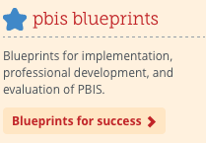
SWPBIS Evaluation Blueprint
“Evaluation is the process of collecting and using information for decision making.”
“A hallmark of School-wide Positive Behavior Support (SWPBIS) is a commitment to formal evaluation.”
www.pbis.org

Slide 88
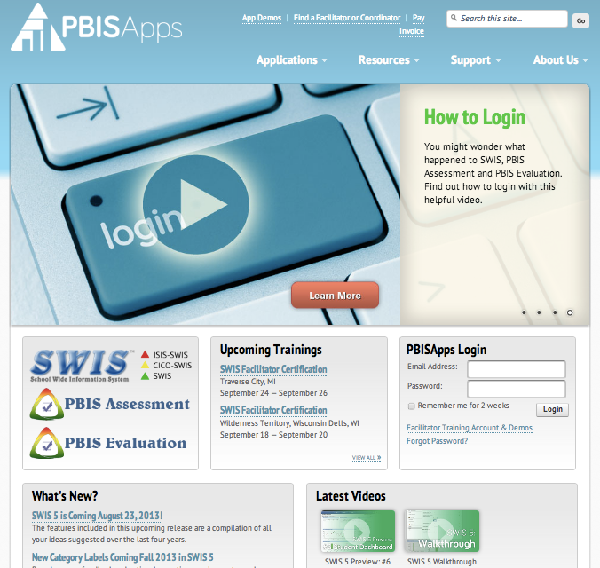
www.pbisapps.org
Let’s review your evaluation plan in a bit more depth.

Slide 89
Measure | Year 1 Training |  | Year 2 Training
 | Winter | Spring | Fall | Winter | Spring
District Capacity Assessment (DCA) |  | X |  |  | X
PBIS Tiered Fidelity Inventory (TFI) |  | X | X |  | X
Self-Assessment Survey (SAS) |  | X |  |  | X
Team Implementation Checklist (TIC) | X | X | X | X | X
Georgia School Climate Surveys |  | X | X
SWIS | Weekly | Weekly | Weekly | Weekly | Weekly

Slide 90
Measure | Year 1 Training |  | Year 2 Training
 | Winter | Spring | Fall | Winter | Spring
District Capacity Assessment (DCA) |  | X |  |  | X
PBIS Tiered Fidelity Inventory (TFI) |  | X | X |  | X
Self-Assessment Survey (SAS) |  | X |  |  | X
Team Implementation Checklist (TIC) | X | X | X | X | X
Georgia School Climate Surveys |  | X | X
SWIS | Weekly | Weekly | Weekly | Weekly | Weekly

Slide 91
The PBIS Self-Assessment Survey (SAS)
1. Used by all school staff for initial and annual assessment of effective behavior support systems in their school.
2. The survey examines the status and need for improvement of four behavior support systems:
    school-wide discipline systems
  non-classroom management systems (e.g., cafeteria, hallway, playground
  classroom management systems
  systems for individual students engaging in chronic problem behaviors
Notes:
1. Talking stuff: Survey results are summarized and used for a variety of purposes including: annual action planning, internal decision making,
assessment of change over time, awareness building of staff, and team validation.

Slide 92
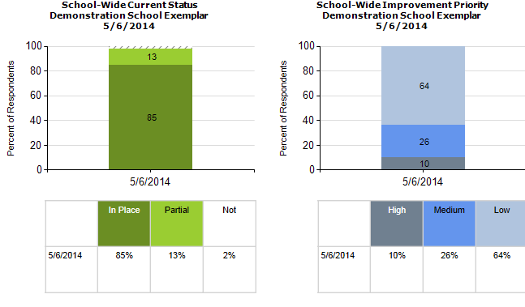
Notes:
1. Talking stuff--Initially, the entire staff in a school completes the SAS. In subsequent years and as an on-going assessment and planning tool, the SAS can be completed in several ways:
All staff at a staff meeting.
Individuals from a representative group.
Team member-led focus group.
Add discussion about results/reports you get…how to report back to staff

Slide 93
Measure | Year 1 Training |  | Year 2 Training
 | Winter | Spring | Fall | Winter | Spring
District Capacity Assessment (DCA) |  | X |  |  | X
PBIS Tiered Fidelity Inventory (TFI) |  | X | X |  | X
Self-Assessment Survey (SAS) |  | X |  |  | X
Team Implementation Checklist (TIC) | X | X | X | X | X
Georgia School Climate Surveys |  | X | X
SWIS | Weekly | Weekly | Weekly | Weekly | Weekly

Slide 94
Team Implementation Checklist (TIC)
COACHES (1 per team) go to www.pbisapps.org
Go to pbis applications login on the top right corner of your screen
Login with your email and password (if you haven’t set up your password yet, just go through forgot password process)
Select PBIS Assessment
Under Surveys Currently Open, Select Team Checklist 3.1
Click “Take Survey”
  Find Team Checklist
Select under Action column
Complete TIC as a team
9. Review reports to support your action planning
Also see Appendix C
Complete during Team Action Planning Time TOMORROW

Slide 95
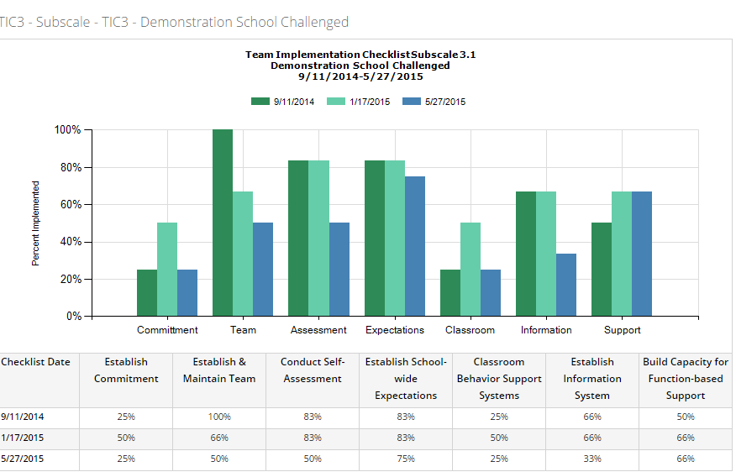
TIC 3.1 Subscale Report

Slide 96
Measure | Year 1 Training |  | Year 2 Training
 | Winter | Spring | Fall | Winter | Spring
District Capacity Assessment (DCA) |  | X |  |  | X
PBIS Tiered Fidelity Inventory (TFI) |  | X | X |  | X
Self-Assessment Survey (SAS) |  | X |  |  | X
Team Implementation Checklist (TIC) | X | X | X | X | X
Georgia School Climate Surveys |  | X | X
SWIS | Weekly | Weekly | Weekly | Weekly | Weekly

Slide 97
Good Data Systems
Defined in observable terms
Data easy to summarize & present
Data easy to input
Educationally relevant
Mutually exclusive
Comprehensive
Linked to questions
Routine
<1% of time
Graphic format
Data linked to decisions & actions
Notes:
1. Again this slide might be totally redundant with previous slide…

Slide 98
Big Ideas
Collect data!
Present the data in a user-friendly fashion (i.e., graph).
Use the data to make decisions
Use your data today for action planning.
Data should inform outcomes, practices, and systems!

Slide 99
Lunch

Slide 100
Getting Started with SWPBIS
Establish an effective leadership team
Develop brief statement of behavioral purpose
Identify positive SW behavioral expectations
Develop procedures for teaching SW expectations
Develop procedures for teaching class-wide expectations
Develop continuum for strengthening appropriate behavior
Develop continuum for discouraging violations of expectations
Develop data-based procedures for monitoring
Develop systems to support staff
Build routines to ensure on-going implementation
SYSTEMS
II.B.ix

Slide 101
Key Systems Features
Staff Buy-in
Embedded Professional Development
Staff Recognition for Implementation
Team-based Implementation
Clear Action Plan
I.C.iv
Notes:
Build section numbers, color coding, and structure into ppt.

Slide 102
Avoiding “Train & Hope”
WAIT for
New
Problem
REACT to
Problem
Behavior
Expect, But
HOPE for
Implementation
Select &
ADD
Practice
Hire EXPERT
to Train
Practice
I.C.iv

Slide 103
GENERAL IMPLEMENTATION PROCESS
Team
Agreements
Data-based
Action Plan
Evaluation
Implementation
I.C.iv
Notes:
SAY: In general, the implementation of a school-wide PBS approach at the school level is built around five main implementation steps.

Slide 104
Key Systems Features
Staff Buy-in
Embedded Professional Development
Staff Recognition for Implementation
Team-based Implementation
Clear Action Plan
I.C.iv
Notes:
Build section numbers, color coding, and structure into ppt.

Slide 105
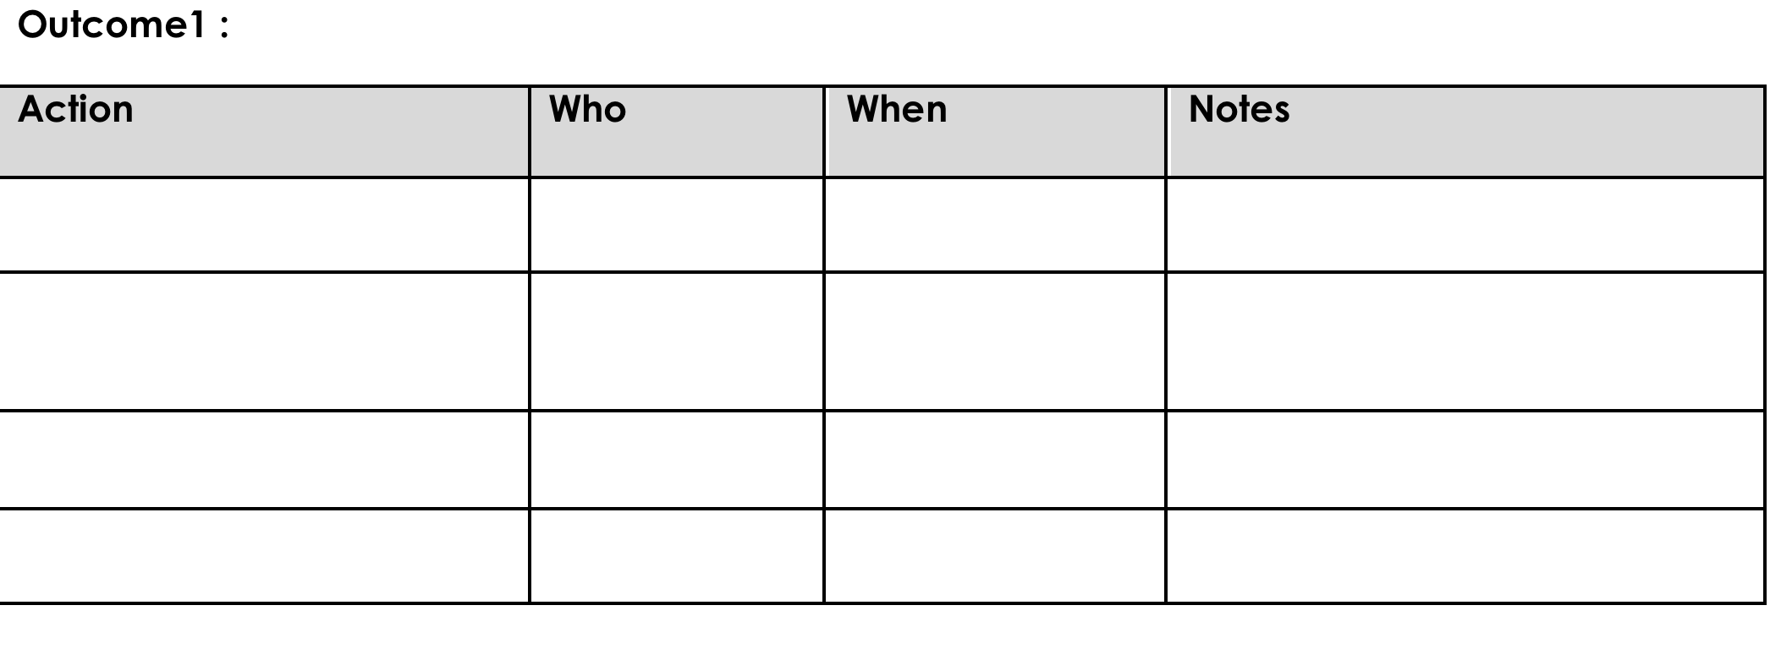
Action Planning
Process of organizing and using resources to enable individuals to engage in activities designed to achieve specific and important outcomes

Slide 106
Key Systems Features
Staff Buy-in
Embedded Professional Development
Staff Recognition for Implementation
Team-based Implementation
Clear Action Plan
I.C.iv
Notes:
Build section numbers, color coding, and structure into ppt.

Slide 107

Staff Buy-In
Effective Messenger(s)
Buy-in!
Effective
Team…
Staff
Info & Drafts
Feedback
…powered
by Data
Effective Leadership

Slide 108
80% Rule
Tertiary Prevention:
Specialized
Individualized
Systems for Staff with High-Risk Behavior
~5%
Primary Prevention:
Systems to support
all staff:
Professional development
Reinforcement
~15%
Apply the triangle to adult behavior!
Secondary Prevention:
Specialized Group
Systems for Staff who are “At-Risk”
Additional instruction
Increased support
~80% of Staff
Notes:
Good sequence on staff acknowledgements…..important one for teams to get

Slide 109
Guidelines for Staff Buy-In
SYSTEMS
Use data to establish need
  Self-assessment
  Baseline discipline/behavior/climate data
Establish an effective team (past item) with active administrator participation
Present information in clear and efficient way(s)
Obtain and incorporate feedback on all elements of SWPBIS from staff
Start small and demonstrate success
And always remember to consider systems, culture, & context:

Slide 110
Activity:
Establishing Staff Buy-In
Work as team for 5 min
Develop a list of strategies for bringing this content back to you staff/co-workers that will help increase buy-in.
Pick spokesperson to give one example of how you will help establish buy-in from your staff/co-workers.
Add relevant items to your action plan
Notes:
SLIDE ADDED

Slide 111
Key Systems Features
Staff Buy-in
Embedded Professional Development
Staff Recognition for Implementation
Team-based Implementation
Clear Action Plan
I.C.iv
Notes:
Build section numbers, color coding, and structure into ppt.

Slide 112
Embedded Professional Development
Explicit Training
Coaching/Prompting
Desired Outcomes
Performance Feedback

Slide 113
Embedded Professional Development
Explicit Training
Coaching/Prompting
Desired Outcomes
Performance Feedback
Model, lead, test format
  Demonstrate desired skill (I do)
  Provide effective examples/non-examples
  Provide sufficient group practice (We do)
  Provide opportunities to demonstrate and receive feedback (You do)
Connected to/embedded in typical practice/routines
Brief training/practice spaced out

Slide 114
Embedded Professional Development
Explicit Training
Coaching/Prompting
Desired Outcomes
Performance Feedback
In-vivo prompts, observation, and feedback
On-going support
Problem-solving process

Slide 115
Embedded Professional Development
Explicit Training
Coaching/Prompting
Desired Outcomes
Performance Feedback
Data-based feedback (based on self-, peer-, or consultant collected data)
  Data presented graphically
  Key observations may be summarized in words
Delivered frequently (daily or weekly)
Specific suggestions for improvement or recognitions of good performance

Slide 116
Embedded Professional Development
Explicit Training
Coaching/Prompting
Desired Outcomes
Performance Feedback

Slide 117
Guidelines for Embedded PD
SYSTEMS
Ensure PD includes explicit training, performance feedback and ongoing coaching
Document staff systems in staff handbook
Align staff evaluation procedures with expected practices where possible
And always remember to consider systems, culture, & context:

Slide 118
Activity:
Avoiding Train and Hope
Work as team for 10 min
Describe 2-3 strategies for embedding staff development into daily, weekly, monthly, etc. routines of school (using table provided in your workbook)
Update action plan as appropriate.
Pick spokesperson to give 1 min. report

Slide 119
Key Systems Features
Staff Buy-in
Embedded Professional Development
Staff Recognition for Implementation
Team-based Implementation
Clear Action Plan
I.C.iv
Notes:
Build section numbers, color coding, and structure into ppt.

Slide 120
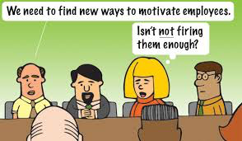
Staff Recognition
If we want staff to recognize kids, we should recognize them!
We can (and should) do better!

Slide 121
Staff Acknowledgements
What
  Social contact
  Professional recognition
  Time
  Other
Features
  Regular & sincere
  School/staff-wide
  Culturally/contextually appropriate
  Functionally relevant
  Administrator & team involvement
some examples…

Slide 122
“Golden Plunger”
Involve custodian
Procedure
  Custodian selects one classroom/ hallway each week that is clean & orderly
  Sticks gold-painted plunger with banner on wall

Slide 123
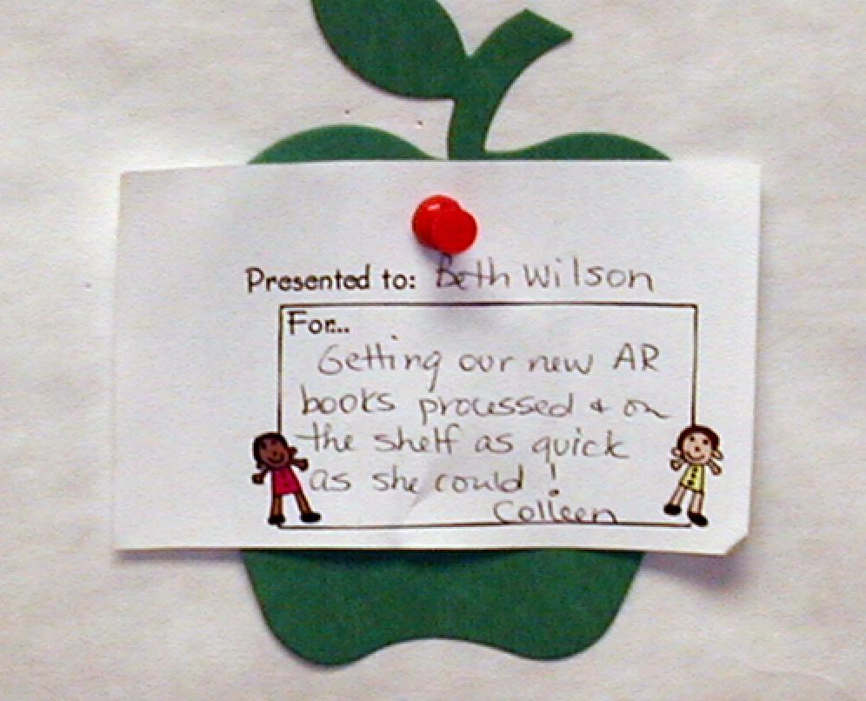
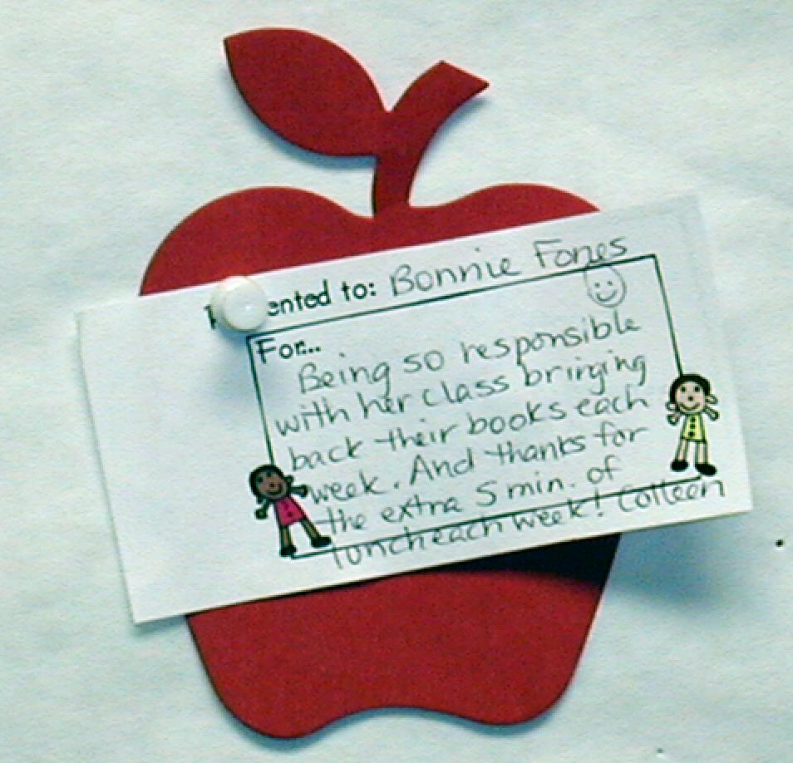
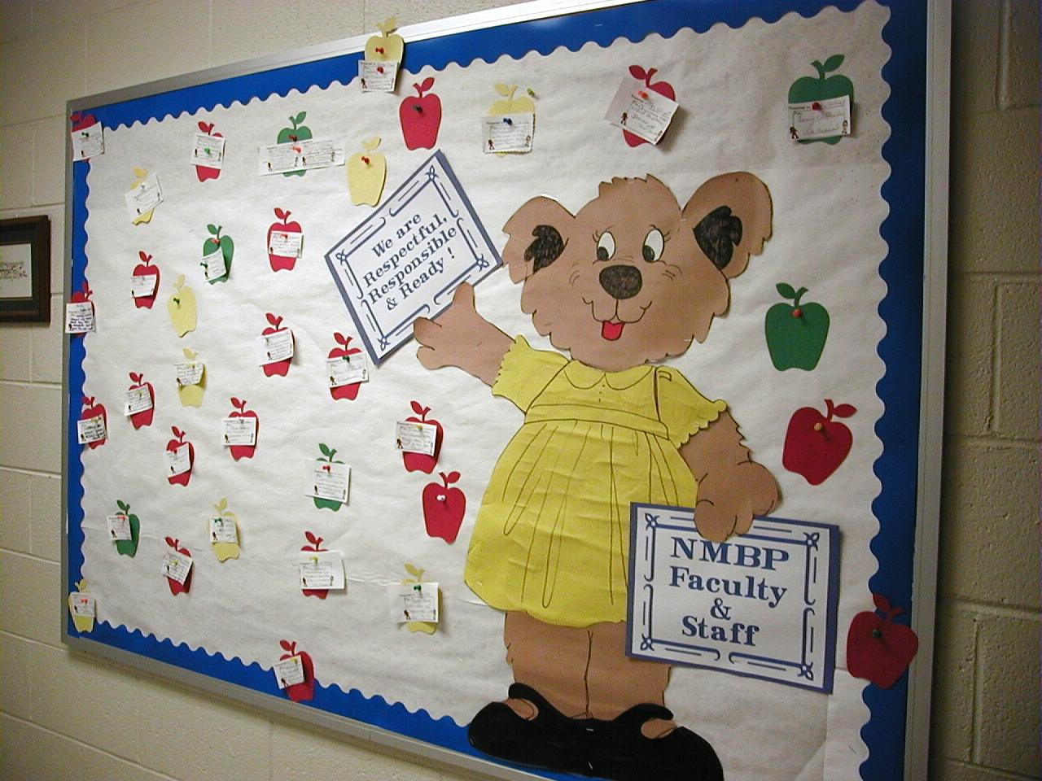
North Myrtle Beach Primary June 8, 2004 SC

Slide 124
“Staff Dinger”
Reminding staff to have positive interaction
Procedures
  Ring timer on regular, intermittent schedule
  Engage in quick positive interaction

Slide 125
“1 Free Period”
Contributing to a safe, caring, effective school environment
Procedures
  Given by Principal
  Principal takes over class for one hour
  Used at any time

Slide 126
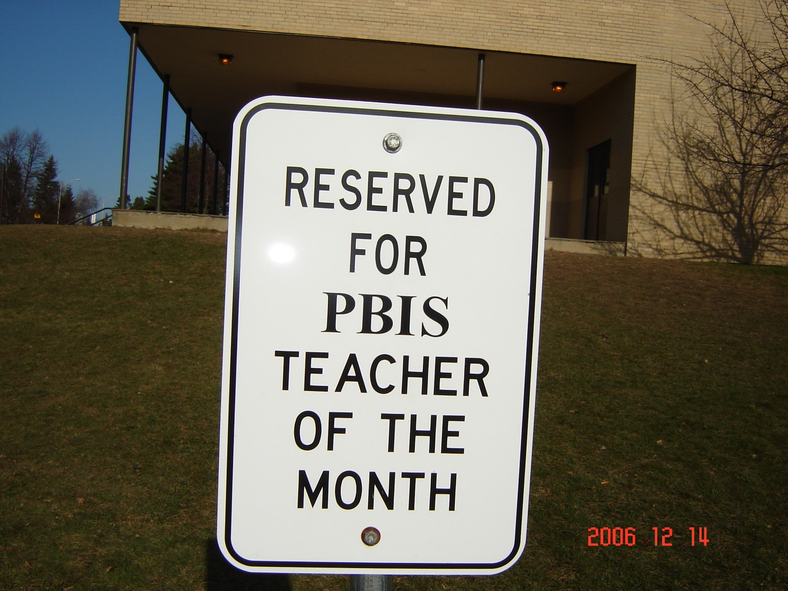
“Free Parking
“Free Parking”
Procedures
  Staff allowed to park in a preferred and reserved spot
Burncoat Middle School
Teacher Incentive

Slide 127
Guidelines for Staff Recognition
SYSTEMS
Easy and quick form of acknowledgement
Considerate of strategies/processes that already exist
Culturally, developmentally, contextually appropriate/relevant name and form of acknowledgement
Consider Back-up or follow-up acknowledgements
Schedule for initial introduction of acknowledgements and regular boosters or reimplementation of acknowledgements
Schedule for daily, weekly, monthly, and quarterly feedback to students and staff
And always remember to consider systems, culture, & context:

Slide 128
Activity:
Staff Recognition
Work as team for 20 min
Review/develop procedures for acknowledging/encouraging staff contributions & accomplishments
Add to your action plan!
Report 2-3 “big ideas” from your team discussion (1 min. reports)

Slide 129
Getting Started with SWPBIS
Establish an effective leadership team
Develop brief statement of behavioral purpose
Identify positive SW behavioral expectations
Develop procedures for teaching SW expectations
Develop procedures for teaching class-wide expectations
Develop continuum for strengthening appropriate behavior
Develop continuum for discouraging violations of expectations
Develop data-based procedures for monitoring
Develop systems to support staff
Build routines to ensure on-going implementation
SYSTEMS
II.B.x

Slide 130
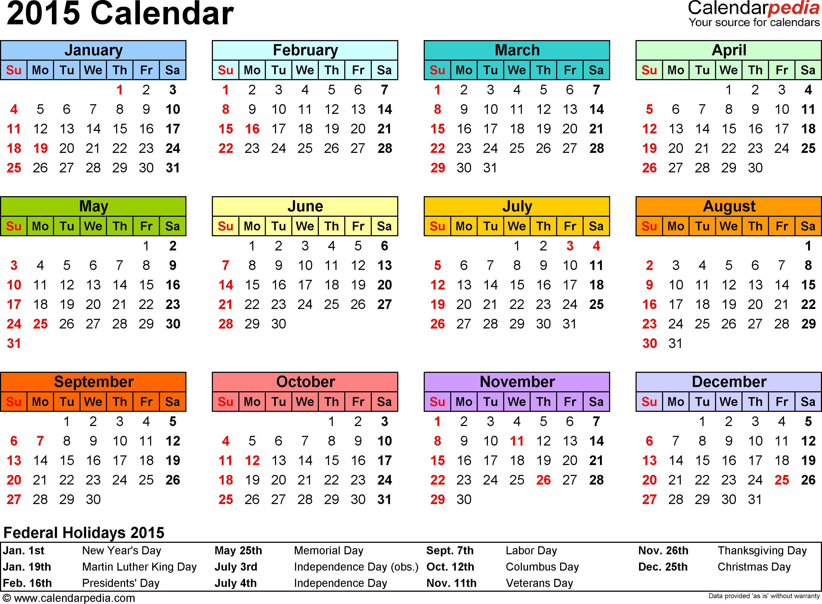
To start your semester/year off well, begin teaching and learning activities on the first day of semester/school
CHAPTER
II.X

Slide 131
Guidelines for Building Routines for
On-going Implementation
SYSTEMS
Work as a team.
Make decisions based upon data.
Consider needs of all students.
Integrate PBS activities into other initiatives and projects.
Begin teaching, learning, and behavioral expectations on the first day.
Involve students, staff, parents, and community.
Increase use of reminders and pre-corrections before and after transitions.
Increase/maintain high rates of positive acknowledgements.
Specify expected outcomes of every activity.
And always remember to consider systems, culture, & context:

Slide 132
Activity:
Building Routines for On-Going Implementation
Work as team for 10 min
Consider the items in the On-Going Implementation Checklist
Return to your action plan
Make sure you have plans to plan for the start of the semester/year
Identify one person who will present big ideas for your group

Slide 133
SWPBIS Action Planning

Slide 134
Activity:
Action Planning
Work as team for 120 min
Return to your Action Plan
Update each section based on what you’ve learned in today.
In particular, make sure have a plan for sharing information with and gathering/using feedback from your school faculty!
Present 2-3 “big ideas” from your group (1 min. reports)

Slide 135
Review of SWPBIS

Slide 136
Getting Started with SWPBIS
Establish an effective leadership team
Develop brief statement of behavioral purpose
Identify positive SW behavioral expectations
Develop procedures for teaching SW expectations
Develop procedures for teaching class-wide expectations
Develop continuum for strengthening appropriate behavior
Develop continuum for discouraging violations of expectations
Develop data-based procedures for monitoring
Develop systems to support staff
Build routines to ensure on-going implementation

Slide 137

Establish Team
Develop Statement of Behavioral Purpose or Vision
At BSG, we are responsible for ourselves, respect each other, and maintain safety in our school.
Establish Behavioral Expectations/Rules
Teach Expectations in the
Context of School Settings

Slide 138
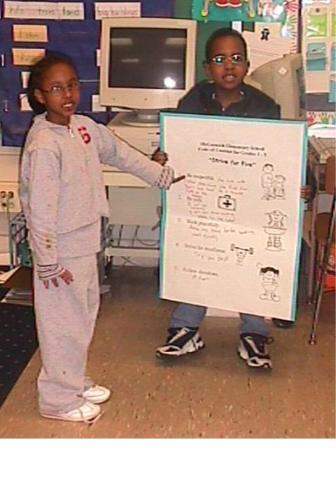
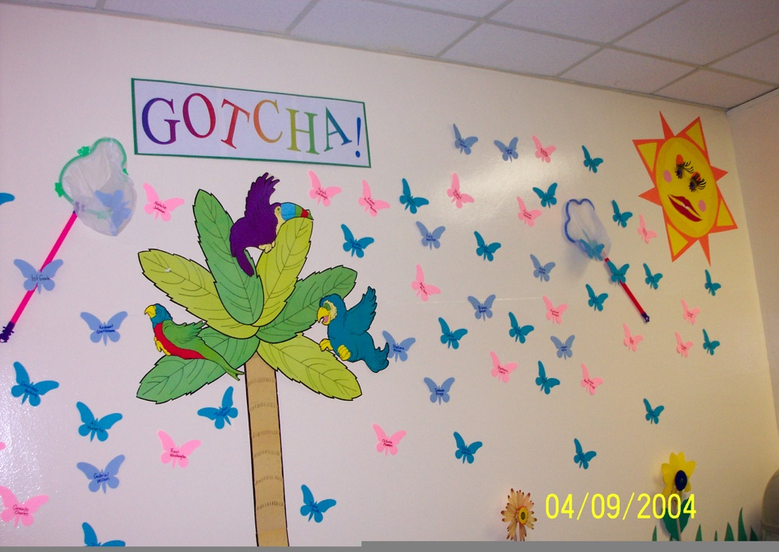
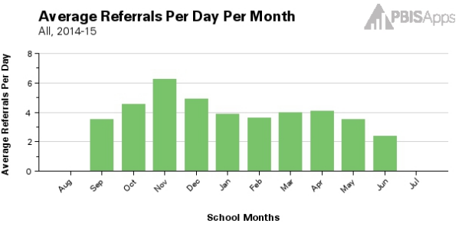
Teach Expectations in the
Context of Class Routines
Establish Procedures for Encouraging Appropriate Behavior
Establish Procedures for Responding to Inappropriate Behavior
Develop data-based procedures for monitoring

Slide 139
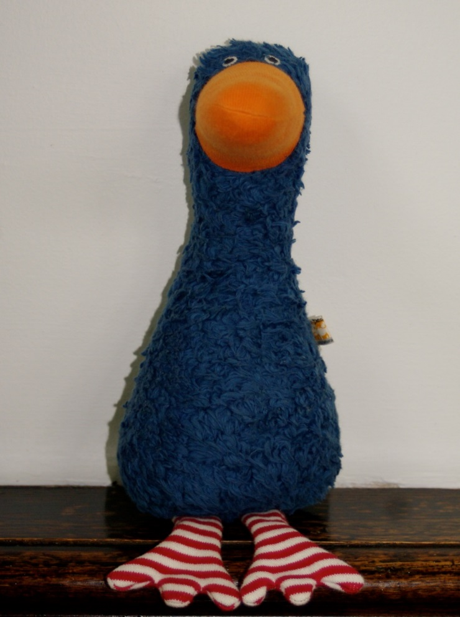

Develop Systems to Support Staff
Build Routines to Ensure On-Going Implementation

Slide 140
Consider Tattoos!
4 SWPBIS Elements
School Systems
Supporting Social Competence &
Academic Achievement
OUTCOMES
School-wide
Classroom
SWPBIS
SYSTEMS
DATA
Supporting
Decision
Making
Supporting
Staff Behavior
Non-classroom
Family
PRACTICES
Tertiary Prevention:
Specialized
Individualized
Systems for Students with High-Risk Behavior
~5%
Student
Supporting
Student Behavior
Primary Prevention:
School-/Classroom-
Wide Systems for
All Students,
Staff, & Settings
~15%
Secondary Prevention:
Specialized Group
Systems for Students with At-Risk Behavior
~80% of Students

