Slide 1
Coaching School-Wide Positive Behavioral Interventions and Supports (SWPBIS)
Northeast PBIS (NEPBIS) Coaches Training
Coaching Day 7
INSERT TRAINER NAMES
with support from Brandi Simonsen, Jen Freeman,
Susannah Everett, Adam Feinberg, & George Sugai
Notes:
Add trainer names for your event

Slide 2

Advance Organizer
Introduction and Focus on Coaching
Quick Review and Focus on Year 3 training activities
Coaching Self-Assessment and Reports
Share information on implementation of the PBIS Framework
Advanced Skill Building
Integrating School Climate and PBIS
Preparation for Next Training Event

Slide 3
Main Coaching Objectives
By the end of today’s meeting, you will be able to…
  …Describe your role as a coach.
  …Articulate the basic elements of SWPBS.
  …Identify resources for SWPBS.
  …Problem solve roadblocks in coaching
  …Facilitate your team’s activities at the next SWPBS team training.

Slide 4
Training Expectations:
RESPECT…
SELF
Self-monitor (Are you participating? Engaged as a learner? Talking during allotted times?)
Stretch, break, stand as needed
OTHERS
Cell phones (inaudible): Converse in lobbies and breaks
ENVIRONMENT
Recycle
Work as a team: Room for every voice, reinforce participation
Maintain neat working area

Slide 5


Tools!
nepbis.org
pbis.org
Coaching SWPBIS Workbook and Appendices
Evaluation Plan
Action Plan

Slide 6

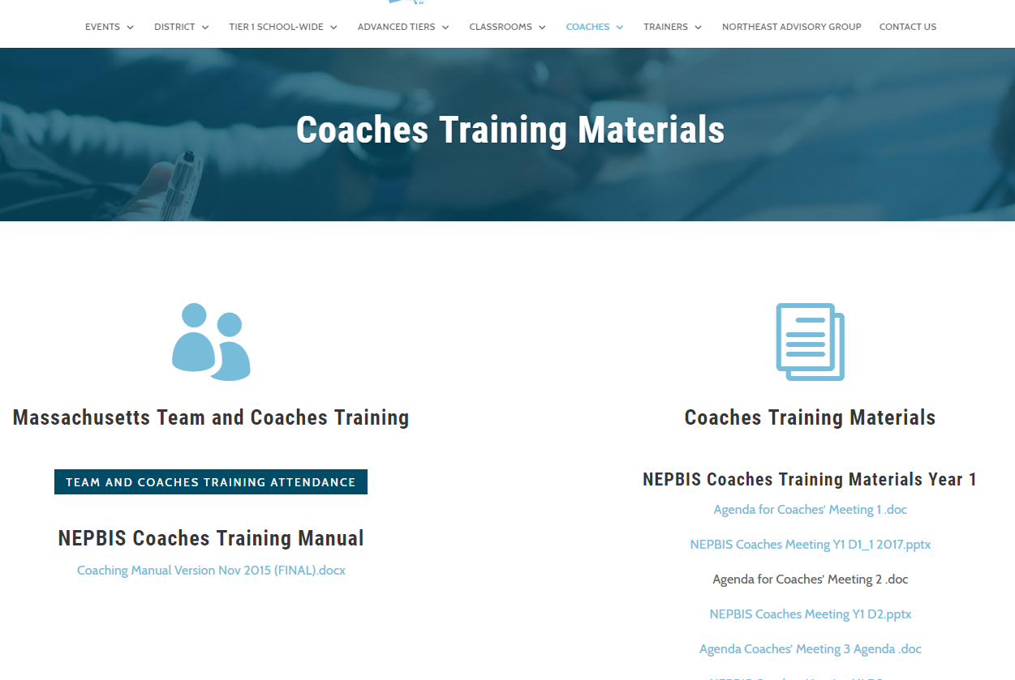
Activity:
Please Enter Attendance
1 min
Please login on nepbis.org, go to the coaches’ tab, and click on the Team Training Attendance Link. Follow prompts to enter team attendance.

Slide 7





Legend
New Content
Review
Guidelines
+Ex
-Ex
Training Organization
Activity

Slide 8


Legend
Section Header (I.A)
Chapter Header (e.g., I)

Slide 9
Advance Organizer
Introduction and Focus on Coaching
Quick Review and Focus on Year 3 training activities
Coaching Self-Assessment and Reports
Share information on implementation of the PBIS Framework
Advanced Skill Building
Integrating School Climate and PBIS
Preparation for Next Training Event

Slide 10
Overview of Coaching in swpbis
(Chapter i)

Slide 11
How is it going with your various roles?
Coaching Roles
Facilitate
Content Knowledge
Communicate
  Team meetings
  Activities at training events
  Implementation
  Local PBS expert
Positive “nag”
Link to resources (e.g., nepbis.org, www.pbis.org)
  Share advanced content with team
  Share information at faculty meetings
I.A.ii
Notes:
Move quickly through review content (just hit the highlights). Then, for each item, ask questions about how its going and use this to reinforce, correct, or problem solve as appropriate.

Slide 12
Basics of swpbis for coaches
(Chapter Ii)

Slide 13
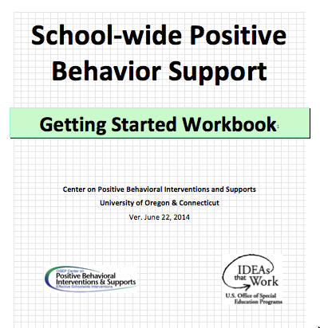
Critical Features of PBIS
Supporting Culturally Equitable
Social Competence & Academic Achievement
OUTCOMES
Supporting
Culturally
Knowledgeable
Staff Behavior
Supporting
Culturally Valid
Decision
Making
SYSTEMS
DATA
(Vincent, Randal, Cartledge, Tobin, & Swain-Bradway, 2011; Sugai, O’Keefe, & Fallon 2012 ab)
PRACTICES
I.C
Supporting Culturally Relevant
Evidence-based Interventions
Notes:
Move quickly through review content (just hit the highlights). Then, for each item, ask questions about how its going and use this to reinforce, correct, or problem solve as appropriate.

Slide 14
coaching team meetings
(Chapter iII)

Slide 15
Facilitating Effective Team Meetings
(see details in Coaches’ Workbook)
Be prepared and expect others to be as well
Begin on time by reviewing agenda and outcomes
Involve everyone
Use data to clearly and quickly define a problem before beginning problem solving
Create an action plan
At the end of the meeting debrief
After the meeting, electronically publish meeting minutes
III.A.i

Slide 16
Using Data Effectively
(see details in Coaches’ Workbook)
Collect appropriate and relevant data
Organize the data in a user-friendly manner that aides comprehension
Review and analyze the data at least monthly to guide decision-making
Make data available to all stakeholders
Provide staff development to all staff to use data to inform decision making
Use data analysis to inform decisions related to school-wide programs, classroom-based instructional practices, and student-specific interventions
Review data collection procedures and practices to ensure that data accurately reflect school events
Collect data on extent to which practice or intervention is being implemented accurately and fluently (implementation fidelity)
III.A.ii

Slide 17

MA PBIS Academy Year 3 Goals
Support implementation and sustainability of the PBIS framework
  Review current school implementation related to specific framework principles
  Gather information on other exemplars of implementation of framework principles.
Build coaching knowledge and fluency with PBIS content
  Connect specific school systems, features, or practices with PBIS content principles
  Practice communicating important framework features present or needed in your school

Slide 18
MA PBIS Academy Year 3 Activities
Training Day 10
  Guest Speaker on School Climate: Dr. Tamika La Salle
  Roundtable Discussions w/School Leaders
  Action Planning
Training Day 11
  Guest Speaker on Sustainability: Dr. Adam Feinberg
  Poster Session
  Action Planning

Slide 19
Roundtable Discussions
Target Goal:
  Networking across districts and schools through sharing examples of PBIS framework implementation
Roundtable Discussions (75 Minutes)
Elementary: Systems
Elementary: Data
Elementary: Practices
Middle / High: Systems
Middle / High: Practices
Middle / High: Data

Slide 20
Roundtable Discussions
Structure (75 Minutes)
  5 to 6 separate tables / groups with each table having a discussion focus on implementation
  Each school team will divide up and send team members to two or three tables.
  Peer leaders from schools in your Cohort that will be identified to lead discussions.
  After roundtable discussions, teams will have action planning time to process content discussed previously.
Elementary: Systems
Elementary: Data
Elementary: Practices
Middle / High: Systems
Middle / High: Practices
Middle / High: Data

Slide 21
Roundtable Discussions
Sample Roundtable Discussion Format
  First 10 minutes: School exemplar discussion leaders will review current features present in their school related to the table’s topic
  Second 65 minutes: Tables will engage in a discussion sharing examples of features relative to the tables topic including…
    Asking questions of school exemplar discussion leaders on the content initially reviewed.
    Other round table participants share other examples of features from their school as comparision

Slide 22
Roundtable Discussions
Roundtable Discussion Format
  Table members discuss at-large questions provided at the table
    At-large questions will be previously drafted by having school teams earlier in the day draft questions they have for that domain.
    School teams will be given time to write down questions for round table discussion that will occur later in the day.
    These questions will be collected and distributed later for table discussions
    Roundtable discussions structure will include (1) exemplar school discussion related to topic, (2) questions from table participants, and (3) discussion based on submited questions.

Slide 23
MA PBIS Academy Year 3 Activities
Training Day 10
  Guest Speaker on School Climate: Dr. Tamika La Salle
  Roundtable Discussions w/School Leaders
  Action Planning
Training Day 11
  Guest Speaker on Sustainability: Dr. Adam Feinberg
  Poster Session
  Action Planning

Slide 24
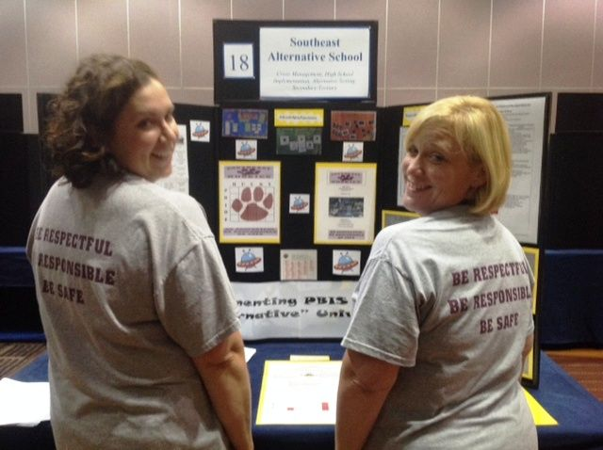
Poster Session
Target Goal:
  Share examples of implementation of the PBIS Framework across districts and schools
Structure
  Show off! Each school will present a
  poster and have at least 1 or 2 team
  members present at poster during the
  session
  Take turns! Other team members walk
  around browse other posters to review
  PBIS features of other schools
  Get ideas! Bring ideas back to your
  school for follow up action planning

Slide 25
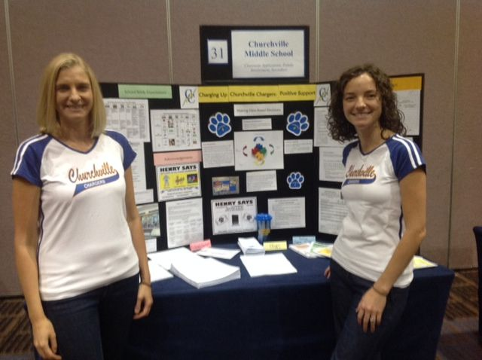
What to include in your Poster?
Ideas Examples of Systems, Data, and Practices!
  Data Examples:
    Fidelity Data (e.g., TFI or TIC)
    Outcome Data (e.g., ODR or attendance)
  System Examples
    Team action plans
    Staff Survey
  Practice Examples
    Lesson plan
    Teaching Matrix
    Consequence Flow-chart
Please include data as part of your poster!

Slide 26
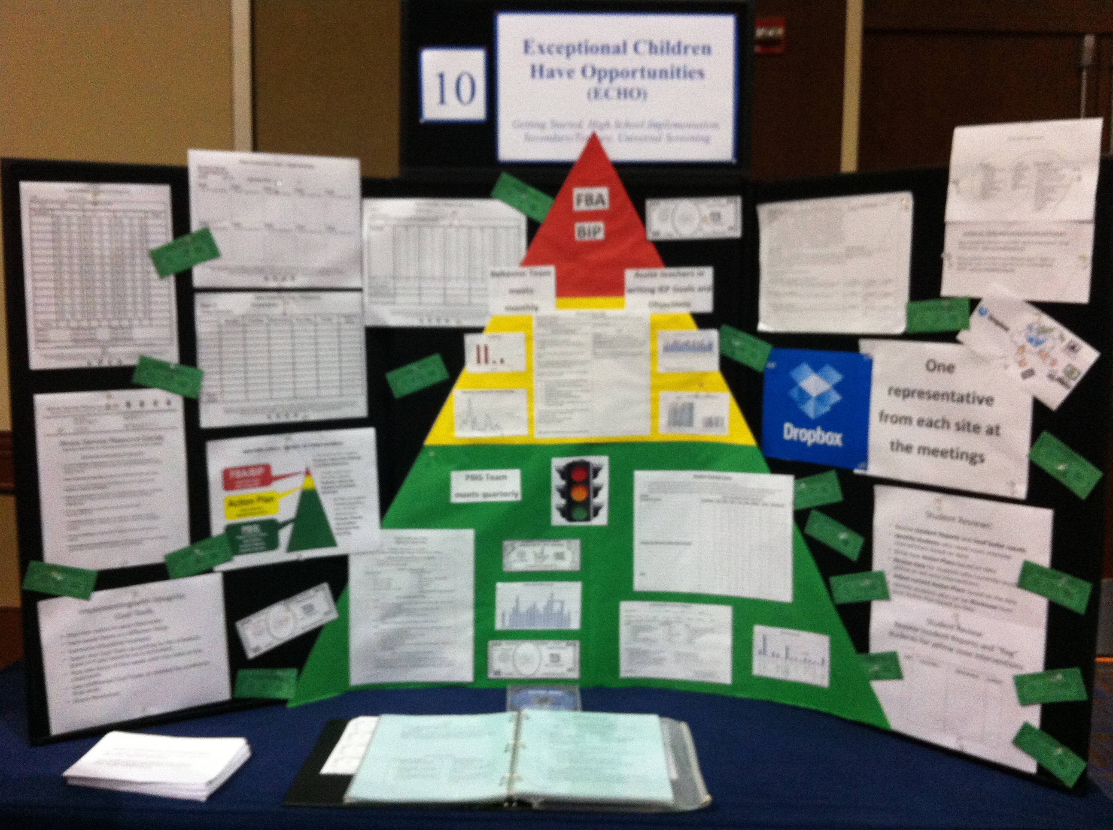
Poster Session
Invite your colleagues and administrators:
  We will email you in the winter to
  alert you of the time of the poster
  sessions.
  Please invite colleagues with whom
  you want to share your work with.
  Consider important stakeholders!
  (e.g., school board, PTO, etc.)
  Consider inviting relevant
  administrators

Slide 27
Activity:
Poster Planning
Work individually (or with partner coach) for 15 min
Review Round table and Poster format
Discuss with your fellow coach what your school may show on your poster in the Spring.
Discuss what potential steps may need to be completed between now and the Spring training session to complete a poster.
Be prepared to share any ideas and bring up any potential barriers for problem solving.

Slide 28
Advance Organizer
Introduction and Focus on Coaching
Quick Review and Focus on Year 3 training activities
Coaching Self-Assessment and Reports
Share information on implementation of the PBIS Framework
Advanced Skill Building
Integrating School Climate and PBIS
Preparation for Next Training Event

Slide 29
A reminder you’ll see throughout to help us remember the role.
Coach

Slide 30
Coaching Reports
(+ or Δ)
Coach
      Complete Coaches’ Self-Assessment and Prepare:
      1-2 Details to introduce yourself
      1-2 Strengths
      (with respect to coaching)
      1-2 Concerns or challenges
      (with respect to coaching)

Slide 31
Activity:
Coaching Implementation Review
Work individually (or with partner coach) for 20 min
Review Coaches Implementation Activity as well as the TFI Tier 1 Features
Review your TFI results from PBISApps.org
Review what is / is not in place in your school
Based on your school’s level of implementation, identify what other schools are doing that could be effective for your school
Be prepared to share out 1-2 ideas per domain during the upcoming discussion

Slide 32
Implementation Planning
1.1 Team Composition
Tier I team includes a Tier I systems coordinator, a
school administrator, a family member, and individuals able to provide (a) applied behavioral expertise, (b) coaching expertise, (c) knowledge of student academic and behavior patterns, (d) knowledge about the operations of the school across grade levels and programs, and for high schools, (e) student representation.
In Place
In Development
Not in Place

Slide 33
Implementation Planning
1.2 Team Operating Procedures
Tier I team meets at least monthly and has (a) regular meeting format/agenda, (b) minutes, (c) defined meeting roles, and (d) a current action plan.
In Place
In Development
Not in Place

Slide 34
Implementation Planning
1.3 Behavioral Expectations
School has five or fewer positively stated behavioral expectations and examples by setting/location for student and staff behaviors (i.e., school teaching matrix) de defined and in place.
In Place
In Development
Not in Place

Slide 35
Implementation Planning
1.4 Teaching Expectations
Expected academic and social behaviors are taught directly to all students in classrooms and across other campus settings/locations.
In Place
In Development
Not in Place

Slide 36
Implementation Planning
1.5 Problem Behavior Definitions
School has clear definitions for behaviors that interfere with academic and social success and a clear policy/ procedure (e.g., flowchart) for addressing office managed versus staff managed problems.
In Place
In Development
Not in Place

Slide 37
Implementation Planning
1.6 Discipline Policies
School policies and procedures describe and emphasize proactive, instructive, and/ or restorative approaches
to student behavior that are implemented consistently.
In Place
In Development
Not in Place

Slide 38
Implementation Planning
1.7 Professional Development
A written process is used for orienting all faculty/staff on 4 core Tier I SWPBIS practices:
(a) teaching school-wide expectations, (b) acknowledging appropriate behavior, (c) correcting errors, and (d) requesting assistance.
In Place
In Development
Not in Place

Slide 39
Implementation Planning
1.8 Classroom Procedures:
Tier I features (school-wide expectations, routines, acknowledgements, in-class continuum of consequences) are implemented within classrooms and consistent with school-wide systems.
In Place
In Development
Not in Place

Slide 40
Implementation Planning
1.9 Feedback and Acknowledgement
A formal system (i.e., written set of procedures for specific behavior feedback that is
[a] linked to school-wide expectations and [b] used across settings and within classrooms) is in place and used by at least 90% of a sample of staff and received by at least 50% of a sample of students.
In Place
In Development
Not in Place

Slide 41
Implementation Planning
1.10 Faculty Involvement
Faculty are shown school- wide data regularly and provide input on universal foundations (e.g., expectations, acknowledgements, definitions, consequences) at least every 12 months.
In Place
In Development
Not in Place

Slide 42
Implementation Planning
1.11 Student / Family / Community Involvement
Stakeholders (students, families, and community members) provide input on universal foundations (e.g., expectations, consequences, acknowledgements) at least every 12 months.
In Place
In Development
Not in Place

Slide 43
Implementation Planning
1.12 Discipline Data
Tier I team has instantaneous access to graphed reports summarizing discipline data organized by the frequency of problem behavior events by behavior, location, time of day, and by individual student.
In Place
In Development
Not in Place

Slide 44
Implementation Planning
1.13 Data-based Decision Making
Tier I team reviews and uses discipline data and academic outcome data (e.g., Curriculum-Based Measures, state tests) at least monthly for decision-making.
In Place
In Development
Not in Place

Slide 45
Implementation Planning
1.14 Fidelity Data
Tier I team reviews and uses SWPBIS Fidelity (e.g., SET, BoQ, TIC, SAS, Tiered Fidelity Inventory) data at least annually.
In Place
In Development
Not in Place

Slide 46
Implementation Planning
1.15 Annual Evaluation
Tier I team documents Fidelity and effectiveness (including on academic outcomes) of Tier I practices at least annually (including year- by-year comparisons) that are shared with stakeholders (staff, families, community, district) in a usable format.
In Place
In Development
Not in Place

Slide 47
Advance Organizer
Introduction and Focus on Coaching
Quick Review and Focus on Year 3 training activities
Coaching Self-Assessment and Reports
Share information on implementation of the PBIS Framework
Advanced Skill Building
Integrating School Climate and PBIS
Preparation for Next Training Event

Slide 48
MA PBIS Academy Year 3 Activities
Training Day 10
  Guest Speaker on School Climate: Dr. Tamika La Salle
  Roundtable Discussions w/School Leaders
  Action Planning
Training Day 11
  Guest Speaker on Sustainability: Dr. Adam Feinberg
  Poster Session
  Action Planning

Slide 49
Integrating School Climate and PBIS
Is there a way to use both subjective data (school climate perceptions) and objective data (PBIS outcome indicators) to support data-based decision making for school improvement efforts?
Objective
Subjective
School Climate within the Context of PBIS
PBIS
SCHOOL CLIMATE

Slide 50
Creating a Positive School Climate
From a PBIS perspective, a positive school climate results from school environments that are:
  Predictable
    Common language
    Common vision (understanding expectations)
    common experience
  Positive
    Regular recognition for positive behavior
  Safe
    Violence and disruptive behavior is not tolerated
  Consistent
    Adults use similar expectations

Slide 51
Building a Framework…
PBIS
Safe
Predictable
Positive
Consistent

Slide 52
Building a Framework…
PBIS
Safe
Predictable
School Climate
Fairness/Equity
Positive
Consistent

Slide 53
Building a Framework…
PBIS
Safe
Predictable
School Climate
Fairness/Equity
Positive
Consistent
Safety

Slide 54
Building a Framework…
PBIS
Safe
Predictable
School Climate
Fairness/Equity
Positive
Consistent
Safety
Order & Discipline
Order & Discipline

Slide 55
Building a Framework…
PBIS
Safe
Predictable
School Climate Perceptions
Fairness/Equity
Positive
Consistent
Safety
Order & Discipline
Order & Discipline
PBIS/SCHOOL
Attendance
Suspensions/Referrals
Disproportionality Data
Discipline Referrals
Student Outcomes

Slide 56
School Climate Survey
Teaching & Learning
School Climate
Safety
Institutional Environment/Structure
“Teachers at my school have high standards for achievement
•Support for Learning
“I know an adult I can talk to if I need help”
“I have been bullied or threatened by other students”
“I feel successful at school”
“I feel safe in my school”
Relationships
•Peer/adult relations
•Connectedness (professional relationships)
•Parent Involvement
•Order and Discipline
Peer Victimization
“I Have worried about other students hurting me”
“Instructional materials are up to date and in good condition”
“Students in my school take pride in keeping the school building clean”
•Physical Environment
Notes:
This is a guide- the list of potential factors is exhaustive
Reflects some or most of the commonly identified categories related to school climate
There are 4 major dimensions/area of school climate. Each major area contains several subdimensions that are more specific
Identified by Nscc
List is not exhaustive- potentially innumerable amount of influences on school climate- this provides a guide
Safety: referring to the physical and emotional safety of students and the rules and procedures in place to ensure student safety;
–Relationships: student social support from educators and parents, the level of respect students have for others, school and community engagement, and student and parental leadership;
Student social support from teachers, administrators, counselors, parents etc- respect for one another- student and parent leadership- community engagement.
–Teaching and Learning: a positive and professional student-teacher-school relationship, social and emotional skills training, civic education, and positive support for learning; and
Positive and professional student-teacher relationships= social and emotional skills- social learning- civic education- positive support for learning
One of six goals is to promote strong character and citizenship
–Institutional Environment: the physical environment of the school.

Slide 57
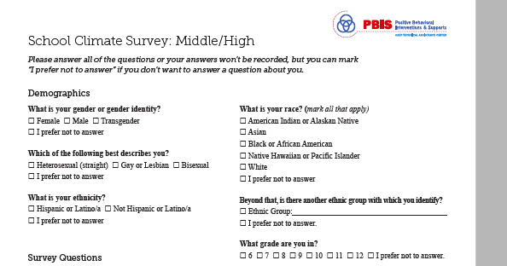
School Climate Survey
Notes:
I always end up foung that

Slide 58
Activity:
Getting Ready for Team Training
Work with partner coach for 15 min
Review implementation guidelines and preview slides just presented.
Discuss above with a partner
  Is there content you’d like re-explained?
  What key questions do you have?
  What questions/challenges do you anticipate from your team members?
Share key highlights (1 min. reports)

Slide 59
Review of
Coaching SWPBIS

Slide 60
Main Coaching Objectives
By the end of today’s meeting, you will be able to…
  …Describe your role as a coach.
  …Articulate the basic elements of SWPBS.
  …Identify resources for SWPBS.
  …Problem solve roadblocks in coaching
  …Facilitate your team’s activities at the next SWPBS team training.

Slide 61
What roles do coaches play?
Coaching Roles
Facilitate
Content Knowledge
Communicate
  Team meetings
  Activities at training events
  Implementation
  Local PBS expert
Positive “nag”
Link to resources (e.g., nepbis.org, www.pbis.org)
  Share advanced content with team
  Share information at faculty meetings
I.A.ii

Slide 62
Consider Tattoos!
4 PBIS Elements
School Systems
Supporting Social Competence &
Academic Achievement
OUTCOMES
School-wide
Classroom
SWPBIS
SYSTEMS
DATA
Supporting
Decision
Making
Supporting
Staff Behavior
Non-classroom
Family
PRACTICES
Tertiary Prevention:
Specialized
Individualized
Systems for Students with High-Risk Behavior
~5%
Student
Supporting
Student Behavior
Primary Prevention:
School-/Classroom-
Wide Systems for
All Students,
Staff, & Settings
~15%
Secondary Prevention:
Specialized Group
Systems for Students with At-Risk Behavior
~80% of Students

Slide 63
TAKE AWAY MESSAGE
You’re a coach!
Prepare for the next training event, and use your resources to guide your team’s activities (both at training and at school).

