Slide 1
Coaching School-Wide Positive Behavioral Interventions and Supports (SWPBIS)
Northeast PBIS (NEPBIS) Coaches Training
Coaching Day 4
INSERT TRAINER NAMES
with support from Brandi Simonsen, Jen Freeman,
Susannah Everett, Adam Feinberg, & George Sugai
Notes:
Add trainer names for your event

Slide 2

Advance Organizer
Introduction and Focus on Coaching
Quick Review and Focus on Problem Solving in Tier 1
Coaching Self-Assessment and Reports
Re-introduce Yourself and Your school
Advanced Skill Building
Using Data to Drive Decision Making
Preparation for Next Training Event

Slide 3
Main Coaching Objectives
By the end of today’s meeting, you will be able to…
  …Describe your role as a coach.
  …Articulate the basic elements of SWPBS.
  …Identify resources for SWPBS.
  …Problem solve roadblocks in coaching
  …Facilitate your team’s activities at the next SWPBS team training.

Slide 4
Training Expectations:
RESPECT…
SELF
Self-monitor (Are you participating? Engaged as a learner? Talking during allotted times?)
Stretch, break, stand as needed
OTHERS
Cell phones (inaudible): Converse in lobbies and breaks
ENVIRONMENT
Recycle
Work as a team: Room for every voice, reinforce participation
Maintain neat working area

Slide 5


Tools!
nepbis.org
pbis.org
Coaching SWPBIS Workbook and Appendices
Evaluation Plan
Action Plan

Slide 6

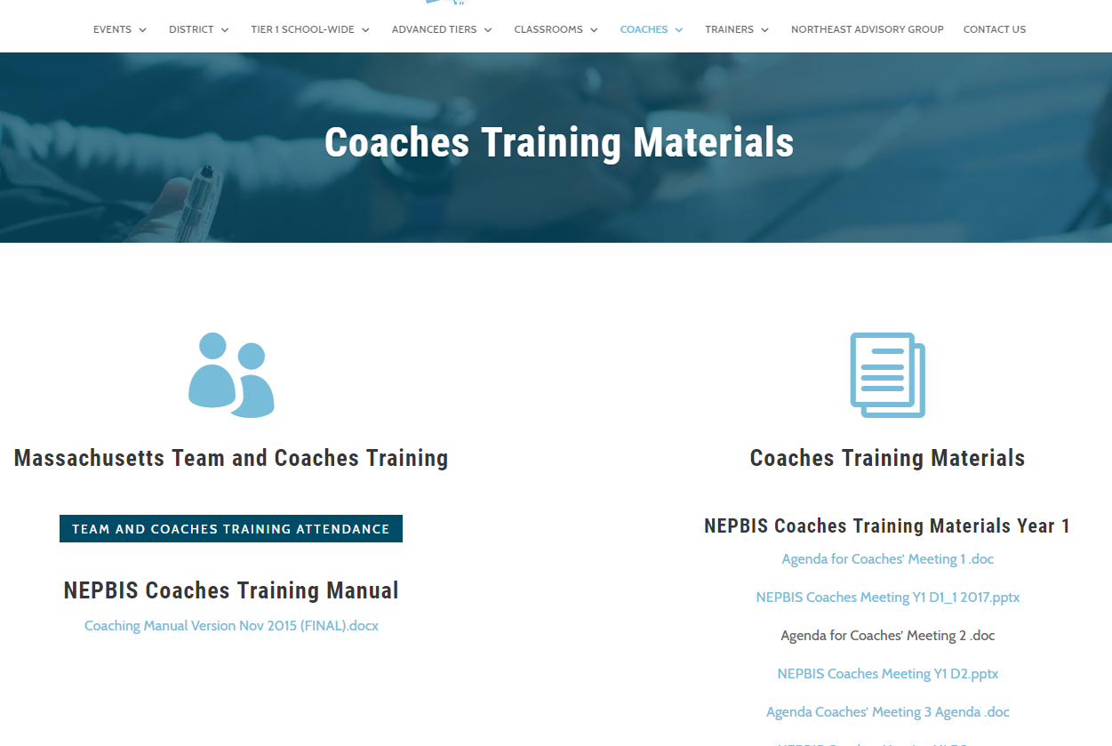
Activity:
Please Enter Attendance
1 min
Please login on nepbis.org, go to the coaches’ tab, and click on the Team Training Attendance Link. Follow prompts to enter team attendance.

Slide 7





Legend
New Content
Review
Guidelines
+Ex
-Ex
Training Organization
Activity

Slide 8


Legend
Section Header (I.A)
Chapter Header (e.g., I)

Slide 9
Advance Organizer
Introduction and Focus on Coaching
Quick Review and Focus on Problem Solving in Tier 1
Coaching Self-Assessment and Reports
Re-introduce Yourself and Your school
Advanced Skill Building
Using Data to Drive Decision Making
Preparation for Next Training Event

Slide 10
Overview of Coaching in swpbis
(Chapter i)

Slide 11
What roles do coaches play?
Coaching Roles
Facilitate
Content Knowledge
Communicate
  Team meetings
  Activities at training events
  Implementation
  Local PBS expert
Positive “nag”
Link to resources (e.g., nepbis.org, www.pbis.org)
  Share advanced content with team
  Share information at faculty meetings
I.A.ii
Notes:
Move quickly through review content (just hit the highlights). Then, for each item, ask questions about how its going and use this to reinforce, correct, or problem solve as appropriate.

Slide 12
Basics of swpbis for coaches
(Chapter Ii)

Slide 13

Critical Features of PBIS
Supporting Culturally Equitable
Social Competence & Academic Achievement
OUTCOMES
Supporting
Culturally
Knowledgeable
Staff Behavior
Supporting
Culturally Valid
Decision
Making
SYSTEMS
DATA
(Vincent, Randal, Cartledge, Tobin, & Swain-Bradway, 2011; Sugai, O’Keefe, & Fallon 2012 ab)
PRACTICES
I.C
Supporting Culturally Relevant
Evidence-based Interventions
Notes:
Move quickly through review content (just hit the highlights). Then, for each item, ask questions about how its going and use this to reinforce, correct, or problem solve as appropriate.

Slide 14
GENERAL IMPLEMENTATION PROCESS
Team
Agreements
Data-based
Action Plan
Evaluation
Implementation
I.C.iv
Notes:
Move quickly through review content (just hit the highlights). Then, for each item, ask questions about how its going and use this to reinforce, correct, or problem solve as appropriate.

Slide 15
Self-Check:
Effective Leadership Team
Work as team for 10 min
Review guidelines for team composition.
  Administrator
  Grade/Department Representation
  Specialized Support
    (e.g., Special Educator, Counselor, School Psychologist, Social Worker, etc.)
  Support Staff
    (e.g., Office, Supervisory, Custodial, Bus, Security, etc.)
  Parent (who is not also a staff member)
  Community
    Mental Health, Business
  Student
Ensure you have 1-2 parents on your leadership team this year
Review relevant items to your action plan and add/adjust as needed to ensure your team is ready to work this year (and in the future)!

Slide 16
Family Engagement Rubric
Review the Family, School, and Community Partnership Fundamentals (http://www.doe.mass.edu/boe/sac/parent/FSCPfundamentals.pdf)
Complete self assessment as a team
Add relevant items to your action plan
New this year! You will complete this with your team each time you complete the TIC
See Appendix M
Complete during Team Action Planning Time TODAY
Notes:
Add this to the appendix

Slide 17
coaching team meetings
(Chapter iII)

Slide 18
Facilitating Effective Team Meetings
(see details in Coaches’ Workbook)
Be prepared and expect others to be as well
Begin on time by reviewing agenda and outcomes
Involve everyone
Use data to clearly and quickly define a problem before beginning problem solving
Create an action plan
At the end of the meeting debrief
After the meeting, electronically publish meeting minutes
III.A.i

Slide 19
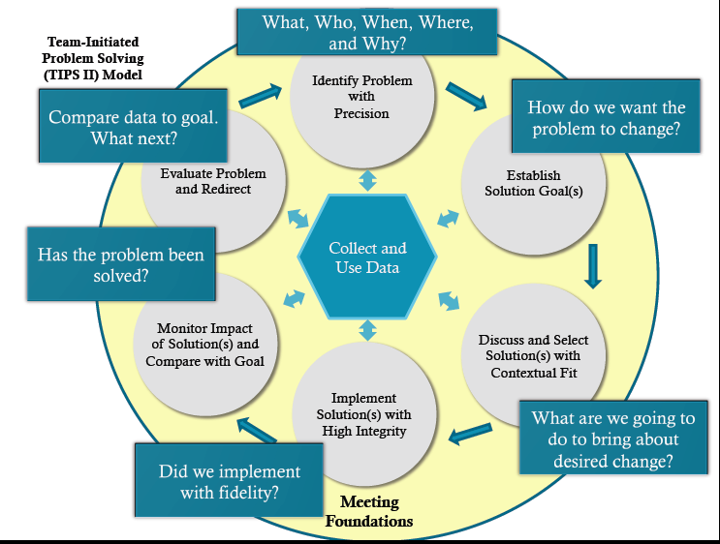
Consider the TIPS Model
(see additional resources for TIPS on pbis.org)
http://www.pbis.org/common/cms/files/Forum12/E2_TIPS_Teaser.pdf
III.A.i

Slide 20
Using Data Effectively
(see details in Coaches’ Workbook)
Collect appropriate and relevant data
Organize the data in a user-friendly manner that aides comprehension
Review and analyze the data at least monthly to guide decision-making
Make data available to all stakeholders
Provide staff development to all staff to use data to inform decision making
Use data analysis to inform decisions related to school-wide programs, classroom-based instructional practices, and student-specific interventions
Review data collection procedures and practices to ensure that data accurately reflect school events
Collect data on extent to which practice or intervention is being implemented accurately and fluently (implementation fidelity)
III.A.ii

Slide 21
Advance Organizer
Introduction and Focus on Coaching
Quick Review and Focus on Problem Solving in Tier 1
Coaching Self-Assessment and Reports
Re-introduce Yourself and Your school
Advanced Skill Building
Using Data to Drive Decision Making
Preparation for Next Training Event

Slide 22
Activity:
Coaching Self-Assessment
Work individually (or with partner coach) for 15 min
Review and Update Coaching Self-Assessment
Develop an Action Plan to address areas for growth from your self assessment
Present 1-2 “strengths” and 1-2 “concerns or challenges” (1 min. reports)

Slide 23
A reminder you’ll see throughout to help us remember the role.
Coach

Slide 24
Coaching Reports
(+ or Δ)
Coach
      1-2 Details to introduce yourself
      1-2 Strengths
      (with respect to coaching)
      1-2 Concerns or challenges
      (with respect to coaching)

Slide 25
Advance Organizer
Introduction and Focus on Coaching
Quick Review and Focus on Problem Solving in Tier 1
Coaching Self-Assessment and Reports
Re-introduce Yourself and Your school
Advanced Skill Building
Using Data to Drive Decision Making
Preparation for Next Training Event

Slide 26
What roles do coaches play?
Coaching Roles
Facilitate
Content Knowledge
Communicate
  Team meetings
  Activities at training events
  Implementation
  Local PBS expert
Positive “nag”
Link to resources (e.g., nepbis.org, www.pbis.org)
  Share advanced content with team
  Share information at faculty meetings
I.A.ii
Notes:
Move quickly through review content (just hit the highlights). Then, for each item, ask questions about how its going and use this to reinforce, correct, or problem solve as appropriate.

Slide 27

In other words…
Critical Components of Coaching Practice
Effective Communication
Organization
Technical Assistance
Reinforcement of Leadership Team and School Faculty
Participate in Leadership Team Activities
Deepen Content Knowledge
adapted from:
Notes:
Trainer Notes: This is an animated slide.
Trainer Talk:
“Here are the six critical components on the Coaching Practice Profile. ADVANCE SLIDE: During our last meeting we focused on organization. ADVANCE SLIDE: Today we are going to focus the critical component of Reinforcement of the Leadership Team and School Faculty. Since we are moving into the end of the school year, this is a crucial time to begin celebrating and reinforcing the leadership team and staff for all of their hard work this year.

Slide 28
Where do data fit into these roles?
Recognizing and communicating changes in staff behavior that should be celebrated/reinforced (e.g., school-wide roll out!)
Encouraging team to identify their accomplishments and plan for reinforcement
Providing specific, descriptive feedback on progress towards goals and other successes
Pinpointing specific targets of opportunity for growth, developing specific action plans, updating progress along the way
Ensuring that both program quality/fidelity data and student outcome data are used for problem solving and decision making
adapted from:

Slide 29
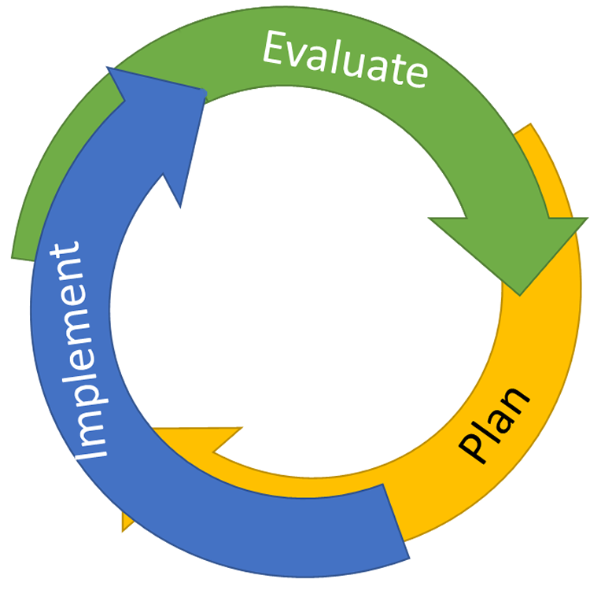
Continuous Quality Improvement
Identify problems with precision
DATA
Notes:
Trainer Note: We want to interrupt the traditional cycle of admiring the problem, by talking and talking about the problem before quickly launching into determining solutions.
We can do this by building a system for improved decision making.

Slide 30
Primary vs. Precision Statements
Primary Statements
Precision Statement
Too many referrals
September has more suspensions than last year.
Gang behavior is increasing.
The cafeteria is out of control.
Student disrespect is out of control.
There are more ODRs for aggression on the playground than last year. These are most likely to occur during first recess, with a large number of students, and the aggression is related to getting access to the new playground equipment.
Notes:
Trainer Notes:
Here are examples of several primary statements and a precision statement.

Slide 31
Continuous Quality Improvement
Identify problems with precision
DATA
Establish goal(s)
Develop solution(s)
Notes:
Trainer Note: We want to interrupt the traditional cycle of admiring the problem, by talking and talking about the problem before quickly launching into determining solutions.
We can do this by building a system for improved decision making.

Slide 32

Improving Decision Making
Problem
Solution
Problem
Problem Solving
Solution
Action Planning

Slide 33
Continuous Quality Improvement
Reassess and revise solution(s) as needed
Identify problems with precision
Monitor outcomes and compare
to goal(s)
DATA
Establish goal(s)
Develop solution(s)
Implement solution(s) with integrity and fidelity
Notes:
Trainer Note: We want to interrupt the traditional cycle of admiring the problem, by talking and talking about the problem before quickly launching into determining solutions.
We can do this by building a system for improved decision making.

Slide 34
To effectively use data to drive decision making,
use your evaluation plan…
DISTRICTS/SCHOOLS IN TRAINING |  |  | SCHEDULE
Purpose | Measure | Function | Year 1 Training |  | Year 2 Training
 |  |  | Winter | Spring | Fall | Winter | Spring
Capacity Building—District Level | District Capacity Assessment (DCA) | Completed by district leadership team (with the support of a trained facilitator) to assess district capacity and to guide Action Planning. |  | X |  |  | X
Fidelity of Implementation—Building Level | PBIS Tiered Fidelity Inventory (TFI) | Leadership team self-evaluation (with support of external coach) to assess the critical features of PBIS across Tiers I, II, and III. |  | X | X |  | X
Progress Monitoring—Building Level | Self-Assessment Survey (SAS) | Used by school staff for initial and annual assessment of effective behavior support systems in their school and to guide Action Planning. |  | X |  |  | X
Progress Monitoring—Team Level | Team Implementation Checklist (TIC) | A self-assessment tool that serves as a multi-level guide for creating School-Wide PBIS Action Plans and evaluating the status of implementation activities. | X | X | X | X | X
School Climate | Georgia School Climate Surveys | An annual survey that assesses student (grades 3-12), teacher, and parent perceptions of school climate. The middle and high school surveys also include items about adolescent drug/alcohol/tobacco use, self-harm ideation and behaviors, school dropout, and parental involvement. The survey provides information to determine training support needs related to school climate, safety, and violence prevention. |  | X | X
Student Outcomes | School-wide Information System (SWIS) | Office discipline referrals (ODR) provide data for monthly team reviews and decision-making by teachers, administrators, and other staff to guide prevention efforts and Action Planning. | Weekly | Weekly | Weekly | Weekly | Weekly
…and tools available at:

Slide 35

What is most related to high sustainability?
The frequency that data are presented to all schools staff.
(McIntosh, Kim, Pinkelman,, Rasplica,, Berg, & Strickland-Cohen, in press)

Slide 36
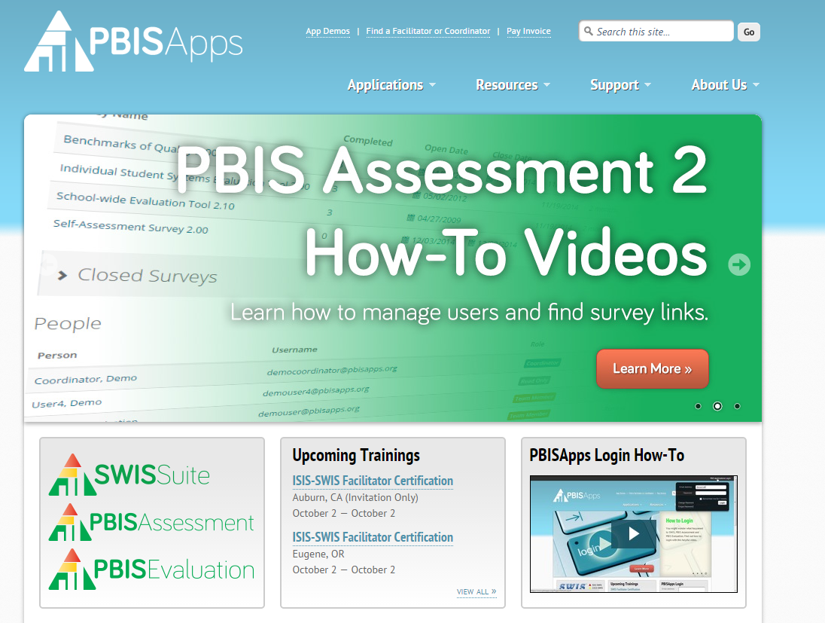
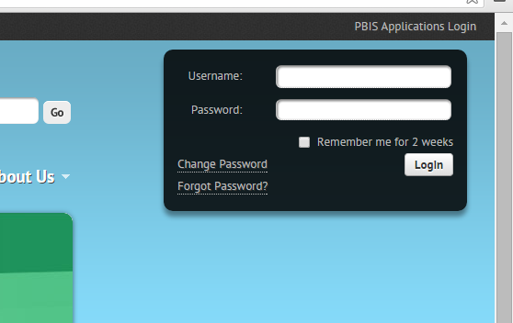
Data-Driven Problem Solving
We are about to engage in a series of activities that require you to review and use your school’s data on pbisapps.org
  Log on to pbisapps.org
  Go to closed survey windows
  Choose a survey (e.g., Self Assessment Survey, Team Checklist)
  Choose View Reports
Remember different types of reports (total, subscale, subsubscale, item reports)

Slide 37
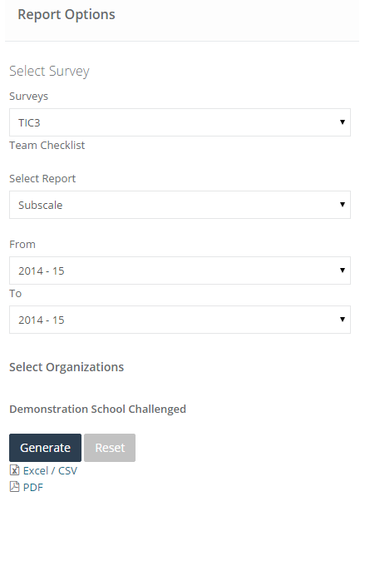
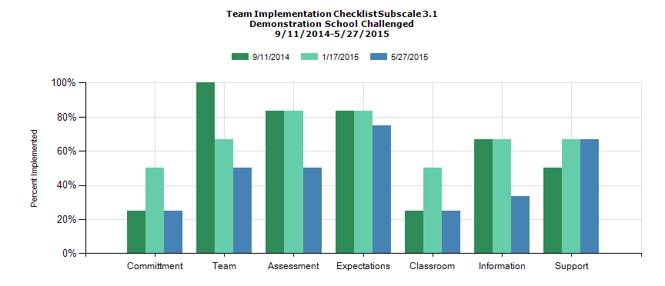
Example: Team Implementation Checklist Subscale Report

Slide 38
Activity:
Review Your School’s Self-Assessment Survey
Work individually (or with partner coach) for 15 min
Follow directions to log-on to pbisapps.org and retrieve Self-Assessment Survey (SAS) data.
Review your school’s SAS data.
  Identify 1-2 key strengths and 1-2 need areas
  Review your plan for administering this survey again this year (note intended timeline on evaluation plan)
Share 2 min reports (strengths, need areas, and questions).

Slide 39
Evaluation Questions
What are the critical features of data review activities that will lead to continued improvements in student outcomes?
What are the necessary behaviors of school personnel that will increase the sustainability of data review practices?
adapted from:

Slide 40
Activity:
Review Your Office Discipline Referrals (ODRs) D
Work individually (or with partner coach) for 15 min
Log-on to pbisapps.org (or appropriate site) to review your school’s ODR data.
Review your school’s ODR data.
  Identify 1-2 improvements relative to last year or observations
  Identify and precisely define 1-2 problems related to ODR data
  Review your plan for using ODR data to monitor progress
Share 2 min reports (strengths, need areas, and questions).
If you do not presently have ODR data to review, use this time to develop an action plan to secure a user-friendly interface.

Slide 41
“The critical mechanism by which a practice sustains is fidelity.”
(McIntosh, Filter, Bennett, Ryan, & Sugai, 2010; p.10)
adapted from:
Notes:
Trainer Notes:
Please be sure to read the rest of the quote to the coaches.
This quote comes from the article Principles of sustainable prevention: Designing scale-up of school-wide positive behavior support to promote durable systems. The article goes on to state, “a practice can be said to sustain if school personnel continue implementing enough critical features to criterion that effects are still observed. An effort in which school personnel continue to implement with low fidelity, or implement only non-critical features, does not meet the definition of sustainability. The target for sustainability initiative is therefore the behavior of school personnel, and targeting sustainability requires targeting the environment of the adults in the school.”
Then pose the questions on the next slide to the coaches to set them up for the discussion activity that follows the questions.

Slide 42
Activity:
Review Your School’s Fidelity Data (TIC/TFI)
Work individually (or with partner coach) for 30 min
Log-on to pbisapps.org.
Review your school’s fidelity data (TIC and/or TFI).
  Identify 1-2 key strengths and 1-2 need areas
  Precisely define problem statements
  Review your plan for administering this survey again this year (note intended timeline on evaluation plan)
Share 2 min reports (strengths, need areas, and questions).

Slide 43
Activity:
Update Action Plan
Work individually (or with partner coach) for 15 min
Across all data sources, consider:
  Plan for sharing data with team and faculty/staff
  Evaluation plan (when to complete administration of each assessment)
Update your action plan to enhance your enhanced using data to drive problem solving and decision making related to Tier 1 implementation.

Slide 44
Advance Organizer
Introduction and Focus on Coaching
Quick Review and Focus on Problem Solving in Tier 1
Coaching Self-Assessment and Reports
Re-introduce Yourself and Your school
Advanced Skill Building
Using Data to Drive Decision Making
Preparation for Next Training Event

Slide 45

Topics to Be Covered on Day 7
Quick Recap of Year 1 (Days 1-6) Training
Celebrate Accomplishments
Tier 1 SWPBIS: Problem Solving Critical Features
Preview of Additional Tier 1 Resources
  Equity
Action Planning

Slide 46
Activity:
Show, Tell, and Ask
Work as team for 10 min
Review your action plan and identify
  1-2 accomplishments
  1-2 questions or concerns shared by most members of team
You’ll have 5 min to show, tell, and ask!

Slide 47
Implementing SWPBS: Guidelines, Examples, &
Self-check Activities
For each element, we will review guidelines, present a few examples, and give your teams 5-10 min to perform a quick self-check. The following is an example for outcomes.

Slide 48
Critical Features of PBIS
Supporting Culturally Equitable
Social Competence & Academic Achievement
OUTCOMES
Supporting
Culturally
Knowledgeable
Staff Behavior
Supporting
Culturally Valid
Decision
Making
SYSTEMS
DATA
PRACTICES
Supporting Culturally Relevant
Evidence-based Interventions
Notes:
Use data
Focus on outcomes: Academic & behavior success
On-going evaluation
Ensure cultural and contextual fit
Invest in systems
Organize research-validated practices within a continuum
Instructional & preventative approach
Integration
Tier 1 for all

Slide 49
Focus on Outcomes
OUTCOMES
How do we develop outcome statements?
I.C.i

Slide 50
Guidelines for Good Outcomes
OUTCOMES
Based on data
Locally important and meaningful
Applicable to all (culturally equitable)
  Students’ social competence and academic achievement
  Staff implementation of critical skills
Observable and measurable
Written as a goal
I.C.i

Slide 51
Example Outcome Statements
During the first semester of PBIS implementation, staff members will implement PBIS with fidelity, as measured by meeting criteria on the Tiered Fidelity Inventory.
As a result of implementing PBIS during the 20XX-20XY school year, ODR data will decrease by __% relative to that same period the prior year.
As a result of implementing PBIS, staff, student, and parent surveys will indicate improved overall school climate (or target specific items related to acknowledgement, respect, etc.) as measured by an improvement of __ points on the Georgia Brief School Climate Surveys.

Slide 52
Self-Check:
Relevant Measurable Outcomes
Work as team for 10 min
Review your 1-3 observable and measurable outcome statements for your school.
Check to see outcomes reflect guidelines and include critical features illustrated by examples.

Slide 53
Getting Started with SWPBIS
Establish an effective leadership team
Develop brief statement of behavioral purpose
Identify positive SW behavioral expectations
Develop procedures for teaching SW expectations
Develop procedures for teaching class-wide expectations
Develop continuum for strengthening appropriate behavior
Develop continuum for discouraging violations of expectations
Develop data-based procedures for monitoring
Develop systems to support staff
Build routines to ensure on-going implementation
We’ll use a similar process to problem solve each step of “Getting Started.” Here’s an example for Step 1.

Slide 54
Getting Started with SWPBIS
Establish an effective leadership team
Develop brief statement of behavioral purpose
Identify positive SW behavioral expectations
Develop procedures for teaching SW expectations
Develop procedures for teaching class-wide expectations
Develop continuum for strengthening appropriate behavior
Develop continuum for discouraging violations of expectations
Develop data-based procedures for monitoring
Develop systems to support staff
Build routines to ensure on-going implementation
How will we play together?
SYSTEMS
II.B.i

Slide 55
Guidelines for Team Composition
SYSTEMS
Representative of school/community demographics
1-2 individuals with behavior/classroom management competence
Administrator as active member
Schedule for presenting to whole staff at least monthly
Schedule for meeting at least monthly
Integration with other behavior related initiatives and programs
Appropriate priority relative to school/district goals
Rules/agreements established
Schedule for annual self-assessments (see list)
Coaching support (school/district/region)

Slide 56
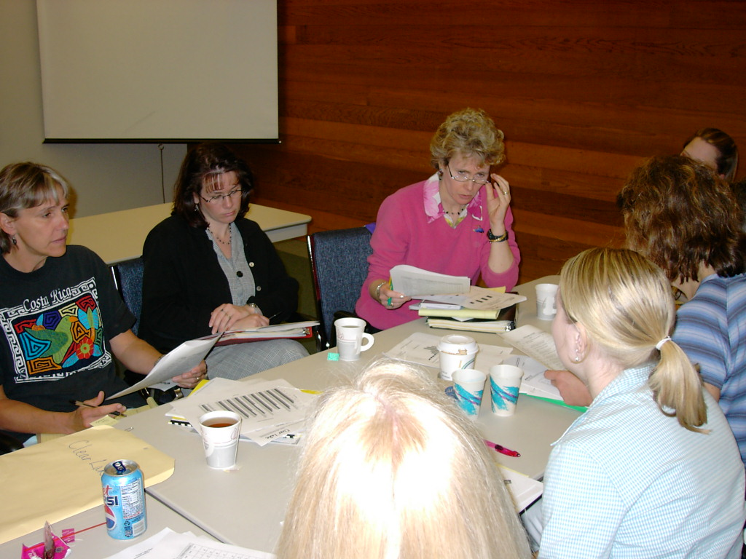
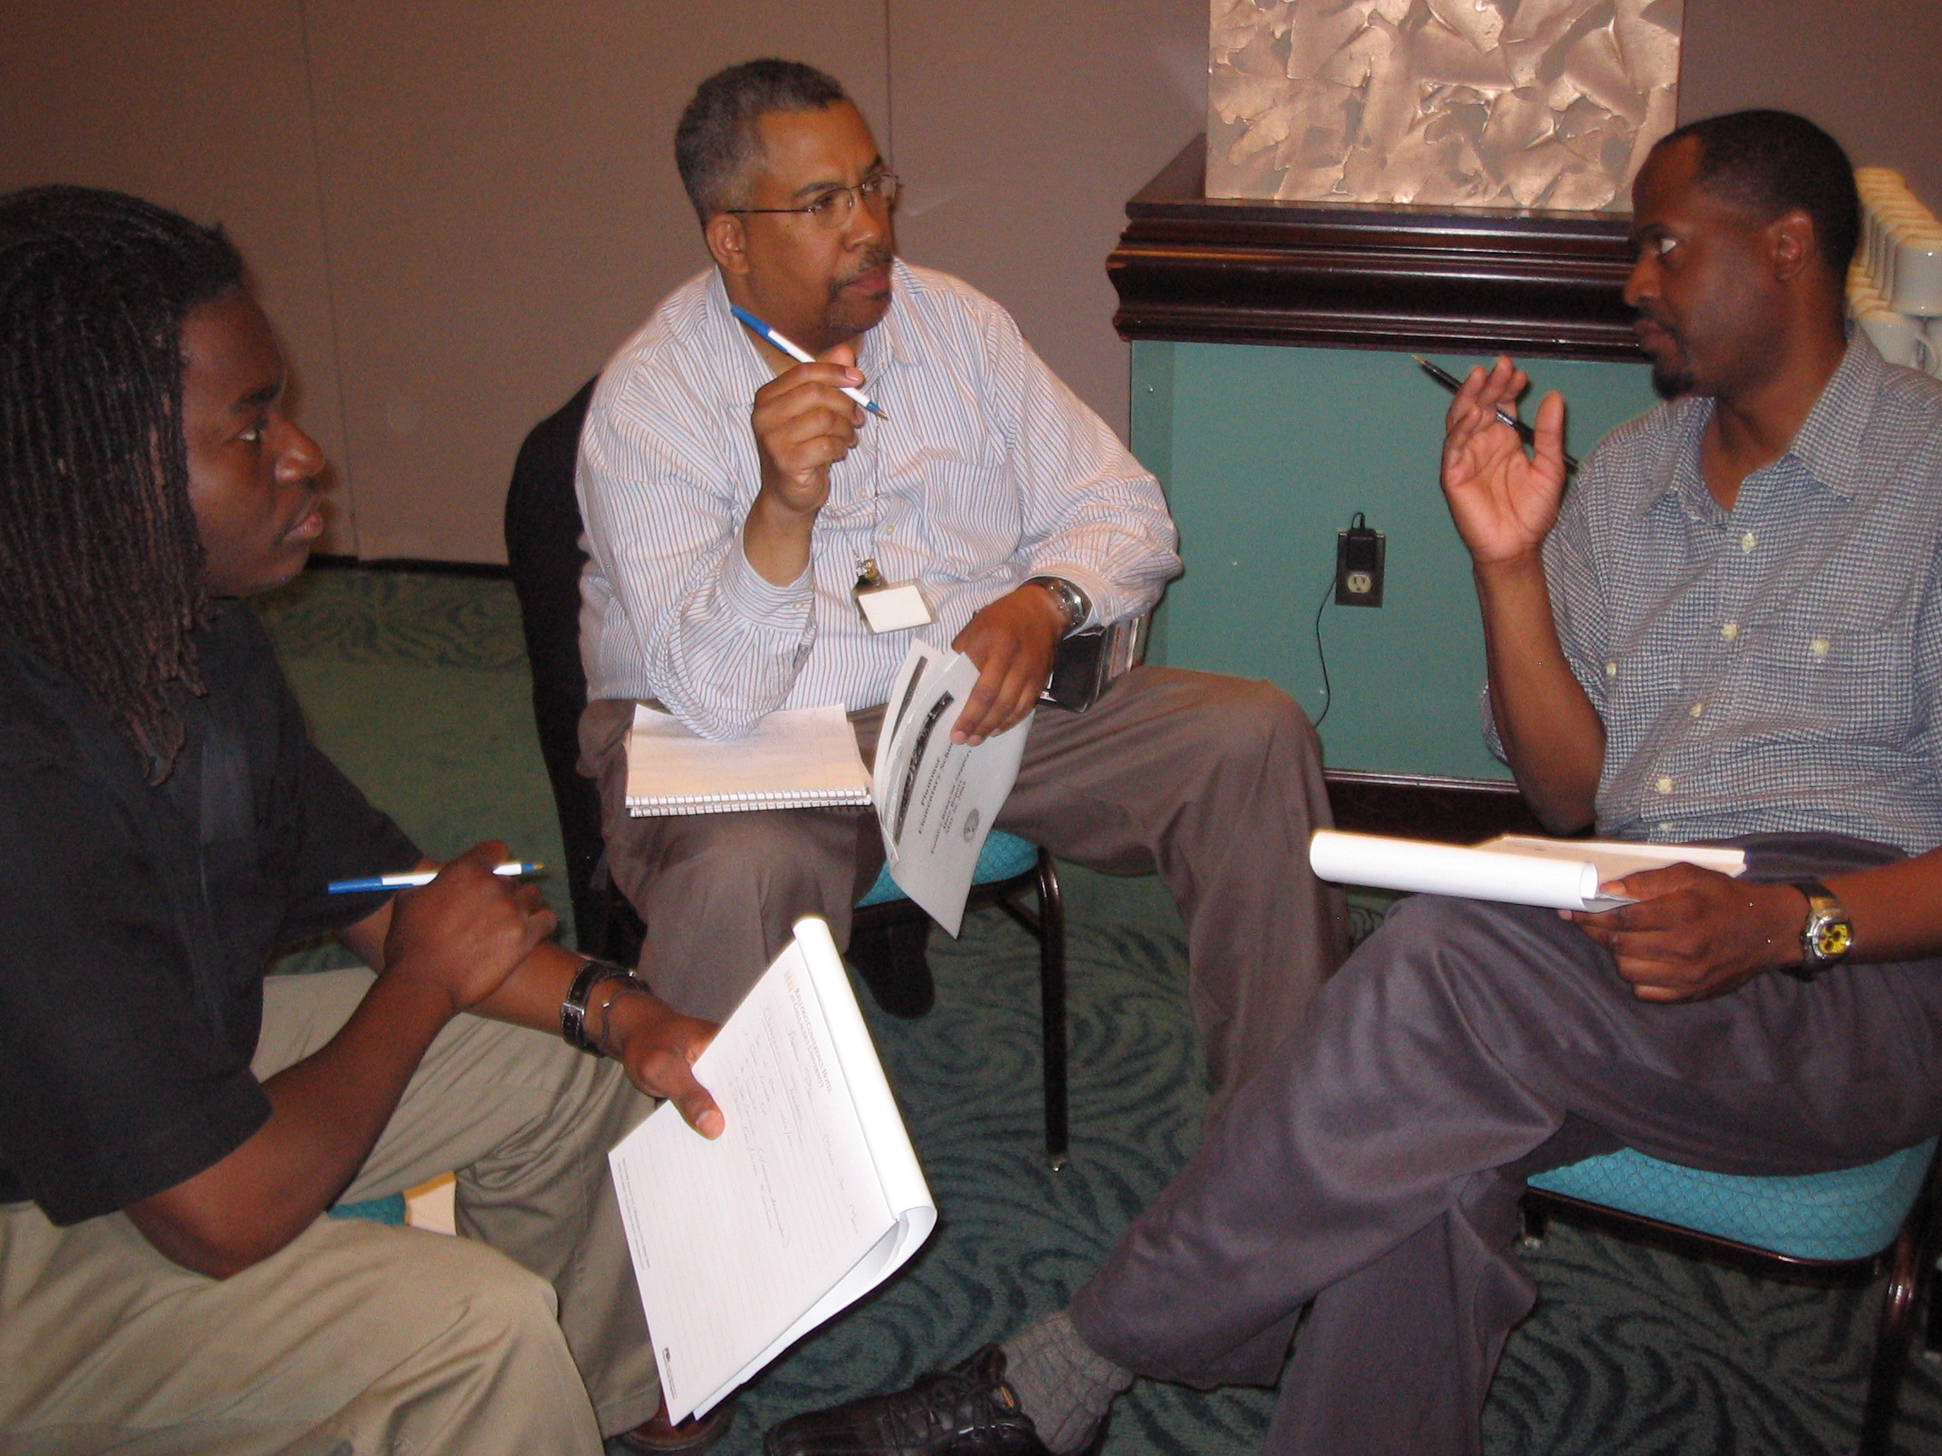
Team Composition
Administrator
Grade/Department Representation
Specialized Support
  Special Educator, Counselor, School Psychologist, Social Worker, etc.
Support Staff
  Office, Supervisory, Custodial, Bus, Security, etc.
Parent
Community
  Mental Health, Business
Student
Start with a
team that
“works.”

Slide 57
Self-Check:
Effective Leadership Team
Work as team for 10 min
Review guidelines for team composition.
How is your school team doing?
  Do you need to vote anyone on/off?
  Are you operating effectively?
  Are your coaches supporting the team? Is the team supporting the coaches?
  Have you considered building capacity throughout the staff?
Review relevant items to your action plan and add/adjust as needed to ensure your team is ready to work this year (and in the future)!

Slide 58
Preview Tier 1 Topics:
    Equity
    Integrating Initiatives: Bully Prevention

Slide 59
Equity
(adapted from Kent McIntosh)

Slide 60
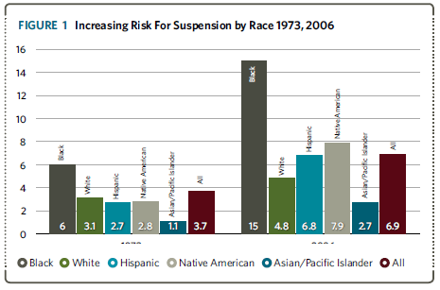
Disproportionality in School Discipline (Losen & Skiba, 2010)
Notes:
This graph indicates the changes in risk for suspension by race over time. The first half shows risk by racial group in 1973, the second half indicates risk by race in 2006. You can pause here and ask participants for ideas about reasons for increased risk now, or just use this slide to point out the fact that there is a problem.

Slide 61
Definitions
Overt Bias
  Conscious belief in superiority of a group
Explicit Bias
  Conscious belief that some groups aspire to desirable traits more than others
Implicit Bias
  Unconscious associations regarding some groups
Notes:
Critical definitions of terms we will use in this discussion.

Slide 62

A 5-point
Intervention to Enhance Equity in School Discipline
http://www.pbis.org/school/equity-pbis
Notes:
The content and additional resources on this topic can be found at PBIS.org/equity

Slide 63
5-point Intervention to Enhance Equity in School Discipline
Use effective instruction to reduce the achievement gap
Implement SWPBIS to build a foundation of prevention
Collect, use, and report disaggregated student discipline data
Develop policies with accountability for disciplinary equity
Teach neutralizing routines for vulnerable decision points
http://www.pbis.org/school/equity-pbis
Notes:
These are the 5 key steps to enhancing equity in school discipline. This is also the overview slide we will come back to between each step

Slide 64
Why a focus on effective academic instruction?
The discipline gap may be related to the achievement gap
  Academic skills (or the lack thereof) dramatically shapes school experiences
  Students who fall behind are more likely to act out, exposing themselves to discipline
  By catching and intervening with students early, we can change students’ school experiences for the better
(Gregory et al., 2010; McIntosh et al., 2008, 2012)
Notes:
Step one is to focus on effective academic instruction. It is important to emphasis here that although we are focused on implementing behavior supports effective academic instruction is a critical part of ensuring all students have equal access and opportunity.

Slide 65
What do we mean by effective academic instruction?
Explicit instruction
High rates of engagement and OTRs
Quality performance feedback
Progress monitoring and data-based decision making
(Hattie, 2009)
Notes:
Tie this back to how we teach behavior- so in previous training we’ve talked about how we teach behavior like academics now we want to tie back to teaching academics explicitly, keeping kids engaged in instruction and using data to guide instruction.

Slide 66
Effects of Effective Instruction on the Achievement Gap
Tigard-Tualatin School District (Chaparro, Helton, & Sadler, in press)
Notes:
This graph shows that the use of explicit instruction can help close achievement gaps.

Slide 67
5-point Intervention to Enhance Equity in School Discipline
Use effective instruction to reduce the achievement gap
Implement SWPBIS to build a foundation of prevention
Collect, use, and report disaggregated student discipline data
Develop policies with accountability for disciplinary equity
Teach neutralizing routines for vulnerable decision points
http://www.pbis.org/school/equity-pbis
Notes:
Step 2 is using SWPBIS as a foundation. Equity is NOT a separate initiative. We use the same data-based decision making framework and systems.

Slide 68
Why use a foundation of SWPBIS?
Proactive, instructional approach may prevent problem behavior and exposure to biased responses to problem behavior
Increasing positive student-teacher interactions may enhance relationships to prevent challenges
More objective referral and discipline procedures may reduce subjectivity and influence of cultural bias
Professional development may provide teachers with more instructional responses
(Greflund et al., 2014)
Notes:
Rational for using SWPBIS as a foundation. Use this to reinforce that all the work they have been doing so far is an important first step in ensuring that all students have equal access and opportunity.

Slide 69
5-point Intervention to Enhance Equity in School Discipline
Use effective instruction to reduce the achievement gap
Implement SWPBIS to build a foundation of prevention
Collect, use, and report disaggregated student discipline data
Develop policies with accountability for disciplinary equity
Teach neutralizing routines for vulnerable decision points
http://www.pbis.org/school/equity-pbis
Notes:
Step 3 is to collect, use and report disaggregated data. – for schools using swis they can already do this! For others this may take some work.

Slide 70
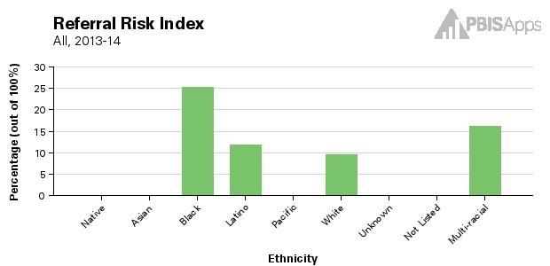
Risk Indices
Black/White ODR Risk Ratio = 2.5
Notes:
Here is an example of the risk indices that can be generated in swis. Compared to white students black students are 2.5 times more likely to receive an ODR. If data indicate there is a problem it is important not to get stuck admiring the problem- use data to guide the next 2 steps.

Slide 71
5-point Intervention to Enhance Equity in School Discipline
Use effective instruction to reduce the achievement gap
Implement SWPBIS to build a foundation of prevention
Collect, use, and report disaggregated student discipline data
Develop policies with accountability for disciplinary equity
Teach neutralizing routines for vulnerable decision points
http://www.pbis.org/school/equity-pbis
Notes:
Policy with accountability is the next step

Slide 72
What does not work in policy
Enacting policies that nobody knows about
Enacting policies that don’t change practice
Policies without accountability for implementation
Notes:
Pause here to ask teams what they know about existing policy in their districts. If they don’t know what currently exists they should review that. If policy exists but without accountability then the PBIS team can suggest some revisions based on the next suggestions

Slide 73
Equity Policy Recommendations
Include a Specific Commitment to Equity
  Create mission statements that include equity
  Enact hiring preferences for equitable discipline
Install Effective Practices
  Require clear, objective school discipline procedures
  Support implementation of proactive, positive approaches to discipline
  Replace exclusionary practices w/ instructional ones
Create Accountability for Efforts
  Create teams and procedures to enhance equity
  Share disproportionality data regularly
  Build equity outcomes into evaluations
Notes:
You can ask teams if they have examples of these specific recommendations

Slide 74
5-point Intervention to Enhance Equity in School Discipline
Use effective instruction to reduce the achievement gap
Implement SWPBIS to build a foundation of prevention
Collect, use, and report disaggregated student discipline data
Develop policies with accountability for disciplinary equity
Teach neutralizing routines for vulnerable decision points
http://www.pbis.org/school/equity-pbis
Notes:
Step 5 teach neutralizing routines – this will be guided by data!

Slide 75
What is a Vulnerable Decision Point?
A specific decision that is more vulnerable to effects of implicit bias
Two parts:
  The person’s decision state (internal state)
  The situation
Notes:
The persons decision state (fatigue, hunger, stress etc)
The situation: unknown kids (e.g., hallways, café, extra-curricular events) or new routines in which the expectations are not clearly defined

Slide 76
Different Biases,
Different Solutions
Explicit Bias
  Ineffective: Cultural sensitivity training, explaining value of diversity, telling people to be less biased
  Effective: Top-down policies with accountability
Implicit Bias
  Ineffective: Top-down policies with accountability
  Effective: Clear discipline systems, specific guidance in decision-making
(Girvan, 2014; Girvan et al., 2014; Lai et al., 2013; Pettigrew & Tropp, 2006)
Notes:
What do we know about ways to address the different types of bias? We know we need a combination of clear policy and clear discipline systems and decision making systems.

Slide 77
What is implicit bias?
Unconscious, automatic
Based on stereotypes
  We all have it (even those affected by it)
  Generally not an indication of what we believe or would endorse
More likely to influence:
  Snap decisions
  Decisions that are ambiguous
Notes:
Let’s look further at implicit bias.

Slide 78
Reduce Effects of Implicit Bias through Specific Training
Reduce ambiguity in ODR definitions and processes
  Clear guidelines for classroom vs. office-managed behaviors
  Avoid rules that result in disproportionate exclusion
Identify specific vulnerable decision points
  General
  Local (school)
Teach a neutralizing routine
  Self-assess presence of VDP
  Use alternative response
Notes:
In order to reduce the effects of implicit bias we can take these steps. 1) ensure discipline systems are clearly defined teams can pause here to review the work they have done on this so far. 2) use data to identify if there are specific times, locations or rules in your school where disproportionality is more likely to show up. 3) teach a response that can be used to address those specific situations.

Slide 79
VDPs from national ODR data
Subjective problem behavior
  Disruption, defiance, major vs. minor
Non-classroom areas
  Hallways
Afternoons
ambiguity
LACK OF contact
fatigue
Notes:
Nationally the most disproportionality shows up in ODRS in the following situations. Schools should review their data – but if they don’t have it can start with national data and refine as they improve their data systems.

Slide 80
Two-step Neutralizing Routine for Staff:
When you see problem behavior, stop and ask yourself:
Is this a VDP?
  Situation
  Decision state
If so, use an agreed-upon alternative response
Notes:
Staff can be taught a 2 step process to use during vulnerable decision points.

Slide 81
Neutralizing Routines for Reducing Effects of Implicit Bias
Self-assessment
“Is this a vulnerable decision point?”
Setting event
Antecedent
Behavior
Consequence
Lack of positive interactions with student
Fatigue
Loud complaints about work (subjective behavior)
Student leaves class (Escape social interaction)
Send student to office (ODR)
Self-instruction
“See me after class.”
Notes:
An example of a neutralizing routine in practice

Slide 82
Two-step Neutralizing Routine for Administrators:
(Susan Barrett)
When you have to handle problem behavior, stop and tell yourself:
Don’t just do something, stand there!
  Be sure you are ready to act in line with values
  Get information from student and staff
  Assess student-teacher relationship
Whenever possible, use an agreed-upon instructional response
  Teaches missing skills
  Connects student to school and staff
Notes:
The same can work for administrators. 1) pause and be sure you are ready to act with all the information you need and 1) take an instructional approach which re-builds a students connection to school and teachers rather than further separates the student from the class or teacher.

Slide 83
The Restorative Chat
(Lucille Eber)
Tell me what happened.
What you were thinking at the time?
What do you think about it now?
Who did this affect?
What do you need to do about it?
How can we make sure this doesn't happen again?
What I can do to help you?
Notes:
The restorative chat is one way to do this. This script can be used by administrators when handling problem behaviors.

Slide 84
What makes for a good neutralizing routine?
Brief
If-then statements
Clear steps
Doable
Notes:
Guidelines for good neutralizing routines. You can pause here and ask teams to quickly brainstorm an example of one they could use in their classrooms. You can also share that in some schools staff have worked on these together during staff meeting time and that when the identify (with their data) a VDP for their school the administrator can even provide reminders to staff to for example use their neutralizing routines after lunch!

Slide 85
SWPBIS Action Planning

Slide 86
Activity:
Action Planning
Work as team for 150 min
Complete the Team Implementation Checklist
Return to your Action Plan
Identify relevant resources and steps to help move your school forward.
In particular, make sure you have completed all of the steps in getting started (review your notebook).
Present 2-3 “big ideas” from your group (1 min. reports)

Slide 87
Activity:
Coaches Preview Discusion
Work with partner coach for 15 min
Review implementation guidelines and preview slides just presented.
Discuss above with a partner
  Is there content you’d like re-explained?
  What key questions do you have?
  What questions/challenges do you anticipate from your team members?
Share key highlights (1 min. reports)

Slide 88
Review of
Coaching SWPBIS

Slide 89
Main Coaching Objectives
By the end of today’s meeting, you will be able to…
  …Describe your role as a coach.
  …Articulate the basic elements of SWPBS.
  …Identify resources for SWPBS.
  …Problem solve roadblocks in coaching
  …Facilitate your team’s activities at the next SWPBS team training.

Slide 90
What roles do coaches play?
Coaching Roles
Facilitate
Content Knowledge
Communicate
  Team meetings
  Activities at training events
  Implementation
  Local PBS expert
Positive “nag”
Link to resources (e.g., nepbis.org, www.pbis.org)
  Share advanced content with team
  Share information at faculty meetings
I.A.ii

Slide 91
Consider Tattoos!
4 PBIS Elements
School Systems
Supporting Social Competence &
Academic Achievement
OUTCOMES
School-wide
Classroom
SWPBIS
SYSTEMS
DATA
Supporting
Decision
Making
Supporting
Staff Behavior
Non-classroom
Family
PRACTICES
Tertiary Prevention:
Specialized
Individualized
Systems for Students with High-Risk Behavior
~5%
Student
Supporting
Student Behavior
Primary Prevention:
School-/Classroom-
Wide Systems for
All Students,
Staff, & Settings
~15%
Secondary Prevention:
Specialized Group
Systems for Students with At-Risk Behavior
~80% of Students

Slide 92
TAKE AWAY MESSAGE
You’re a coach!
Prepare for the next training event, and use your resources to guide your team’s activities (both at training and at school).

