Slide 1
Culturally Responsive Education Practices: Integrating School Climate Data within the MTSS Framework
Tamika P. La Salle, Ph.D

Slide 2
Presentation Agenda
School Climate
PBIS & School Climate
Data Sheet
Recommendations
PBIS
School Climate

Slide 3
Enhancing Decision-Making within PBIS
Promoting Prosocial Behaviors
Positive Student Outcomes
Data-Based Decision Making & Fidelity
Culture, Climate, & Context

Slide 4
Defining School Climate
school climate
every school
difficult to describe
difficult to measure
elusive
individual & group
phenomenon
  “School Climate is based on patterns of students, parents, and school personnel’s experience of school life and reflects norms, goals, values, interpersonal relationships, teaching and learning practices, and organizational structures” (National School Climate Centers, 2007).
Notes:
Anderson, 1982 review of literature identified most identified components of school climate
Individual and group phenomenon- bi-directional

Slide 5
What Does That Mean?
Students:
If students do not feel safe at school, do not feel welcomed at school, are not treated with respect, and are not given opportunities to learn, mature and grow, they will not meet their academic potential or learn positive social lessons.
Schools:
If the school climate is not positive, students are more likely to underperform, student attendance and student discipline are less likely to improve, school safety could be compromised, and teacher retention may be negatively affected.

Slide 6
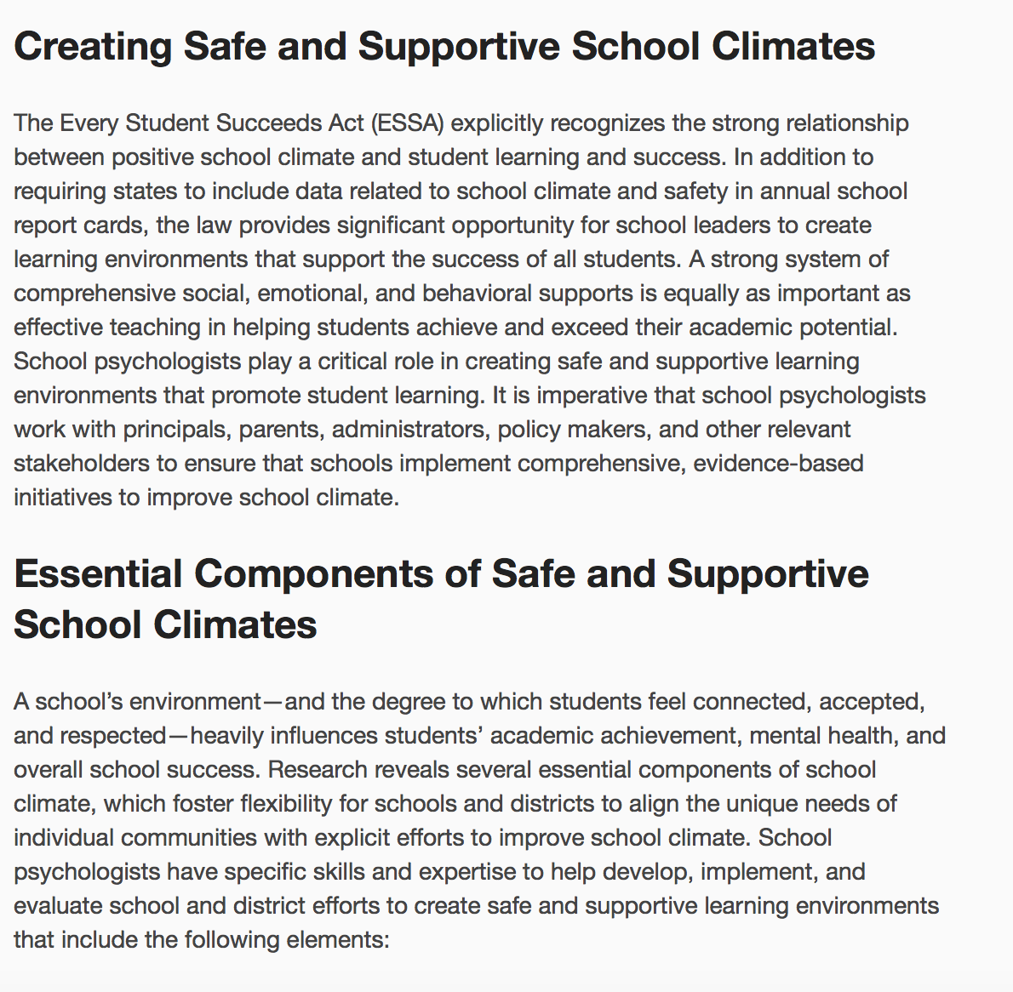


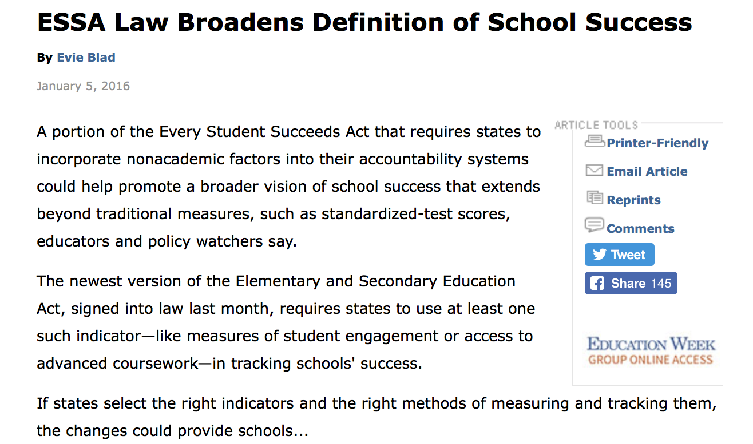
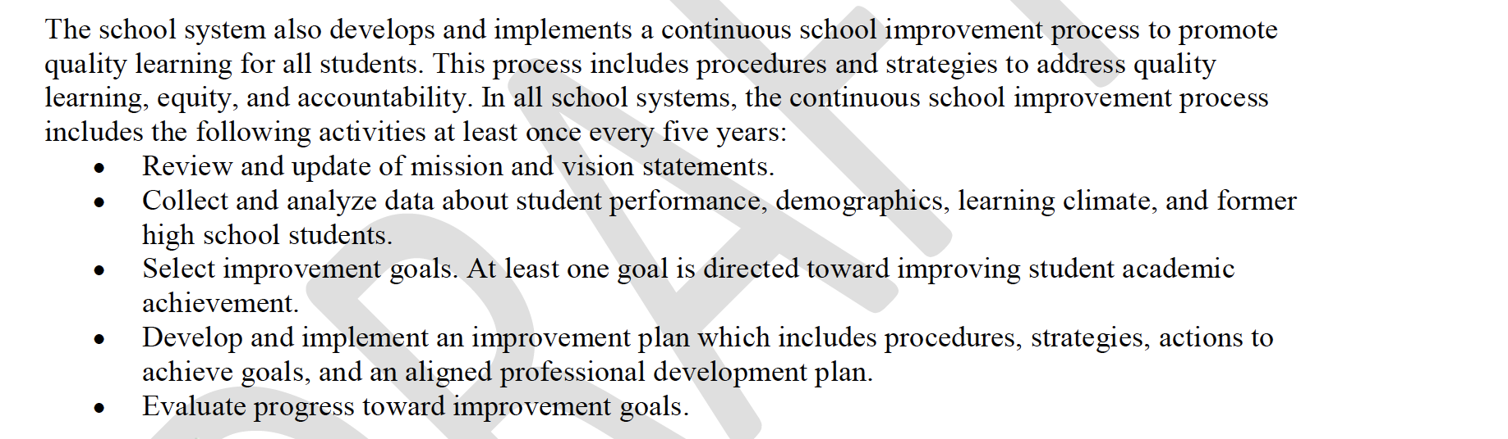
ACCESS
ACCESIBLITY
PERCEIVED VALUE
INTEGRATION
ONE MORE TASK

Slide 7


Culturally Diverse Students
Culturally diverse students at risk
less likely to have their:
  academic and social needs met
  cultural experience and background validated
  cultural qualities respected or affirmed
Unless…..We seek to understand, respect and value similarities and differences, and continuously evaluate our actions and impact on students.
Notes:
82% white teacher force – 50 % non-white students
National Assessment of Educational Performance (NAEP)

Slide 8

Culture is set of values, beliefs, or behaviors shared by a group of people based on race, geography, socioeconomic status, experiences, or other unifying denominators. Culture permeates throughout contexts and guides the ways that individuals assign meaning to, interact with, and adapt to their environments. Culture is ever evolving and results from intra-and interpersonal experiences, development, and growth
Notes:
Discuss why it important to think of culture using a more inclusive and comprehensive framework….who is culturally “diverse”- core pieces (maybe you can add underlines which would help)
Unifying denominator
Permeates throughout contexts – refer to next slide here to show the overarching influence of culture in visible and not visible ways

Slide 9
Complexity of Cultural Identity
Race
Sexuality
Physical/
Cognitive Ability
Language
Gender Identity
Family
Community
Socio-economic Status (SES)
School Influences
Individual
Nationality
WE ARE ALL CULTURAL BEINGS
Notes:
HELP!!!!

Slide 10
Activity: We are all Cultural Beings
Make a list of all the aspects of your identity that are important to you
  The list may include information about friends, family, work, education, hobbies and anything else about hobbies or family that is a routine part of your discussions with others. Essentially, if someone from another country wanted to know “who you are” – how would you describe yourself and your life
In groups of 2, introduce yourself to someone you do not know.
You may NOT mention any topic generated on your list of meaningful aspects of your identity.
Now, you can continue your conversation and this time talk about the topics written on your paper
Notes:
The silenced introductions- Virginia document page 40

Slide 11
Discussion: The Silenced Self
There is no greater pain than the untold story inside of you ~ Maya Angelou
How did you feel as you were completing the exercise?
  What was it like making introductions and not being able to talk about important aspects of yourself
  What were some items you listed
  What were some items you decided to talk about?
How do you think students might feel when important aspects of their identity or cultural backgrounds are not included in the curriculum or addressed through communications and instructional strategies?
What are some suggestions from preventing this from happening?
Notes:
The silenced introductions- Virginia document page 40

Slide 12
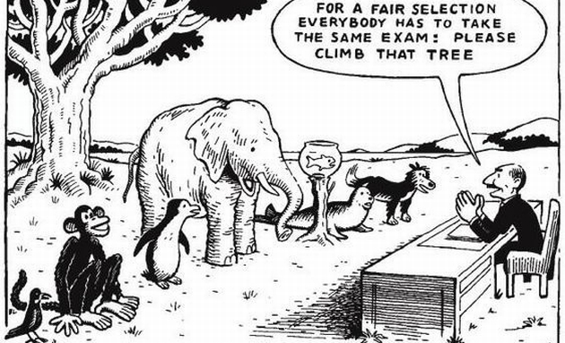
Equality v. Equity
Equality has become synonymous with “leveling the playing field.” So let’s make equity synonymous with “more for those who need it.” The Education Trust
Notes:
We think/assume that by standardizing everything we are creating fairness – but at least one person will always be at an advantage- here, the fish and elephant will inevitably struggle, at least more than the monkey.
Difference is not a deficit- instead, accept similarities and differences- then, identify necessary supports for children to provide them equitable opportunities for success

Slide 13
“Everybody is a genius. But if you judge a fish by its ability to climb a tree, it will live its whole life thinking that it is stupid.”
Albert Einstein

Slide 14
Achievement Gap VS. Opportunity Gap?
  Dispelling the myth of innate “inferiority” or characteristics that are “less than” or need to be “fixed”
  Achievement gap ignores the diversity and cultural similarities and differences in schools, and even our country
Instead
  How can we, as educators, facilitate an environment that creates opportunities for students to be successful
Notes:
Supper vs. dinner
Pop vs. soda v. coke

Slide 15
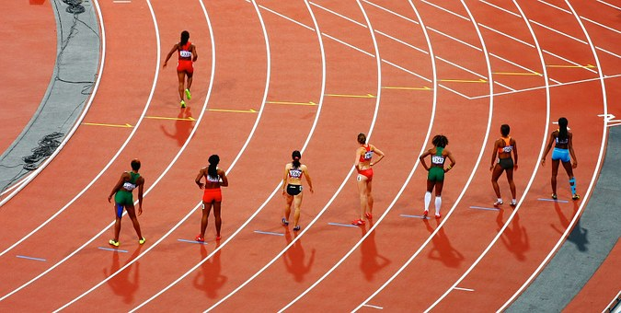
SWOMHC
SWOD
WHITE STUDENTS
STUDENTS OF COLOR
STUDENTS WITH DISABILITIES
STUDENTS WITH MENTAL HEALTH CONCERNS

Slide 16
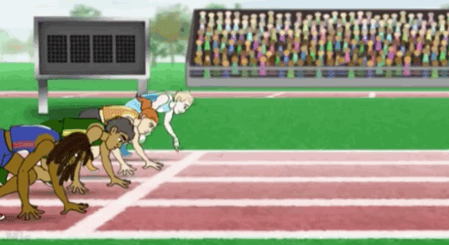
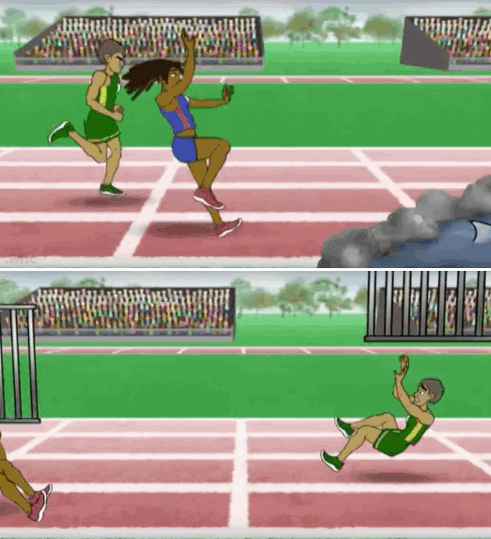
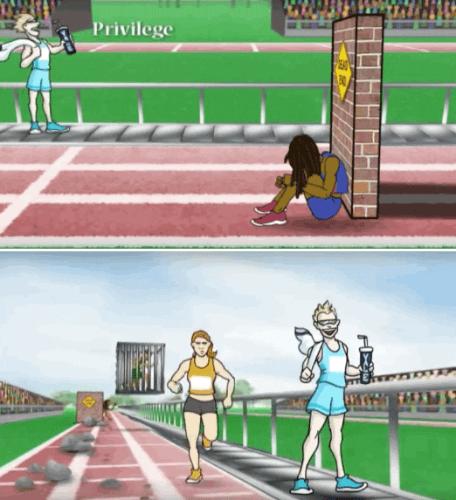
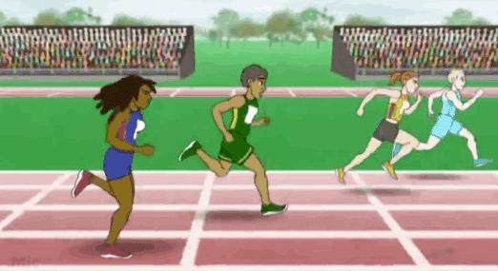
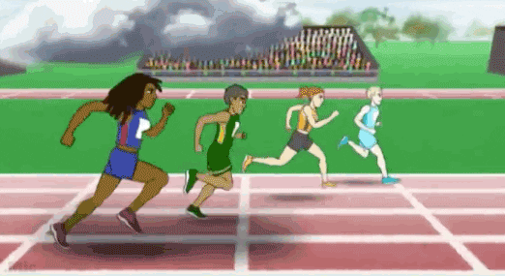
Students with Positive Wellbeing
Middle Class
WHITE STUDENTS
Students with Mental Health Concerns
Students Living in Poverty
STUDENTS OF COLOR

Slide 17


Example Relative to Discipline
 | Achieving Equity In School Discipline McIntosh, K., Horner, R., & Sugai, G. A promising and practical multi- component approach. OSEP Center on Positive Behavioral Interventions and Supports. Washington D.C.
Considerations
Use engaging academic instruction to reduce the opportunity (achievement) gap
Implement a multi-tiered and culturally responsive behavior framework
Collet, review, use, and report disaggregated discipline data; develop state, district, and school policies with accountability for disciplinary equity
Teach neutralizing routines to address implicit bias
Culturally Mediated Instruction incorporates and integrates diverse ways of learning, understanding, and demonstrating knowledge. Culturally mediated instruction takes place in an environment where multicultural views are encouraged and includes knowledge that is relevant to students

Slide 18
If the purpose of education is to create educational environments where students can thrive academically, socially, and emotionally, then, what better way to assess these efforts than by asking them?

Slide 19

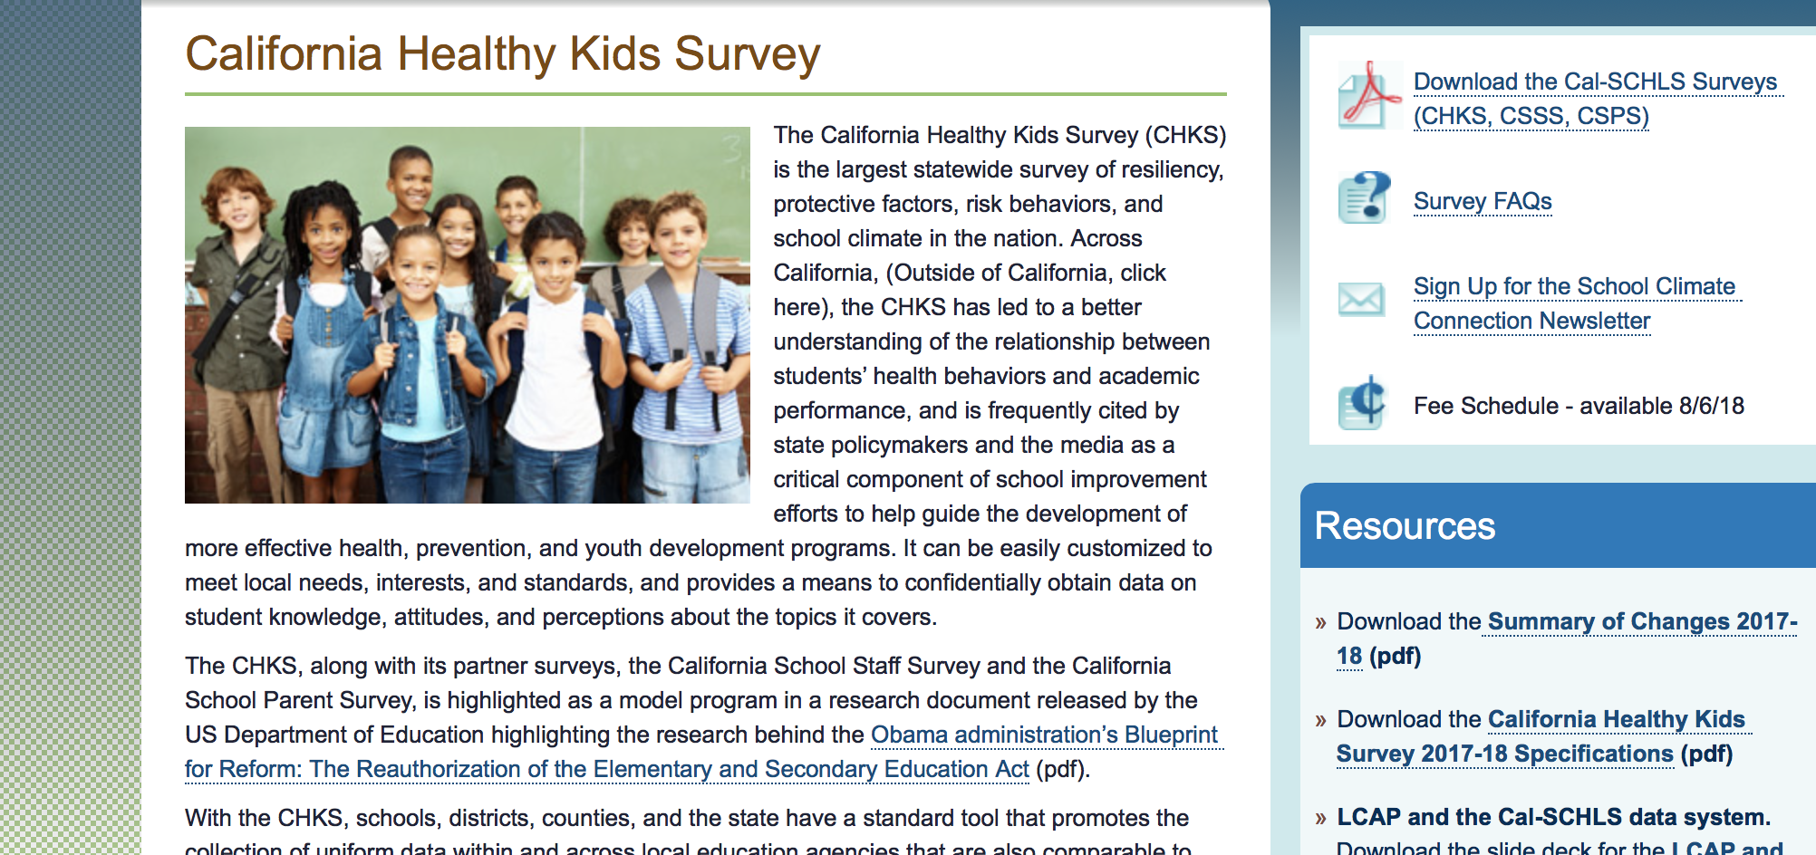
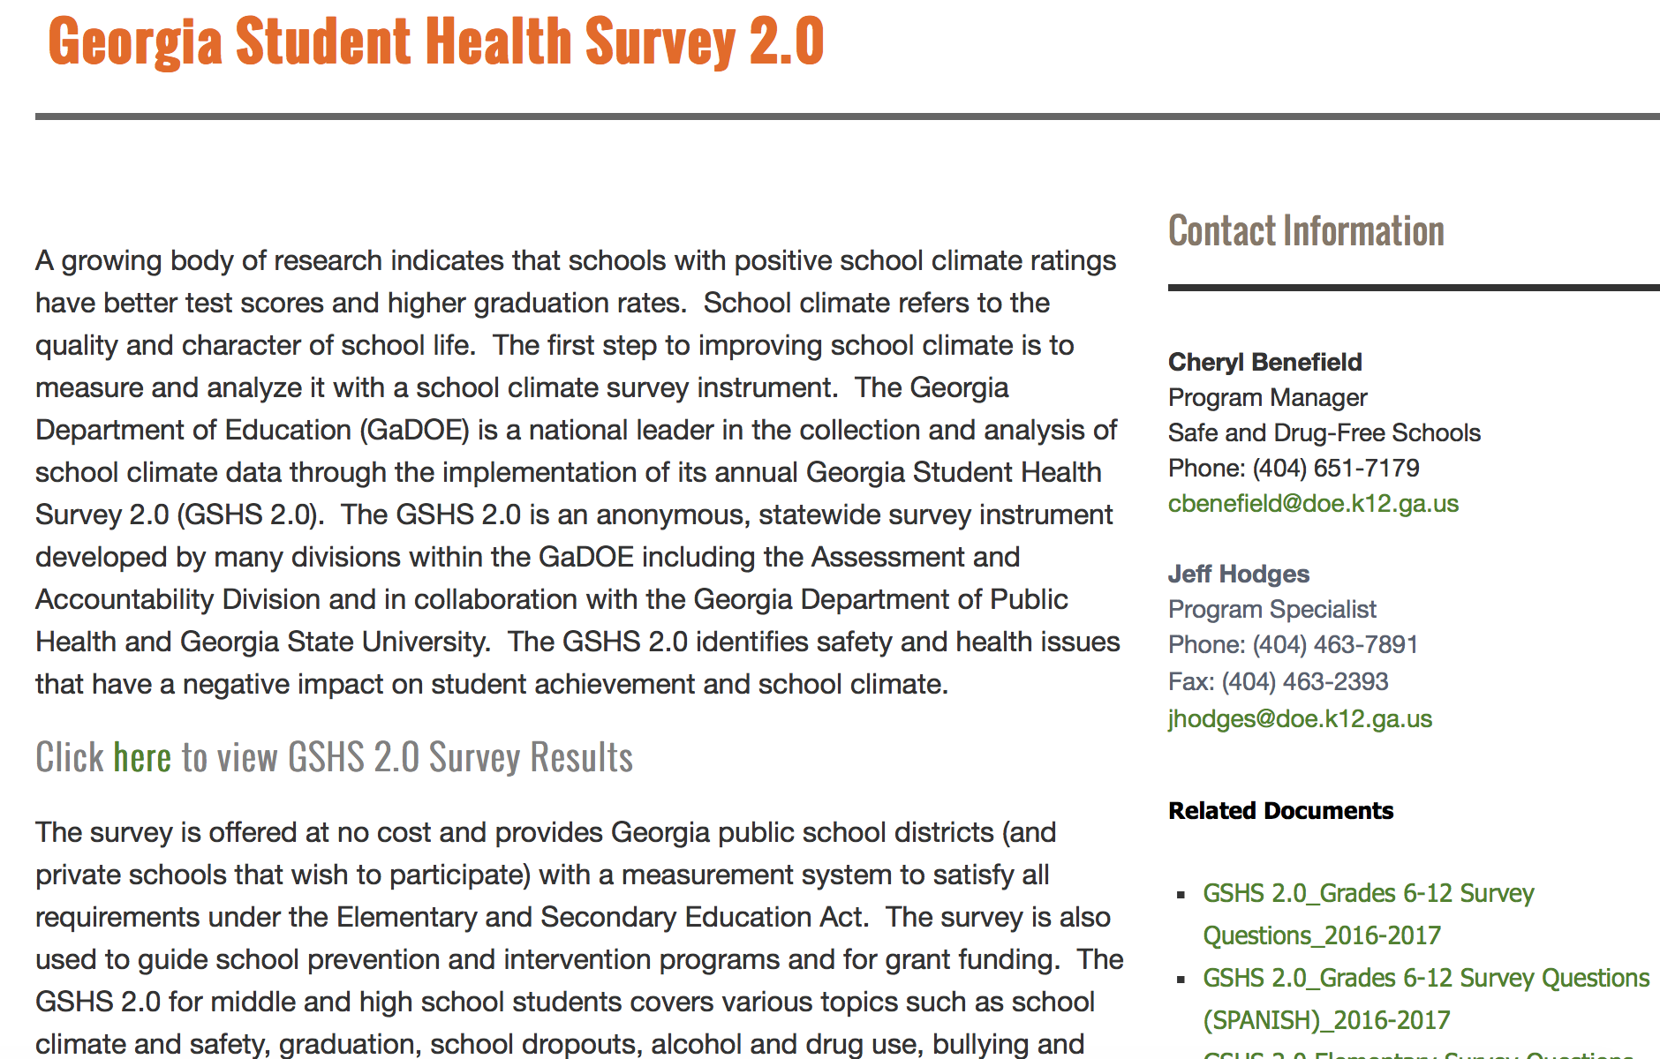
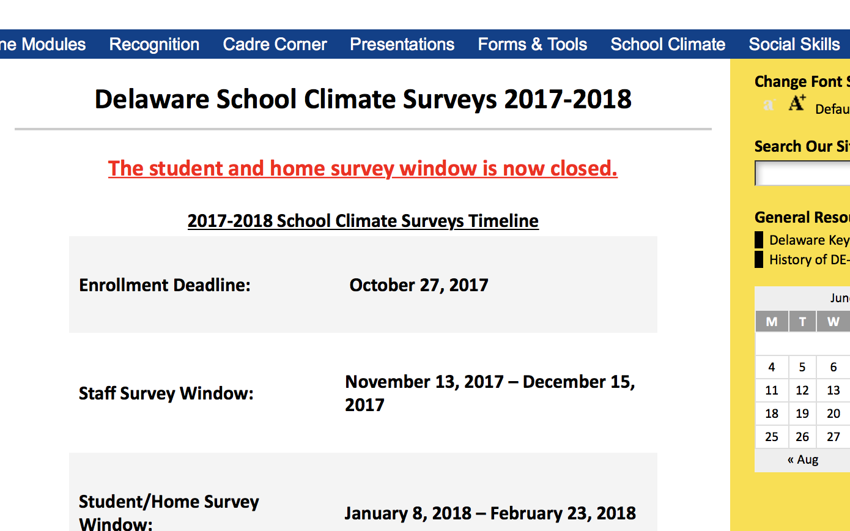
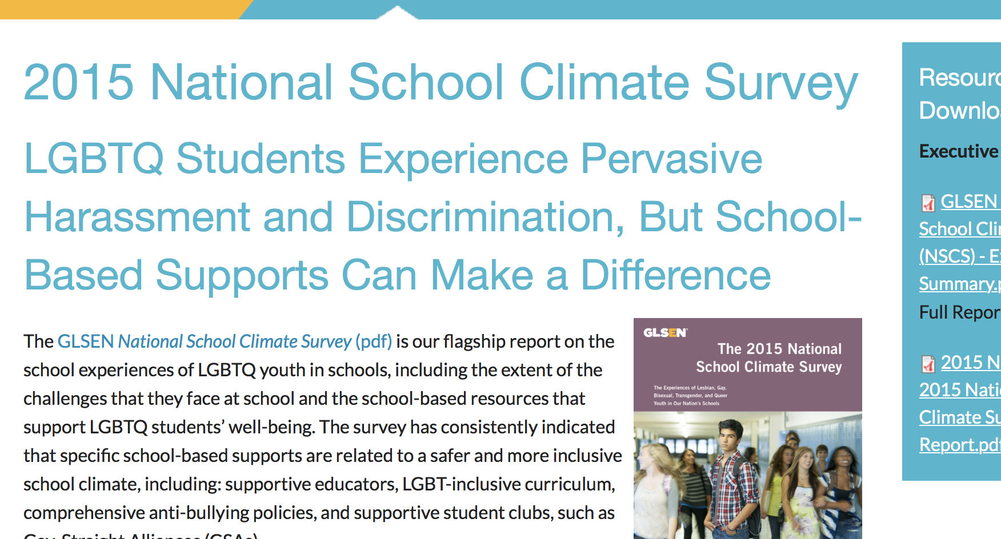
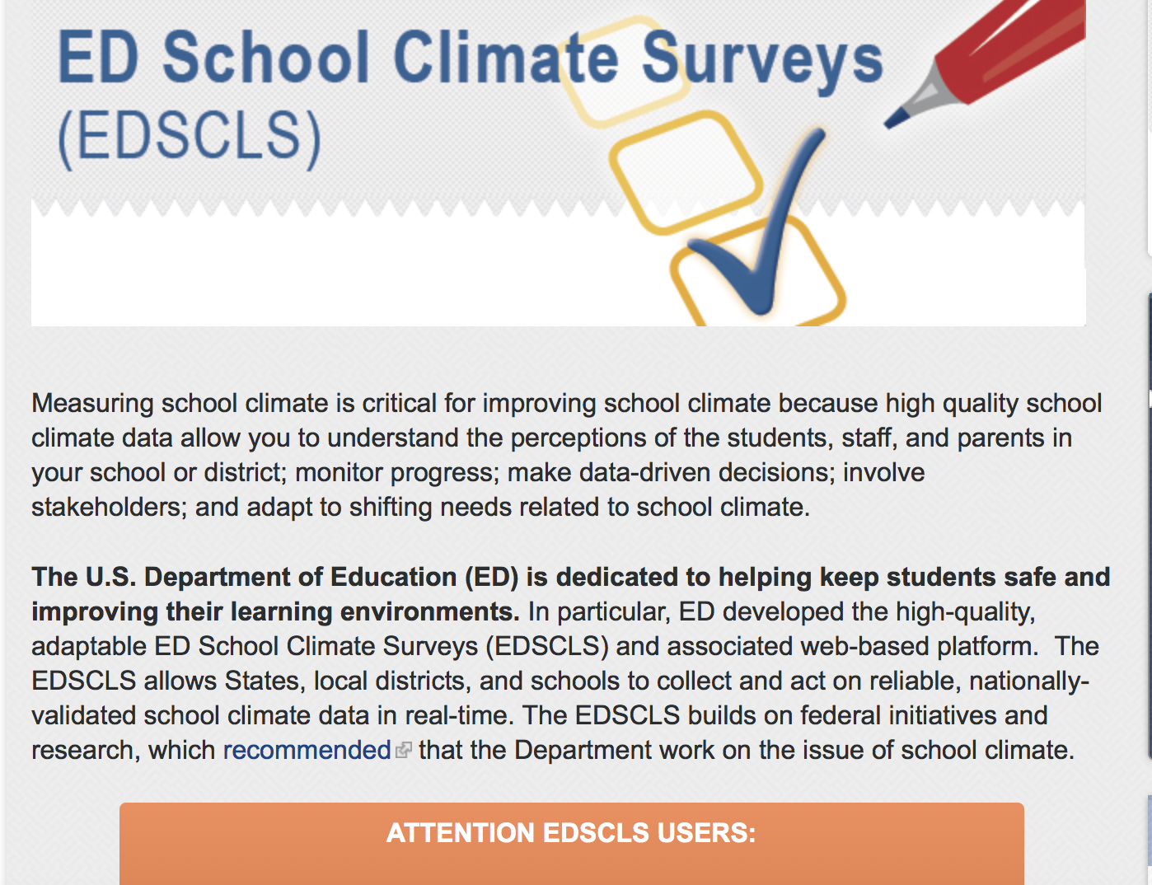

Slide 20
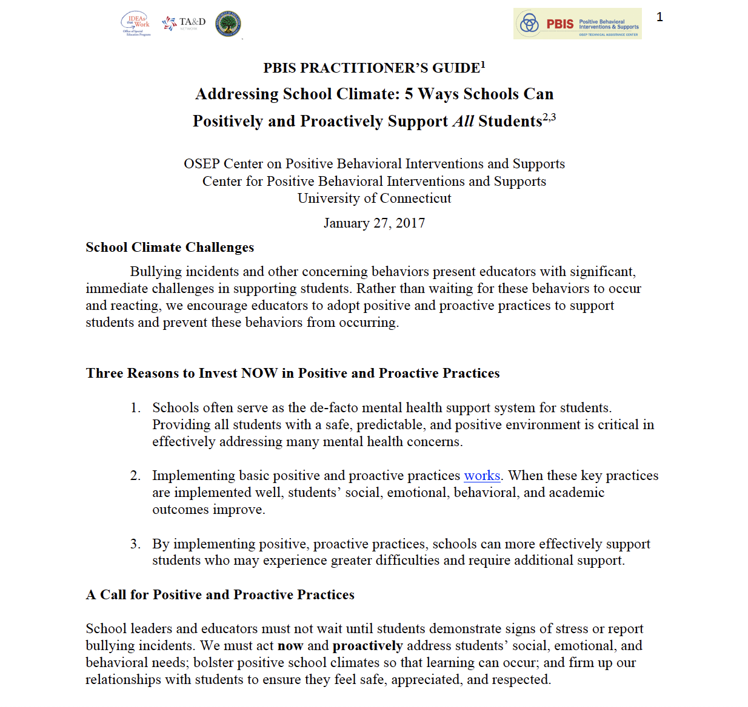



Slide 21
SWOMHC
SWOD
WHITE STUDENTS
STUDENTS OF COLOR
STUDENTS WITH DISABILITIES
STUDENTS WITH MENTAL HEALTH CONCERNS

Slide 22
Actionable School Climate Framework
  Relationships:
    How Measured: Ask students whether they can identify an adult they can talk to if they need help.
    How one intervenes: Ensure teachers know students’ names and interests and that each student is connected with and supported by a caring adult. Opportunities for mentoring- identify a “safe” adult for all students
  Respect for Diversity:
    How Measured: Ask parents whether or not they feel the school welcomes families that are similar to them; ask students whether they feel like they are treated fairly despite their race/ethnicity, religion, academic ability, or other cultural markers
    How one intervenes: Put cultural competence standards into effect; professional development (e.g., implicit bias, PBIS); employ social emotional learning curricula that focuses on community building addresses the importance of valuing and addressing diversity.
Notes:
Engagement, Relationships, Learning Envioronment, and Safety
As an example of how one measures aspects of school climate and intervenes to improve it, I am going to walk through the Safe and Supportive Schools Model by pillar, as they are often referred.

Slide 23
Actionable School Climate Framework (cont.)
  School Participation:
    How Measured: Ask students whether they participate in extracurricular activities or whether they feel successful in school
    How one intervenes: Ensure all students are invited and can participate in extracurricular activities. Reinforce student efforts and progress towards goals. Focus on the process – not just the outcome
  Social and Emotional Safety:
    How Measured: Ask students if they feel emotionally safe- have they been picked on or verbally victimized.
    How one intervenes: Employ curricula that include a focus on community building and empathy- (re) establish school-wide norms
  Physical Safety:
    How Measured: Ask students if they feel physically safe- have they been physically victimized
    How one intervenes: Employ curricula that include a focus on community building and empathy- (re) establish school-wide norms- promote pro-social behaviors-
Notes:
As an example of how one measures aspects of school climate and intervenes to improve it, I am going to walk through the Safe and Supportive Schools Model by pillar, as they are often referred.

Slide 24
Actionable School Climate Framework (cont.)
Environment
  Physical Environment:
    How Measured: Ask students and staff whether the lavatories are safe and clean.
    How one intervenes: Identify why they are not clean, and work with facilities to create a clean environment.
  Academic Environment:
    How Measured: Ask students whether teachers provide feedback on their assignments that helps them improve their work and whether teachers think all students can do challenging work.
    How one intervenes: Provide Professional Development to teachers.
  Wellness:
    How Measured: Ask students if they eat salty snack food at school.
    How one intervenes: Work with students and the appropriate administrators to find and make available attractive and healthy snack food.
  Disciplinary Environment:
    How Measured: Ask students if students at the school are comfortable sharing ideas about rules and polices.
    How one intervenes: Develop opportunities for student voice in the development of class norms.
Notes:
As an example of how one measures aspects of school climate and intervenes to improve it, I am going to walk through the Safe and Supportive Schools Model by pillar, as they are often referred.

Slide 25
Questions to Consider
Alignment/Comprehensiveness- does it represent the intended areas of focus
Psychometrics- is the survey psychometrically sound
Frequency of administrations
Budget- cost/sustainability
Usability- how is the data presented/ formatting/ ability to disaggregate

Slide 26
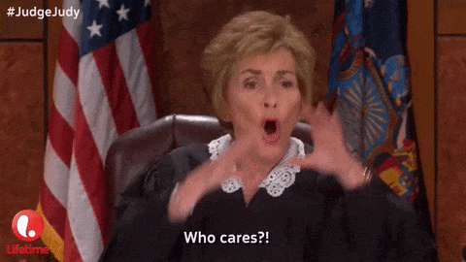



Who Should Complete School Climate Surveys?
STUDENTS
TEACHERS
PARENTS/GUARDIANS

Slide 27
Using School Wide Data
Who does the data represent
  Multiple data points
  Most individuals In the school
  Is the group aggregate accurate? Misleading? Not representative of all students?
  Do different groups (e.g., students, teachers) feel similarly or differently about the climate
    Students feel really positively…teachers do not
    Teachers feel really positively…students do not

Slide 28
School Climate Survey
“Teachers at my school have high standards for achievement
Teaching & Learning
School Climate
Relationships
Safety
Institutional Environment/Structure
Support for Learning
“I know an adult I can talk to if I need help”
“I feel safe in my school”
“I have been bullied or threatened by other students”
“I feel successful at school”
Peer/adult relations
Connectedness (professional relationships)
• Parent Involvement
Order and Discipline
Peer Victimization
“I Have worried about other students hurting me”
“Instructional materials are up to date and in good condition”
“Students in my school take pride in keeping the school building clean”
Physical Environment
Notes:
This is a guide- the list of potential factors is exhaustive
Reflects some or most of the commonly identified categories related to school climate
There are 4 major dimensions/area of school climate. Each major area contains several subdimensions that are more specific
Identified by Nscc
List is not exhaustive- potentially innumerable amount of influences on school climate- this provides a guide
Safety: referring to the physical and emotional safety of students and the rules and procedures in place to ensure student safety;
–Relationships: student social support from educators and parents, the level of respect students have for others, school and community engagement, and student and parental leadership;
Student social support from teachers, administrators, counselors, parents etc- respect for one another- student and parent leadership- community engagement.
–Teaching and Learning: a positive and professional student-teacher-school relationship, social and emotional skills training, civic education, and positive support for learning; and
Positive and professional student-teacher relationships= social and emotional skills- social learning- civic education- positive support for learning
One of six goals is to promote strong character and citizenship
–Institutional Environment: the physical environment of the school.

Slide 29
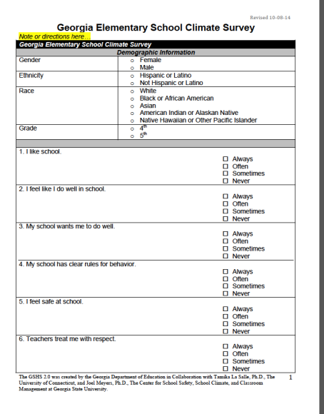
School Climate Measures
Survey Name | Georgia Elementary School Climate Survey | Georgia Brief School Climate Inventory (GaBSCI) | Georgia School Personnel Survey (GSPS) | Georgia Parent School Climate Survey
Target Group | Grades 3-5 | Grades 6-12 | Teachers, Administrators | Parents
Number of Items | 11 | 9 | 29 | 21

Slide 30
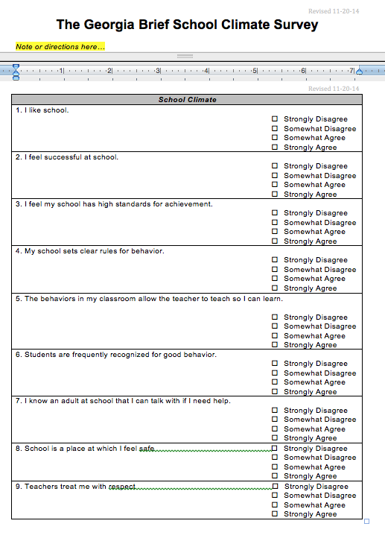
School Climate Measures
Survey Name | Georgia Elementary School Climate Survey | Georgia Brief School Climate Inventory (GaBSCI) | Georgia School Personnel Survey (GSPS) | Georgia Parent School Climate Survey
Target Group | Grades 3-5 | Grades 6-12 | Teachers, Administrators | Parents
Number of Items | 11 | 9 | 29 | 21

Slide 31
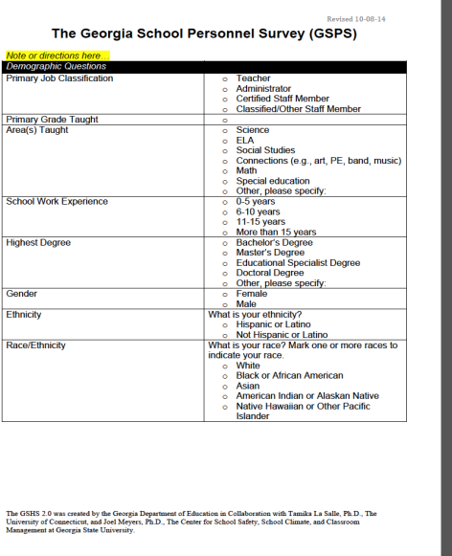
School Climate Measures
Survey Name | Georgia Elementary School Climate Survey | Georgia Brief School Climate Inventory (GaBSCI) | Georgia School Personnel Survey (GSPS) | Georgia Parent School Climate Survey
Target Group | Grades 3-5 | Grades 6-12 | Teachers, Administrators | Parents
Number of Items | 11 | 9 | 29 | 21

Slide 32
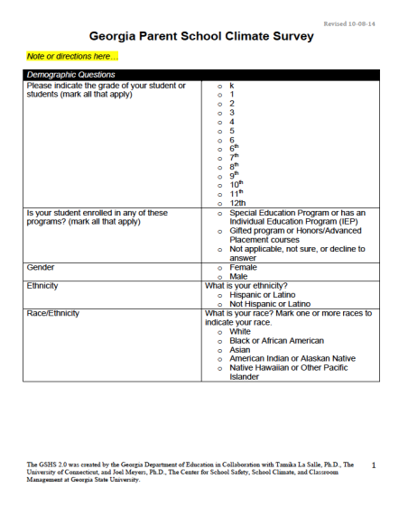
School Climate Measures
Survey Name | Georgia Elementary School Climate Survey | Georgia Brief School Climate Inventory (GaBSCI) | Georgia School Personnel Survey (GSPS) | Georgia Parent School Climate Survey
Target Group | Grades 3-5 | Grades 6-12 | Teachers, Administrators | Parents
Number of Items | 11 | 9 | 29 | 21

Slide 33
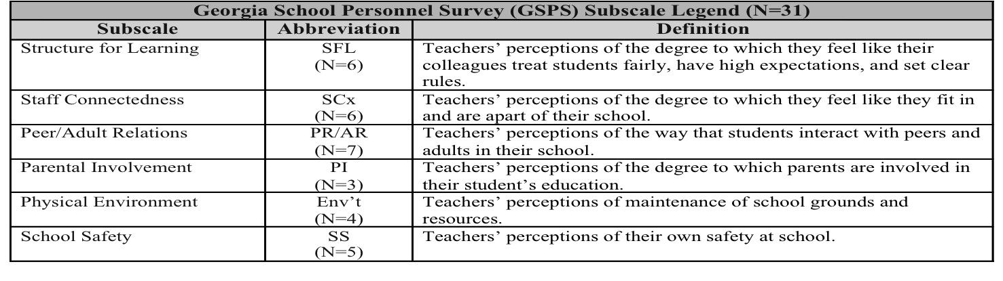
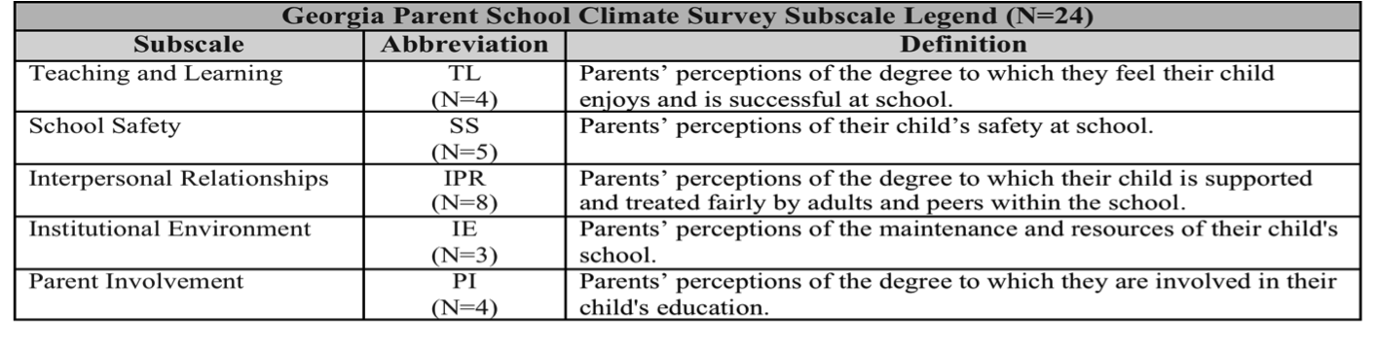
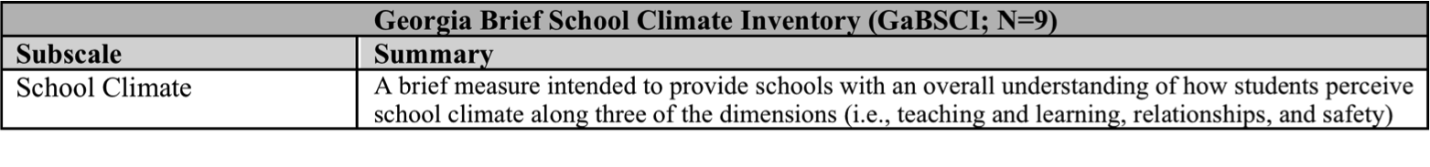
Teacher Perceptions
Parent Perceptions
Secondary Student Perceptions

Slide 34
PBIS Decision Making: Integrating Data
PBIS decision making can be enhanced by integrating:
Multiple Sources of Data School climate perceptions School Outcome Data Suspension/expulsion data Discipline referrals | PBIS Fidelity Data School-wide Evaluation Tool Benchmarks of Quality Tiered Fidelity Inventory

Slide 35
A Comprehensive Framework
PBIS DATA
ODRs
(E.G., MAJORS VS. MINORS; PATTERNS ACROSS GRADES, GENDER, CULTURAL GROUPS)
SCHOOL CLIMATE DATE
TEACHER PERCPETIONS
STUDENT PERCEPTIONS
Suspension/Expulsion
Parent Perceptions
School Level Data
Disproportionality Data
Achievement
Subjective data (school climate perceptions) and objective data (PBIS outcome indicators) can be used to support data-based decision making for school improvement efforts
PBIS outcome data is informed by other aspects of school functioning
Successes and challenges are best understood by considering the outcomes and potential reasons behind them
Comprehensive data can reveal information about cultural aspects that are affecting outcomes

Slide 36
Culturally Diverse Students
Culturally diverse students at risk
less likely to have their:
  academic and social needs met
  cultural experience and background validated
  cultural qualities respected or affirmed
Unless…..We seek to understand, respect and value similarities and differences, and continuously evaluate our actions and impact on students.
Notes:
82% white teacher force – 50 % non-white students
National Assessment of Educational Performance (NAEP)

Slide 37
Data, measures, and assessing impact
Tiered Fidelity Inventory (TFI)
Trainer & Team assessment of PBIS Implementation
Completed 1x per year
Team Implementation Checklist (TIC)
Team assessment of PBIS Implementation
Completed 2-3x per year
School Outcome Data
Office discipline referrals (ODRs) – some schools
In school suspension
Out of school suspension
Social Validity Data
School Climate Surveys
School Climate Interviews/Focus groups

Slide 38
Using PBIS and School Climate Data
Office Discipline Referrals
Suspensions/Expulsions
Disproportionality
Achievement
Patterns across groups (teachers, students, parents)
Patterns within groups (grade, gender, race/ethnicity)
Patterns across time (school years)

Slide 39
Using PBIS and School Climate Data
Office Discipline Referrals
Suspensions/Expulsions
Disproportionality
Achievement
Do patterns pair with existing data?
Examples
There are significantly more discipline referrals in 7th grade when compared to other grades.
Boys are suspended at a much higher rate than girls
Absentee rates for certain student groups are disproportionate

Slide 40
Georgia School Climate Survey
Interactive Data Sheet

Slide 41
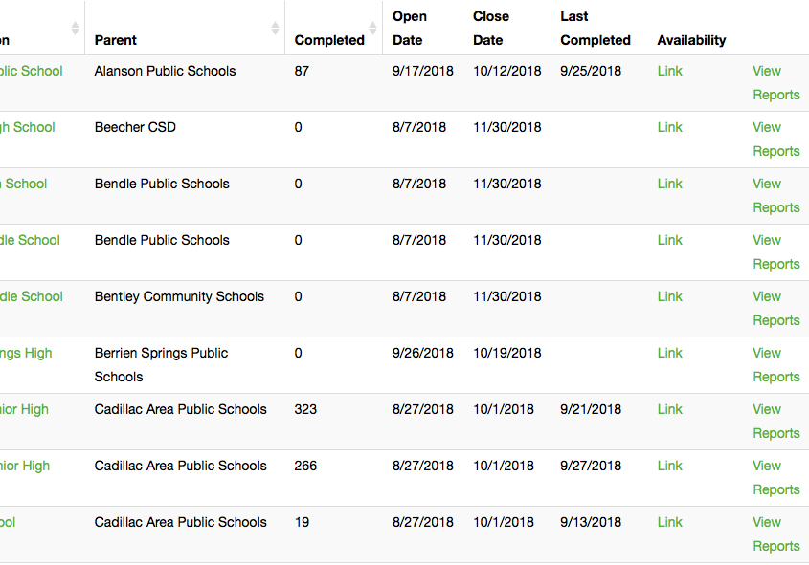
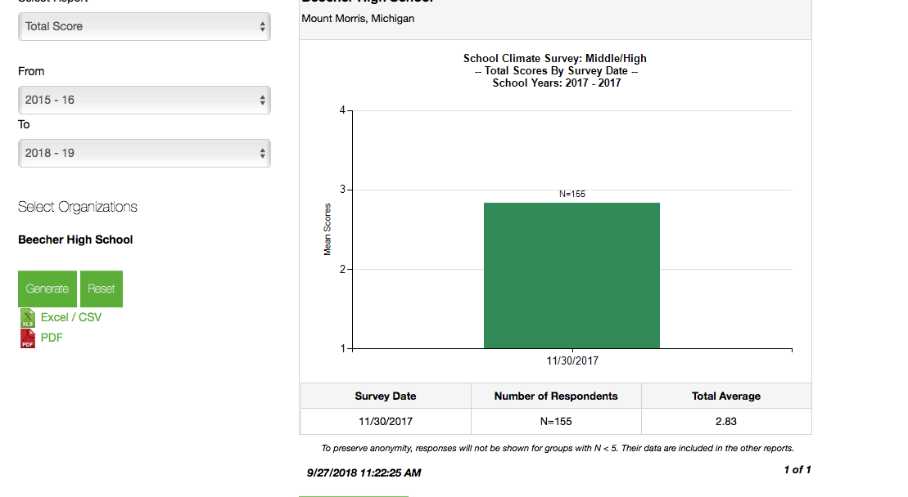
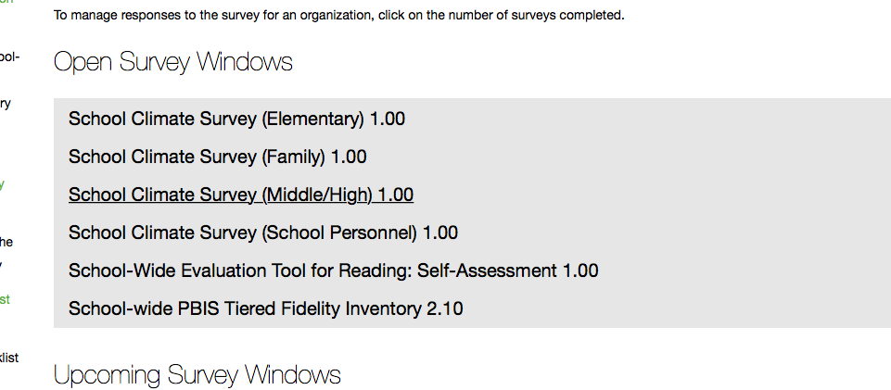
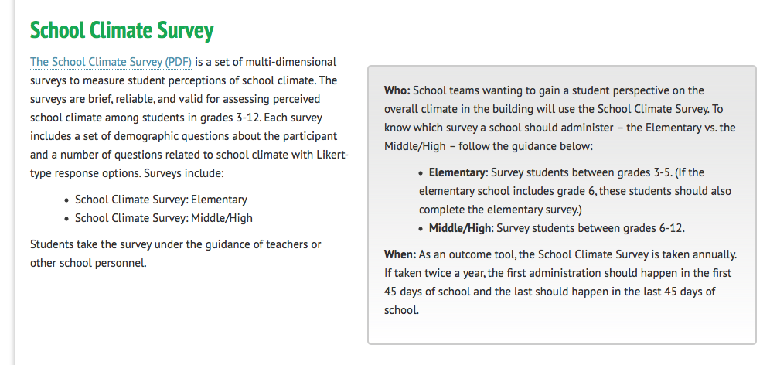

Slide 42

Interactive Data Sheet

Slide 43
Interactive Data Sheet
What? | Why? | Who? | When?
Tool to examine data from the Georgia School Climate Surveys Reveals patterns at the district, school and subgroup levels Graphic representations of school climate survey results
Organize school climate survey data in a centralized format that can be distributed Use visuals to make sense of results by looking at trends and subgroup comparisons Easily integrate school climate data with other school outcome data you use
District and school level administrators School improvement teams
Twice annually at fall and spring GSCS administration Following receipt of school climate survey data Be timely to ensure utility of results!

Slide 44
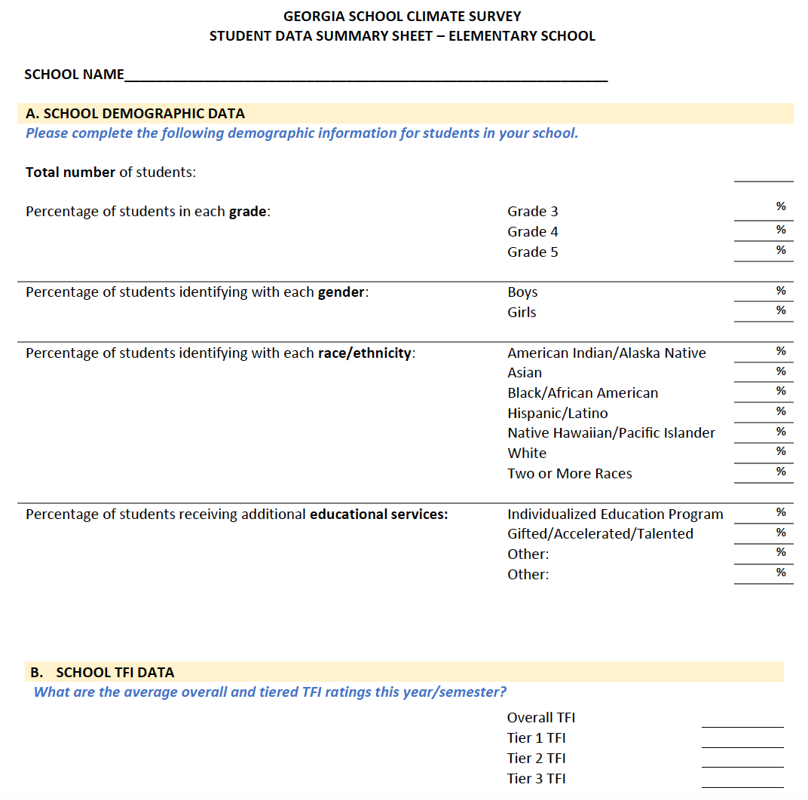
Navigating the Data Sheet
Indicates the
Level of data analysis (e.g. district, school)
Type of school (e.g. elementary)
Population (e.g. elementary student, parent, personnel)
Section headings indicate which information is described (demographic data, school climate ratings)
Fill in the lines with values from your school profile, outcome data or GSCS results.
Directions in blue help you complete each section.

Slide 45
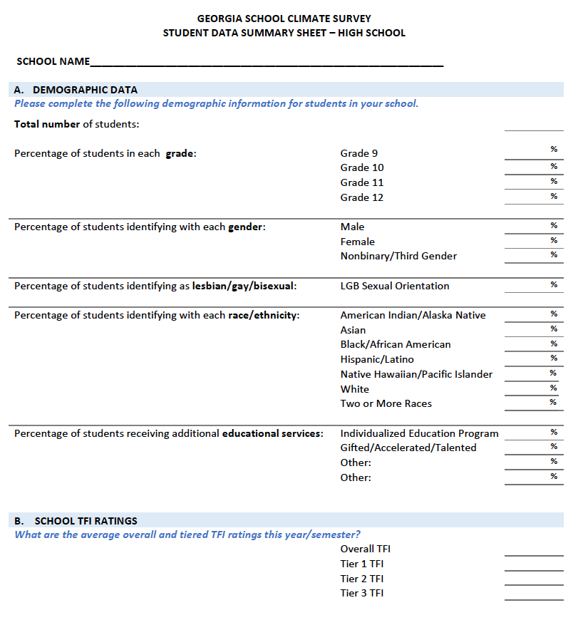
School Demographic Sections
Included to provide a profile of students, personnel and parents/families
Demographic categories vary depending on population summarized (e.g. grade, job classification for personnel).
Include additional school level information like TFI data.

Slide 46
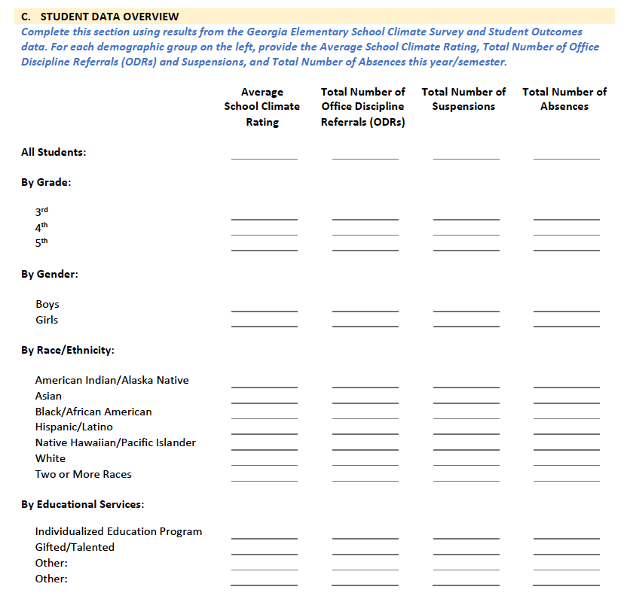
Data Summary Sections
Detailed overview of all student data for a given quarter, semester or year.
Includes data from school climate surveys and other student outcomes.
Easily review values for the whole school, and values for demographic subgroups.

Slide 47
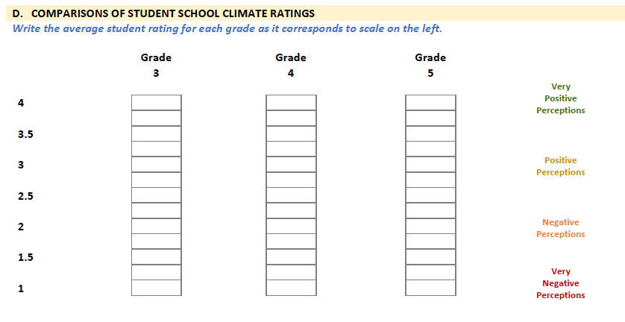
Visual Data Comparisons

Slide 48
Customizing the Integrated Data Sheet
Use sections of the data sheet that are relevant considering the GSCS surveys you administered, your school’s student demographics, and the goal of your data collection efforts.
Concise Reports
Goal Oriented
Relevant
Data

Slide 49
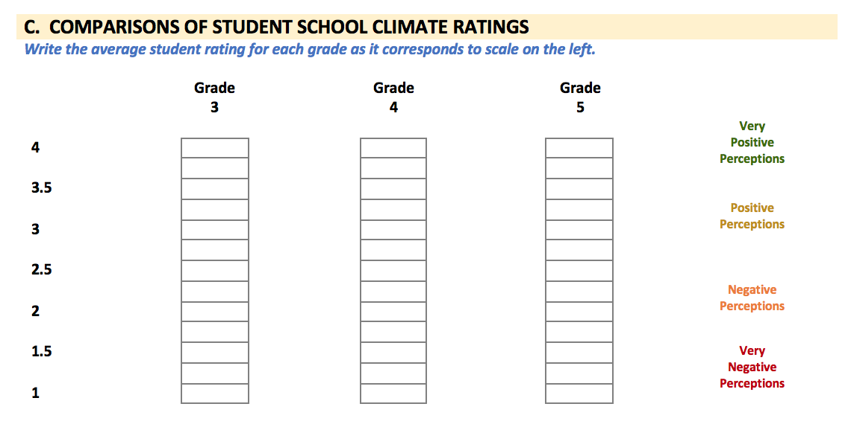
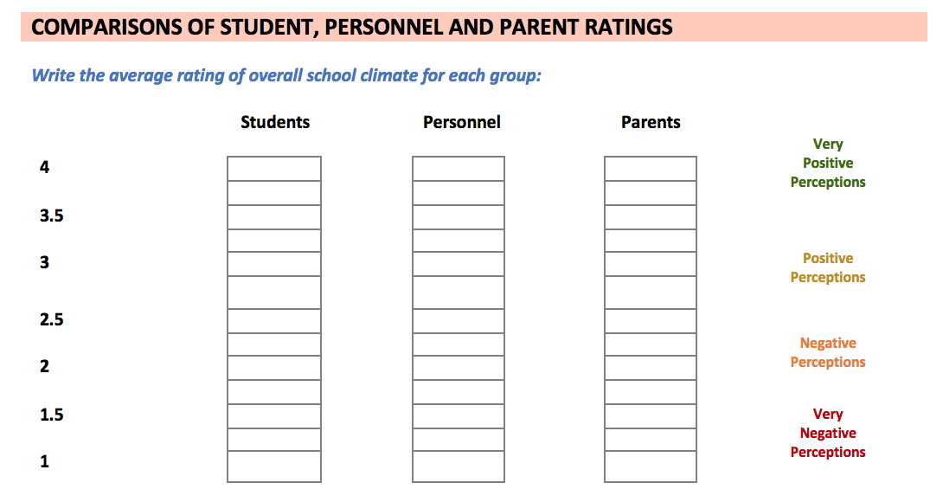
OR….

Slide 50
Why might the data drop initially?

Slide 51
Comparing Student Subgroups within Your School

Slide 52
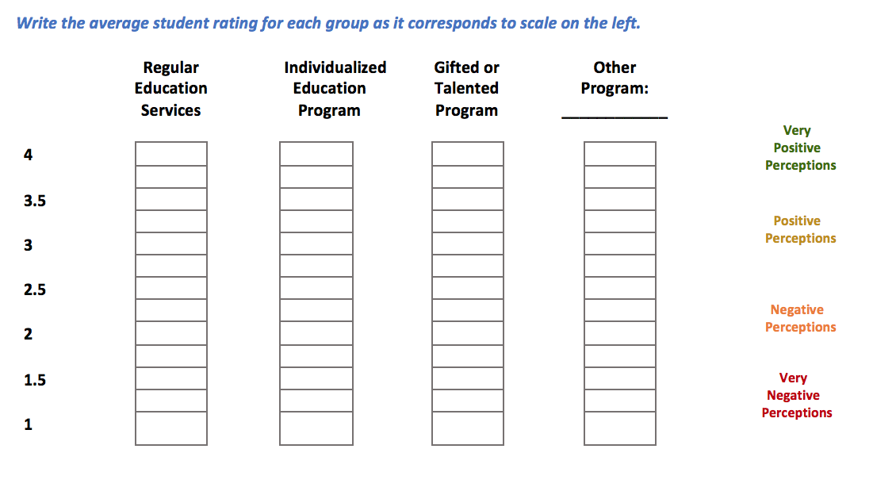
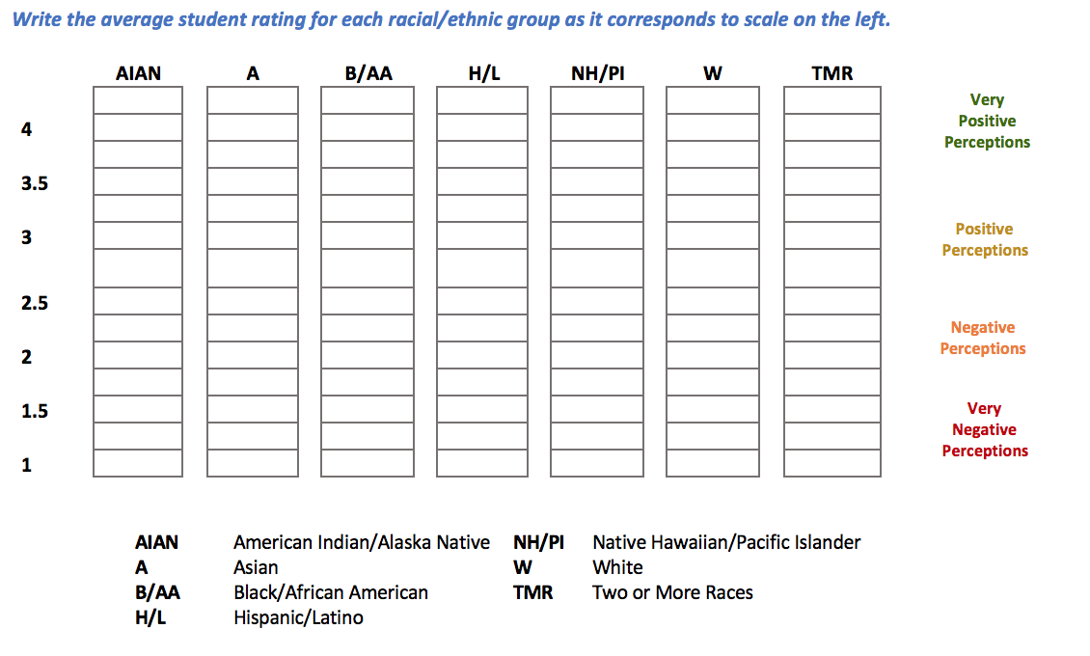
OR….

Slide 53
Customizing the Integrated Data Sheet
Goal: Investigate High School Student Perceptions of School Climate to Target Interventions
Demographic Overview
Data Summary
Goal: Initial Assessment of School Climate in Elementary School Community
Demographic Overview
Visual comparisons within student demographic groups:
School
Student
Grade
School
Data Summary
Student
Visual comparison across overall respondent groups
Personnel
Family/Parent
Personnel
Family/Parent
Educational services received
Gender

Slide 54
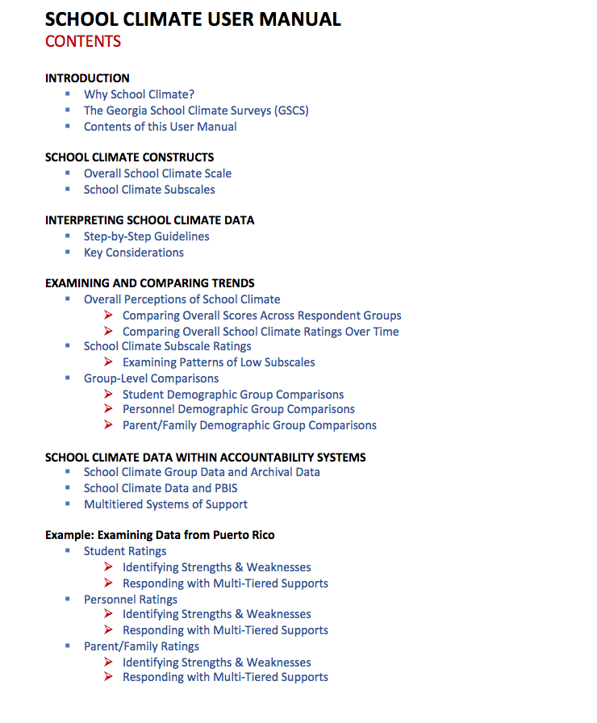
School Climate User Manual
A guide that assists schools to:
Interpret school climate data across multiple informants including students, personnel and parents/family
Reflect on school climate survey results
Respond with appropriate multi-tiered supports and interventions.

Slide 55
School Climate User Manual
Contents:
Background on School Climate and GSCS
What are School Climate Scores?
  Overall
  Subscale
Examining School Climate Data
  Recommendations
  Considerations
  Tips
School Climate Data Within Accountability Systems
Example: Case Study

Slide 56
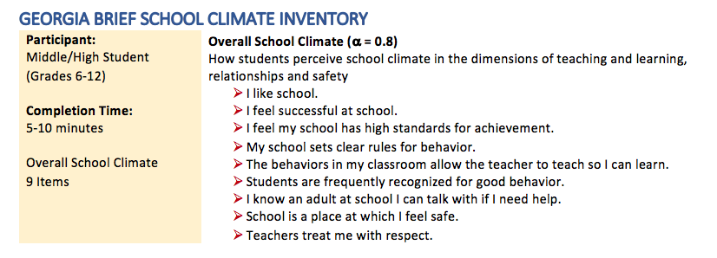
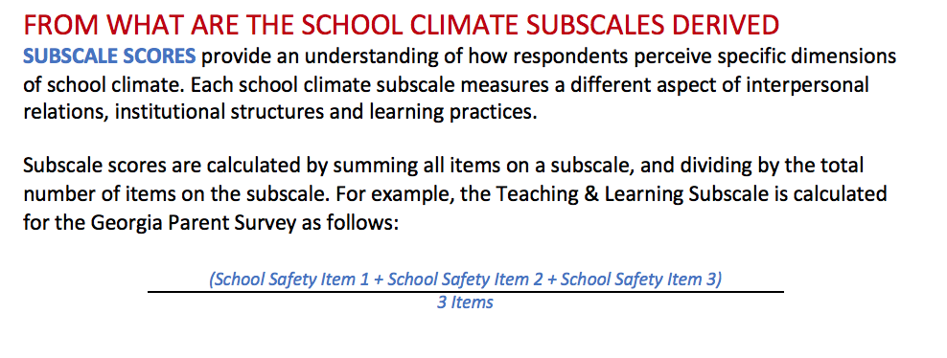
Contents of the User Manual
Overview of GSCS
Georgia Elementary School Climate Survey
Georgia School Climate Survey – Extended
Georgia Brief School Climate Survey
Georgia Personnel Survey
Georgia Parent Survey
Explanation of how school climate scores are derived

Slide 57


Contents of the User Manual
Considerations to contextualize school climate data
Recommendations for examining school climate survey
Tips and common data trends to support understanding

Slide 58
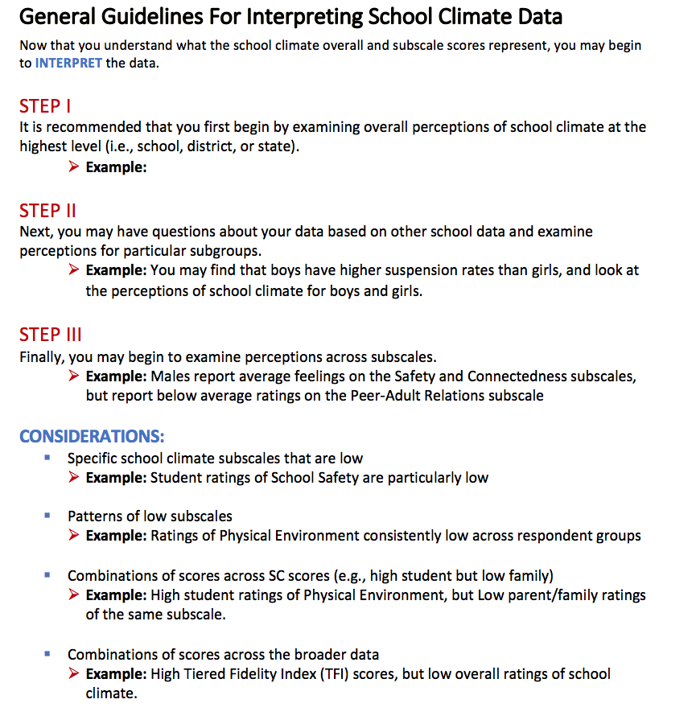
Step-by-Step Data Interpretation Guidelines

Slide 59
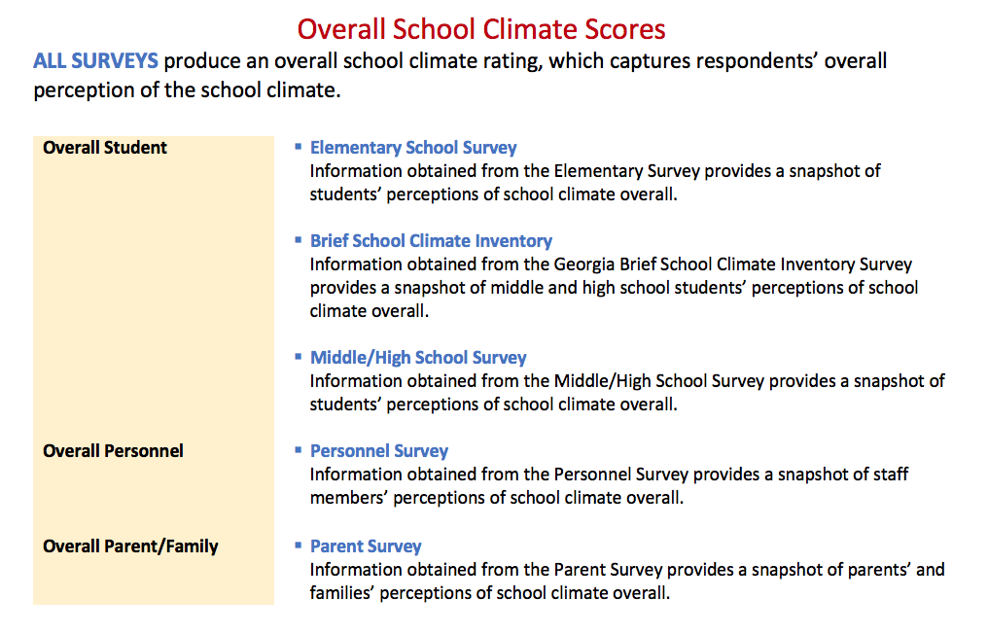
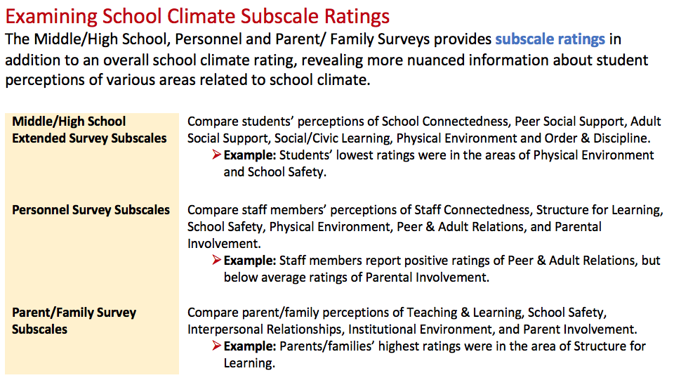
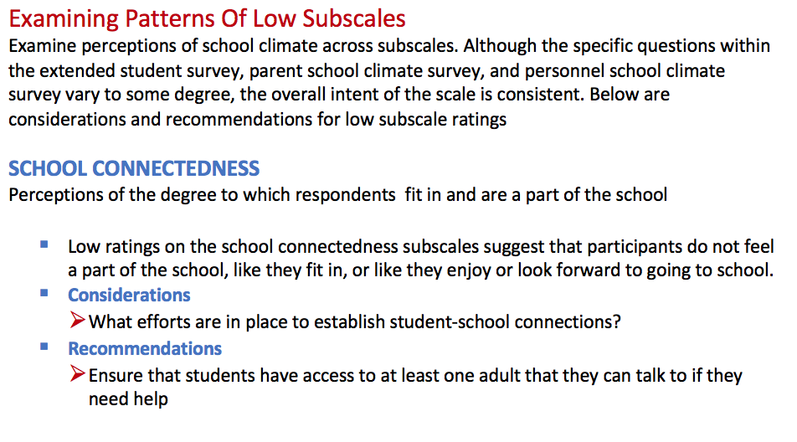
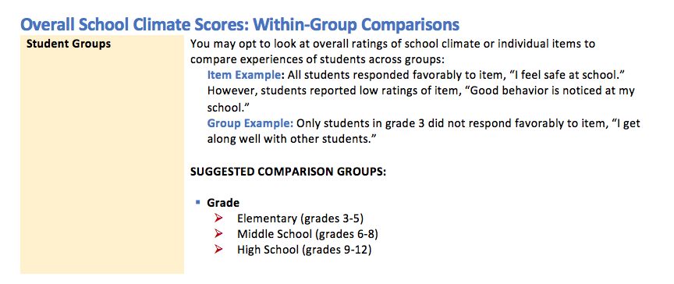
Understanding & Comparing…
Overall School Climate Scores
School Climate Subscale Scores

Slide 60
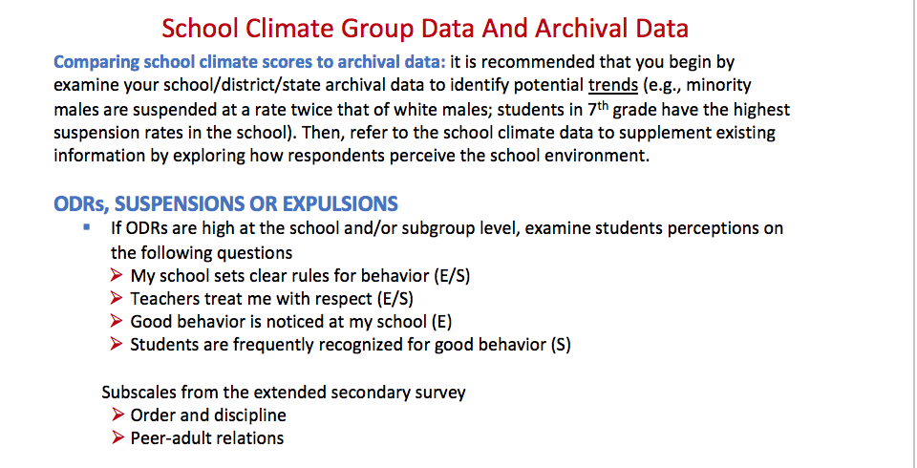
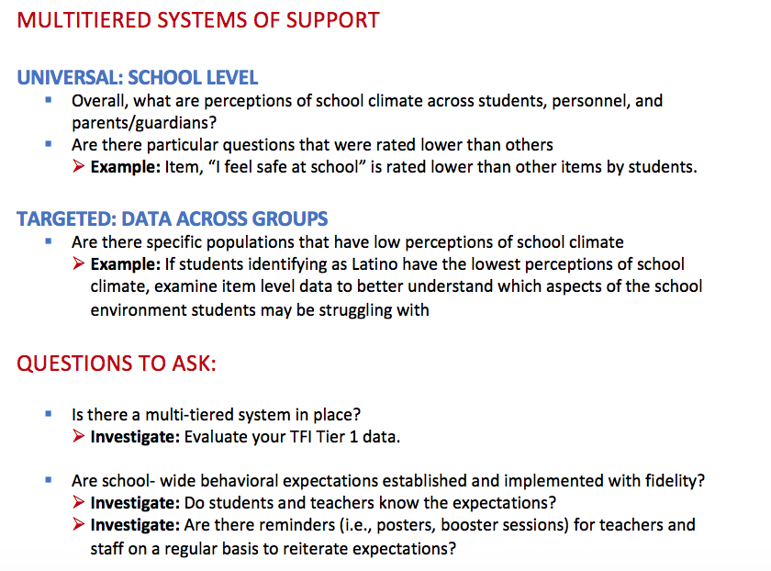
Integrating School Climate Data and Other Data Sources

Slide 61
Additional Resources
Georgia School Climate Survey
Evaluation Brief
Comprehensive Secondary School- now available at fieldtest.pbisassessment.org
Integrated Data Sheet
User Manual
coming soon!

Slide 62
Questions/Comments
          Tamika La Salle
          University of Connecticut
          tamika.la_salle@uconn.edu

Slide 63

Miami, FL
Hyatt Regency Miami
For more information, visit:
conference.apbs.org
March 11-14, 2020

