Slide 1
Coaching School-Wide Positive Behavioral Interventions and Supports (SWPBIS)
Northeast PBIS (NEPBIS) Coaches Training
Coaching Day 7
INSERT TRAINER NAMES
with support from Brandi Simonsen, Jen Freeman,
Susannah Everett, Adam Feinberg, & George Sugai
Notes:
Add trainer names for your event

Slide 2

Advance Organizer
Introduction and Focus on Coaching
Quick Review and Focus on Year 3 training activities
Coaching Self-Assessment and Reports
Share information on implementation of the PBIS Framework
Advanced Skill Building
Efficient Data Systems with TIPS
Preparation for Next Training Event

Slide 3
Main Coaching Objectives
By the end of today’s meeting, you will be able to…
  …Describe your role as a coach.
  …Articulate the basic elements of SWPBS.
  …Identify resources for SWPBS.
  …Problem solve roadblocks in coaching
  …Facilitate your team’s activities at the next SWPBS team training.

Slide 4
Training Expectations:
RESPECT…
SELF
Self-monitor (Are you participating? Engaged as a learner? Talking during allotted times?)
Stretch, break, stand as needed
OTHERS
Cell phones (inaudible): Converse in lobbies and breaks
ENVIRONMENT
Recycle
Work as a team: Room for every voice, reinforce participation
Maintain neat working area

Slide 5


Tools!
nepbis.org
pbis.org
Coaching SWPBIS Workbook and Appendices
Evaluation Plan
Action Plan

Slide 6

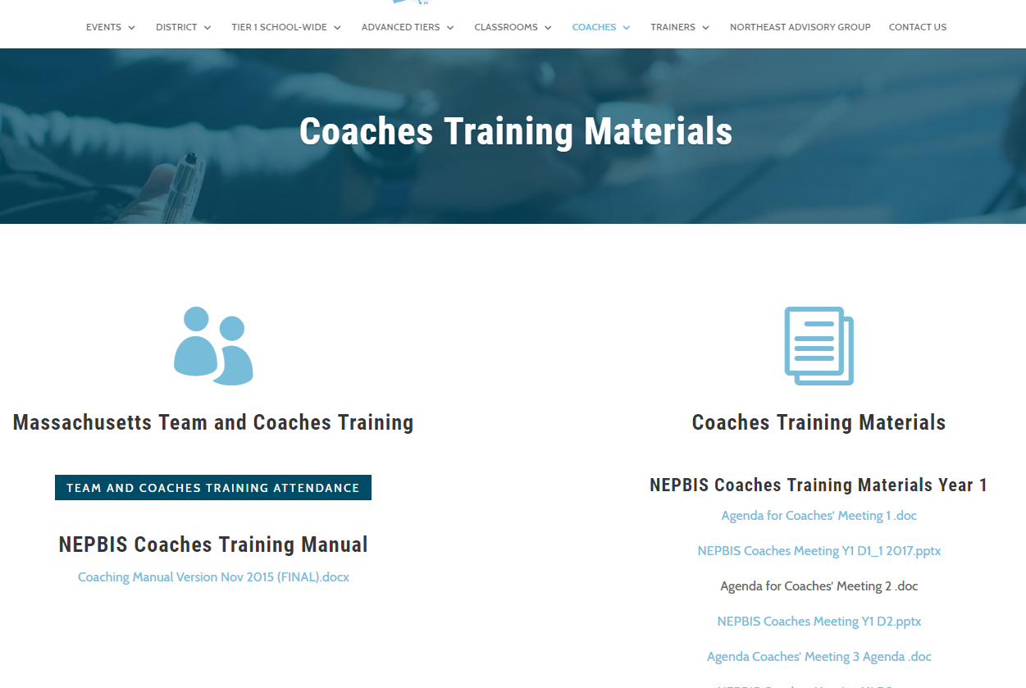
Activity:
Please Enter Attendance
1 min
Please login on nepbis.org, go to the coaches’ tab, and click on the Team Training Attendance Link. Follow prompts to enter team attendance.

Slide 7





Legend
New Content
Review
Guidelines
+Ex
-Ex
Training Organization
Activity

Slide 8


Legend
Section Header (I.A)
Chapter Header (e.g., I)

Slide 9
Advance Organizer
Introduction and Focus on Coaching
Quick Review and Focus on Year 3 training activities
Coaching Self-Assessment and Reports
Share information on implementation of the PBIS Framework
Advanced Skill Building
Efficient Data Systems with TIPS
Preparation for Next Training Event

Slide 10
Overview of Coaching in swpbis
(Chapter i)

Slide 11
How is it going with your various roles?
Coaching Roles
Facilitate
Content Knowledge
Communicate
  Team meetings
  Activities at training events
  Implementation
  Local PBS expert
Positive “nag”
Link to resources (e.g., nepbis.org, www.pbis.org)
  Share advanced content with team
  Share information at faculty meetings
I.A.ii
Notes:
Move quickly through review content (just hit the highlights). Then, for each item, ask questions about how its going and use this to reinforce, correct, or problem solve as appropriate.

Slide 12
Basics of swpbis for coaches
(Chapter Ii)

Slide 13

Critical Features of PBIS
Supporting Culturally Equitable
Social Competence & Academic Achievement
OUTCOMES
Supporting
Culturally
Knowledgeable
Staff Behavior
Supporting
Culturally Valid
Decision
Making
SYSTEMS
DATA
(Vincent, Randal, Cartledge, Tobin, & Swain-Bradway, 2011; Sugai, O’Keefe, & Fallon 2012 ab)
PRACTICES
I.C
Supporting Culturally Relevant
Evidence-based Interventions
Notes:
Move quickly through review content (just hit the highlights). Then, for each item, ask questions about how its going and use this to reinforce, correct, or problem solve as appropriate.

Slide 14
coaching team meetings
(Chapter iII)

Slide 15
Facilitating Effective Team Meetings
(see details in Coaches’ Workbook)
Be prepared and expect others to be as well
Begin on time by reviewing agenda and outcomes
Involve everyone
Use data to clearly and quickly define a problem before beginning problem solving
Create an action plan
At the end of the meeting debrief
After the meeting, electronically publish meeting minutes
III.A.i

Slide 16
Using Data Effectively
(see details in Coaches’ Workbook)
Collect appropriate and relevant data
Organize the data in a user-friendly manner that aides comprehension
Review and analyze the data at least monthly to guide decision-making
Make data available to all stakeholders
Provide staff development to all staff to use data to inform decision making
Use data analysis to inform decisions related to school-wide programs, classroom-based instructional practices, and student-specific interventions
Review data collection procedures and practices to ensure that data accurately reflect school events
Collect data on extent to which practice or intervention is being implemented accurately and fluently (implementation fidelity)
III.A.ii

Slide 17

MA PBIS Academy Year 3 Goals
Support implementation and sustainability of the PBIS framework
  Review current school implementation related to specific framework principles
  Gather information on other exemplars of implementation of framework principles.
Build coaching knowledge and fluency with PBIS content
  Connect specific school systems, features, or practices with PBIS content principles
  Practice communicating important framework features present or needed in your school

Slide 18
MA PBIS Academy Year 3 Activities
Training Day 10
  Guest Speaker on School Climate: Dr. Tamika La Salle
  PBIS Showcase
  Action Planning
Training Day 11
  Guest Speaker on Sustainability: Dr. Adam Feinberg
  Poster Session
  Action Planning

Slide 19
PBIS Showcase
Target Goal:
  Networking across districts and schools through sharing examples of PBIS framework implementation
Afternoon Brief (30-Minutes) Presentations Topics
PBIS Systems
PBIS Data
PBIS Practices
PBIS Secondary

Slide 20
PBIS Showcase
Structure (Three 30 Minute Presentations)
  12 total presentations across four content areas
  30 minute presentations
    15-min school example on the topic
    15-min school Q & A
  Repeat
PBIS Systems
PBIS Data
PBIS Practices
PBIS in Secondary

Slide 21
PBIS Showcase Format
 | Practices | Systems | Data | Secondary
1:00 – 1:15 | Team #1 Presentation | Team #1 Presentation | Team #1 Presentation | Team #1 Presentation
1:15 – 1:30 | Team #1 Q&A | Team #1 Q&A | Team #1 Q&A | Team #1 Q&A
1:30 – 1:45 | Team #2 Presentation | Team #2 Presentation | Team #2 Presentation | Team #2 Presentation
1:45 – 2:00 | Team #2 Q&A | Team #2 Q&A | Team #2 Q&A | Team #2 Q&A
2:00 – 2:15 | Break
2:15 – 2:30 | Team #3 Presentation | Team #3 Presentation | Team #3 Presentation | Team #3 Presentation
2:30 – 2:45 | Team #3 Q&A | Team #3 Q&A | Team #3 Q&A | Team #3 Q&A
2:45 – 3:30 | Wrap up & Action Planning
    Asking questions of school exemplar discussion leaders on the content initially reviewed.

Slide 22
PBIS Showcase Discussions
Plan ahead!
  Consider which team members will attend which presentations...
  Consider questions you may want to ask other teams.

Slide 23
PBIS Showcase full day Agenda
Time | Main Rm | Room 2 | Room 3 | Room 4
8:30 – 9:00 | Introductions and Overview of the Day
9 – 10:30 | School Climate Guest Speaker: Dr. Tamika LaSalle | PBIS 101 Booster | SWIS Training (Part 1) | District Team Training
10:30 – 10:45 | Break
10:45 – 12noon | Action Planning | PBIS 101 Booster | SWIS Training (Part 2) | District Team Training: Guest Speaker
12- 1:00 | Lunch
 | PBIS Showcase
 | Practices | Systems | Data | Secondary
1:00 – 1:15 | Team #1 Presentation | Team #1 Presentation | Team #1 Presentation | Team #1 Presentation
1:15 – 1:30 | Q&A | Q&A | Q&A | Q&A
1:30 – 1:45 | Team #2 Presentation | Team #2 Presentation | Team #2 Presentation | Team #2 Presentation
1:45 – 2:00 | Q&A | Q&A | Q&A | Q&A
2:00 – 2:15 | Break
2:15 – 2:30 | Team #3 Presentation | Team #3 Presentation | Team #3 Presentation | Team #3 Presentation
2:30 – 2:45 | Q&A | Q&A | Q&A | Q&A
2:45 – 3:30 | Wrap up & Action Planning

Slide 24
MA PBIS Academy Year 3 Activities
Training Day 10
  Guest Speaker on School Climate: Dr. Tamika La Salle
  PBIS Showcase
  Action Planning
Training Day 11
  Guest Speaker on Sustainability: Dr. Adam Feinberg
  Poster Session
  Action Planning

Slide 25
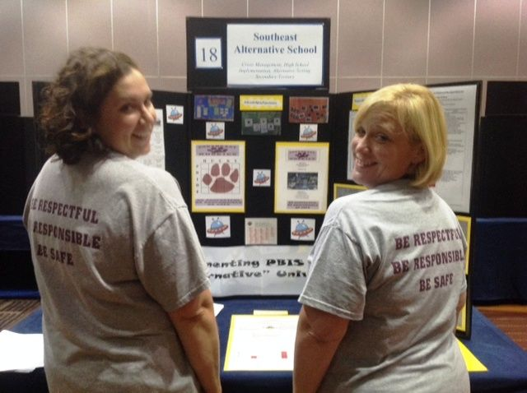
Poster Session
Target Goal:
  Share examples of implementation of the PBIS Framework across districts and schools
Structure
  Show off! Each school will present a
  poster and have at least 1 or 2 team
  members present at poster during the
  session
  Take turns! Other team members walk
  around browse other posters to review
  PBIS features of other schools
  Get ideas! Bring ideas back to your
  school for follow up action planning

Slide 26
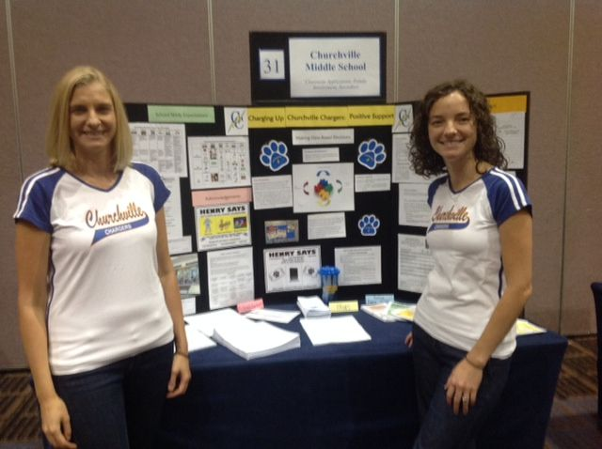
What to include in your Poster?
Ideas Examples of Systems, Data, and Practices!
  Data Examples:
    Fidelity Data (e.g., TFI or TIC)
    Outcome Data (e.g., ODR or attendance)
  System Examples
    Team action plans
    Staff Survey
  Practice Examples
    Lesson plan
    Teaching Matrix
    Consequence Flow-chart
Please include data as part of your poster!

Slide 27
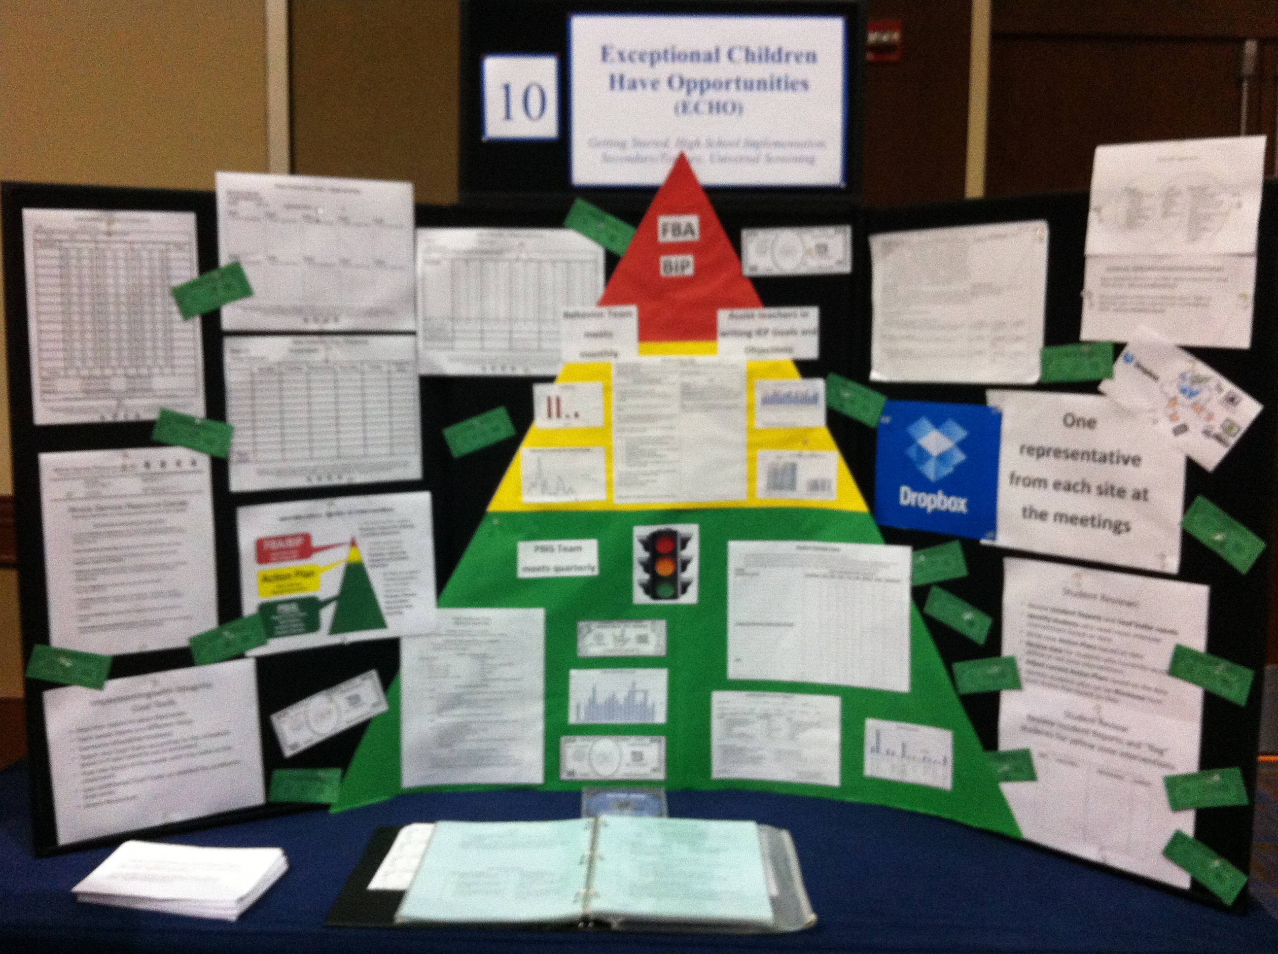
Poster Session
Invite your colleagues and administrators:
  We will email you in the winter to
  alert you of the time of the poster
  sessions.
  Please invite colleagues with whom
  you want to share your work with.
  Consider important stakeholders!
  (e.g., school board, PTO, etc.)
  Consider inviting relevant
  administrators

Slide 28
Activity:
Poster Planning
Work individually (or with partner coach) for 15 min
Review Round table and Poster format
Discuss with your fellow coach what your school may show on your poster in the Spring.
Discuss what potential steps may need to be completed between now and the Spring training session to complete a poster.
Be prepared to share any ideas and bring up any potential barriers for problem solving.

Slide 29
Advance Organizer
Introduction and Focus on Coaching
Quick Review and Focus on Year 3 training activities
Coaching Self-Assessment and Reports
Share information on implementation of the PBIS Framework
Advanced Skill Building
Efficient Data Systems with TIPS
Preparation for Next Training Event

Slide 30
A reminder you’ll see throughout to help us remember the role.
Coach

Slide 31
Coaching Reports
(+ or Δ)
Coach
      Complete Coaches’ Self-Assessment and Prepare:
      1-2 Details to introduce yourself
      1-2 Strengths
      (with respect to coaching)
      1-2 Concerns or challenges
      (with respect to coaching)

Slide 32
Activity:
Coaching Implementation Review
Work individually (or with partner coach) for 20 min
Review Coaches Implementation Activity as well as the TFI Tier 1 Features
Review your TFI results from PBISApps.org
Review what is / is not in place in your school
Based on your school’s level of implementation, identify what other schools are doing that could be effective for your school
Be prepared to share out 1-2 ideas per domain during the upcoming discussion

Slide 33
Implementation Planning
1.1 Team Composition
Tier I team includes a Tier I systems coordinator, a
school administrator, a family member, and individuals able to provide (a) applied behavioral expertise, (b) coaching expertise, (c) knowledge of student academic and behavior patterns, (d) knowledge about the operations of the school across grade levels and programs, and for high schools, (e) student representation.
In Place
In Development
Not in Place

Slide 34
Implementation Planning
1.2 Team Operating Procedures
Tier I team meets at least monthly and has (a) regular meeting format/agenda, (b) minutes, (c) defined meeting roles, and (d) a current action plan.
In Place
In Development
Not in Place

Slide 35
Implementation Planning
1.3 Behavioral Expectations
School has five or fewer positively stated behavioral expectations and examples by setting/location for student and staff behaviors (i.e., school teaching matrix) de defined and in place.
In Place
In Development
Not in Place

Slide 36
Implementation Planning
1.4 Teaching Expectations
Expected academic and social behaviors are taught directly to all students in classrooms and across other campus settings/locations.
In Place
In Development
Not in Place

Slide 37
Implementation Planning
1.5 Problem Behavior Definitions
School has clear definitions for behaviors that interfere with academic and social success and a clear policy/ procedure (e.g., flowchart) for addressing office managed versus staff managed problems.
In Place
In Development
Not in Place

Slide 38
Implementation Planning
1.6 Discipline Policies
School policies and procedures describe and emphasize proactive, instructive, and/ or restorative approaches
to student behavior that are implemented consistently.
In Place
In Development
Not in Place

Slide 39
Implementation Planning
1.7 Professional Development
A written process is used for orienting all faculty/staff on 4 core Tier I SWPBIS practices:
(a) teaching school-wide expectations, (b) acknowledging appropriate behavior, (c) correcting errors, and (d) requesting assistance.
In Place
In Development
Not in Place

Slide 40
Implementation Planning
1.8 Classroom Procedures:
Tier I features (school-wide expectations, routines, acknowledgements, in-class continuum of consequences) are implemented within classrooms and consistent with school-wide systems.
In Place
In Development
Not in Place

Slide 41
Implementation Planning
1.9 Feedback and Acknowledgement
A formal system (i.e., written set of procedures for specific behavior feedback that is
[a] linked to school-wide expectations and [b] used across settings and within classrooms) is in place and used by at least 90% of a sample of staff and received by at least 50% of a sample of students.
In Place
In Development
Not in Place

Slide 42
Implementation Planning
1.10 Faculty Involvement
Faculty are shown school- wide data regularly and provide input on universal foundations (e.g., expectations, acknowledgements, definitions, consequences) at least every 12 months.
In Place
In Development
Not in Place

Slide 43
Implementation Planning
1.11 Student / Family / Community Involvement
Stakeholders (students, families, and community members) provide input on universal foundations (e.g., expectations, consequences, acknowledgements) at least every 12 months.
In Place
In Development
Not in Place

Slide 44
Implementation Planning
1.12 Discipline Data
Tier I team has instantaneous access to graphed reports summarizing discipline data organized by the frequency of problem behavior events by behavior, location, time of day, and by individual student.
In Place
In Development
Not in Place

Slide 45
Implementation Planning
1.13 Data-based Decision Making
Tier I team reviews and uses discipline data and academic outcome data (e.g., Curriculum-Based Measures, state tests) at least monthly for decision-making.
In Place
In Development
Not in Place

Slide 46
Implementation Planning
1.14 Fidelity Data
Tier I team reviews and uses SWPBIS Fidelity (e.g., SET, BoQ, TIC, SAS, Tiered Fidelity Inventory) data at least annually.
In Place
In Development
Not in Place

Slide 47
Implementation Planning
1.15 Annual Evaluation
Tier I team documents Fidelity and effectiveness (including on academic outcomes) of Tier I practices at least annually (including year- by-year comparisons) that are shared with stakeholders (staff, families, community, district) in a usable format.
In Place
In Development
Not in Place

Slide 48
Advance Organizer
Introduction and Focus on Coaching
Quick Review and Focus on Year 3 training activities
Coaching Self-Assessment and Reports
Share information on implementation of the PBIS Framework
Advanced Skill Building
Efficient Data Systems with TIPS
Preparation for Next Training Event

Slide 49
Setting Up Efficient Decision Systems
(Special Thanks to Erin Dunn & Ravit Stein of EASTCONN)

Slide 50
Building Decision Systems
Guide schools to build comprehensive “decision systems” not just “data systems”.
Data System | Decision System
Technology that houses data District student information system (SIS) Excel spreadsheet SWIS application | Agreements on the collection and use of data (including a data system) Routines and procedures to embed SWIS application data into decision making
Notes:
Although we often refer to SWIS as a “data system”, it’s important to recognize that we can’t just build data systems that store information. If we want to improve the school climate, we have to build comprehensive decision systems. As a decision system, SWIS is designed to help schools be more effective in decision making by gathering the right data, at the right times, and in the right formats.
Schools/facilities want to build structures that enhance decision making. If they just want a place to store information, then Excel or their SIS will work just fine. If they want to actively use the information for continuous quality improvement, then SWIS can become a valuable tool.

Slide 51
Essential Elements of Decision Systems
Team foundations (roles, schedule, agenda)
Define problems with precision
Define the goal before the solution
Build functional and contextually-relevant solutions
Transform solutions into action plans
Measure fidelity and impact (repeatedly)
Adapt solutions over time to fit new data
Notes:
When schools/facilities are engaged in the problem-solving process using data-based decision making, there are key concepts and critical components that must be present to be most effective.
Teams should have solid meeting foundations to move through the problem-solving process efficiently.
Teams should work to clarify problems and define them with precision so everyone knows exactly where solution efforts are being focused.
Teams should define goals prior to designing solution plans. This helps design solutions that are truly effective.
Teams should transform solutions into actionable plans so they are more likely to happen.
Teams should regularly measure fidelity and impact so they know if they did what they said they would do and whether it had the outcome they intended.
Teams should regularly monitor their data so they can easily transition to new problems and adapt solutions.

Slide 52
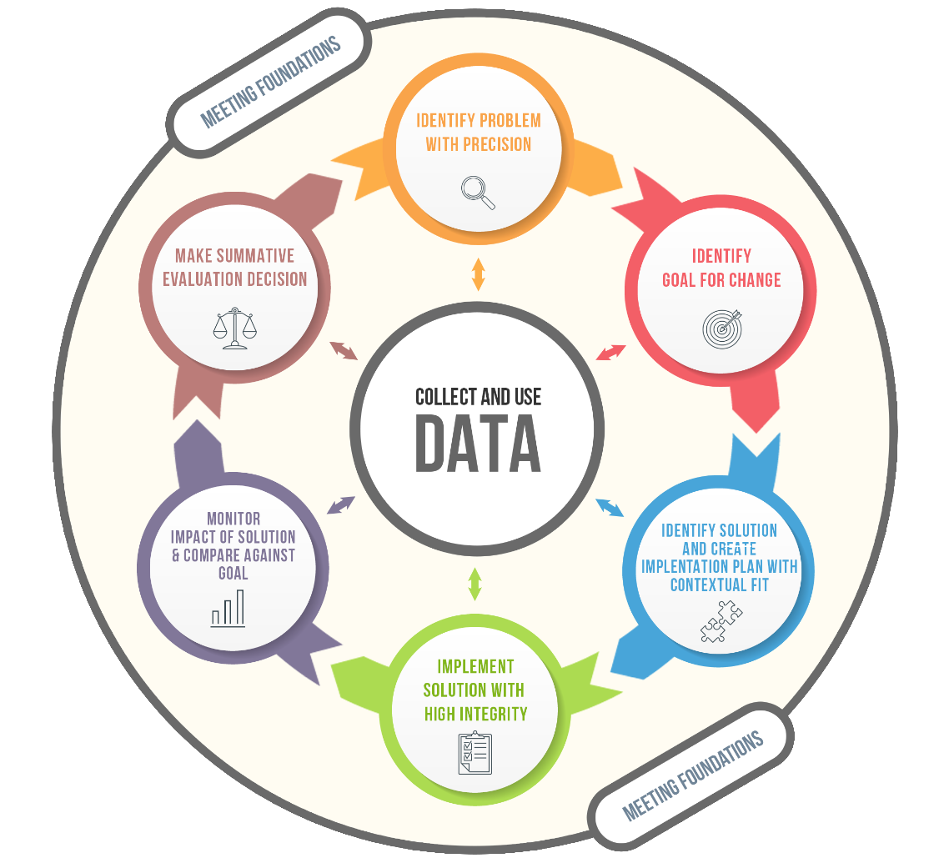

TIPS Model
Team-Initiated Problem Solving (TIPS) Model
https://www.pbis.org/training/tips
Notes:
This information grew from the research on the Team Initiated Problem Solving (TIPS) model. This is a comprehensive model that teams can adopt to maximize meeting minutes by using data to drive discussion.
TIPS grew out of the work at PBISApps, and the research on this model is influencing our ongoing development of the applications and training materials. If you’re interested in further information about TIPS, please visit the pbis.org website. All the materials and resources on pbis.org are available for free through a federally funded grant.

Slide 53
90,000 public schools in the United States
We have to make our Problem Solving Team minutes count!
810,000 hours of meetings
Each school has 1+ teams to address challenges and build solutions
4,050,000 hours of personnel time annually
Each team meets at least monthly
On average there are 5 people on each team
Notes:
Use this slide to show that although we are not solving all our problems (asses first by asking for thumbs up or down if all problems at school are being solved) and we are using a lot of time but we most likely are not going to be provided with more time. So…we need to be more effective and efficient with the time we do have for problem solving.

Slide 54
Action Planning
Precise Problem Solving
Meeting Foundations
Meetings that Work

Slide 55
Meeting Foundations
Meeting Foundations
To improve meeting efficiency

Slide 56
Meeting Foundations
Clear Purpose
Predictable Structure
Member Roles & Responsibilities
Agenda & Minutes

Slide 57
Meeting Foundations
Clear Purpose
Predictable Structure
Member Roles & Responsibilities
Agenda & Minutes
Notes:
With respect to our conference calls and meetings for the RESC Alliance I want to touch base about the purpose and roles & responsibilities

Slide 58

Clear Purpose
What is the purpose of our team?
What is the impact we are to have on students/ families/ school?
What authority do we have to implement solutions?
Notes:
Let them know that we review each of the meeting foundation components they should take notes and think about which of the components is needs the most development

Slide 59
Meeting Foundations
Clear Purpose
Predictable Structure
Member Roles & Responsibilities
Agenda & Minutes

Slide 60
Member Roles & Responsibilities
Additional Members
Critical Members
Administrator
School social worker
School Psychologist
Nurse
School Counselor
Teacher(s)
Attendance clerk or school secretary
Tier 2 Intervention coordinators (e.g., mentorship program)
District Staff
Community Partner(s)

Slide 61
Member Roles & Responsibilities
Team members can contribute most effectively if they know what is expected of them
Responsibilities before, during, and after the meeting

Slide 62
Member Roles & Responsibilities
Core Roles
Additional Roles
Facilitator
Minute Taker
Data Analyst
Administrator
Active Team Members
Timekeeper
Parent/family member
Consultant
Parking Lot Supervisor
Assumption Buster
Communicator
Parent/family Liaison
Back-up for each role!
Can one person serve multiple roles?
Are more roles needed?

Slide 63
Meeting Foundations
Clear Purpose
Predictable Structure
Member Roles & Responsibilities
Agenda & Minutes

Slide 64
Predictable Structure
A meeting schedule is created and respected (date and times)
Clear start time/stop time
Attendance at meetings
Consideration of group size
Agreement on group norms
Notes:
Meetings that start/end on time are found to be less disruptive, leader to higher perceived quality by team members, and result in higher engagement by meeting attendants
Larger groups have lower participation

Slide 65
Meeting Foundations
Clear Purpose
Predictable Structure
Member Roles & Responsibilities
Agenda & Minutes

Slide 66
Agenda & Minutes
A framework to guide the meetings and record critical decisions
Problem
A key to collective problem solving is to provide a visual context that allows everyone to follow and contribute
Out of Time
Solution

Slide 67
Meeting Agenda & Minutes
Core Components:
Purpose
Meeting demographics
  Attendants
  Location
  Start/stop time
  Next meeting information
Agenda items
  With time allotted to each
  Standard agenda items across meetings
Place to record key decisions from meetings (i.e., minutes)
Action planning/To Do List

Slide 68
Action Planning
Precise Problem Solving
Meeting Foundations
Meetings that Work

Slide 69
Action Planning
Action Planning
To improve meeting effectiveness

Slide 70
Action Planning:
A Critical Step
Action planning and documentation provides direction for team, increases implementation integrity, and accountability among implementers
Increases purposeful directive conversations about progress

Slide 71
Key Components of Action Planning
Date | Task/ Goal | Action Plan | Who? | By When? | Status?
What was the date this goal was discussed? | What task or goal does the team want to achieve? | What specific tasks need to be done to achieve the team’s task/goal? | Who will complete each task item? | What is the deadline for completion? | Have task items been completed?

Slide 72
Sample Action Planning
Date | Task/ Goal | Action Plan | Who? | By When? | Status?
3/2/19 | Improve average daily school attendance | Send monthly attendance data to all families Greet all students who are on time and provide tickets Provide all teachers with signs of being at risk for absenteeism | Ava All building admin Paige | 4/5/19 Ongoing begin 3/8/19 4/1/19 | In progress In progress Completed

Slide 73
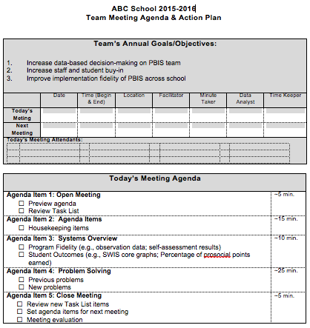
Purpose
Meeting demographics
Agenda Items
(with times)

Slide 74
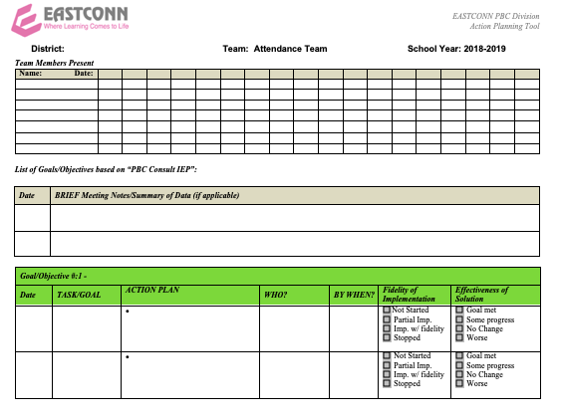
Meeting demographics
Purpose/agenda
Minutes
Action items

Slide 75
Action Planning
Precise Problem Solving
Meeting Foundations
Meetings that Work

Slide 76
Precise Problem Solving
Precise Problem Solving
To improve meeting effectiveness

Slide 77
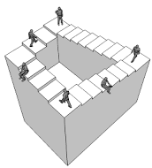
People aren’t tired from solving problems – they are tired from solving the same problem over and over.
Notes:
TIPS came about not because people were tired of solving problems – many teams like identifying areas for improvement and are good at coming up with solutions – but were tired of solving the same problem over and over. In September your team identifies that the hallways are a problem, put a bunch interventions in place over the year, and in May are still talking about the problems in the hallway. Spending a lot of time and energy on the problem, but the problem hasn’t been solved.

Slide 78

Defining the Problem
“If I had 60 minutes to solve a problem, I’d spend 55 minutes defining it, and 5 minutes solving it.”
- Albert Einstein

Slide 79
Start with Primary Problem Statements
Our school has a high number of absences.
Then use data to define the 6 WH Questions to redefine the problem into a Precise Problem Statement.
Move to Precise Problem Statements
Starting in September, students in K have high rates of chronic absenteeism. A majority of these students are either staying home due to illness (30%) or traveling to visit relatives in their family’s native country (15%). The chronic absenteeism rate for K students in September is 23%.
Notes:
A big picture look at social behaviors at a school. We start with a primary statement that identifies we have a problem and then move to a precise statement so that we can align solutions that fit with the contextual factors around the problem.

Slide 80
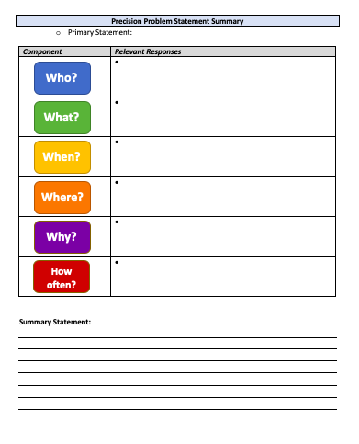
Precision Problem Statement

Slide 81
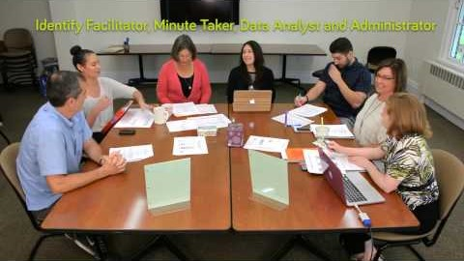
Meeting Foundations In Action

Slide 82
Activity: Meeting Foundations, Action Planning, and DBDM
Group Discussion (15 minutes)
Action Plan with your co-coach (15 minutes)
Group Discussion
  What was your impression of the meeting video?
  What are your Tier 1 Team’s strengths and areas of growth with regard to meeting foundations, action planning, and DBDM?
With your co-coach:
  Identify action planning items for your team
  Do you need role clarifications?
  Are you looking at data within your first 5 minutes?
  Is your action planning process working?

Slide 83
Advance Organizer
Introduction and Focus on Coaching
Quick Review and Focus on Year 3 training activities
Coaching Self-Assessment and Reports
Share information on implementation of the PBIS Framework
Advanced Skill Building
Efficient Data Systems with TIPS
Preparation for Next Training Event

Slide 84
MA PBIS Academy Year 3 Activities
Training Day 10
  Guest Speaker on School Climate: Dr. Tamika La Salle
  Roundtable Discussions w/School Leaders
  Action Planning
Training Day 11
  Guest Speaker on Sustainability: Dr. Adam Feinberg
  Poster Session
  Action Planning

Slide 85
Integrating School Climate and PBIS
Is there a way to use both subjective data (school climate perceptions) and objective data (PBIS outcome indicators) to support data-based decision making for school improvement efforts?
Objective
Subjective
School Climate within the Context of PBIS
PBIS
SCHOOL CLIMATE

Slide 86
Creating a Positive School Climate
From a PBIS perspective, a positive school climate results from school environments that are:
  Predictable
    Common language
    Common vision (understanding expectations)
    common experience
  Positive
    Regular recognition for positive behavior
  Safe
    Violence and disruptive behavior is not tolerated
  Consistent
    Adults use similar expectations

Slide 87
Building a Framework…
PBIS
Safe
Predictable
Positive
Consistent

Slide 88
Building a Framework…
PBIS
Safe
Predictable
School Climate
Fairness/Equity
Positive
Consistent

Slide 89
Building a Framework…
PBIS
Safe
Predictable
School Climate
Fairness/Equity
Positive
Consistent
Safety

Slide 90
Building a Framework…
PBIS
Safe
Predictable
School Climate
Fairness/Equity
Positive
Consistent
Safety
Order & Discipline
Order & Discipline

Slide 91
Building a Framework…
PBIS
Safe
Predictable
School Climate Perceptions
Fairness/Equity
Positive
Consistent
Safety
Order & Discipline
Order & Discipline
PBIS/SCHOOL
Attendance
Suspensions/Referrals
Disproportionality Data
Discipline Referrals
Student Outcomes

Slide 92
School Climate Survey
Teaching & Learning
School Climate
Safety
Institutional Environment/Structure
“Teachers at my school have high standards for achievement
•Support for Learning
“I know an adult I can talk to if I need help”
“I have been bullied or threatened by other students”
“I feel successful at school”
“I feel safe in my school”
Relationships
•Peer/adult relations
•Connectedness (professional relationships)
•Parent Involvement
•Order and Discipline
Peer Victimization
“I Have worried about other students hurting me”
“Instructional materials are up to date and in good condition”
“Students in my school take pride in keeping the school building clean”
•Physical Environment
Notes:
This is a guide- the list of potential factors is exhaustive
Reflects some or most of the commonly identified categories related to school climate
There are 4 major dimensions/area of school climate. Each major area contains several subdimensions that are more specific
Identified by Nscc
List is not exhaustive- potentially innumerable amount of influences on school climate- this provides a guide
Safety: referring to the physical and emotional safety of students and the rules and procedures in place to ensure student safety;
–Relationships: student social support from educators and parents, the level of respect students have for others, school and community engagement, and student and parental leadership;
Student social support from teachers, administrators, counselors, parents etc- respect for one another- student and parent leadership- community engagement.
–Teaching and Learning: a positive and professional student-teacher-school relationship, social and emotional skills training, civic education, and positive support for learning; and
Positive and professional student-teacher relationships= social and emotional skills- social learning- civic education- positive support for learning
One of six goals is to promote strong character and citizenship
–Institutional Environment: the physical environment of the school.

Slide 93
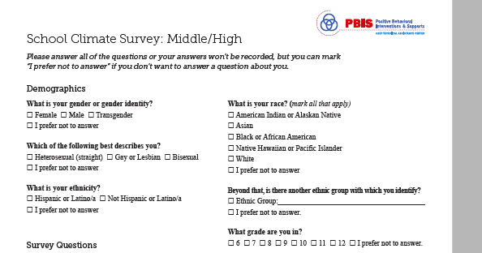
School Climate Survey
Notes:
I always end up foung that

Slide 94
Activity:
Getting Ready for Team Training
Work with partner coach for 15 min
Review implementation guidelines and preview slides just presented.
Discuss above with a partner
  Is there content you’d like re-explained?
  What key questions do you have?
  What questions/challenges do you anticipate from your team members?
Share key highlights (1 min. reports)

Slide 95
Review of
Coaching SWPBIS

Slide 96
Main Coaching Objectives
By the end of today’s meeting, you will be able to…
  …Describe your role as a coach.
  …Articulate the basic elements of SWPBS.
  …Identify resources for SWPBS.
  …Problem solve roadblocks in coaching
  …Facilitate your team’s activities at the next SWPBS team training.

Slide 97
What roles do coaches play?
Coaching Roles
Facilitate
Content Knowledge
Communicate
  Team meetings
  Activities at training events
  Implementation
  Local PBS expert
Positive “nag”
Link to resources (e.g., nepbis.org, www.pbis.org)
  Share advanced content with team
  Share information at faculty meetings
I.A.ii

Slide 98
Consider Tattoos!
4 PBIS Elements
School Systems
Supporting Social Competence &
Academic Achievement
OUTCOMES
School-wide
Classroom
SWPBIS
SYSTEMS
DATA
Supporting
Decision
Making
Supporting
Staff Behavior
Non-classroom
Family
PRACTICES
Tertiary Prevention:
Specialized
Individualized
Systems for Students with High-Risk Behavior
~5%
Student
Supporting
Student Behavior
Primary Prevention:
School-/Classroom-
Wide Systems for
All Students,
Staff, & Settings
~15%
Secondary Prevention:
Specialized Group
Systems for Students with At-Risk Behavior
~80% of Students

Slide 99
TAKE AWAY MESSAGE
You’re a coach!
Prepare for the next training event, and use your resources to guide your team’s activities (both at training and at school).

