Slide 1
Coaching School-Wide Positive Behavioral Interventions and Supports (SWPBIS)
Northeast PBIS (NEPBIS) Coaches Training
Coaching Day 4
INSERT TRAINER NAMES
with support from Brandi Simonsen, Jen Freeman,
Susannah Everett, Adam Feinberg, & George Sugai
Notes:
Add trainer names for your event

Slide 2

Advance Organizer
Introduction and Focus on Coaching
Quick Review and Focus on Problem Solving in Tier 1
Coaching Self-Assessment and Reports
Re-introduce Yourself and Your school
Advanced Skill Building
Using Data to Drive Decision Making
Preparation for Next Training Event

Slide 3
Main Coaching Objectives
By the end of today’s meeting, you will be able to…
  …Describe your role as a coach.
  …Articulate the basic elements of SWPBS.
  …Identify resources for SWPBS.
  …Problem solve roadblocks in coaching
  …Facilitate your team’s activities at the next SWPBS team training.

Slide 4
Training Expectations:
RESPECT…
SELF
Self-monitor (Are you participating? Engaged as a learner? Talking during allotted times?)
Stretch, break, stand as needed
OTHERS
Cell phones (inaudible): Converse in lobbies and breaks
ENVIRONMENT
Recycle
Work as a team: Room for every voice, reinforce participation
Maintain neat working area

Slide 5


Tools!
nepbis.org
pbis.org
Coaching SWPBIS Workbook and Appendices
Evaluation Plan
Action Plan

Slide 6

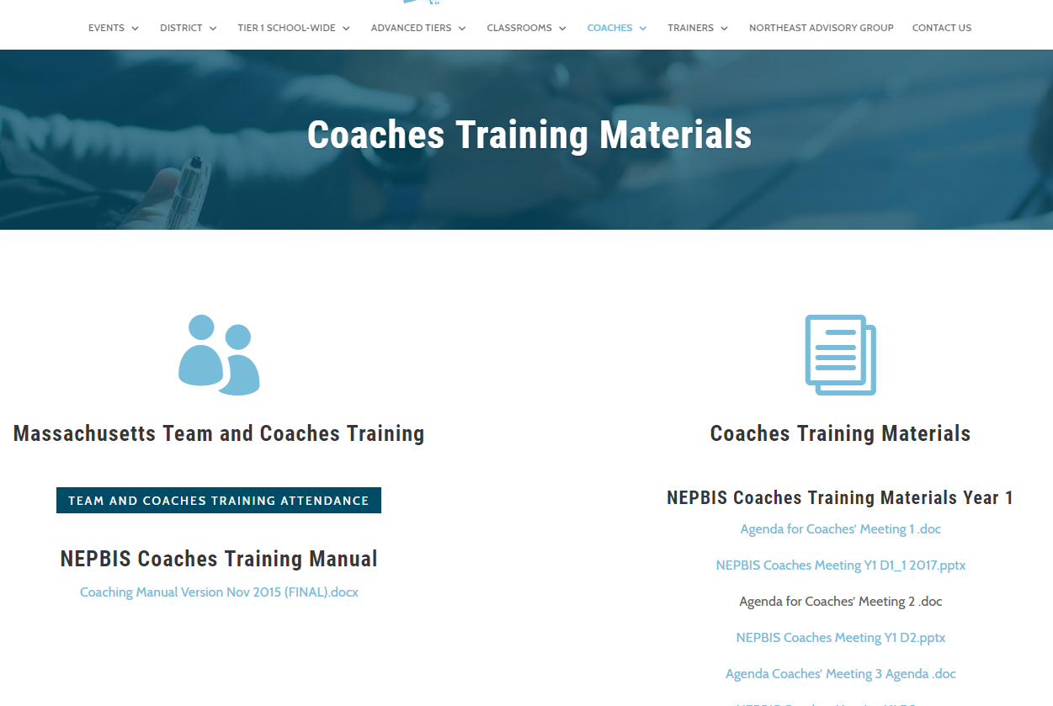
Activity:
Please Enter Attendance
1 min
Please login on nepbis.org, go to the coaches’ tab, and click on the Team Training Attendance Link. Follow prompts to enter team attendance.

Slide 7





Legend
New Content
Review
Guidelines
+Ex
-Ex
Training Organization
Activity

Slide 8


Legend
Section Header (I.A)
Chapter Header (e.g., I)

Slide 9
Advance Organizer
Introduction and Focus on Coaching
Quick Review and Focus on Problem Solving in Tier 1
Coaching Self-Assessment and Reports
Re-introduce Yourself and Your school
Advanced Skill Building
Using Data to Drive Decision Making
Preparation for Next Training Event

Slide 10
Overview of Coaching in swpbis
(Chapter i)

Slide 11
What roles do coaches play?
Coaching Roles
Facilitate
Content Knowledge
Communicate
  Team meetings
  Activities at training events
  Implementation
  Local PBS expert
Positive “nag”
Link to resources (e.g., nepbis.org, www.pbis.org)
  Share advanced content with team
  Share information at faculty meetings
I.A.ii
Notes:
Move quickly through review content (just hit the highlights). Then, for each item, ask questions about how its going and use this to reinforce, correct, or problem solve as appropriate.

Slide 12
Basics of swpbis for coaches
(Chapter Ii)

Slide 13

Critical Features of PBIS
Supporting Culturally Equitable
Social Competence & Academic Achievement
OUTCOMES
Supporting
Culturally
Knowledgeable
Staff Behavior
Supporting
Culturally Valid
Decision
Making
SYSTEMS
DATA
(Vincent, Randal, Cartledge, Tobin, & Swain-Bradway, 2011; Sugai, O’Keefe, & Fallon 2012 ab)
PRACTICES
I.C
Supporting Culturally Relevant
Evidence-based Interventions
Notes:
Move quickly through review content (just hit the highlights). Then, for each item, ask questions about how its going and use this to reinforce, correct, or problem solve as appropriate.

Slide 14
GENERAL IMPLEMENTATION PROCESS
Team
Agreements
Data-based
Action Plan
Evaluation
Implementation
I.C.iv
Notes:
Move quickly through review content (just hit the highlights). Then, for each item, ask questions about how its going and use this to reinforce, correct, or problem solve as appropriate.

Slide 15
Self-Check:
Effective Leadership Team
Work as team for 10 min
Review guidelines for team composition.
  Administrator
  Grade/Department Representation
  Specialized Support
    (e.g., Special Educator, Counselor, School Psychologist, Social Worker, etc.)
  Support Staff
    (e.g., Office, Supervisory, Custodial, Bus, Security, etc.)
  Parent (who is not also a staff member)
  Community
    Mental Health, Business
  Student
Ensure you have 1-2 parents on your leadership team this year
Review relevant items to your action plan and add/adjust as needed to ensure your team is ready to work this year (and in the future)!

Slide 16
Family Engagement Rubric
Review the Family, School, and Community Partnership Fundamentals (http://www.doe.mass.edu/boe/sac/parent/FSCPfundamentals.pdf)
Complete self assessment as a team
Add relevant items to your action plan
New this year! You will complete this with your team each time you complete the TIC
See Appendix M
Complete during Team Action Planning Time TODAY
Notes:
Add this to the appendix

Slide 17
coaching team meetings
(Chapter iII)

Slide 18
Facilitating Effective Team Meetings
(see details in Coaches’ Workbook)
Be prepared and expect others to be as well
Begin on time by reviewing agenda and outcomes
Involve everyone
Use data to clearly and quickly define a problem before beginning problem solving
Create an action plan
At the end of the meeting debrief
After the meeting, electronically publish meeting minutes
III.A.i

Slide 19
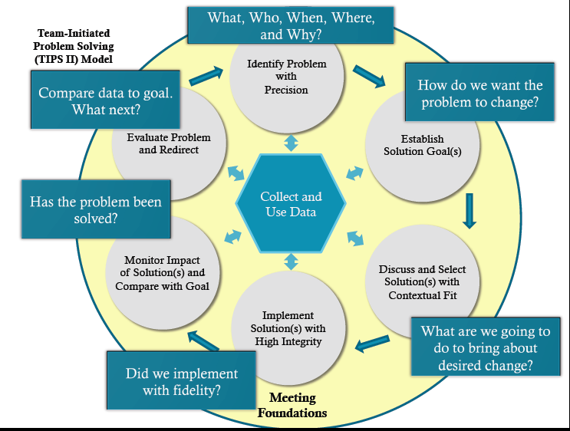
Consider the TIPS Model
(see additional resources for TIPS on pbis.org)
http://www.pbis.org/common/cms/files/Forum12/E2_TIPS_Teaser.pdf
III.A.i

Slide 20
Using Data Effectively
(see details in Coaches’ Workbook)
Collect appropriate and relevant data
Organize the data in a user-friendly manner that aides comprehension
Review and analyze the data at least monthly to guide decision-making
Make data available to all stakeholders
Provide staff development to all staff to use data to inform decision making
Use data analysis to inform decisions related to school-wide programs, classroom-based instructional practices, and student-specific interventions
Review data collection procedures and practices to ensure that data accurately reflect school events
Collect data on extent to which practice or intervention is being implemented accurately and fluently (implementation fidelity)
III.A.ii

Slide 21
Advance Organizer
Introduction and Focus on Coaching
Quick Review and Focus on Problem Solving in Tier 1
Coaching Self-Assessment and Reports
Re-introduce Yourself and Your school
Advanced Skill Building
Using Data to Drive Decision Making
Preparation for Next Training Event

Slide 22
Activity:
Coaching Self-Assessment
Work individually (or with partner coach) for 15 min
Review and Update Coaching Self-Assessment
Develop an Action Plan to address areas for growth from your self assessment
Present 1-2 “strengths” and 1-2 “concerns or challenges” (1 min. reports)

Slide 23
A reminder you’ll see throughout to help us remember the role.
Coach

Slide 24
Coaching Reports
(+ or Δ)
Coach
      1-2 Details to introduce yourself
      1-2 Strengths
      (with respect to coaching)
      1-2 Concerns or challenges
      (with respect to coaching)

Slide 25
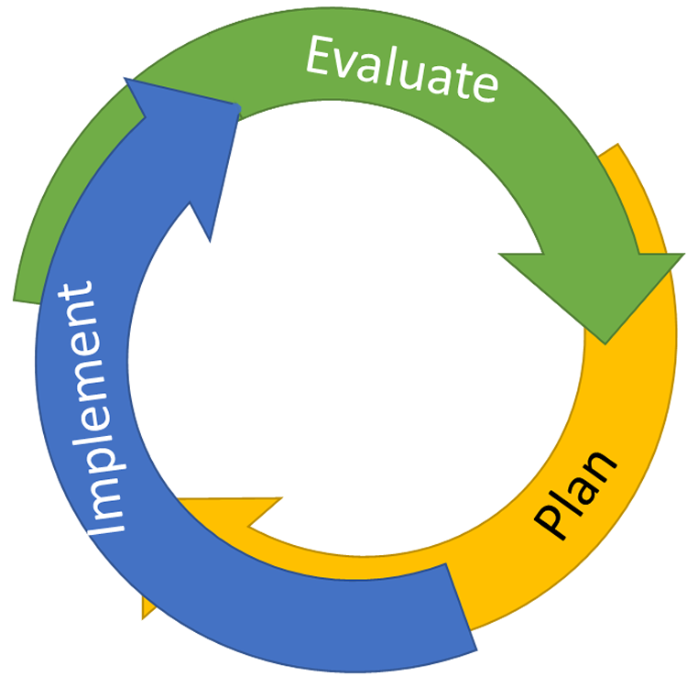
Continuous Quality Improvement
Identify problems with precision
DATA
Establish goal(s)
Develop solution(s)
Notes:
Trainer Note: We want to interrupt the traditional cycle of admiring the problem, by talking and talking about the problem before quickly launching into determining solutions.
We can do this by building a system for improved decision making.

Slide 26

Improving Decision Making
Problem
Solution
Problem
Problem Solving
Solution
Action Planning

Slide 27
Continuous Quality Improvement
Reassess and revise solution(s) as needed
Identify problems with precision
Monitor outcomes and compare
to goal(s)
DATA
Establish goal(s)
Develop solution(s)
Implement solution(s) with integrity and fidelity
Notes:
Trainer Note: We want to interrupt the traditional cycle of admiring the problem, by talking and talking about the problem before quickly launching into determining solutions.
We can do this by building a system for improved decision making.

Slide 28
To effectively use data to drive decision making,
use your evaluation plan…
DISTRICTS/SCHOOLS IN TRAINING |  |  | SCHEDULE
Purpose | Measure | Function | Year 1 Training |  | Year 2 Training
 |  |  | Winter | Spring | Fall | Winter | Spring
Capacity Building—District Level | District Capacity Assessment (DCA) | Completed by district leadership team (with the support of a trained facilitator) to assess district capacity and to guide Action Planning. |  | X |  |  | X
Fidelity of Implementation—Building Level | PBIS Tiered Fidelity Inventory (TFI) | Leadership team self-evaluation (with support of external coach) to assess the critical features of PBIS across Tiers I, II, and III. |  | X | X |  | X
Progress Monitoring—Building Level | Self-Assessment Survey (SAS) | Used by school staff for initial and annual assessment of effective behavior support systems in their school and to guide Action Planning. |  | X |  |  | X
Progress Monitoring—Team Level | Team Implementation Checklist (TIC) | A self-assessment tool that serves as a multi-level guide for creating School-Wide PBIS Action Plans and evaluating the status of implementation activities. | X | X | X | X | X
School Climate | Georgia School Climate Surveys | An annual survey that assesses student (grades 3-12), teacher, and parent perceptions of school climate. The middle and high school surveys also include items about adolescent drug/alcohol/tobacco use, self-harm ideation and behaviors, school dropout, and parental involvement. The survey provides information to determine training support needs related to school climate, safety, and violence prevention. |  | X | X
Student Outcomes | School-wide Information System (SWIS) | Office discipline referrals (ODR) provide data for monthly team reviews and decision-making by teachers, administrators, and other staff to guide prevention efforts and Action Planning. | Weekly | Weekly | Weekly | Weekly | Weekly
…and tools available at:

Slide 29

What is most related to high sustainability?
The frequency that data are presented to all schools staff.
(McIntosh, Kim, Pinkelman,, Rasplica,, Berg, & Strickland-Cohen, in press)

Slide 30
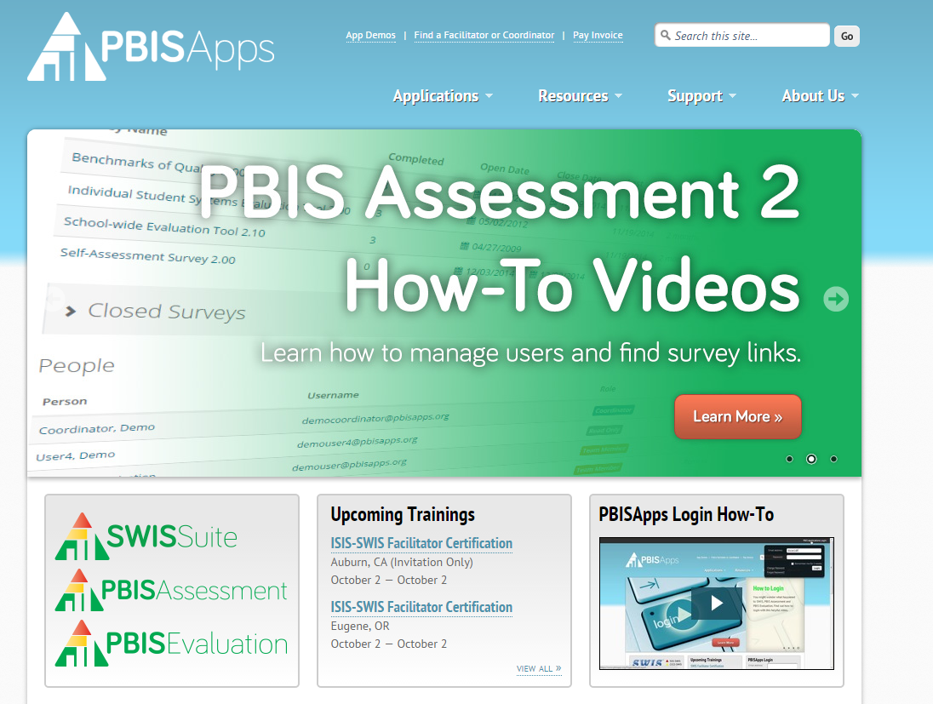
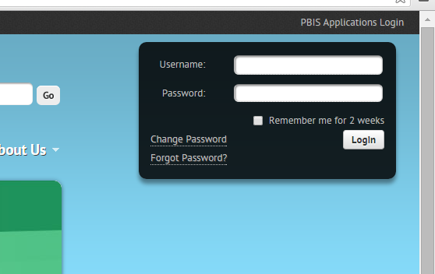
Data-Driven Problem Solving
We are about to engage in a series of activities that require you to review and use your school’s data on pbisapps.org
  Log on to pbisapps.org
  Go to closed survey windows
  Choose a survey (e.g., Self Assessment Survey, Team Checklist)
  Choose View Reports
Remember different types of reports (total, subscale, item reports)

Slide 31
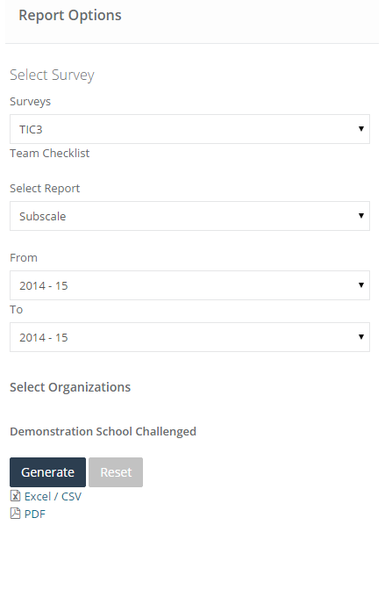
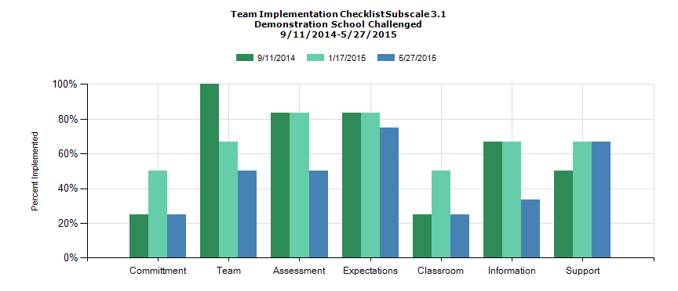
Example: Team Implementation Checklist Subscale Report

Slide 32

Evaluation Questions
What are the critical features of data review activities that will lead to continued improvements in student outcomes?
What are the necessary behaviors of school personnel that will increase the sustainability of data review practices?
adapted from:

Slide 33
“The critical mechanism by which a practice sustains is fidelity.”
(McIntosh, Filter, Bennett, Ryan, & Sugai, 2010; p.10)
adapted from:
Notes:
Trainer Notes:
Please be sure to read the rest of the quote to the coaches.
This quote comes from the article Principles of sustainable prevention: Designing scale-up of school-wide positive behavior support to promote durable systems. The article goes on to state, “a practice can be said to sustain if school personnel continue implementing enough critical features to criterion that effects are still observed. An effort in which school personnel continue to implement with low fidelity, or implement only non-critical features, does not meet the definition of sustainability. The target for sustainability initiative is therefore the behavior of school personnel, and targeting sustainability requires targeting the environment of the adults in the school.”
Then pose the questions on the next slide to the coaches to set them up for the discussion activity that follows the questions.

Slide 34
Activity:
Review Fidelity & Outcome Data
Work individually (or with partner coach) for 60 min
Log-on to pbisapps.org
Review your fidelity data (SAS, TIC, TFI).
  Identify 2-4 key strengths and 2-4 need areas
  Review your plan for administering surveys again this year (note intended timeline on evaluation plan)
Review your school’s ODR data.
  Identify and precisely define 1-2 problems
  Review your plan for using ODR data to monitor progress
Develop plan for sharing data with team and faculty/staff
Update your action plan
Share 2 min reports (strengths, need areas, and questions).
If you do not presently have ODR data to review, use this time to develop an action plan to secure a user-friendly interface.

Slide 35
Monitoring Outcomes: SWIS Drill Down

Slide 36

Drill Down Approach
The Drill Down approach starts with the big picture and looks for potential “red flags” identifying a problem that might need to be addressed.
What is our current reality or big picture?
Is there a problem (red flag)?
What is the precise context & function of the problem?
  What, where, when, who, how often, why?
  Be efficient, don’t “drown” by getting too specific

Slide 37
Primary vs. Precision Statements
Primary Statements
Precision Statement
Too many referrals
September has more suspensions than last year.
Gang behavior is increasing.
The cafeteria is out of control.
Student disrespect is out of control.
There are more ODRs for aggression on the playground than last year. These are most likely to occur during first recess, with a large number of students, and the aggression is related to getting access to the new playground equipment.
Notes:
Trainer Notes:
Here are examples of several primary statements and a precision statement.

Slide 38
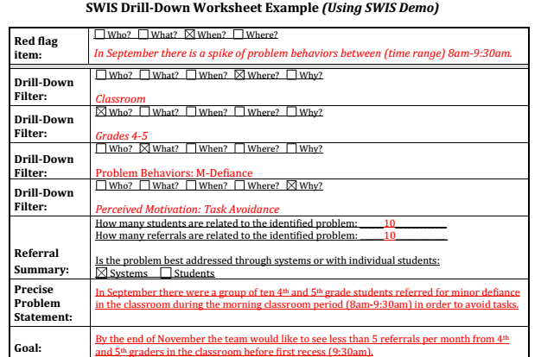
Drill Down Worksheet

Slide 39
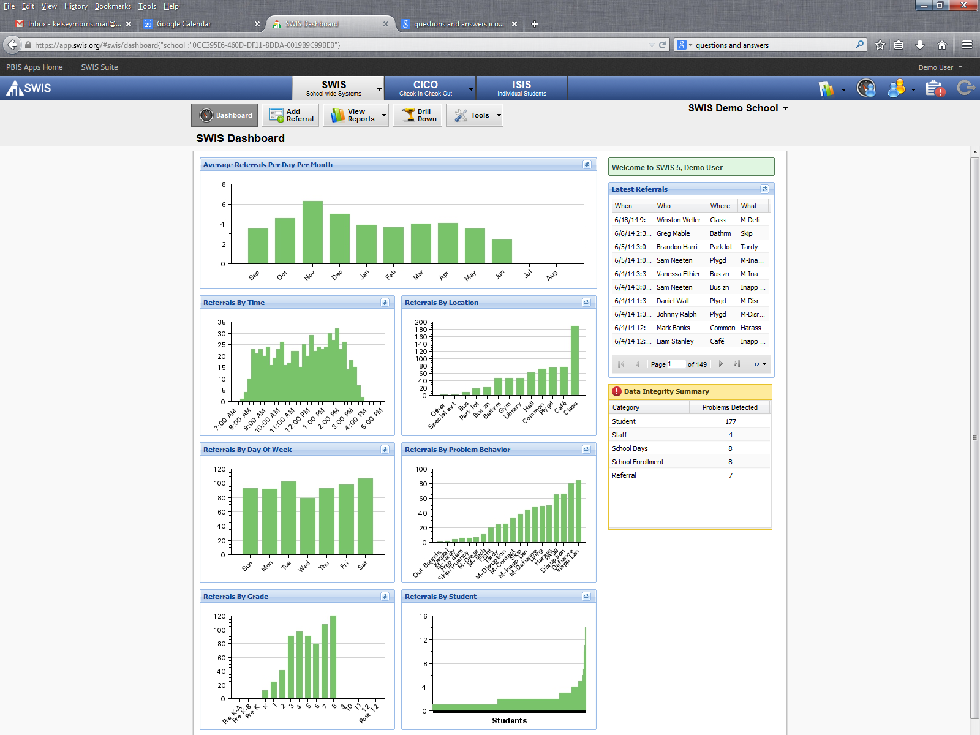




Using SWIS Data to Solve Problems
SWIS Dashboard
summarizes the current school year.
It provides a bird’s-eye view.
Notes:
The SWIS Dashboard is a way to check the temperature, to check the blood pressure, to see what problems or “red flags” may exist. It keeps things at the school-wide level.
For those items off the dashboard that need a deeper level of inquiry, SWIS assists by drilling down into the data based upon various filters. Data can then be analyzed based upon action taken, motivation, grade level, others involved, date range, gender, ethnicity, IEP status, time range, etc.
The use of these filters can be helpful when trying to isolate problems and develop solution plans.
Caution: The Dashboard ONLY provides a summary for the full school year. Looking at information beyond the first month of school, the SWIS Dashboard will not provide the most recent summary of referrals. For more recent data or specific time ranges, we need to go to the Core Reports and choose the specific date range in which we are interested (e.g., since the last Tier I meeting or the last 6-8 weeks).

Slide 40
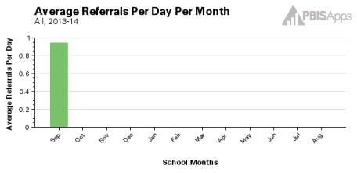
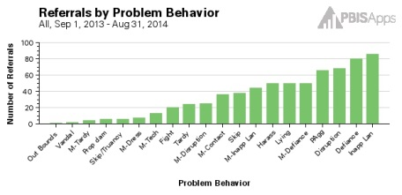
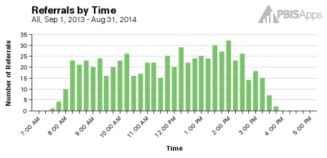
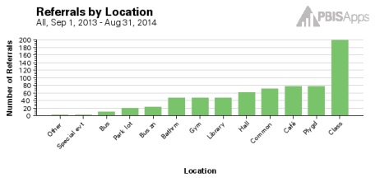
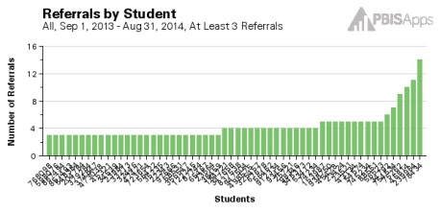
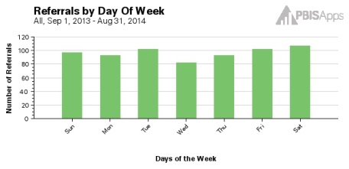
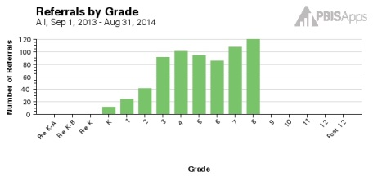
Using SWIS Data to Solve Problems
SWIS Core Reports
Helps check the current vital signs of the school
Helps identify areas for further inquiry
Notes:
The SWIS Core Reports allow teams to check the temperature and blood pressure, to see what problems or “red flags” may exist currently (e.g., since last meeting). It keeps things at the school-wide level and relevant to current needs.
For those items from the dashboard that need a deeper level of inquiry, SWIS assists by drilling down the data based upon various filters. Data can then be analyzed based upon action taken, motivation, grade level, others involved, date range, gender, ethnicity, IEP status, time range, etc.
The use of these filters can be helpful when trying to isolate problems and develop solution plans.

Slide 41
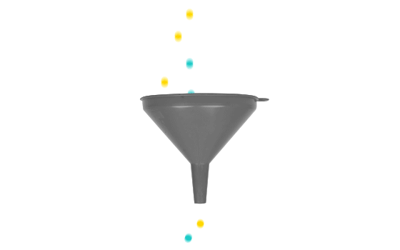
Creating a Precise Problem Statement
System Update/
Big Picture
Primary
Use DATA to define…
a PRIMARY summary statement
a PRECISE problem statement
Red Flag
then
Identify Problem
with
Precision
Notes:
To start this process, we are going to get a system update or a “big picture” (click) of what’s going on in our school.
From there, we should be able to easily come up with a few primary summary statements. (Click)
These are very general and give us a direction, but they aren’t specific enough to act upon. E.g. The hallway is crazy. The cafeteria is too noisy. Dismissal is complete chaos.
(Click) These are red flags that need our attention!
From here, we can start to craft a more specific problem statement. (Click) Once we drill down and identify our problem with precision, we can start to take action steps to solve it.

Slide 42

Creating a Precise Problem Statement
Step 1: Look at overall picture
  What are the levels, trends, peaks, and/or valleys?
  How does this year compare with last year?
  How do our data compare with national/regional norms?
  How do our data compare with our preferred/expected status?
Step 2: Filter to a more precise problem statement by adding in additional data/“clues”
Notes:
Digging into the data will help us get to that precise problem statement. If you were to tell a principal that the hallways are crazy, the principal or the leadership team would be able to do very little to try and solve such a generalized problem. But by adding additional clarifying data such as who, what, when, where, and why…. we can get to a problem that is much more manageable. The 6th graders are running in the hallway between 11:15 and 11:20 in order to get into the lunch line ahead of the 5th graders.

Slide 43

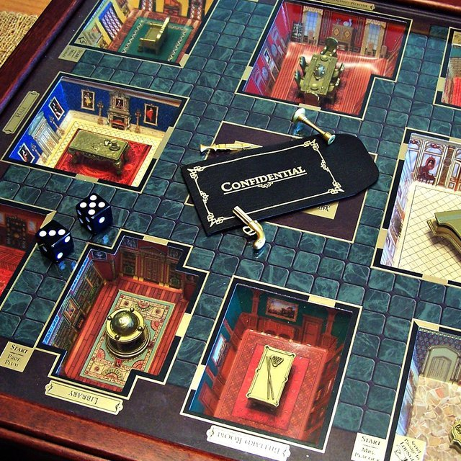
Drilling Down and The Game of Clue
When you drill down into your data, you are like a detective who follows clues to isolate a problem context and function until it is precise but still socially important to address.
Notes:
Remember that your role is like a detective. You find one contextual clue that seems problematic and you slowly drill deeper until you have isolated the who, what, when, where, and how often (context) and finally the “why” …the perceived motivation reported by staff. Just like in the game of Clue, you start off with a big problem, and you eventually sort through all of the data you collect until you figure it out.

Slide 44

Drill Down Orientation
Notes:
Alternative link to video: https://screencast-o-matic.com/watch/cFit08FLSx
**If audio is not available at your coaching location, please demonstrate the drill down process in the SWIS demo account.

Slide 45
Continuous Quality Improvement
Reassess and revise solution(s) as needed
Identify problems with precision
Monitor outcomes and compare
to goal(s)
DATA
Establish goal(s)
Develop solution(s)
Implement solution(s) with integrity and fidelity
Notes:
Trainer Note: We want to interrupt the traditional cycle of admiring the problem, by talking and talking about the problem before quickly launching into determining solutions.
We can do this by building a system for improved decision making.

Slide 46
Defining Goals
Define the problem with precision
  Context and function
Measure the problem (current level or amount)
Define the goal
  What would be “good enough” to move to another problem?
Use the goal to guide the solution
  How can we move from here (current reality) to there (desired outcomes)?
Notes:
The problem-solving process is multi-faceted. We do not just want to make snap judgments based upon perception alone. Acting solely on our day-to-day experiences, feelings, and assumptions is ineffective. Best practice involves using data to make informed decisions.
Best practice involves:
Using data to define a problem with precision
Use the data to define the current measure of the problem. How many? How often?
Use the current measure of the problem to define what is considered “good” or what a SMART goal would be.
Use the SMART goal to guide solution steps.
SMART goals are: Specific, Measurable, Achievable, Realistic, and Timely

Slide 47
Defining Goals
Problem | Current Status | Goal
Many students are leaving garbage in the cafeteria resulting in conflict and ODRs. The behavior is maintained by task avoidance. | 22 ODRs per month from the cafeteria Heidi (cafeteria supervisor) rates cafeteria as “1” (low) on a 1-5 scale of cleanliness. | Less than 5 ODRs per month from the cafeteria. Heidi rates cafeteria cleanliness as 4 or greater for two weeks in a row.
Notes:
***This slide is designed to be an example and to be moved through quickly.***
I Do. Click to remove boxes that cover current status and goal.
Example Think Aloud:
“OK, I first define my problem with precision. I know that many students are leaving garbage in the cafeteria because it is easy to do and this results in conflict with adults and ODRs from the cafeteria supervisors.
(Click) I know that we have an average of 22 ODRs per month from the cafeteria, and the supervisors rate the cleanliness at a low (1 out of 5). That’s my level or current status .
(Click) With this information, I can design an appropriate goal. We need to decrease to less than 5 ODRs per month from the cafeteria, and we need cafeteria supervisors to rate the cleanliness at a 4 or higher for two consecutive weeks.”
First, define the problem with precision (Level/amount). Then, define what would be a reasonable goal to work towards. Once the goal is defined, use the goal to guide the solution development.

Slide 48
Defining Goals
Problem | Current Status | Goal
7th grade students are tardy for 5th period classes after their lunch. Tardiness is rewarded by peer attention and no consequences in the classroom. | 5 out of 6 of the 7th grade teachers indicate they have more than 3 students tardy on a regular basis for 5th period. Estimated 18, 7th grade students tardy for 5th period last week. | Consistent reporting of tardiness. Fewer than 10 referrals for tardiness in the 7th grade per month
Notes:
***This slide is designed to be an example and to be moved through quickly.***
We Do. Give participants a chance to share aloud what the goals could be. Click to remove boxes that cover current status and goal.
Example Response:
“OK, I first define my problem with precision. I know that seventh grade students are tardy for their class right after lunch. They keep repeating this behavior because of a lack of consequences, and it gets attention from their peers.
(Click) Currently, 5 of the 6 seventh grade teachers say that on average, more than 3 students are regularly tardy, and we have about 18 seventh grade students who were tardy last week alone.”
Encourage participants to use the current level to identify what “good” would look like and identify an appropriate, SMART goal.
(Click) Here is what this school team chose.
SMART goals are: Specific, Measurable, Achievable, Realistic, and Timely

Slide 49
Defining Goals
Problem | Current Status | Goal
Phil is engaging in physical/verbal aggression toward 3 younger students during unstructured times. We believe this is maintained by social positives from his peer group and responses from the 3 students. | Phil has received 4 ODRs this week for bullying, teasing, or aggression. | ???
Notes:
***This slide is designed to be an example and to be moved through quickly.***
We Do. Give participants a chance to share aloud what the goals could be. Click to remove boxes that cover current status and goal.
Response:
“OK, again, I first define my problem with precision. I know that Phil is engaging in physical and verbal aggression during unstructured times. It is primarily directed at three younger students, and it keeps happening because he gets attention both from his peers and from the students he is targeting.
(Click) This week alone, he has received four office referrals for this behavior.”
Encourage participants to use the current level to identify what “good” would look like and identify an appropriate, SMART goal.
SMART goals are: Specific, Measurable, Achievable, Realistic, and Timely

Slide 50
Continuous Quality Improvement
Reassess and revise solution(s) as needed
Identify problems with precision
Monitor outcomes and compare
to goal(s)
DATA
Establish goal(s)
Develop solution(s)
Implement solution(s) with integrity and fidelity
Notes:
Trainer Note: We want to interrupt the traditional cycle of admiring the problem, by talking and talking about the problem before quickly launching into determining solutions.
We can do this by building a system for improved decision making.

Slide 51
Using Data to Build Solutions
Focus on prevention first. How could we reduce the situations that lead to these behaviors?
How do we ensure that students know what they SHOULD be doing when these situations arise?
How do we ensure that appropriate behavior is recognized?
How do we work to ensure that problem behavior is NOT being rewarded.
Are corrective consequences needed?
How will we know (a) if we are doing what we plan, and (b) if what we plan is working to benefit students?
Prevention
Teaching
Reward
Extinction
Corrective Consequence
Data Collection

Slide 52
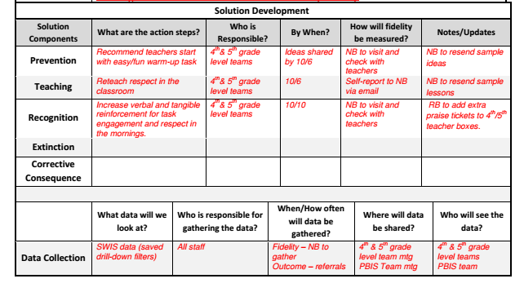

Slide 53
Activity:
Drilling Down into your Data
Work individually (or with partner coach) for 30 min
Use the Drill Down Worksheet to:
  Identify a “red flag”
  Drill down into your data
  Save the template
  Work on potential solutions that you can share with your team
Plan how you will incorporate Drill Down into your team’s data systems
  How often will Drill Down be completed?
  Who will summarize and present drill down data at team meetings?

Slide 54
Advance Organizer
Introduction and Focus on Coaching
Quick Review and Focus on Problem Solving in Tier 1
Coaching Self-Assessment and Reports
Re-introduce Yourself and Your school
Advanced Skill Building
Using Data to Drive Decision Making
Preparation for Next Training Event

Slide 55

Topics to Be Covered on Day 7
Quick Recap of Year 1 (Days 1-6) Training
Celebrate Accomplishments
Tier 1 SWPBIS: Problem Solving Critical Features
Preview of Additional Tier 1 Resources
  Equity
Action Planning

Slide 56
Activity:
Show, Tell, and Ask
Work as team for 10 min
Review your action plan and identify
  1-2 accomplishments
  1-2 questions or concerns shared by most members of team
You’ll have 5 min to show, tell, and ask!

Slide 57
Implementing SWPBS: Guidelines, Examples, &
Self-check Activities
For each element, we will review guidelines, present a few examples, and give your teams 5-10 min to perform a quick self-check. The following is an example for outcomes.

Slide 58
Critical Features of PBIS
Supporting Culturally Equitable
Social Competence & Academic Achievement
OUTCOMES
Supporting
Culturally
Knowledgeable
Staff Behavior
Supporting
Culturally Valid
Decision
Making
SYSTEMS
DATA
PRACTICES
Supporting Culturally Relevant
Evidence-based Interventions
Notes:
Use data
Focus on outcomes: Academic & behavior success
On-going evaluation
Ensure cultural and contextual fit
Invest in systems
Organize research-validated practices within a continuum
Instructional & preventative approach
Integration
Tier 1 for all

Slide 59
Focus on Outcomes
OUTCOMES
How do we develop outcome statements?
I.C.i

Slide 60
Guidelines for Good Outcomes
OUTCOMES
Based on data
Locally important and meaningful
Applicable to all (culturally equitable)
  Students’ social competence and academic achievement
  Staff implementation of critical skills
Observable and measurable
Written as a goal
I.C.i

Slide 61
Example Outcome Statements
During the first semester of PBIS implementation, staff members will implement PBIS with fidelity, as measured by meeting criteria on the Tiered Fidelity Inventory.
As a result of implementing PBIS during the 20XX-20XY school year, ODR data will decrease by __% relative to that same period the prior year.
As a result of implementing PBIS, staff, student, and parent surveys will indicate improved overall school climate (or target specific items related to acknowledgement, respect, etc.) as measured by an improvement of __ points on the Georgia Brief School Climate Surveys.

Slide 62
Self-Check:
Relevant Measurable Outcomes
Work as team for 10 min
Review your 1-3 observable and measurable outcome statements for your school.
Check to see outcomes reflect guidelines and include critical features illustrated by examples.

Slide 63
Getting Started with SWPBIS
Establish an effective leadership team
Develop brief statement of behavioral purpose
Identify positive SW behavioral expectations
Develop procedures for teaching SW expectations
Develop procedures for teaching class-wide expectations
Develop continuum for strengthening appropriate behavior
Develop continuum for discouraging violations of expectations
Develop data-based procedures for monitoring
Develop systems to support staff
Build routines to ensure on-going implementation
We’ll use a similar process to problem solve each step of “Getting Started.” Here’s an example for Step 1.

Slide 64
Getting Started with SWPBIS
Establish an effective leadership team
Develop brief statement of behavioral purpose
Identify positive SW behavioral expectations
Develop procedures for teaching SW expectations
Develop procedures for teaching class-wide expectations
Develop continuum for strengthening appropriate behavior
Develop continuum for discouraging violations of expectations
Develop data-based procedures for monitoring
Develop systems to support staff
Build routines to ensure on-going implementation
How will we play together?
SYSTEMS
II.B.i

Slide 65
Guidelines for Team Composition
SYSTEMS
Representative of school/community demographics
1-2 individuals with behavior/classroom management competence
Administrator as active member
Schedule for presenting to whole staff at least monthly
Schedule for meeting at least monthly
Integration with other behavior related initiatives and programs
Appropriate priority relative to school/district goals
Rules/agreements established
Schedule for annual self-assessments (see list)
Coaching support (school/district/region)

Slide 66
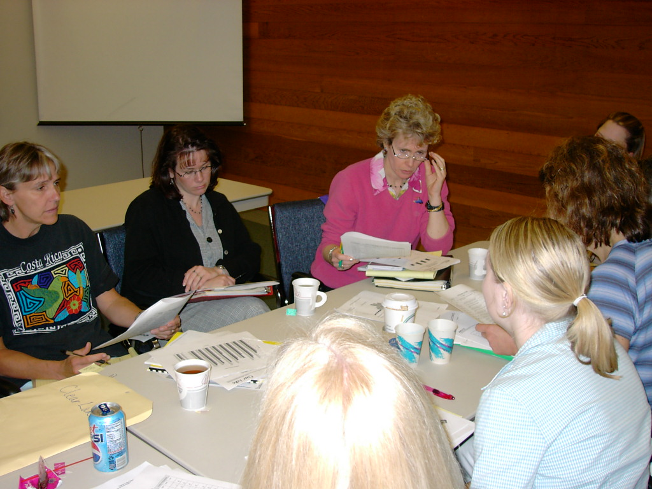
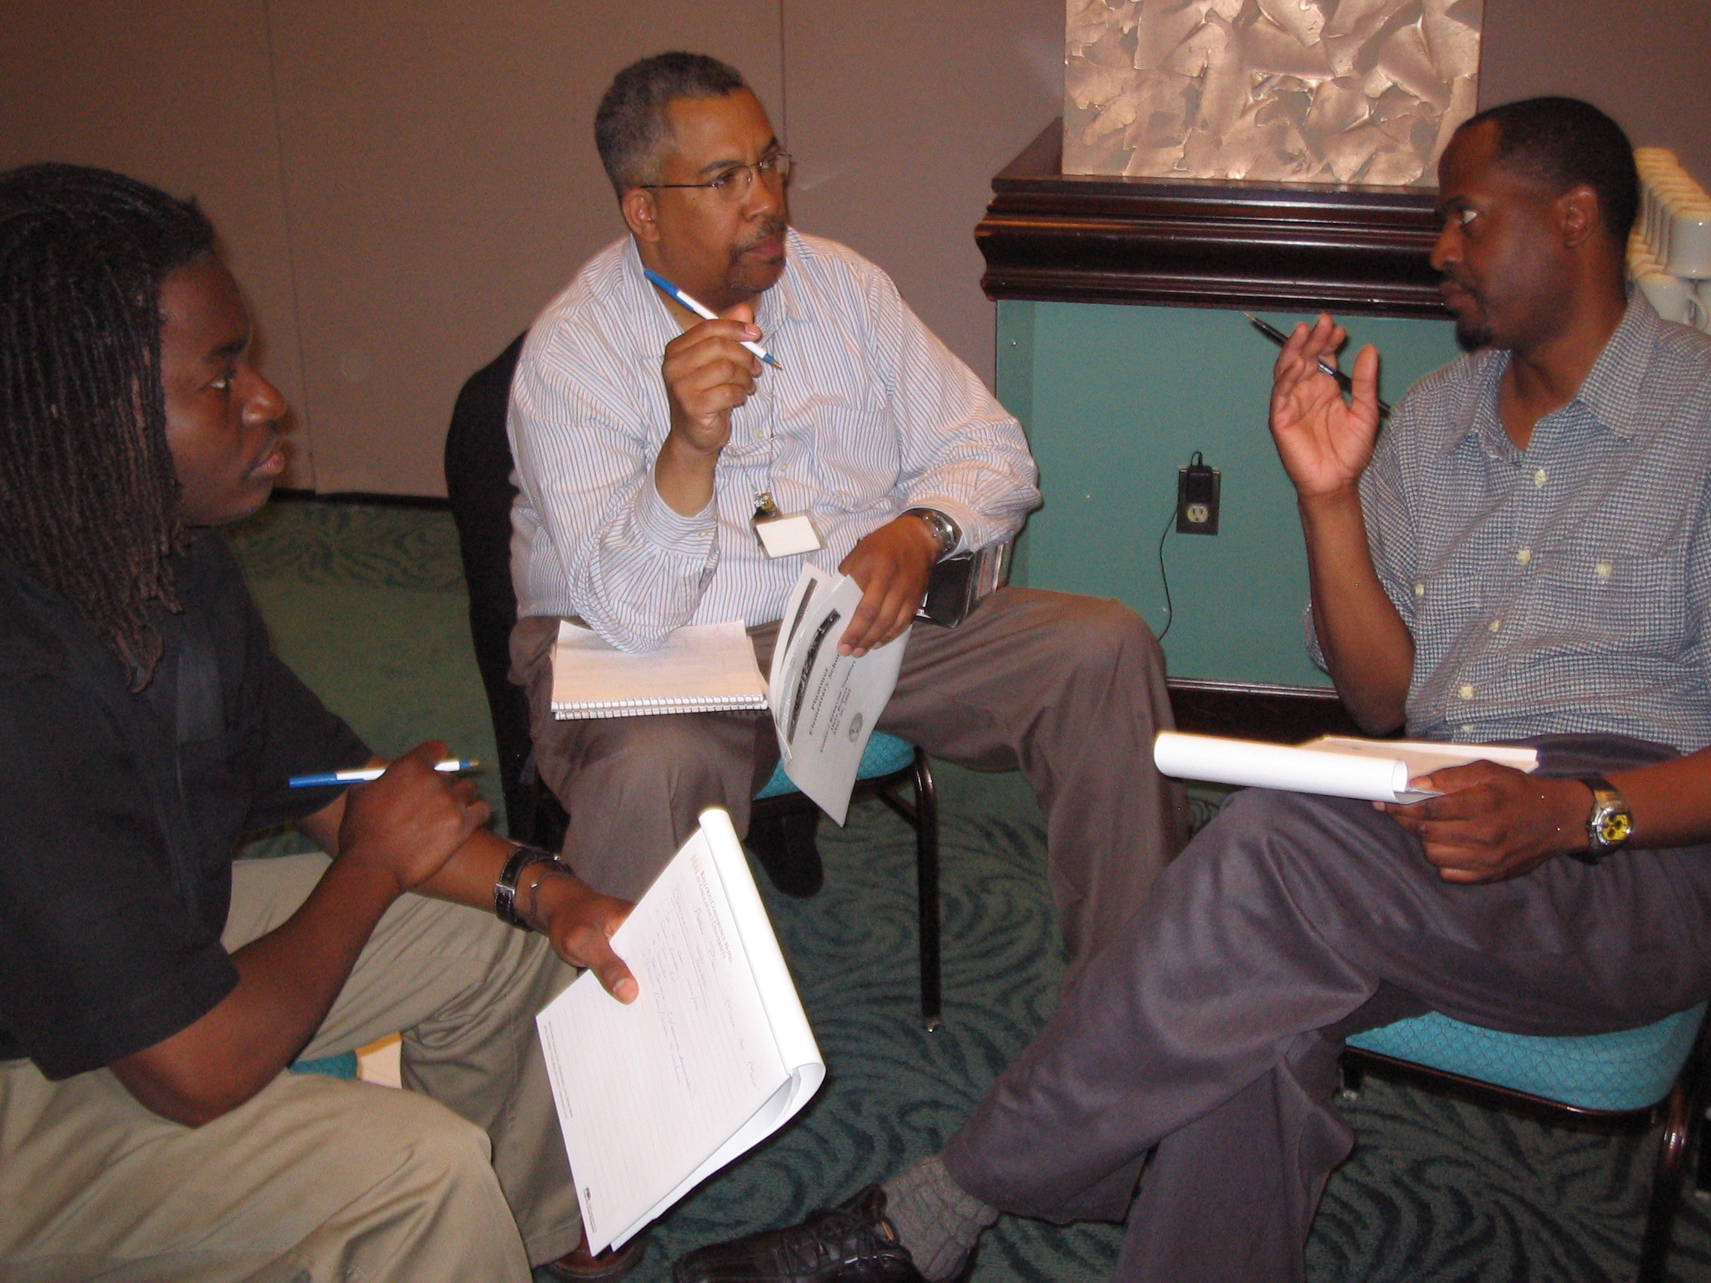
Team Composition
Administrator
Grade/Department Representation
Specialized Support
  Special Educator, Counselor, School Psychologist, Social Worker, etc.
Support Staff
  Office, Supervisory, Custodial, Bus, Security, etc.
Parent
Community
  Mental Health, Business
Student
Start with a
team that
“works.”

Slide 67
Self-Check:
Effective Leadership Team
Work as team for 10 min
Review guidelines for team composition.
How is your school team doing?
  Do you need to vote anyone on/off?
  Are you operating effectively?
  Are your coaches supporting the team? Is the team supporting the coaches?
  Have you considered building capacity throughout the staff?
Review relevant items to your action plan and add/adjust as needed to ensure your team is ready to work this year (and in the future)!

Slide 68
Preview Tier 1 Topics:
    Equity

Slide 69
Equity
(adapted from Kent McIntosh)

Slide 70
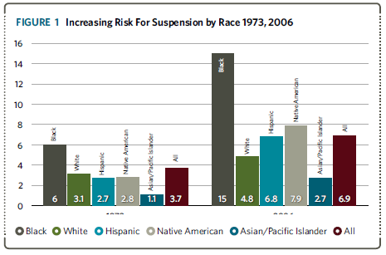
Disproportionality in School Discipline (Losen & Skiba, 2010)
Notes:
This graph indicates the changes in risk for suspension by race over time. The first half shows risk by racial group in 1973, the second half indicates risk by race in 2006. You can pause here and ask participants for ideas about reasons for increased risk now, or just use this slide to point out the fact that there is a problem.

Slide 71
Definitions
Overt Bias
  Conscious belief in superiority of a group
Explicit Bias
  Conscious belief that some groups aspire to desirable traits more than others
Implicit Bias
  Unconscious associations regarding some groups
Notes:
Critical definitions of terms we will use in this discussion.

Slide 72

A 5-point Intervention to Enhance Equity in School Discipline
http://www.pbis.org/school/equity-pbis
Notes:
The content and additional resources on this topic can be found at PBIS.org/equity

Slide 73
5-point Intervention to Enhance Equity in School Discipline
Use effective instruction to reduce the achievement gap
Implement SWPBIS to build a foundation of prevention
Collect, use, and report disaggregated student discipline data
Develop policies with accountability for disciplinary equity
Teach neutralizing routines for vulnerable decision points
http://www.pbis.org/school/equity-pbis
Notes:
These are the 5 key steps to enhancing equity in school discipline. This is also the overview slide we will come back to between each step

Slide 74
Why a focus on effective academic instruction?
The discipline gap may be related to the achievement gap
  Academic skills (or the lack thereof) dramatically shapes school experiences
  Students who fall behind are more likely to act out, exposing themselves to discipline
  By catching and intervening with students early, we can change students’ school experiences for the better
(Gregory et al., 2010; McIntosh et al., 2008, 2012)
Notes:
Step one is to focus on effective academic instruction. It is important to emphasis here that although we are focused on implementing behavior supports effective academic instruction is a critical part of ensuring all students have equal access and opportunity.

Slide 75
What do we mean by effective academic instruction?
Explicit instruction
High rates of engagement and OTRs
Quality performance feedback
Progress monitoring and data-based decision making
(Hattie, 2009)
Notes:
Tie this back to how we teach behavior- so in previous training we’ve talked about how we teach behavior like academics now we want to tie back to teaching academics explicitly, keeping kids engaged in instruction and using data to guide instruction.

Slide 76
Effects of Effective Instruction on the Achievement Gap
Tigard-Tualatin School District (Chaparro, Helton, & Sadler, in press)
Notes:
This graph shows that the use of explicit instruction can help close achievement gaps.

Slide 77
5-point Intervention to Enhance Equity in School Discipline
Use effective instruction to reduce the achievement gap
Implement SWPBIS to build a foundation of prevention
Collect, use, and report disaggregated student discipline data
Develop policies with accountability for disciplinary equity
Teach neutralizing routines for vulnerable decision points
http://www.pbis.org/school/equity-pbis
Notes:
Step 2 is using SWPBIS as a foundation. Equity is NOT a separate initiative. We use the same data-based decision making framework and systems.

Slide 78
Why use a foundation of SWPBIS?
Proactive, instructional approach may prevent problem behavior and exposure to biased responses to problem behavior
Increasing positive student-teacher interactions may enhance relationships to prevent challenges
More objective referral and discipline procedures may reduce subjectivity and influence of cultural bias
Professional development may provide teachers with more instructional responses
(Greflund et al., 2014)
Notes:
Rational for using SWPBIS as a foundation. Use this to reinforce that all the work they have been doing so far is an important first step in ensuring that all students have equal access and opportunity.

Slide 79
5-point Intervention to Enhance Equity in School Discipline
Use effective instruction to reduce the achievement gap
Implement SWPBIS to build a foundation of prevention
Collect, use, and report disaggregated student discipline data
Develop policies with accountability for disciplinary equity
Teach neutralizing routines for vulnerable decision points
http://www.pbis.org/school/equity-pbis
Notes:
Step 3 is to collect, use and report disaggregated data. – for schools using swis they can already do this! For others this may take some work.

Slide 80
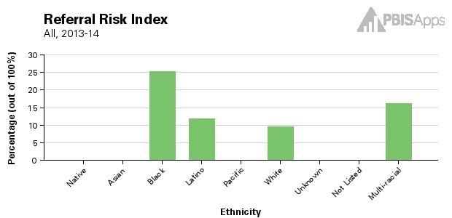
SWIS: Risk Indices
Proportion of each ethnic group with an ODR
Use to compare referral rates across ethnic groups
Black/White ODR Risk Ratio = 2.5
Notes:
Here is an example of the risk indices that can be generated in swis. Compared to white students black students are 2.5 times more likely to receive an ODR. If data indicate there is a problem it is important not to get stuck admiring the problem- use data to guide the next 2 steps.

Slide 81
5-point Intervention to Enhance Equity in School Discipline
Use effective instruction to reduce the achievement gap
Implement SWPBIS to build a foundation of prevention
Collect, use, and report disaggregated student discipline data
Develop policies with accountability for disciplinary equity
Teach neutralizing routines for vulnerable decision points
http://www.pbis.org/school/equity-pbis
Notes:
Policy with accountability is the next step

Slide 82
What does not work in policy
Enacting policies that nobody knows about
Enacting policies that don’t change practice
Policies without accountability for implementation
Notes:
Pause here to ask teams what they know about existing policy in their districts. If they don’t know what currently exists they should review that. If policy exists but without accountability then the PBIS team can suggest some revisions based on the next suggestions

Slide 83
Equity Policy Recommendations
Include a Specific Commitment to Equity
  Create mission statements that include equity
  Enact hiring preferences for equitable discipline
Install Effective Practices
  Require clear, objective school discipline procedures
  Support implementation of proactive, positive approaches to discipline
  Replace exclusionary practices w/instructional ones
Create Accountability for Efforts
  Create teams and procedures to enhance equity
  Share disproportionality data regularly
  Build equity outcomes into evaluations
Notes:
You can ask teams if they have examples of these specific recommendations

Slide 84
5-point Intervention to Enhance Equity in School Discipline
Use effective instruction to reduce the achievement gap
Implement SWPBIS to build a foundation of prevention
Collect, use, and report disaggregated student discipline data
Develop policies with accountability for disciplinary equity
Teach neutralizing routines for vulnerable decision points
http://www.pbis.org/school/equity-pbis
Notes:
Step 5 teach neutralizing routines – this will be guided by data!

Slide 85
What is a Vulnerable Decision Point?
A specific decision that is more vulnerable to effects of implicit bias
Two parts:
  The person’s decision state (internal state)
  The situation
Notes:
The persons decision state (fatigue, hunger, stress etc)
The situation: unknown kids (e.g., hallways, café, extra-curricular events) or new routines in which the expectations are not clearly defined

Slide 86
What is implicit bias?
Unconscious, automatic
Based on stereotypes
  We all have it (even those affected by it)
  Generally not an indication of what we believe or would endorse
More likely to influence:
  Snap decisions
  Decisions that are ambiguous
Notes:
Let’s look further at implicit bias.

Slide 87
Activity:
Explore Implicit Bias
15 min
5 min (team debrief)
  Individually spend some time exploring some of the implicit association tests
  Select “guest” as login
  Choose a preferred implicit association test (IAT) to complete
  Team Debrief: Discuss with your team how this information can impact or our relationships with staff and students.
  https://implicit.harvard.edu/implicit/selectatest.html
Notes:
The IAT measures the strength of associations between concepts (e.g., black people, gay people) and evaluations (e.g., good, bad) or stereotypes (e.g., athletic, clumsy). The main idea is that making a response is easier when closely related items share the same response key.
https://implicit.harvard.edu/implicit/selectatest.html

Slide 88
Reduce Effects of Implicit Bias through Specific Training
Reduce ambiguity in ODR definitions and processes
  Clear guidelines for classroom vs. office-managed behaviors
  Avoid rules that result in disproportionate exclusion
Identify specific vulnerable decision points
  General
  Local (school)
Teach a neutralizing routine
  Self-assess presence of VDP
  Use alternative response
Notes:
In order to reduce the effects of implicit bias we can take these steps. 1) ensure discipline systems are clearly defined teams can pause here to review the work they have done on this so far. 2) use data to identify if there are specific times, locations or rules in your school where disproportionality is more likely to show up. 3) teach a response that can be used to address those specific situations.

Slide 89
VDPs from national ODR data
Subjective problem behavior
  Disruption, defiance, major vs. minor
Non-classroom areas
  Hallways
Afternoons
ambiguity
LACK OF contact
fatigue
Notes:
Nationally the most disproportionality shows up in ODRS in the following situations. Schools should review their data – but if they don’t have it can start with national data and refine as they improve their data systems.

Slide 90
Two-step Neutralizing Routine for Staff:
When you see problem behavior, stop and ask yourself:
Is this a VDP?
  Situation
  Decision state
If so, use an agreed-upon alternative response
Notes:
Staff can be taught a 2 step process to use during vulnerable decision points.

Slide 91
What makes for a good neutralizing routine?
Brief
If-then statements
Clear steps
Doable
Notes:
Guidelines for good neutralizing routines. You can pause here and ask teams to quickly brainstorm an example of one they could use in their classrooms. You can also share that in some schools staff have worked on these together during staff meeting time and that when the identify (with their data) a VDP for their school the administrator can even provide reminders to staff to for example use their neutralizing routines after lunch!

Slide 92
Activity:
5-Point Intervention Brief
10 min
  Find “A 5-Point Intervention Approach for Enhancing Equity in School Discipline” research brief at http://www.pbis.org/school/equity-pbis
  Review the article and consider saving or bookmarking.

Slide 93
SWPBIS Action Planning

Slide 94
Activity:
Action Planning
Work as team for 150 min
Complete the Team Implementation Checklist
Return to your Action Plan
Identify relevant resources and steps to help move your school forward.
In particular, make sure you have completed all of the steps in getting started (review your notebook).
Present 2-3 “big ideas” from your group (1 min. reports)

Slide 95
Activity:
Coaches Preview Discussion
Work with partner coach for 15 min
Review implementation guidelines and preview slides just presented.
Discuss above with a partner
  Is there content you’d like re-explained?
  What key questions do you have?
  What questions/challenges do you anticipate from your team members?
Share key highlights (1 min. reports)

Slide 96
Review of
Coaching SWPBIS

Slide 97
Main Coaching Objectives
By the end of today’s meeting, you will be able to…
  …Describe your role as a coach.
  …Articulate the basic elements of SWPBS.
  …Identify resources for SWPBS.
  …Problem solve roadblocks in coaching
  …Facilitate your team’s activities at the next SWPBS team training.

Slide 98
What roles do coaches play?
Coaching Roles
Facilitate
Content Knowledge
Communicate
  Team meetings
  Activities at training events
  Implementation
  Local PBS expert
Positive “nag”
Link to resources (e.g., nepbis.org, www.pbis.org)
  Share advanced content with team
  Share information at faculty meetings
I.A.ii

Slide 99
Consider Tattoos!
4 PBIS Elements
School Systems
Supporting Social Competence &
Academic Achievement
OUTCOMES
School-wide
Classroom
SWPBIS
SYSTEMS
DATA
Supporting
Decision
Making
Supporting
Staff Behavior
Non-classroom
Family
PRACTICES
Tertiary Prevention:
Specialized
Individualized
Systems for Students with High-Risk Behavior
~5%
Student
Supporting
Student Behavior
Primary Prevention:
School-/Classroom-
Wide Systems for
All Students,
Staff, & Settings
~15%
Secondary Prevention:
Specialized Group
Systems for Students with At-Risk Behavior
~80% of Students

Slide 100
TAKE AWAY MESSAGE
You’re a coach!
Prepare for the next training event, and use your resources to guide your team’s activities (both at training and at school).

