Slide 1
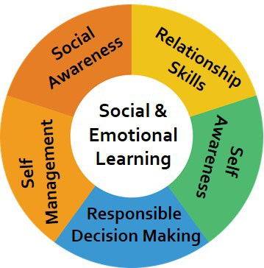
Integrating SEL with PBIS Efforts
OUTCOMES
Sara Whitcomb
PBIS Training Academy
March 2018
SYSTEMS
DATA
PRACTICES

Slide 2
Agenda
Challenges of children’s mental health/trauma
Challenges of integrating programming/frameworks
Overview of PBIS/SEL integration ideas
Data-driven example

Slide 3
A Big Thank You: Credit Given To
My School Partners!
Sarah Fefer, University of Massachusetts
CBER, University of Connecticut
ECS, University of Oregon
Laura Feuerborn, University of Washington, Tacoma
The May Institute
George Bear, University of Delaware
Catherine Bradshaw, UVA
Strongkidsresources.com
www.pbis.org
CASEL (www.casel.org)

Slide 4
Big Ideas
Attending to the mental health needs of our students and staff is important.
Aligning our SEL and PBIS efforts can facilitate implementation efforts.
Driving with data/information is critical.

Slide 5
Children’s Mental Health

Slide 6
A Problem
17-20% of children experience an emotional, mental or behavioral concern that meets criteria for a disorder
Prevalence of anxiety is increasing, while depression remains the same
Suicidality is increasing
26% of US children will experience or witness trauma by age 4
Prevalence is increased for children of color, those within juvenile justice system, those from low income households

Slide 7
The Externalizing and Internalizing Behavioral Dimensions
Externalizing Problems Aggressive Delinquent Hyperactive-Impulsive Antisocial Disruptive Destructive Undercontrolled Outer/other-directed | Internalizing Problems Depressed, sad Low self-esteem Anxious, tense, fearful Socially withdrawn Physical symptoms Overcontrolled Inner/self-directed

Slide 8
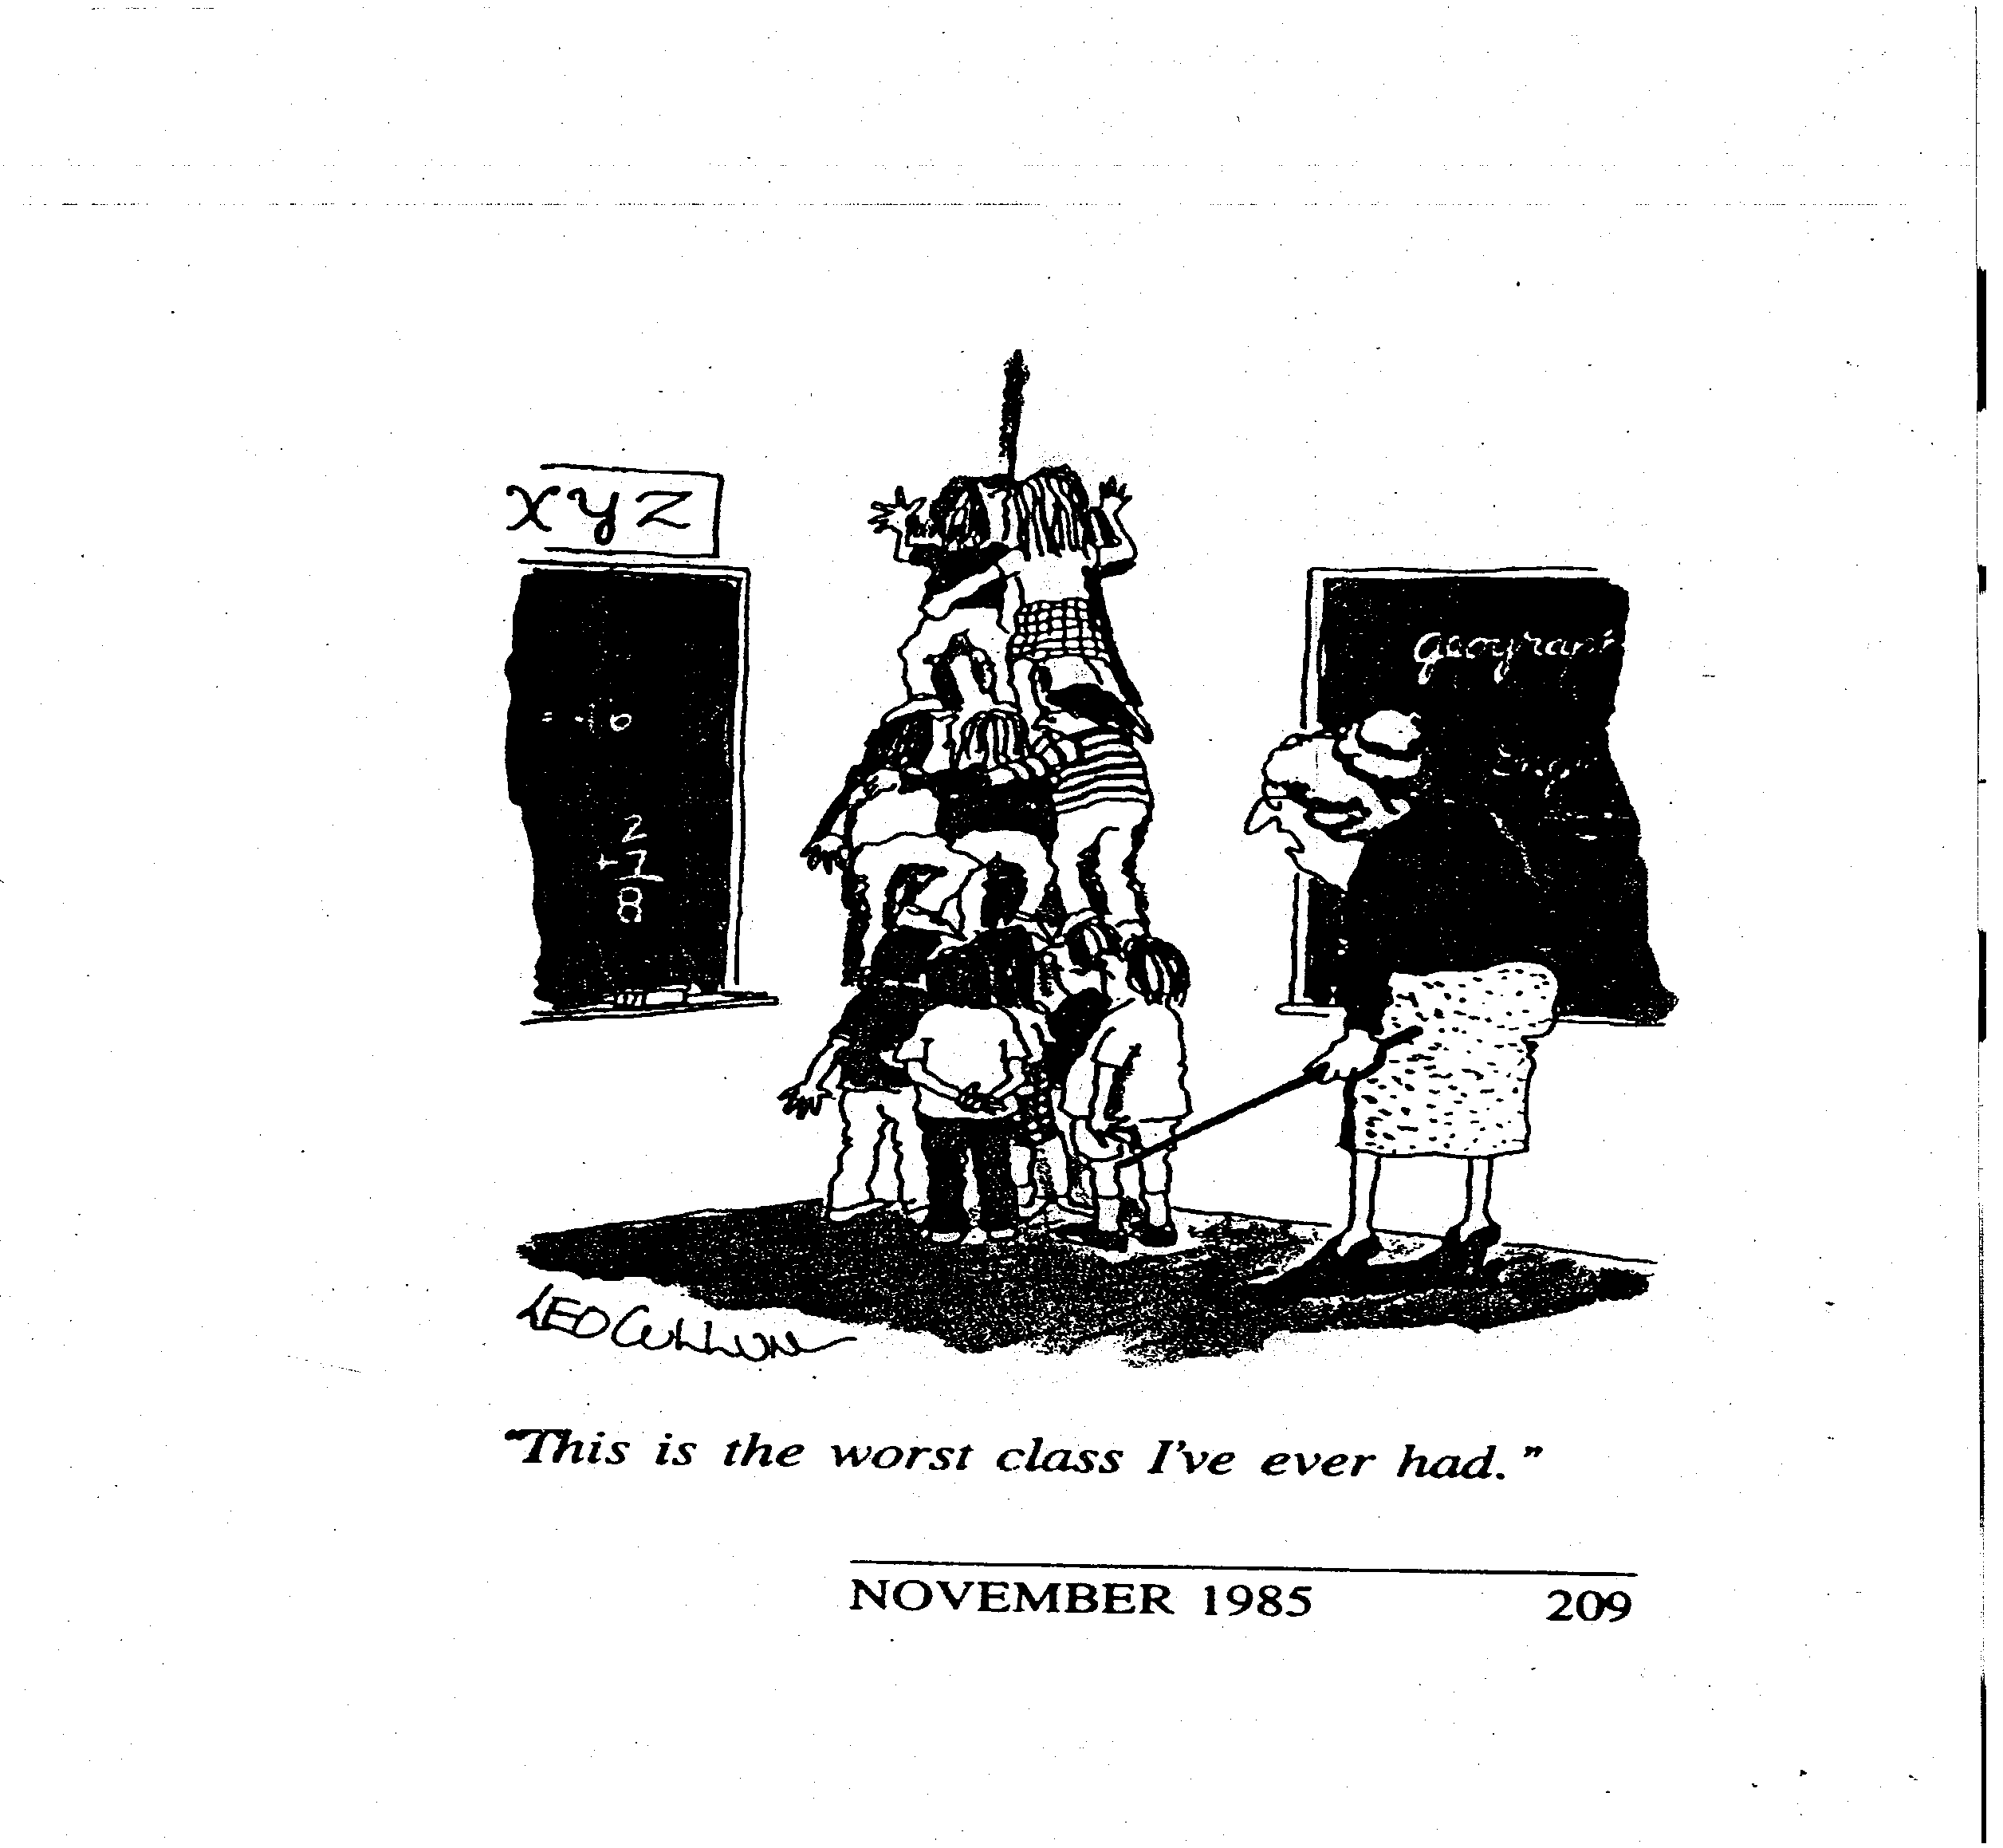
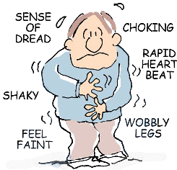
What It Looks Like

Slide 9
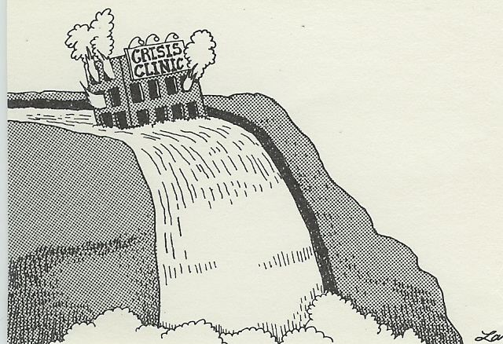
What it feels like
Notes:
Even with the best of intentions, withough systems and an integrated set of supports, we often feel like this!

Slide 10
How we address it
Climate
PBIS
SEL
Notes:
Our silos in research and professional training efforts, lead to “silo-ed” practices in education. As if teachers are not trying to juggle enough!

Slide 11
Bradshaw et al., (2010) found an average of 5.1 programs were being introduced in each school on “character education and /or development, social-emotional or social skills, bullying prevention, drug prevention (e.g., D.A.R.E.), and conflict resolution and/or peer mediation” (p. 146).
McIntosh (2015)
“One of the major variables affecting sustained implementation of effective practices is the introduction of new initiatives that either (a) compete with resources needed for sustained implementation or (b) contradict existing initiatives.”
Notes:
SIMPLIFY!

Slide 12
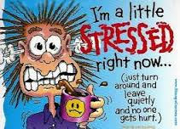
How this impacts our people
https://www.youtube.com/watch?v=ctjtpMxVjzw
Notes:
Stressed and Unprepared
Overall, State and colleagues found
that across all the required coursework, students
received in the typical teacher education
program, on average, only 6 hours and
50 minutes (range 1–1,331 minutes) were
devoted to issues related to understanding,
identifying, and managing students’ problematic
behaviors and promoting their social
and emotional development.

Slide 13
Teacher Burnout
The Stats
~1/2 million teachers leave the profession each year.
41% of teachers leave the profession after 5 years
The U.S. spends 7 billion on teacher turnover each year
The Reasons
Volume
Environment
Student Behavior
Administration
Community Relations

Slide 14
Model for Prevention
PBIS
(Structure)
SEL
(Support)
Positive School Climate
Notes:
In this presentation, we want to acknowledge that a positive school climate is generated from a combination of adequate structure and supportive relationships and this can reduce problematic behaviors.

Slide 15
Social and Emotional Learning (SEL)

Slide 16
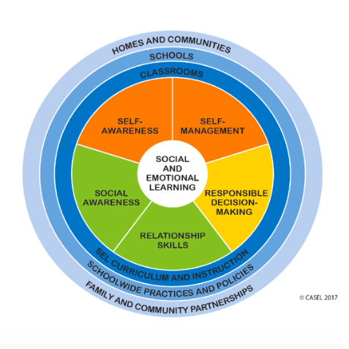
SEL Competencies
Self Awareness
Self-Management
Social Awareness
Relationship Skills
Responsible Decision Making

Slide 17
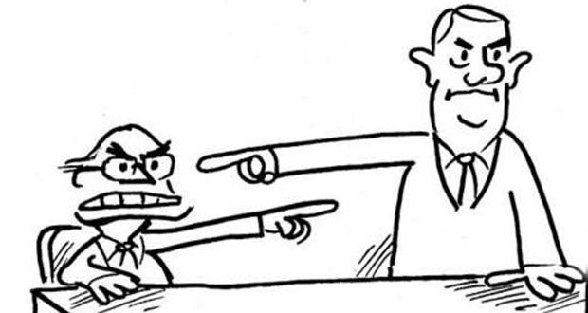
Emotions and Thoughts Influence Behavior That is Modeled For Others
“Thinking traps are thoughts or patterns of thoughts that are either inaccurate or unrealistic interpretations of events. They can trap us and make us feel even worse or make the situation worse.”
Brené Brown on Blame: https://www.youtube.com/watch?v=IL1JgIj3_fA

Slide 19
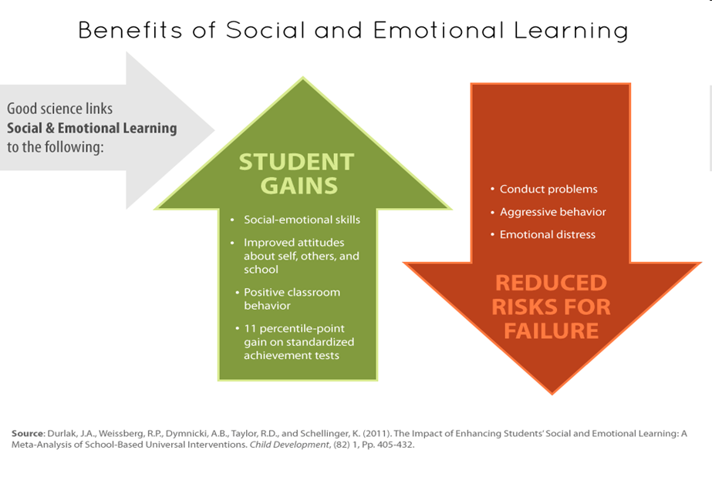
Notes:
bg

Slide 20
Why Integrate/Align?
To reduce fragmentation and redundancy.
Because SEL and PBIS complement each other.
Because SEL and PBIS in combination can enhance one another.

Slide 21
Strengths and Challenges of Each Approach
SEL (support)
+ Specific teaching tools
+ Emphasis on classroom practices and student relationships (student-student; student-teacher; teacher-teacher)
Programs outpace outcome assessments
Fidelity measurement
Fewer resources for building capacity/systems and planning for roll-out
PBIS (structure)
+ Emphasis on structures and systems to support behavioral change
+ Emphasis on measurement of outcomes and fidelity to support action planning and roll out
+ Contextually specific
Misunderstood as a system for positive reinforcement
Generally does not address thoughts and emotional education

Slide 22
Initial Effective Examples of Integration
PATHS to PAX-GBG
Considered two approaches as one continuum (lessons, activities, practice)
Developed one set of training materials
Looked for overlapping practices and and adapted to create a common language and guidelines for consistent implementation
Monitored implementation with developed fidelity tools
Gained back 391 instructional minutes/week!!!
Notes:
PATHS to PAX¹³—A collaboration between the Johns Hopkins Center for Prevention and Early Intervention, the Pennsylvania State University Prevention Research Center, and the Paxis Institute.
Integration of Promoting Alternative Thinking Strategies (PATHS) and PAX-GBG
PATHS is an evidence-based SEL curriculum focused on all five CASEL competencies (self-awareness, self-management, social awareness, responsible decision-making, and relationship skills.
PAX-GBG is an updated version of the Good Behavior Game, originally developed by a classroom teacher in the 1960’s¹⁴, with years of research supporting its use. It is an example of an interdependent classroom contingency system in which students are taught and rewarded for meeting classroom behavioral expectations.

Slide 23
Examples (cont)
Strong Kids and CW-PBIS
Combination of SEL and PBIS was highly effective for decreasing both externalizing (e.g. disruptive behaviors) and internalizing (e.g. depression, anxiety) behavior.
PBIS was highly effective for externalizing behaviors and only slightly effective for internalizing behaviors.
SEL was highly effective for externalizing behaviors and moderately effective for internalizing behaviors.

Slide 24
How do we integrate and align?
Supporting Culturally Equitable
Social Competence & Academic Achievement
OUTCOMES
Supporting
Culturally
Knowledgeable
Staff Behavior
Supporting
Culturally Valid
Decision
Making
SYSTEMS
DATA
PRACTICES
Supporting Culturally Relevant
Evidence-based Interventions
(Vincent, Randal, Cartledge, Tobin, & Swain-Bradway, 2011; Sugai, O’Keefe, & Fallon 2012)
Notes:
Use data
Focus on outcomes: Academic & behavior success
On-going evaluation
Ensure cultural and contextual fit
Invest in systems
Organize research-validated practices within a continuum
Instructional & preventative approach
Integration
Tier 1 for all

Slide 25
How to align and integrate?
Identify schoolwide needs (Outcomes & Data)
Select practices/approach based on instructional needs (Practices)
Develop explicit routines to support practices (Systems)
Routines for student learning
Routines for staff learning
Monitor and evaluate practices (More data!)

Slide 26
Activity #1
List the outcomes, practices, data of your current SEL programming and PBIS framework

Slide 27
Primary Considerations and Recommendations for Integrating PBIS & SEL
Adapted from Bradshaw et al. (2014)

Slide 28
1. Commit to Coordinated Implementation of PBIS & SEL
Requires administrator involvement
Setting the vision
Allocating resources
Planning for job-embedded professional development
Faculty meetings
Grade level teams
Notes:
Grounded in day-to-day teaching practices
Includes sustained collaboration driven by an ongoing cycle of inquiry or problem-solving process
Linked to school improvement plans and state-wide standards for learning

Slide 29
2. Obtain Staff/Community Buy-In
Ensure staff understand the key features of each model
Have staff share existing examples of PBIS & SEL that they are already implementing in their classes
Build agreements in how to move forward

Slide 30
3. Engage Stakeholders to Form a Team
School Leadership Team
Grade Level Teachers
Counselor / School Psychologist
PE/Health
Teaching Assistants
Parent
SEL Master Teacher
Administrator
Notes:
The PBIS literature has also defined the role of a “coach,” or someone who facilitates the team process.³ This is an important role, and in this case, needs to be someone who can articulate the integration well and keep others on track with program planning and implementation. Stakeholders should meet at least monthly with clear agendas and meeting protocols. Research has suggested that teams that regularly use some form of data to drive planning and decision-making are more likely to create and implement a sustainable model.

Slide 31
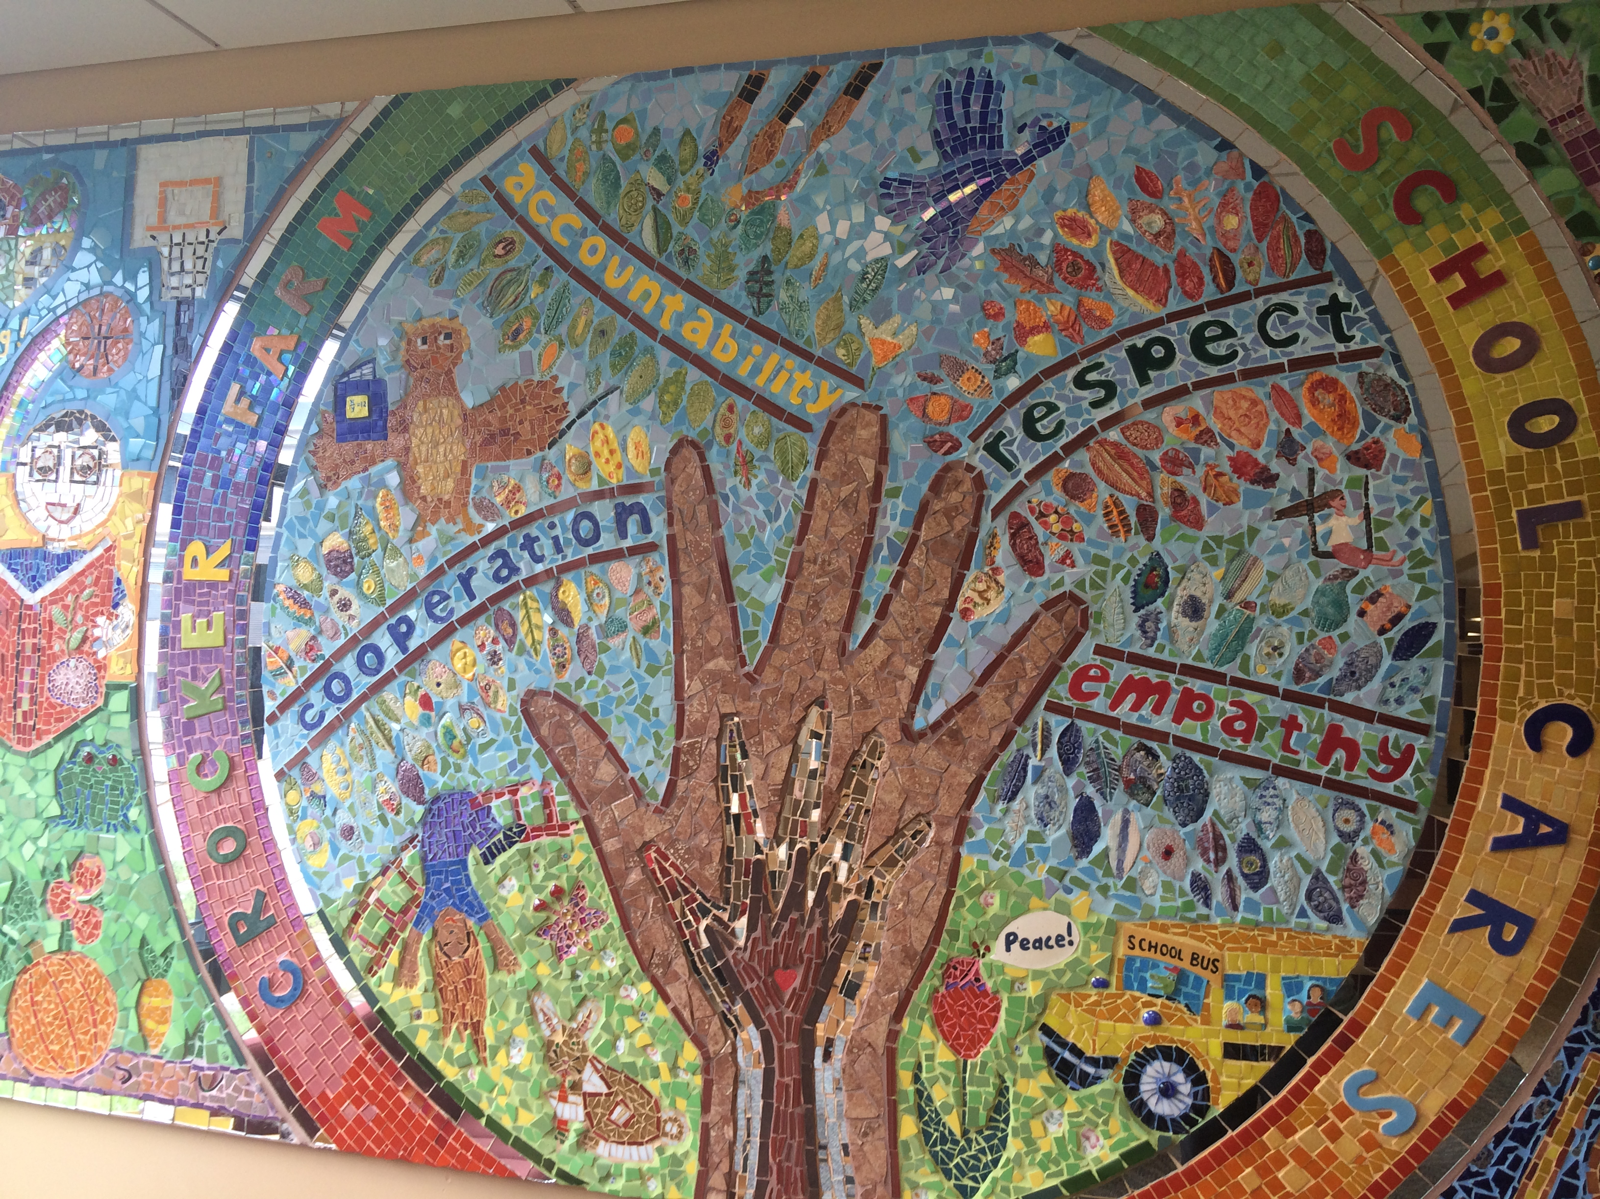
Develop a Shared Vision for Integrated Model
Engage in a visioning process with staff, students, parents
Consider how current SEL or PBIS efforts capture core values/vision of the school

Slide 32
5. Conduct a SWOT Analysis
What are the strengths of PBIS and our selected SEL program?
What are the weaknesses?
Where are there opportunities to integrate strengths and enhancements?
What barriers currently exist? What may be barriers to integration?
Do we need more information from our stakeholders (e.g. School Climate Survey)

Slide 33
6. Use Data to Identify and Select Programming
Use SWOT data
Use extant data to identify important student outcomes to target schoolwide:
Office disciplinary referrals
Nurse visits
Counselor contacts
Consider social-emotional screening if you are not capturing perceived social-emotional concerns
Consider requests for assistance forms

Slide 34
6. (cont) Example Request for Assistance Form
Number of ODR: __________ Number of nurses visits: ____________

Slide 35
7. Create an Integration Action Plan
Statement of purpose for integration
Create visuals/”cheat sheets” for teachers to easily use common language
Develop implementation measures that reflect integrated treatment integrity
Explicitly state strategies for maintaining faculty buy-in and orienting new faculty
Set up explicit opportunities for faculty to reflect on implementation and effectiveness
Create an implementation timeline

Slide 36
A Sample Cheat Sheet: Crosswalk PBIS with SEL
 | Cooperation | Accountability | Respect | Empathy
Understanding your Feelings |  |  | X
Understanding Other People’s Feelings | X |  | X | X
When You’re Angry | X | X | X | X
When You’re Worried |  | X | X
Notes:
Tier 1 Leadership Team might address SEL programming AND PBIS
Giving scripts/cheat sheets to help teachers make links
Integrating PBIS teaching/lessons intro Morning Meeting (Responsive Classroom)
Crosswalking the language from various curricula

Slide 37
8. Develop Job-Embedded PD Opportunities
Become a Professional Learning Community dedicated to PBIS & SEL
Build in structures for PLC learning
Give implementation updates at each faculty meeting
Use exit tickets at faculty meetings to obtain feedback on implementation
Use a portion of shared grade level planning time to observe grade level data and do classroom problem-solving
Use new teacher orientation structures to insure SEL & PBIS implementation is occurring and to troubleshoot barriers.

Slide 38
9. Launch PBIS & SEL Together
Help students and staff to connect the dots!
Avoid confusion by giving this initiative one name
Create a calendar for implementation of lessons, practice, and activities

Slide 39
10. Develop an On-Going Technical Assistance Plan
Identify the role that internal coach can take to support implementation of PBIS & SEL
Identify needs for external consultation
Plan should include content, timeline, and format of assistance
District/statewide vision for integrated PBIS & SEL should also be considered in TA planning.

Slide 40
11. Use data to evaluate programming
Identify Problems
Hypothesize/Certify Problem
Explore and Select Solutions
Implement Solution
Evaluate Solution
Use implementation fidelity data
Use extant data, climate data
Develop a problem-solving protocol to drive intervention planning and evaluation

Slide 41
Case Example
Pilot study within one elementary school
Previously district adopted Responsive Classroom and academic RTI approaches
More recently district adopted SAEBRS social-emotional screening across
Most recently district adopted PBIS

Slide 42
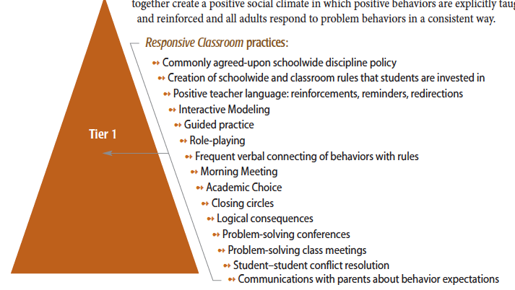
Responsive Classroom as an SEL Approach

Slide 43
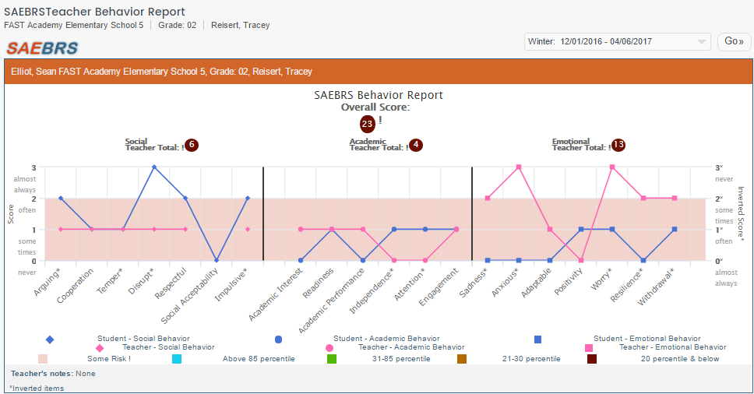
SAEBRS (FASTBridge)

Slide 44
School’s Reason to Examine SAEBRS
Academic and social-emotional screening three times per year
Data team structure for reviewing academic data
Two groups by grade level
Facilitated by Principal and School Psychologist
Academic coaches and academic specialists rotate between the two groups
Review tier 1 data and plan for tier 1 instructional modifications
Intervention planning for small group of students (tier 2)
Routine of collecting SAEBRS data established, but no routine for using SEL screening data in the same way as academic data
Notes:
Monique

Slide 45
Moving from Horizontal to Vertical Analysis
Ms. Fuentes First Grade Classroom
 | Exhibits positive behavior | Regulates behavior appropriately | Participates appropriately in group activities | Works and plays without disrupting others | Follows classroom routines | Adjusts to transitions and changes | Responds to conflict effectively | Takes care of materials and belongings
Student
1
2
3
4
5
6
7
8
9
10
11
12
13
14
15
16
17
18
19
20
Notes:
Conditional formatting

Slide 46
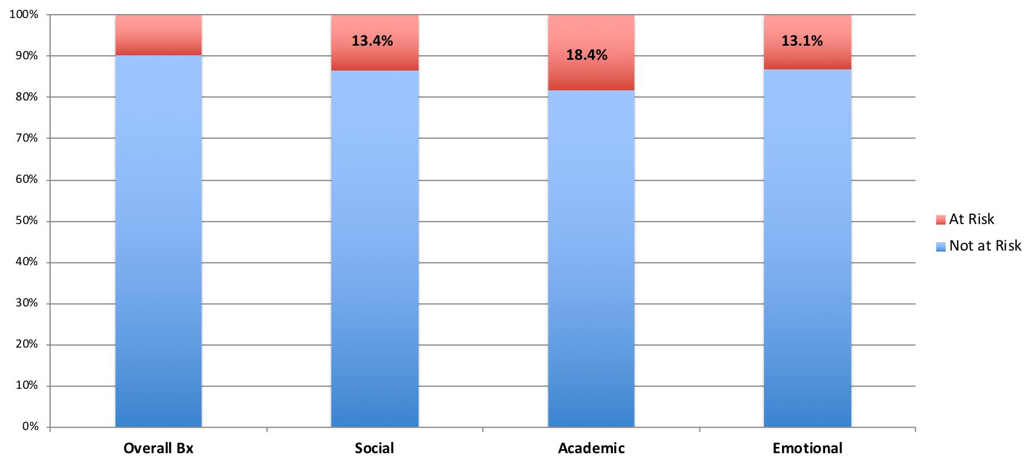
Stony Hill Fall 2018 SAEBRS
9.7%
90.3%
86.6%
86.9%
81.6%
Notes:
Monique

Slide 47
SAEBRS Data Team Pilot
Goals:
Use SAEBRS data to make Tier 1 instructional adjustments
Mirror the structure and process used within academic data teams
Pilot Structure:
Three grade-level teachers, SEL specialists (School Counselor and Responsive Classroom trainers), School Psychologist, and Principal
Pilot Process:
Identify area of concern, specific behaviors of concern, instructional practices, and measurement of student behavior change
Notes:
Monique
Review briefly and then go into detail in next slide

Slide 48
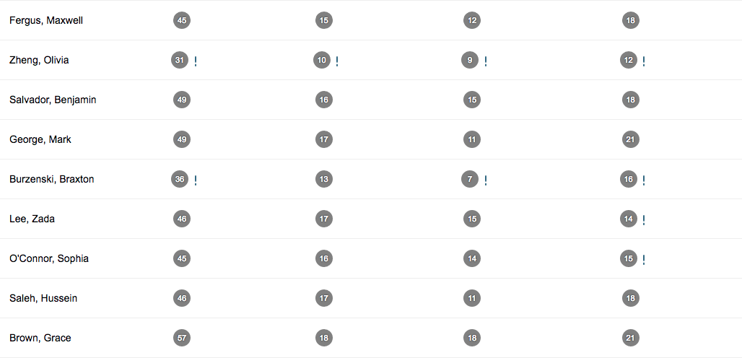
Student 1
Student 2
Student 3
Student 4
Student 5
Student 6
Student 7
Student 8
Student 9
At Risk = <37 At Risk = <13 At Risk = <10 At Risk = <13
Notes:
Melanie – 3 mins
This is an example of SAEBRS data from one classroom, which was used within our pilot. Looking vertically, you can see that there are 2 students at risk in the overall bx area, 1 at risk in the social bx area, 2 at risk in the academic bx area, and 4 at risk in the emotional bx area. In planning tier 1 SEL modifications, this teacher would probably want to start by focusing on what emotional problems she sees within her classroom and how she can alter her practices or start new practices to support all students emotionally. It’s important to remember that although this data indicates emotional as the greatest area of concern, the SAEBRS is just a screener and should never be used in isolation. Some of the most problematic behavior the teacher observes within her classroom may not be in the emotional domain, so it is important to balance both what the teacher knows / experiences and what the data tells us.

Slide 49
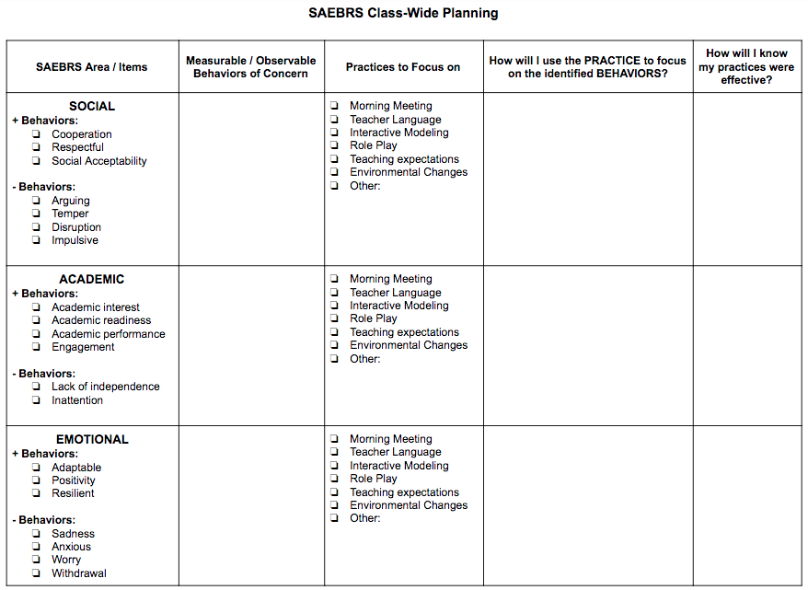
Notes:
Melanie – 3 mins
This is the worksheet we used to facilitate the pilot data meeting. First, teachers looked at their SAEBRS data vertically and identified which area (social, academic, or emotional) was the greatest area of concern within their classroom. For the purpose of this pilot, we had teachers choose just one area of focus, but it would be beneficial for teachers to identify all areas of concern in a real data meeting. The items within each area are the items from the SAEBRS. Second, teachers identified which behaviors they observe within their classroom that are of concern within that area. For example, a teacher who has many student’s at-risk in the area of emotional may observe students frequently crying or withdrawing from instruction or peers. While completing these first two columns, teachers and specialists discussed as a group and helped each other brainstorm. For the rest of the columns, we paired each teacher with an SEL “expert” (RC coach or counselor). With that support, teachers identified 1-3 practices within their classroom or teaching practices where they could focus on improving tier 1 SEL instruction. Teachers then identified specifically how they would use that practice to focus on the behaviors they have observed. Finally, the whole group discussed how each teacher could monitor their student’s progress in decreasing problem behaviors and increasing positive behaviors within their identified area.

Slide 50
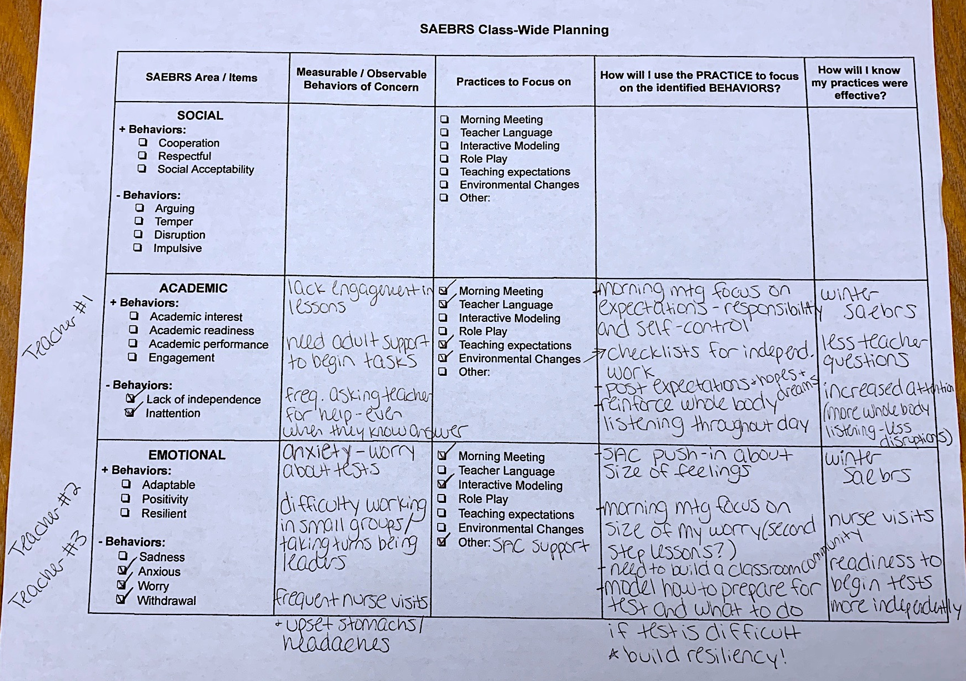
Notes:
Melanie – 5 mins
Summary of what all 3 teachers did

Slide 51
Procedural Facilitator Worksheet
Teachers identify SAEBRS area of concern (most # of students at-risk)
Teachers identify specific behaviors seen within their classroom that are both observable and measurable
With support of SEL “experts”, teachers identify 1-3 practices for improvement within their classroom
With support of “experts”, teachers plan how they will use their selected practices to decrease problem behaviors / increase positive behaviors
Lastly, teachers identify measureable ways they will know their practices were effective
Notes:
Monique
Briefly summarize the process of the worksheet again

Slide 52
What We Learned
Teachers and experts who participated in the pilot agreed…
This activity helped them to think about instructional adjustments
This activity will help them to implement instructional adjustments
This process will make a difference in changing student behavior
They would engage in this process again
Administrative priority and support is critical in designating time to review data
More time/structure needed for each person to receive feedback from the group (time for teachers to access multiple experts)
Teachers would benefit from available materials (RC handbook, Second Step lessons, etc.) during data meeting time
Notes:
Monique

Slide 53
Our Next Steps
Follow up with these teachers – are there changes within their practice / student behavior as a result of this pilot?
How do we grow this routine from a pilot to a system?
How to make SEL planning time as important as academic planning time
Could we use SEL curriculum planning time to do run SEL data meetings?
Continue teaching teachers how to complete SAEBRS reliably
Possibly complete with SAC, special education teacher, paraprofessional, etc.
Notes:
Melanie – 4 mins
We feel that this pilot was mostly successful, and the teachers who participated also felt that it was useful. Now, we need to follow up with these teachers to see if engaging in the process had a meaningful impact on their tier 1 SEL practices and their student’s behavior? We also need to do some more work on how to grow this routine from a pilot into a system. It was challenging to carve out time to do this pilot within the school day, even with teachers offering to meet before or after school. We know that school life is hectic, so we need to thoughtfully plan how to make reviewing SAEBRS data a routine just like reviewing our academic data. At Stony Hill, teachers have weekly curriculum planning time which rotate between reading, math, and SEL. Thus far, we have used SEL time to help teachers problem-solve around issues within their classroom, and also as a means to support teachers in their own self-care. This may be an avenue for building a system for SAEBRS data meetings, although there would be the barrier of making all SEL experts available at the same time, as both of our RC trainers are also classroom teachers. Finally, we realized that we need to support teachers in completing their SAEBRS reliably. For example, one classroom within our school had 0 students identified as at risk, whereas another teacher had 10 students identified as at risk. In looking at those students and their needs, it is clear that one classroom is under represented while another is over represented in our SAEBRS data. We realize that completing SAEBRS is a tedious task, but we do need to find time to review how the SAEBRS should be completed and what each item means. To support this, it may be helpful for our counselor, special education teachers, paraprofessionals, and others who frequently spend time within classrooms to complete the SAEBRS along with the teachers in order to improve some of our reliability.
Overall, this pilot provided an opportunity for some of our teachers to use their SAEBRS data meaningfully and it also gave our SEL experts an opportunity to share their expertise with staff. Our goal now is to shape our systems so that all teachers have the opportunity to engage in this process throughout the year.

Slide 54
Pittsfield Case Example

Slide 55
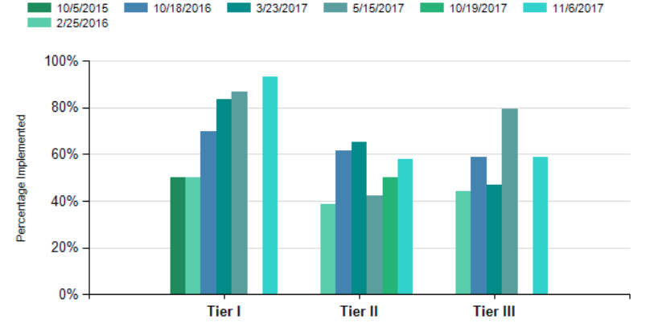
Problem ID: PBIS Tiered Fidelity Inventory
Classroom practices

Slide 56
Using Data to Drive Action in Pittsfield
Spring 2017
Feedback Surveys
Understand family, staff and student perceptions of school climate, in conjunction with district strategic plan
Fall 2017
Student Self-Perception of Social Emotional Learning Skills
Student reflection on SEL helps school staff support skill building and individual student growth
Spring 2018
Panorama Student Success
Promote data driven student supports
56￼

Slide 57
Problem ID: Insight from Panorama
Student Survey
Teacher/Staff SurveY
Engagement
Sense of Belonging
Emotion Regulation
Self-Efficacy
Social Awareness
Educating All Students
Professional learning about SEL
School Climate

Slide 58
Problem Certification: Screening
19 items
6 items Social Behavior
6 items Academic Behavior
7 items Emotional Behavior
Teacher Report
Strong reliability and validity coefficients
Incorporated into the FAST (Formative Assessment for Teachers)

Slide 59
Exploring Solutions
What are primary concerns in my classroom based on SAEBRS?
How am I going to use Second Step to address my concerns?
How will I know when behavior has improved?

Slide 60
Implementation

Slide 61
Activity #2
Work with your colleagues to consider how you might start planning to integrate your SEL and PBIS efforts

Slide 62
Core Features of Effective Schools | Initiative: | Initiative: | Initiative:
OUTCOMES (Measures)
Student Outcomes
Other Outcomes
PRACTICES
SYSTEMS
Teaming
Training
Coaching/Support
DATA
Fidelity of Implementation
Impact

